Slide 1
Electric field stabilisation in Landau cavities, coresponding with beam stability
Lund, 12.10.2022
Mateusz Szczepaniak
SOLARIS National Synchrotron Radiation Centre

Slide 2
Our 300MHz Landau cavities

Slide 3
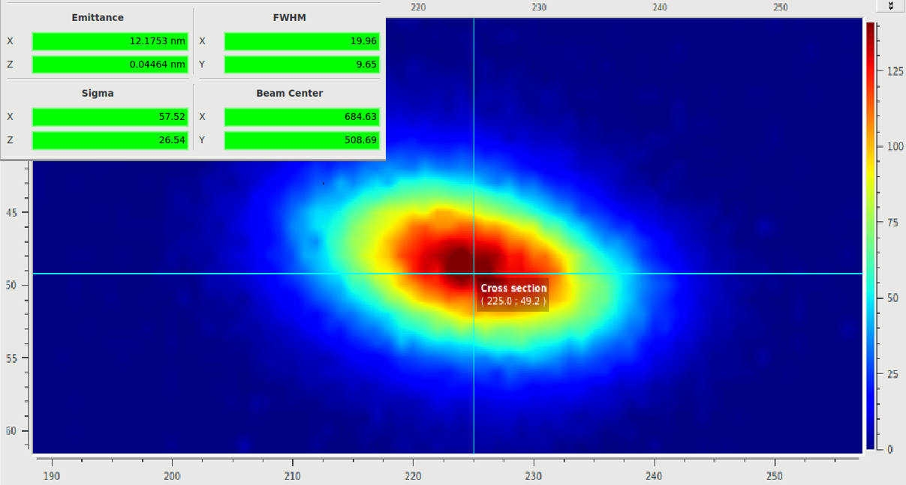
Starting parameters

Slide 4
Automatic tuning GUI

Slide 5
Parameters with tuning enable

Slide 6
Plunger positions with tuning enable

Slide 7
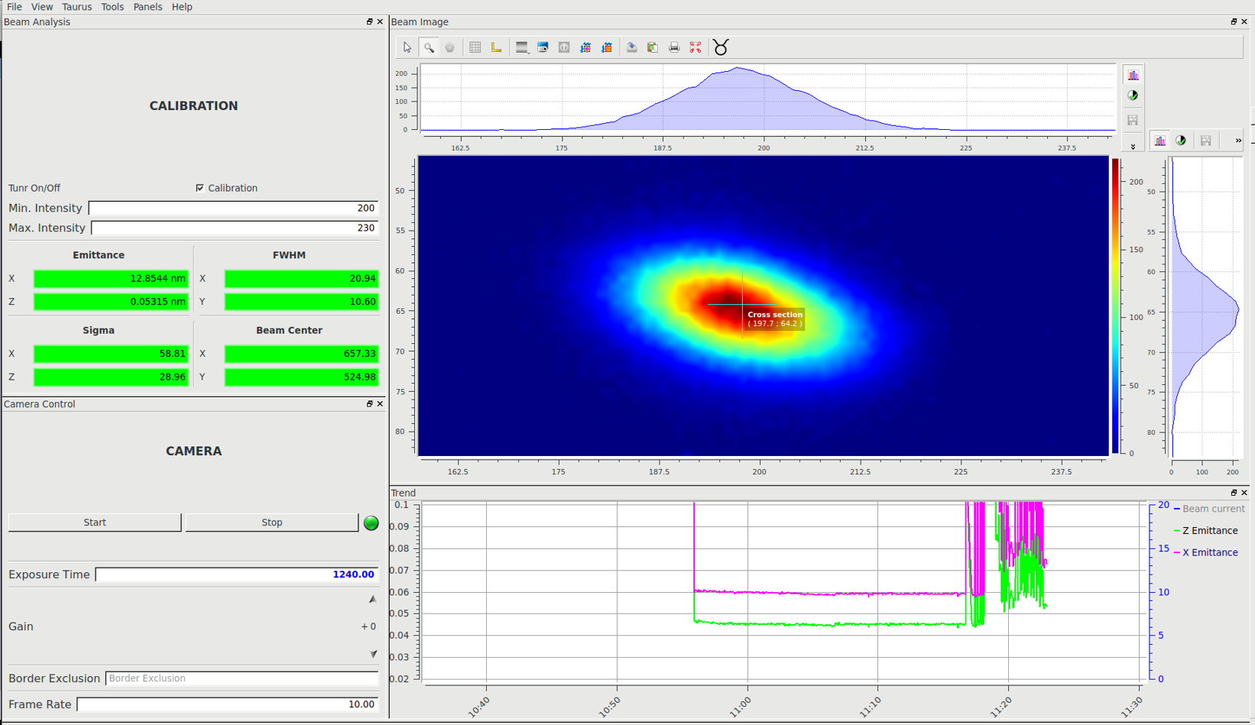
Beam shape during decreasing beam current and Landau tuning enable
350 mA with starting power level
260 mA with lower power level

Slide 8
Spectrum during decreasing beam current and Landau tuning enable
350 mA with starting power level
260 mA with lower power level

Slide 9
Thank you!
Lund, 12.10.2022
Mateusz Szczepaniak
SOLARIS National Synchrotron Radiation Centre

