Slide 1

Electric field stabilisation in Landau cavities, coresponding with beam stability
Lund, 12.10.2022
Mateusz Szczepaniak
SOLARIS National Synchrotron Radiation Centre

Slide 2

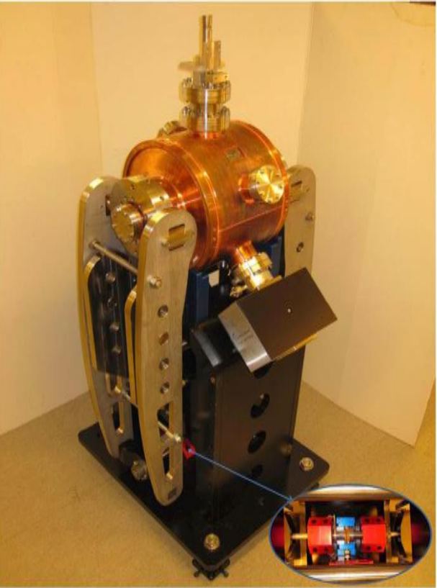
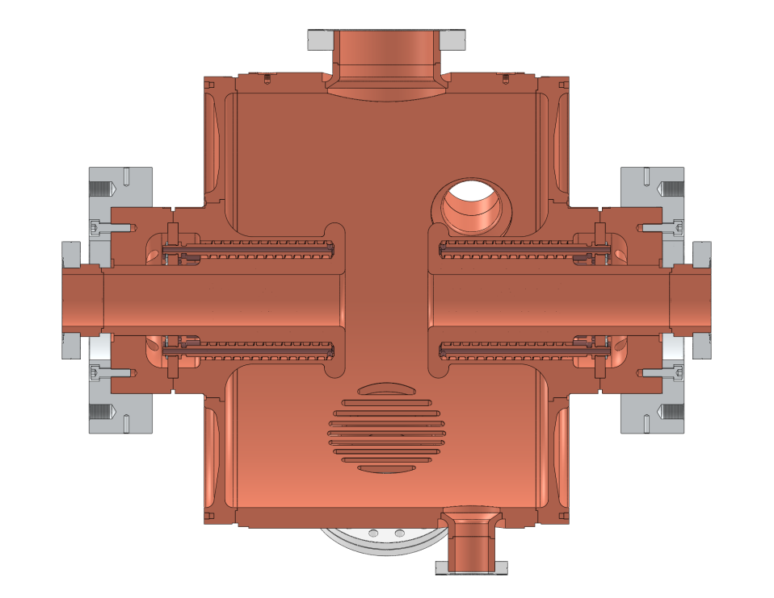
Our 300MHz Landau cavities

Slide 3
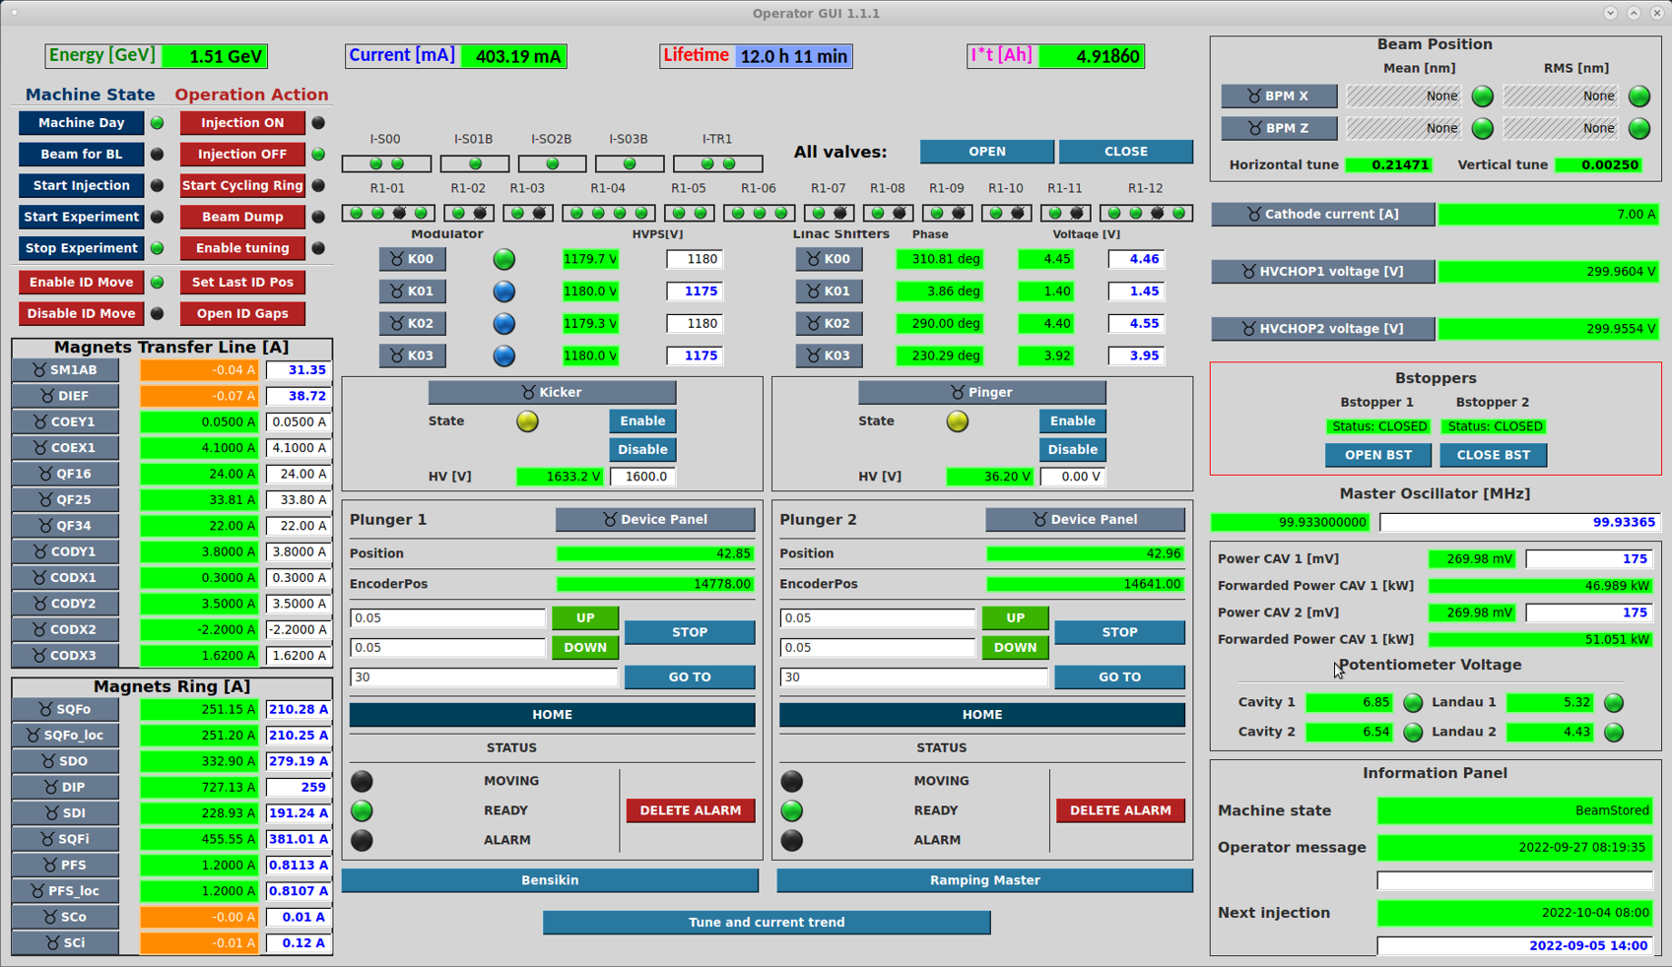
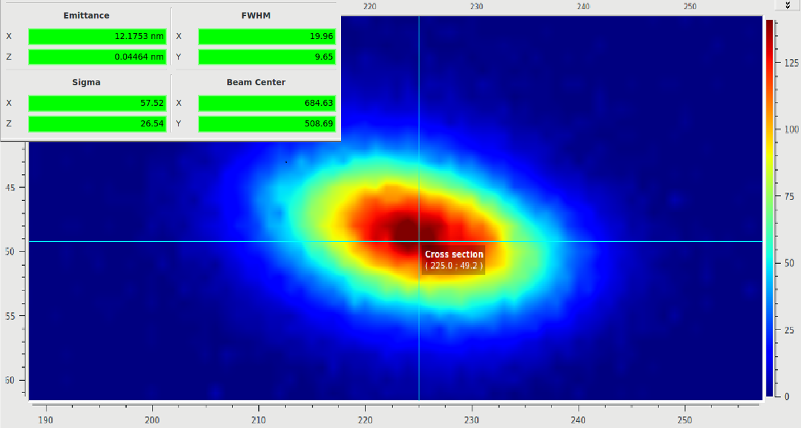
Starting parameters

Slide 4
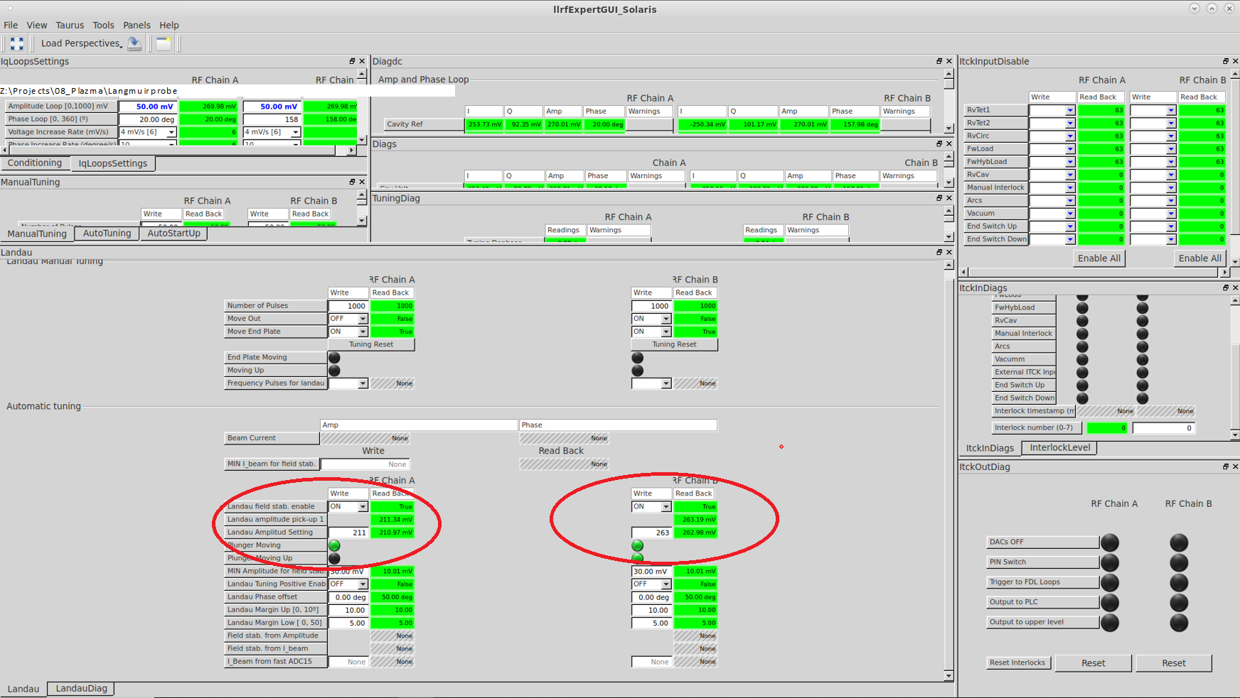
Automatic tuning GUI

Slide 5
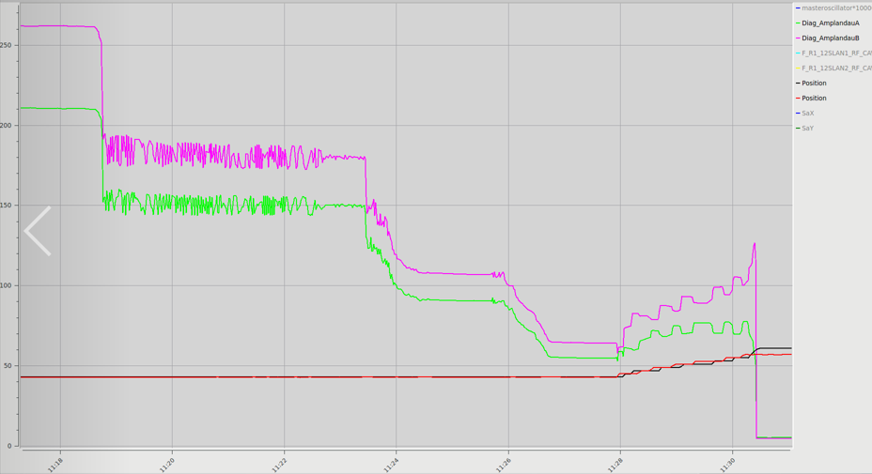
Parameters with tuning enable

Slide 6
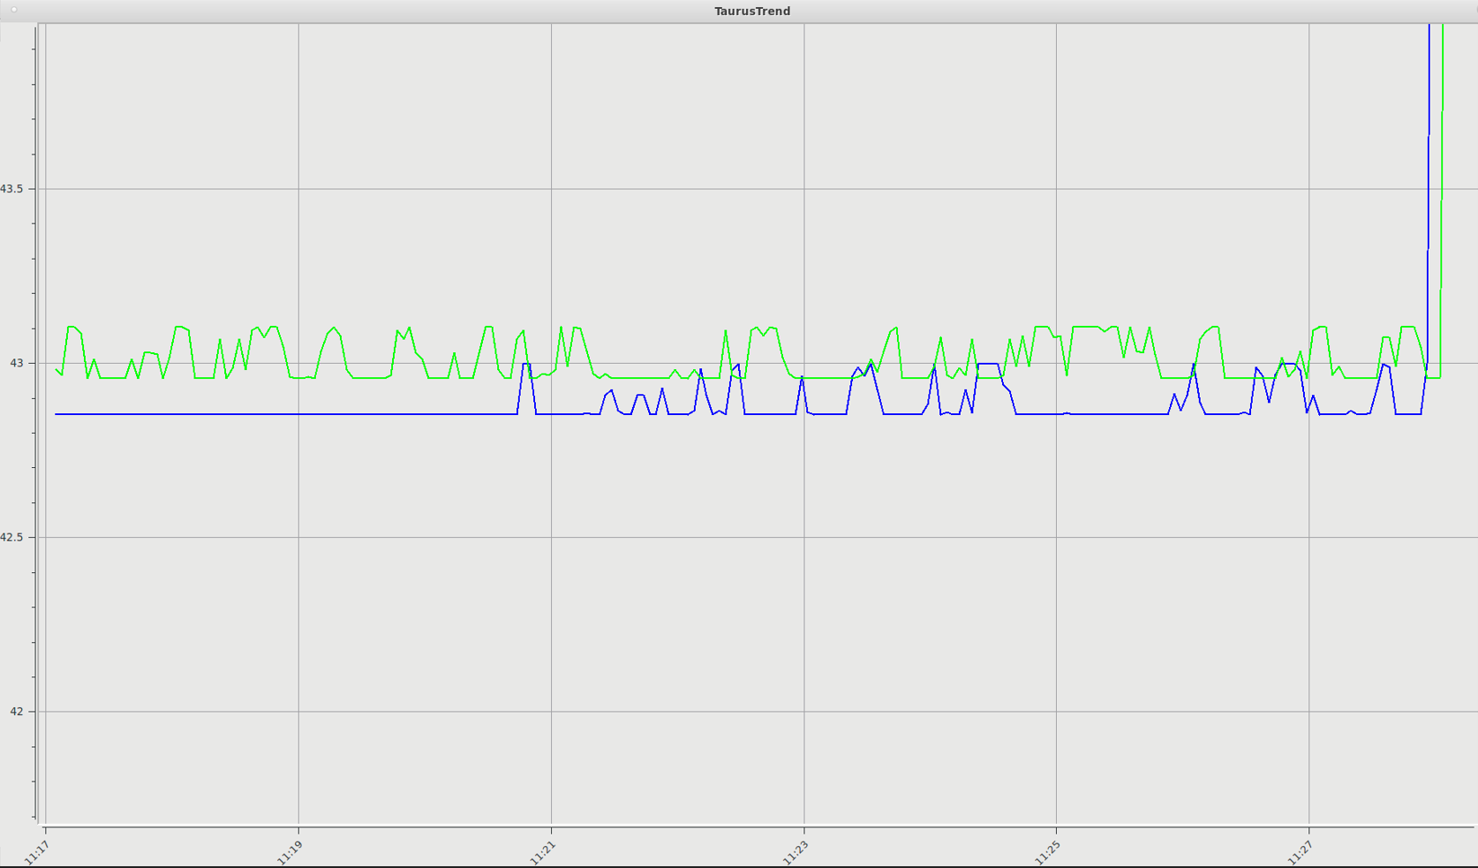
Plunger positions with tuning enable

Slide 7
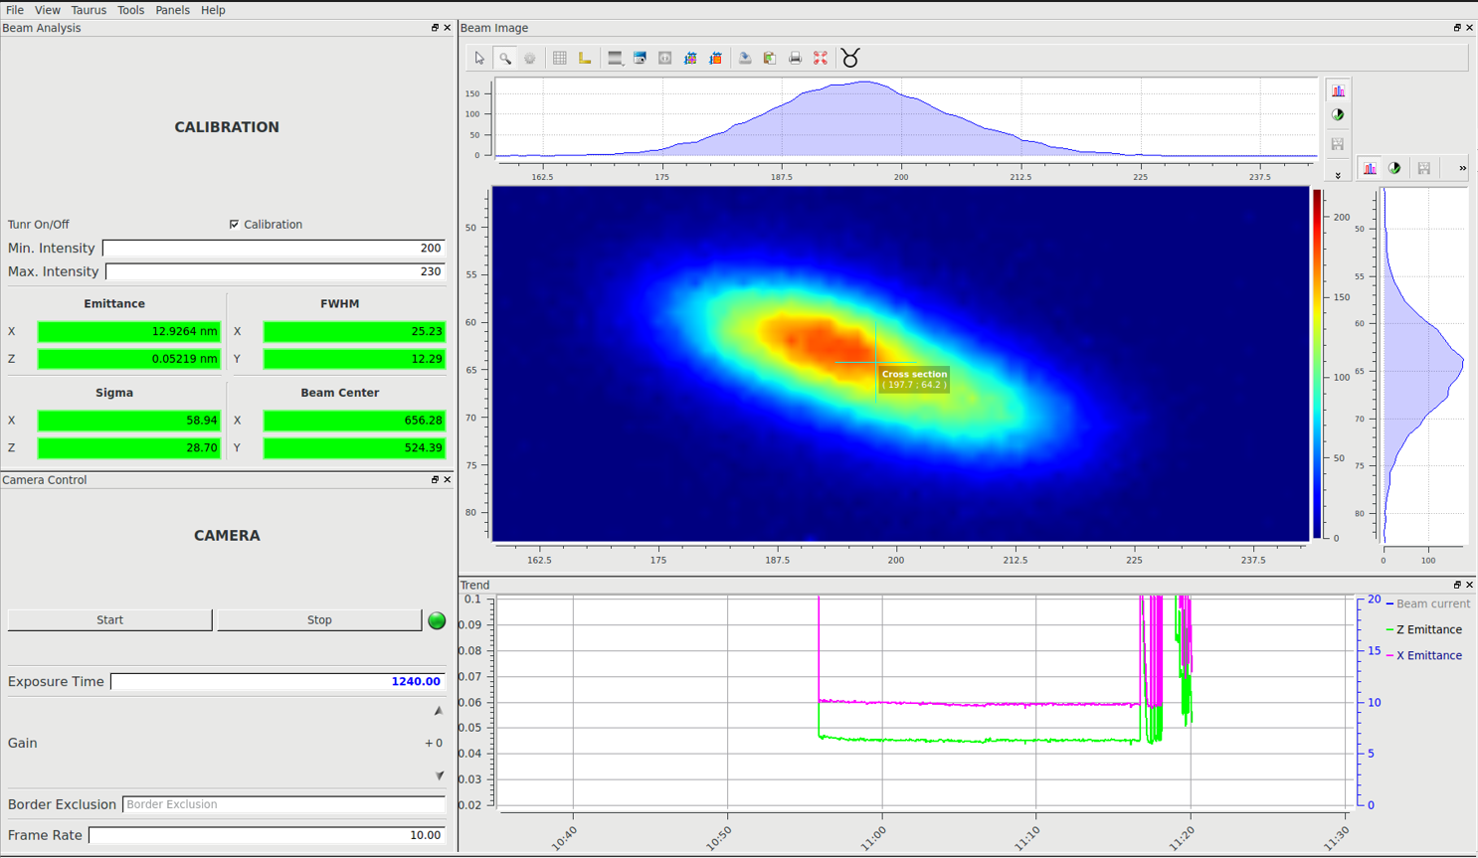
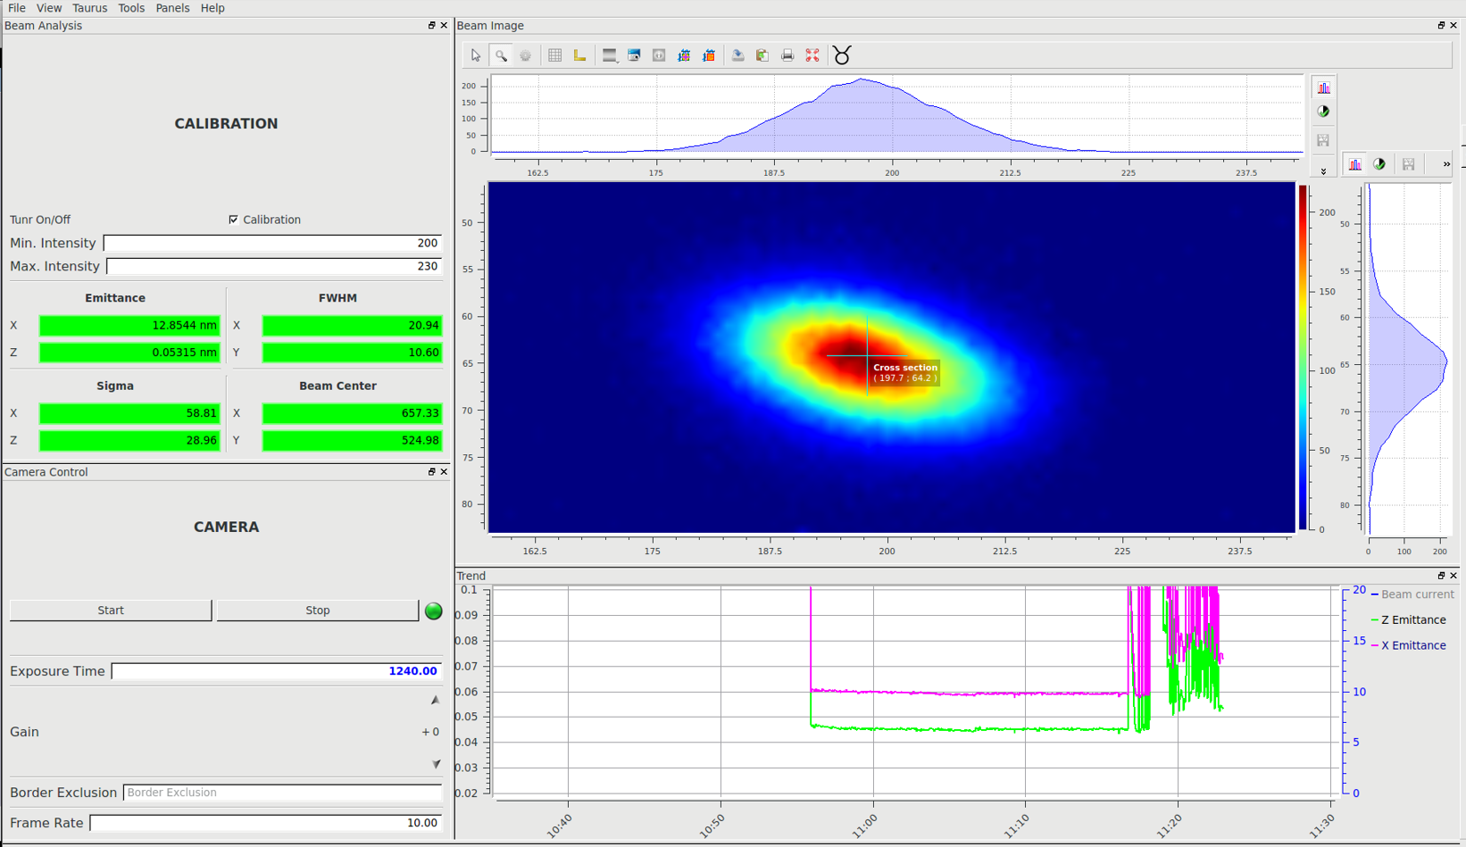
Beam shape during decreasing beam current and Landau tuning enable
350 mA with starting power level
260 mA with lower power level

Slide 8
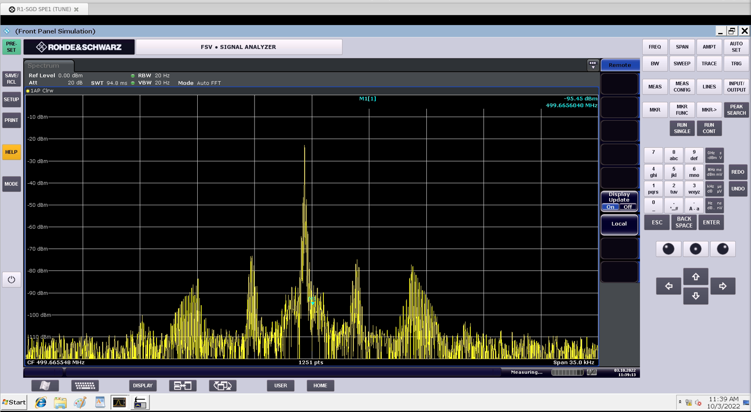
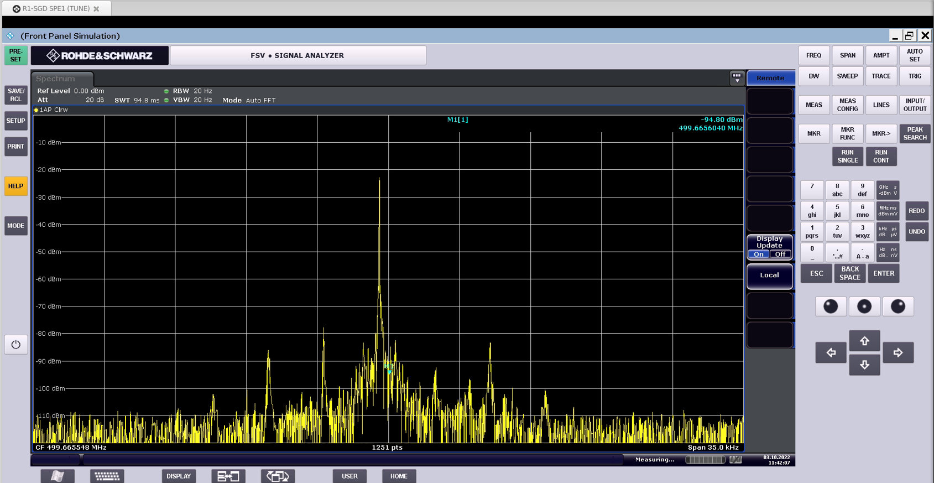
Spectrum during decreasing beam current and Landau tuning enable
350 mA with starting power level
260 mA with lower power level

Slide 9
Thank you!
Lund, 12.10.2022
Mateusz Szczepaniak
SOLARIS National Synchrotron Radiation Centre

