Slide 1
The VSR Demo Project
Helmholtz Zentrum Berlin
Adolfo Velez Saiz
12.10.2022
HarmonLIP
MAXIV, Lund

Slide 2
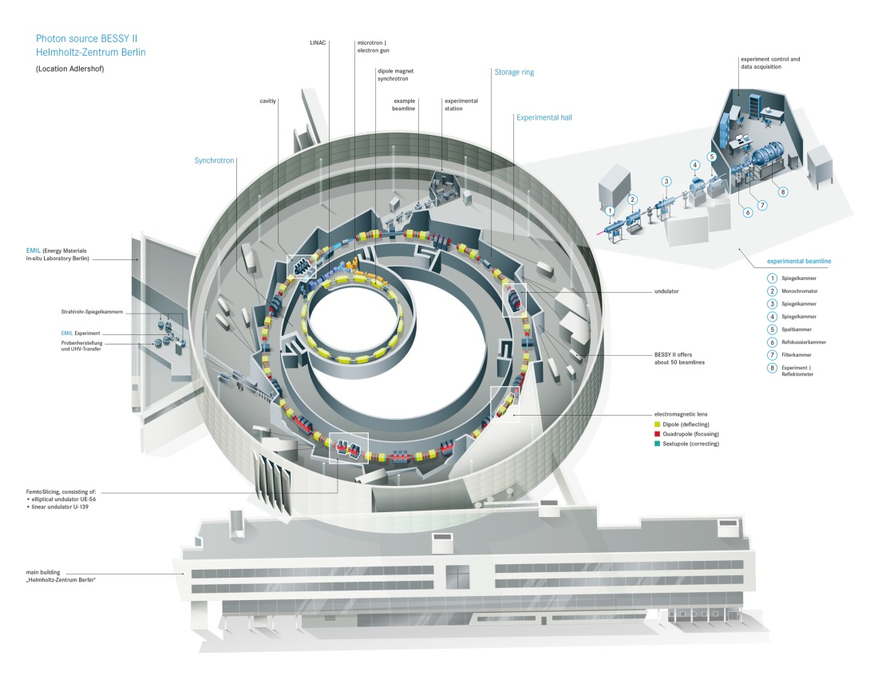
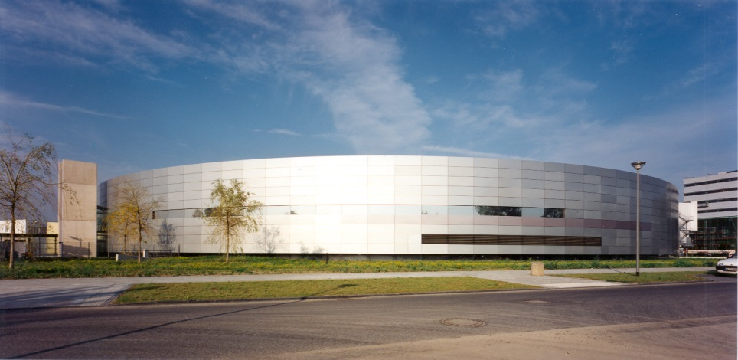
The context
The SR BESSY II is a 1.7 GeV synchrotron radiation source operating for 20 years in Berlin
BESSY II emits extremely brilliant photon pulses ranging from the long wave terahertz region to hard X rays
Pioneer in offering low α operation with a comunity of user performing dynamic measurements in „functional materials“
Nevertheless BESSY II has passed ist halve life and needs to be renewed to be competitive among other light sources
BESSY III

Slide 3
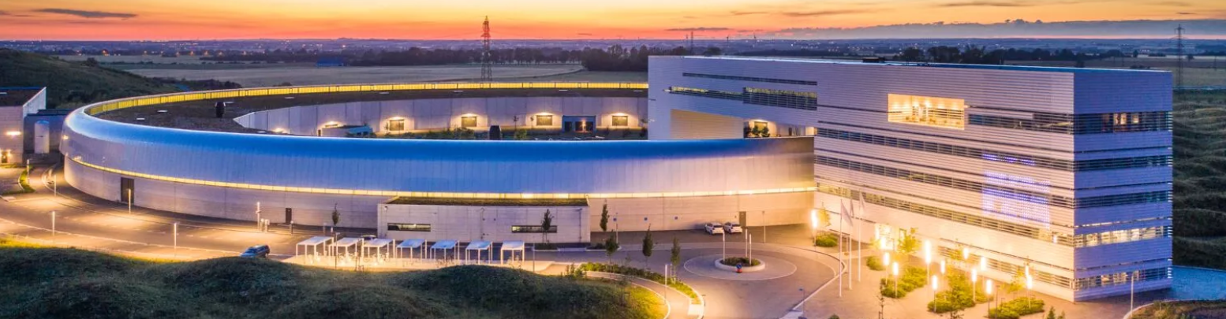


New generation light sources move in the direction of minimizing beam emmitance
DLSR by multi-bend achromats (MBA)
Complete new ring
New magnet/vacumm system
Long dark time (1 year ESRF)
Very expensive (100sM€)
Long pulses needed
Lifetime problems
BUT ...
Short pulse experiments (1ps) represent one of the strong fields at HZB (low-Alpha, femtoslicing)
Such a pitty to lose the stablished community!

Slide 4
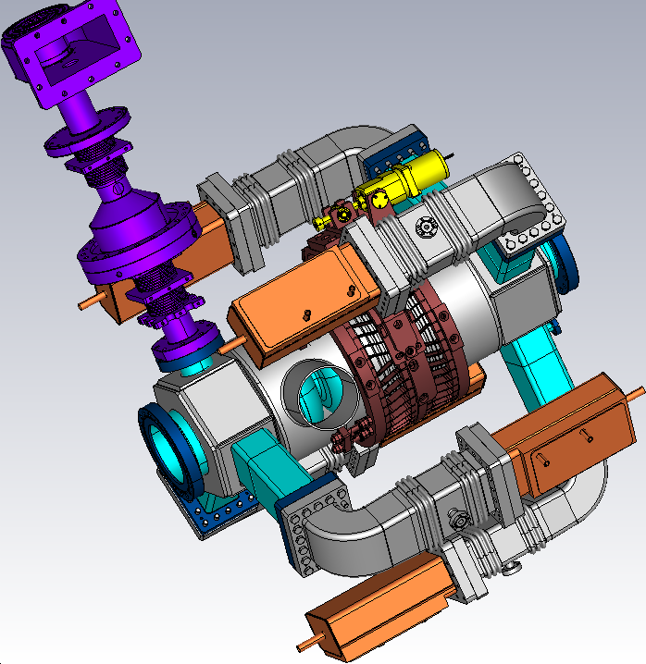
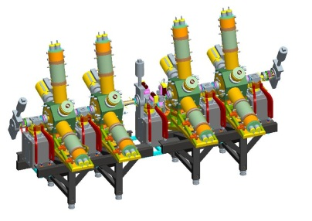
The VSR Concept
BESSY II @ present
Limited pulse length in storage ring
Machine optics
Hardware (RF cavities)
At high current beam becomes unstable
  For ps pulses, flux is reduced by
  nearly 100
User optics
10
  Supply short pulses down to 1.5 ps
    100× more bunch current
Low alpha optics
I_{th} roughly proportional to V´_{rf} σ²
  Low α permits few 100 fs
User optics
RMS bunch length (ps)
1
100 × more voltage gradient
  Could we configure BESSY VSR so 1.5 ps
  and 15 ps bunches can be supplied
  simultaneously for maximum flexibility and flux?!!
Low alpha
0.1
10⁻⁴
10⁻³
10⁻²
10⁻¹
1
10
Bunch current (mA)

Slide 5
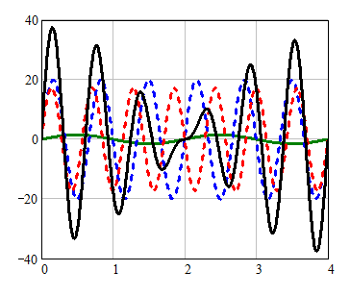
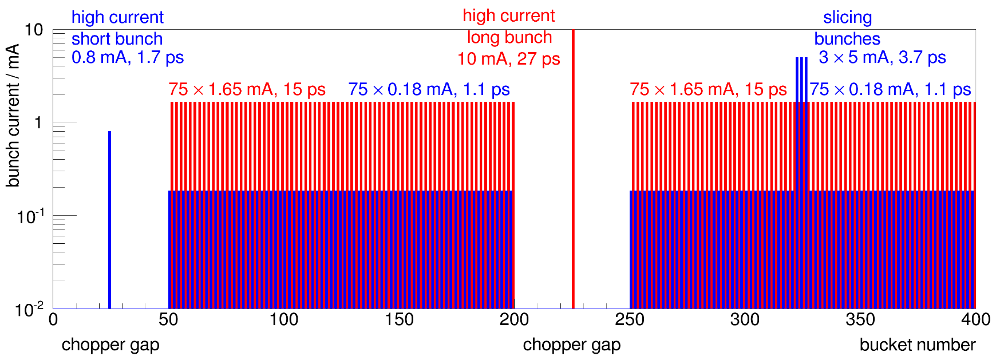

Long and short bunches simultaneously
BESSY VSR
Long Bunch
Voltage / MV
Short Bunch
Time [ ns ]

Slide 6
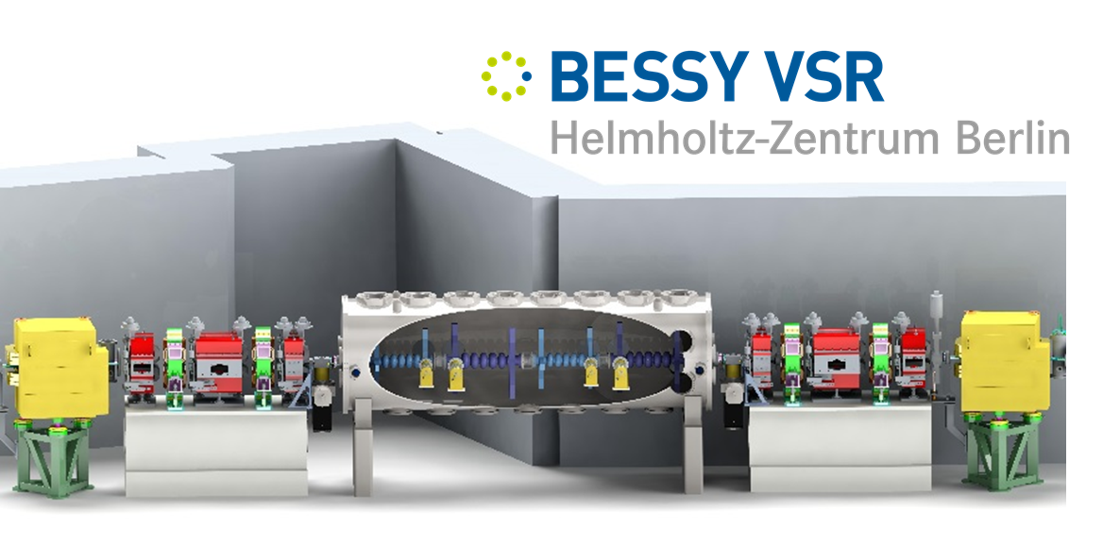
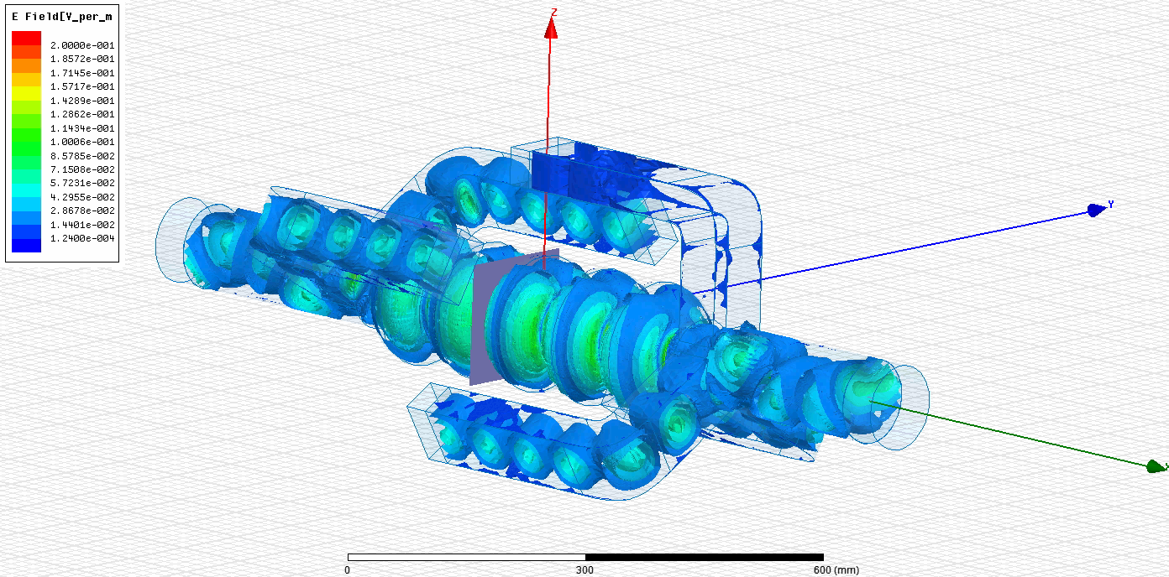
BESSY VSR, a great challenge
High gradient SRF cavities + High Current
20 MV/m in continuous wave (CW)
High current, 300 mA
  Particulate free vacuum in a “dirty”machine
  Transparent “parking” of cavities
Coupled-bunch instabilities
Trans. beam loading & Robinson instabilities
  Higher-order modes in SRF systems in relation to beam spectrum
  Very strong damping of HOMs
  Sufficiently strong bunch-by-bunch feedback to suppress instabilities
  RF and tuning control for the cavities
  Choice of BW and available RF power
  Changing bunch profile along bunch train
Technical realization
  Integration in a single straight (4.2m)
  Cryogenic installation
  Required infrastructure for system development and tests

Slide 7
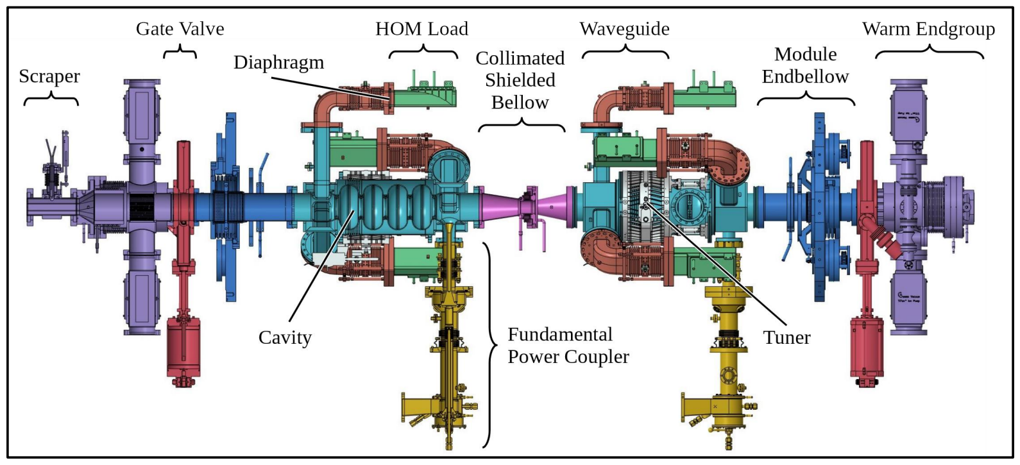
VSR Demo for BESSY VSR,a preparatory phase
Challenges
High current (300mA)
CW operation
High gradients (20MV/m)
Few cavity systems with high HOM damping capabilities
+
Very demanding impedance budget (Z$=8ⅇ^{4}Ω;Ztrans=1ⅇ^{7}Ω/m)$
Short straight = 4m (low β), compact cavities, damping integrated
Not State of the Art
New methods and components to be developed
BESSY VSR Demo
Validate the technology by SRF R&D
2 x 1.5 GHZ cryomodule to be commissioned in bERLinPro/SEALab
Several components commissioned with beam in BESSY II (CSB, beam-pipe absorbers …)
Cavities, couplers, etc, commissioned in SUPRALAB
Module ready for BEAM at BESSY/SEALab

Slide 8
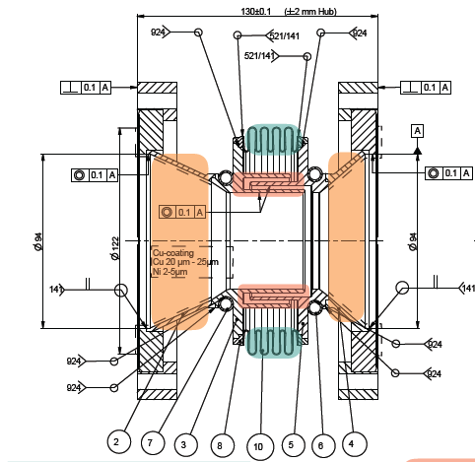
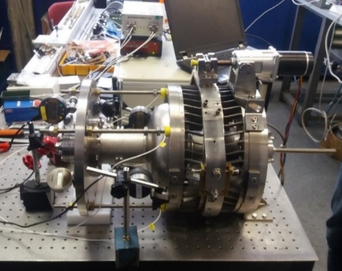
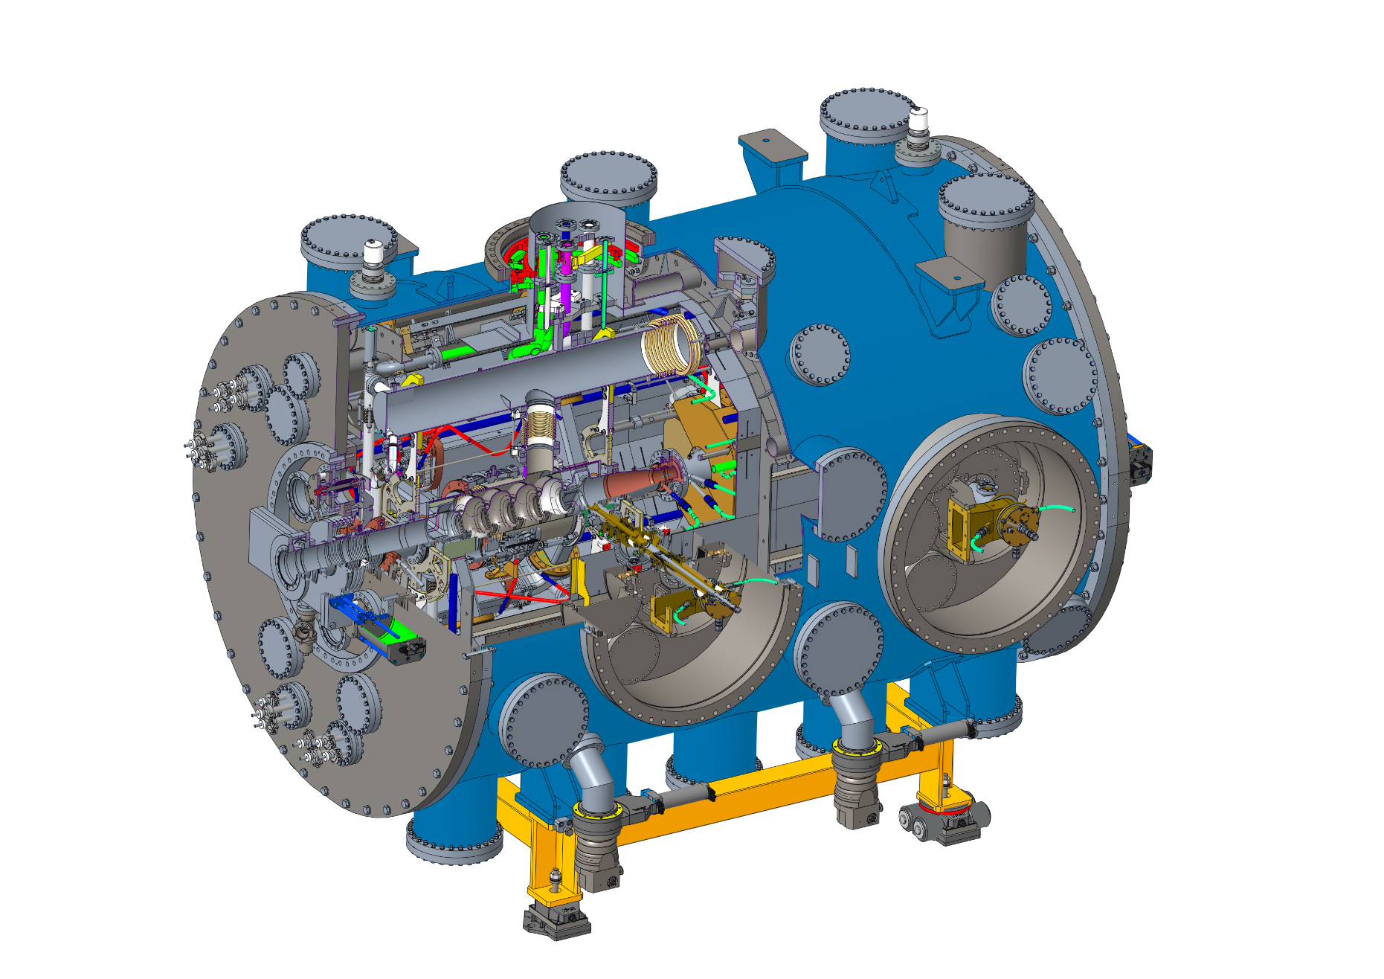
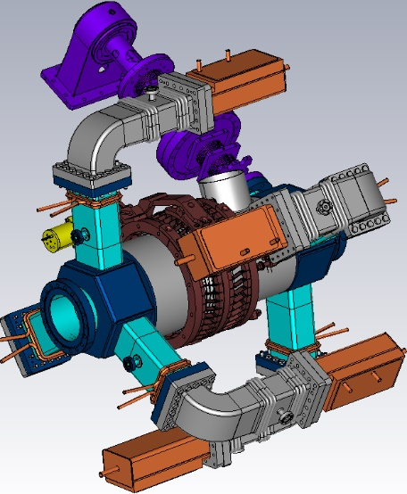
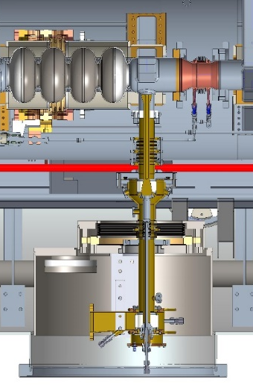
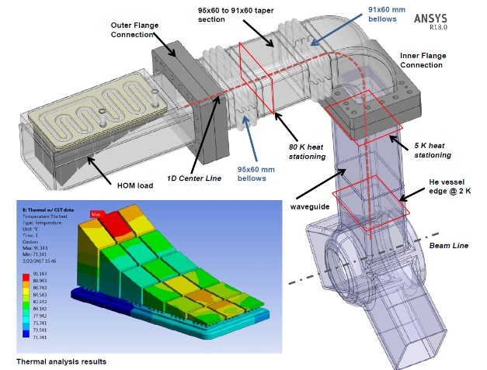
VSR Demo
Collimating Shielded bellow. Disipates synchroton light impacting on surface avoiding module quenching by losses. Novel component!
Blade tuner. Streches the cavity to control the operation frequency. Critical component for operation. Operational forces must be optimized so no damage is induced in the cavities.
High current highly damped SRF cavities, novel component! Tailore bunch length by applying high field gradients. In the mean time disipate unwanted high order power by means of HOM loaded waveguides
1 Unit
X 2 Units
Beam vacuum:
Needs to be ultra-clean.
Any dust particulate could cause
Malfunction and
Quenching
(operation down)
X 2 Units
X 2 Units
X 10 Units
High power couplers.
Throw RF power into the cavities to maintain volgae and ensure control. Challenging component. Connects cavity vacuum to the outside. Failure could imply contamination
High order mode waveguides/loads. Unwanted power is transported through waveguide arms to cooled ceramics for disipation. Transition from 2K (cavity) to room temperature. Challenging design.

Slide 9
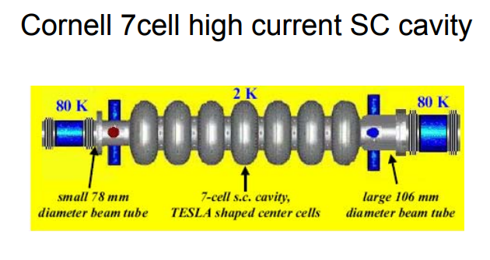
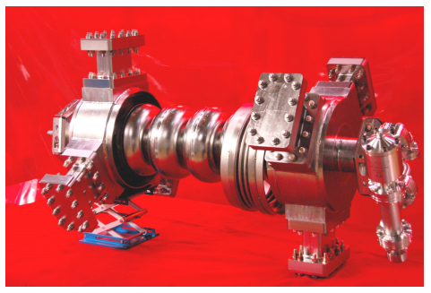
Which cavity
Damping HOM modes
Very High HOM power expected (1.5KW per cavity)
A few cavity/damping concepts available are able to cope both with high current and high gradient
VSR requires a very compact cavity system (4.2 max. module length)
Beam dynamics calculations on VSR show extreme HOM damping level required to avoid coupled bunch instabilities (CBI‘s)
JLAB High current CW cavity
  5e4 Ω, longitudinal modes
  1e7 Ω/m, transverse modes
  2e5 Ω, longitudinal
  2e7 Ω/m, transverse
The state of the art at this point was not mature enough to fulfill the VSR impedance requirements
Waveguide damping seem a good starting point
  Waveguides can transport high power levels
  Reduce the risk of dust contamination (loads far from the cavity)
  „In principle„ easy to design (well defined cut-off frequencies)
I_{b} =100 mA
V=20 MV
E_{acc}=20MV/m

Slide 10
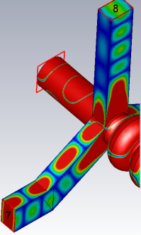
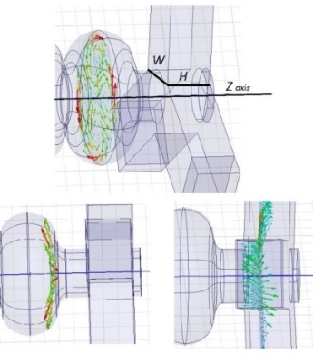
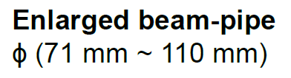
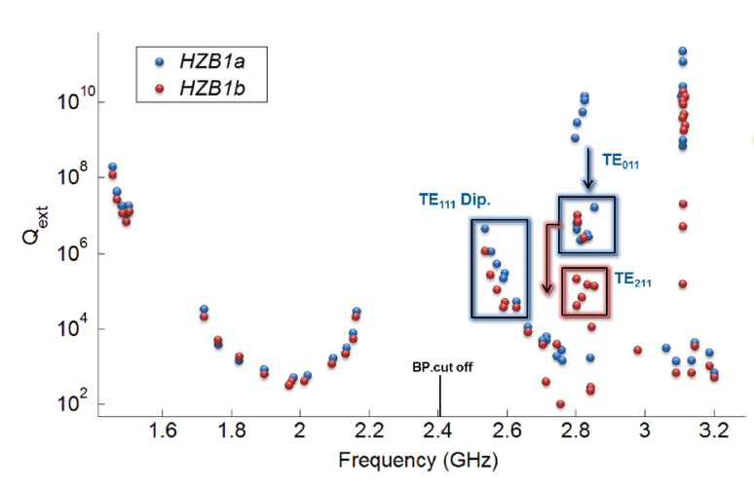
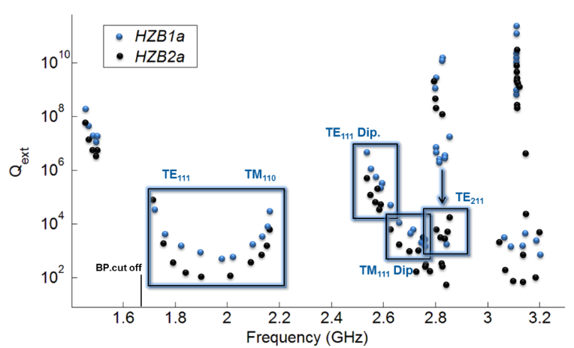
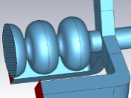
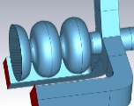
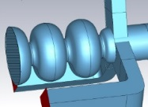
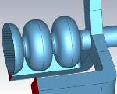
Optimizing the cavity, impedance budget
Impedance Budget (R/Q*Q)
Modified WG aspect ratio
  5e4 Ω, long. modes
  1e7 Ω/m, trans. modes
Propagation in WG is defined by orientation of H
Same cavity modes result into ortogonal orientations Inside WGs
Enlarged beam-tubes (as used by bERLinPro)
Beam pipe cut off is reduced (2.4 GHz to 1.7GHz)
Coupling to waveguides is enhanced (also propagation through beam pipes)
Some mode bands such as TE₀₁₁ are not affected
Standard WG to extended WG
H>W/2 (50mm → 60mm)
A.Velez et al. WEPMA013
IPAC15
A.Velez et al. MOPP071, LINAC‘14
f = 2.755 GHz TM Dipole

Slide 11
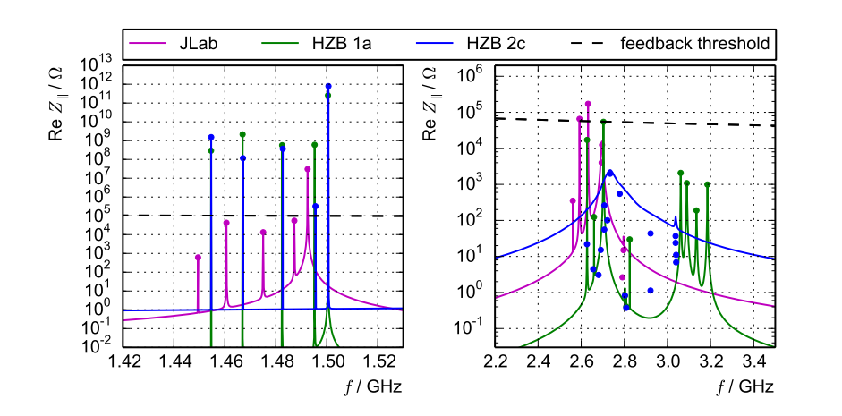
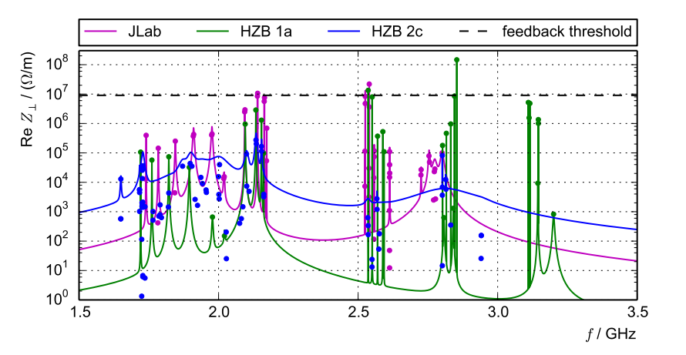
Impedance on multicell cavities
A price is to be paid when increasing total gradient ufortunately …

Slide 12
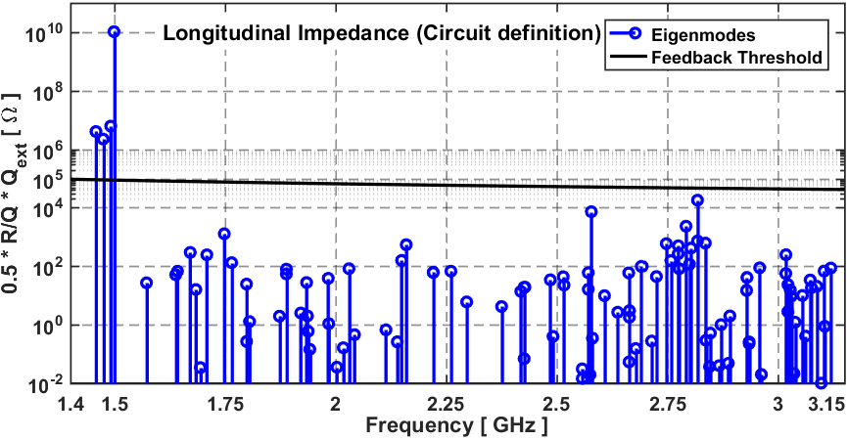
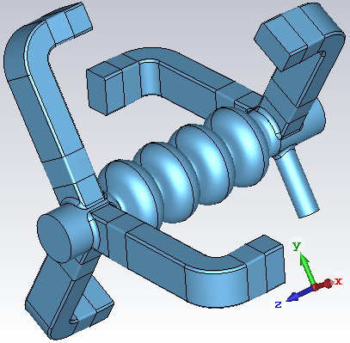
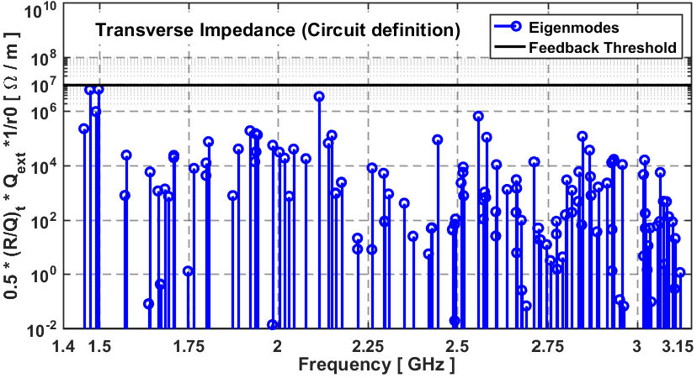
Optimizing the cavity
Monopole Band
 | Frequency [GHz] | R/Q [Ω] | Q_{ext} | Mode Type
1 | 1.49866 | 386 | 5.00∙10⁷ | π
2 | 1.49134 | 0.41 | 2.98∙10⁷ | 2π/3
3 | 1.47424 | 0.09 | 4.74∙10⁷ | π/2
4 | 1.45785 | 0.05 | 1.60∙10⁸ | 2π
Impedance budget below threshold!!
8

Slide 13
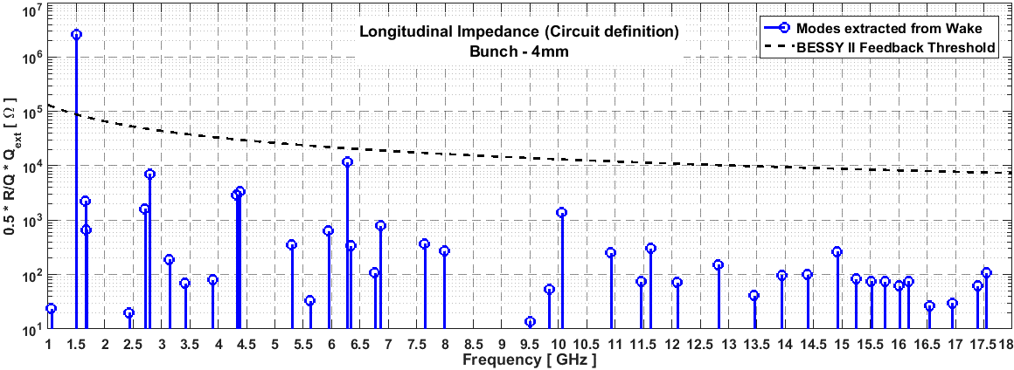
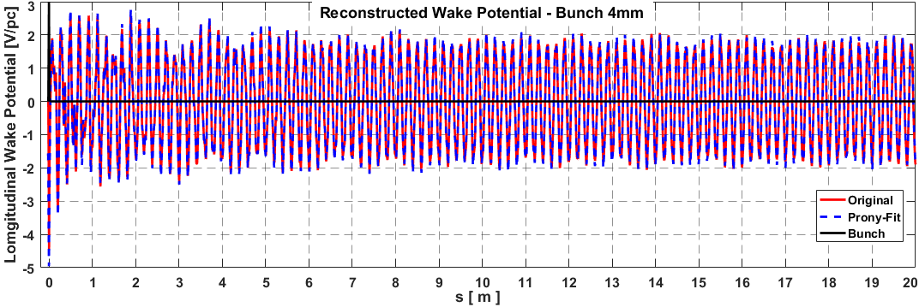
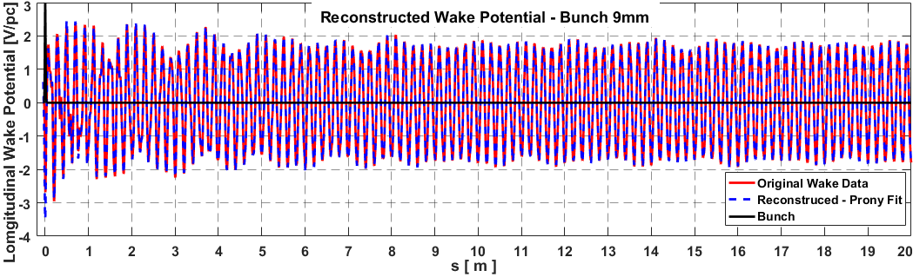
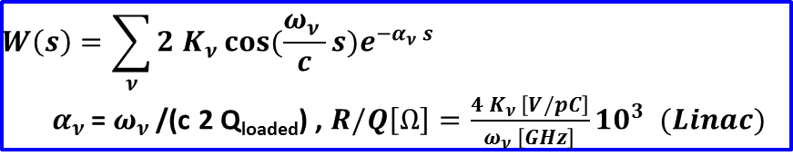
Developing numerical methods
$$W\left(s\right)=\sum_{ν}{2 K_{ν }cos⁡(\frac{ω_{ν }}{c}s)e^{−α_{ν }s}}$$
$α_{ν }$= $ω_{ν }$/(c 2 Q_{loaded}) , $R/Q\left[Ω\right]=\frac{{4 K}_{ν }\left[V/pC\right]}{ω_{ν }\left[GHz\right]}{10}^{3} (Linac)$
Bunch 4mm
Bunch 9mm
Pole-fitting gives quantitative estimate on the resonances of the system (Mode type undefined)
For the fundamental mode Qext=5e7 should be used, because the wake length 20m is too short to extract such high Qext
The search for best fit is done manually, it depends on frequency range & filter settings in the algorithm
Pole fitting is a fast estimate of the resonances in the system (low resolution)
Eigenmode analyses is required (High resolution).
At high frequencies >4GHz is very time consuming
& requires huge hardware resources

Slide 14
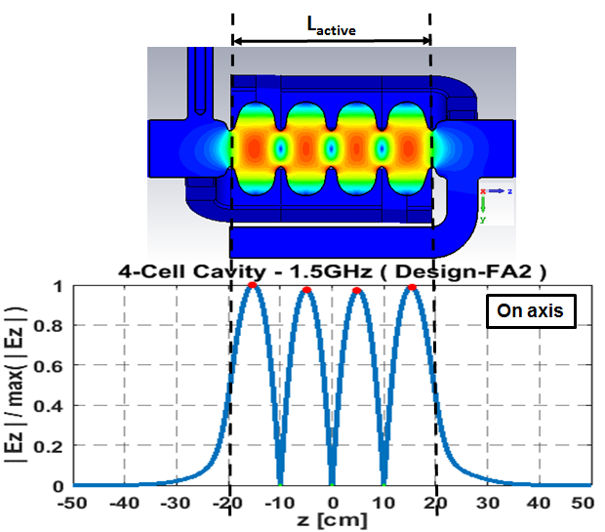
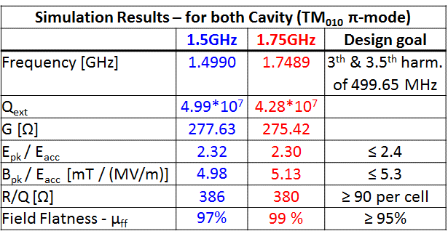
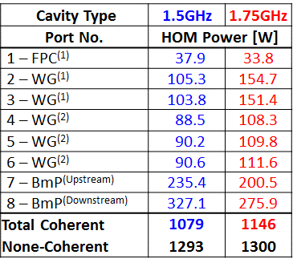
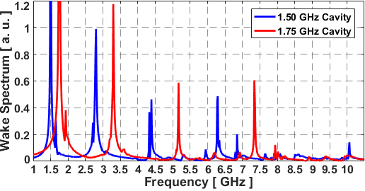
HOM Damping
To minimize HOM power Cavity resonant eigenfrequencies must avoid beam harmonics!!!
Spectrally Weighted with “Baseline” pattern
Wakefield Simulations (CST)
During cavity design additional to standard parameters (peak fields, field flatness …), HOM spectrum should be controlled to avoid any resonances with circulating beam harmonics
Both cavities are not hitting any of beam resonances that are multiple of 250MHz
More than 1KW per cavity!

Slide 15
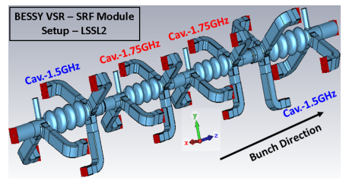
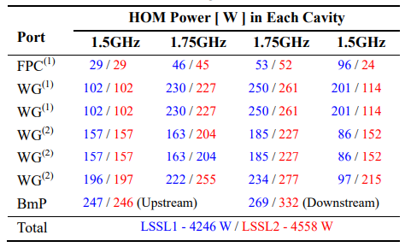
HOM Damping
To minimize HOM power Cavity resonant eigenfrequencies must avoid beam harmonics!!!
Spectrally Weighted with “Baseline” pattern
Wakefield Simulations (CST)
More than 4KW in total!

Slide 16
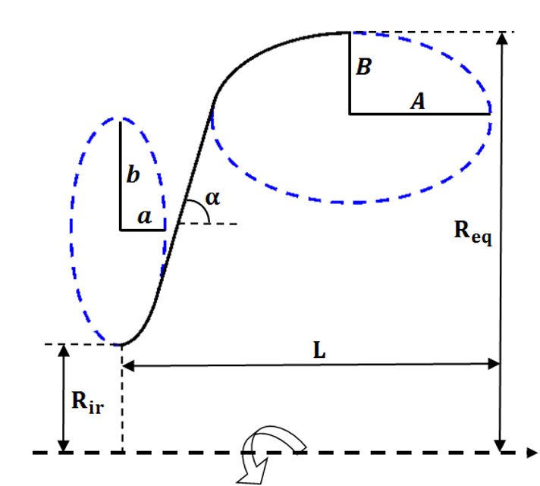
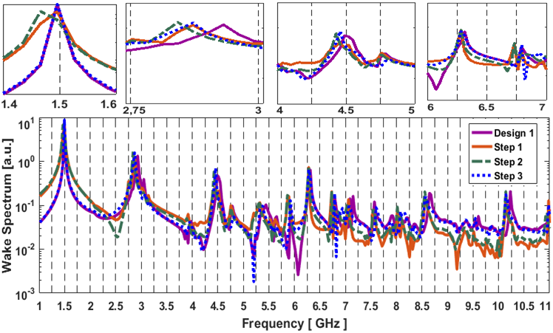
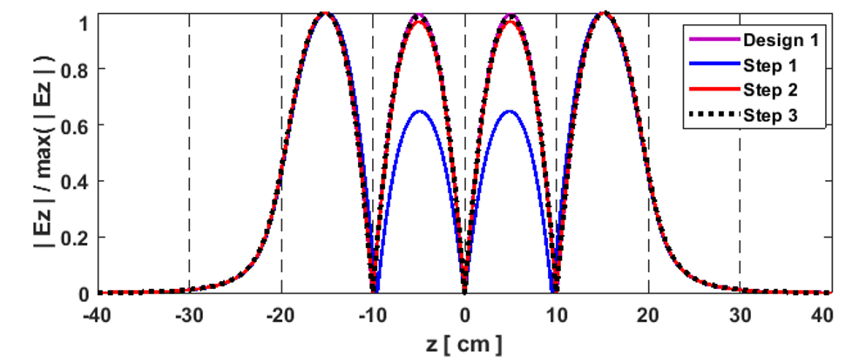
Tuning unwanted HOMs
Cavities must be designed so that dangerous HOM modes lay far apart from synchrotron harmonics to avoid beam loss
Standard technique is limited to a few GHz due to eigenmode limitations

Slide 17

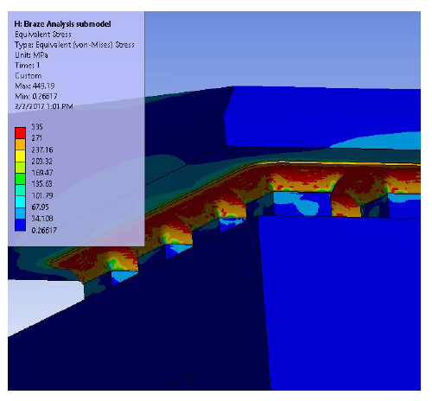
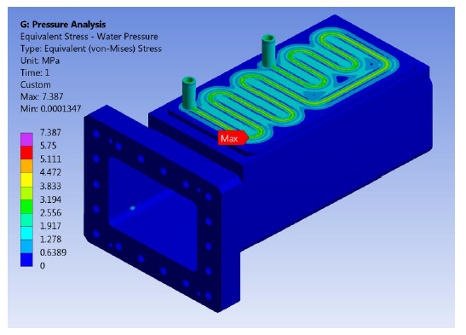
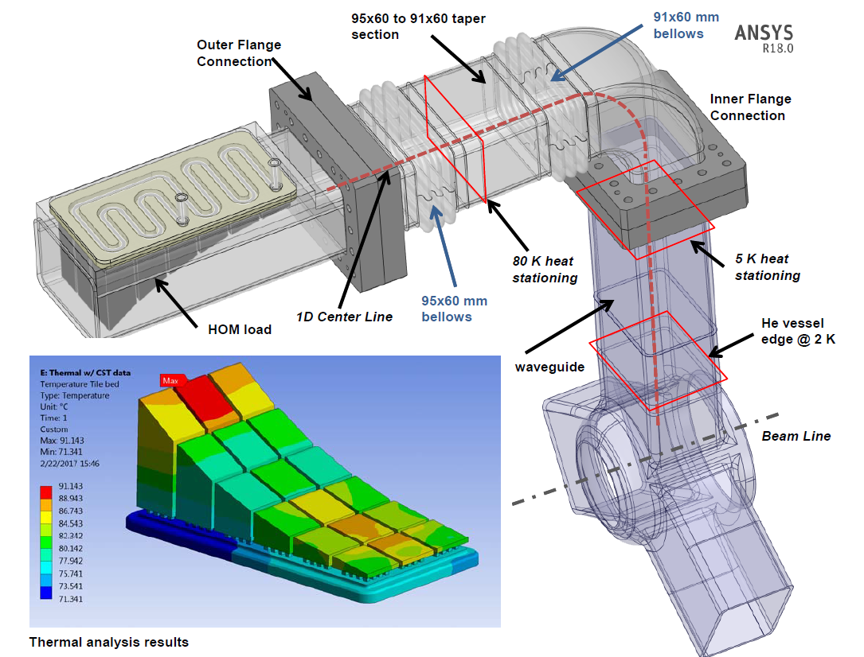
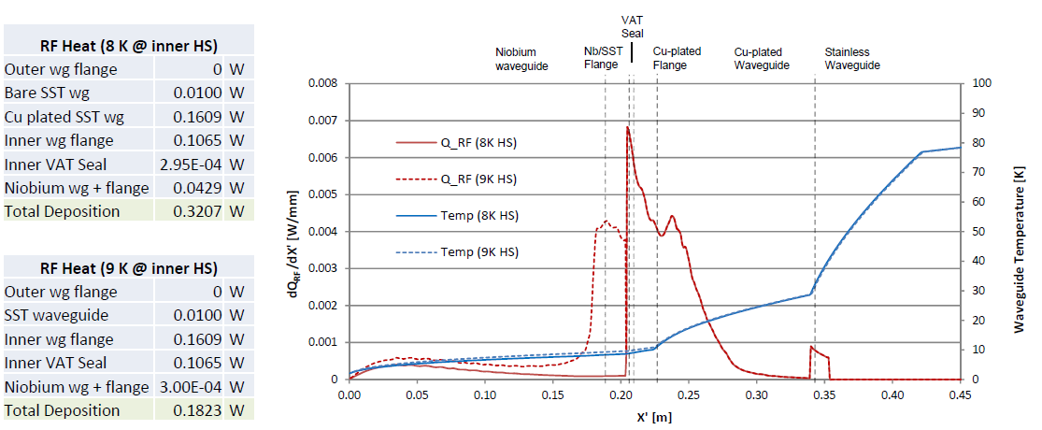
Damping unwanted HOMs
Water-cooled HOM loads (room temperature 300K)
Specifications: 460W per load
Design, fabrication and tests @ JLab
60-80K
5K
2K
Risk of a local quench: Superconducting region transitions above Tc (9.2K)
and superconductivity is lost

Slide 18
VSR Demo
High current highly damped SRF cavities, novel component! Tailore bunch length by applying high field gradients. In the mean time disipate unwanted high order power by means of HOM loaded waveguides
X 2 Units
X 10 Units
High order mode waveguides/loads. Unwanted power is transported through waveguide arms to cooled ceramics for disipation. Transition from 2K (cavity) to room temperature. Challenging design.

Slide 19
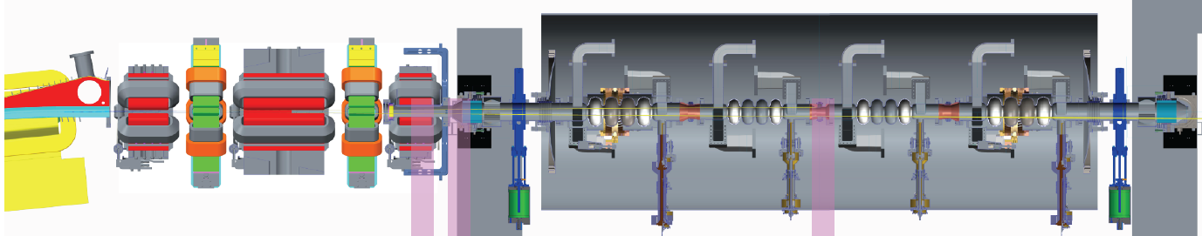


Collateral damage, synchrotron light
Since we are working in a synchroton we expect Synchrotron Light
89 W !!!
Courtesy of H.W.Glock

Slide 20
VSR Demo
Collimating Shielded bellow. Disipates synchroton light impacting on surface avoiding module quenching by losses. Novel component!
1 Unit

Slide 21




Collimating shielded bellow (CSB)
Of course the community (specially SRF) was concerned …
Impedance issues? Is the beam stable?
Particulates? Are we going to Quench?

Slide 22



Beam Tests
CSB Installed in BESSY T2 Straight
Close view on CSB
Collimated Shielded Bellow (CSB) as critical component to BESSY VSR successfully commissioned with beam at BESSY II (350mA)
First Fundamental Power Coupler prototypes fabricated at Research Instruments (RI)
SRF cavity fabrication in full swing at RI
SRF Cryomodule fabrication running
Impedance computed for beam excited CSB

Slide 23











Prototyping and testing
VSR Blade tuners
5-cell cold model 1.5 GHz
4-cell VSR 1.5 GHz
4-cell VSR 1.5 GHz
VSR 1.5 GHz FPC
Single cell 1.5 GHz
16KW FPC VSR 1.5 GHz
ALL to be TESTED @ SUPRALAB HZB

Slide 24


Testing infrastructure

Slide 25


Testing infrastructure
view north-west
SeaLab (former bERLinPro)
LN₂
storage
Technical Infrastructure building
High-bay
building
BESSY II

Slide 26
Tack för din vänliga uppmärksamhet
Thank you for your kind attention
Muchas gracias por su atencion

