Slide 1
HarmonLIP Workshop
MAX IV / Lund, 10-12 October 2022
Mechanical Engineering of 4 HC cavities
Alessandro D’Elia, Jörn Jacob, Vincent Serrière

Slide 2
Introduction
TM₀₂₀ cavity (low R/Q), initially proposed by Naoto Yamamoto / KEK
Frequency= 1409.45 MHz (4th harmonic of main RF frequency)
Active cavity with coupling β = 1
Both two coupled cells and two uncoupled single cells considered:
2 coupled cells: Rs = 1.35 MΩ, cooling system designed to evacuate 23 kW/cell → 500 kV total.
2 uncoupled cells: Rs = 1.47 MΩ, cooling system designed to evacuate 48 kW/cell → 750 kV total.
LOM & HOM Impedances:
2 coupled cells: no need of additional HOM dampers (for EBS case).
2 uncoupled cells: 3 rectangular HOM dampers (fc=1.8 GHz) needed
The coupled cavities design was presented by Alex and Jörn during ESLS-RF’22 meeting and this conference.
Only the 2 uncoupled cells design will be presented in this talk.

Slide 3
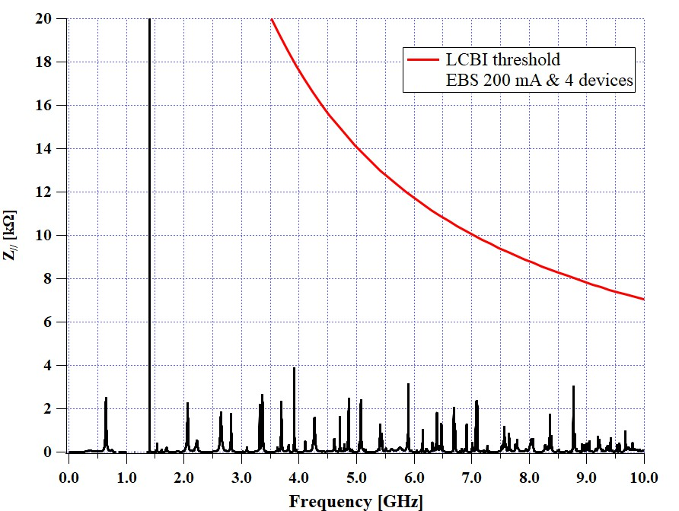
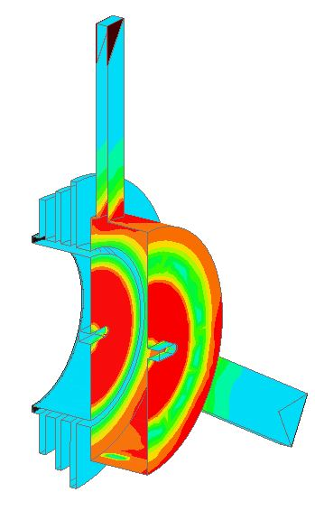
Mono Cell Cavity - EM design
TM₀₂₀ cavity
F= 1409.45 MHz
R/Q = 44 Ω
Q0 = 33500
→ Rs= 1.47 kΩ
Additional HOM dampers for remaining
TM_{m2p} modes and few others HOM…
(rectangular waveguide loaded by C48)
Very ‘fresh’ results:
3 chocks to filters most of TE modes propagating in the structure to minimize the power density on the ferrite ring
( H field)
C48 ferrites for LOM & HOM damping

Slide 4
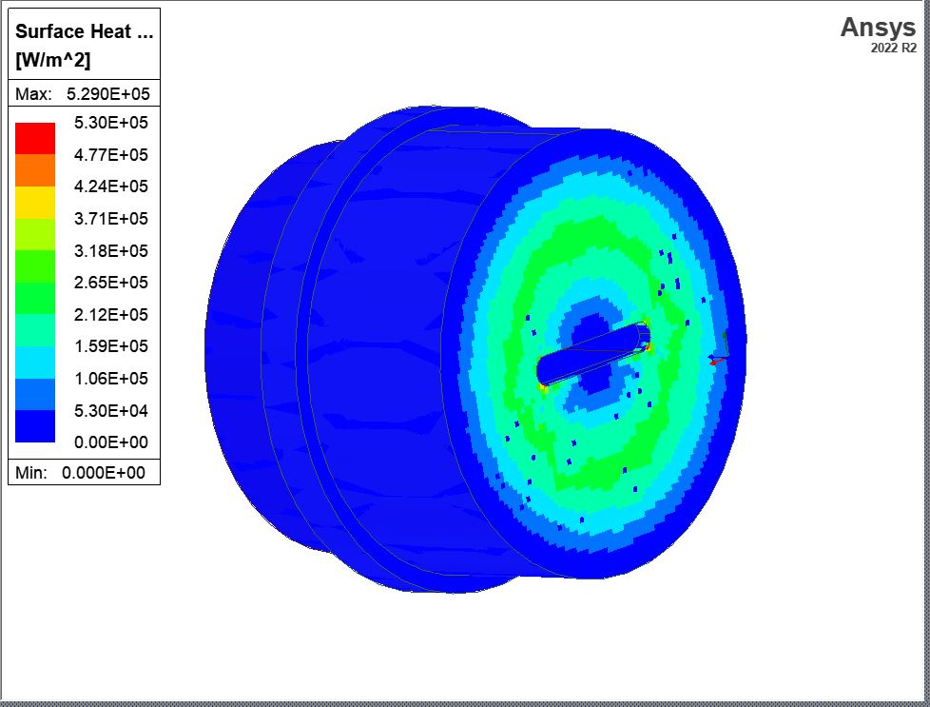
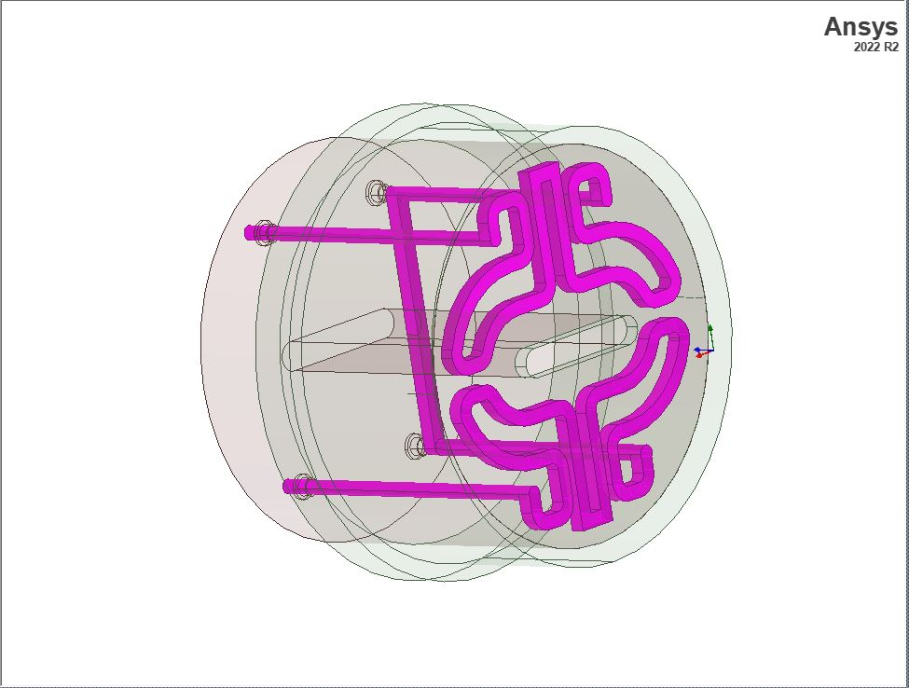
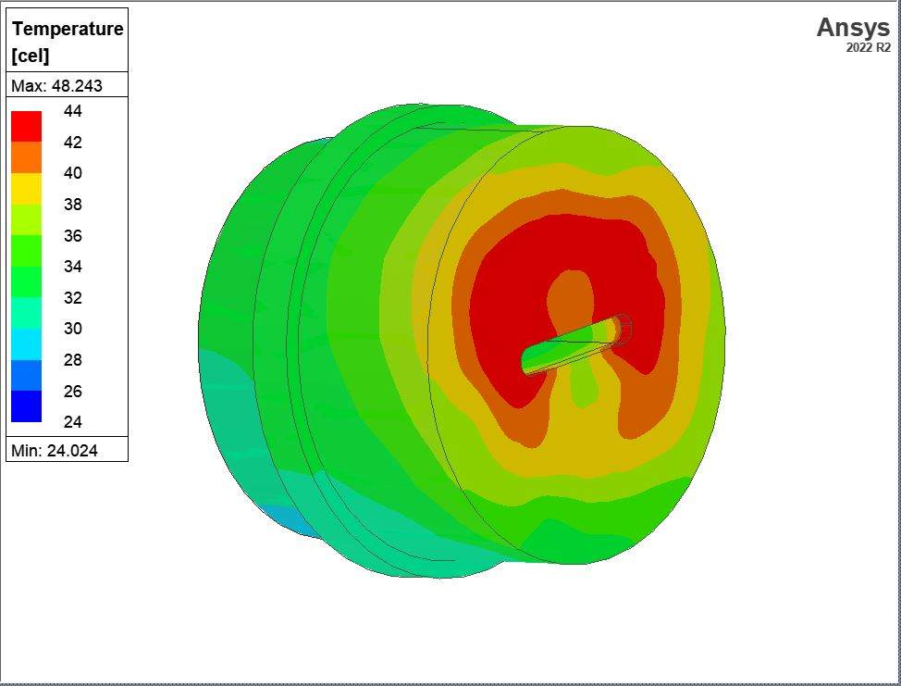
Cooling Design - Example
The most difficult part to design is the cylinder of the LOM-HOM dampers
(this part is common to uncoupled and coupled cells design)
EM-Thermal (cfd) simulations
HFSS results – V_{cav}=380 kV
IcePack modeler
IcePack solver
(one simulation needed)
(… a lot of models…)
Icepack solver take into account the local calorimetric water temperature increase in the computations → asymmetric reults.

Slide 5
Mechanical Design – Cylinder of the LOM-HOM damper
Brazing of vacuum flanges and cover of cooling channels
Brazing of the 3 parts
brazing
brazing
Surface inside
the cell
Cooler
Beam Port
VAT Flange
brazing

Slide 6
Mechanical Design – C48 Ferrites Ring
C48 Tiles – Soft Brazing
Copper Ring
Brazing @ low temperature

Slide 7
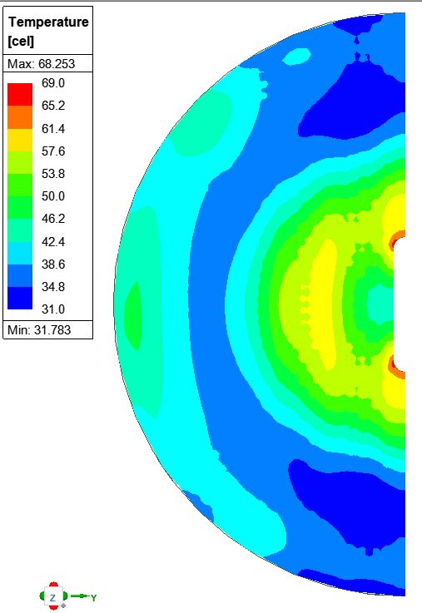
Mechanical Design – Central Disc
Vcell=380 kV
Central Disc for stacked cells

Slide 8
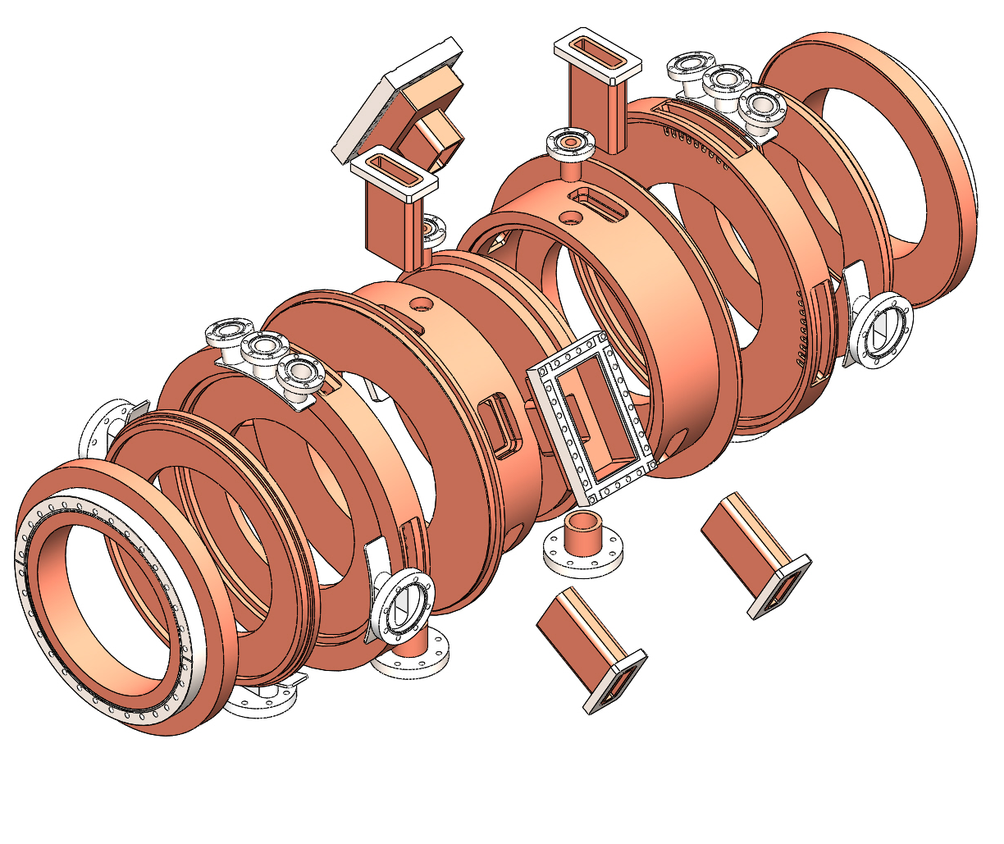
Mechanical Design – Cavity Body – Brazing step 1 & 2
Two mono cells will be stacked in order to gain place on straight section
All outlets already brazed or TIG welded
Brazing of outlets already on their dedicated disc or cylinders

Slide 9
Mechanical Design – Cavity Body – Brazing step 3 & final assembly
Brazing of discs and cylinders after RF tuning
Total Length = 710 mm

Slide 10
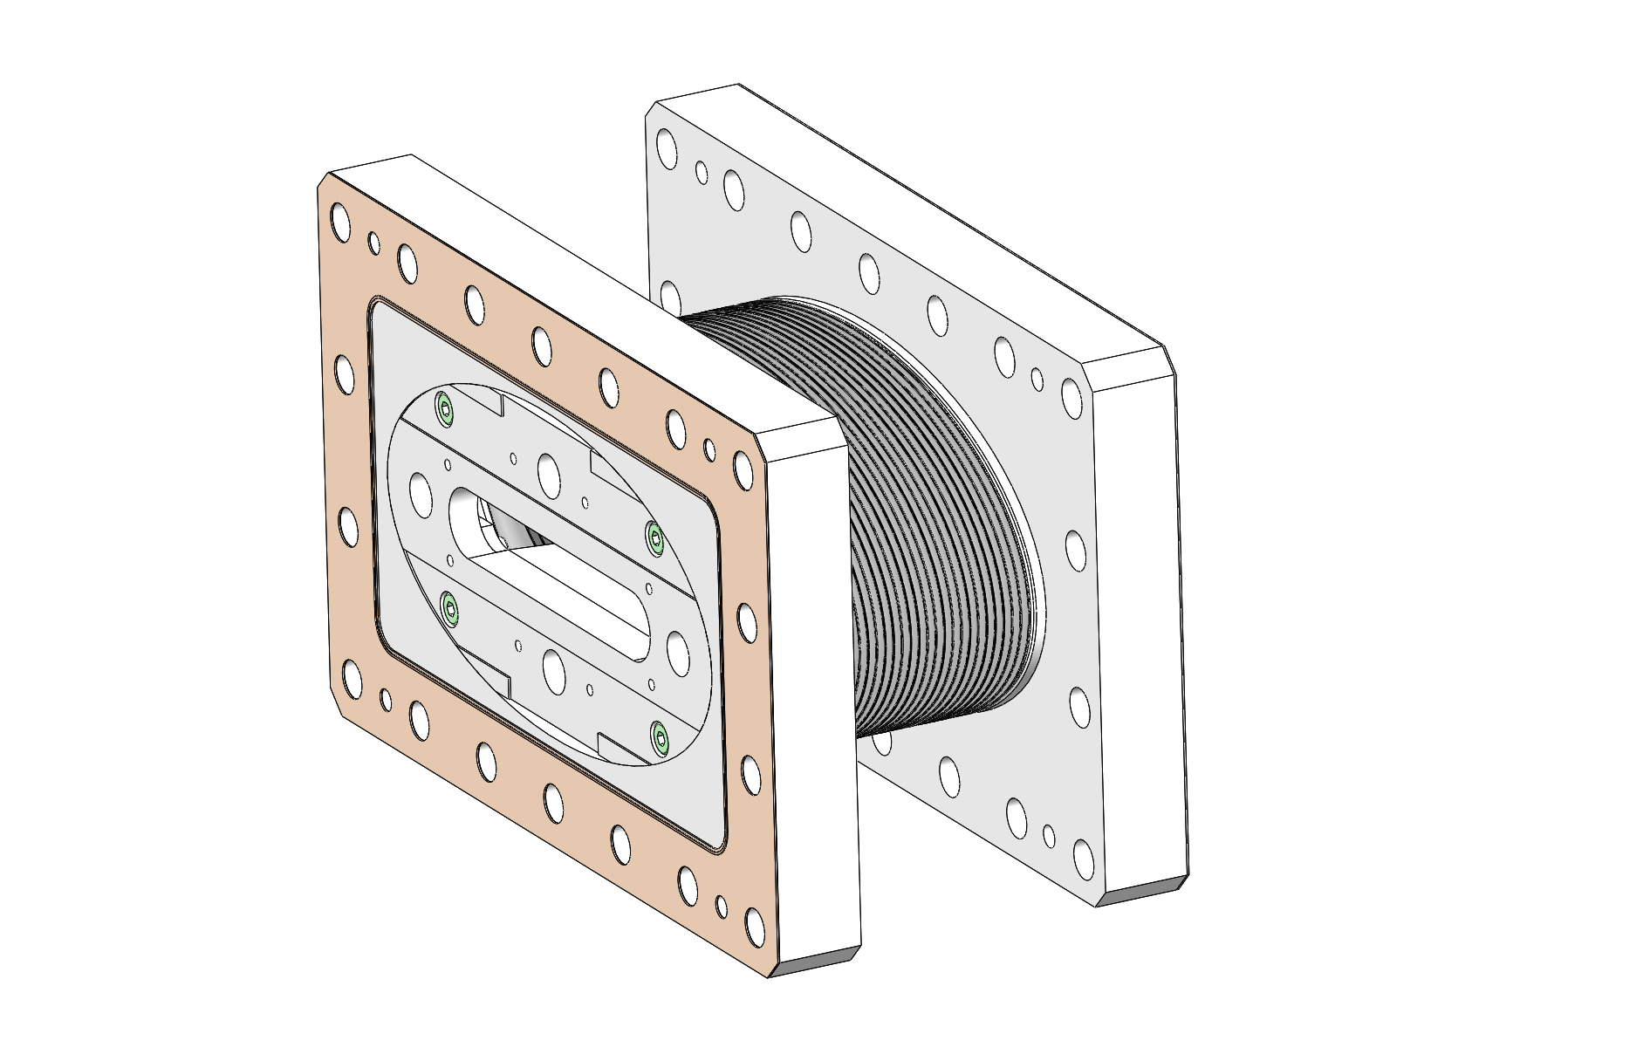
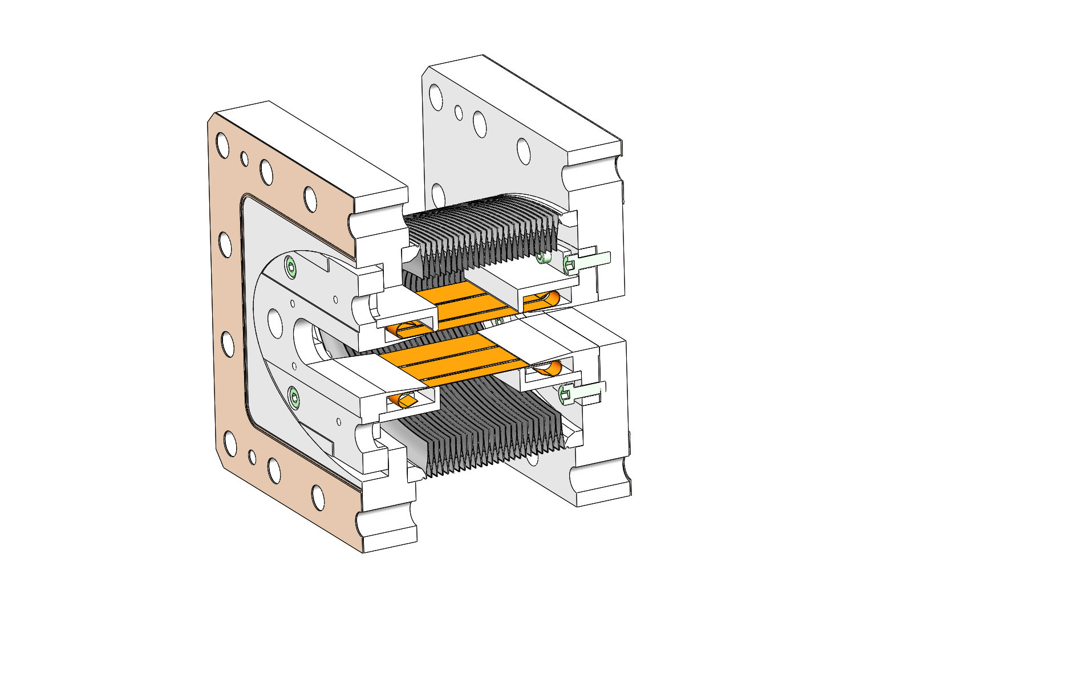
Intermediate Elliptical Bellow – RF fingers
Total Length = 100 mm
VAT Flanges
EBS rf fingers
Elliptical bellow
Design: B.Ogier, V. Serrière, J. Marchal [VAT]

Slide 11
Conclusions
Design of uncoupled cavity well advanced
Next Steps:
Mechanical design of rectangular waveguide HOM absorber
Mechanical design of Tuner
EM + mechanical design of RF windows & Coupler & Field Probe
Power dissipation in ferrite ??
THANK YOU FOR YOUR ATTENTION

