Slide 1
SC vs NC Harmonic Systems for SOLEIL II
HarmonLIP 2022
MAX IV, October 2022
Massamba DIOP
On Behalf of SOLEIL II Project Team
Part of this work has been performed within the frame of
the WP2 collaboration among ESRF, HZB, KEK, PSI and SOLEIL

Slide 2
Main SR parameters & fundamental RF specifications
PARAMETERS | SOLEIL | SOLEIL II (V0356)
Circumference, L [m] | 354 | 354
Energy, E_{n} [GeV] | 2.75 | 2.75
RF frequency, f_{RF} [MHz] | 352 | 352
Max beam current, I_{b} [mA] | 500 | 500
Energy loss per turn, δU [keV] | 1 150 | 722.5 ^{ǂ}
RF power into the beam, P_{b} [kW] | 575 | 362
Overall RF voltage, V_{RF} [MV] | 2.8 * | 1.8
Energy spread, σ_{E} / E | 1 10⁻³ | 9.10⁻⁴ **
Momentum compaction factor, α | 4.2 10⁻⁴ | 1.05 10⁻⁴
Emittance, ε_{x} / ε_{z} [pm.rad] | 4 10³ / 40 | 84 / 25 **
RF energy acceptance, (ΔE / E)_{RF} | 6 10⁻² | 7.7 10⁻²
Longitudinal damping time, τ_{s} [ms] | 3.3 | 12.2 **
Transverse damping times, τ_{x} / τ_{z} [ms] | 6.6 / 6.6 | 7.7 / 14.4 **
Synchrotron frequency, f_{s} [kHz] | 4.5 | 1.78
Natural RMS bunch length, σ_{s} [ps] | 16 | 8.5
^{ǂ} Including 264 keV for the ID’s
* 2.8 MV in standard operation,
3.2 MV in low α mode (α_{nom} / 25)
** Without ID’s contribution

Slide 3
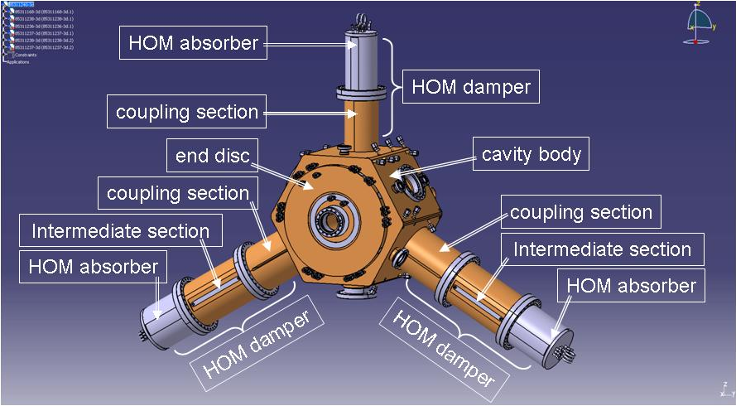
352 MHz cavities for SOLEIL-II
2 considered options
Ferrite
 | 1 SOLEIL CM 2 SC cavities | 4 (3) NC cavities ESRF-EBS
Length [m] | ~ 6 | ~ 4.20
Redundancy | No | Yes
V_{RF} [MV] | 1.8 | 1.8
P_{b} [kW] | 362 | 362
V_{cav} [kV] | 900 | 450 (600)
P_{dis} [kW] | ≈ 0 | 4 x 20 (3 x 36)
P_{cav} [kW] | 181 | 111 (157)
P_{RF} [kW] | 362 | 444 (471)
Coupling | Q_{ext} = 5 10 ⁴ | ß_{c} = 5
Z_{HOM} | Ok | TBD
4 x ESRF-EBS NC cavities
ESRF design (V. Serrière)
R_{shunt} ≈ 5 MΩ
Q_{o} ≈ 35 000
NC system less power consuming than complete SC one (including + ~300 kW for the cryo-plant)

Slide 4
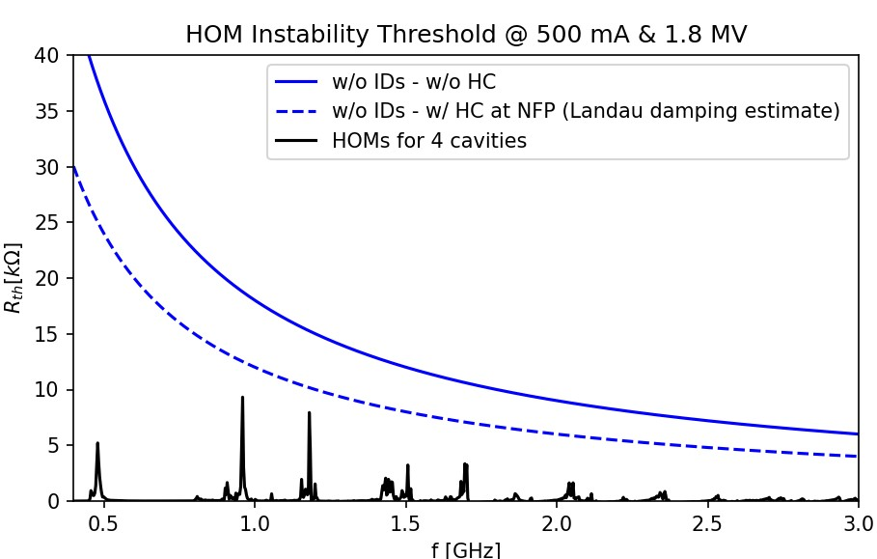
CBI due to the MC longitudinal HOMs
Although much more critical than ESRF case, first estimate of LCBI threshold extrapolated from tracking for a single HOM at 1.7 GHz shows a 30% stability margin compared to the computed HOM impedance.
Additional simulations and analytical estimates are necessary to confirm this margin.
Space reserved for a bunch by bunch longitudinal FB, if it was finally needed.
1.5 reduction factor
Stable point from tracking
Transverse HOMs are not an issue (the actual bunch by bunch TFB will anyway be reused for other kinds of instabilities)

Slide 5
Harmonic RF system
SOLEIL II 3rd harmonic case
Main purpose :
Lengthen the bunches up to ~ 100 ps FWHM and thus reduce their charge density to preserve the low emittance and insure suitable beam lifetime
Initial specifications aimed at allowing :
  Short bunch production (~10 ps FWHM) → ~1.7 MV needed @ 3 x F_{RF}
  Hybrid mode with asymmetric beam filling pattern
  → transient beam loading (TBL) issues
Such high RF voltage requirement together with available space constraints along the ring and attempts to reduce TBL justified the choice of SC cavity technology as the most suitable one.
V [MV]
V_{1h} = 1.7 MV
V_{1h} + V_{3h}
V_{3h} = 0.53 MV
Long bunch
Long bunch
But after the CDR, it was decided to remove from the baseline specification the option of producing short bunches (~10 ps FWHM) and the non-uniform beam filling patterns with long bunches (~100 ps FWHM) so NC technology option for harmonic system had to be investigated and compared to the SC one.
Bunch lengthening : phase and amplitude of V_{3h}
adjusted such that the overall voltage is flat at ϕ_{s}
For V_{3h} ≈ V_{1h} / 3 ≈ 0.53 MV, τ ≈ 4 τ_{o} ≈ 100 ps FWHM

Slide 6
Harmonic RF system technological options
The required performance could be achieved using several technological options : NC or SC, passive or powered, 3rd or 4th harmonic RF systems, which are all under investigation and compared in terms of stability, bunch lengthening performance, compatibility with all modes of operation, etc.
This study is conducted in the frame of a collaboration with ESRF, KEK, PSI and HZB, which encounter similar problematics ; longitudinal beam dynamics simulations are performed using three particle tracking codes, mbtrack, mbtrack2 and P-Elegant, whose results will be crosschecked with the experimental ones from tests in SLS (SC cavities) and BESSY II (NC cavities).
Until the modification of the specifications, high voltage demand for short bunch production and TBL issues caused by asymmetric beam filling pattern pointed out the passive SC RF system to be the most suitable for SOLEIL II.
→ Collaboration was set with CEA and CERN for the design and realization of a Super3HC * type CM @ 1.41 (or 1.06) GHz
* The Super3hc CM, used in SLS and ELETTRA, is a scaling to 1.5 GHz of the SOLEIL CM with two HOM free SC cavities, but they are passive, without any input power coupler. CEA and CERN were already involved in the design and realization of the SOLEIL and Super3HC cryomodules.
Since the new specs, from the beginning of 2022, a new direction is driving the study to bring NC harmonic systems for SOLEIL II to a level of understanding close to the SC one, allowing technological option comparison.

Slide 7
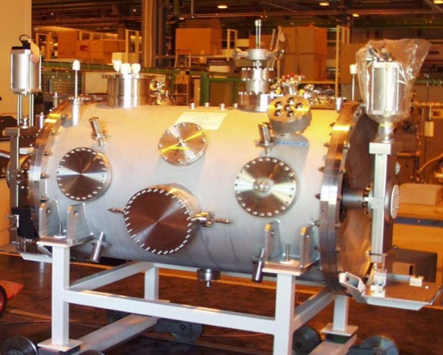
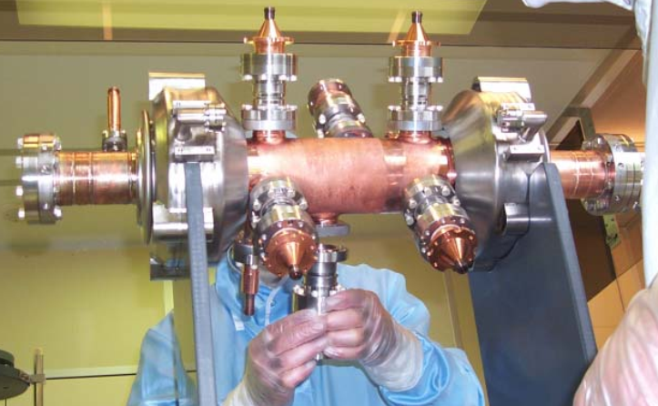
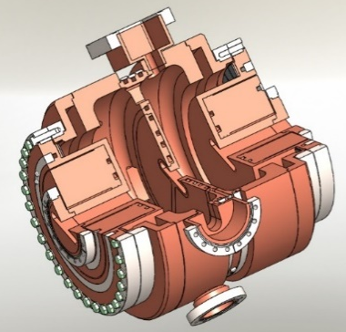
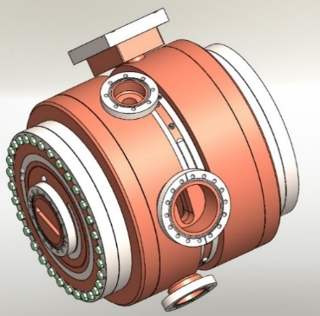
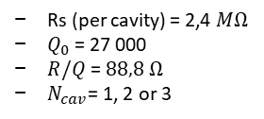
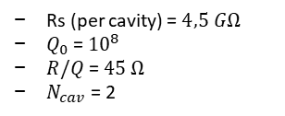
Baseline comparison candidates
Passive SC cavities of the Super3hc type, scaled to 3 or 4 times 352 MHz (1.06 or 1.41 GHz)
SUPER3HC cryomodule
T1
T2
Cavity_1
Cavity_2
Rs (per cavity) = $4,5 GΩ$
$Q_{0}$ =${10}^{8}$
$R/Q$ = $45 Ω$
$N_{cav}$ = 2
L1
Full benefit from beam induced voltage :
V_{ind} ≈ I_{b *} R/Q * f /δ f , as δ f >> f / Q
No external harmonic power source nor additional power on fundamental RF system
T3
T4
L2
NC passive or active cavities of the ESRF-EBS harmonic 1.41 GHz 2-cell type
& cavities
Rs (per cavity) = 2,4 $MΩ$
$Q_{0}$ = 27 000
$R/Q$ = $88,8 Ω$
$N_{cav}$= 1, 2 or 3
Design under completion
ESRF call for tenders
to be launched

Slide 8
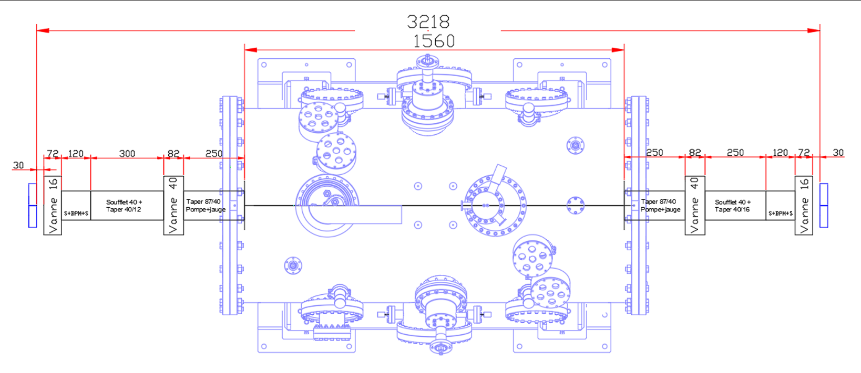
Harmonic RF system – Mechanical Integration
Worst case (3H) - Location : SD06L

Slide 9
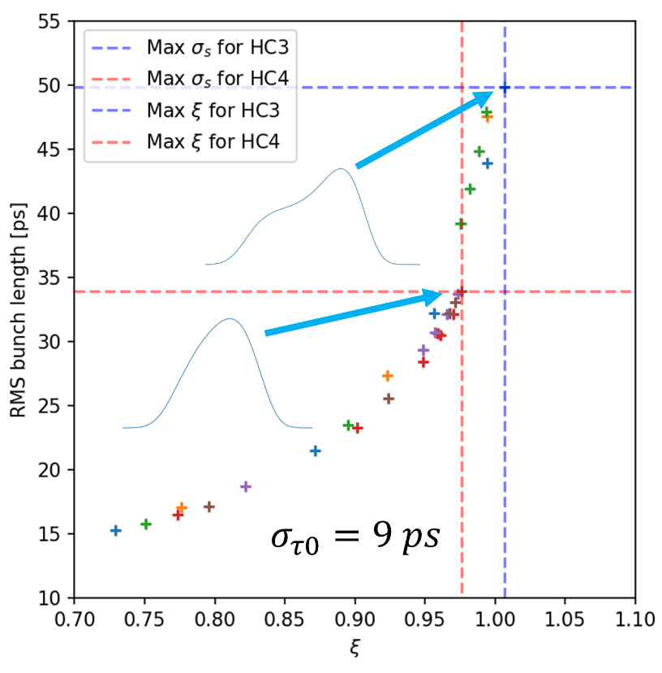
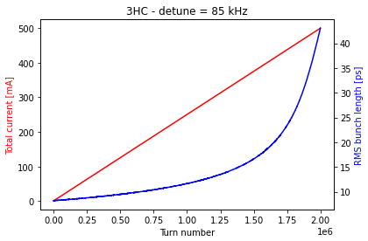
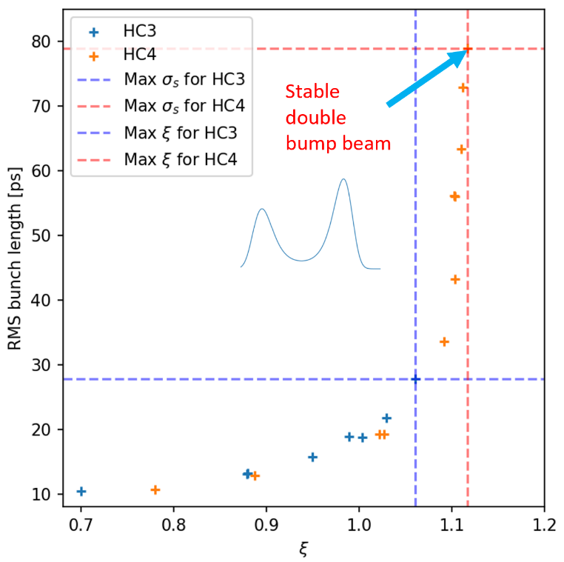
Passive SC case – 500 mA and single bunch (20 mA)
Lengthening growth during injection
Bunch lengthening @ 500 mA
Bunch lengthening @ 20 mA
Beam injection up to 500 mA with fixed HC detuning is tracking stable
Without impedance model
Max σ_{s} of 50 ps reached for 3HC and 36 ps (BLF = 4) for 4HC limited by « periodic transient beam loading instability » (PTBL)
3HC bunch lengthening limited by conventional Robinson instability or dipole-quadrupole instability (?)
With impedance model, BLF > 4.5 for all operating modes h = 3 and 4

Slide 10
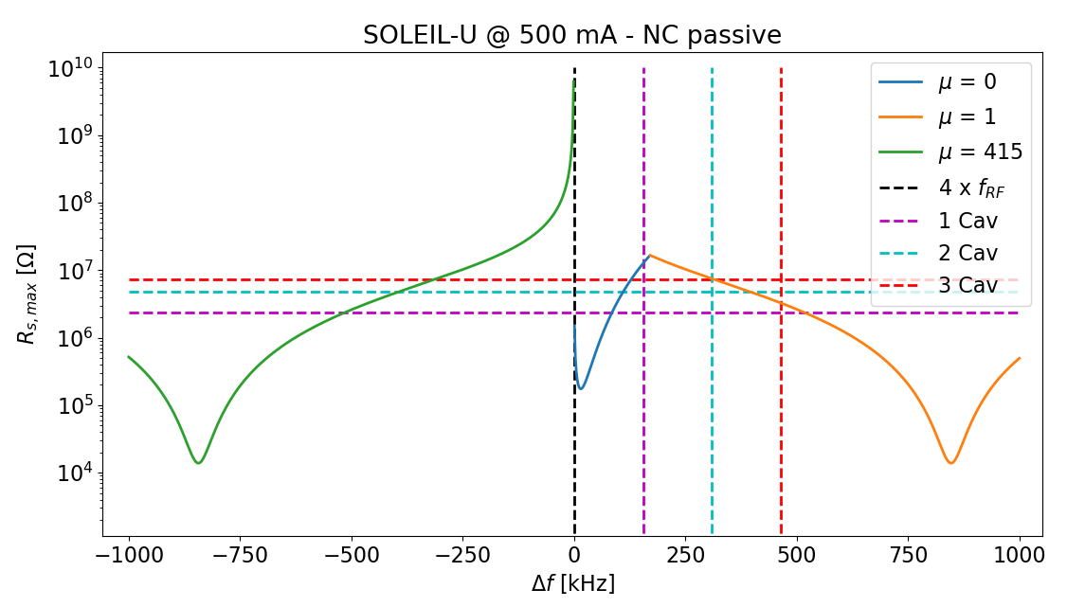


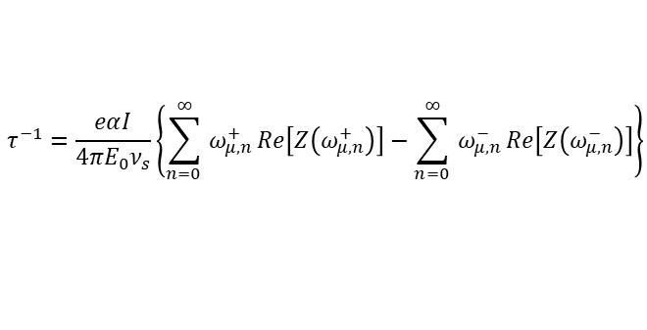

Passive NC case – 500 mA
The operating point of each system ($R_{s}$, $Δf$) close to the NFP is given by the number of cavities $N_{cav}$ and the beam current $I.$
$$τ^{−1}=\frac{eαI}{4πE_{0}ν_{s}}\left\{\sum_{n=0 }^{∞}{ω_{μ,n}^{+}}Re\left[Z\left(ω_{μ,n}^{+}\right)\right]−\sum_{n=0 }^{∞}{ω_{μ,n}^{−}}Re\left[Z\left(ω_{μ,n}^{−}\right)\right]\right\}$$
$$Z\left(ω\right)=\frac{R_{s}}{1+iQ_{L}\left(\frac{ω_{r}}{ω}−\frac{ω}{ω_{r}}\right)}$$
$$ω_{μ,n}^{±}=\left\{nM±\left(μ+ν_{s}\right)\right\}ω_{0}$$
Number of bunches
Coupled bunch mode number
The above formula is valid for :
Single RF system
Equally spaced M bunches
Coherent frequency close to the incoherent one (f_{s})
« Extended » to double-RF
system with HCs
$$Δf=I\frac{R_{s}}{Q}\frac{{m f}_{RF}}{V_{2}}$$
Analytical calculation predicts
N_{cav} = 1 or 2 as the only potential stable solutions regarding LCBI thresholds.

Slide 11
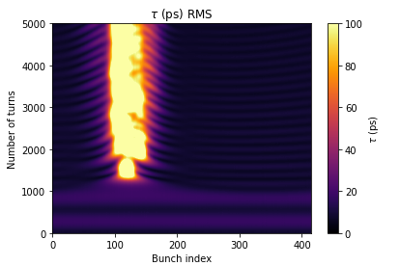
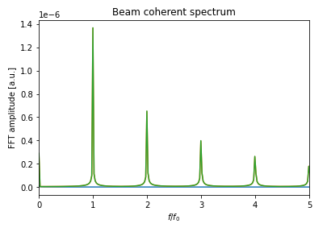

Passive NC case – 500 mA
Tracking simulations, N_{cav} = 3
$$μ=1$$
Tracking confirms that using 3 NC HC, beam is unstable for operation parameters.

Slide 12
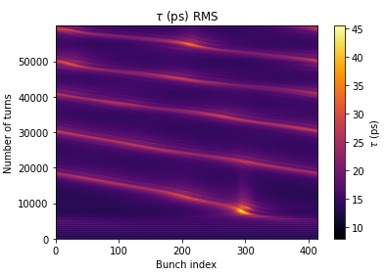
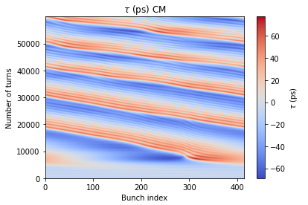
Passive NC case – 500 mA
Tracking simulations, N_{cav} = 2
Available tuning range is unstable, beam presents different bunch profiles → PTBL signature
Using one single passive NC cavity is the solution to prevent the beam from CBI or PTBL.

Slide 13
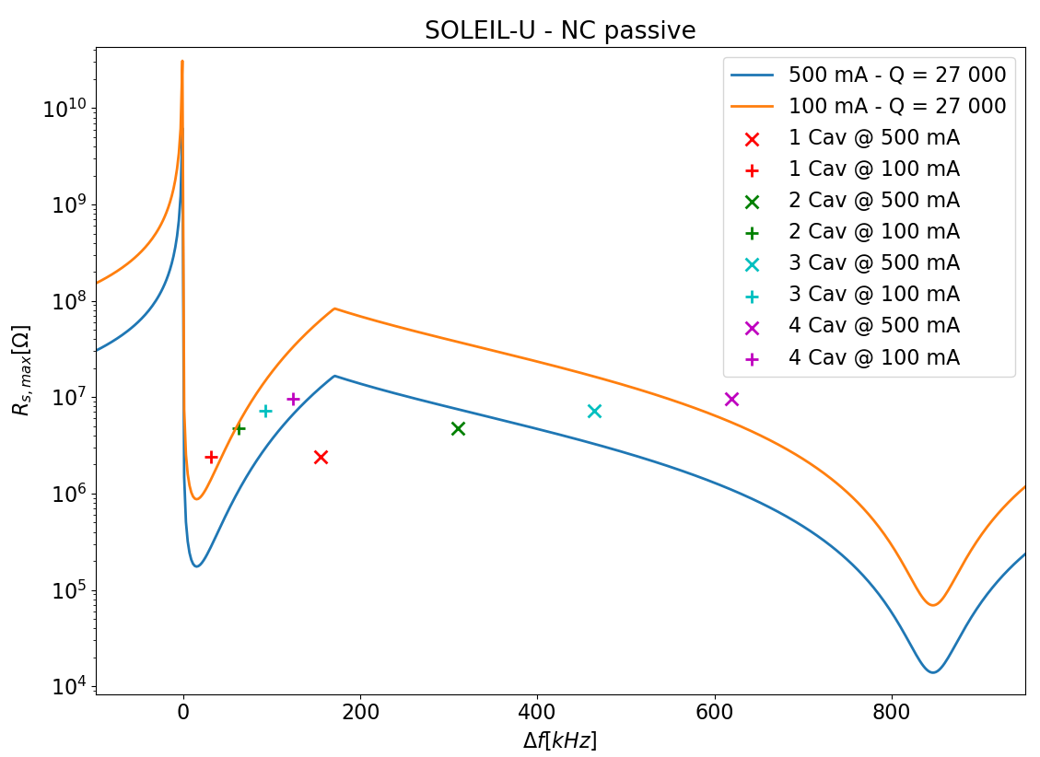
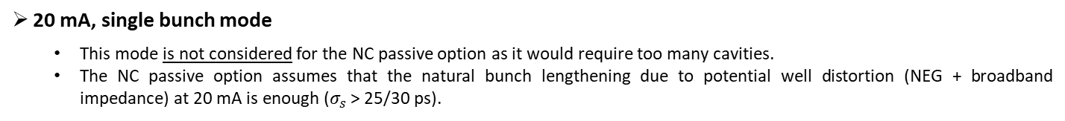
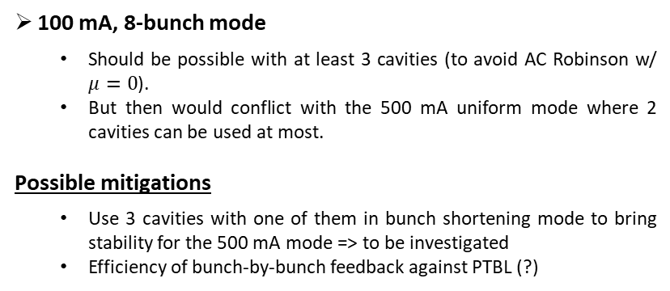
Passive NC case – 20 and 100 mA
20 mA, single bunch mode
  This mode is not considered for the NC passive option as it would require too many cavities.
  The NC passive option assumes that the natural bunch lengthening due to potential well distortion (NEG + broadband impedance) at 20 mA is enough ($σ_{s}$ > 25/30 ps).
100 mA, 8-bunch mode
  Should be possible with at least 3 cavities (to avoid AC Robinson w/ $μ=0$).
  But then would conflict with the 500 mA uniform mode where 2 cavities can be used at most.
Possible mitigations
  Use 3 cavities with one of them in bunch shortening mode to bring stability for the 500 mA mode => to be investigated
  Efficiency of bunch-by-bunch feedback against PTBL (?)
Passive NC case option discarded because of limited stable domain, incompatibility between operation modes and 20 mA bunch lengthening impossibility.

Slide 14
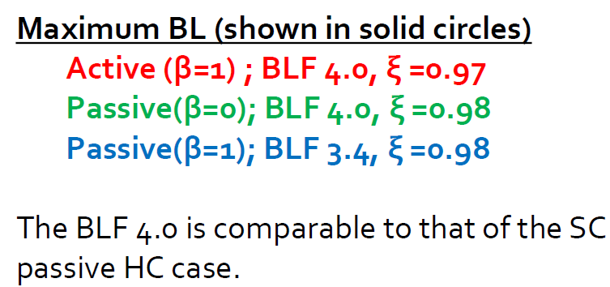
Active NC case – 500 mA

Slide 15
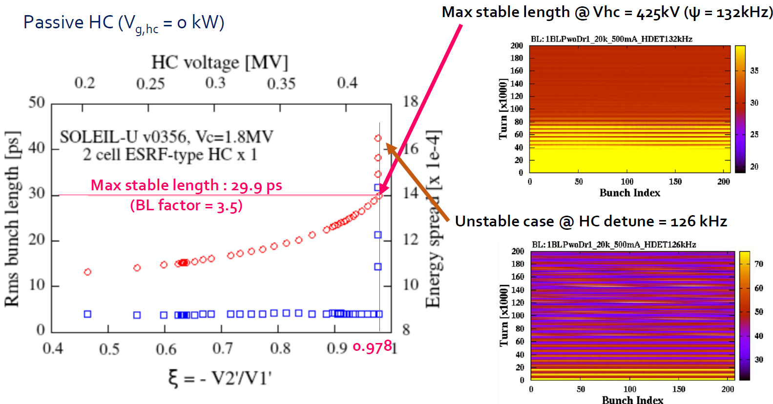
Active NC case – 500 mA
1 x active NC HC with generator OFF

Slide 16
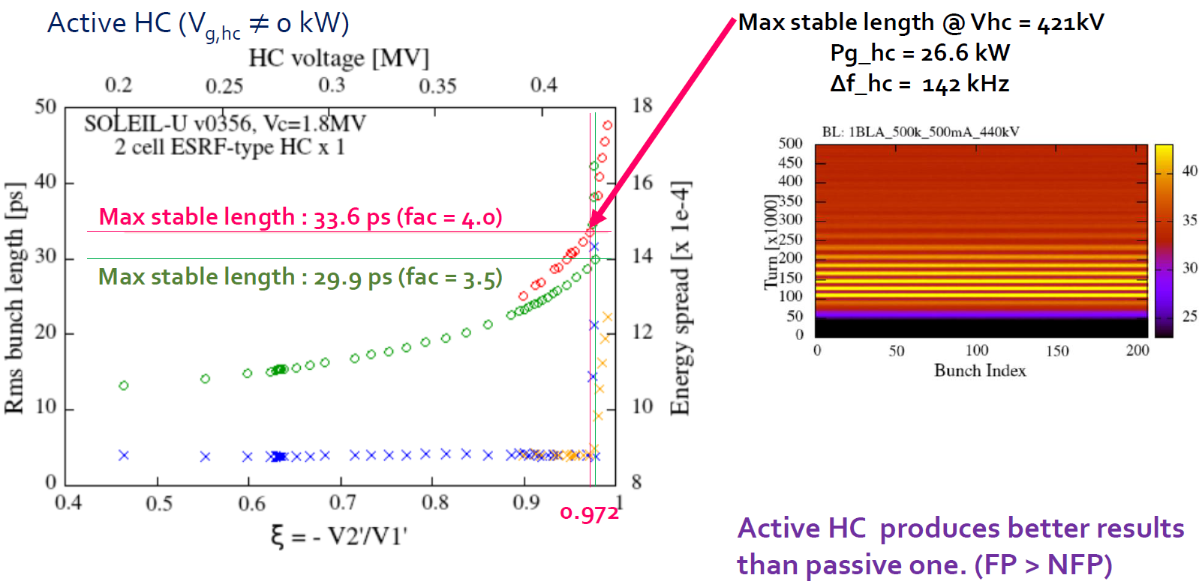
Active NC case – 500 mA
1 x active NC HC with generator ON
o Active NC HC with gen OFF
o Active NC HC with gen ON
Active NC with gen ON allows to meet FP conditions (≠ gen OFF and passive case)

Slide 17
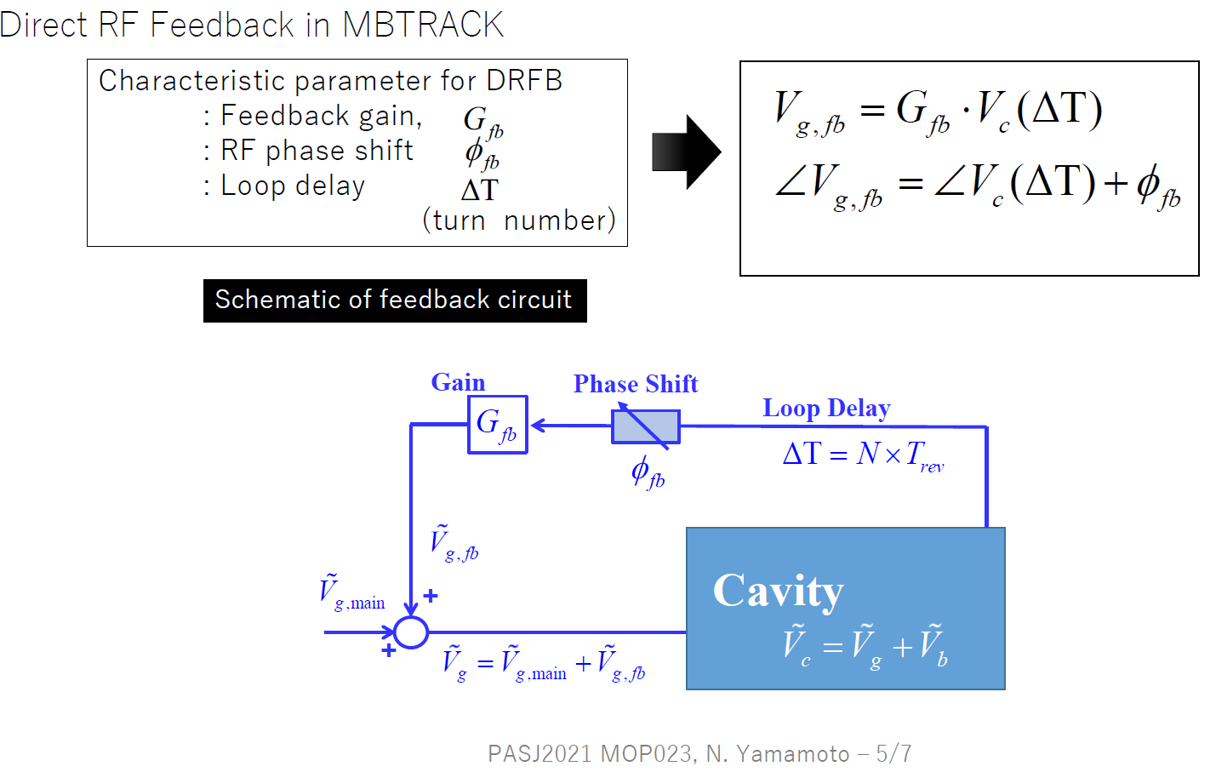
Active NC harmonic cavity case

Slide 18
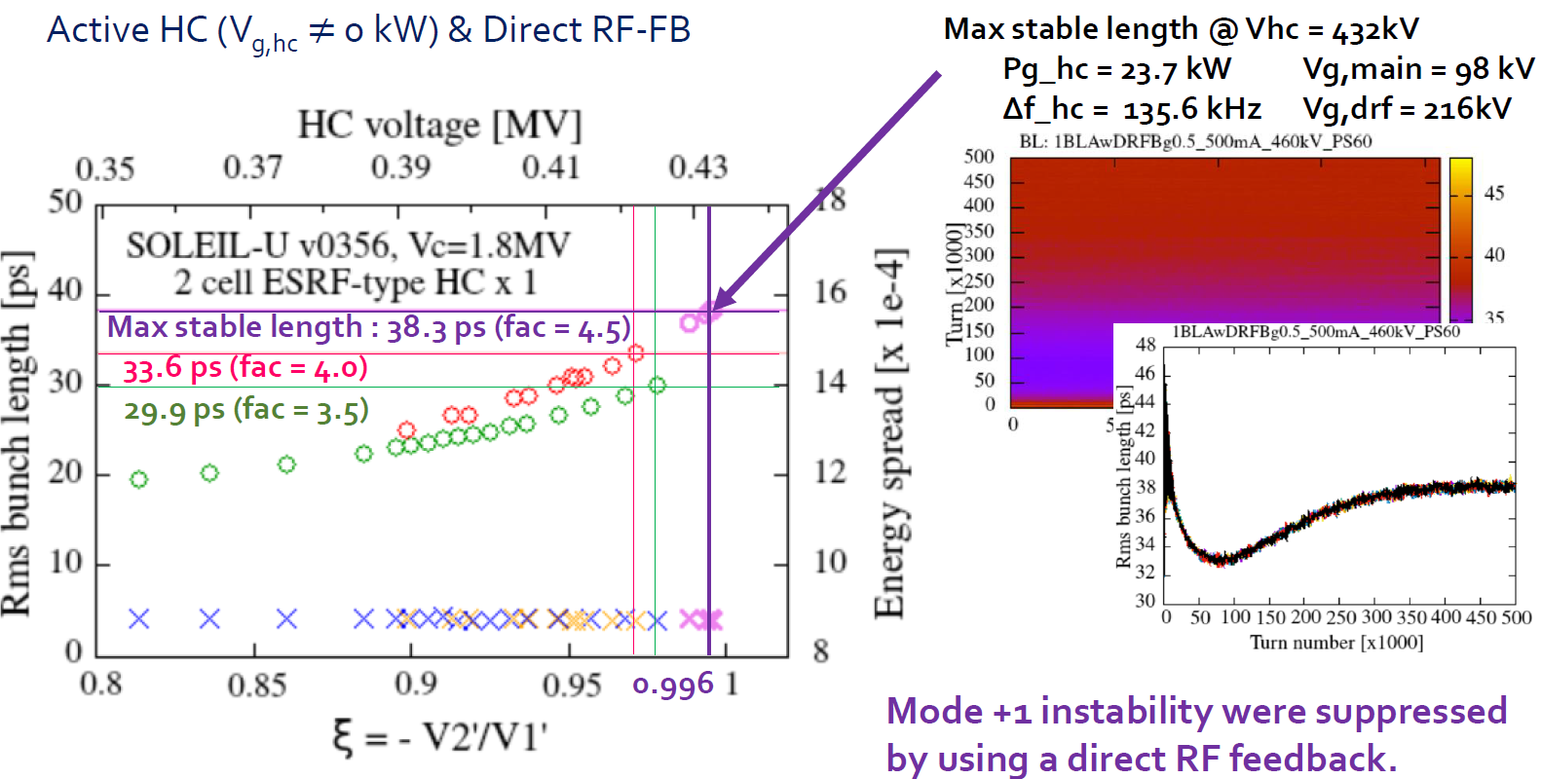
Active NC case – 500 mA
1 x active NC HC & direct feedback
Preliminary
o Active NC HC with gen OFF
o Active NC HC with gen ON & RF FB OFF
o Active NC HC with gen ON & RF FB ON

Slide 19
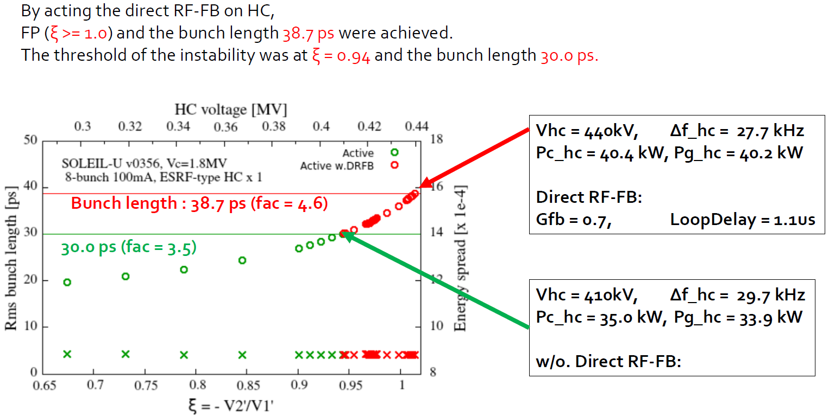
Active NC case – 8-bunch mode (100 mA)
1 x active NC HC & direct feedback
Preliminary

Slide 20
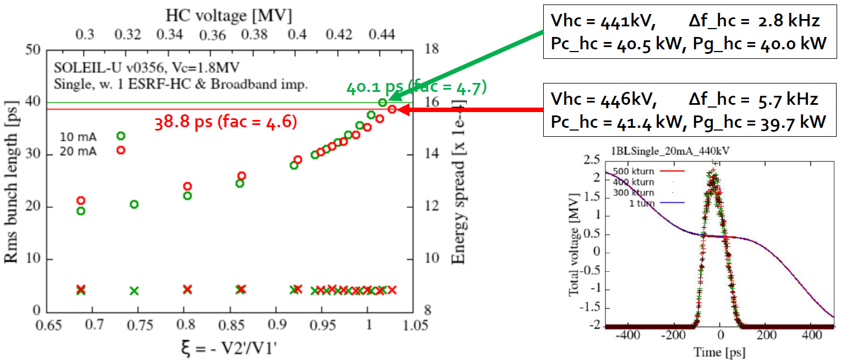
Active NC case – Single bunch mode (20 mA)
1 x active NC HC & direct feedback
Preliminary

Slide 21
1.3-1.4 GHz SSPA R&D
RF Power Source requirements for LUCRECE* : 20 kW CW SSPA @ 1.3 GHz
Comparison between GaN and LDMOS technology
* RF R&D program for the French FEL project LUNEX5
Transistor performance measurements in CW mode
 | Old Gen GaN | Old Gen GaN | New Gen LDMOS | New Gen GaN
V_{d} (V) | 50 | 50 | 50 | 50 (65Vpulse)
P_{out} (W @ 1 dB comp.) | 71.2 | 150.2 | 700 | X
P_{out} (W @ 3 dB comp.) | 425.9 | 430.9 | X | 1000
Gain (dB) | 14.11 | 18.33 | 18.16 | 17
Efficiency (%) | 55.6 | 65 | 62 | 71
X : not relevant
R&D @ 1.4 GHz
On going tests at 40V to limit dissipated power on dice → 740W at 3dB comp. with 65% efficiency and expected to reach 900W with ~ 70% efficiency
Perspective : Possible adaptation of LUCRECE SSPA for SOLEIL II if the harmonic system
is active (1.41 GHz)

Slide 22
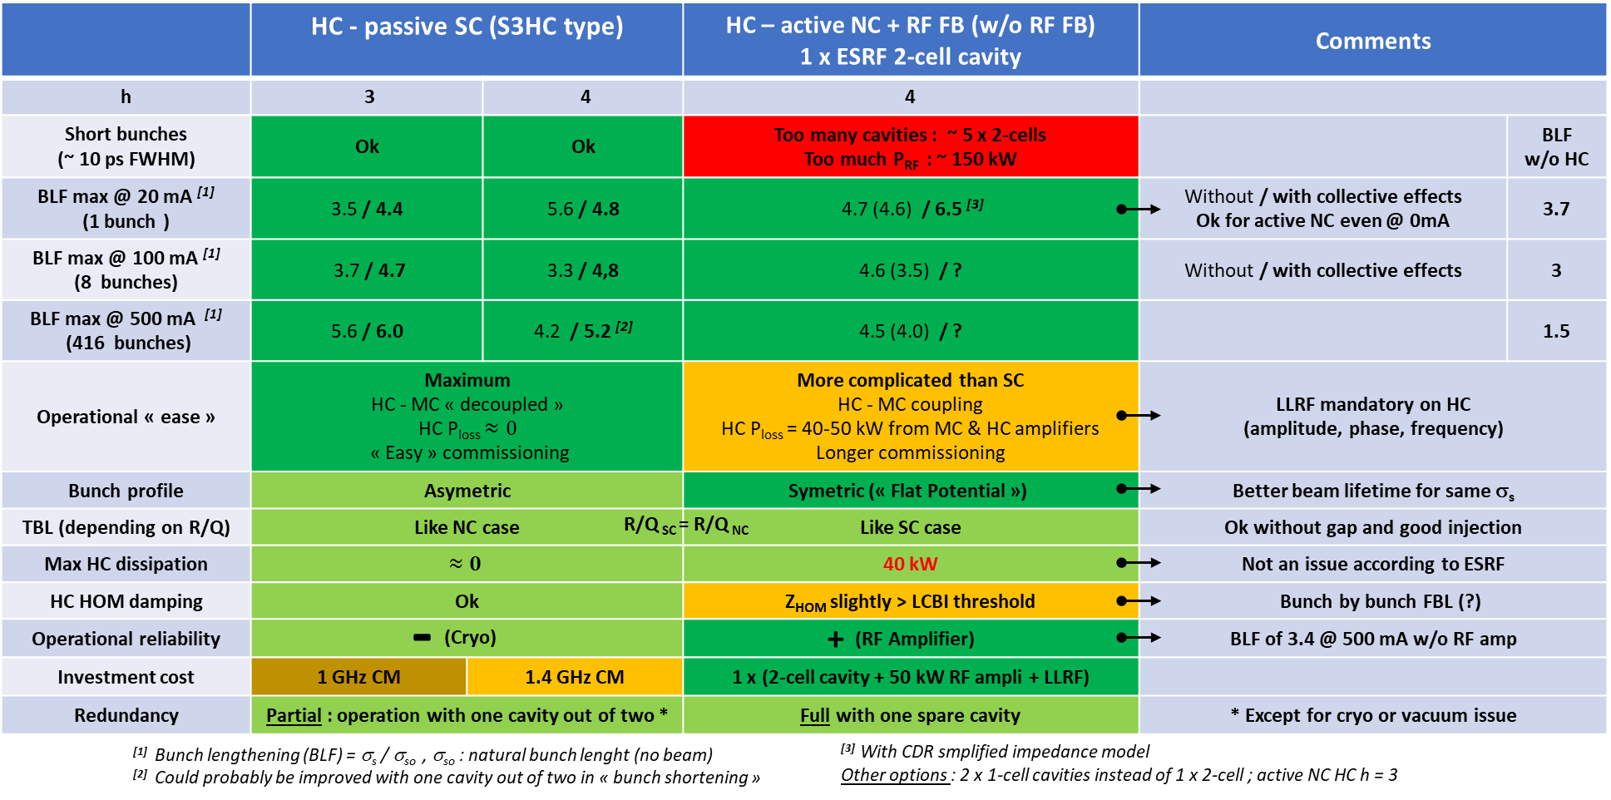
Summary

Slide 23
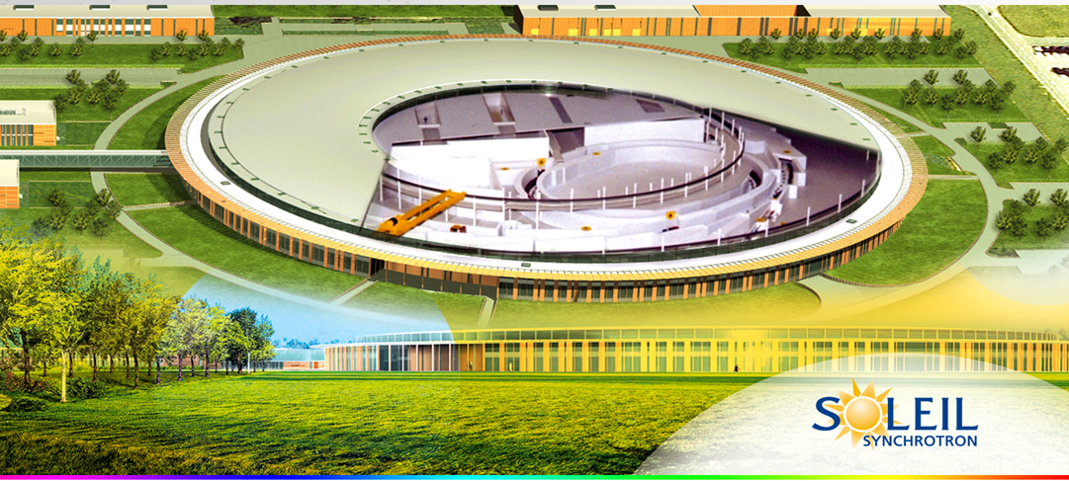
Thank you for your attention

Slide 24
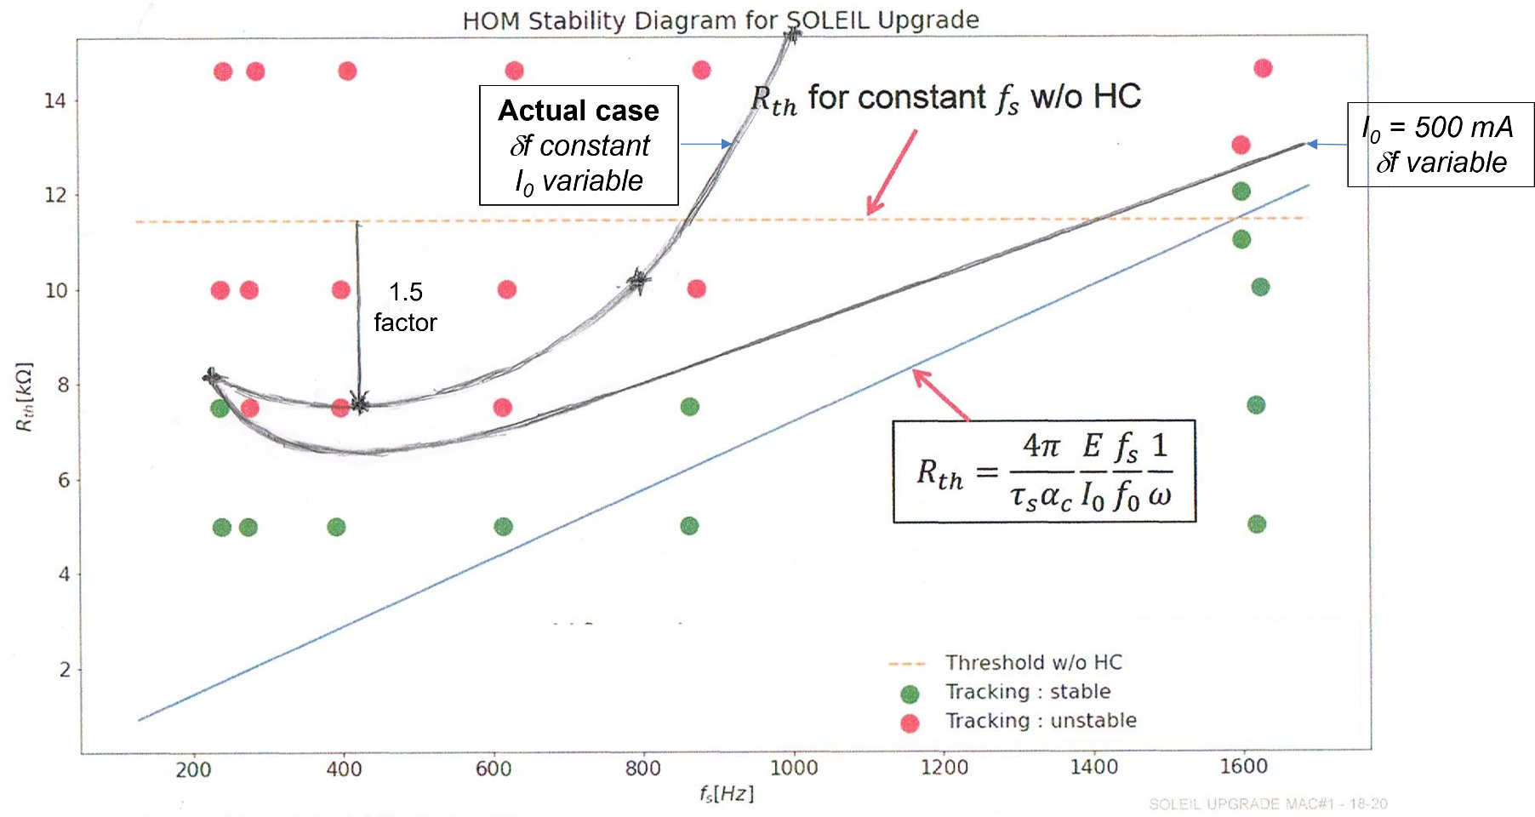
Backup slides
1.7 GHz HOM stability threshold with HC

