Slide 1
MAX IV Deployment and Monitoring
ESS/MAX IV Control System Workshop - 20231117 B.Bertrand

Slide 2
Agenda
Introduction
Deployment
Monitoring
2

Slide 3
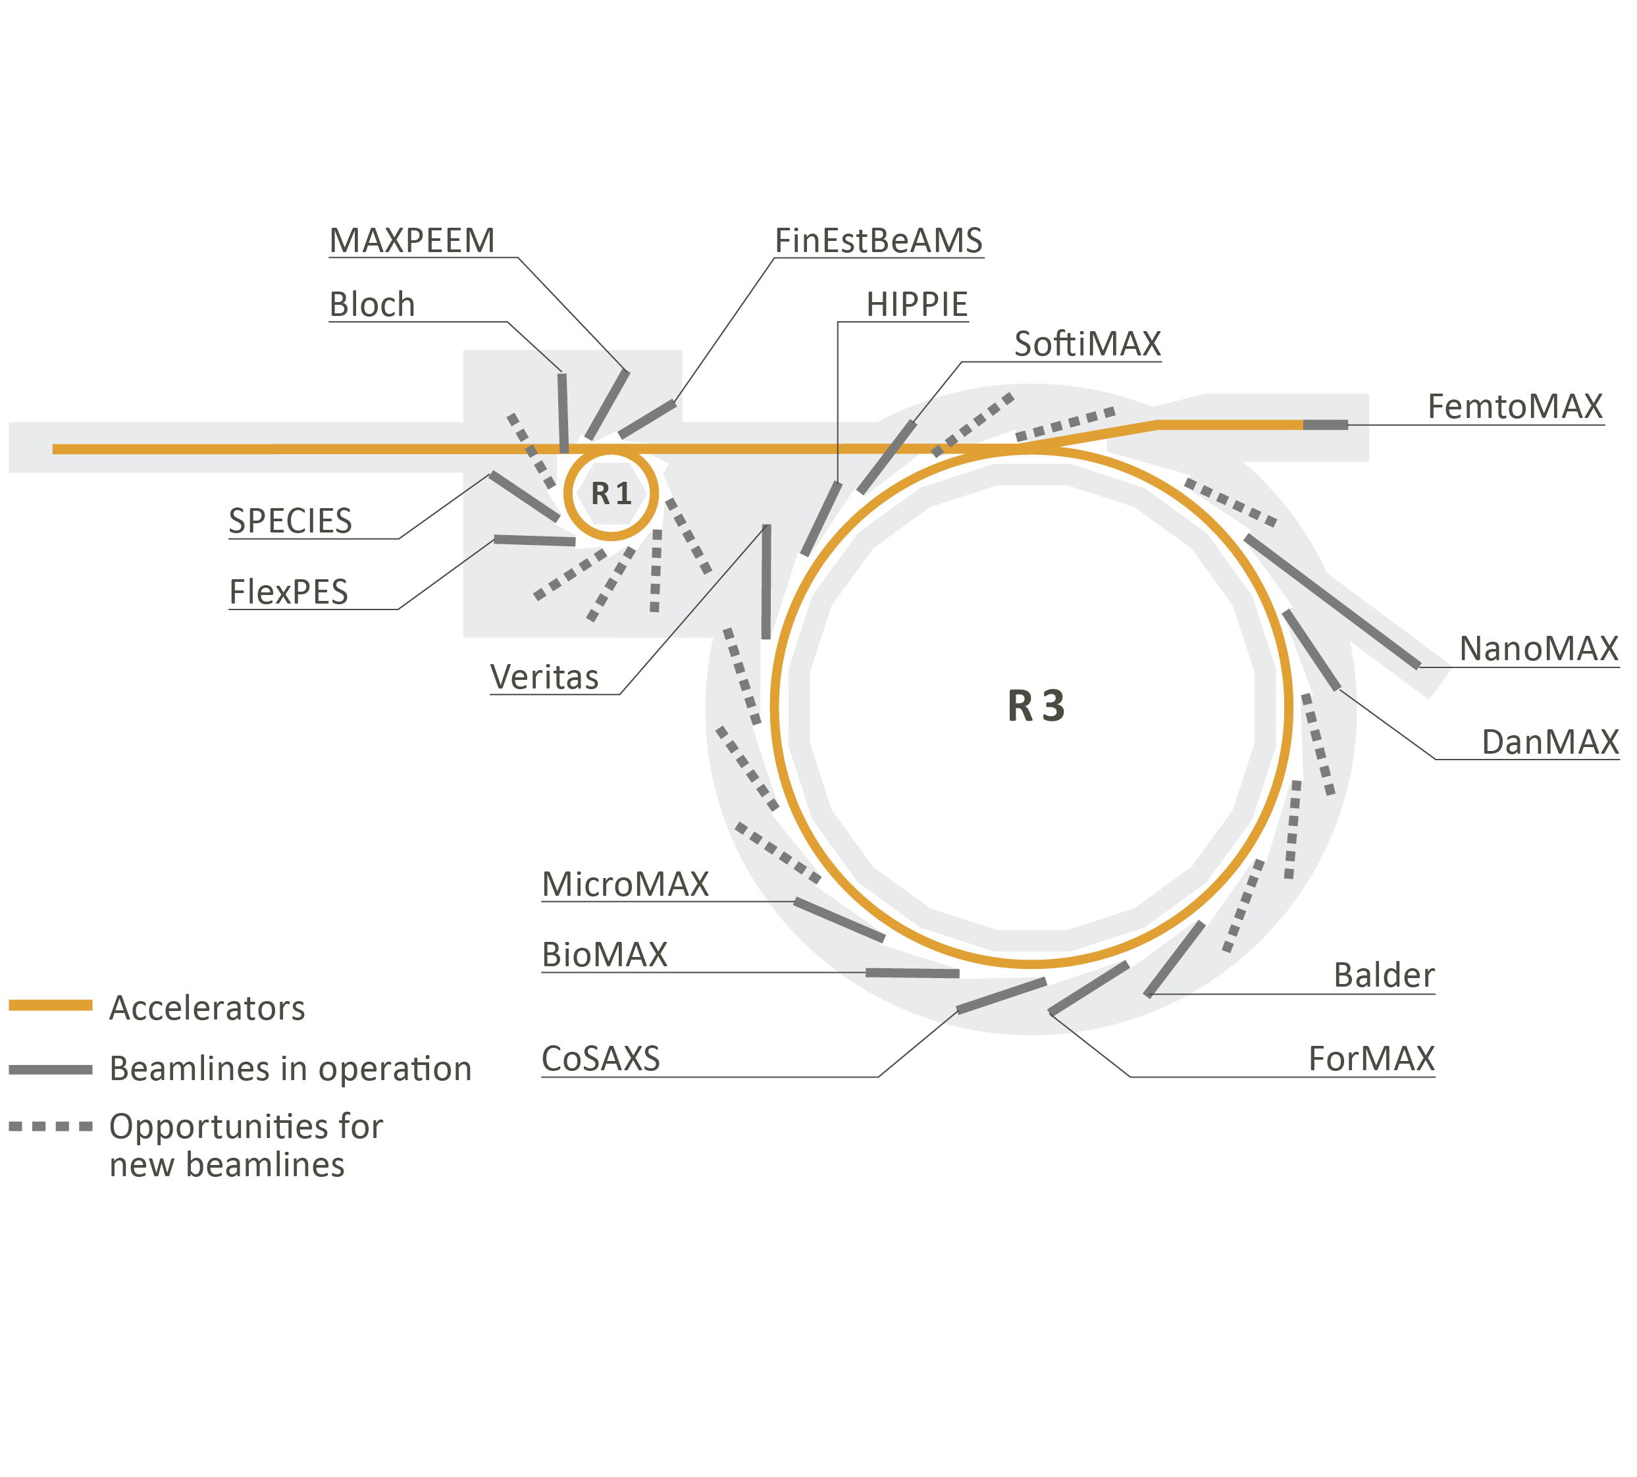
Introduction
4th generation synchrotron
16 beamlines
In operation since 2016
> 300 employees
> 1000 users/year
Control System based on Tango
More than 500 Virtual and Physical machines
24k Tango devices with 134k configurable properties
3
Notes:
MAX IV Laboratory is a 4th generation synchrotron radiation facility, that has been operational since 2016. It is part of Lund university and receives funding from the Swedish government.

Slide 4
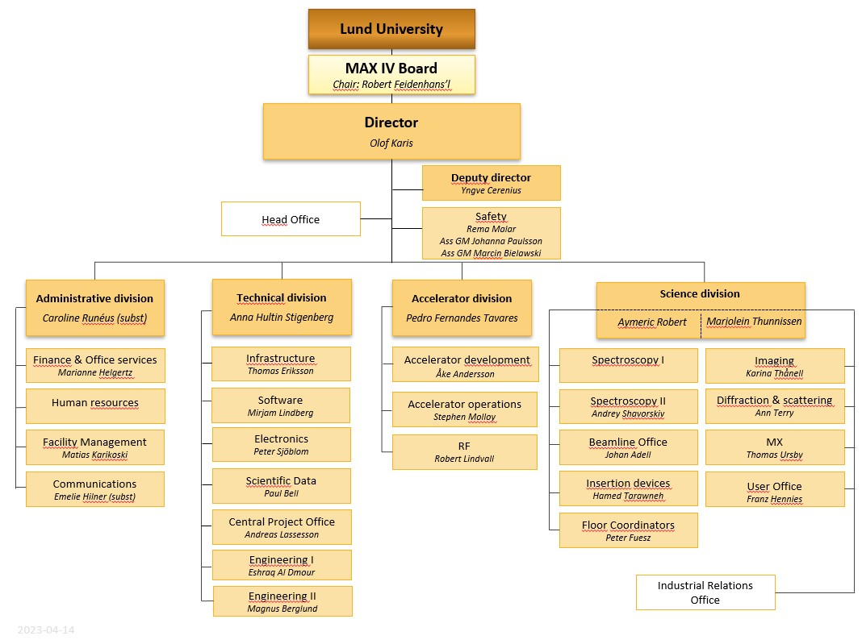
MAX IV Organisation
New Technical Division
Software group moved from Science Division
Enabling operational excellence
Enabling world leading technology and science
4
Notes:
Our new organisation was formed in a change process during 2022​.
The change process has recently been finalized ​and has resulted in the creation of a new technical division, combining support functions, previously placed in the accelerator and science divisions.
The Technical Division is responsible for the control and computing systems of the entire laboratory.
In the Technical Division the Software Group has 20 developers + 6 consultants working with control system software, as well as information management and data management tools. We support the operation of beamlines and accelerators and we participate in around 40 development projects per year. We hope the new organisation will allow a longer term perspective on building sustainable and robust systems that allow reliable operation in our diverse and fast changing environment.

Slide 5
Deployment
5
Notes:
We deploy everything with Ansible.
Have been using Ansible for 10 years.

Slide 6
Ansible deployment
Machine installation from scratch (VM or physical):
OS installation via network using PXE boot (Rocky Linux 8)
configure-new-control-machine (AWX workflow template)
basic playbook: OS setup (internal repositories, NTP, authentication, desktop…)
CS playbook: Control System requirements and configuration
deploy playbook: Software deployment (mostly Python and some C++)
6
Notes:
CS playbook: setup tango database, starter on servers, jive and astor (common tools) on clients…

Slide 7
Software deployment: RPM & conda
Using a package manager to build, distribute and update software is a requirement in modern software development.
Have been using RPM for many years
RPM Package Manager (originally Red Hat Package Manager)
Distribution package manager
Switched to conda
Package, dependency and environment management for any language
Run on Windows, macOS and Linux
Easy to develop locally in a conda env
Create isolated environments
Separate the deployment from the OS packaging and system Python version
Use modern Python: 3.9 for a while – moving to 3.11
OS independent (conda Linux packages can be installed on any Linux distribution)
Migrated from CentOS 7 to Rocky Linux 8 using the same packages
conda-forge ecosystem provides many packages
7

Slide 8
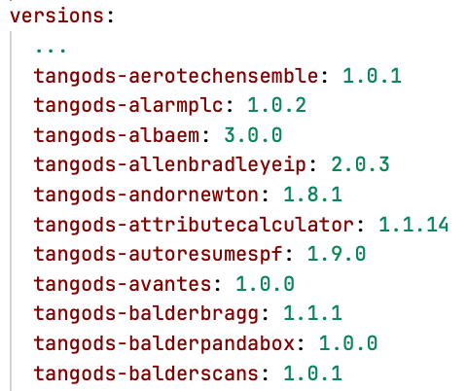
Ansible inventory
One git repository:
One inventory split in several files:
machine
beamlines
Variables under hosts_vars / group_vars. group_vars/all.yml includes a versions dict of package: version
8

Slide 9
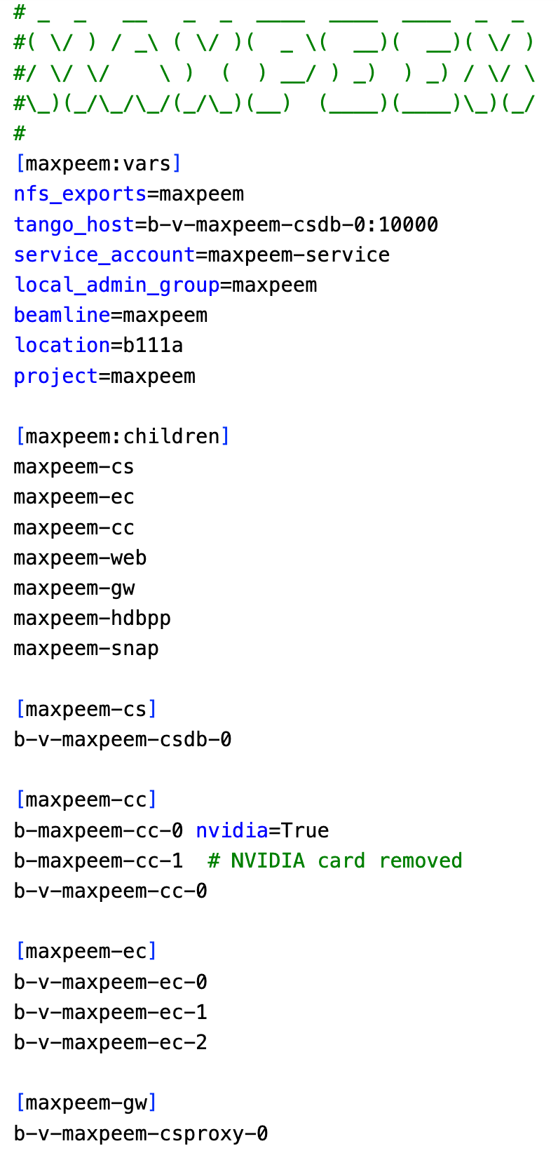
Ansible inventory: beamlines
Tango database
Client computers
Equipment computers
9

Slide 10
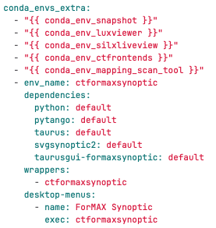
Ansible inventory: client computers
group_vars/<beamline>-cc.yml
default refers to the version defined in group_vars/all.yml
wrapper created under /usr/local/bin (no need to activate the env)
10
Notes:
Ansible role to deploy generic conda environments (using conda and conda_env Ansible modules):
- default refers to the version defined in group_vars/all.yml: keep the same version deployed everywhere (but possible to pin)
- create wrapper script under /usr/local/bin so users don’t have to activate the env
- possible to define desktop menus
Typically defined in group_vars/<beamline>-cc.yml

Slide 11
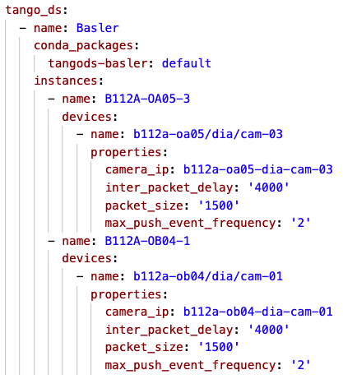
Ansible inventory: equipment computers
host_vars/<beamline ec host>.yml
tango_ds role:
- add the tango devices to the database
- ensure the instance is restarted if the version changes
- cpptango/ python / pytango added automatically to the env
11
Notes:
Specific Ansible role to deploy Tango Device Servers. Elegant way to define Tango Device Servers using a nested list of servers, instances and devices + packages The role ensures the instance is restarted if the version changes.
cpptango / pytango added automatically to the env -> same version used everywhere (can be overwritten)

Slide 12
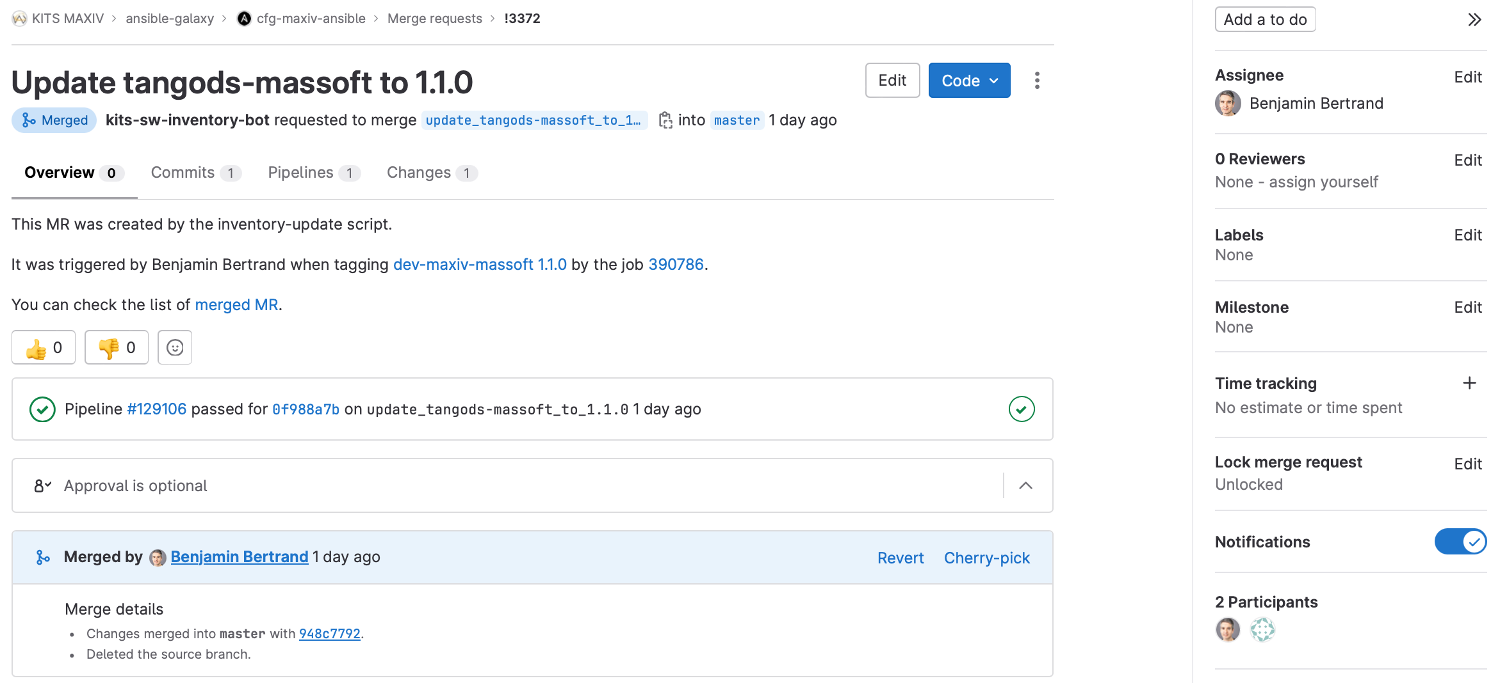
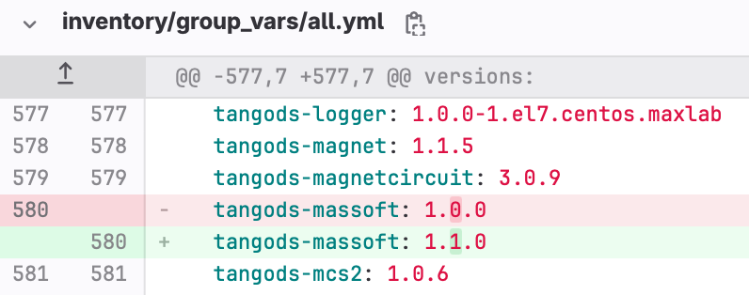
Inventory update
12
Notes:
The default version is defined in a versions dict in the all group_vars. Updated automatically when tagging a repo.

Slide 13
Continuous deployment
MR in the inventory is automatically merged
Only for specific use-case! Synoptic is a typical one. Beamline staff can update the app themselves.
13
Notes:
This is enabled by defining some extra variables in the gitlab-ci.yml file.
The application needs to be defined in the inventory first.

Slide 14
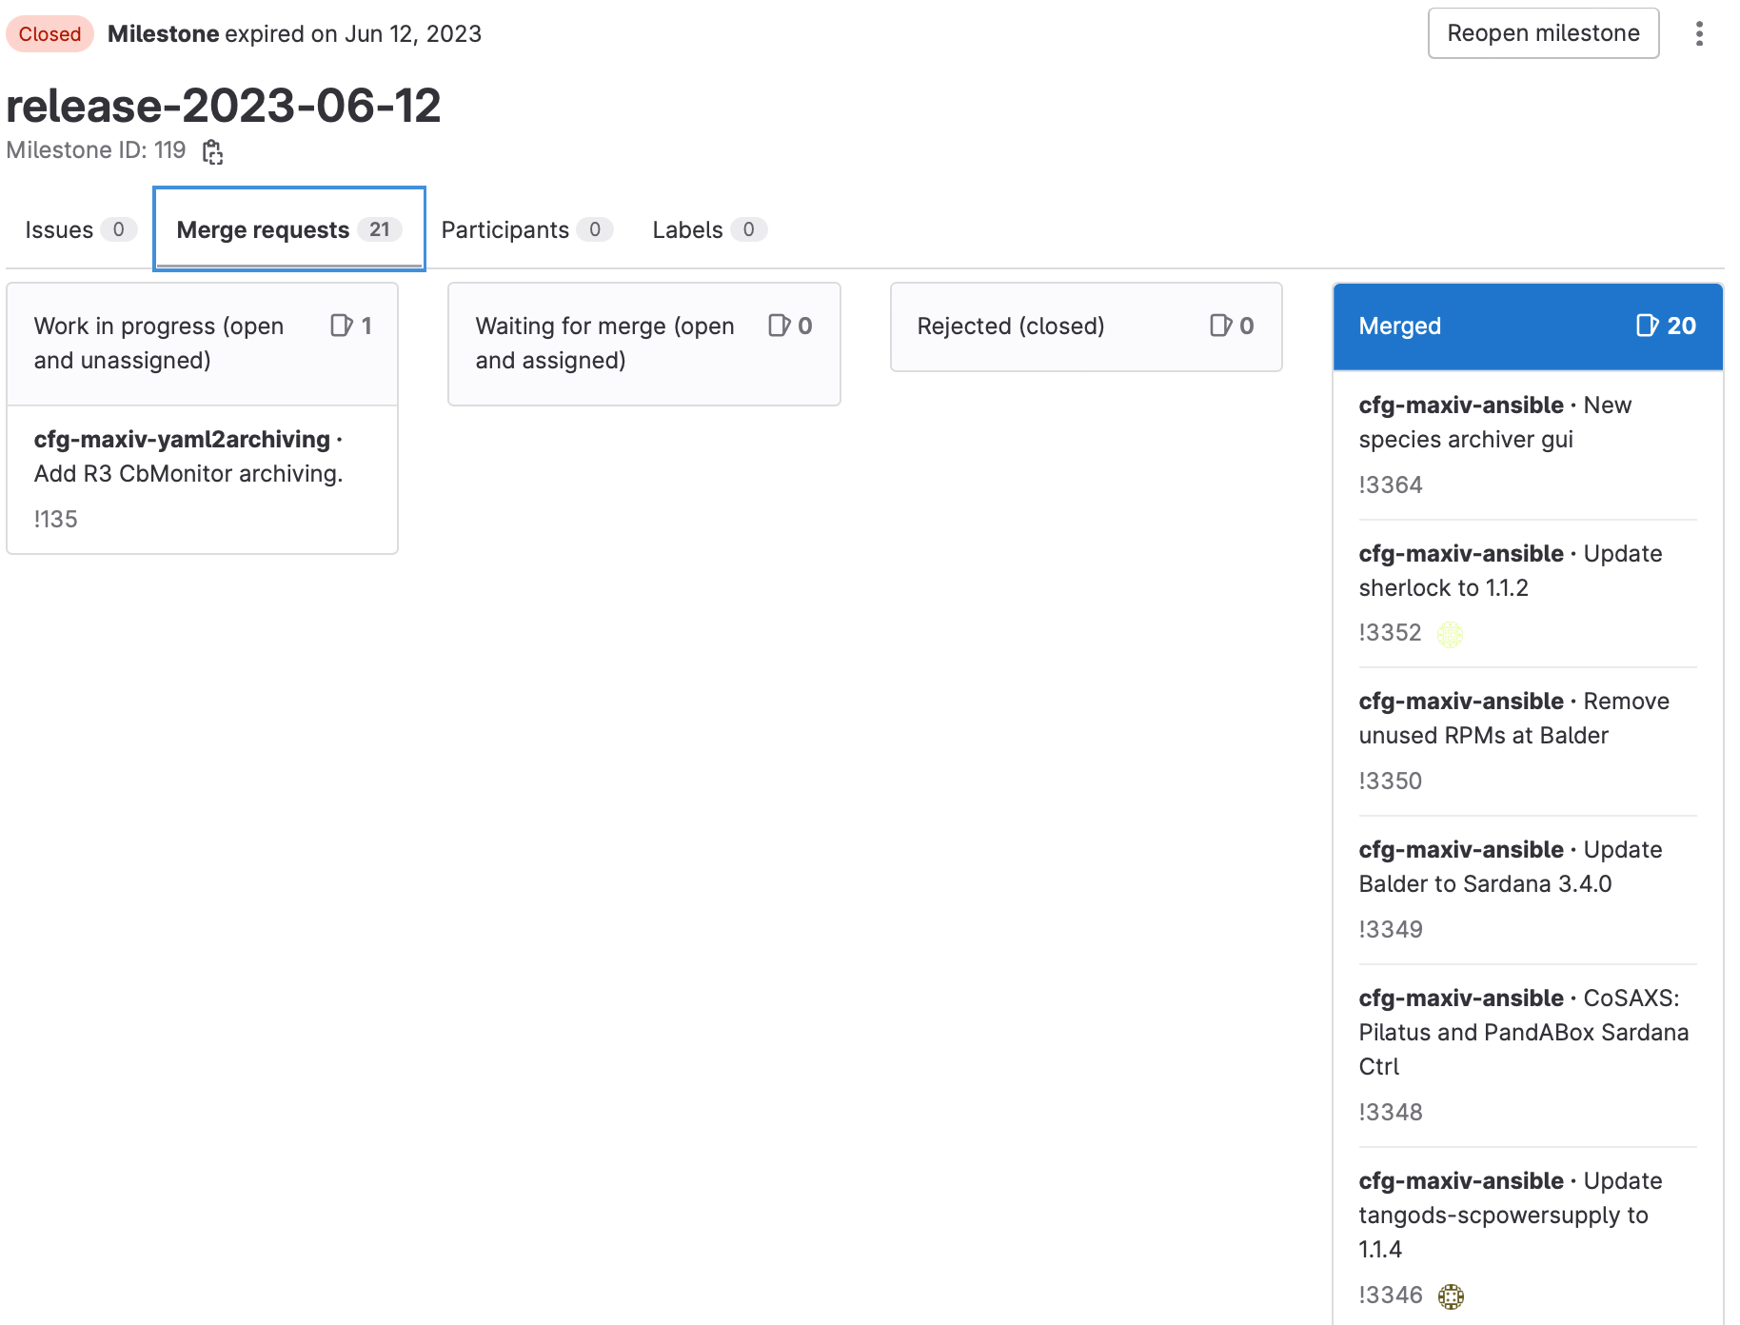
Monday deployment
All approved Ansible MRs belonging to the corresponding milestone are merged by the Monday Deployment Crew.
The Monday Deployment Crew deploys the updates by running the deploy playbook in AWX, limited to <beamlines>-ec and <beamlines>-cc groups
Important to keep the inventory in sync with what is deployed. Playbook shall be run regularly.
14
Notes:
We can’t setup continuous deployment for most applications as we don’t want to update software during operations.
It is thus important to deploy regularly to ensure the inventory matches what is installed on all machines.
Monday is a maintenance day.
Keep beamlines up-to-date!

Slide 15
Monitoring
15
Notes:
Monitoring is done using Prometheus and Grafana dashboards

Slide 16
KITOS
KITOS is the KITS Operations Service; a support service for user, beamline and accelerator operations.
KITOS is comprised of a daytime shift (Mon–Fri 08:00–17:00) and an evening/weekend shift (Mon–Fri 17:00–23:00, Sat–Sun 08:00–20:00).
The daytime shift is staffed by two people, sourced on an opt-out basis from all ICT staff.
The evening/weekend shift is remotely staffed by one person, sourced on an opt-in basis from a collective of heroes 🦸
The responsibilities of the daytime shift include;
Handling incoming calls to the support phone
Resolving issues where possible
Forwarding issues when necessary
Logging all incoming calls
Handling support tickets (RT)
Resolving urgent/minor tickets
Triaging long-term/complex tickets
Proactively monitoring the control and IT systems for issue prevention
Support service development
Contributing support service development tasks
Working on support service development tasks
Participating in handover meetings
On-the-job training of shift-crew
16

Slide 17
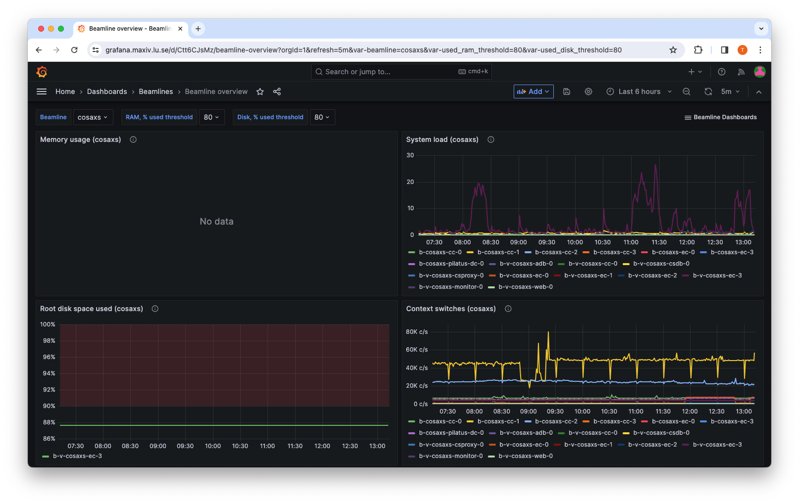
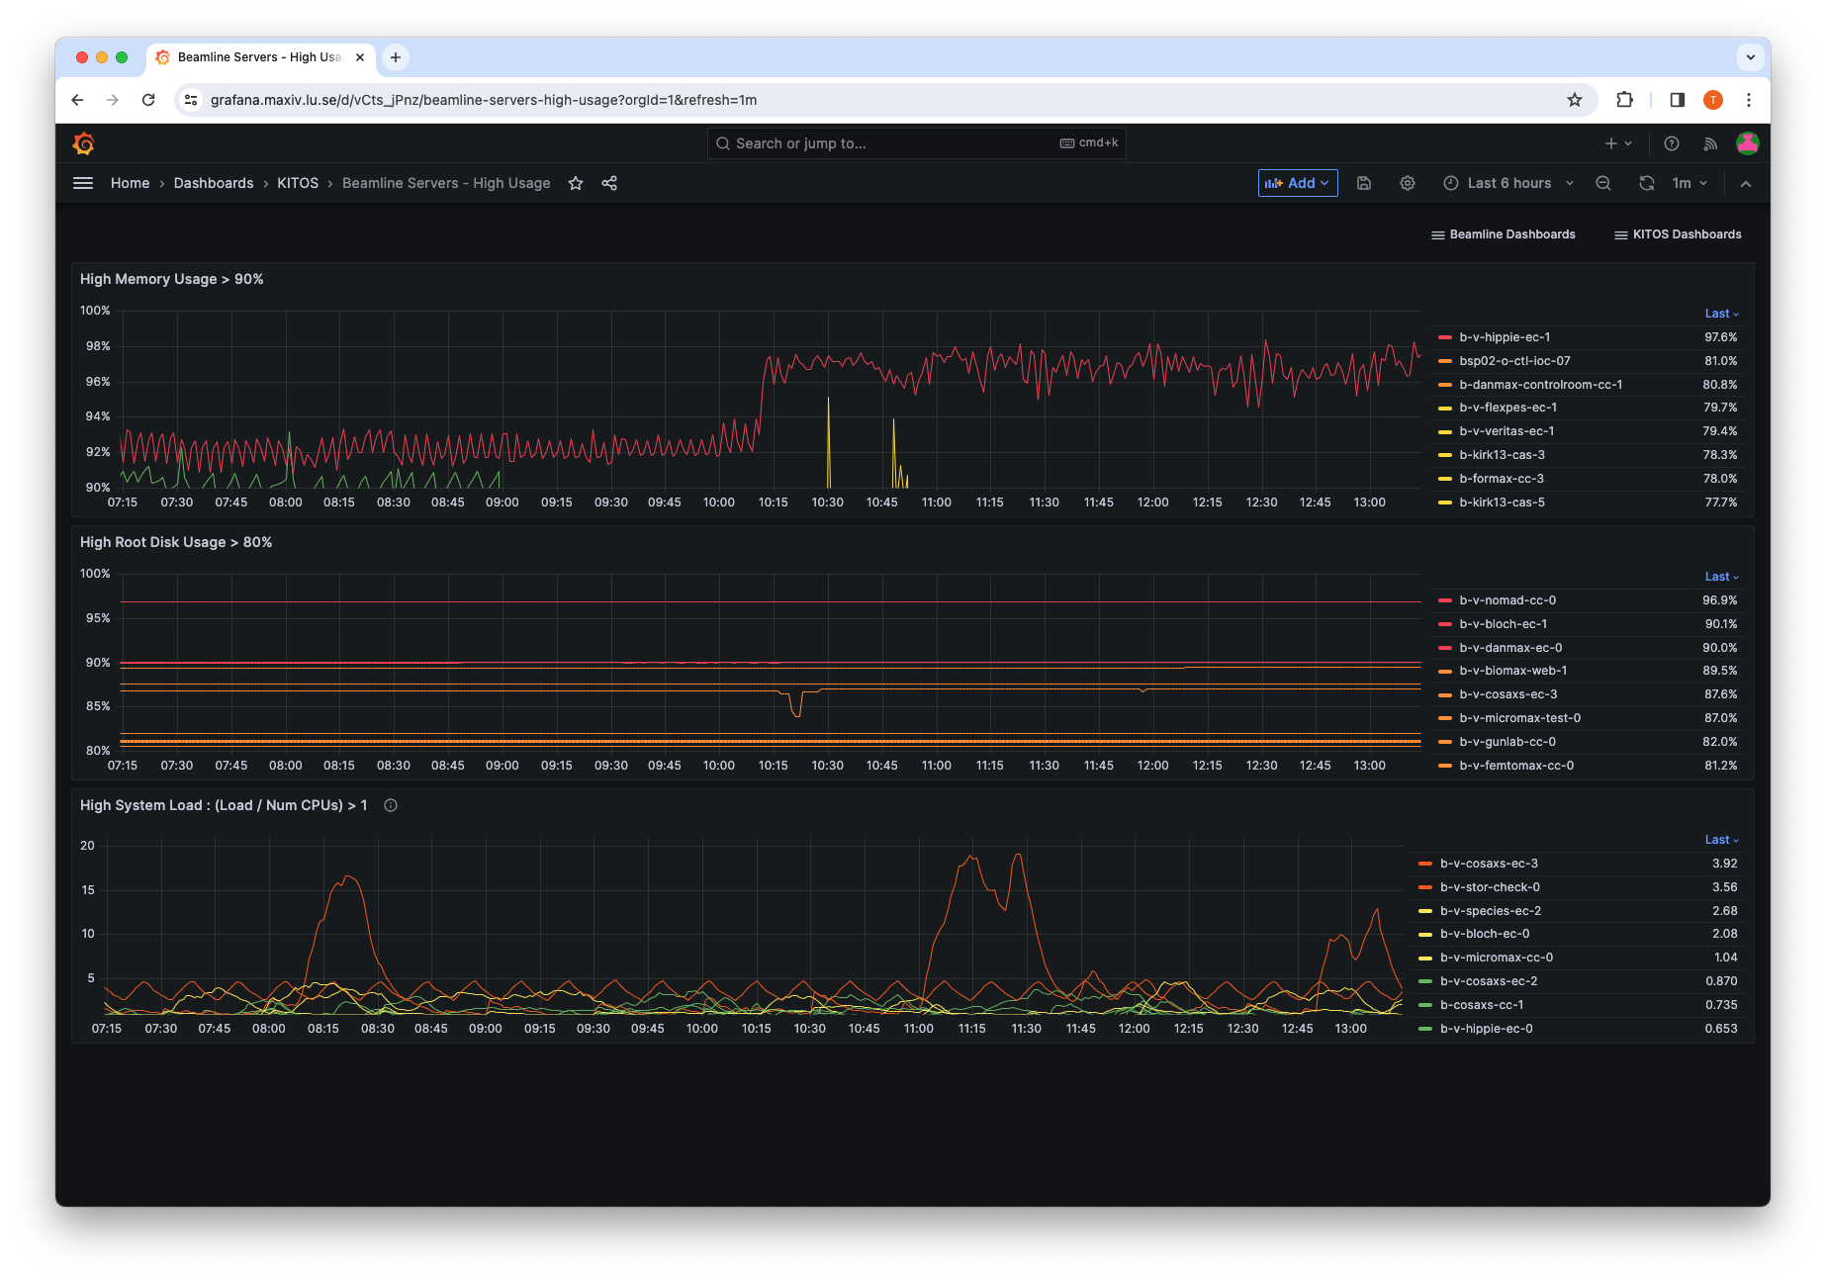
Prometheus node_exporter
17
Notes:
Use prometheus node_exporter to monitor CPU / memory / disk

Slide 18
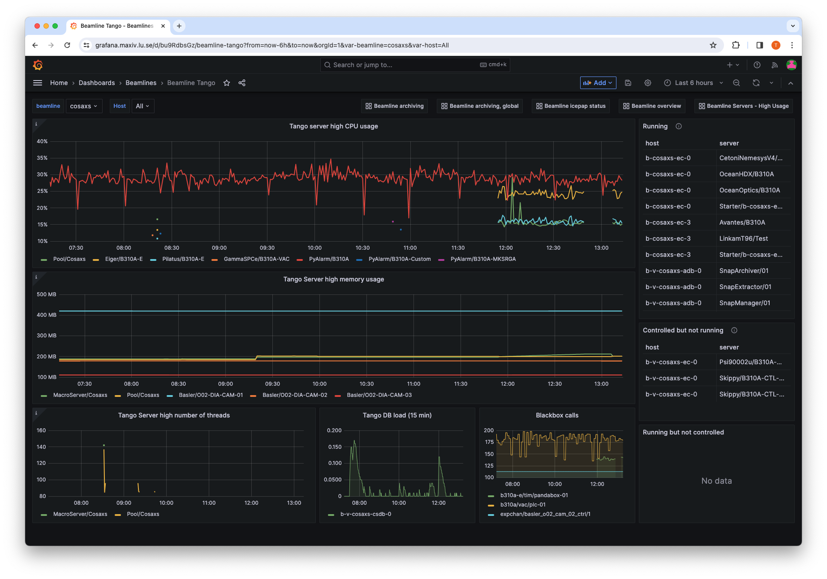
Prometheus tango_exporter
18
Notes:
Specific Tango exporter to monitor Tango Servers

Slide 19
Prometheus packages export
*/30 * * * * root nice -n 10 /usr/local/bin/prometheus_packages_export > /var/lib/node_exporter/packages.prom
packages.prom example
Grafana dashboard
19
Notes:
The Ansible inventory is very valuable but does not give us the full picture.
Some software could have been installed manually or using Ansible but removed from the inventory and still present on a machine.
To keep better track of what is deployed at any time, we developed a script to collect packages data.
Script is run every 30 minutes in the crontab.
Can search for packages. Need to create some dashboards to get some overview (check dev version deployed for too long for example)

Slide 20
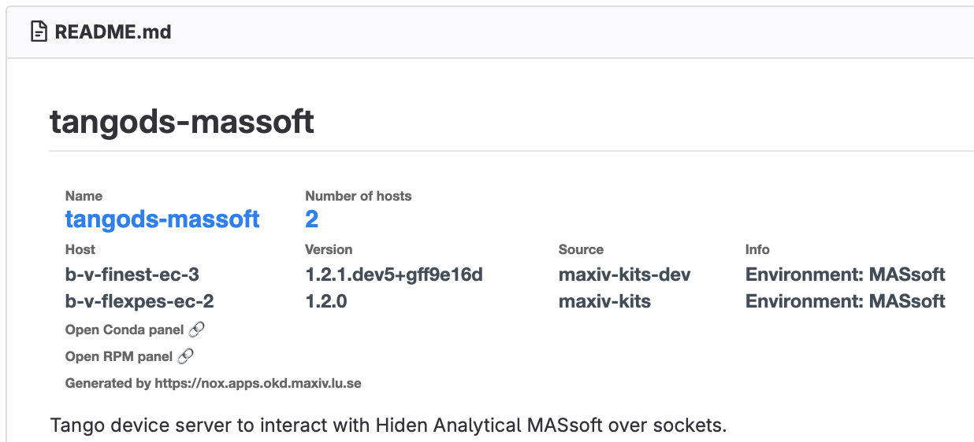
Nox
20
Notes:
Web application to create widgets (image) to be integrated in README.
Give information to the developer directly in the GitLab source repository (no context switching).
Know directly what will be impacted by a modification. Where and what version is deployed?

Slide 21
Conclusion
Ansible used to deploy everything
Software packaged with conda
Regular deployment process
Monitoring tools with Prometheus and Grafana
KITOS: support service – proactive monitoring
21

