Slide 1
Test and Test Automation for Control Systems
MAX IV/ESS Workshop
Hanno Perry, Benjamin Bertrand, Carla Takahashi
Software

Slide 2
Automated Python Tests
Standard Pytest Unit Tests
PyTango Test Resources
Device Test Context
Database Integration
Sardana Tests Resources
GitLab CI Pipeline
Python GitLab CI Template
Test Python
Integration Test
Test on the Beamline
Development Versions
Difficulties and Pitfalls
Problems at MAX IV

Slide 3
Automated Python Tests
Software

Slide 4
Standard Python Test
Pytest
Pytest is a popular testing framework for Python that simplifies the process of writing and executing unit tests. It provides a concise syntax, powerful fixtures, and advanced features, making it widely used for test automation and ensuring code reliability in Python projects.
Unittest.mock
In Python, the unittest.mock module provides a Mock class that allows you to create and configure mock objects. The mock objects encapsulates and replaces part of the system with a simulated version.

Slide 5
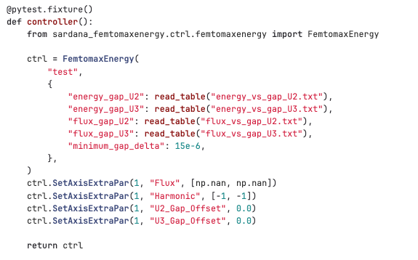
Fixture
Fixture functions are defined using decorators.
Fixtures are then injected on test functions as parameters

Slide 6
pytest.mark
Markers are essentially metadata tags that can be associated with specific tests, making it easier to organize and customize the test suite.
Test input parametrization can be used to enable, for instance, Boundary Testing.
It is also possible to inject parameters into fixtures, by using the parametrize parameter indirect=True

Slide 7
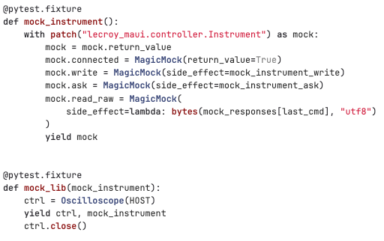
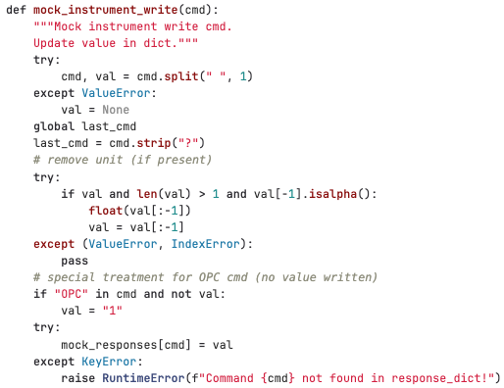
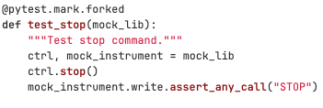
Mock
The mock object patches a part of them code, replacing it with a simulated implementation.
Each component of the mock can have a specific implementation.
In the test, we can check if the code correctly interacted with the mock.

Slide 8
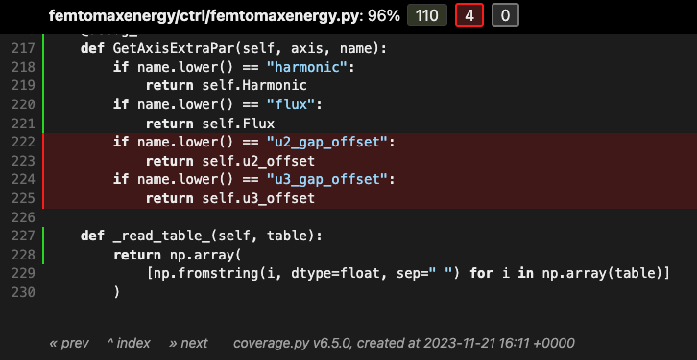
Coverage
pytest tests --cov femtomaxenergy --cov-report html

Slide 9
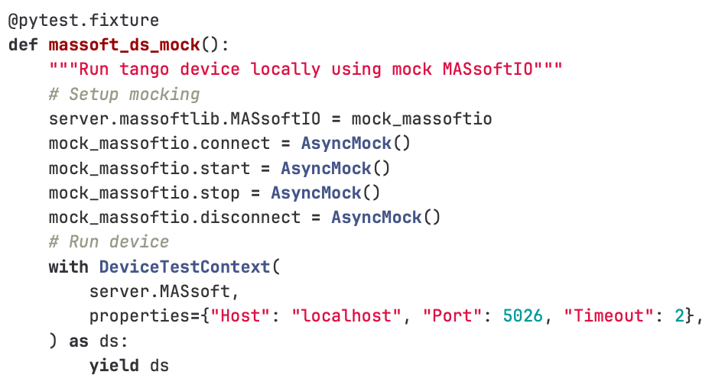
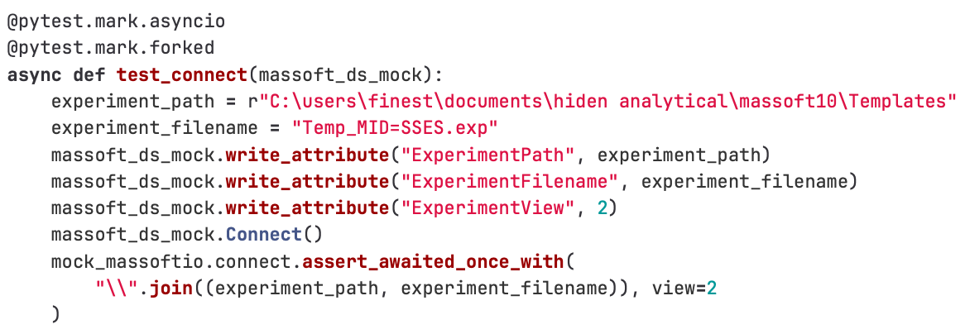
Pytango Test Resources
Device Test Context
Uses Pytango DeviceTestContext
No Tango database needed
Requires pytest-forked
Or use DeviceTestContext(…, process=True)

Slide 10
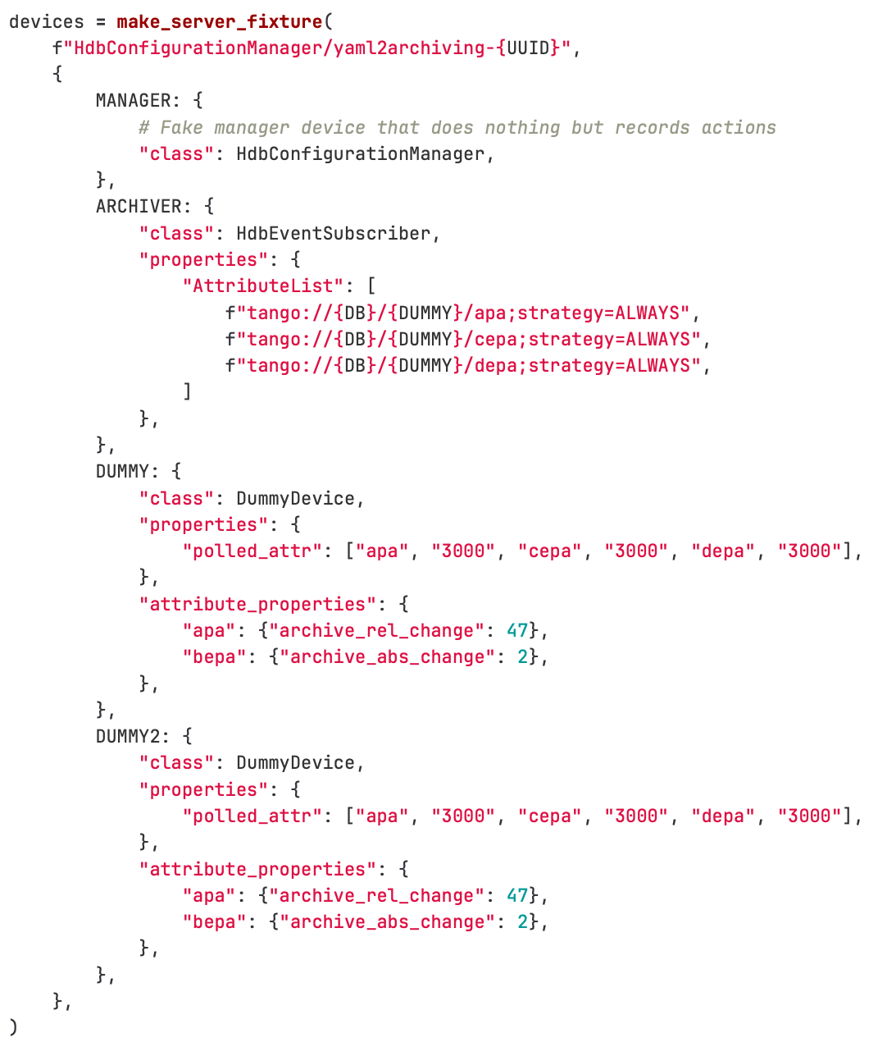
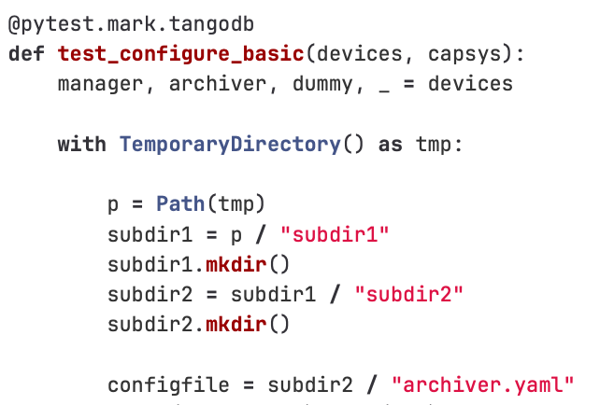
Database Integration
Uses a fixture decorator to define that a real database should be used.
Uses a fixture to populate the database.
Notes:
Not showing the full test. What is important is that the test is marked with “tangodb”.

Slide 11
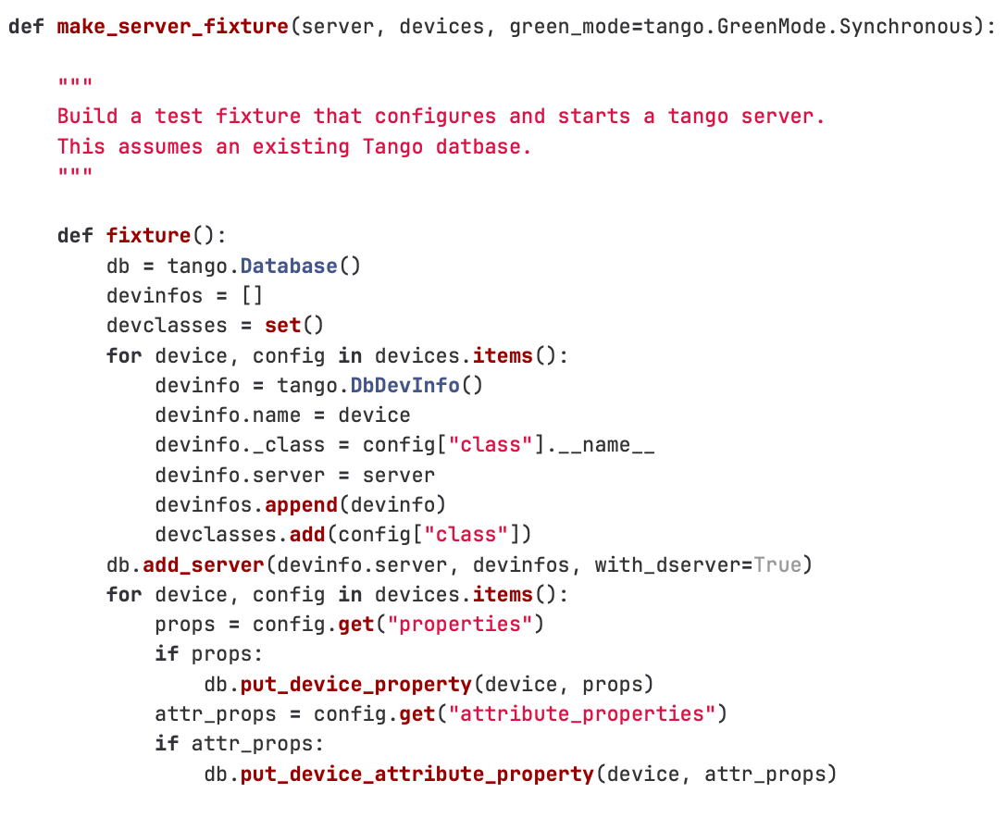
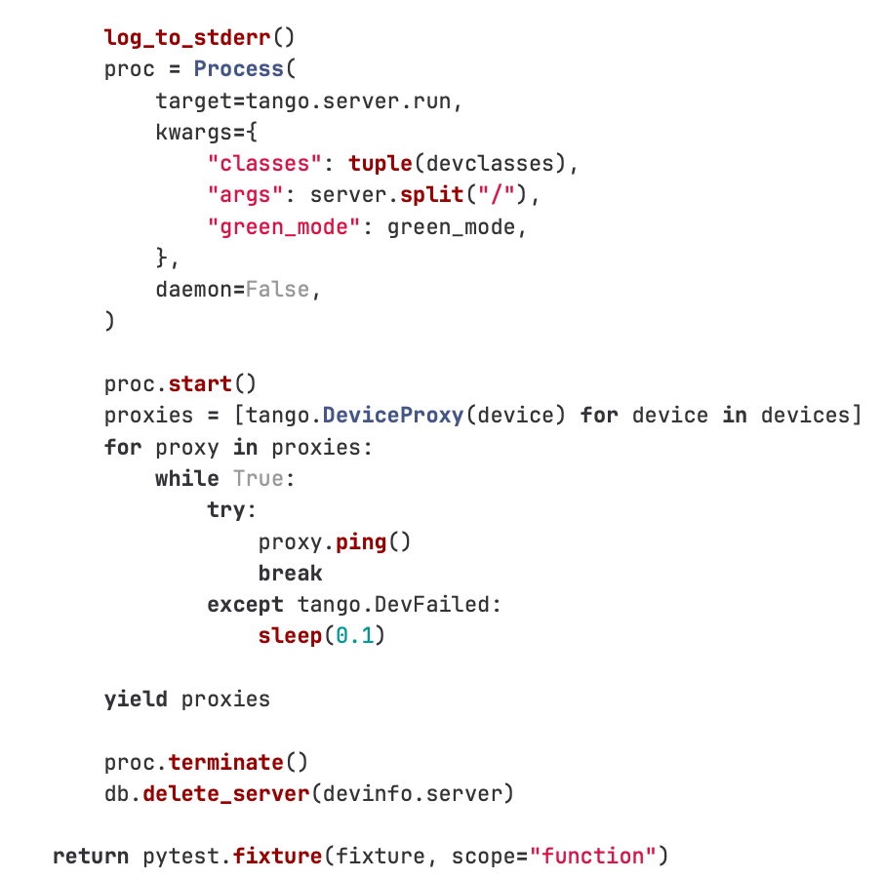
Database Integration
Uses a fixture to create the Tango server.
This fixture starts the server process.

Slide 12
Sardana Test Resources
Sardana Fixtures
For controllers development, it is recommended to develop their integration tests with the pool.
Sardana install them as pytest plugins, so they can be used in tests without explicitely importing them.
This has only been available on the latest release of sardana.

Slide 13
GitLab CI Pipelines
Software

Slide 14
Python GitLab CI template
On branch (dev package: 1.0.1.dev3+g9c9a3d7)
On tag (prod package: 1.1.0)
Notes:
One project where we keep GitLab CI templates. Only one file to include in projects

Slide 15
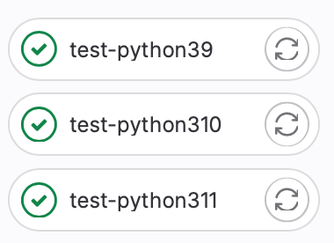
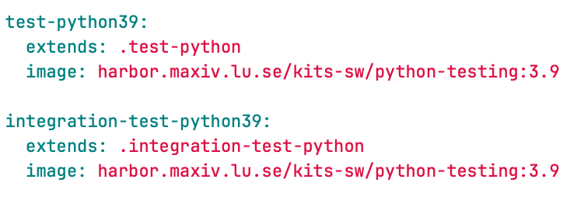
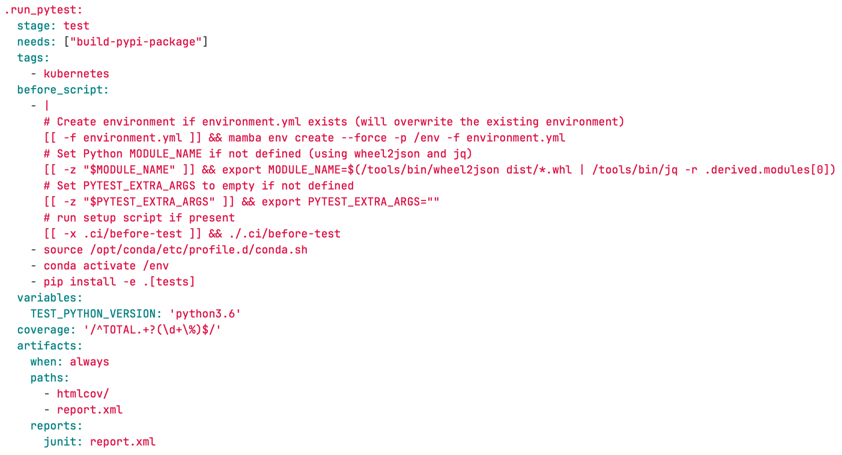
Test Python
Docker image with pytango and sardana already installed (with conda)
Notes:
We pip install the package. PyTango wasn’t available as wheel. Also ensure that we test with the current version deployed (9.3.6) and not latest.

Slide 16
Test Python
Simple Pytest coverage report is present on the GitLab pipeline.
No percentage of coverage is required or systematically reinforced.
Notes:
We pip install the package. PyTango wasn’t available as wheel. Also ensure that we test with the current version deployed (9.3.6) and not latest.

Slide 17
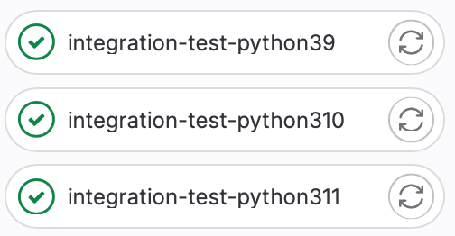
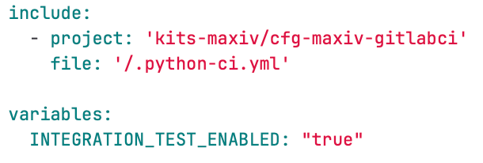
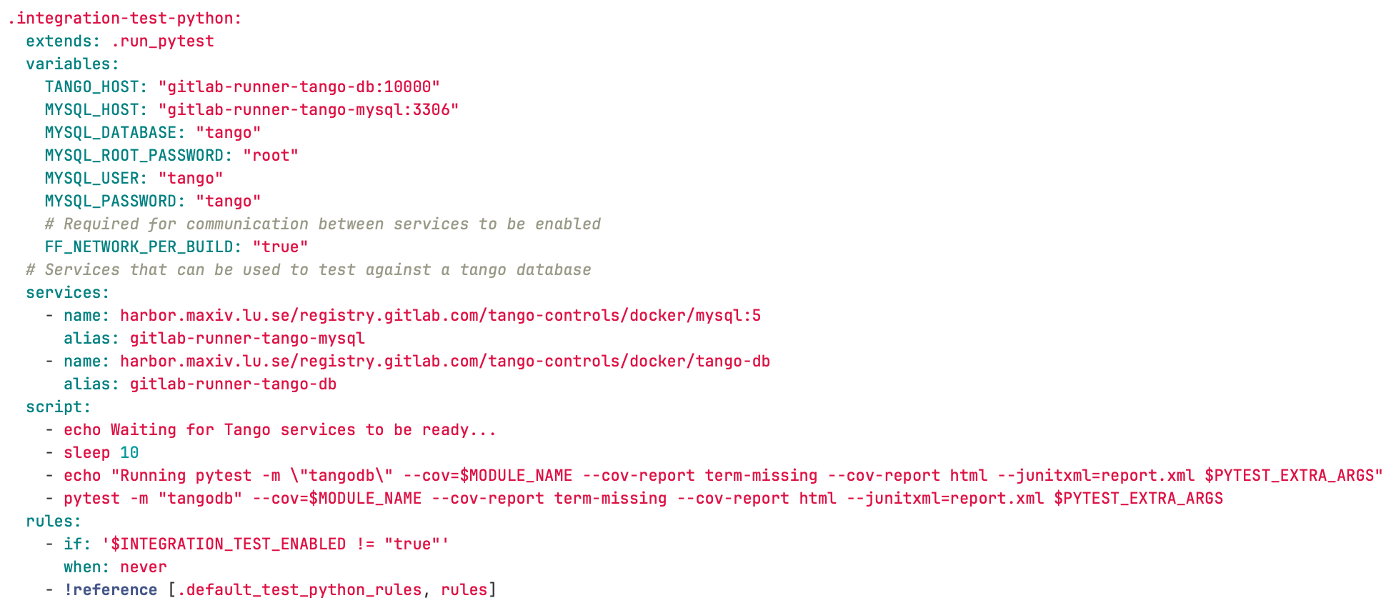
Integration Test
Tango database required

Slide 18
Development Packages
Software

Slide 19
Testing on the Beamlines
Testing new features or fixes on deployed systems
During the development of new features, it is often necessary to test non-stable packages on the beamlines.
It is strongly recommend propper packaging, build and publication of development packages from the feature branches.
The development packages should be used on beamline tests, as opposed to local copies of the code.

Slide 20
Difficulties and Pitfalls
Software

Slide 21
Difficulties and Pitfalls
Problems at MAX IV
Graphical User Interfaces are not tested.
We have a lot of repos and many of them have very low coverage or no tests at all, specially the older ones.
Tests implementation skills vary a lot between team members.

