Slide 1
Collaboration with operators and scientific users at MAX IV
MAX IV / ESS Workshop
Yimeng Li
TECHNICAL DIVISION - SOFTWARE GROUP
Notes:
Add slide number

Slide 2
Why important?
Ensures that the development process meet the actual needs and preferences of end-users.
A good collaboration:
Increases the likelihood of creating solutions that are effective and user-friendly
Helps in clarifying and refining project requirements
Establishes a feedback loop and contributes to increased user satisfaction
Scientific users bring domain-specific expertise which contribute to a better understanding of the complexity of a problem
Notes:
Each software engineer is responsible for 2 beamlines.

Slide 3
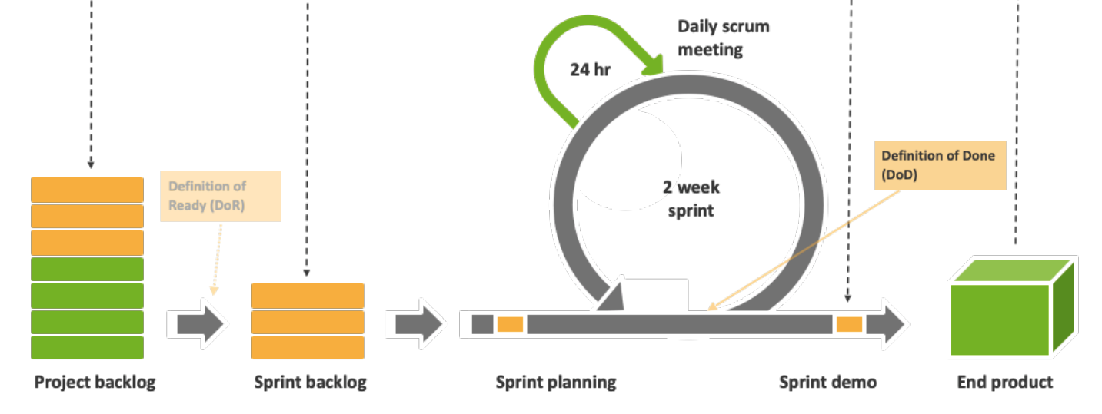
Best Practises
Software Group
Distribution
18 staffs
Ideally 2 beamlines / collaborations per person
4 consultants
Offering expertise in development
No contact responsibility

Slide 4
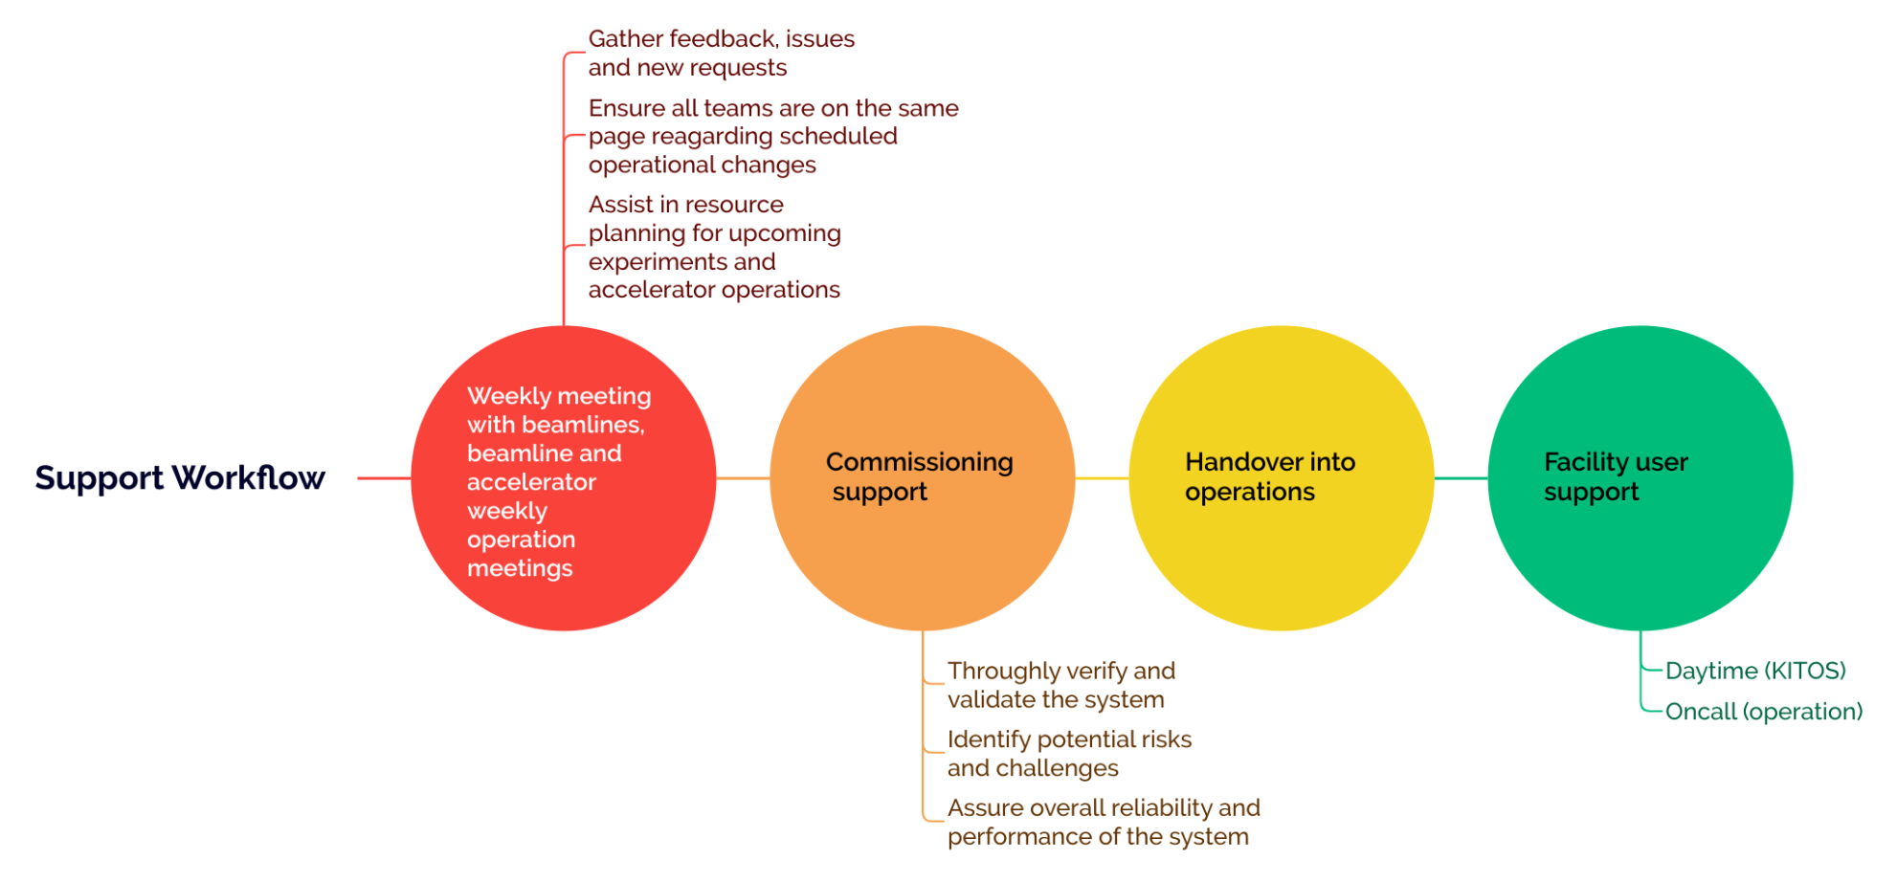
Support Workflow
Notes:
Each software engineer is responsible for 2 beamlines.

Slide 5
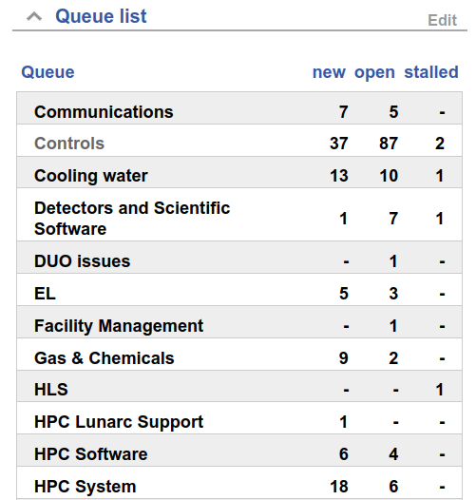
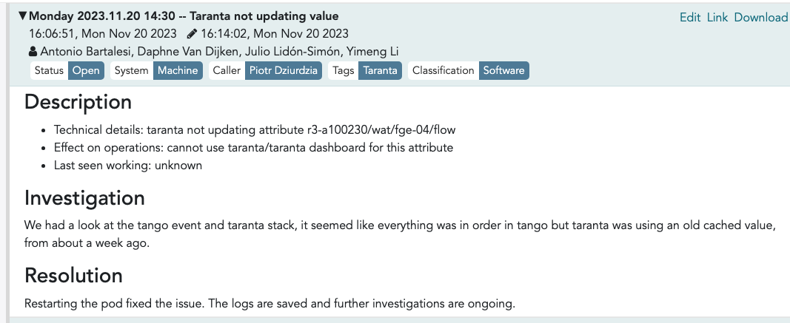
Communication
RT ticket
Categorize issues
Follow up on common issues and requests
Not urgent
KITOS
Urgent problems
General support
Direct channel
Information
Specialist questions

Slide 6
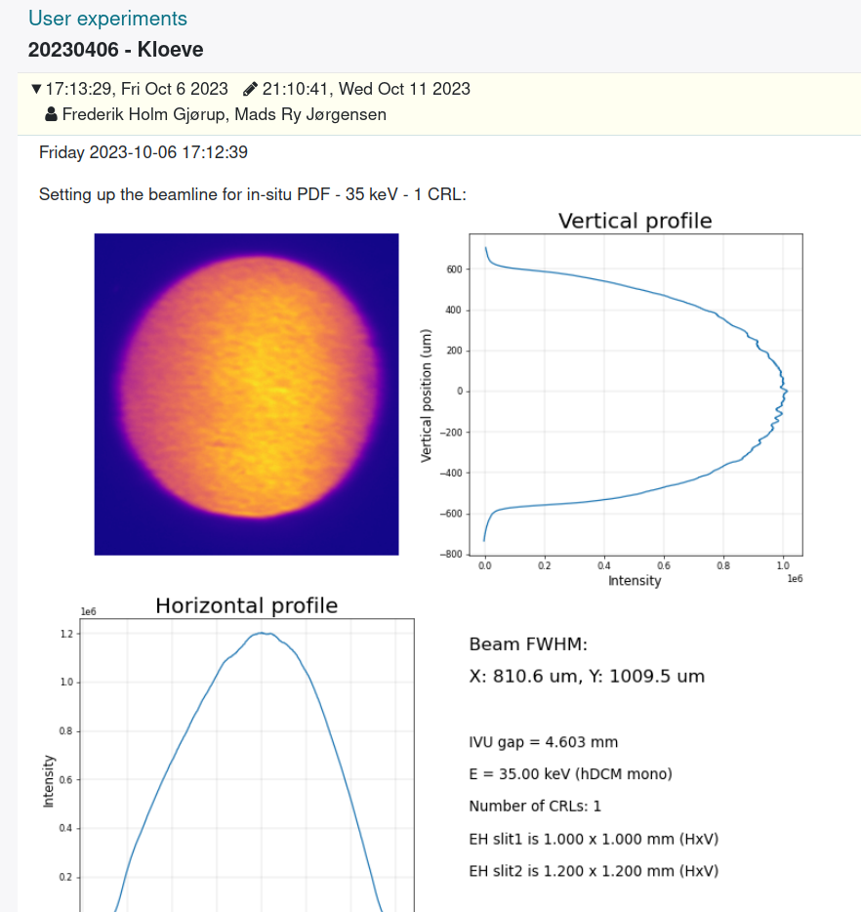
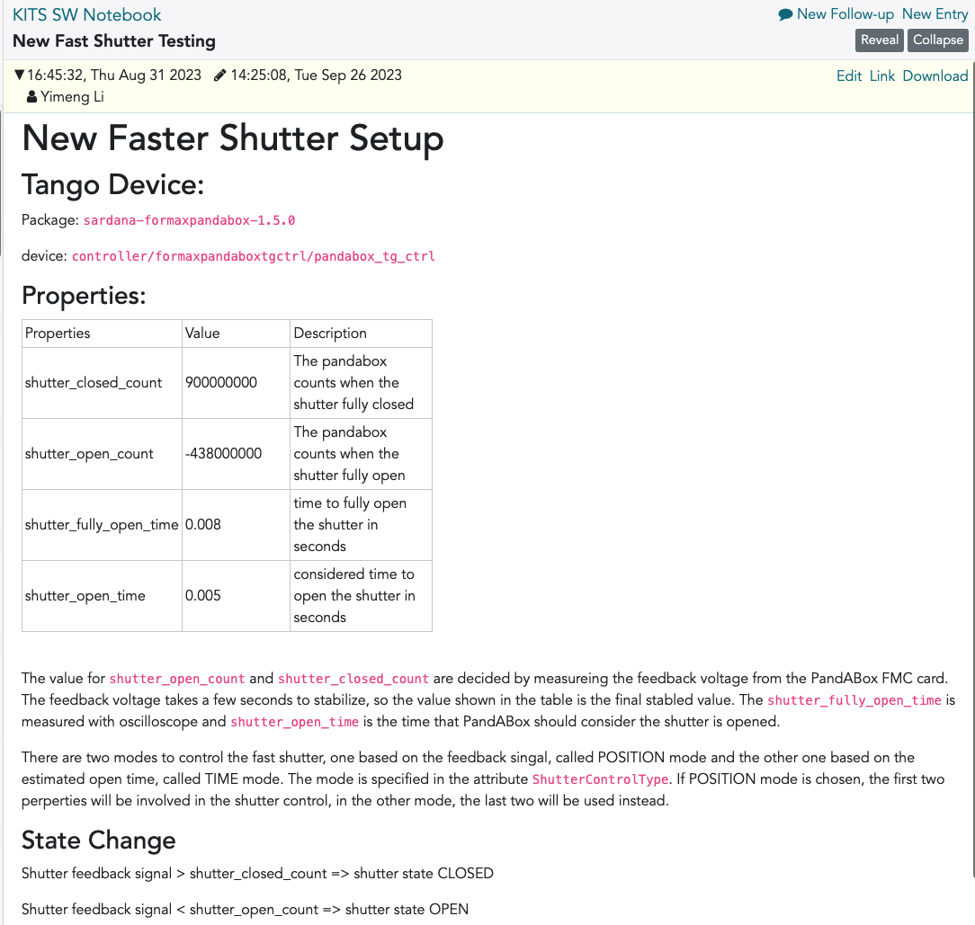
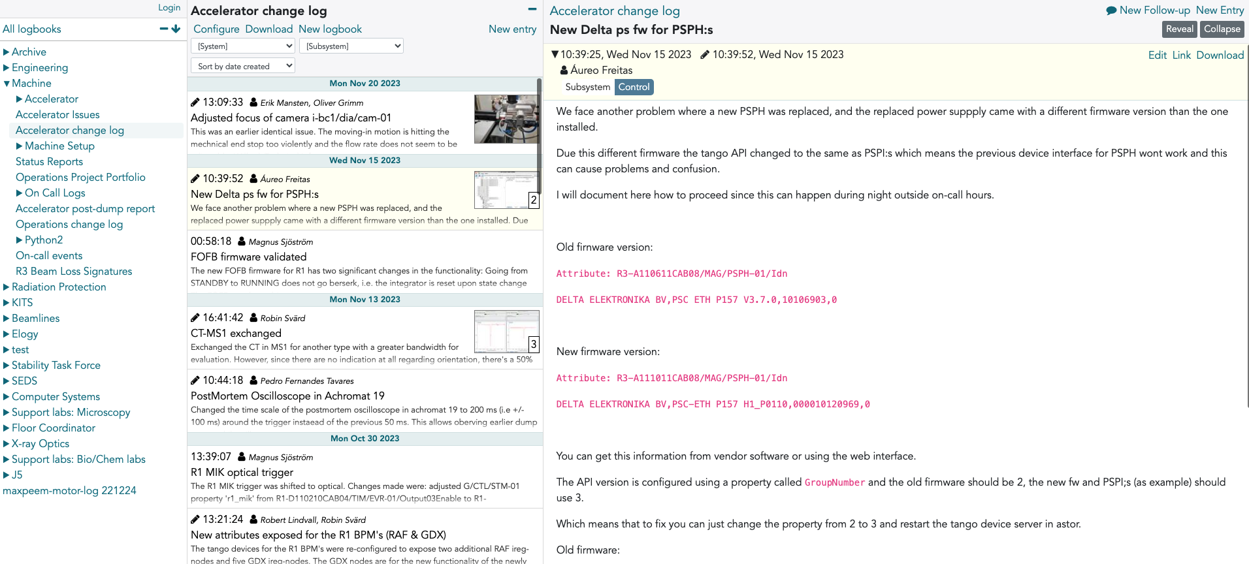
Documentation
Elogy - log book
beamline/machine operation
Testing/commissioning process
Technical changelog

Slide 7
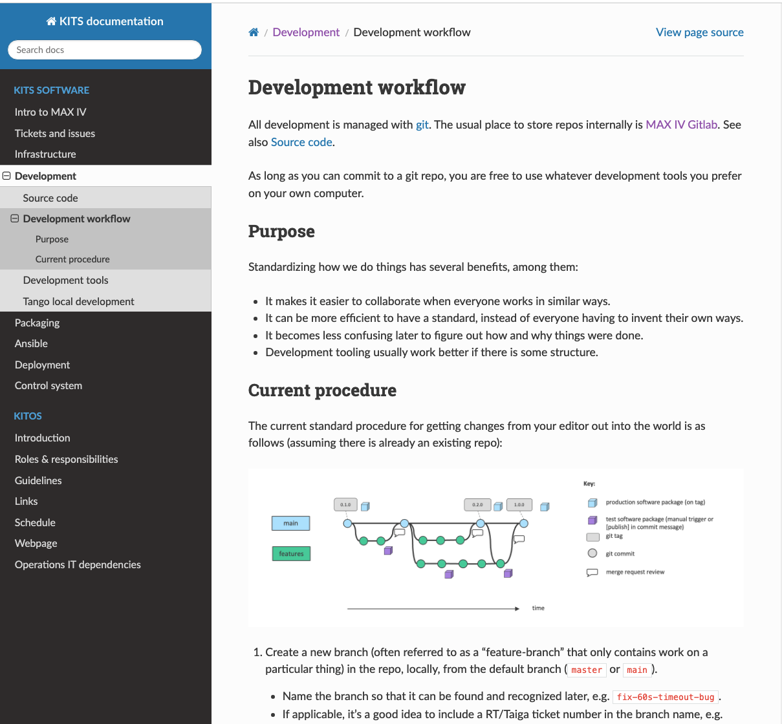
Best Practises
Guidelines
Online documentation describing guidelines for development workflow and best practices defined by our team.
The workflow also applies to beamline staff and operators. They are very welcome to develop their software.

Slide 8
Challenges
Differences in technical language can lead to misunderstandings
Differing Priorities, operational concerts vs long-term technical solutions
Resistance to change, concerning about disruptions
Time constraints, obtaining timely feedback challenging
Clear communication channels to bridge gaps
Effective negotiation and compromise
Addressing concerns and
Improve training
Find ways to accommodate time constraints
Notes:
Find ways?

Slide 9
Best Practises
Direct communication channel
Immediate feedback in early design phase
Clear documentation
Software changelog
Regular training on common software we use
User autonomy highly encouraged
Understanding of experiments
Provide professional solutions
Clear expectation definition
Best Practices

Slide 10
Questions ?

