Slide 2
Collaboration with operators and scientific users
PRESENTED BY Nicklas holmberg

Slide 3
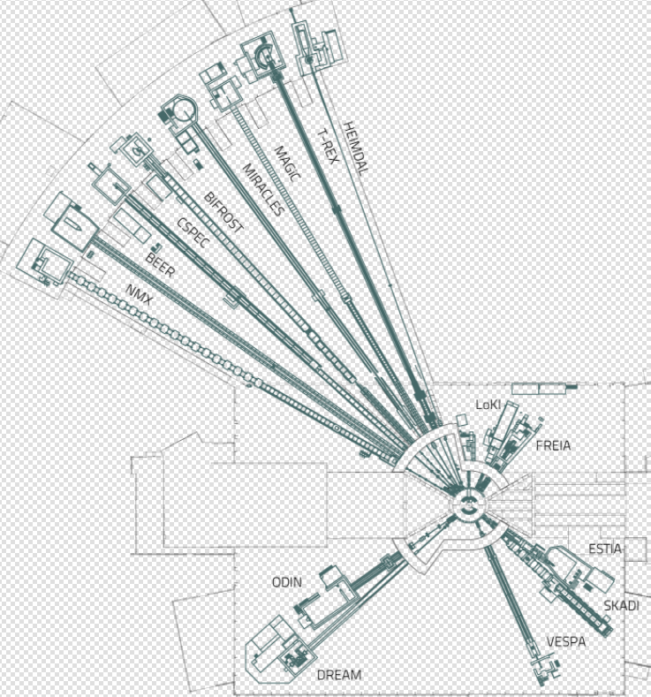
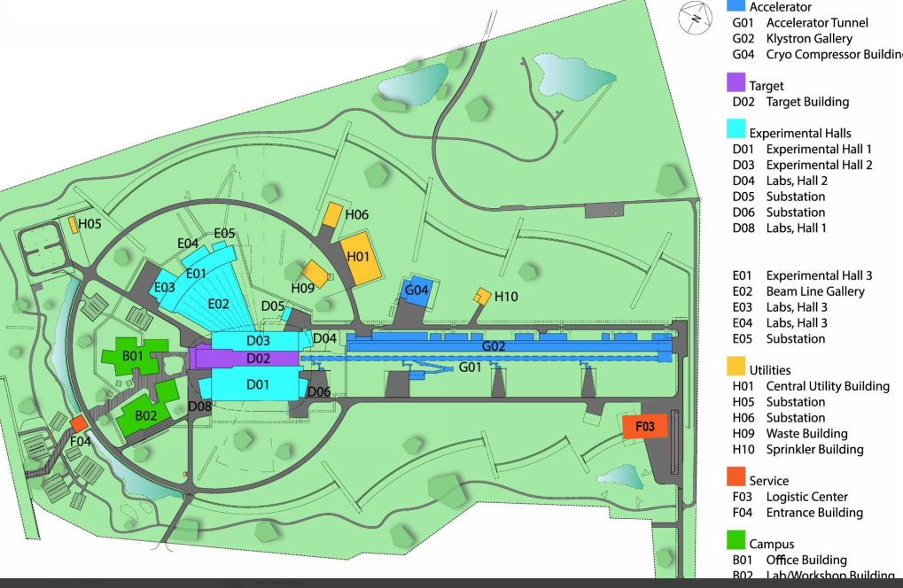
ESS overview
Neutron production
- Proton accelerator
- Target station
Neutron Consumption
- 16 beam lines
14Hz base frequency

Slide 4
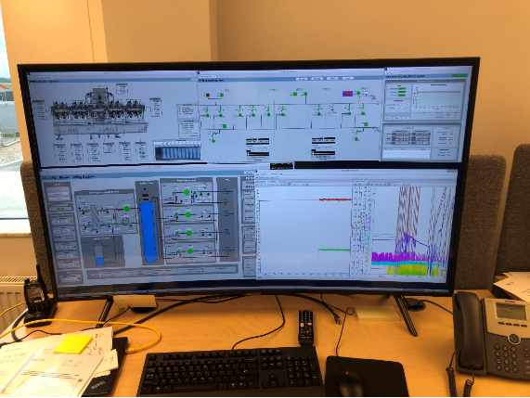
Accelerator and Target station operations
In operations
Control system
CS Studio
EPICS
CS Studio GUI 1
CS Studio
GUI 2
Devices
IOC VM1
IOC IPC1
IOC IPC2
Cryo
RF
Vac

Slide 5
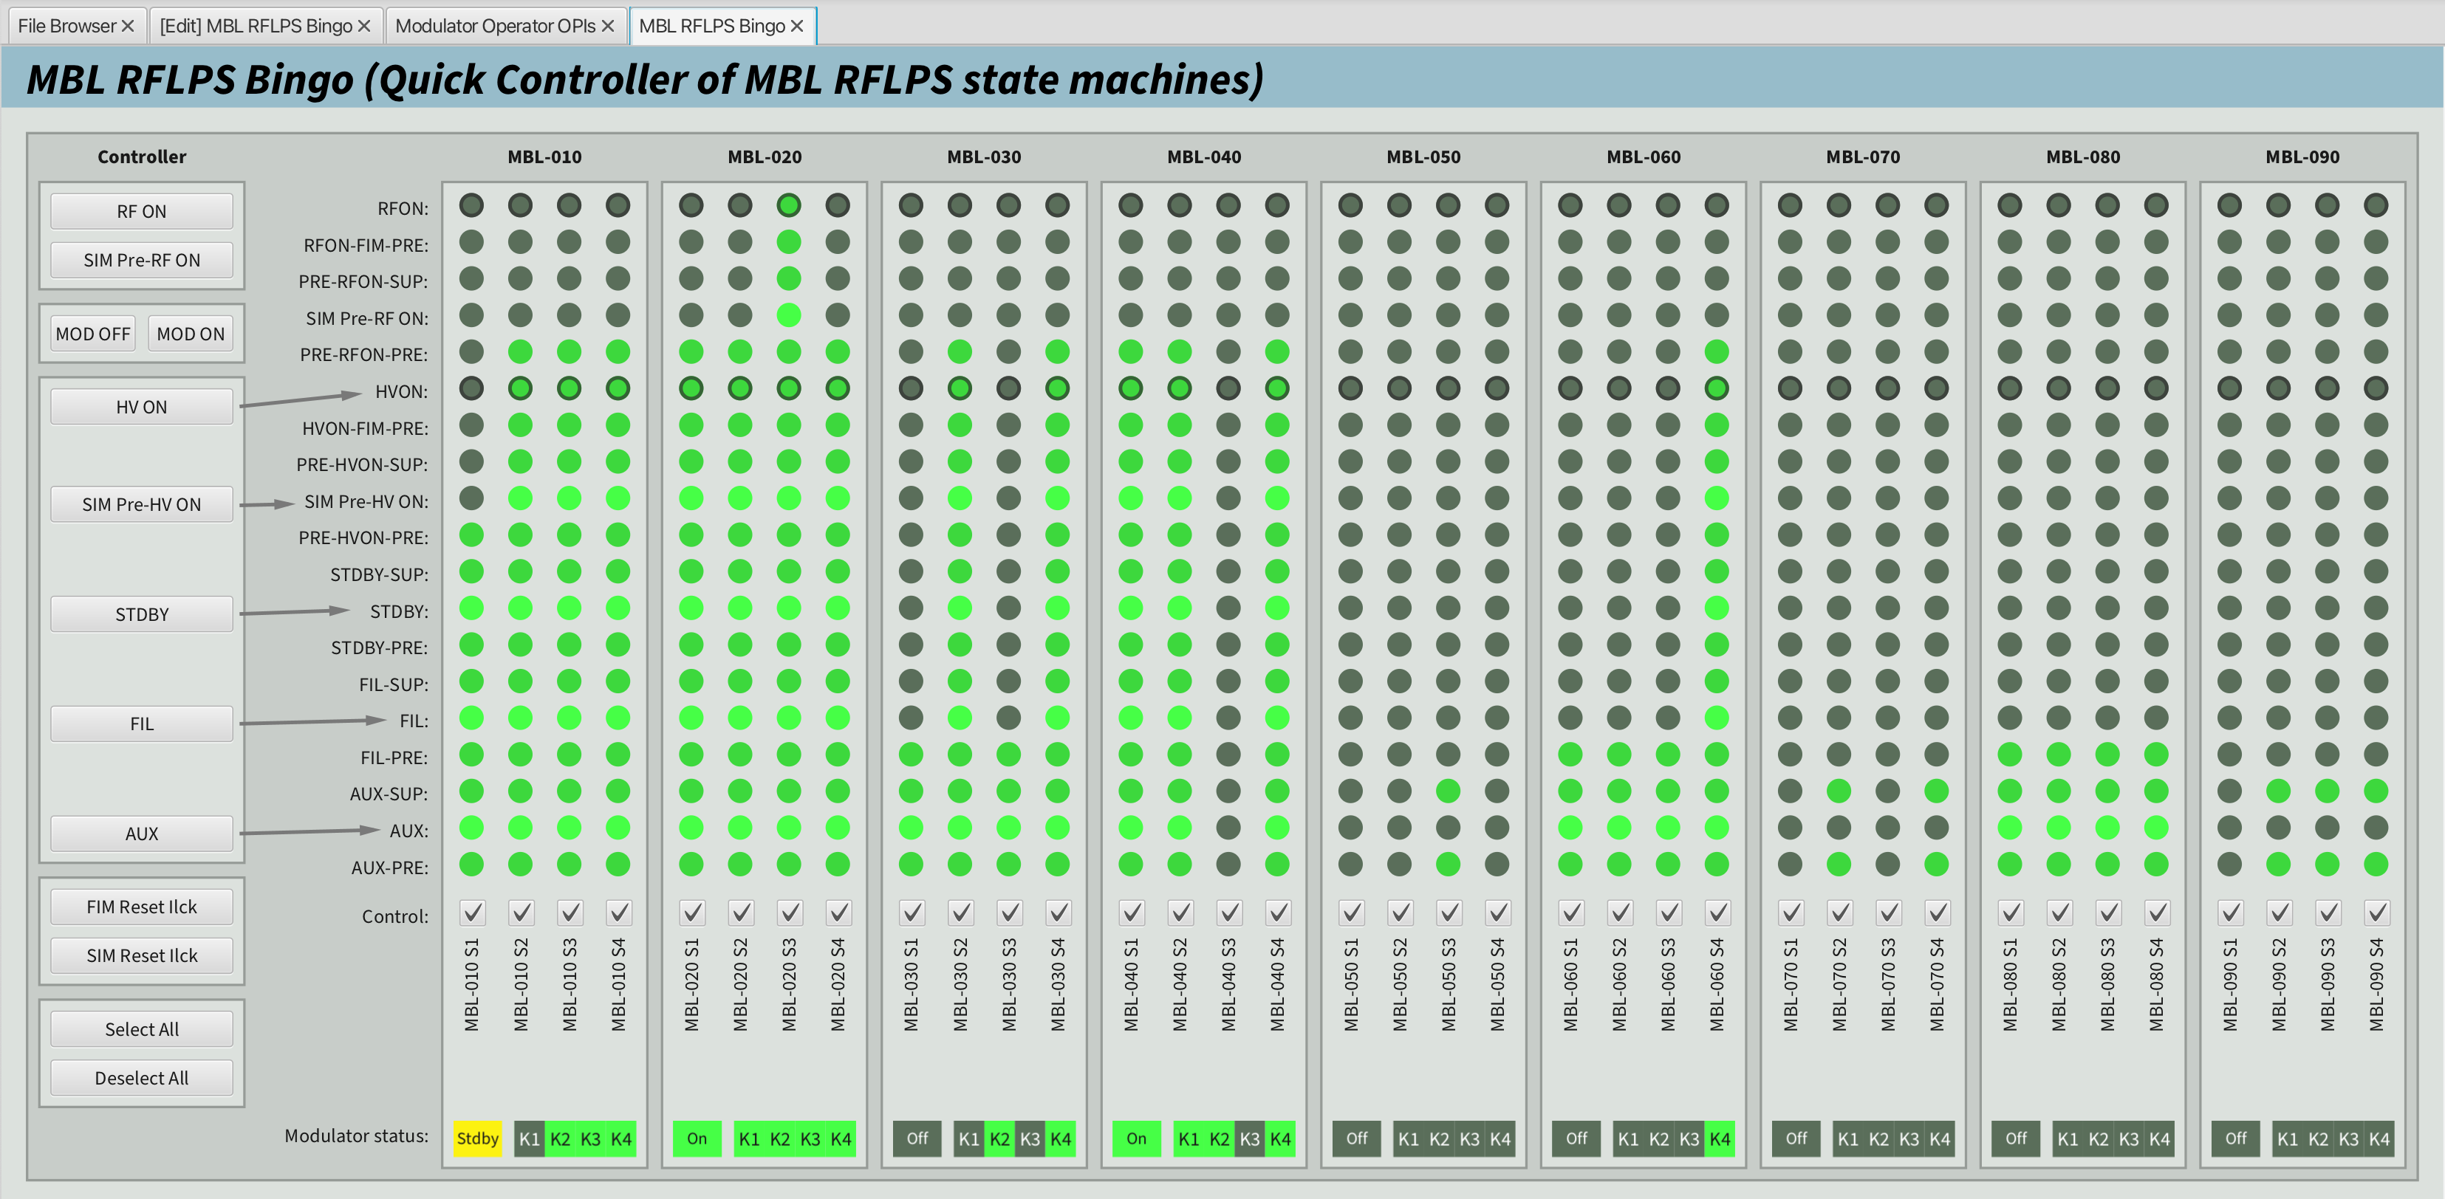
Current status on accelerator and target
Some collaboration examples
Examples of efficient collaboration with the operators
OPIs review and deployment
Integrators prepare expert GUIs
Operators creates OPIs from them
Close collaboration during system integrated testing.
Bumpless IOC restart testing, ensure recovery after a crash
Management of alarms and archiver configuration
Additional input on top of system owners
Operational limits alarm parameters
Examples of inefficient collaboration with operators
Best Effort Technical Support setup
IOC restarts
Operations scripts
Sequencing, logic, GUI layouts
RF Local protection system overall display for MBLRF stations
Notes:
OPIs review and deployment
Many of OPIs especially the operator level OPIs are implemented by operators themselves based on the Engineer and System Expert OPIs that are prepared by integrators. There is a good collaboration here between ICS and Operators in preparation of such OPIs.
Before the deployment of OPIs, it goes through review process that operators are part of it as well. This ensures that operations are in the loop for each OPIs that are deployed in control room.
Close collaboration during system integrated testing.
We try to take part in testing and operation of our control systems during system tests and early operation together with system owners and operators in control room.
This gives us a better understanding on how the system is going to be used and operated.
One test that we usually do before the beam commissionings together with operator is Bumpless IOC restart testing to make sure that all IOCs can come back to the known and good state after each IOC reboot.
Management of alarms and archiver configuration
The operational limits and alarm parameters are set in the IOCs while the alarm server configurations are defined on specific server that reflects the hierarchy of alarms in control room.
We work closely with control room on what PVs and parameters should be in alarmed or archived and also also on their configuration and testing,
BETS setup
The Best Effort Technical Support was a setup used during previous beam commissionings to allow engineers to support control room during operation outside working hours on voluntarily basis.
IOC restart
Operators tend to restart the IOCs when an issue happens on a particular system that appeared to be controls issued.
This was an issue from controls perspective on uncontrolled management of IOCs and also not performing root cause analysis on the issue
Operations scripts
Operation group have a dedicated VM in TN where they can deploy their operation’s related scripts apart from Jupyter notebook.
In most of the cases these scripts are not reviewed by ICS so the coherence of the IOCs and the scripts fetching IOC information is not always guaranteed.
Also some of these logics that are implemented in the scripts can perhaps be moved to the IOCs for more stable operation

Slide 6
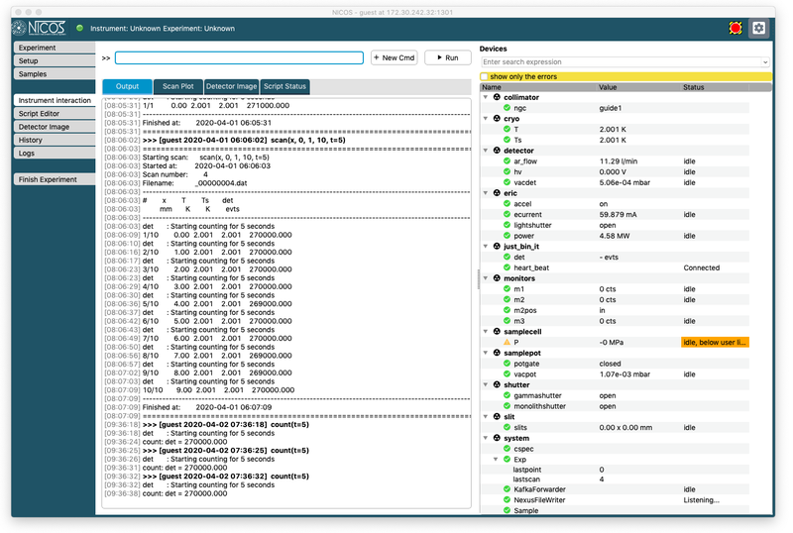
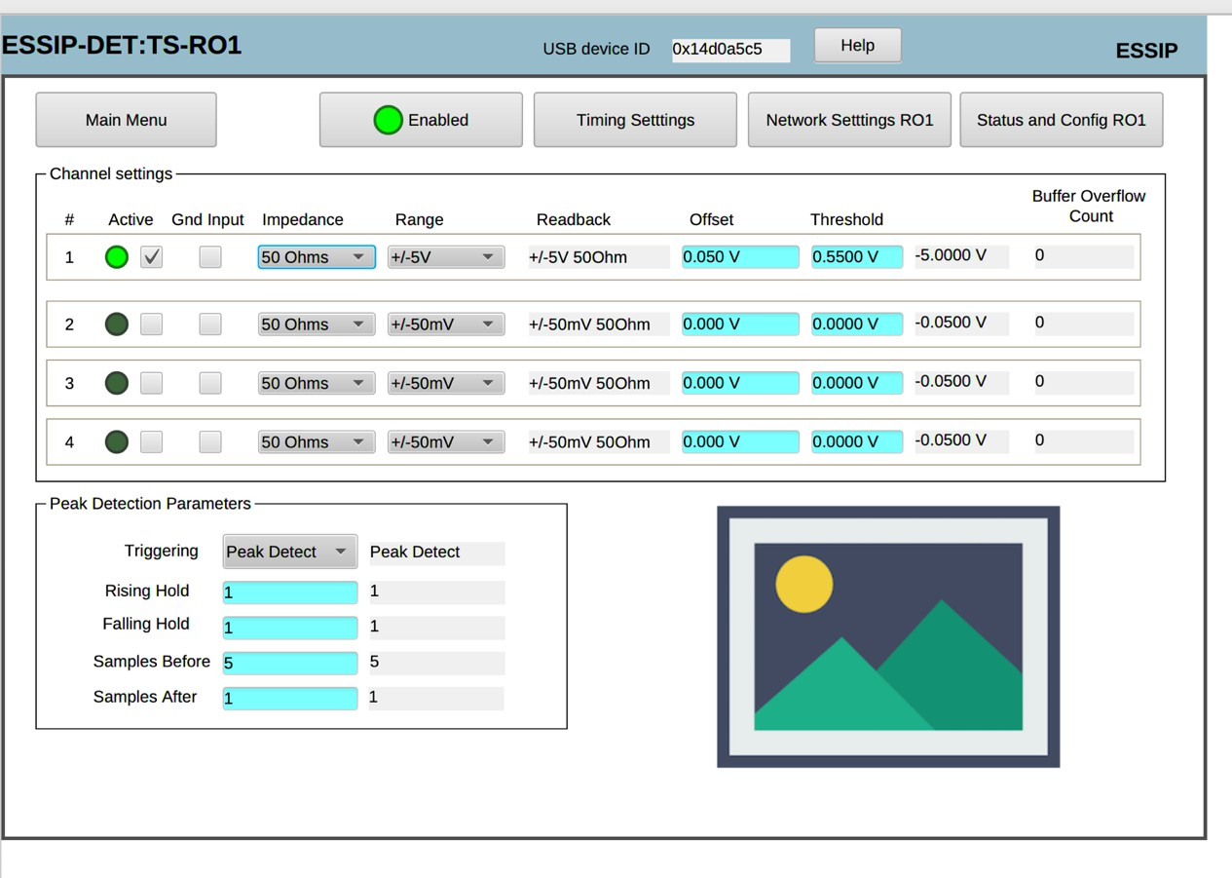
A neutron instrument control system
Controls overview
Neutron Instrument controls
NICOS
CS Studio
NICOS
EPICS
Device
CS Studio
Engineering GUI
IOC VM1
IOC IPC1
IOC IPC2
Motion
Chopper
Detector

Slide 7
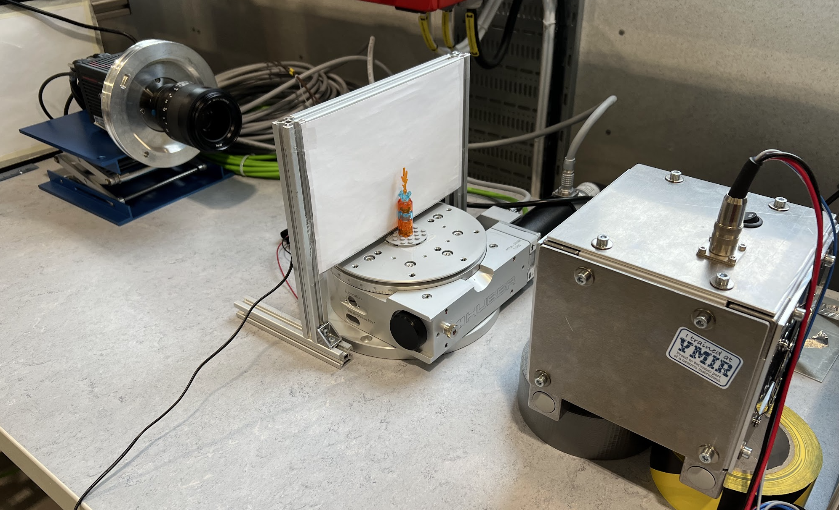
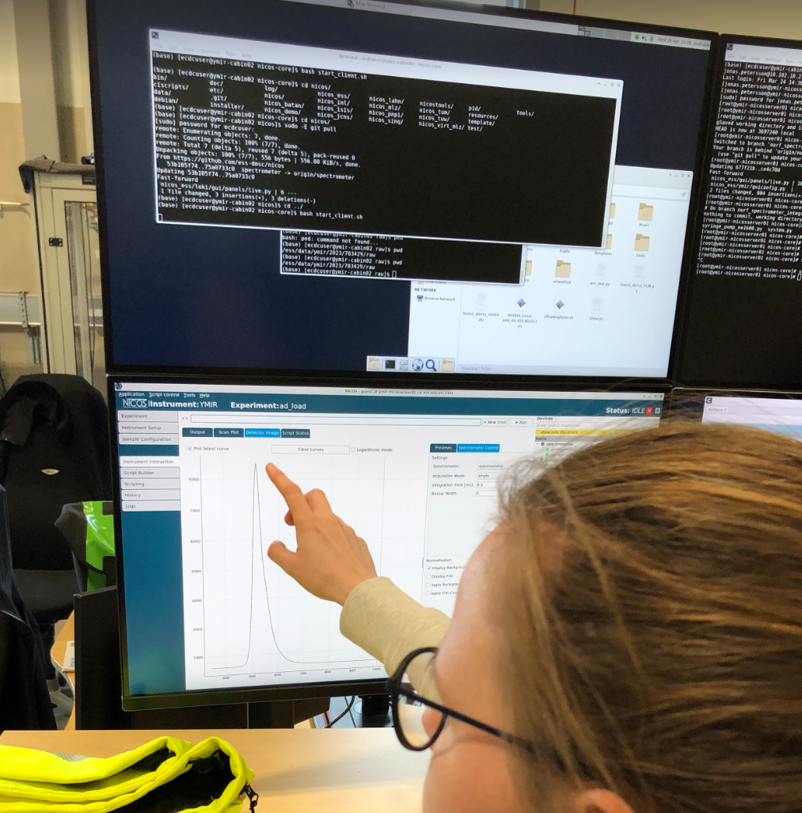
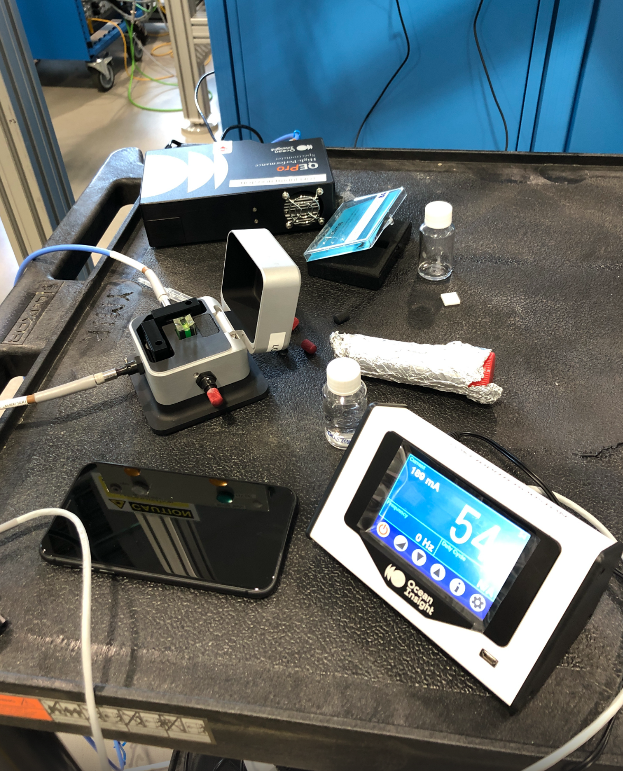
Current status on neutron instruments
In a installation and commissioning state
Examples of efficient collaboration with the instrument scientists
Test Beam Line Area Detector
Spectrometers
Clear use cases
Engaged receiver
Examples of inefficient collaboration with instrument scientists
Off the shelf products where the system owner is not the system specialist
New technology - TimePix3
Non ESS standard control systems - Interferometer
Requires a lot of iterations to reach an acceptable state, basically trial and error

Slide 8
Future challenges
Foreseen situations
Visitors bringing equipment
Detectors
Sample environment equipment
High level and facility wide sequencer
Cascading alarms mitigation
Notes:
I would add followings as well:
High level applications and facilility-wide sequencer
Alarm management to mitigate cascading alarms (refer to alarms session)

Slide 9
Finish presentation

Slide 10
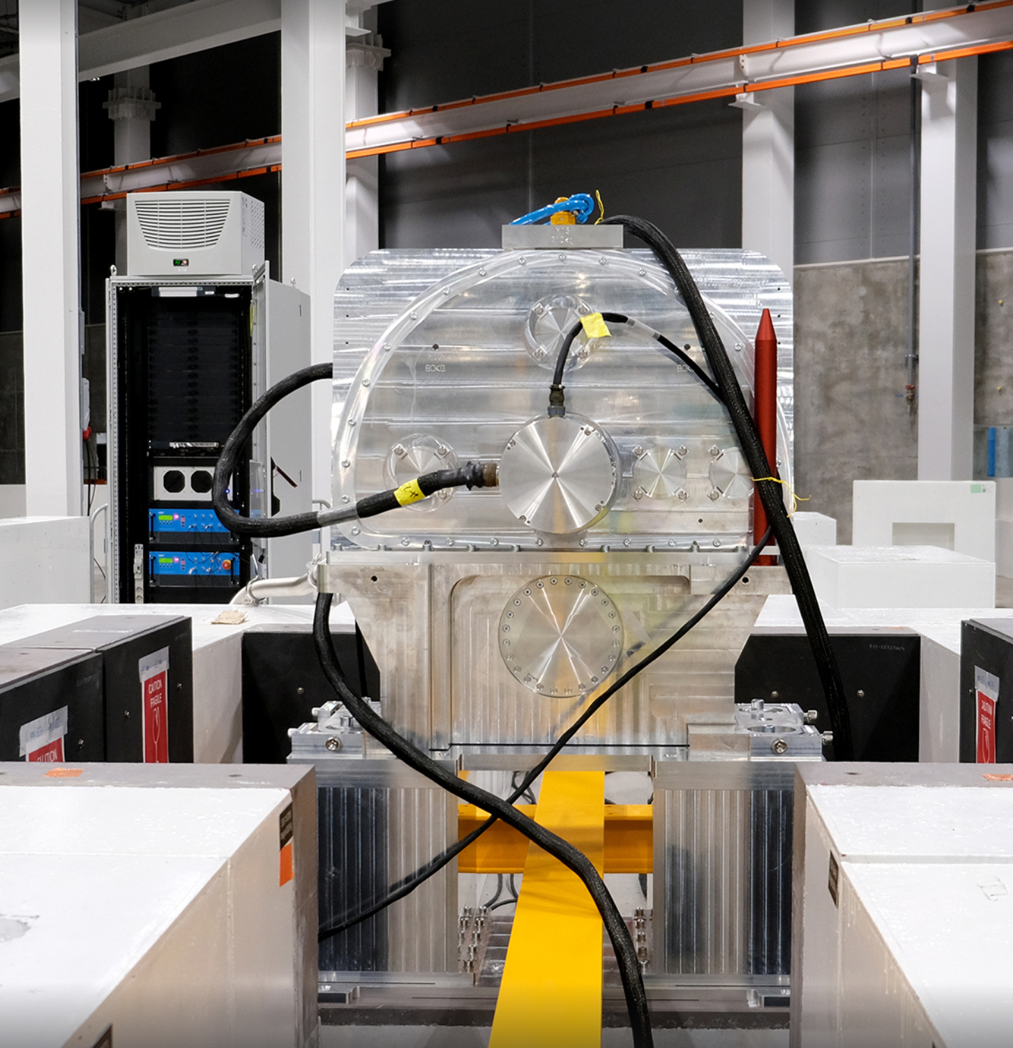
Current status on neutron instruments
Some collaboration examples
Some cold commissioning being done
BIFOST neutron choppers
Some example of instrument control hutch
Instrument scientist work flow together with integrators

Slide 11
Current status on accelerator and target
Some collaboration examples
First part of beam line up to DTL4 commissioned successfully in July 2023.
Some example of control room
Operator workflow with integrators during operations
Commissioning workflows
Phoebus GUIs
Screenshots

