Slide 1
Testing and test automation
ESS status and challenges
www.europeanspallationsource.se
2023-11-22

Slide 2
Background
The control system of large research facilities, like ESS and MAX IV, encompasses thousands of diverse subsystems. Managing the development and maintenance of such a complex system-of-systems poses significant verification challenges.
All components that goes into a system should be thoroughly verified before system assembly. This level of testing is typically referred to as component or unit testing. Components that have interfaces with each other are then tested together. This type of testing is referred to as integration testing.
Before a system can be integrated with the larger machine, we need to develop confidence that this system will work as expected and that all the components, when put together as per the system design, fulfil the intended function. At ESS we refer to this type of testing as system testing.
Finally, the system need to be tested in conjunction with other systems before the machine can be declared ready for operation. We call this type of testing integrated testing.
System testing
Component/unit testing
Integration testing
Integrated testing
Notes:
KRISTINA

Slide 3
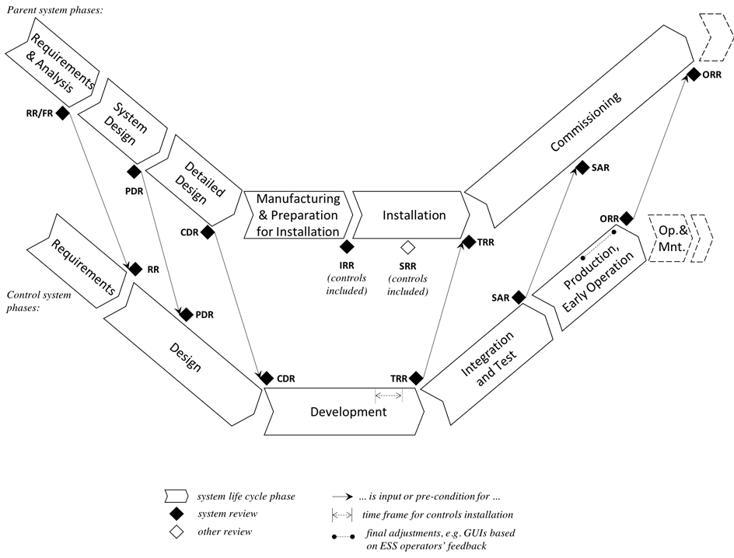
System engineering process
Substantial test effort is linked to the system life cycle and engineering process. Test are planned and performed in collaboration with the system owner in each stage of the system life cycle.
The tests are mostly manual, and always documented in a verification report that is then part of the facility baseline.
The devil, as per usual, hides in the details and implementation.
Notes:
KRISTINA

Slide 4
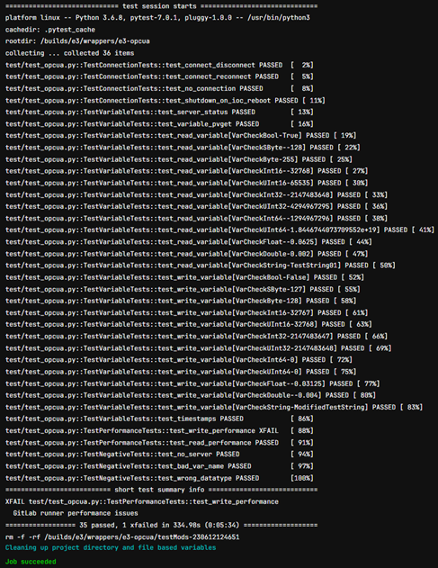
EPICS testing
EPICS base and many core modules have automated unit tests.
For our in-house developed modules we have the capability to build and run unit testing using pytest and GitLab CI
Test results are automatically stored in GitLab
Notes:
KRISTINA

Slide 5
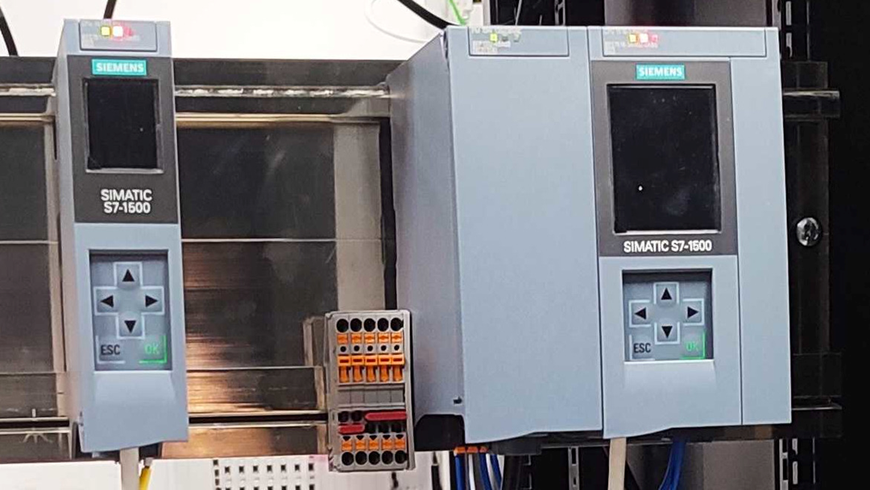
PLC testing
Test automation for PLC’s is facilitated using a standardized Python virtual environment that bundles essential tools for PLC project connectivity and testing.
The tests utilize OPCUA to emulate input and output signals for the PLC. This approach enables automation engineers at ESS to verify the behaviour of the PLC software without relying on connected hardware.
Notes:
KRISTINA

Slide 6
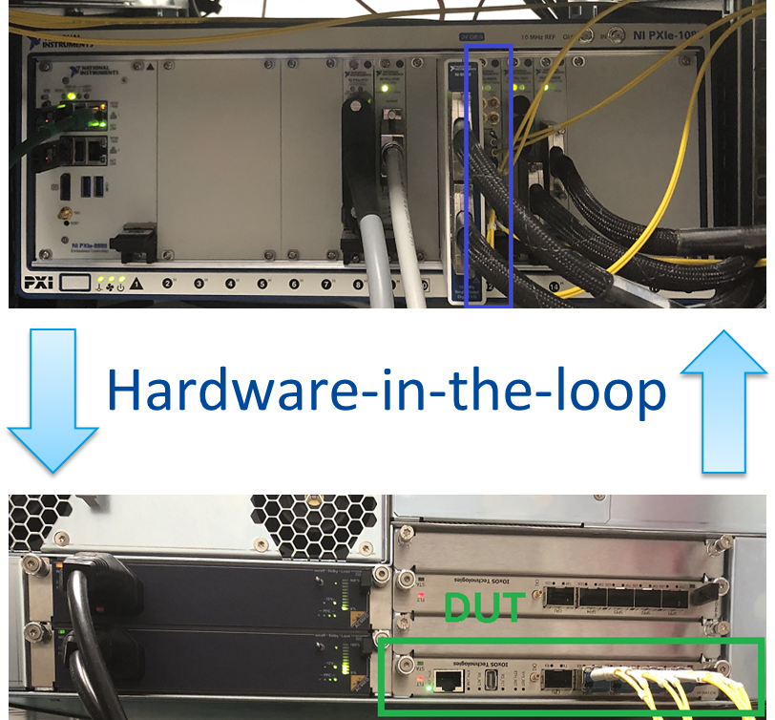
Firmware testing
Firmware for FPGAs undergoes testing at the unit, integration, and system levels using various techniques.
Unit testing employs test benches with constraint-randomized test vectors for efficient function-level testing.
Integration testing relies on hand-written test cases using register transfer languages like Verilog.
System-level verification uses Python and pytest with emulated input data.
Test results are stored on a shared file server to ensure traceability.
The ESS Fast Beam Interlock
System during testing using a hardware-in-the-loop test setup
Notes:
KRISTINA

Slide 7
Challenges
We currently do not have the capability to re-run the community unit tests for EPICS base and modules in the ESS EPICS Environment.
Test coverage on our own software unit tests is low
Test coverage on PLC device drivers is moderate, but we have yet to implement actual process simulation and application level test automation for PLCs
Hardware and process emulation is the logical next step in test automation, but development and maintenance costs for such emulation is substantial
For system level testing the coordination with stakeholders and other parts of the organization is a recurring problem
Planning and executing re-tests after updates is an ongoing challenge
In parts of the organization the view on system testing in “one and done”, meaning that no changes to software are permitted after the system level testing is completed. This meshes poorly with modern approaches to software maintenance.
Notes:
KRISTINA

Slide 8
Testing and test automation
Workshop
www.europeanspallationsource.se
2023-11-22

Slide 9
Inspiration for discussion
What does this group consider to be “best practises” regarding re-testing of a commissioned control system that has been updated?
Describe a scenario where test automation can be meaningfully applied to a control system? What are the factors that makes this system suitable for test automation?
Describe some common pitfalls regarding test automation for control system. What can go wrong? What are warning signs to look for?
Notes:
KRISTINA

Slide 10
Curve ball
Assume you and your group gets full mandate to implement and enforce rules, policy and practise for testing and test automation.
What would be the 1-3 first decisions you would make?
What would be the benefit for the organization?
How would you enforce them?
Notes:
KRISTINA

