Slide 1
SOLEIL Tools to Improve the Reliability of the Accelerators
Thomas MARION, Operation group, Synchrotron SOLEIL

Slide 2
Layout
SOLEIL in a Nutshell
Issue reporting and knowledge database
Web based data-monitoring system
Example of a Recent Major Incident
Conclusions

Slide 3
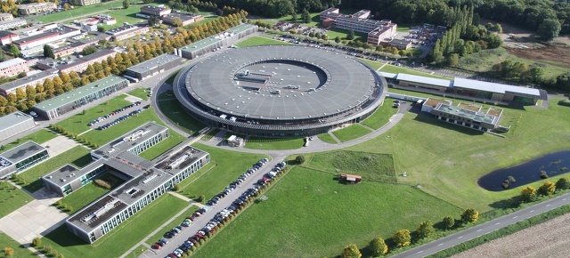
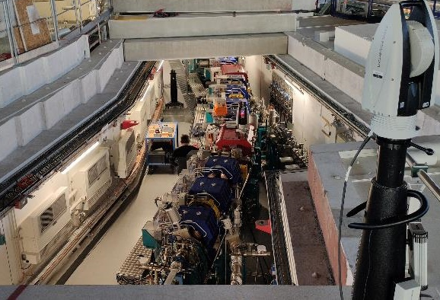
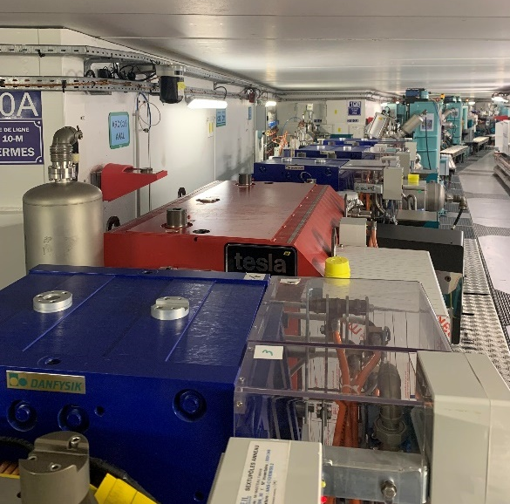
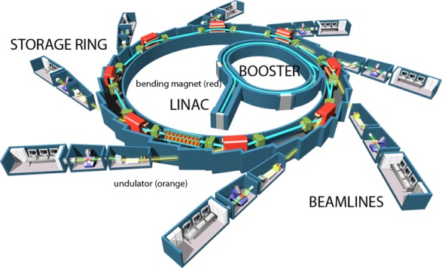
SOLEIL in a Few Metrics
Synchrotron SOLEIL is the 3rd generation French synchrotron radiation light source located South of Paris.
Nominal energy: 2.75 GeV
354 m electron Storage Ring (SR)
First user beam delivered in 2007
29 beamlines
Maximum intensity 500 mA, 4 filling modes
User beamtime: 5000 hours per year
About 700 publications a year
In the TDR phase of the SOLEIL II upgrade

Slide 4
SOLEIL in a Few Metrics
Beam availability: 97.32 % in 2023
113h of failure including 72h for a single failure
Mean Time Between Failure (MTBF): 146 hours
Cumulative beam time without failure 640h (4.5 weeks)
19 weeks > 99% availability
10 weeks = 100%

Slide 5
Historical Ecosystem
Operation Group
Power Supply
Group
Intervention
Procedure
Procedure
Statistics
Operation LogBook
Group LogBook
Vacuum Group
Intervention
Disadvantage :
Each group have their own ecosystem
Data are scattered
Slow interaction
Procedure
Group LogBook

Slide 6
Ecosystem
Operation Group
Vacuum Group
Goals:
Make interaction between group easier
Improve traceability and reporting at group level
Save time
Create a Knowledge Database
Power Supply
Group
JIRA Incidents
JIRA Intervention
Statistics
Grafana
Confluence
JIRA: Incident Tracking Software
CONFLUENCE: Collaborative wiki system
GRAFANA: Data-monitoring web-based software
Accelerator DB

Slide 7
Issue Reporting and Knowledge Database

Slide 8
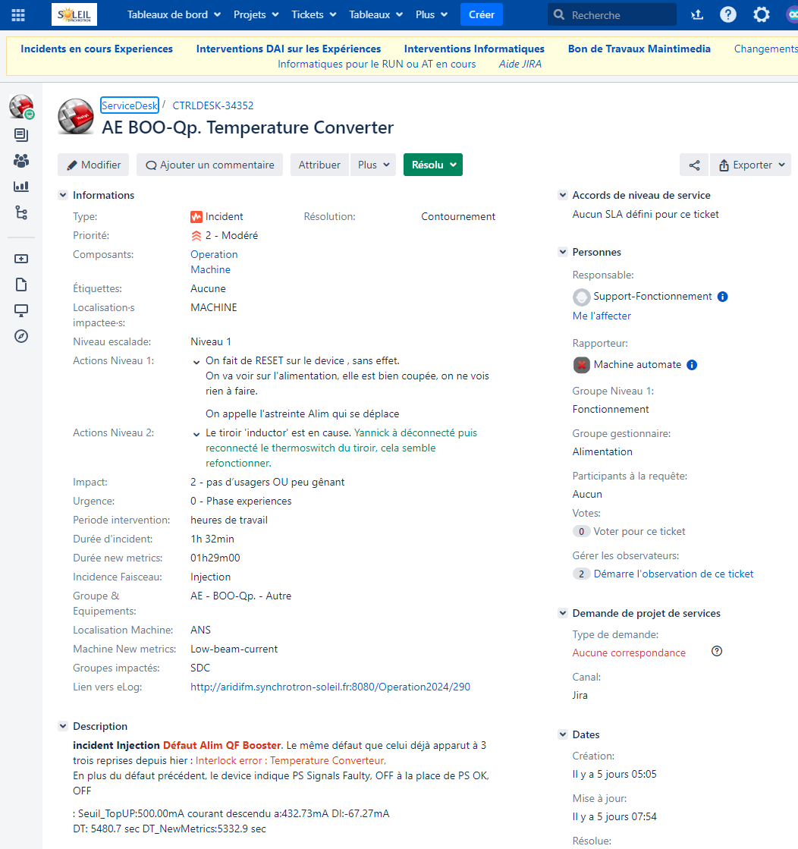
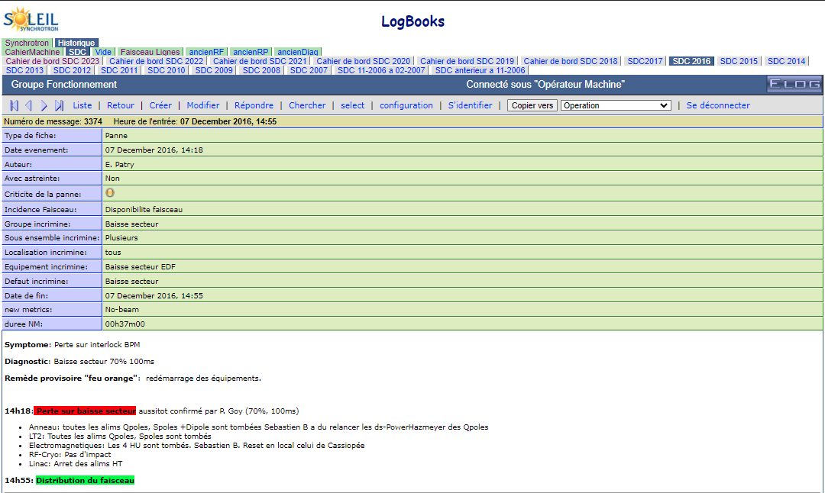
Incident Reporting: From Elog to JIRA
Until 2018: Elog
Manually by Operator
Slow
Hard to request with scripts
No collaboration between group
Incident resolution transmitted orally to the operator
Can lead to information loss or transcription error
Since 2018: JIRA
An issue-tracking tool developed by Atlassian
At SOLEIL
Since 2015 for IT Teams
Since 2018 for Machine Incidents
Objectives:
Cross-team collaboration
Share operation knowledge

Slide 9
Incident Workflow
Project: ServiceDesk CTRLDESK)
type of request: Incident
components: Machine operation
Summary:
Description:
Creation
Start date/ End Date
Beam incidence
Group (support) / equipment / fault
Location
Operator Rooting
Incident requiring action of the Operator
Incident requiring action of the support group
Known Incident not requiring the intervention of the support group (INIT, RESET, ...)
Level 1
Level 2
Create / link to problem(s)
Create / link : Mondays Machine or shutdown intervention
Resolved
Add comments / report ... by the support group
Reviewed by support group
Closing the ticket by the Incident Manager
Closed

Slide 10
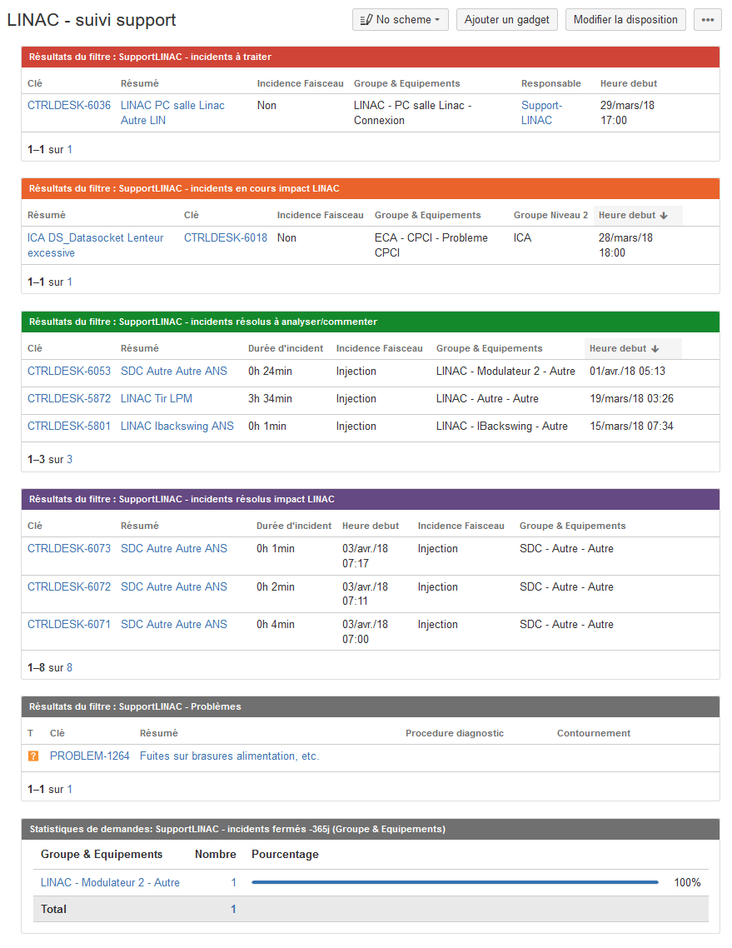
JIRA Dashboards Tailored for Accelerator and IT Support Groups
Incidents in progress - To be processed by the technical team
Incidents in progress – with impacts on the team
Resolved issues assigned to the group - waiting for REVIEW by the team
Resolved issues – with impacts on the team
Problems
Incidents closed (resolved and reviewed) over 365 rolling days

Slide 11
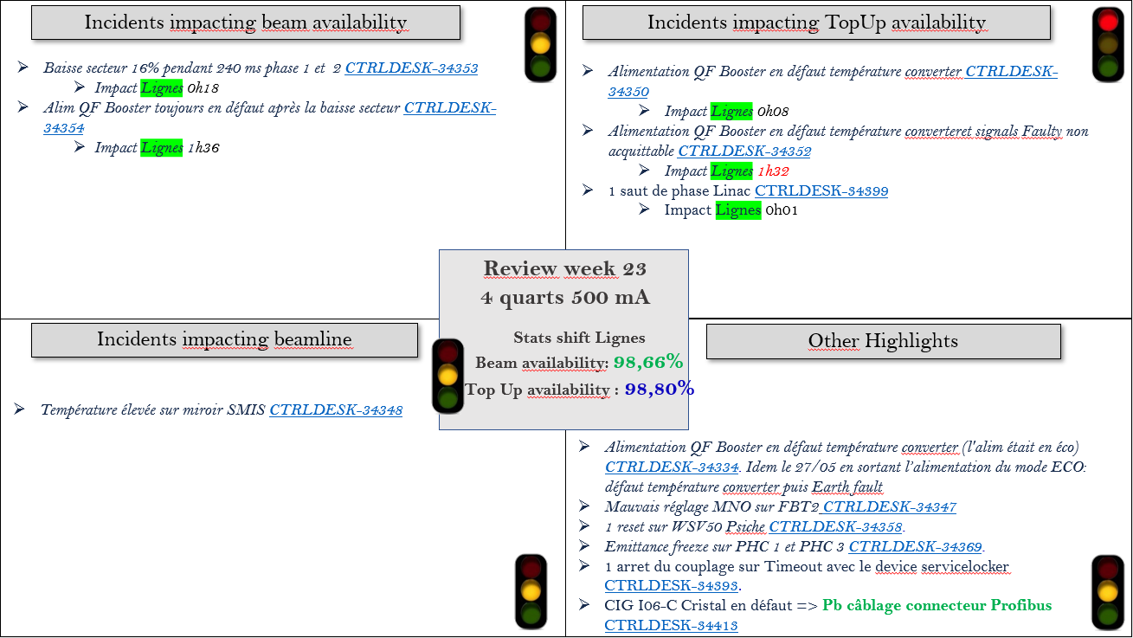
Weekly Operation Meeting
Incidents:
We review all the incidents of the previous week
Time saved for preparation of the meeting for the organizer
Better efficiency during the meeting
Support group can prepare in advance
Intervention: urgency, priority, duration
We plan the next Monday's intervention shift
and the technical shutdown intervention
One-page incident summary sorted by impact
Notes:
JIRA is the support of the meeting

Slide 12
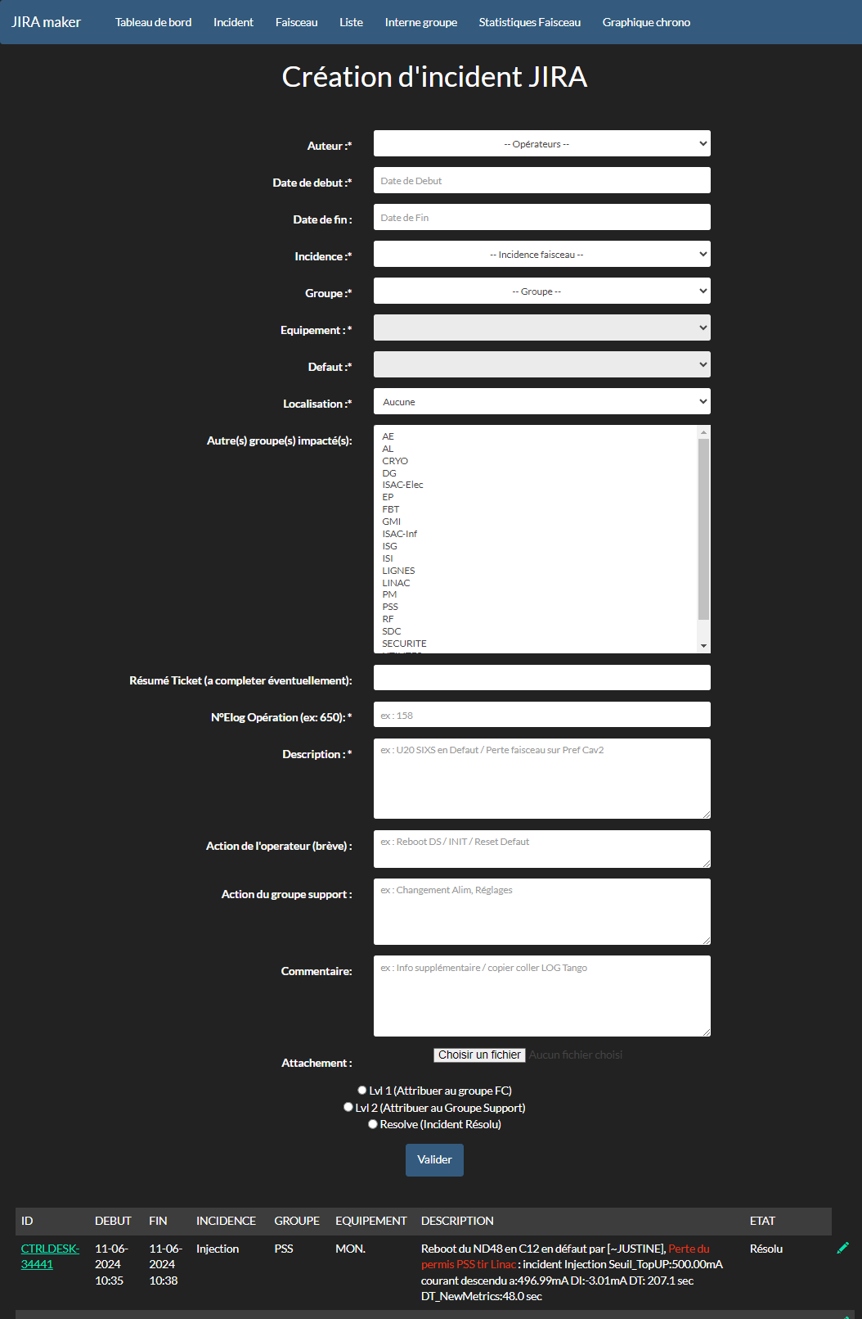
JIRA User-Friendly and Efficient Interface for Report and Incident
Goals
Report everything and Reducing the number of manual actions
Ease the task to report as soon as possible an incident with all relevant information and a link to our operation Elog
Redirect incidents and escalations to the right support group
Development
Web interface
Fast incident creation
Avoid error in rooting
Automatic issue creation (Low Current, Insertion device in fault…)
No misses or errors
Log attachments

Slide 13
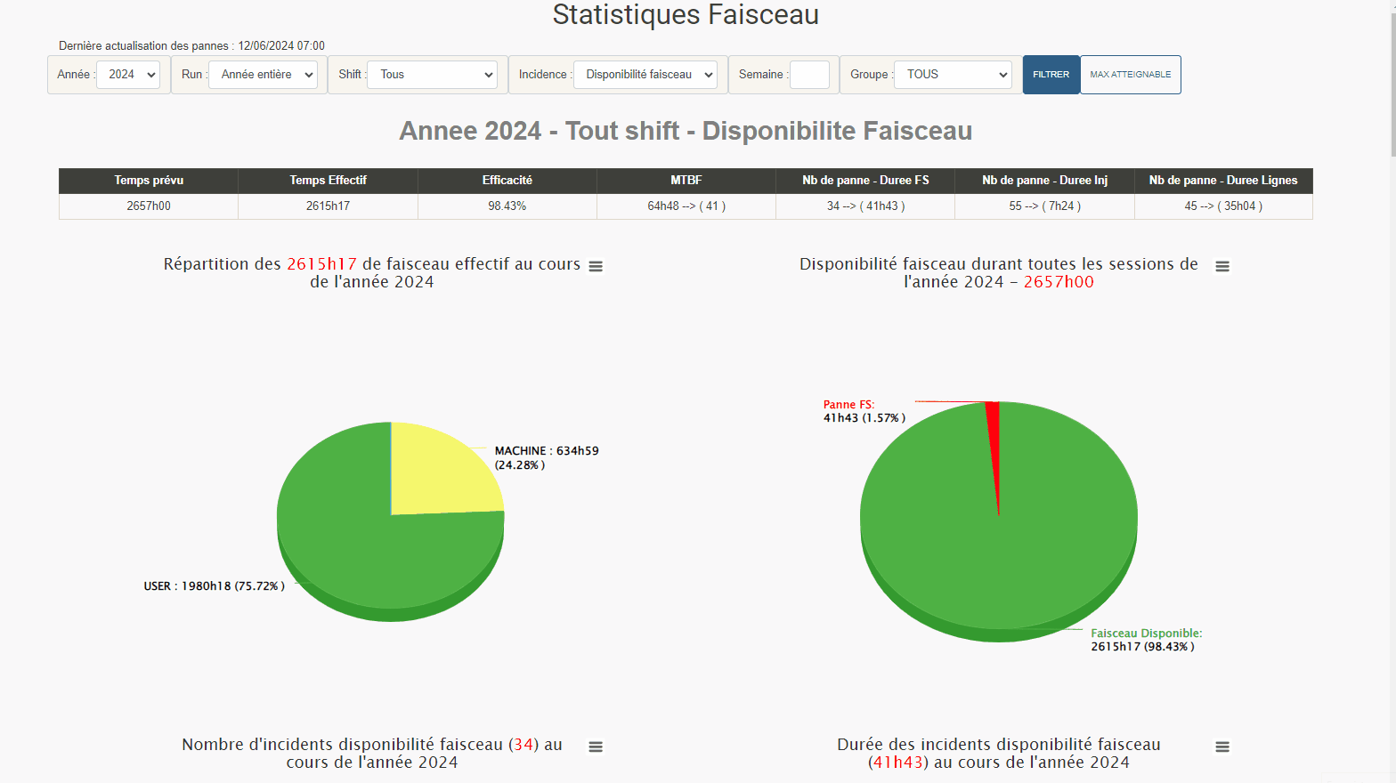
Web Statistics
Developed in Python
Build on top of Jira
Updated every day
Statistics since 2008
Accessible to every group

Slide 14
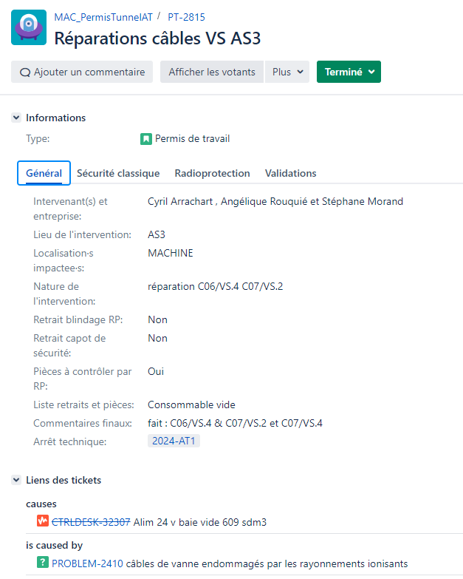
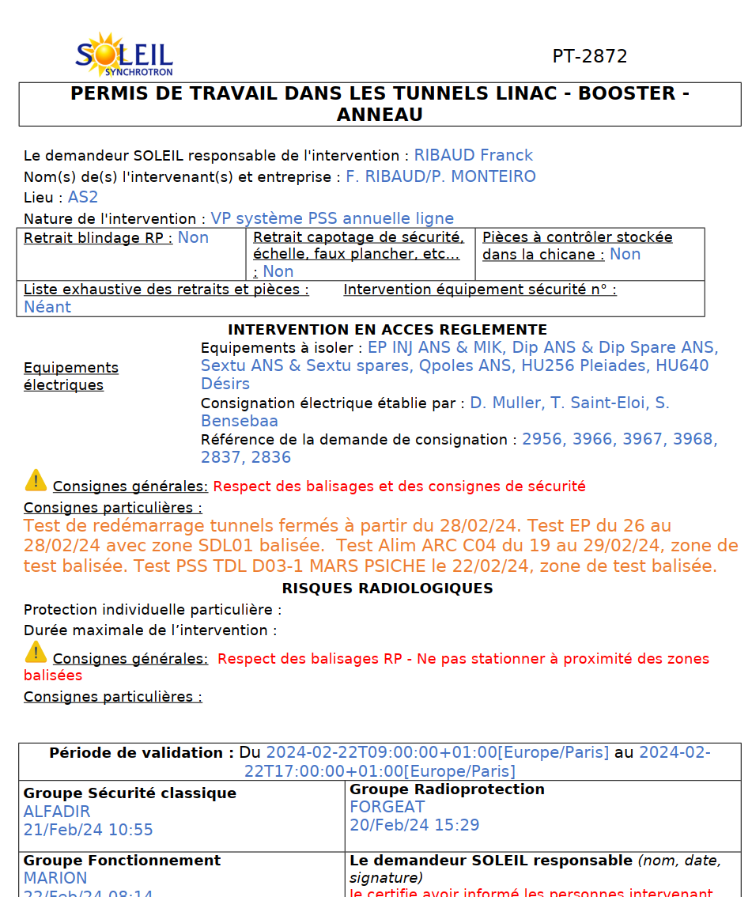
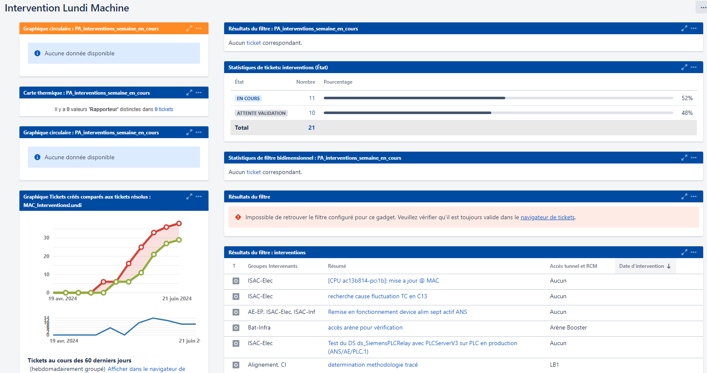
Intervention Tracking
Historically:
Handwritten forms for downtime interventions.
Mail for intervention on machine day
Disadvantage:
Time consuming
Difficult to track
The applicant, security and radio-protection need to be physically in the control room to sign the paper
Hard to archive
Integration in JIRA:
Easier to track and archive
Requests validation and signatures made easy
Reliable Metric for annual review
Link between incident and intervention

Slide 15
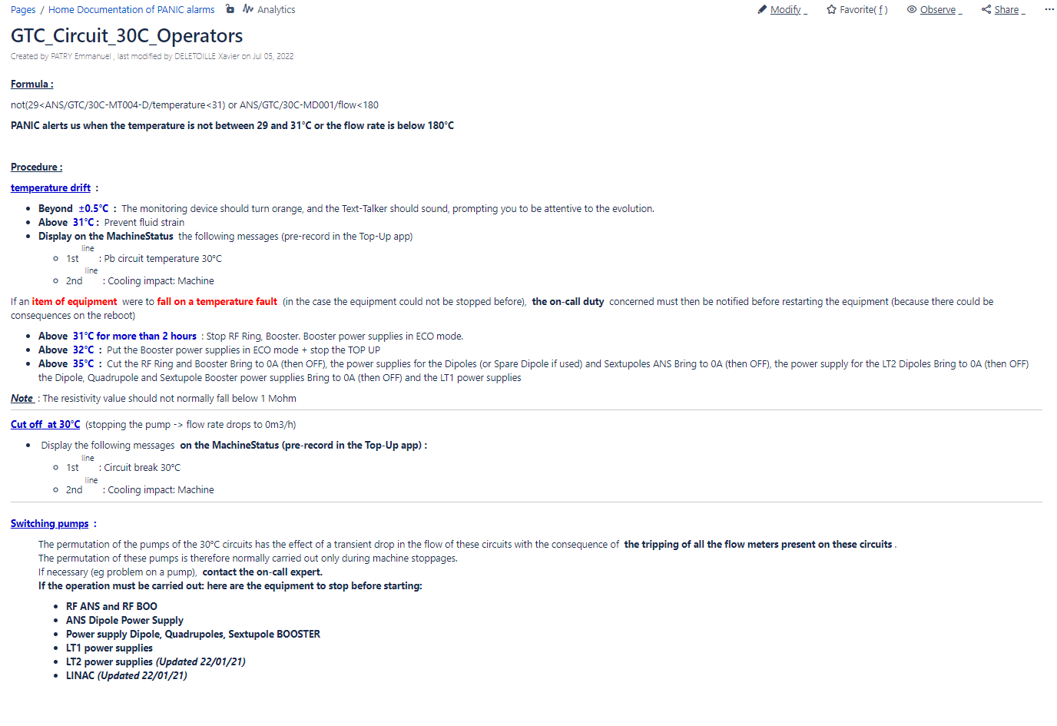
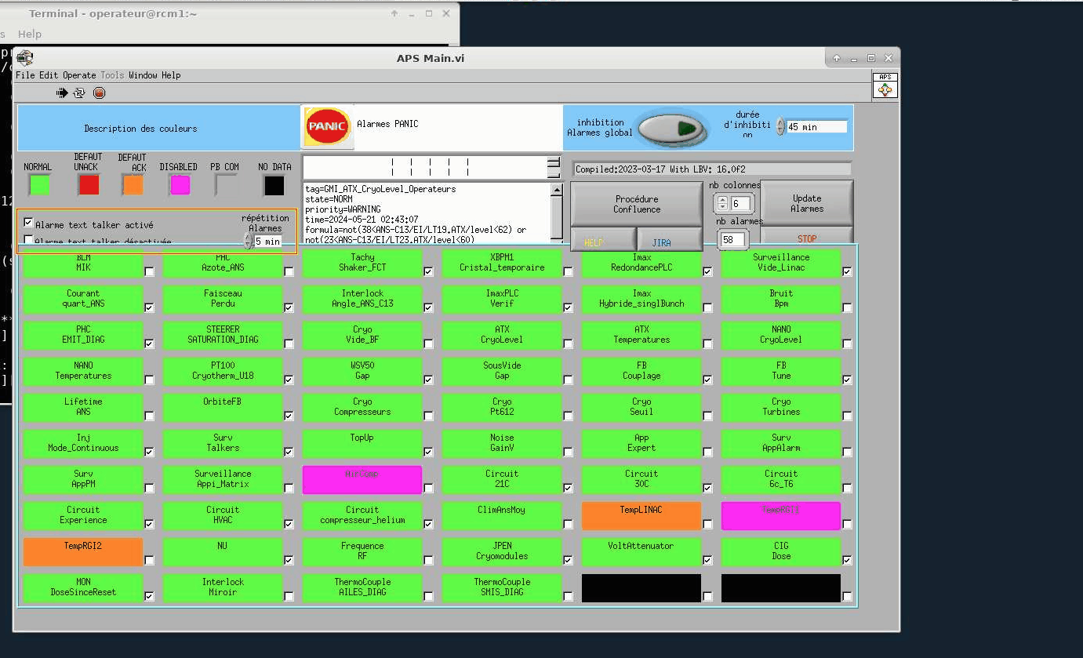
Confluence
Collaborative software based on a wiki system.
Procedure
Meeting report
Decision Logbook
Operator reaction time improved

Slide 16
JIRA and Related tools Benefits
Benefits
Time-saving for reporting
≈ 700+ Tickets / year -> 50% Automatic
Time-saving for Statistics and weekly meeting preparation
More information for support group
Significant reduction of minor incident
Incident resolution time has decreased drastically
Traceability has increased
Quality insurance
Incident manager (Operation Engineers)
Daily incident review to consolidate the information
Incident
Procedure
Intervention
Knowledge database

Slide 17
Grafana
Web based data-monitoring system

Slide 18
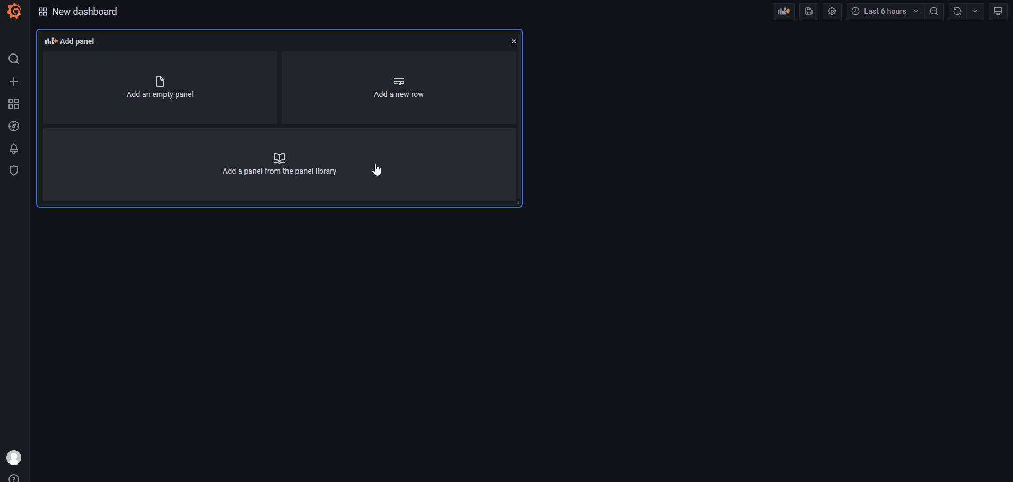
Grafana
What is Grafana
Grafana is a free web-based software that allows you to build your own dashboards on various data sources.
We developed a data source plugin dedicated to our archiving system.
Advantages
“Live” data
Accessible from a web browser on any network
Every user have their own space
Dashboard creation is fast, No-Code and easy to share
Grafana dashboard creation

Slide 19
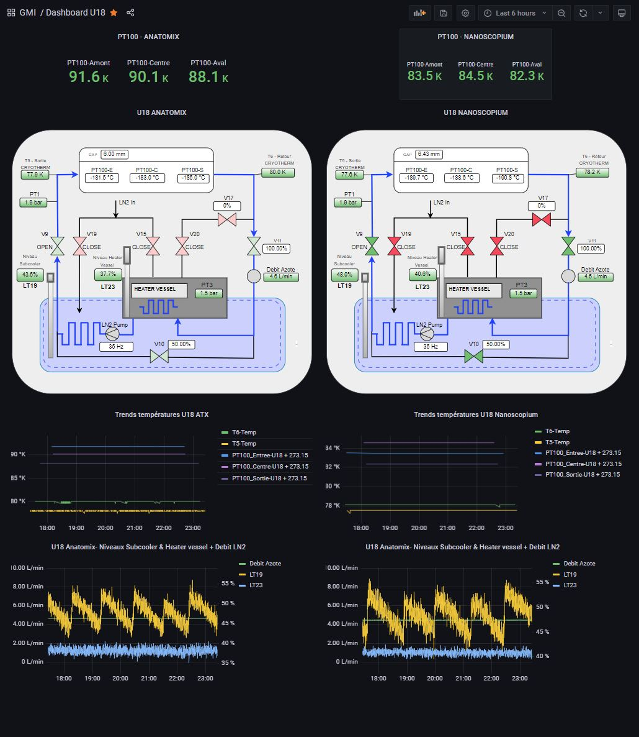
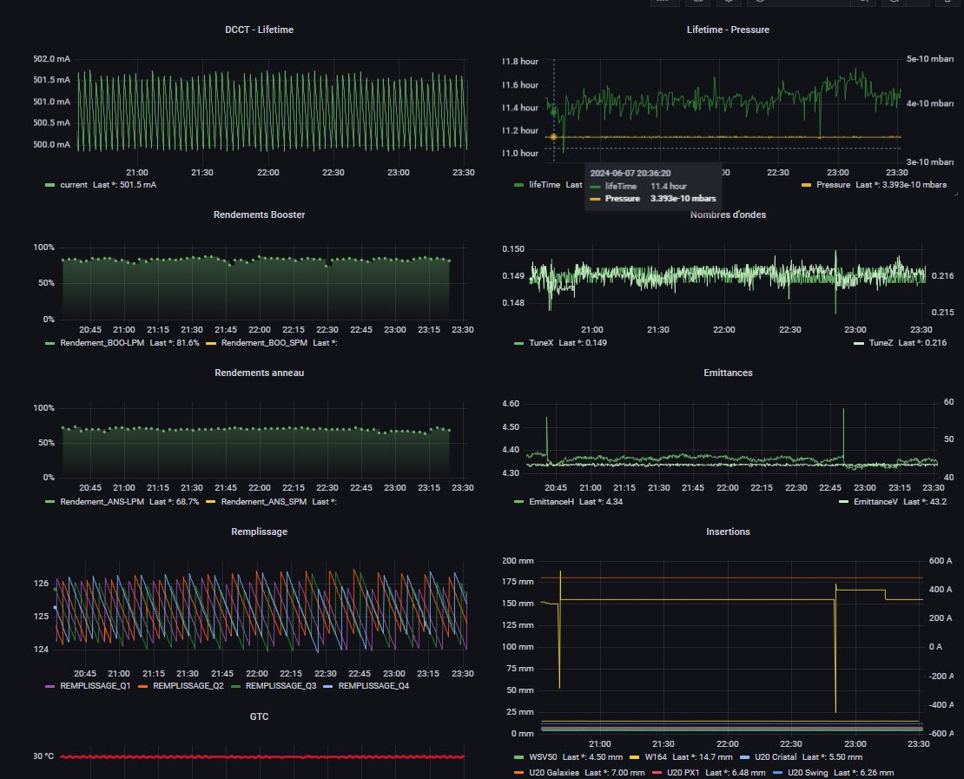
Examples of Grafana Dashboards

Slide 20
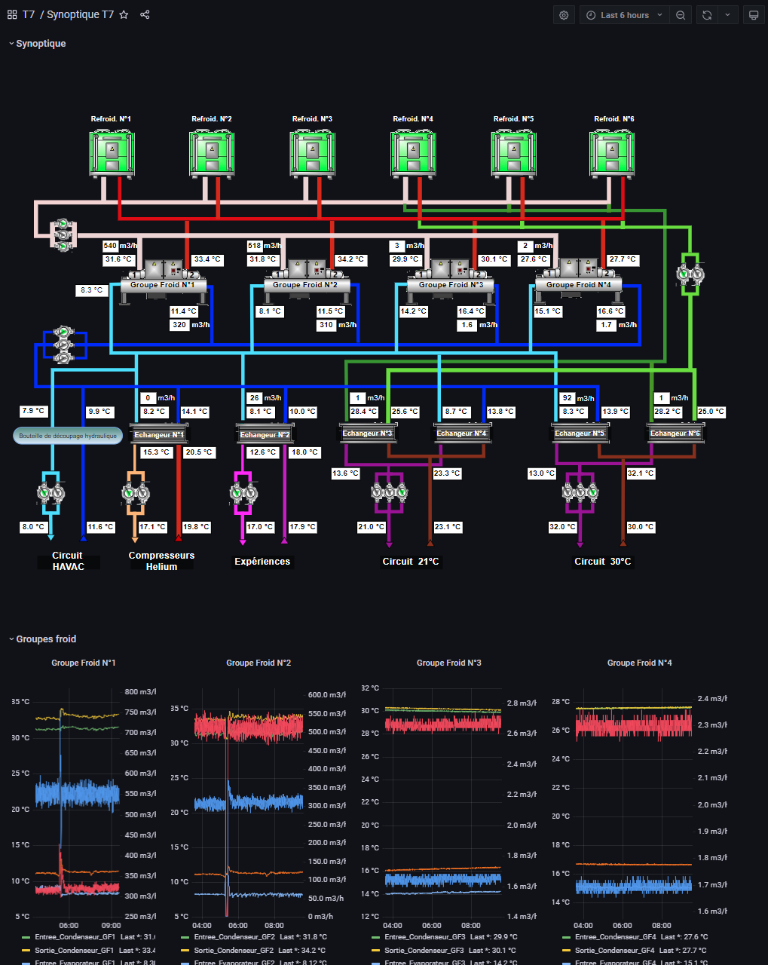
Grafana Use Cases
Data monitoring in and outside of control room
On call monitoring:
Before:
Connect to the Machine Network
Launch archiving plot / or dedicated application
With Grafana:
In the same view we can monitor all the metrics we want on the same dashboard
Visible from a Computer or a Smartphone
Emergency development:
After the inauguration of our new water-cooling station the utility group had a problem reading back values from their supervision software.
We developed a dashboard in 2 hours on Friday evening, so that they could monitor the data remotely.

Slide 21
Example of a Recent Major Incident
Transfer Line Bending Magnets incident

Slide 22
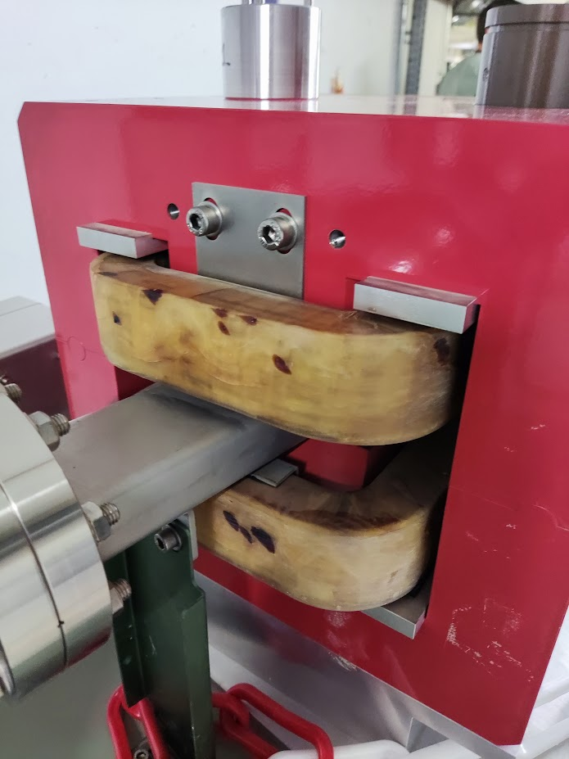
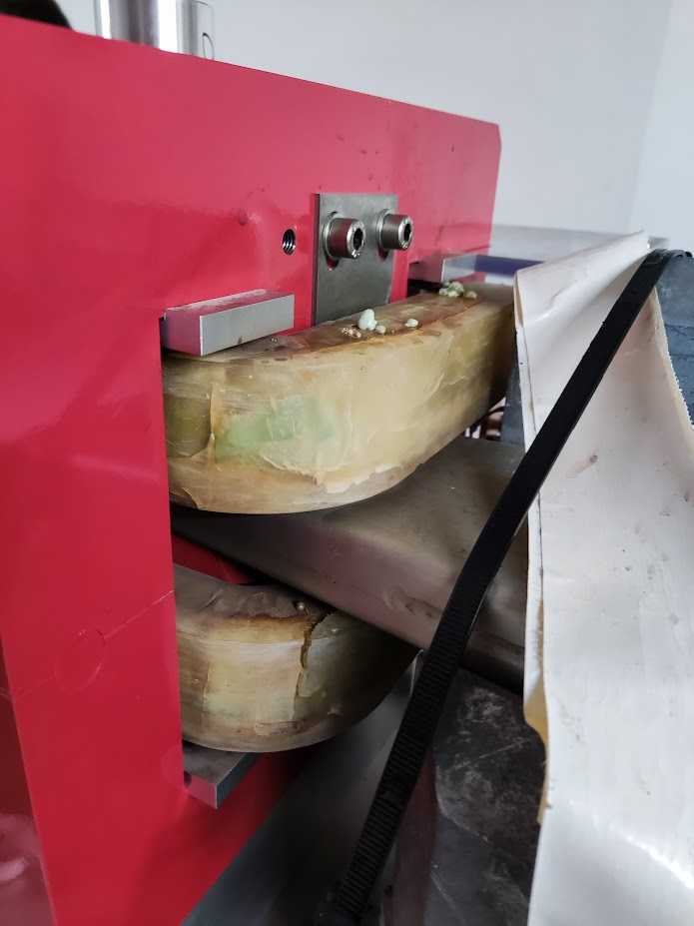
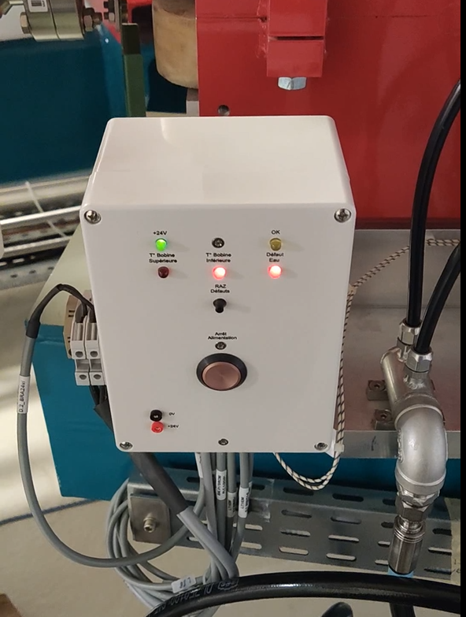
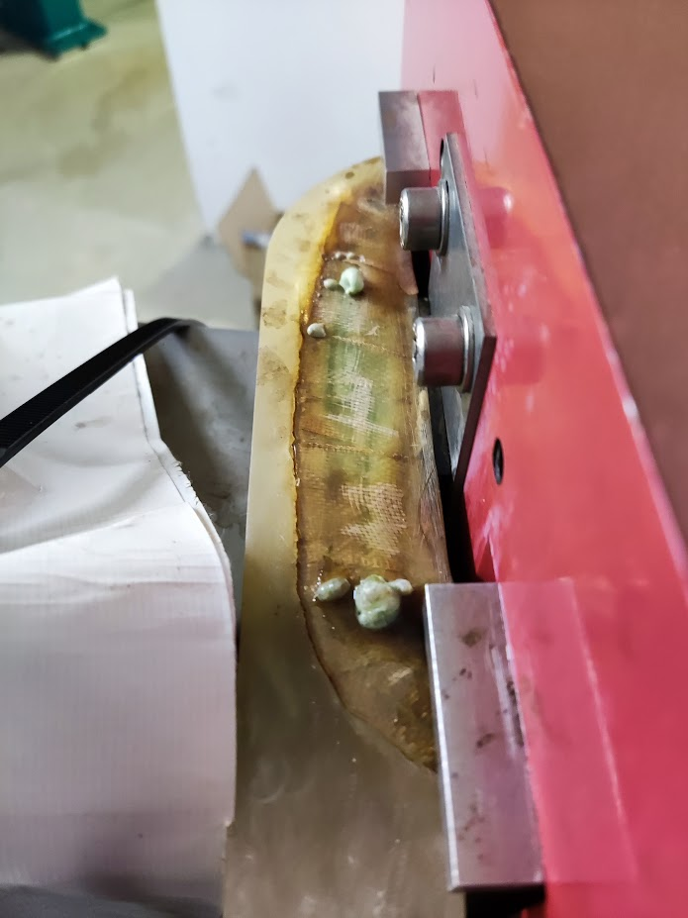
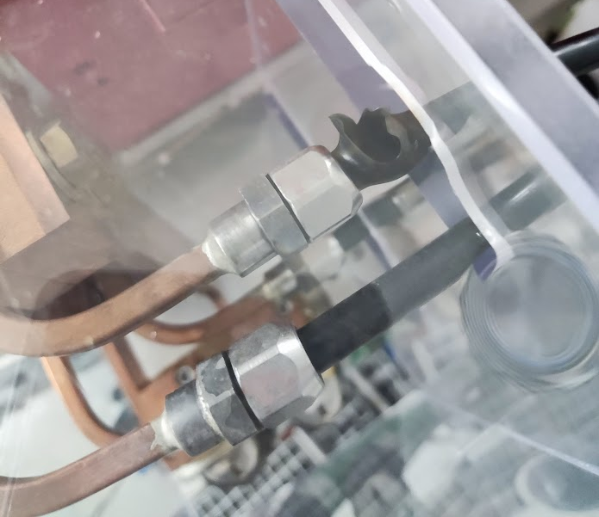
Transfer Line BMs (Bending Magnets) incident
Repair intervention on a Booster RF cavity on a holiday (reduced personnel). Not possible to locally turn OFF the water cooling, The entire Booster cooling circuit is turned OFF.
About 20 minutes later: Fire Alarm in the Linac area. Smoke is coming out of the Bending Magnets.
The Power supply was not turned OFF by the security box,
We turned the Power supply OFF. Water cooling is turned ON again.
cooling tubes have burst due to the temperature drop.
The BM coils seems to be severely damaged

Slide 23
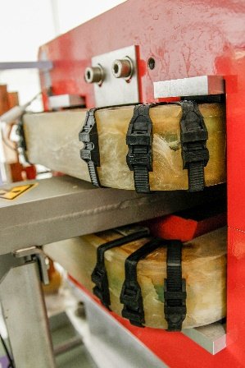
Incident Timeline
Emergency meeting with On-Call expert:
Decision to cancel user beam on Tuesday morning
Wednesday evening meeting
Decided to restart the Machine on the next day to deliver the beam on Friday morning.
.
Emergency meeting involving groups expert
Accelerator restart + live testing
Incident
Monday (public holiday)
Tuesday
Wednesday
Thursday
Friday
Control and interventions
Interlock system
Hydraulic system
Power supply
Magnets
Vacuum
Beam delivery
Tuesday meeting:
We only have two spare coils (and we need 4)
How long to change them? (1 week)
Are the coils still viable?
Why did the interlock system not work?
Could the problem exist elsewhere?
Damaged coils replaced during summer shutdown
Periodic test of all the safety box at every shutdown
Lessons learned for Magnet Protection System upgrade (With PLC)
Yes
1 relay of power supply in test mode
1 more defective security box

Slide 24
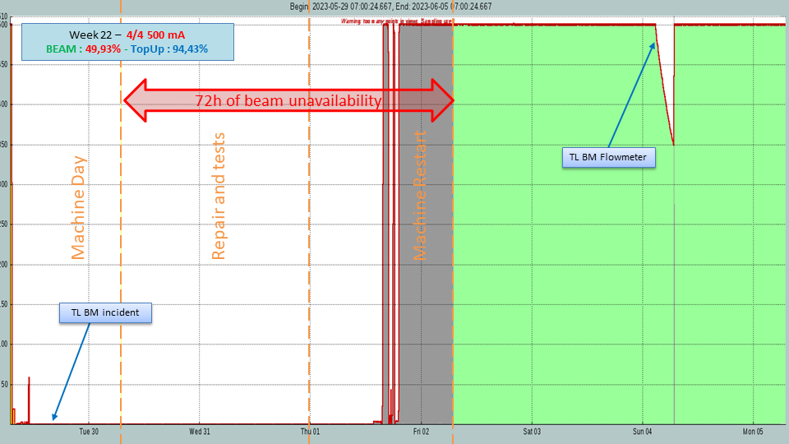
Incident Conclusions
Complex incident involving 5 groups
All actions have been tracked in JIRA and Confluence
Incident
Tests and Interventions report
Meeting notes
Smooth information flow between groups
72 hours of beam unavailability
But it could have been much worse

Slide 25
Conclusions and Perspectives

Slide 26
Conclusions and Perspectives
Conclusion:
Better interaction between groups
Traceability and Efficiency increased
Incident resolution time has decreased
Creation of a high-trusted knowledge Database
Enhanced Operation
How could Machine Learning improve operation reliability?
Challenges of SOLEIL II with a significant increase of equipment and more complex accelerators handled, serviced, and operated with the same human resources
Predictive Maintenance
Benefit of Retrieval-Augmented Generation (future of LLM and generative IA) using our high-trusted knowledge databases

Slide 27
Thank you for your attention
Questions?

