Slide 2
Automatic Fault Identification and Recording in the CERN accelerator complex
Michi Hostettler, Anti asko, Jean-Charles dumont, Lukas Felsberger, Jack Heron, Piotr skowronski, Matteo Solfaroli, Eric Veyrunes

Slide 3
Outline
introduction: down the accelerator chain
automatic fault detection & recording
diagnostics & fault identification
statistics, consolidation & maintenance
conclusions

Slide 4
1
introduction down the CERN accelerator chain

Slide 5
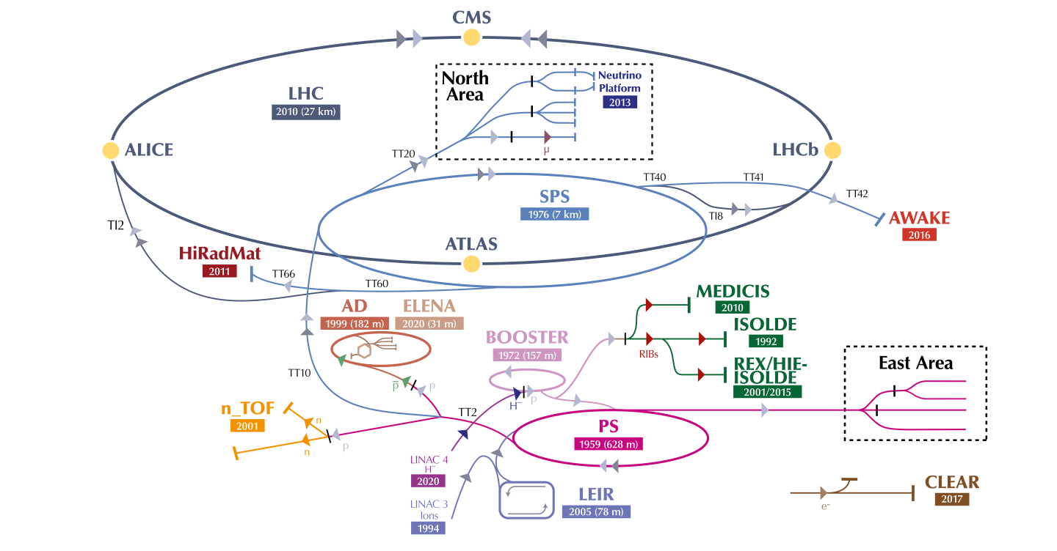
the CERN accelerator complex
it is a supply chain!

Slide 6
the CERN accelerator complex
it is a supply chain!

Slide 7
the CERN accelerator complex
it is a supply chain!
equipment fault

Slide 8
the CERN accelerator complex
it is a supply chain!
equipment fault

Slide 9
down the accelerator complex
the larger the machine, the higher the stakes
6800 GeV
450 GeV
2 - 24h
10 - 20s
26 GeV
higher beam energy = higher damage potential
1.2 - 3.6s
LHC
2 GeV
1.2s
SPS
PS
PSB
longer cycle times = longer downtime after a fault

Slide 10
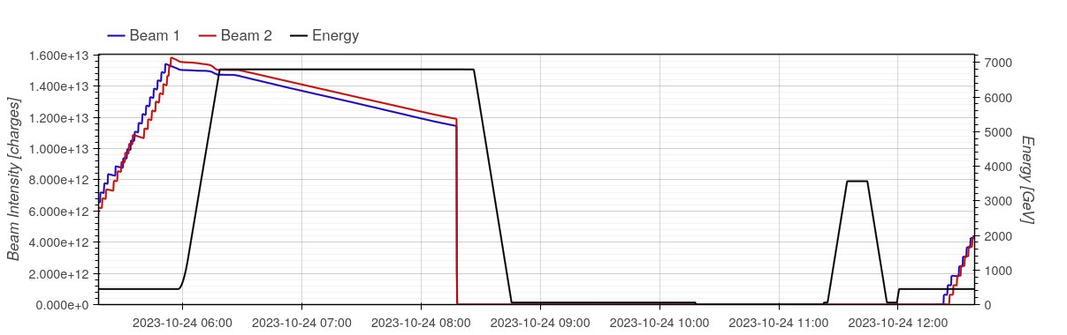
down the accelerator complex
the larger the machine, the higher the stakes
turn-around
production
equipment in fault
recovery
fault

Slide 11
2
fault detection & recording

Slide 12
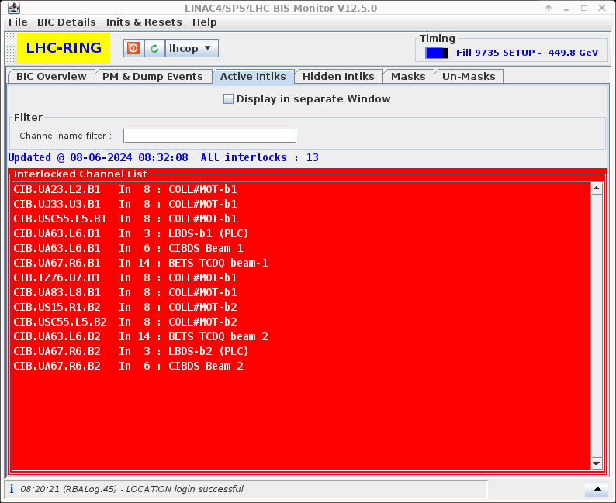
fault detection
what has failed, and what impact it has on the beam?
failure of a critical system ➜ beam interlock
Beam Interlock System (BIS): hardware interlock fast (μs), connected to the most critical systems
Software Interlock System (SIS): software interlock slow (s), monitoring more but less critical conditions
failure of an “optional” system ➜ beam degradation
monitoring is important!
different alarm systems in the CERN accelerator complex
LASER: individual systems actively raising alarms
Big Sister: SIS like surveillance system to detect non-critical problems – raises alarms instead of generating interlocks
LHC Announcer: audible warnings, speech synthesis
“orbit corrector fault on beam 2”

Slide 13
fault recording
keeping track
CERN Accelerator Fault Tracking tool (AFT)
what failed? when?
what downtime did it cause?
fault recording mostly automated
automatic fault recording logic in every accelerator
detect a fault is present (no beam, or degraded beam)
identify the system or equipment in fault
open a fault in AFT
detect the end of fault ➜ close the fault in AFT
➜ improve data quality (no faults missed!)
weekly working group: review of recorded faults
LHC 2023: 66% of all faults recorded automatically in AFT

Slide 14
fault recording
keeping track

Slide 15
fault tracking through the complex
“no beam from injectors”
East Area
upstream faults block downstream machines
need to identify root cause for fault recording!
automatic fault recording instances expose status
downstream machines link faults upstream
find the first machine in the chain with a fault
experimental areas: “passive” fault recording
fully dependent on next upstream machine
e.g. East Area from PS, North Area from SPS
ISOLDE
AD
ELENA
Linac4
PSB
PS
N_TOF
North Area
Awake
AFR operational
AFR possible long-term
SPS
HiRadMat
No AFT
AFR passive
LHC

Slide 16
fault tracking through the complex
“no beam from injectors”
special case: LHC
very long cycle!
once beams are in, independent from injector complex (for > 10 h if all goes well)
keep (even degraded) beams if injector complex is down
record fault only if beam is requested and a fault is present in the injector complex
LHC beams only produced on request
request not made if a known fault is present in injectors
➜ ”best-effort” detection: LHC at pre-injection and no local fault
Comments (30-May-2024 12:23:46)
**Stable beams**
We will try to keep this fill as long
as possible

Slide 17
3
fault identification & diagnostics

Slide 18
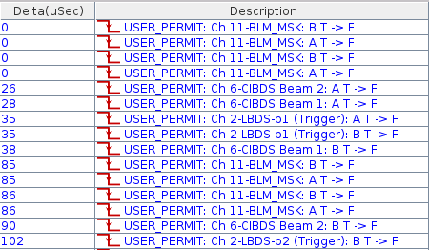
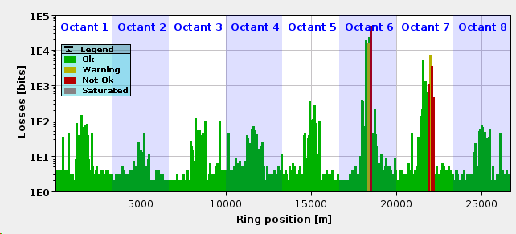
fault identification
post-mortem diagnostics
interlock(s) triggered ➜ why?
initial interlock may be transient
more interlocks may appear as a consequence
need to understand the first trigger and why it fired
re-try and watch the event sequence online?
commonly done in injector complex – not always easy!
LHC: too costly due to > 2h cycle time
LHC: post-mortem system
sequence of interlocks triggered
circular buffers of key systems data, frozen at trigger

Slide 19
putting it all together
from detection to identification to recording
Equipment
Automatic Fault Recording of upstream injectors
Equipment
Equipment
SIS (Software Interlock System)
Automatic Fault Recording
Post Mortem System
BIS (Beam Interlock System)
Accelerator Fault Tracking (AFT) database

Slide 20
system dependencies
the obvious fault may not be the root cause
TOTEM interlock
TOTEM (movable devices close to the beam) interlock!
… but why ATLAS_AFP (similar system) triggered as well?

Slide 21
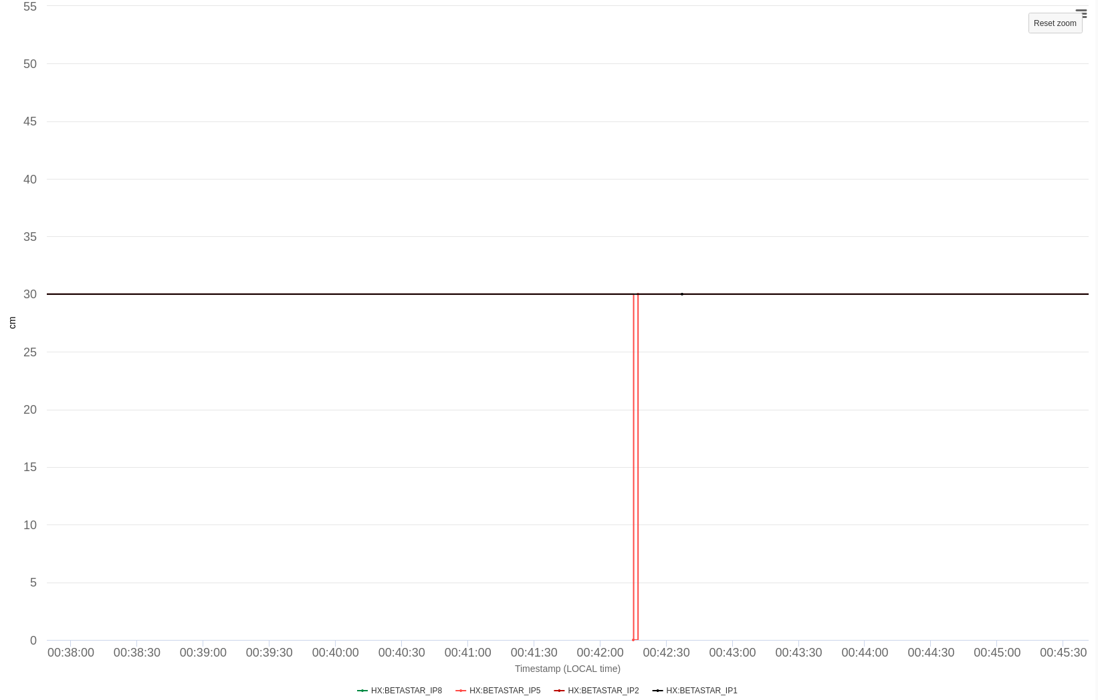
system dependencies
the obvious fault may not be the root cause
TOTEM/AFP interlocks depend on the beam size (β*)
TOTEM interlock
β* publication
β* = 30cm – as expected
β* = 0 ???
that explains the interlock of both TOTEM and AFP: but why did β* jump to 0 for one second?

Slide 22
system dependencies
the obvious fault may not be the root cause
β* is reconstructed from magnet currents by SIS and distributed through the timing system
TOTEM interlock
ERROR BetaStarValueConditionExtImpl => No data for : RPHSA.RR53.RQ7.L5B1_DATA ERROR BetaStarValueConditionExtImpl => Error - b* computation not valid or data out of range IR5
β* publication
lost current subscriptions
SIS lost subscriptions for magnet currents from power converters, connection drop: network issue?

Slide 23
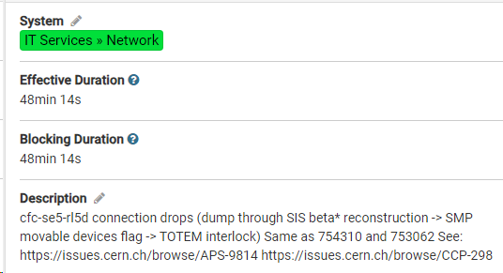
system dependencies
the obvious fault may not be the root cause
after further investigation: problem traced to a faulty network switch port
TOTEM interlock
[…]
We believe that that the switch port 33 is the root cause, in the coming hours we will patch the outlet 3319/05 on a different switch port.
[…]
β* publication
lost current subscriptions
faulty network switch port

Slide 24
4
statistics, consolidation & maintenance

Slide 25
fault statistics
availability by facility
Facility | ’16-‘18 Overall [%] | ’21/’22 Overall [%] | ’23 Overall [%] | ‘24 up to June [%]
LINAC2 | 98.5
LINAC4 |  | 96.7/97.1 | 98.0 | 95.7
PSB | 95.3 | 94.4/95.1 | 96.1 | 94.4
PS | 87.6 | 88.6/88.7 | 91.6 | 90.6
SPS | 82.4 | 74.5/73.3 | 86.4 | 85.9
LHC | 80.8 | 63.9 * | 57.7 * | 73
general availability steady - improving
‘21/’22: re-commissioning after long shutdown (‘19-’21)
LHC ‘22/’23: dominated by single “black swan” events
2024 looks good so far!
downstream fault propagation clearly visible
faults in early machines affect the entire complex!
high (>95%) availability of early machines is key
these are not new machines!
PS from 1959, PSB from 1972
maintenance and consolidation is crucial to keep availability
cumulative availability
* dominated by a few long, major events

Slide 26
impact on LHC luminosity yield
availability matters!
80% availability
70% availability
100 fb⁻¹: 2024 target
60% availability

Slide 27
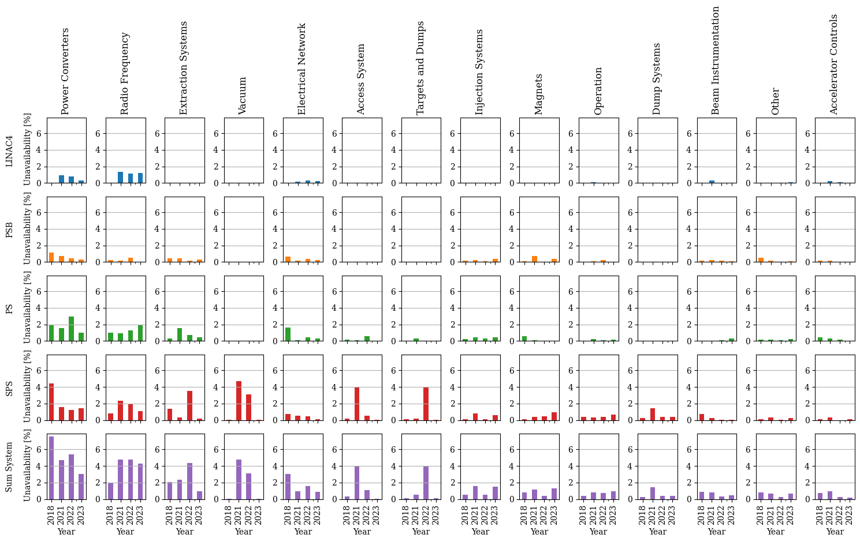
fault statistics
availability by system
fault statistics by system possible thanks to rigorous tracking in AFT
fault time attributed to the root cause, not the consequences
e.g. magnet quench ➜ loss of cryogenics: fault time assigned to magnets

Slide 28
fault-tracking culture
statistics are there to help, not to blame
fault statistics by facility / system are not to blame!
understand why some systems fail more often than others
intrinsic complexity?
ageing? maintenance?
need for consolidation?
emphasize what can be improved for the future
… not what went wrong in the past
fault tracking data: foundation for future developments
e.g. automated analyses, predictive maintenance
reliable automatic recording important for data quality
Availability

Slide 29
5
conclusions

Slide 30
conclusions & outlook
CERN accelerator complex: a beam production chain
each machine depends on its injectors
faults early in the chain can bring the complex down
faults detected & recorded automatically
fault detection: ensure machines are protected
fault recording: identify the root cause (equipment, upstream machine, ..) and record fault
important diagnostics: what failed in which sequence (post-mortem system)
focus on getting the majority of faults recorded correctly: there is always an unexpected case!
outcome: reliable fault statistics by root cause and system
crucial input for consolidation efforts!
foundation for future developments: preventive maintenance, fault prediction, …

Slide 31
42
spare slides

Slide 32
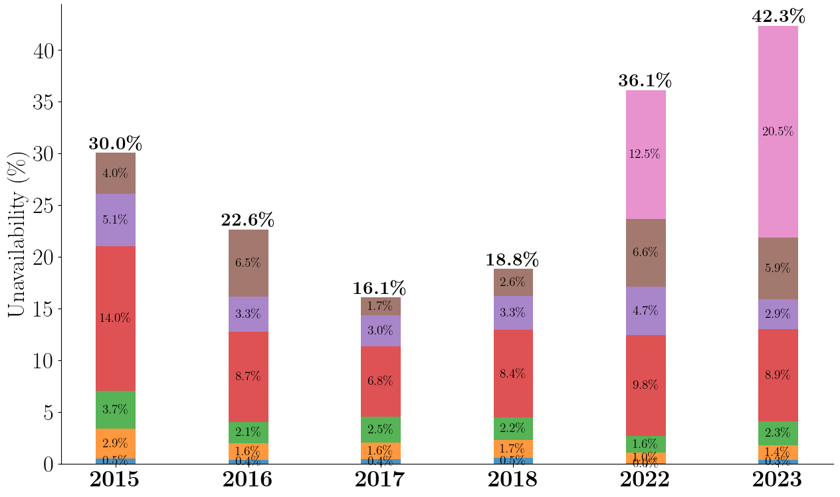
2023 in context
Fault duration:
long faults: dominant for run 3
faults < 1 day: stable ~16%
thanks to the continuous effort of the equipment groups!

