Slide 1
Minimizing Fault Troubleshooting Time by Linking Equipment Protection Faults to Part Replacement
Charles Peters
25 June 2024

Slide 2
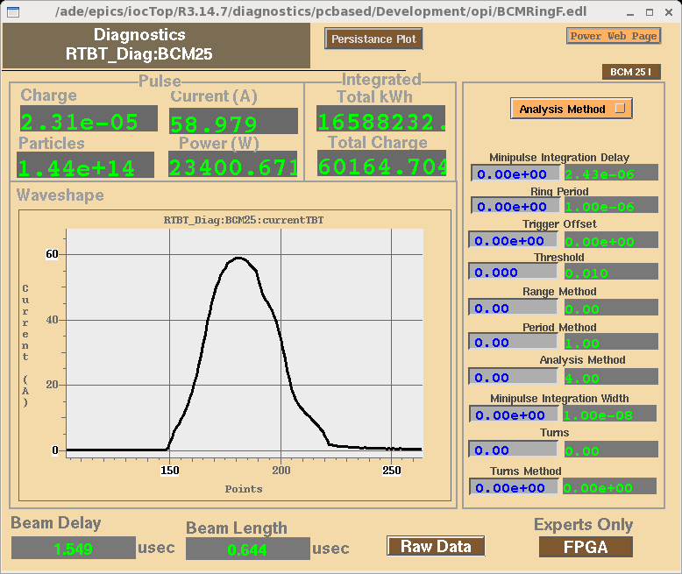
The SNS Produces Short High Power Beam Pulses for Neutron Production
Linac Beam Pulse
Current (mA)
Current (A)
Pulse length (msec)
Ring
1.6x10¹⁴
protons
Pulse length (nsec)
Injection
PARAMETERS
33 kW per pulse
60 Hz repetition rate
2.0 MW beam power
5000 production hours
Linac
To Target
H- to 1.3 GeV
Nick Evans

Slide 3
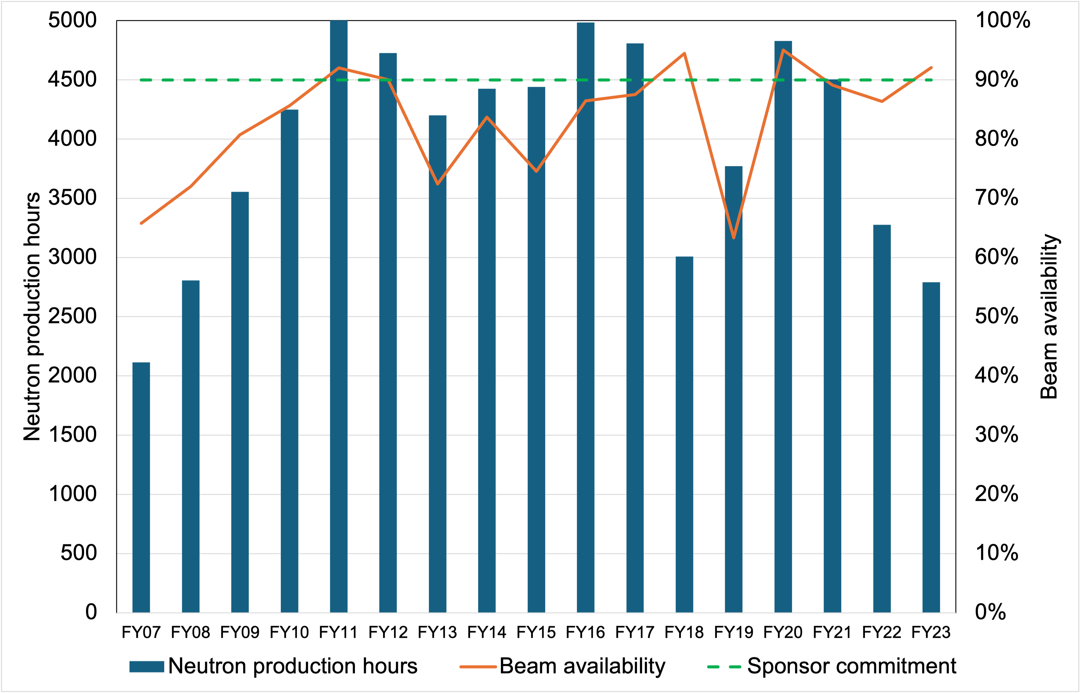
Sponsor Deliverables are Beam Availability and Operating Hours
High beam power makes Beam Reliability difficult
A lot of sensitive interlocks to the Machine Protection System (MPS) to prevent damage from beam loss
Focus on Beam Availability to maximum operating hours
Redundancy and spares
Predictive and preventive maintenance
Keep beam trips short
*FY18, 22, 23 operating hours reduced due to extended maintenance outages for upgrade installation

Slide 4
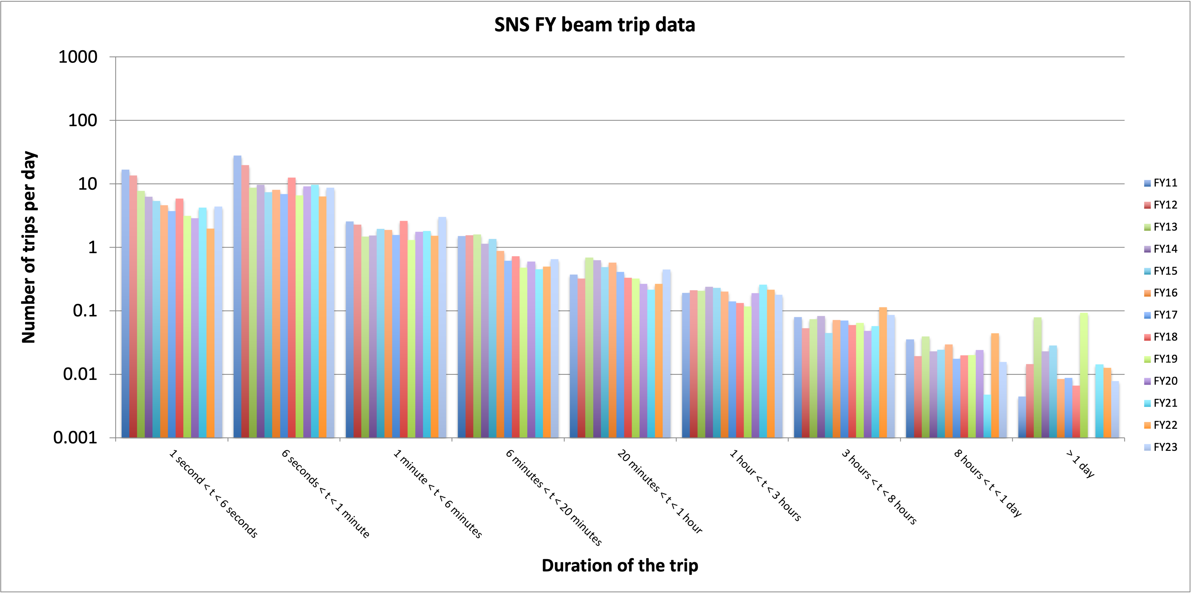
Downtimes > 1 day Dictate Beam Availability
Errant beam, magnet ps
SCL RF cavity trips
DTL/CCL RF cavity trips
Requires tech expert or repair (call-in)

Slide 5
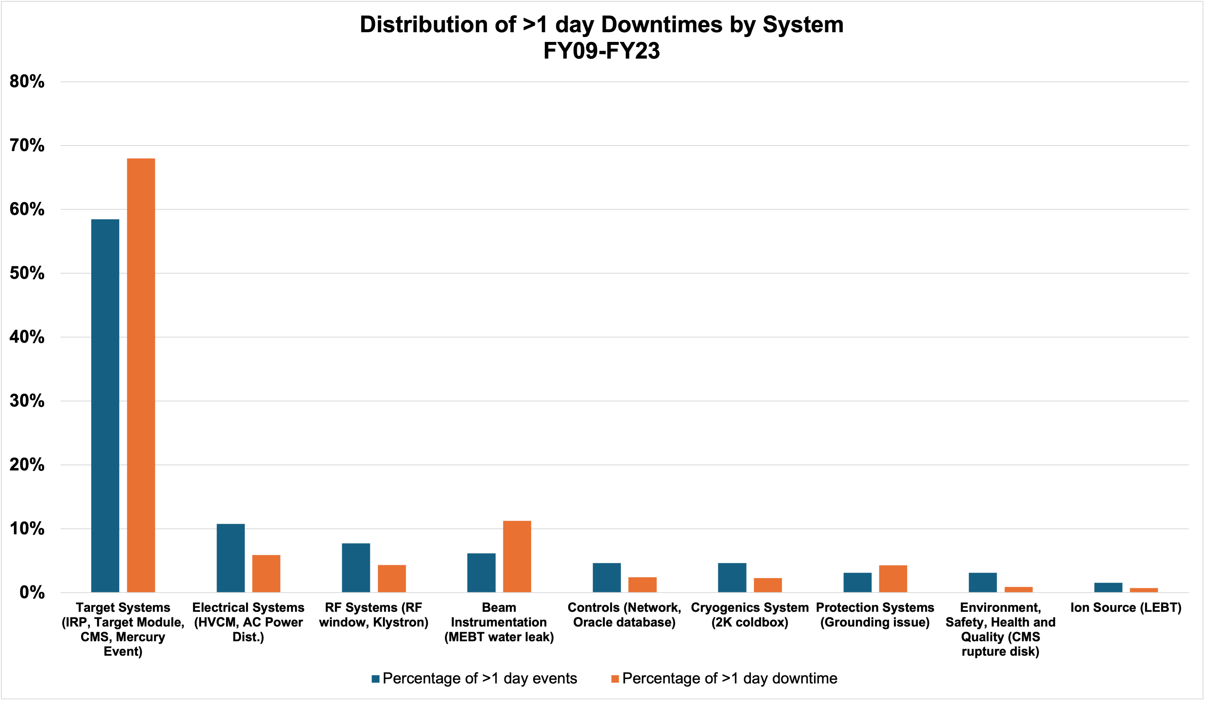
Most trips >1 day come from single point failures with limited access for maintenance and repair
Clear investment should be made to minimize the probability of target failures

Slide 6
Minimize Recovery Time for Shorter Trips
Errant beam, magnet ps
SCL RF cavity trips
DTL/CCL RF cavity trips
Requires tech expert or repair (call-in)

Slide 7
Benefits of Linking First Fault to Action Taken
Goal is to link a downtime to a solution instantly
Operators know the history without searching
Average time to repair
Probability of
Needing an expert
Part replacement
Which part to replace
System | First Fault | Trips in last year | Trips in last month | Trips in last week | Trips in last day | Max downtime (hours) | Average downtime (hours) | Min downtime (hours) | Action code (operator reset) | Action code (expert reset) | Action code (expert repair) | Highest mode part replacement
SCL_HPRF_XMTR27_fault | FF: Cathode 3 Over Current | 25 | 5 | 2 | 1 | 8 | 0.5 | 0.4 | 92% | 7% | 1% | CPI Klystron Model XYZ
Last 3 trips
Date | System | First Fault | Downtime (hours) | Action code | Part replaced
15 June 2024 034535 | SCL_HPRF_XMTR27_fault | FF: Cathode 3 Over Current | 0.48 | Operator Reset | No
1 June 2024 130516 | SCL_HPRF_XMTR27_fault | FF: Cathode 3 Over Current | 0.42 | Operator Reset | No
22 May 2024 092150 | SCL_HPRF_XMTR27_fault | FF: Cathode 3 Over Current | 0.45 | Operator Reset | No

Slide 8
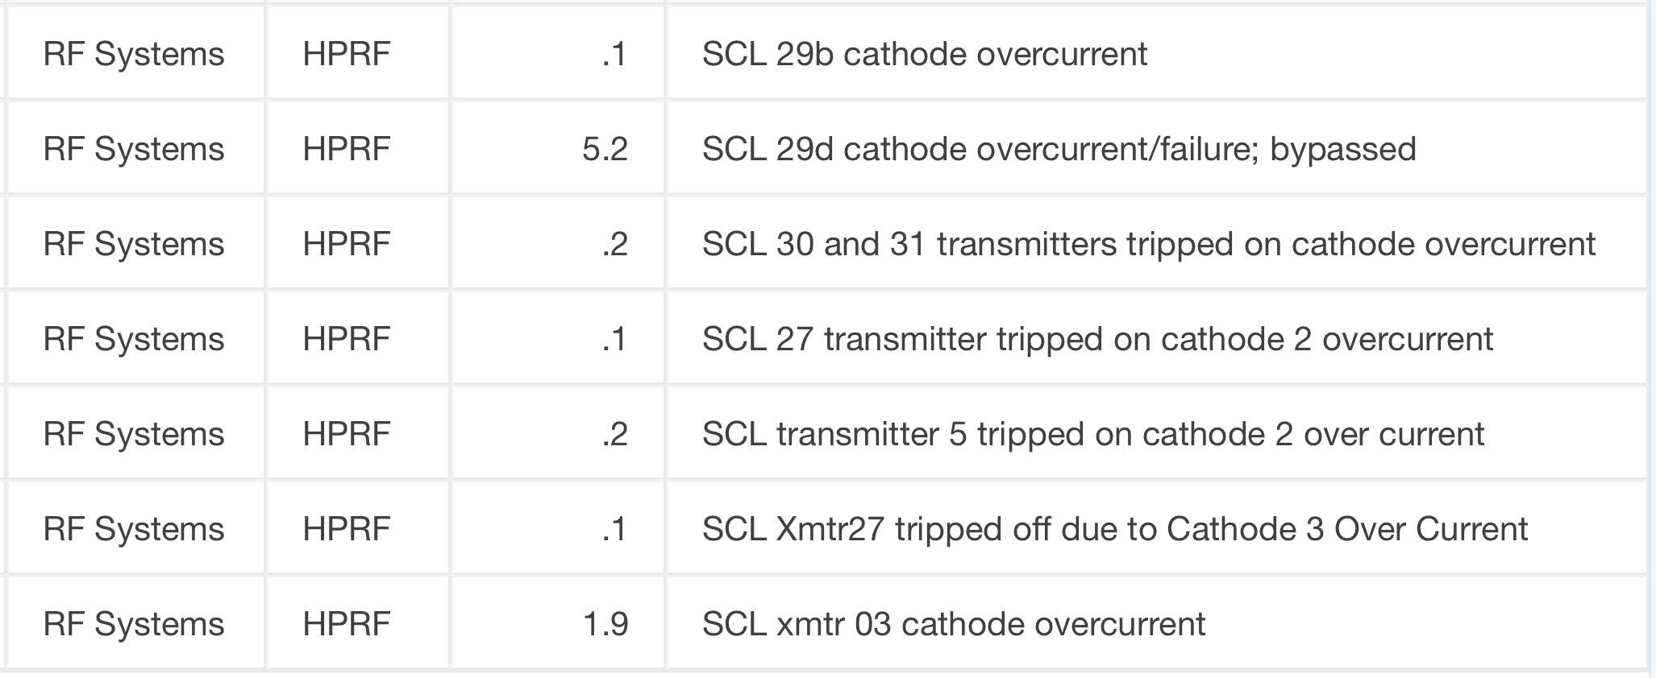
Tools Used to Track System Reliability and Availability
EPICS – Experimental Physics and Industrial Control System
The accelerator control system is the data feed for Asset Performance Management (APM) software
E-log – Electronic logbook
How accelerator operations tracks changes to just about anything!!
Minimal standardization
System
Subsystem
Downtime
Fault Code
OAS – Operations Administration System
How accelerator operations tracks system downtime
Some standardization
EAM – Enterprise Asset Management
Computerized Maintenance Management System (CMMS) technical personnel document preventive and corrective maintenance on systems, positions, and assets
Some standardization
Need standardization!

Slide 9
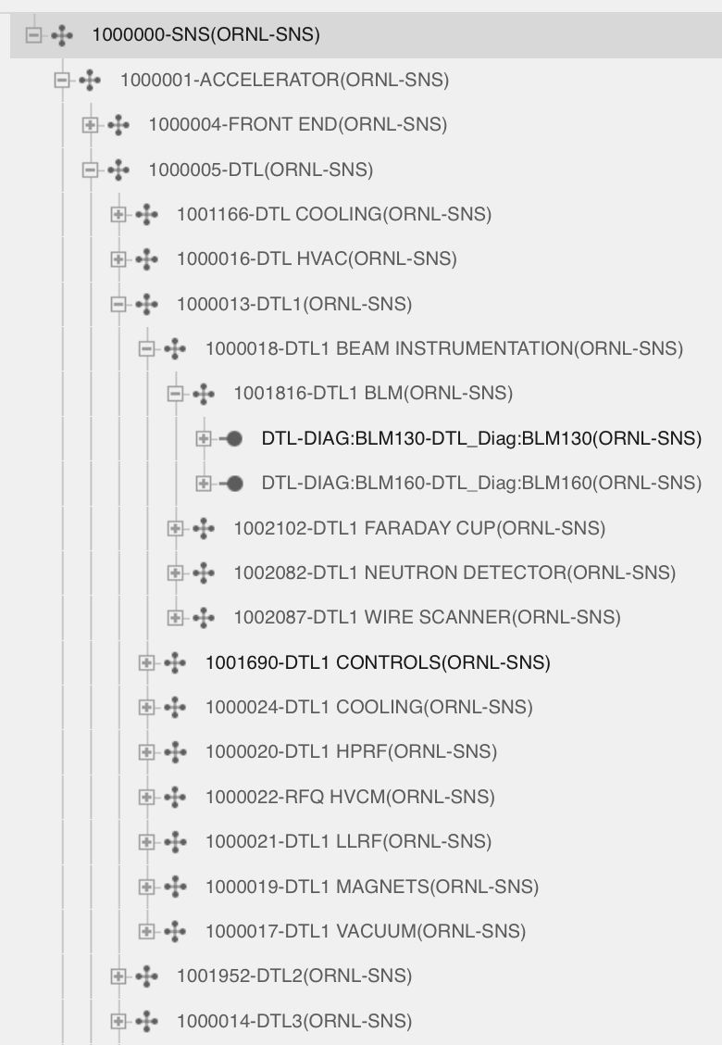
Machine Protection System (MPS) EPICS PVs Build the EAM System Hierarchy
MPS EPICS Process Variables (PVs) are nicely named to help provide a way to define the EAM System and Position hierarchy
RF Cavities (124)
DTL_LLRF:HPM1
…
Klystrons (38)
DTL_HPRF:XMTR1
…
Klystron power supplies (18)
DTL_HPRF:MOD1
…
Beam control system
MPS
Magnets (432)
DTL_MAG:PS_DCH01
…
Vacuum (46)
DTL_VAC:SGV01
…
The PV breakdown also makes first fault logic simple
Diagnostics (435)
DTL_DIAG:BLM130
…
Misc (51)
TGT_MPS:PLC1
…
Example for RF
Cavity, Klystron, Klystron power supply, Diagnostic, Vacuum = Klystron
Cavity, Klystron power supply, Diagnostic, Vacuum = Klystron Power Supply
Cavity, Diagnostic = Cavity

Slide 10
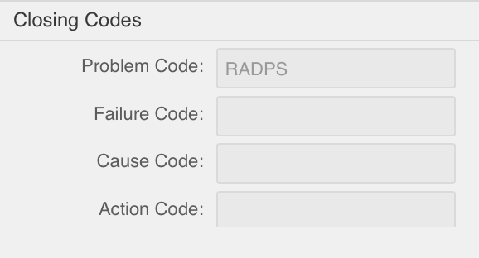
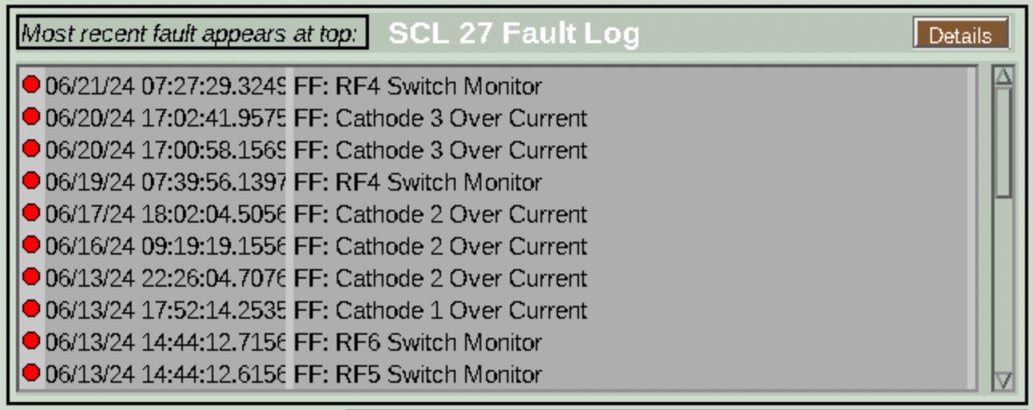
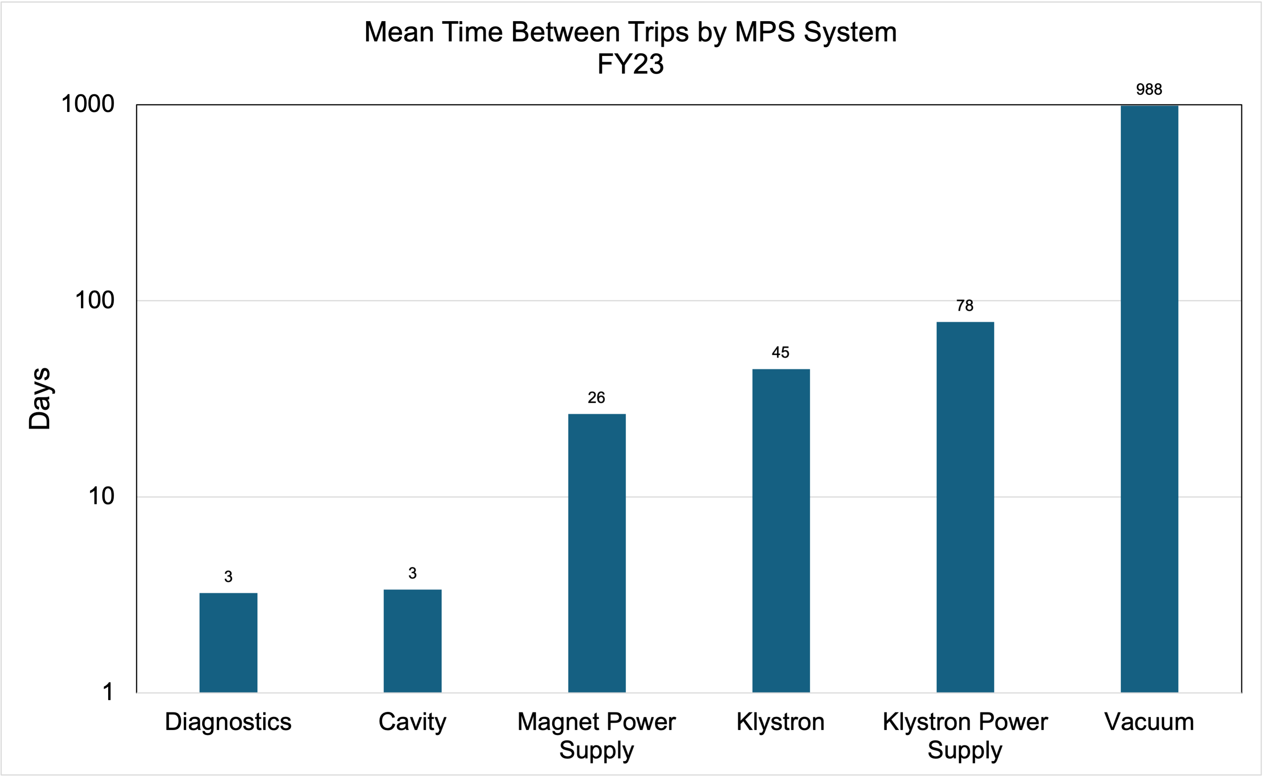
Equipment First Fault EPICS PVs Build the EAM Failure Codes
Failure code creation is easy with systems with first fault software
Complication comes from each MPS equipment breakdown not having first fault software
Klystron First Fault
EAM
RF Cavities (124)
Klystrons (38)
Klystron power supplies (18)
Magnets (432)
Vacuum (46)
Diagnostics (435)
Highest trip frequency systems have no first fault software
Misc (51)
Working on it!

Slide 11
Fault Response Currently 11 Steps (5.5 manual)
Automated Steps
Operator Manual Steps
Expert Manual Steps
MONITOR
EPICS Production State PV
Monitor MPS EPICS PVs
Monitor Beam Power on Target
RESPOND
Beam Power on Target = 0 kW
Log Signals and Create Work Order
Scan MPS EPICS PVs and Determine Cause
Determine Equipment First Fault
RECOVER
Recover Equipment
Recover Beam
Log Downtime
Close Work Order

Slide 12
Future Fault Response 14 Steps (5.5 manual)
Automated Steps
Operator Manual Steps
Expert Manual Steps
MONITOR
EPICS Production State PV
Monitor MPS EPICS PVs
Monitor Equipment First Fault EPICS PVs
Monitor Beam Power on Target
👍
👍
👍
👍
RESPOND
Beam Power on Target = 0 kW
Determine Equipment First Fault
Log Signals and Create Work Order
Scan MPS EPICS PVs and Determine Cause
👍
👍
👎
👍
Recover Equipment
Recover Beam
Log Downtime
Enter Action Code (Operator Reset Expert Reset Expert Repair)
Add Parts to Work Order
Close Work Order
RECOVER
👍
👍
👍
👍
👎
👍
Notes:
Library of standard work orders based on system equipment first fault

Slide 13
Making Progress with Asset Management Upgrade Project in FY22
Goals are to utilize Enterprise Asset Management (EAM) to:
Record labor and parts cost to maintain systems required for neutron production
Track parts inventory
Provide trend data to become more predictive
Help with budget planning
Free up engineer/tech time
Determine where to focus resources
FY21
FY22-FY23
FY24 and beyond
Step 1
Step 2
Step 3
Take data to understand needs
Adapt the software to meet needs
Add ability to record labor time
Add parts into the system by group
Establish and utilize centralized maintenance inventory
Utilize data to improve maintenance processes
Continue to adapt software to meet needs and continue to utilize centralized inventory

Slide 14
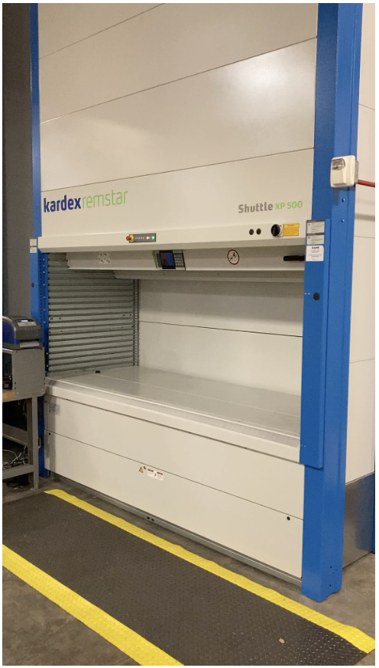
Bottlenecks on Keeping Inventory Current
Experts don’t want to do inventory (it’s not fun)
Just order more when preventive maintenance is due or when they use the last part
Experts don’t want to move parts to central inventory
Worried they won’t get their parts back promptly so they continue to hoard in their shops
Perception central inventory doesn’t have the space
A spreadsheet is way easier than dealing with the EAM application for maintaining inventory
Vertical Lift Module

Slide 15
Current and Future Plans
Write the first fault software for RF cavities and magnets
Continue to build trust with technicians and mechanics
Go into the field to experience their issues and fix them
Work with central inventory and willing groups to develop processes for keeping EAM inventories updated
Simplify the interface to EAM
Moving toward an SNS homegrown version of CERN EAM Light (SNS EAM Lighter Than Light)
Let individual group planners easily update their inventory
Updates are screened before being pushed to EAM
Simplify part additions to work orders
Using the as-built application there are too many button clicks to swap a part
Focus on barcode scanners
Previous attempts were slowed by IT requirements
LAST THING IS TO BE PATIENT!

Slide 16
THANK YOU
QUESTIONS?

Slide 17
Research Accelerator Division
Fulvia Pilat, Director
Accelerator Science and Technology Section
Sarah Cousineau
Accelerator Systems Section
Sang-ho Kim
Control Systems Section
Karen White
Operations, Integration, and Maintenance Section
Glen Johns
Target and Mechanical Systems Section
Mike Dayton
Accelerator Physics Group
Nick Evans
Electrical Power Conversion Group
Yugang Tan
CF and Vacuum Group
Derrick Williams
Accelerator Operations Group
Geoff Milanovich
Cooling Systems Group
Ben Goddard
Beam Instrumentation Group
Sasha Aleksandrov
Front End Systems Group
Baoxi Han
Controls Integration Group
Klemen Vodopivec
Electrical Support Group
Ben Cagley
Target Systems Group
Jeffrey Saunders
Mechanical Engineering Group
Charlotte Barbier
RF Systems Group
John Moss
Cryogenics and Target Group
Aaron Coleman
Integration and Planning Group
Charles Peters
Target Operations Group
John Denison
Superconducting Linac Group
Matt Howell
Protection Systems Group
Kelly Mahoney
Mechanical Support Group
Doug Engle
Vacuum Systems Group
Jeremy Price

Slide 18
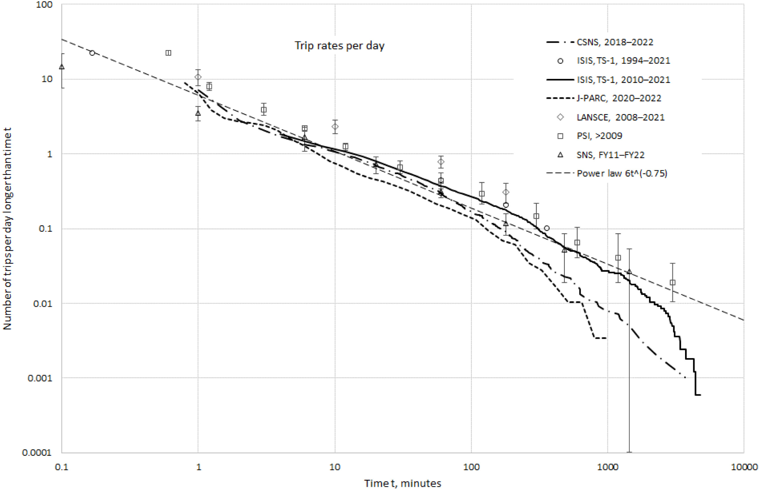
120 kW
160 kW
1 MW capable
80 kW
1.3 MW
1.4 MW
Availability and reliability statistics at ISIS and at other high-power proton accelerators
J.W.G. Thomason, S.A. Fisher, D.J. Adams, M.G. Glover, J. Ranner, D.J.S. Findlay ∗ ISIS, Rutherford Appleton Laboratory, Chilton, Oxon. OX11 0QH, UK
Nuclear Inst. and Methods in Physics Research, A 1053 (2023) 168338
Notes:
This plot was put together by personnel from the ISIS neutron source in the UK. It shows the number of beam trips per day on the y-axis (log scale) binned by length of trip on the x-axis for various accelerator driven sources from around the world. They show a power law fit to the data for estimating beam trips per day by length of trip.
Pretty clear that the focus for the different types of accelerators is on trips lasting more than a minute (availability and I’ll show why), but here at SNS we do focus on even shorter length trips because we understand these short trips can be indications of potential longer failures in the future.

