Slide 1
Unknown beam dump investigations at MAX IV
By the Accelerator Development and Accelerator Operations group at MAX IV

Slide 2
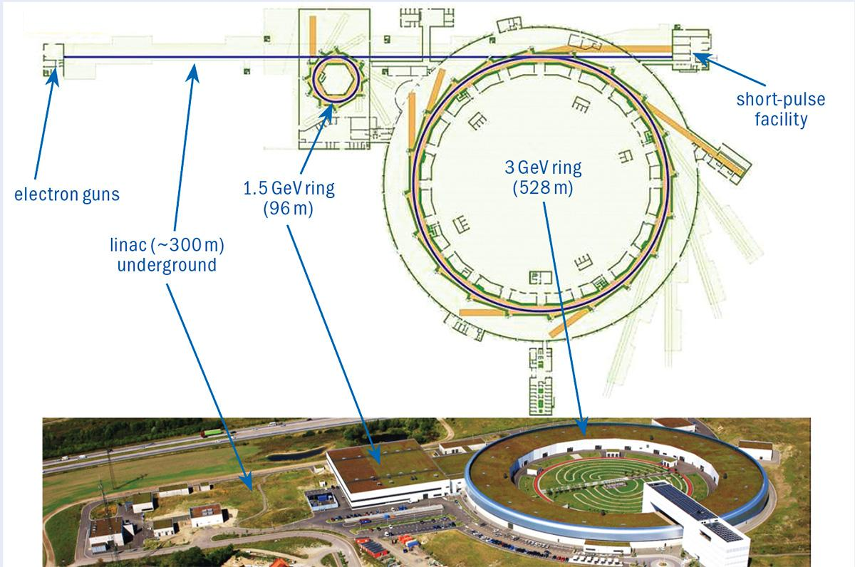
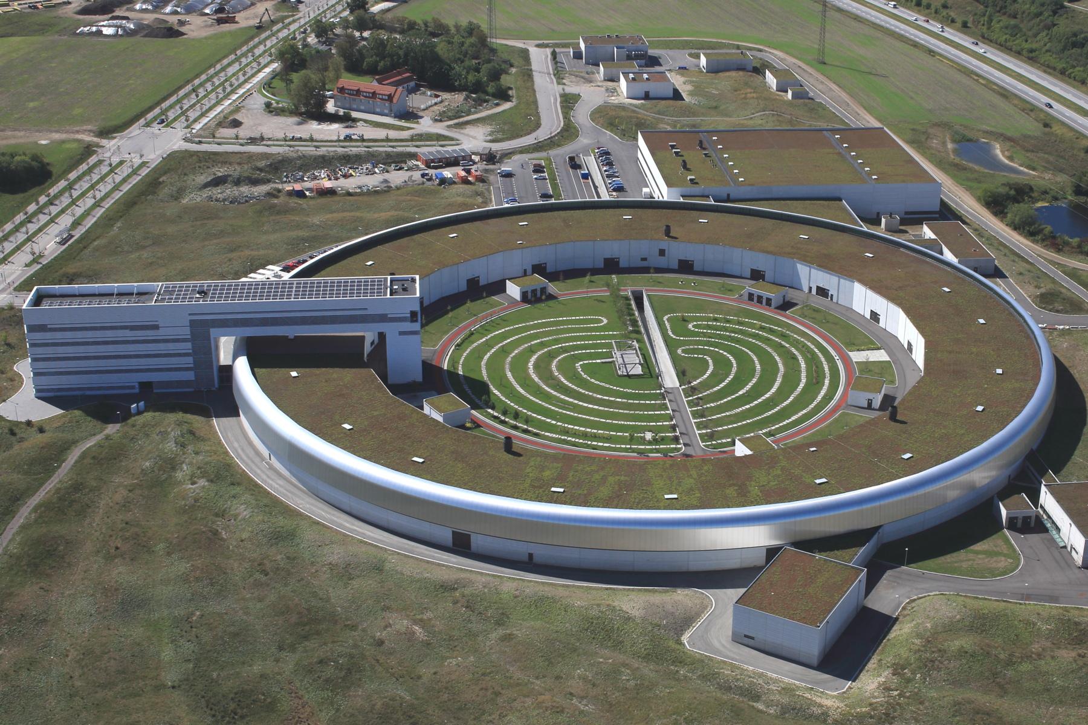
MAX IV Laboratory
Part of Lund University in Sweden
3 GeV Linear electron accelerator (linac) powering:
Short pulse facility (SPF)
1.5 GeV Soft x-ray storage ring (R1)
3 GeV Hard x-ray storage ring (R3)
16 Specialized beamlines for user access
Photographer: Perry Nordeng

Slide 3
Downtimes at MAX IV

Slide 4
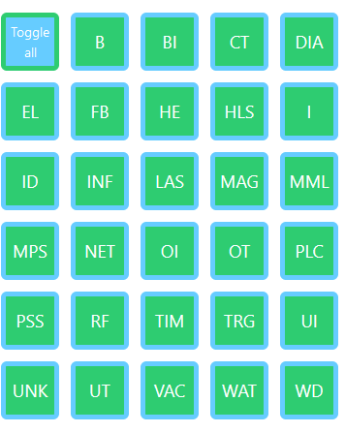
Downtime Classification at MAX IV
Direct cause: What caused the beam to go away?
Root cause: Which system misbehaved and in what way? (from an ops perspective)
Examples direct cause:
Orbit interlock
RF dump request
Examples root cause:
Vacuum trip
Cavity tuning in the wrong direction
Classification always goes via root cause!

Slide 5
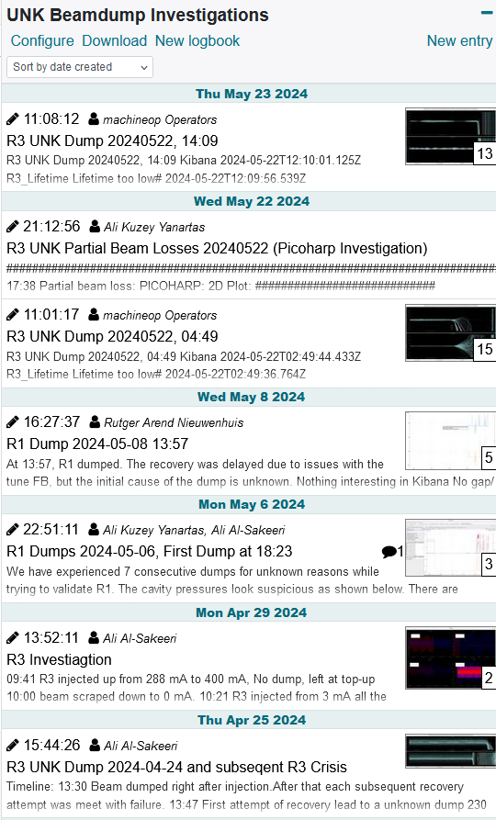
After a Dump & Recovery
Check alarms for root cause
e.g. Vacuum trip, contactor glitch
If no clear root cause, start investigation from archived data
Causes: e.g. gap movement, tune drift
Hints: e.g. drift in x-plane -> loss of RF
Limited by unsynced timestamps
Data collection is automated
If no cause is found -> log as unknown
Further investigation by accdev & other operators

Slide 6
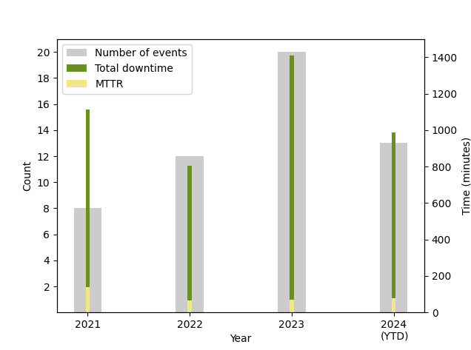
The Problem
Increase in unknown dumps in R3
Mostly no persistent issues: reset & recover
But problems during recovery can appear…

Slide 7
Deployed Tools

Slide 8
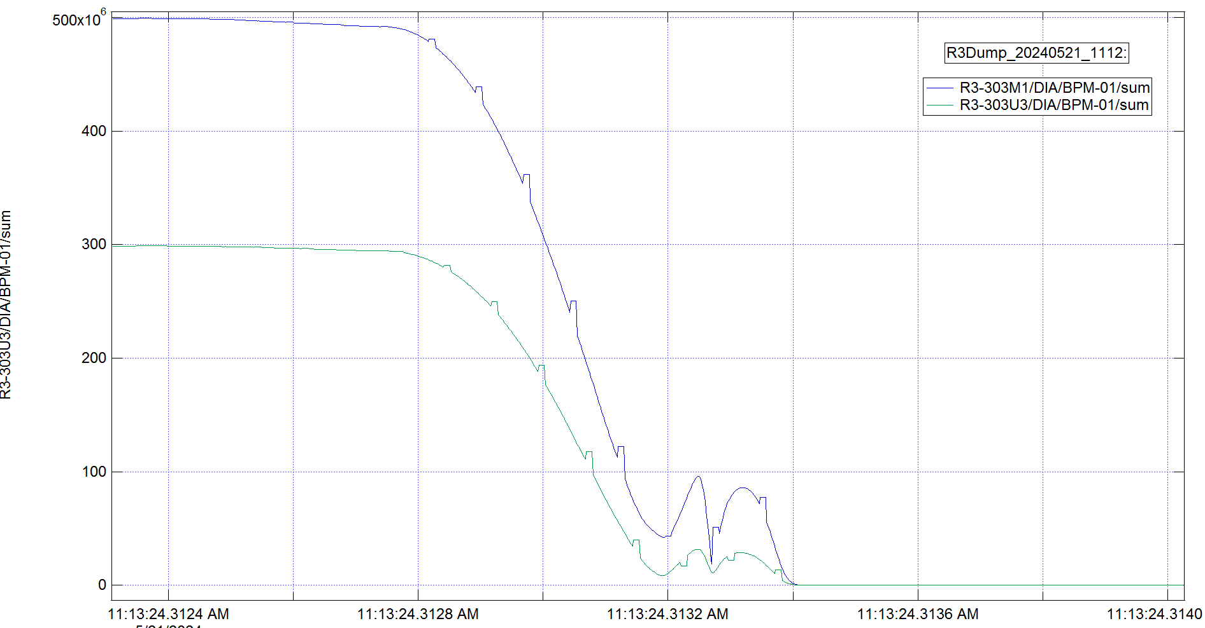
Libera post-mortem
Turn-by-turn data for last 20k turns (about 0.3 seconds)
Sum & Position signal
Dump signatures catalog

Slide 9
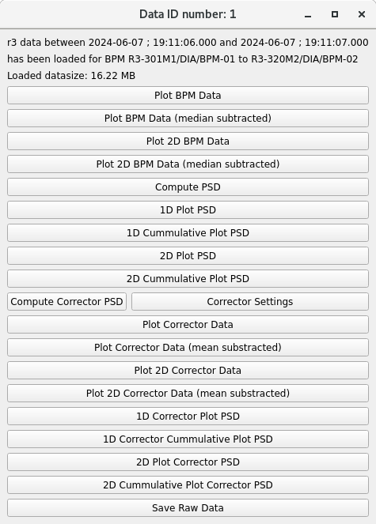
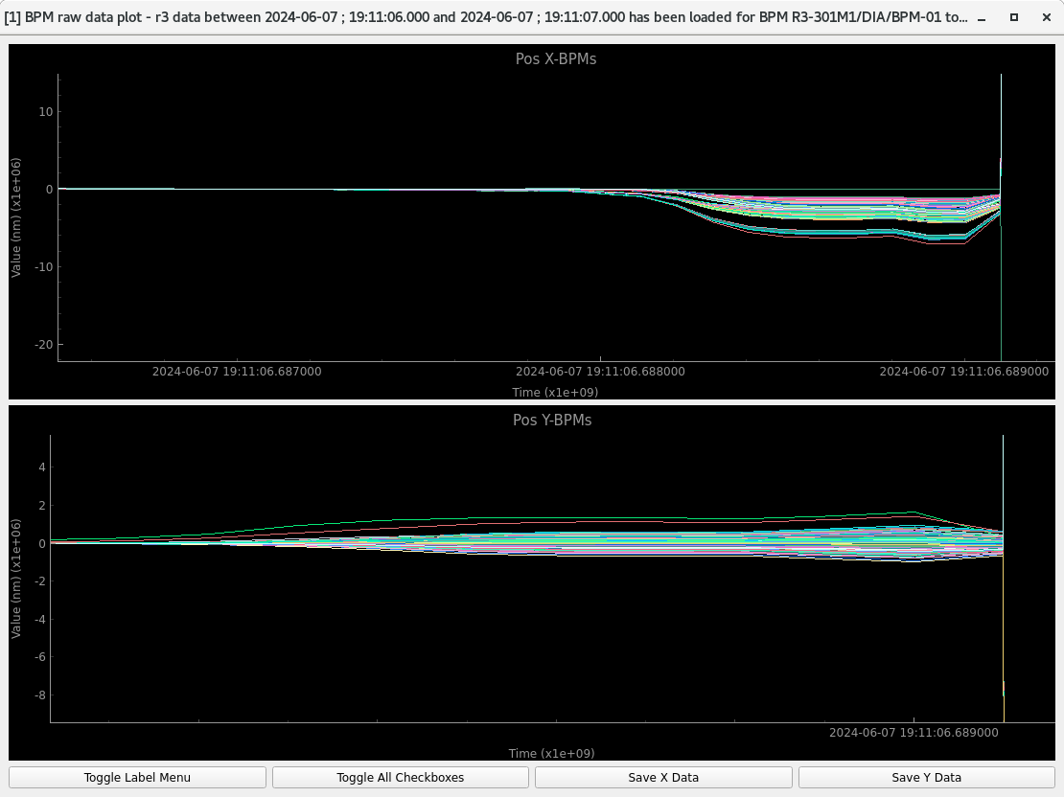
Diamond fast archiver
BPM data at 10kHz
Last two weeks available
Beam dump triggers storing of last 2 seconds of data
Python tools allows manipulation and analysis of data

Slide 10
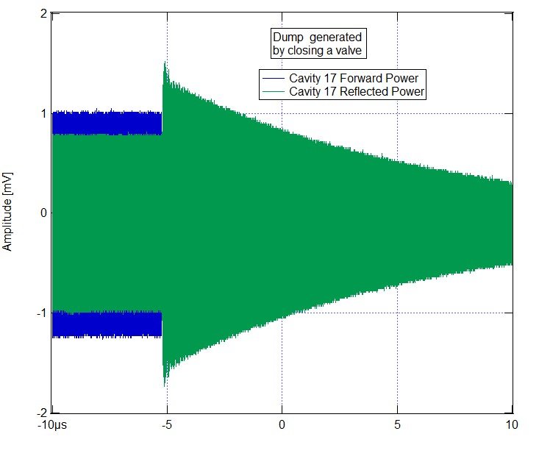
Other post mortems
Bunch by bunch: Modal amplitudes, spectrum and bunch charge saved after a dump
Low level RF: interlocks in RF system per tick
Scopes: monitor forward and reflected RF power

Slide 11
Examples of Investigations & Lessons Learned

Slide 12
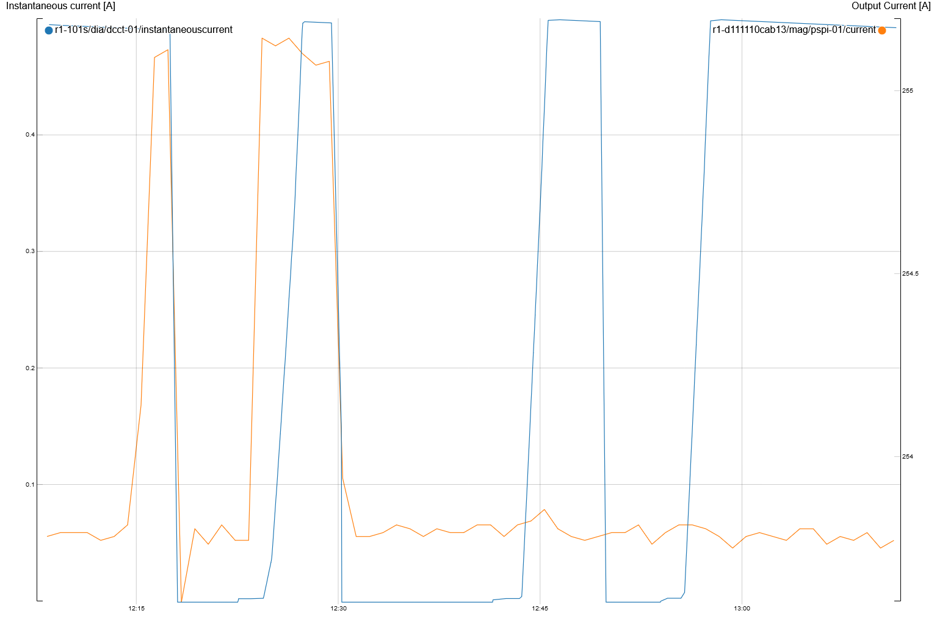
Feed Forward of an R1 Beamline
What is seen?
Dump of R1 after MaxPEEM gap movement coincides with magnet current peeks
This magnet is moved by MaxPEEM feed-forward (FF)
What goes wrong?
FF measures disturbances and alters magnets
FF table depends on MaxPEEM mode
FF only has tables for mode 1 and 4
MaxPEEM was in mode 2, which is interpolated
Lessons learned:
FF needs to be altered
Interpolation: halfway there might be nowhere

Slide 13
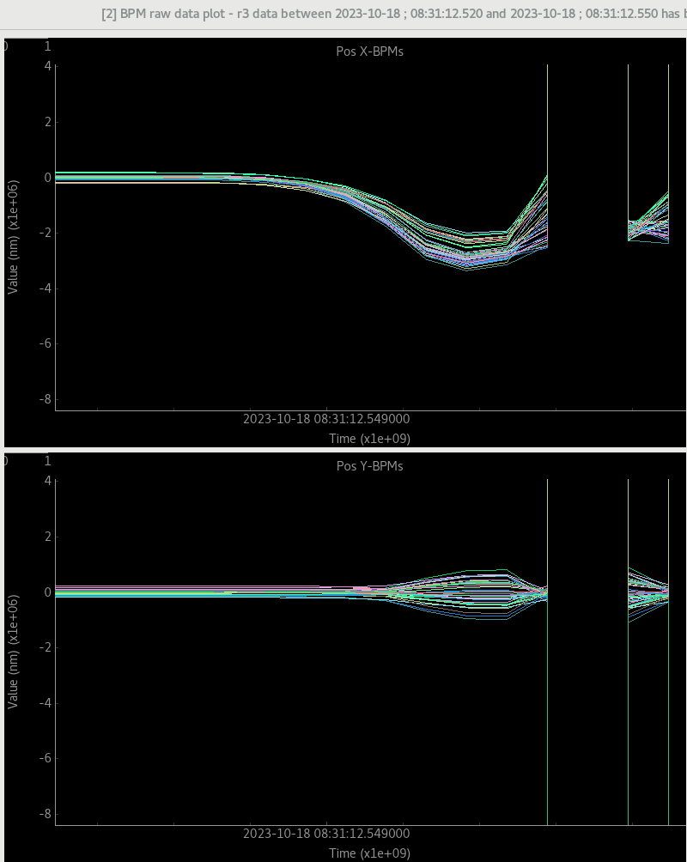
Touch this to Dump
Event 1:
A mysterious dump of R3 due to loss of RF
A few minutes later we got a call about an MPS cable…
Event 2:
A lot of loose/broken relays were found (not the cause)
Lessons learned:
Regularly tighten relays, cables etc
Mark/protect important cables

Slide 14
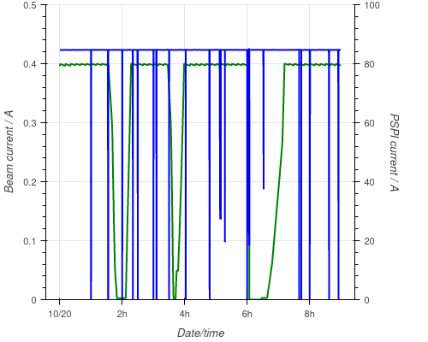
Sextupole Glitches
Sextupole glitch sometimes causes beam dump
The powersupply was recently repaired by the manufacturer
Replace/repair again
Lessons learned:
Something repaired is not always fixed
Glitches could be monitored by alarms

Slide 15
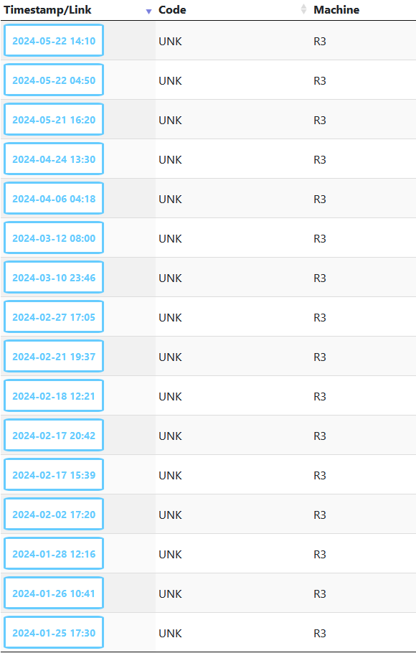
Conclusions
A dump is unknown until the root cause is found
Post-mortem systems gather useful data
Investigations can lead to identifying root causes
But many unknown dumps remain…
How does your facility classify downtime? Root or direct cause?
Do you have unknown downtimes?
What tools does your facility use?
How could we improve our investigation at MAX IV?

