Slide 1
LIPAc procurement policy for upgraded sub-systems and maintenance services
Hervé Dzitko (F4E)
on behalf of the IFMIF/EVEDA Integrated Project Team

Slide 2
Outline
LIPAc context
IFMIF/EVEDA - LIPAc overview and status
Reliability/availability in LIPAc Procurements
RAMS in new Injector Procurement
RAMS in new RF Power Supply Procurement
Conclusion
1
2
3
4
5
6

Slide 3
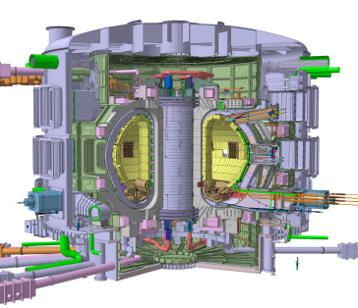
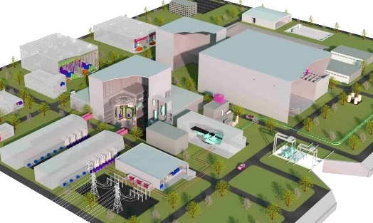
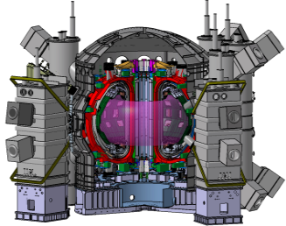
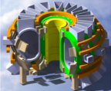
The Broader Approach Initiative
Background
Designed in 2005 during ITER negotiations as a “privileged partnership” between Euratom, represented by the European Commission, and Japan, represented by MEXT (Ministry of Education, Culture, Sports, Science and Technology)
Complementary of the ITER project and foster fusion energy research for early realization of commercial fusion power
Activities to support to ITER and DEMO structured in 3 Projects:
STP, the Satellite Tokamak Programme Project JT-60SA,
largest superconducting tokamak until ITER starts
IFERC, the International Fusion Energy Research Centre
IFMIF/EVEDA, the Engineering Validation and Engineering Design Activities for the International Fusion Materials Irradiation Facility
All located in Japan
In practice ➔ Work carried out by two Implementing Agencies:
National Institutes for Quantum Science and Technology for JA
F4E for EU
Experimental reactors
- Present -
DEMO
(Engineering demonstration and economical feasibility)
（Scientific and engineering feasibility）
ITER (International Thermonuclear Experimental Reactor
Fusion DEMO
Demonstrate sustainment of burning plasma 500MW
ITER Org. 7 Parties
Site: France, Saint-Paul-lès-Durance
Fusion Power of 500 MW for 7’, Q=10
Electricity generation
Economical prospects
Support ITER
Complement ITER
Establish Engineering Basis for DEMO
JT-60SA project
IFERC project
IFMIF/EVEDA project
Accelerator based
Neutron source
（for Material R&D）
【Naka in Ibaraki】
【Rokkasho in Aomori】
Broader Approach activities for Fusion Energy

Slide 4
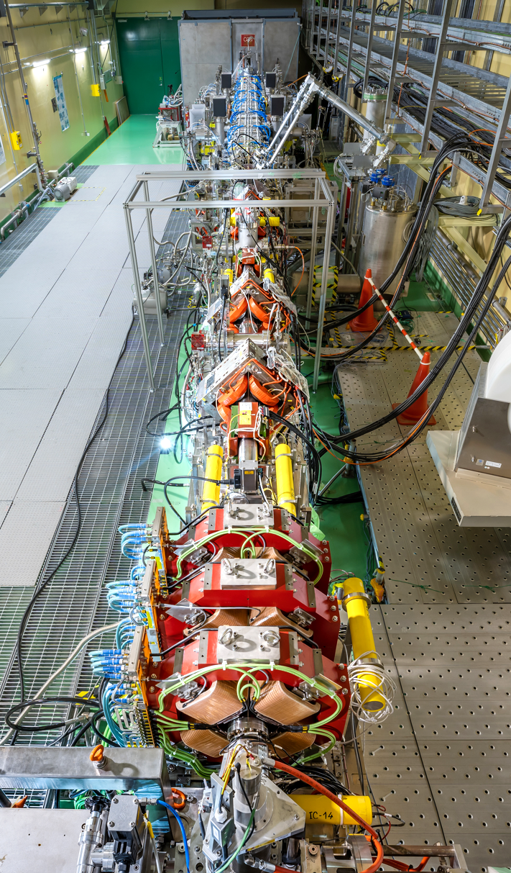
Broader Approach Key Facts
Broader Approach Agreement
Broader Approach Agreement signed on February 5, 2007 in Tokyo
Entered into force on June 1, 2007, for at least 10 years (BA phase I)
2020, Europe and Japan committed to continuing their joint activities.
March 2, 2020 Euratom and Japan signed Joint declaration prolonging BA activities
Start of BA phase II focused on exploiting the facilities already been built, i.e. JT60-SA and IFMIF/EVEDA prototype accelerator LIPAc
BA phase I
Japan and Europe contributed equally a fixed amount to the Broader Approach
80% of the EU contribution came from Voluntary contributors
Phase I ➔ Mostly design and construction phase successfully implemented
LIPAc’s construction relied on in-kind contributions from EU and Japan, managed by F4E and QST
BA phase II
Phase II focuses on operating, enhancing, and exploiting facilities already been set up like LIPAc
A sliding 5-year Project Plan is submitted for approval to the BA Steering Committee every year
➔ Forecast for the procurements to the operations, maintenance, and enhancements

Slide 5
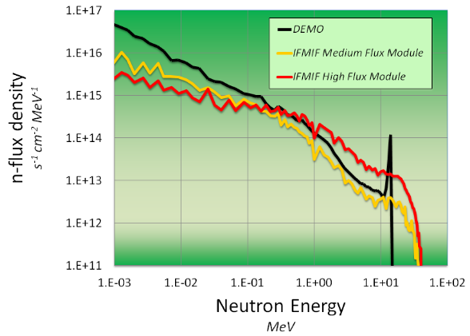
IFMIF/EVEDA Programme and LIPAc Concept
IFMIF International Fusion Materials Irradiation Facility):
Accelerator based neutron source using Li(d,n) nuclear stripping reactions
For material irradiation database for design, construction, licensing, and operation of DEMO
EVEDA Engineering Validation and Engineering Design Activities for IFMIF neutron factory
Providing Engineering Design of IFMIF ➔ Completed in 2013
Validating the key technologies:
Li target facility ➔ Completed in 2017
Test facility ➔ Completed in 2015
Only remaining activity ➔ Validation of the Linear IFMIF Prototype Accelerator (LIPAc)
LIPAc 9MeV, 125mA, CW
Injector
(0.1 MeV)
SRF-Linac (40 MeV)
Goal: validation of the low energy section of the IFMIF accelerator concept ➔ IFMIF-DONES and A-FNS
1st Cryomodule
(9 MeV)
RFQ
(5 MeV)

Slide 6
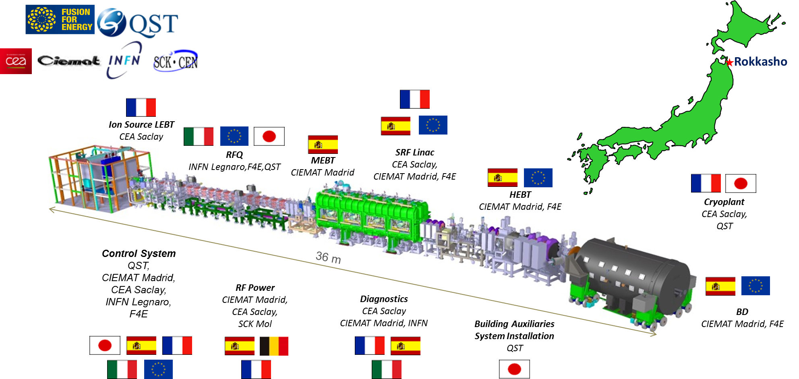
LIPAc = Japan-Europe scientific collaboration
LIPAc = a compact but very challenging and thrilling accelerator to run
➔ Cutting edge technologies: world’s longest RFQ, world’s highest light hadron current through SRF cavities in CW, high average beam power
Equipment designed and constructed in Europe, Installed and commissioned in Rokkasho

Slide 7
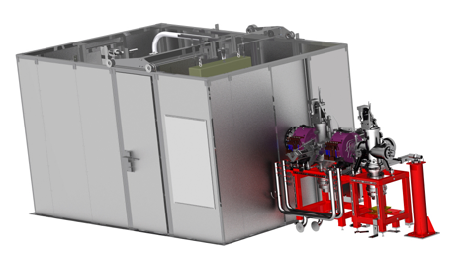
LIPAc Beam Commissioning: 4 Configurations – 5 Phases
Phase A
RFQ
Low Power Beam Dump
1 ms (0.625 kW)
Completed in Dec. 2017
MEBT
1st p beam: 13/06/18
1st D beam: 11/03/19
Completed in Aug 2019
2) Phase-B
3) Phase-B+
Current configuration
5 MeV
D-Plate
(Diagnostic Plate)
Started in July 2021
To be ended this week
27/06/2024
Beam dump
0.625 MW, 10%
5 MeV
4) Phases-C and D
Due to start in Nov 2025
Expected completion in July 2028
Beam dump
1.125 MW, CW
More details in K. Kondo’s presentation this afternoon
9 MeV

Slide 8
Reliability in LIPAc Procurement
Construction phase (BA Phase I)
LIPAc primary purpose was a demonstrator to validate the feasibility of the IFMIF accelerator concept
LIPAc was at first meant to run until reaching performance then stopped
Initial timeline: start of the Project in July 2007 and validation of the prototype accelerator completed end of June 2013
The focus was on demonstrating the performance, not the reliability and maintainability
No reliability RAMI study done (Reliability, Availability, Maintainability, and Inspectability)
Although reliability was not the priority of the construction phase of prototype, first phases of commissioning provided valuable feedback
Commissioning and enhanced phase (BA Phase II)
The objective of the phase II is twofold:
Demonstrate asap that the LIPAc can reach the targeted performance: 125 mA D+, 9 MeV, i.e. demonstrate the SRF Linac can work!
Validate LIPAc in terms of availability, reliability and maintainability ➔ Important inputs for DONES
➔ Key identified subsystems are enhanced based on operational experience: Injector, RFPS, MPS, RFQ couplers.
Tech Spec of the enhanced subsystems include RAMI & Safety from the design phase.
Request to evaluate new technologies available that might improve performance and RAMI
Strong emphasis given to operability and maintainability in view of DONES development
Obsolescence management ➔ availability of potentially critical COSTS will be ensured over the lifetime of the subsystems

Slide 9
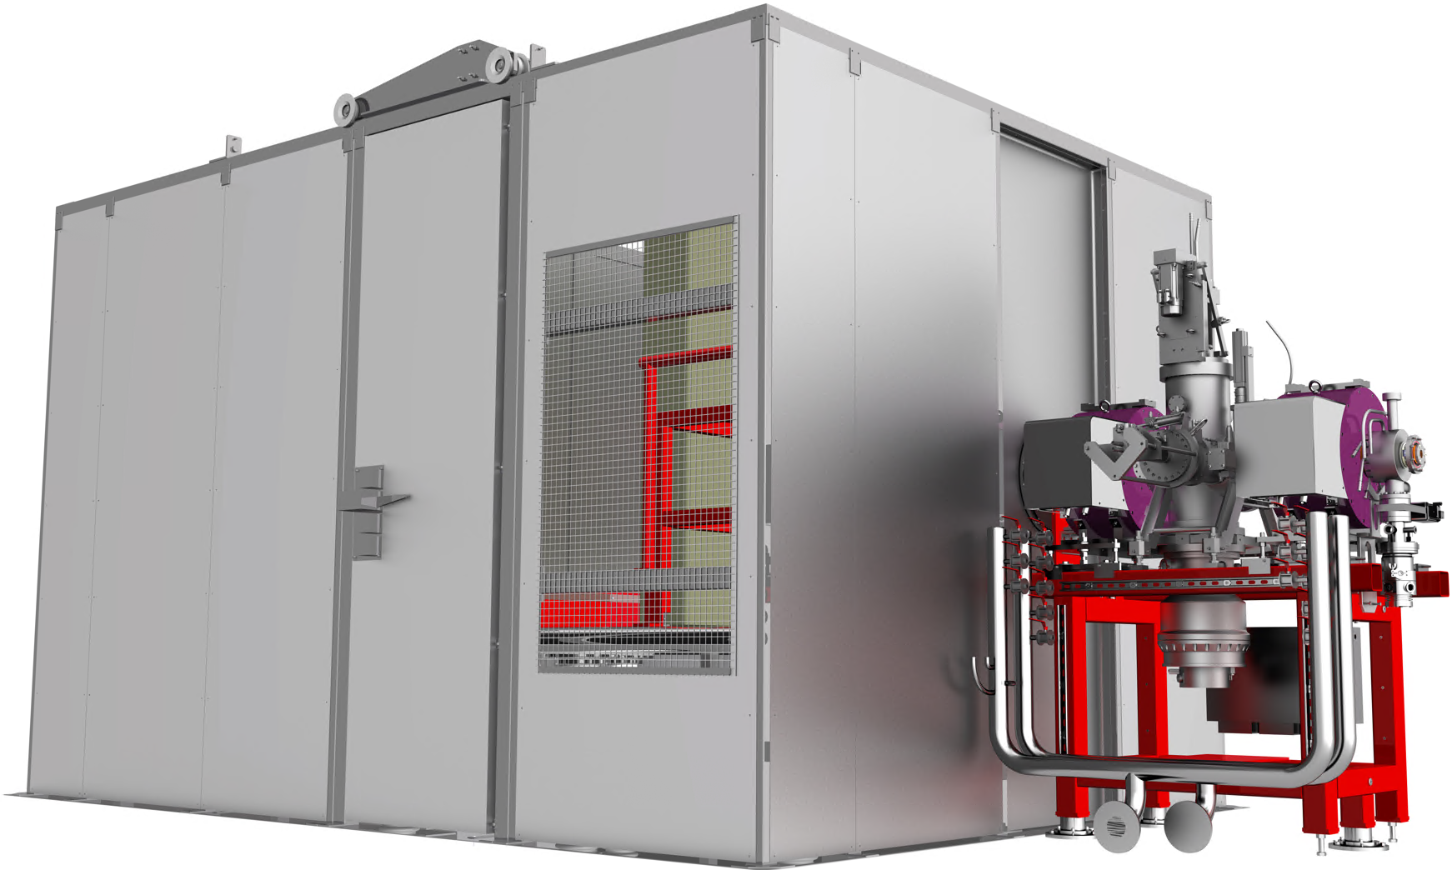
Enhanced Injector Procurement
Scope
Supply the upgrade of the injector for LIPAc/DONES
Conceptual design phase to include analysis of the lessons learned from the injector operation
Development of improved and optimized design
Manufacturing, procurement of components, assembly (full injector with diagnostic chamber and ancillaries)
Acceptance tests in dedicated tests facility in EU
Transport and delivery at Rokkasho site
Procurement strategy
Contract entirely managed and financed by F4E
Tendering process for a competitive procedure with negotiation

Slide 10
Enhanced injector procurement timeline
2024
2025
2026
2027
2028
2029
2030
2031
Design
Manufacturing & Testing
Transport, Assembly & Commissioning
Manufacturing Spare & DONES
Design Review
Onsite Support
Offsite Support

Slide 11
Upgrade of the IFMIF Injector – Technical Specification
Brief overview of the main Work Packages
Milestones M1, M2, … are Hold Points (HP) for the acceptance of the corresponding WPs.
WP1000 – Project Management & Quality Assurance
WP2000 – Design and work plan
– Stage 1
M3
WP3000 – Verification
and Validation – Stage 2
WP6000 –
Additional Tasks
– Options
Kick-off
Meeting
M4
M1
M2
…
M8i
Scope:
Design activities
+
Work plan
incl. Safety & RAMI (WP4000 & WP5000)
From engineering, manufacture, and procurement to final validation (FATs) of the technical proposal
+
Test stand upgrade/refurbishment (optional)
Release of additional tasks and provision of on-site/off-site support after M2
Definition of organizational structure
and responsibilities
+ PM&QA provisions to be applied during the whole extent of the contract
10 hours CW at nominal beam parameters (measured at RFQ entrance).

Slide 12
Upgrade of the IFMIF Injector – Technical Specification
3.2. WP2000 – Design activities and work plan – Stage 1
Pre-design phase:
T2010 – Critical review of current design …
T2020 – System requirements review
T2030 – Technical solution → Design phase
Main design considerations
Design strategy and coordination
Safety analysis
RAMI analysis
Design definition documentation
T2040 – Work plan
T2050 – Review and approval
D1 – Design and Work Plan Dossier
D1.1 – Critical review of current design and performances
D1.2 – System requirements review
D1.3 – FMEA
D1.4 – Safety Analysis Report
D1.5 – RAMI analysis
D1.6 – Design description documentation
D1.7 – Work plan
Presentation and review of [D1] at a LIPAc Engineering Meeting with the attendance of the F4E, QST and/or IFMIF-DONES and any experts appointed by them.

Slide 13
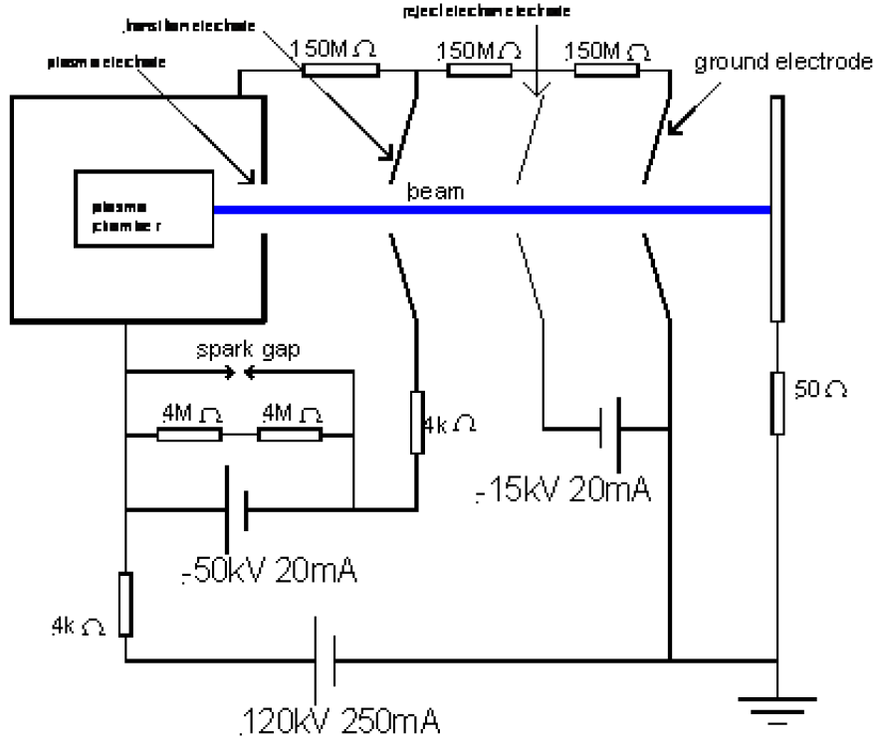
Design improvements to increase reliability, availability, maintainability
Source
Magnetron with PS replaced by SSPA
Fast beam interruption based on SSPA
Magnetic-field configuration adjustment ➔ Optimize the ion-source perf. and RAMI (BN disks degradation)
Alternative material(s) to the BN disk for longer lifetime, e.g. SiC, Al₂O₃,
Extraction system
Ease exchange of the Plasma Electrode.
Optimize electrode arrangement to ease and improve the control of their alignment, and ease the construction and maintenance of the accelerator column.
Brazed stack of electrodes + alumina rings ➔ No risk of misalignment in operation
HV resistor chain improved and made more reliable ➔ Reduce occurrence of sparks and minimize the need of periodic adjustments
Ancillaries
Oil-free solution for the fore-vacuum
Water-cooling system with Swagelok-type connectors

Slide 14
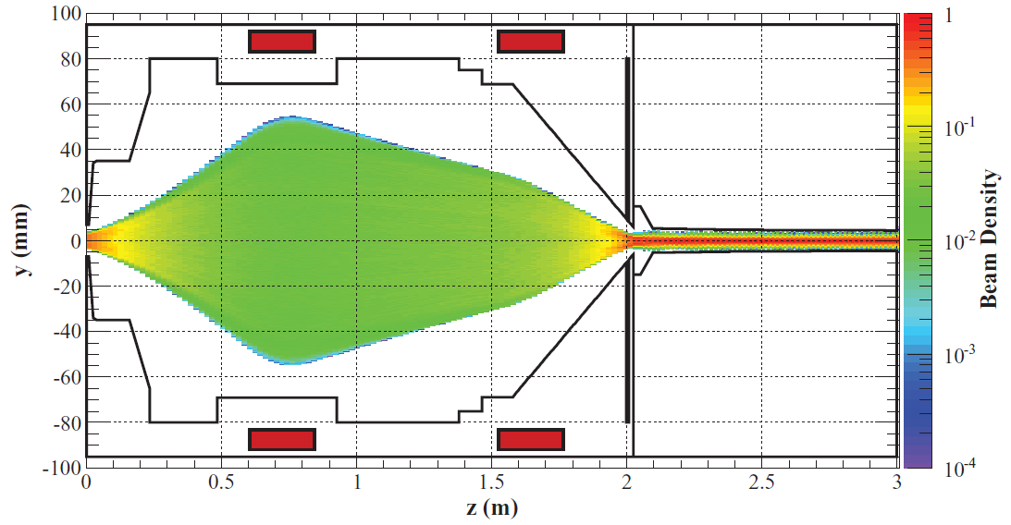
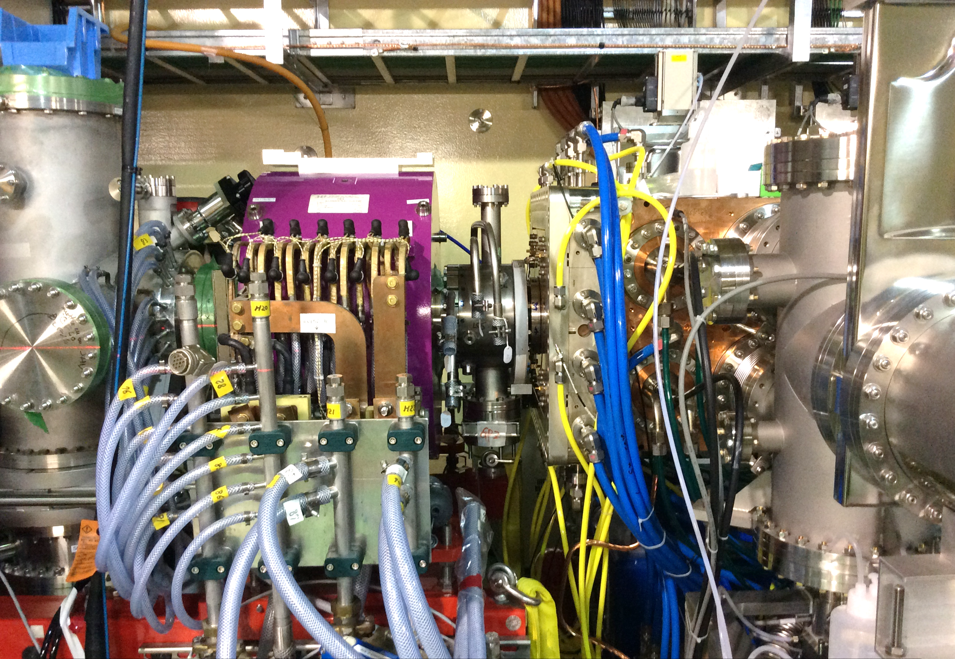
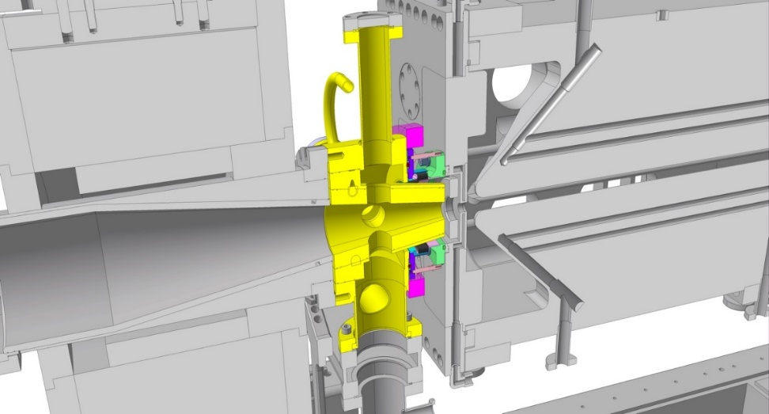
Design improvements to increase reliability, availability, maintainability
LEBT
Maximize the accessibility of components to minimize the intervention time, e.g. by putting as much cables as possible in cable trays attached to the frame of the LEBT
Alignment of the solenoid will be improved
Solenoid aperture and B-field linearity. The solenoid design shall be optimized to maximize the aperture ➔ maximizing the linear region of the magnetic field
Solenoids shall be mechanically decoupled from the beam pipe to enable the fine adjustment of the alignment of these two components w.r.t. the beam axis independently
Additional viewports between the accelerator column and the first solenoid to monitor the horizontal/vertical beam profile
New LEBT-RFQ interface
that allows for more space to ease
the assembly and maintenance
Beam transport in the LEBT with RFQ injection
In yellow LEBT-RFQ interface
Second LEBT solenoid and interface with RFQ

Slide 15
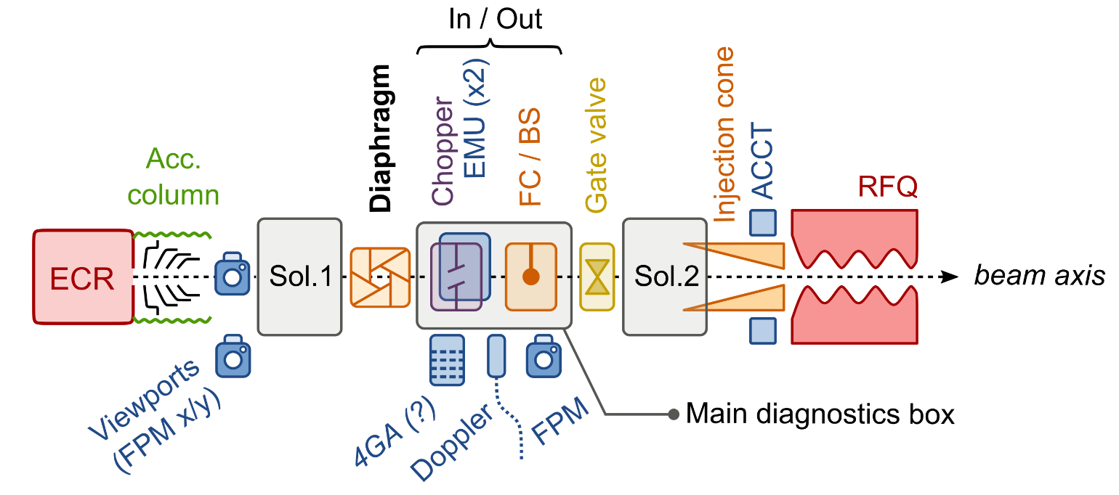
Design improvements to increase reliability, availability, maintainability
Use of a diaphragm/scrapper
To adjust the beam intensity at the injector's output without changing the plasma electrode ➔ Minimize machine downtime
Extraction column works always at nominal at working point ➔ Scrapper used for pilot beam during tuning phases, tests, etc.
Allocated length of 20-30 cm
Most appropriate installation location would be right after the first solenoid of the LEBT
Design to be validated for:
Differential-pumping effects: avoid accumulation of gas on the upstream side by means of evacuation apertures,
Production of secondary electrons: can affect space-charge and beam characteristics
Thermomechanical performance
Diagnostics
Improvements based on operational experience will be made: EMU, new camera to have better SNR, 4-grid analyser, etc
Add other diagnostics to improve the characterisation/monitoring of the beam: additional FPMs, additional ACCTs for intensity measurement after diaphragm, if implemented

Slide 16
RF Power System: Operational Efficiency and System Enhancement
Procurement strategy for Operational Efficiency and System Enhancement
1st axis to address the maintenance problems on current RFPS and ensure it can be operated reliably, covered entirely thanks to framework contracts
2nd axis to procure and commission new SSPA to replace the current RFPS modules for the RFQ
Legend
Procurement Arrangements
Now
Contracts
2021
2022
2023
2024
2025
2026
2027
2028
F4E-OPE-1078 PSYS refurbishment / Safran Spain
5 specific contracts for maintenance and improvement
Maintenance current RFPS
F4E-OFC-1326 Online purchase / ENERGY TECHNOLOGY SRL
F4E-OFC-1650 RFPS Maintenance / OCEM-Ampegon-BTESA-Safran Spain
F4E-OFC-1298 RFPS Maintenance / OCEM-Ampegon-BTESA-Safran Spain
F4E-OPE-0984 HVPS support / JEMA
SSPA workplan based on operational feedback
One staged contract for RFQ SSPA / BTESA
RFQ SSPA
SSPA prototype chain
FAT of the prototype
SSPA series production

Slide 17
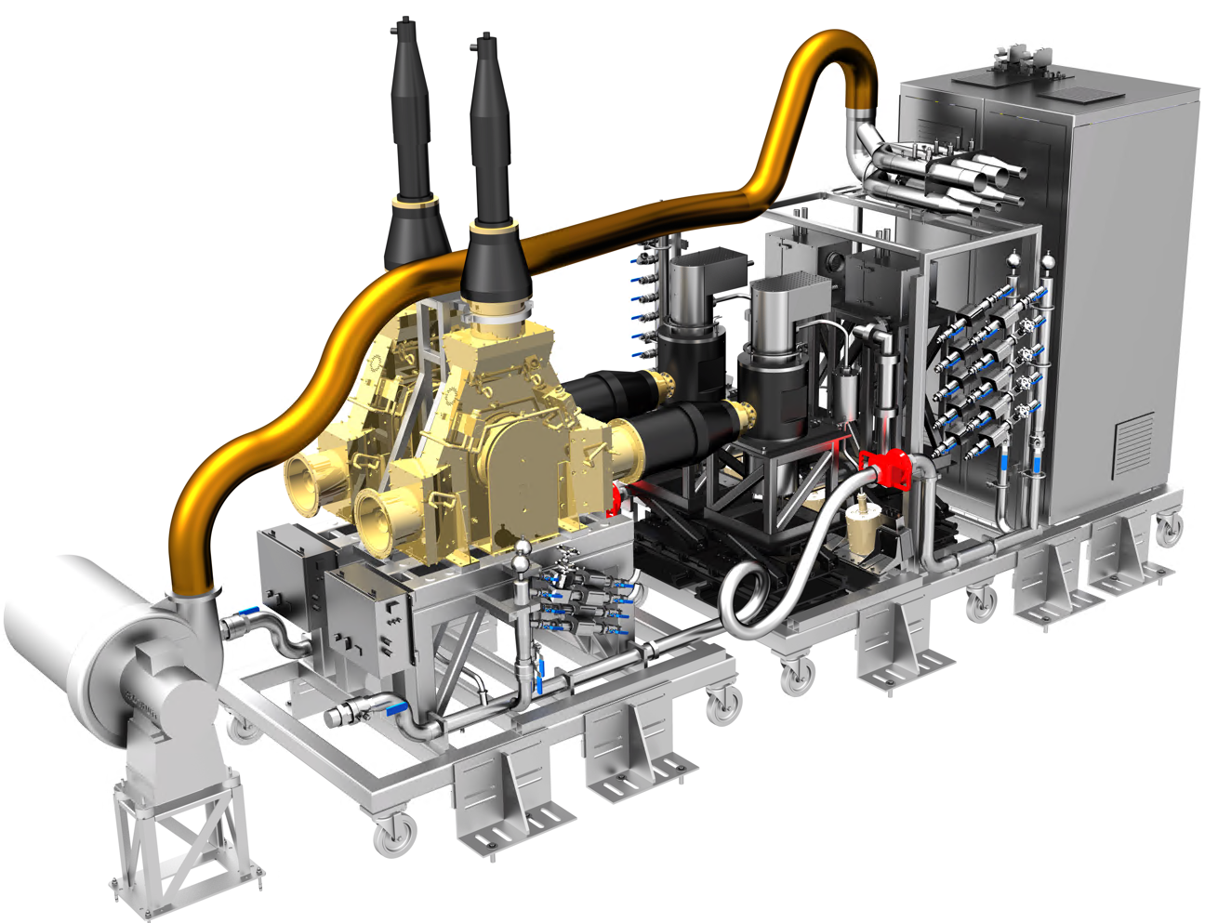
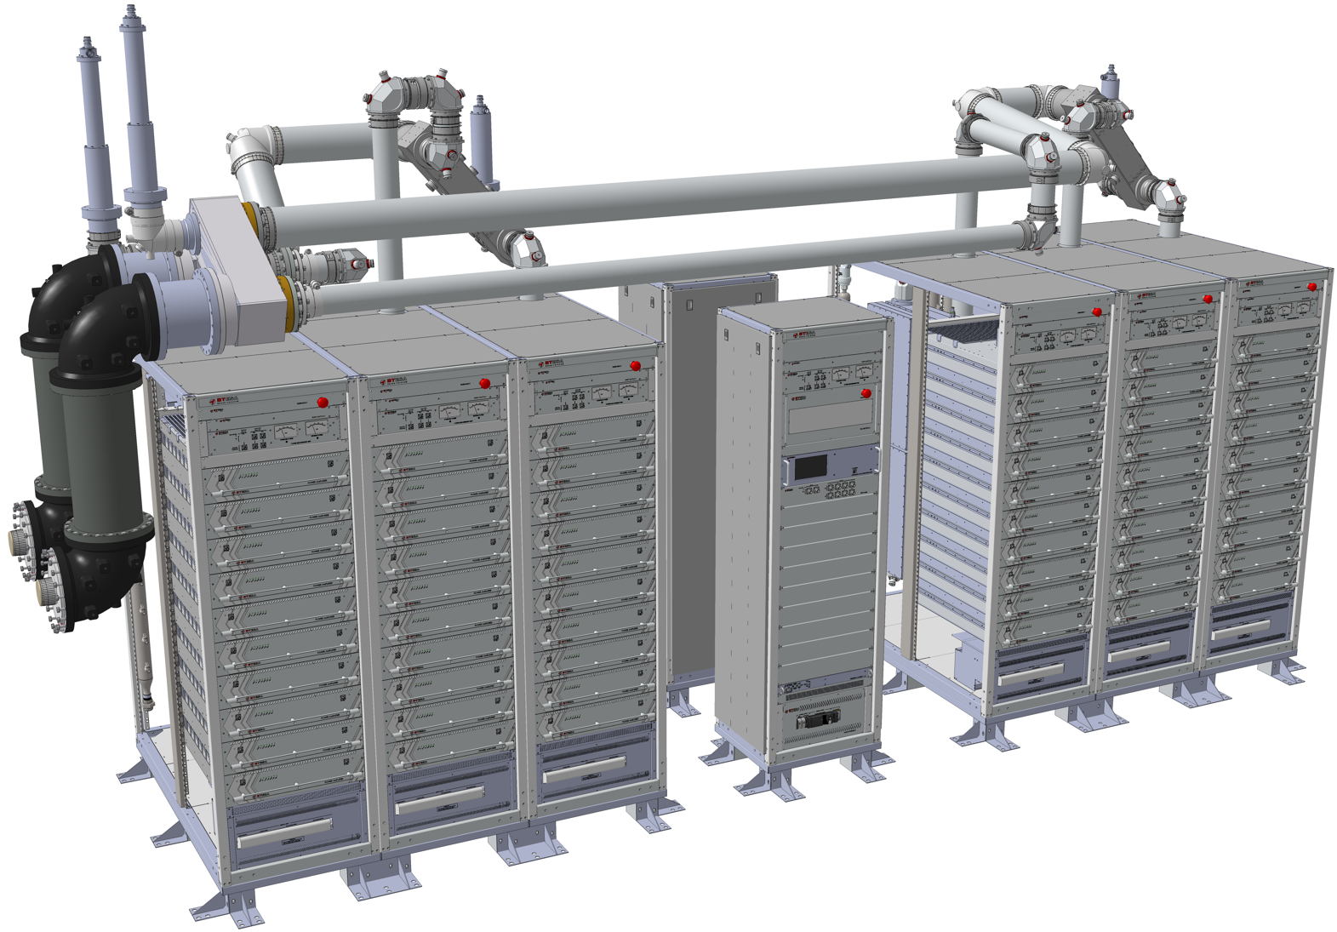
Enhanced RFPS
Scope
Replace current RFQ RFPS by new SSPA including lessons from operation
Procure, assemble, test the SSPA prototype, including verification and validation dossier
SSPA series engineering, manufacturing, factory acceptance tests and shipment
SSPA series installation and integration in the LIPAc building
Beam commissioning and on-site and off-site support
RFPS Required availability >98% for the 8 RF chains working simultaneously (same as DONES)
RAMS analysis implemented in the design: Reliability, Availability, Maintainability, Safety
Operation and Maintenance Dossier:
Report of the study demonstrating the reliability and availability,
List of necessary spares parts and their quantity to ensure an optimal availability,
Preventive maintenance plan with the procedures that describe how to maintain or replace the parts with their spares
Inspection plan with schedule including ancillaries (e.g. WCS),
The inspection procedures.
Procurement strategy
Tendering process for a competitive procedure with negotiation.
Current tetrode based RFPS
New SSPA

Slide 18
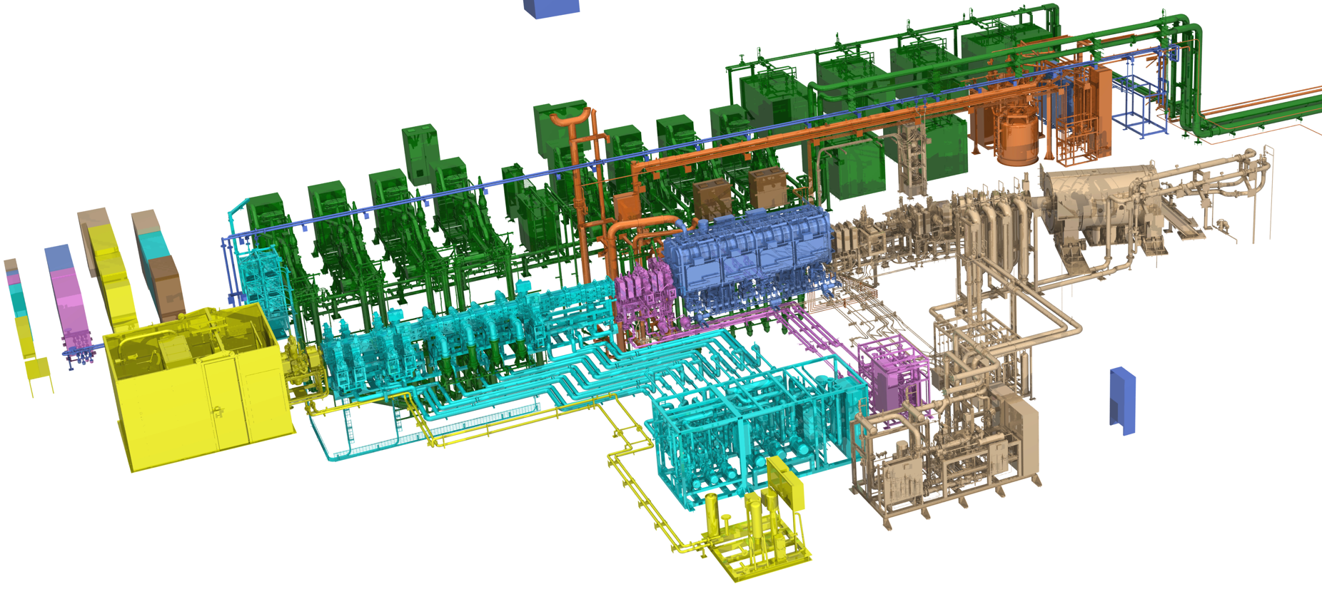
LIPAc RFQ SSPA layout
8 RF chains to replace current LIPAc’s RFQ tetrode based RFPS

Slide 19
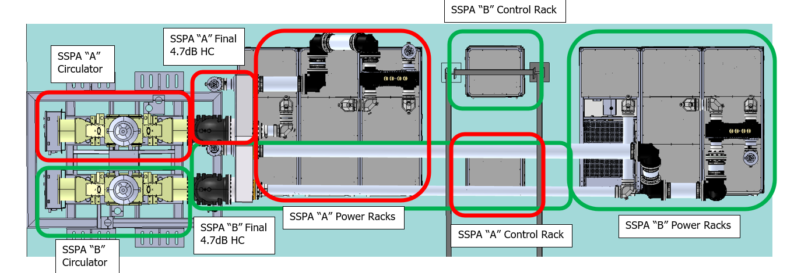
SSPA Design overview
Key features
Modularity: SSPA consists of two chains, "A" and "B", potentially allowing for independent operation and maintenance.
Power Amplifier Modules: Utilizes MAB702C01 modules with ART2K0FE transistors for high gain and hot-swappable capability.
Power Distribution: Features a passive power splitting system for signal distribution and a power combining system for signal summation.
Cooling System: Integrated cooling system to manage heat and maintain performance.
Better sustainability thanks to lower electrical consumption
Control Subsystem: Includes a PLC and a main data gateway for operation monitoring and implementing protections.
Measurement and Protection Unit (MPU): Measures input/output power and implements safety protections.
Design Justification: Ensures compatibility with the RF chain and focuses on reliability, efficiency, and safety.

Slide 20
RAMS Approach
Methodology
Comprehensive RAMS analysis ensures the SSPA system meets high standards of reliability, availability, maintainability, and safety.
MoSCoW method helps prioritize and validate requirements effectively
Analysis
SSPA system reliability thoroughly assessed to ensure the overall availability of the 8-chain system exceeds 98%.
Assessment based on detailed calculations of the MTTF for critical components and implementation of redundancy to enhance reliability
MTTF of critical components, such as power transistors, driver transistors, and power supplies, calculated based on their operating conditions
Redundancy to enhance reliability. Particularly MTTF of the complete power amplifier module with redundant power supplies is estimated at 710,000 hours (81 years)
One of the three power supplies in the module is redundant
 | Failure rate (λ) (failures/hour) | MTTF (hours) | MTTF (years)
ART2K0FE (λ_{Trt1}) | 1.46∙10⁻⁸ | 6.84∙10⁷ | 7813
ART150FE (λ_{ART150FE}) | 3.4∙10⁻⁹ | 2.9∙10⁸ | 33472
MAB500P01 Driver Amplifier | 6.8∙10⁻⁹ | 1.46∙10⁸ | 16736
Power Supplies (DC/DC Converters) | 1.1∙10⁻⁶ | 9∙10⁵ | 103
Complete module MAB702C01 (with Redundant Power Supplies) |  | 7.1∙10⁵ | 81
New SSPA
MAB702C01 Power amplifier: Left front view, right rear view(b).

Slide 21
RAMS Approach (cont’d)
Tolerance to component failure
The overall SSPA system includes 30 power amplifier modules,
System is designed to tolerate failures in up to 10 transistors (equivalent to a whole power amplifier module and 4 individual transistors in failure), without affecting the output power requirements.
Overall SSPA System Reliability
For the entire SSPA system, the redundancy in power amplifier modules and power supplies is taken into account, resulting in a high overall MTTF.
The 8-chain SSPA system's reliability is calculated without any redundancy between the chains,
Overall MTTF is 55,551 hours (6.34 years).
Availability
MTTR can be maximized by increasing MTTF or/and minimizing MTTR.
$$Availability=\frac{MTTF}{MTTF+MTTR}>98\%$$

Slide 22
RAMS Approach (cont’d)
Strategy to minimize MTTR
Modular design with pluggable modules
modules are hot-swappable and integrate all the active connections in the rear panel ➔ Maintaining operational continuity and safety
Connectors designed so that hot disconnection/connection sequences can be performed safely without any risk of electric arcs, high VSWR (Voltage Standing Wave Ratio) or oscillations.
Standardized and interchangeable components within the modules so that can be quickly swapped out
Power transistors (e.g., ART2K0FE) and driver transistors (e.g., ART150FE) are standardized components ➔ Ease spare part management
Technicians can be trained to handle standardized components, making repairs and maintenance more efficient
Spare modules and parts readily available on-site
Technicians can quickly replace the faulty module with a spare and then repair the faulty module offline
Easy access and maintenance
Accessible Design ➔ Technicians can quickly reach and replace faulty modules or component
Clear documentation
Trained Personnel
Automated Diagnostics
Measurements and Protections Units: detect and measure input, forward, and reflected RF power ➔ providing fast protection against overdrive, power exceedances, and gain loss by inhibiting the RF input signal to ensure system safety and reliability
Parameter Monitoring: system measures over 600 parameters every second, including currents, voltages, temperatures, and power levels across various components
Alarm and Warning Thresholds: Configurable thresholds for alarms and warnings.

Slide 23
Conclusion
LIPAc is the prototype accelerator for the IFMIF facility and more particularly DONES which has started
While LIPAc’s primary purpose was to demonstrate performance, enhancements have started to assess operational availability, reliability and maintainability ➔ Important inputs for DONES
Key identified subsystems identified based on operational experience: Injector, RFPS, MPS, couplers
The examples of the injectors and RFPS are presented to illustrate how the RAMS approach is integrated from the very beginning of the procurement up to the commissioning and exploitation phases
Thank you for your attention
Mont Iwaki from Hirosaki –Aomori prefecture

Slide 24
Summary
Thank you for your attention
Mont Iwaki from Hirosaki –Aomori prefecture
Notes:
Thank you for your attention. I look forward to your questions and comments

Slide 25
Upgrade of the IFMIF Injector – Technical Specification
3.3. WP3000 – Verification and validation of the technical proposal – Stage 2
T3010 – Engineering, manufacture and procurement of components and parts
T3020 – Additional developments – Test facility (EU)
T3030 – Verification tests of critical components
T3040 – Assembly, integration, and check-out at test facility
T3050 – Factory Acceptance Tests and injector characterization at test facility
T3060 – Instruction documentation
T3070 – Review and approval
D2 – Verification and Validation Dossier
D2.1 – Eng., manufacture, and procurement documentation
D2.2 – Additional development documentation
D2.3 – Verification of critical components report
D2.4 – Assembly, integration, and check-out report
D2.5 – Factory Acceptance Tests report
D2.6 – Instruction documentation
Updated
D1.3 – Safety Analysis Report
Presentation and review of [D2] at a LIPAc Engineering Meeting with the attendance of the F4E, QST and/or IFMIF-DONES and any experts appointed by them.

