Slide 2
Towards safe and reliable Neural Network controllers
CERN Industrial Control Systems group (BE-ICS)
Borja Fernández Adiego (CERN BE-ICS) Borja.Fernandez.Adiego@cern.ch
Ignacio D. Lopez-Miguel (TU Wien university)
Xaver Eugen Fink (CERN BE-ICS)
Thanapong Sommart (Osaka University)
Enrique Blanco Viñuela (CERN BE-ICS)

Slide 3
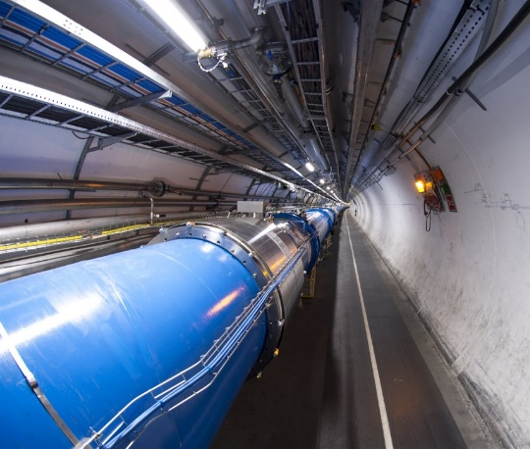
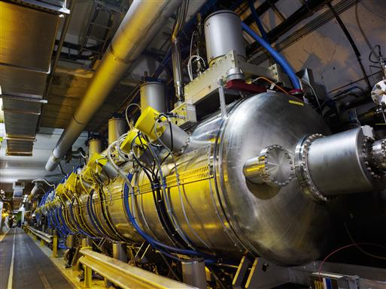
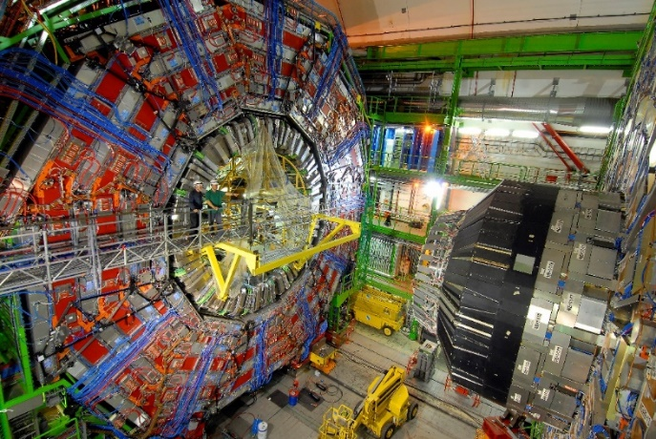
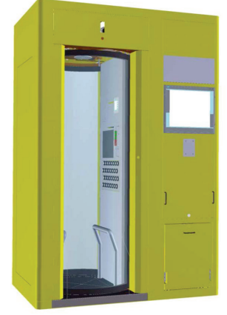
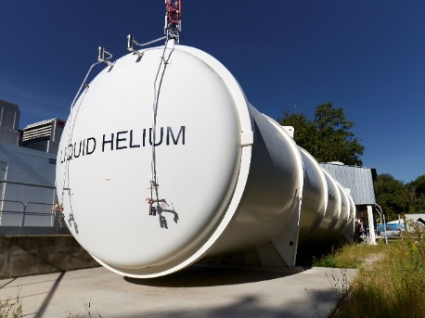
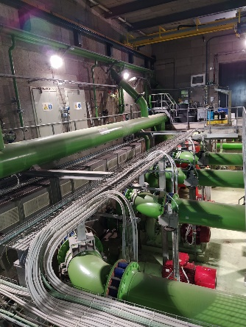
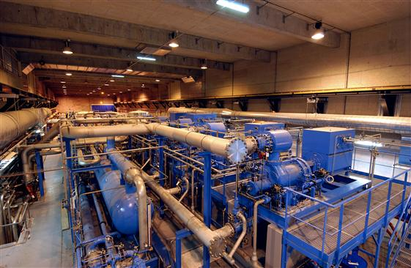
Context
CERN
LHC
(Large Hadron Collider)
Access and protection systems
Cryogenics plants
Cooling and ventilation systems
Superconducting magnet test benches
Images from cds.cern.ch

Slide 4
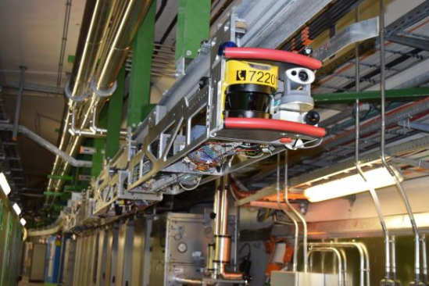
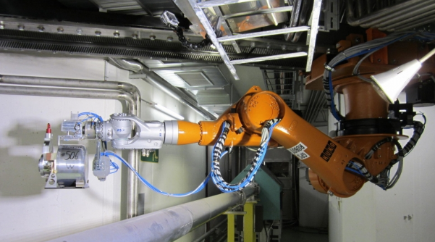
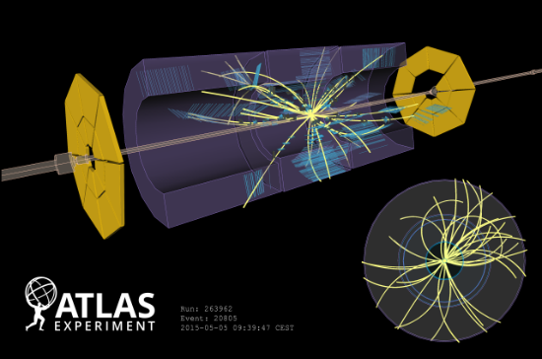
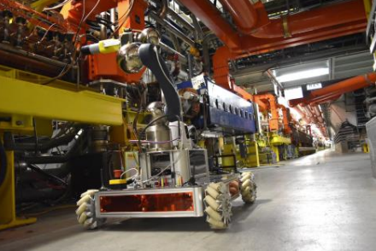
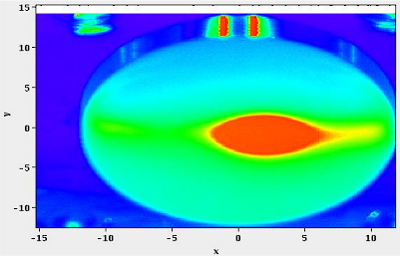
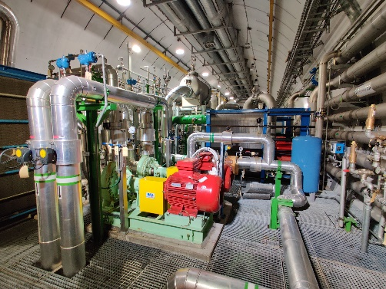
Context
Machine learning at CERN
Robotics
Data analysis of the physics experiments
Particle accelerators Operation and beam optimization
Industrial controls
Images from cds.cern.ch

Slide 5
Context
Machine learning at CERN
Kain, Verena, et al. “Sample-efficient reinforcement learning for CERN accelerator control.” Physical Review Accelerators and Beams 23.12 (2020): 124801
Robotics
P. Arpaia, et al. “Machine learning for beam dynamics studies at the CERN Large Hadron Collider.” Nuclear Instruments and Methods in Physics Research Volume 985, 1 January 2021, 164652
Ghawash, Faiq, et al. "Approximate Model Predictive Control of Switched Affine Systems using Multitask Learning with Safety and Stability Guarantees. 62nd IEEE Conference on Decision and Control (CDC), December 2023"
Particle accelerators Operation and beam optimization
Industrial controls
Images from cds.cern.ch

Slide 6
Motivation
Can we trust Neural Networks for critical applications?
In general, software failures in controls can have significant negative consequences
And Neural Network controllers?
Neural network improves efficiency/cost
Difficult to predict the behavior in all situations
Accelerator downtime
Equipment damage
Reputation loss
Environmental pollution
Personnel safety
Financial loss

Slide 7
Roadmap
Why neural-network based controllers
Formal verification of neural-network based controllers
Formal methods introduction
Standards and state of the art for verification of NNs
Case study at CERN (our first steps)
Conclusions and future

Slide 8
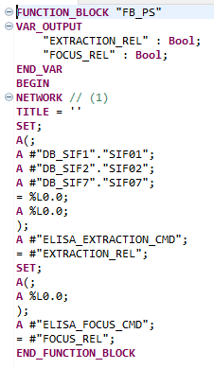
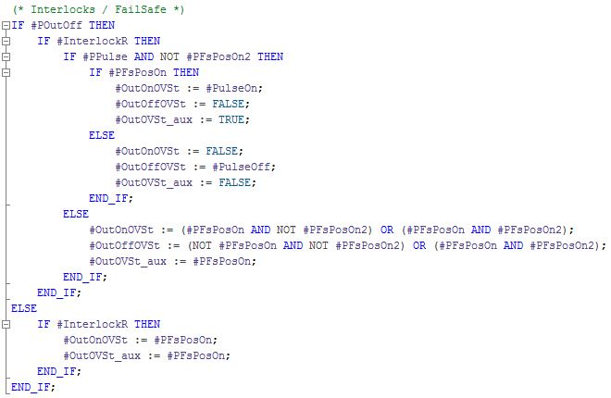
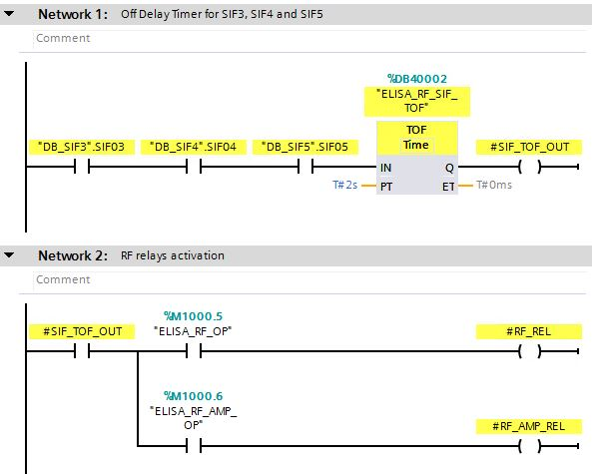
Why NN-based controllers?
… instead of “traditional” controllers

Slide 9
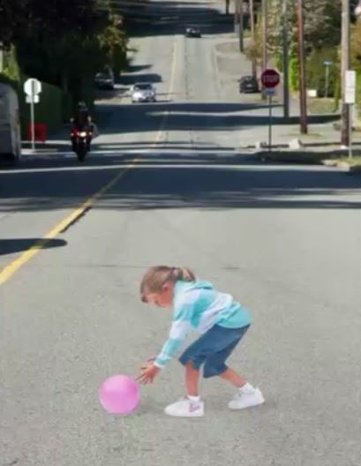
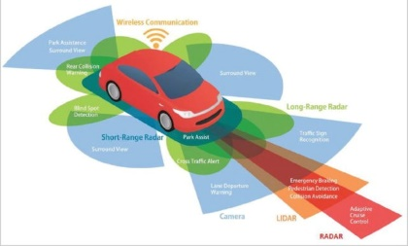
Why NN-based controllers?
Many applications
$$x_{i}$$
$$y_{i}$$
NN (controller)
System/
Plant
Tasks hard to specify
Autonomous driving
Computationally fast
Matrix multiplication
Versatile
Non-linearities
No need to linearize
Only data needed
No physical modelling required
Collect data
Several rule exceptions
Rare but critical events
Changes in the environment
Pisarov, Jelena & Mester, Gyula. (2020). The Future of Autonomous Vehicles. FME Transactions. 49. 29-35. 10.5937/fme2101029P.

Slide 10
Challenges NN-based controllers?
A few challenges to solve
From Keynote Talk at the NASA Formal Methods Symposium by Professor Simon Burton
https://conf.researchr.org/home/nfm-2024#program
“Safety under uncertainty: Automotive standards for AI safety and research perspectives”
Data as specification:
Does the data accurately represent the intended behavior in all scenarios?
How to demonstrate coverage?
Which KIPs/metrics can be used?
…
Model uncertainty and explainability:
Lack of generalization and robustness (residual errors) due to insufficient training data
Prediction uncertainty
…

Slide 11
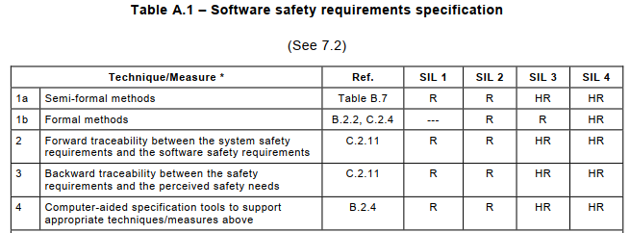
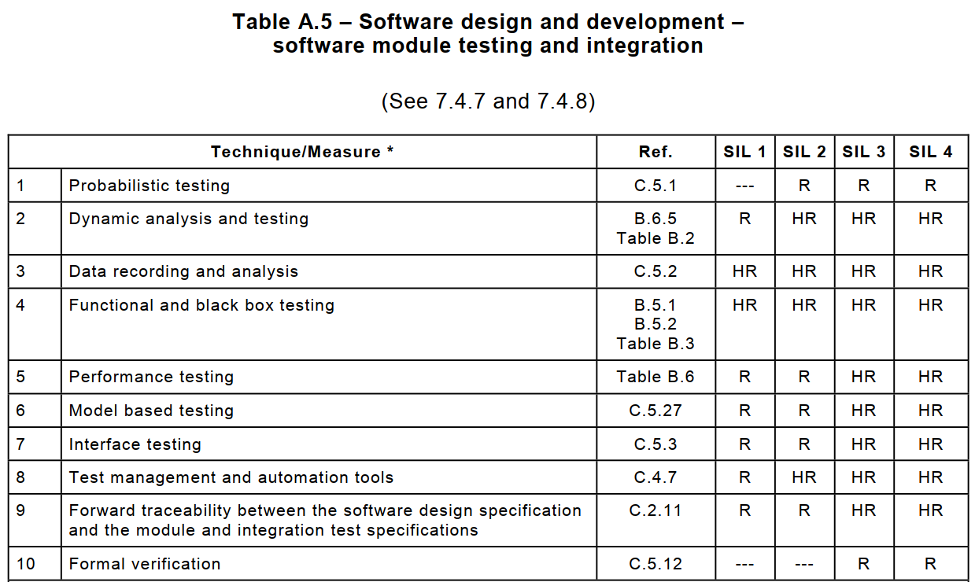
Standards for NNs?
Formal methods and NNs
Functional safety standards like IEC 61508 recommend the use of formal methods
What about AI for critical applications?
ISO/IEC 24029-2:2023: Artificial intelligence (AI) - Assessment of the robustness of neural networks - Part 2: Methodology for the use of formal methods
Extensions to Functional Safety standards. ISO 26262 and ISO 21448 with ISO PAS 8800: Road vehicles – Safety and Artificial intelligence https://www.iso.org/standard/83303.html (in progress)
(?) Aerospace industry is also pushing to extend standards like DO-178C (Software Considerations in Airborne Systems and Equipment Certification) to assess AI reliability by using formal methods (See NFM 2024 program https://conf.researchr.org/home/nfm-2024#program)

Slide 12
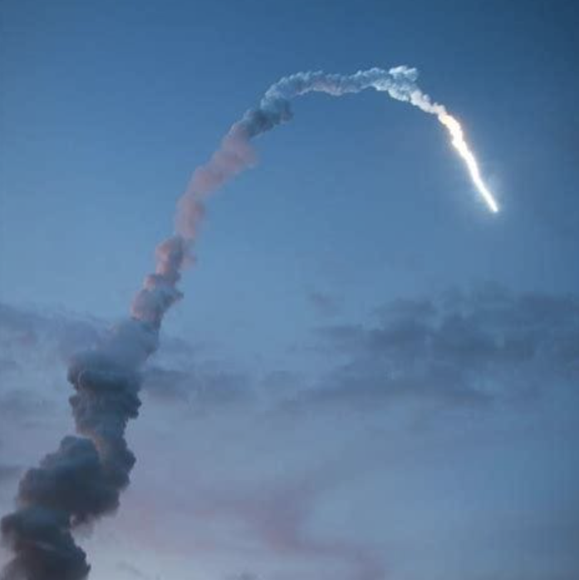
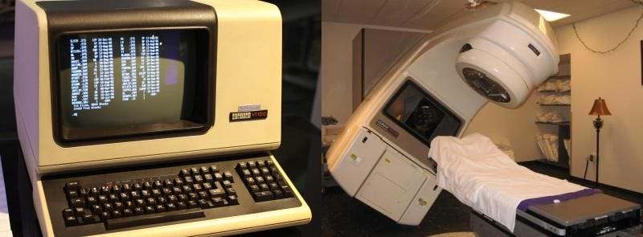
Formal Methods
Ariane-5 satellite rocket accident
(June 1996)
US$370 million
Software bug
https://www.youtube.com/watch?v=5tJPXYA0Nec
How to produce reliable software?
Therac-25 Radiation Overdosing
(1985-1987)
6 cases of overdoses (3 of them died)
Software bug
https://www.youtube.com/watch?v=41Gv-zzICIQ

Slide 13
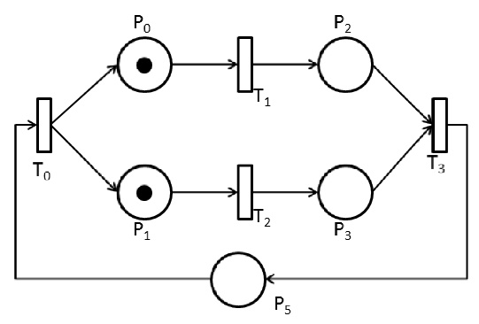
Formal methods
… and formal verification (e.g. model checking)
Techniques based on mathematics and formal logic (precise semantics)
Graphical languages
Textual languages
Mathematical languages
Petri nets, automata, …
B-method, VDM, TLA+,…
Temporal logic, propositional logic, Z notation,…
Petri net
B-method
MACHINE
Switch
SETS
STATE = {closed, open}
VARIABLES
state
INVARIANT
state : STATE
INITIALISATION
state := open
OPERATIONS
toggle =
IF state = open
THEN
state := closed
ELSE
state := open
END ;
END
Temporal
logic
Formalization of the specification properties
Model checking
$$AG((a∧b)→c)$$
Automata
Propositional
logic
init
Model of the system
Model checking
(a formal verification technique)
in ← IntNonDet()
$$\text{(}\text{A}\text{ → }\text{B}\text{) ⊢ (¬}\text{B}\text{ → ¬}\text{A}\text{)}$$
in>10
l0
in≤10
l1
l2
out1 ← False
out1 ← True
out2 ← True
out2 ← False
l3

Slide 14
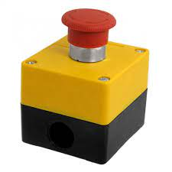
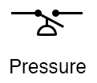
Formal Verification
Formal verification vs Testing
Input1
Controller
software
Input2
Output1
Input3
Output2
Sensors
Input4
Actuators
Functionality requirement
Safety requirement
If Input1 is False, then Output1 is False
If Output1 is False, then Output2 is True
If “Input1”, “Input2”, “Input3” and “Input4” are BOOL, then we need to check 2⁴ = 16 combinations
If they are INT (16-bit), then 2^{16*4} ≈ 1.8*10¹⁹ combinations
for large systems (many variables), such requirements cannot (practically) be checked by using testing techniques
Peer reviews and testing can (normally) catch most of the “problems” (e.g. code bugs), but not the corner cases
Solution: Model checking
Model of control software (e.g., automata)
Formalize the requirement (e.g., temporal logic)
Explore all combinations in the model to find a violation of the requirements
Model Checking lectures (RWTH Aachen university) https://www.youtube.com/watch?v=Y5Hg4MvUXc4&list=PLwabKnOFhE38C0o6z_bhlF_uOUlblDTjh

Slide 15
Formal methods and verification
in industry
Formal specification
Formal verification
Correctness, Modelling and Performance of Aerospace Systems
http://www.compass-toolset.org
Integration of their static analyser INFER into their software development process https://www.inf.ed.ac.uk/teaching/courses/sp/2019/lecs/distefano-scaling-2019.pdf
Using TLA+ to create a clear and concise specification, leading to a subsequent code reduction https://cacm.acm.org/magazines/2015/4/184701-how-amazon-web-services-uses-formal-methods/fulltext
NASA AMES Robust Software Engineering group
https://www.nasa.gov/isd-robust-software-engineering
Use of the model checker SPIN to verify the model of a software
http://spinroot.com/gerard/pdf/spin04.pdf
Use of the formal specification language VDM to specify industrial applications https://www.researchgate.net/publication/2879682_The_IFAD_VDM-SL_toolbox
Verification of neural-network-based control systems in non-towered airports to avoid collisions at landing
https://www.researchgate.net/publication/356096882_Formal_Analysis_of_Neural_Network-Based_Systems_in_the_Aircraft_Domain
And many more …
Formal Verification of Critical Aerospace Software https://hal.archives-ouvertes.fr/hal-01184099/document
15

Slide 16
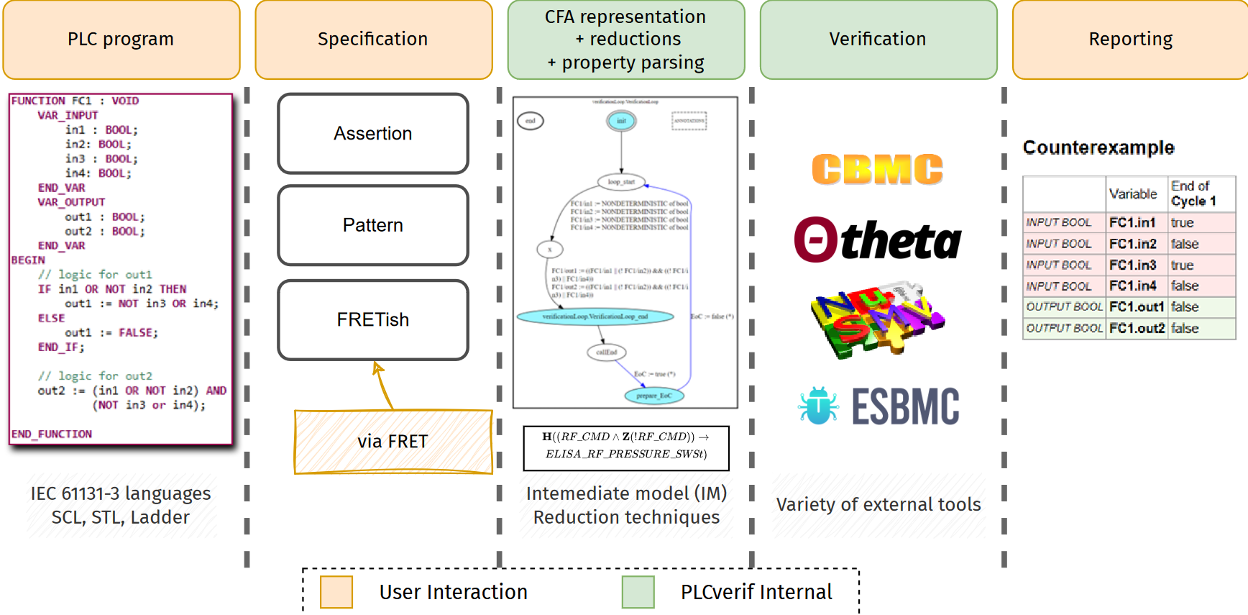
Formal verification at CERN
… of PLC programs (PLCverif tool)
PLCverif
16

Slide 17
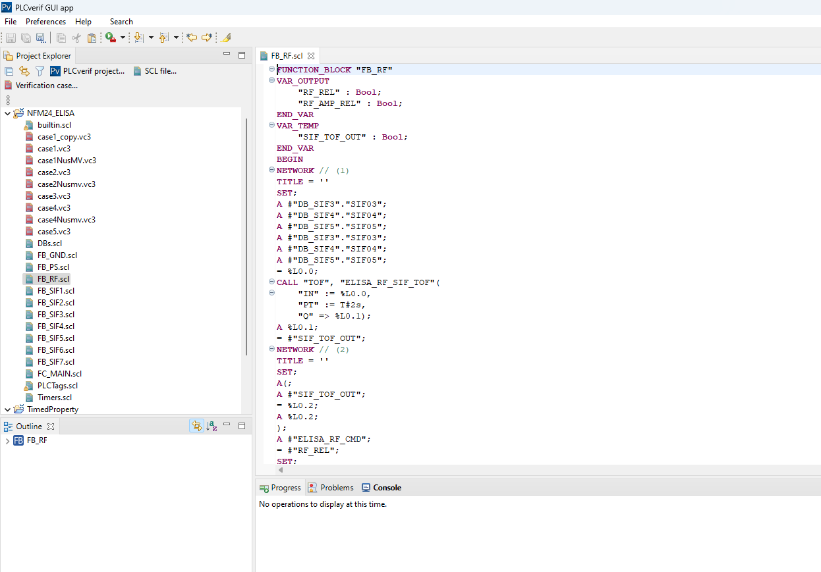
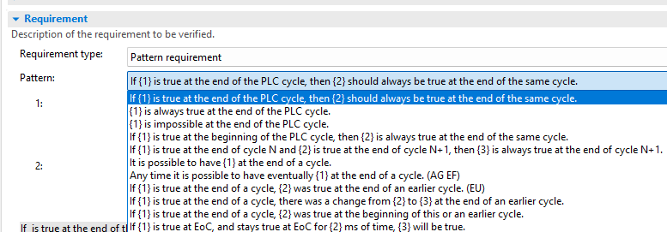
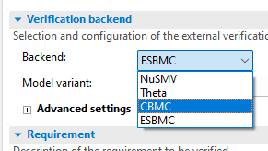
Formal verification
… of PLC programs at CERN (PLCverif tool)
PLCverif
https://gitlab.com/plcverif-oss/
17

Slide 18
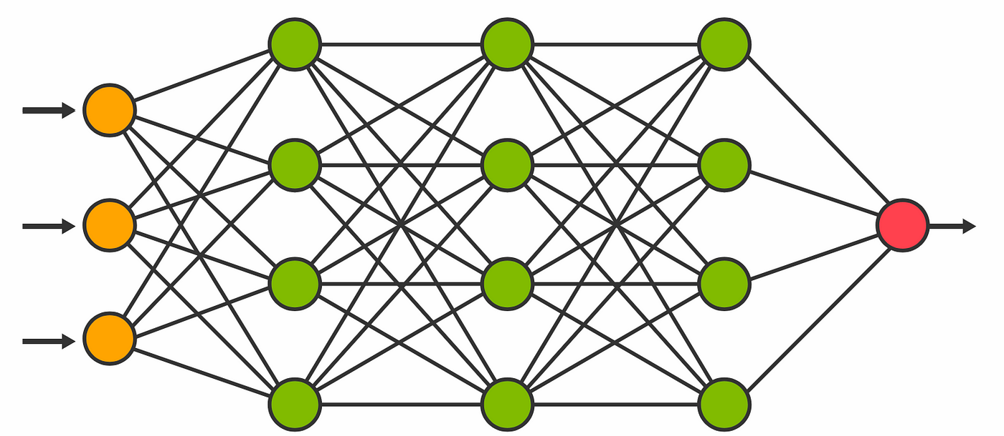
Formal verification of Neural Networks
Any tool available?
https://sites.google.com/view/vnn2023

Slide 19
Formal verification of NNs
State of the art (not exhaustive)
T. Sommart summer internship report at CERN https://cds.cern.ch/record/2867415
Tool | method
alpha-beta CROWN | linear bound propagation and the branch and bound method for adversarial search
nnenum | zonotopes for over-approximation and geometric path enumeration for efficiently splitting ReLU networks
VeriNet | symbolic interval propagation and a branch-and-bound-based method
Check VNN competition (since 2020) https://sites.google.com/view/vnn2023
Many research initiatives (for example check NASA Formal Methods 2024 symposium)

Slide 20
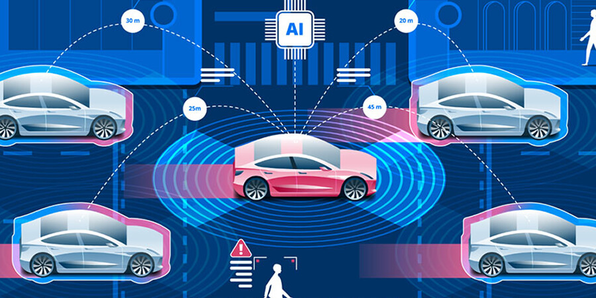
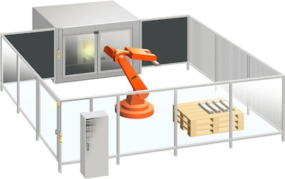
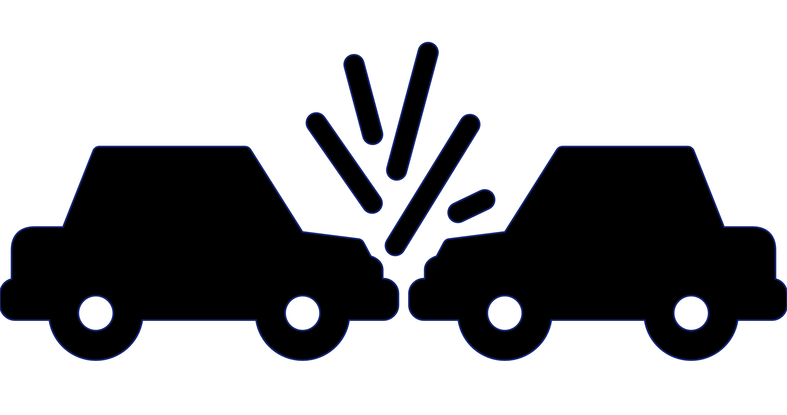
Formal verification of NNs
Which properties should we verify?
Robustness
Monotonicity
Safety
Explainability
Output
Output
Is it possible that a given situation ever occurs?
Is there a combination of inputs that leads to a given output?
Image
Noise
Safe region
Input
↑ Temperature → ↑ Fan speed
Input
Reachability
Stability
System’s output
System’s output
Dangerous curve to the right
+ noise
Children crossing
Time
Time

Slide 21
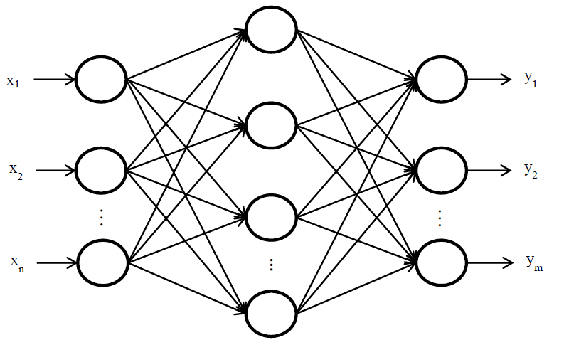
Formal verification of NNs
General approach (user perspective)
NN model
✓
NN Model
(*ONNX Format)
Property OK
Result
(SAT / UNSAT)
✗
(declare-const X_0 Real)
(declare-const X_1 Real)
(declare-const X_2 Real)
(declare-const Y_0 Real)
(declare-const Y_1 Real)
(declare-const Y_2 Real)
(assert (>= X_0 20.0))
(assert (<= X_0 25.0))
(assert (>= X_1 23))
(assert (<= X_1 27))
(assert (>= X_2 8.0))
(assert (<= X_2 21.0))
(assert (>= Y_2 Y_0))
(assert (>= Y_2 Y_1))
Specification
(VNNLIB Format)
Specification
(list of properties)
NN Verifier
Property failed
Trace leading to the violation
e.g. nnenum
* Open Neural Network exchange

Slide 22
Formal verification of NNs at CERN
Where are we?
Previous experience in formal methods applied to PLC programs (since ~ 2013)
Case study in 2023: Verification of NN controller for LHC Cooling Tower
Evaluation of existing NN-verification tools by summer student in 2023
~ 20 publications related to this project + PLCverif tool
Ignacio D. Lopez-Miguel et al. “Verification of Neural Networks Meets PLC Code: An LHC Cooling Tower Control System at CERN”.
In EANN 2023: Engineering Applications of Neural Networks conference https://link.springer.com/chapter/10.1007/978-3-031-34204-2_35
Thanapong Sommart report. “Formal Verification of Neural Networks”. https://cds.cern.ch/record/2867415

Slide 23
CERN case study
LHC cooling towers

Slide 24
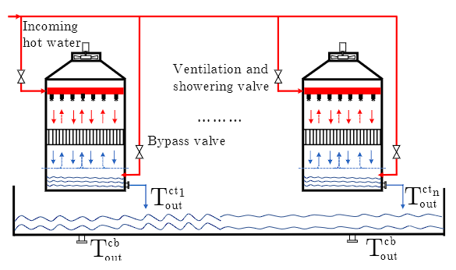
CERN case study
LHC cooling towers control
Induced draft cooling towers (IDCTs)
Provide cold water for different LHC subsystems (e.g. cryogenics, chillers, air handling units, etc.)
Control actions:
Mode selection:
Ventilation
Showering
Bypass
Fan speed
Control objective:
Keep outlet water temperature within strict limits
Utilize minimum amount of energy
regression
Ghawash, F., Hovd, M., Schofield, B.: Model predictive control of induced draft
cooling towers in a large scale cooling plant. IFAC-PapersOnLine 55(7), 161–167
(2022) https://www.sciencedirect.com/science/article/pii/S2405896322008394
NN
$$fan_{speed}$$
Neural Network controller
$$t_{wetbulb}$$
Model predictive controller (MPC)
$$t_{supply}$$
common
NN fan
IDCT
$$t_{outlet}$$
The idea was replacing the MPC by a NN
But the NN is NOT DEPLOYED YET!!
NN mode
$$mode$$
classification

Slide 25
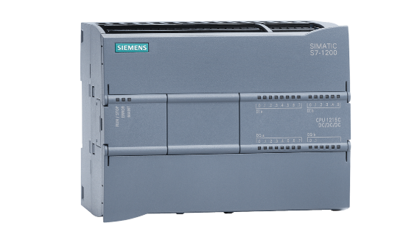
CERN case study
NN on a PLC
Neural network will be implemented in a PLC (Programmable Logic Controller)
Siemens S7-1200
Why NN on PLCs?
Widely used in the process industry
Hardware robustness
Communication capabilities
Modularity
Simple to be programmed
NN on PLC code (structured control language)

Slide 26
CERN case study
Initial non-conventional NN architecture
LHC cooling towers control
Hidden layers
Input set
+bias
+bias
+bias
+bias
Output set
$$t_{wetbulb}$$
$$t_{supply}$$
ReLU
ReLU
ReLU
ReLU
ReLU
Regression
problem
$$Fan Speed$$
$$t_{outlet}$$
+bias
+bias
+bias
Feedforward NN with ReLU and SoftMax activation functions
Developed and trained with Python Keras
Automatically translated to S7-1200 Siemens PLC Structured Control Language (SCL)
$$Ventilation$$
ReLU
ReLU
Softmax
Classification
problem
$$Showering$$
$$Bypass$$

Slide 27
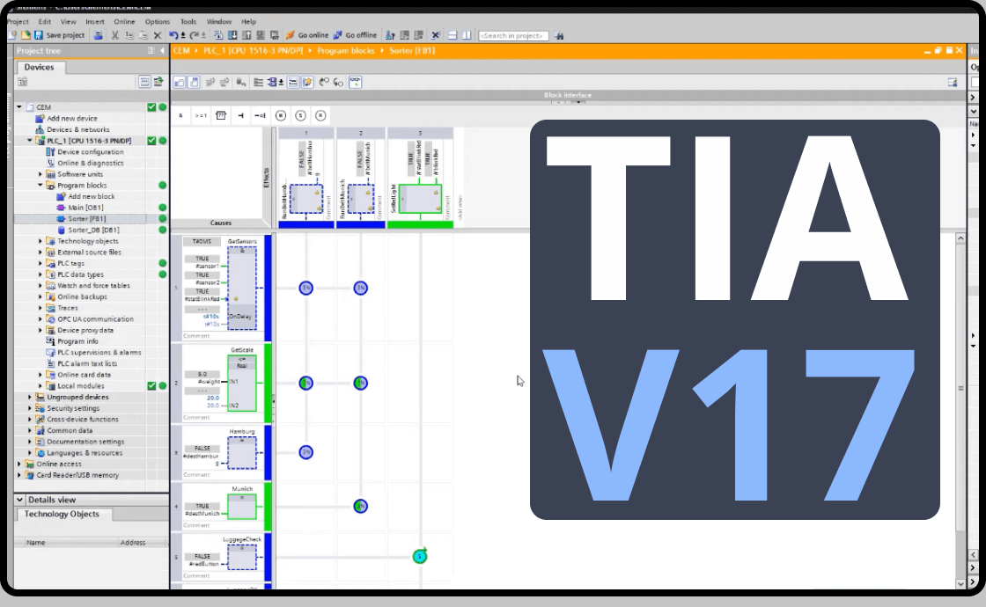
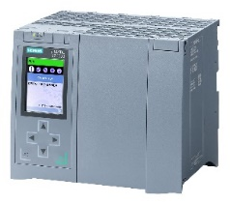
CERN case study
How to verify these properties?
Different methods were applied and compared:
nnenum: an open-source NN verification tool for ReLU NNs from Stony Brook University https://github.com/stanleybak/nnenum
Z3: an open-source theorem prover from Microsoft Research https://github.com/Z3Prover/z3
PLCverif: an open-source formal verification tool for PLC programs from CERN https://gitlab.com/plcverif-oss
Testing: traditional testing techniques
NN design
PLC source code
Executable
Ignacio D. Lopez-Miguel et al. “Verification of Neural Networks Meets PLC Code: An LHC Cooling Tower Control System at CERN”. In EANN 2023: Engineering Applications of Neural Networks conference https://link.springer.com/chapter/10.1007/978-3-031-34204-2_35

Slide 28
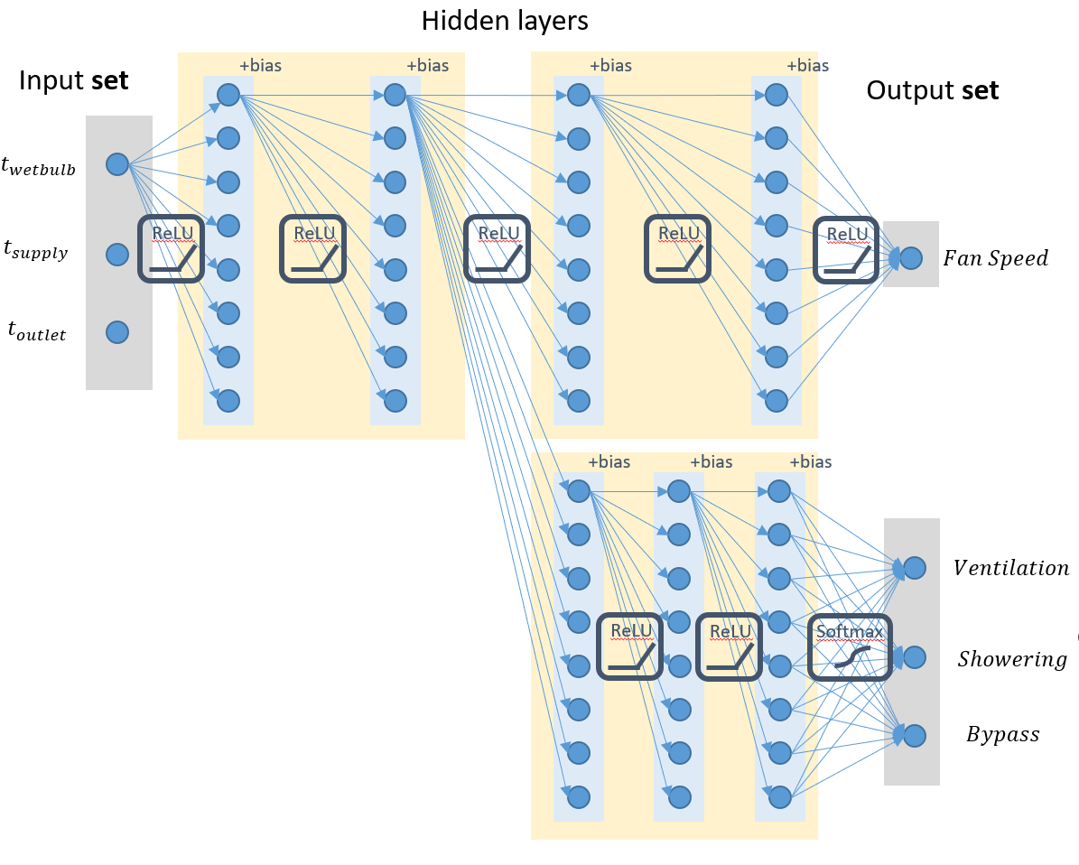
CERN case study
Some properties to be verified
Operational modes reachability
They represent problems
Monotonicity
They help to better understanding the NN
Fan speed
Ventilation
Input1
$$s_{0}$$
Showering
Input2
$$s_{1}$$
Bypass
Input3
Do these inputs exist?
$$t_{0}$$
$$t_{1}$$
Temperature
Find an example that satisfies where
a set of $\{x_{0},x_{1},x_{2}\}$ such that$(y_{0}≥y_{1}∧$ $y_{0}≥y_{2})$
Do $t_{0}<t_{1}$exist such that $s_{0}>s_{1}$?
(declare-const X_0 Real)
(declare-const X_1 Real)
(declare-const X_2 Real)
(declare-const Y_0 Real)
(declare-const Y_1 Real)
(declare-const Y_2 Real)
(assert (>= X_0 20.0))
(assert (<= X_0 25.0))
(assert (>= X_1 23))
(assert (<= X_1 27))
(assert (>= X_2 8.0))
(assert (<= X_2 21.0))
(assert (>= Y_0 Y_1))
(assert (>= Y_0 Y_2))
Inputs (temperatures)
Property encoding (vnnlib)
Outputs (op. modes)
Range of the inputs:
$$25≥x_{0}≥20$$
$$27≥x_{1}≥23$$
$$21≥x_{2}≥8$$
Property to verify:
$y_{0}≥y_{1}∧$ $y_{0}≥y_{2}$

Slide 29
Conclusions and future
Formal methods and formal verification

Slide 30
Conclusions and future
Formal verification of NN-based controllers
Formal methods and verification are now widely used in critical industries for software (recommended by standards)
Formal verification of NNs is a (relatively) new research trend
There are still many challenges to overcome
However, the existence of tools, guidelines from IEC and ISO, and critical industries are pushing towards the goal of designing “Safe Neural Networks controllers“
In general, it is mportant to verify NN-based controllers to:
guarantee properties such as robustness, stability, safety, etc.
have a better understanding of the behaviour of the NN
Our plans – PhD in formal verification of NNs (starting Sept. 2024):
How to specify complex properties?
Verification capabilities and performance
Repair/train/explain when finding a violation
Robust neural network training

Slide 31
Conclusions and future
Not only formal verification for NN controllers
NN-based controllers
NN design
NN design verification
Code synthesis
Formal verification (model checking)
Compositional verification
Counterexample analysis
Source code
Executable
Runtime monitoring
Testing

