Slide 1
World Tour Panel Session
benjamin.todd@cern.ch version 9
v3

Slide 2
2002 → 2024: 22 years of ARW
2002
2009
2011
2013
2015
2017
2019
2022
2024
ESRF
Grenoble
iTHEMBA
Cape Town
ORL, SNS
Knoxville
IHEP
Guangzhou
ESS/MAX IV
Helsingborg
TRIUMF
Vancouver
Australian
Synchrotron
Melbourne
SOLEIL
Paris
JLAB
Newport News

Slide 3
9
2
6
1
8
5
7
3
4

Slide 4
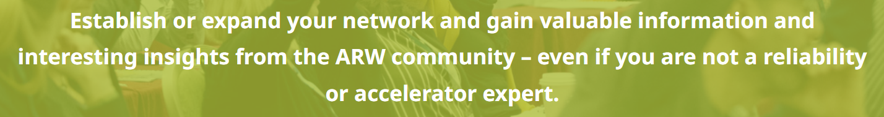
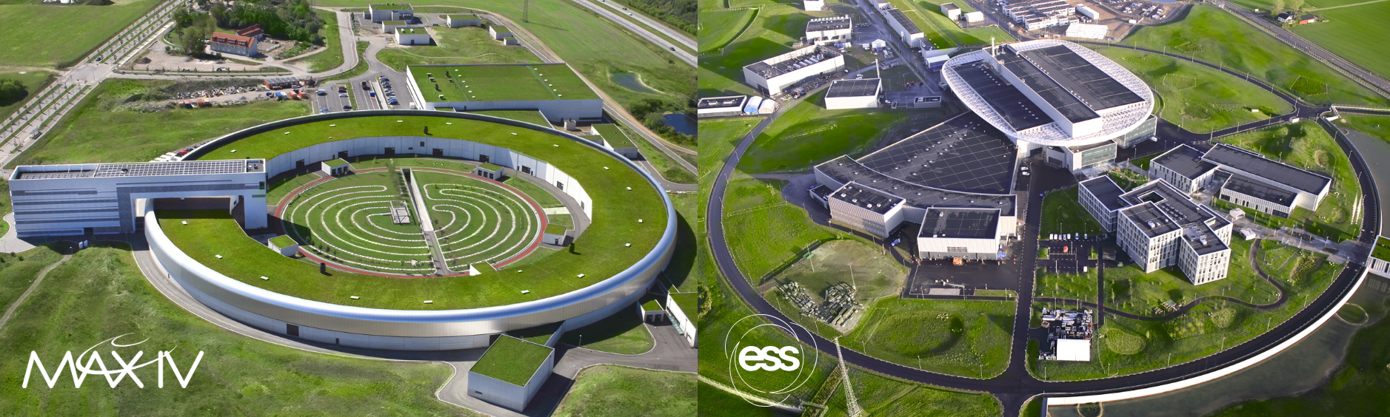
It’s our Workshop… To…

Slide 5
Now to the Tour…

Slide 6
Where does reliability fit?
Evolving nature of our work in the last decade:
The changing nature of our technical facilities
Consolidation → performance improvement → entirely new
The changing nature of our work and workforce.
individuals → teams → collaborations → in-kind → AI
The changing nature of our institutes
pure scientific pursuit → return on investment
A worldwide interest in this challenging issue
How to get the most out of our machines

Slide 7
…at the end of ARW 2022
The major reliability themes emerged that applied almost universally to our domain
Handling diverse viewpoints: equipment vs operation vs directors
Creating tools and deriving statistics to inform ourselves
Designing and operating large, complex systems, assets, manging different risk profiles
Understanding failures, and making maintenance core business
Make our machines work at the limit of their ability, but not beyond.
managing equipment and facility lifetimes of decades vs. industrial lifetimes of months.
All the while managing the changing nature of; facilities, personnel, sponsors

Slide 8
…at the end of ARW 2024?
Identify some core themes we should start to think about.
I would argue that reliability is the core business we must concentrate on in our domain.
When we say Reliable; people hear dependable, efficient, safe, maintainable, with diagnostics, testable, easy to commissioning, east and cheap to operate…
Get the most out of our present and future facilities, by sharing thoughts, lessons and ideas.

Slide 9
About me
B. Eng. Electrical and Electronic Engineering
Ph.D. Dependable Electronic Control Systems
Chartered Engineer
Fellow of the Institute of Engineering and Technology
10 years engineering machine protection systems, then
10 years section leader for all CERN power converter controls electronics, with
8 years availability working group co-chair
Our organisations demand “reliable” equipment…

Slide 10
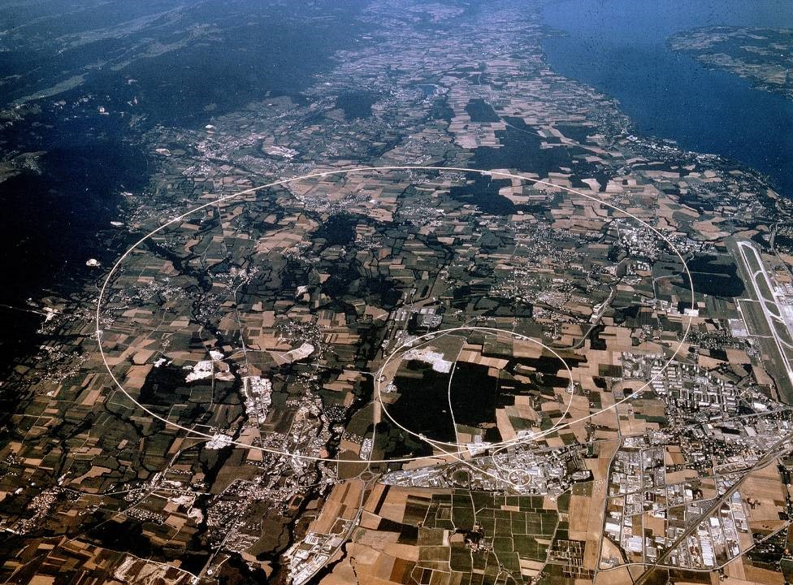
Large Hadron Collider
(LHC)
Super Proton Synchrotron
(SPS)
Proton Synchrotron
(PS)

Slide 11
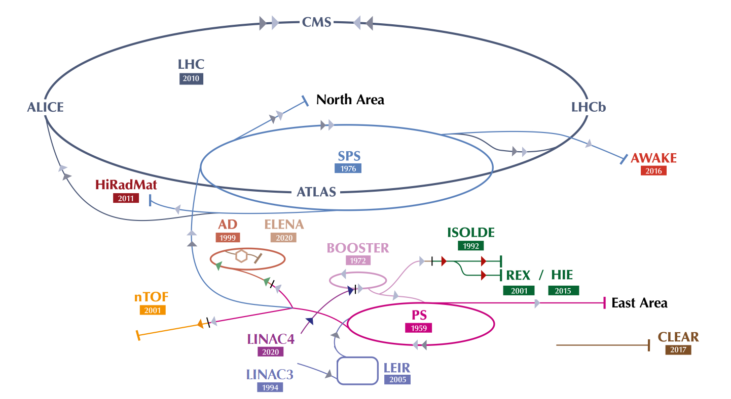
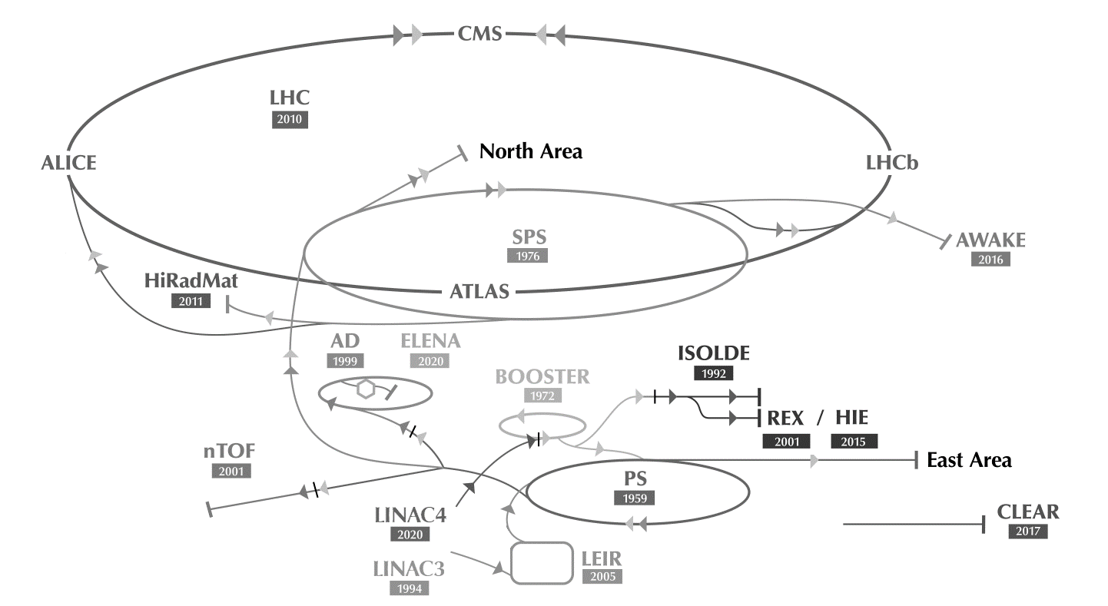

Anti-Protons
Radioactive Ions
Neutrons
Protons
Hydrogen Ions
Electrons
Heavy Ions

Slide 12

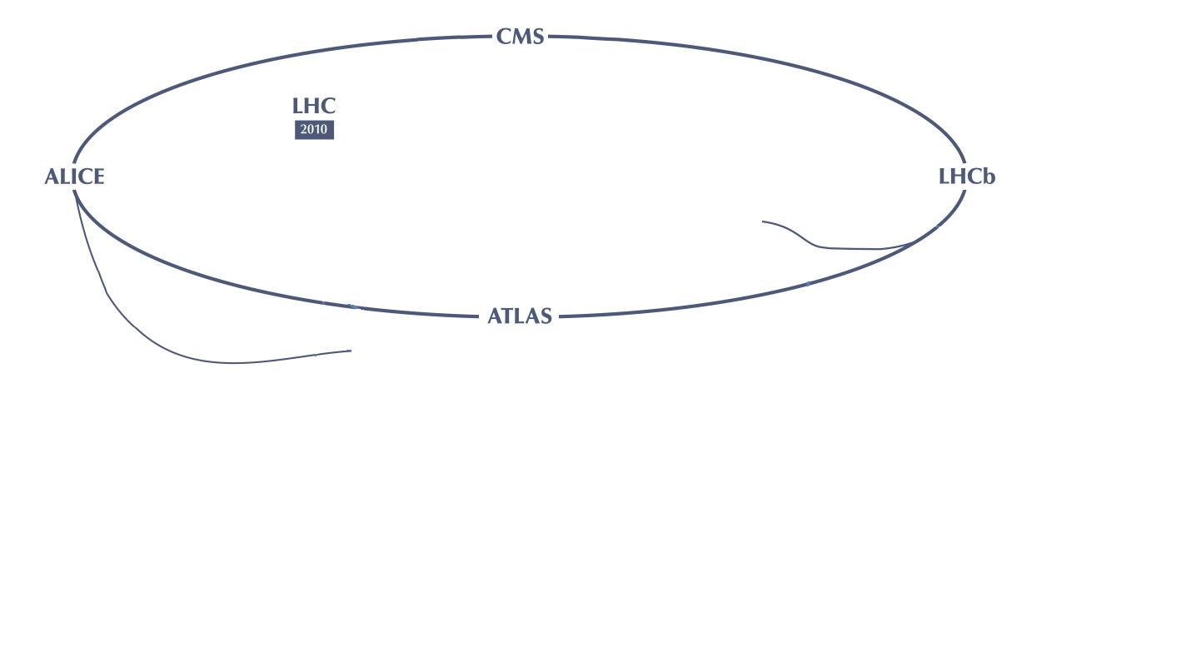

Slide 13
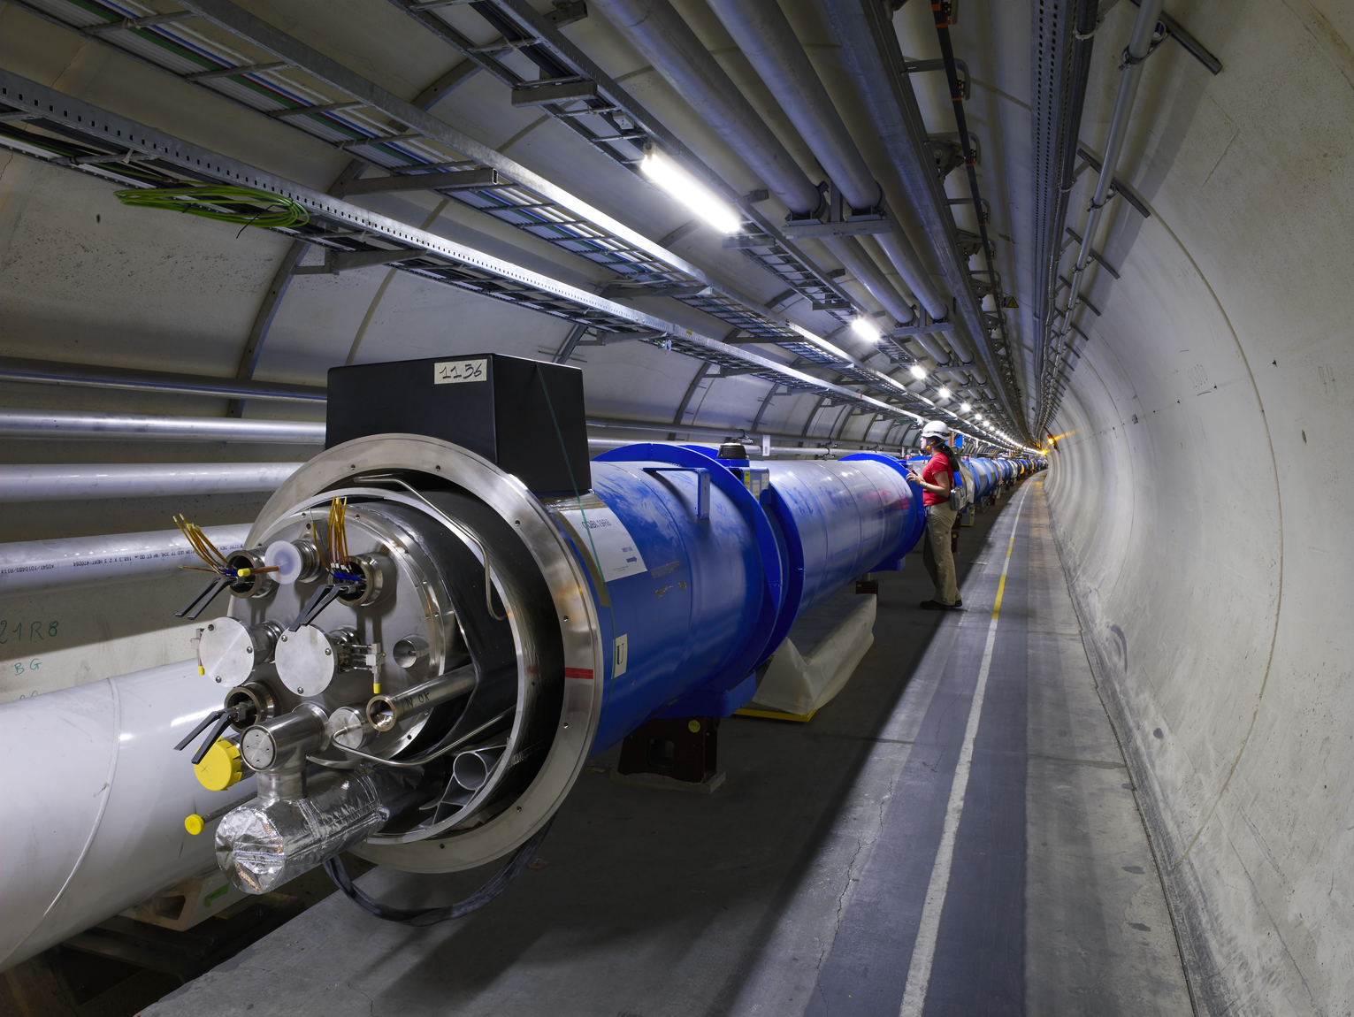
LHC
LHC operates for 12 hours, then takes 2 hours to refill
“Reliable” means should not break during operation
high performance for field regulation: ppm levels
superconducting magnets: low voltage, high current
High current = high stored energy: dependability
>100kCHF per hour downtime: reliability
Converters in radiation fields

Slide 14
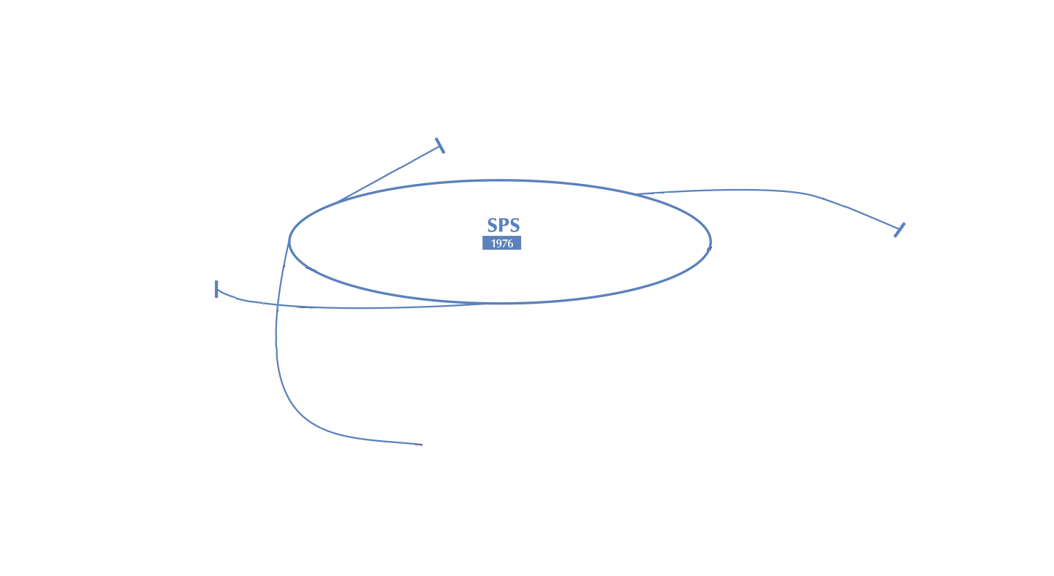

Slide 15
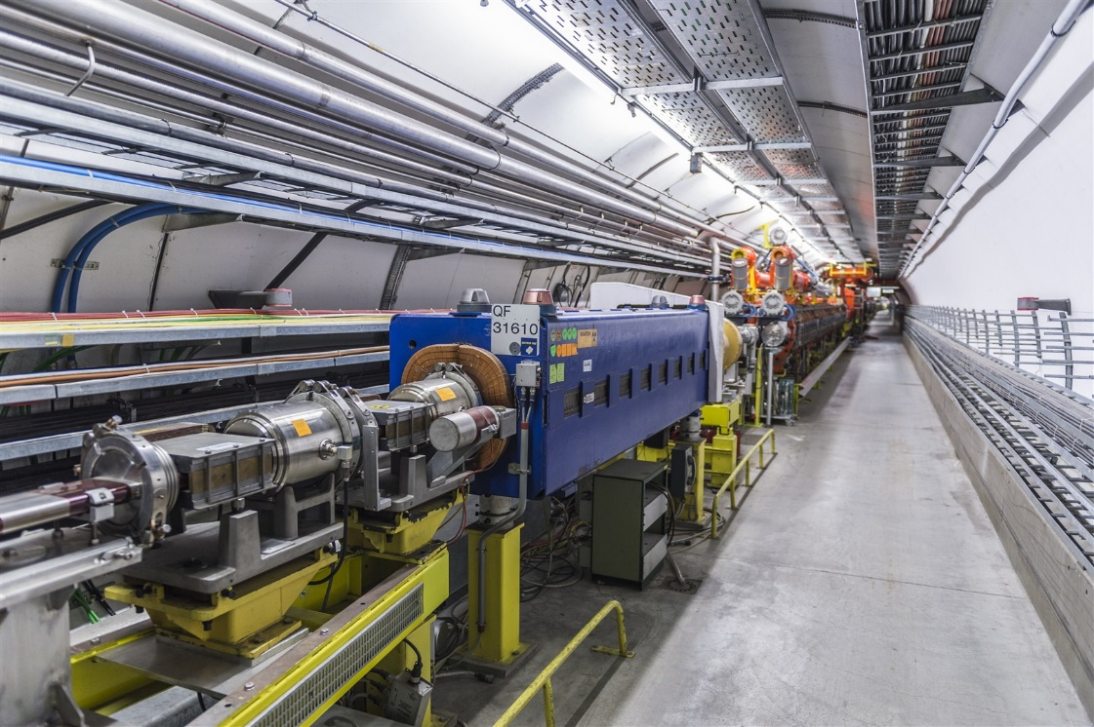
SPS
50 years of controls: maintenance challenging
multi destination, on-the-fly reconfiguration
serving high profile experiments, 24/7: availability
Warm magnets, kW to Multi-MW converters: diversity
High power, no local storage 3 x 150MVAr compensators
SPS cycles up to a minute, loses beam quite often, and has auto-reset
“Reliable” means it should be quick to fix

Slide 16
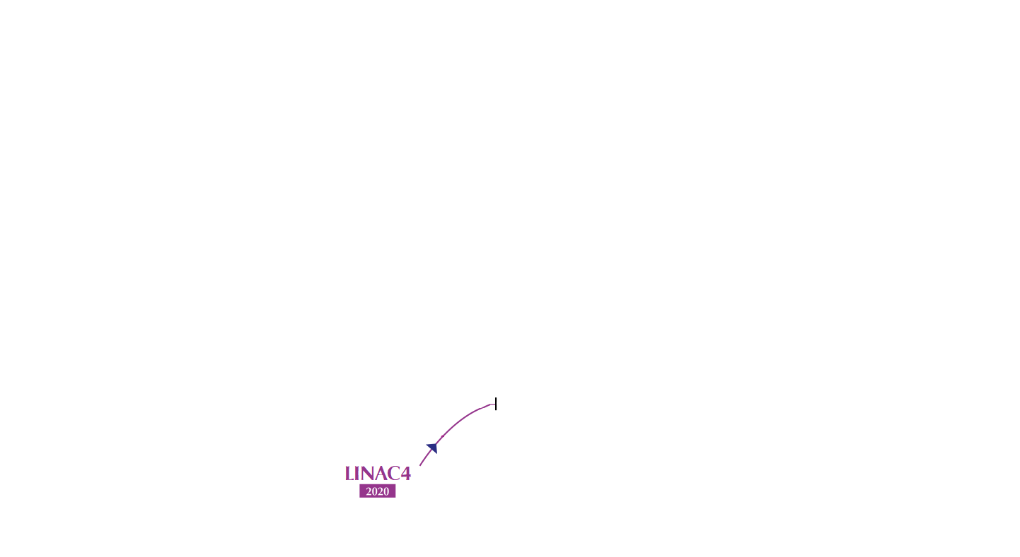

Slide 17
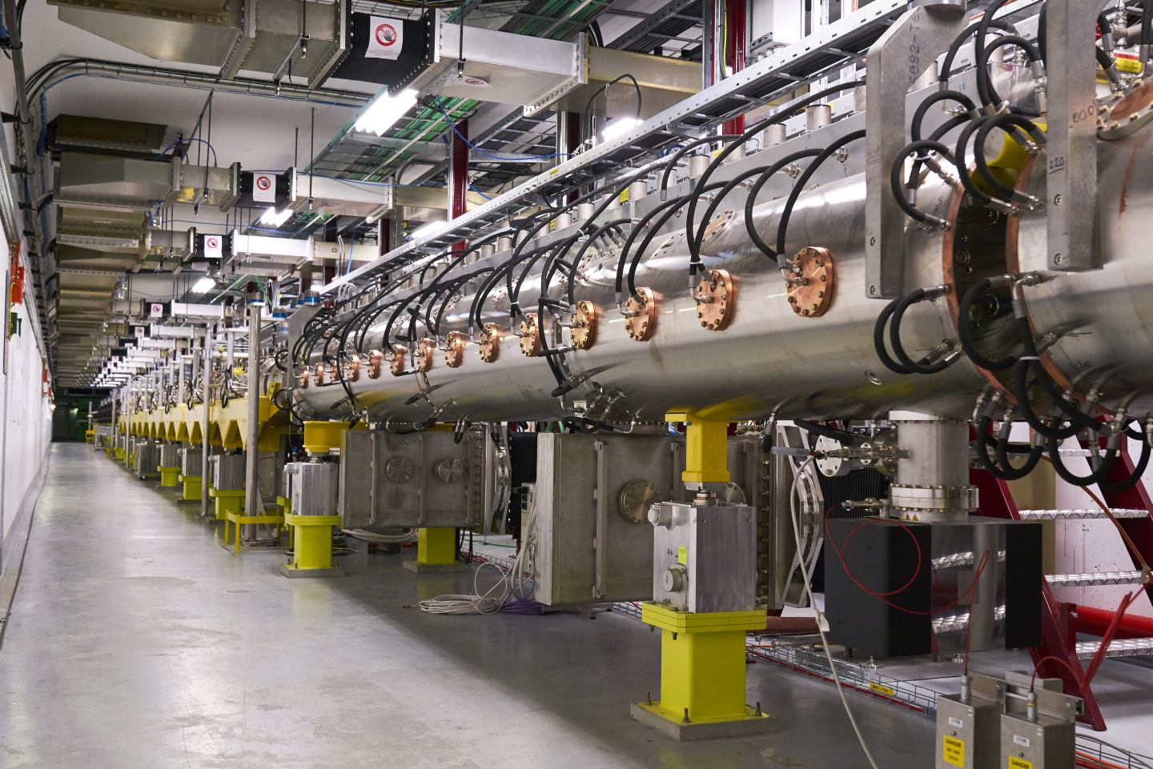
LINAC4
LINAC beam several times a second
“Reliability” really means it should be easy to diagnose
160MeV at 2Hz
pulsed converters millisecond output at 2Hz
Charge → Discharge converters called DISCAP
FPGA based regulation using CERN hardware

Slide 18
Electronics from the Past to the Future
Specification
Schematic
Circuit Board
Mechanical Integration
Past
Present
Design Programmable Logic
Future ?
one person did all
One person for each level
Write Software
Mass Produce
Install
Test and Commission
Support in Operation
+ functionally “correct” and “reliable”

Slide 19
World Tour from the Past to the Future
It’s a lot for people to be proficient across all domains, and each domain is getting more challenging; and on top of this we expect and require “reliability”.
We need to learn from each other, and share the techniques that work, and those that don’t. And we need to look forwards to bigger machines, different ways of working, and the future technologies.
To kick us off we have invited five World Tour Members to give views from their domains:
Charles PETERS (SNS)
Jonny RANNER (ISIS)
Stephen MOLLOY (MAXIV)
Keitaro KONDO (IFMIF)
Tasha SUMMERS (SLAC)
Setting the scene of similarities and differences to start your workshop

Slide 21
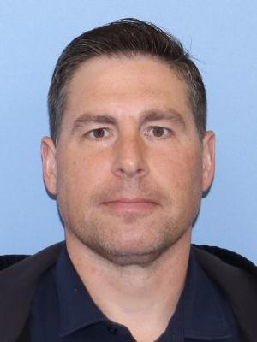
Charles Peters, Integration & Planning Group Leader, Oak Ridge National Laboratory Spallation Neutron Source (SNS)
Accelerator operations, liaison between technical groups, accelerator setup, fault detection, analysis, and remedy, planning, scheduling

Slide 22
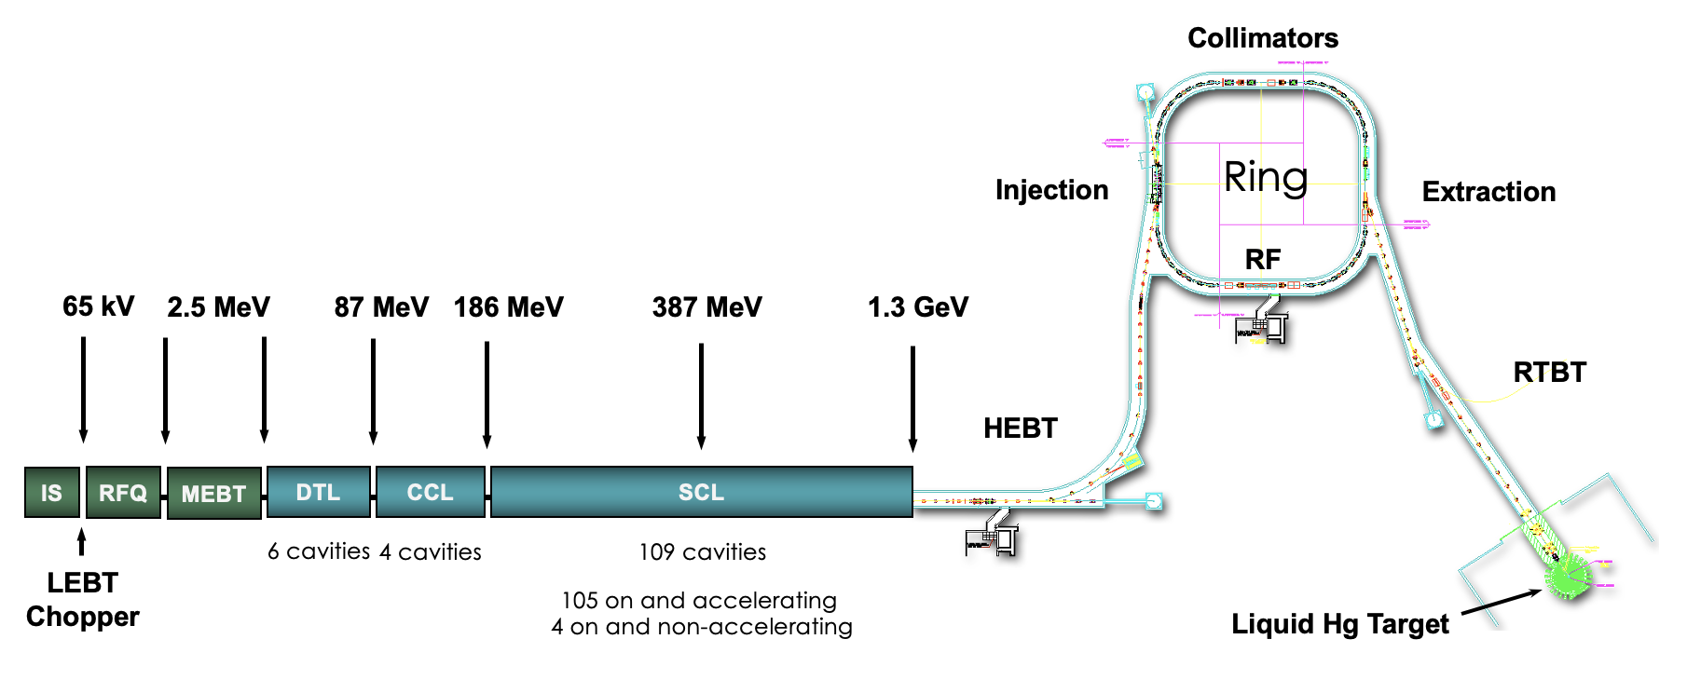
Workplace
Single product accelerator driven short pulse neutron source
2.8 MW capable pulsed proton accelerator
48 mA peak current H- ion source pulsed for 1000 microseconds at 60 pulses per second
1.3 GeV linac pulsed for 1000 microseconds at 60 pulses per second
Accumulator ring produces 700 nanosecond pulse at 60 pulses per second
2 MW capable liquid mercury target
peterscc@ornl.gov

Slide 23
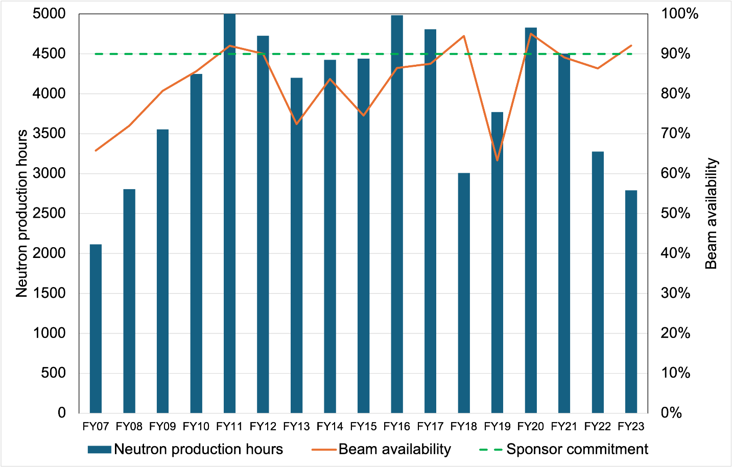
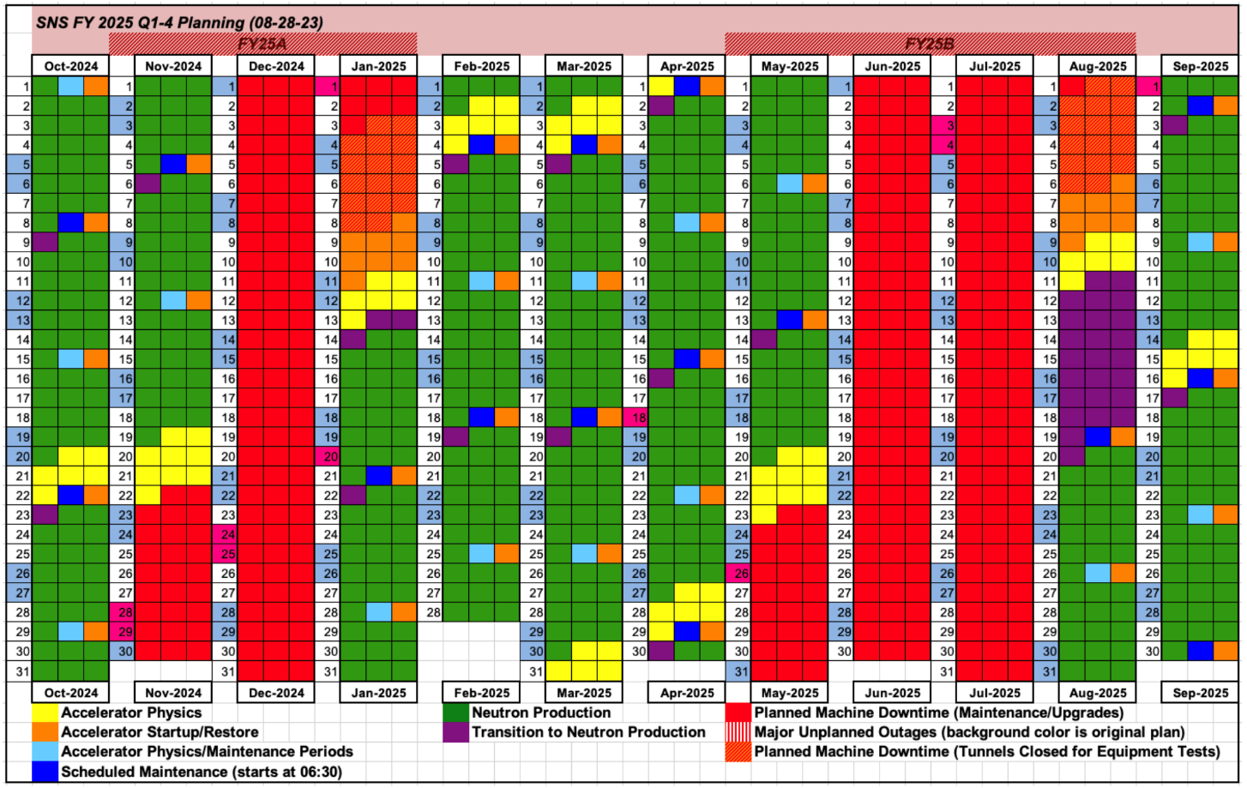
Machines and Availability
Complex has been in operation since 2006, upgrade project to double beam power completed in June 2024
KPIs are 5000 neutron production hours at 90% availability
peterscc@ornl.gov

Slide 24
Lessons from the Past
Major lessons learned about reliability in your time in your role?
Target systems are the choke point for beam availability for high power accelerators
Tight interlock requirements to avoid damage from beam limit beam reliability for high power accelerators
What was the original reliability culture in your domain?
Equipment reliability specifications were too low which developed a “my equipment is operating at spec” mentality instead of a constant improvement mentality.
Hind-sight: What would you advise to others here at ARW from your experience?
Track all beam trips. Develop the mentality that beam should never trip. Encourage engineering in each group to always be pushing for higher equipment reliability limits.
peterscc@ornl.gov

Slide 25
Looking to the Future
How will availability culture evolve in your organisation? (behavioural / technical)
Currently transitioning to new guard due to retirement of personnel that built the SNS. The standard of 90% availability is established so it is how we do business for new hires. The new focus is on a standard of high beam reliability.
Where do you hope ARW and delegates can help you?
Provide lessons learned and present ideas to improve beam reliability and availability. Establish a healthy competition between facilities.
Where do you think you could help ARW and delegates?
Provide lessons learned and present ideas for fault analysis to improve beam reliability and availability. Establish a healthy competition between facilities.
peterscc@ornl.gov

Slide 26
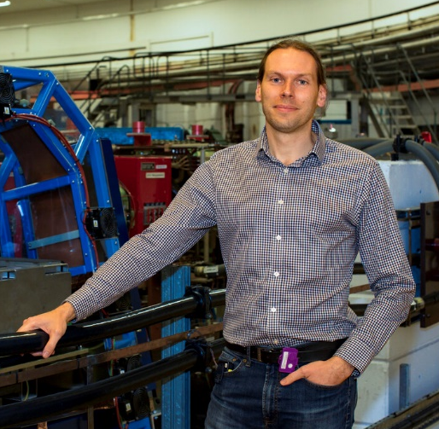
Area of expertise
Electrical engineering
Facility operations
Work history
2005
Electrical engineer
2MW AC/DC main magnet power supply
Real-time control systems
2008
SCADA engineer
Automation and interlocks for water, air and vacuum plant, motion control, magnet protection, personnel protection
2015
Pulsed power development
Design of new pulsed power systems
Development of pulsed power technologies
2017
Magnet Power Supplies Group Leader
Responsible for team who look after all AC, DC, and pulsed power supplies
Project management of complex, multidisciplinary projects
Jonny Ranner
ISIS Neutron and Muon Source, STFC
Rutherford Appleton Laboratory (RAL)
Oxfordshire, UK
2022
Accelerator Technology Division Head
Responsible for team who look after RF, mechanical engineering, water, air and vacuum plant, and accelerator operations.

Slide 27
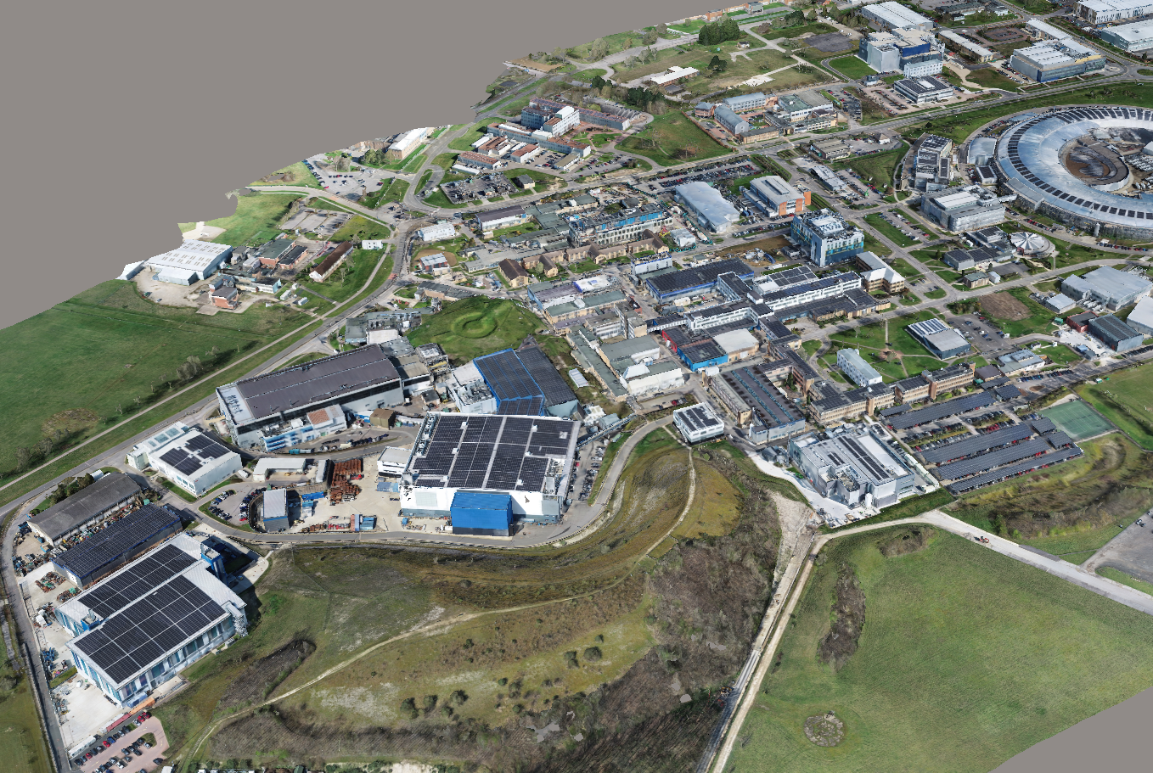
Workplace
Rutherford Appleton Laboratory (RAL)
Space cluster
Medical research council
RAL Space
Diamond
Public Health England - radiation protection
National Quantum Computing Centre
Atomic Energy Research Establishment
CLF (lasers)
ISIS
Nearby:
Didcot power station
Culham Centre for Fusion Energy
ESA
Williams F1
jonny.ranner@stfc.ac.uk

Slide 28
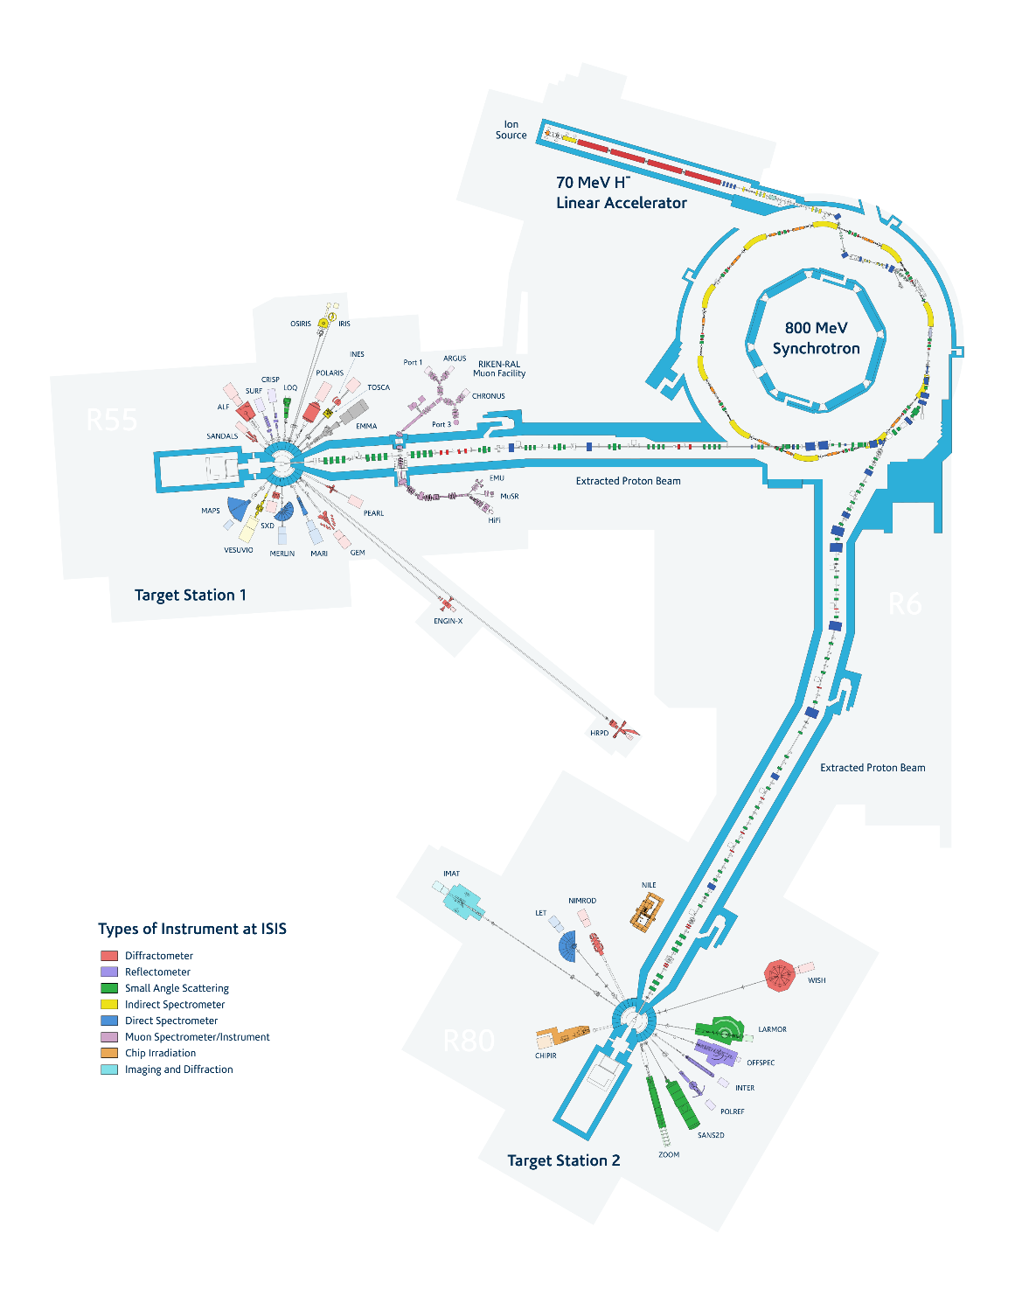
Machines and Availability
ISIS Neutron and Muon Source - First neutrons in 1984
70 MeV H- Linac
800 MeV proton synchrotron
50 Hz repetition rate
2 neutron targets and 1 muon target
50 experiment beamlines
5 user runs per year, each around 30 days
Used for material science
3000 users per year
1200 experiments per year
600 publications per year
Performance goals:
Metric | Goal | Achievement
Availability | 90% | 86% average
Intensity | 220 µA | 240 µA was normal until the last long shutdown. Currently 180 µA
Sustainability | 25% of projects | <10%
jonny.ranner@stfc.ac.uk

Slide 29
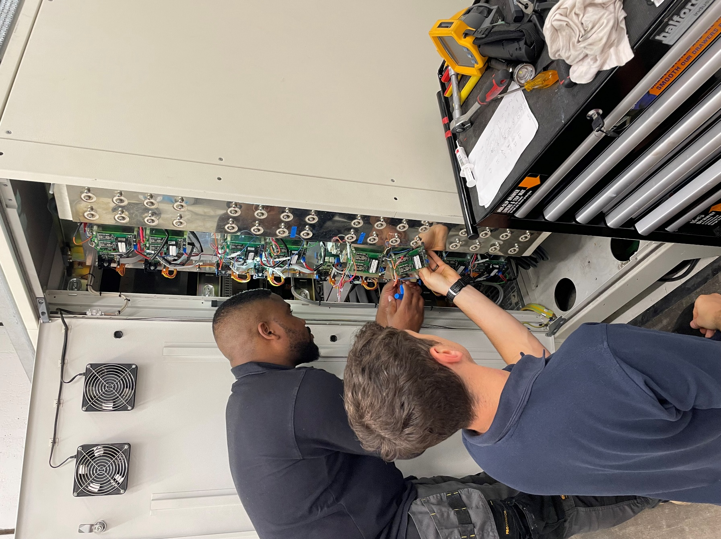
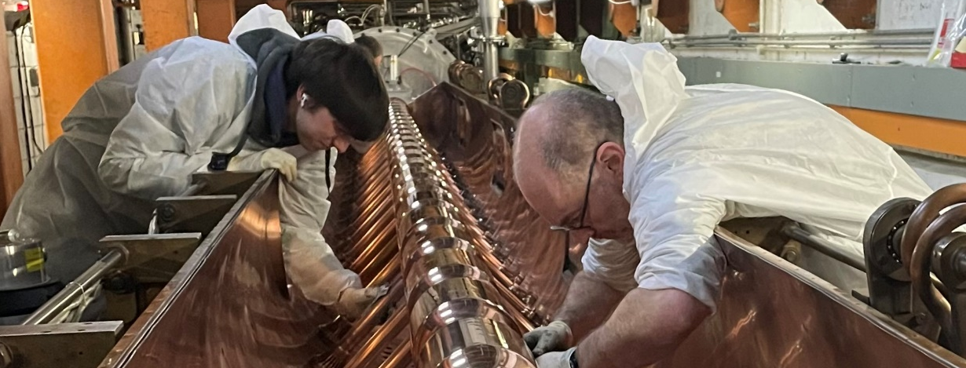
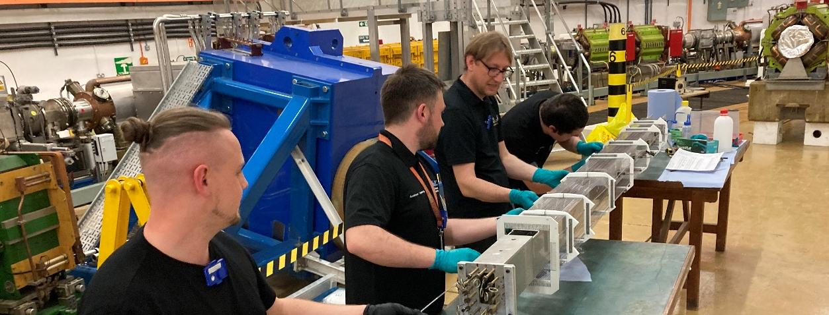
Lessons from the Past
Our people are the best asset we have!
Maintenance
Spares. Know where they are and what condition they are in.
Have good diagnostics and alarms to tell operators what is holding the beam off.
Projects
Only install things that you can repair.
Prove it works before installing, as much as possible.
Knowledge transfer
Have a good system to store documents and drawings.
Allow time for people to talk.
Continuous improvement
Provide a route for new ideas to be proposed, reviewed, prioritised and implemented.
Learnt from mistake with a no blame culture.
jonny.ranner@stfc.ac.uk

Slide 30

Looking to the Future
Accelerator strategic roadmap
Gives everyone a common goal – availability!
Guides everyone to have the same priorities
Balance conflicting goals – sustainability
Enterprise asset management (EAM/CMMS) and Failure mode and effects analysis (FMEA) tools
Control spares stock and availability
Schedule planned maintenance
Analyse and plan mitigation measures in advance
A question for ARW…
Can we standardise availability metrics, across similar or dissimilar facilities?
What does 90% available mean to you?
At ISIS, we count every pulse that is above a minimum intensity threshold, during the published user cycle.
Image generated by AI
jonny.ranner@stfc.ac.uk

Slide 31
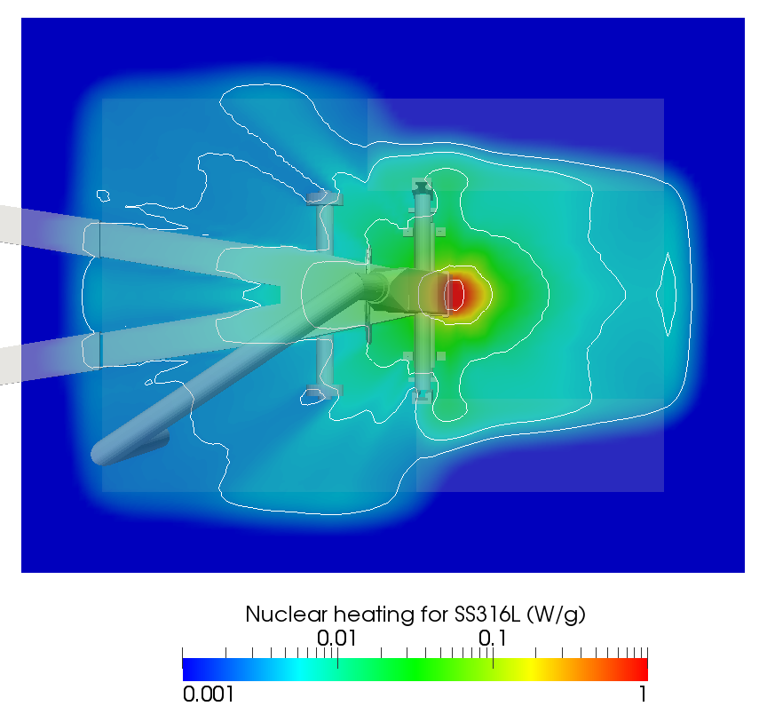
Keitaro KONDO
Group Leader, IFMIF Accelerator Group, QST Rokkasho Institute for Fusion Energy
LIPAc Japanese Home Team Leader
Area of expertise:
  Nuclear Interaction, Radiation Measurement, Nuclear Data:
    Ph.D. thesis: Study on breakup reactions in light nuclei induced by DT fusion neutrons, using a Cockcroft-Walton accelerator.
  Radiation Transport Simulation
    Worked at KIT in Germany for 3.5 years.
    In charge of nuclear safety analysis for IFMIF Test Facility.
    Large-scale parallel computing using a supercomputer.
  Accelerator System Commissioning
    In 2014 started working at QST Rokkasho.
    Responsible for installation of the RF power system, RFQ, cooling systems, etc.
    Involved in its check out and commissioning.
1
1e-1
1e-2
5e-3
3e-3

Slide 32
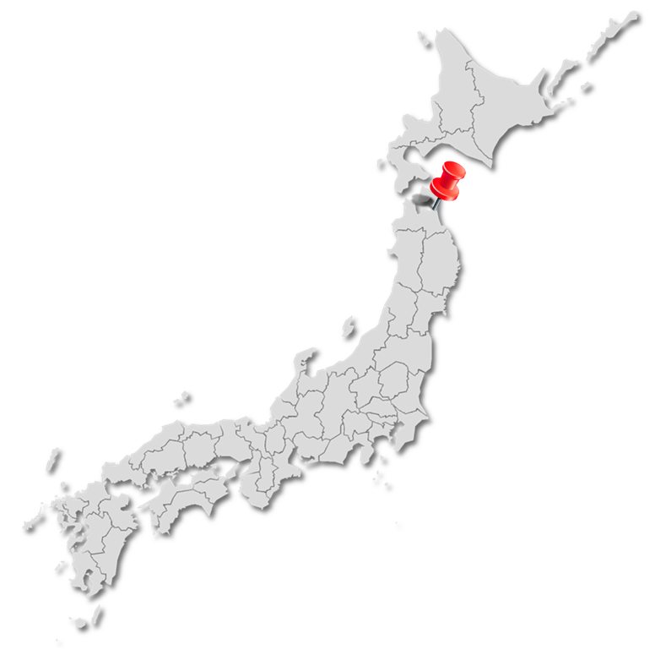
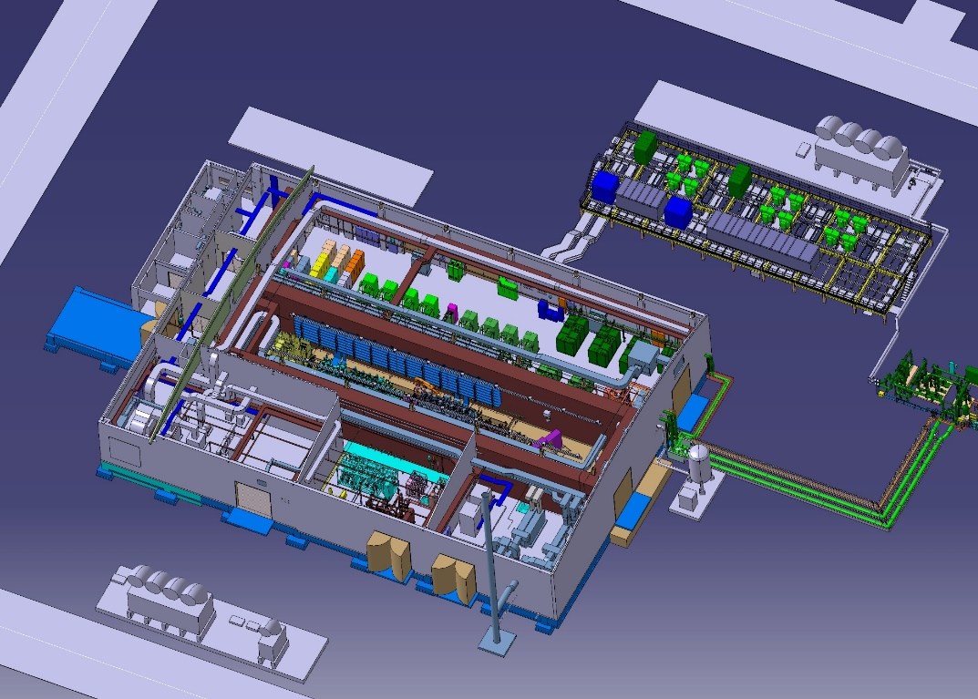
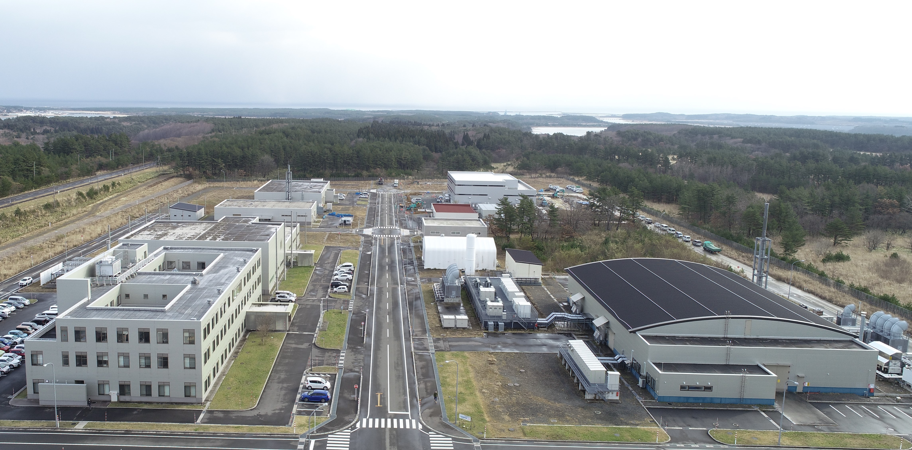
Workplace
QST Rokkasho Institute for Fusion Energy
LIPAc: Linear IFMIF Prototype Accelerator
RF power system
Accelerator
Beam dump
kondo.keitaro@qst.go.jp

Slide 33
Machines and Availability
LIPAc: under commissioning
  Now up to RFQ, 5 MeV-d+.
  Beam commissioning in only daytime, while 24/7 operations for cavity conditioning
Key Performance Indicator
  LIPAc is not a user machine but an experimental accelerator.
  The most important is to achieve some key target parameters rather than availability:
    Injector: 150-160 mA extraction, CW, stable, low emittance
    RFQ: 125 mA peak current, CW operation
    RF system: 1.6 MW, CW for RFQ. Stable operation.
    SRF: still under assembly
  To achieve the above, availability of some components is critical…
    RF power system: availability required
    Cooling systems: essentially very important for the high-power machine!
kondo.keitaro@qst.go.jp

Slide 34
Lessons from the Past
Major lessons learned about reliability in your time in your role?
  A lot of (a few major, many minor) issues on RF power system
    High-power RF components has risk and specific difficulties
    EMC issues
  Some major troubles on cooling systems
    Needed to introduce some big modifications of systems
    Difficult to say in a word, but cooling is a key for high-power machine
What was the original reliability culture in your domain?
  QST Rokkasho Institute is a new.
  Majority has no any experience in other major accelerator facilities.
  (while some technicians / operators do - typically in J-PARC)
  Started from no-reliability culture, but we have been developed.
Hind-sight: What would you advise to others here at ARW from your experience?
  We have experienced many difficulties that would be unique to in-kind contribution.
  When procuring a product, maintenance at the delivery site must also be taken into account.
kondo.keitaro@qst.go.jp

Slide 35
Looking to the Future
How will availability culture evolve in your organisation? (behavioural / technical)
  Now that the IFMIF-DONES project is just up and starts running, the LIPAc team is beginning to be aware of what feedback it can bring to that user facility. It will be increasingly important to proceed with commissioning of LIPAc from this perspective.
  The key would be to report events that affect reliability, accumulate records, and accumulate knowledge about maintenance as well. Not to mention feedback on events that directly affect the target performance.
Where do you hope ARW and delegates can help you?
  If there is anything that seems to be common sense or strongly recommended, I would love to hear it.
  All the experience of other high-power hadron facilities has been extremely useful.
Where do you think you could help ARW and delegates?
  LIPAc is a small machine, but unique in several respects, and is full of a state-of-the-art piece of equipment. We will be able to provide information on matters not experienced elsewhere.
kondo.keitaro@qst.go.jp

Slide 36
Stephen Molloy
Head of Accelerator Operations, MAX-IV, Lund, Sweden
  AccOps at MAXIV consists of me, my deputy (Filip Persson), and 8 FTE’s working shifts
  24/7 coverage by at least one person
    …User delivery, machine studies, RF conditioning…
My expertise
  Beam diagnostics
  RF (low-level for diags, and high power)
  Software engineering

Slide 37
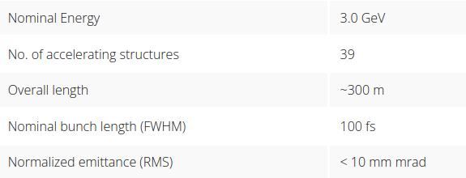
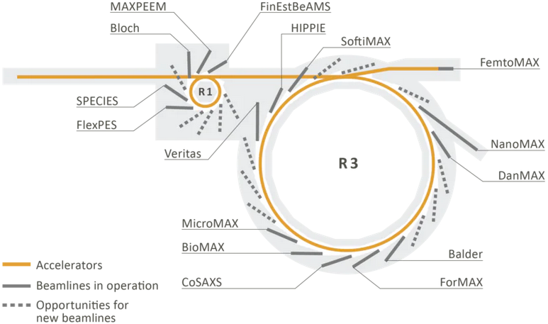
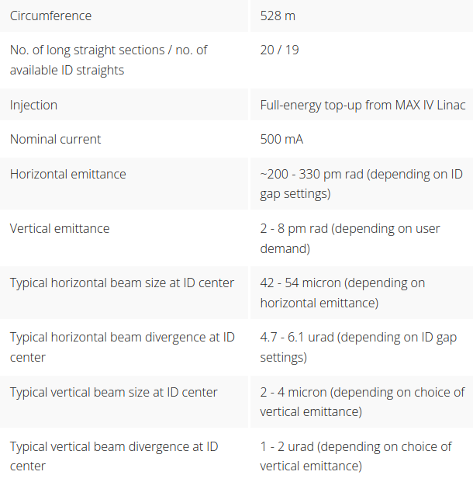
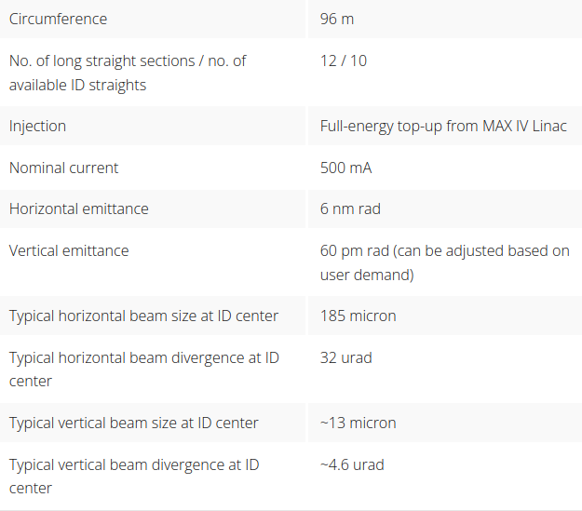
MAX-IV Machines
stephen.molloy@maxiv.lu.se

Slide 38
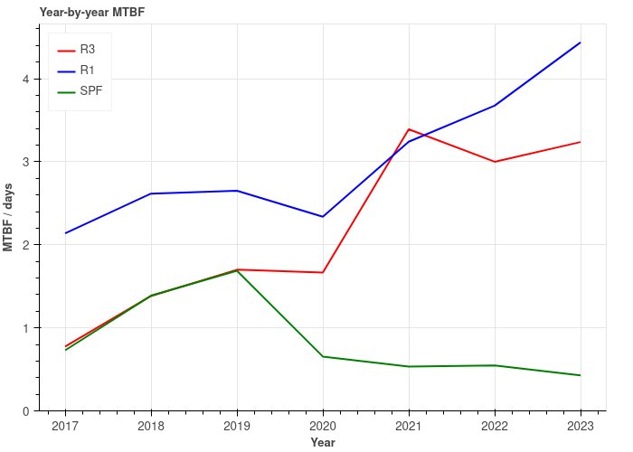
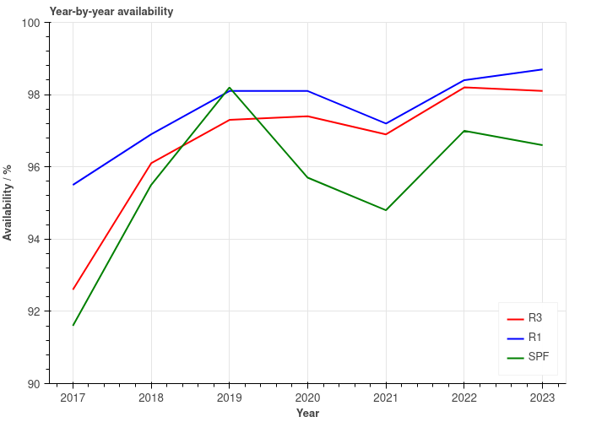
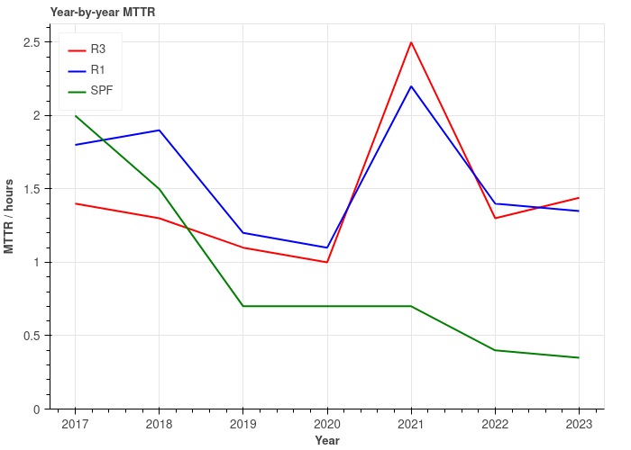
MAX-IV Availability
stephen.molloy@maxiv.lu.se

Slide 39
Lessons from the Past
Decisions made during design/construction are (necessarily) cautious
  Reviewing these after some years of operation can allow for improvements
  E.g., beamline vac protection at MAXIV
Make reliability everyone’s problem
  Easy lab-wide access to stats and prompt reporting of downtimes to sub-system owners
Skilled on-call teams are worth their weight in gold
Two ways to look at reliability
  Technical – e.g., “The cooling system responds too severely to RF load. We should fix that.”
  Statistical – e.g., “Our MTBF is not in line with similar facilities. Why is that?”
  Both points of view can yield improvements
stephen.molloy@maxiv.lu.se

Slide 40
Looking to the Future
The “J5” maintenance tool
  Deployment at MAXIV should lead to solutions based on data
  Rigorous maintenance methods
How can ARW help us?
  Sharing of knowledge on how statistics are kept and used at your facilities
  How to deal with an aging facility
  …Machine learning?
    A solution looking for a problem, or a goldmine of potential?
What can MAXIV offer ARW?
  Recent experience of moving a facility from construction, through commissioning, into delivery
  Maintenance of high reliability delivery on a tight budget
stephen.molloy@maxiv.lu.se

Slide 42

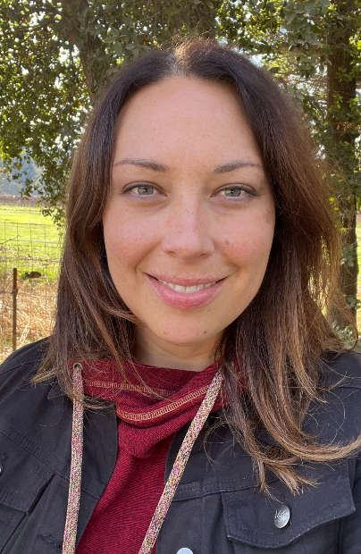



Biography – Tasha Summers
2020 – now: SLAC – Deputy Dept. Head of Operations Computing
Accelerator Directorate, Electronics & Engineering Division.
1 of 2 “Controls Deputies” – work planning coordinators and liaison to Operations.
First point of contact for many controls software or computing issues.
Involved in several upgrade and improvement projects, focusing on software.
2016 – 2020: FRIB – Accelerator Controls Physicist for the ReAccelerator
Responsible for updating the controls HMI to the same toolkit as the new linac.
2013 – 2016: BNL – Lead Operator & Operator Interfaces at NSLS-II
Commissioning lightsource, making interfaces & applications, managing alarms.
2009 – 2013: BNL – Accelerator Operator at RHIC
On-shift operator for collider-accelerator complex.
2005 – 2009 CLS – Accelerator Operator and Physicist in training
Operating new lightsource, building undulators, working on machine optics.
tsummers@slac.stanford.edu

Slide 43
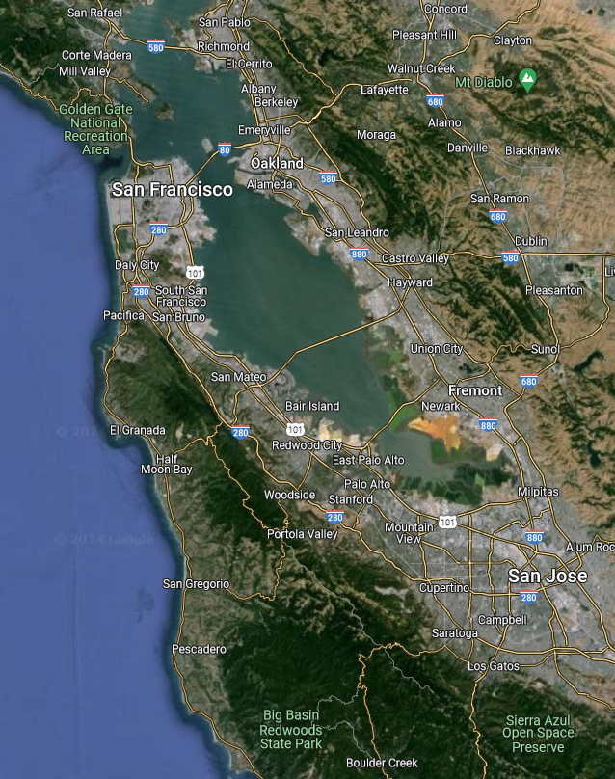
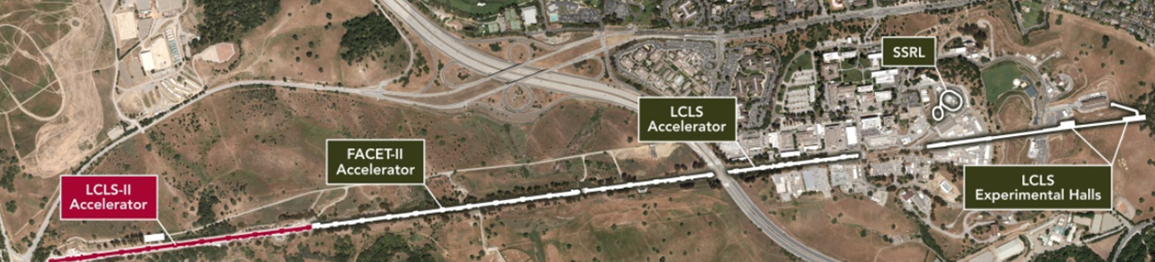
Workplace
SLAC Linear Accelerator Facility
Located in the San Francisco Bay Area, California
Original 3 km long linac (1960s) is now three 1 km accelerators:
LCLS-I (2009): 6-18 GeV FEL, 0.2-25 keV Xrays, 120 Hz.
LCLS-II (2022): 4 GeV superconducting FEL, 1 MHz.
  LCLS-I and LCLS-II share two undulator lines and experiment halls.
FACET-II (2022): 20 GeV linac for advanced accelerator experiments.
SSRL – Stanford Synchrotron Radiation Lightsource:
SPEAR3 (2004): 3rd generation 3 GeV light source with 27 beamlines.
tsummers@slac.stanford.edu

Slide 44
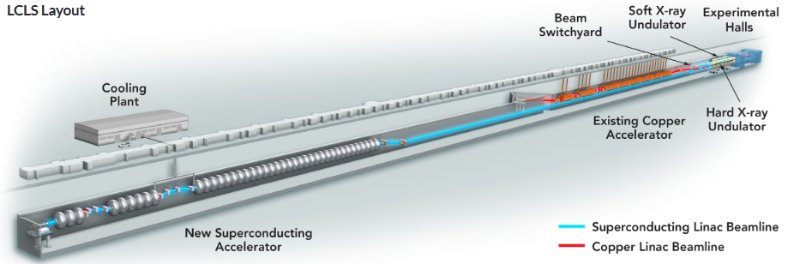
Machines and Availability
Focusing on the Linear Accelerator
LCLS-I Run 22 January-July with 2658 program hours, goal of >95% availability.
  Electronics Engineering Division availability is 97.2% (goal 98%), spread over controls hardware, software and computing infrastructure, RF and high-power electronics.
  Source of most EED downtime is DC power supplies and aging controls hardware (VME, CAMAC).
FACET-II accelerator similar vintage as LCLS-I, availability of 93.6%.
LCLS-II superconducting accelerator upgrade project completed in 2023.
  Currently ramping up beam power, first users are expected this week!
  Officially started recording availability this month.
LCLS-II HE (High Energy) project installation underway.
  More cryomodules, another cryogenic transfer line, several updated and new undulators.
tsummers@slac.stanford.edu

Slide 45
Lessons from the Past
It is a challenge to operate and maintain older systems while installing and commissioning new accelerators - in the same tunnel, at the same time, with the same people!
Regular maintenance periods of 2-3 days every 2 weeks, plus several longer downtimes each year are used for repairs, upgrades, and installation.
Scheduling is complex but groups can plan months in advance. There have still been cross-program conflicts that required compromise.
SLAC does fairly well with planning for spares and keeping old equipment maintained.
But some systems are nearing their end and will require large upgrade projects, at high cost.
Maybe victims of our groups own competence? Experts maintain aging equipment well and can repair failures quickly so these may not be seen as urgent problems to address. But that human expertise, and the number of spares is dwindling, and we may be getting close to falling off a cliff in some areas.
I fear we are all bidding against each other on eBay equipment parts!
To improve availability, it is important to optimize usability and improve documentation.
While focusing on the new projects, we are often in a hurry to hand over new systems to operations and move onto the next task. This can eat away at availability as operations struggle to learn to use them and troubleshoot things when they don’t work as expected.
Effort spent making their jobs more efficient pays off repeatedly over time.
tsummers@slac.stanford.edu

Slide 46
Looking to the Future
SLAC has been focused on improving work planning and on better integrating safety into our daily workflow.
How can you help me?
I would like to know your strategies for work planning and coordination. Do you have a dedicated person or team responsible for this?
Our software tools for reliability/availability reporting, issue tracking, work planning, configuration and asset management are aging, and not well optimized for the complex environment we have now. We have a project underway to modernize this.
How can you help me?
I would like to see the software tools other labs use to track these things, especially for facilities with multiple programs running at the same time sharing the same space.
How can I help you?
I would be happy to talk about any of these topics, especially our software tools!
I am here with colleagues who are experts in maintaining our hardware, planning our equipment upgrades, and identifying how we can be more resilient to power outages.
I look forward to great discussions with everyone here :)
tsummers@slac.stanford.edu

