Slide 1
benjamin.todd@cern.ch v4
v3

Slide 2
Changing Times…
…Times Change

Slide 3
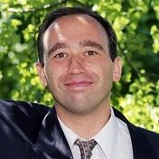
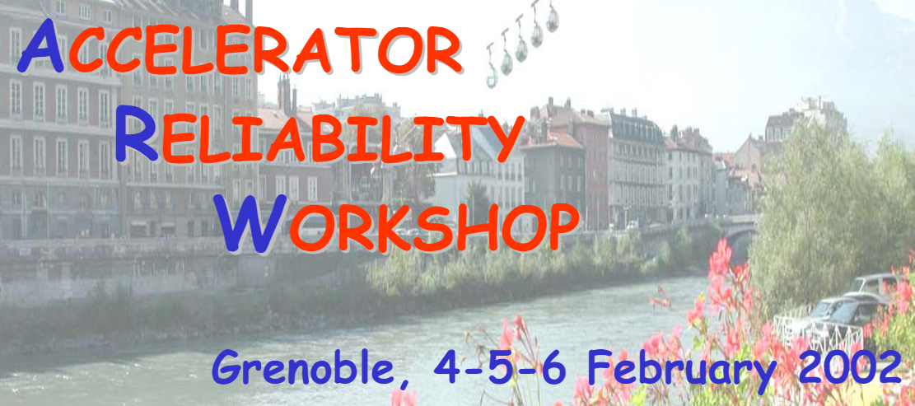
2002 → 2024: 22 years of ARW
ESRF
Grenoble
L. Hardy – (European Synchrotron Radiation Facility)
triggered the community and organised first workshop
2002
need a community to share reliability aspects, ≈ 80 attendees
Reliability gaining in priority for accelerator designers

Slide 4
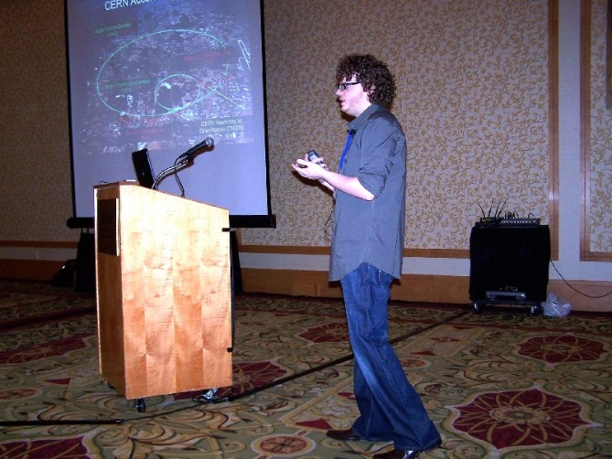
2002 → 2024: 22 years of ARW
ESRF
Grenoble
TRIUMF
Vancouver
2002
2009
Community re-born after a hiatus

Slide 5
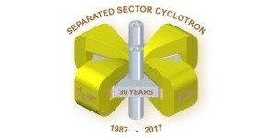
2002 → 2024: 22 years of ARW
ESRF
Grenoble
iTHEMBA
Cape Town
TRIUMF
Vancouver
2002
2009
2011
The scientific program expands
Structure shows different accelerator reliability aspects.
Community interest to have a workshop every 2 years

Slide 6
2002 → 2024: 22 years of ARW
ESRF
Grenoble
iTHEMBA
Cape Town
TRIUMF
Vancouver
Australian Synchrotron
Melbourne
2002
2009
2011
2013
Decision to rotate around continents
Maintenance management comes to the front

Slide 7
2002 → 2024: 22 years of ARW
ESRF
Grenoble
iTHEMBA
Cape Town
ORL, SNS
Knoxville
TRIUMF
Vancouver
Australian Synchrotron
Melbourne
2002
2009
2011
2013
2015
Organization and program quality a new milestone.
New labs: ITER, Myrrha, IFMIF, CIEMAT, ESS, Chinese Academy of Science, Ganil, Medical
High participation of equipment specialists and reliability experts .

Slide 8
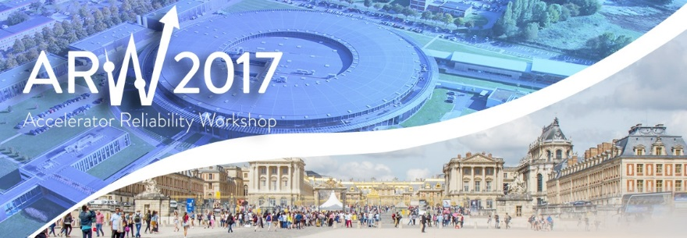
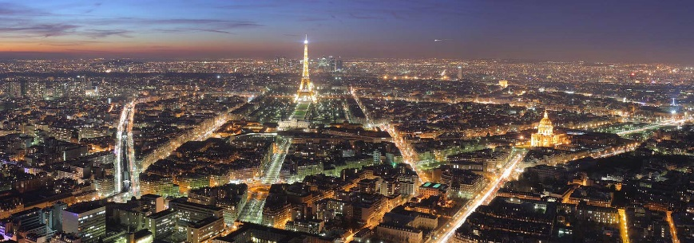
2002 → 2024: 22 years of ARW
ESRF
Grenoble
iTHEMBA
Cape Town
ORL, SNS
Knoxville
TRIUMF
Vancouver
Australian Synchrotron
Melbourne
SOLEIL
Paris
2002
2009
2011
2013
2015
2017
More than 140 participants - had to close the inscription early!
Scientific program balanced; Oral, Posters and Discussions

Slide 9
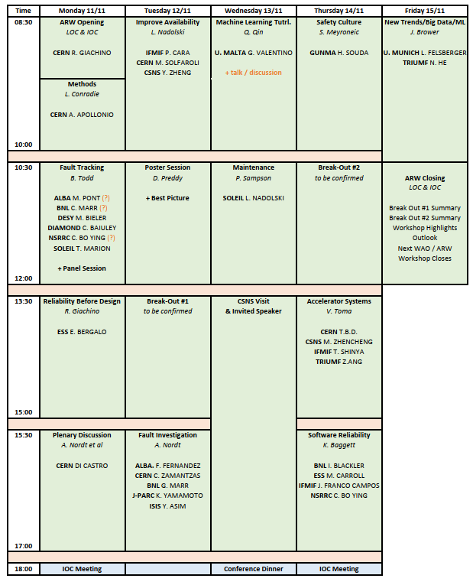
2002 → 2024: 22 years of ARW
ESRF
Grenoble
iTHEMBA
Cape Town
ORL, SNS
Knoxville
IHEP
Guangzhou
TRIUMF
Vancouver
Australian Synchrotron
Melbourne
SOLEIL
Paris
2002
2009
2011
2013
2015
2017
2019
Fully structured program
Poster sessions
Breakout sessions

Slide 10
2002 → 2024: 22 years of ARW
ESRF
Grenoble
iTHEMBA
Cape Town
ORL, SNS
Knoxville
IHEP
Guangzhou
TRIUMF
Vancouver
Australian Synchrotron
Melbourne
SOLEIL
Paris
JLAB
Newport News
2002
2009
2011
2013
2015
2017
2019
2022
https://indico.jlab.org/event/495/ all online, a permanent record of what we’re undertaking

Slide 11
2002 → 2024: 22 years of ARW
ESRF
Grenoble
iTHEMBA
Cape Town
ORL, SNS
Knoxville
IHEP
Guangzhou
ESS/MAX IV
Helsingborg
TRIUMF
Vancouver
Australian Synchrotron
Melbourne
SOLEIL
Paris
JLAB
Newport News
2002
2009
2011
2013
2015
2017
2019
2022
2024
170 participants
90 posters
All content online
An energing masterplan for going forward for our community
Reached a level of quality of program and content which is truly worldclass

Slide 12
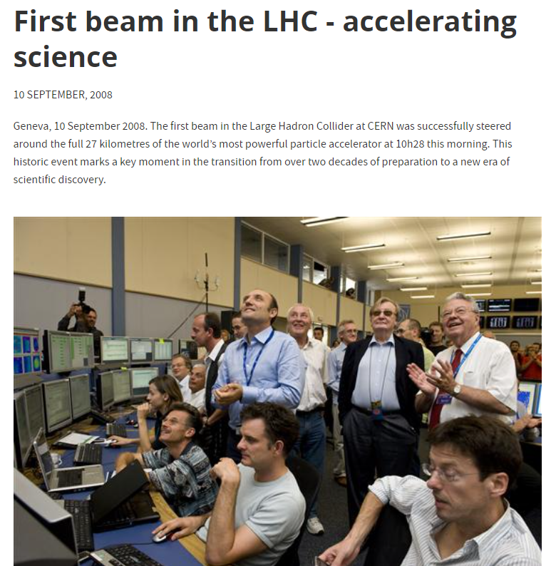
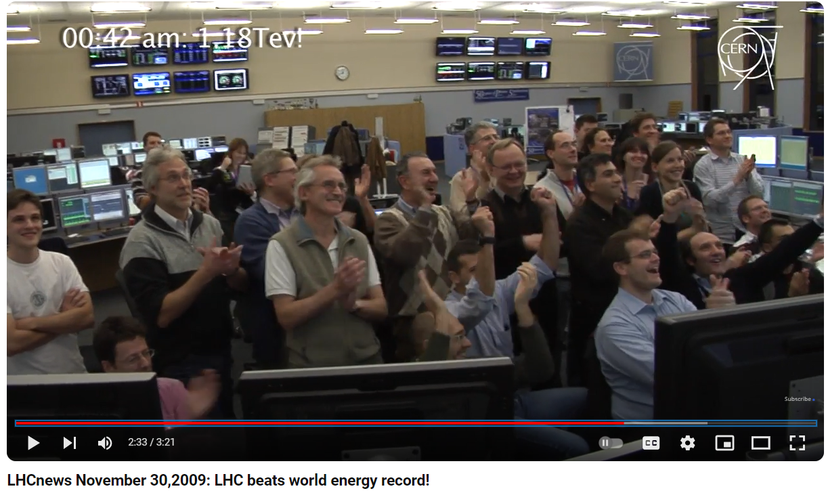
This doesn’t happen on its own

Slide 13
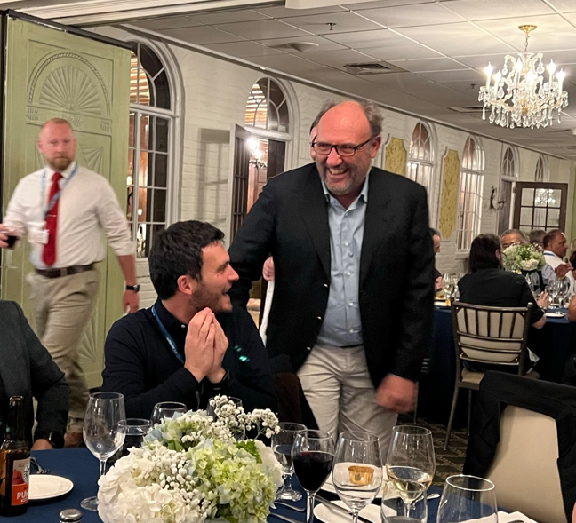
This doesn’t happen on its own
…specialist in getting people together to solve problems
after fixing all our machines at CERN… Rossano devoted his time and passion to finding ways to help everyone else get together to fix theirs…across our community
Rossano has been chair of ARW for over ten years, and ARW2024 is his final workshop, passing the baton on.
I’ve made some truly lifelong friends and partners from this community, go back fizzing with ideas, and I’ve made major changes to my work and beyond based on people I have met and things I have learned…
Rossano’s leadership has taken our workshop from the seeds of an idea, to a self-standing world-class community.
Thank you Rossano!! from IOC, LOC, ARW

Slide 14
Thanks to you Rossano!
v3

