Slide 1
ESP32 microcontrollers
Sofia Bukreeva,
research engineer

Slide 2
Primary goal
To have some solution for various tasks which are not reasonable to implement with PLC, PandaBox, Electrometer, etc.
Flexible
Scalable
Easy-to-use
2

Slide 3
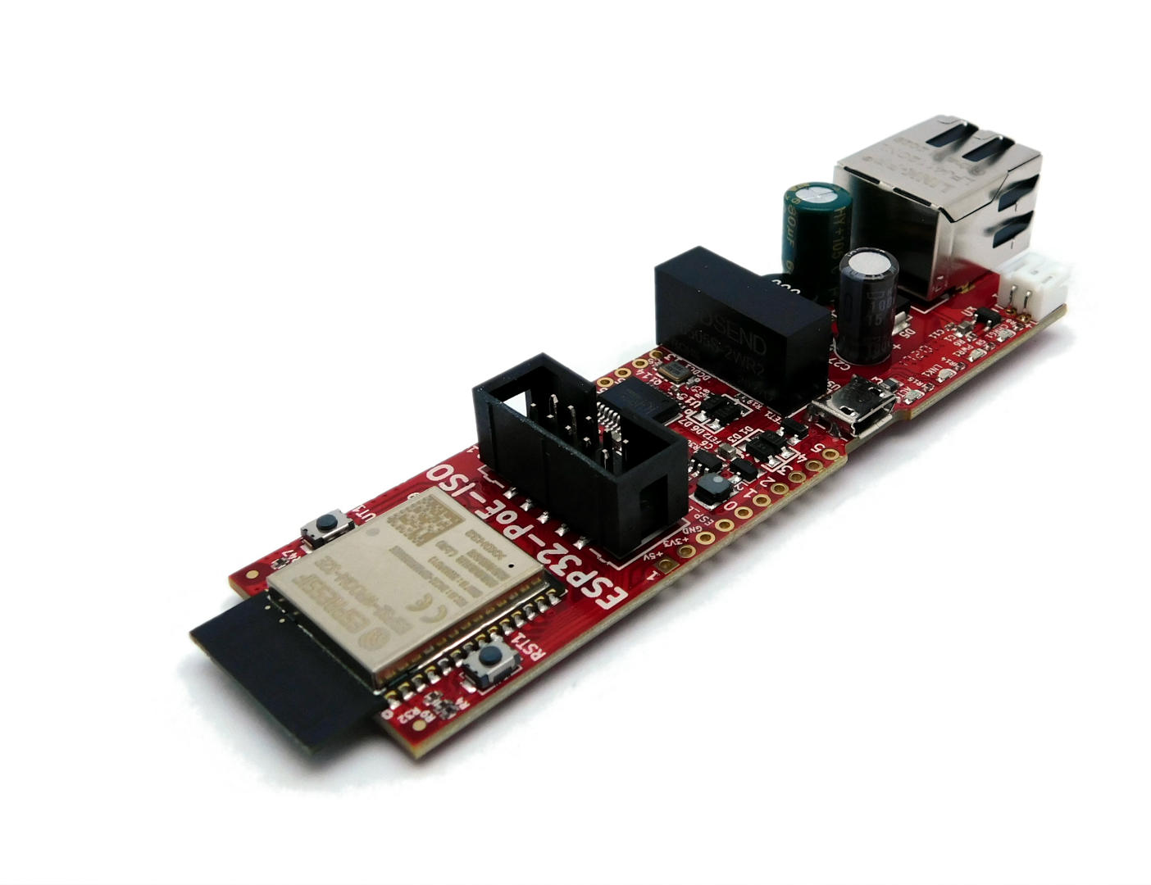
What we have: ESP32-POE-ISO board
Made by Olimex company.
Easy to start
Small and cheap
Power over Ethernet
General serial interfaces like SPI, I2C, UART
12 GPIOs (+4 input only)
Bluetooth/Wi-Fi
USB-UART for flashing the firmware/communicating/powering
3

Slide 4
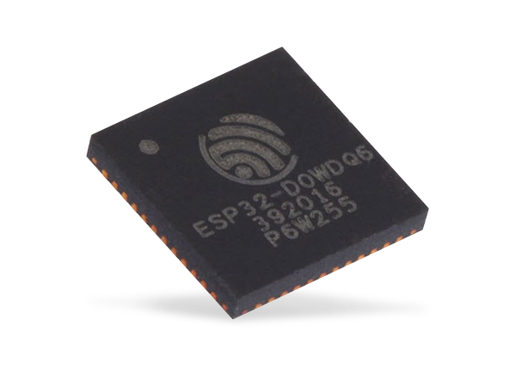
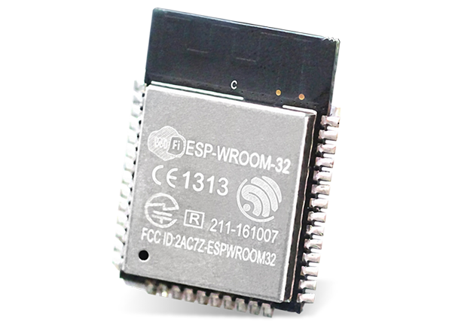
What is ESP32:
ESP32-D0WD-V3
SoC
ESP32-WROOM-32E Module
ESP32-POE-ISO
Board
4

Slide 5
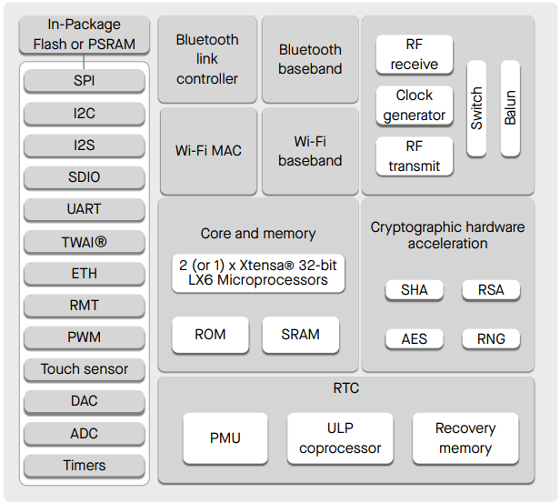
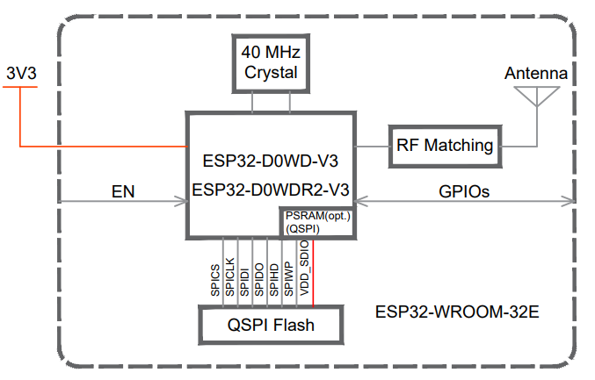
What is ESP32:
ESP32 SoC
ESP32 module
*No Flash/PSRAM
5

Slide 6
What is ESP32:
Wireless connectivity (Wi-Fi, Bluetooth)
32-bit dual-core Xtensa LX6, 240 MHz
Ethernet MAC, CAN-compatible controller (TWAI)
UART, SPI, I2C, I2S, 12-bit ADC, 8-bit DAC…
520 KB SRAM, 448 KB ROM
28 GPIOs (but only 26 in ESP32 module) and +6 reserved for Flash
Low price 1-2 Euro per chip
6

Slide 7
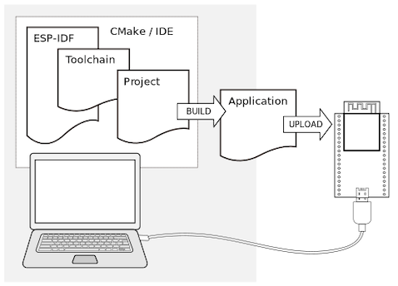
What is ESP32:
Open-source ESP-IDF
Espressif IDE
Supported by Arduino IDE
Extensions for VS Code, Eclipse
IoT Development Framework
7

Slide 8
What is ESP32:
Minimum longevity commitment for ESP32 is
15 years starting from 2016.
Xtensa 32-bit LX7 dual/single-core, up to 240 MHz
RISC-V 32-bit single-core, up to 160 MHz
8

Slide 9
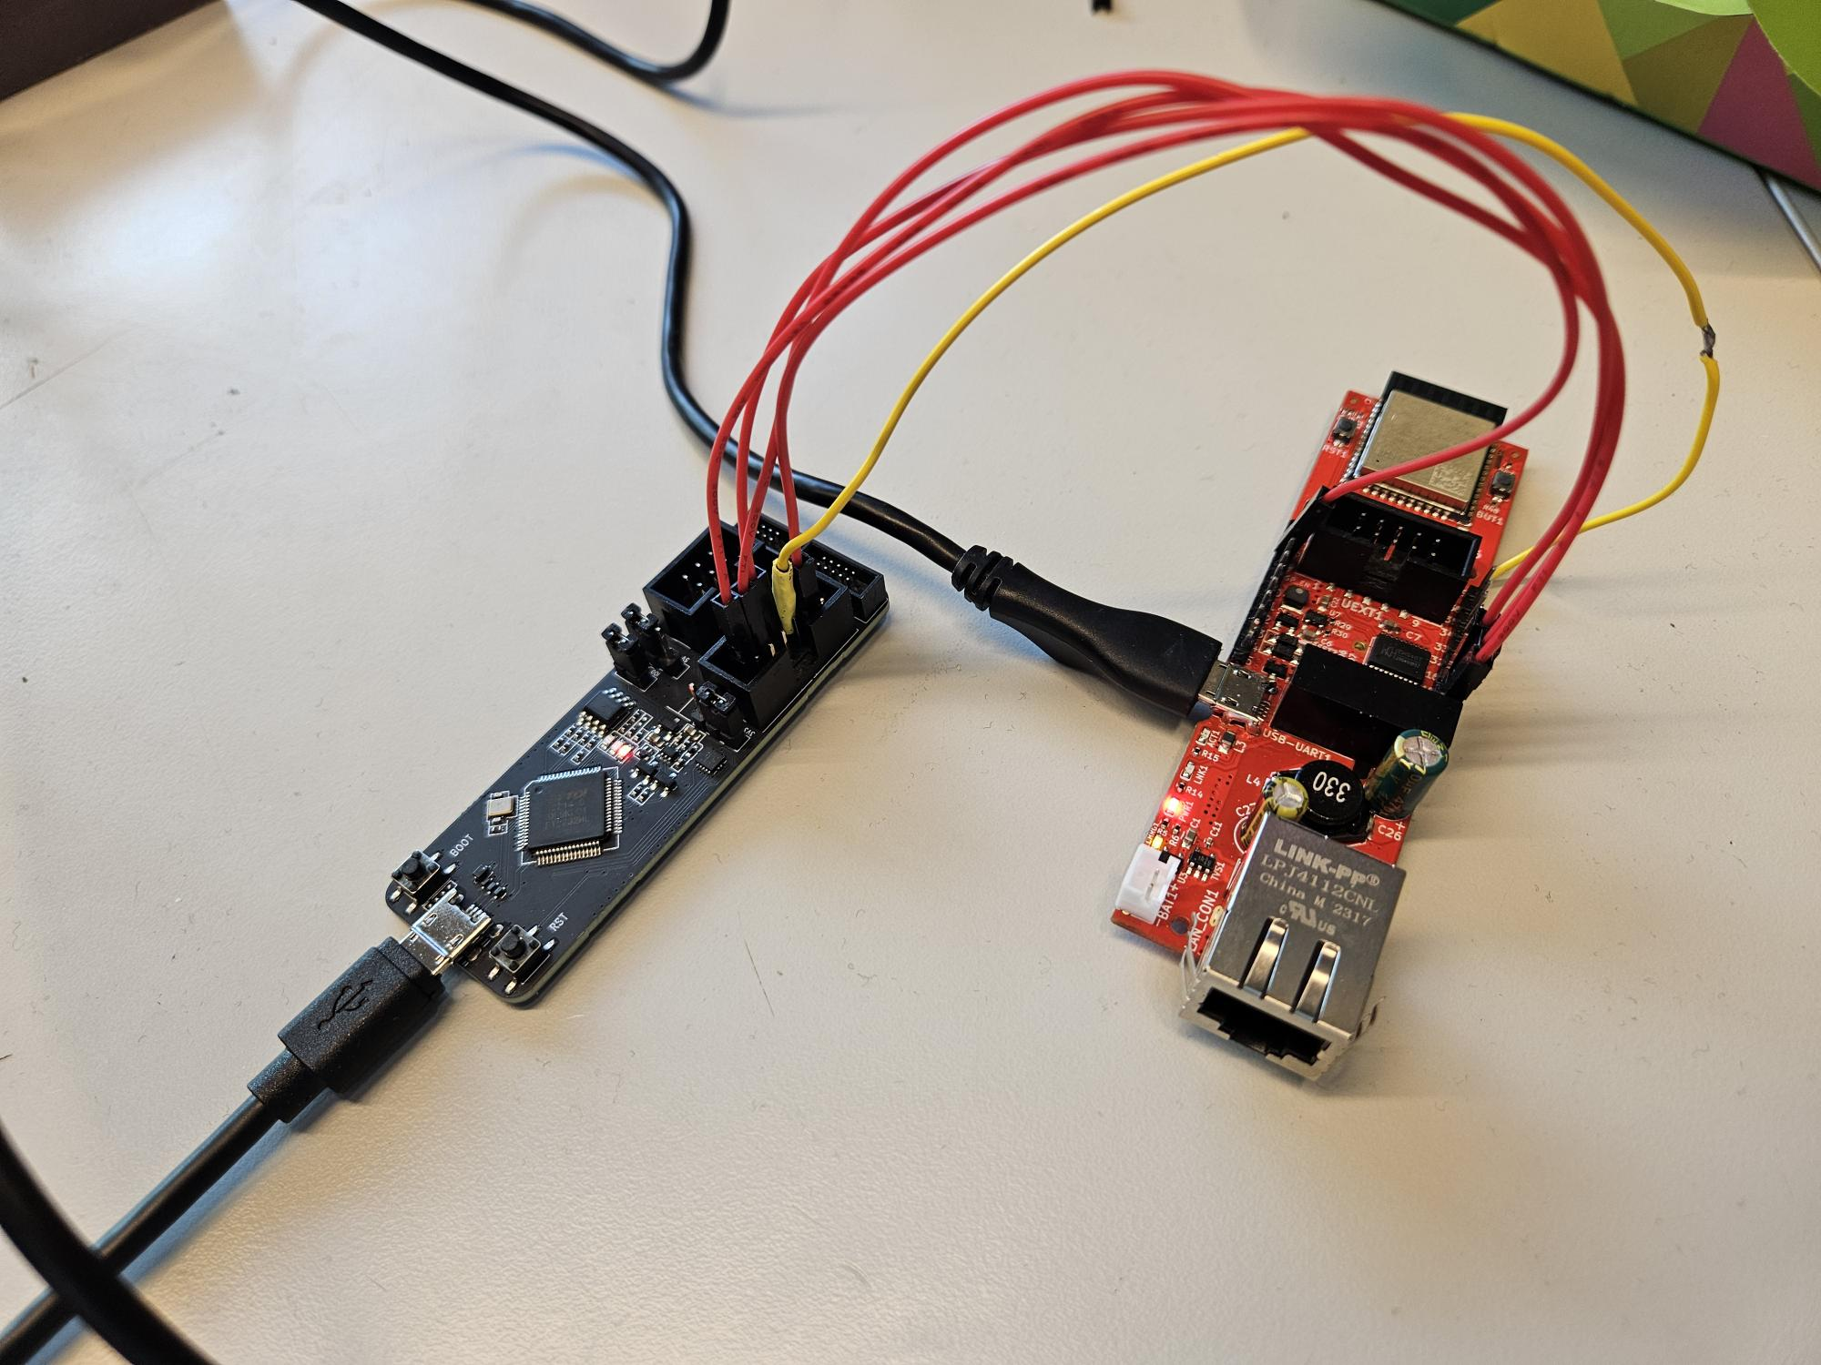
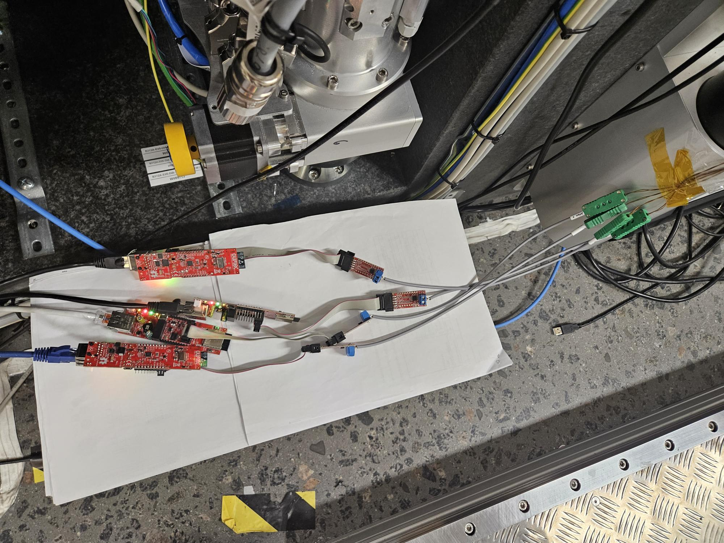
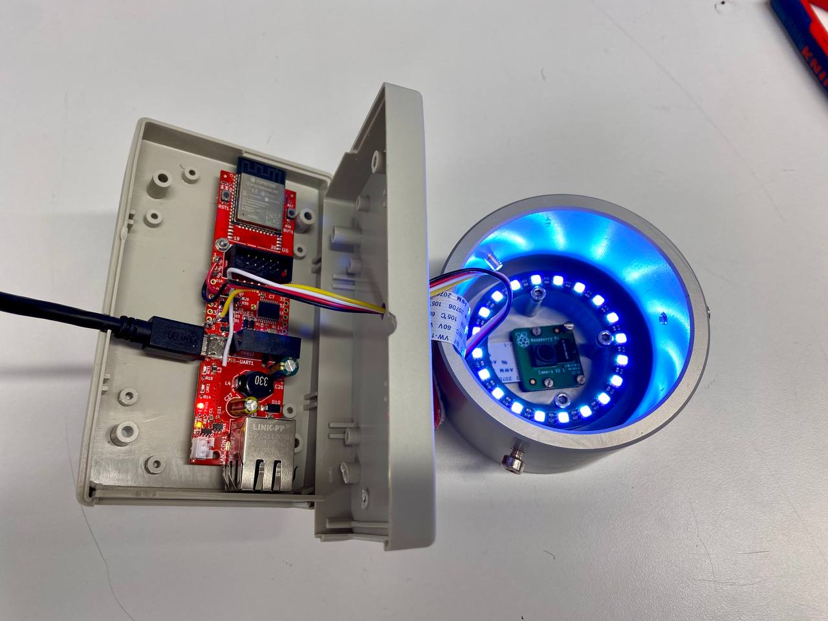
Current situation
~10 ESP32-POE-ISO boards are spread at the facility within a couple of months.
Used at beamlines for reading sensors and simple logic implementation.
9

Slide 10
Two ways of designing
New task
Specific ESP32 firmware
Specific Tango Device
New task
Generic ESP32 firmware
Generic Tango Device
10

Slide 11
Main points
Settings can be sent with JSON messages over MQTT
Protocol - to be implemented on ESP32 and Tango Device
ESP32 firmware upgrade via OTA
FreeRTOS (for using two cores, at least)
To standardize the approach in the end.
11

Slide 12
Considerations (ESP32-POE-ISO)
Might need more GPIO and level shifters
Might need external power
No JTAG on the board
Might need to make our own board
Or find similar on the market
Might need to change microcontroller at all
12

Slide 13
Plan
To make a plan…
Choose IDE
Choose module or board
Test software features which are available
Start developing protocol
13

Slide 15
Links
ESP32-POE-ISO board
ESP32-POE-ISO - Open Source Hardware Board (olimex.com)
ESP32 datasheet
esp32_datasheet_en.pdf (espressif.com)
ESP32 technical manual
esp32_technical_reference_manual_en.pdf (espressif.com)
ESP32-WROOM-32E datasheet
esp32-wroom-32e_esp32-wroom-32ue_datasheet_en.pdf (espressif.com)

