Slide 1
MAXIV – WASP - Visualization Center C - InfraVis Mini-Workshop Next Generation Visual Data Analysis Tools
October 3rd 2024

Slide 2
Agenda for today
10.00 Arrival, coffee, introductions (15) - MAX III
10.15 Presentation by MAX IV director (15) - MAX III
10.30 Tour (45)
– Move to Möllegarden –
11.30 Presentation by WASP program director (15)
11.45 Machine session (20 + 10)
12.15 Lunch (delivered to Möllegarden)
13.00 Beamline and data/DAQ session: Introduction (15)
13.15 Balder beamline session (20 + 10)
13.45 DanMAX beamline session (20 + 10)
14:15 WASP presentations session I (2x15)
14.45 Coffee
15.00 WASP presentations session II (2x15)
15.30 InfraVis - Kajsa M Paulsson (15)
15.45 discussion (45)
16.30 Close

Slide 3
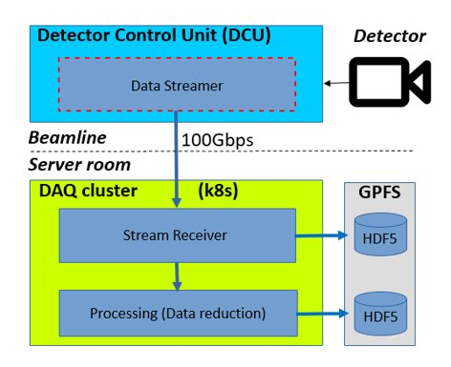
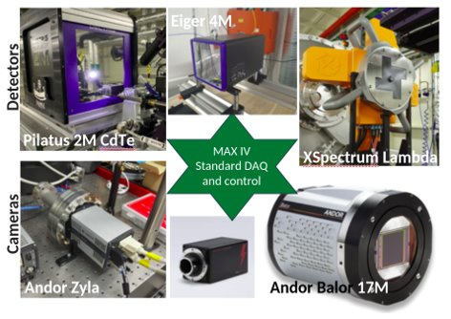
MAX IV detector-DAQ scheme
Consolidated 30 systems/10 unique types into common Kubernetes-managed DAQ cluster
Saving of camera images (raw frames) and on-the-fly processed data (frame by frame) in real time.

Slide 4
MAX IV detector-DAQ scheme
Consolidated 30 systems/10 unique types into common Kubernetes-managed DAQ cluster
Saving of camera images (raw frames) and on-the-fly processed data (frame by frame) in real time.

Slide 5
MAX IV detector-DAQ scheme
Consolidated 30 systems/10 unique types into common Kubernetes-managed DAQ cluster
Saving of camera images (raw frames) and on-the-fly processed data (frame by frame) in real time.

Slide 6
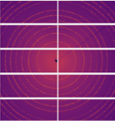
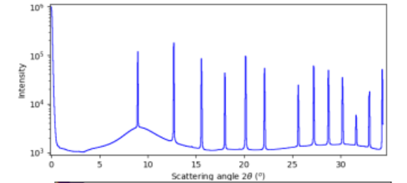
Online data processing and visualisation
Algorithms range from simple operations (frame accumulation, ROI sums...) to real time tomography reconstruction on Nvidia GPUs
Azimuthal integration common to many beamlines using in-house python implementation

Slide 7
Data throughput in numbers
Current system handles up to a few GB/s throughput
Corresponds to ≤ 2kHz frame rate for a 1 Mega pixel detector, 16 bit-depth image with no compression
Data from photon counting detectors (pixel values = 0s and integers) usually losslessly compressed on DCU
Receivers and processing are parallelised
All data are stored: processed data along-side raw data
So 1 "scan" of 8 hours can create ~100TB raw data

Slide 8
Future detectors and data rates
Various consortiums working on next generation detectors. Examples:
Timepix4 collaboration
Event driven detection at 200ps resolution
1M pixel == 80 GBytes/s (x20 over today)
Diamond-ESRF "XIDyn"
100kHz framing detector
1M pixel version late 2020s: 360 GB/s (x100*)
-> the famous "data deluge": 3 aspects:
Network / writing to disk bandwidth * conversion to photon counts on DCU (hw accel.) allows factor few compression
Ultimate storage volume This can be considered part of the detector system
Difficulty for end user analysis

Slide 9
AI schemes to manage "data deluge"
Reduce data rate close to detector
Addresses 1, 2 and 3
Must be fully trusted if we talk about discarding data
2. Record full rate but with "AI guidance" to increase efficiency – abort bad scans, advise next steps, map phase space...
Addresses 2 and 3
Human still in the loop
3. Continue as today but AI assistance in final analysis
Addresses only 3
In all cases, the AI needs some domain knowledge
"data deluge" problems:
Network / writing to disk bandwidth
Ultimate storage volume
Difficulty for end user analysis

Slide 10
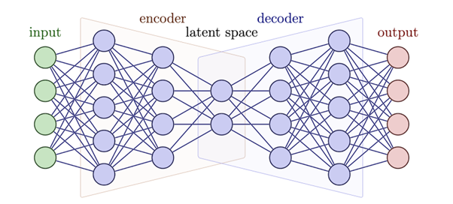
Reduce data rate close to detector: Edge compression
Compression is appealing since data are reduced but not discarded, and it can be applied as a general approach, not an experiment specific analysis step. Addresses 1, 2 and 3.
"Auto encoder" (type of NN) to harness AI
"Baler" collaboration, originating from particle physics
Currently testing on MAX IV data
Attempting to deploy on FPGA
(PI recently moved from Lund to Manchester)

Slide 11
Record full rate but with "AI guidance" to increase efficiency: Automation
Take "AI guidance" to the limit -> fully automated experiments
Decision can be on:
Next scan point (in whatever variable is being scanned, e.g. position, energy)
Next sample composition

Slide 12
Summary
Today's approach of processing and storing all data at full rate looks hard to scale to future detectors. 3 limits:
Bandwidth throughput 2. Storage 3. End user analysis
Can address all 3 issues by reducing "at the edge", close to the detector.
Reducing meaning discarding data is the hardest thing to do! To be analysis specific and fully trustable.
Edge-compression can be one route – reduction but no discarding. Domain-independent implementation?
As alternative, an "advisory" AI, to steer experiments and thus increase the data quality (hence reduce total data recorded). Also needs domain knowledge. Taken to the limit implies automated control.
Disclaimer – these are views from a detector-daq perspective, not a beamline scientist

