Slide 1
EnvironmentManager: modular backends with Redis & TangoDB support
Wojciech Kitka

Slide 2
Introduction
This live demo presents a proof-of-concept refactor of the Sardana EnvironmentManager into a modular backend system. The refactor introduces three interchangeable backends—Shelve (default), Redis, and TangoDB—while maintaining full API compatibility.
https://gitlab.com/sardana-org/sardana/-/merge_requests/2054

Slide 3
Why the change and what was changed?
Split into a base class and shelve, redis, and tangodb backends
Drop-in backend choice via a single config prefix (redis://, property:); no macro changes
API compatibility maintained
Allow choice of storage with a single config value
Keep user macros and clients unchanged

Slide 4
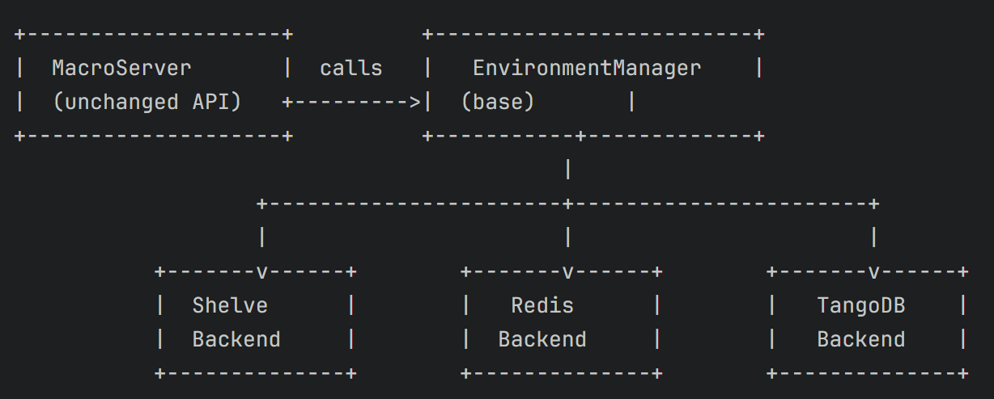
Architecture (at a glance)
Backend selection

Slide 5
Backend selection
redis://host:port or rediss://host:port -> Redis backend
property:<property_name> -> TangoDB backend
anything else -> Shelve backend

Slide 6
Risks
Risk is managed by design:
  Shelve stays default: no behavior change if you ignore the feature
  Single switch to try: change environment_db, restart, done
  Easy rollback: revert the prefix and you’re back on Shelve

Slide 7
Trade-offs
Adds optional dependencies (Redis server)
Slightly more code to maintain, but modularization isolates it, so it’s manageable

Slide 8
Thank you!
Questions?

