Slide 1
Arbitrary Two-Dimensional Mapping Scan Utilizing the Sardana Framework
Yimeng Li | Software team

Slide 2
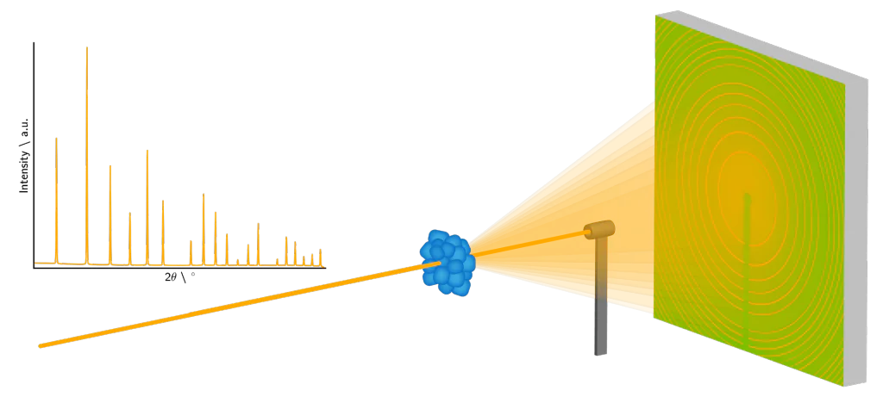
Background
Advanced materials such as energy materials, catalysts, and biological materials have complex hierarchical structures spanning several length scales where chemical elements are organized in a spatial heterogeneous fashion.
To understand such materials, it is essential to be able to map the structure and elements within them.
2D micro X-ray diffraction/small-angle X-ray scattering (µXRD/SAXS) and micro X-ray fluorescence (µXRF), available at MAX IV, are particularly well-suited for this purpose.

Slide 3
Motivation
The 2D mesh mapping process consists of a sequence of linear scans. For competitive speed it is essential to keep overhead to a minimum.
The Sardana meshct scan enables efficient mapping over large sample areas but are constrained to rectangular scan geometries. This limitation leads to inefficiencies when targeting arbitrarily shaped regions of interest, resulting in prolonged scan times due to the inclusion of irrelevant surrounding areas.

Slide 4
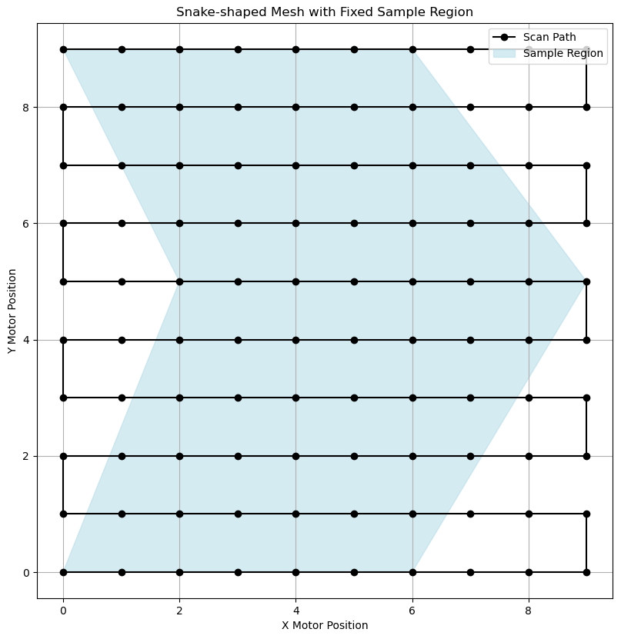
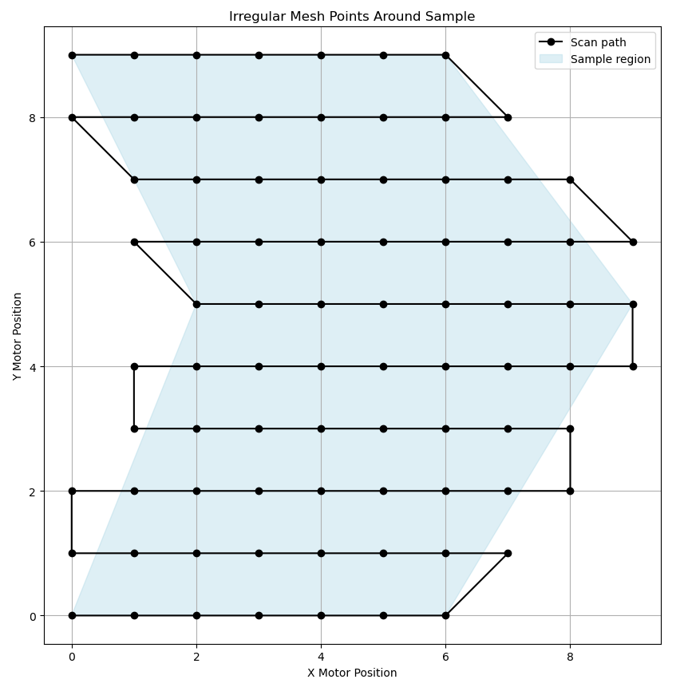
Purpose

Slide 5

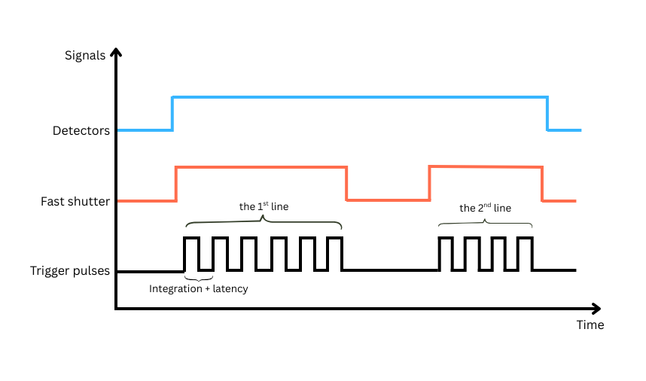

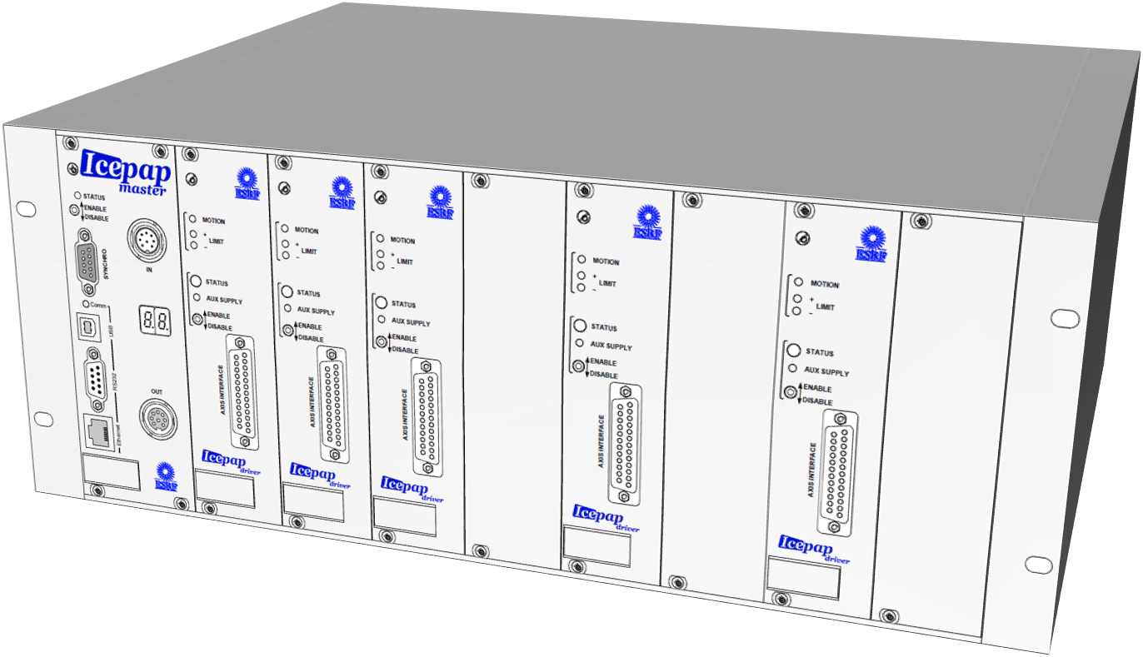

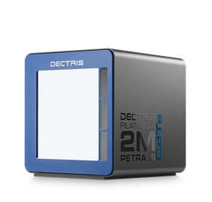

Signal pulse stream
Arm
Control process

Slide 6
Irregular mesh continuous scan(imeshct)
The scan macro is capable of executing a mesh scan over arbitrarily defined mapping regions. It exacts the scan regions from a user-provided input file and generates a table of motor positions, which is then passed to the detectors and trigger gate controllers.
mapping_file.json
{
"Region01":{
"m1_start_pos": [0, 1, 0.5],
"m1_final_pos": [1, -0.2, 1.5],
"m1_nr_interv": [15, 10, 5],
"m2_start_pos": 0,
"m2_final_pos": 1
},
"Region02":{
"m1_start_pos": [0, 1],
"m1_final_pos": [1, -0.2],
"m1_nr_interv": [15, 10],
"m2_start_pos": 2,
"m2_final_pos": 3
},
"integ_time": 0.1,
"latency_time": 0.1,
"motor1": "pd_sam_y",
"motor2": "pd_sam_x"
}
Door_B304A_ct [2]: imeshct?
Syntax:
imeshct <mapping_file>
meshct for irregular scanning area. Scan information are defined in a json file which should include:
m1_start_pos(list), m1_final_pos(list), m1_nr_interv(list), m2_start_pos(float),
m2_final_pos(float), integ_time(float), latency_time(float), motor1(string), motor2(string)
Parameters:
mapping_file : (String) The path for mapping info json file

Slide 7
Handle varying number of triggers
In meshct:
def _go_through_waypoints(self):
for i, waypoint in waypoints:
……
if index == 0:
# Prepare Controllers only once
self.measurement_group.prepare()
In imeshct:
def _go_through_waypoints(self):
for i, waypoint in waypoints:
……
# Prepare Controllers for each line to update nr_intervs
self.measurement_group.prepare()
In pre-scan hook(for each detector):
def getImeshctMacro(macro):
for ancestor in ancestors(macro):
macro_name = ancestor.getMacroCommand()
if macro_name.startswith("imeshct"):
return ancestor
return None
def ancestors(macro):
if macro is not None:
while (macro := macro.getParentMacro()) is not None:
yield macro
self.imeshct_macro = getImeshctMacro(self)
if self.imeshct_macro is not None:
nr_intervs = self.imeshct_macro.m1_nr_intervs
pilatus_elem_dp.MeshEnabled = True
pilatus_elem_dp.TotalTriggers = sum(nr_intervs)

Slide 8
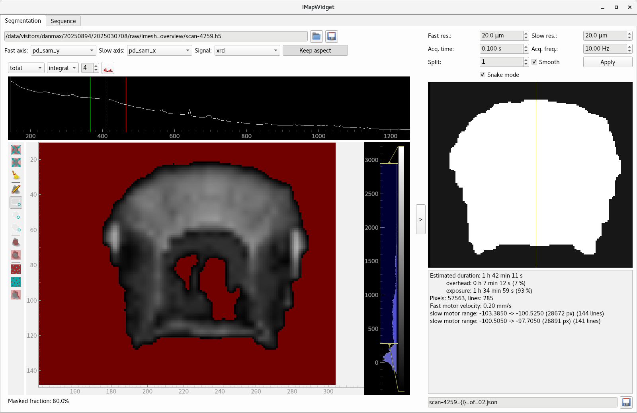
Prepare irregular mesh scan
Coarse scan
Segmentation of the interested area
Imesh parameters
(integration, resolution)
Split scans
Scan sequence

Slide 9






Preliminary test with different shapes of samples
Acquisition:
Resolution: 50 um
Frequency: 50 Hz
Scanning motion: snake
Detectors:
Pilatus, Alba electrometer, Xspress 3 mini
Synchronization:
PandABox hardware synchronized
Scanning stage:
Icepap controlled Owis motors
Each sample scanning is composed of 6 scans in sequence to avoid generating one large data file.

Slide 10
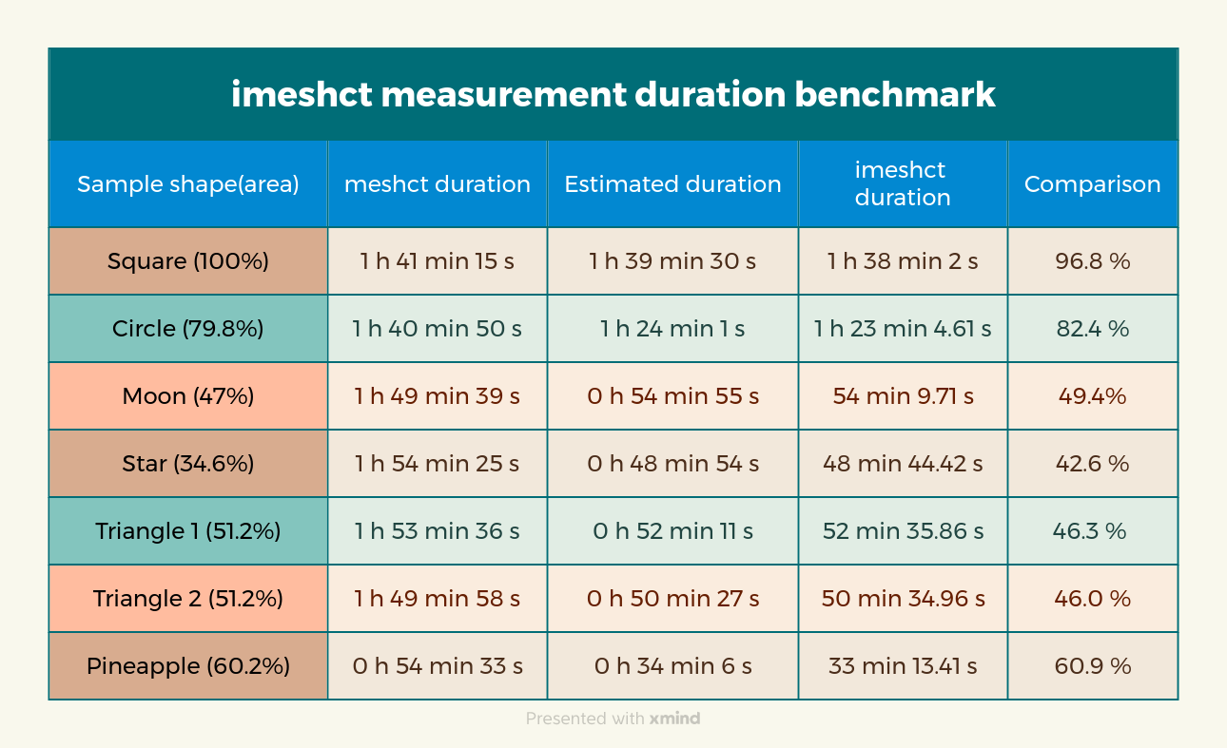

Slide 11

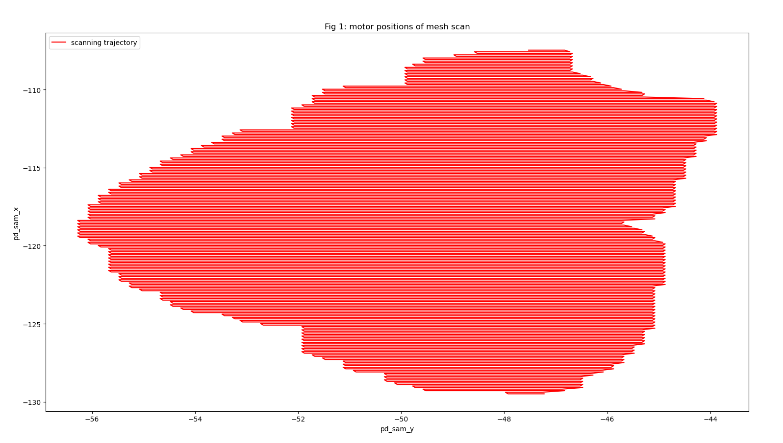
Pineapple outer shell

Slide 12
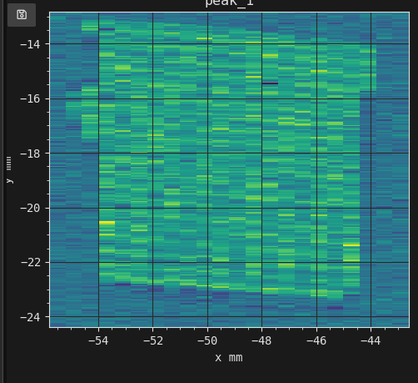

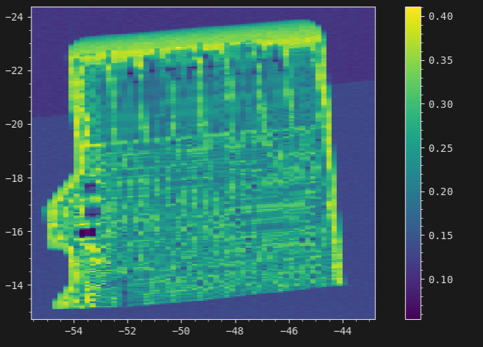
SD Card
Conventional meshct scan
Irregular meshct scan

Slide 13
Conclusion

Slide 14
Conclusion
The reduction in scan time is proportional to the decrease in sample area relative to the original rectangular scan region
It significantly enhance the efficiency of high-resolution structural and compositional mapping workflows.
All detectors are only armed once in the beginning of the scan to save more overhead between scanning lines.

Slide 15
Future

Slide 16
Future
The complicated implementation for passing the synchronization description to the Sardana controllers for detectors could be improved with the new feature that allows transmission of multiple synchronization description directly to Sardana.
It will be valuable to compare it with the mesh scans with parameterized trajectory solution in IcePAP(ongoing).

