Slide 1
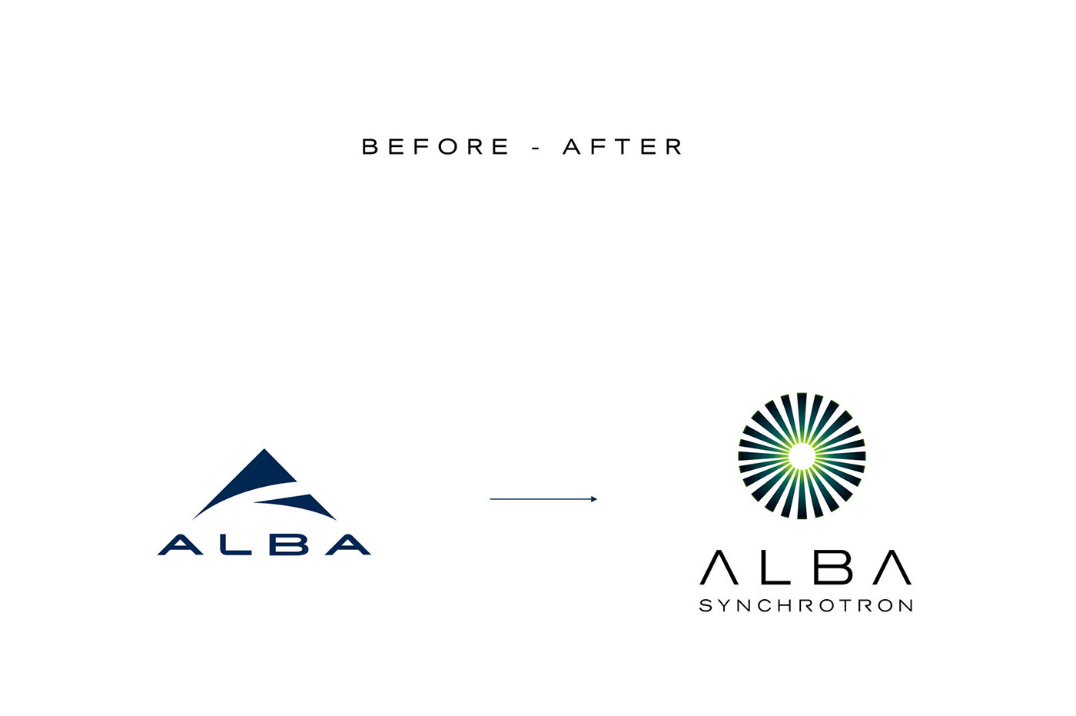
Advances in experiment synchronization
Jordi Aguilar
Roberto Homs
Zbigniew Reszela
Oriol Vallcorba
on behalf of
ALBA Synchrotron
Controls Section

Slide 2
Index
Multiple Synchronization Description
Shutter object
Next steps

Slide 3
MultipleSynchDescription: What is it?
< 3.6
>= 3.6
Single synchronization description for all channels in measurement group
Specific synchronization description for each trigger gate controller axis
tg01
tg01
tg02
...
tg02
{
tg01:[{Delay: {Time: 0},
Active: {Time: 0.5},
Total: {Time: 1},
Repeats: 5}],
tg02:[{Delay: {Time: 0.5},
Active: {Time: 0.25},
Total: {Time: 0.5},
Repeats: 10}]
}
[{Delay: {Time: 0},
Active: {Time: 0.5},
Total: {Time: 1},
Repeats: 5}]

Slide 4
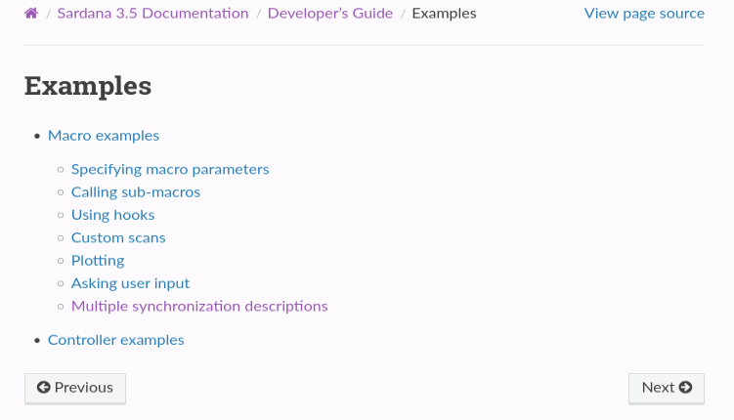
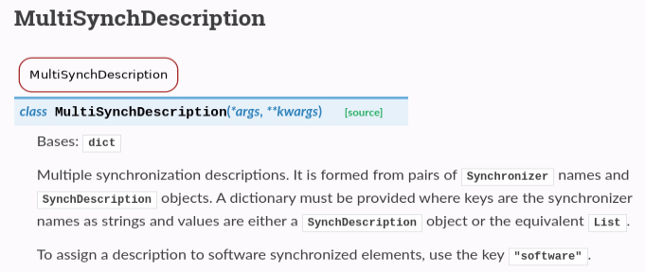
MultipleSynchDescription: Docs

Slide 5
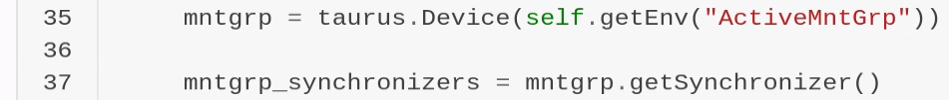
Working with MultipleSynchDescription
Get channels and synchronizers from MG

Slide 6
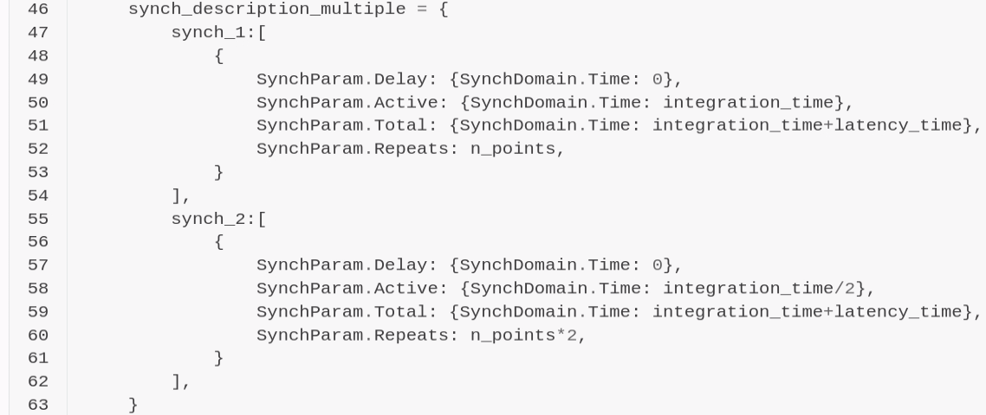
Working with MultipleSynchDescription
Get channels and synchronizers from MG
Create synch descriptions

Slide 7
Working with MultipleSynchDescription
Get channels and synchronizers from MG
Create synch descriptions
Set MSD, prepare and start MG

Slide 8
Working with MultipleSynchDescription
Get channels and synchronizers from MG
Create synch descriptions
Set MSD, prepare and start MG
Wait until ready

Slide 9
Working with MultipleSynchDescription
Get channels and synchronizers from MG
Create synch descriptions
Set MSD, prepare and start MG
Wait until ready
To improve:
Low level API
No native data handling for now (Redis)

Slide 10
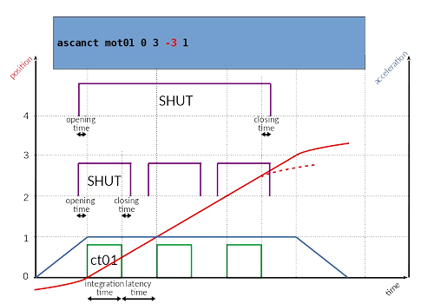
Shutter object
MOTIVATION: Automatic shutter configuration in a Scan

Slide 11
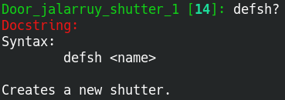
Shutter object
MOTIVATION: Automatic shutter configuration in a Scan
No specific plugin
Has attributes:
  Time to open
  Time to close
  Time to exposure
  Mode (Simple / Multiple)
No commands (only HW triggered shutter)

Slide 12



Shutter object
MOTIVATION: Automatic shutter configuration in a Scan
Has attributes
Can be added in a measurement group
  Passive element (no data)
  Synchronized by a trigger gate controller axis
  Measurement group is aware of it
  Measurement group can access its attributes
Great for integration in a Scan macro
Great for customizing synch description

Slide 13
Shutter object
MOTIVATION: Automatic shutter configuration in a Scan
Has attributes
Can be added in a measurement group
  Passive element (no data)
  Synchronized by a trigger gate controller axis
  Measurement group is aware of it
  Measurement group can access its attributes
It is integrated in the config tool
Great for integration in a Scan macro
Great for customizing synch description
pools:
my_pool:
shutters:
shutter01:
time_to_exposure: 0.1
time_to_open: 0.2
time_to_close: 0.1
mode: simple
YAML

Slide 14
Shutter object
MOTIVATION: Automatic shutter configuration in a Scan
Has attributes
Can be added in a measurement group
  Passive element (no data)
  Synchronized by a trigger gate controller axis
  Measurement group is aware of it
  Measurement group can access its attributes
It is integrated in the config tool
Native support in Sardana scans: timescan, step scans, cont. scans...
Great for integration in a Scan macro
Great for customizing synch description

Slide 15
Shutter object
MOTIVATION: Automatic shutter configuration in a Scan
Has attributes
Can be added in a measurement group
  Passive element (no data)
  Synchronized by a trigger gate controller axis
  Measurement group is aware of it
  Measurement group can access its attributes
It is integrated in the config tool
Native support in Sardana scans: timescan, step scans, cont. scans... [TODO]
Great for integration in a Scan macro
Great for customizing synch description
Ready to be merged after being tested in ALBA for months

Slide 16
Next steps: master-slave relations
Issue that affected the shutter integration:
  When there are master-slave relations between hardware Trigger Gates, the execution order is very important
  Currently, we can’t configure Trigger Gate axis execution order
    Axis are started following the axis number (1 -> 2 -> 3 ...)
  Introduce new parameters (tree/graph) configurable through a GUI
tg01
t
tg02
tg03
tg04

Slide 17
Next steps: Programmatic Scan API
Scan levels
Custom Scan class:
- Inherit from GSCan
- Repeat a lot of code just to change something subtle
- Redo macro that uses customs scan class
Macros:
- dscan
- timescan
- ascanct
- ....
Rethink Scan API to make it more friendly
High level
Low level

