Slide 1

PandABox integration in Sardana
Jordi Aguilar

Slide 2
Index
Context
PandABox Workflow with Sardana
  Fixed multidisciplinary layout
  Software generated layouts
  Flexible layouts modified by LLMs (demo)
Conclusions

Slide 3
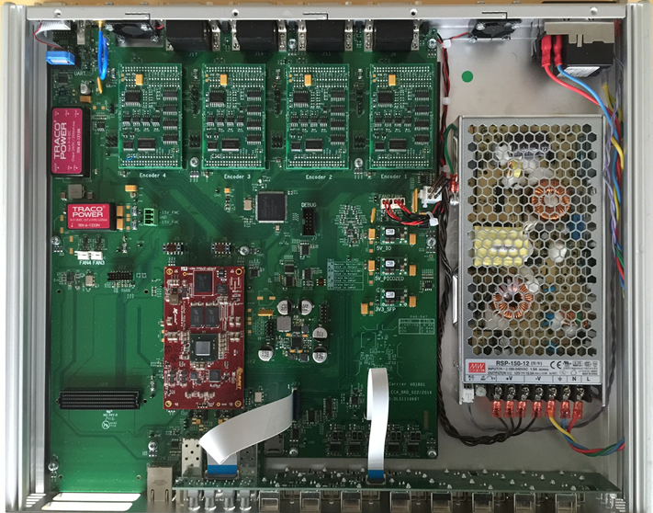
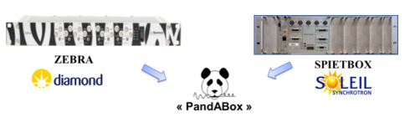
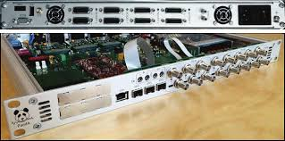
PandABox
TTL Inputs (6)
TTL Outputs (10)
Encoder Inputs (4)
Encoder Outputs (4)
Xilinx Zynq 7030 FPGA:
Analog card option
(4 out + 4 in)
SFP Connectors
...
https://accelconf.web.cern.ch/icalepcs2017/papers/tuapl05.pdf

Slide 4
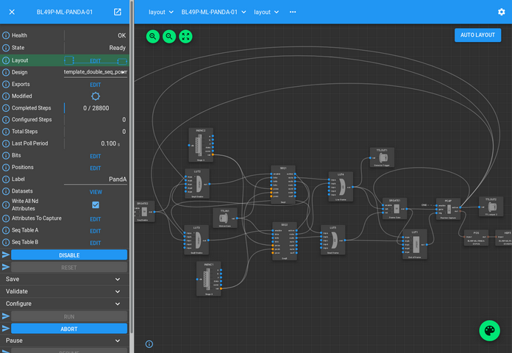
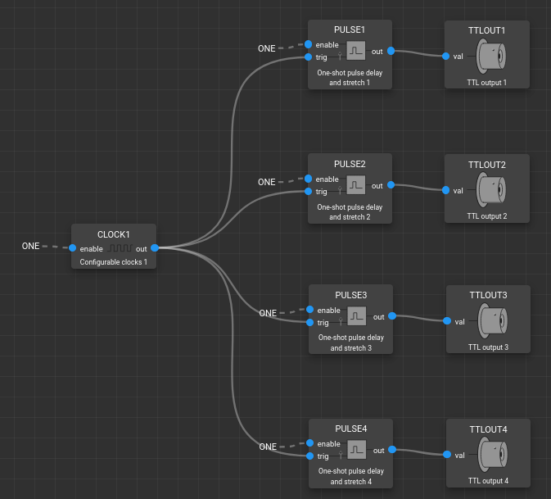
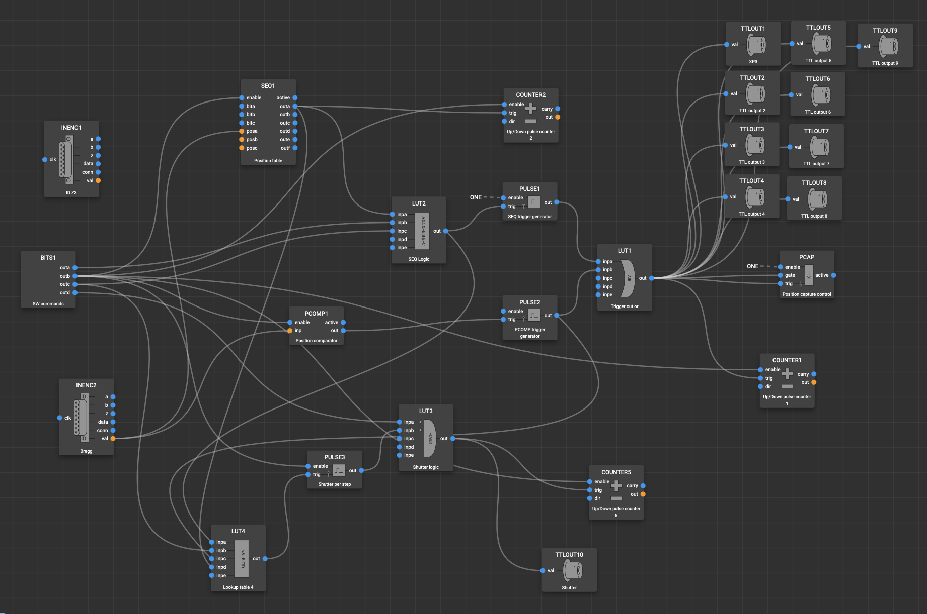
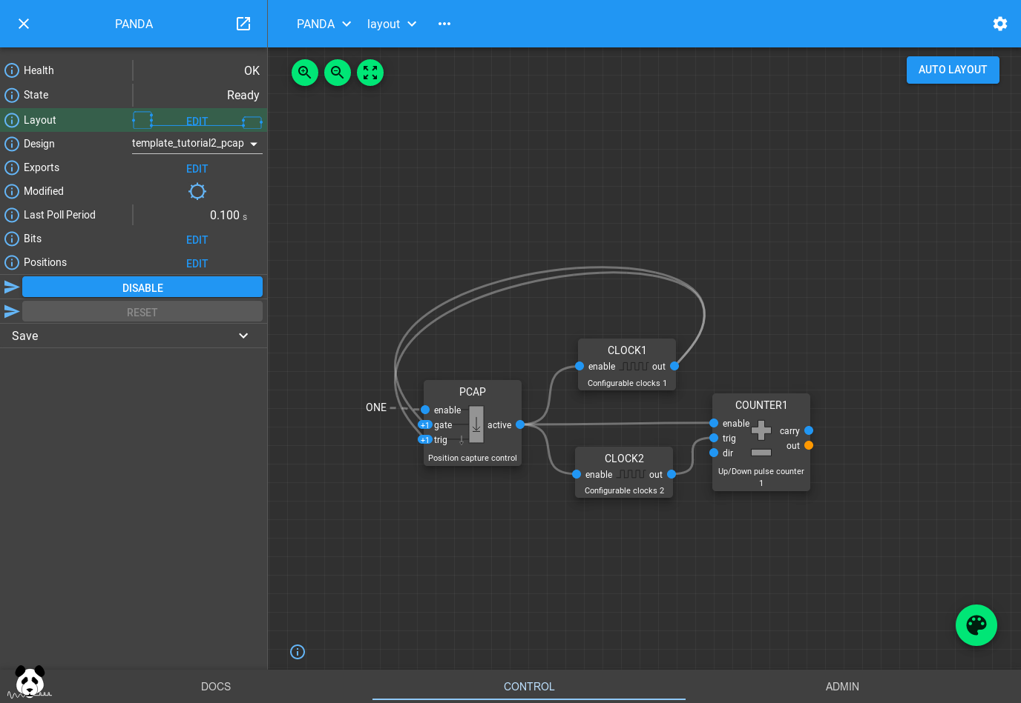
PandABox
FPGA programmable through blocks
Blocks perform logic:
  Pulse generation
  Counting/Sum/Diff
  Logic operations AND/OR/NOT
Blocks connect to:
  Other Blocks
  Outputs
  Inputs
  Position Capture
  Encoders

Slide 5
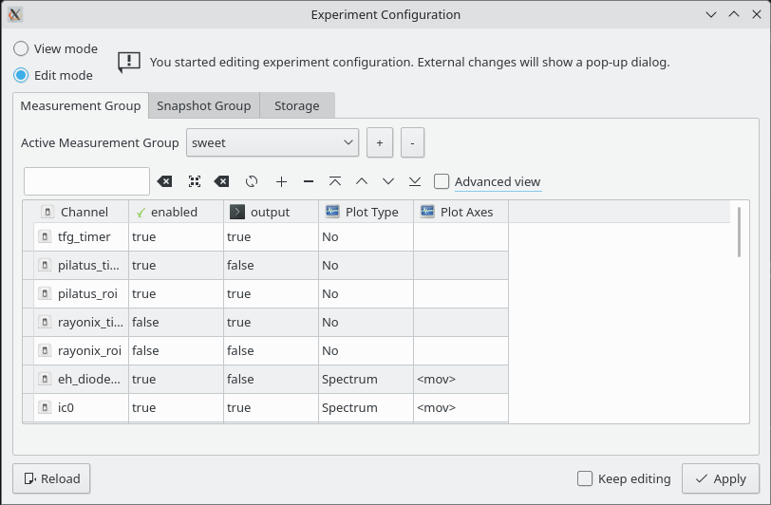

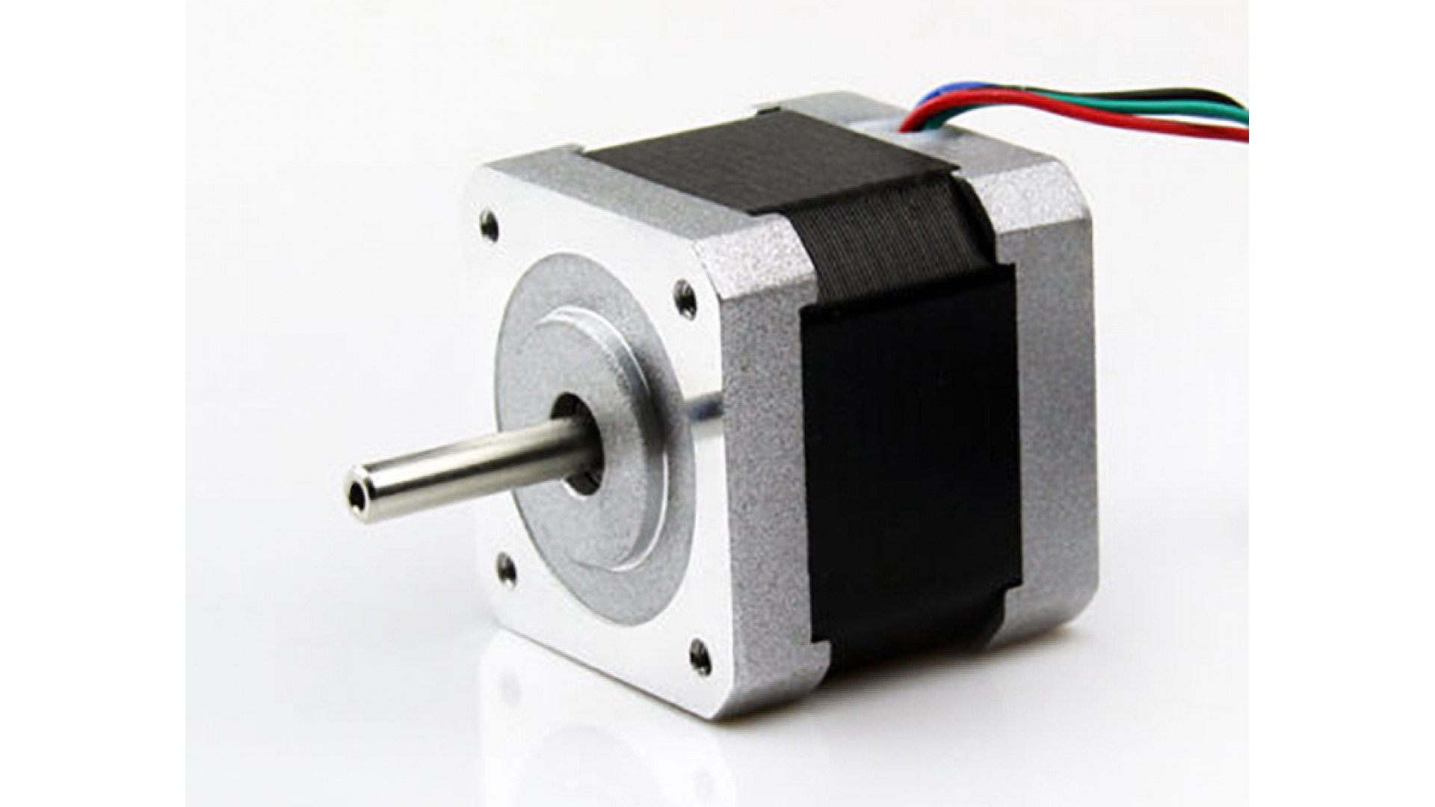
PandABox Workflow in Sardana Scans
User
Sardana
HW
expconf GUI
Controller Plugin
Detector
List of experimental channels
Acquisition pattern
Controller Plugin
Scan macro params:
<motor>
<n_points>
<exposure_time>
...
Controller attributes:
Slave (NI)
Motor axis (Icepap)
...
Controller Plugin

Slide 6
PandABox Workflow in Sardana Scans
Sardana
HW
Controller Plugin
Detector
Controller plugins are responsible for the translation between scan configuration and HW commands
SCAN
CONFIG
Controller Plugin
Controller Plugin

Slide 7
PandABox Workflow in Sardana Scans
How do we programatically configure a PandABox to meet the user requirements of each scan?
Programatically configure a layout from scratch:
Clean layout and blocks
Decide which blocks have to be used
Configure and connect blocks
Modify a predefined layout:
Known layout
Subtle changes based on rules
Evaluate arbitrary layout and modify it
Arbitrary layout
Minimal set of changes to accomplish requirements
+ Controller is lightweight
+ Layouts can be version controlled (e.j. git)
Tightly coupling between controller and layout
High layout complexity
+ No assumptions about the layout.
~ Deterministic based on the parameters
Hard to implement, high code complexity
+ No assumptions about layout
~ Deterministic based on the parameters + layout
Hard to implement, high code complexity
1
2
3

Slide 8
PandABox Workflow in Sardana Scans
How do we programatically configure a PandABox to meet the user requirements of each scan?
Programatically configure a layout from scratch:
Clean layout and blocks
Decide which blocks have to be used
Configure and connect blocks
Modify a predefined layout:
Known layout
Subtle changes based on rules
Evaluate arbitrary layout and modify it
Arbitrary layout
Minimal set of changes to accomplish requirements
LLMs will do it!
+ Controller is lightweight
+ Layouts can be version controlled (e.j. git)
Tightly coupling between controller and layout
High layout complexity
MaxIV approves
+ No assumptions about the layout.
~ Deterministic based on the requirements
Hard to implement, high code complexity
+ No assumptions about layout
~ Deterministic based on the requirements + layout
Hard to implement, high code complexity
1
2
3

Slide 9

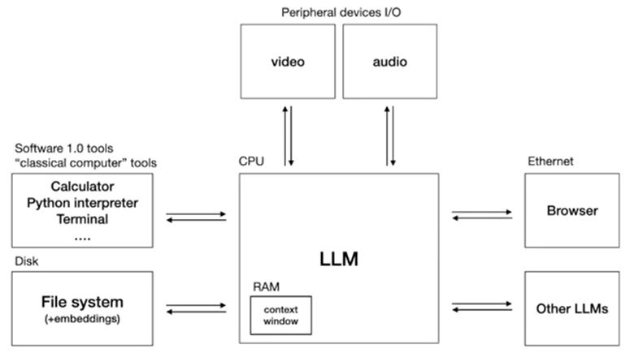
LLM Context
Many providers, not only OpenAI
Fierce competition:
  Frequent updates
  Prices drop
  Same API for everyone
Open source frameworks:
  LangChain
  LangGraph
  ...
More than chatting:
  See next slide
LLM OS: http://y2u.be/tsTeEkzO9xc

Slide 10
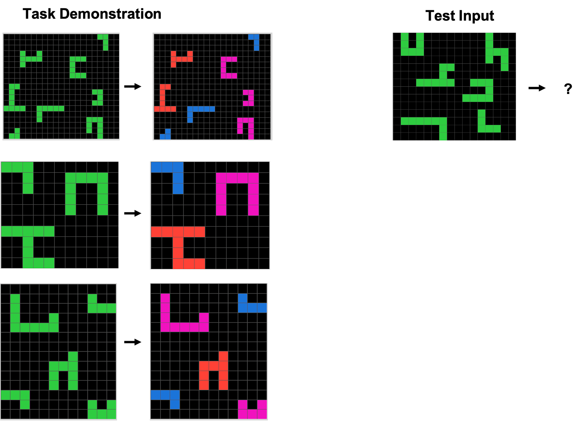
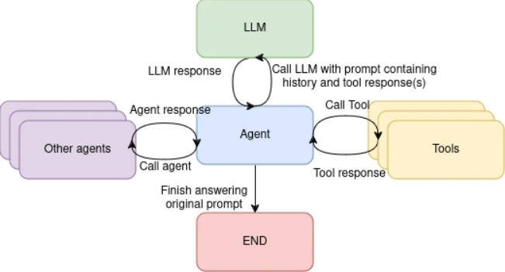
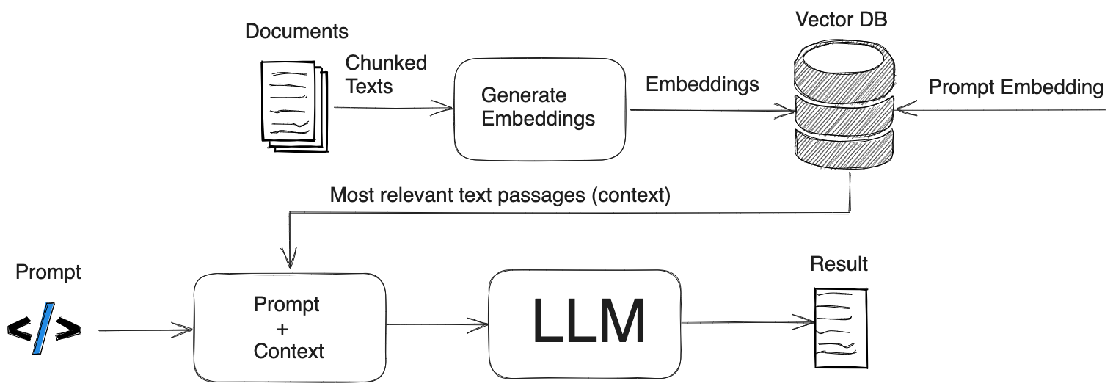
LLMs More than chatting
Information extraction
Contextual understanding
Task automation
Logical inference, abstract reasoning
Different “architectures”:
  Structured Output
  Function calling
  Agents
  RAG
  MCP Servers
  ...
ARC: https://aiguide.substack.com/p/why-the-abstraction-and-reasoning?trk=public_post_comment-text
Agents: https://knative.dev/blog/articles/llm-agents-overview/
RAG: https://safjan.com/understanding-retrieval-augmented-generation-rag-empowering-llms/

Slide 11
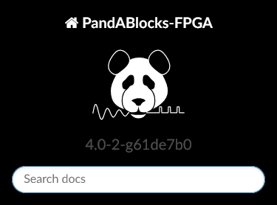
LLM for PandABox: Approach
Preliminary layout
LLM
{synchronization_params}
Modified layout
Blocks Documentation
Everything’s JSON

Slide 12
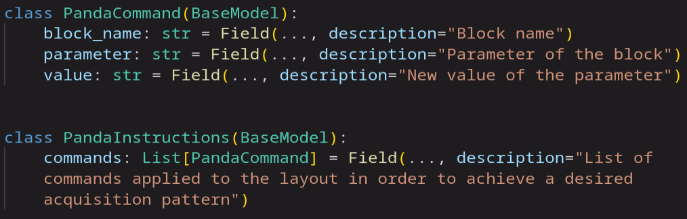
LLM for PandABox: Approach
prompt = ”””
You are responsible for updating the blocks parameters of a PandaBox layout [...]
You will be given three inputs [...]
The goal is to [...]
Make sure to [...]
<Blocks documentation>
<Initial layout>
<Synchronization_parameters>
”””
INPUT
LLM
OUTPUT
(STRUCTURED OUTPUT)

Slide 13
LLM for PandABox: DEMO
Tests performed:
Time based:
  Change basic parameters: num points, integration time, latency
  Add/remove outputs, different synch description
  Add a shutter, change shutter configuration according to other outputs
Position based:
  Change triggered positions
  Switch to time based

Slide 14
LLM for PandABox: Conclusions
LLMs are cool:
  Great at reasoning
  They solve the unsolved
  New paradigm: new tools, new integrations, etc...
PandaBox is cool:
  Endless possibilities

Slide 15
LLM for PandABox: Conclusions
LLMs are cool:
  Great at reasoning
  They solve the unsolved
  New paradigm: new tools, new integrations, etc...
PandaBox is cool:
  Endless possibilities
LLMs may not be the best solution for deterministic problems
Currently it has accuracy limitations
PandaBox lacks abstractions
BUT

Slide 16
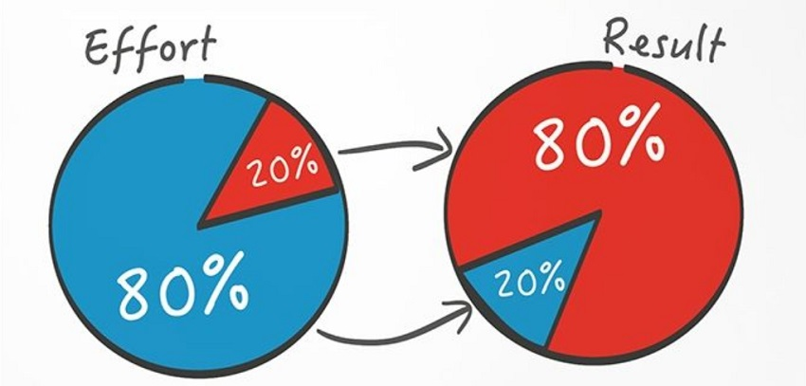
PandABox in Sardana: Conclusions
Programatically configure a layout from scratch
Modify a predefined layout:
Evaluate arbitrary layout and modify it with LLMs
Covers most of the cases investing little time
  No need to know about PandaBox internals
Ej. can replace a Ni660x card
Perfect for more complex cases
Potential is there, but needs refinement
Other limitations:
  Deployment
  Latency
  Costs
  ...
Reuse for documentation purposes

Slide 17
Refresh: “Demultiplexor” of trigger/gate element
“DEMUX”
1
# configuration, done once,
# corresponds to the external hardware cabling
tg01.ElementOnOutput = {
“ct01”: 1,
“ct02”: 2,
“ct03”: 3
}
SEL
2
3
Element | Synchronizer | Synchronization
ct01 | tg01 | Gate
ct02 | tg01 | Gate
# implemented on Controller
# using SetAxisPar method
SetAxisPar(
<axis>,
“active_outputs”,
[1, 2]
}
Sardana core, interprets the measurement group config.
and calls the Controller’s SetAxisPar() in the measurement group prepare() method.

