Slide 1
Improving Tango Controls Documentation
Sardana Workshop 2025
B. Bertrand

Slide 2
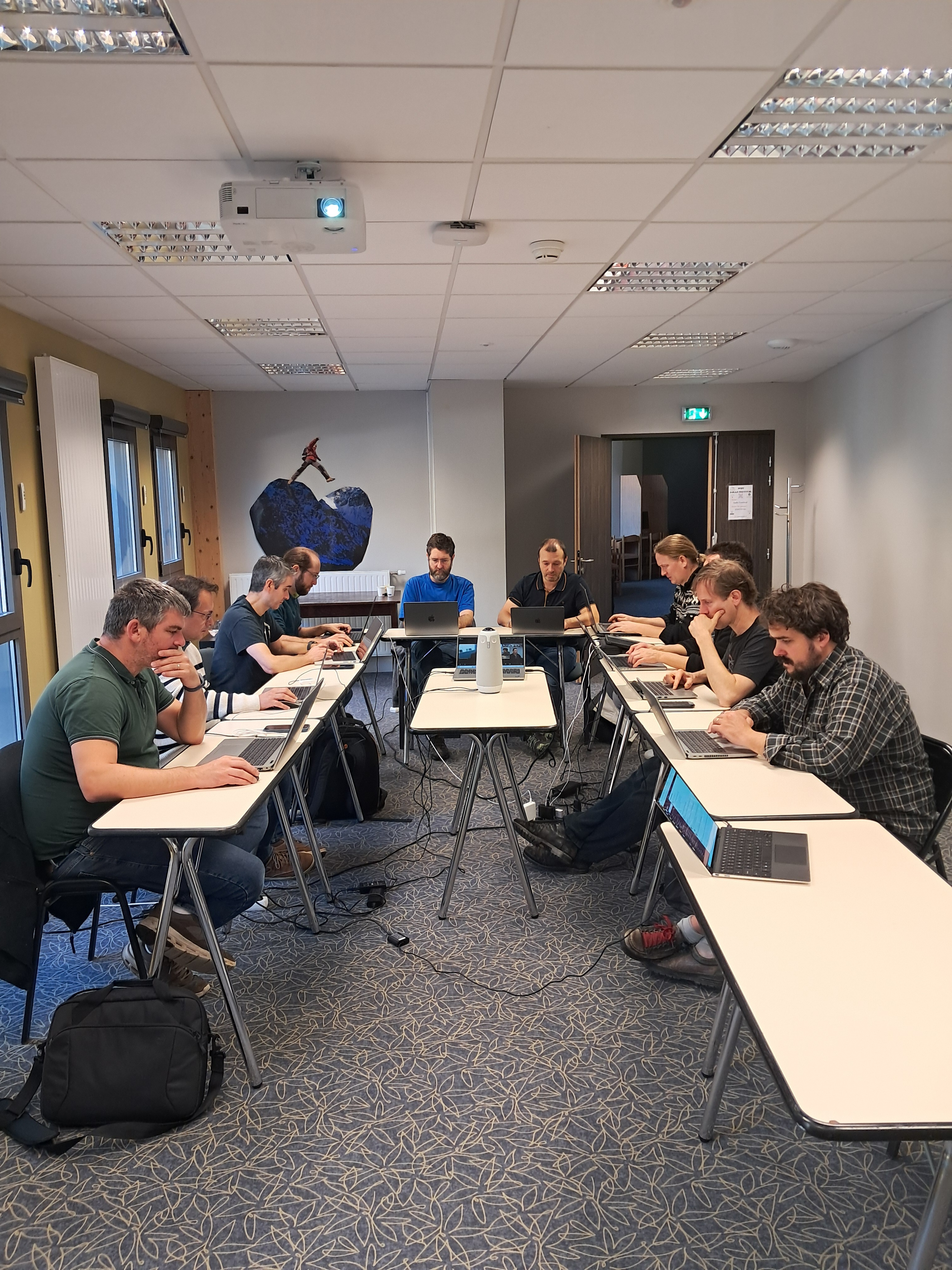

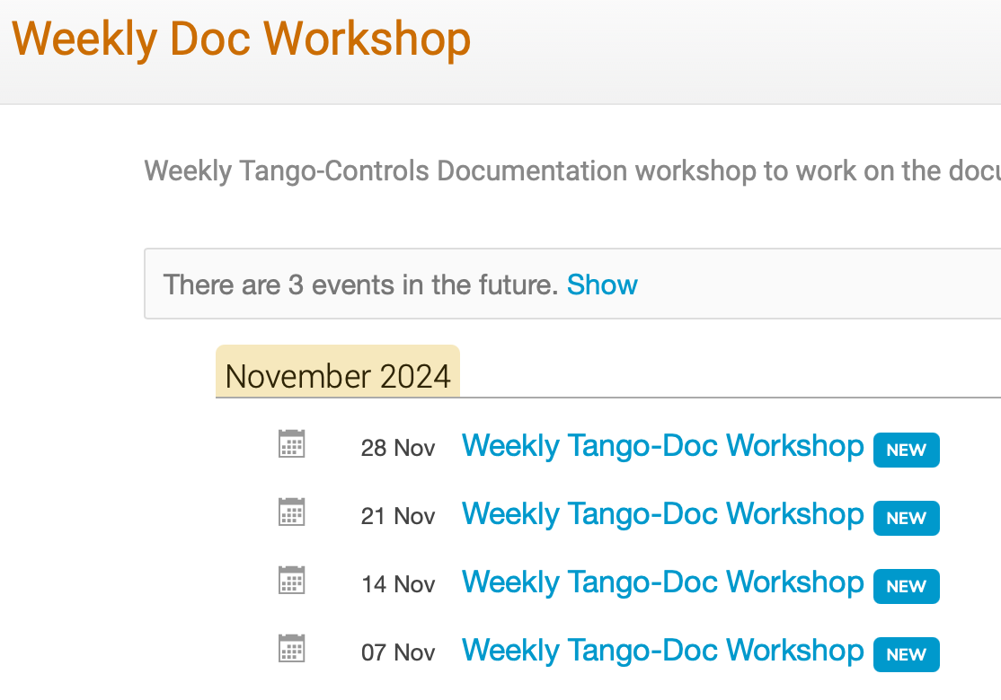
Tango Documentation Workshop
28 October 2024 to 1 November 2024
L'Escandille – Autrans
3 full days
Dedicated 2 hours meetings every Thursday on Zoom from November 2024 to May 2025
11 participants on site
1 online (Becky)
https://indico.tango-controls.org/event/422/contributions/899/

Slide 3
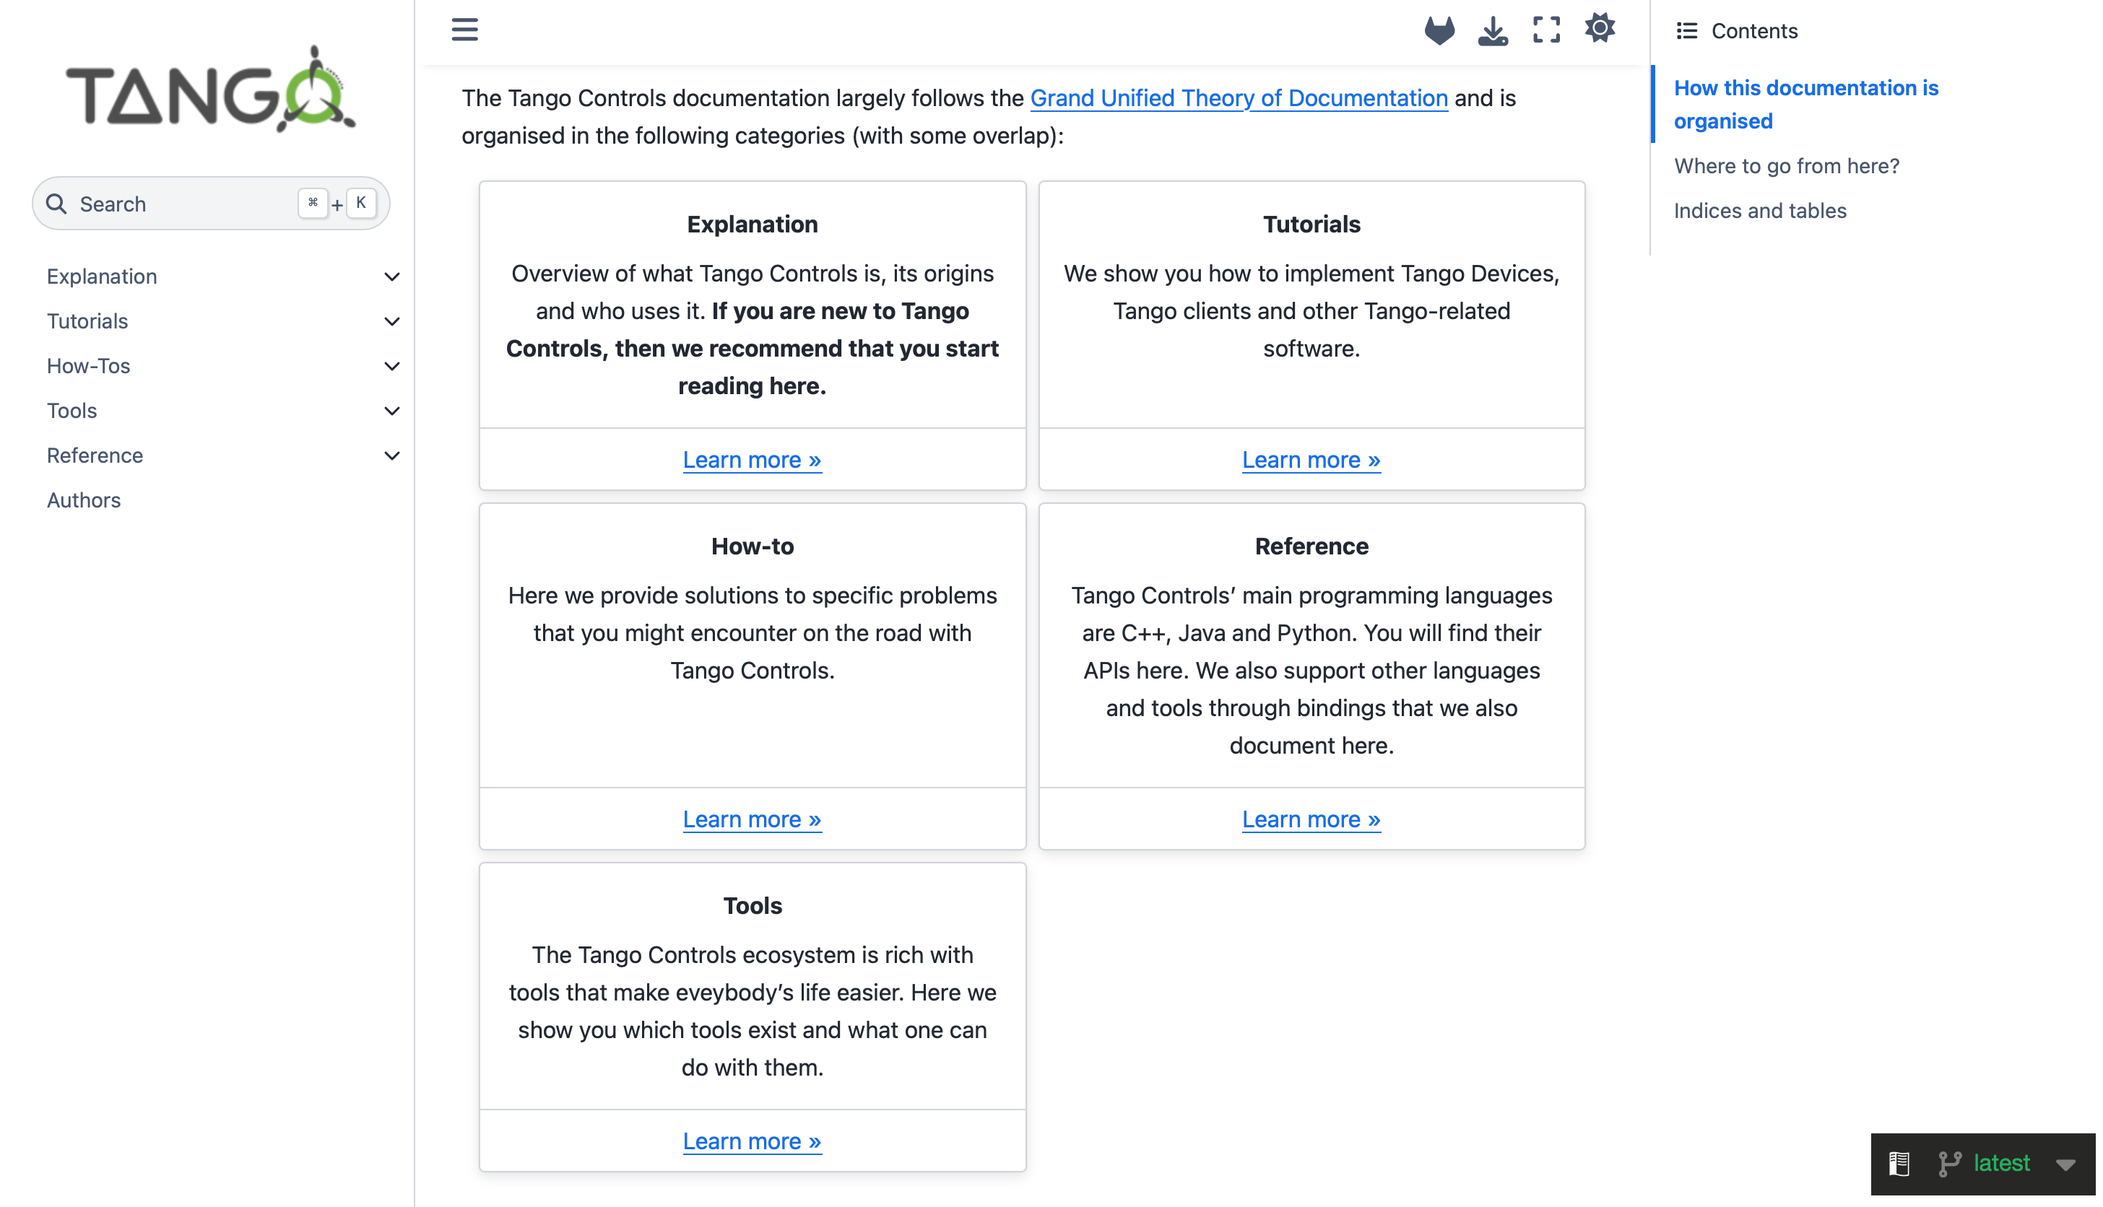
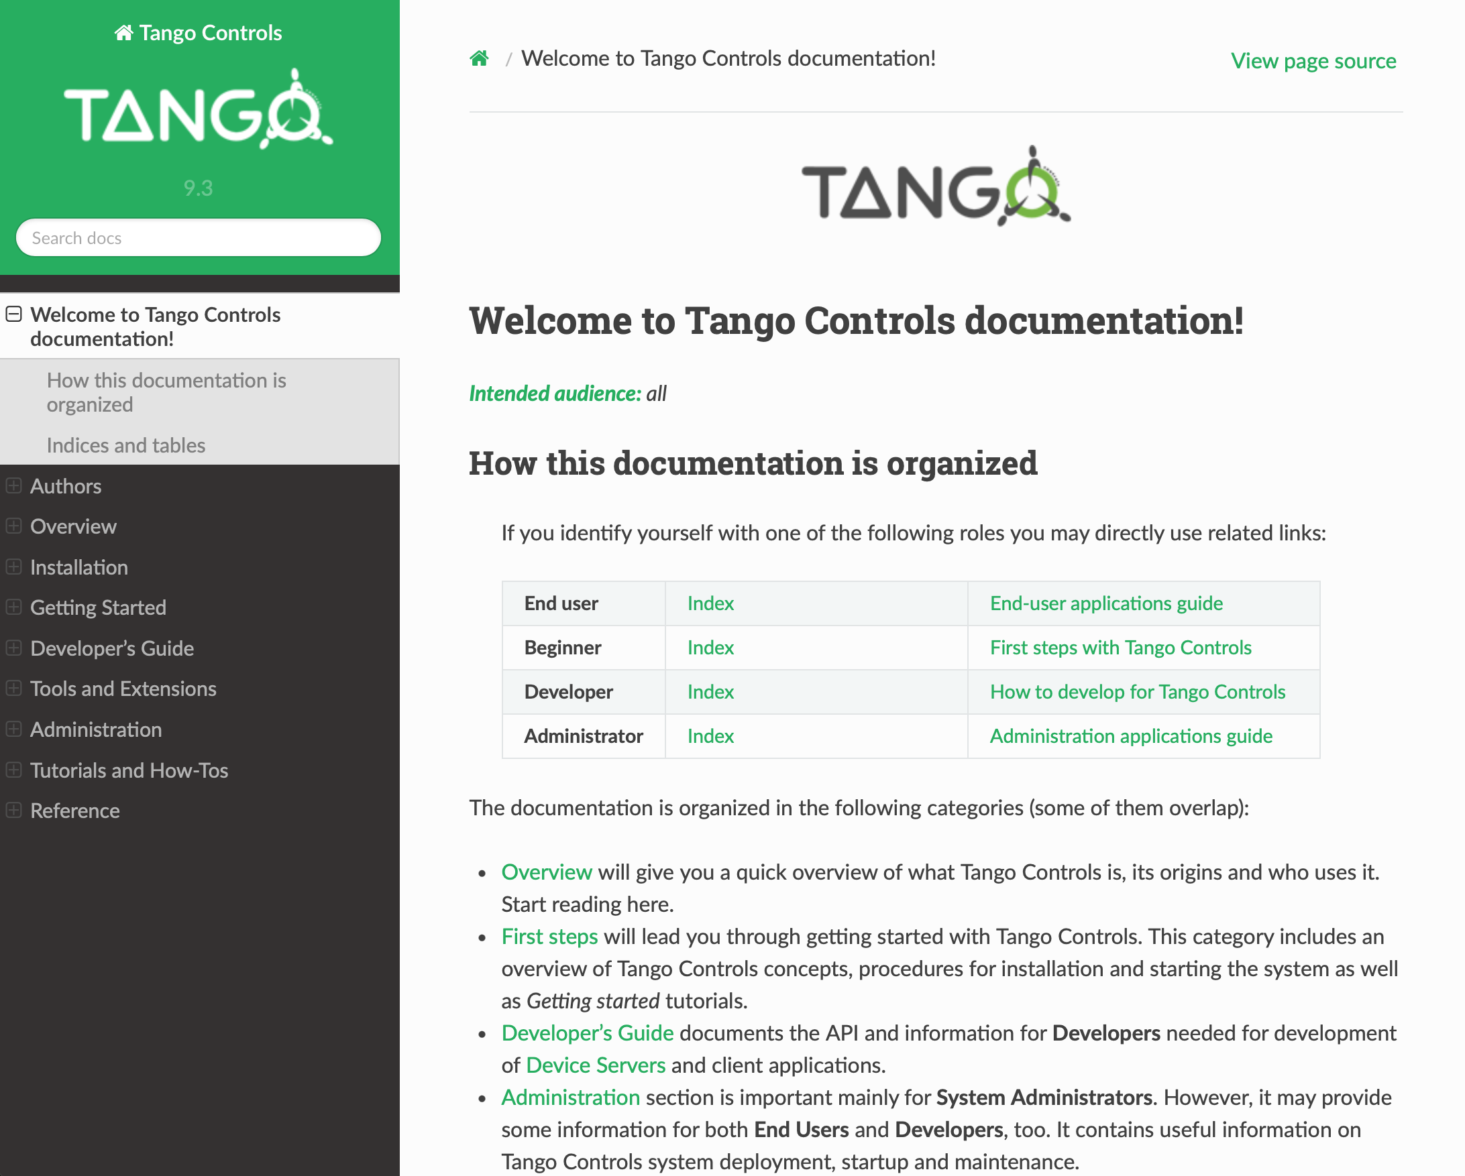
Tango documentation restructure

Slide 4
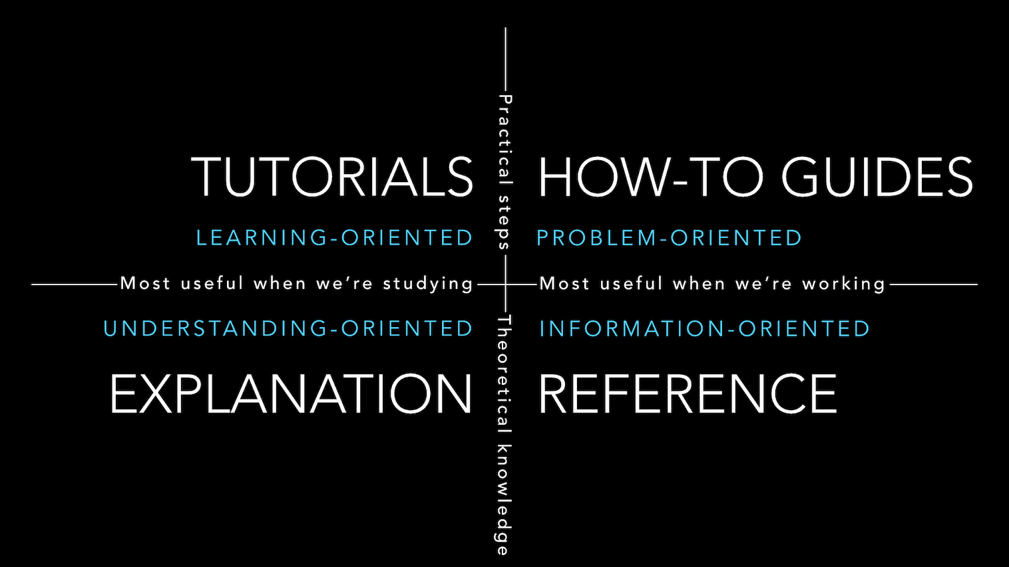
The Grand Unified Theory of Documentation / Diátaxis Approach
https://docs.divio.com/documentation-system/ and https://diataxis.fr
Notes:
Restructure to follow the Diataxis documentation approach, a.k.a. GUTD
The Diátaxis approach to documentation organizes technical documentation into four types — tutorials, how-tos, reference, and explanation
4 distinct needs of the reader

Slide 5
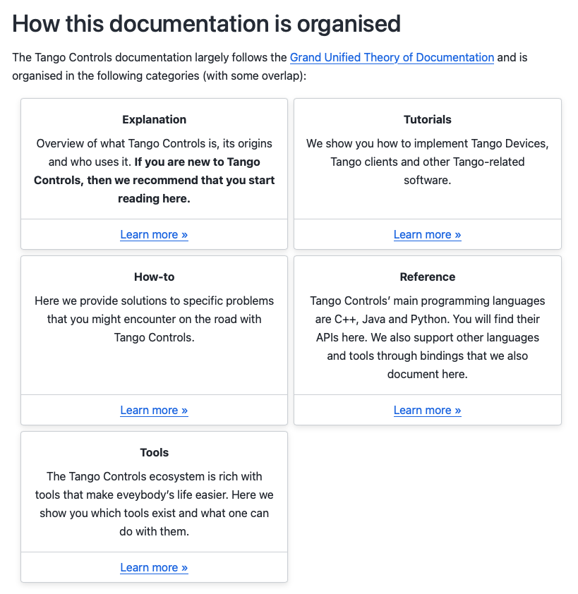
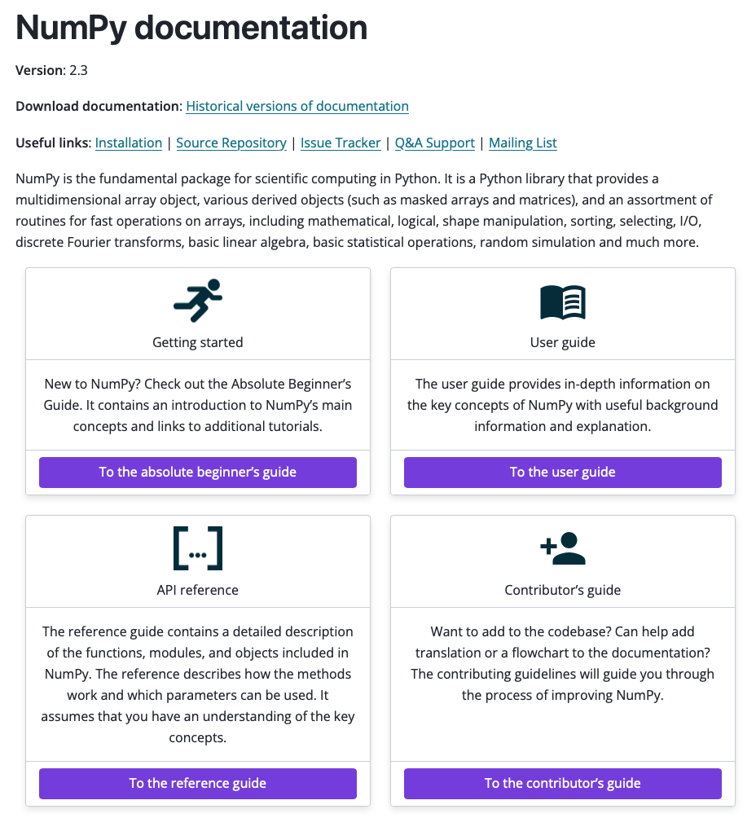
GUTD examples

Slide 6
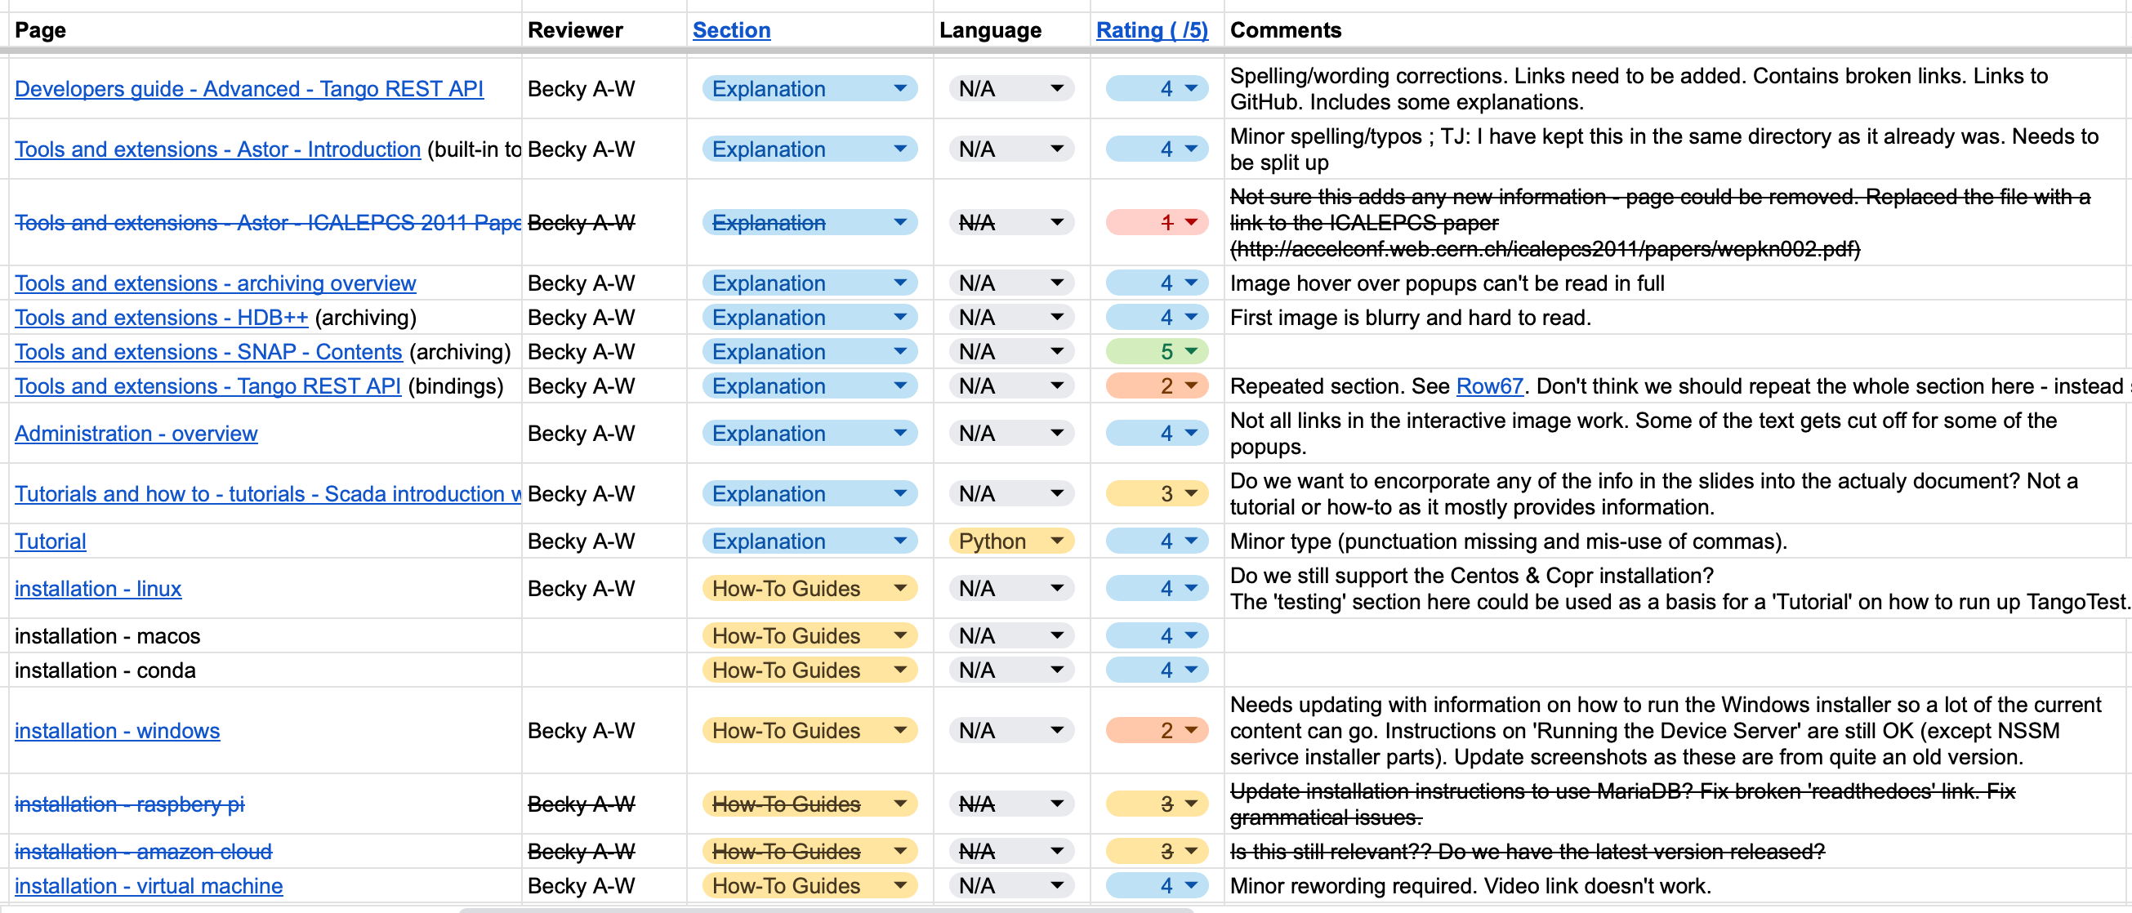
Doc review
Review and classify the existing content
Notes:
Sections to remove / update

Slide 7
Tools choice
reStructuredText: default markup language used by Sphinx
Jupyter Book: https://jupyterbook.org/ (now https://next.jupyterbook.org)
  MyST Markdown language
  Executable content
  Live environments with Binder
MkDocs: https://www.mkdocs.org
MyST: https://myst-parser.readthedocs.io
  Sphinx compatible
  Flavour of Markdown

Slide 8
MyST
Markdown has become very popular
  Used for README on GitHub/GitLab
  Easy syntax for common things (titles, links, list)
  Easier to contribute for new users?
Compatible with all Sphinx extensions
Tool to convert rst to MyST: rst2myst (https://github.com/executablebooks/rst-to-myst)
sphinx.ext.autodoc: hard-coded to use RestructureText -> has to be used with eval-rst – docstrings still in rst
sphinx-autodoc2 is an alternative that allows docstrings to be written in both RestructureText and MyST - performs static (rather than dynamic) analysis of the source code – couldn’t make it work on PyTango

Slide 9

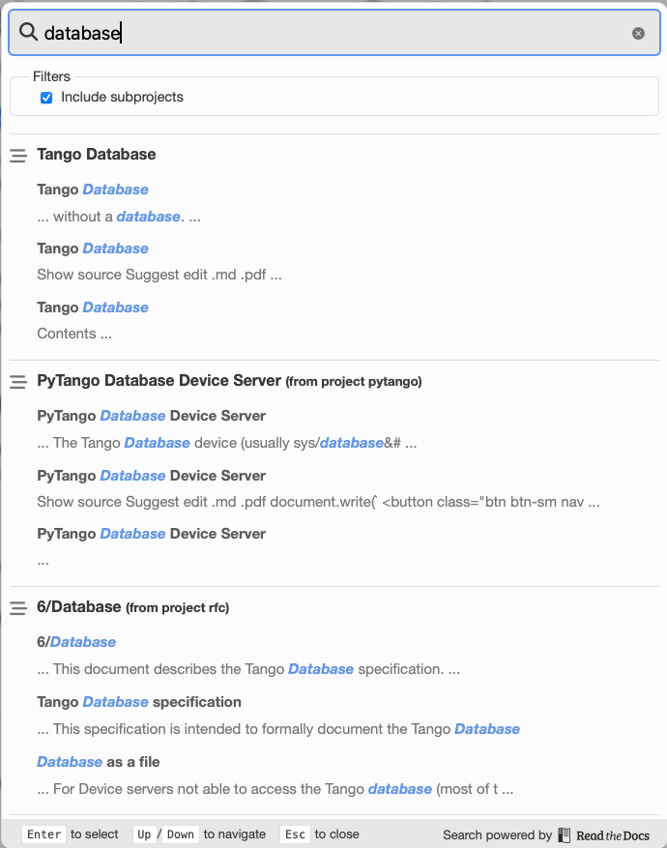
Readthedocs subprojects
Main page:
Subproject:
http://pytango.readthedocs.io/ redirects to
https://tango-controls.readthedocs.io/projects/pytango
Subprojects under the same domain (Jive, Pytango, Astor…)
Doc kept closed to each projects
Search across subprojects
Notes:
Could be used for sardana-config?

Slide 10
Useful links

Slide 11
GUTD links
https://labs.quansight.org/blog/2020/03/documentation-as-a-way-to-build-community
https://numpy.org/neps/nep-0044-restructuring-numpy-docs.html
https://numpy.org/doc/stable/index.html
https://toga.readthedocs.io/en/stable/

Slide 12
Useful Sphinx extensions
myst_parser
sphinx.ext.autodoc
sphinx.ext.intersphinx
sphinx-copybutton: add a little “copy” button to the right of your code blocks
sphinx_design: https://sphinx-design.readthedocs.io/ (add Tabs, Cards, Dropdowns)
Theme: https://sphinx-book-theme.readthedocs.io

