Slide 1
Sardana Archiving
Dmitry Egorov, MAX IV
Sardana Workshop at MAX IV Laboratory, 2025-08-29

Slide 2
Logs parsing
Attributes archiving

Slide 3

Logs parsing (FluentBit)
[INPUT]
name tail
path /tmp/tango*/Pool/*/*.txt
tag Pool
multiline on
parser_firstline sardana_default
offset_key offset
path_key path
db {{ fluent_bit_db_path }}/pool_logs.db
read_from_head True
[INPUT]
name tail
path /tmp/tango*/MacroServer/*/*.txt
tag MacroServer
multiline on
parser_firstline sardana_default
offset_key offset
path_key path
db {{ fluent_bit_db_path }}/macroserver_logs.db
read_from_head True
[OUTPUT]
name gelf
match_regex Pool|MacroServer
host {{ fluent_bit_host }}
port {{ fluent_bit_port }}
mode tcp
gelf_short_message_key message
gelf_Host_Key source
[PARSER]
name sardana_default
format regex
regex /^(?<thread>[\S]+)\s+(?<loglevel>[A-Z]+)\s+(?<time>\S+\s\S+)\s+(?<logger>\S+):\s+(?<message>[\s\S]+)/
time_key time
time_format %Y-%m-%d %H:%M:%S,%L

Slide 4

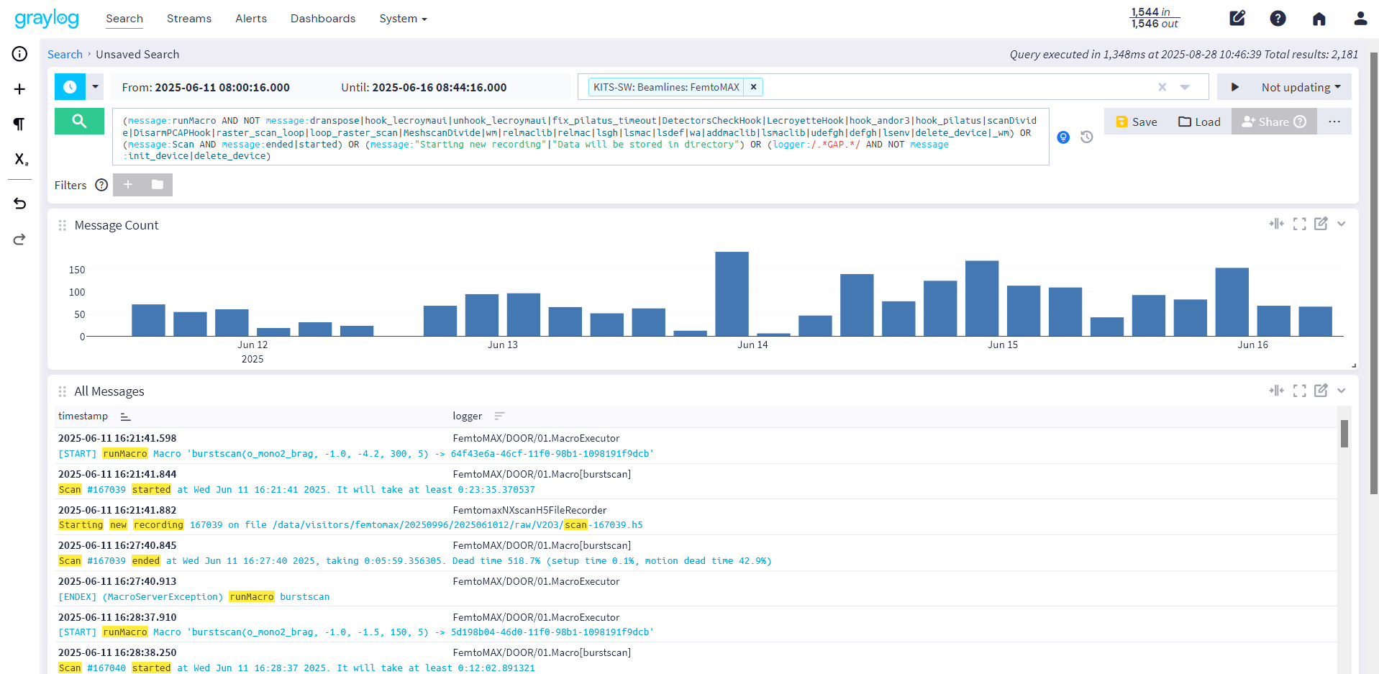
Logs storage (Graylog)
(message:runMacro AND NOT message:dranspose|hook_lecroymaui|unhook_lecroymaui|fix_pilatus_timeout|DetectorsCheckHook|LecroyetteHook|hook_andor3|hook_pilatus|scanDivide|DisarmPCAPHook|raster_scan_loop|loop_raster_scan|MeshscanDivide|wm|relmaclib|relmac|lsgh|lsmac|lsdef|wa|addmaclib|lsmaclib|udefgh|defgh|lsenv|delete_device|_wm) OR (message:Scan AND message:ended|started) OR (message:"Starting new recording"|"Data will be stored in directory") OR (logger:/.*GAP.*/ AND NOT message:init_device|delete_device)

Slide 5
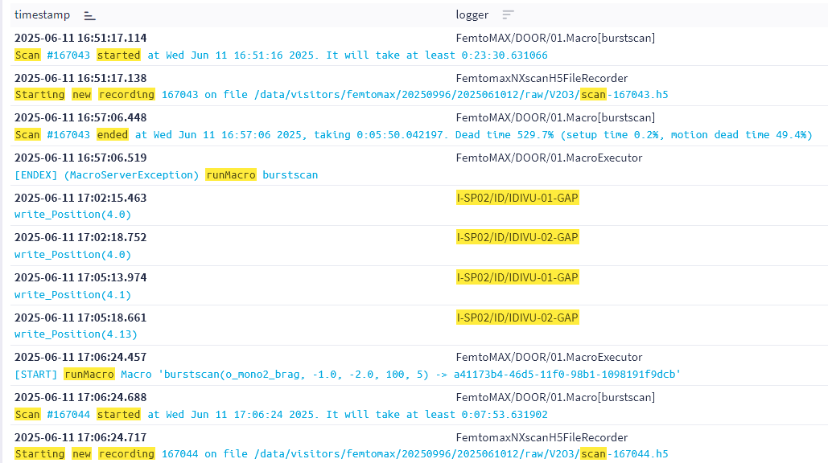
User operation

Slide 6
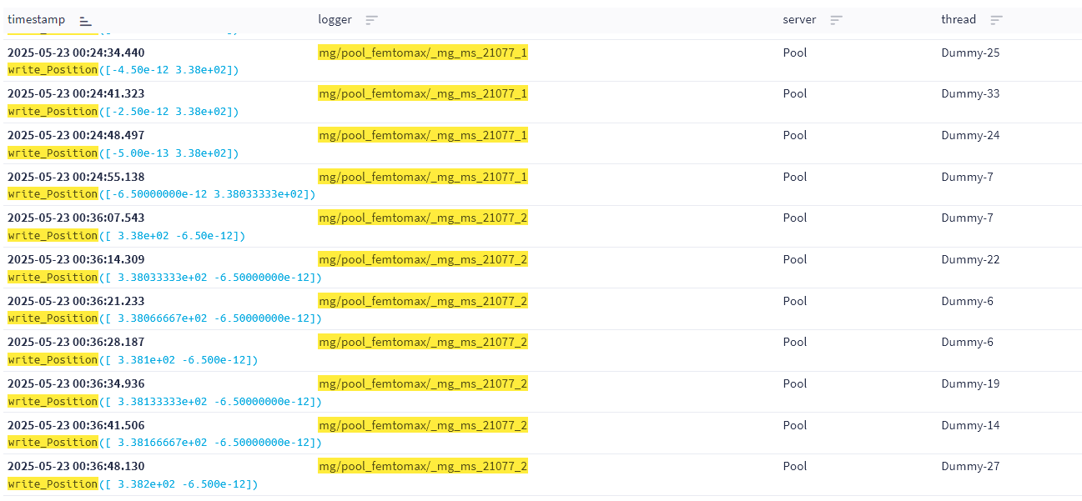
Motor groups in logs
Same motors?
https://gitlab.com/sardana-org/sardana/-/merge_requests/2084

Slide 7
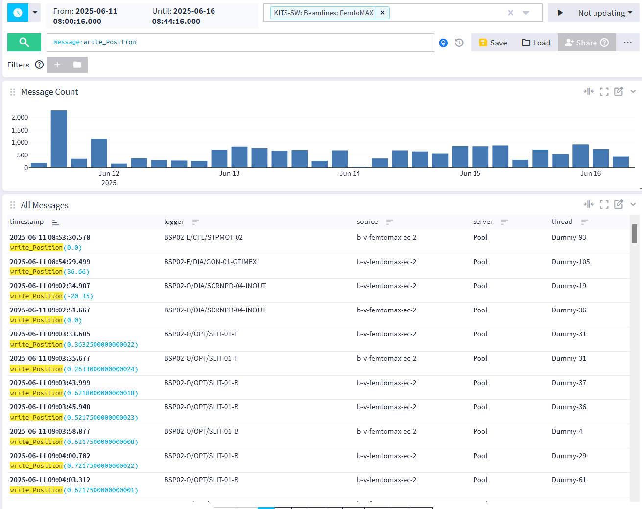
Manual move vs scan
Manual move?
Scan?

Slide 8
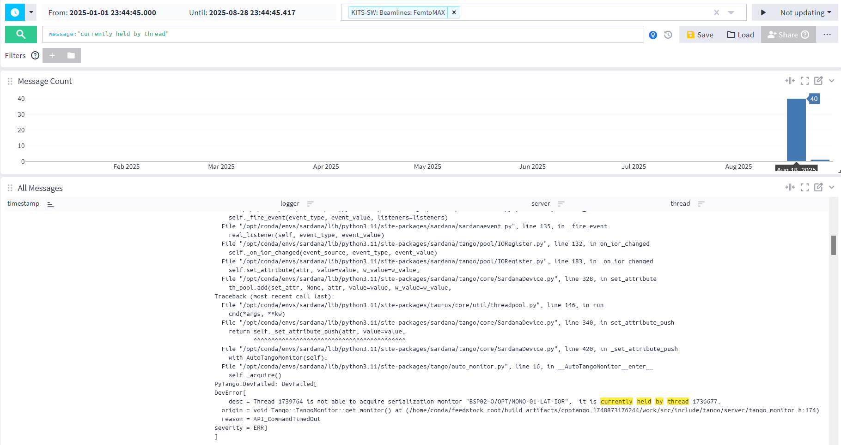
Errors history

Slide 9
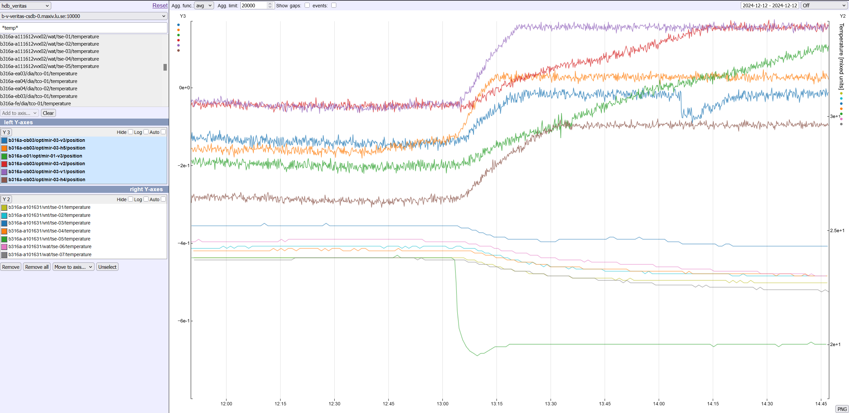
Why positions archiving is nice to have

Slide 10
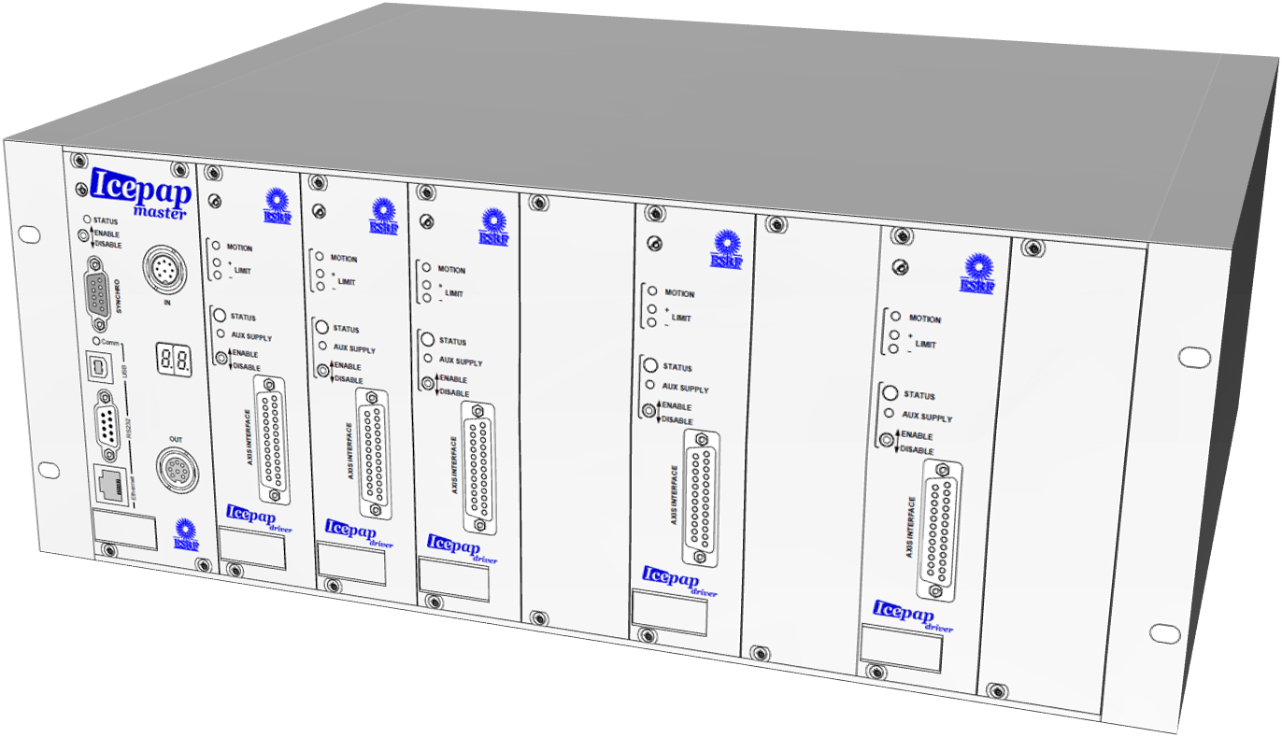
read_Position()
ReadAll()
and
ReadOne()
Polling
Sardana magic
tango/pool/Motor.py
“Sardana->Tango” Motor Device
IcePAPCtrl.py
Sardana Controller
Attribute polling
==
check archiving config and send event
get_pos()
HDB

Slide 11
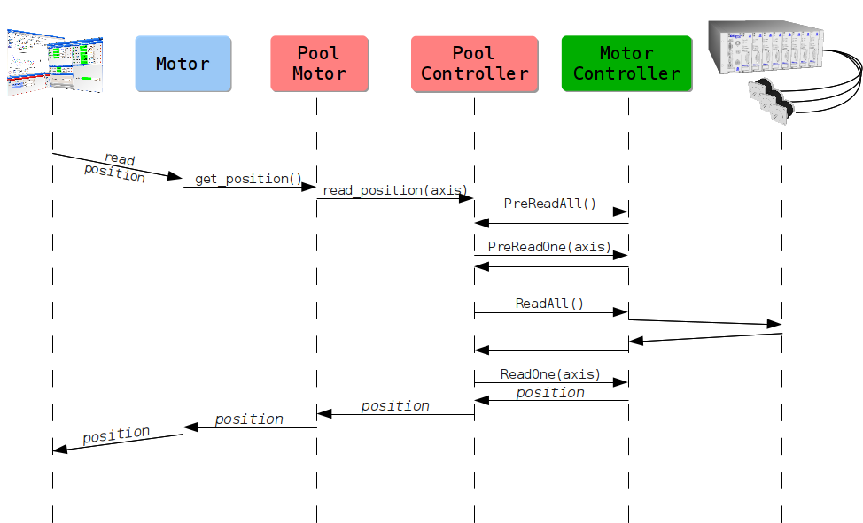
Read_position()
https://gitlab.com/sardana-org/sardana/-/issues/1995

Slide 12
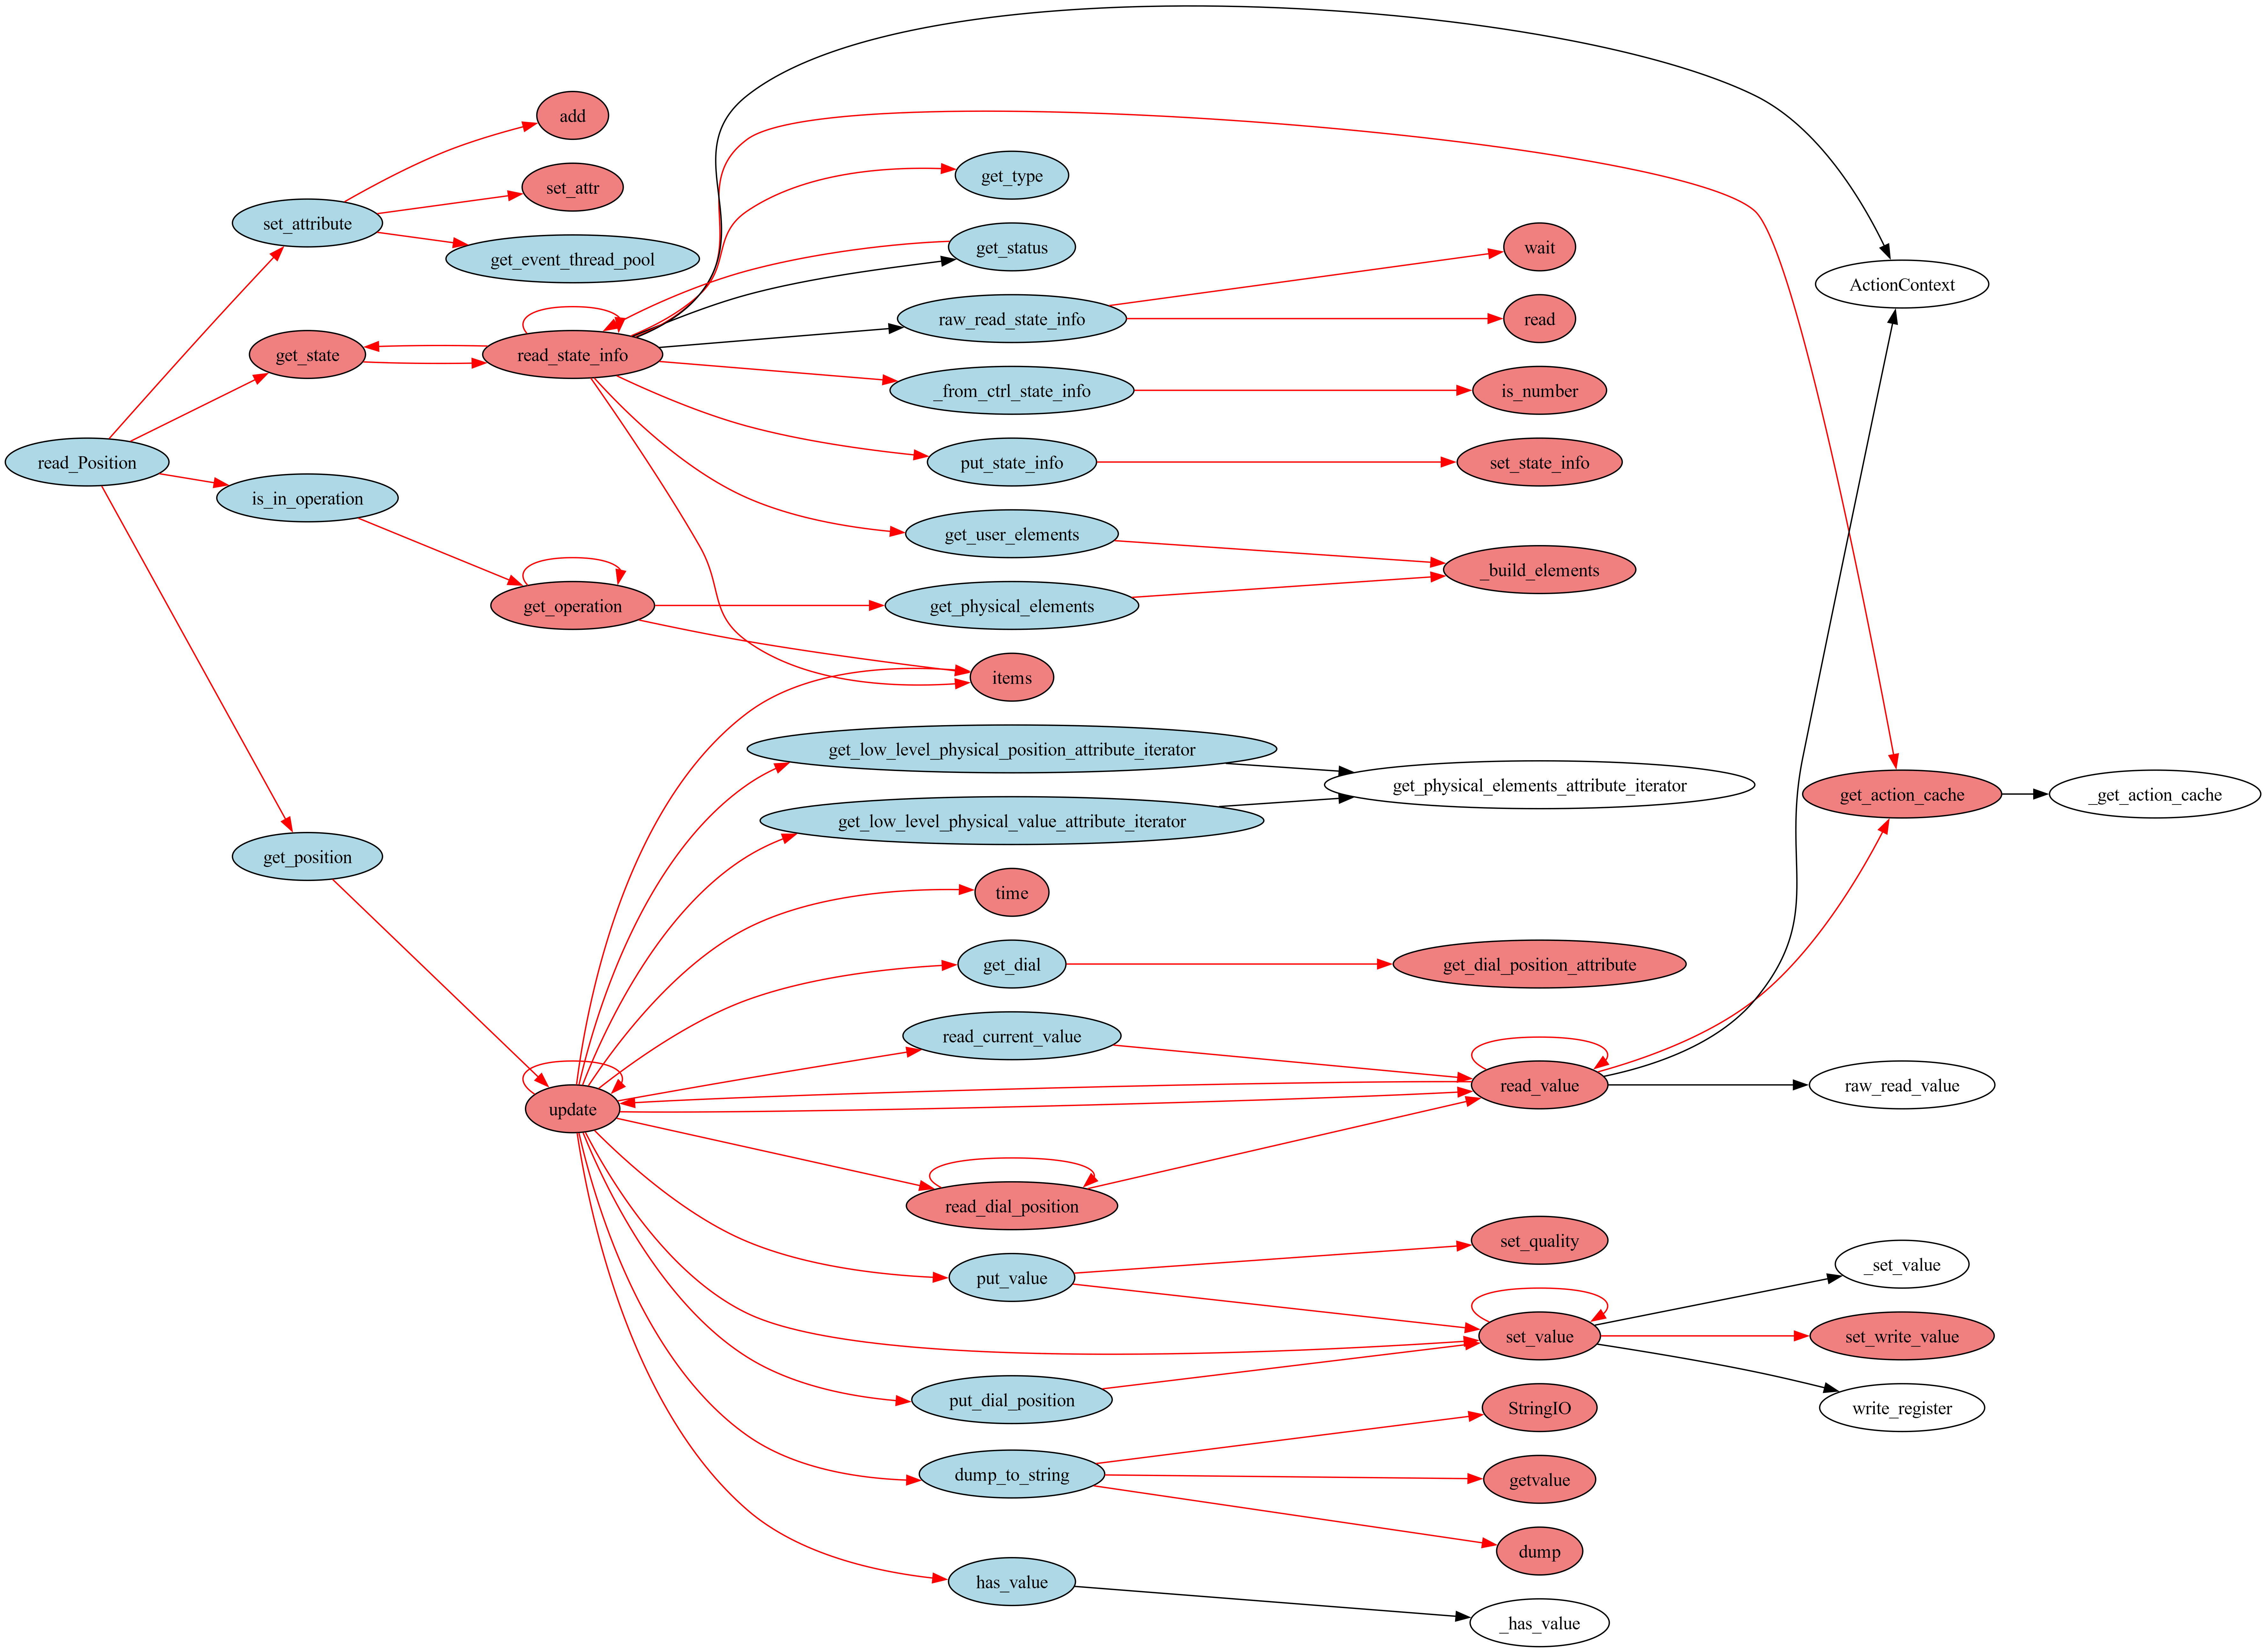
Read_position()
Not 100% correct, but close to what’s actually happening

Slide 13
New way
readout_thread()
self.ctrl.add_listener()
callback()
fire_event()
IcePAPCtrl.py
Sardana Controller
tango/pool/Motor.py
“Sardana->Tango” Motor Device
push_archive_event()
HDB
ReadAll()
push_change_event()
get_pos()
Set_attribute()
_set_attribute_push()
push_archive_event()
tango/core/SardanaDevice.py
“Sardana->Tango” generic class
Works only when the motor is MOVING

Slide 14
What we need to do
Add “push_archive_events” when the motor is in MOVING state
Add readout to MotorController, e.g. IcePAP, and send events to Motor class
Add a listener and a callback to the Motor class to expect events from the MotorController and “push_archive_events”. Enable “push_events_by_code”
But keep in mind:
How to query dozens of axes? Do it in batches, multiple threads, etc.?
Do we need to stop readout during a scan?
GIL?

Slide 15
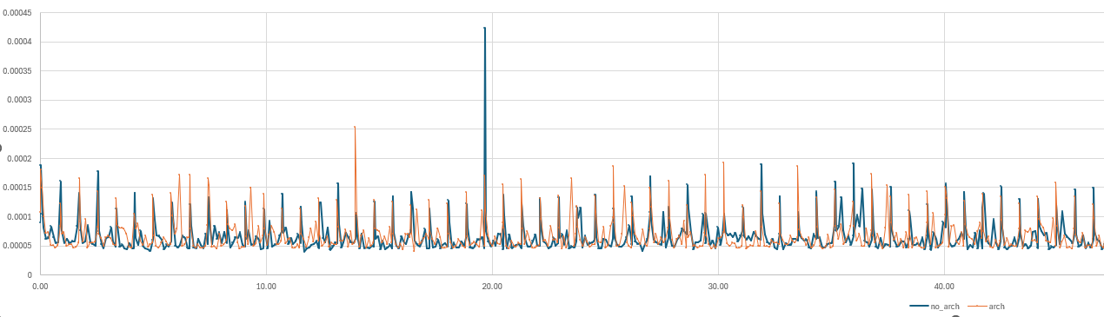
Push events when motor is in MOVING state
def _set_attribute_push in SardanaDevice.py
if fire_event:
if data_type == ArgType.DevEncoded:
fmt, data = value
args = attr_name, fmt, data, timestamp, quality
else:
args = attr_name, value, timestamp, quality
self.push_change_event(*args)
self.push_archive_event(*args)
https://gitlab.com/sardana-org/sardana/-/merge_requests/2041

Slide 16
Read positions in IcePAP controller (simplified example)
ctrl_attributes = {…
"Positions": {
Type: str,
Description: 'Poll this attribute to read positions for archiving',
Access: DataAccess.ReadOnly},
}
def getPositions(self):
positions = {}
try:
axes = self._getPoolController().get_element_axis()
ans = self.ipap.get_fpos(
axes,
register="AXIS"
)
for axis, position in zip(axes, ans):
self.attributes[axis]['position_value'] = float(position)
calc_pos = float(position) / self.attributes[axis]["step_per_unit"]
self._getPoolController().fire_event(EventType(f"{axis}"), SardanaValue(calc_pos))
positions[axis] = calc_pos
except Exception as e:
print(e)
return str(positions)

Slide 17
Add listener and callback to Motor.py
def init_device(self):
……
self.ctrl.add_listener(self.ctrl_event)
def ctrl_event(self, ev_src, ev_type, ev_val):
try:
if str(ev_type.name) == str(self.Axis):
quality = AttrQuality.ATTR_VALID
timestamp = ev_val.timestamp
value = ev_val.value
attr_name = "position"
args = attr_name, value, timestamp, quality
self.push_archive_event(*args)
except Exception as e:
print(e)

