Slide 1
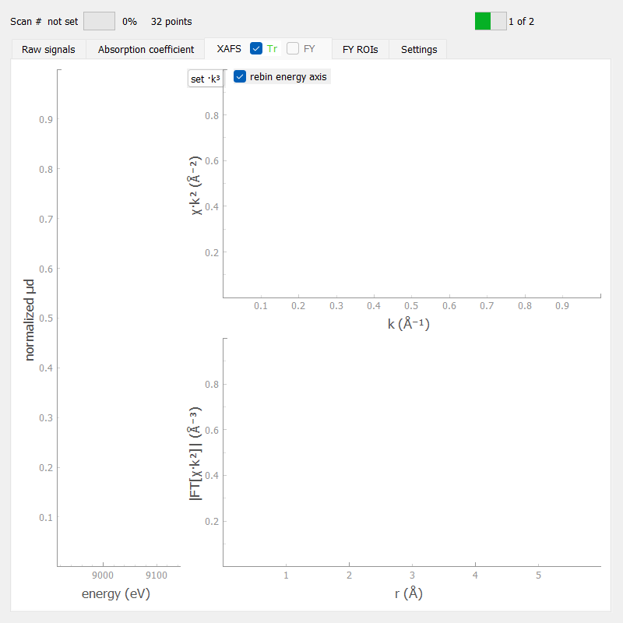
Multimodal DAQ system at Balder beamline
Heps-max iv visit 2025
Vanessa Silva
vanessa.silva@maxiv.lu.se
Software group

Slide 2
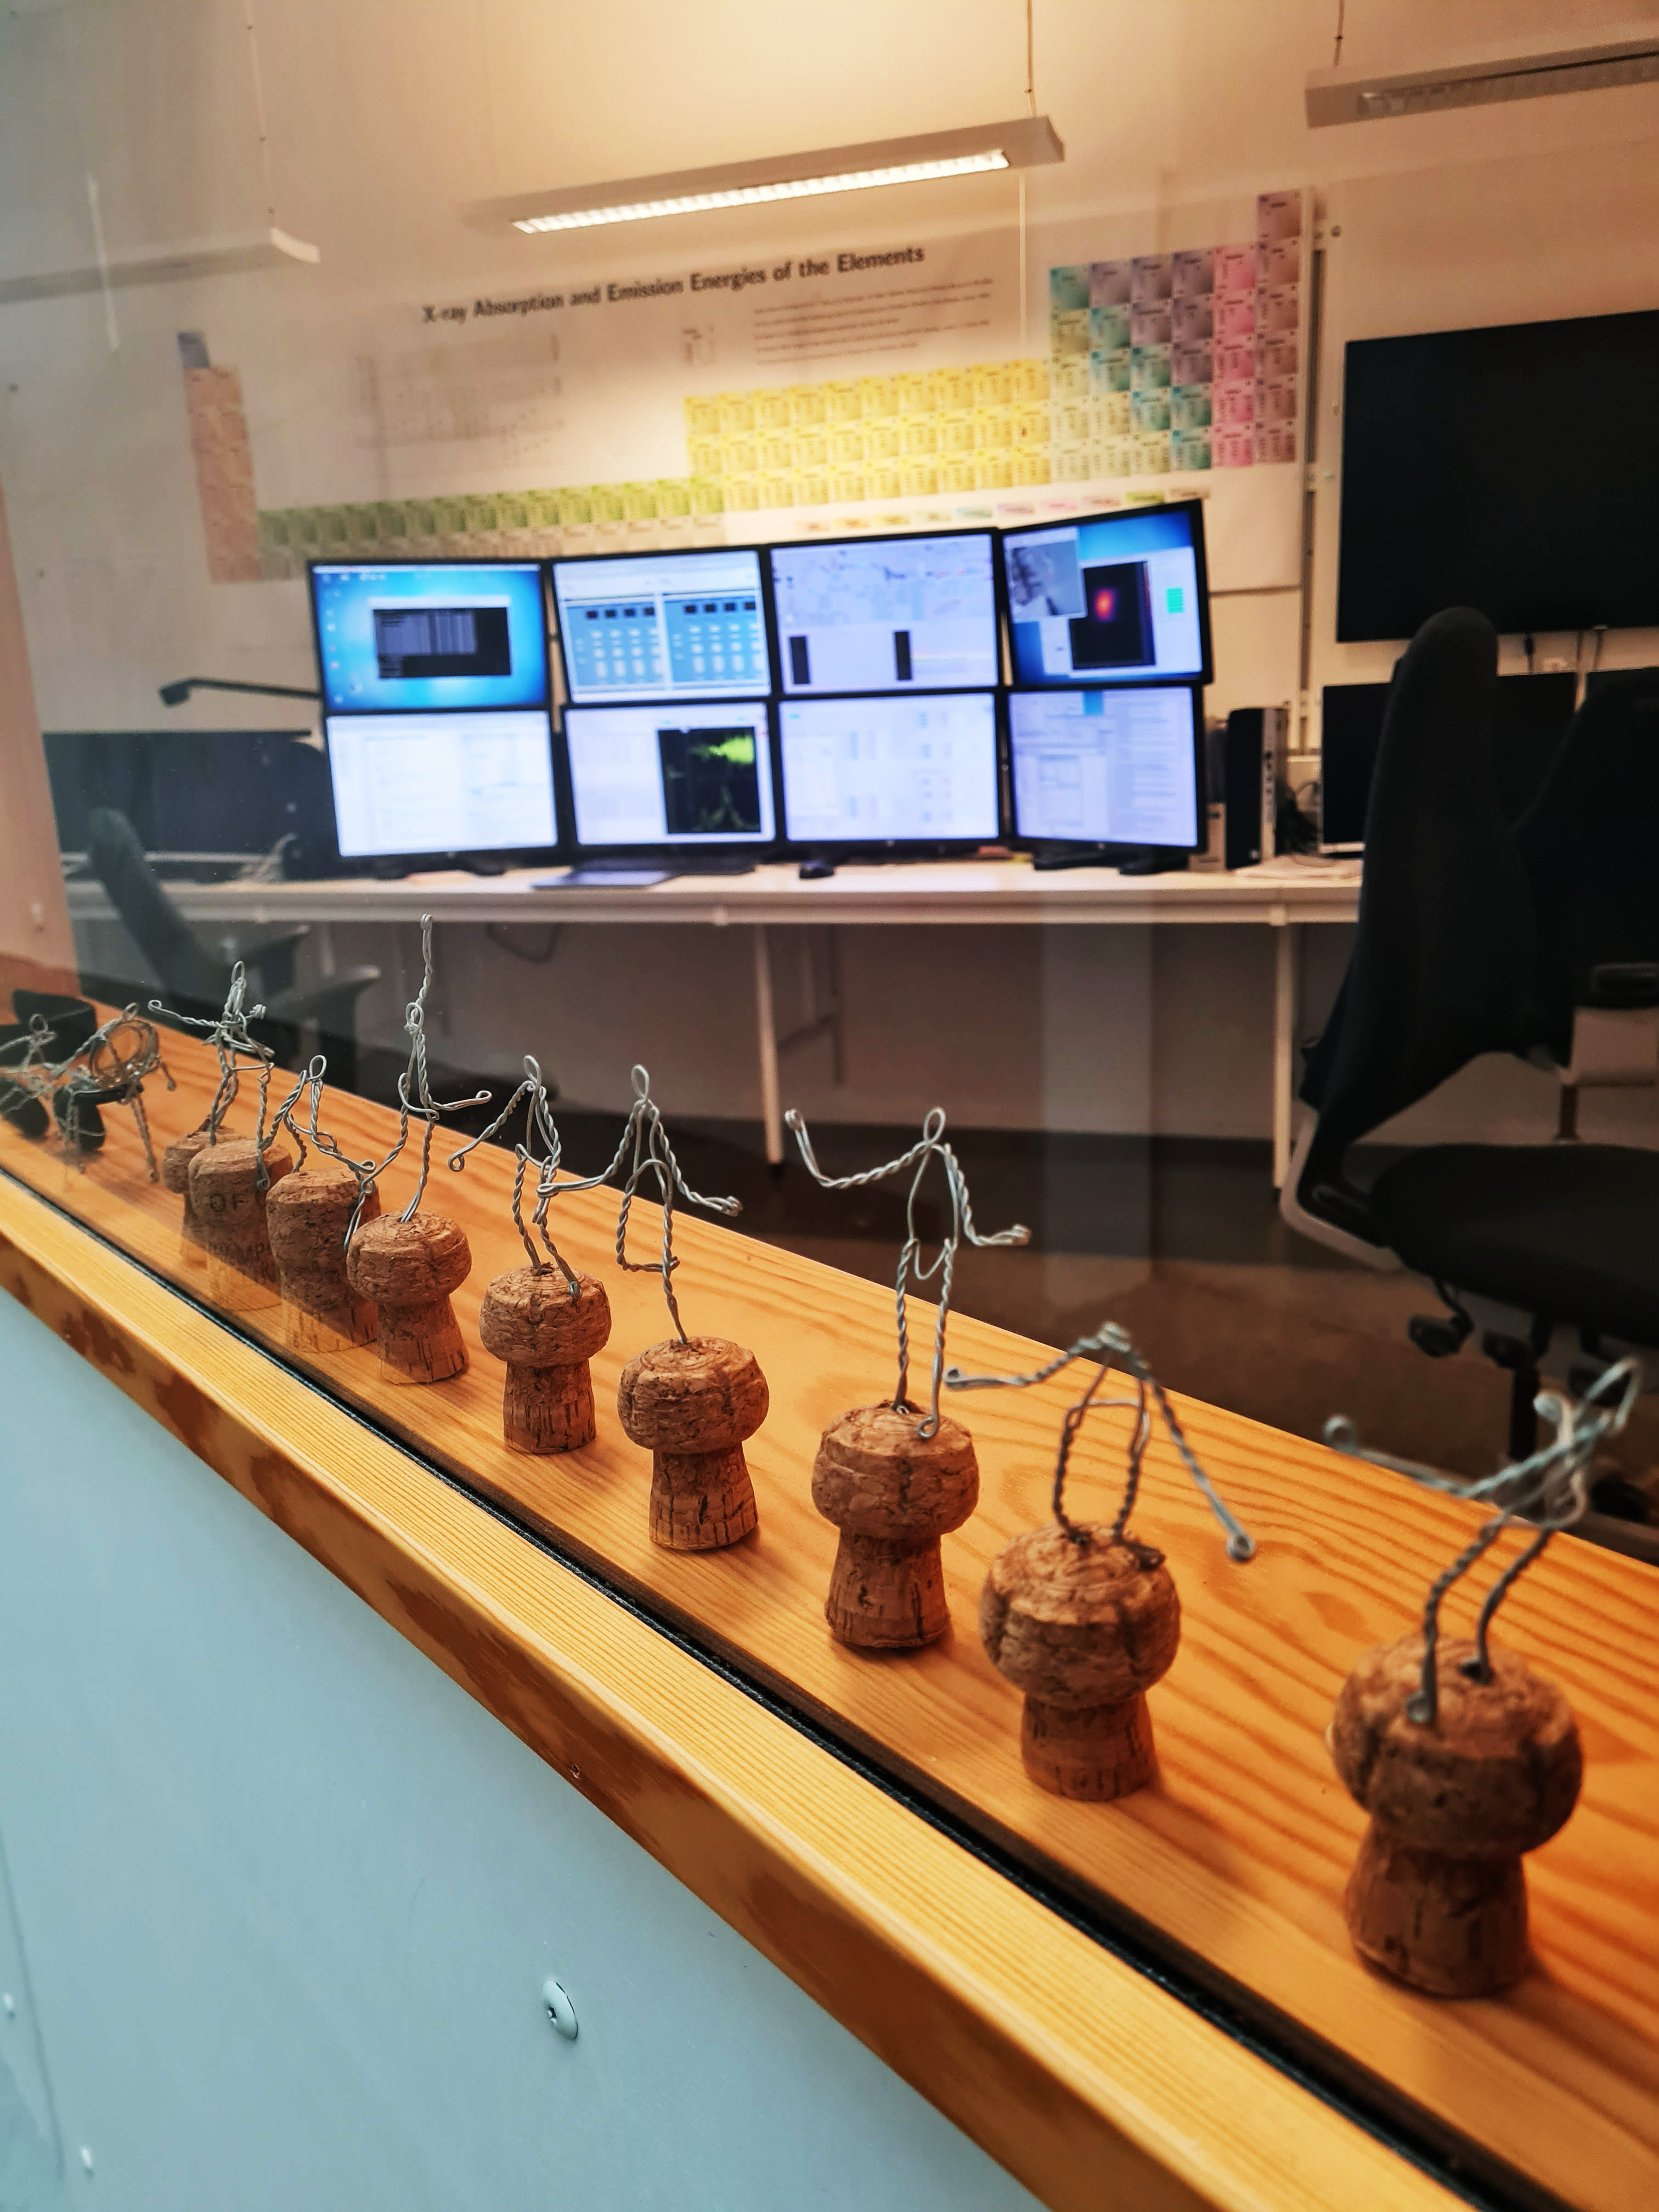
Balder
Hard X-ray Spectroscopy Beamline
Software group

Slide 3
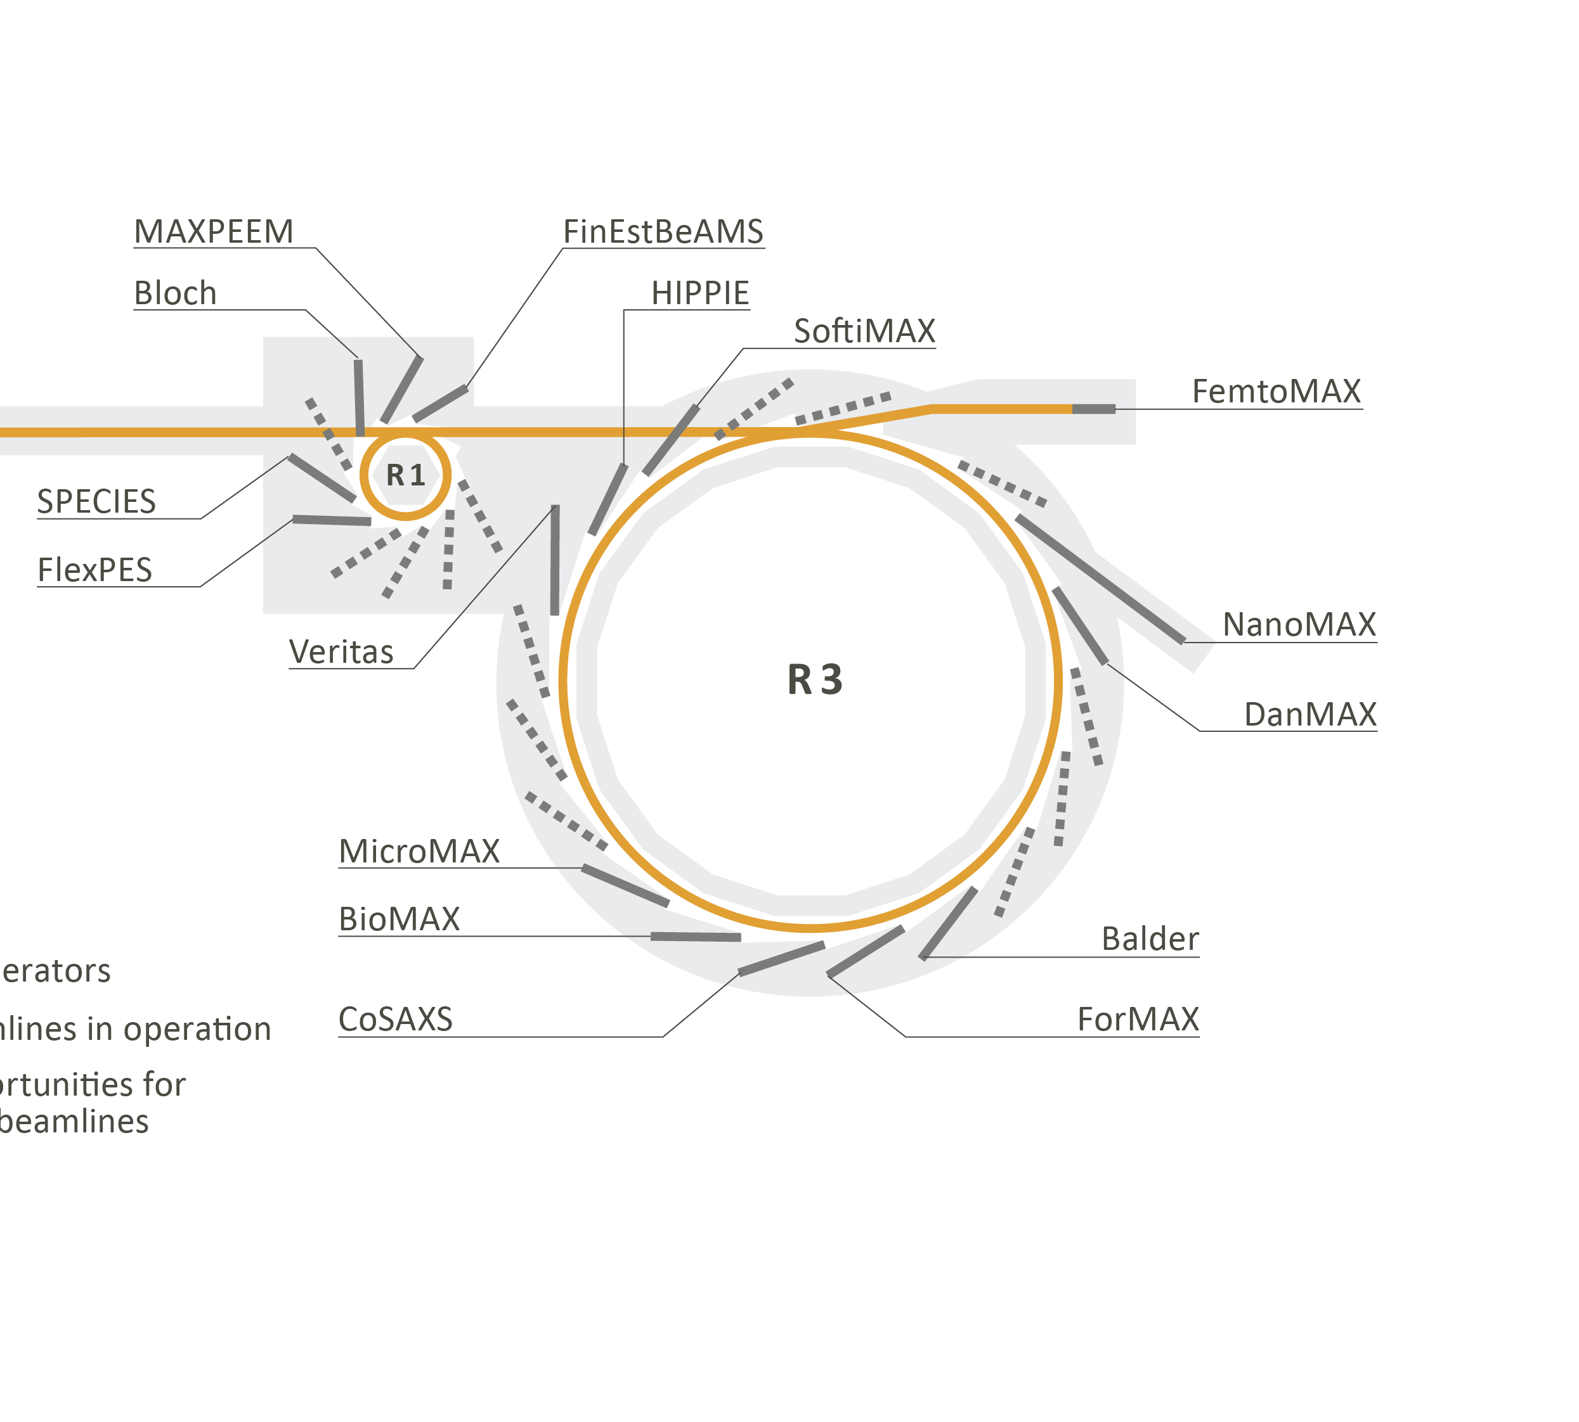
Balder
Hard X-ray Spectroscopy Beamline
Software group
Notes:
The Balder beamline is dedicated to X-ray absorption and emission spectroscopy in the medium to hard X-ray
energy range (2.4 to 40 keV) and is located at the 3 GeV ring. This is the only spectroscopy beamline in the
hard X-ray energy range at MAX IV, while several soft X-ray spectroscopy beamlines exist.

Slide 4
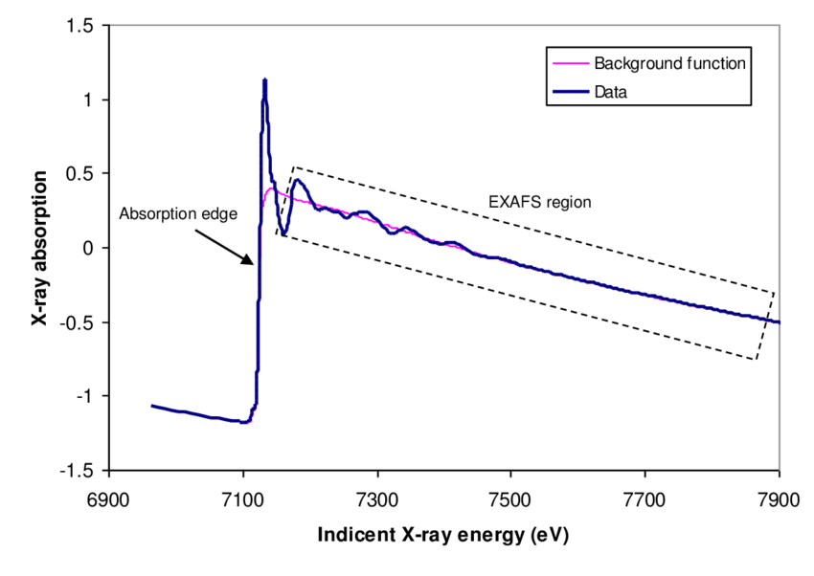
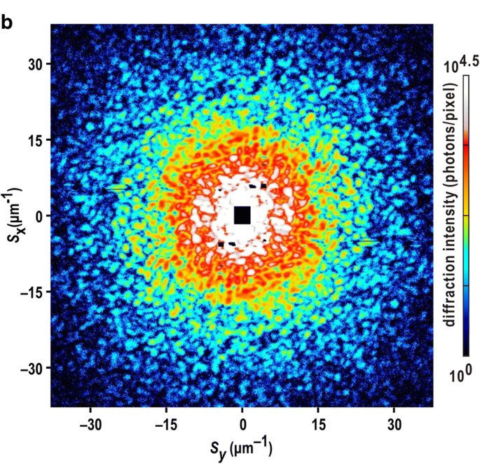
Combined
XAS
XRD
X-ray Absorption Spectroscopy
X-ray Diffraction
Main experiment performed at Balder

Slide 5
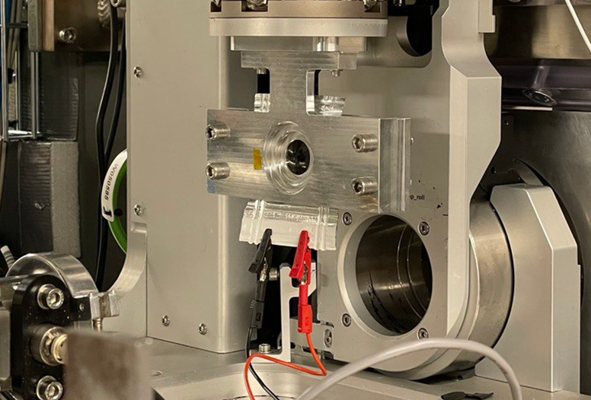
Multimodal Experiment
Combined
Perform XAS (range 1000 eV) in sub-second time resolution
XAS
XRD
Quickly change edges several thousands of eV apart: suitable for multi-element materials
Perform XRD combined with XAS in the end of every edge scanning
System flexible enough to allow user to configure desired experiment combination order
Data saved on the same HDF5 file
The experiment scan and its multiple energy edges & techniques are configured only once by the user in a single scan macro
Hard X-ray Beamline
No need for in vacuo sample environment
Easy to perform in situ/in operando experiments
Battery Sample Environment @ Balder
Main Application and Project Scope

Slide 6
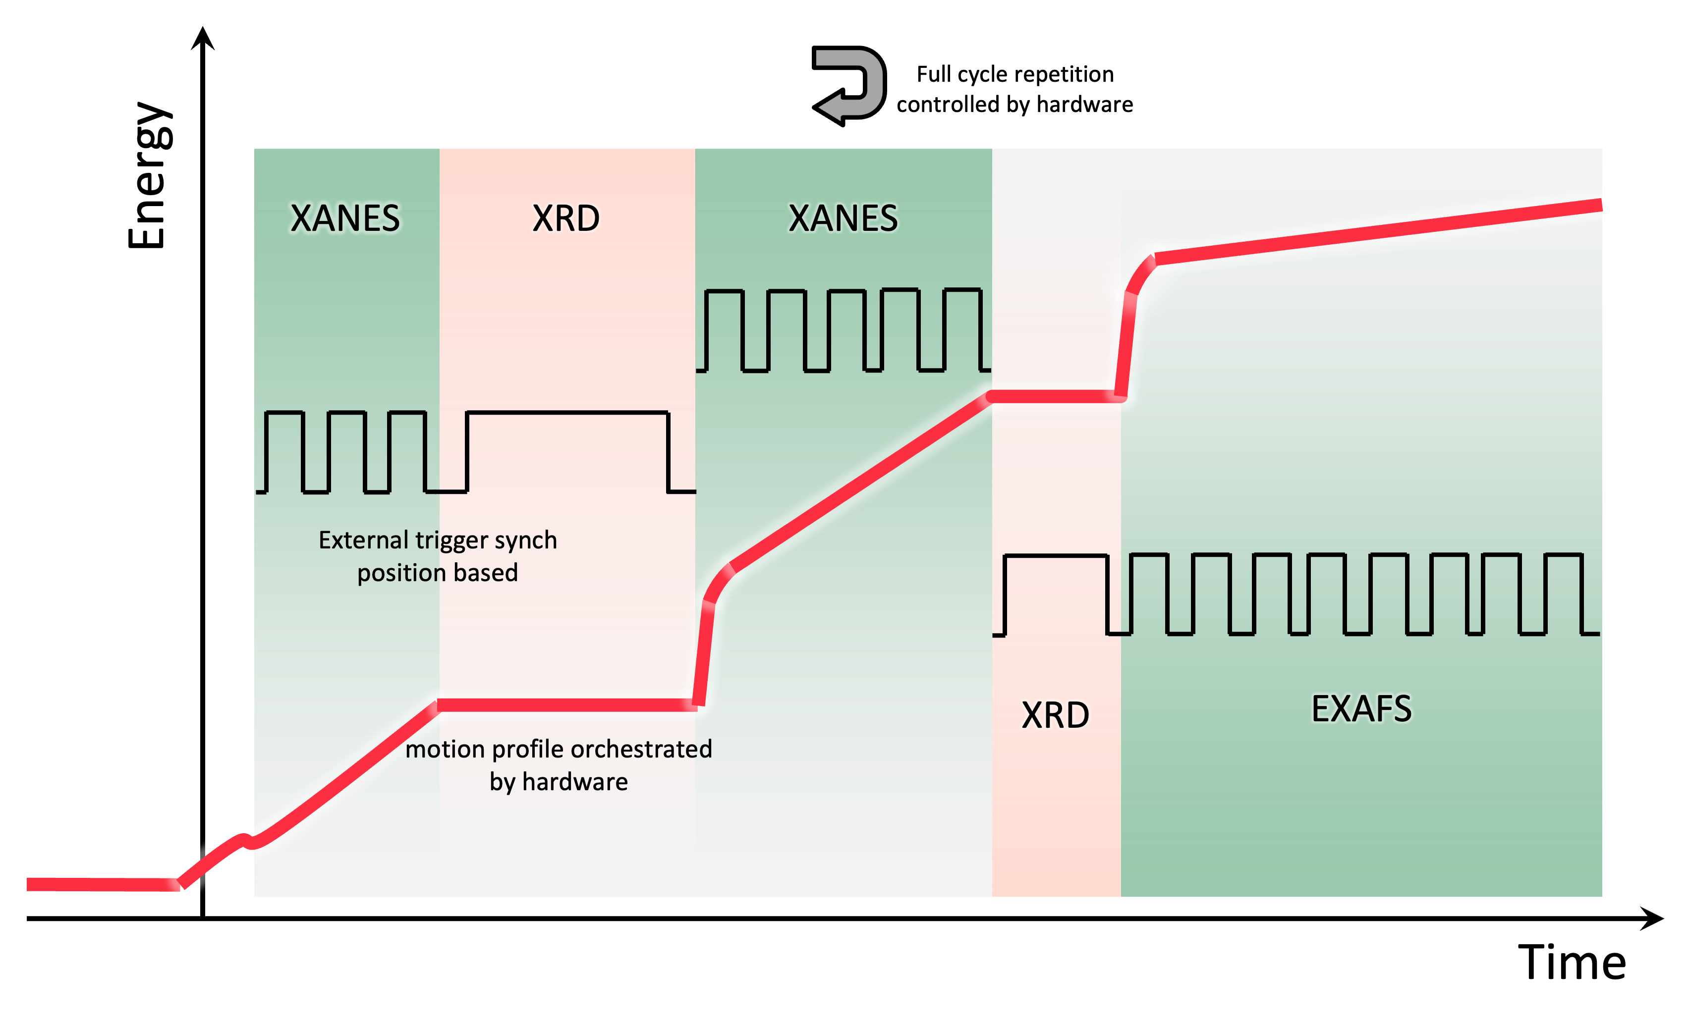
The challenge
Scan motion orchestration done by hardware
Allow multi-techniques scan to be performed
Easy to be configured by the user
Use Sardana framework
New concept of scan macro
Current
New
Scan macro
(continuous scan)
Scan macro
(continuous scan)
Scan single energy range
Prepares and acquire data using same pulse train for all detectors
Scan multiple energy ranges
Prepares and acquire data using different pulse trains for different detectors and its associated technique
Software group
Notes:
Scan multiple energy ranges
Prepares and acquire data using different pulse trains for different detectors and its associated technique

Slide 7
How’s the beamline energy scanned?
Software group

Slide 8
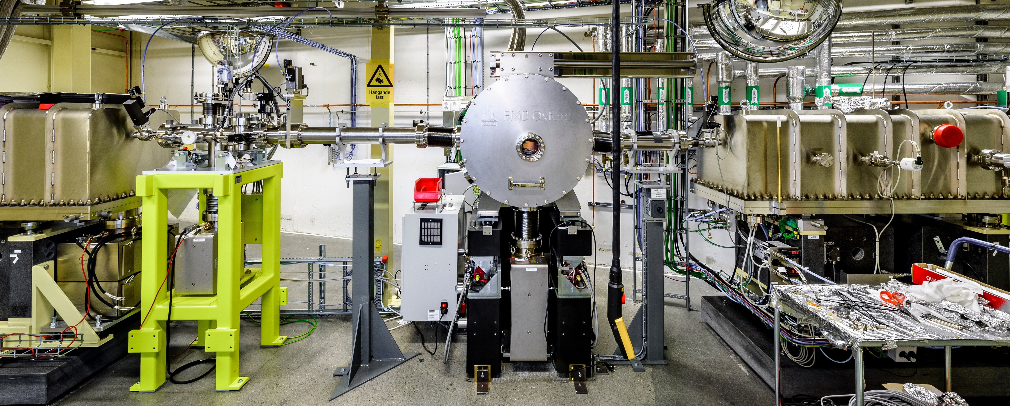
Balder’s Optical Hutch
Energy Scan

Slide 9
Balder’s Optical Hutch
Energy Scan

Slide 10


Balder’s Optical Hutch
Bragg motor
$$θ$$
mono beam
vertical
beam offset
$$θ$$
white beam
Si (111)
DCM
Energy Scan

Slide 11
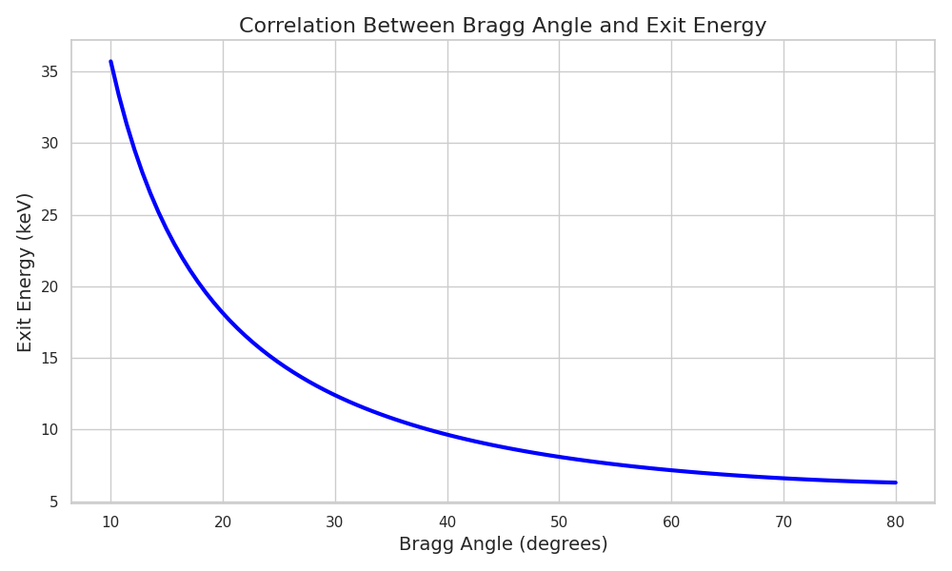



ç
What’s the correlation between Bragg Angle θ and energy?
$$λ=2d\sin{θ}$$
Bragg’s Law
$$λ=\frac{hc}{E}$$
Bragg motor
$$λ$$
mono beam
$$θ$$
vertical
beam offset
$$θ$$
white beam
Si (111)
DCM
Energy Scan

Slide 12
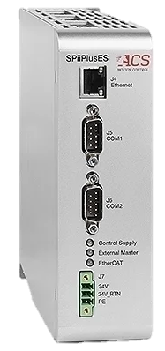
ç
Motion Control
EtherCAT master motion controller
ACS SPiiPlusEC
Bragg motor
mono beam
performs parameterized trajectories
$$θ$$
vertical
beam offset
master-follower implementation by synchronization formula for fixed-exit
$$θ$$
white beam
Si (111)
allow implementation arbitrary motion trajectories for energy scans
DCM
Full energy edge can be executed up to a 2 Hz repetition frequency
Monochromator Motion Control
Notes:
The two axes, which are used for energy scanning (Bragg angle and perpendicular motion of the second crystal
- x2perp) are driven by a high-precision and high-dynamic range dedicated motion control system (Figure 10).
Motions are controlled by an EtherCAT master motion controller (ACS SPiiPlusEC) with a motion control
update frequency of 5kHz

Slide 13

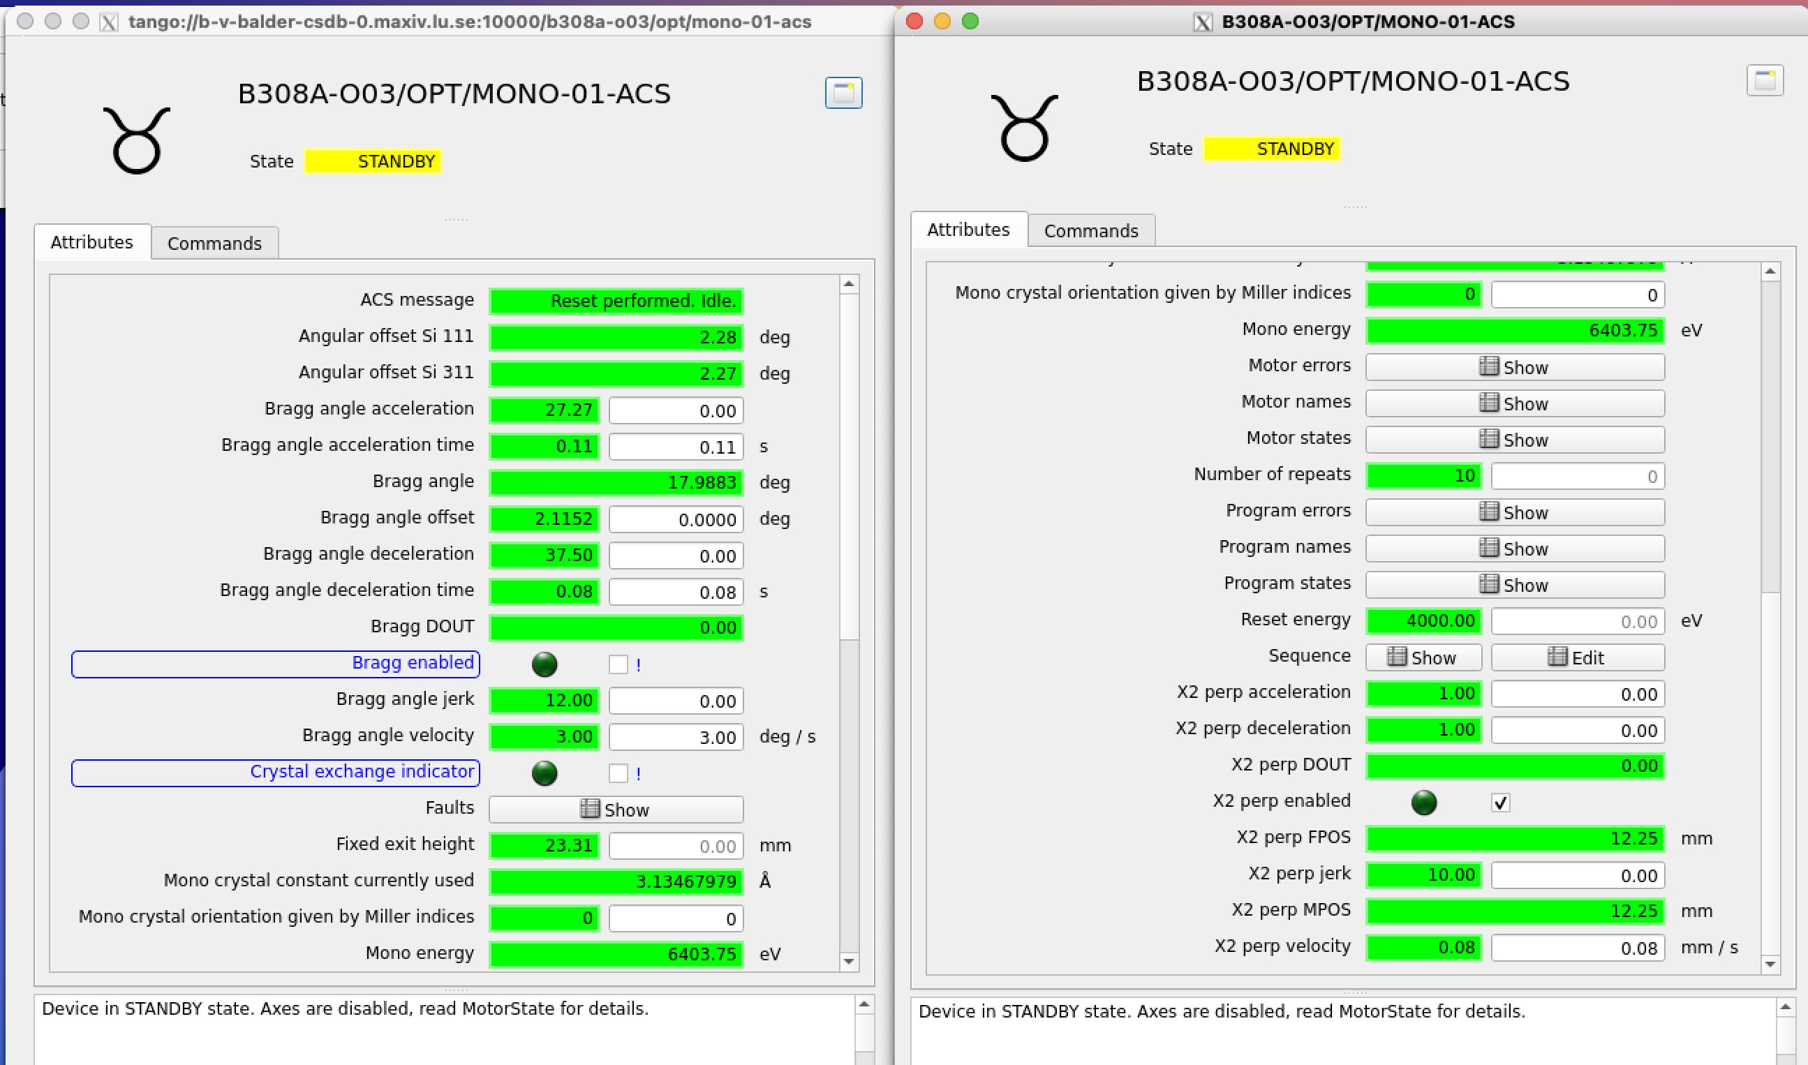
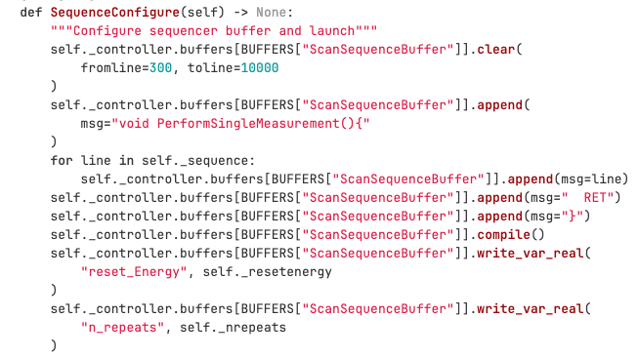
ç
Motion Control
Bragg motor
mono beam
$$θ$$
vertical
beam offset
$$θ$$
white beam
Si (111)
DCM
EtherCAT
Load different types of trajectory into the controller buffer, based on pre-defined and programmed functions
Monochromator Motion Control Hardware Integration
Notes:
The two axes, which are used for energy scanning (Bragg angle and perpendicular motion of the second crystal
- x2perp) are driven by a high-precision and high-dynamic range dedicated motion control system (Figure 10).
Motions are controlled by an EtherCAT master motion controller (ACS SPiiPlusEC) with a motion control
update frequency of 5kHz

Slide 14
How’s the experiment synchronization performed?
Software group

Slide 15
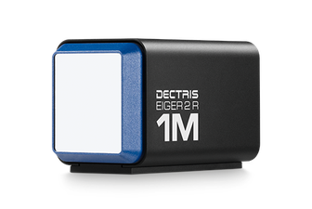
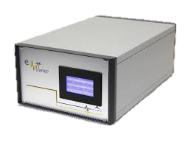
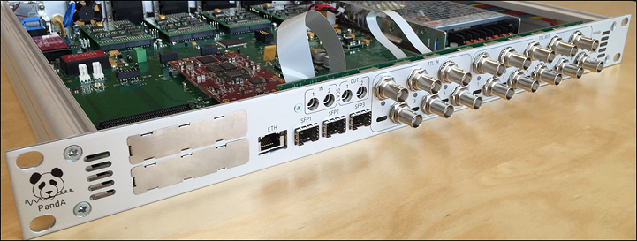
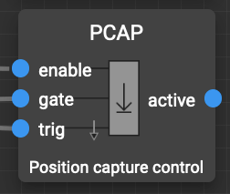

Bragg motor
Trajectory
mono beam
$$θ$$
vertical
beam offset
ACS SPiiPlusEC
motor controller
$$θ$$
white beam
Si (111)
performs parameterized trajectories
DCM
Detectors
encoder reading input
TTLOUT
PandABox
Eiger
DAQ
Alba EM
Analog input
Synchronization
How’s the data acquisition performed?

Slide 16
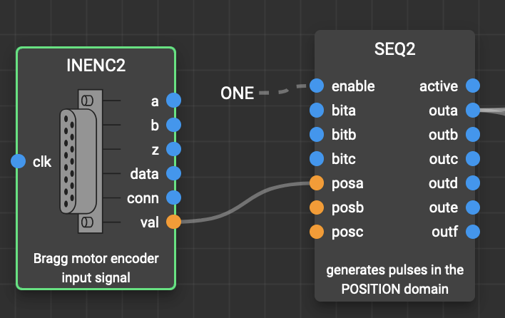
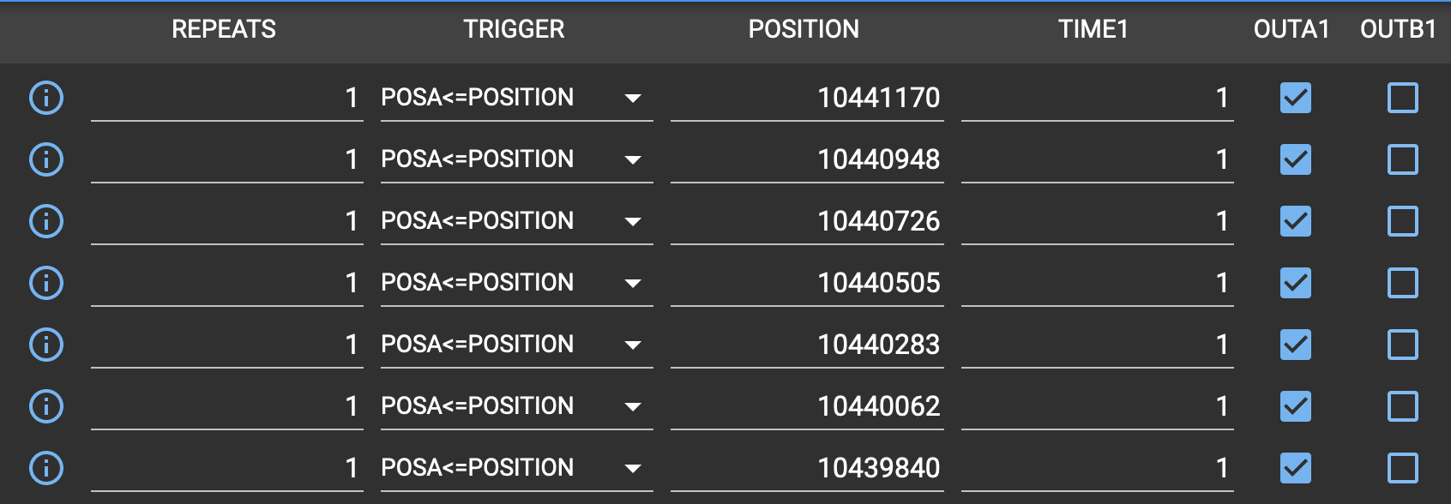
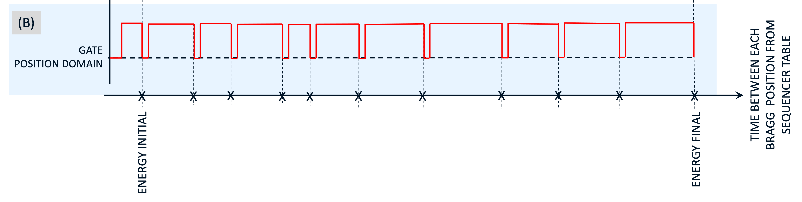
PandABox
encoder reading input
TTLOUT
Analog input
Bragg Motor
Position-based hardware synchronization

Slide 17
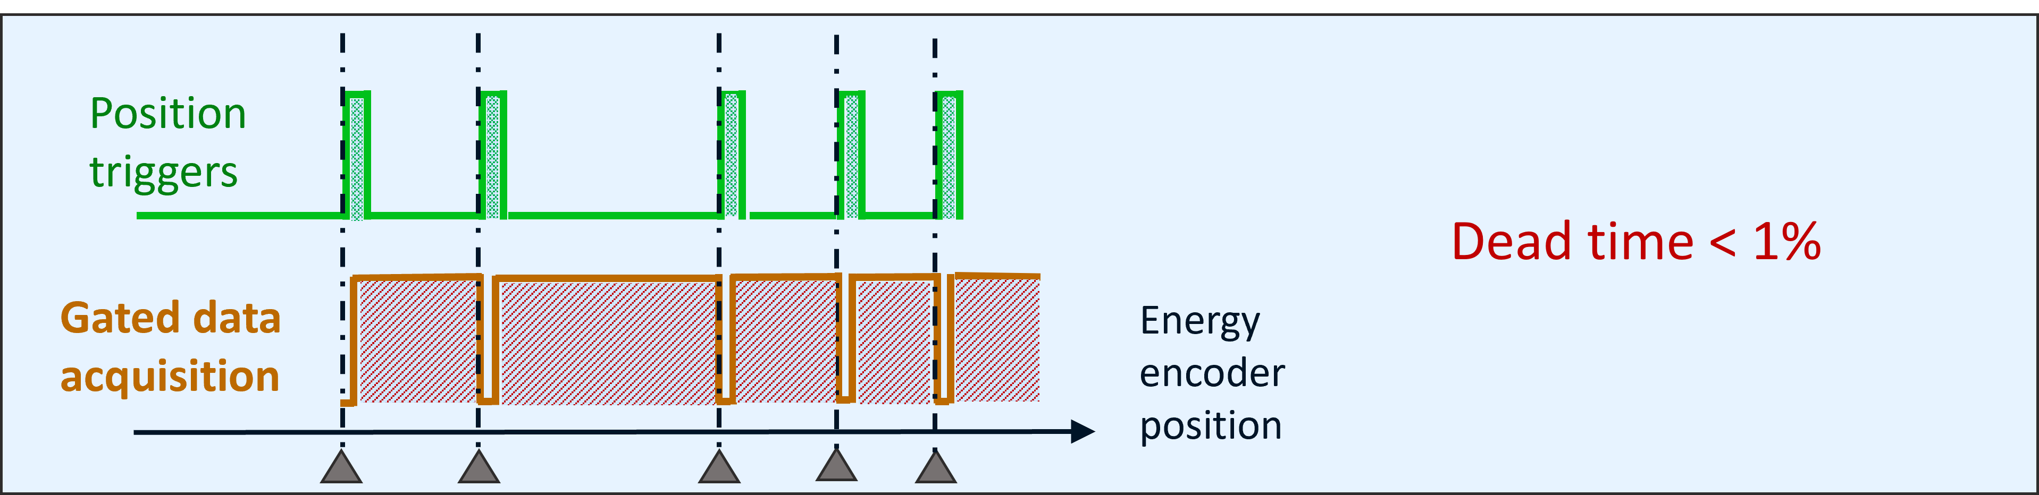
PandABox
Why gates?
Standard latency time = 0.1 ms
Position-based hardware synchronization

Slide 18
Coming back to the beamline techniques ….
Combined
XAS
XRD
Main experiment performed at Balder

Slide 19
Coming back to the beamline techniques ….
Combined
XAS
XRD
Main experiment performed at Balder

Slide 20
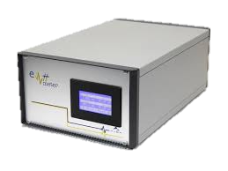
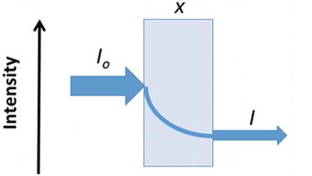
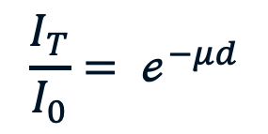
z
XAS
ALBA Electrometer
$$\frac{I_{T}}{I_{0}}= ℯ^{−μd}$$
DCM motion trajectories with EtherCAT ACS
Main experiment performed at Balder

Slide 21
Coming back to the beamline techniques ….
Combined
XAS
XRD
Main experiment performed at Balder

Slide 22
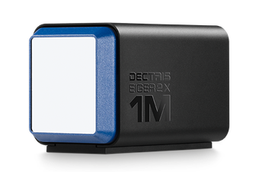
Eiger
Fixed energy positions
beginning and/or end of XAS spectrum
XRD
Main experiment performed at Balder

Slide 23
encoder reading input
TTLOUT
Generate a gate for XRD fixed energy position [beginning or end of the spectrum]
Analog input
XRD
Bragg Motor
Generate gates for all configured energy positions for XAS intensity measurements & PCAP
XAS
Position-based hardware synchronization

Slide 24
encoder reading input
TTLOUT
Analog input
Bragg Position
Bragg Motor
PCAP
Time
Alba EM
Eiger
Position-based hardware synchronization

Slide 25
How’s the experiment configured and controlled at the beamline?
Software group

Slide 26


Pool
Motors
1D Channels
2D Channels
Counters
Controllers
MacroServer
Macros
Recorders
Experiment Control with Sardana

Slide 27
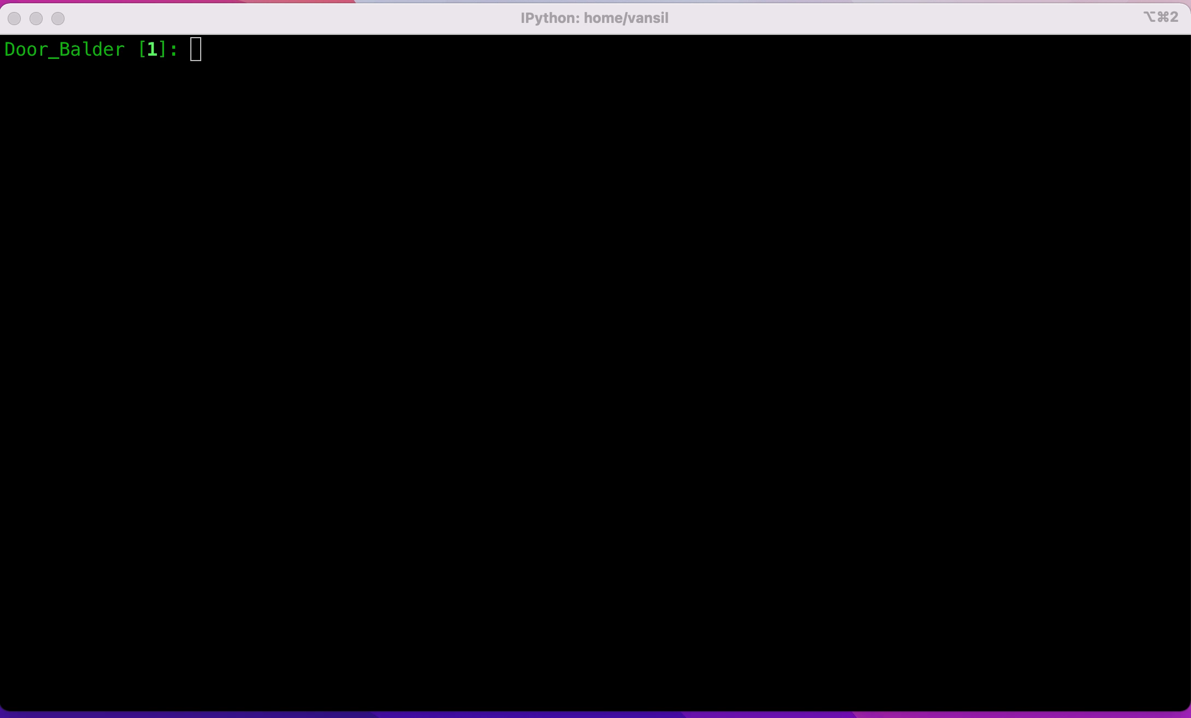
Pool
MacroServer
SPOCK
🖖
Experiment Control with Sardana

Slide 28
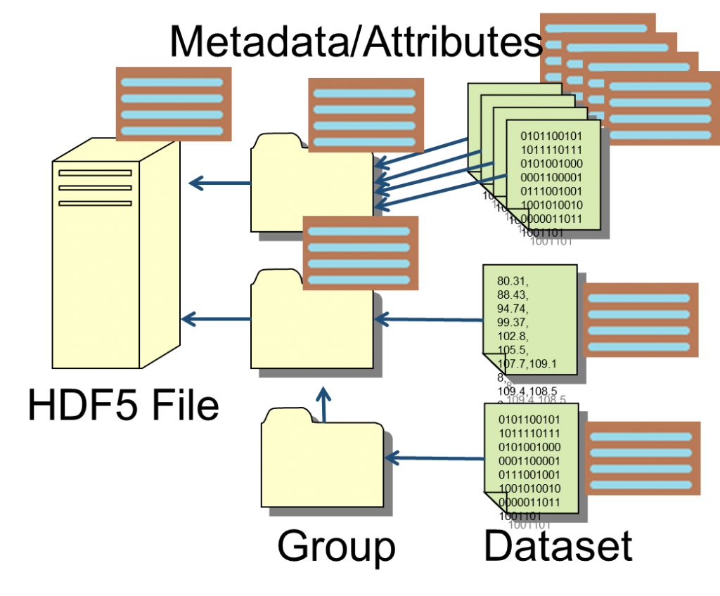
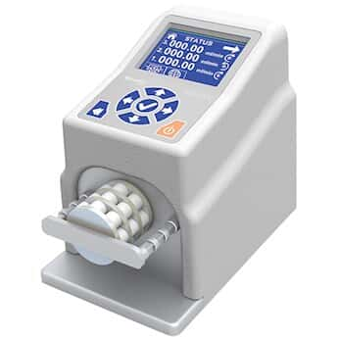
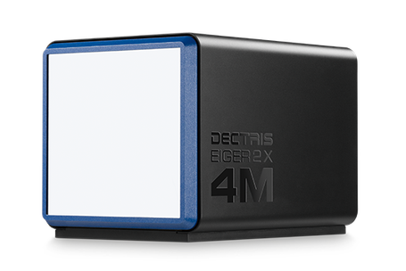
Scan Orchestration
scan macro
User input layear
START DATA RECORD
END DATA RECORD
RUN PRE-SCAN HOOKS
RUN POST-SCAN HOOKS
peristaltic pump
PREPARE EQUIPMENTS
MOTION ORCHESTRATION
detector
DATA ACQUISITION
SYNCHRONIZATION
Experiment Control with Sardana

Slide 29
ç
MOTION ORCHESTRATION
Bragg motor
mono beam
$$θ$$
vertical
beam offset
$$θ$$
white beam
Si (111)
DCM
EtherCAT
Load different types of trajectory into the controller buffer, based on pre-defined and programmed functions
Experiment Control with Sardana

Slide 30
Scan Orchestration
scan macro
User input layear
START DATA RECORD
END DATA RECORD
RUN PRE-SCAN HOOKS
RUN POST-SCAN HOOKS
peristaltic pump
PREPARE EQUIPMENTS
DATA ACQUISITION
SYNCHRONIZATION
detector
Run buffer program -> start trajectory
ACS
Experiment Control with Sardana
Notes:
start

Slide 31
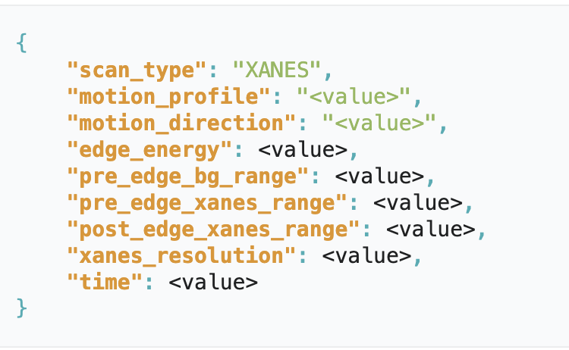
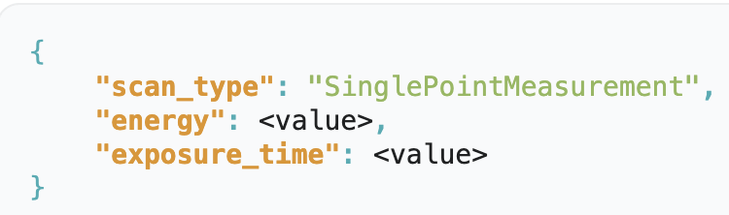
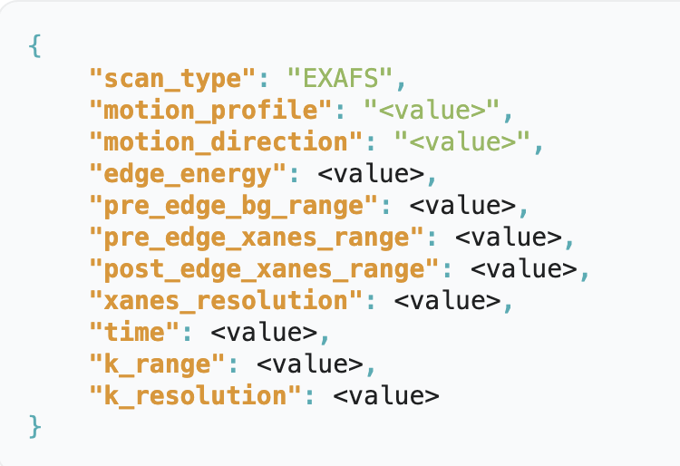
hardware motion orchestrated scan
hmoscan <config_file> <nb_repeats> <latency_time:Optional>
JSON format
JSON format
Different technique have different parameters defined by the keys
Complex scan parameters can be defined easily in a JSON file format
Experiment Control with Sardana

Slide 32
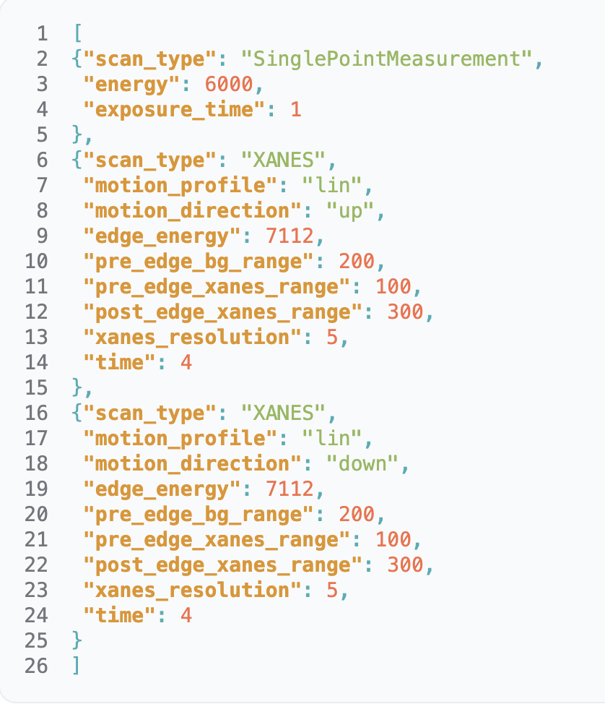
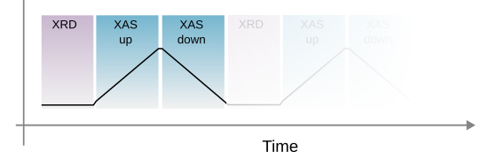
Configuration file in JSON format example
hmoscan <config_file> <nb_repeats> <latency_time:Optional>
JSON format
It can be edited by beamline staff and/or users
Different techniques can be sequenced (XAS, XRD and EXAFS)
Experiment Control with Sardana
Software group

Slide 33

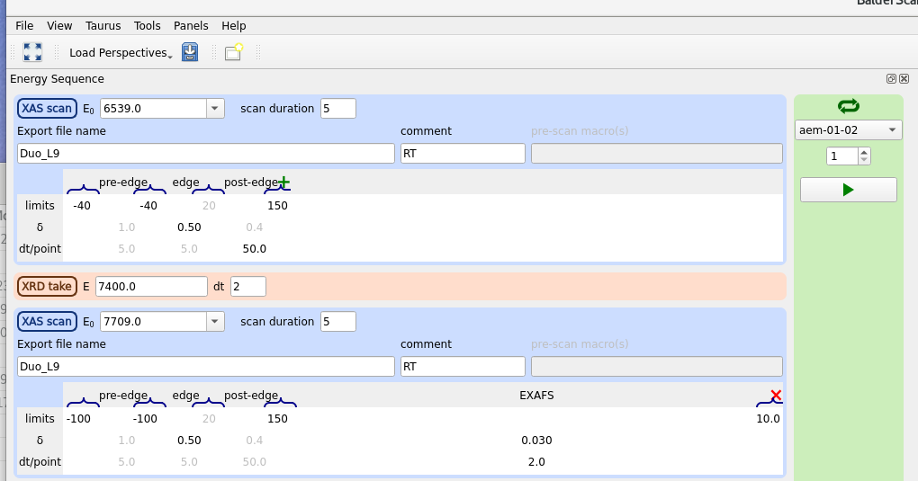
Taurus GUI where the USER can organize the sequence of techniques to be performed using “drag and drop” system.
Each technique will have its own set of parameters to be configured. The USER can choose between XAS scan and XRD. Inside each technique, many variations are allowed.
The GUI generates the experiment JSON file with specific keys
hmoscan <config_file> <nb_repeats> <latency_time:Optional>
JSON format
Experiment Control with Sardana

Slide 34
hmoscan <config_file> <nb_repeats> <latency_time:Optional>
JSON format
BalderScans
ACS Tango Device
Experimental channels
detector
PositionArray
TriggerArray
ConfigureACS
TotalTriggers
SPMTriggers
Load trajectory using pre-configured functions into ctrl BUFFER
Trigger/Gate controller
Experiment Control with Sardana

Slide 35
hmoscan <config_file> <nb_repeats> <latency_time:Optional>
BalderScans
START DATA RECORD
END DATA RECORD
PositionArray
TriggerArray
ConfigureACS
TotalTriggers
SPMTriggers
RUN PRE-SCAN HOOKS
RUN POST-SCAN HOOKS
peristaltic pump
PREPARE EQUIPMENTS
DATA ACQUISITION
SYNCHRONIZATION
detector
Run buffer program -> start trajectory
ACS
Experiment Control with Sardana

Slide 36
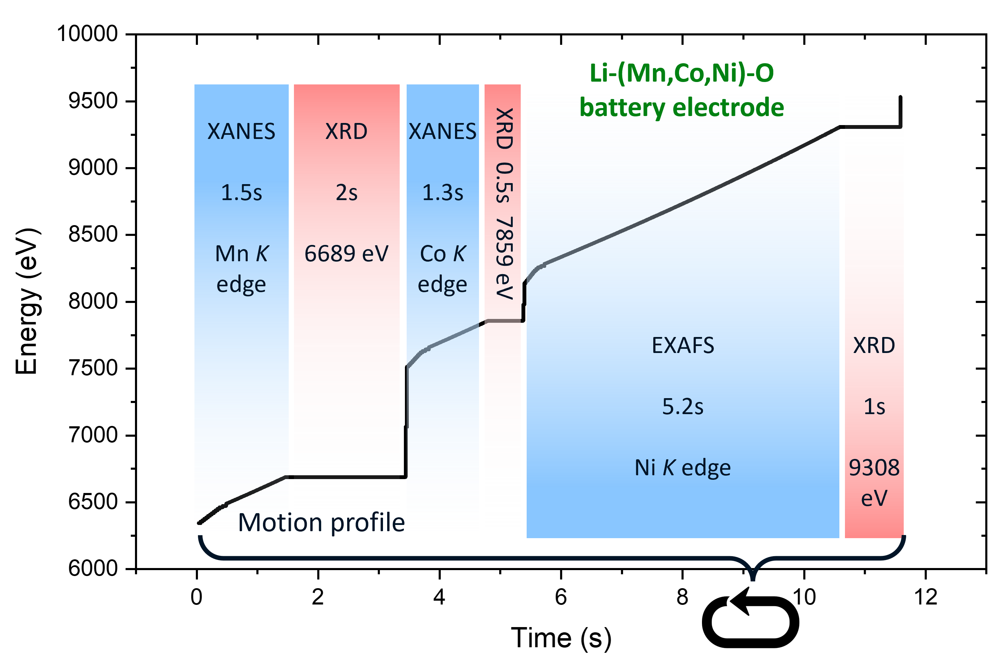
Balder Use Case Tested with This System

Slide 37
Initial Results
Software group

Slide 38
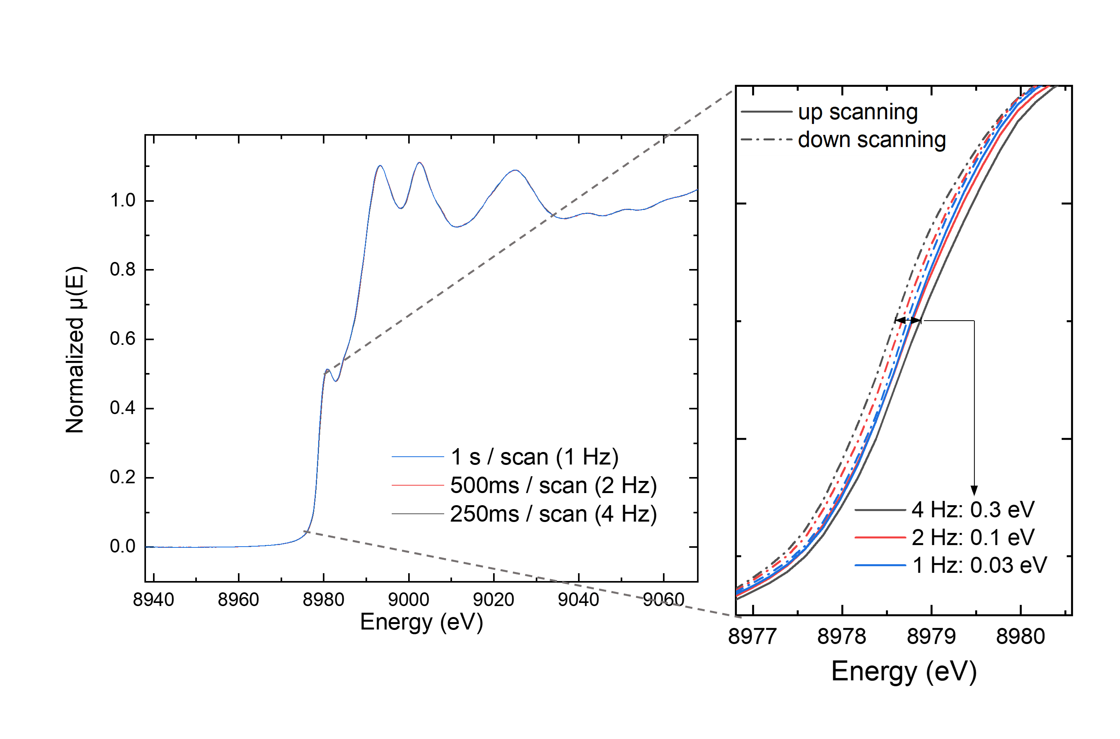
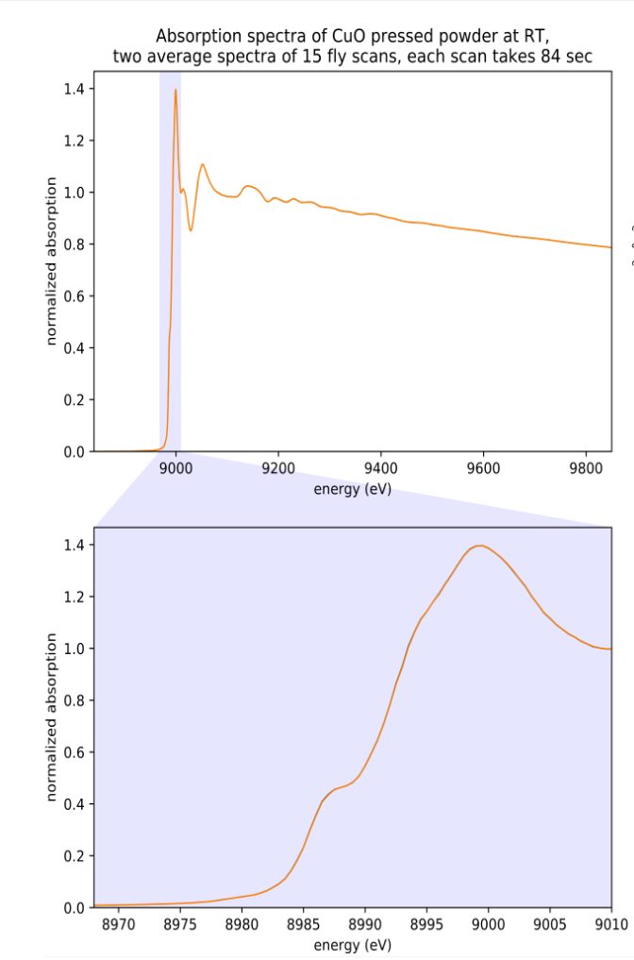
HW orchestrated scan
Up to 10x faster
Very good data quality as evaluated on last beamline review in 2024
Not HW orchestrated scan – 84 seconds
XAS for Standard Cu Foil

Slide 39
Perform XAS (range 1000 eV) in sub-second time resolution
Combined
Quickly change edges several thousands of eV apart: suitable for multi-element materials
XAS
XRD
Perform XRD combined with XAS in the end of every edge scanning
System flexible enough to allow user to configure desired experiment combination order
Data saved on the same HDF5 file
The experiment scan and its multiple energy edges & techniques are configured only once by the user in a single scan macro
Hard X-ray Beamline
No need for in vacuo sample environment
Easy to perform in situ/in operando experiments
Battery Sample Environment @ Balder
Main Application and Project Scope

Slide 40
Next steps
Software group

Slide 41
Next steps
Full replacement of the Configuration Layer by Sardana new features
MultiSynchDescription: allow detectors to be configured for different pulse trains
Decouple data acquisition from data recording
Perform XAS-2d mapping with HW orchestrated scan

Slide 42

Thank you!
Vanessa Silva
vanessa.silva@maxiv.lu.se
Software group

