Slide 1
Software Deployment Workflow
Benjamin Bertrand – SW Group

Slide 2
Outline
SW Infrastructure
Ansible
Internal GitLab Workflow
C++ projects
Python projects
Deployment workflow
GitLab.com

Slide 3
SW Infrastructure

Slide 4

GitLab
Internal instance: https://gitlab.maxiv.lu.se
Gitlab Community Edition
No access from outside – only via VPN
GitLab CI runners on Kubernetes
GitLab.com: https://gitlab.com/MaxIV
Ultimate SaaS Plan via Open Source Program
Every project in MaxIV group must be published under an OSI-approved open source license
Every project must be publicly visible and available
GitLab.com hosted runners
One internal runner
Notes:
Restricted functionality in CE

Slide 5


MAX IV repositories
Artifactory: https://artifactory.maxiv.lu.se
RPMs
remote repos (proxy): centos, epel…
public: RPMs built internally via CI (not used for Rocky 8)
private: RPMs downloaded from outside manually (codium, zoom, xspress3-sdk)
PyPI: https://artifactory.maxiv.lu.se/artifactory/api/pypi/pypi-virtual-stable/simple (both PyPI mirror + maxiv-stable)
Generic
kits-sw: SDK, installer like Miniforge3…
kits
Quetz: https://conda.maxiv.lu.se
Notes:
I can create a generic repo for SciData

Slide 6
Ansible

Slide 7
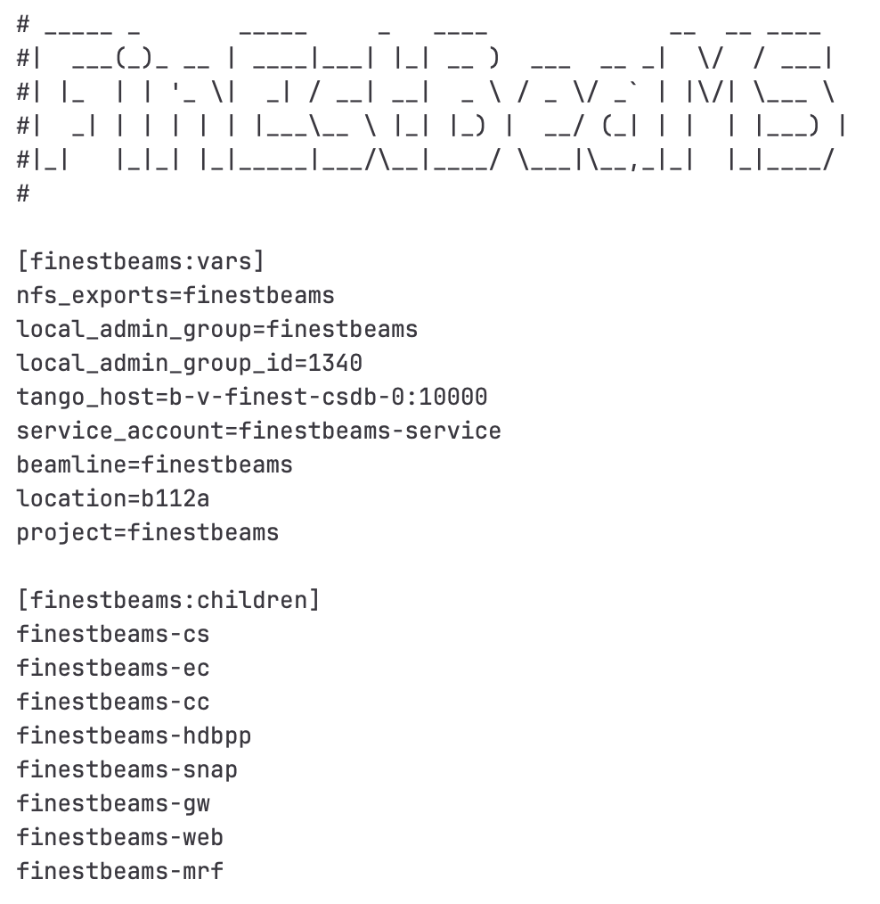
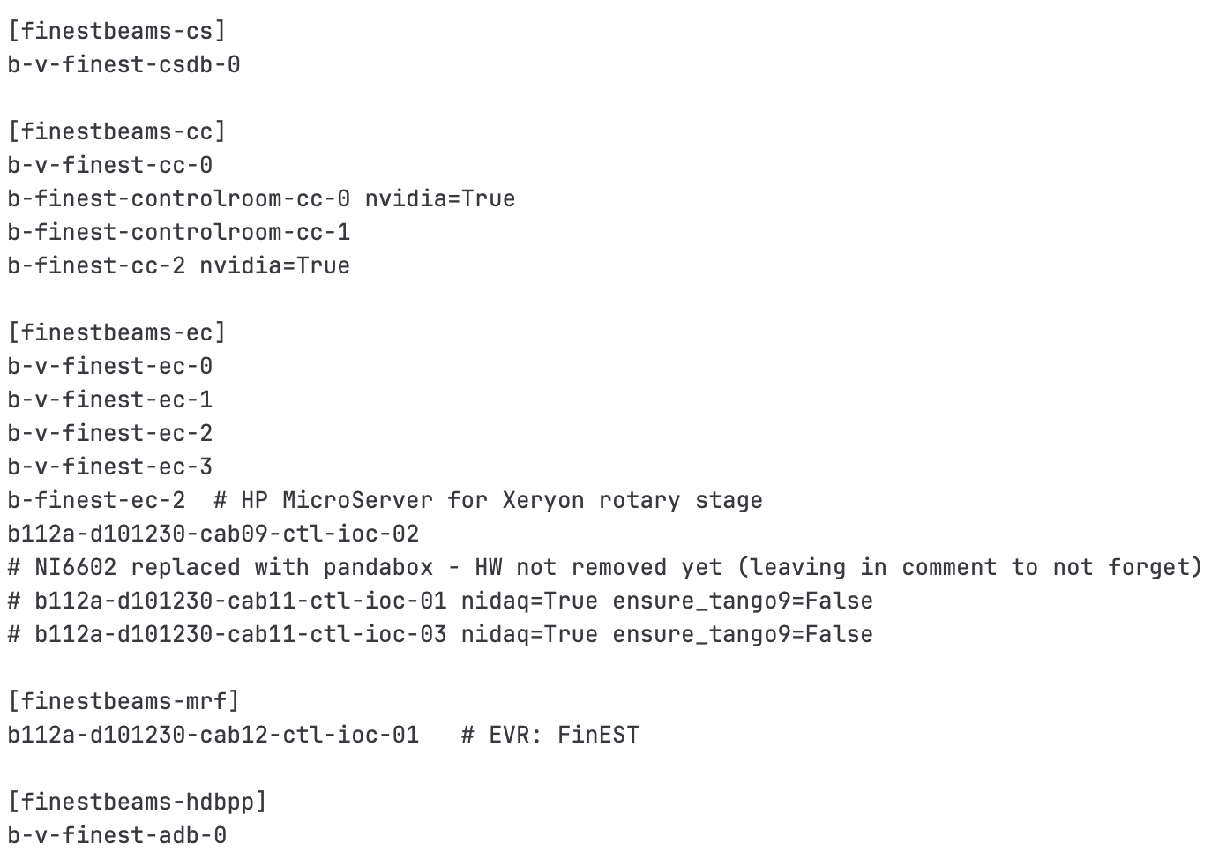
Ansible inventory
https://gitlab.maxiv.lu.se/kits-maxiv/ansible-galaxy/cfg-maxiv-ansible
Around 600 hosts (VMs + physicals)

Slide 8

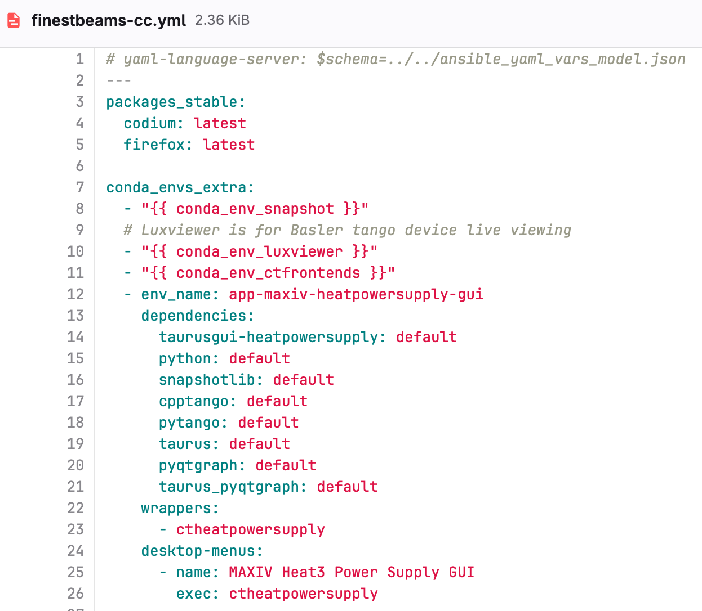
Ansible inventory: client

Slide 9

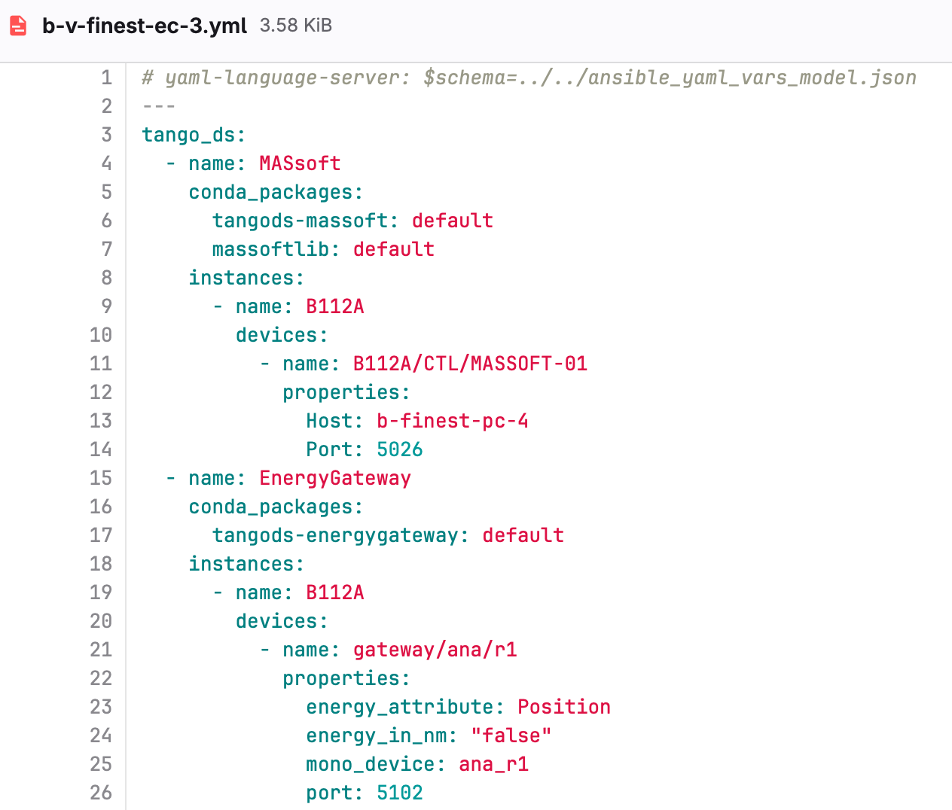
Ansible inventory: server
Notes:
The tango_ds role automatically installs python, cpptango and pytango using the inventory default value. Can be overwritten to test new versions.
Ansible role will automatically restart the tango ds if the version changes.

Slide 10


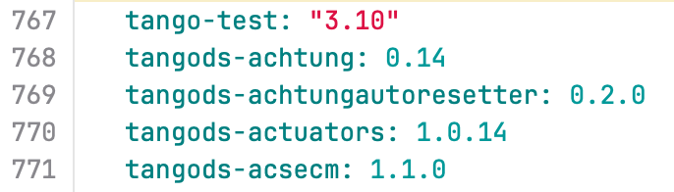
Ansible inventory: all.yml

Slide 11

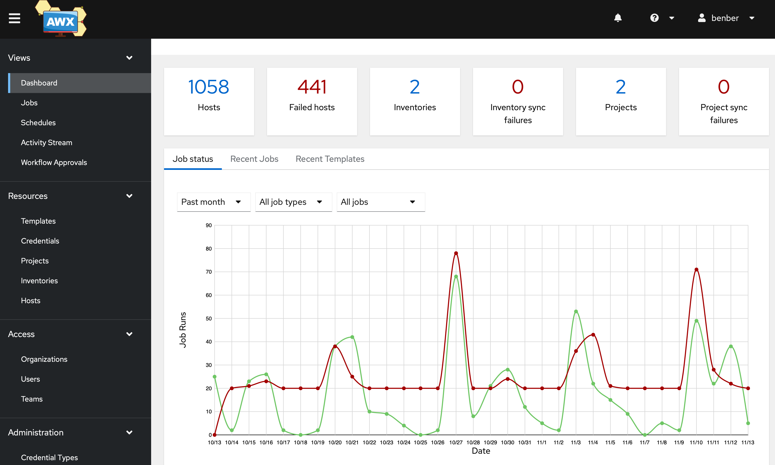
AWX

Slide 12
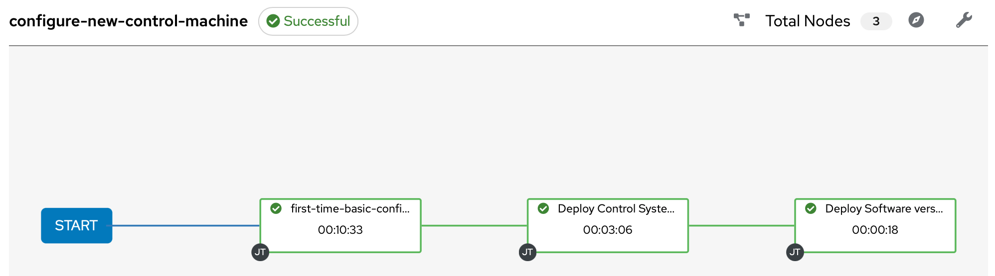
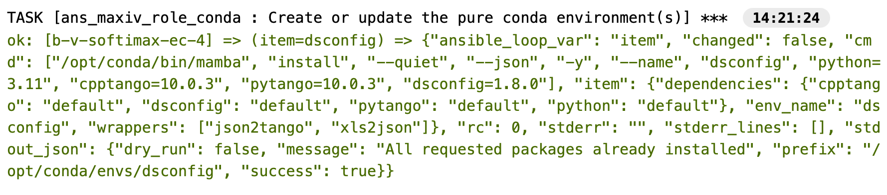
AWX

Slide 13
Internal GitLab Workflow https://gitlab.maxiv.lu.se

Slide 14
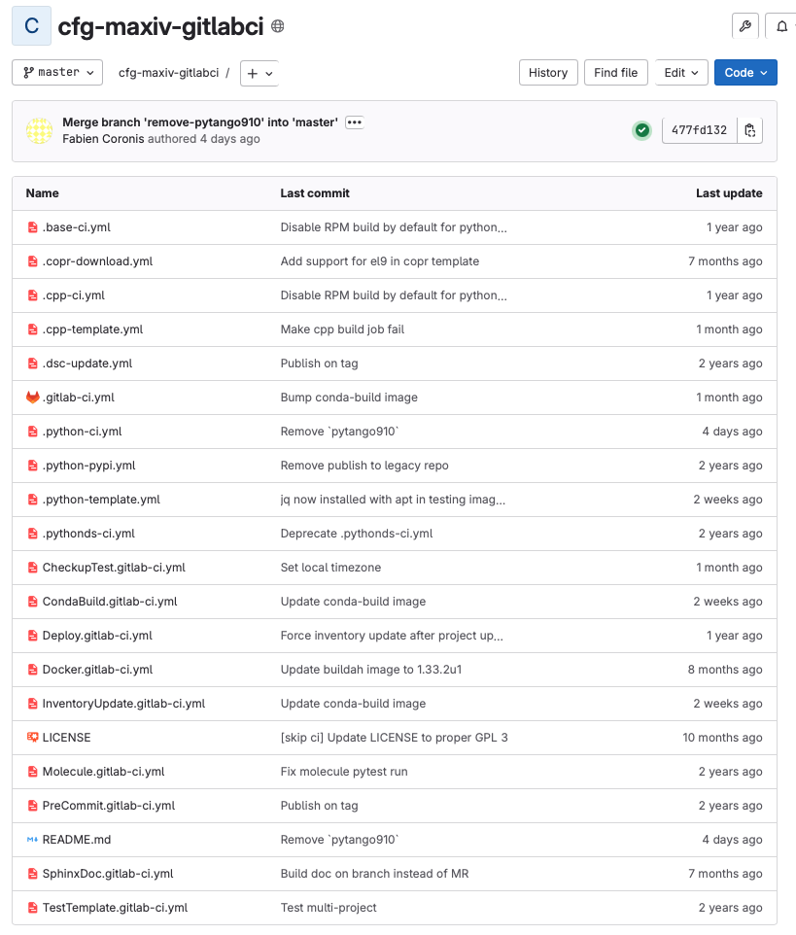
GitLab CI templates
Notes:
Restricted functionality in CE

Slide 15


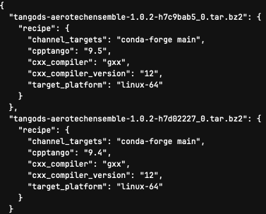

C++ projects: CI template
On branch
On tag

Slide 16
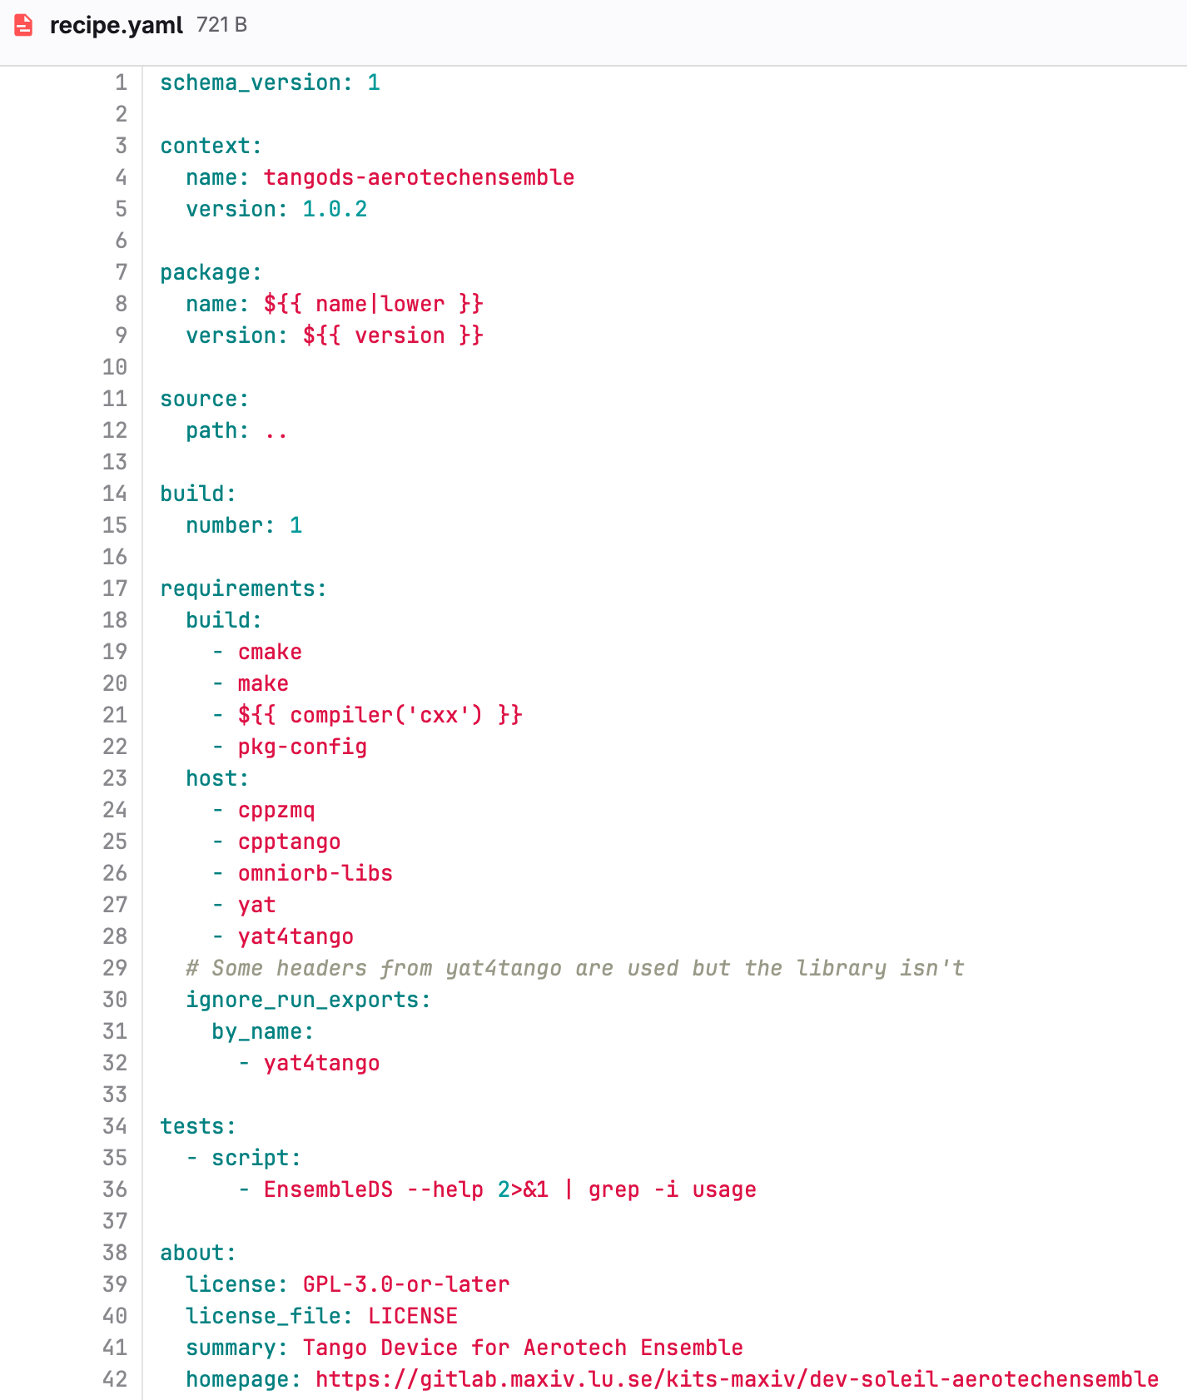
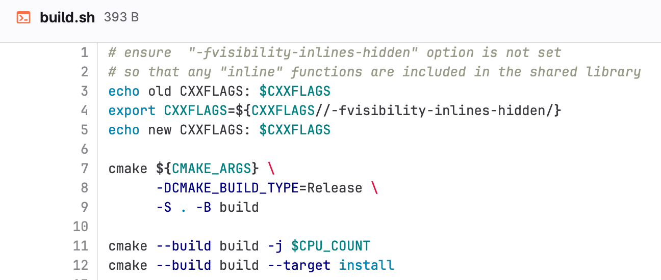
C++ projects: conda recipe
Notes:
Used to have a specific CPP template to create RPM. Less than 30 tango device servers.

Slide 17
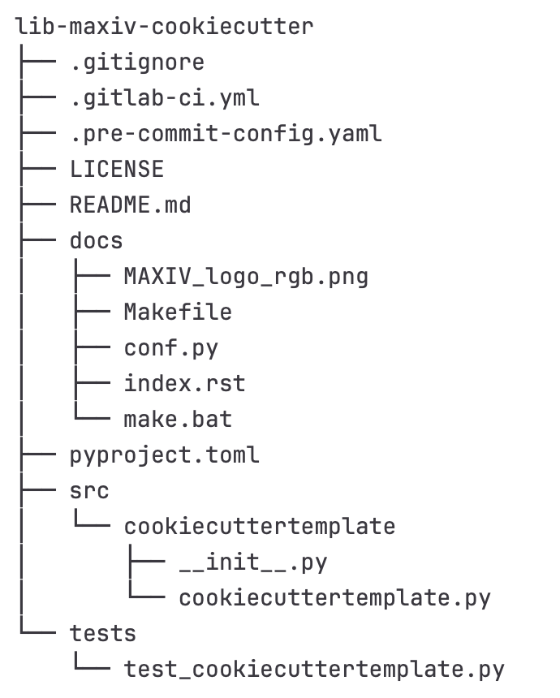
Python projects: cookiecutter template
cookiecutter https://gitlab.maxiv.lu.se/kits-maxiv/cookiecutters/cookiecutter-pythonmodule.git
GitLab CI
pre-commit configuration (linting and formatting with ruff)
pyproject.toml with setuptools-scm

Slide 18
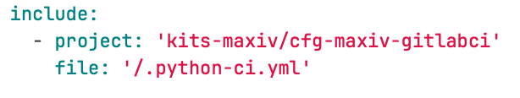
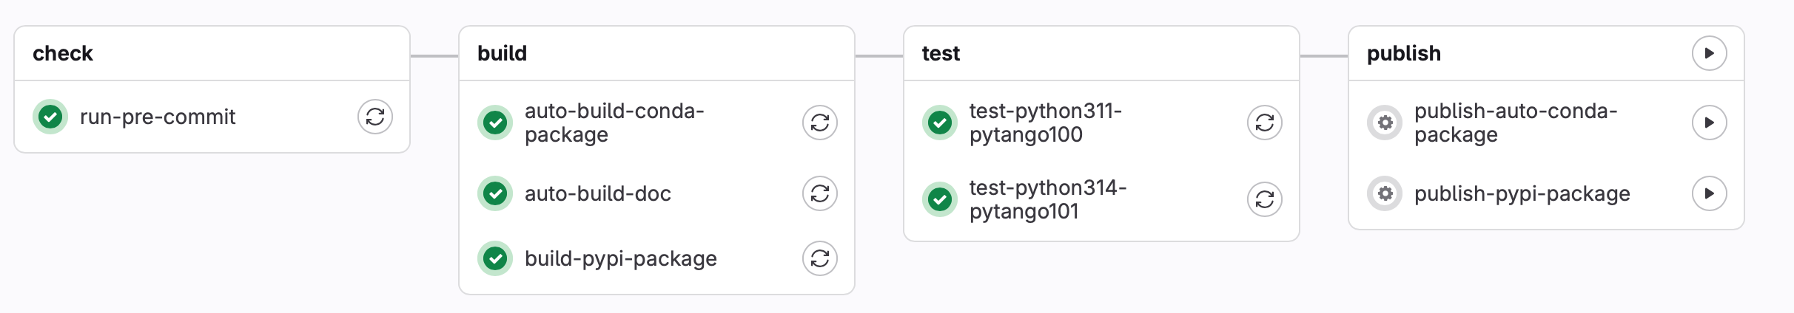
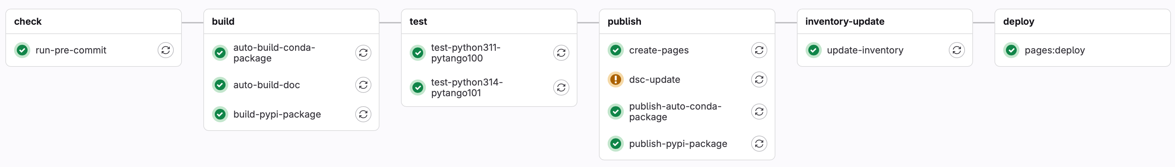
Python GitLab CI template
On branch (dev package: 1.0.1.dev3+g9c9a3d7)
On tag (prod package: 1.1.0)
Notes:
One project where we keep GitLab CI templates. Only one file to include in projects

Slide 19

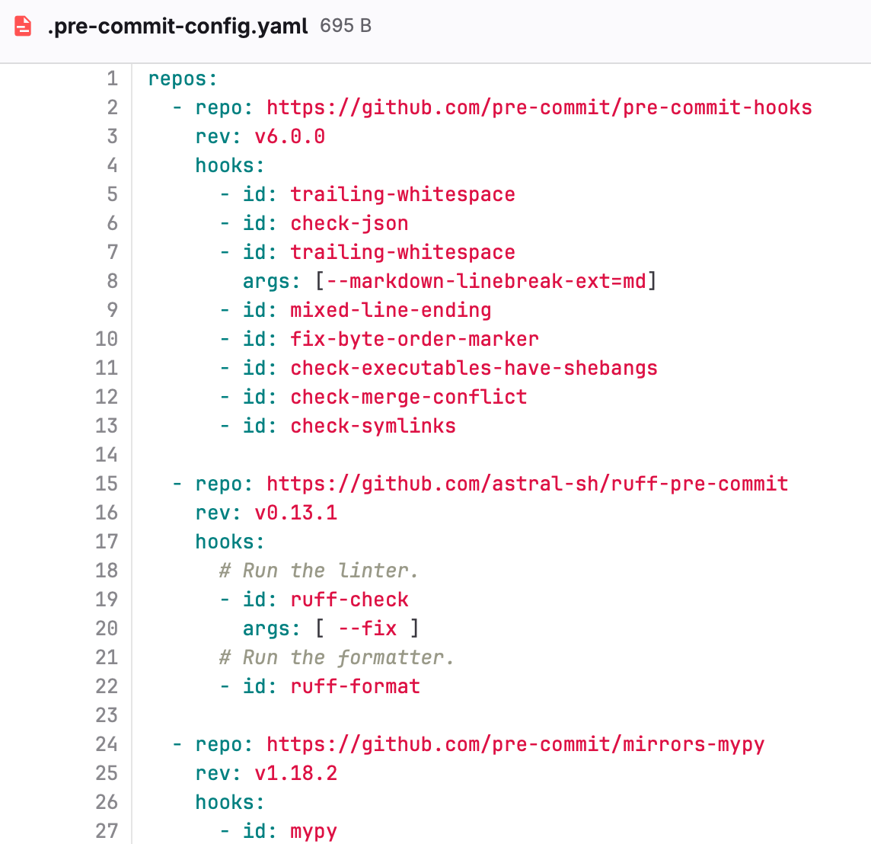
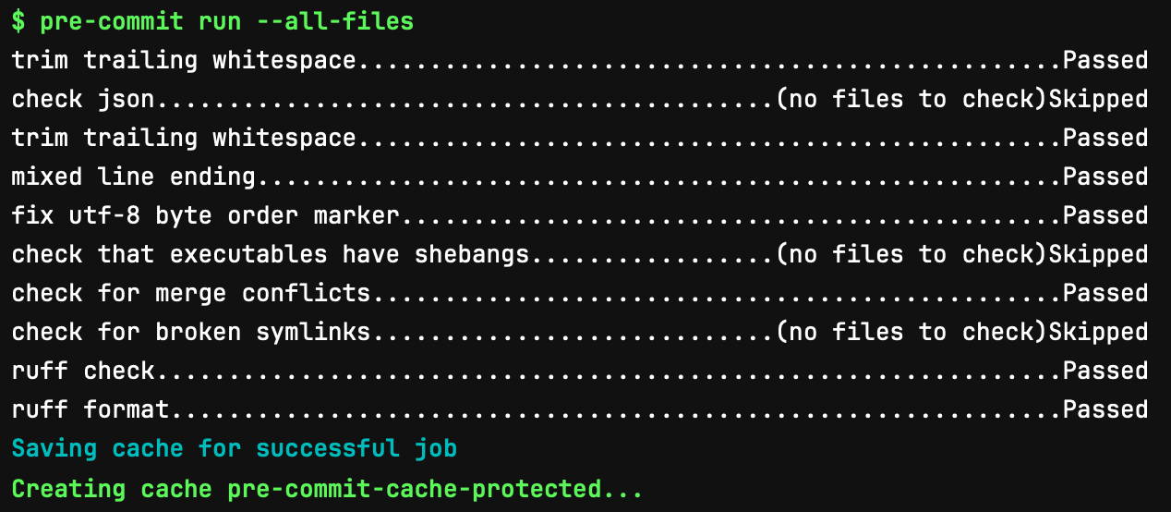
pre-commit
https://pre-commit.com A framework for managing and maintaining multi-languages pre-commit hooks

Slide 20

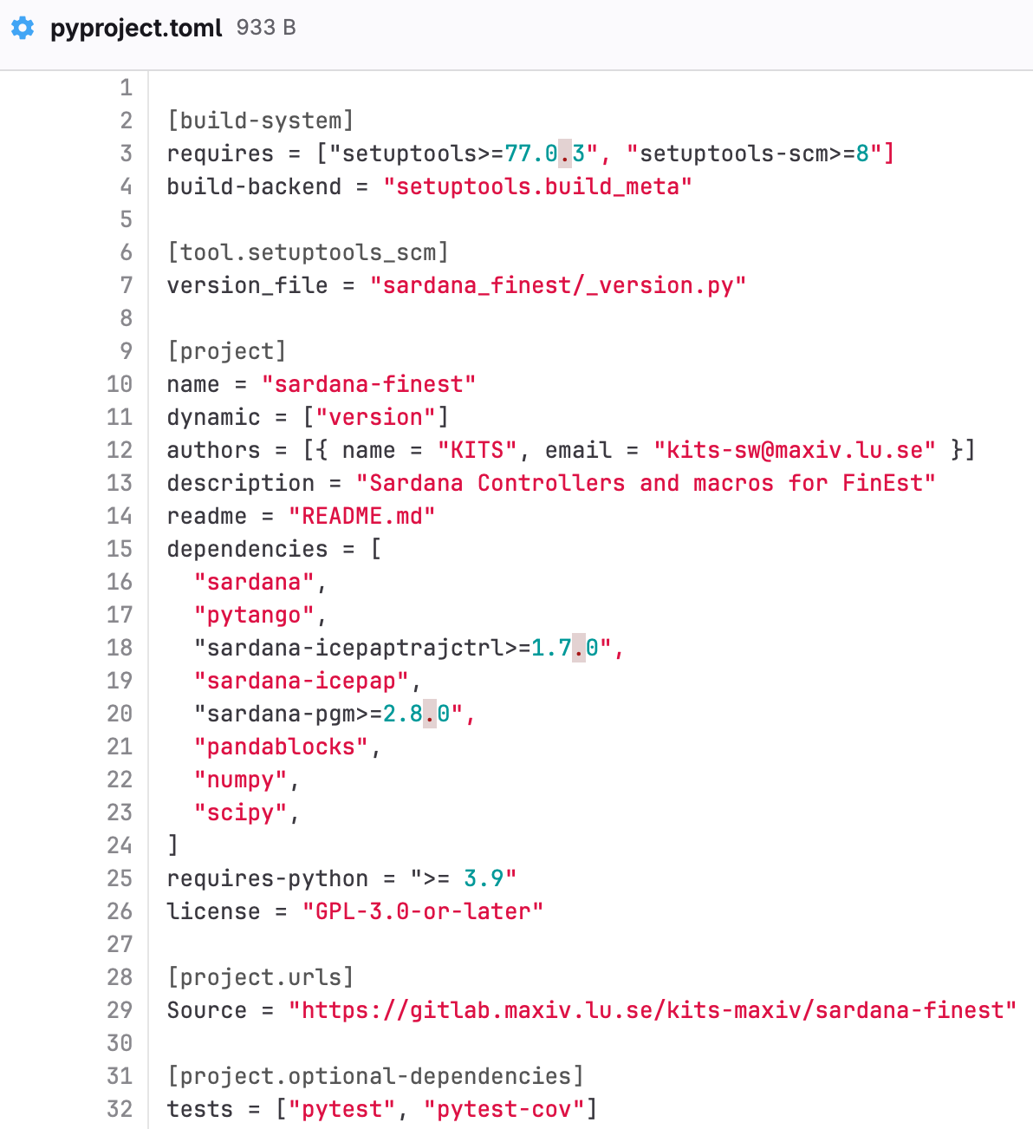
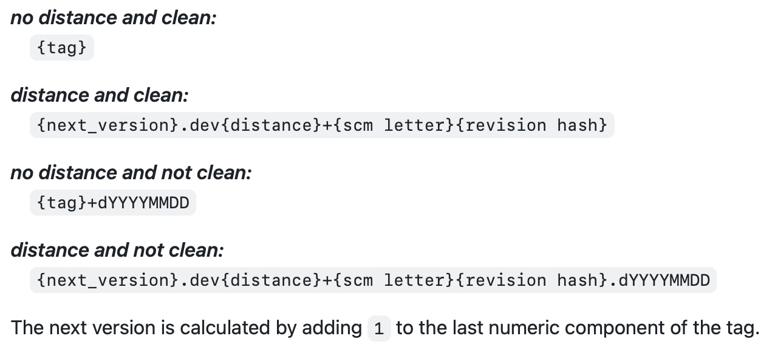
pypi build
python -m build
On branch: 1.0.1.dev3+g9c9a3d7
On tag: 1.1.0
setuptools-scm rules:
Notes:
Not fully migrated to pyproject.toml. But planning to.

Slide 21

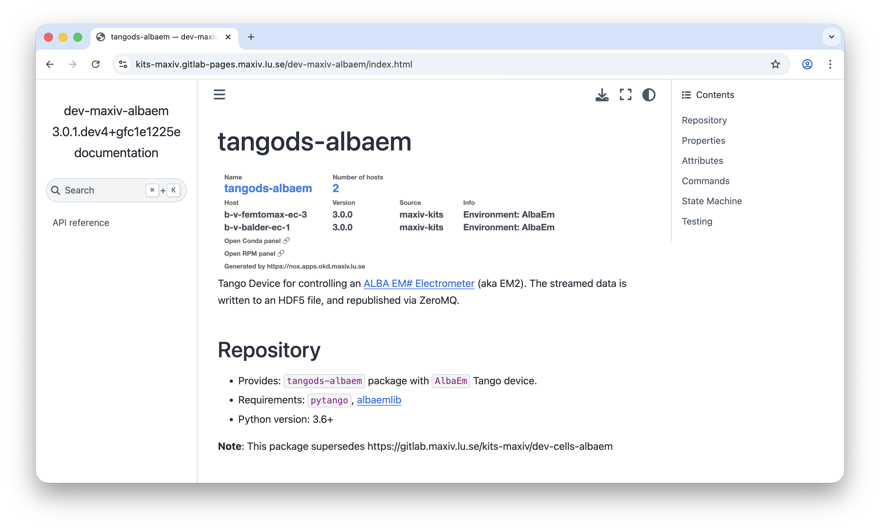
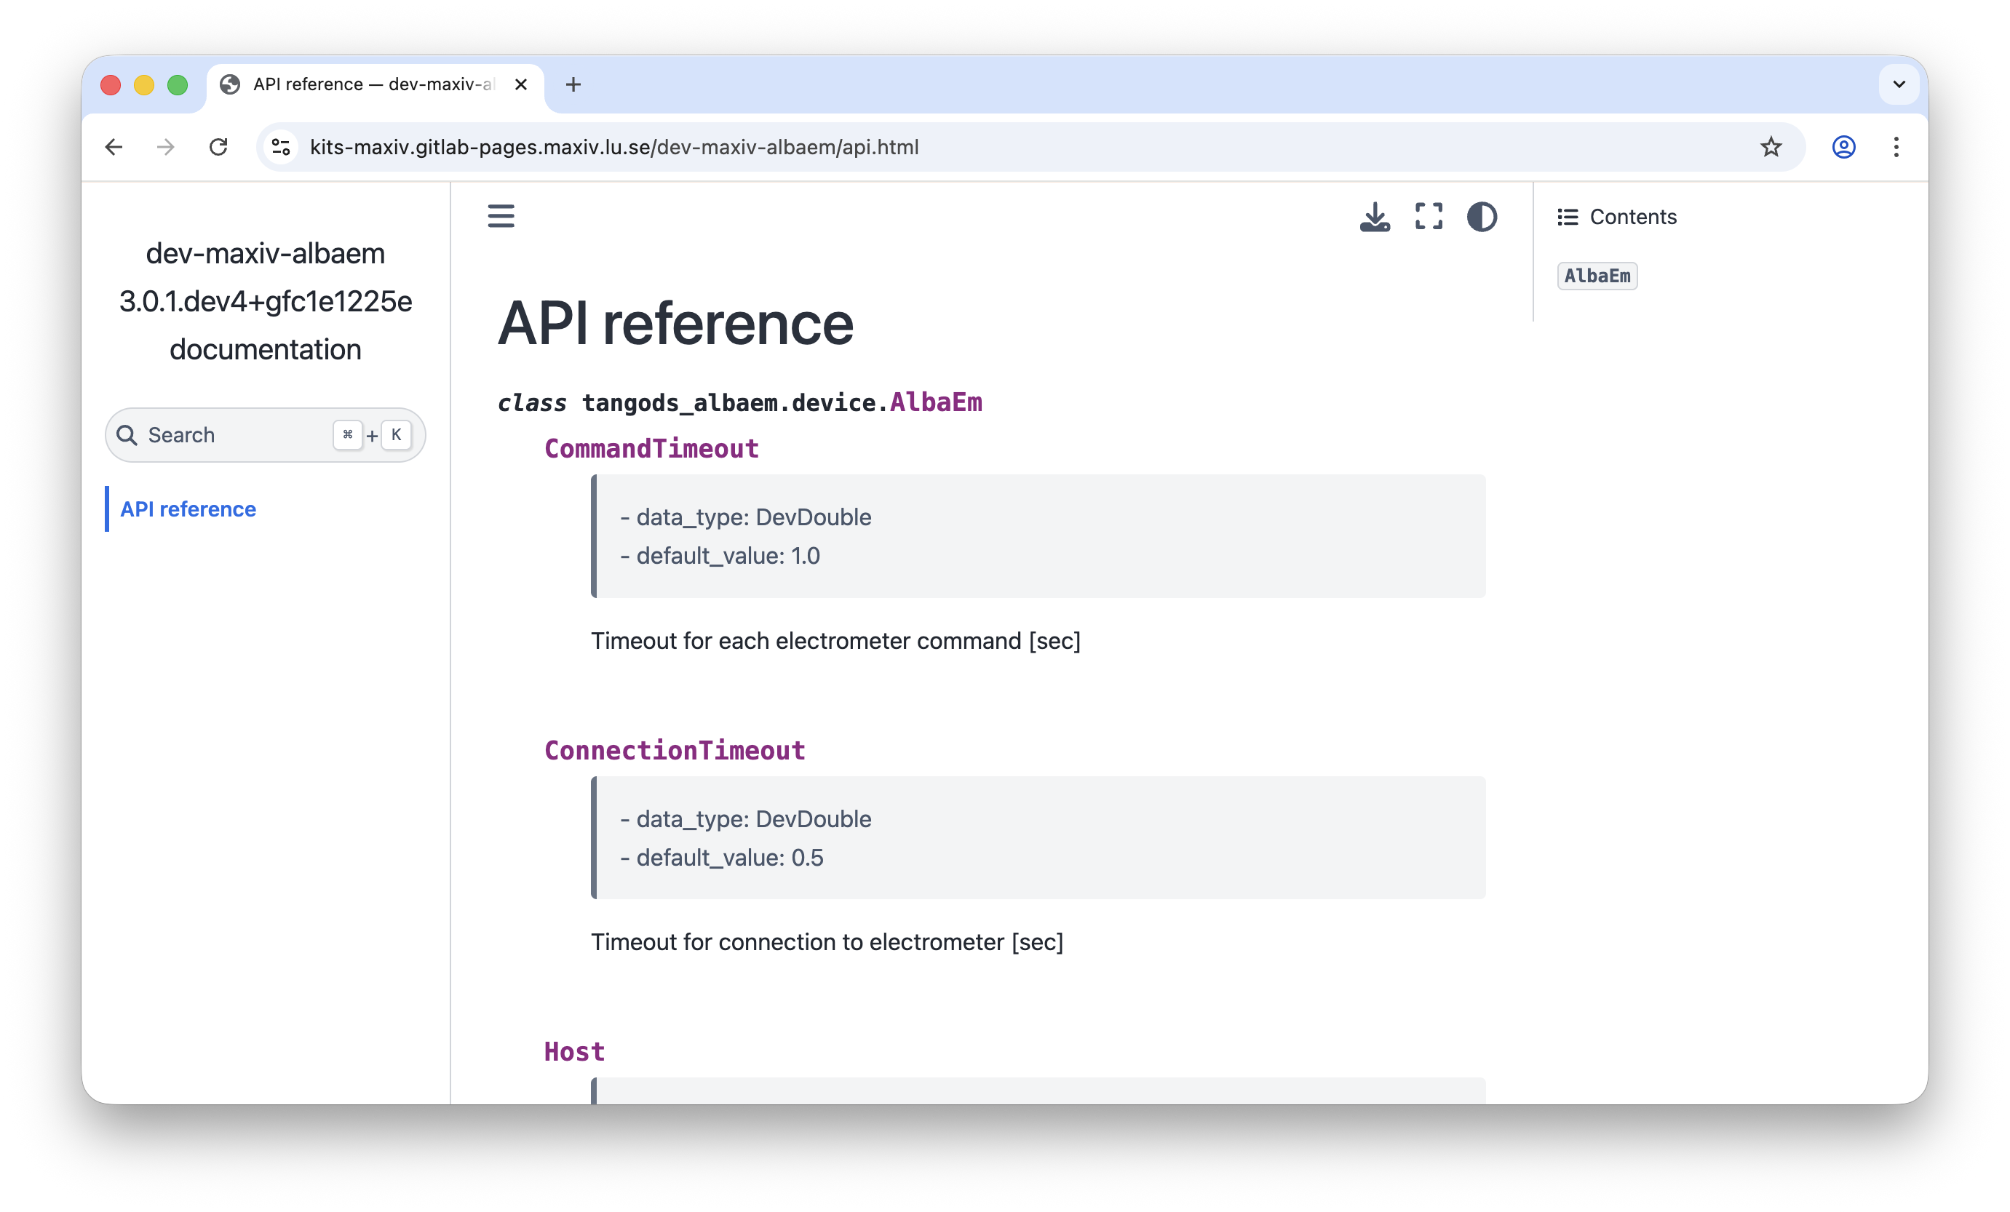
auto build doc
Script to generate API doc from tango device code
README.md
Notes:
Published on GitLab Pages. Still experimental – script to improve

Slide 22

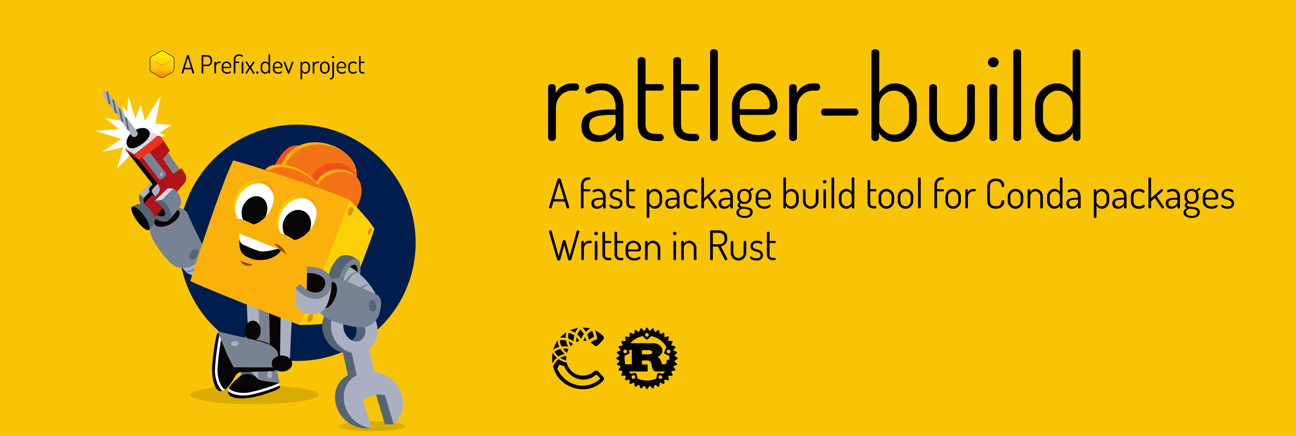

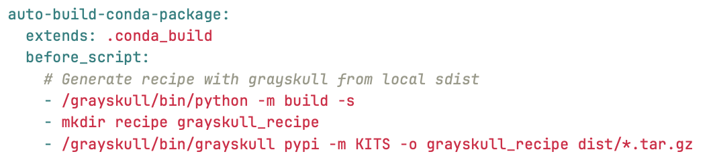
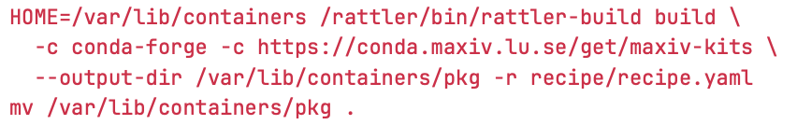
auto build conda package
Grayskull 💀 Recipe generator for Conda

Slide 23
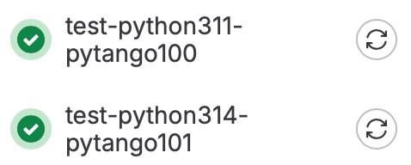
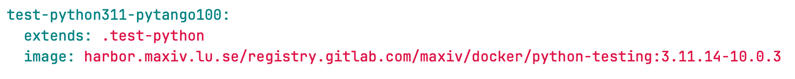
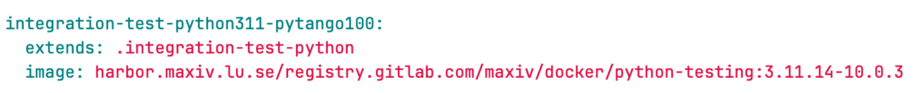
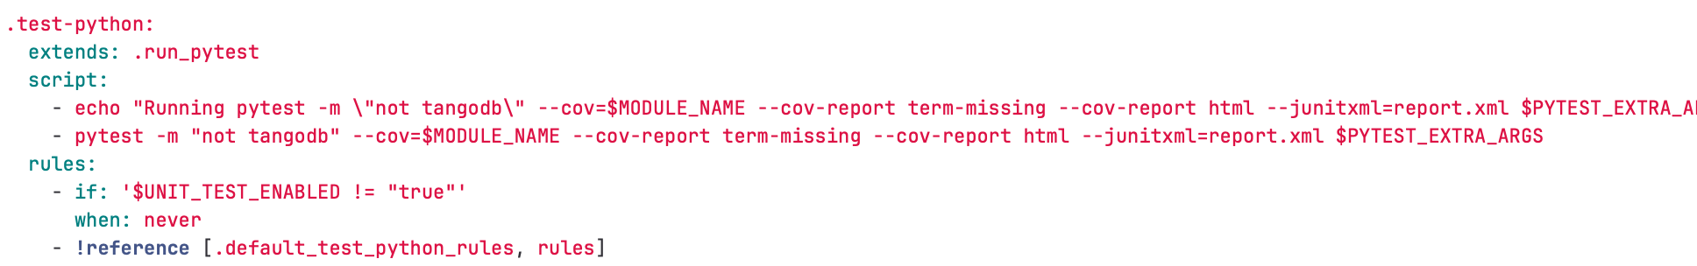
Test python
Docker image with pytango and sardana already installed (with conda)
Testing on Python 3.14 and PyTango 10.1 (allowed to fail)
Notes:
We pip install the package. PyTango wasn’t available as wheel. Also ensure that we test with the current version deployed (9.3.6) and not latest.

Slide 24
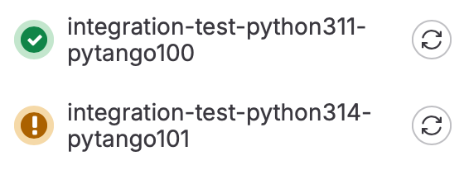
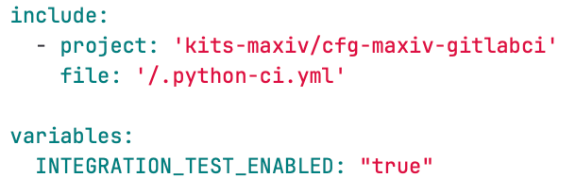
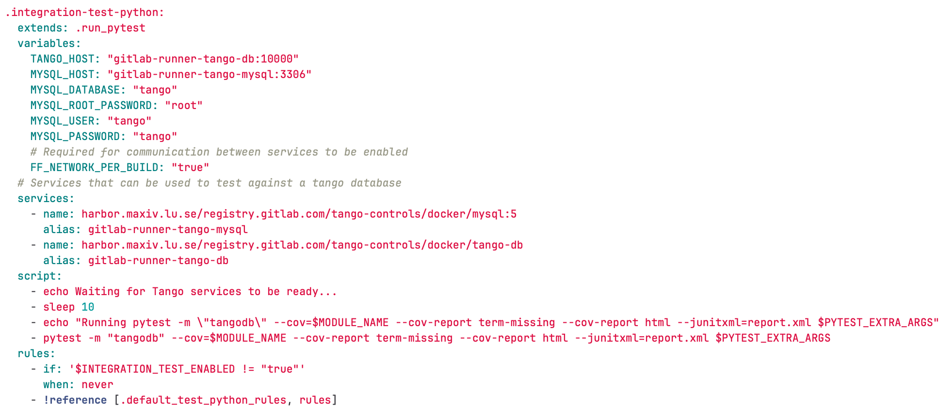
Integration test
Tango database required

Slide 25


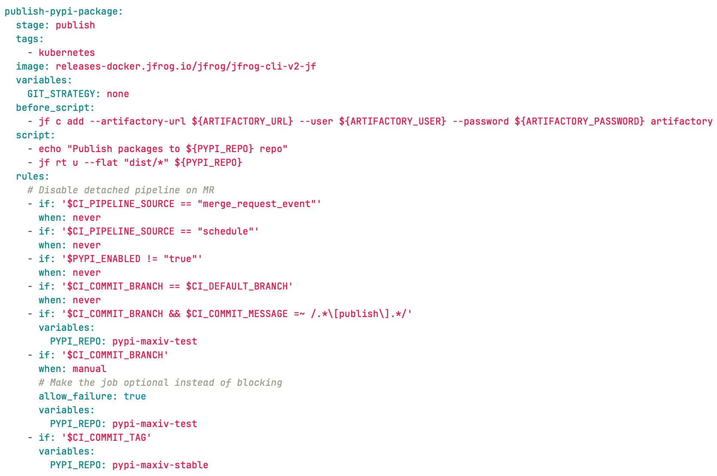
Publish

Slide 26

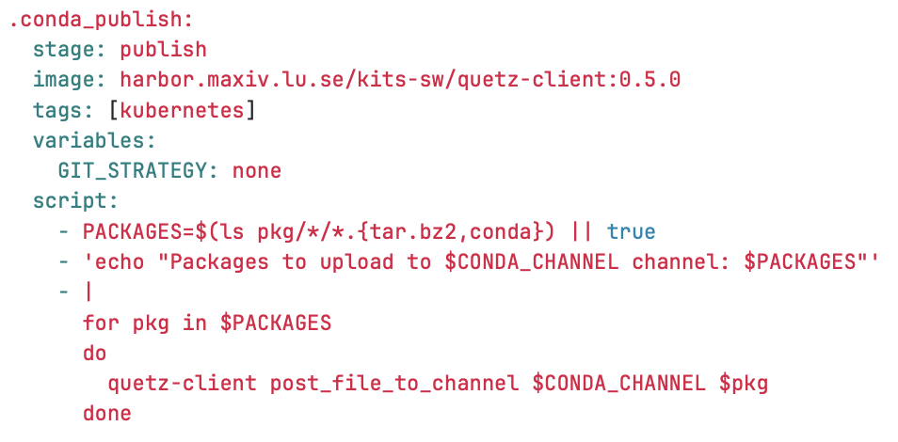
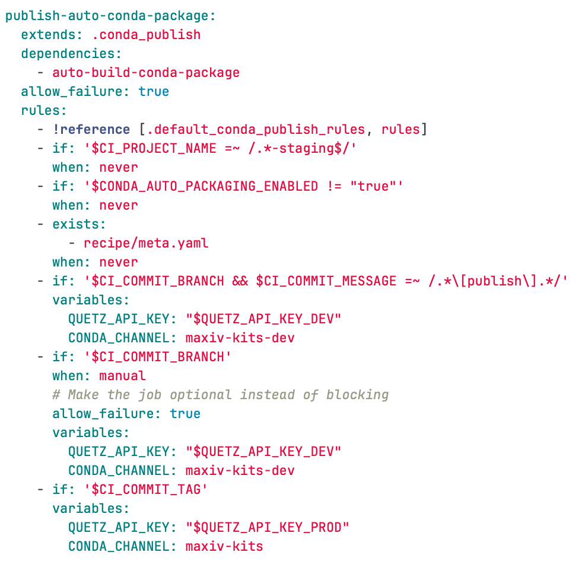
Publish

Slide 27

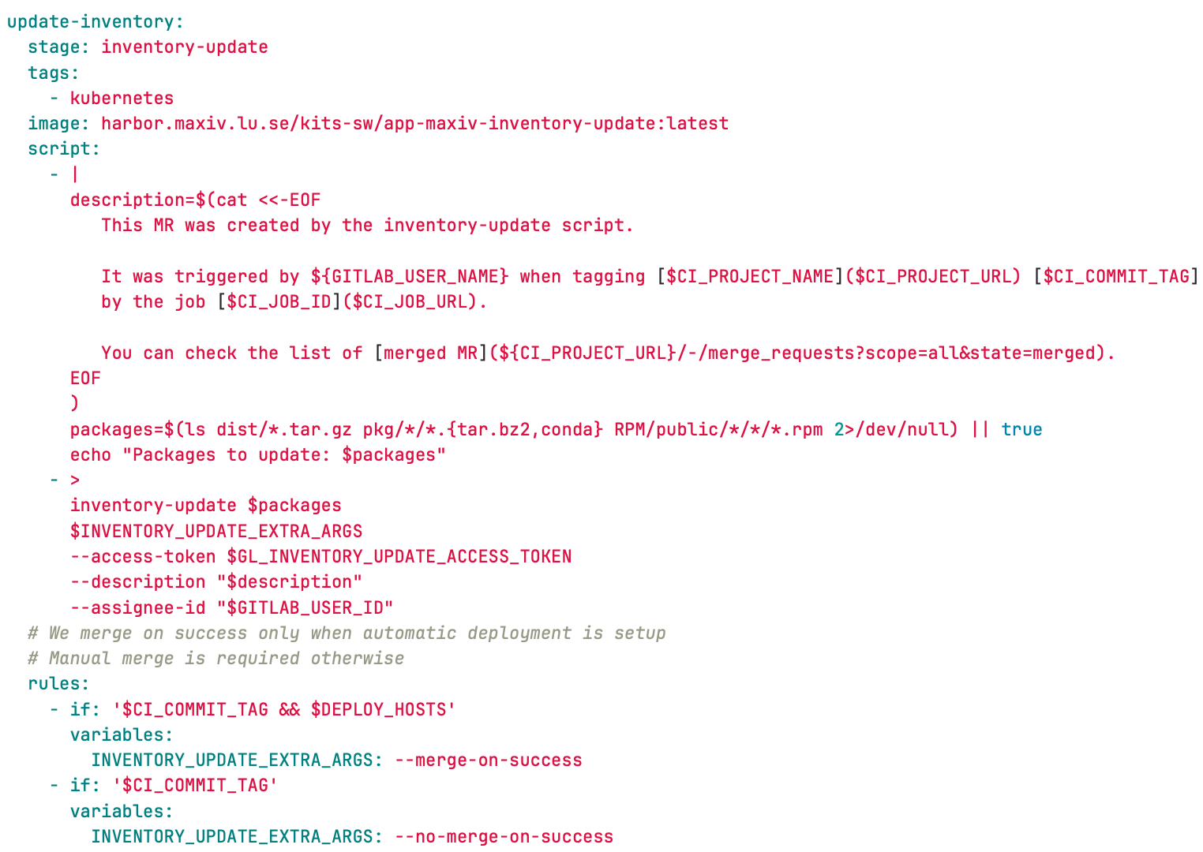
Update inventory

Slide 28
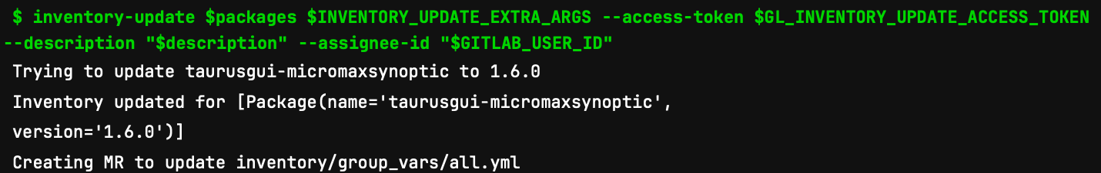
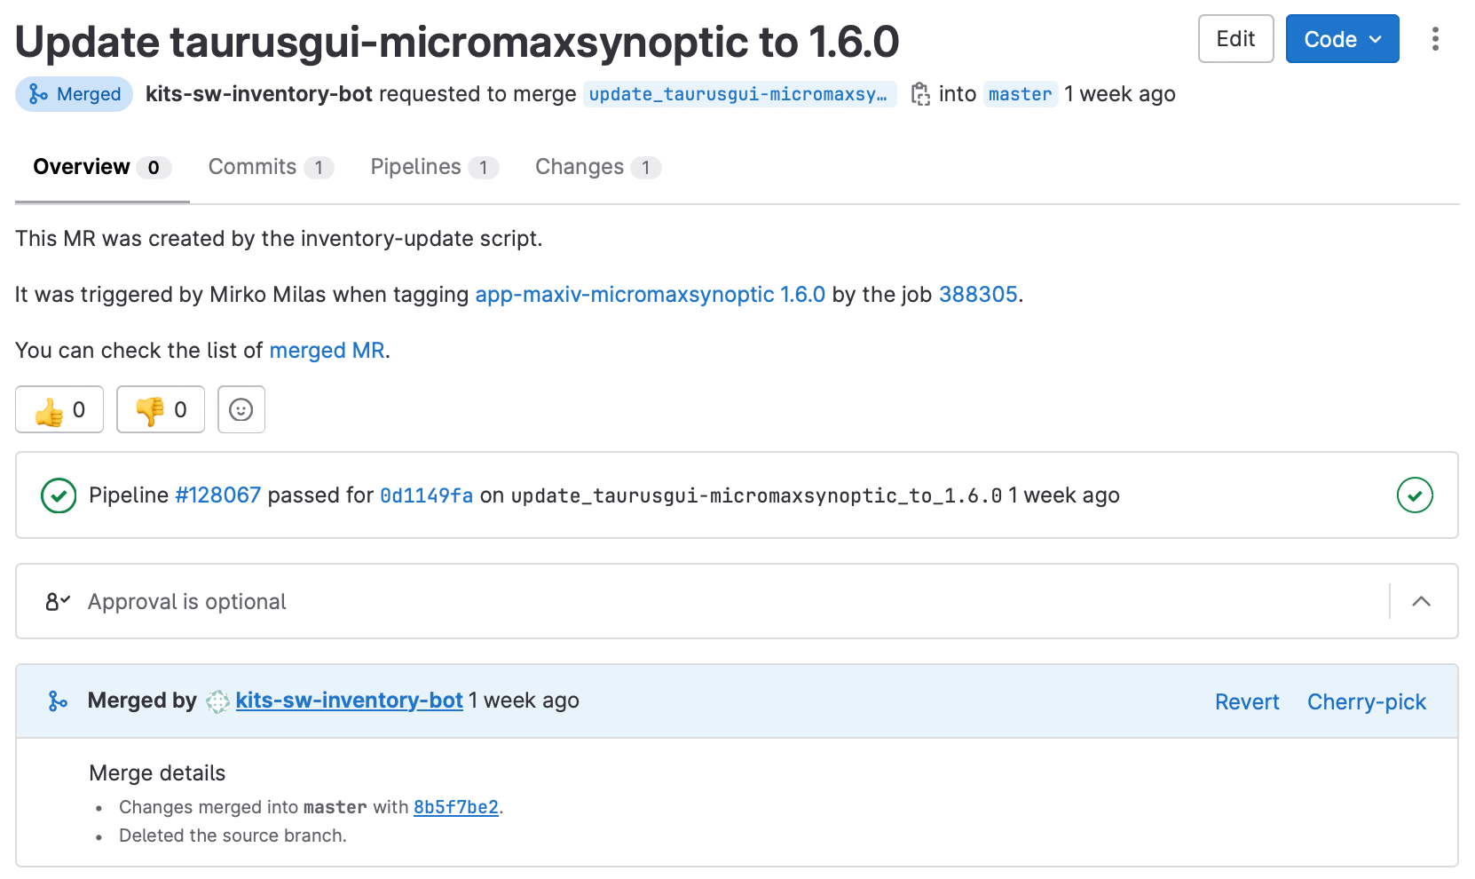
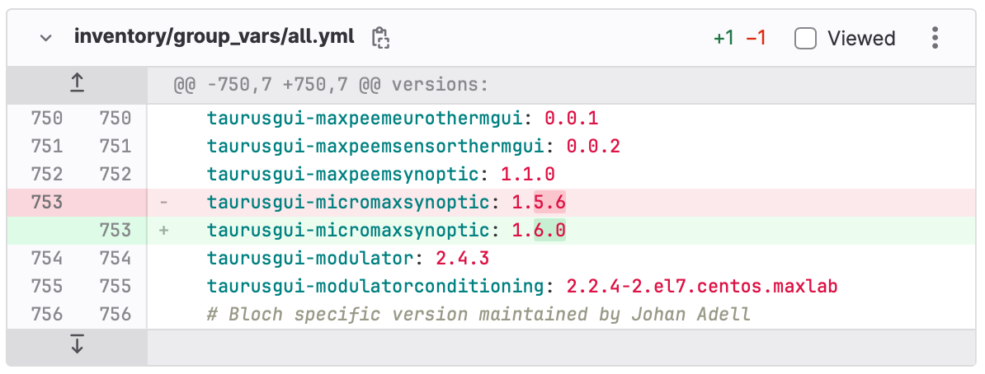
Update inventory

Slide 29
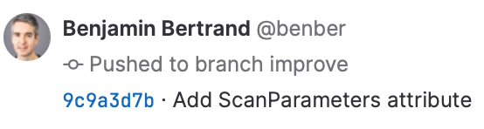
Continuous Integration
Dev package published only if needed – for testing

Slide 30
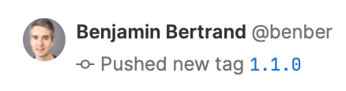
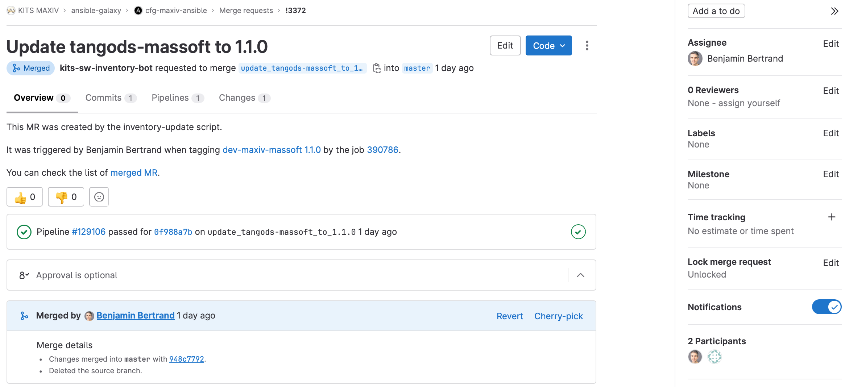
Continuous Integration

Slide 31
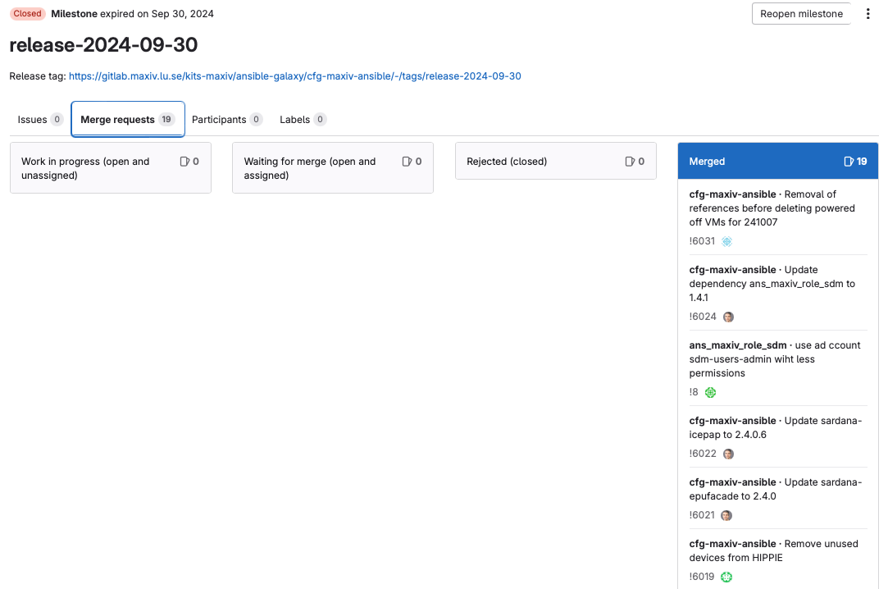

Monday deployment
All approved Ansible MRs belonging to the corresponding milestone are merged by the Monday Deployment Crew.
The Monday Deployment Crew deploys the updates by running the deploy playbook in AWX, limited to beamlines group.

Slide 32
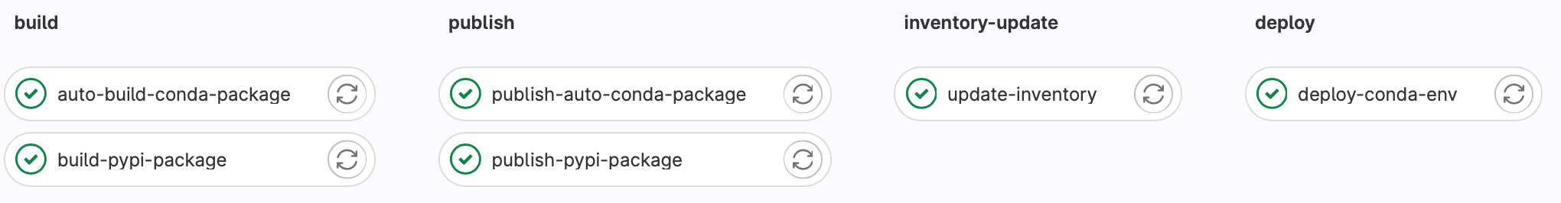
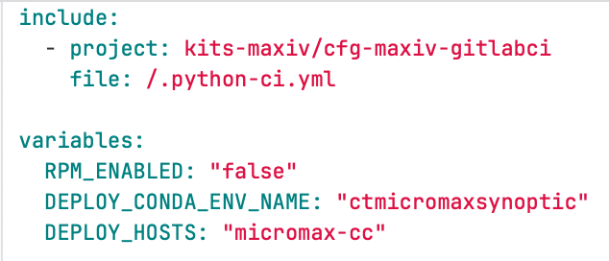
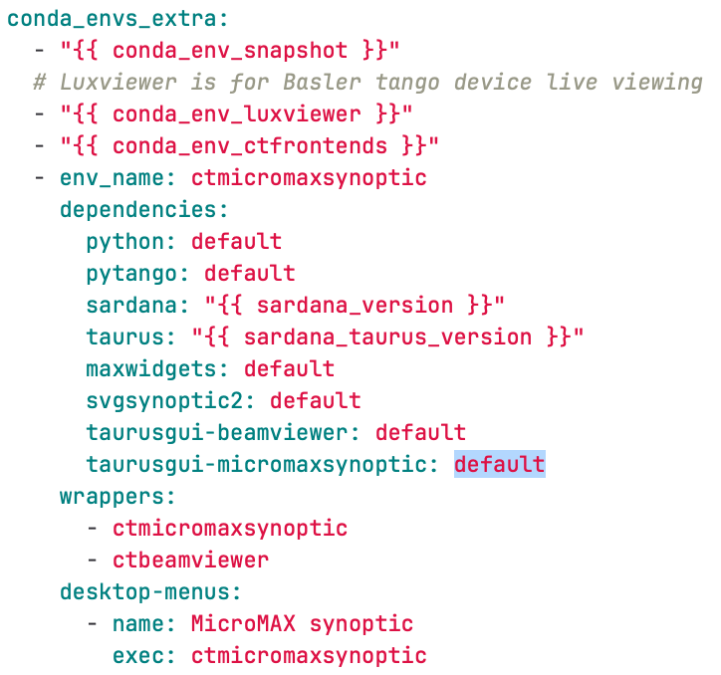
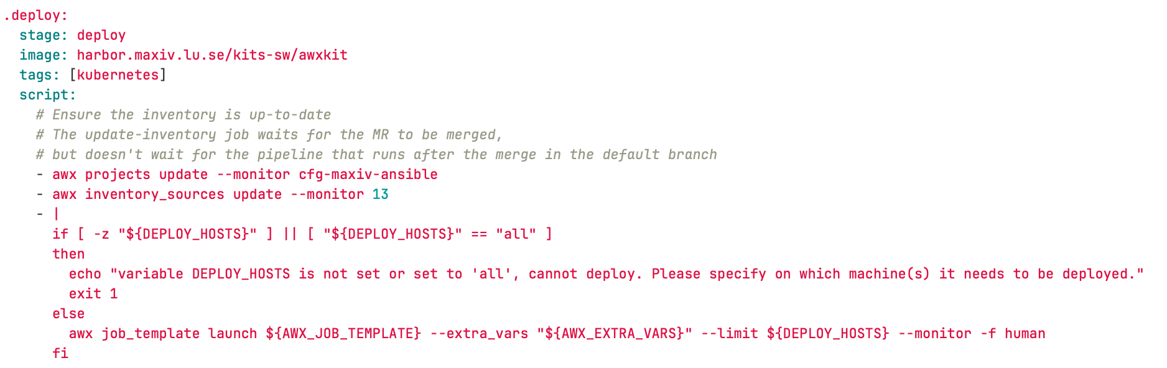
Continuous deployment

Slide 33
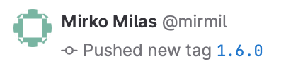
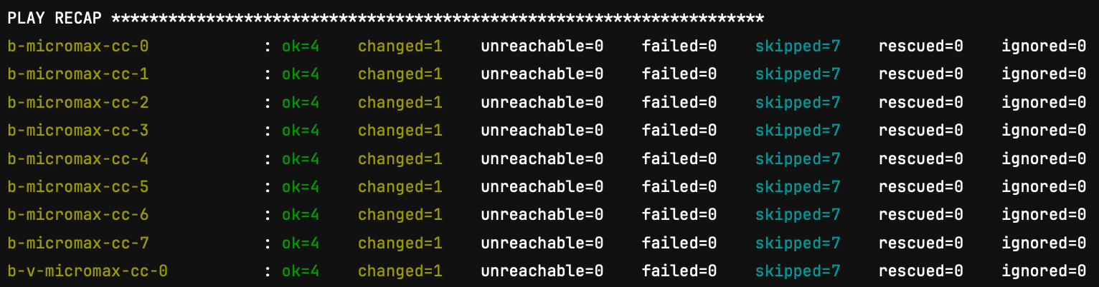
Continuous deployment
MR in the inventory is automatically merged
Only for specific use-case! Synoptic is a typical one. Beamline staff can update the app themselves.

Slide 34
GitLab.com https://gitlab.com/MaxIV

Slide 35
GitLab.com
GitLab.com: https://gitlab.com/MaxIV
Ultimate SaaS Plan via Open Source Program
Every project in MaxIV group must be published under an OSI-approved open source license
Every project must be publicly visible and available
GitLab.com hosted runners
One internal runner
Notes:
Restricted functionality in CE

Slide 36
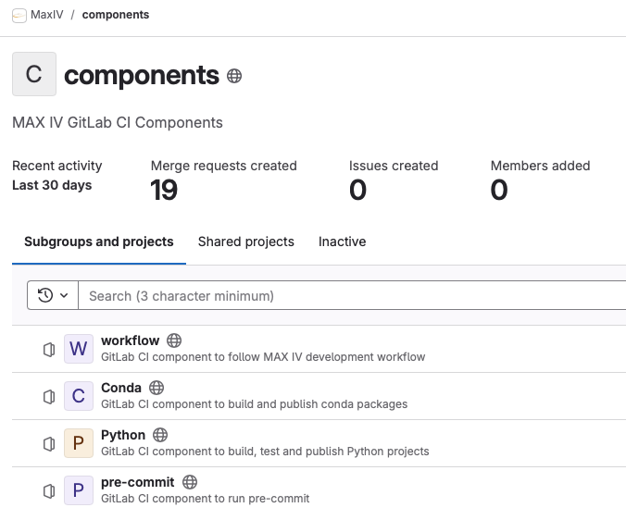
GitLab.com MAX IV CI components
https://gitlab.com/MaxIV/components

Slide 37






GitLab.com CI component - public
On branch (dev package: 1.0.1.dev3+g9c9a3d7)
Dev package for internal testing
On tag (prod package: 1.1.0)
Official conda package handled on conda-forge

Slide 38






Public projects

Slide 39




GitLab.com CI component - internal
On branch (dev package: 1.0.1.dev3+g9c9a3d7)
On tag (prod package: 1.1.0)
SaaS runners
Internal runner

Slide 40
Links
https://pre-commit.com
https://setuptools-scm.readthedocs.io/
https://conda.github.io/grayskull/
https://github.com/conda-incubator/conda-recipe-manager
https://prefix-dev.github.io/rattler-build/
https://docs.gitlab.com/ee/ci/components/
https://gitlab.com/MaxIV/components
https://gitlab.com/MaxIV/docker

