Slide 1
Full Energy Linacs as Injectors to High Brightness Storage Rings
MAXIV
10th & 11th March 2026

Slide 2
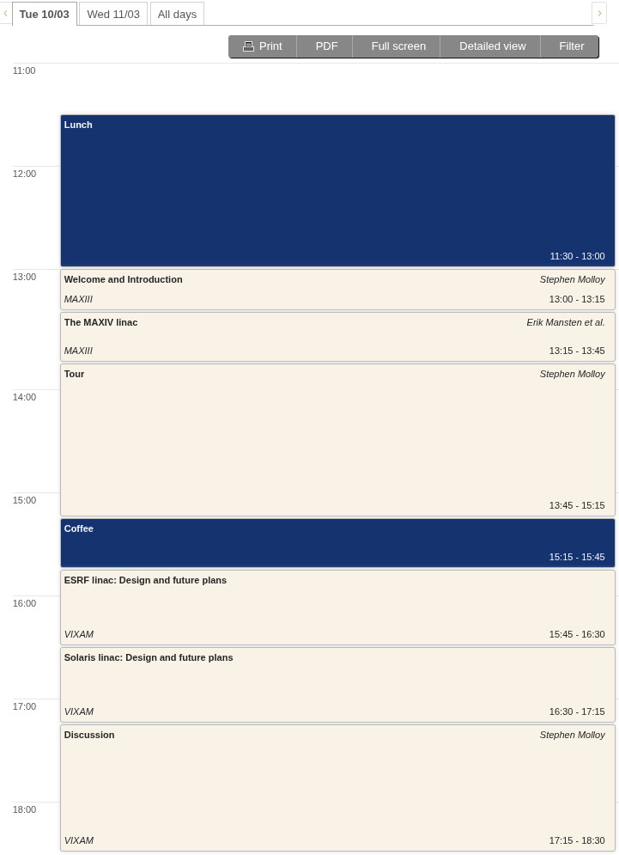
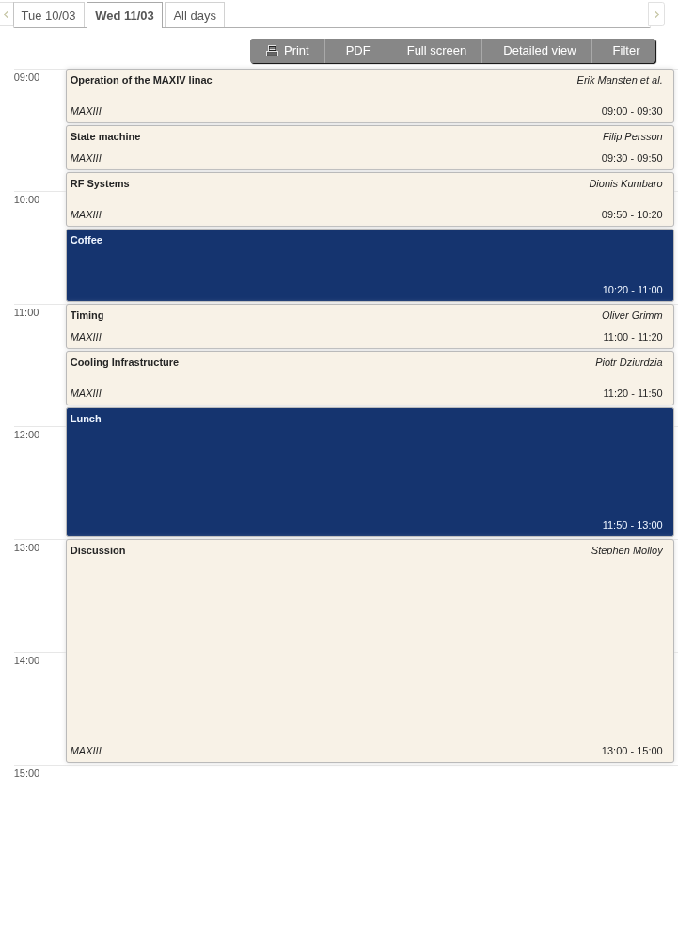
Welcome

Slide 3
Practicalities
The session after the tour will be in a different room
  There will be somewhere to lock your belongings during the tour
Lunches are provided for visitors
I have added a lot of space in the schedule for discussions, so feel free to ask all your questions!

