Slide 1
MAX IV linear accelerator
Introduction
Workshop on Full Energy Linacs – March 2026
Erik Mansten

Slide 2
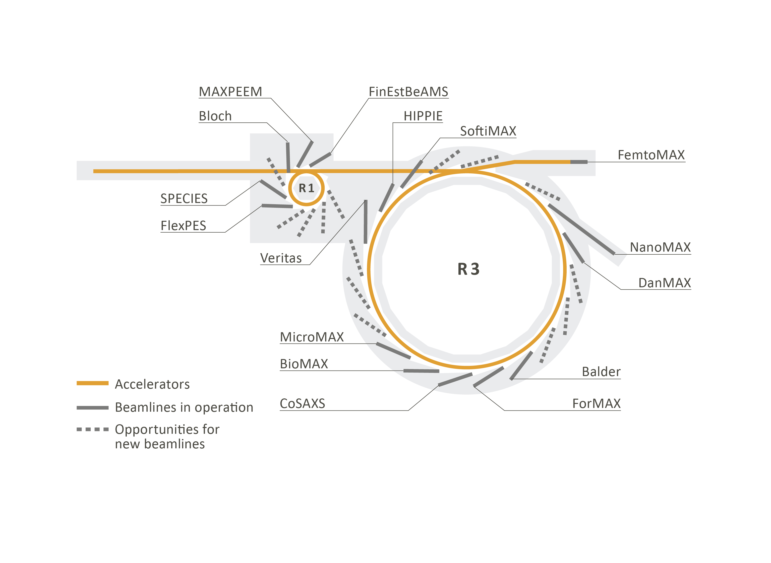
Full energy?
LINAC

Slide 3
MAX IV presentations
Injection – Sara Thorin
State Machine – Filip Persson
RF Systems – Dionis Kumbaro
Timing – Oliver Grimm
Cooling – Piotr Dziurdzia
LINAC

Slide 4
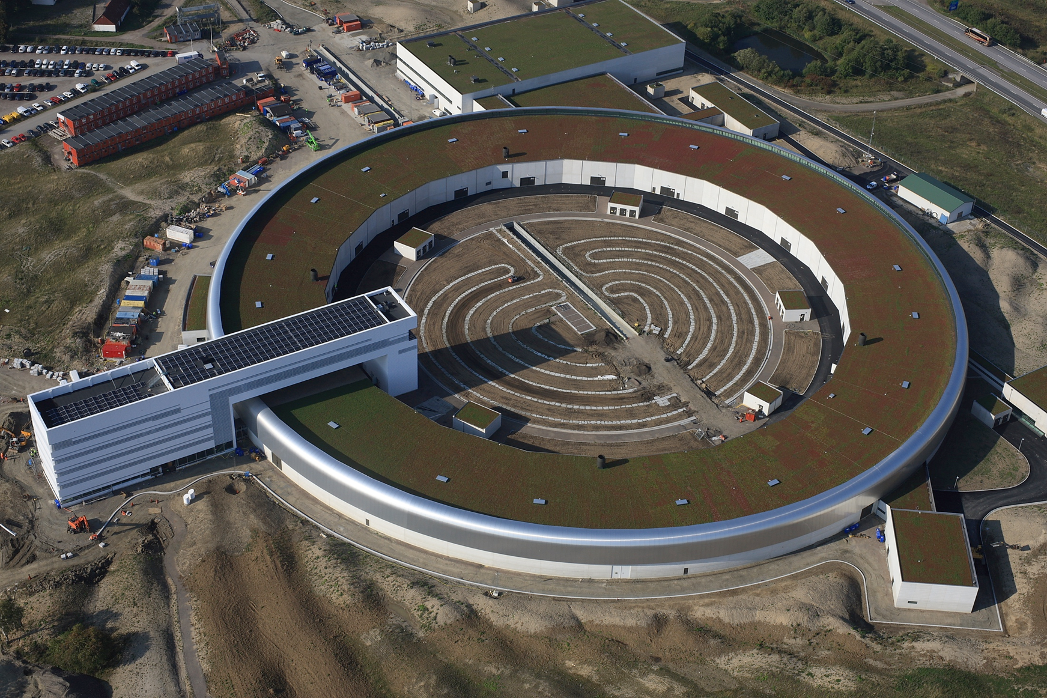


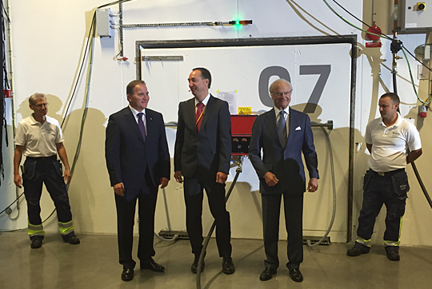

MAX IV news - 2016
 | 2010 | 2011 | 2012 | 2013 | 2014 | 2015 | 2016 | 2017
Linac building
Linac installation
Linac commissioning
Linac operation
Notes:
2017 and on
RF upgrade
SXL
Reliable injection into R1 and R3
SPF operation

Slide 5
The MAX IV facility
LINAC

Slide 6
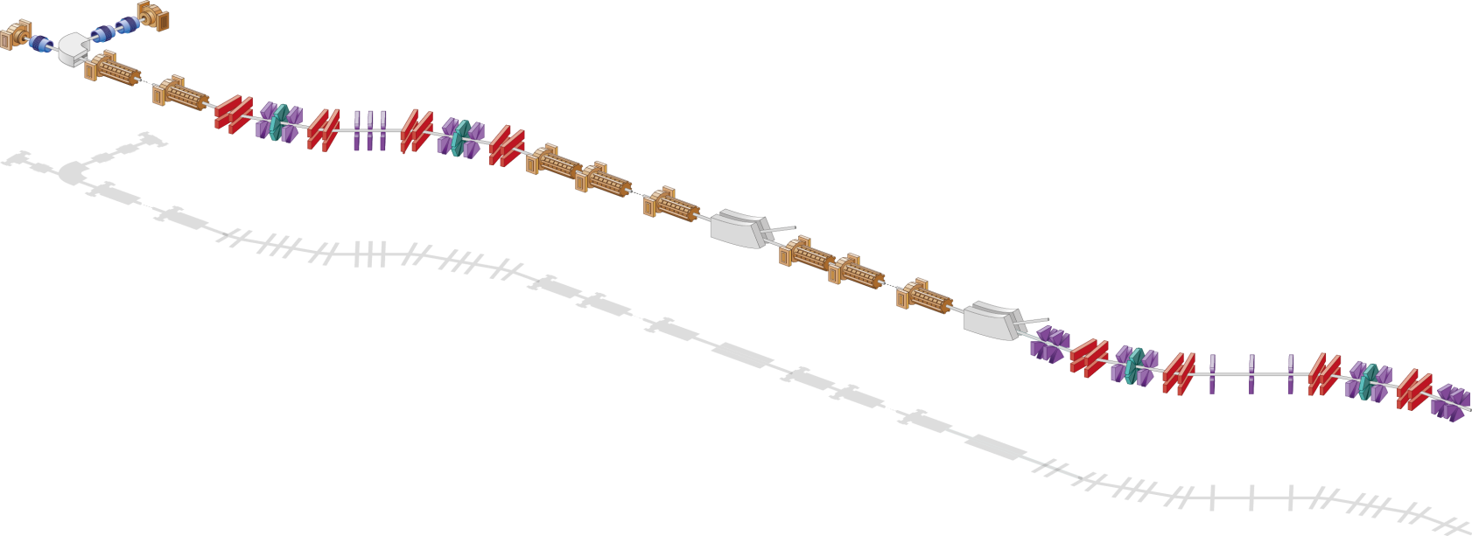
MAX IV linac overview
Thermionic RF gun
Photo cathode RF gun
Photo cathode RF gun
Extraction 1.5 GeV
BC1 @ 260 MeV
Extraction 3 GeV
Full energy injection and top up
BC2 @ 3 GeV
Injection
Energy | 1.5 GeV/ 3GeV
Repetition rate | 10 Hz
Charge | 0.3 nC/shot
Emittance | 5 mm mrad
Energy spread | ^{<0.25 %}

Slide 7
MAX IV linac overview
Thermionic RF gun
Photo cathode RF gun
Extraction 1.5 GeV
BC1 @ 260 MeV
Extraction 3 GeV
BC2 @ 3 GeV
SPF
Full energy injection and top
High brightness driver for the Short Pulse Facility
Injection
Energy | 1.5 GeV/ 3GeV
Repetition rate | 10 Hz
Charge | 0.3 nC/shot
Emittance | 5 mm mrad
Energy spread | ^{<0.25 %}
 | Design | Currently
Energy | 3GeV | 3 GeV
Repetition rate | 100 Hz | 10 Hz
Charge | 100 pC | 75-150 pC
Bunch length (FWHM) | 100 fs | 300 fs – 30 fs
Emittance | 1 mm mrad | 2 mm mrad
Energy spread | <0.4% | ^{0.15-0.07%}

Slide 8
Compression, linearization and stability
Photo cathode RF gun
BC1 @ 260 MeV
E
ΔE
E₀
ΔE
E₀
BC2 @ 3 GeV
SPF
φ
t
Δt
Δt
Notes:
As an introduction I will briefly discuss two options for bunch compression and linearization.
In this cartoon the yeallow field represents integrated energy gain as a function of phase or time.
The black pat of the curve shows the electron bunch energy bofore compression.
Through the bunch compresors the linear momentum compaction R56 makes the til catch up with the head resulting in a shorter bunch.
Without linearization the curvature of the filed remains.

Slide 9



Compression and linearization
E
$$R_{56}<0$$
Chicane type bunch compression
R56<0
Pre crest acceleration
T566>0
Linearize with harmonic cavity
Harmonic non-linearized tuning
ΔE
E₀
ΔE
E₀
φ
t
Δt
Δt
$$R_{56}>0$$
$$T_{566}>0$$
E
ΔE
E₀
ΔE
E₀
Arc type bunch compressor
R56>0
Post crest acceleration
T566>0
Magnetic linearization
Magnetic non-linear tuning
φ
t
Δt
Δt
Notes:
There are two main types of bunch compressors chicane like and arc like.
Chicane like compressors have a negative R56 and operate with acceleration phases pre crest.
A harmonic cavity is needed to linearize.
Arc like compressors have a positive R56 and operate at post crest phases.
I will later show you that this gives some advantages for stability.
Linearization in arcs can be done by magnetic tuning of the quadratic momentum compaction T566.

Slide 10
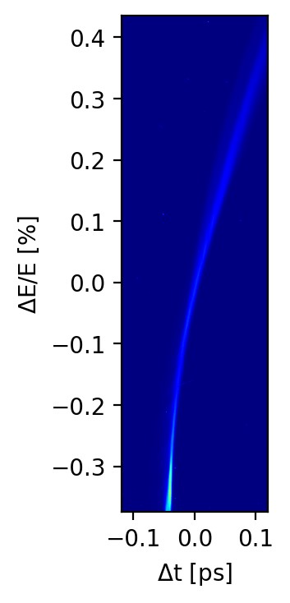

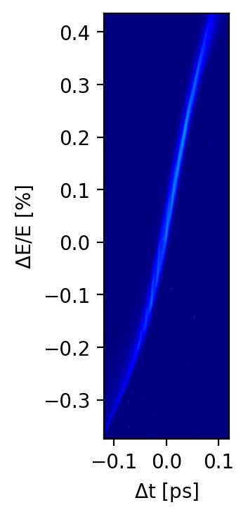
Linearization scan – Longitudinal phase space
E
E
E
0.4
0.4
0.4
0.2
0.2
0.2
ΔE/E [%]
0
ΔE/E [%]
0
ΔE/E [%]
0
-0.2
-0.2
-0.2
-0.4
-0.4
-0.4
-0.1
0
0.1
-0.1
0
0.1
-0.1
0
0.1
t [ps]
t [ps]
t [ps]

Slide 11
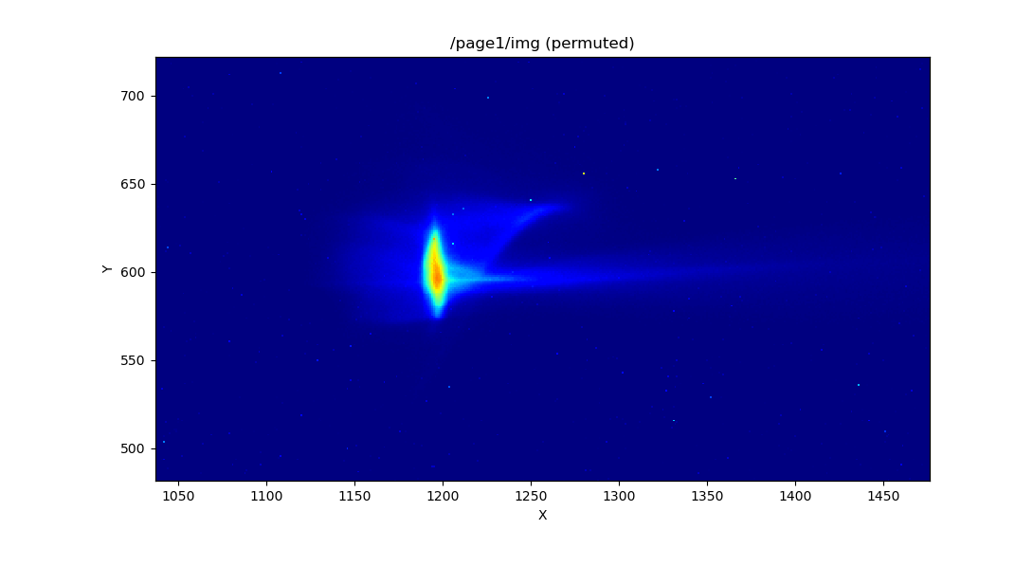
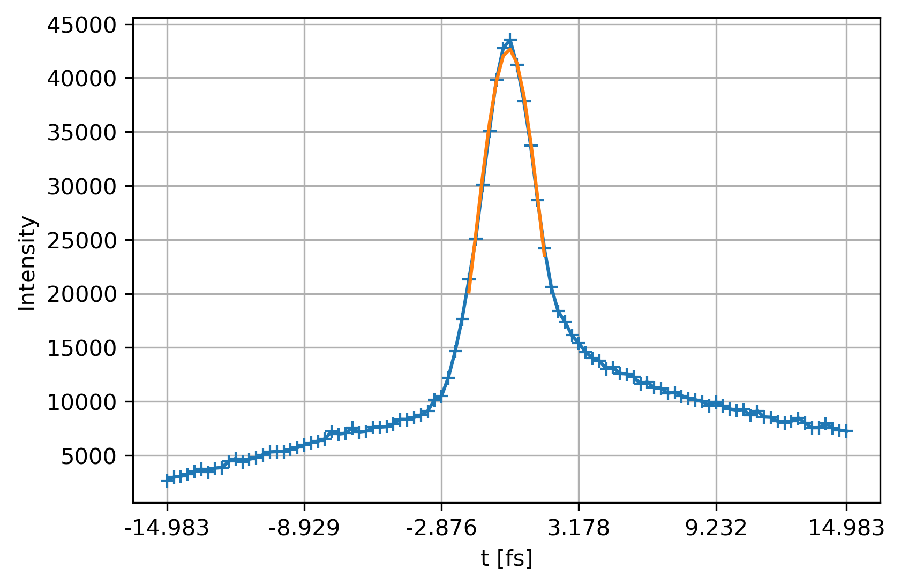
Shortest bunch measured
3.4 fs
Notes:
To access the temporal reolution we combine a measured beam profile with RF off with a scan where we change the phase between the deflecting field and the electron beam and measure how the centroid moves as a function of phase.
The blue dots in the scatter plot is the raw data and the red line is a linear fit.
The slope of the fit connects time and position on the screen.
Plugging the numbers into the formula for temporal resolution we end up with 3 fs.

Slide 12

Energy and timing jitter
Photo cathode RF gun
BC1 @ 260 MeV
E
ΔE
E₀
E₀
BC2 @ 3 GeV
SPF
t₀
t
Δt
$R_{56}\frac{{∆E}_{RMS}}{E}$ >> $T_{566}{\left(\frac{{∆E}_{RMS}}{E}\right)}^{2}$
Notes:
The momentum compaction of bunch compressors connects energy and timing jitter.
In this example with positive R56 an energy increase delays the electron bunch.
Low arrival time jitter thus require low energy jitter.
For jitter studies we only have to include the linear momentum compaction, since higher order terms are insignificant.

Slide 13
Energy jitter sources
Synchronization
Gun laser timing
RF distribution and amplification
RF amplitude
RF phase
Klystron
Modulator HV
RF amplitude
RF phase
Klystron
Amp
Linac structure
Gun laser
Low-level RF
Master oscillator
Experimental laser

Slide 14
Energy jitter sources
Synchronization
Gun laser timing
RF distribution and amplification
RF amplitude
RF phase
Klystron
Modulator HV
RF amplitude
RF phase
Klystron
Amp
Linac structure
Gun laser
Low-level RF
Master oscillator
Experimental laser

Slide 15
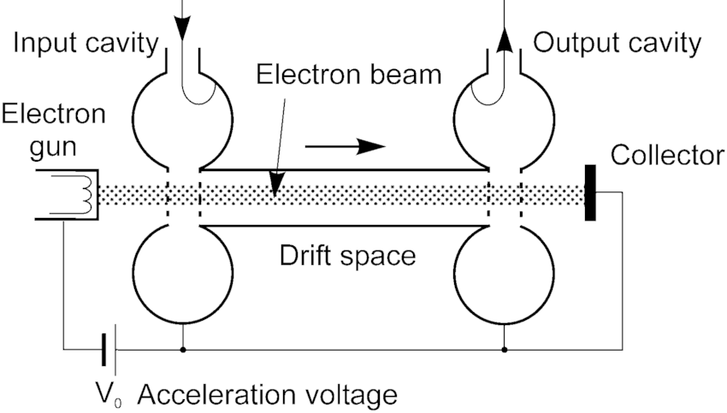
Klystron working principle
U₀
Notes:
Hot filament electron gun
HV, usually provided by a modulator
The input RF generates an energy modulation, which in the drift tube turns into a density modulation.
The density modulated beam radiates efficiently in the output cavity.

Slide 16


Supression of amplitude jitter
P_{in}
P_{out}
60
40
P_{out} [MW]
20
0
0
200
400
600
P_{in} [W]
U₀
$$P_{out}∝U^{5/2}$$
Amplitude and phase changes in a correlated manner!
$$θ_{out}∝U^{−1/2}$$
Notes:
The output power as a function of input power has a saturation plateau.
Operating the klystrons in saturation is a very good to filter away amplitude variations on the input power.
The output power or amplitude also depends on the accelerating voltage.
Higher voltage, more power.
The time of flight also depend on the same accelerating voltage.
Higher voltage, shorter time of flight and reduced phase. – note that amplitude and phase change in a correlated manner.

Slide 17


HV induced energy jitter
Photo cathode RF gun
BC1 @ 260 MeV
ΔE
BC2 @ 3 GeV
$$A_{RF}∝U^{5/4}$$
SPF
θ_{crest}
$$θ_{RF}∝U^{−1/2}$$
Amplitude and phase changes in a correlated manner!
Notes:
In this illustration energy gain is plotted for three HV settings, nominal setting in yellow.

Slide 18
HV induced timing jitter - chicane
Photo cathode RF gun
BC1 @ 260 MeV
BC2 @ 3 GeV
ΔE
SPF
E₀
θ_{chicane}
Δt

Slide 19
HV induced timing jitter – arc like BC
Photo cathode RF gun
BC1 @ 260 MeV
E₀
E₀
BC2 @ 3 GeV
SPF
θ_{magic}

Slide 20
MAX IV single optical oscillator synchronization system
Fiber amplifier
Rohde Schwarz SMA100A
Low noise fiber oscillator
2ω
Compression
Linac LLRF
RF generation
Fiber amplifier
Spec broadening
KM Labs amplifier
Gun laser lab
Fiber distribution
Fiber amplifier
2ω
Compression
Coherent amplifier
Spec broadening
400m stabilized fiber link to the experimental laser.
Fiber amplifier
2ω
Femtomax
Compression
Experimental laser
KM Labs amplifier
Spec broadening
Notes:
This schematic overview shows the single optical oscillator systems that we have started constructing.
Low noise Erbium laser oscillator

Slide 21
Energy stability results
RF oscillator
BC1
7e-4 energy jitter
38 fs - 74 fs time jitter (after BC1)
BC2
2e-4 energy jitter
26 fs - 84 fs (after BC2)
Low jitter RF conversion
BC1
1.3e-4 energy jitter
7 fs – 14 fs time jitter (after BC1)
BC2
5e-5 energy jitter
5.8 fs - 17 fs (after BC2)
Optical MO – low noise fiber oscillator
New RF reference from Quantic Wenzel
Lower absolute phase noise fiber oscillator
Direct RF conversion @1550nm
Finding and eiminating other phase noise sources
ΔE/E
0
20
40
60
80
100
BC1_BPL01 BC2_BPL01
Time [s]
Notes:
In the plots you see X position data for two BPMs at the dispersive maxima in BC1 and BC2.
BC1 in blue and BC2 in redish.
Already by eye the improvement is quite striking.
A factor of 5 worse oscillator jitter performance gives a factor 2 better accelerator stability

Slide 22
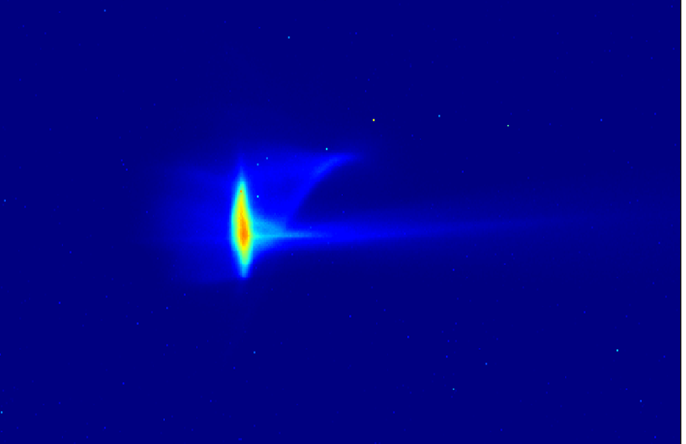
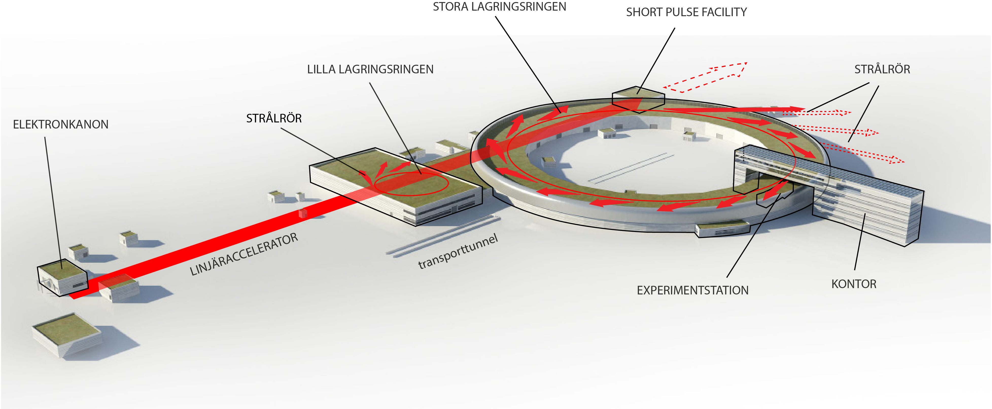
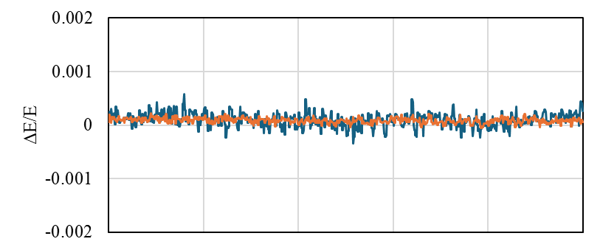
Conclusion - MAX IV linac
Short bunches
Multi-purpose accelerator
Magnetic linearization
High energy stability

Slide 23
Additional slides

Slide 24
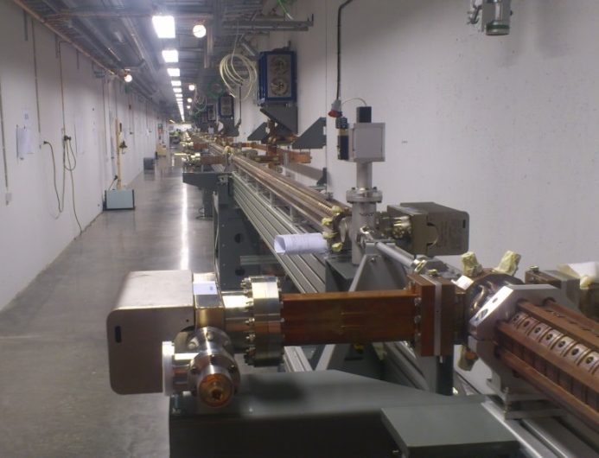
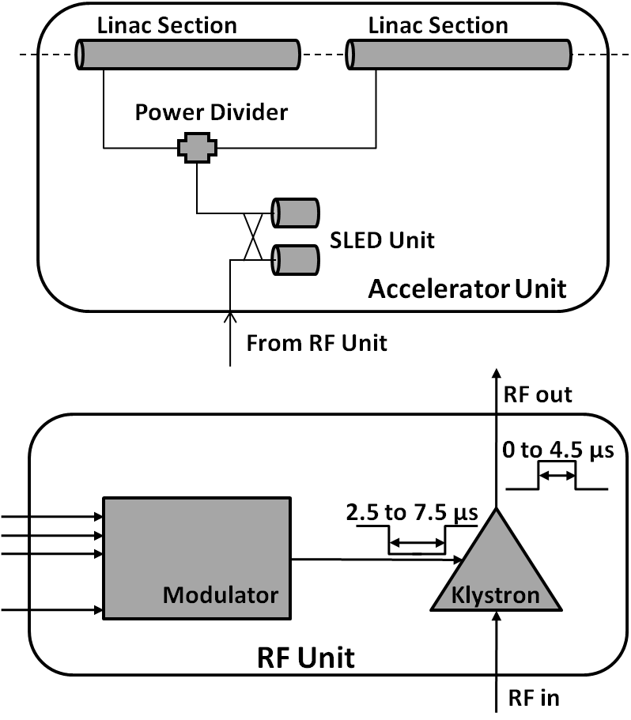
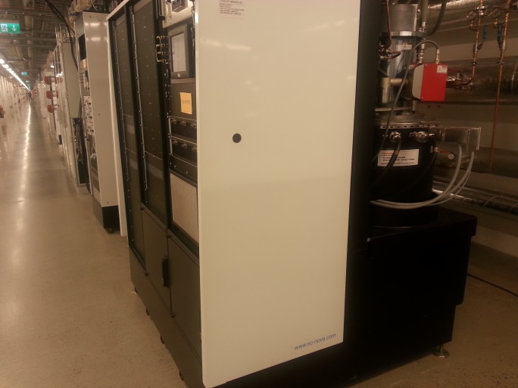
MAX IV linac
39 warm s-band linac structures + SLED
18 units
3 GHz
5.3 m/linac
20 MV/m gradient
3 + 0.6 GeV
18 modulators + klystrons
37 MW peak power
4.5 ms
100 Hz
Thermionic gun: 8 MW 10 Hz RF unit
Notes:
Sits in two different tunnels

Slide 25
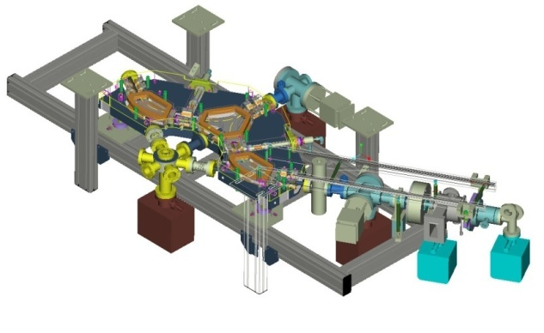
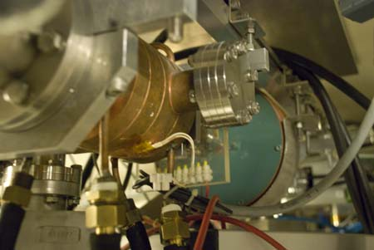
Thermionic gun
Design parameters of the MAX IV thermionic pre-injector
Beam kinetic energy | 2–2.5 MeV
Bunch frequency before chopper, f_{gun} | 2.9985 GHz
Bunch train frequency, f_{ring} | 99.931±0.5 MHz
Number of bunches per bunch train | 3
Number of bunch trains per LINAC shot | 1 or 10
LINAC shot repetition frequency | 10 Hz
Total injected charge per top-up injection | 9.0 nC
RF gun
BaO cathode
Exported to SOLARIS and Canadian light source
270 degree energy filter
In operation at MAX-lab

Slide 26
Thermionic gun
Design parameters of the MAX IV thermionic pre-injector
Beam kinetic energy | 2–2.5 MeV
Bunch frequency before chopper, f_{gun} | 2.9985 GHz
Bunch train frequency, f_{ring} | 99.931±0.5 MHz
Number of bunches per bunch train | 3
Number of bunch trains per LINAC shot | 1 or 10
LINAC shot repetition frequency | 10 Hz
Total injected charge per top-up injection | 9.0 nC
RF gun
BaO cathode
Exported to SOLARIS and Canadian light source
270 degree energy filter
In operation at MAX-lab
+ Chopper system*
10 Hz
100 MHz
3 GHz
Up to 10 micro bunches
* D. Olsson et al, A chopper system for the MAX IV thermionic pre-injector, Nuclear Instruments and Methods in Physics Research, Volume 759, 21 September 2014, Pages 29–35

Slide 27
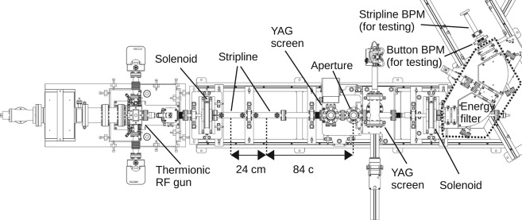
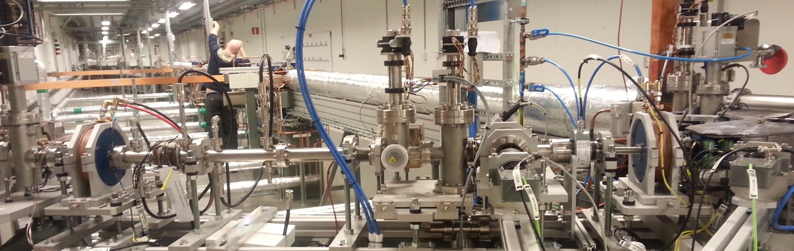
Thermionic gun + chopper
Aperture
Energy
filtering
500 MHz
Strip line

Slide 28
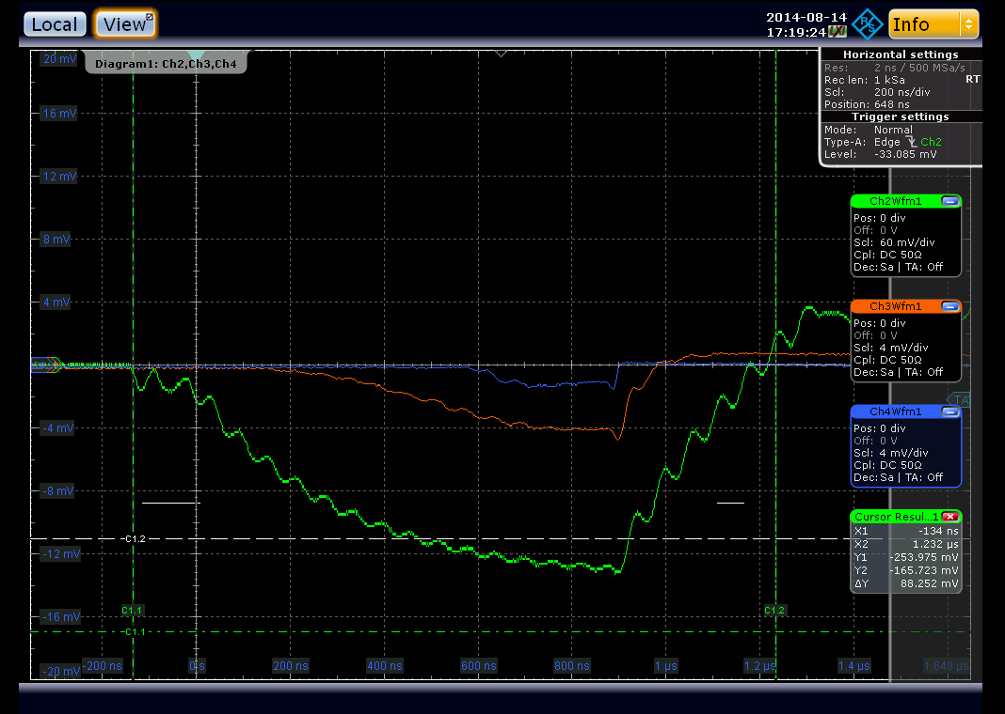
Thermionic gun commissioning
Aperture
Energy
filtering
500 MHz
Strip line
Commissioning parameters
Charge | 0.75 nC/shot
Rep rate | 2 Hz
Chopper f | 500 MHz

Slide 29
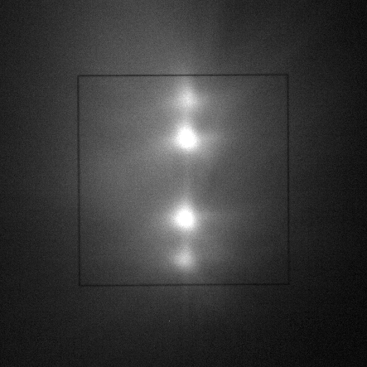
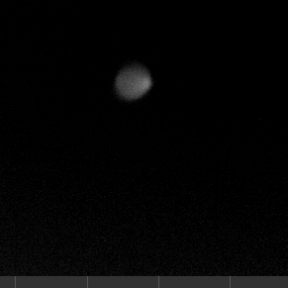
Thermionic gun commissioning
No aperture
With aperture
Aperture
Energy
filtering
500 MHz
Strip line

Slide 30
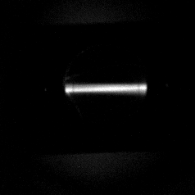
Thermionic gun commissioning
No aperture
With aperture
Aperture
Energy
filtering
500 MHz
Strip line

Slide 31
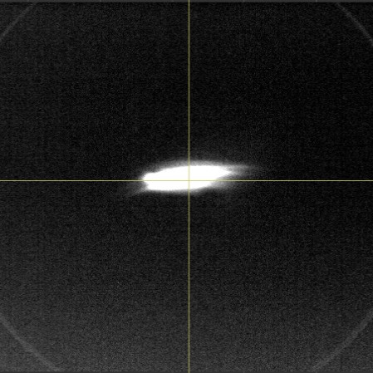
Thermionic gun commissioning
No aperture
With aperture
Aperture
Energy
filtering
500 MHz
Strip line

Slide 32
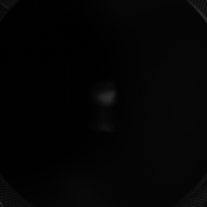
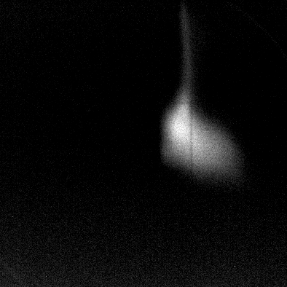
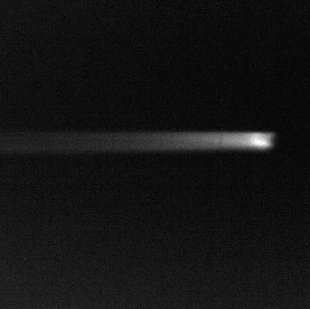
Commissioning
Thermionic RF gun
BC1 (@260 MeV)
L0
L1A
L1B
Photo cathode RF gun
Maximum dispersion
Beam energy
280 MeV

