Slide 1
The Statemachine
Full energy linacs workshop
Filip Persson, Asst. Head of Operations

Slide 2
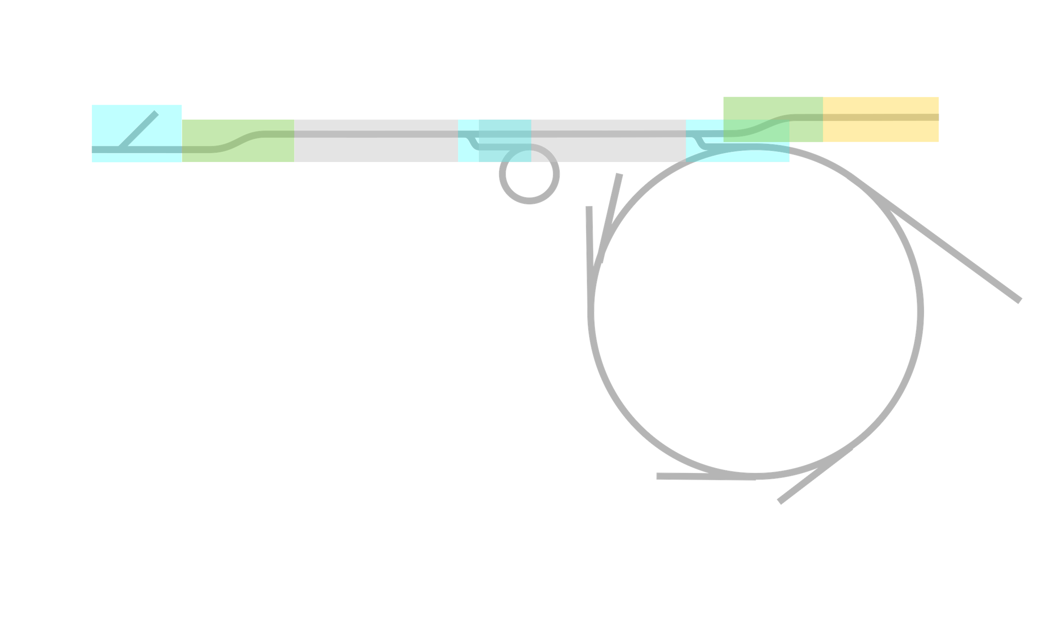
Overview
Thermionic gun
BC 2
SPF
Photo gun
BC 1
R1
Topup every 10 minutes
R3
Filip persson, operations

Slide 3
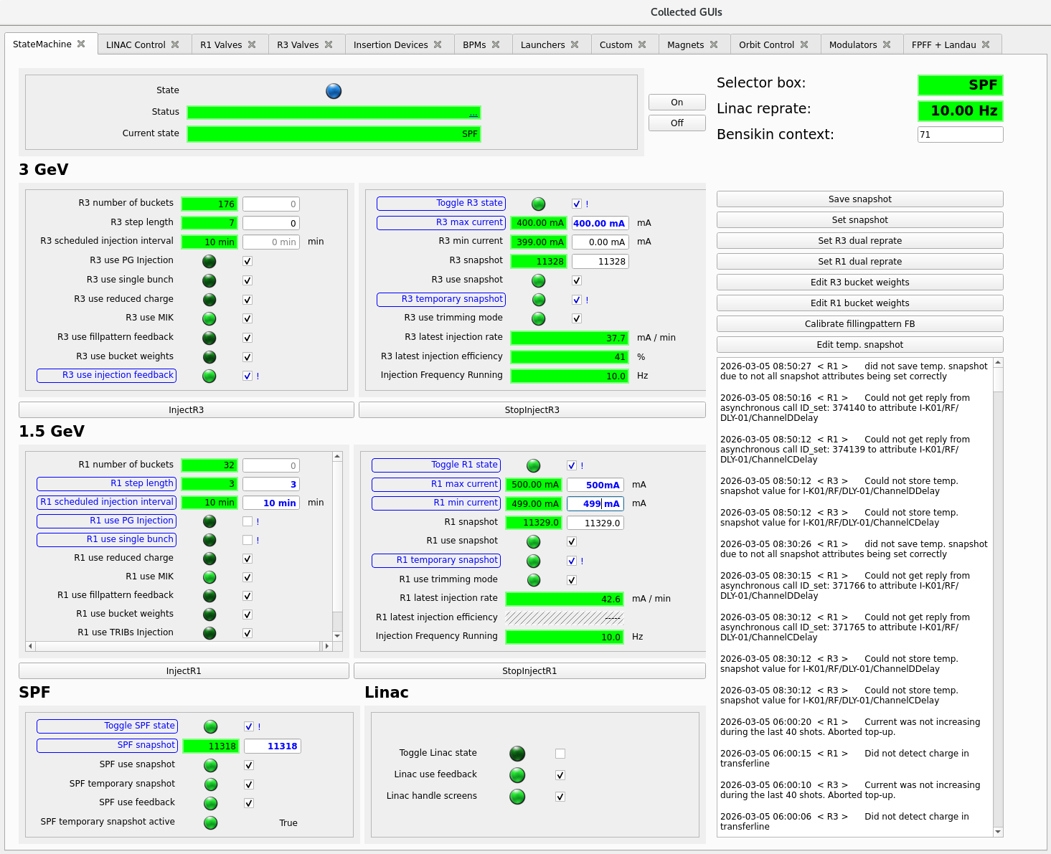
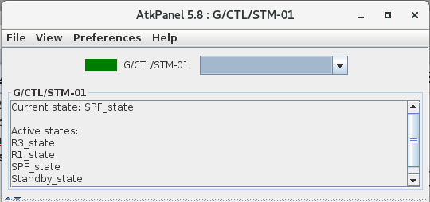
Two layers
Started by Johan Sjögren (former operator),
Current framework developed by Andreas Johansson (former operator)
Statemachine Widget (Taurus based GUI)
Statemachine Tango device
Filip persson, operations

Slide 4
States
The state loop is the brain of the Tango device server.
It checks at each tick (500 ms) if current state should be exited and a new state entered.
Active user?
(requested ring injection/stop injection)
A two loop hierarchy
Active state? (topup)
Each state has rules on how to enter the state
Filip persson, operations

Slide 5
States
5 states with the following hierarchy (looped in order)
3 GeV ring injection
1.5 GeV ring injection
SPF delivery
Linac trimming
Standby
Conditions
Scheduled injection = true, and
Clock exceeds time of injection, and
Current below min limit, and
IDs within allowed limits
Example:
R3 topup activated
OR
Scheduled injection = false, and
Current below min limit, and
IDs within allowed limits
Filip persson, operations

Slide 6
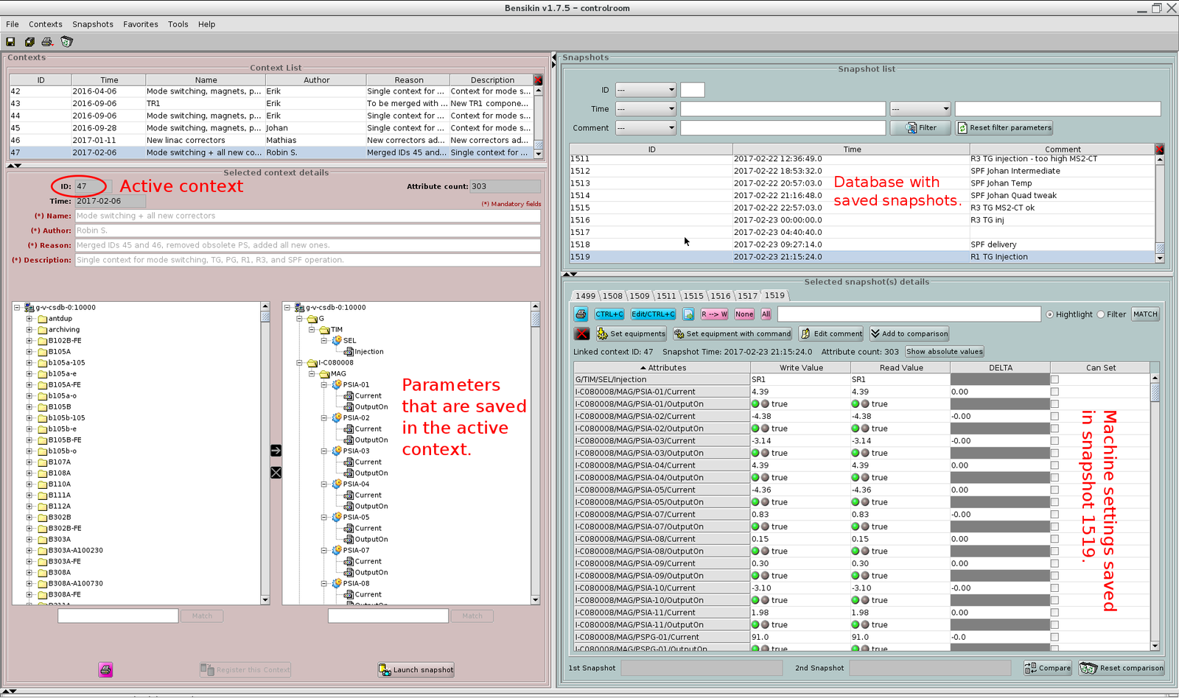
Bensikin software
Software handling linac settings
We’re using the underlying tango snapshot handler to load or save snapshots
filip persson, operations

Slide 7
The injection loop
Starting python thread running at injection frequency
Reads ring current
Evaluates exit conditions (e.g. goal current reached)
Change targeted ring bucket by changing timestamp in the ring event generator using formula or filling pattern feedback
Timestamp for the triggering of the injection kicker is changed by same amount to keep fixed offset
Evaluates additional exit conditions
Additional exit conditions:
topup_max_failed_shots (40) is reached (no ring capture)
topup_max_duration is reached
filip persson, operations

Slide 8
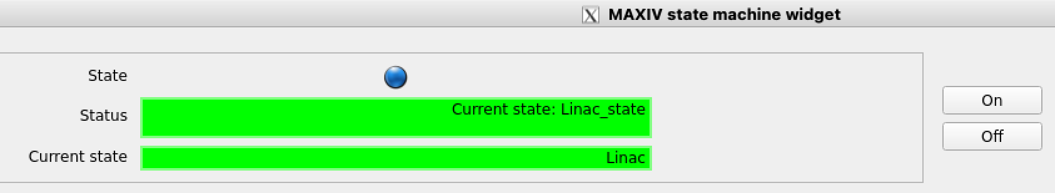
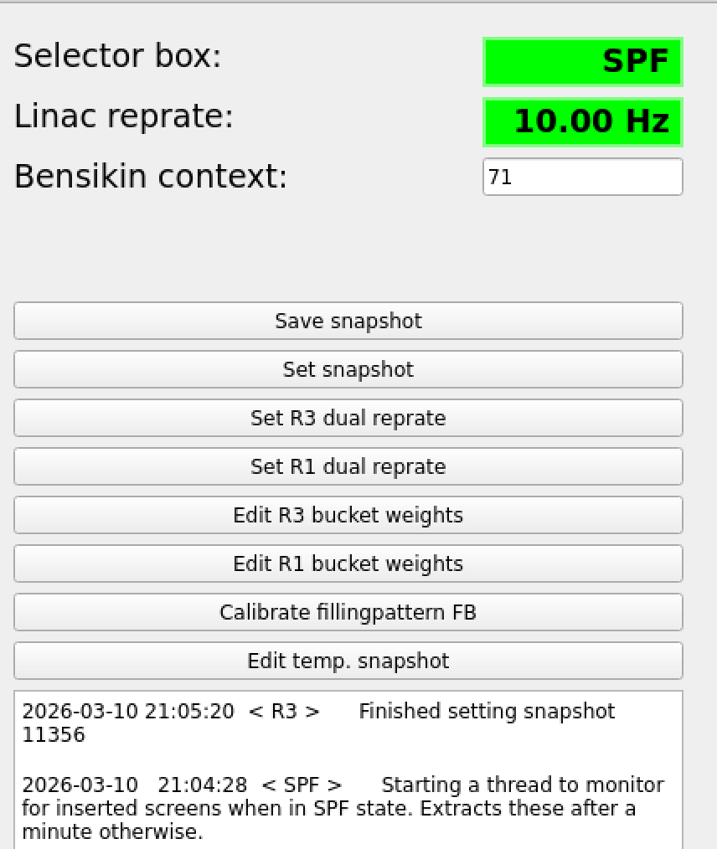
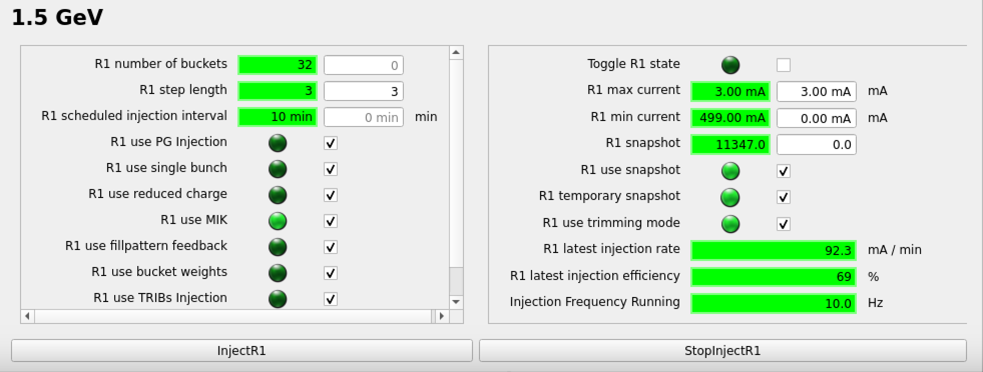
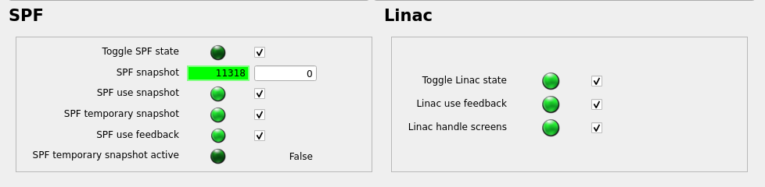
Statemachine control
filip persson, operations

Slide 9
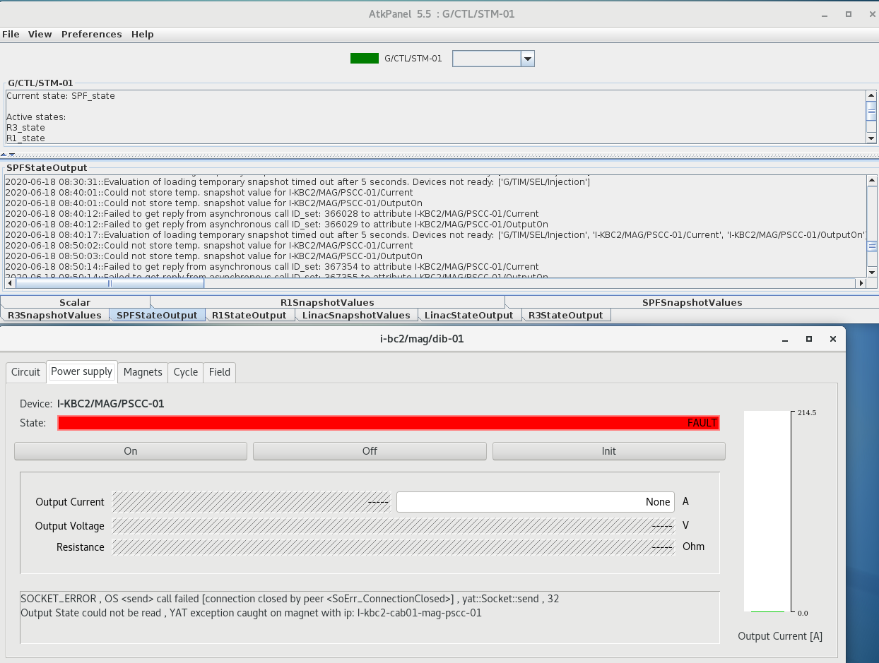
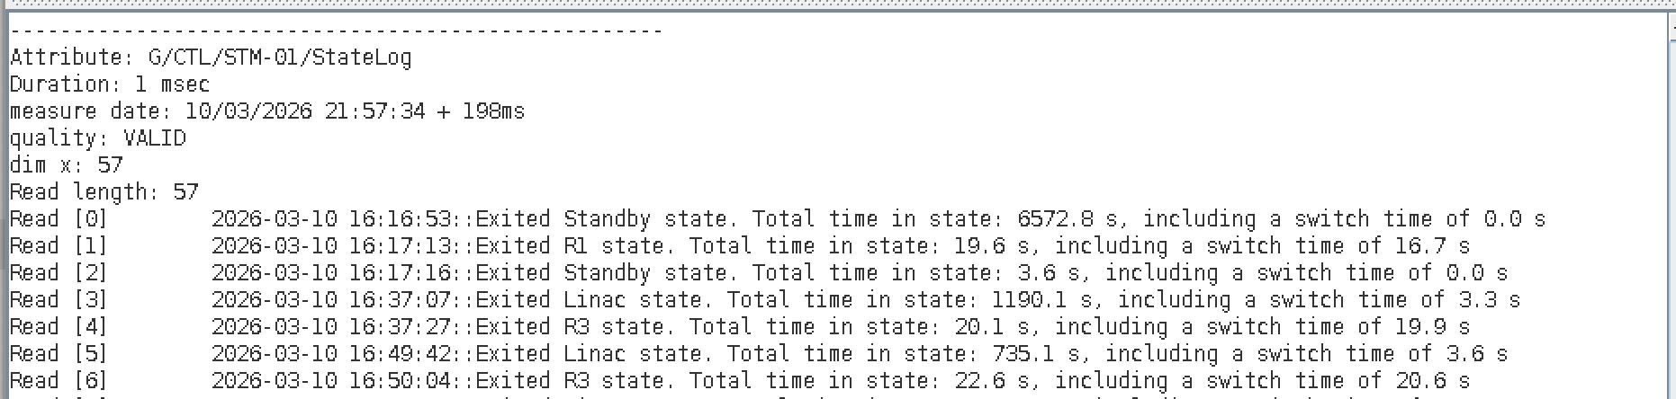
State log output
Logging important output or error messages
filip persson, operations

Slide 10
Alarm state
Often due to failing equipment or communication issues with the equipment
Fail to set snapshot (linac settings)
Fail to enable injection trigger
Fail to control current of horizontal corrector used for deflecting thermionic electrons
Fail to open/close laser shutter controlling photo gun electrons
Failing state transition or ending up in mixed state
filip persson, operations

Slide 11
Special modes of operation
Photo gun injection
Single bunch injection
Timing and DC chopper values set)
Reduced charge mode
Used if a very uniform filling pattern is desired.
Vertical corrector after the gun is used to only let through 1/4 of the charge
Filling pattern control
A vector of bucket weights (0 or 1) is set and the Statemachine only loops through allowed buckets. Best used together with single bunch injection.
filip persson, operations

Slide 12
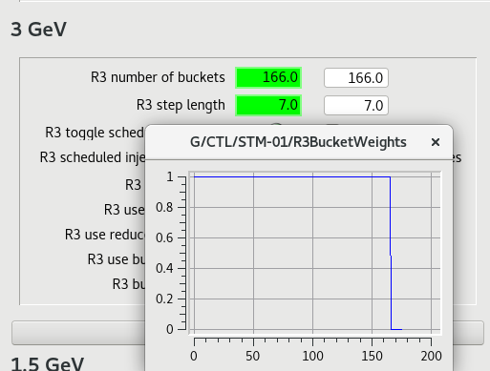
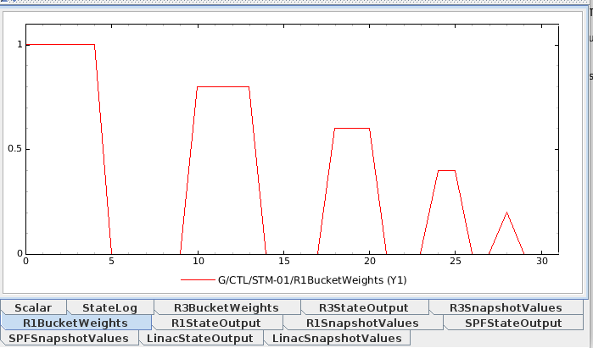
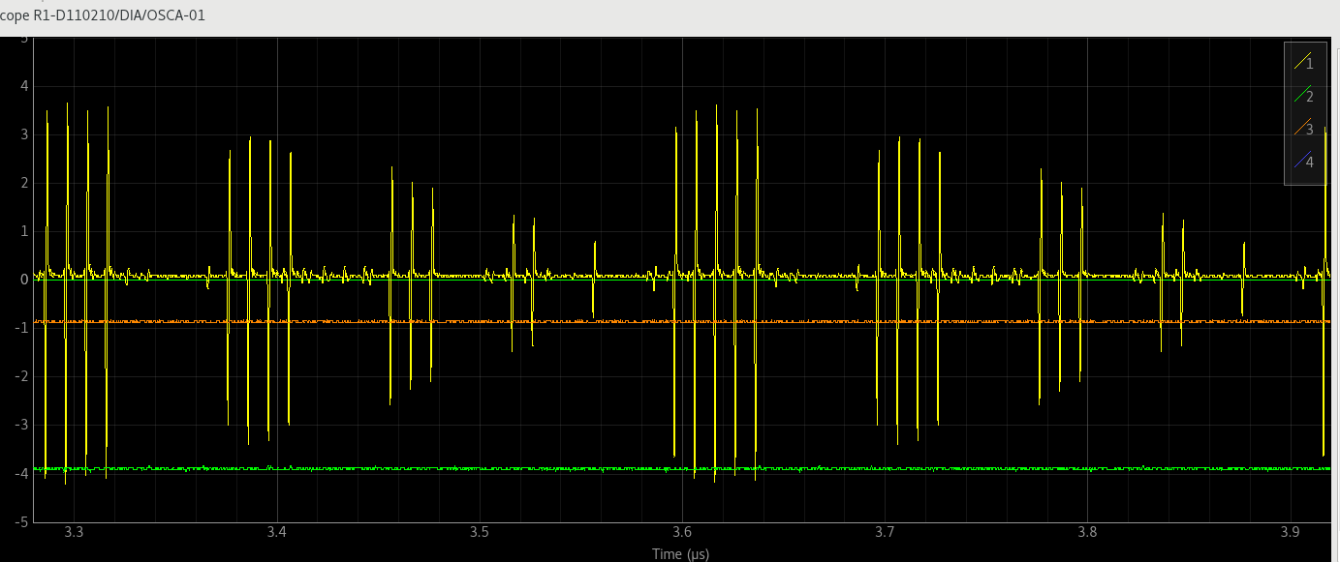
Filling pattern feedback
Effect on bucket weights
Bucket weight attribute
Filling pattern example
filip persson, operations

Slide 13
Questions?

