Slide 1
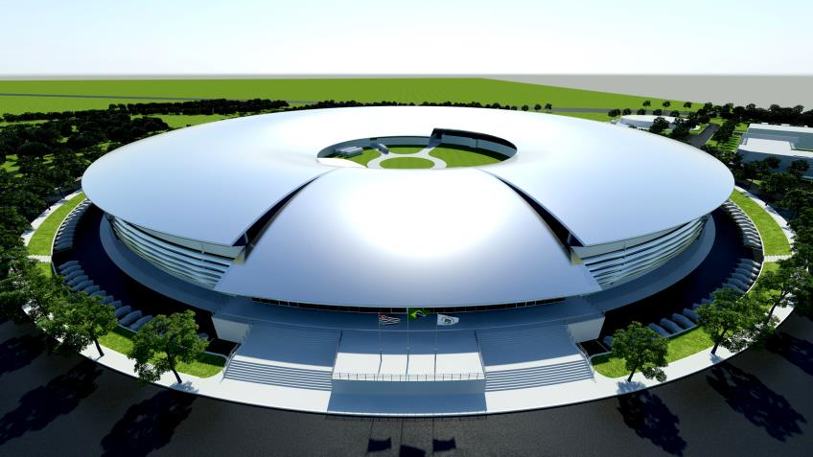
Studies on filling pattern optimization and passive harmonic cavities
Natalia Milas
Workshop on Timing Modes for Low-emittance Storage Rings
March 25th to 27th, 2015

Slide 2
Summary
Why do we use tailored filling patterns?
Elements needed
  Harmonic cavities
  Filling pattern control
  FEMTO beamline and timing experiments
  Simulation tools
Experience in SLS: filling pattern and lifetime optimization
What to expect from other machines?
  Sirius vs. Max IV: difficulties
Closing remarks.

Slide 3
Tailored filling patterns
User’s requests:
  Slicing, Time-of-flight, pump & probe experiments and etc..
Reduce instabilities
Optimize the bunch lengthening when using a combination of passive 3HC + gaps and
Special modes for machine studies.

Slide 4
Elements needed
Harmonic Cavities (3HC)
Filling pattern control
Harmonic cavities:
  SLS, Elettra – SC
  ALS, Max II and Bessy – copper
Same problems regarding transients (R/Q)
Easy of use (?)
Most top-up machines have.
Either a single-bunch or a small train of bunches.
Better control of instabilities and also easier to measure machine quantities (lifetime, bunch length, etc..)

Slide 5
Simulation tools
Diagnostics (verification)
Tracking:
  Mbtrack (multiparticle + multibunch)
  Macroparticle + multibunch calculation [J. M. Byrd, et.al. Phys. Rev. ST - AB, 5(092001), June 2002.]
  Others (?)
IBS calculations (choose a model). I use CIMP, fast and easy to implement. Tests in SLS together with CERN show it is a good model for IBS in electron machines.
Lifetime calculation
  Take into account momentum aperture around the machine
  Working on more realist calculations of elastic scattering for Sirius. (physical + momentum aperture)
  Touscheck (check approximations!)
Streak Camera is a need (or anything that can measure bunch-by-bunch length)
Emittance monitor:
  For Sirius and MAX IV (nad all the new machines to come) this is a more sensitive issue since the emittance is very small
  Account for IBS effects.

Slide 6
Simulation tool used: Macro-bunches + beam-loading
Pros
Cons
Fast calculation. Can handle SC cavities (which requires and awful lots of turns to reach steady state);
Relatively simple to program (anyone can make their own code) and
Easy to merge with other codes and even implements something more challenging (ex: make one bunch multiparticle, etc…)
Doesn’t take into account all the details of the bunch shape when calculating the induced fields into the cavities and
Cannot calculate situation with more than one fixed point (over-stretched case for a 3HC for example)

Slide 7
Experience in SLS: filling pattern and lifetime optimization
Context:
  FEMTO used 1 camshaft but wanted to upgrade the laser frequency ➔ need between 3 and 5 camshafts;
  Problems with lifetime (due to the top-up mode). Lifetime < 5 hours was not acceptable and
  Problems with the camshaft shape ➔ the shorter the better!

Slide 8
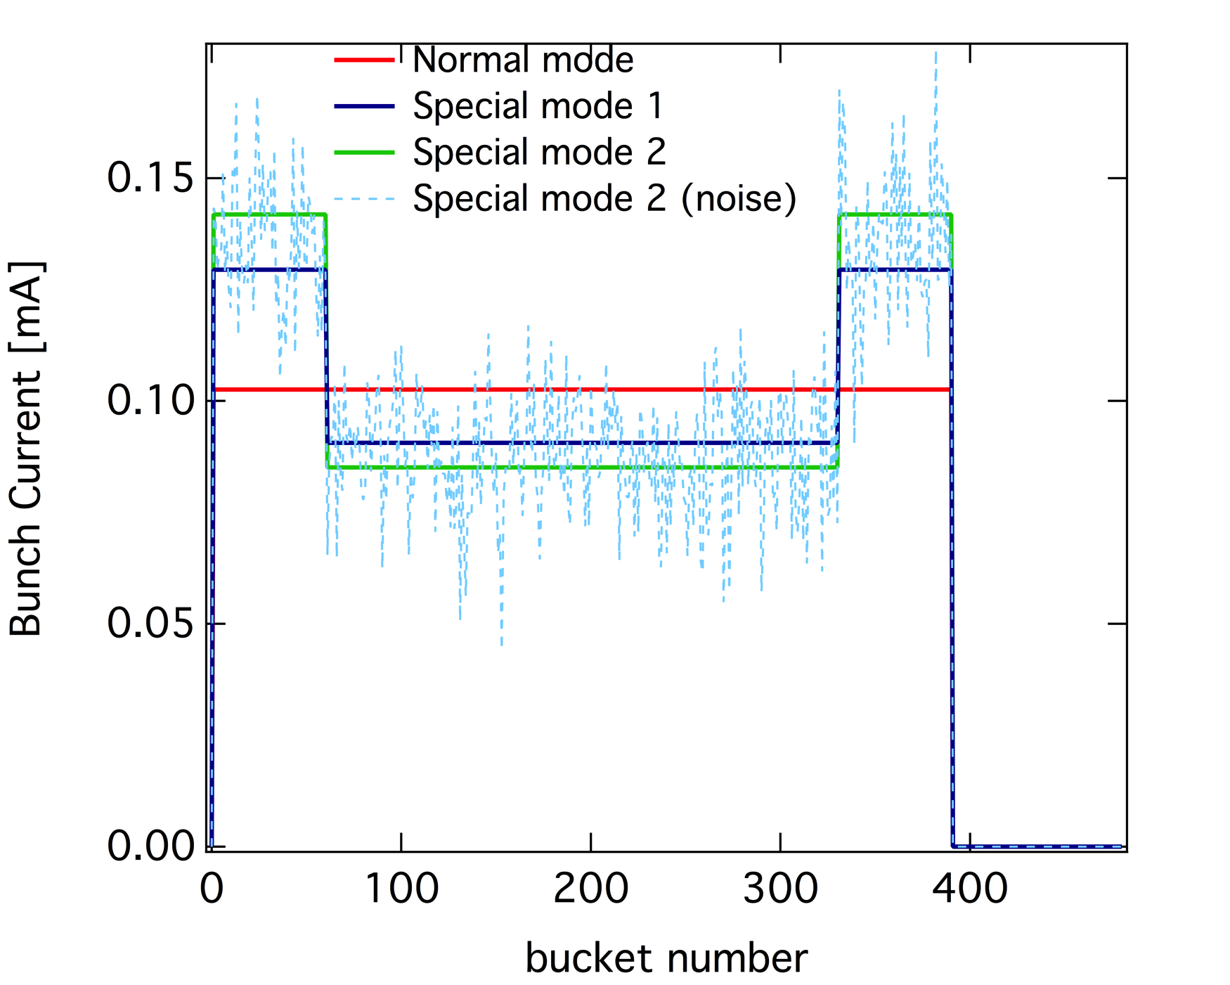
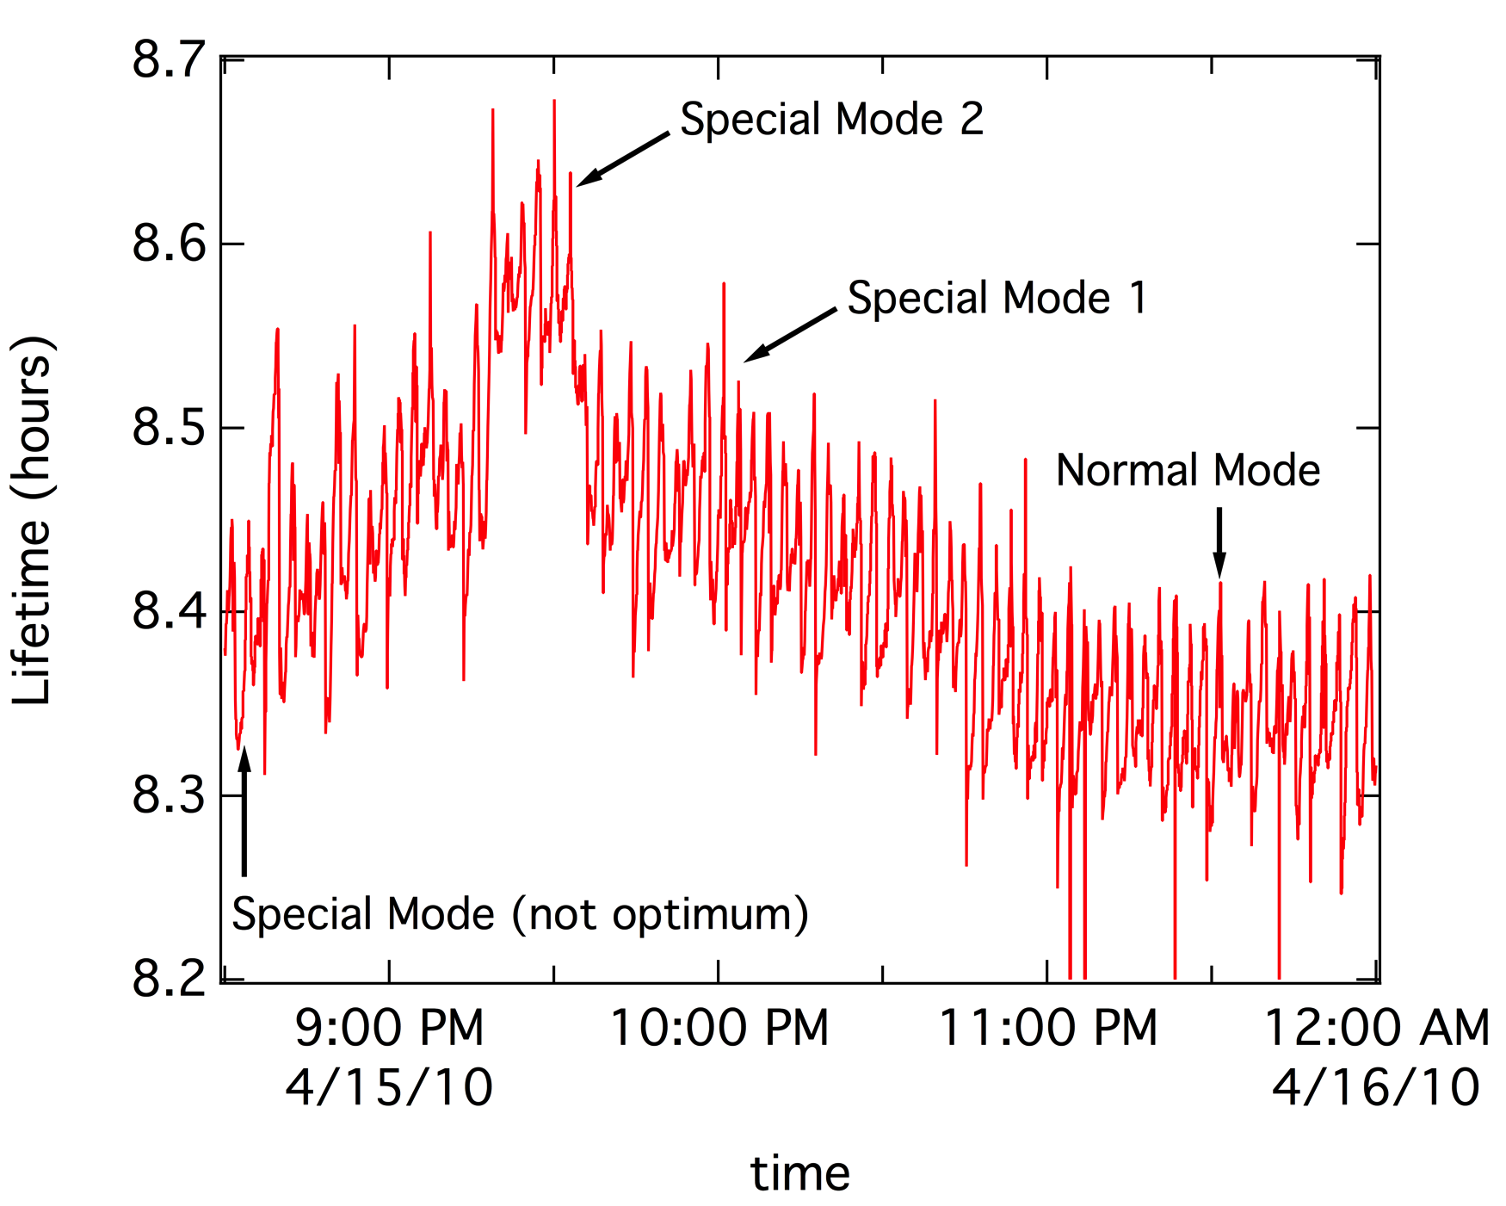
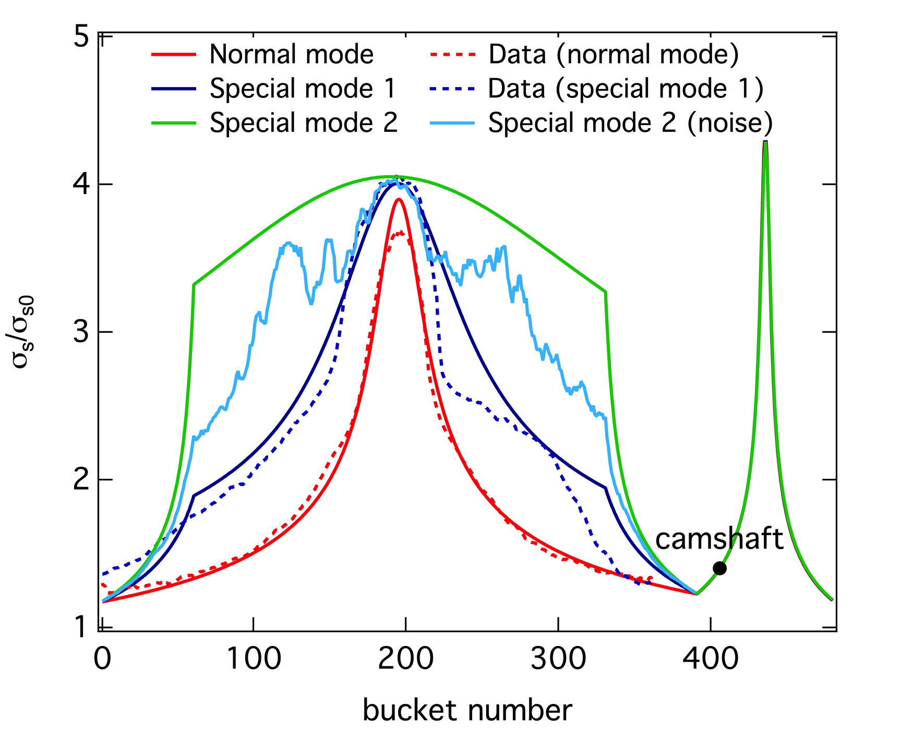
Lifetime optimization during regular user’s shifts
Mode | <σ/σ₀> data simulation |  | Lifetime @ 400 mA [hour] data simulation
Normal | 1.9 ± 0.1 | 1.8 | 8.3 ± 0.1 | 6.6
Mode 1 | 2.2 ± 0.1 | 2.4 | 8.5 ± 0.1 | 6.8
Mode 2 | - | 3.1 | 8.6 ± 0.1 | 7.4
Mode 2 (noise) | - | 2.7 | 8.6 ± 0.1 | 7.2

Slide 9
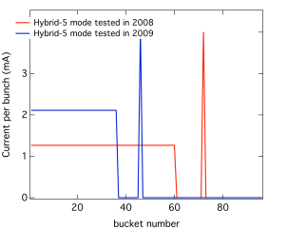
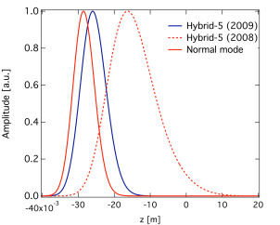
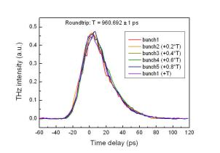
Filling pattern and lifetime optimization for FEMTO – Hybrid 5
Simulation:
Beamline measurement:
Mode | σ [ps] data simulation
Normal | 35 ± 1 | 37
2008 | 110 ± 2 | 80
2009 | 33 ± 1 | 42
Streak-camera data:

Slide 10
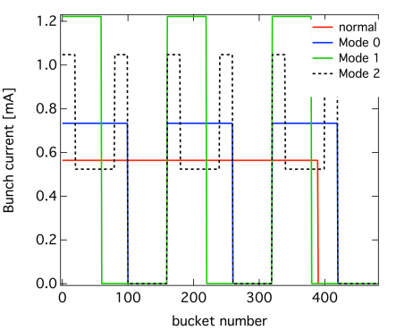
Filling pattern and lifetime optimization for FEMTO – Hybrid 3
Mode | <σ> [ps] data simulation |  | Lifetime[hour] data simulation
Normal | 37 ± 1 | 35.3 | 6 ± 0.5 | 7.6
Mode 0 | 40 ± 1 | 40 | 5 ± 0.5 | 5.1
Mode 1 | 42 ± 1 | 34 | 3.4 ± 0.5 | 3.3
Mode 2 | 41 ± 1 | 45 | 5 ± 0.5 | 5.4

Slide 11
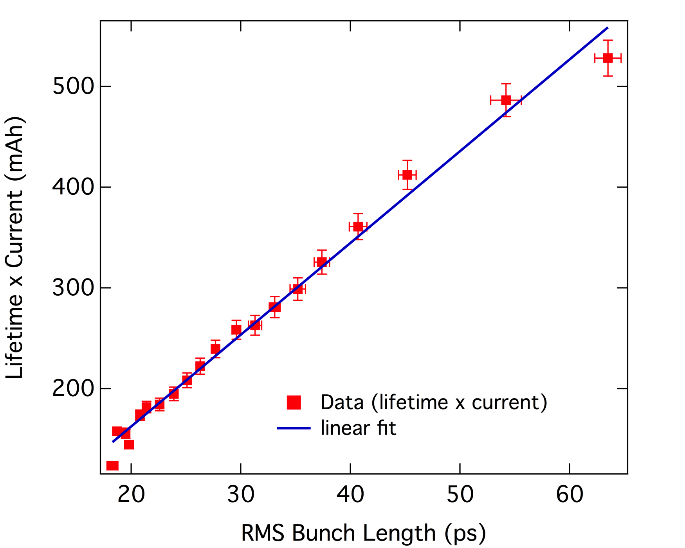
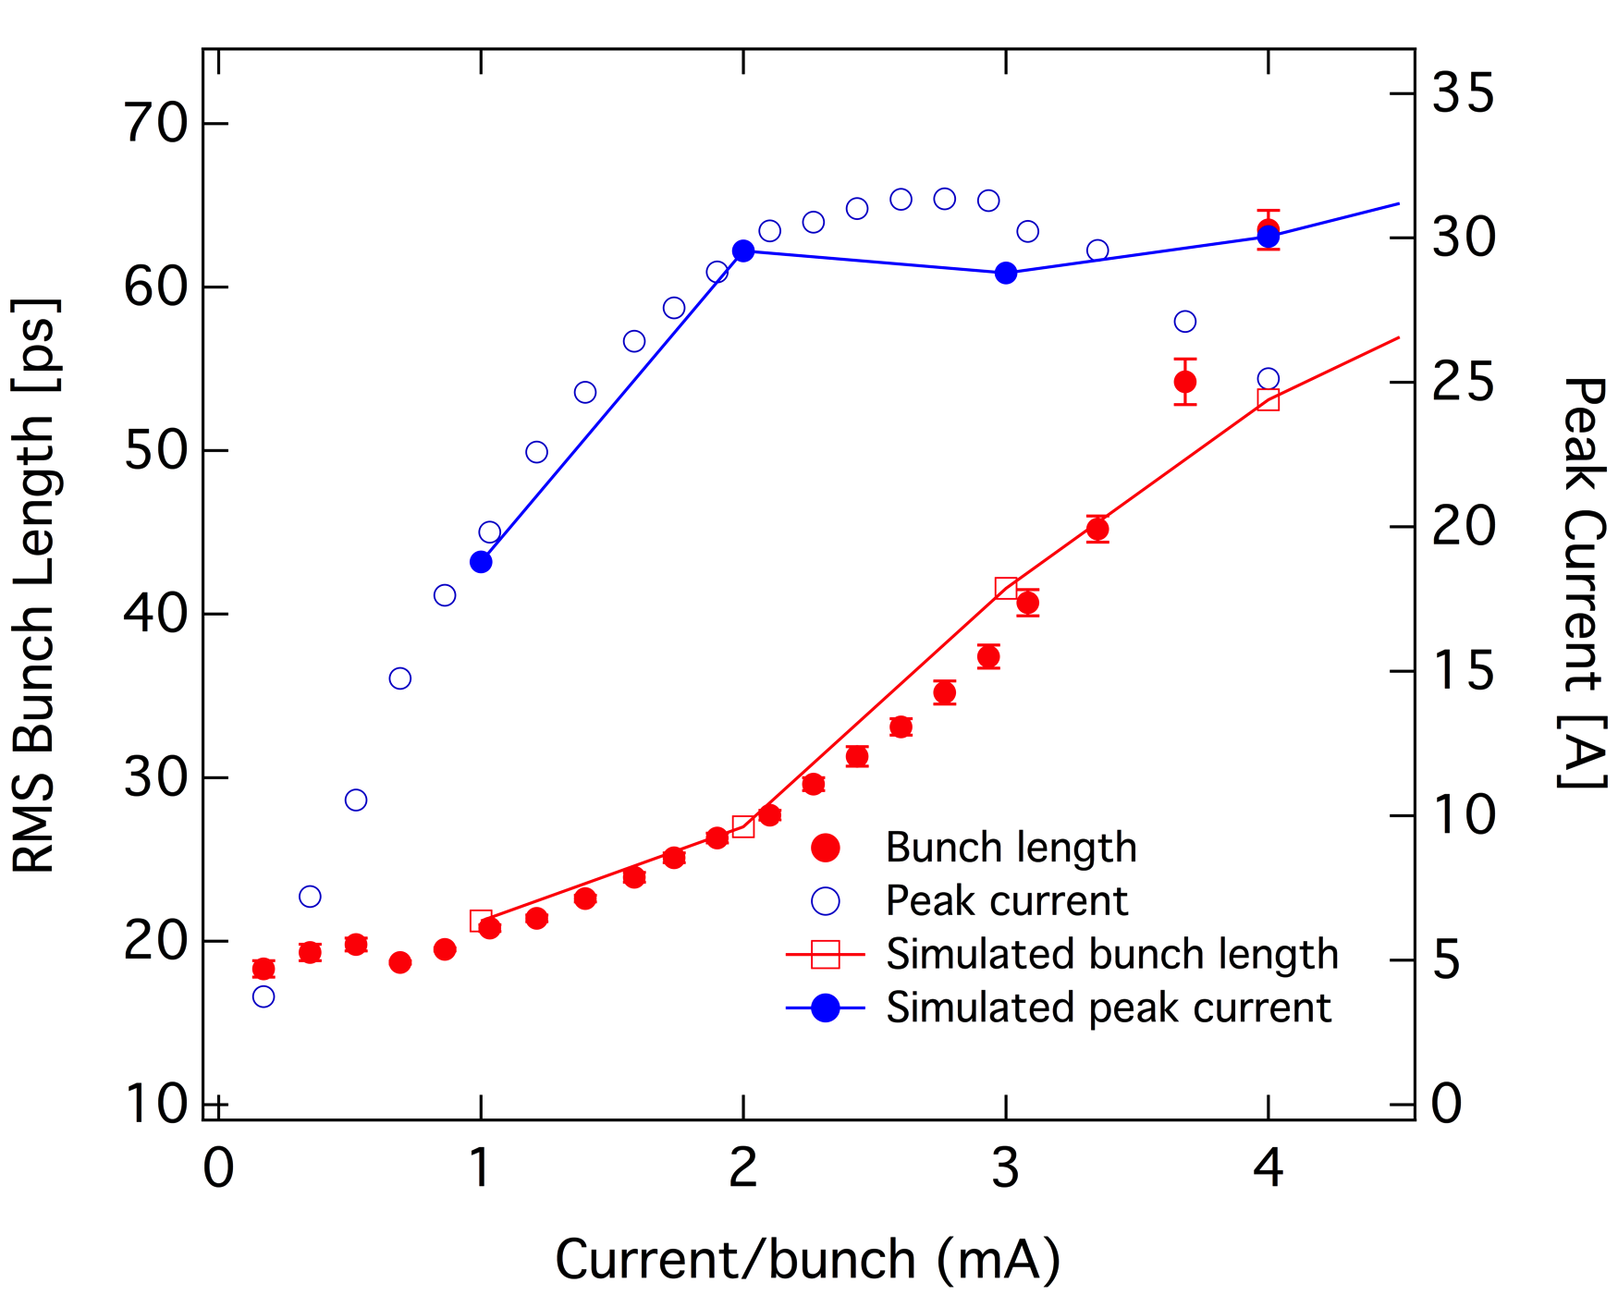
Special mode: COMB
60 single bunches, spaced by 7 empty buckets

Slide 12
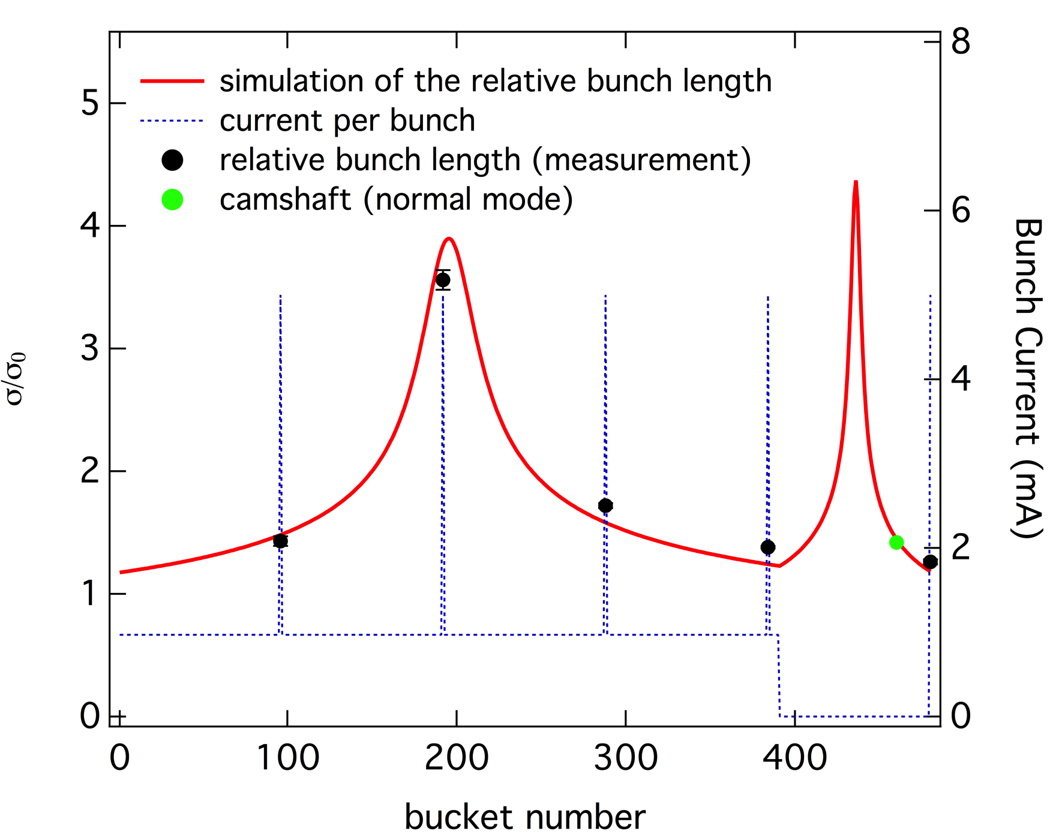
Special mode: test of Bessy2 type filling mode

Slide 13
What to expect from other machines?
MAX IV
Sirius
Cooper cavities (accelerating + 3HC) makes simulation time shorter.
Very long bunches (100 MHz) makes the bunch shape important in accounting for beam loading
Perfect place to cross check semi analytical and multiparticle simulation with reality!
Cavities are an open issue still (copper or SC?). 3HC will be SC.
Short bunches (~ 40 ps max.)
Will have users interested in timing experiments so it is important to know how to check for impacts of gaps in filling patterns

Slide 14
Some (preliminary) results from Sirius
Code used for Sirius includes:
  Tracking of the filling pattern (free of choice) that gives as output ➔ induced voltage in the 3HC, voltage in the main accelerating cavity and phases for both cavities;
  Uses those values to calculate bunch shape (analytical expression)
  Uses the result for the bunch length + other parameters of the machine ➔ semi-analytical calculation of IBS effect for each bunch and
  Finally use all the result to estimate lifetime bunch-by-bunch and average lifetime.

Slide 15
Uniform vs Hybrid modes
Now
Future (?)
Users needs:
  Pump-probe experiments;
  Dynamics of the order (or greater than) 100 ps FWHM, so that even with the 3HC and bunches of 40 ps it is possible to perform the experiments;
  Total current in a camshaft = 2 mA (set by calculations of instability thresholds);
  Trigger type ➔ track-and-hold (no integration required) ➔no need for very long gaps;
  Rep rate between 0.6 and 2.4 MHz.
So far it seams that we can provide up to 4 camshafts in a special fill without a terrible compromise in total lifetime (next slide).
Slicing or more challenging pump-probe will require a longer gap with a camshaft in the middle.
This setup can badly hurt the machine operation in full current mode. Possible solution:
  Single-bunch filling mode or
  Operating for a period of time at lower currents (not sure since we will have a passive 3HC)
  Fast kicks or resonant pulse-picking (???)
Still discussing with beamline scientists which kind of timing experiments they might want in the long term and what other requests we could expect. WE need to think about solutions now!

Slide 16
Results
Mode | <σ> [ps] | Lifetime[hour] @ 500 mA
Uniform | 45.3 | 9.3
20 ns + 1 SB | 46.2 | 9.4
50 ns + 1 SB | 43.2 | 9.0
50 ns + 2 SB | 43.5 | 8.9
50 ns + 4 SB | 43.7 | 8.6
* σ₀ = 43 ps (with 3HC) and 9.7 ps (without 3 HC) at zero current.
** Lifetime at 500 mA with machine fully loaded with IDs.

Slide 17
Closing remarks
Comparison simulation and data (for SLS) is good.
Does the code work?
  Benchmark: vital (for any code).
  More experiments: absolutely necessary!
  Make the code more robust and generic ➔ next natural step.
Better understanding of the effects of 3HC (or any nHC) on beam dynamics is important for the next generation of machines.
Timing experiments are still very interesting for users (maybe we cannot yet delegate it all to free electron lasers).

Slide 18
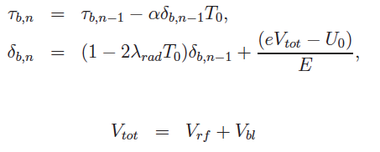

( Simulation idea )
dynamics of the macro-particles
and
field build-up in one cavity
with
generator
beam loading in all cavities

