Slide 1
MAX IV Technical Division
Introduction and Context

Slide 2
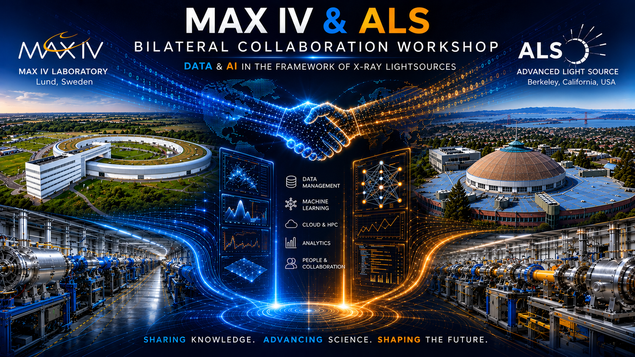
Notes:
Welcome, great to see you here and looking forward to exchanging knowledge and experiences on a technical level

Slide 3
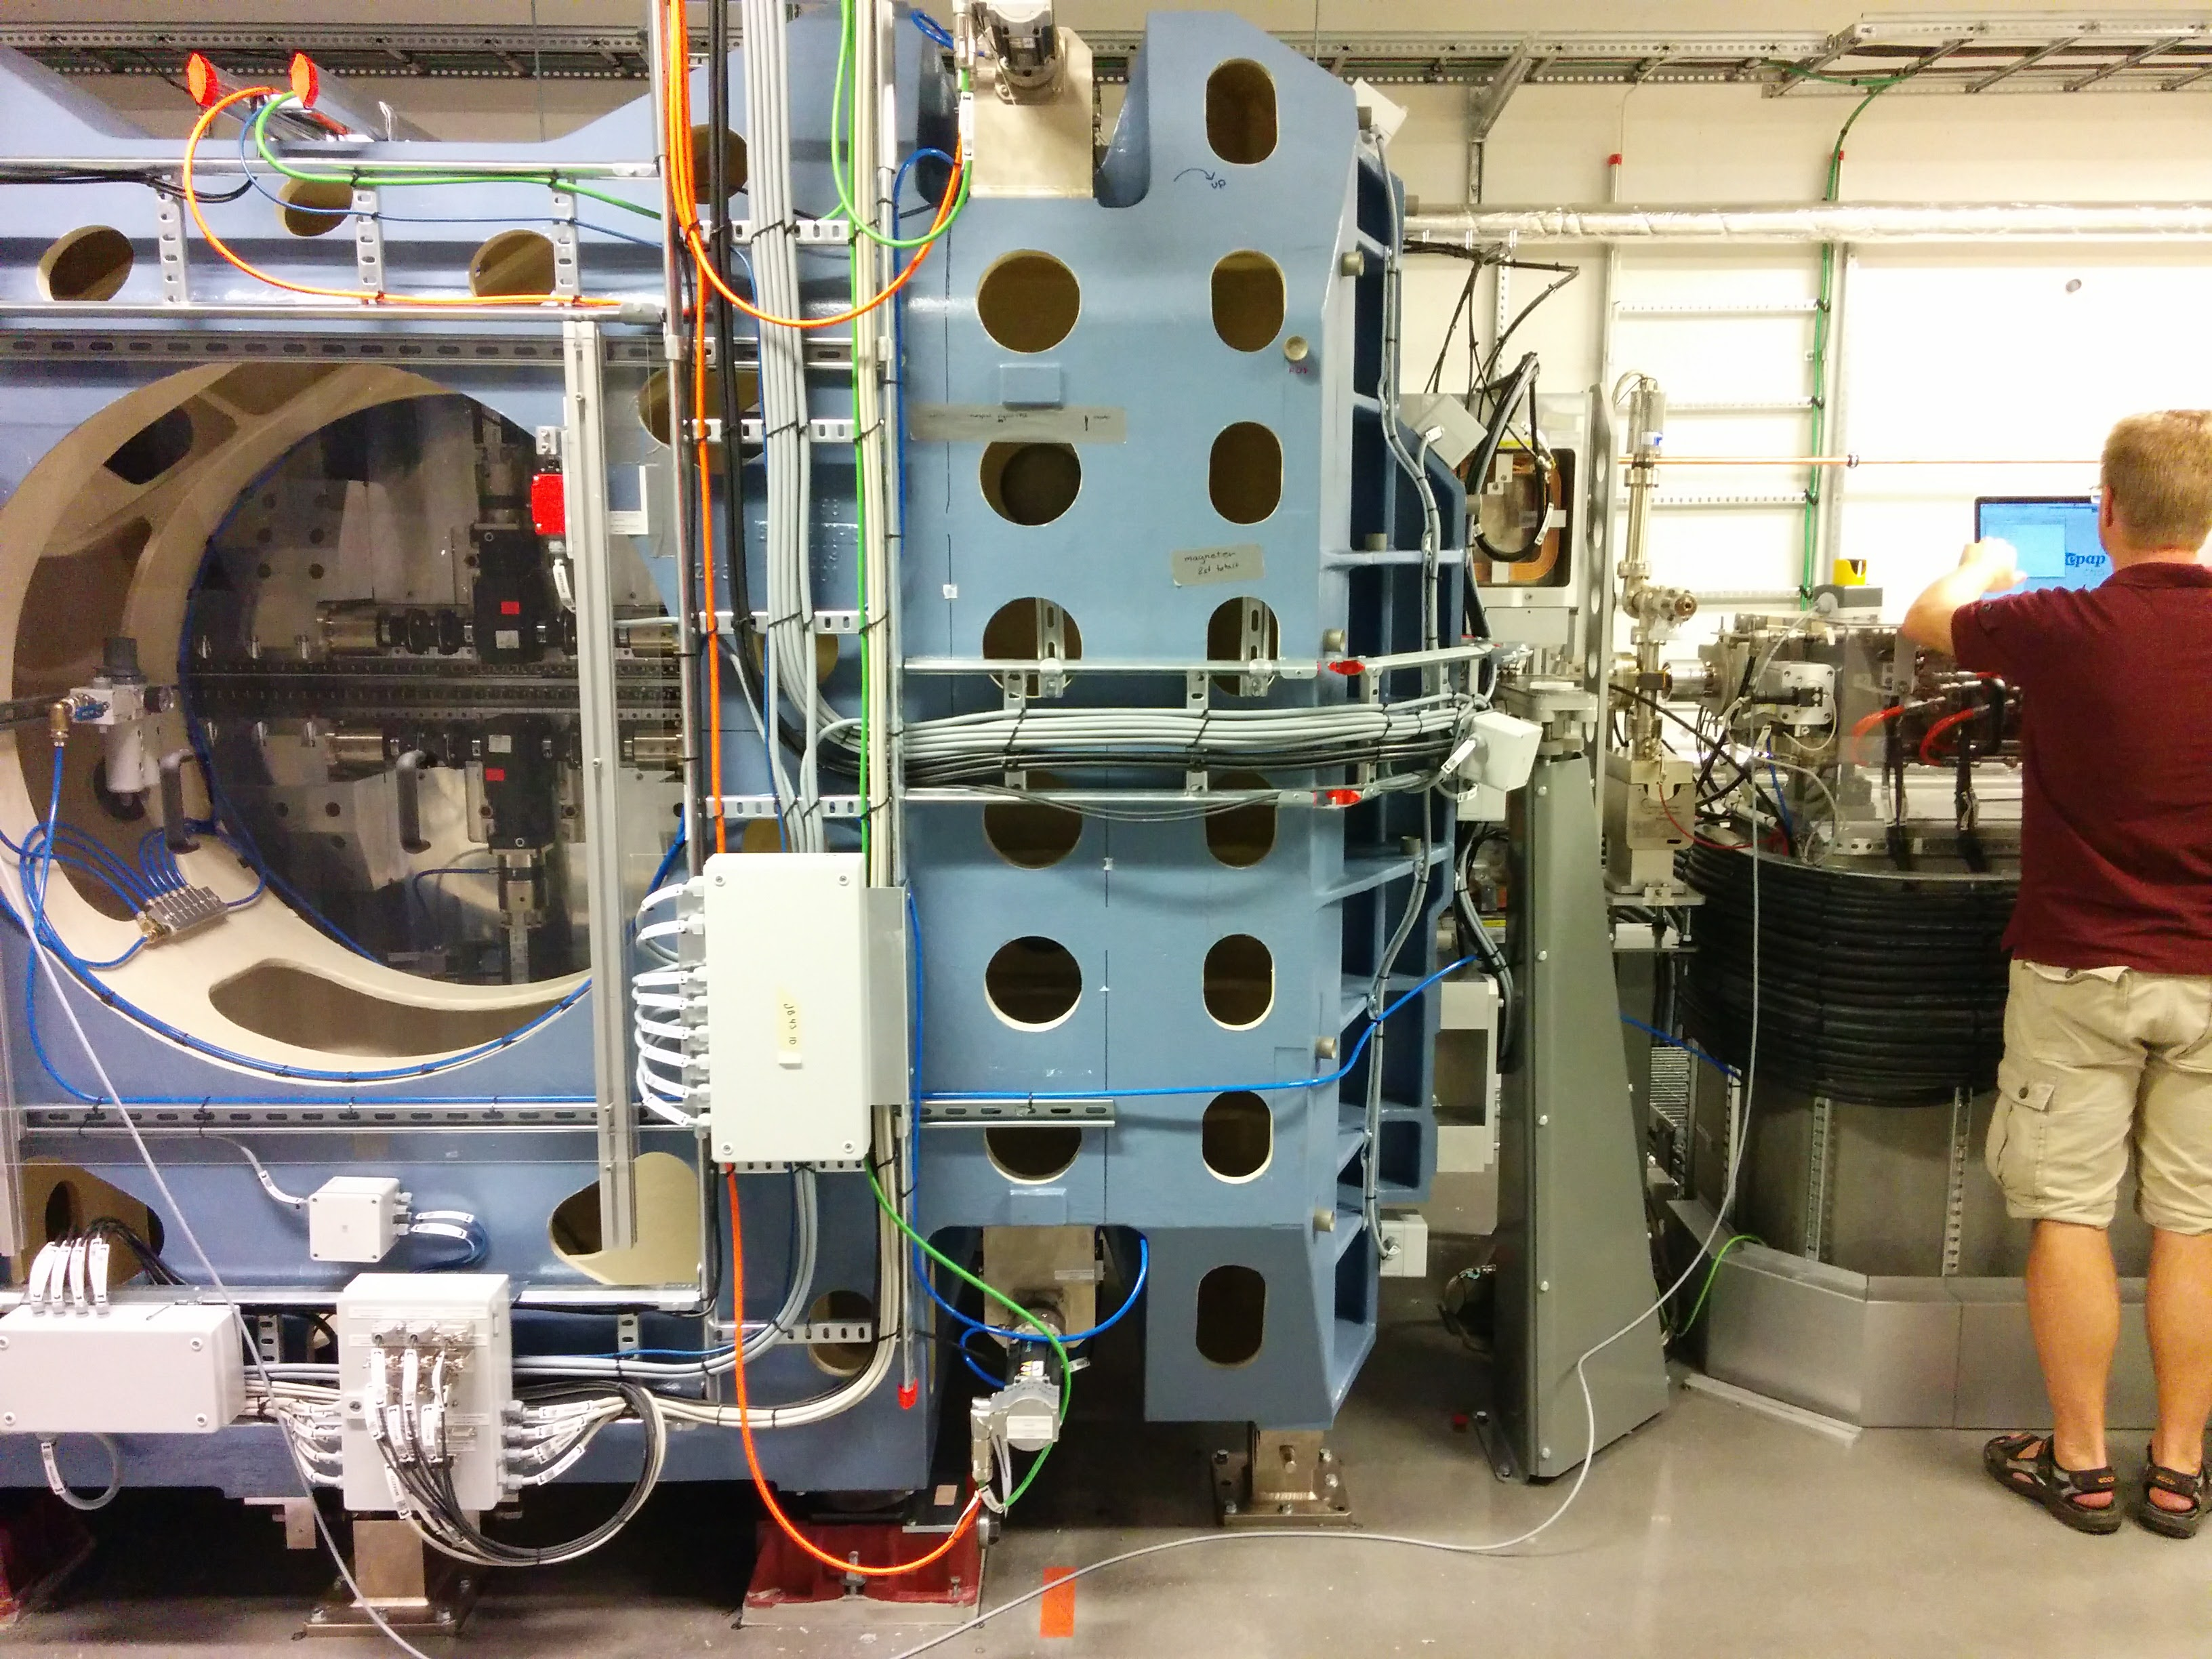
How it is going – 10 years in operation as a 4th generation lightsource
✅ Accelerator performance
✅ Beamline capability
✅ Controls and DAQ infrastructure
✅ Reliable facility operation
Notes:
As a the first 4th gen synchrotron -
We have built our beamline control systems for the experiments of a 4th gen synchrotron without having a real blueprint and we think we have been reasonably successful.
The technical foundations we have built
Controls (Tango)
DAQ and detector infrastructure
Data services and scientific computing
KITOS and operational support
What we think we do well
Continuous and multimodal experiments
Hardware orchestration and DAQ
Operational maturity
Cross-domain technical competence
My colleagues will be presenting this in more detail

Slide 4

Where are we going next? Evolving priorities
Today's challenges lie in the surrounding ecosystem:
❓ Scientific workflows
❓ Data management at scale
❓ Automation of experiments
❓ AI-enabled science
❓ Sustainable operation of increasingly complex facilities
Notes:
However we keep discovering new challenges.
The dramatically increased beam brightness, coherence and experimental capability enables entirely new classes of experiments,
it also shifts many of the limiting factors away from the accelerator itself.
As a result, scientific impact depends not only on accelerator performance,
but on how effectively controls, data, computing and scientific workflows operate as a coherent whole
With new detectors and more complex experiment modes we see an increase in data collection
and we also face higher expectations from our users when it comes to support throughout the entire experiment cycle.
Higher data rates and larger datasets
More complex, multimodal and time-resolved experiments
Greater demands on controls, DAQ and detector systems
Tighter integration between acquisition, analysis and interpretation
Increased importance of automation, reproducibility and metadata
Growing need for sustainable operation of highly interconnected systems

Slide 5
MAX IV Organisation
Director Olof Karis
Head Office
Administrative Division
Safety
Technical Division
Accelerator Division
Science Division
ICT Technical Division
Notes:
Reorganisation – TD established 2022
Previously the technical groups were organised within the Science and Acc divs

Slide 6
Technical Division Organisation
Technical Director Mirjam lLndberg
Central Project Office (8)
ICT groups
Engineering 1 (29)
Engineering 2 (29)
Survey, Alignment and Mechanical Stability
Vacuum
Mechanical Design
Mechanical Workshop
Electrical & Power Supply Systems
Automation
Technical Infrastructure
Electronics (11)
Software (24)
Scientific Data (11)
IT Infrastructure (12)
ICT Technical Division
Notes:
Talk through the slide
In this workshop you will see presentations and interact with experts from the ICT groups

Slide 7
ICT – Information and Communications Technology
ICT groups
Electronics
Software
Scientific Data and Detectors
IT Infrastructure
KITOS
operation support
ICT Technical Division
Notes:
Mention the organised operation support rotation

Slide 8
ICT: Connecting hardware, controls, data acquisition, analysis and computing
Electronics | Software | Scientific Data & Detectors | IT Infrastructure
Hardware interfaces | Controls and DAQ | Detector integration | Networks and security
Configuration and timing | Experiment orchestration | Processing and analysis | Compute and storage
Custom HW | User and operational tools | Scientific services | Platforms and monitoring
Notes:
Talk through the slide

Slide 9
Strategic prioritisation
Scientific Impact
Scientific Services
Data Infrastructure
Operational Foundation
User experience
Analysis, Workflows, Usability
Pipelines, Storage, HPC
DAQ, Control System, Reliability
AI for Science
AI for Operations
&
AI Readiness
Notes:
Foundation – we are strong here, modern, robust and reliable
Infrastructure – Pressure is rising here. Data volumes and new detectors, complex data streams
Services for scientific Insight – Here is where users are struggling today
Impact – this is what really matters to users, depends entirely on the layers below
->
AI strategy:
More impact if we focus where our strength and main responsibility lies while ensuring strong possibility for integration with other actors. If we try to build on the top we risk losing the foundation due to limited resources.
This may look like a strategy for the TD, but it is applicable for the whole facility.
For the actual analysis tooling we hope that we will be able to rely on other actors with strong basis in our user communities, in the Swedish ecosystem.

Slide 10
Questions we hope to explore together
How do we connect controls, DAQ, data and analysis into coherent scientific workflows?
How do we scale facility operations as systems become increasingly complex?
How do we prepare facilities for automation and AI without creating unsustainable architectures?
What organisational models best support long-term evolution and operational excellence?
What capabilities will future users expect from facilities like ALS and MAX IV?
Notes:
Our goal is to learn from experience and identify opportunities for collaboration.
The questions we are trying to answer
How do we connect systems into coherent scientific workflows?
How do we improve metadata, provenance and knowledge reuse?
How do we prepare for AI-enabled science?
How do we scale sustainably while avoiding technical debt?
What should be automated, and what should remain human-driven?
Where we see future capability gaps
Workflow orchestration
Metadata consistency and discoverability
Integration between controls, data and analysis
Automation and closed-loop workflows
Organisational readiness and skills
What we hope to learn from ALS
Data and computing at scale
Controls and data architecture lessons learned
ALS-U organisational experience
Practical barriers to autonomous and AI-enabled operations

