Slide 1
Experiments Control System
Carla Takahashi & Yimeng Li
ICT Software

Slide 2
Orchestrating 4th Generation Experiments at MAX IV
Experiments Control System
Continuous Scans, Multimodal Measurements, and Hardware-Synchronized Data Acquisition
ICT Software

Slide 3
Outline
Control System and Orchestration
Tomography case
Continuous Scans
Multimodal Experiments

Slide 4
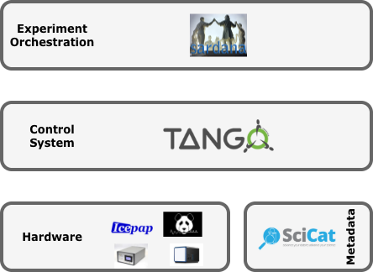
Control System and Orchestration
ICT Software

Slide 5

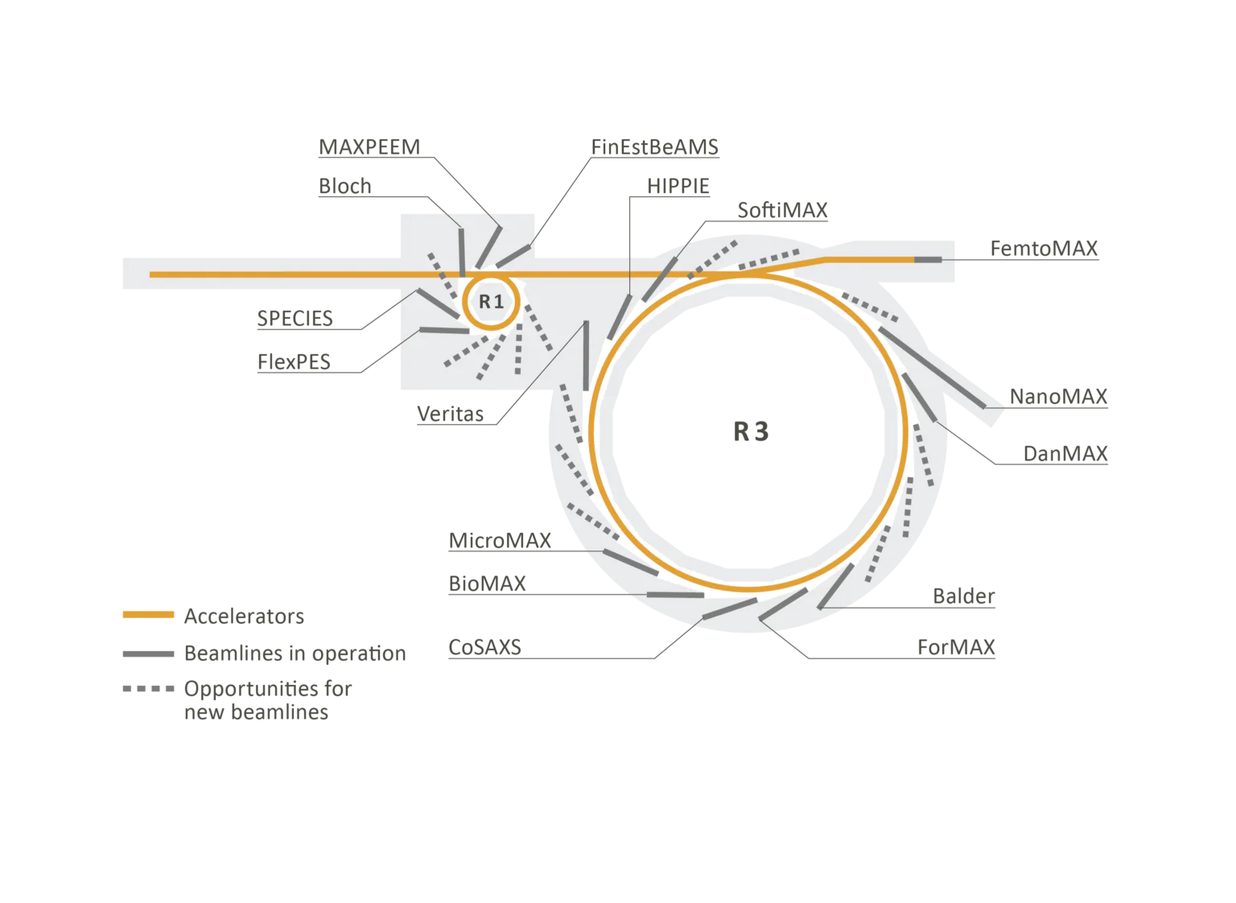
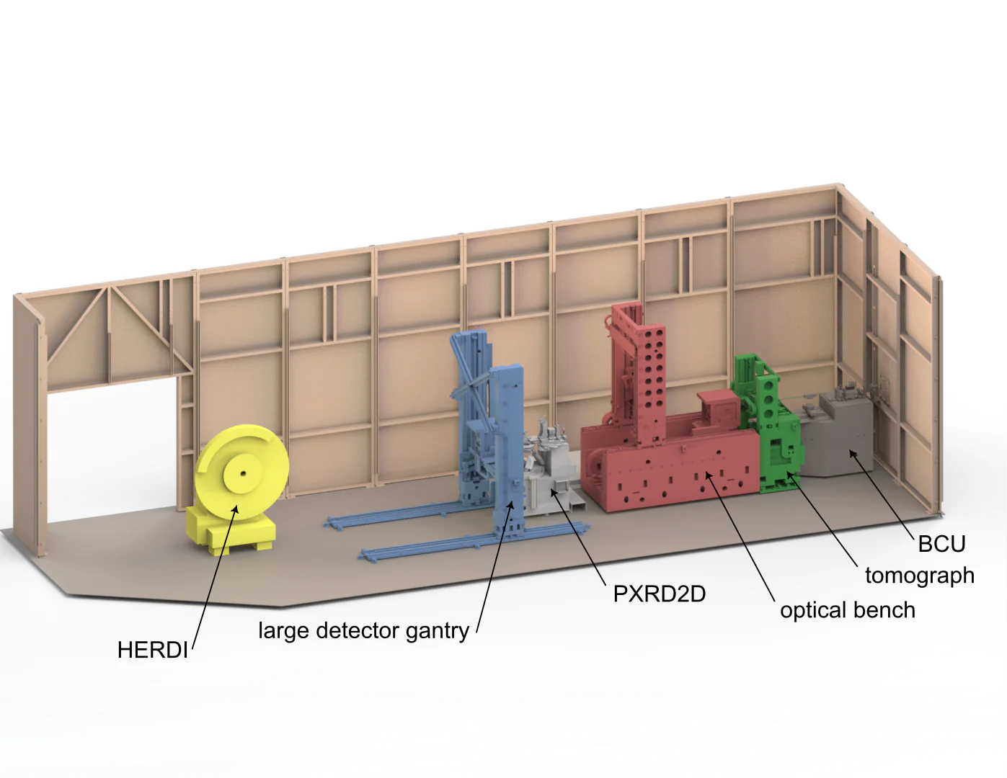
Tomography case
A materials science beamline
Operates in hard X-ray range 15-35 kev
Three endstations: full-field imaging, versatile powder diffraction, and high-resolution powder diffraction(ongoing).

Slide 6
Supports a wide range of sample types and environments
Effective pixel size: 550 nm or 275 nm
Combines transmission-based imaging with diffraction-based imaging.
Sample goniometer:
built around two rotary unions controlled by an ACS system.
Supports the XY alignment stages mounted above it
Offers 20nm radial and axial error motion.
Provides essential electrical connections for user-defined sample environments, including small motors, trigger signals, and high-voltage supplies.
Two additional rotary unions enable high-pressure gas/fluid delivery and vacuum operation.
Measurement time:
Single-volume tomographic scan (~1 mm³) can be as fast as 1 second.
Typical scan times: 10–300 seconds per volume
Scan duration depends on:
  Exposure settings
  Detector dynamic range
  Objective lens used
Notes:
Materials science beamline in range15-35 kev

Slide 7
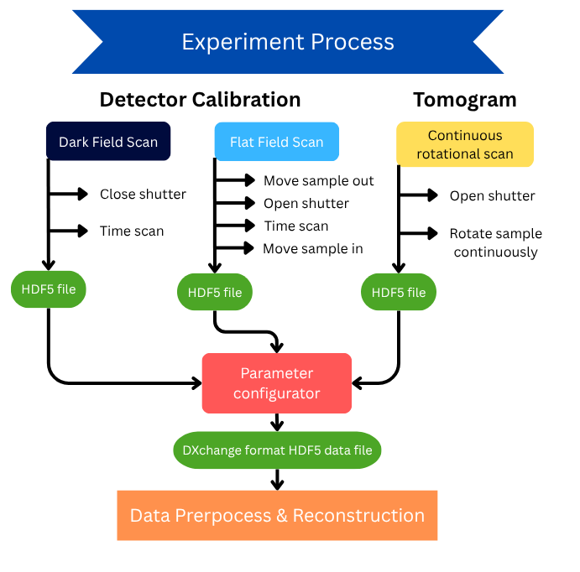
Notes:
Before scanning:
Generate the background image -> Dark image
Experiment Process = Detector calibration+ tomogram. Detector calibration: (Dark scan + White scan: Move sample motor out-> flat scan ->move sample monitor in.) -> Save file path -> Data preprocess and reconstruction. these three steps: Move sample motor out-> flat scan ->move sample monitor in only belongs to White scan not for Dark scan. tomogram: Create customized data file in post-scan hook -> Save file path -> Data preprocess and reconstruction.

Slide 8
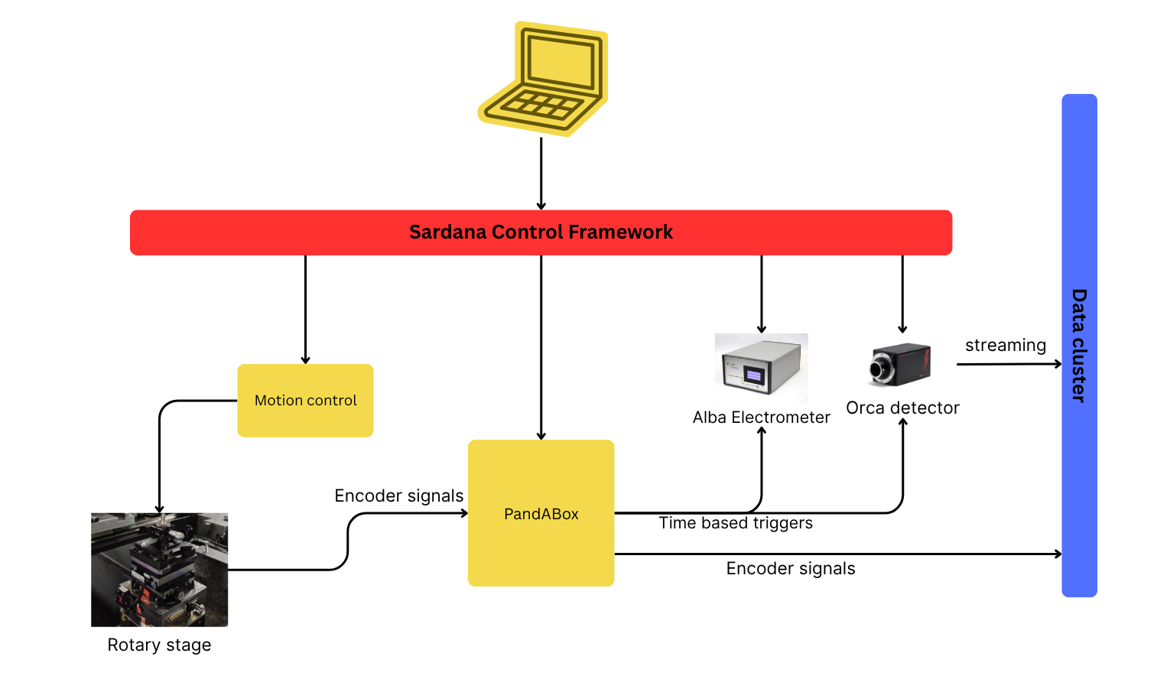
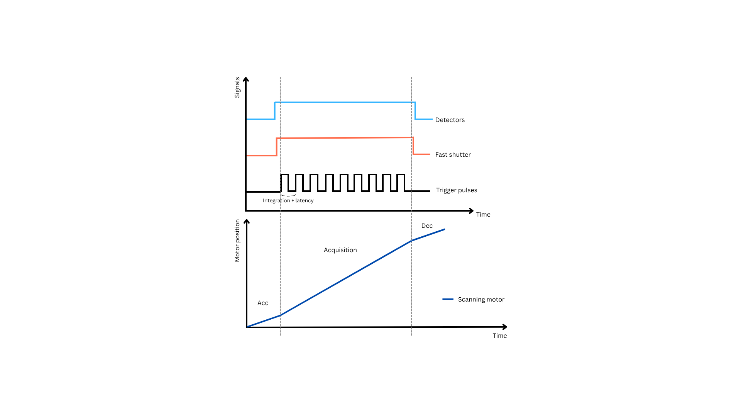
Synchronization
Sardana handles the software synchronization between the detectors and motor movements.
PandABox generates the acquisition triggers and ensures that data are acquired at the correct motor positions.
The acquired data and motor positions are streamed to the cluster in parallel during the scan.
ICT Software

Slide 9
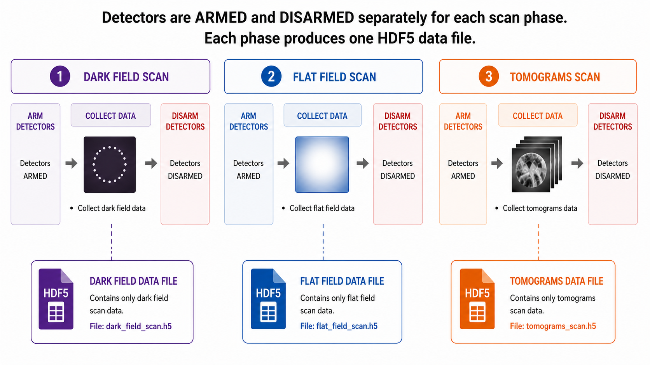
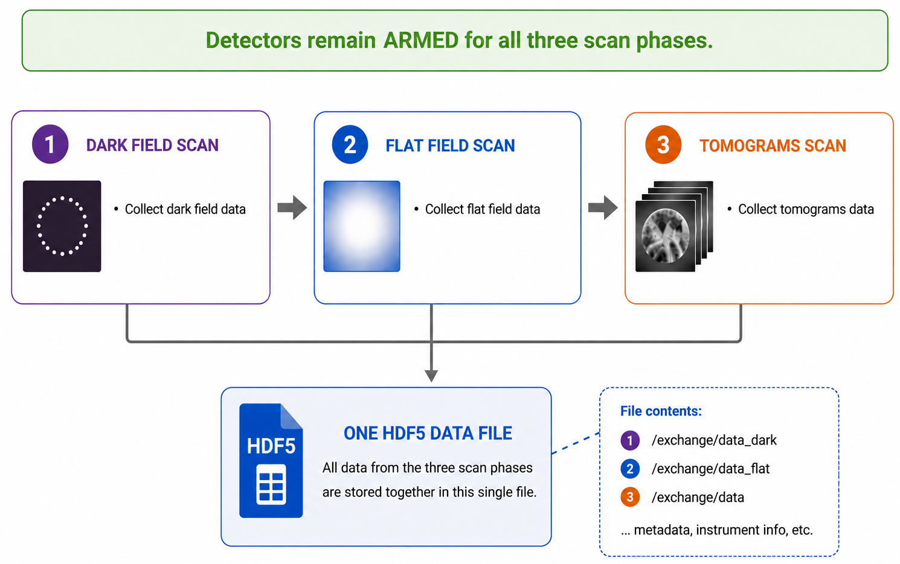
Future Work
BEFORE
AFTER
Improve efficiency
Skip disarming the detector for different scanning phases
Create only 1 data file
Prepare the tomograms while repositioning the sample during the flat field acquisition phase

Slide 10
Continuous scan
At MAX IV, continuous energy scans are performed through continuous monochromator and undulator motion while data are acquired. This makes better use of the available photon flux while shortening measurement time and improving throughput.
Reference:
https://proceedings.jacow.org/icalepcs2025/doi/jacow-icalepcs2025-thag006/
https://proceedings.jacow.org/icalepcs2025/pdf/WEAG006.pdf
https://proceedings.jacow.org/icalepcs2025/pdf/THAG006_talk.pdf

Slide 11
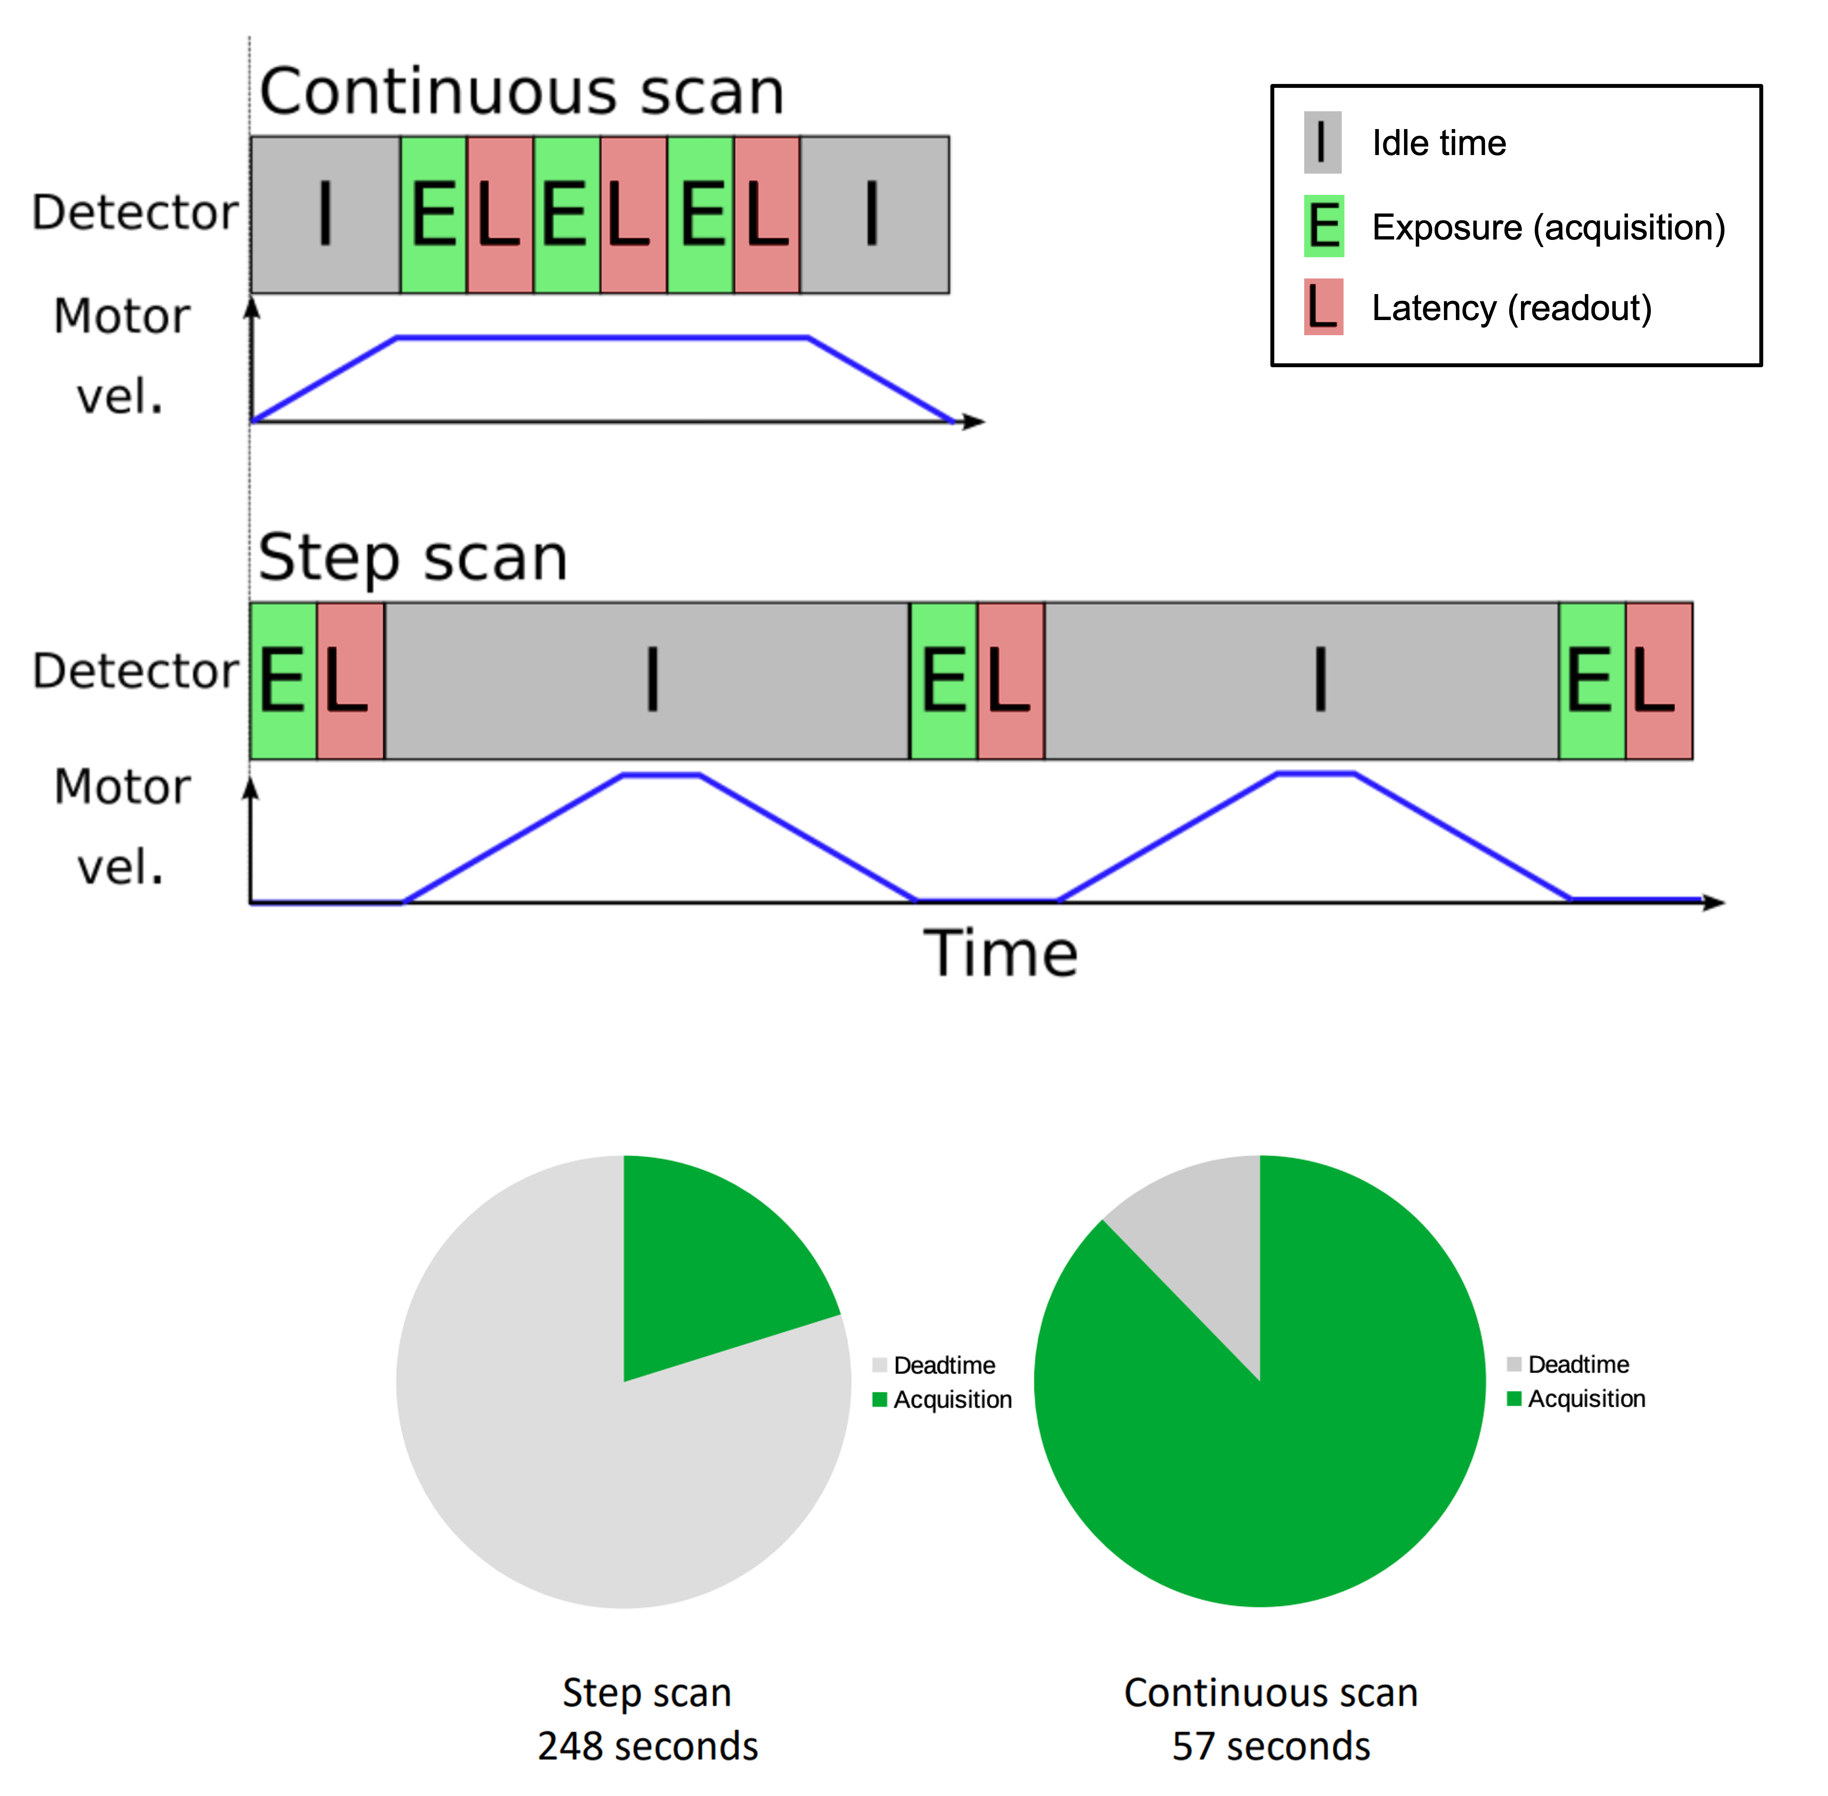
Faster experiments
Reduce the duration of experiments or increase the amount of data collected.
Opposed to step scans, continuous scans acquire data while the motors are continuously moving.
Measurements are triggered as soon as the correct positions are reached and made while the motor is still moving.
It is possible with detectors that have short exposure and integration times.
KITS - Software

Slide 12
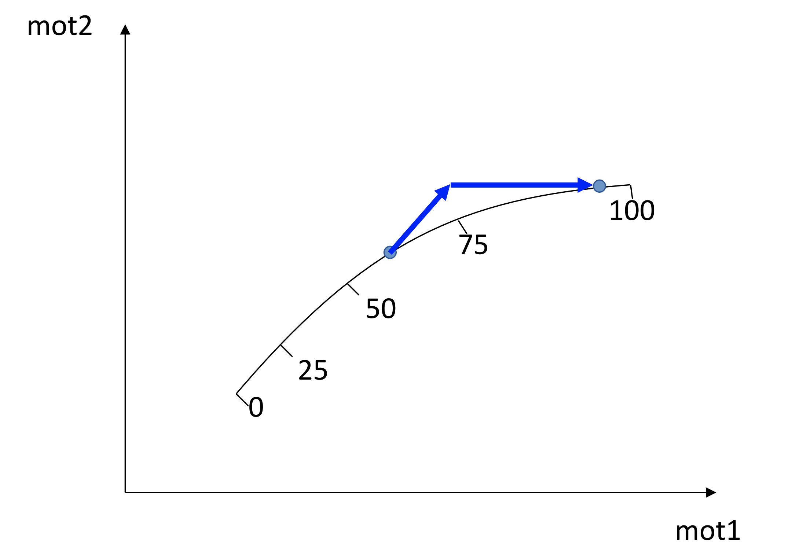
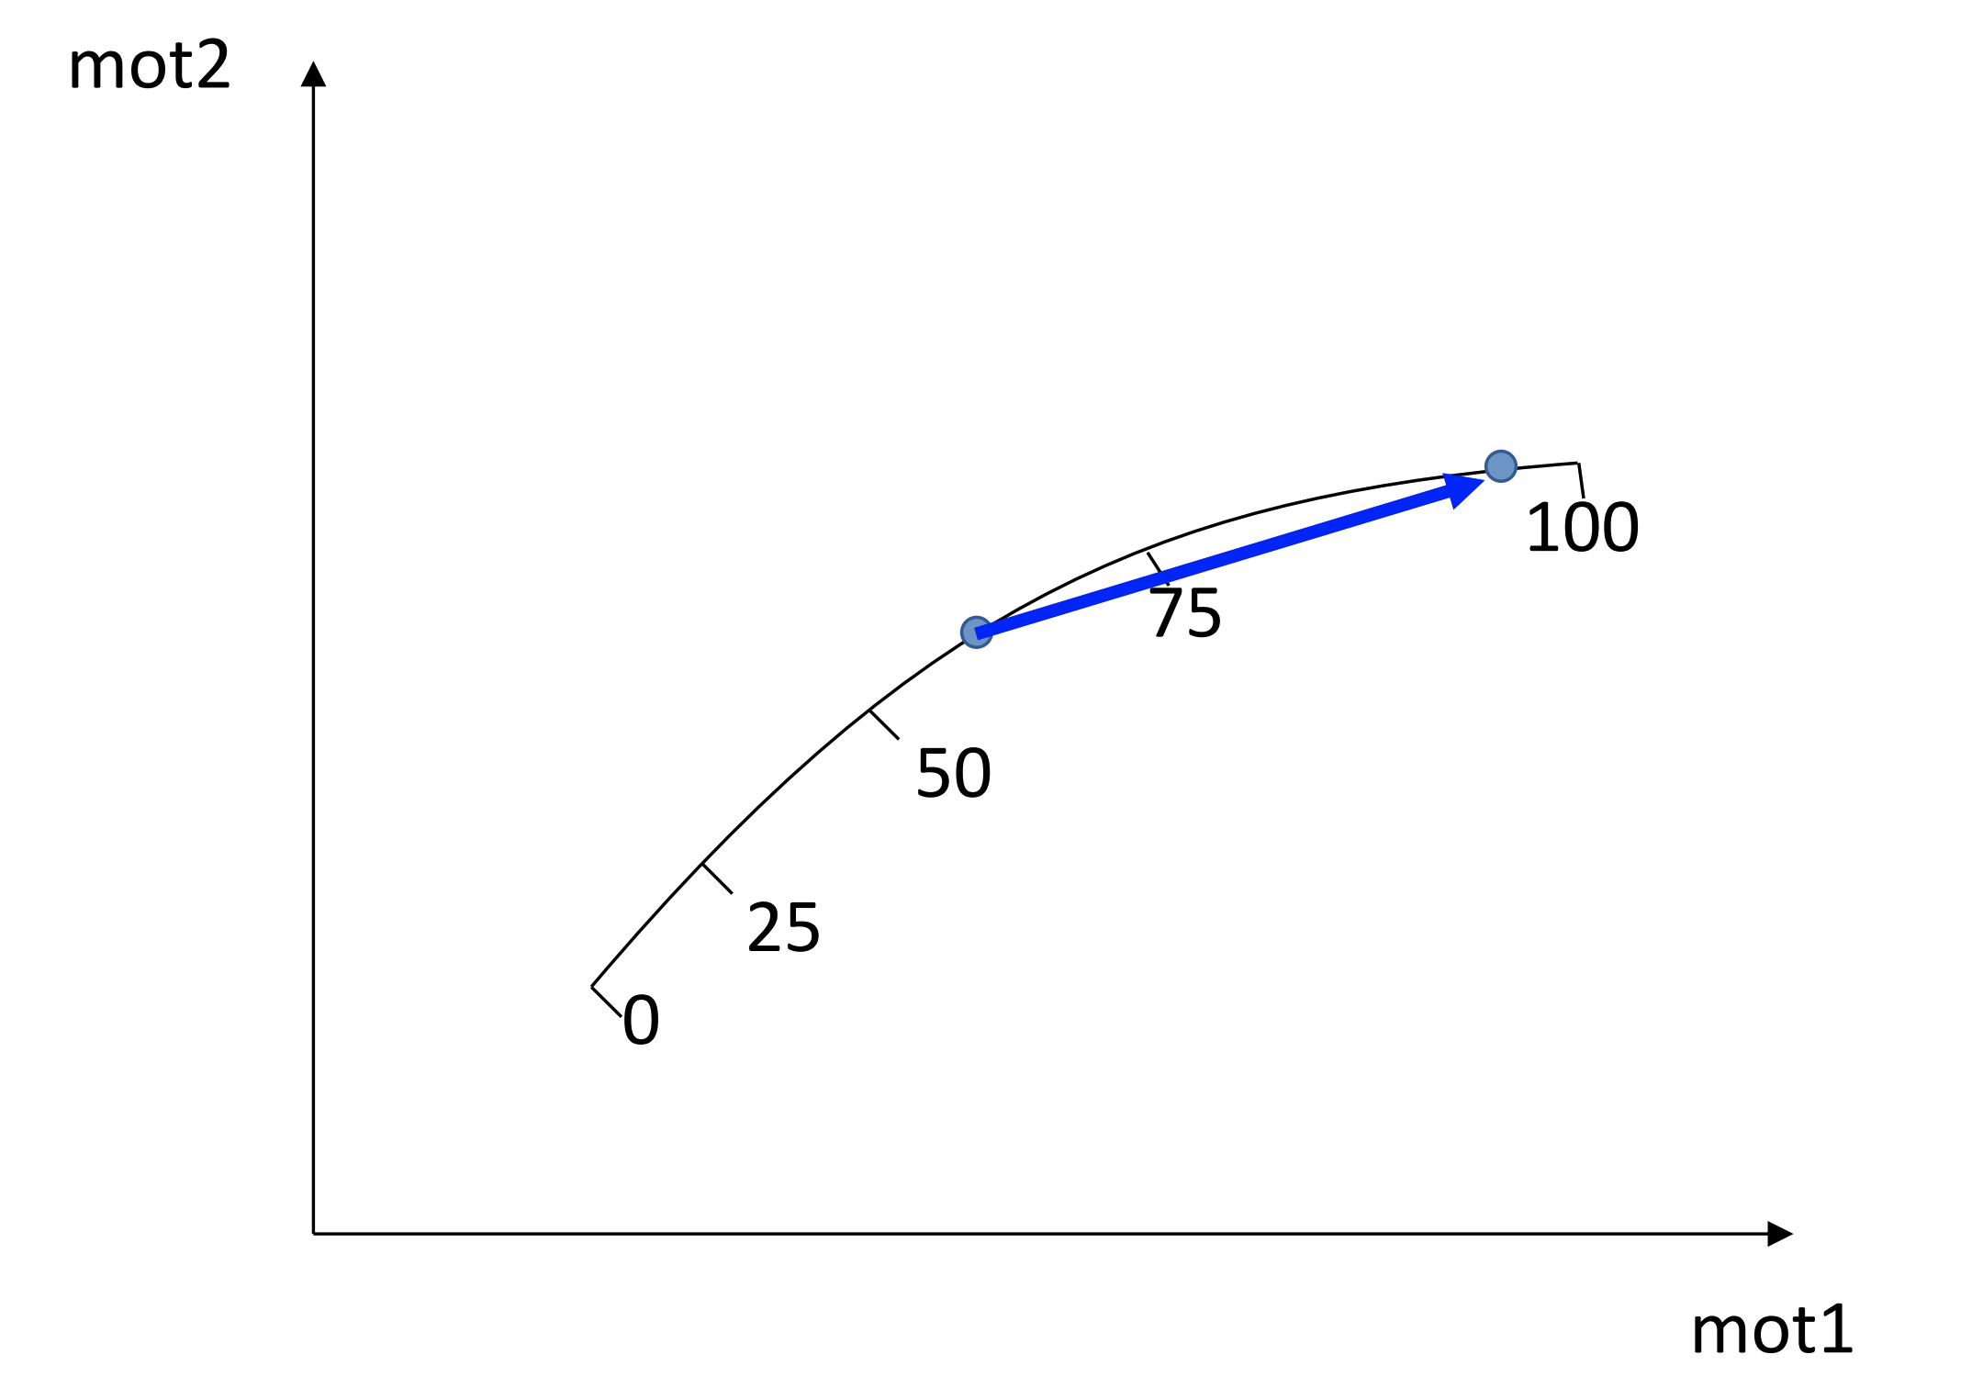
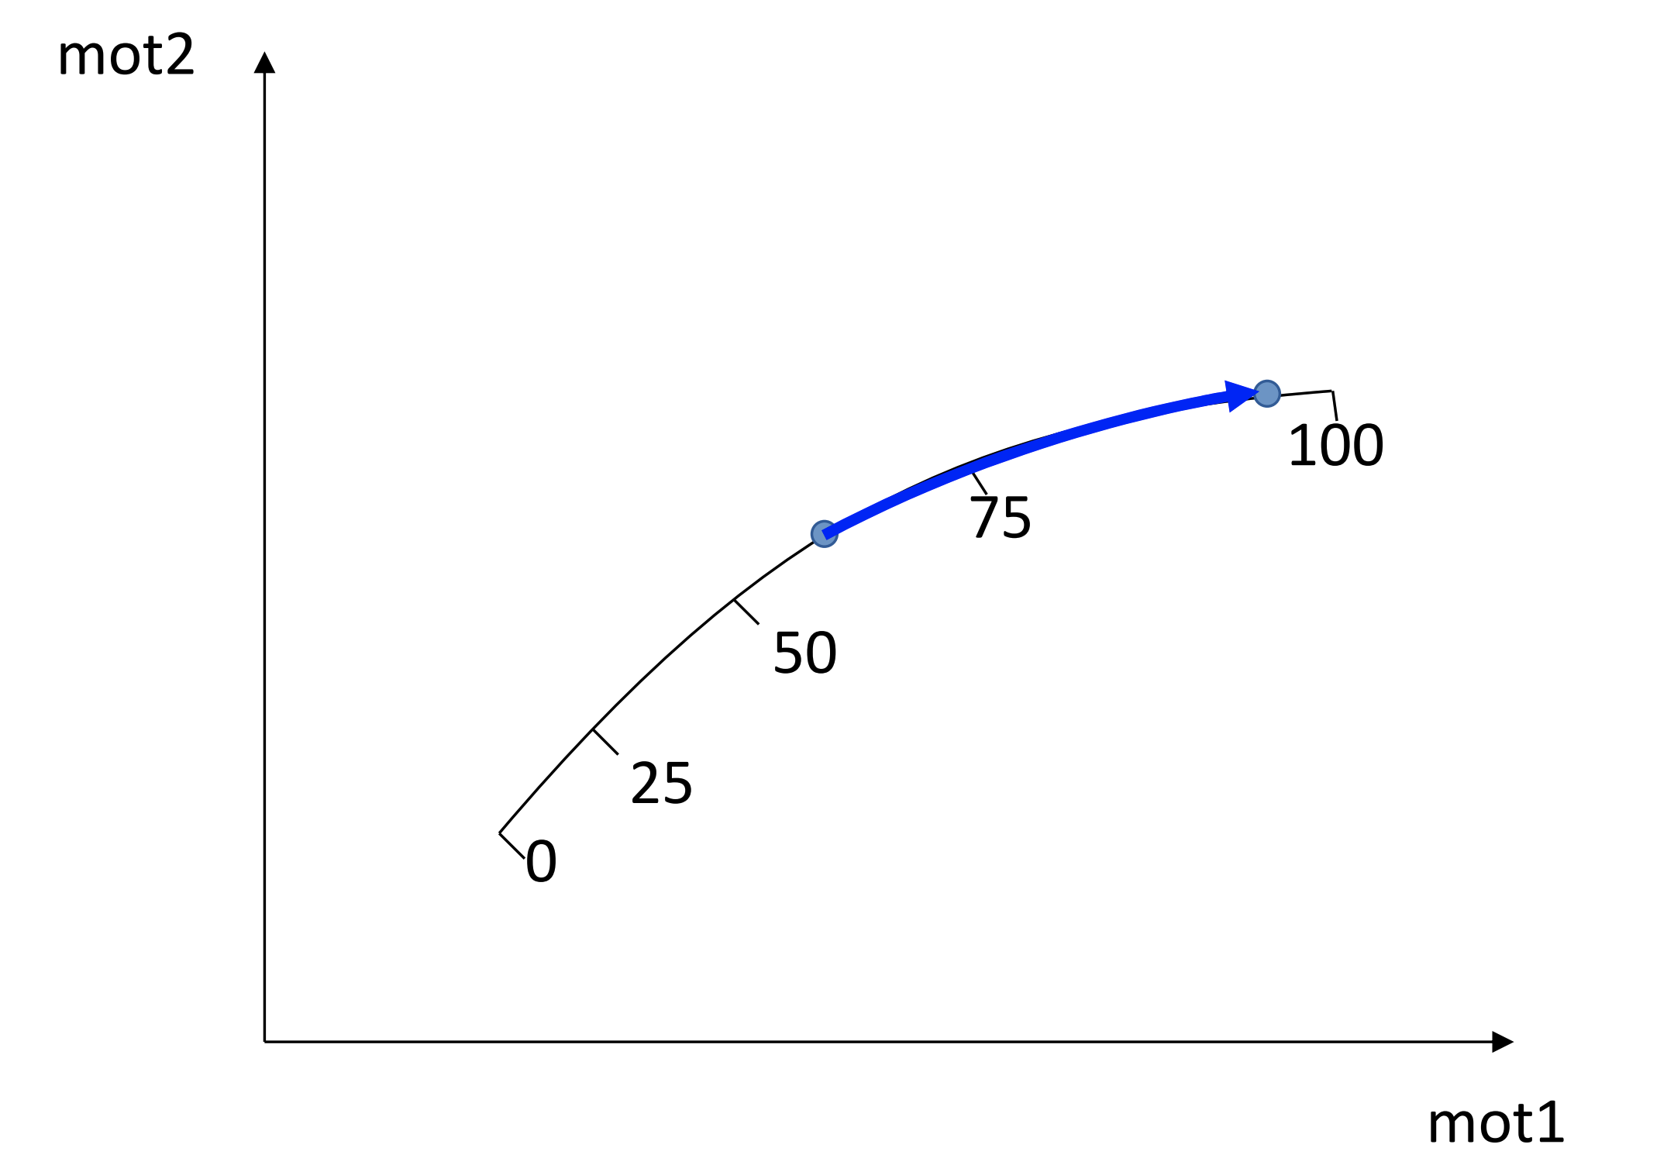
Icepap Parametric Trajectory
It is possible to make non-linear movements in IcePAP keeping a constant value in eV/s.
The trajectory tables are calculated by a sardana controller and inserted in the IcePAP driver.
The IcePAP uses an interpolation method to follow the trajectory.
Energy range and the number of points in the trajectory table are configurable.
Nominal Velocities
Matched Velocities
Parametric Trajectory

Slide 13
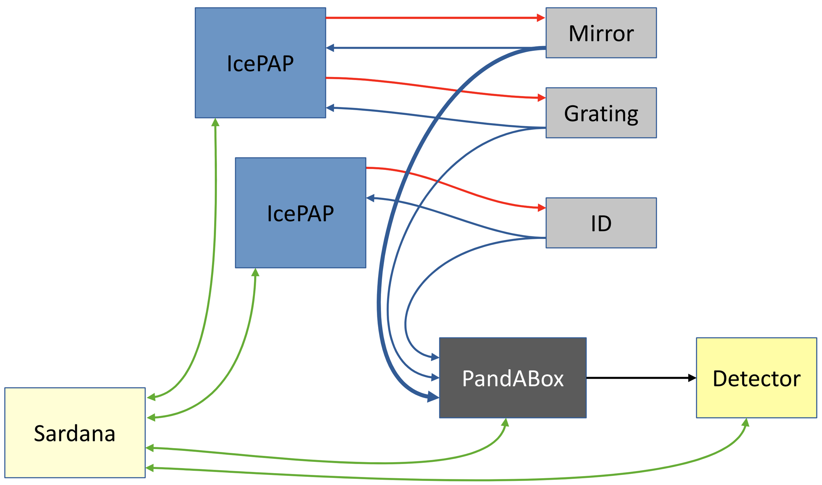
Synchronization Scheme
The synchronization is made through hardware using PandABox (FPGA).
The encoders of the motors are connected to the PandABox.
The orchestration system (Sardana/Contrast) configures at which positions the detectors should be triggered.
The detectors are armed by the orchestration system (Sardana/Contrast) in the beginning of the scan.
KITS - Software

Slide 14
Implementation at MAX IV Beamlines
The continuous scan is a long running project on MAX IV, implemented on 8/16 beamlines.
Each beam line has its own set of requirements, and the implementation of the continuous energy scan needs to be analysed case by case.
Non-linear gap motion prevents photon flux loss.
A general architecture based on hardware components enables scalability across different beamlines and control/scanning systems.

Slide 15
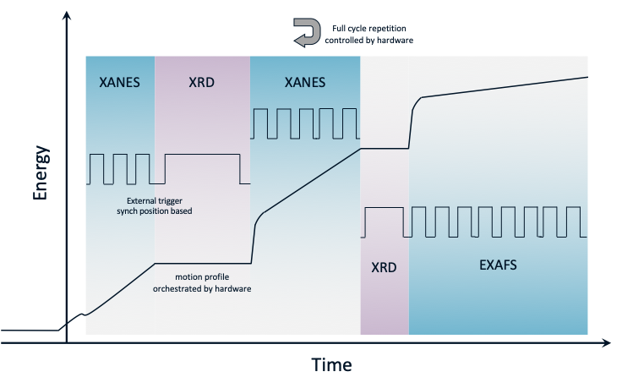
Multimodal Experiments at MAX IV
A combination of complementary techniques within a single synchronized measurement:
  Correlated observations from the same experimental and sample conditions.
  Improved overall beamline throughput.
A combination of measurements made across different beamlines into a single experiment.
Reference:
https://proceedings.jacow.org/icalepcs2025/doi/jacow-icalepcs2025-thag002/
https://proceedings.jacow.org/icalepcs2025/pdf/THAG002.pdf
https://proceedings.jacow.org/icalepcs2025/pdf/THAG002_talk.pdf
ICT Software

Slide 16
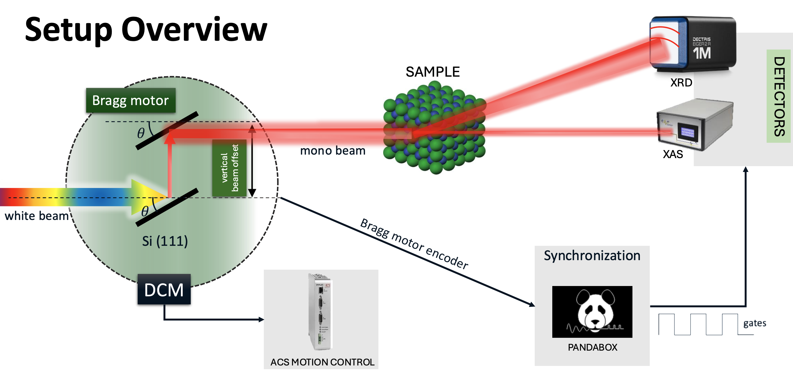
Multimodal at MAX IV

Slide 17
Systematic Experiment Description and Triggering
MultiSynchDescription =
tg01: triggergate axis 1
{
"tg01": [
{
SynchParam.Delay: {SynchDomain.Time: 0},
SynchParam.Active: {SynchDomain.Time: 0.2},
SynchParam.Total: {SynchDomain.Time: 0.3},
SynchParam.Repeats: 4,
}
],
"tg02": [
{
SynchParam.Delay: {SynchDomain.Time: 0},
SynchParam.Active: {SynchDomain.Time: 0.1},
SynchParam.Total: {SynchDomain.Time: 0.5},
SynchParam.Repeats: 2,
}
]
}
tg02: triggergate axis 2
Experiment descriptions capture orchestration logic in a reusable form, reducing reliance on beamline-specific implementations
A common triggering model simplifies the integration of new synchronized techniques
Explicit experiment context ensures consistent data correlation and provenance tracking
TriggerGate
expconf
SynchOne(axis, configuration):
if axis == 1:
configuraton = tg01
if axis == 2:
configuration = tg02
Channel | Synchronizer | Synchronization
Albaem-01 | tg01 | Trigger/Gate
Albaem-02 | tg01 | Trigger/Gate
Eiger-01 | tg01 | Trigger/Gate
Eiger-02 | tg02 | Trigger/Gate
PCAP | tg02 | Trigger/Gate
Albaem-01
PrepareOne(axis, 0.2, 4, 0.1, nb_starts)
Eiger-02
PrepareOne(axis, 0.1, 2, 0.4, nb_starts)
ICT Software

Slide 18
PandABox layout for time based synchronization
UV spec
A
Trigger for UV
Channel | Synchronizer | synchronization
Uv_spec | uv_triggers | Trigger
Fluo_spec | fluo_triggers | Trigger
Eiger | total_triggers | Trigger
Pilatus | total_triggers | Trigger
PCAP | total_triggers | Trigger
Fluo spec
Eiger
Triggers on time-domain
B
Trigger for Fluo
Pilatus
C
Total Triggers
PCAP

Slide 19
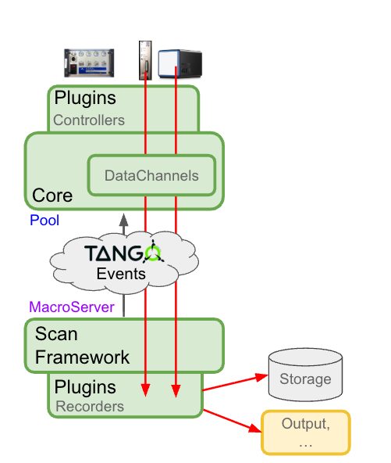
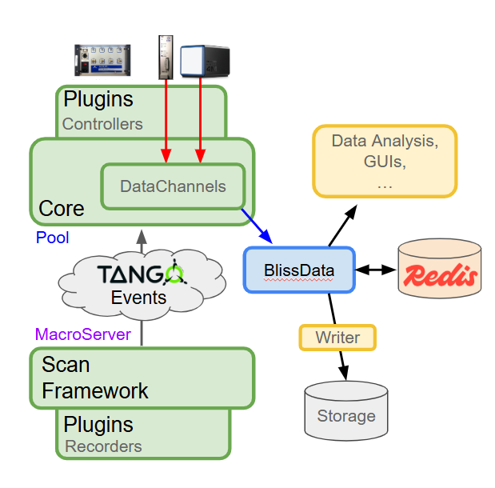
Decouple data acquisition from scan execution

Slide 20
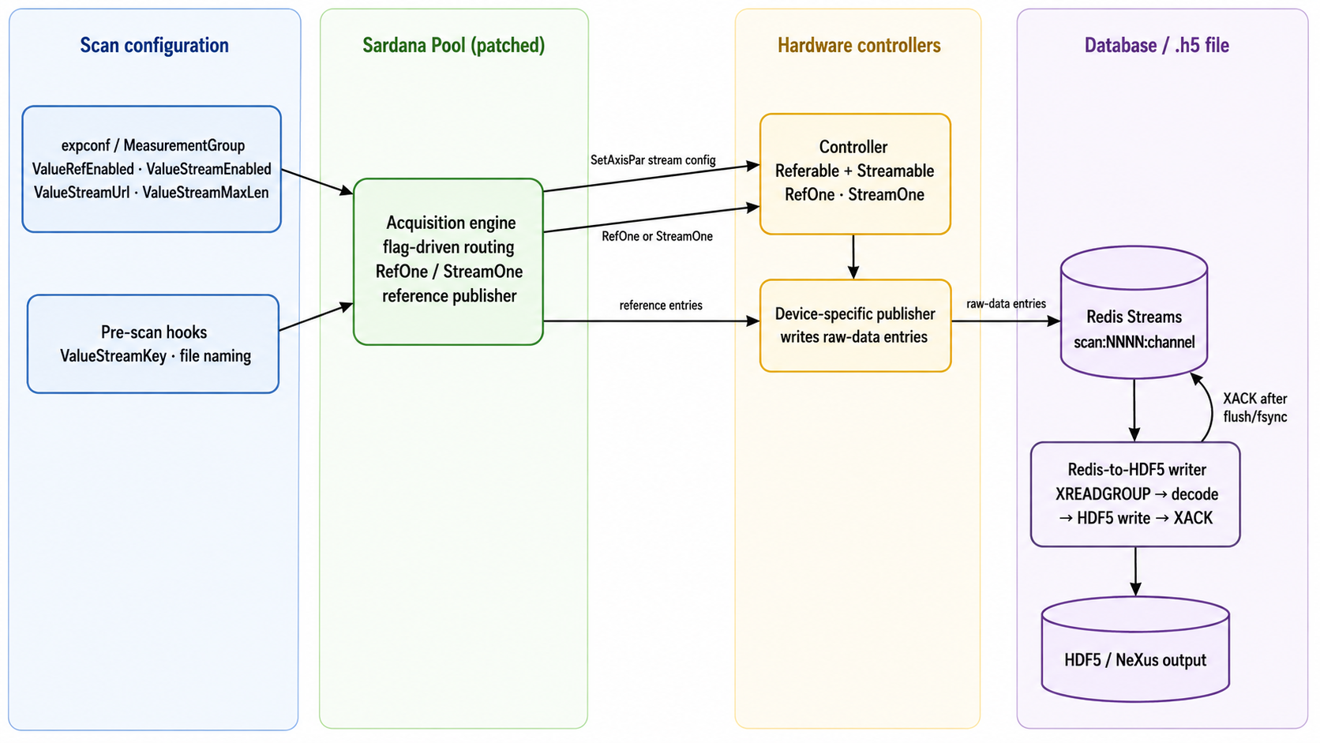
Architecture

