Slide 1

NSLS-II & MAX IV Workshop: Fourth and Future
Generation Light Source Design Challenges
Welcome to MAX IV
Eshraq Al-Dmour

Slide 2
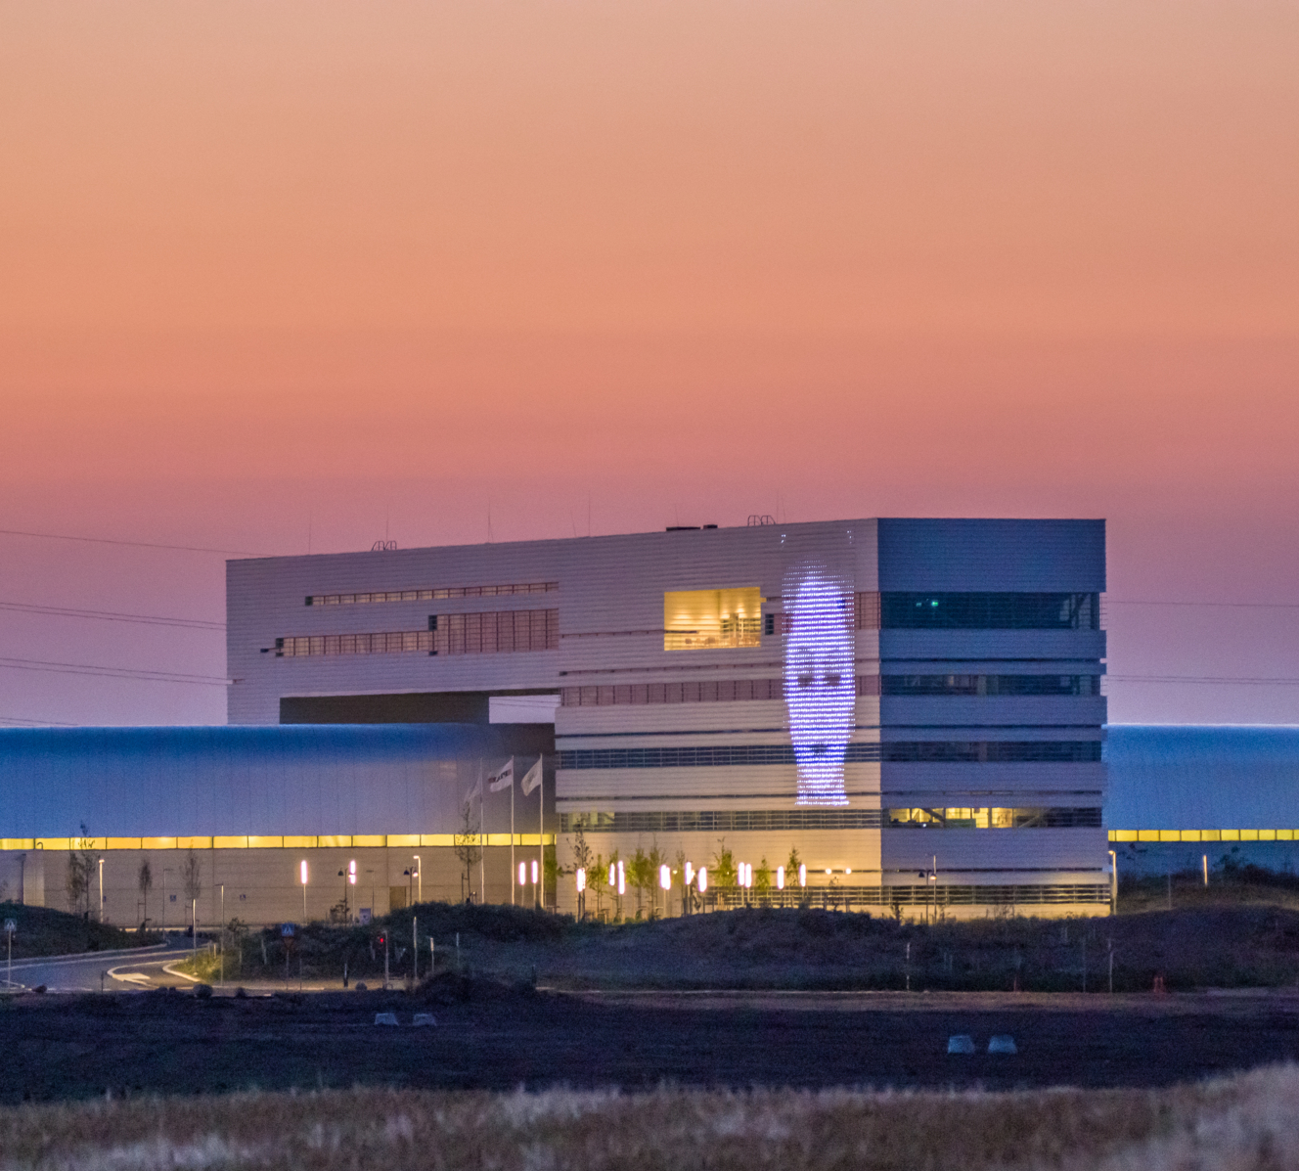
Collaboration Innovation
Knowledge Sharing

Slide 3
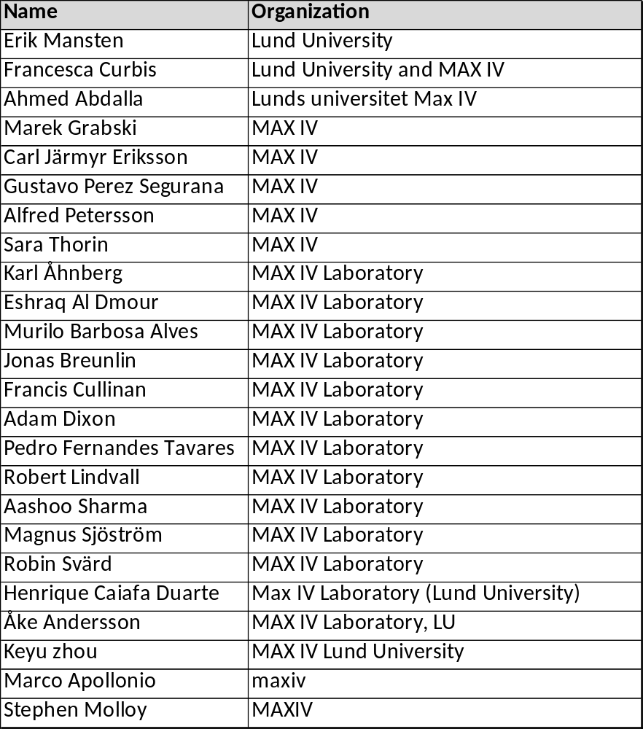
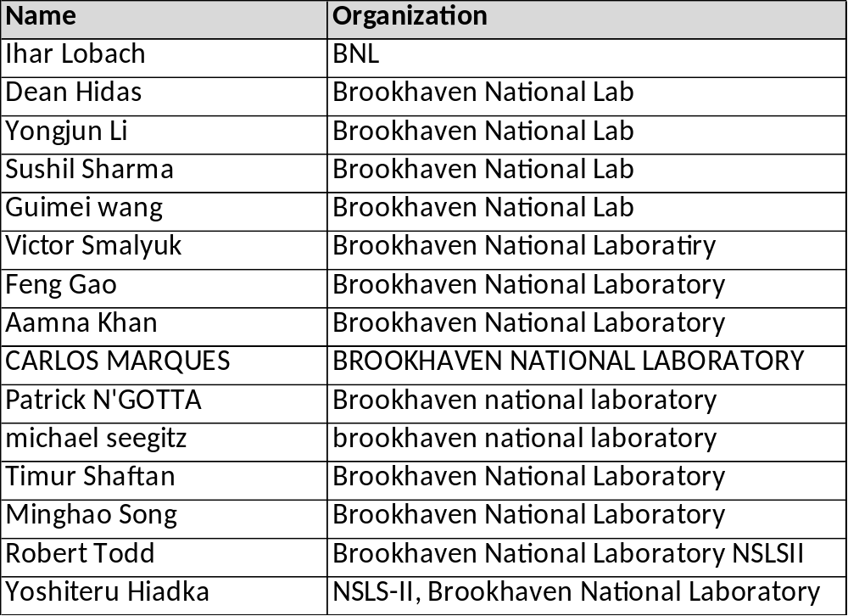
Attendees
Notes:
24, 14

Slide 4
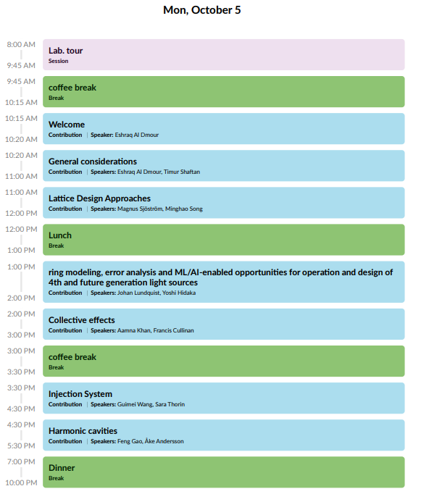
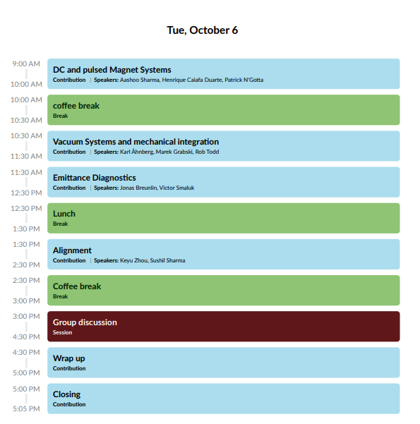
Schedule
Day 1 Chair: Marco Apollonio
Day 2 Chair: Stephen Molloy
Notes:
Six topics day one and 4 day two

Slide 5
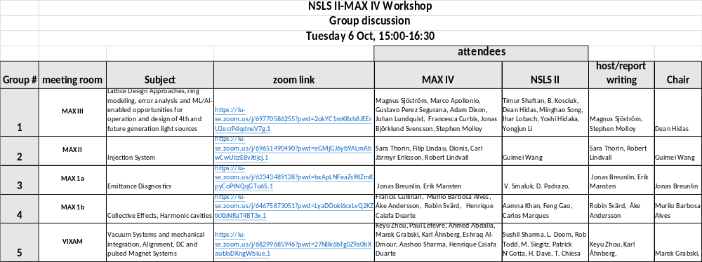
Group discussions
https://indico.maxiv.lu.se/event/6065/page/757-group-discussion
After the group discussion we will have wrap up, where each group will have 5min. To report back on the group discussion.
Notes:
This is a proposal, Feel free to change if you are interested in one topics or the other.

Slide 6
Good to know
Wifi
maxiv_visitor
  Intended for use by temporary visitors to MAX IV.
  This network provides Internet access only – there is no access to MAX IV internal services.
  The login is via a captive portal where an email address is needed for receiving a token that is valid for 24 hours.
eduroam
  The international university wifi network.
  Visiting academics can use the credentials of their home university to establish a wifi connection while at MAX IV.

Slide 7
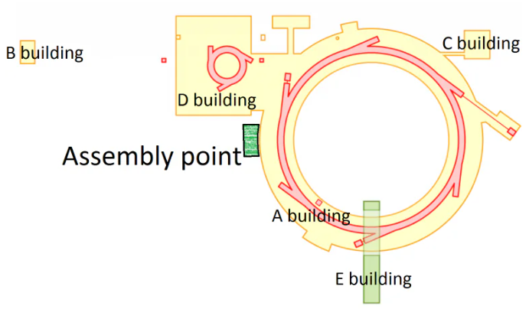

Safety First

Slide 8
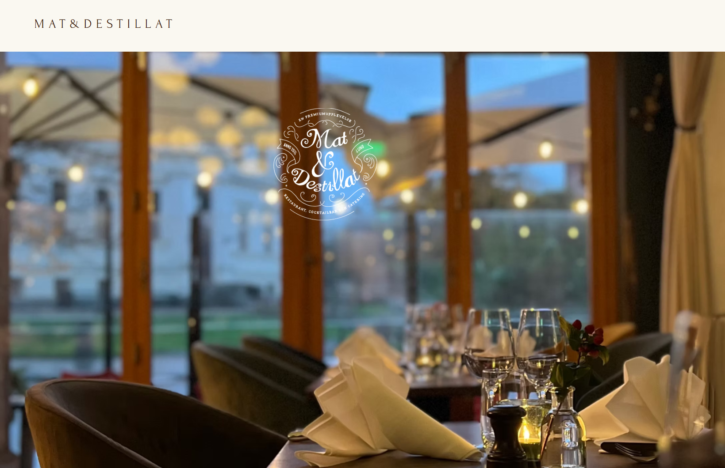
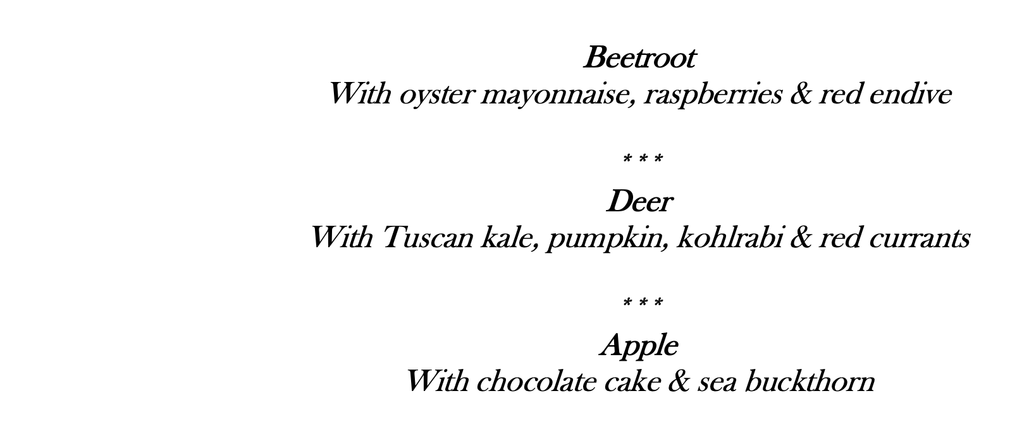
Dinner: BNL, speakers, session and group discussion chairs
Today @ 19:00
https://www.matochdestillat.se/
Your dietary requirements will be accommodated
Kyrkogatan 17, 222 22 Lund

Slide 9
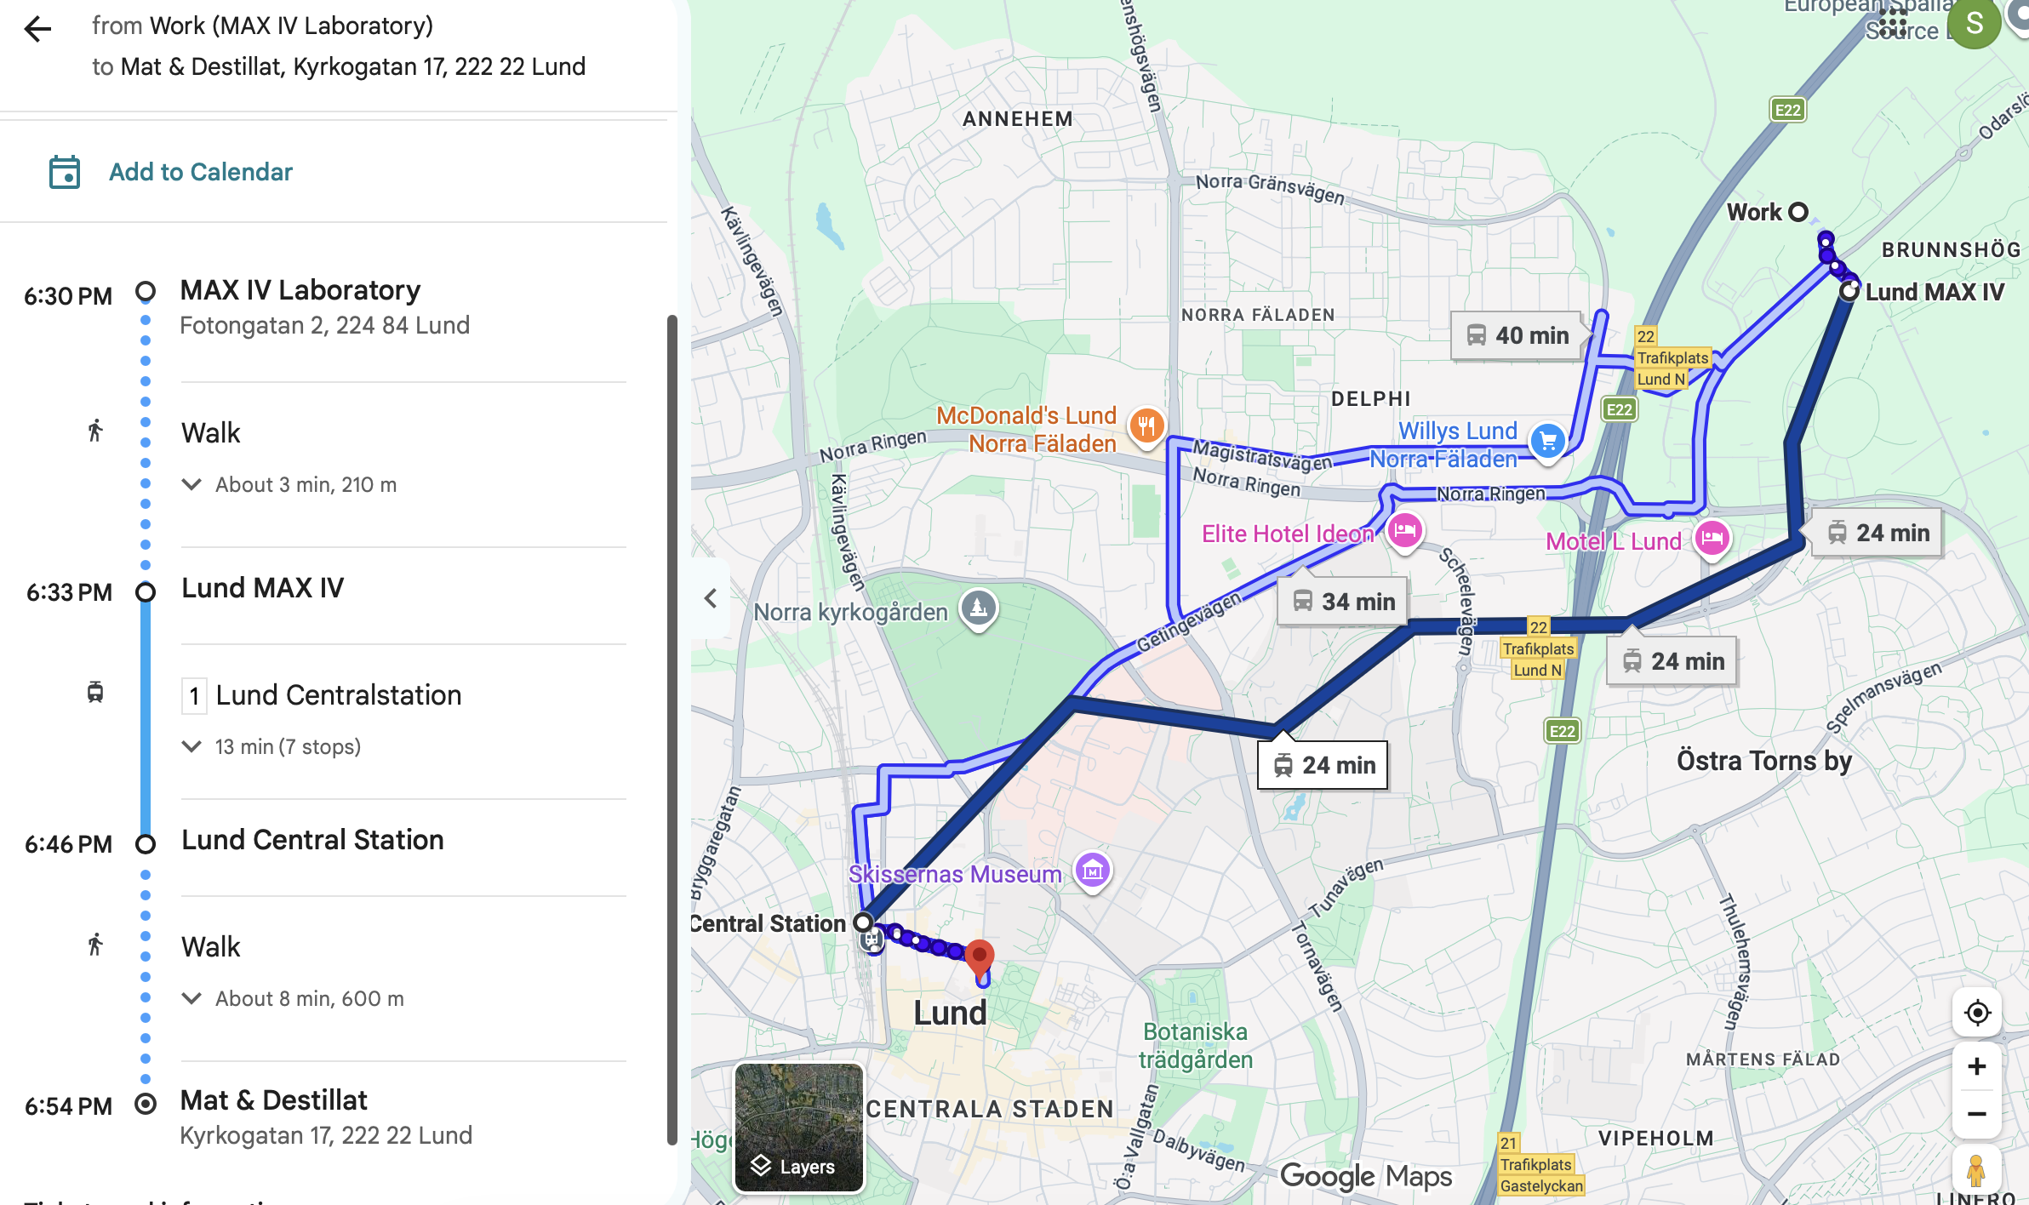
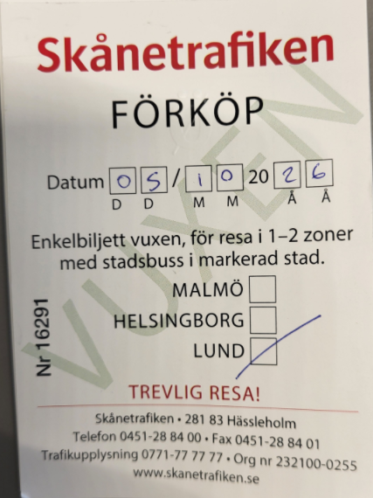
Dinner: instructions to guests:
To get to the restaurant
Take the tram from MAX IV (or Solbjer-(hotel)) to Lund C
Walk 8 minutes to Mat & Destillat (Kyrkogatan 17, 222 22 Lund)
To get back to Motel L
Take the tram from Lund C to Solbjer
You will receive two-single-use tram tickets for your trips (for BNL attendees)
Solbjer

Slide 10
Workshop Picture
Workshop picture will be taken before fika today at 15:00.

Slide 11
Welcome
We wish you a productive workshop and an enjoyable stay.

