Slide 1
NSLS II-MAX IV workshop
5-6 Oct. 2026
2. General Considerations
MAX 4^{U}
The first Upgrade of a 4GLS
Eshraq Al-Dmour

Slide 2
Outline
MAX IV Laboratory in a nutshell
Why MAX 4^{U}?
MAX 4^{U} Design Approach and Goals
Schedule & Budget

Slide 3
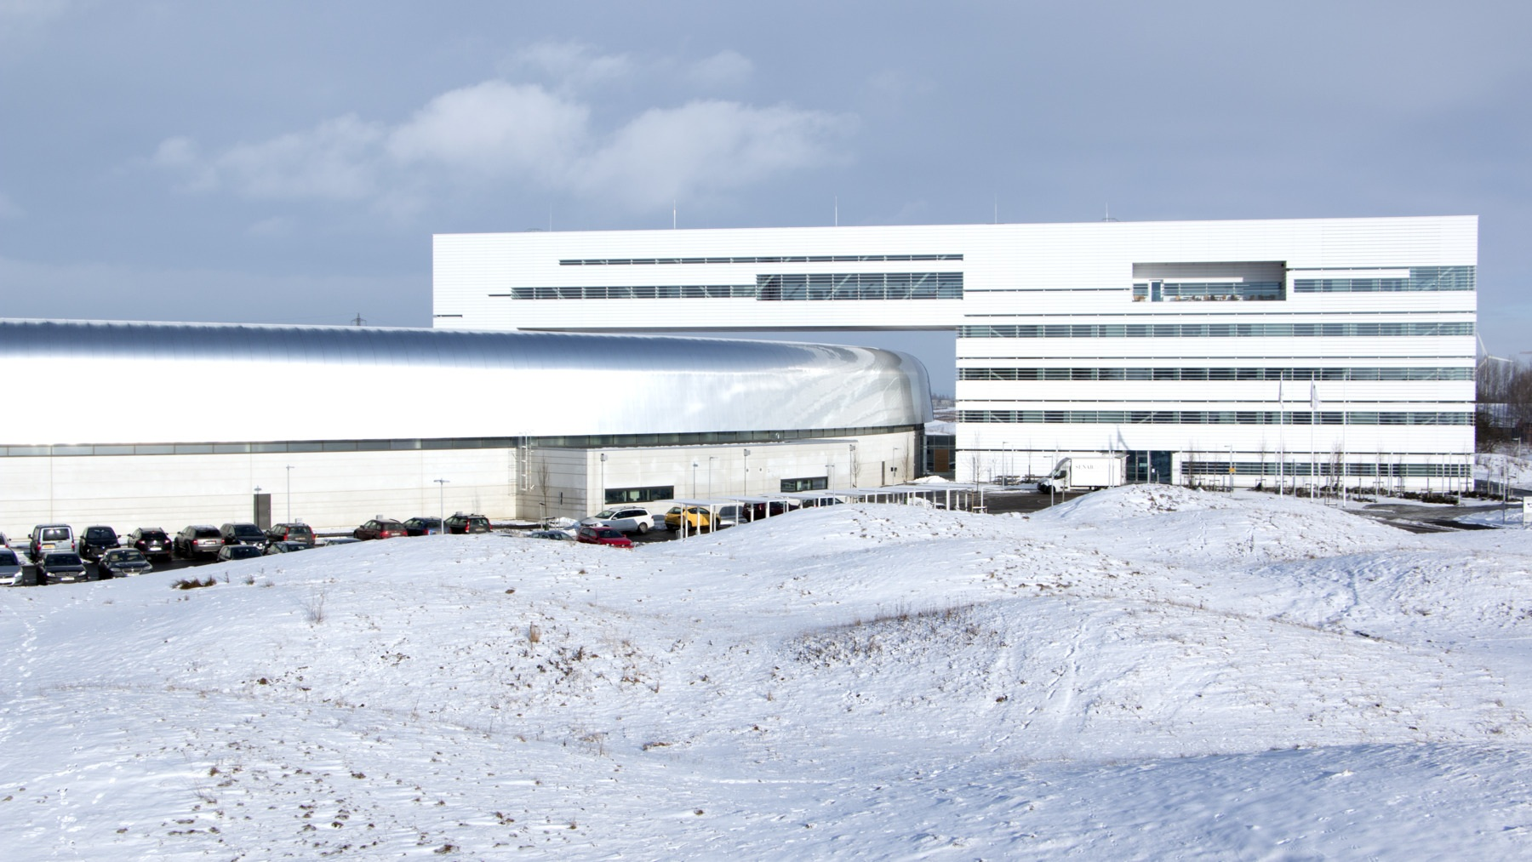
MAX IV Laboratory

Slide 4
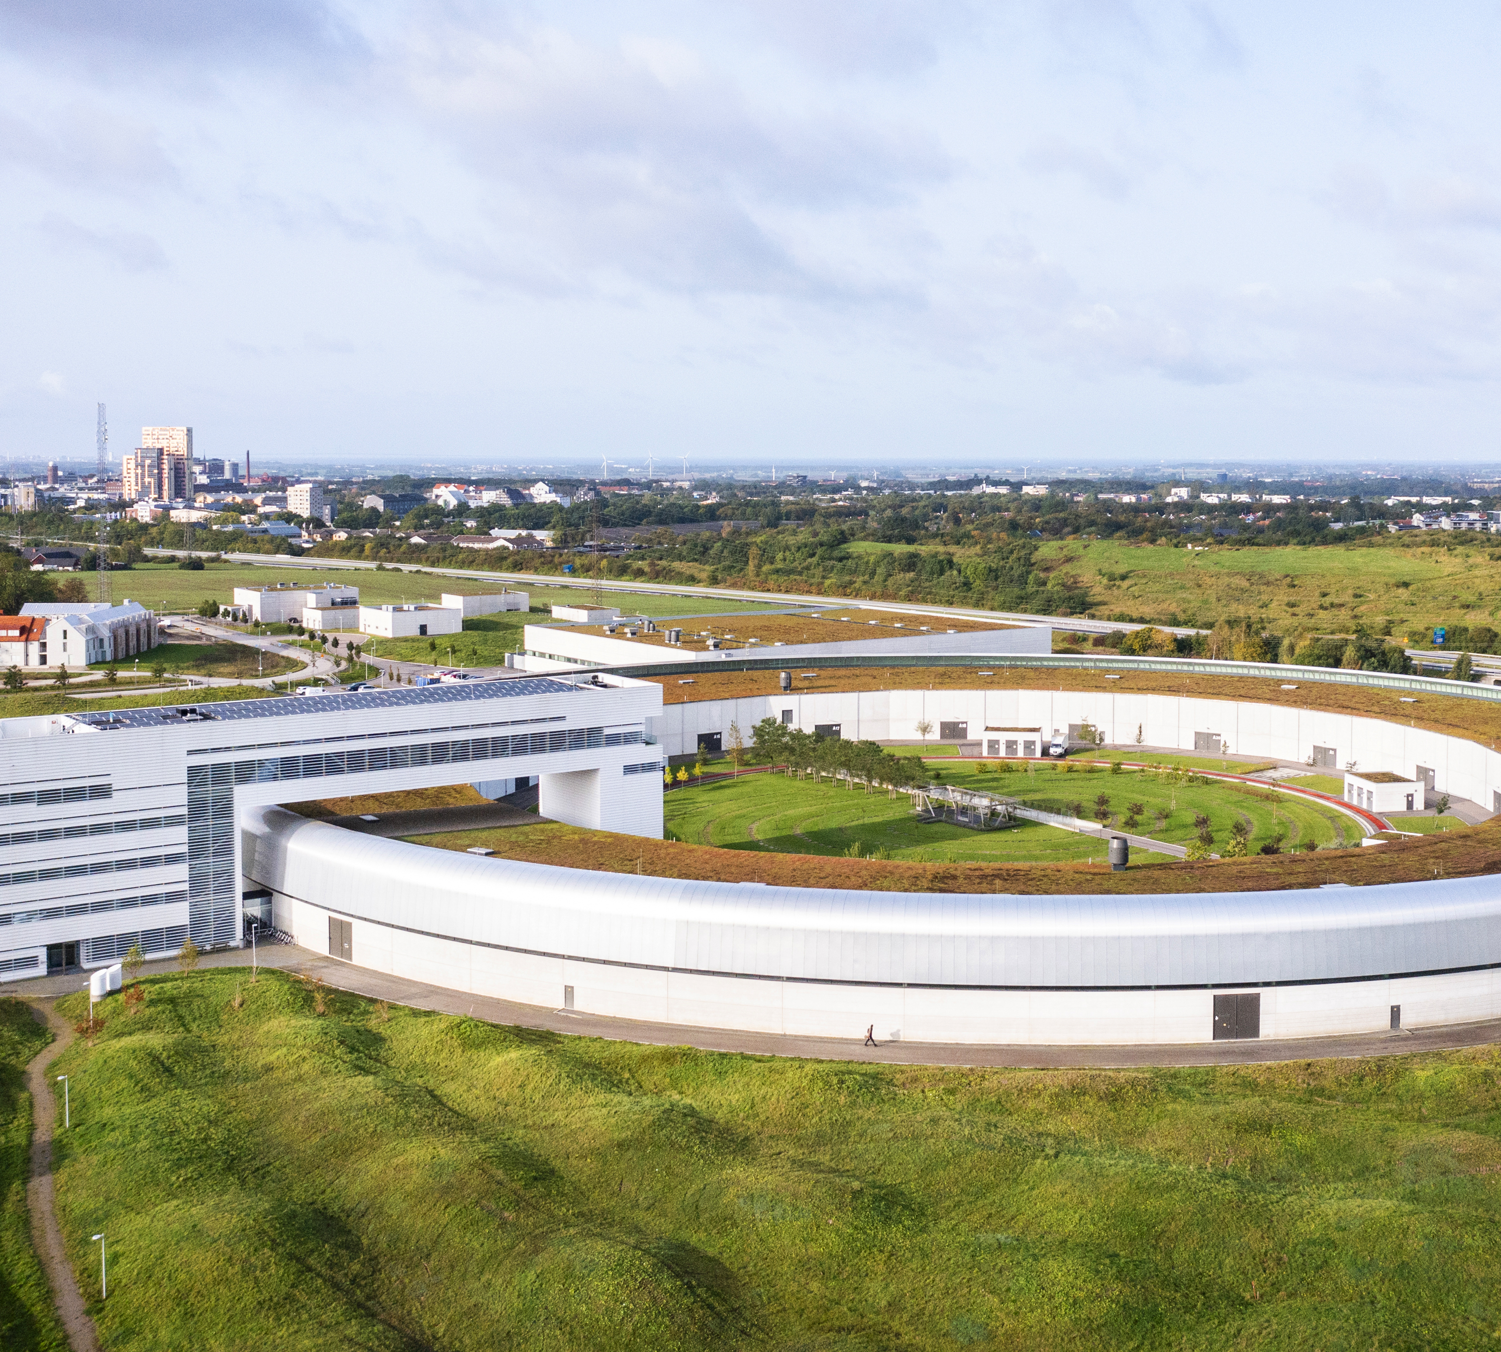
This is MAX IV
Swedish national laboratory for X-ray research with Lund University as host.​
Operates the first fourth-generation light source in the world.
Inaugurated June 2016
16 beamlines in user operation​.
>2000 users/year, from > 300 institutes, from 38 countries.
~5000 hours of delivery, with up-time of 98%.

Slide 5
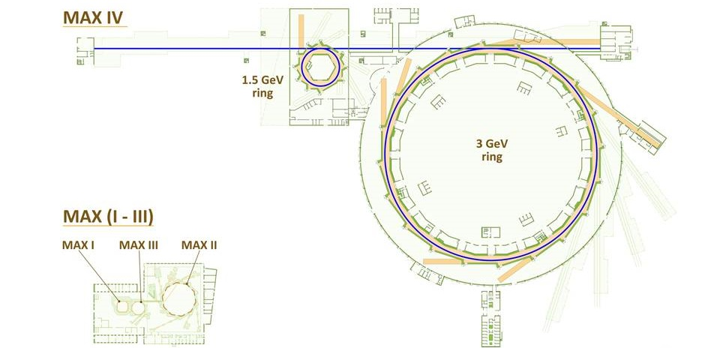
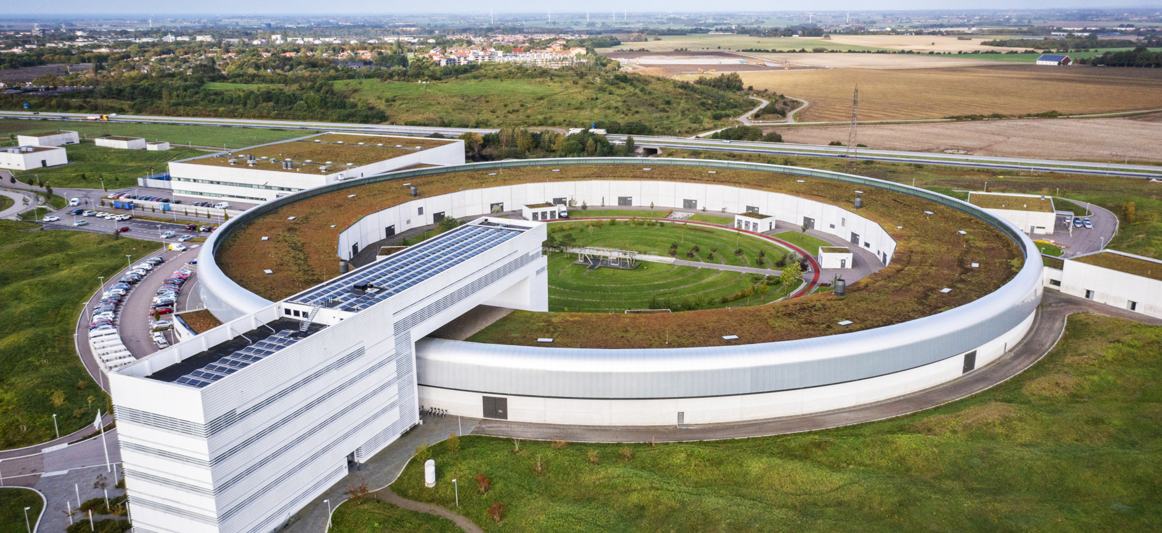
The MAX IV Accelerators
Short pulse facility (SPF)
Linac (~300 m)
Electron Sources
(Thermionic RF gun and a photocathode gun)
1.5 GeV Ring
(cir. 96 m)
DBA
6 nm rad
R3
3 GeV Ring
(cir. 528 m)
7BA
328 pm rad
10 operational beamlines in the 3 GeV ring + 1 under construction.
5 operational beamlines in the 1.5 GeV ring
One operational beamline in the SPF.
5

Slide 6

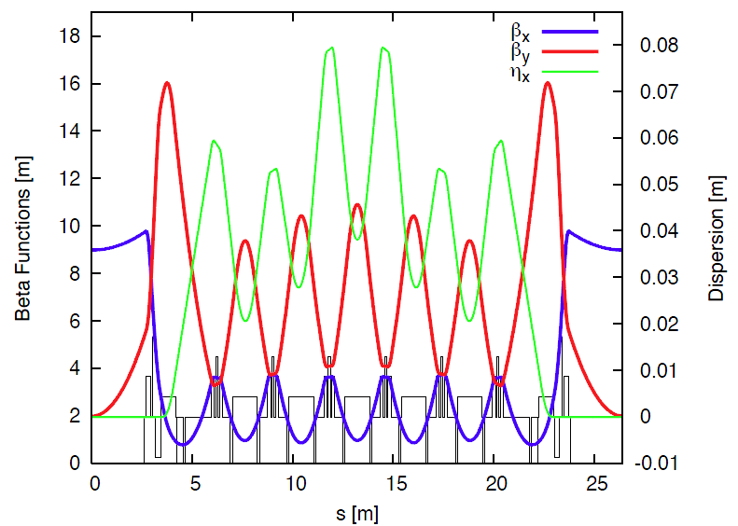
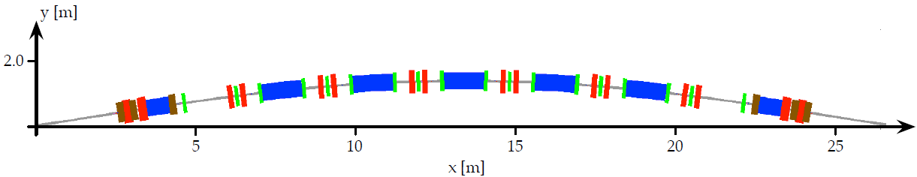
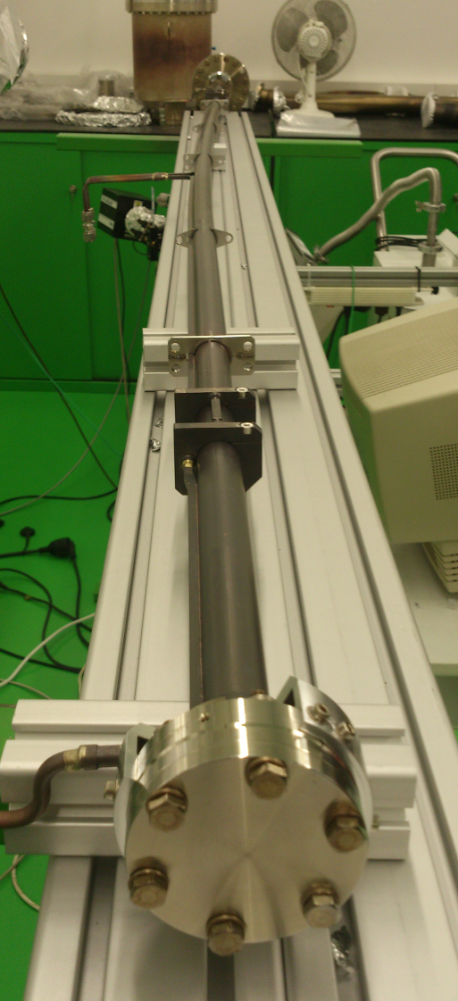
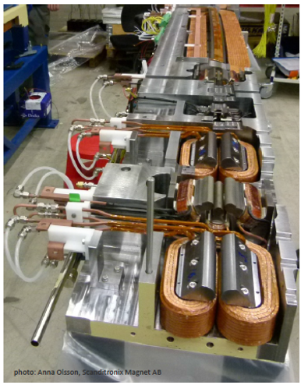
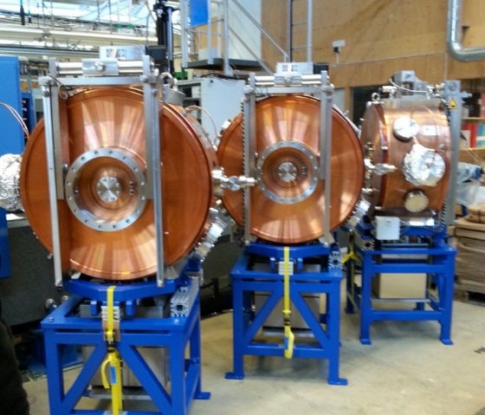
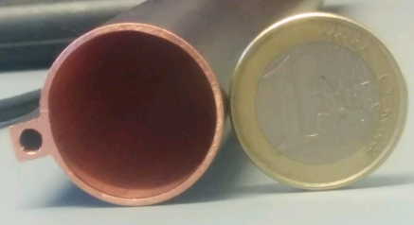
MAX IV 3 GeV Ring (R3) : 528 m, 328 pm rad
7BA
U1
U2
U3
U4
U5
M1
M2
Compact Magnets
(Magnet block concept)
Copper NEG-coated circular vacuum chambers
100 MHz main RF system, plus:
300MHz, 500MHz.
6

Slide 7
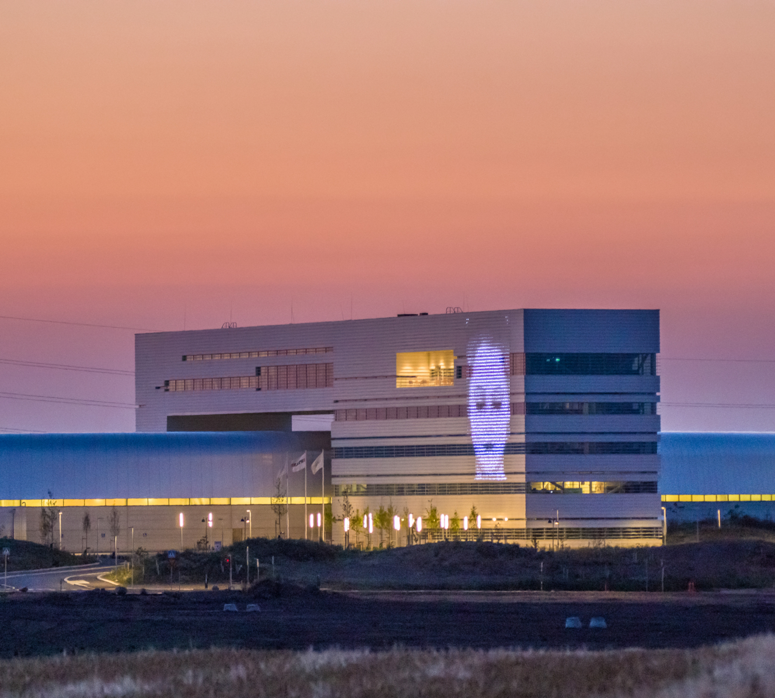
Why MAX 4^{U}?

Slide 8

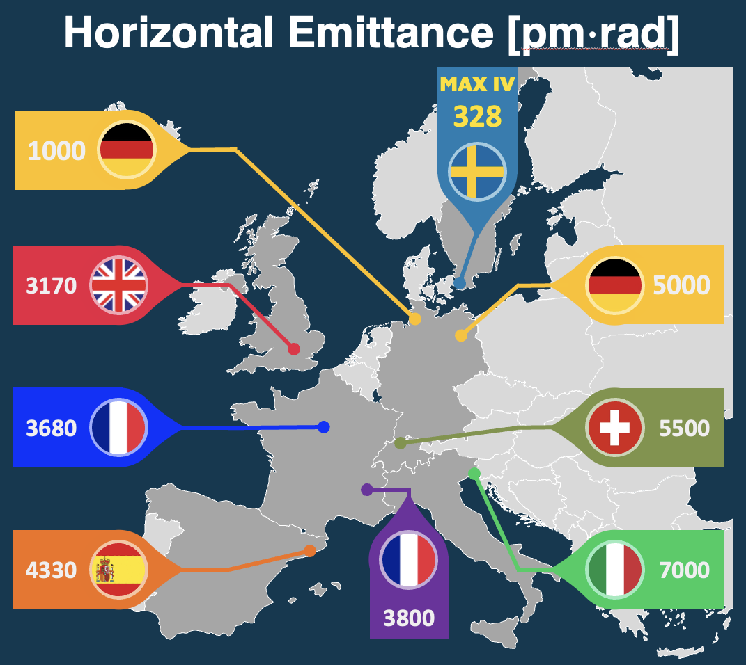
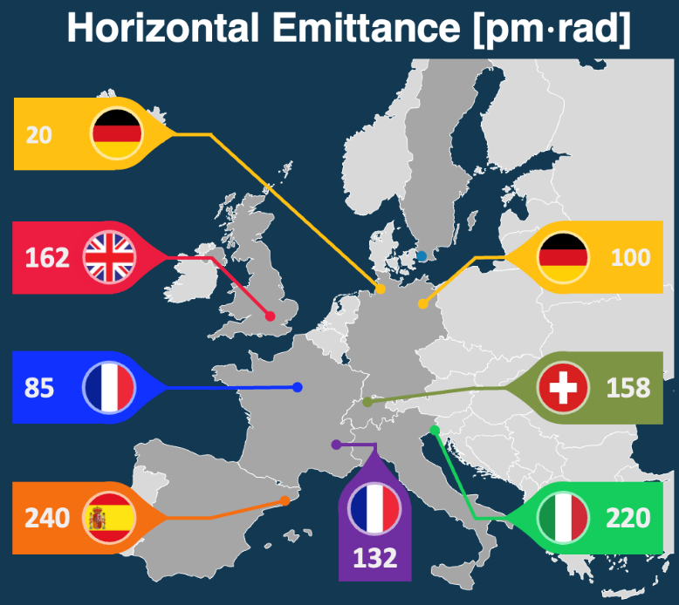
Why MAX 4^{U} ?
MAX 4^{U}
MAX 4^{U}
< 75
MAX IV
328
European Context in >2030
European Context in 2016
Notes:
2016, the European landscape primarily of 3GLS, & many facilities undergoing upgrades into 4GLS by2030s. Within this evolving context, MAX IV has been positioned as a benchmark facility. The innovative design of MAX IV has influenced the development of subsequent light sources worldwide, inspiring facilities to adopt and further refine its concepts.
Maintaining MAX IV at the forefront of X-ray science remains a priority. MAX 4U initiative is aimed at restoring and strengthening its leadership position by enhancing brightness and coherence.

Slide 9
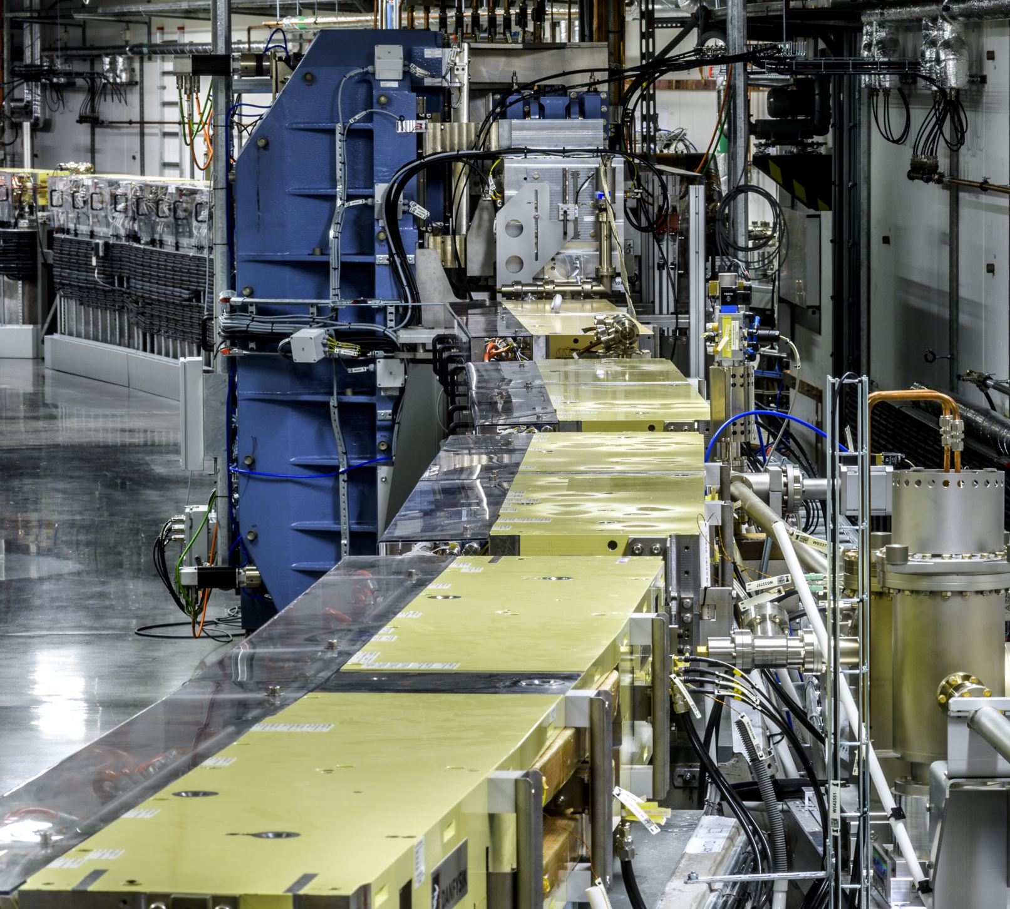
MAX 4^{U} Design Approach and Goals

Slide 10
MAX 4^{U} Design Approach
MAX 4^{U} is NOT a conventional upgrade, which requires the replacement of most components.
MAX 4^{U} is a surgical intervention to provide an outstanding performance improvement while maintaining much of the existing hardware.
How come this is at all possible?
  R3 was designed with future upgrades in mind.
  Innovative approaches are being explored, including advanced injection techniques and ultralong bunches
  MAX 4^{U} can take advantage of new developments in the accelerator community in recent years.
10

Slide 11

MAX 4^{U} Design Approach
Accelerator Physics (Lattice design) and Subsystem design go hand-in-hand from the very start of the project
Subsystem Engineering Experts are asked NOT simply to deliver pre-determined specs but rather to explore the performance envelope that can be achieved within the overall boundary conditions.
Provide a very fast iteration of lattice design to Engineering validation and back.
The conceptual design phase for MAX 4^{U} began in 2024 and continued for two years.
11

Slide 12
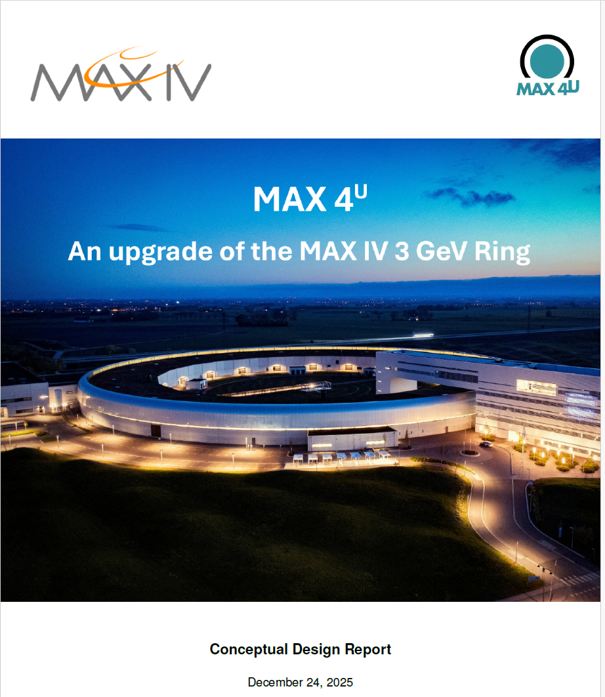

CDR was completed on
December 24th, 2025
https://www.maxiv.lu.se/beamlines-accelerators/max-4u/accelerator-design/
The CDR studies defined the design potential of the upgrade, establishing a strong foundation for more ambitious goals
The emittance goal during the conceptual design was to achieve under 100 pm rad.
TDR goal: Emittance below 75 pm rad

Slide 13
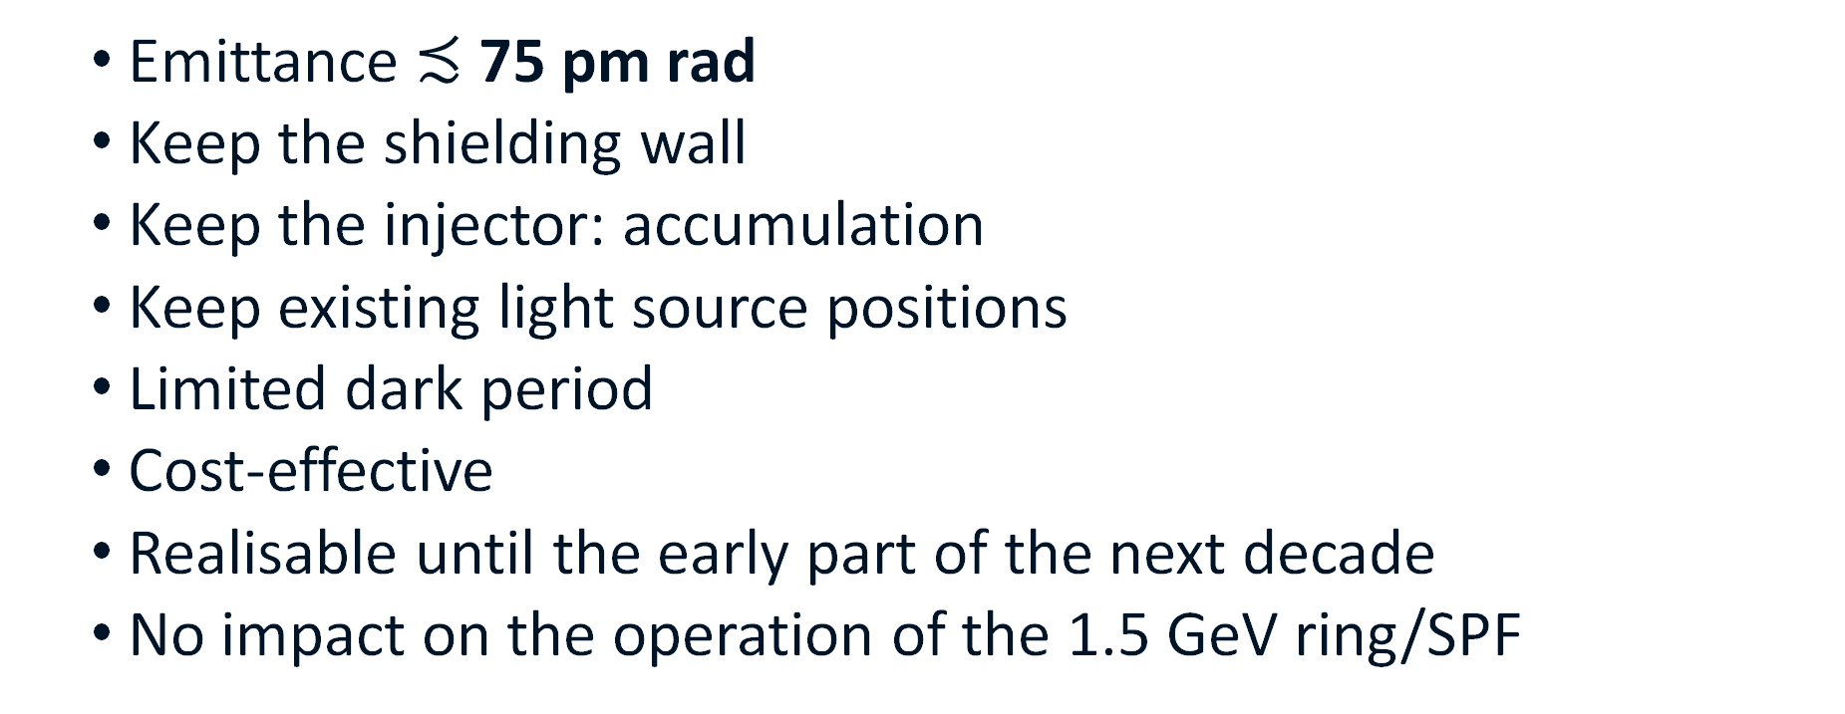
MAX 4^{U} Goals and Boundary Conditions
  Emittance $≾$ 75 pm rad
  Keep the shielding wall
  Keep the injector: accumulation
  Keep existing light source positions
  Limited dark period
  Cost-effective
  Realisable until the early part of the next decade
  No impact on the operation of the 1.5 GeV ring/SPF

Slide 14

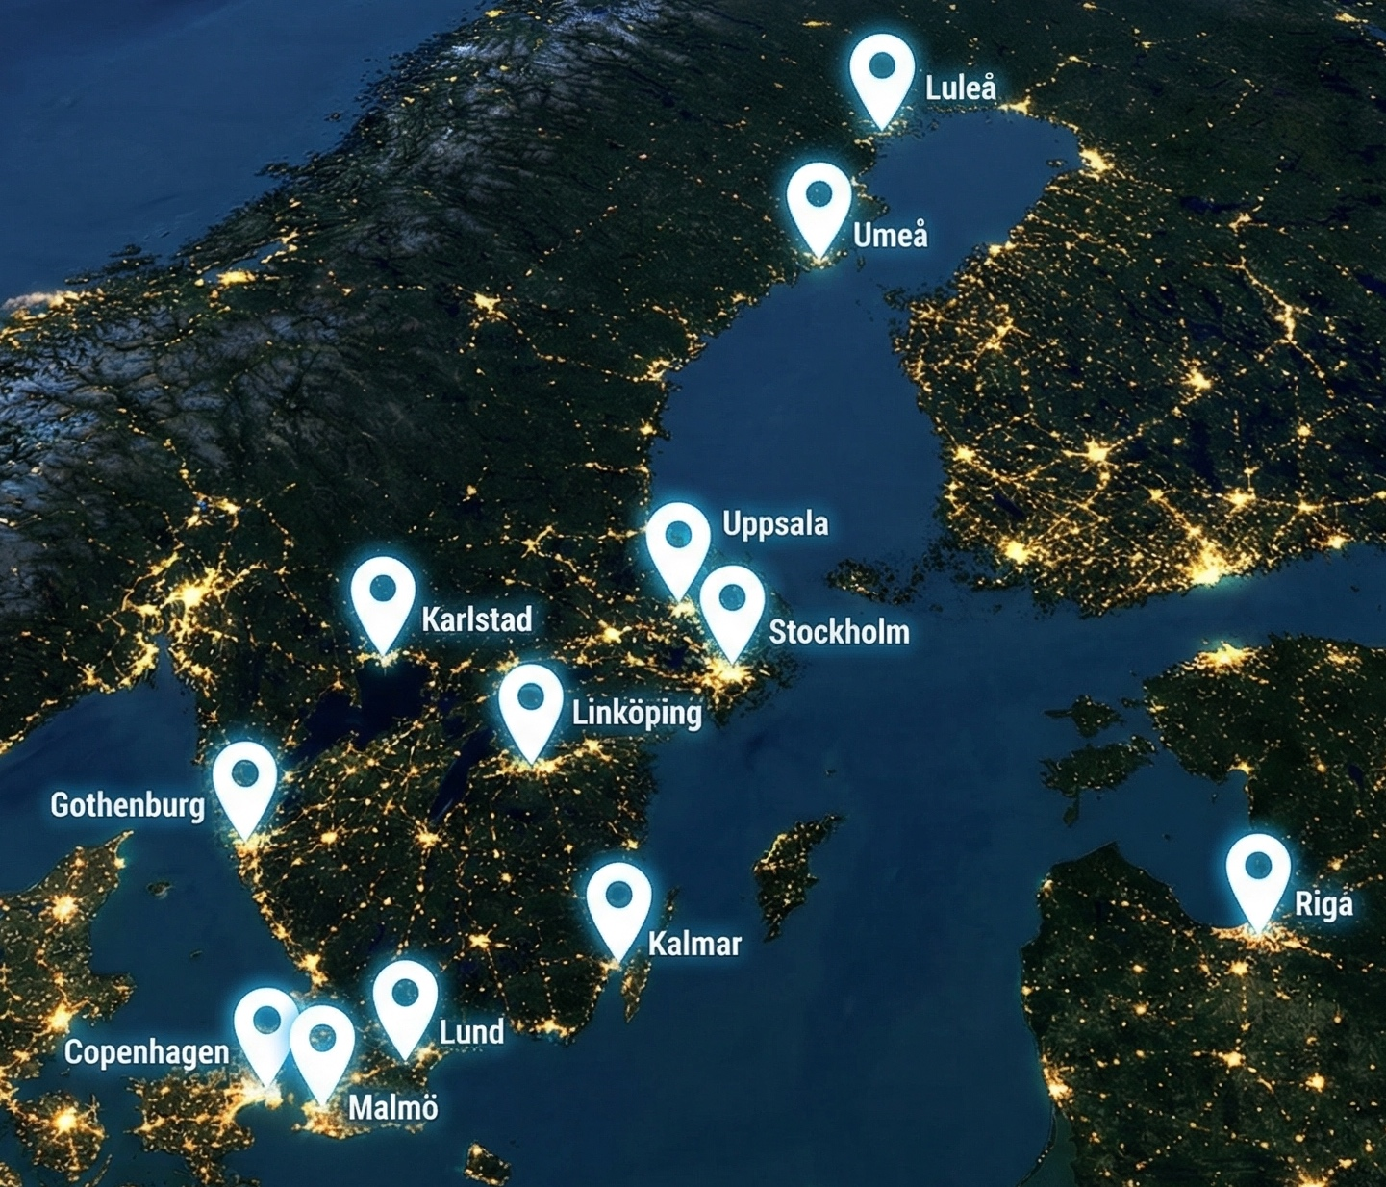
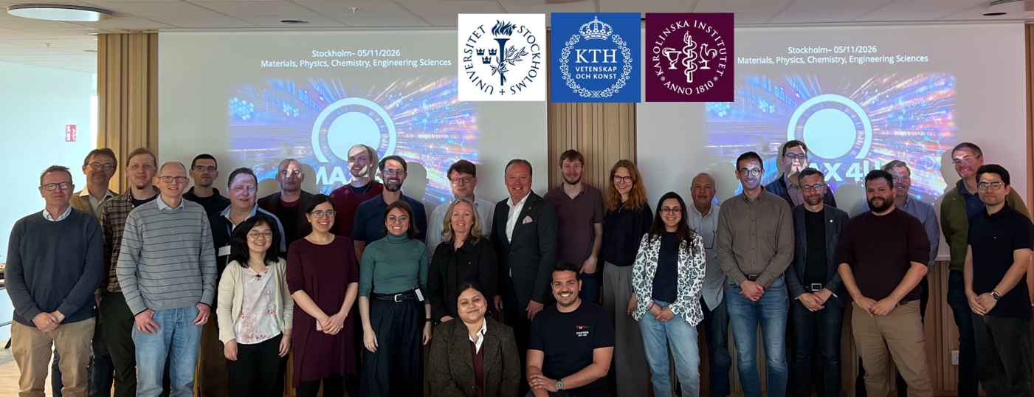

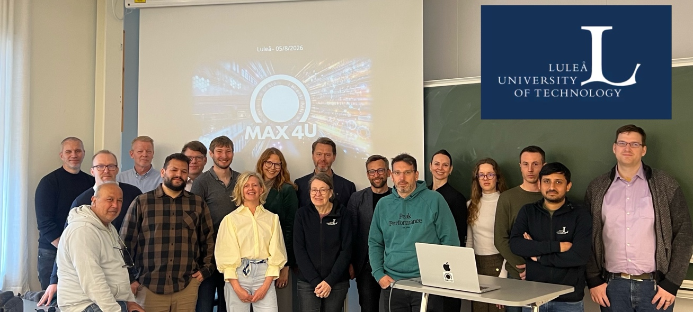
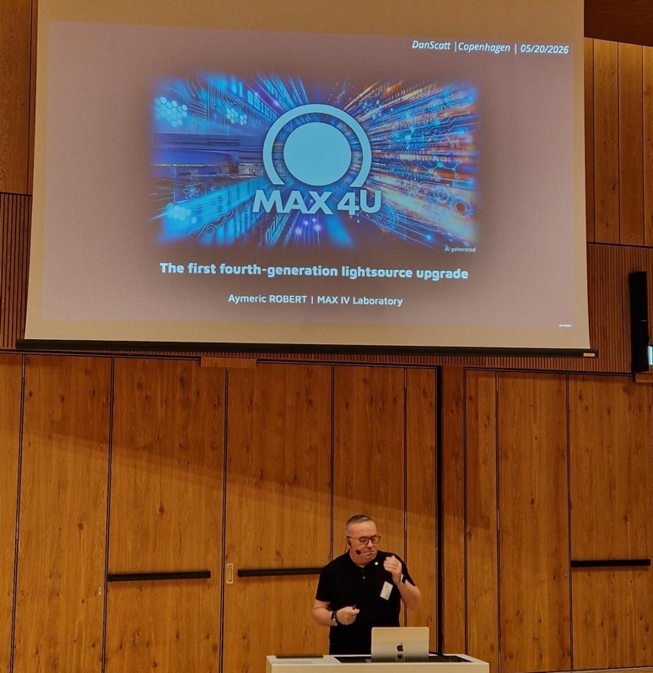
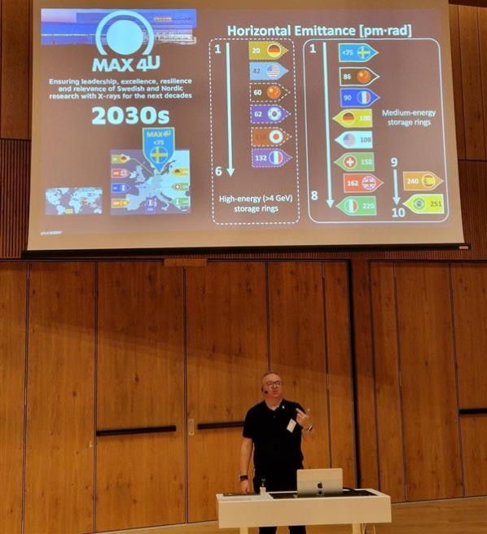


Towards the Science Case
2025 |  |  |  | 2026
Sept | Oct | Nov | Dec | Jan | Feb | Mar | Apr | May | Jun | Jul | Aug | Sep | Oct | Nov | Dec

Slide 15
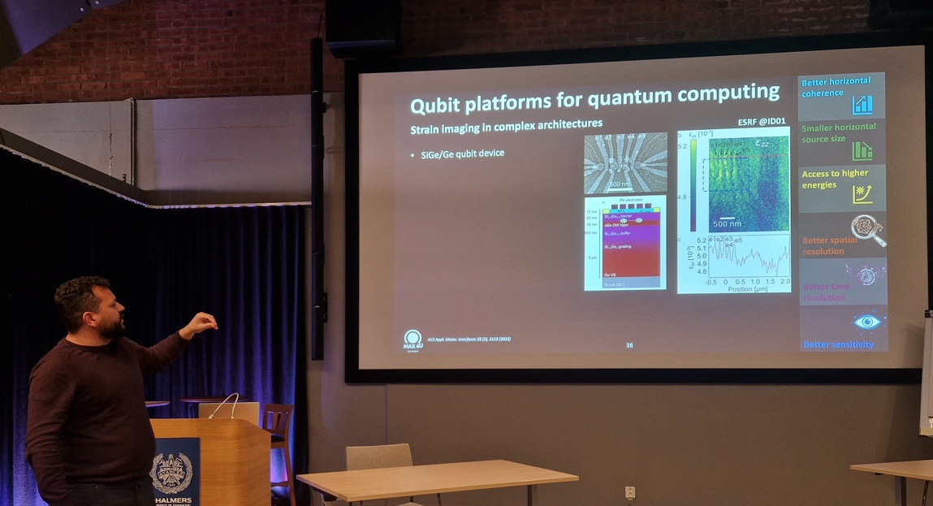

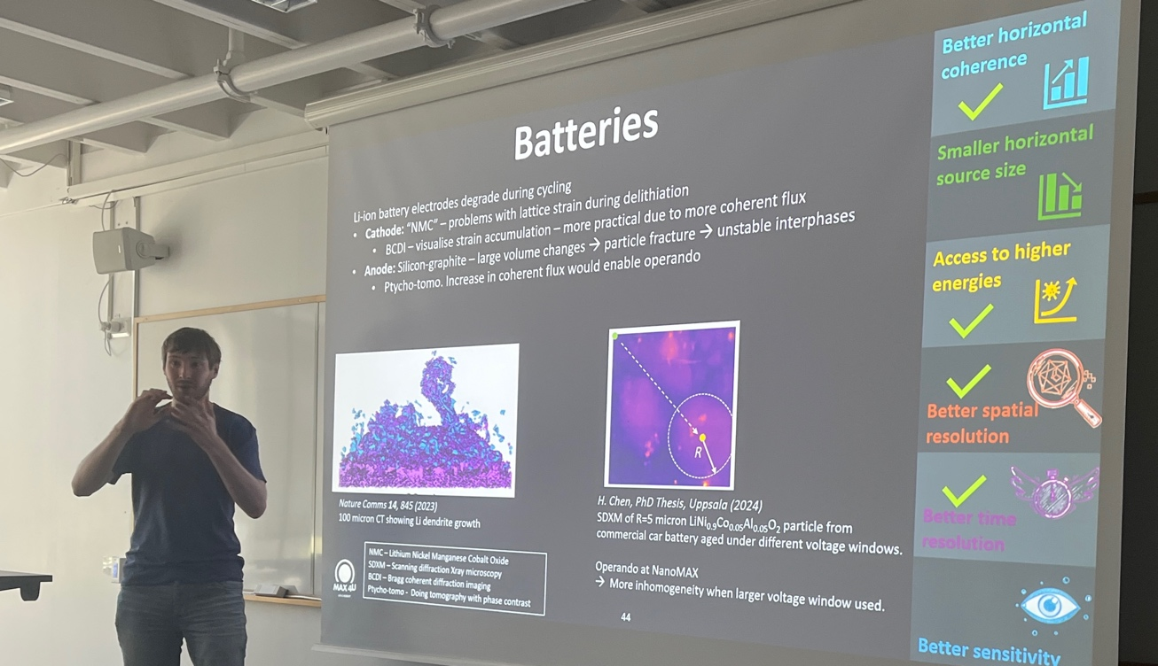

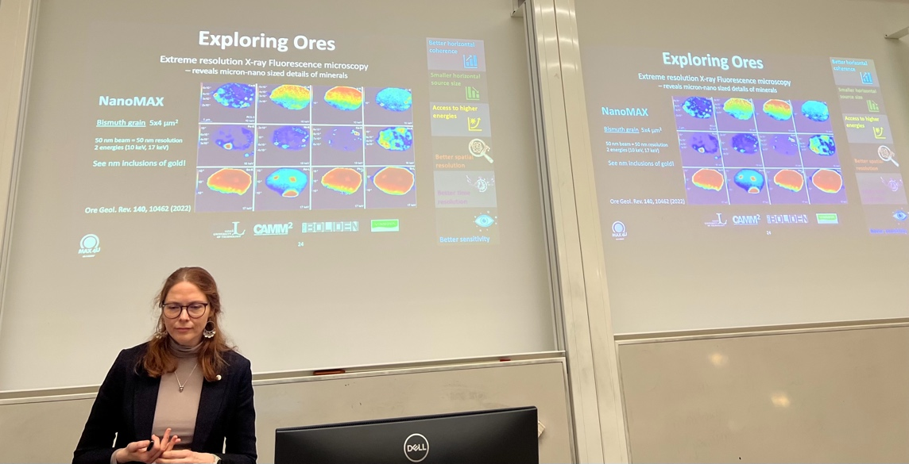
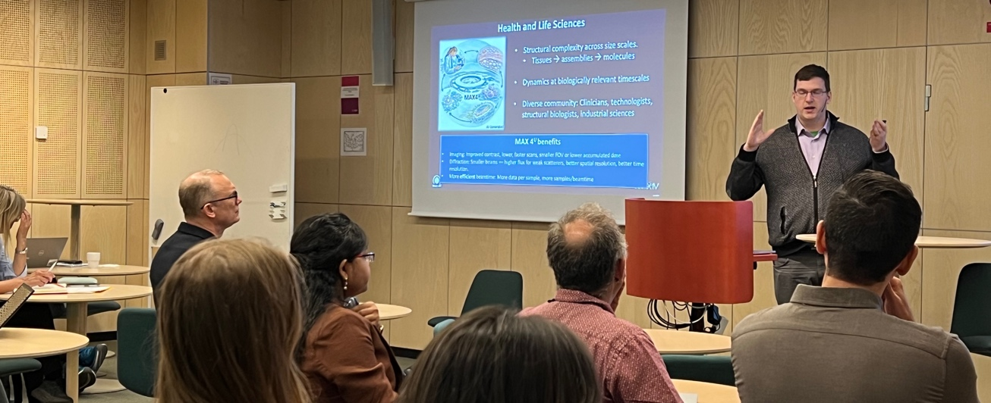
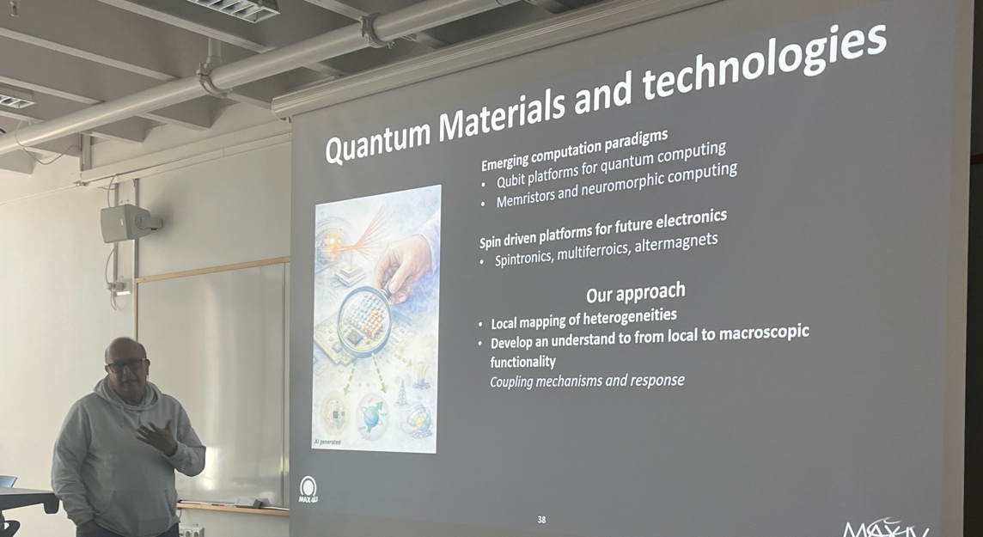
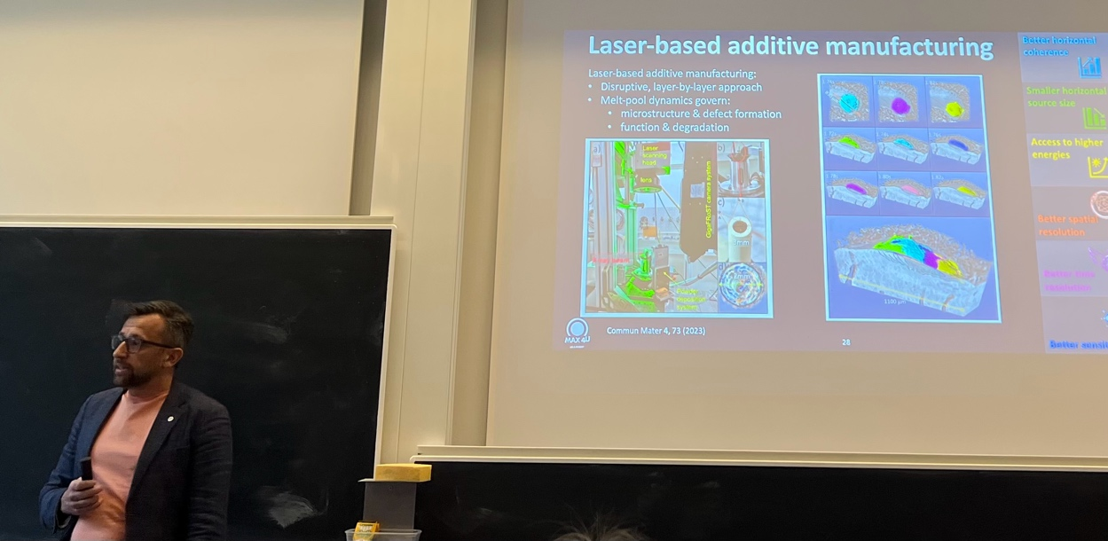
Towards the Science Case
2025 |  |  |  | 2026
Sept | Oct | Nov | Dec | Jan | Feb | Mar | Apr | May | Jun | Jul | Aug | Sep | Oct | Nov | Dec
Rob Temperton
Leonardo Oliveira
Kajsa Sigfridsson Clauss
Dean Lang
“Balu”
Kim Nygård
Balasubramanian Thiagarajan

Slide 16
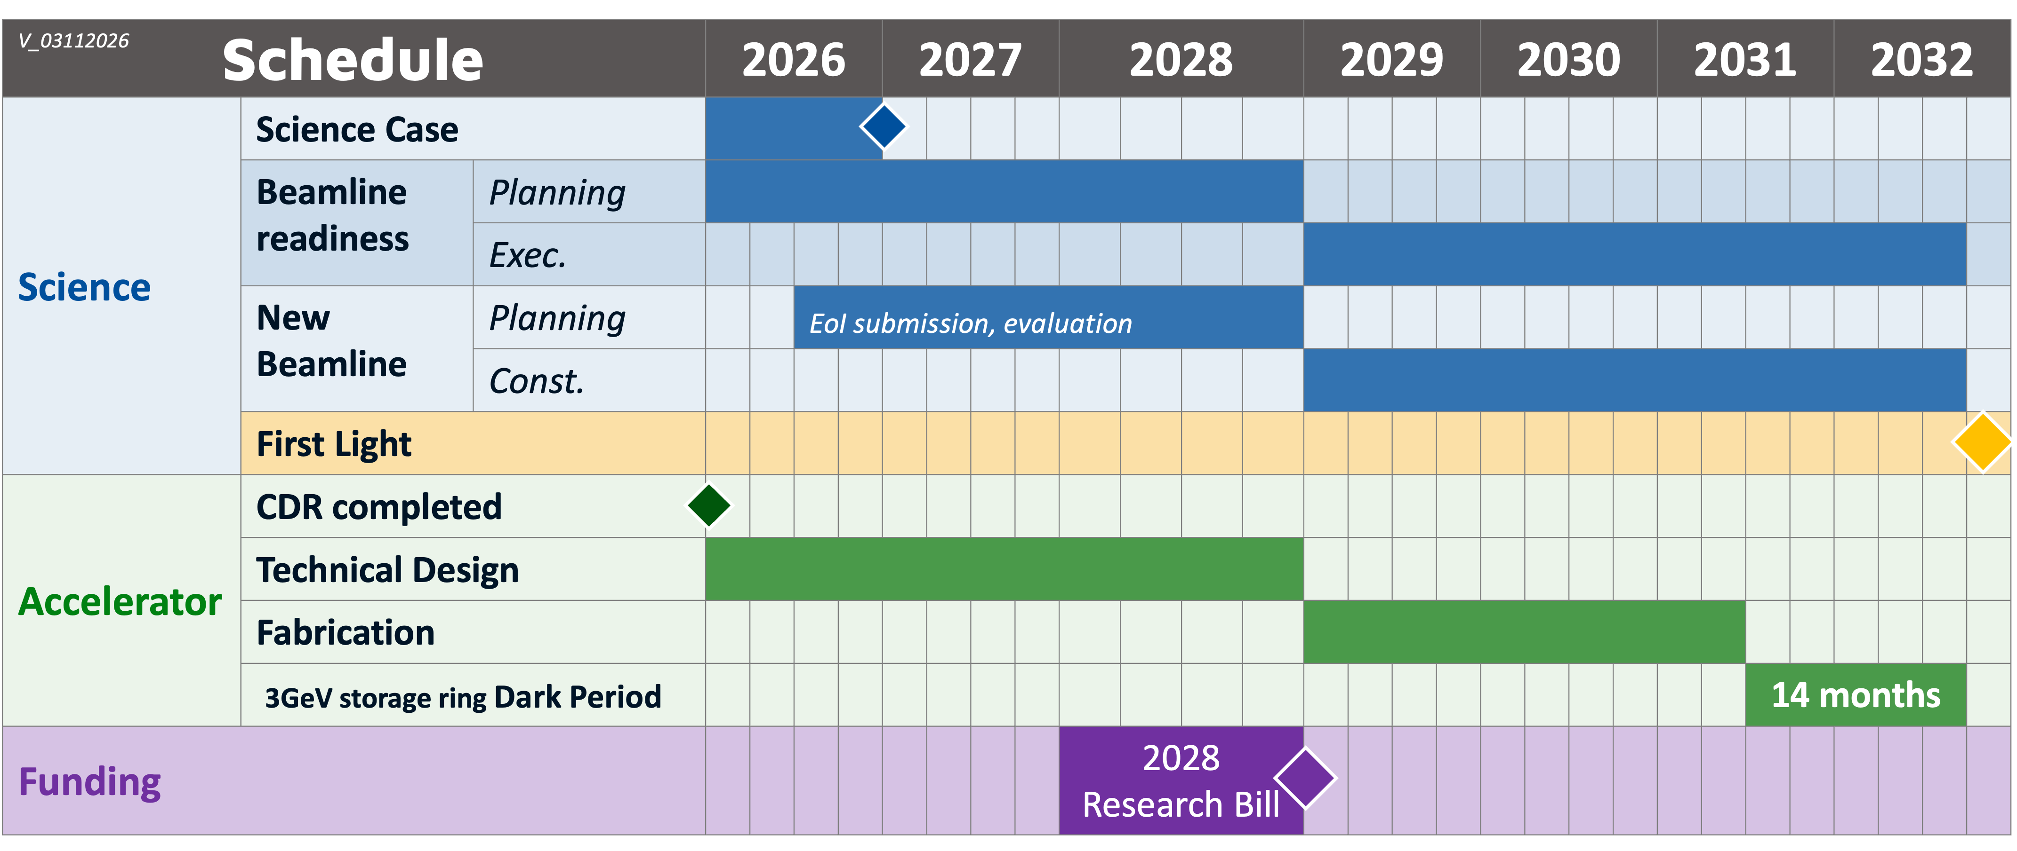
Schedule
Dark Period (14 months):
~6 months: Installation
~3 months: Subsystem testing
~3 months: Beam commissioning
~2 months of buffer.
c/o Aymeric Robert
No downtime for the 1.5 GeV storage ring or the SPF
16

Slide 17

Cost envelope
Accelerator
Science
Beamline
Readiness
Existing Beamlines
One New
Beamline
1BSEK
1BSEK
1BSEK = 700MDKK = 93M€ = 108M$

Slide 18
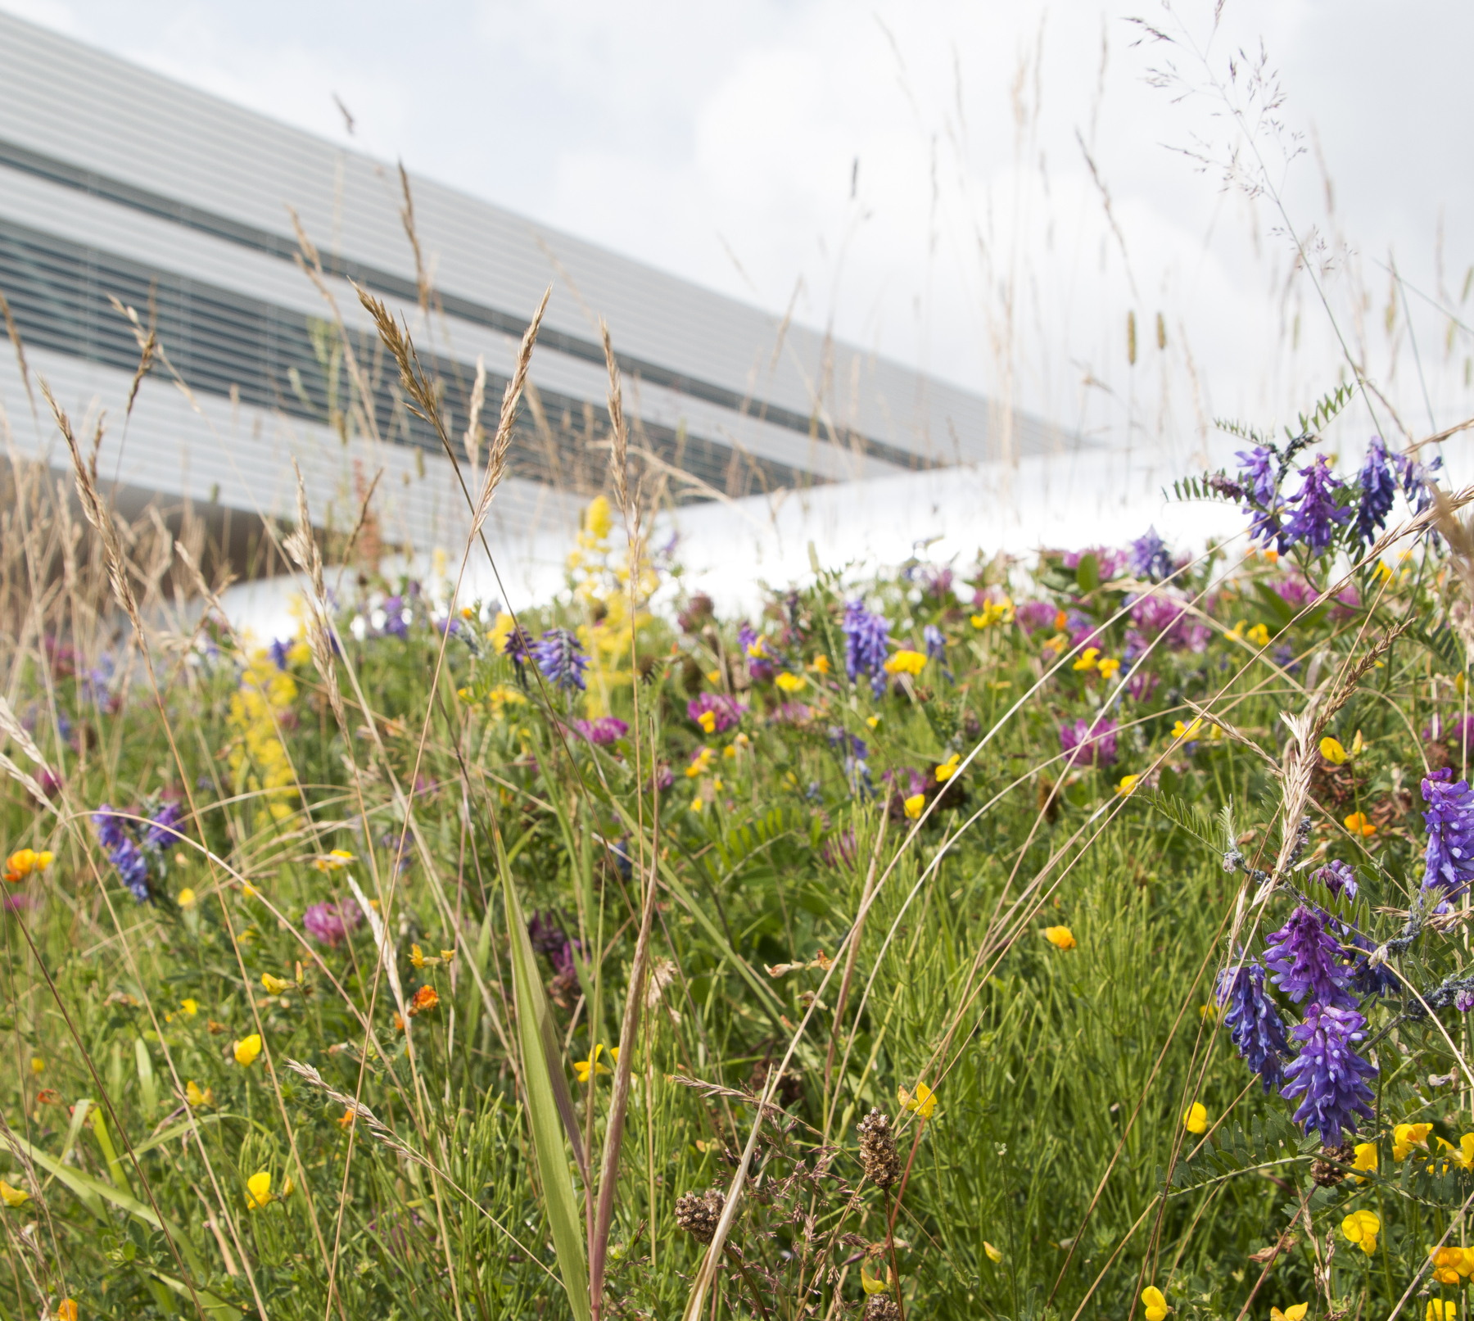
Conclusion

Slide 19
Conclusion
MAX 4^{U} is a strategic, ¨surgical¨ upgrade of the MAX IV 3 GeV ring, marking the first upgrade of a fourth-generation light source.
MAX 4^{U} targets <75 pm rad emittance, while preserving existing infrastructure.
Current lattice design meets the emittance target and boundary conditions.
Reuse of MAX IV infrastructure reduces cost and minimises user downtime.
19

