Slide 1
NSLS-II upgrade concept
T. Shaftan
National Synchrotron Light Source-II, Brookhaven National Laboratory
NSLS II-MAX IV Workshop: Fourth and Future Generation Light Source Design Challenges
October 5th, 2026

Slide 2
Outline
Introduction to NSLS-II facility
NSLS-II operations
NSLS-II upgrade
Complex Bend approach and Triple Complex Bend Achromat lattice
R&D and Prototype program
2
NSLS II-MAX IV Workshop: Fourth and Future Generation Light Source Design Challenges
Notes:
One always needs to be looking forward, and while NSLS-II is among the newest facilities in the world we have been considering upgrade paths for some while.

Slide 3
NSLS-II facility in operations
3
Notes:
One always needs to be looking forward, and while NSLS-II is among the newest facilities in the world we have been considering upgrade paths for some while.

Slide 4
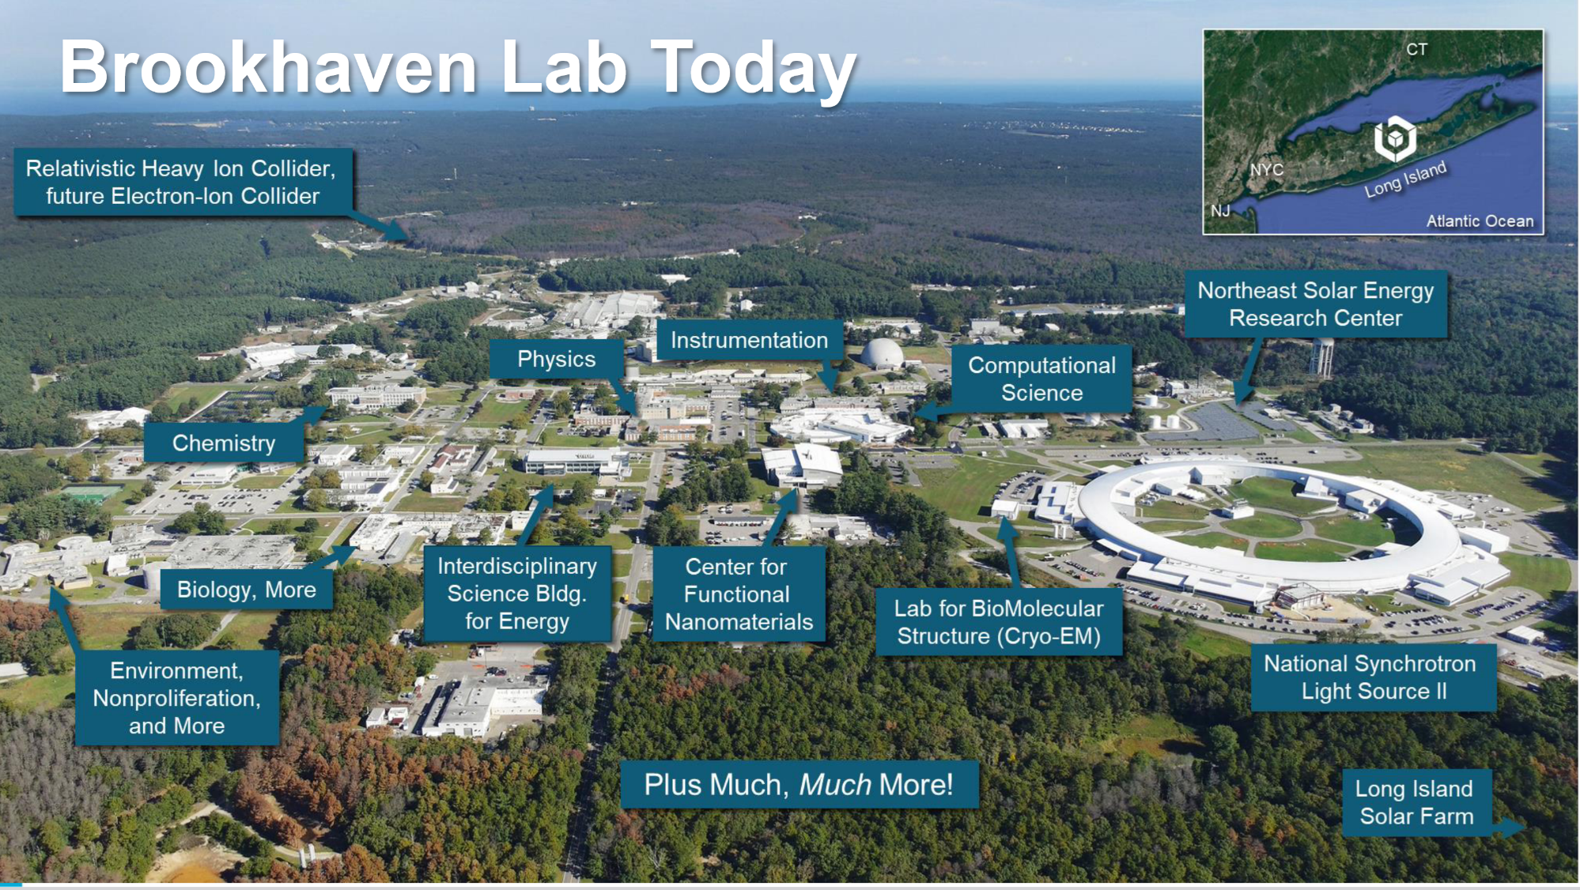
4
NSLS II-MAX IV Workshop: Fourth and Future Generation Light Source Design Challenges

Slide 5
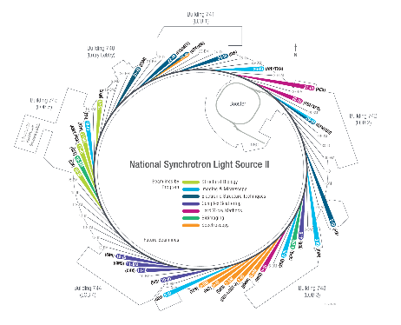
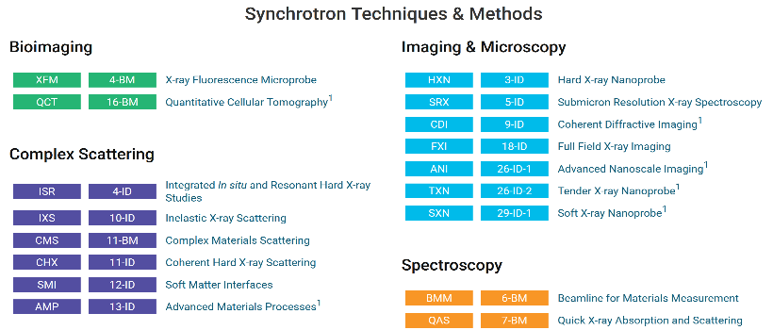
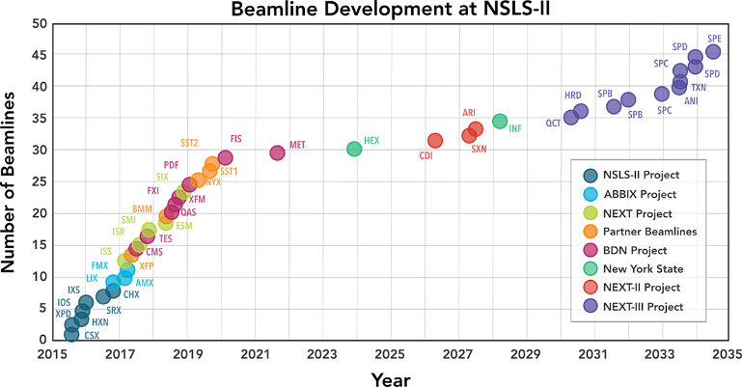
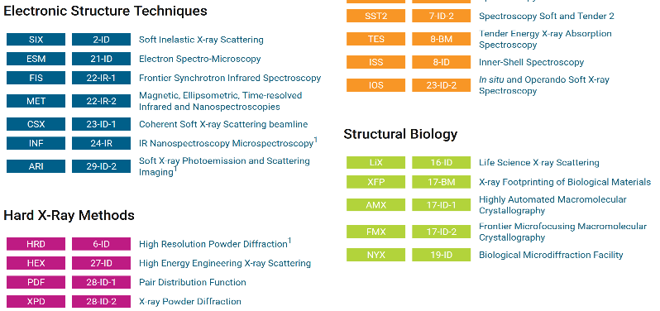
Beamlines at NSLS-II
29 beamlines at NSLS-II
  4 in construction/commissioning (NEXT-II)
  8-12 at CD-1 level (NEXT-III)
Specific capabilities
  3 120 m long beamlines
  Canted beamlines
  6 3PW or bending magnet sources
  1 IR instrument
Compatibility of NEXT-III beamlines with NSLS-IIU
Enterprise experiments vs cutting-edge programs
5
NSLS II-MAX IV Workshop: Fourth and Future Generation Light Source Design Challenges

Slide 6
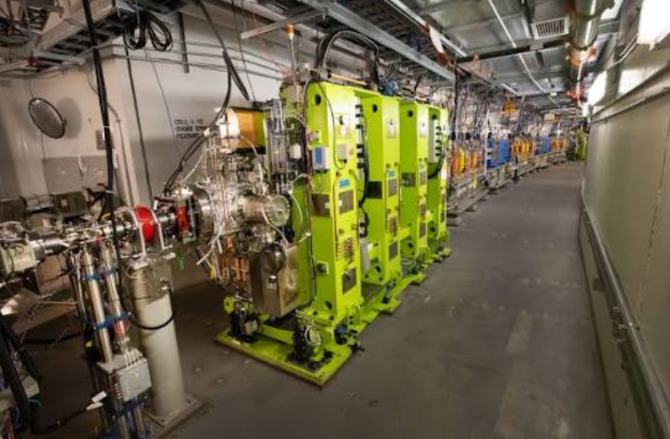
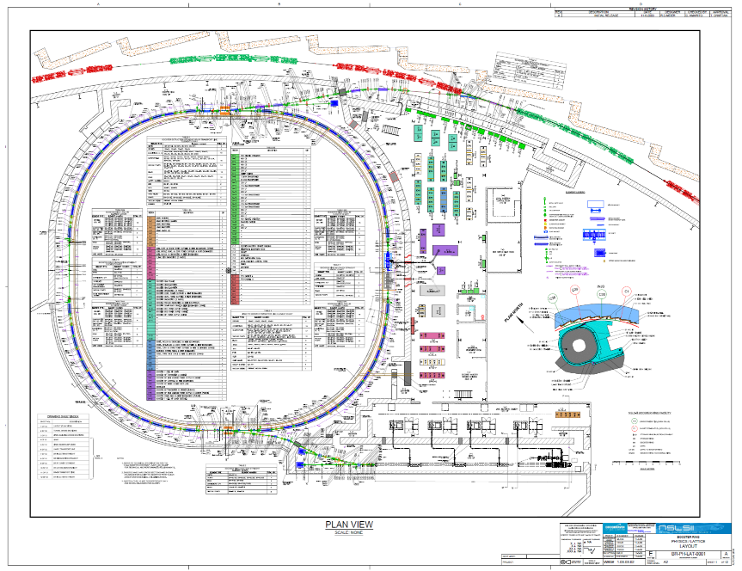
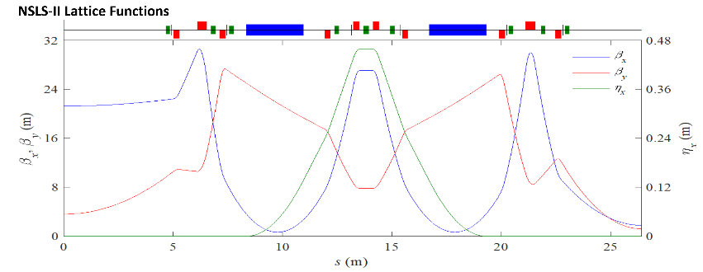
NSLS-II accelerators (2013-2026)
200 MeV linac (Research Instruments)
  Gun, bunching system, 5 3 GHz cavities
3 GeV booster (with BINP and Danfysik)
  158 m, 28+32 CF dipoles, PETRA 7cell cavity + IOT
3 GeV storage ring
  792 m, 30 DBA cells, 3 SC RF cavities
NSLS-II storage ring tunnel
NSLS-II storage ring Twiss parameters for a cell
Emittances 800/30 pm rad at 3 GeV
6
NSLS II-MAX IV Workshop: Fourth and Future Generation Light Source Design Challenges

Slide 7
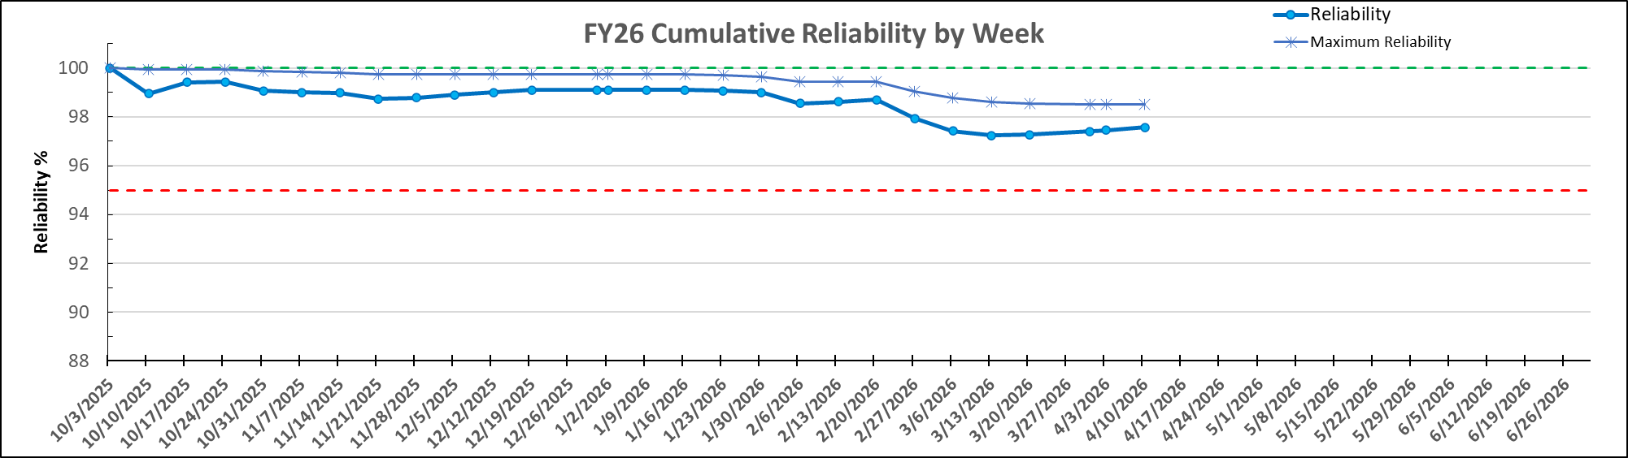
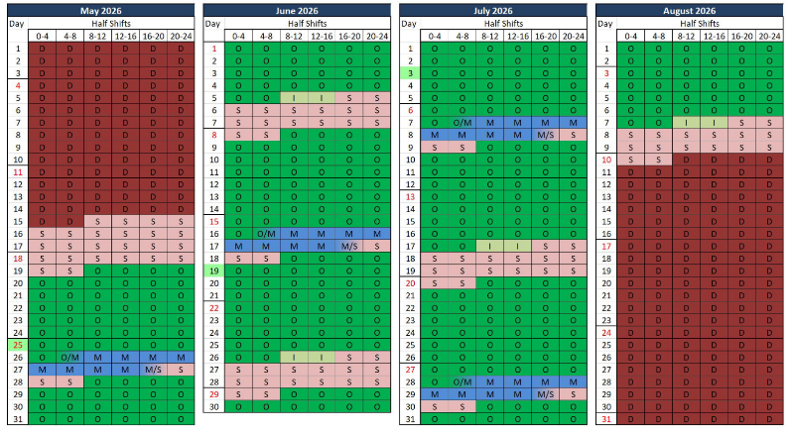
Operations & Reliability
Operations goal is 500mA and 30pm-rad with >97% reliability for ~5000 hours
  Scheduled for 4800 hours in FY26 & 4900 hours in FY27
Power Dip
Site CA loss
Major installation activities occur during machine shutdowns
Three machine shutdowns per year (~4 weeks each)
Two-day maintenance period every 3 weeks
Studies period 2-3 times per month
7
NSLS II-MAX IV Workshop: Fourth and Future Generation Light Source Design Challenges

Slide 8
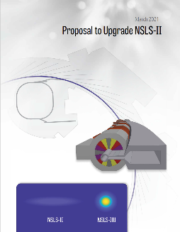
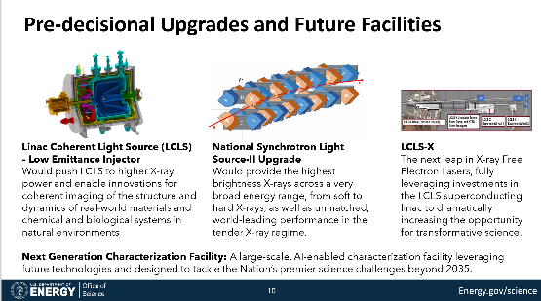

NSLS-II upgrade
2021
2026
2024
NSLS-II proposals
B. Nair and A. Schwarts
https://science.osti.gov/-/media/About/pdf/scac/meetings/2026/BES-101-for-SCAC--20260327-no-backups.pdf
8

Slide 9
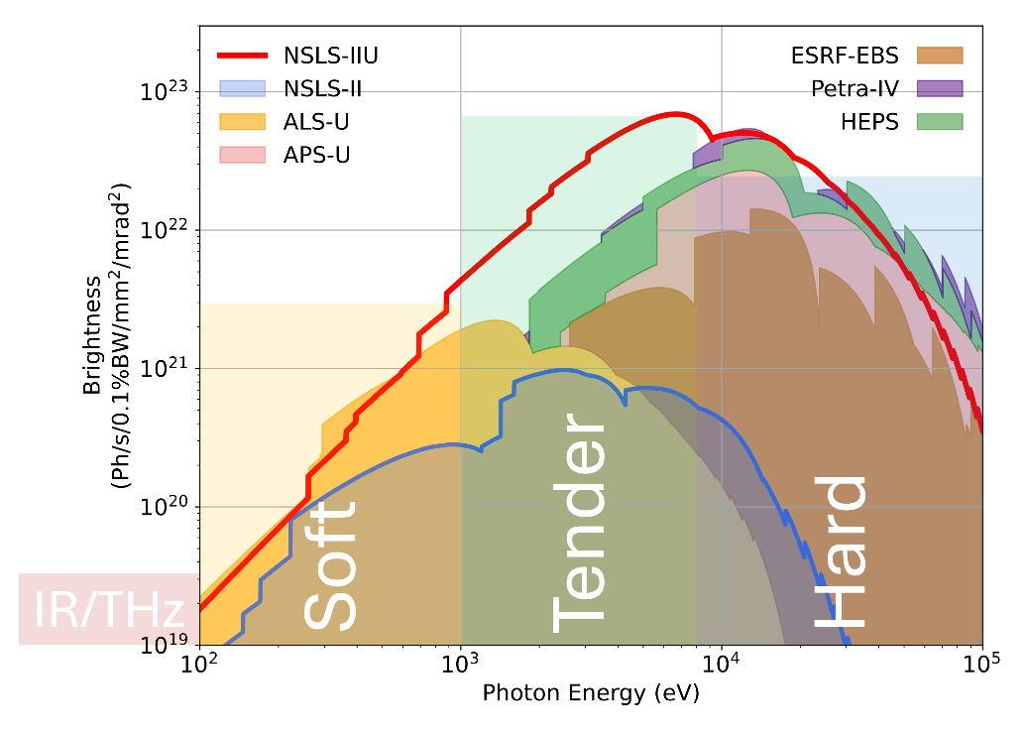
NSLS-IIU: future high-brightness synchrotron light source
The science calls for a source of world-leading brightness between 1 and 10 keV, is competitive over a broader range and is equipped with a portfolio of scattering, imaging, and spectroscopy beamlines.
NSLS-IIU answers this need
Upgrade goals:
  x120 in brightness at 10 keV, x15 at 1 keV
  Preserve present source locations to utilize existing beamlines
  Utilize advanced insertion devices
  Minimize power consumption
  Increase reliability
  Dark time <1 year
D. Hidas (2023)
Goals: 4 GeV, <40 pm rad emittance in flat beam
Secure international competitiveness in the next decade and beyond
9
NSLS II-MAX IV Workshop: Fourth and Future Generation Light Source Design Challenges

Slide 10
Complex Bend (CB) concept
Triple Complex Bend Achromat lattice
10

Slide 11
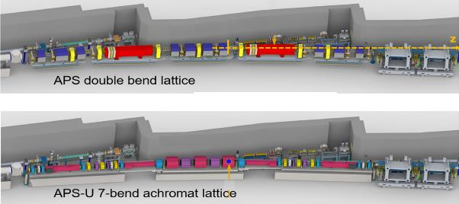


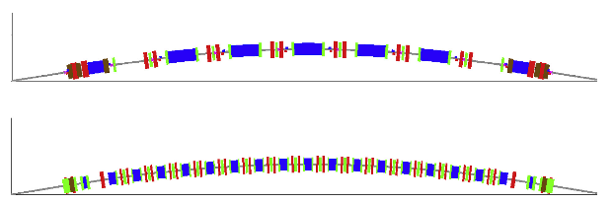
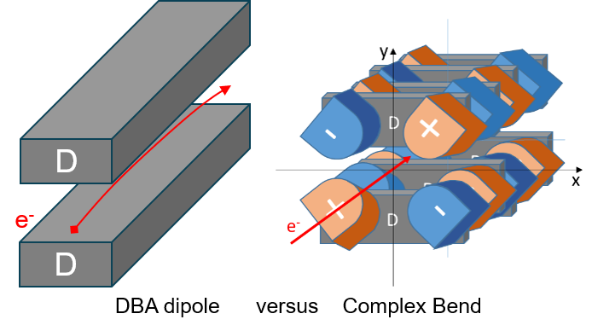
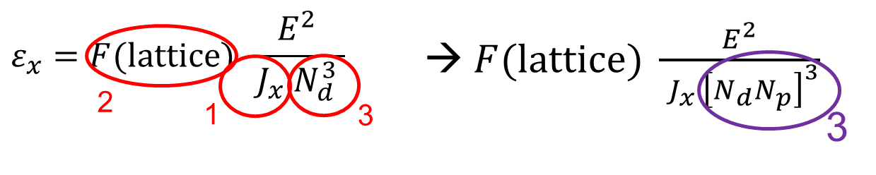
Benefits of CB approach
APS/APS-U
E=7→6 GeV
C=1104 m
𝜀_{x}=3100→36 pm
1. MBA lattices feature much tighter arrangement of elements as compared with DBAs/TBAs
  Large number of magnets
  Small diameter of vacuum chambers constrains conductivity = more pumping required
  Strong focusing results for large number of diagnostics and correctors
Due to tight composition of CB lattice, we free up more room for IDs and accelerator components
2. Relaying on Permanent magnet technology for majority of the lattice magnets
NSLS-IIU magnets at 3 GeV (4 GeV) will consume 17% (30%) of power relative to NSLS-II magnets
3. Low ε_{x}: 792 m long ring with 23 pm at 3 GeV
  IBS sets the limit at 3-4 GeV
ALS/ALS-U
E=1.9→2 GeV
C=197 m
𝜀_{x}=2000→70 pm
Early thoughts on MAX-4 upgrade
E=3 GeV
C=528 m
𝜀_{x}=250→10 pm
NSLS-IIU:
E=3-4 GeV
C=792 m
𝜀_{x}=35 pm
NSLSII-ASD-TN--276; BNL--211211-2019-TECH
(Shaftan, Smaluk and Wang, Concept of Complex Bend, 2018)
11

Slide 12
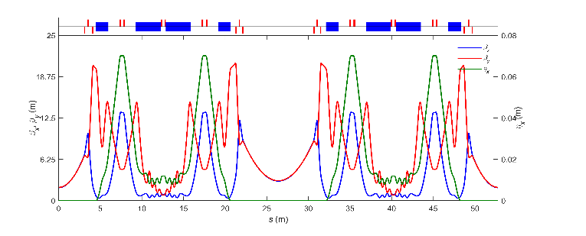
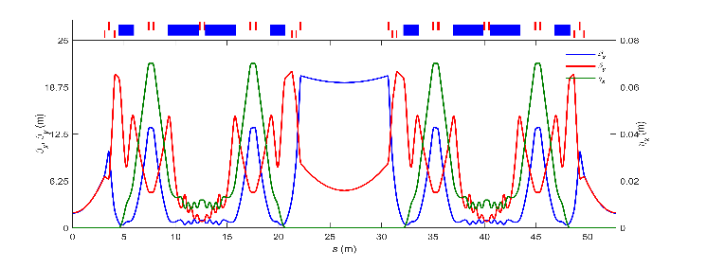
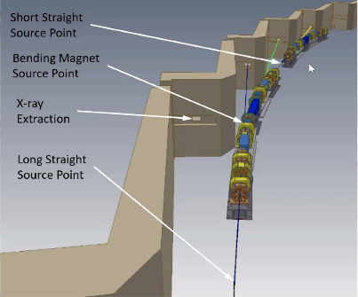
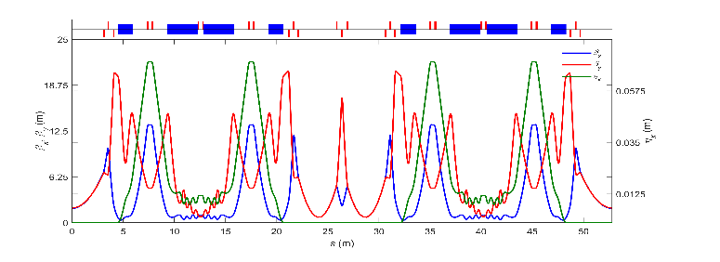



NSLS-IIU Triple Complex Achromat lattice (TCBA)
12 1.5 m Complex Bends
Parameter | values
Circumference [m] | 791.768
Beam energy [GeV] | 3 (4)
Beam emittance [pm rad] | 23 (38)
β_{x}/β_{y} at ID center / SS [m] | 1.94, 1.95
β_{x}/β_{y} at ID center / LS low β [m] | 2.95, 2.99
β_{x}/β_{y} at ID center / LS high β [m] | 19.35, 4.96
β_{x}/β_{y} at ID center / LS double low β [m] | (0.7, 0.7), (0.7, 0.7)
Layout of one supercell with low beta functions
$$\left(Δμ_{x},Δμ_{x}\right)=(3π,π)$$
Layout of one supercell with high beta function
$$\left(Δμ_{x},Δμ_{x}\right)=(3π,π)$$
<100 um accurate fit to the NSLS-II tunnel
Kosciuk, Hidaka
Layout of one supercell with double low beta functions
400 mA at 4 GeV
Smaluk, Khan
$$\left(Δμ_{x},Δμ_{x}\right)=(3π,π)$$
Design study of a low emittance complex bend achromat lattice
Song and Shaftan, Phys. Rev. Accel. Beams 27, 061601, 2024
12

Slide 13
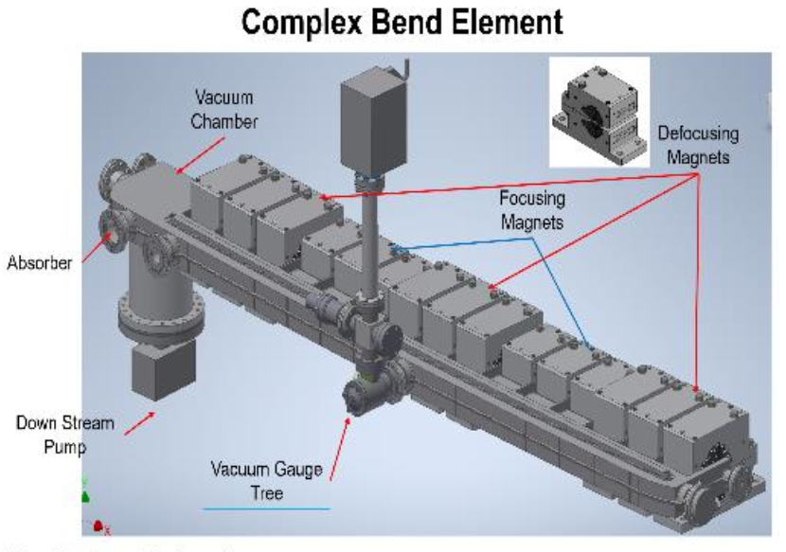
R&D and Prototype program on Complex Bends
13

Slide 14
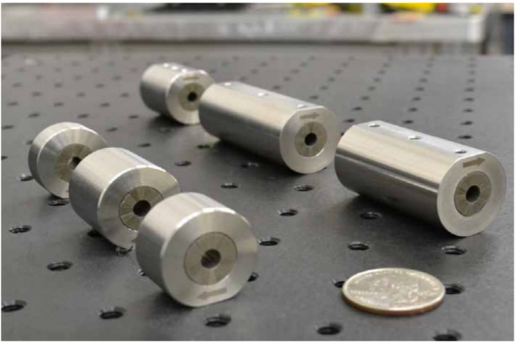
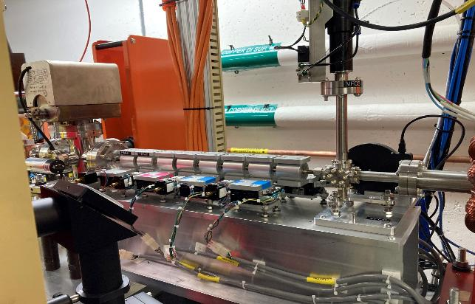
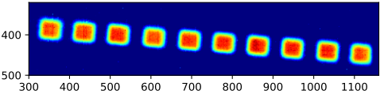

Low energy Complex Bend prototype
We scaled the Complex Bend parameters from 3 GeV down to 100 MeV
  Reduced the quadrupole pole length by a factor of 6 while keeping the values of bend angle and sqrt(𝐾₁)𝐿 the same as for the 3 GeV CB cell.
  The CB prototype pole is 46 mm long and consists of four cells, with the field gradient at 150 T/m.
Installed in NSLS-II linac and commissioned with beam
  Demonstrated high quality of the magnetic field in the Complex Bend set-up
  Achieved focused beam size (X/Y) of 60/120 um at 168 MeV and 50/110 um at 200 MeV
PMQ prototype at 150 T/m
Images collated after the 200 MeV beam passed through CB
Complex Bend prototype beamline design and commissioning, Wang et al., IPAC-2022, MOPA151
Four periods of CB in the NSLS-II linac tunnel
14
NSLS II-MAX IV Workshop: Fourth and Future Generation Light Source Design Challenges

Slide 15
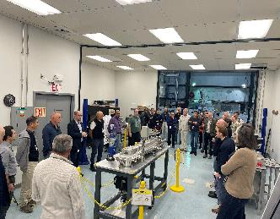
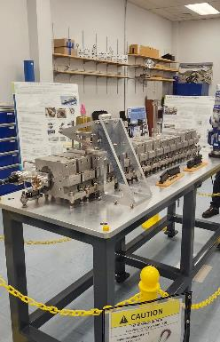
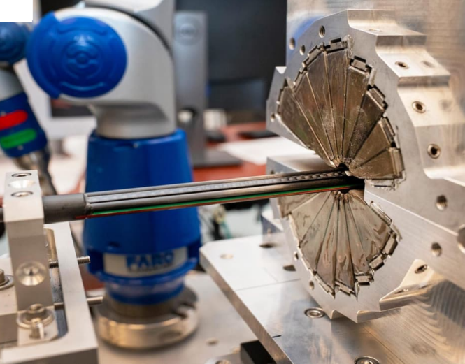
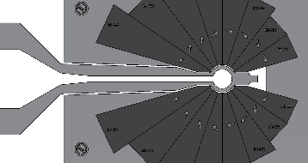
Full-energy Complex Bend prototype
S. Sharma, P. N’Gotta et al.
Supported by BNL we completed the first large-scale Complex Bend prototype
High-precision PM magnet:
  15-segment string of PMQs with 0.25-0.5 T, +/-130 T/m aligned along 4° bend with field quality better than 10⁻⁴
Measured, corrected and assembled
The team
1.7 m
Halbach PMQ
Complex Bend Prototype
15
NSLS II-MAX IV Workshop: Fourth and Future Generation Light Source Design Challenges

Slide 16
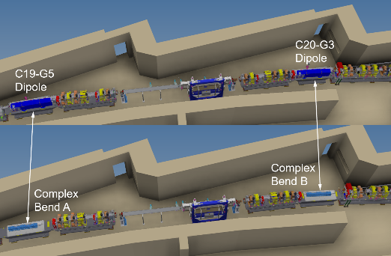
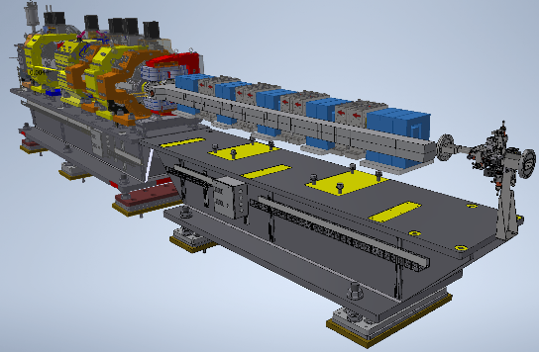
Next step: CBs in NSLS-II operations
DOE FWP project 2025-2028
Project goals
  Develop and demonstrate accelerator design of CBs and their model in the NSLS-II ring lattice.
  With beam study program predict major impact of the mechanical and magnetic constraints on the ring lattice. Use the scraper and the 12-pole magnets to simulate changes imposed by CBs in the ring.
  Build and characterize two CBs and demonstrate the required specifications using mechanical and magnetic measurement benches.
  Install these CBs in the tunnel and prepare the ring for operations within a single shutdown.
  Fully characterize the performance of CBs and performance of the modified ring lattice.
R&D project to replace two 2.4 m NSLS-II dipoles by CBs
B. Kosciuk
16
NSLS II-MAX IV Workshop: Fourth and Future Generation Light Source Design Challenges

Slide 17
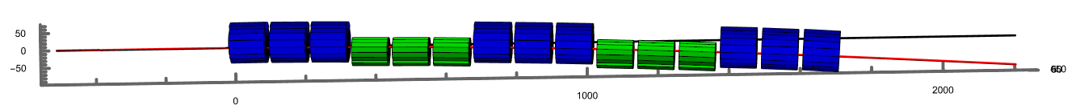


  Accurate representation of CB magnetic fields in lattice models
Patrick’s model in Radia and optimization process
  Straight CB geometry first
  Optimizing PMQ parameters
  Aligning PMQs along bent trajectory
  Minimizing deviations
  Computing integrals
  Optimizing focusing gradients
  Computing residual field errors within GFR (+/- 3mm)
Residual trajectory error 10 um
Residual field harmonics error 10 units x m
Development of detailed field/tracking models
  PMQs 3D model field map extraction
  Tracking with Generalized Gradient Method in Elegant*
* M. Borland, "elegant: A Flexible SDDS-Compliant Code for Accelerator Simulation," Advanced Photon Source LS-287, September 2000
P. N’Gotta
17
NSLS II-MAX IV Workshop: Fourth and Future Generation Light Source Design Challenges

Slide 18
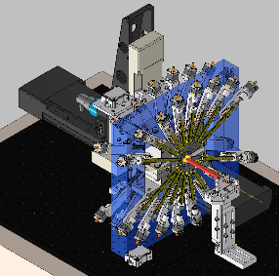
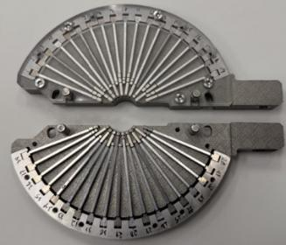
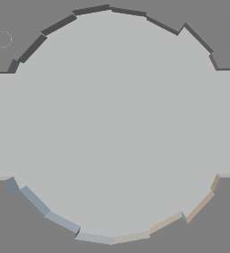
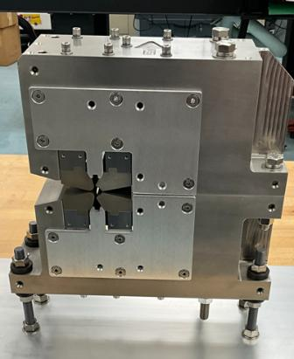
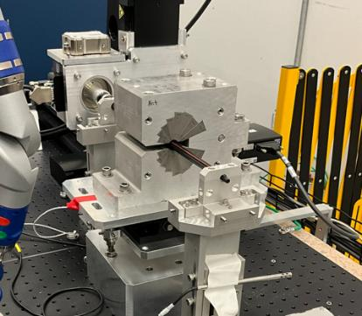
  Complex Bend manufacturing: field quality and manufacturability
PMQs field harmonics ≤10 units
  Halbach PMQ harmonics correction capability ~150 units
    Developed correction methods: PM radial displacement, Magic Finger, PM machining
    Computerized Radial displacement system integrated with measurement bench
    Fast and accurate correction of harmonics
  Hybrid PMQ less sensitive to errors
    design include correction with iron shim
    Precise poles EDM machining of the assembled PMQ
Accurate magnetic measurement and alignment
  PCB rotating coil with small diameter (12 mm) and high precision (0.1 unit)
  Stretch wire bench is in works for cross-check
  Precise alignment of PMQs with CMM <15 µm
Radial displacement system
Magic fingers
Bore EDM machining
Halbach PMQ on rotating coil bench
Hybrid PMQ prototype
S. Sharma et al.
18
NSLS II-MAX IV Workshop: Fourth and Future Generation Light Source Design Challenges

Slide 19
In closing
19

Slide 20
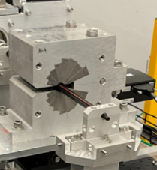
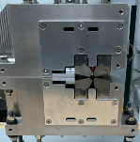
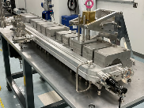
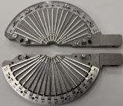
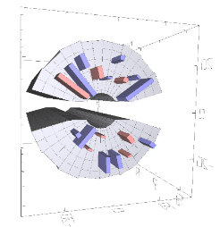
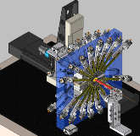
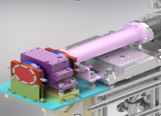
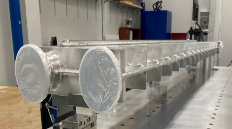
Development of technology for future light sources
We progressing with a program on PM Complex Bend prototypes
CBs provide competitive advantages:
    Building block of low emittance TCBA lattice
    No coils, power supplies, controls and DI water infrastructure. No maintenance!
    Facility magnets energy consumption of ~1.7 MW is reduced by 75% at 3 GeV
    Compact and cost-effective design
Halbach PMQ
Hybrid PMQ
We aim to produce a “standard” element for future synchrotrons
  Optimized design: in B, B’, ΣB_{n} , CB bore, cost
  Develop technologies for design, production, assembly, measurements
Looking forward to your comments and advice
Magic Finger Assembly
Magic Fingers
CB Prototype Assembly
Wedge Moving System
Radiation Resistance Test
CB Vacuum Chamber
20
NSLS II-MAX IV Workshop: Fourth and Future Generation Light Source Design Challenges
Notes:
.

Slide 21
NSLS-II colleagues and collaborators
BNL: M. Song, S. Sharma, P. N’Gotta, B. Kosciuk, G. Wang, M. Musardo, T. Tanabe, D. Hidas, S. Brooks (BNL CAD), R. Todd, M. Seegitz, Y. Hidaka, Y. Li, V. Smaluk, F. Plassard, A. Khan, X. Yang, G. Bassi, J. Choi, L. Doom, O. Chubar, P. Palecek, F. DePaola, L. Doom, R. Faussete, T. Shaftan
ANL/APSU: C. Doose, A. Jain, M. Jaski
FermiLab: J. DiMarco
SLAC: J. Safranek, X. Huang
Korea-4GSR: J. Lee
21
SLS Seminar, 9/2026

