Slide 1
3. Lattice design strategies
NSLS II-MAX IV workshop
5-6 Oct. 2026
Magnus Sjöström (MAX IV)

Slide 2
Outline
Overview
  Boundary conditions
  Toolkit
  Lattice layout
Design principles
Error modelling
Lattice performance
Next steps

Slide 3
Overview
Emittance <= 75 pm rad
Keep the shielding wall
Keep the injector: accumulation
Keep existing light source positions
Limited dark period
Cost-effective
Realisable until the early part of the next decade
No impact on the operation of the 1.5 GeV ring/SPF
Lattice design is a multi-objective optimization problem
Determine constraints and parameters (fluid, will change)
Time is a boundary constraint (project-wise)! To get a rapid start...
  Necessary to work in parallel with engineering, alignment, etc. → information exchange important from the start → tools to export/import data needed early on (e.g. reference orbits)​
  Team competencies determine tool preference (AT, Tracy, Thor)​
  An advantage...
  Cost-effective and limited dark period driver for keeping the vacuum system→ impedance boundary conditions relatively well-known​

Slide 4
Toolkit
Slide by G. P. Segurana
Linear optics
Tune footprint
RDTs, ADTs
Multipole
Optimization
Tracy
lattice file
Tracy
Flat-file
Thor
OPA
AT
Flat-file
pyAT
NB! Tracy, AT, Thor, Thor-scsi all have the same Hamiltonian and Symplectic Integrator(s) (i.e, forward self consistent model)
Cross-checks done vs. elegant, Xsuite
AT
cLatt
Standarized benchmarking and lattice versioning

Slide 5
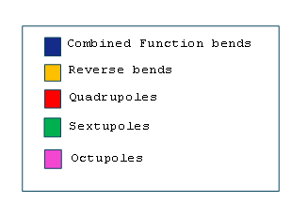
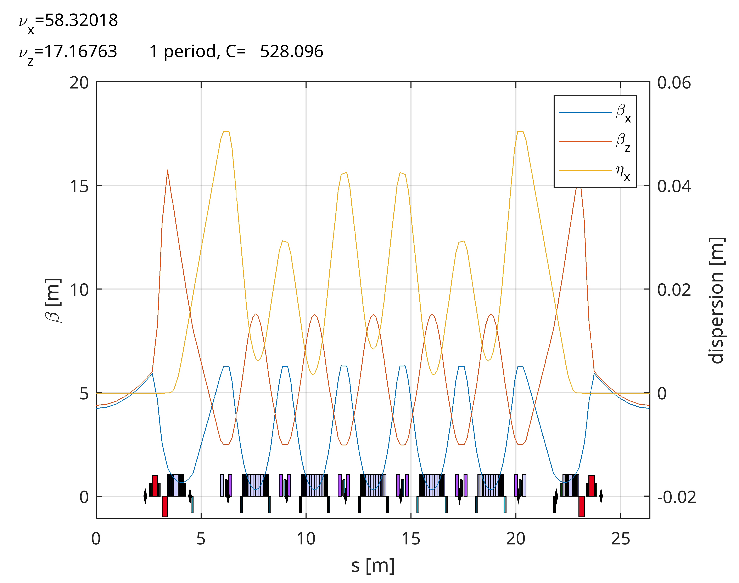


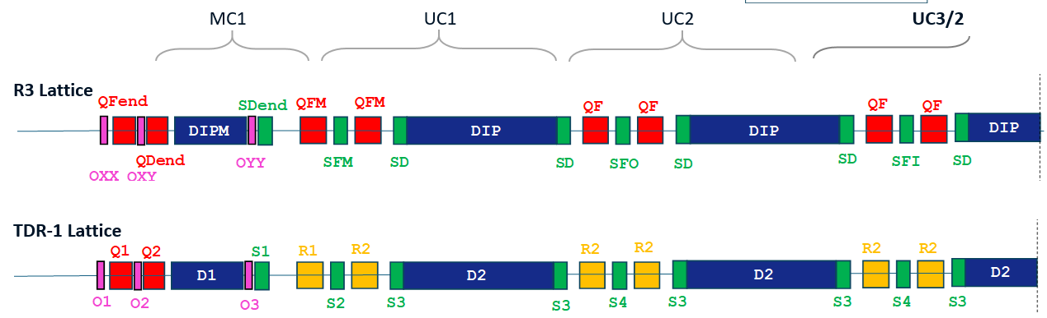
Overview: layout and linear optics
Overall structure (7 MBA) inherited from the current MAX IV 3 GeV ring (R3)
Lattice design
MC1
UC1
UC2
UC3/2
Mechanic
Graphic by A. Sharma

Slide 6
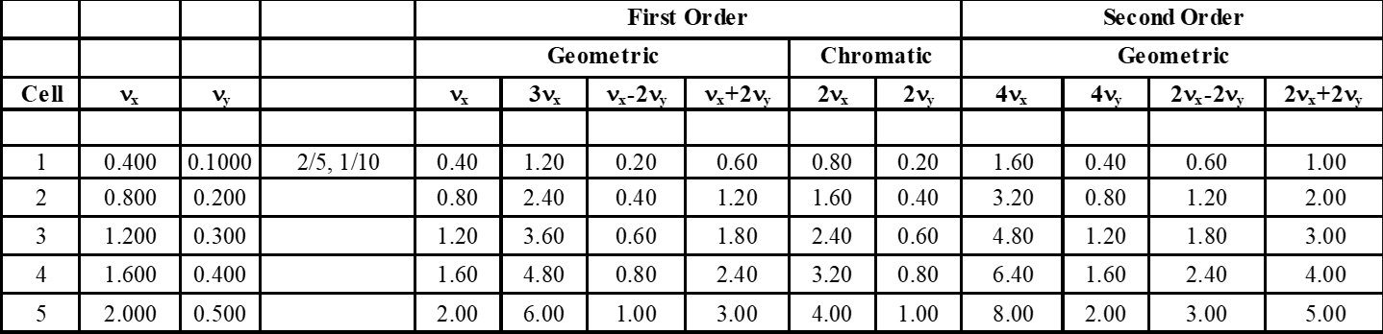
Design principles
Unit cells (UC1-5)
  Fulfil Higher-Order Achromat conditions for robustness
  Distributed chromaticity correction
  Reverse bends for emittance reduction
Matching cells (MC)
  Matching of long straight dispersion
  MC + long straight phase advance chosen to approach a –I transform (Δphi = (2n+1)π, n e Z)
NB!
Matching cell bend angle needed as a tuning knob --> balance needed with engineering constraints (getting light out)
Beta function reduction at long straights under investigation
HOA fulfilment: above green resonances cancelled within the 5 unit cells

Slide 7
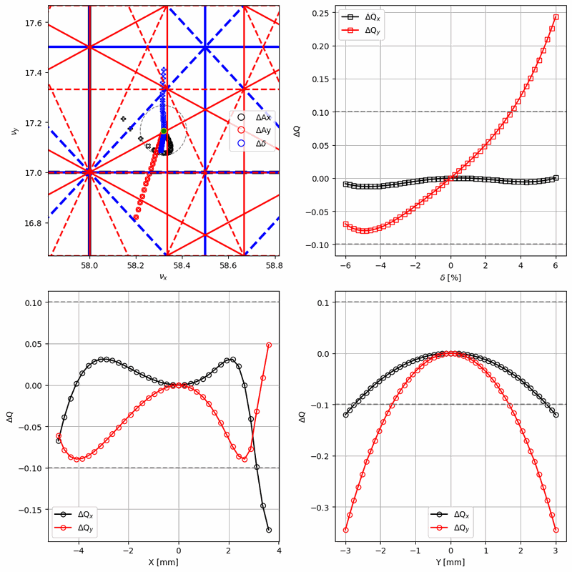
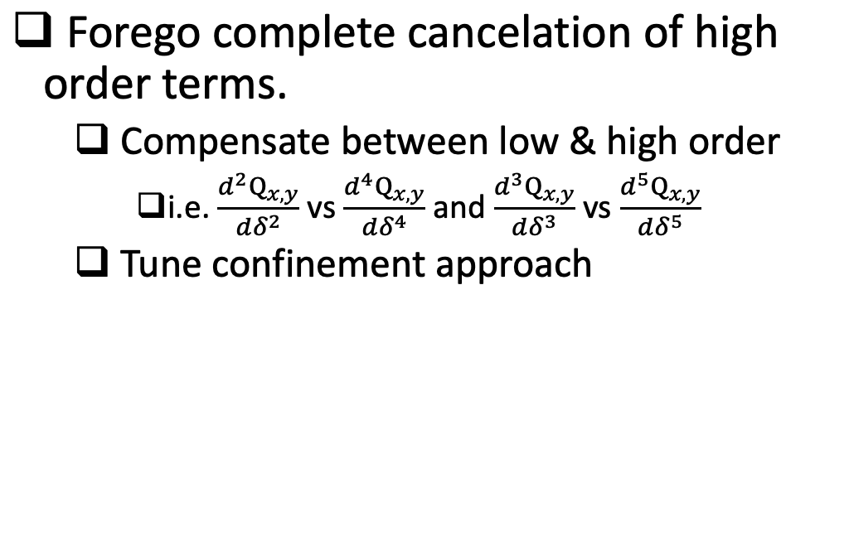
Slide by G. P. Segurana
Design principles: Nonlinear optimization

Slide 8
Nonlinear optimization
Method
  Truncated Power Series Algebra (TPSA) – Compute driving terms up to arbitrary order
  Construct Jacobian
  Iterate (with appropriate set of weights, knobs and constraints)
    4 chromatic sextupole families
    3 geometric octupole families

Slide 9
 | R3 (as designed) | TDR-1 (n01-02-01-01) | Units
Natural Emittance | 328 | 65.2 | pm rad
Natural Energy spread | 7.69 | 8.46 | 10⁻⁴
β @ long straights (x/y) | 9.0 / 2.0 | 4.2 / 4.4 | m
Natural Bunch length | 8.8 | 5.7 | mm
Betatron tunes (x/y) | 42.20, 16.28 | 55.32, 16.17
Natural chromaticity per achromat | -2.50, -2.51 | -4.88, -2.88
Corrected chromaticity | +1, +1 | +2, +2
Momentum compaction factor | [3.06, 1.63, 15.8] | [0.53, 3.63, -4.48] | 10⁻⁴
Total abs. deflection angle | 360 | 442.15 | deg
M1 block deflection angle | 1.50 | 1.30 | deg
Max. orbit shift | 0 | 21.5 | mm
Radio-frequency change | 0 | -18.2 | kHz
Energy loss per turn | 364 | 474.16 | keV
Damping times (H/ V/ L) | 15.73 / 29.05 /25.19 | 11.45 / 22.29 / 21.17 | ms
RF Voltage | 1.8 | 1.0 | MV
TDR-1

Slide 10
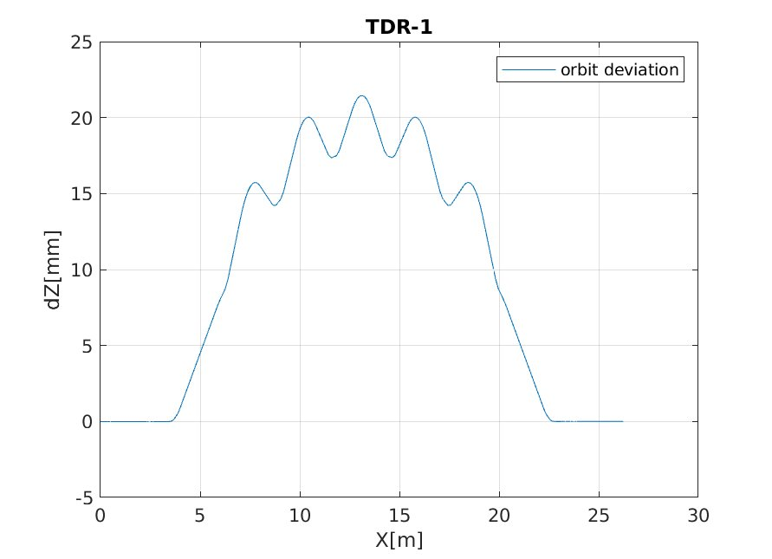
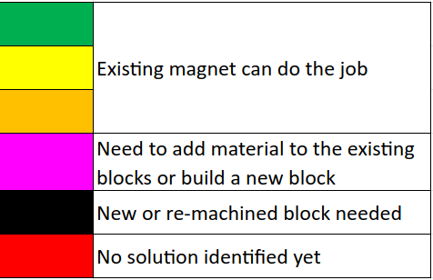
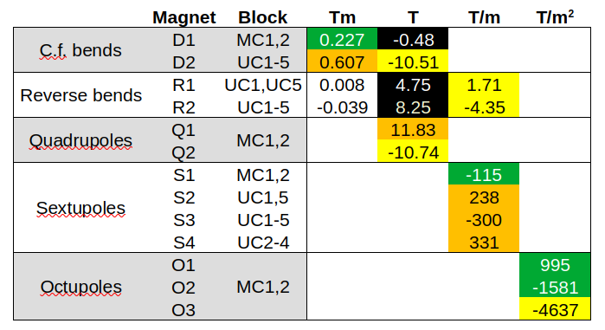
TDR-1: orbit and field strengths
z
UC3
Design orbit difference between TDR-1 and R3.
NB! Inter-block orbit difference significantly smaller.

Slide 11

Error model: multipole errors
Work is ongoing to import field error data from magnet design.
Table on the left shows the multipole errors assumed up to now, i.e. data from the Swiss Light Source (SLS).
E.I. Antokhin et al., "Precise Magnetic Measurements of the SLS Storage Ring Multipoles: Measuring System and Results", Proc. of APAC'01, Beijing, China.

Slide 12
Error model: main field variation
Currently relies on historical data from MAX IV 3 GeV ring series production
Inclusion of field errors from magnet design underway
 | Main field variation, standard dev. (10⁻³) [2,3]
Dipole | 0.87
Dipole gradient | 1.1
Quadrupole | 1.8
Sextupole | 2.3
Octupole | 2.4
Bold – based on data (references below)
(parenthesis) – ignored as impact reasoned to be negligible
Red – proxy value used (measured BBA reproducibility, i.e. only includes random component)
Blue – unavailable, historical assumption used. NB! Magnet roll errors show up as skew components in evaluation of series production field measurement data.
Sources
Internal MAX IV report by SAM
M. Johansson et al., "Magnet design for a low-emittance storage ring", Journal of Synch. Rad., July 2014
M. Johansson et al., "MAX IV 3 GeV STORAGE RING MAGNET BLOCK PRODUCTION SERIES MEASUREMENT RESULTS", Proc. of IPAC 2015
Internal communication, Design Office
Experimental data
NB! Data was available per family; the above are weighted averages.

Slide 13
Error model: misalignments
Magnet misalignments are applied for all magnets inside a block
Girders first treated as stiff bodies (element shifts/rotates around an anchor point), then a sag added
BPM misalignments are added to BPMs along with their BBA magnet misalignment
 | Magnet misalignment (µm/µrad) [2,3] | Girder misalignment (µm/µrad) [1,4] | BPM "misalignment" (µm/µrad) [5]
Sway | 4 | 27 | 3
Heave | 9 | 21 | 3
Surge | (0) | 16 | (0)
Pitch | (0) | 21 | (0)
Yaw | (0) | 21 | (0)
Roll | 100 | 157 | 100
Sag | - | 20 | -
Bold – based on data (references below)
(parenthesis) – ignored as impact reasoned to be negligible
Red – proxy value used (measured BBA reproducibility, i.e. only includes random component)
Blue – unavailable, historical assumption used. NB! Magnet roll errors show up as skew components in evaluation of series production field measurement data.
Sources
Internal MAX IV report by SAM
M. Johansson et al., "Magnet design for a low-emittance storage ring", Journal of Synch. Rad., July 2014
M. Johansson et al., "MAX IV 3 GeV STORAGE RING MAGNET BLOCK PRODUCTION SERIES MEASUREMENT RESULTS", Proc. of IPAC 2015
Internal communication, Design Office
Experimental data

Slide 14
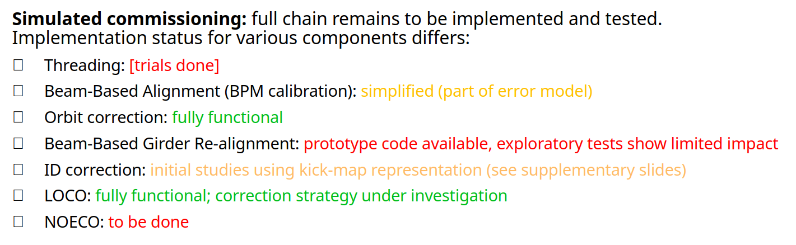
Error correction
Parts included in the optimization and benchmarking chain as they become available.

Slide 15
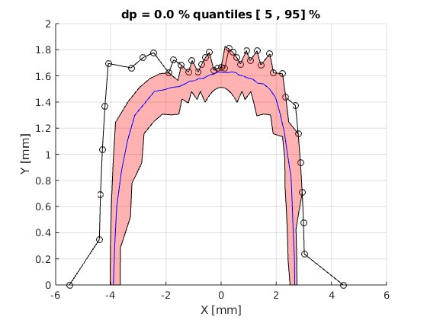
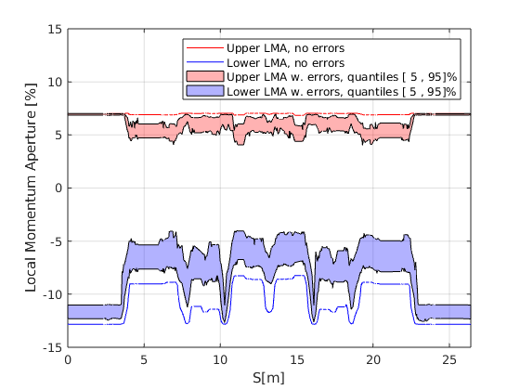
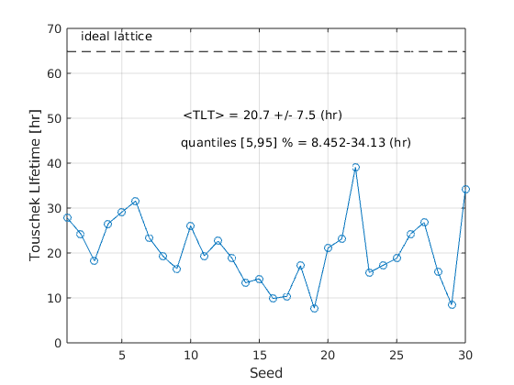
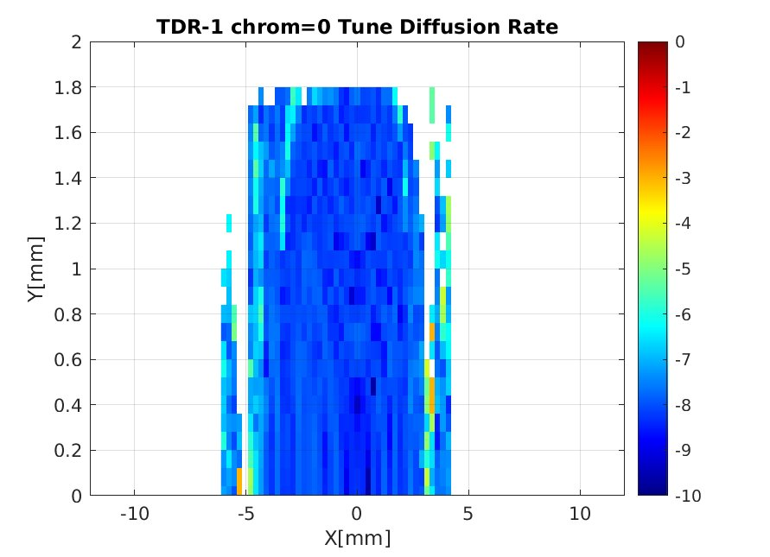
TDR-1: DA and LMA
Reduced error model, orbit + tune correction, 30 seeds
Tune diffusion rate superimposed
(ideal lattice, zero chromaticity)
NB! Lifetime numbers are for unstretched bunches.

Slide 16
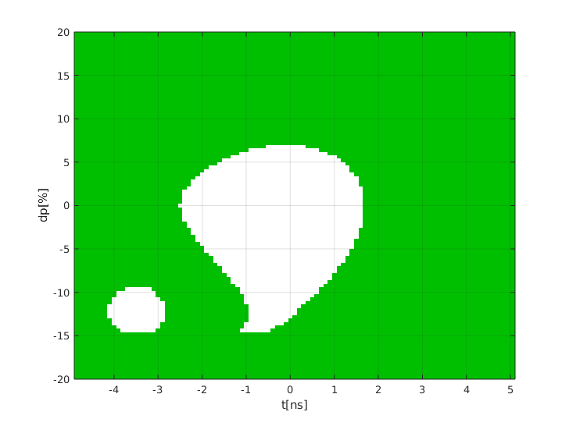
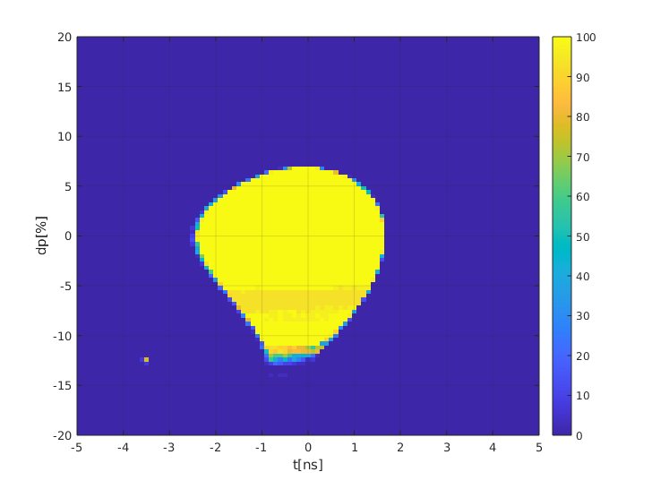
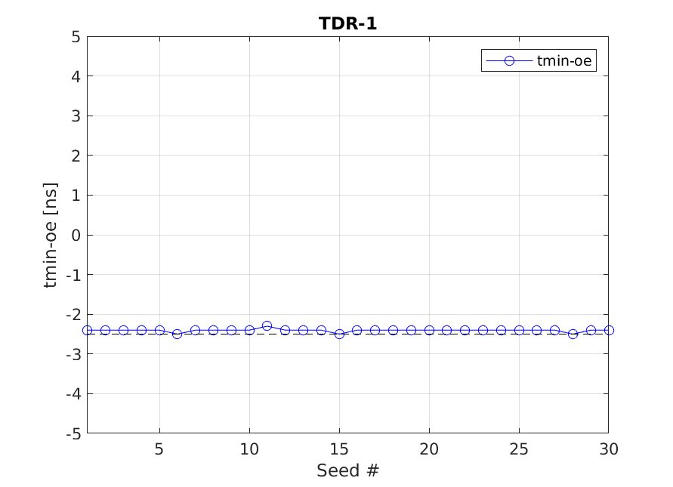
TDR-1: Long. acceptance
Reduced error model, orbit + tune correction
Ideal lattice
30 seeds
Lost
Kept
Particle grid in [cT, dp/p] tracked in 6D for 4525 turns (3 synchrotron periods)
NB! Above does not include harmonic cavities, V_{acc} = 1.0 MV (non-optimized)

Slide 17
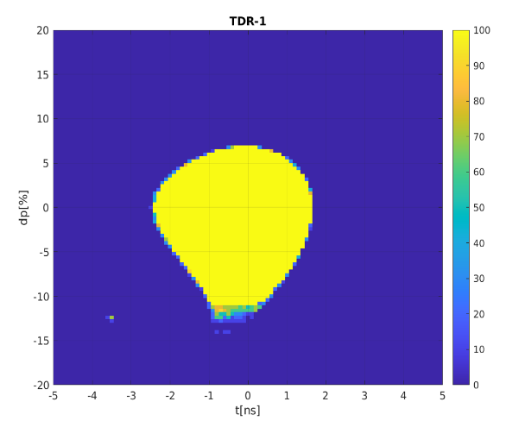
^{ax}_{PH}^{EN} injection – longitudinal acceptance
Material by M. Apollonio
Transverse Dynamic Aperture (TDA) for off-axis accumulation guideline:
[-5,+4] mm (H) with the present MIK
However, newly designed SOLEIL-II MIK may be effective for the purpose
Longitudinal Dynamic Aperture (LDA) for
^{ax}_{PH}^{EN} accumulation promising solution
kick plateau
SLK trailing edge
IE ~ 100%
SLK off
stored bunch
[-3.5,+2.5] mm
-2.4ns
-2.2ns
-2.0ns

Slide 18
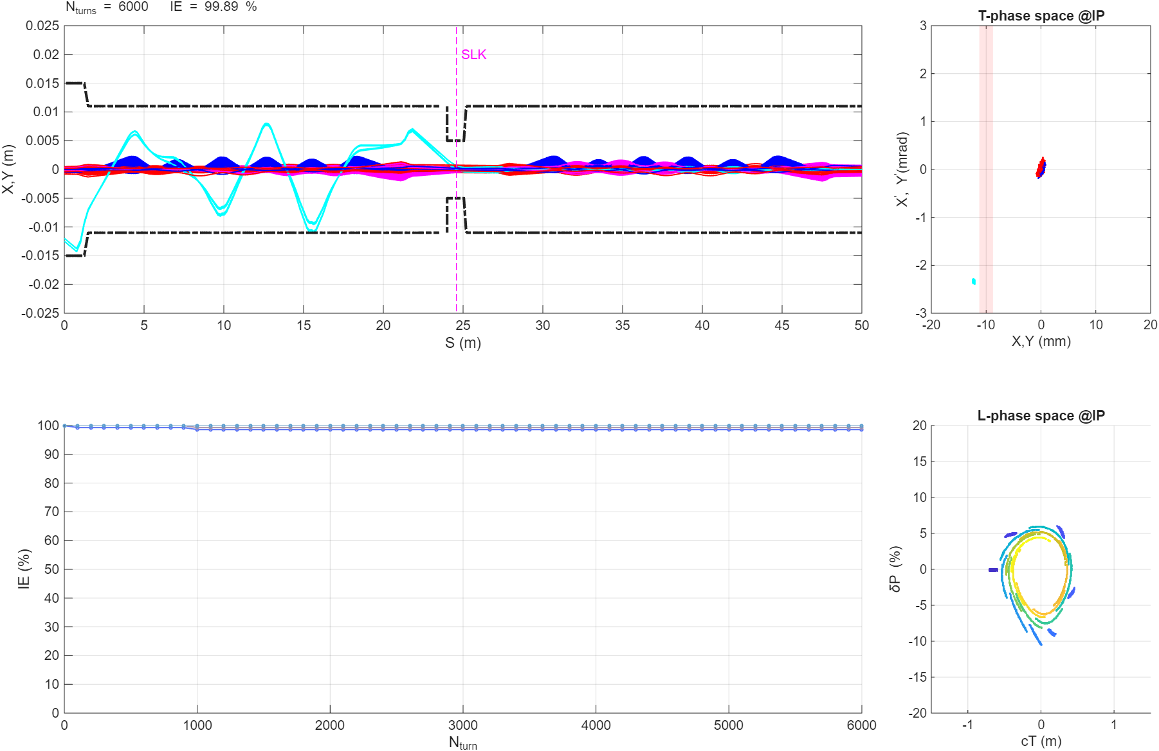
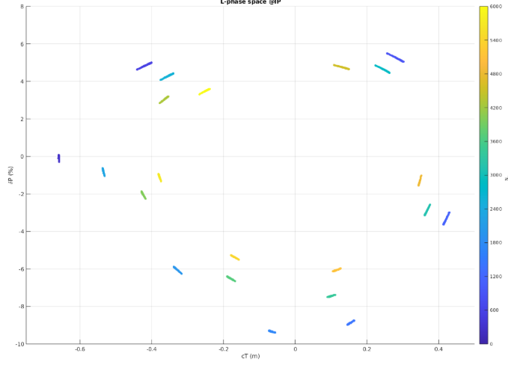
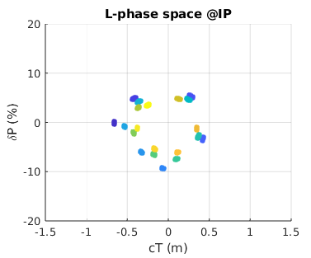
^{ax}_{PH}^{EN} injection – 30 error seeds dynamics
Slide by M. Apollonio
A. Dixon
0 3000 6000
One synchrotron period ≈ 2000 turns (depends on initial amplitude)

Slide 19
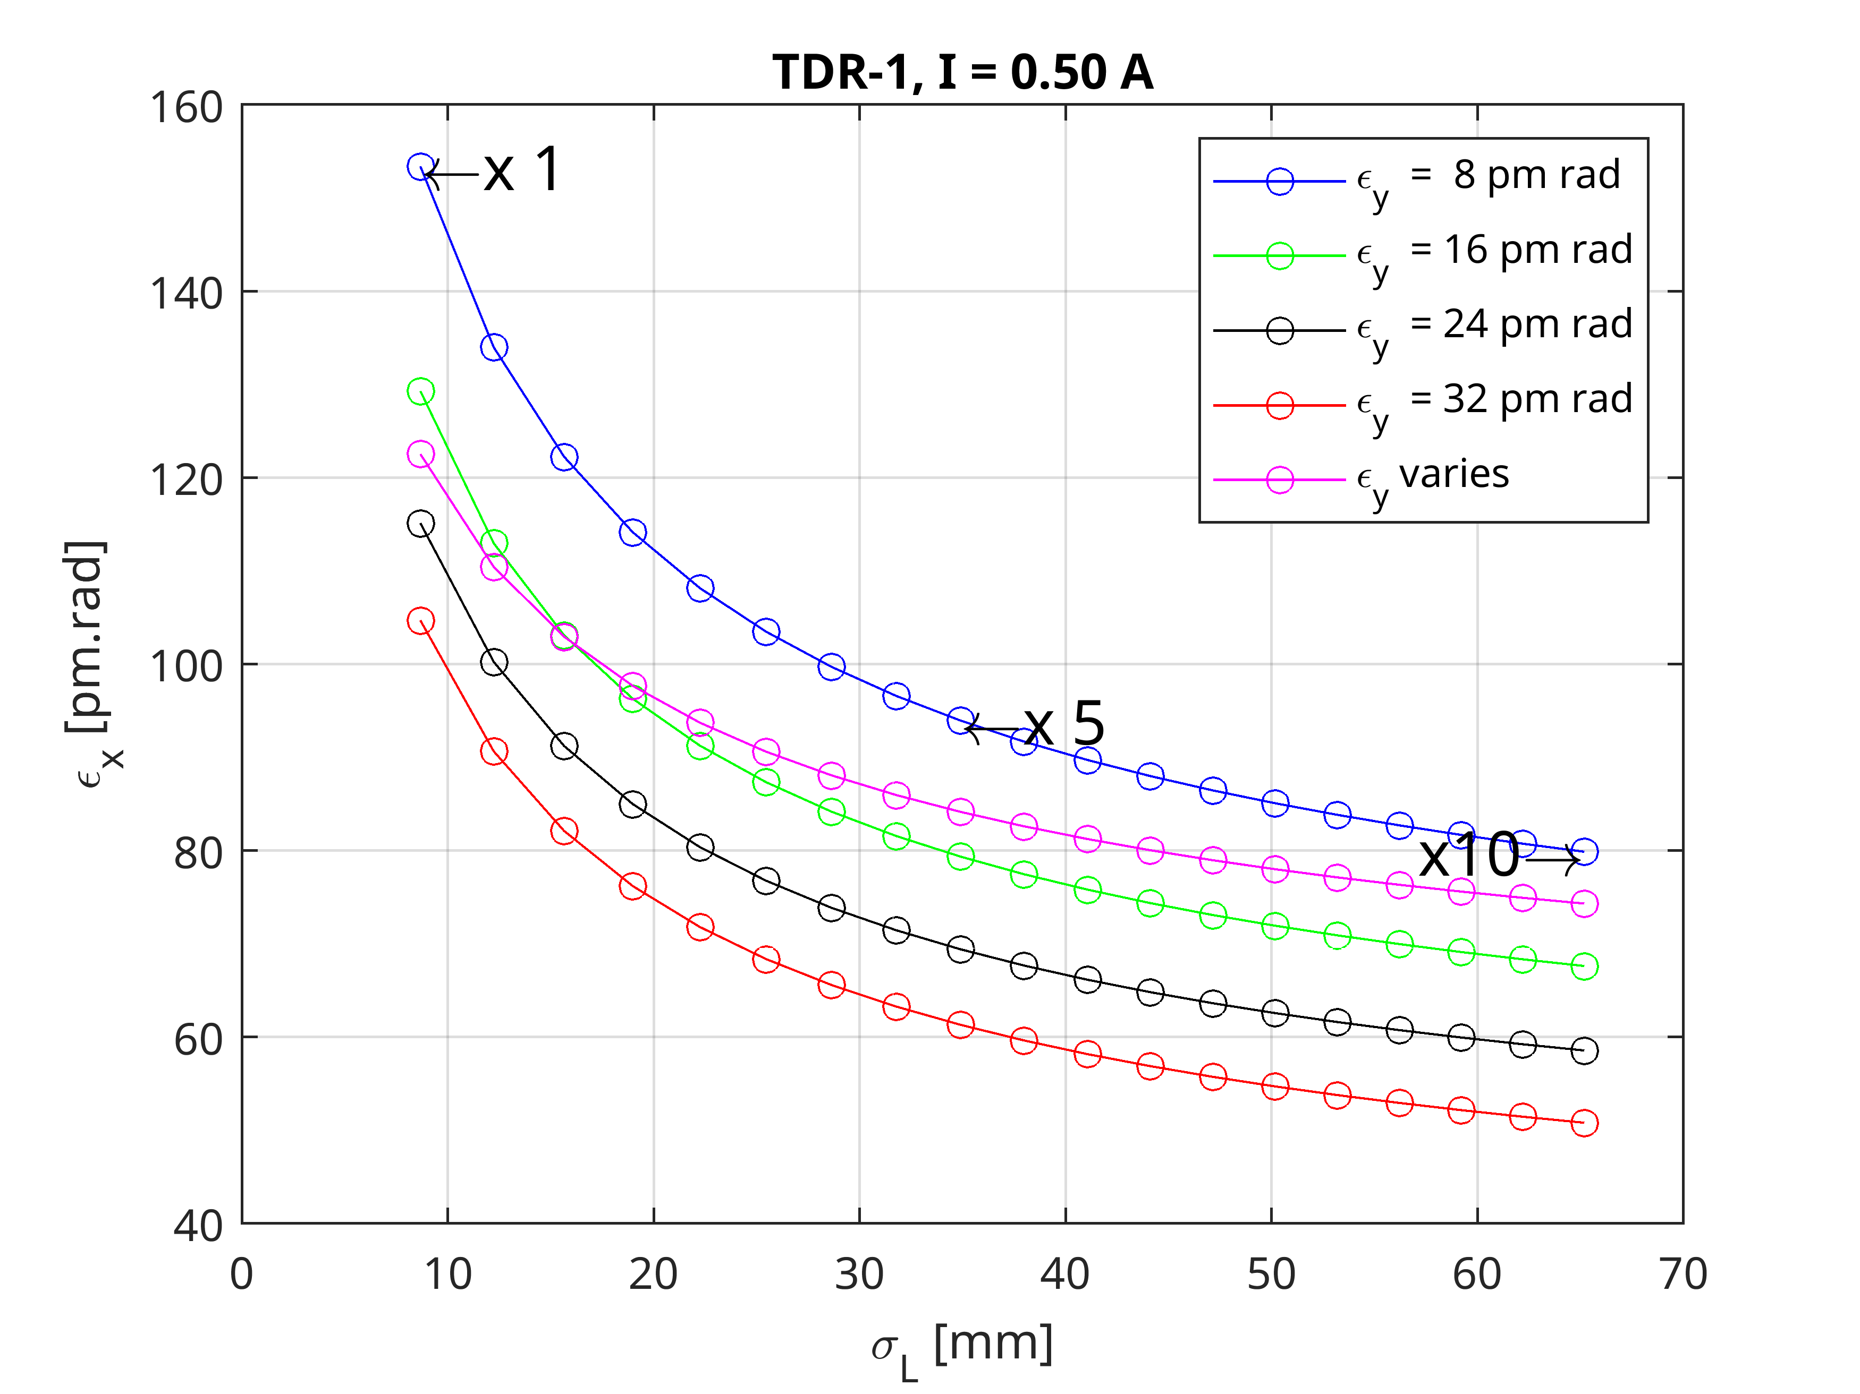
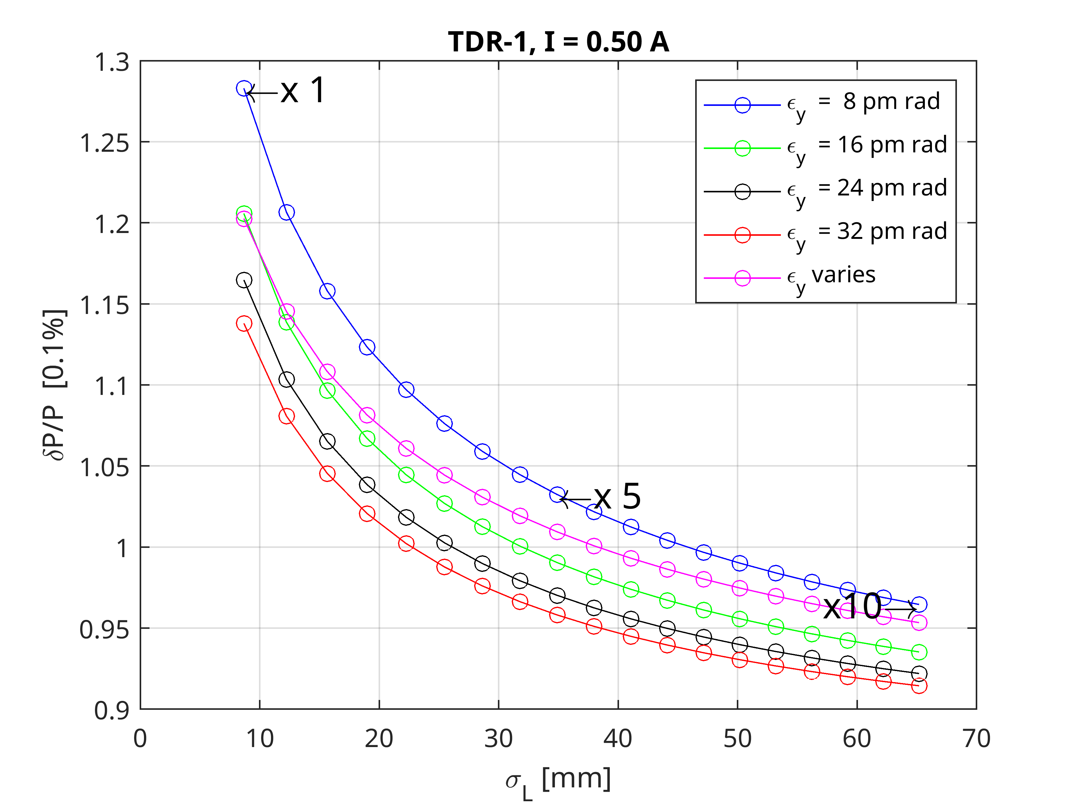
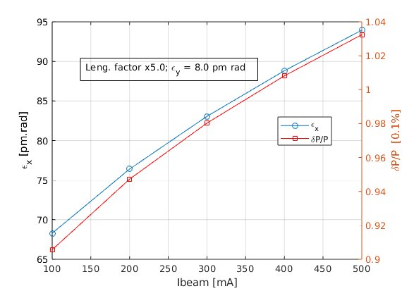
Intra-Beam Scattering
I_{beam} = 500 mA
I_{beam} = 500 mA
Regarding achievable lengthening with the various RF system solutions, see presentation by Å. Andersson.

Slide 20
Outlook / next steps
Review of girder misalignment handling
Error correction: implement full simulated commissioning, identify knob configuration for LOCO, include NOECO, etc.
Iterate with engineering
  Error model update (alignment, field errors, etc.)
  Increase MC bending angle to preserve vacuum chamber
Lattice improvements: lower long straight betas, improve robustness (sextupole family break-up or remove UC dispersion beating), change R1 into pure quadrupole, etc.
MC1
UC1
UC2
UC3/2

Slide 21
Thank you for your attention!

Slide 22
Supplementary Material

Slide 23
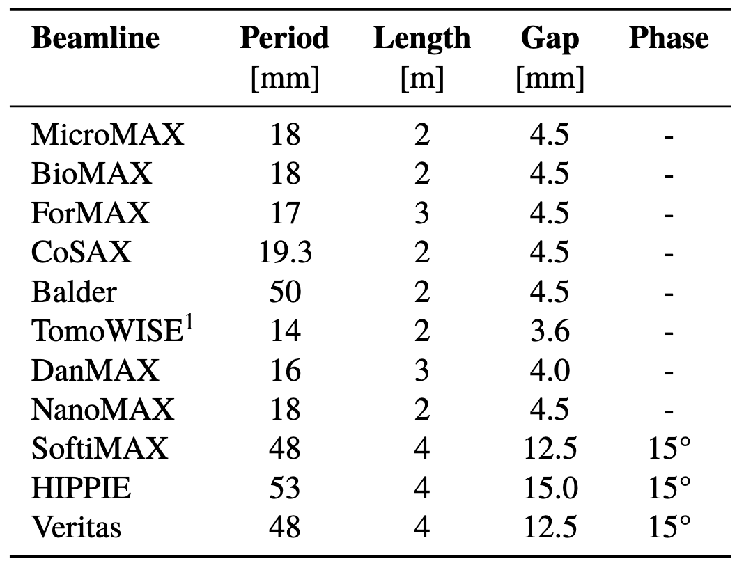
Slide by G. P. Segurana
ID correction scheme
Method
  IDs considered:
    All current and planned IDs at closest gap settings
    EPUs set for horizontal polarization
  Global correction of beta- and phase-beating at sextupoles [2, 3]
  Restore the symmetry of the sextupole lattice. No compensation of non-linearities yet.
[2] J. Bengtsson and E. Forest, “Global matching of the normalized ring,” AIP Conference Proceedings, vol. 255. AIP, 1992. doi: 10.1063/1.42301.
[3] T. V. Shaftan, J. Bengtsson, and S. L. Kramer, “Control of Dynamic Aperture with Insertion Devices”, in Proc. EPAC'06

Slide 24
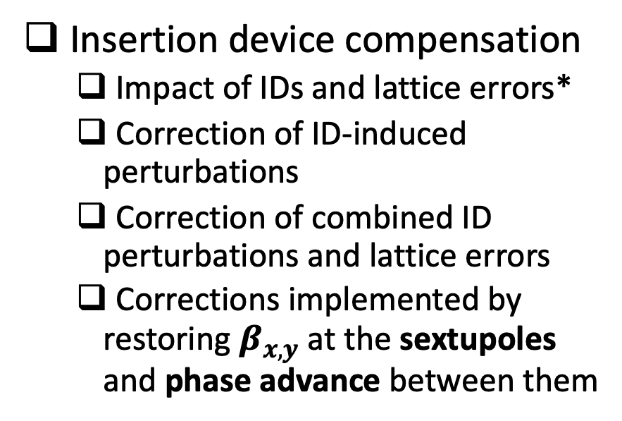
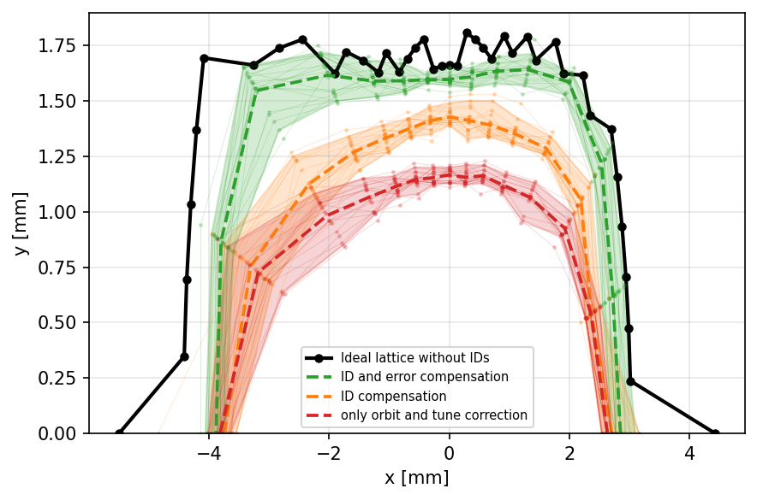
Slide by G. P. Segurana
Insertion Devices
Tuning knobs: Q1, Q2 and R1
*See error model in complementary slides

