Slide 1
Virtual Diagnostics and Bayesian Optimization in the MAX IV Linac
NSLS II-MAX IV workshop
5-6 Oct. 2026
Johan Lundquist

Slide 2
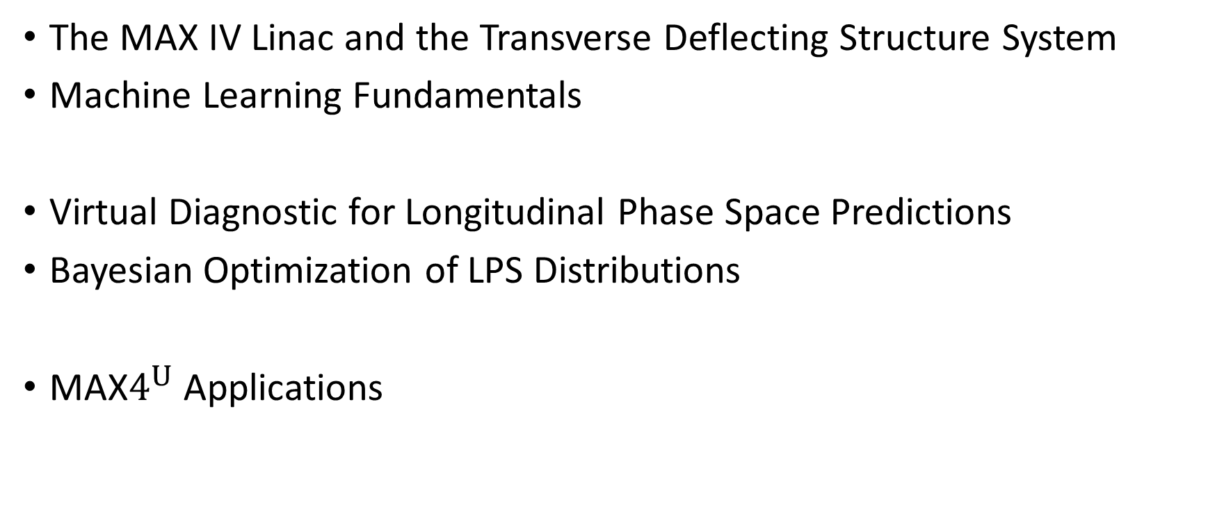
Outline
The MAX IV Linac and the Transverse Deflecting Structure System
Machine Learning Fundamentals
Virtual Diagnostic for Longitudinal Phase Space Predictions
Bayesian Optimization of LPS Distributions
MAX$4^{U}$ Applications

Slide 3
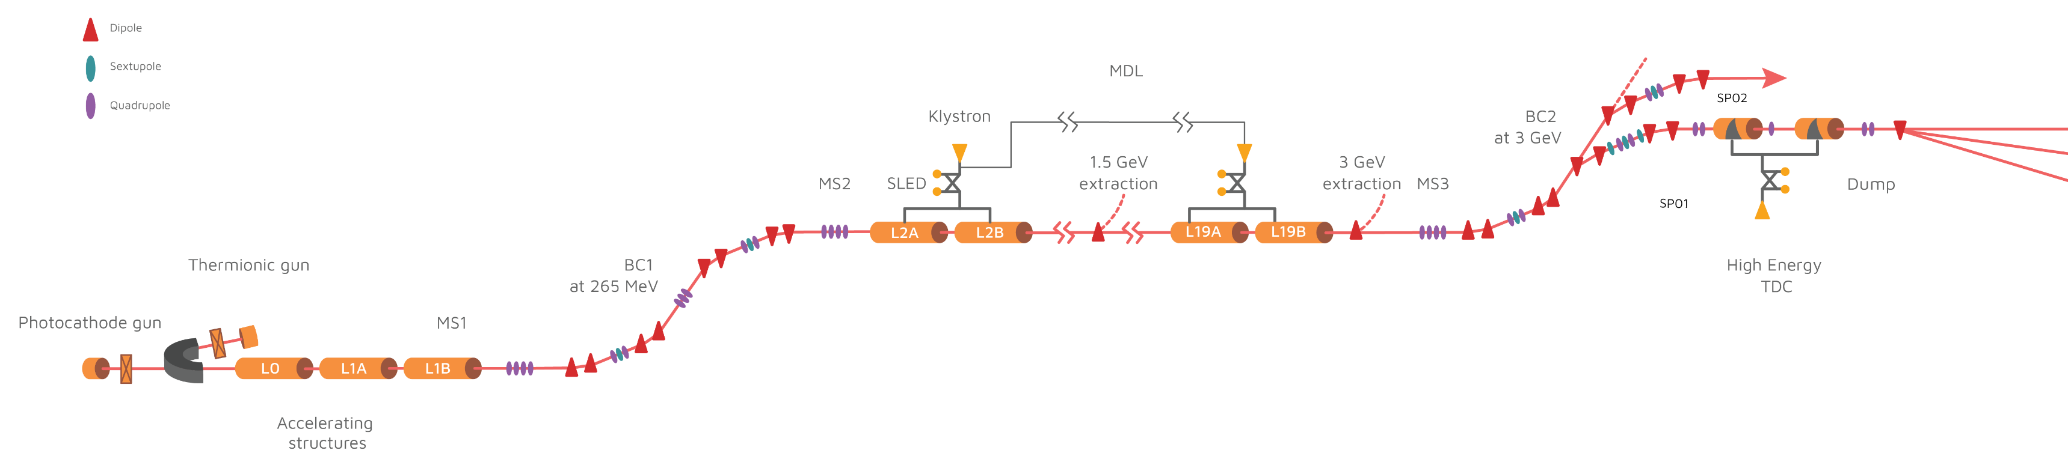
MAX IV – Linear Accelerator
1.5 GeV
SPF
MAX IV Linac
Full energy linac delivering to two rings and one short pulse facility (SPF).
3 GeV
Acceleration
40 S-band normal conducting RF structures. 265 MeV at first bunch compressor, 3 GeV at the second.
SPF: FemtoMAX and TDS
Bunch length is critical, but separate branches makes online measurements very difficult, implement Virtual Diagnostic.
Bunch Compressors
Arc-like bunch compressors allow for tunable, non-linear compression.
FemtoMAX
TDS
370 m
Notes:
Cut here? Not so much general MAX IV
Refer to FemtoMax as experimental beamline

Slide 4
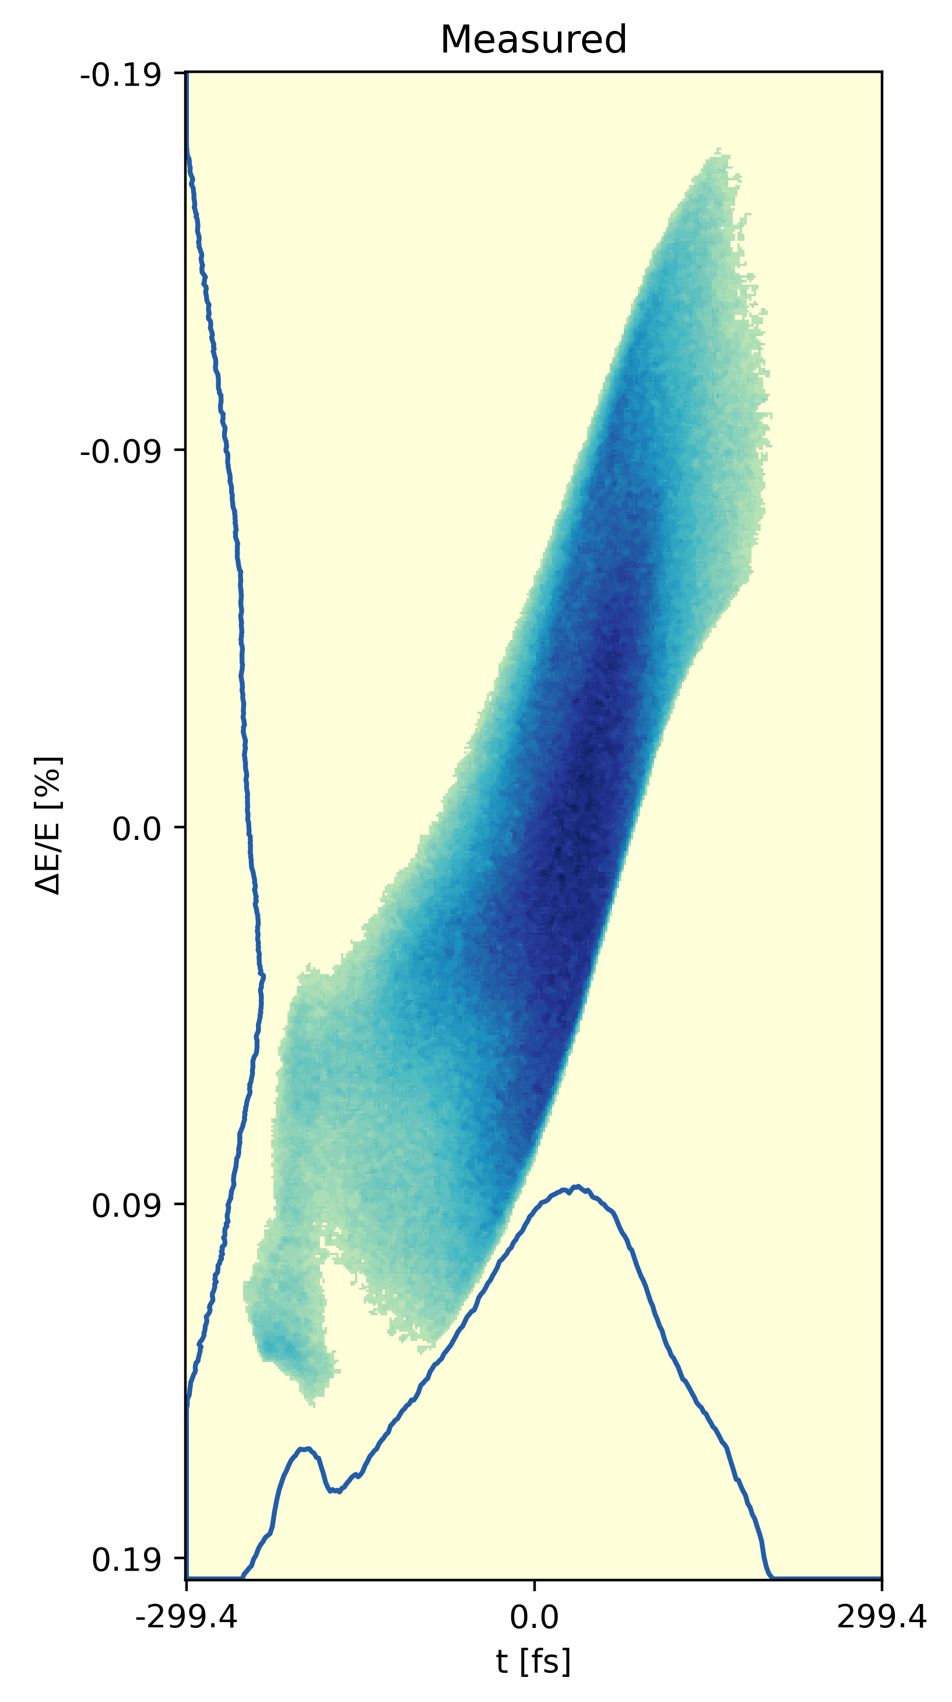
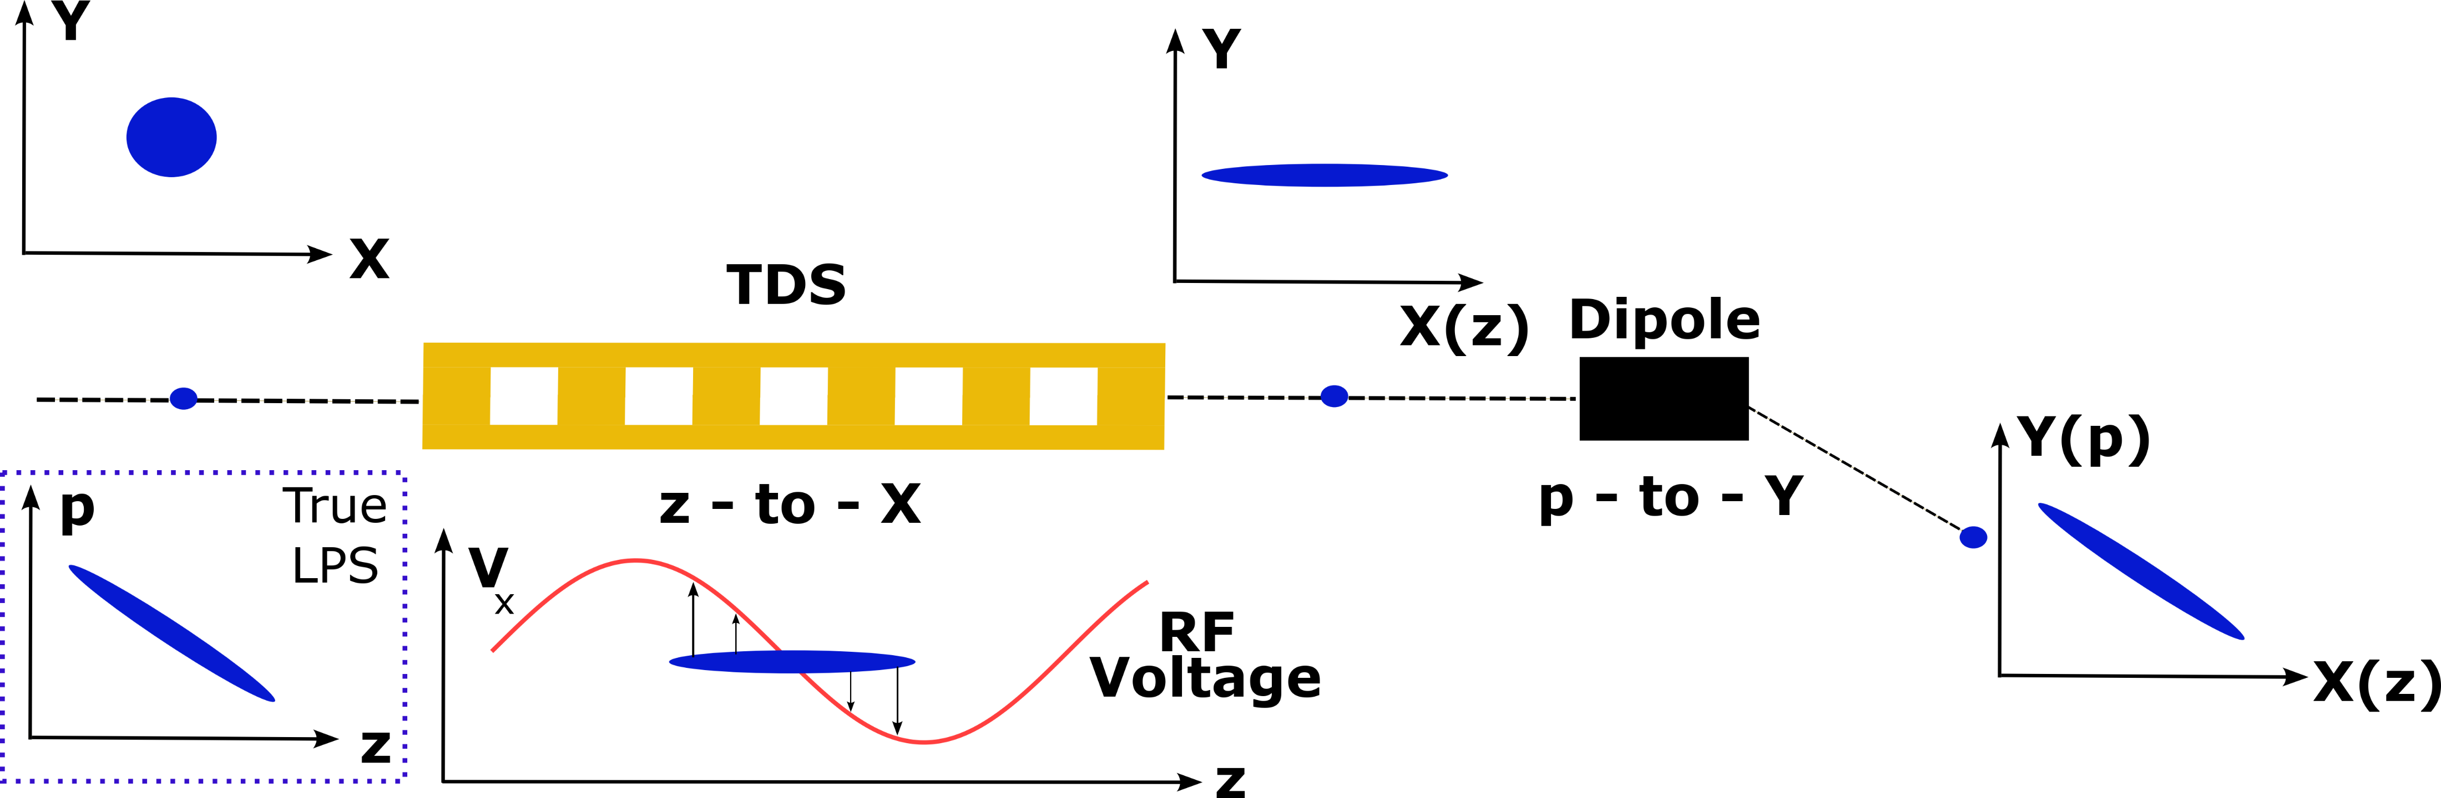
Transverse Deflecting Structure
MAX IV TDS line includes two 3 m deflecting structures.
3 separate branches with multiple YAG screens for varied dispersion and streak
Measured
Longitudinal Phase Space
Notes:
Maybe, mention IBIC23?

Slide 5
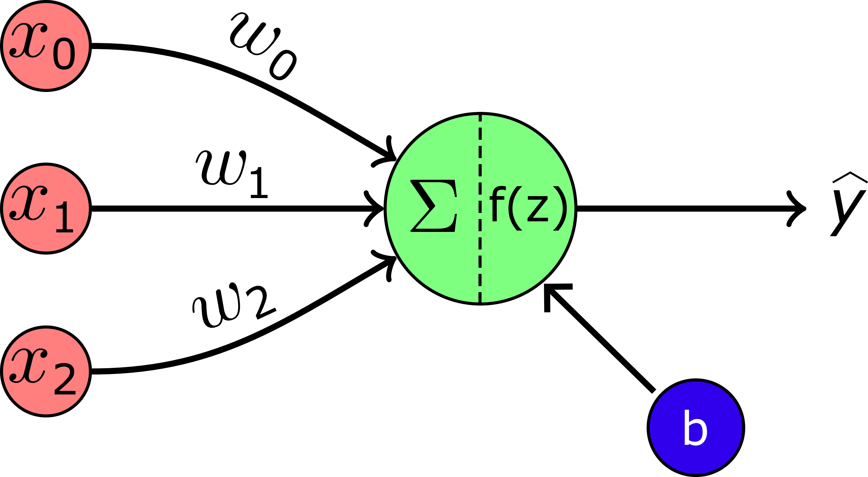
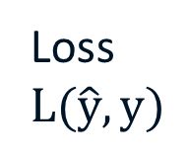
Machine Learning – The Perceptron
Trainable Weights
Sets the relative importance of different inputs
Optimizer, ADAM
Loss
$$L(\hat{y},y)$$
Prediction
Ground truth
y

Slide 6
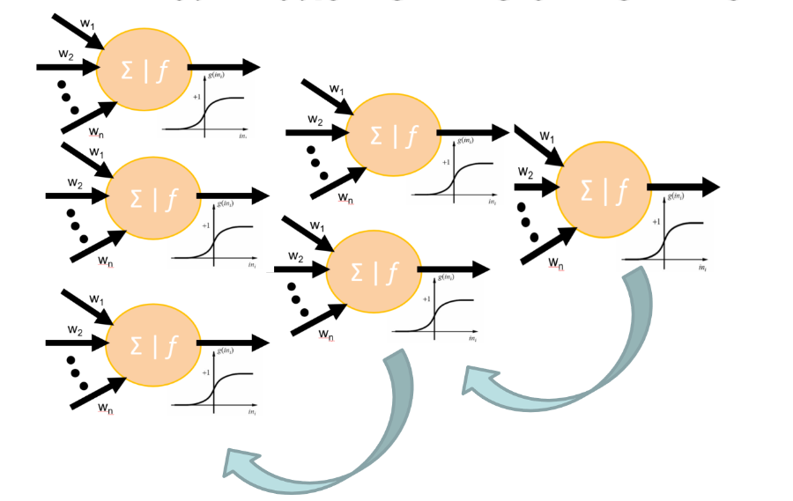
Machine Learning – The Multi-Layer Perceptron

Slide 7
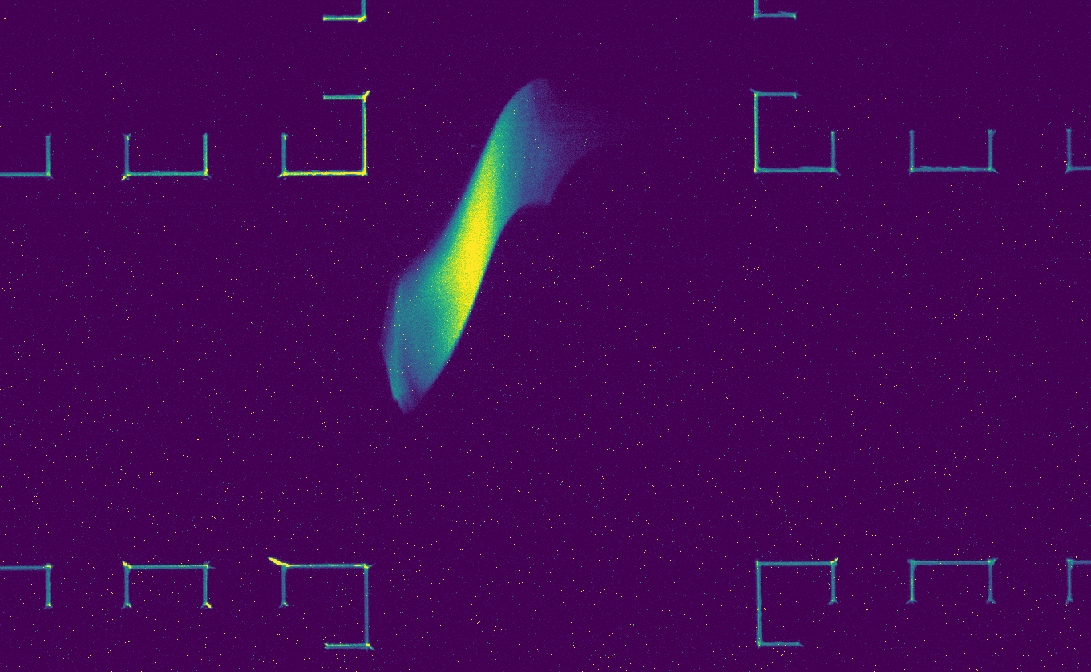
LPS Virtual Diagnostic – Experimental Setup
Scanning RF phases before BC1 and BC2
This provides similar range of LPS shapes to what is used in beamline delivery
Magnets
Dipole
Main Drive Line
L02-19
Bunch Compressor 2
SP03
Sextupole
To FemtoMAX
Quadrupole
SP02
3 GeV
extraction
SP01
High Energy TDS
Dump
Bunch Compressor 1
L2B
L2A L19A
L19A L19B
Thermionic gun
1.5 GeV
extraction
Photocathode gun
Accelerating
Structures
L01
Non-destructive Beam Information
Scanned RF Parameters + Beam Position Monitors + Current Tranformers + etc…
Destructive Measurement
TDS images for output
9000 images collected, ~6 hour beamtime
  HDF5 set with 9000x650x650 images + 108 input params
Virtual Diagnostic

Slide 8
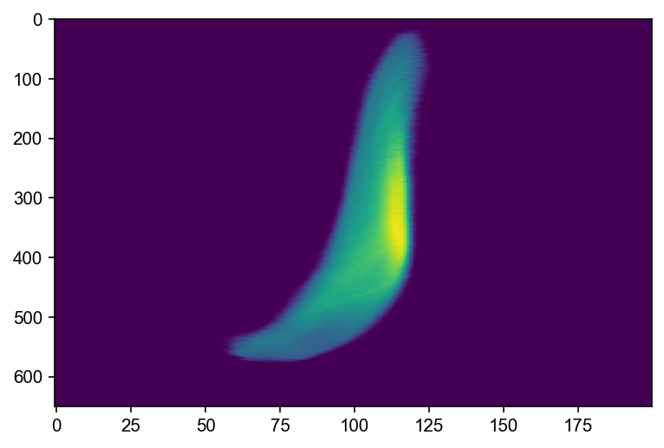
VD - Network Structure and Training
Input Vector
100 Dense Nodes
422 500 Dense Nodes
Batch Normalization
100 Dense Nodes
4*4x4 Convolutional Kernels
Dense Net + CNN trained with ADAM and MAE
  Used scheduled learning rate and checkpoints for early stopping
  Post-processing: Align beam distributions using cross-correlation
Large image size layer
  Extends training time
  Required for full LPS images
  Could be smaller -> lower resolution
Networks trained on LUNARC HPC Cluster
  Training time on Nvidia A100 ~10 minutes
  Training time on Laptop CPU ~1-2 hours
1*5x5 Convolutional Kernels

Slide 9
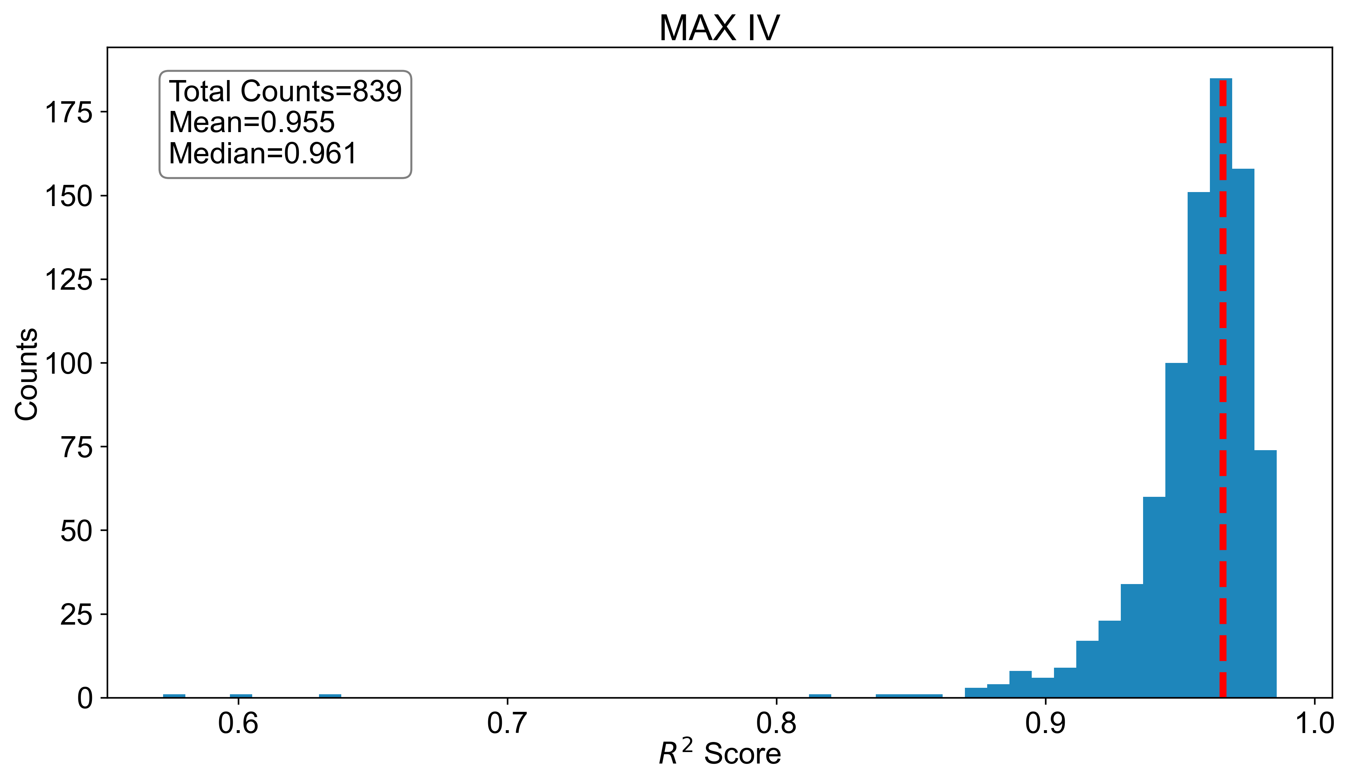
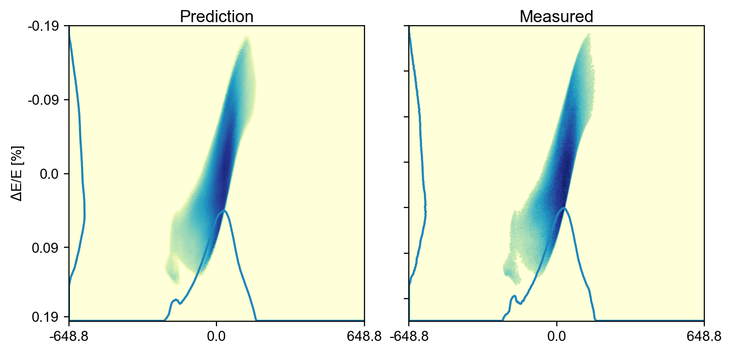
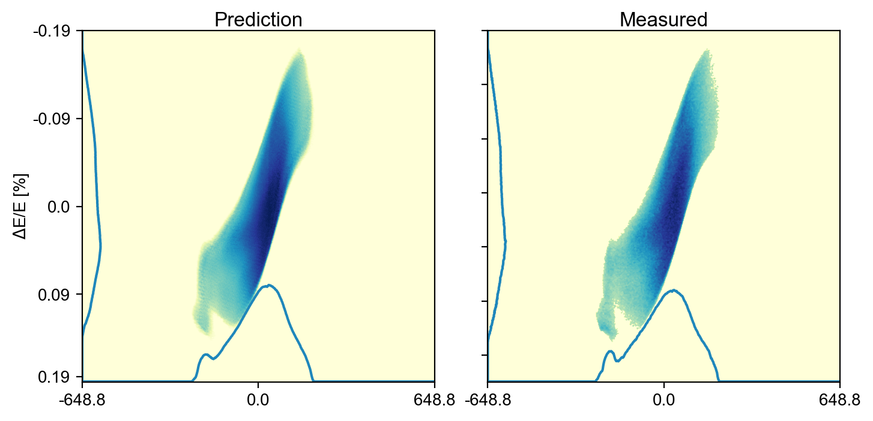
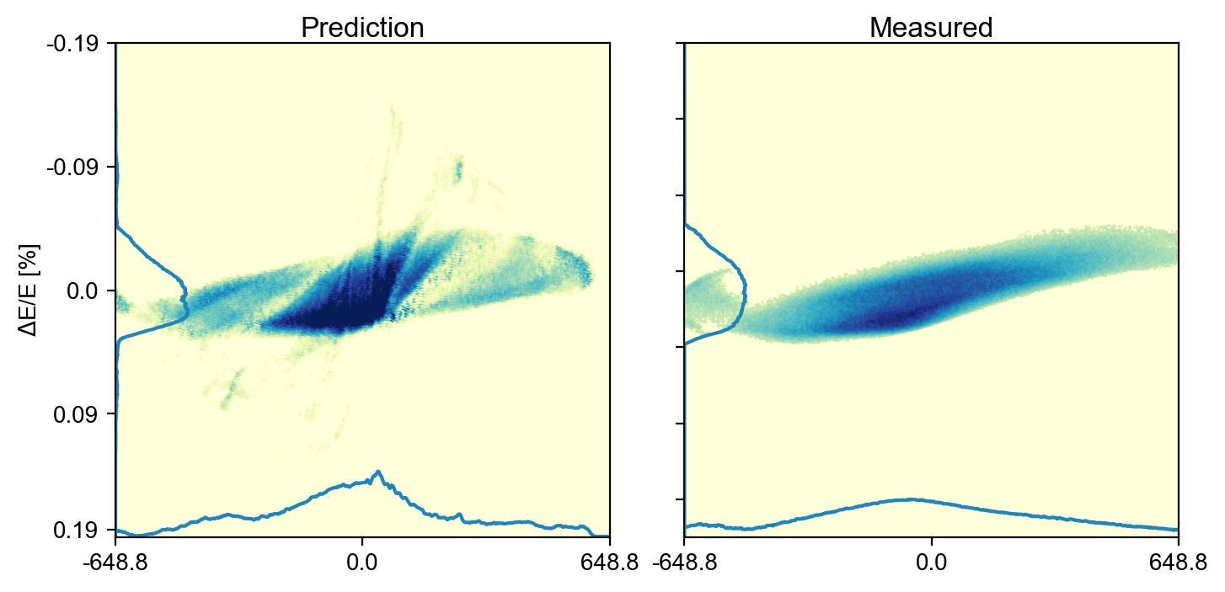
MAX IV – LPS Predictions
Best
10% of data set reserved for testing
R²: Mean = 95.5%, Median = 96.1%
Median
Worst

Slide 10
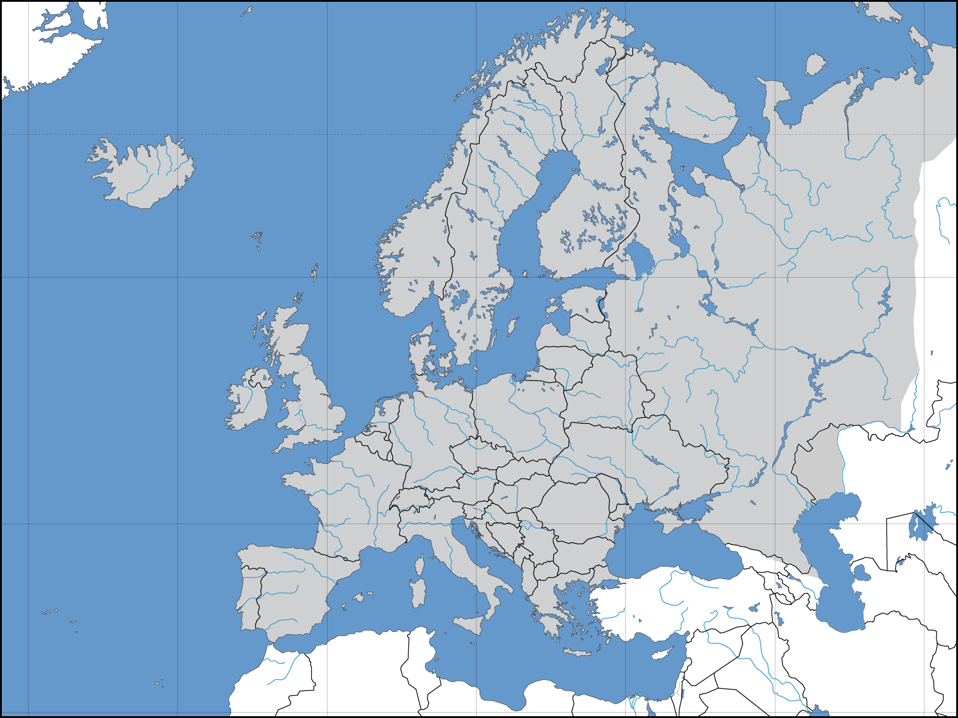
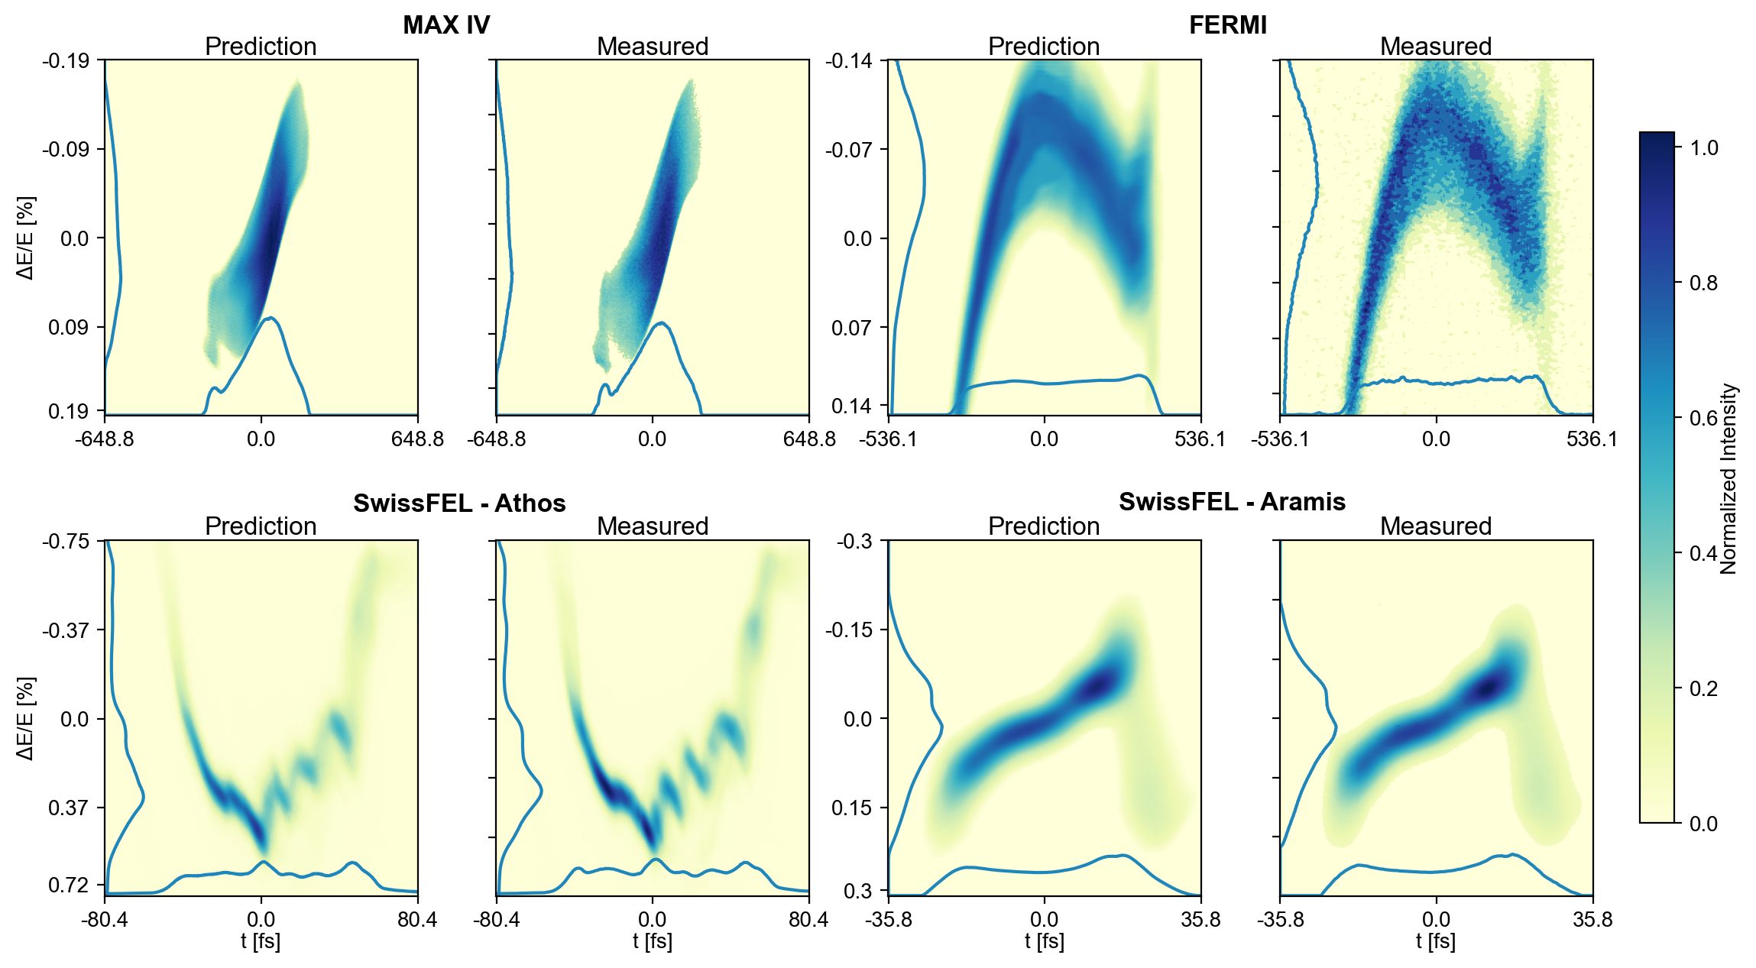

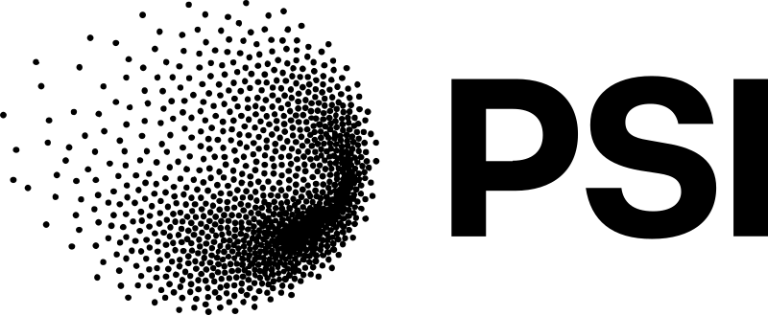

Multi-Facility Virtual Diagnostic for Longitudinal Phase Space Predictions
J. Lundquist, J. Björklund Svensson, P. Dijkstal, E. Mansten, G. Penco, S. Werin and F. Curbis, Scientific Reports Vol. 16, 12021 (2026)
SwissFEL
FERMI

Slide 11
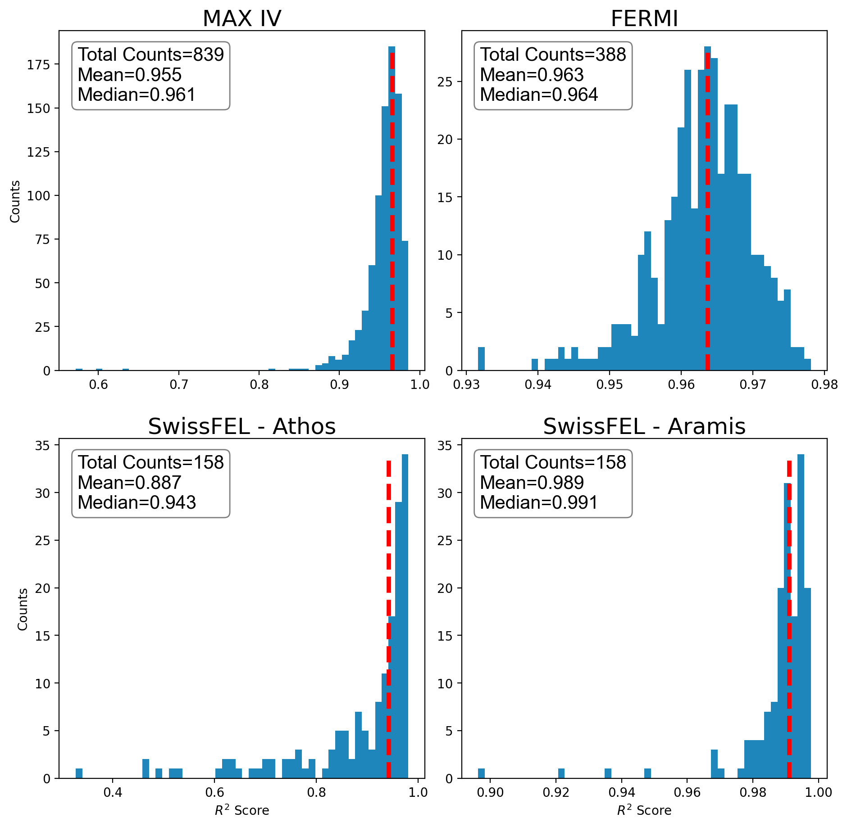
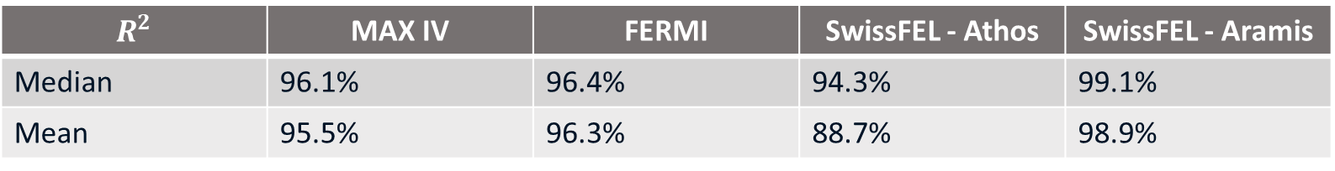
Multi-Facility Virtual Diagnostic – Final Results
$$R^{2}$$ | MAX IV | FERMI | SwissFEL - Athos | SwissFEL - Aramis
Median | 96.1% | 96.4% | 94.3% | 99.1%
Mean | 95.5% | 96.3% | 88.7% | 98.9%
Performance on 10% of each full dataset
Median Images

Slide 12
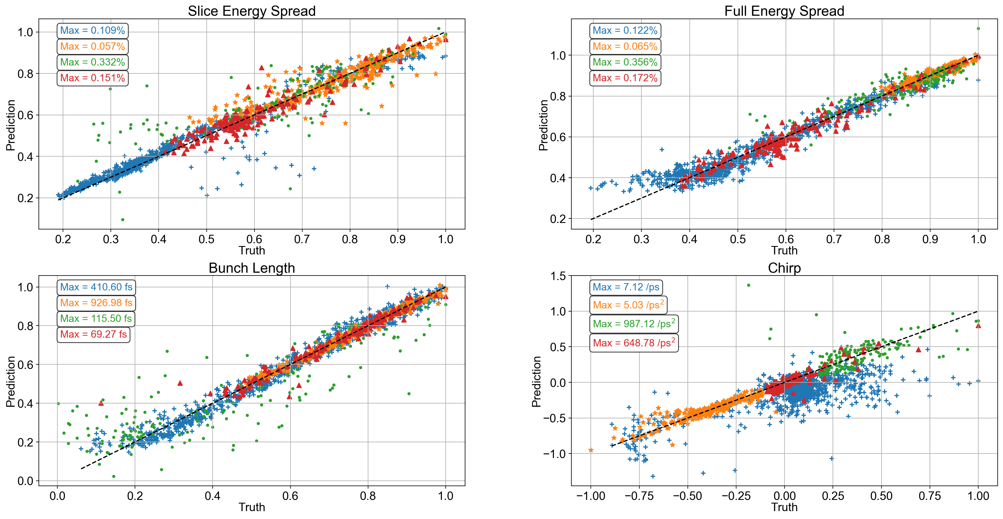
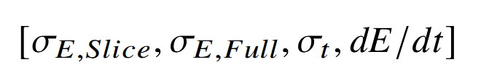
Beam Parameter Approach - Results
MAX IV
SwissFEL - Aramis
Input Vector
FERMI
SwissFEL - Athos
250 Dense Nodes
Batch Normalization
250 Dense Nodes
Beam Parameters

Slide 13
Bayesian Optimization of Longitudinal Phase Space in the MAX IV Linac

Slide 14
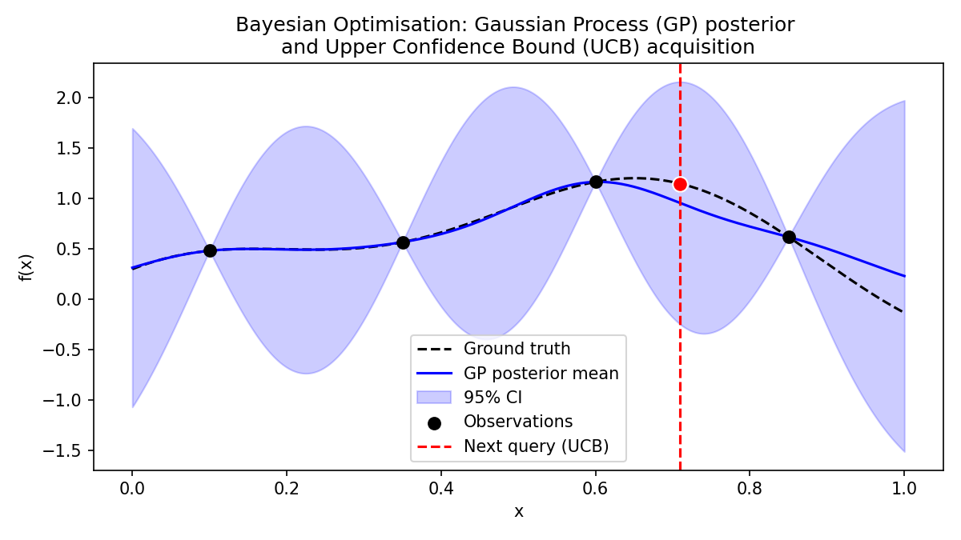
Bayesian Optimization
Optimization of accelerator parameters can be costly and inefficient
Implement machine learning methods to alleviate
Bayesian Optimization works through a posterior model of the environment, which can return both values and uncertainty estimates
This can allow the optimizer to “learn” the response of the environment and optimize with few queries compared to other, traditional gradient optimizations

Slide 15
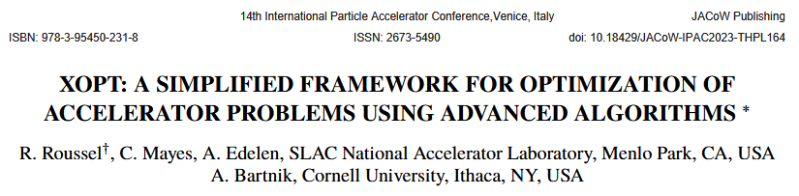
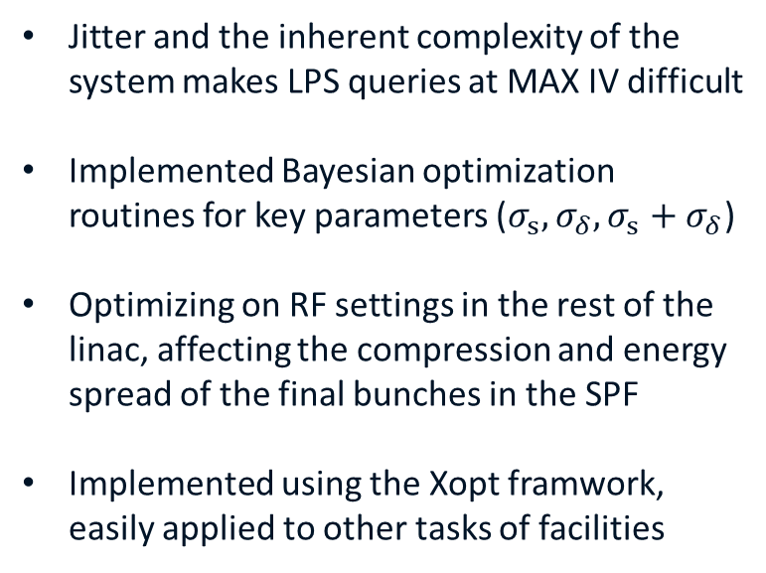
LPS Optimization with XOpt
Jitter and the inherent complexity of the system makes LPS queries at MAX IV difficult
Implemented Bayesian optimization routines for key parameters ($σ_{s}, σ_{δ},σ_{s}+σ_{δ}$)
Optimizing on RF settings in the rest of the linac, affecting the compression and energy spread of the final bunches in the SPF
Implemented using the Xopt framwork, easily applied to other tasks of facilities

Slide 16
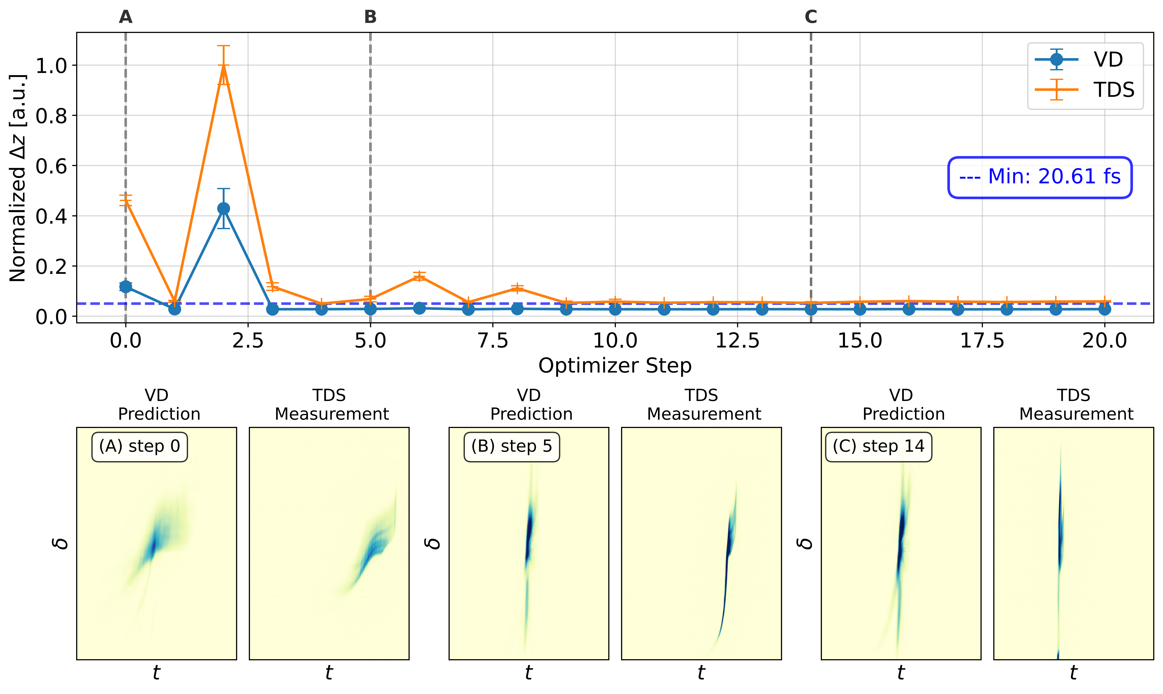
LPS Optimization with XOpt and Virtual Diagnostic
Constructed a VD based on the MAX IV TDS system,
then performed Bayesian optimization on bunch length and energy spread using the XOpt framework.
In theory, allows for continual optimization or feedback on the LPS.

Slide 17

MAX$4^{U}$ Applications

Slide 18
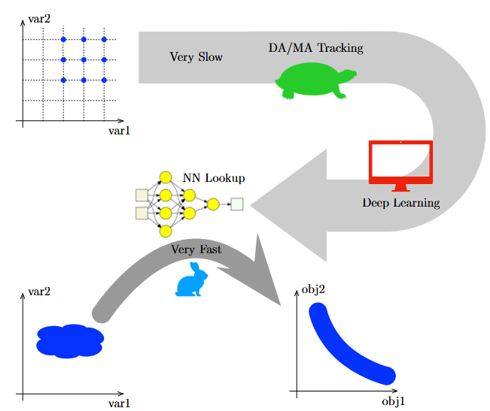
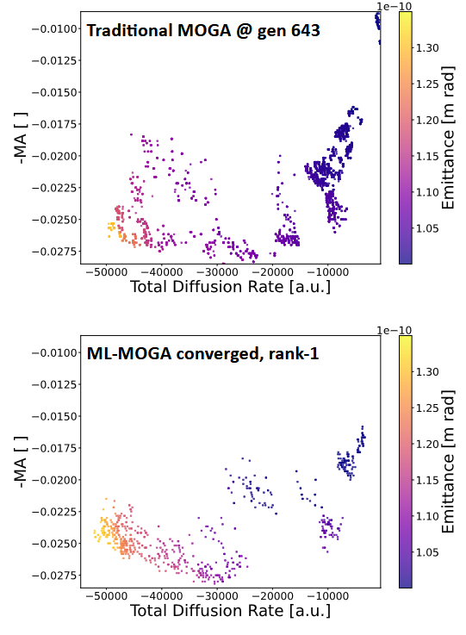
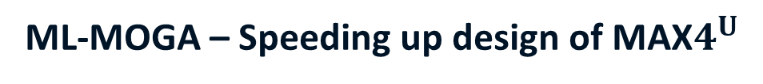
ML-MOGA – Speeding up design of MAX$4^{U}$
MOGA can require many queries of expensive, detailed simulations for convergence
Implement surrogate model of the tracking simulations (NN Lookup) which, once trained, is a cheaper, faster alternative to simulation
From Leeman slides ~40x speed up of MOGA optimizations
Implemented early on in lattice iterations for MAX IV-U

Slide 19
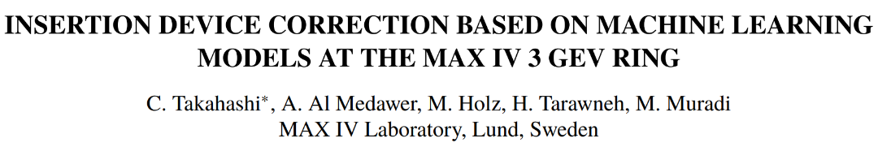
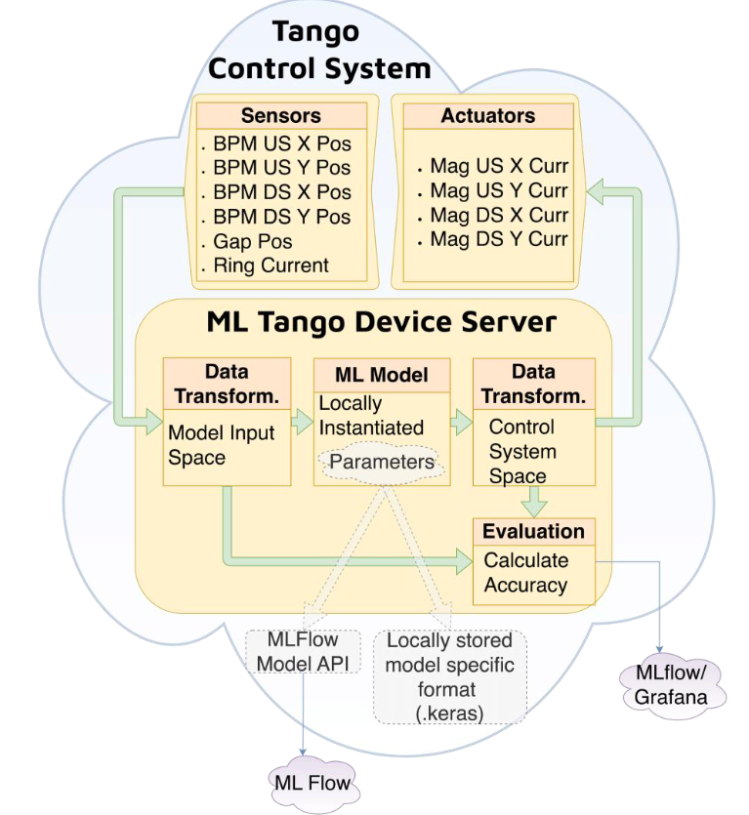
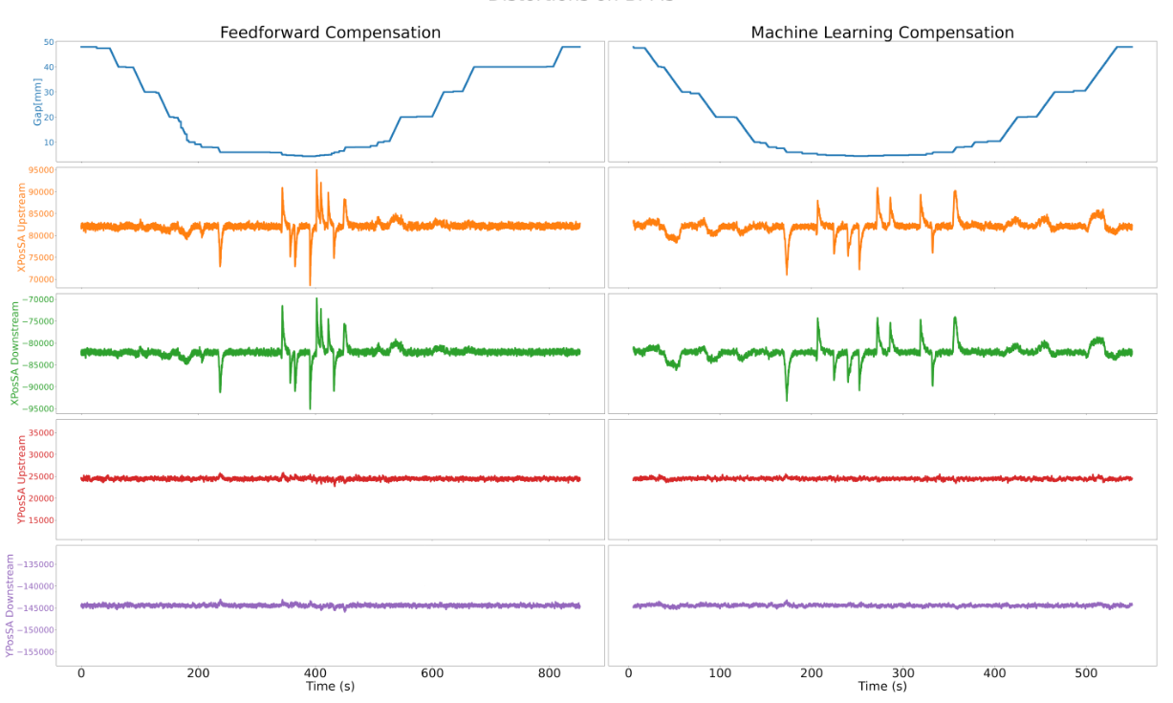
Machine Learning for
ID Orbit Correction
IPAC’25
• Beam orbit distortions by Insertion Devices currently corrected with measured feed-
forward tables → Very time consuming
• Tables might be invalidated over time, or with different machine parameters
(e.g. long-term drift, machine upgrades)
• New modes of ID operation can require several hundreds of measurement
points e.g. universal mode
• Prototyping of ML models that effectively replace
measured feed-forward tables

Slide 20
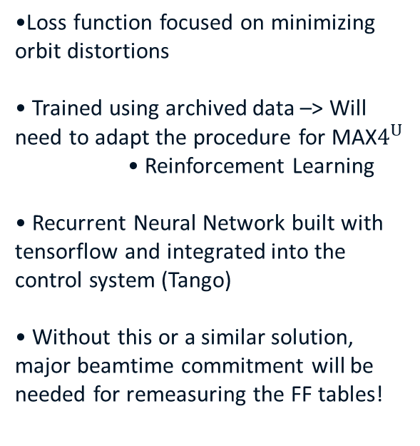
Machine Learning for
ID Orbit Correction
IPAC’25
•Loss function focused on minimizing orbit distortions
• Trained using archived data –> Will need to adapt the procedure for MAX$4^{U}$
• Reinforcement Learning
• Recurrent Neural Network built with tensorflow and integrated into the control system (Tango)
• Without this or a similar solution, major beamtime commitment will be needed for remeasuring the FF tables!

Slide 21
Conclusions
Virtual Diagnostics are relatively easy to implement and methodology can be generalized between facilities.
Plenty of work left to make them more general, outside supervised datasets and limited systems.
Combinations of ML techniques (like BO+VD) shows promise for automating difficult procedures, including applications for ring design and control.
ML-MOGA and Recurrent Machine Learning is assisting in lattice design and online control for ID compensation.

Slide 22
Complementary Material

Slide 23
Non-Destructive Passive Streaker Calibration using Machine Learning

Slide 24
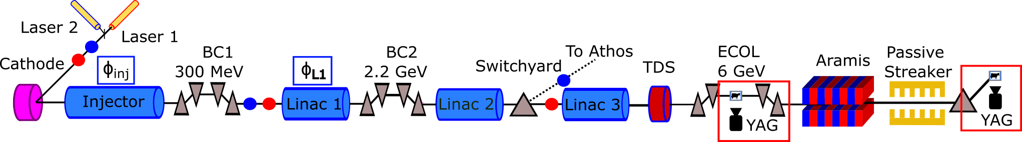
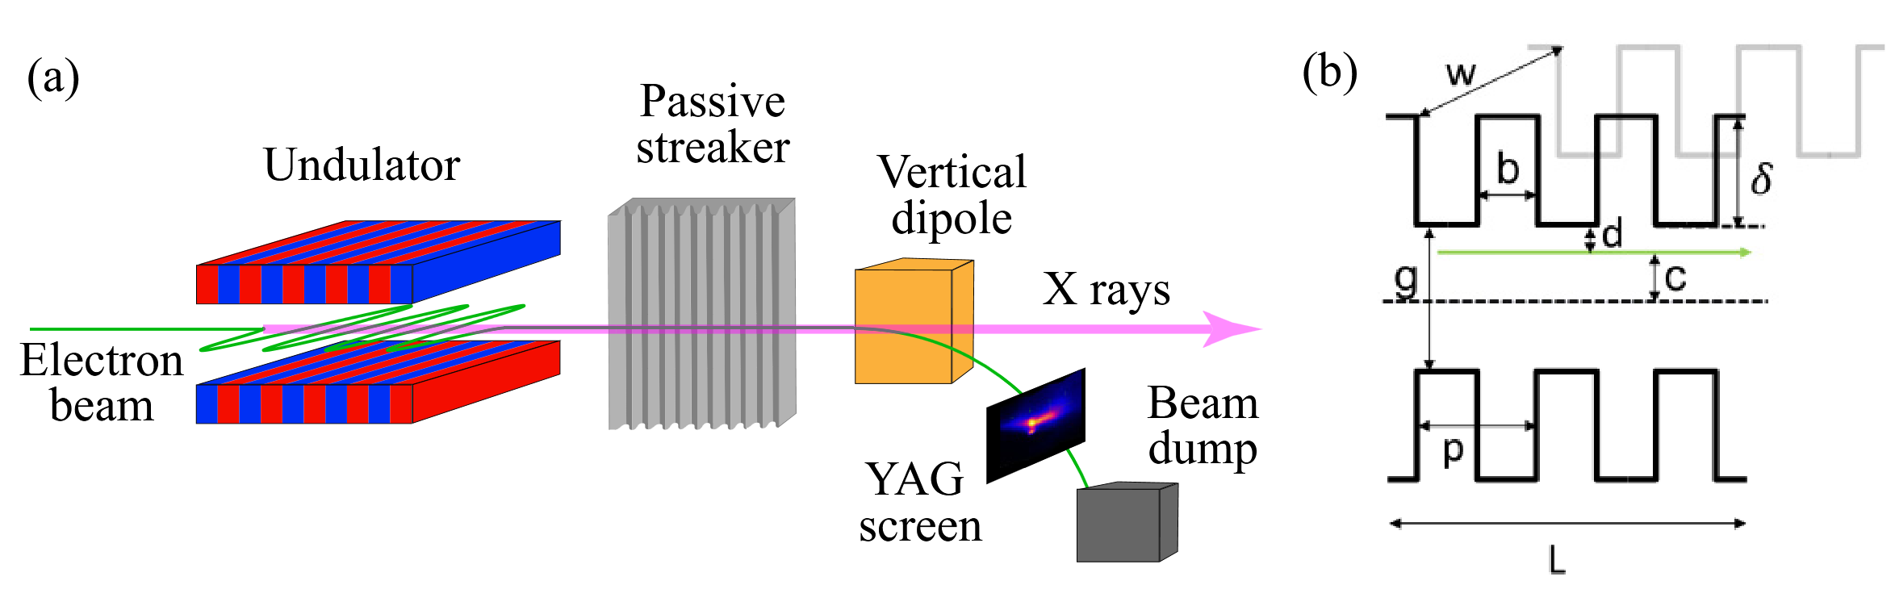
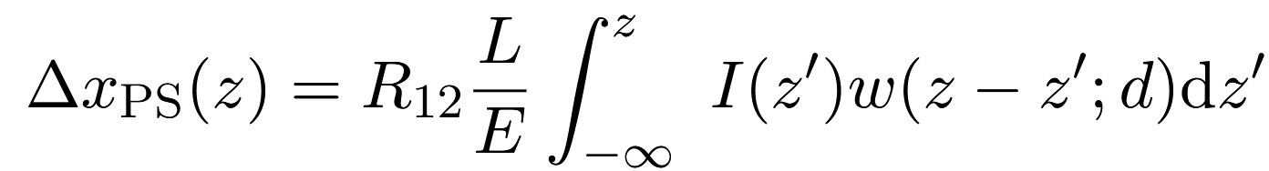
Passive Streaker Calibration using ML - Concept
L | 1 m
w | 40 mm
b | 250 μm
g | ≤28 mm
p | 500 μm
δ | 250 μm
P. Dijkstal, A. Malyzhenkov, P. Craievich, E. Ferrari, R. Ganter, S. Reiche, T. Schietinger, P. Juranić, and E. Prat, Self-synchronized and cost-effective time-resolved measurements at X-ray free-electron lasers with femtosecond resolution, Phys. Rev. Res. 4, 013017 (2022).

Slide 25
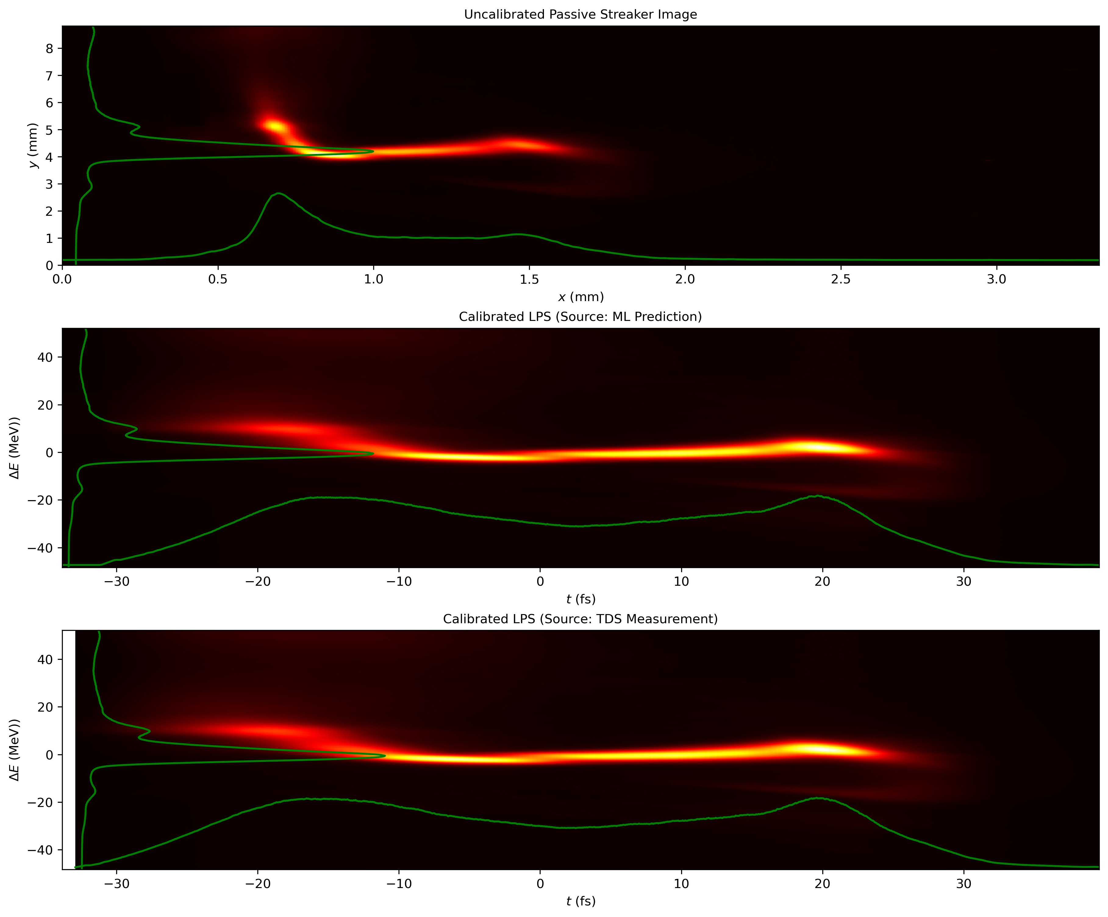
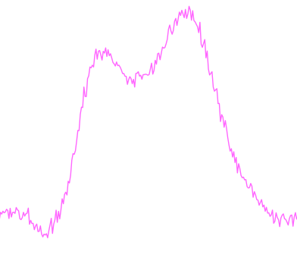
Passive Streaker Calibration using ML - Concept
PS Signal implicitly difficult to calibrate, due to non-linear, trajectory-dependent streak.
We can use the upstream TDS to calibrate using the actual bunch profile, using their cumulative charge distributions.
BUT this is a destructive and time-consuming procedure, we’ve implemented a VD based calibration.

Slide 26
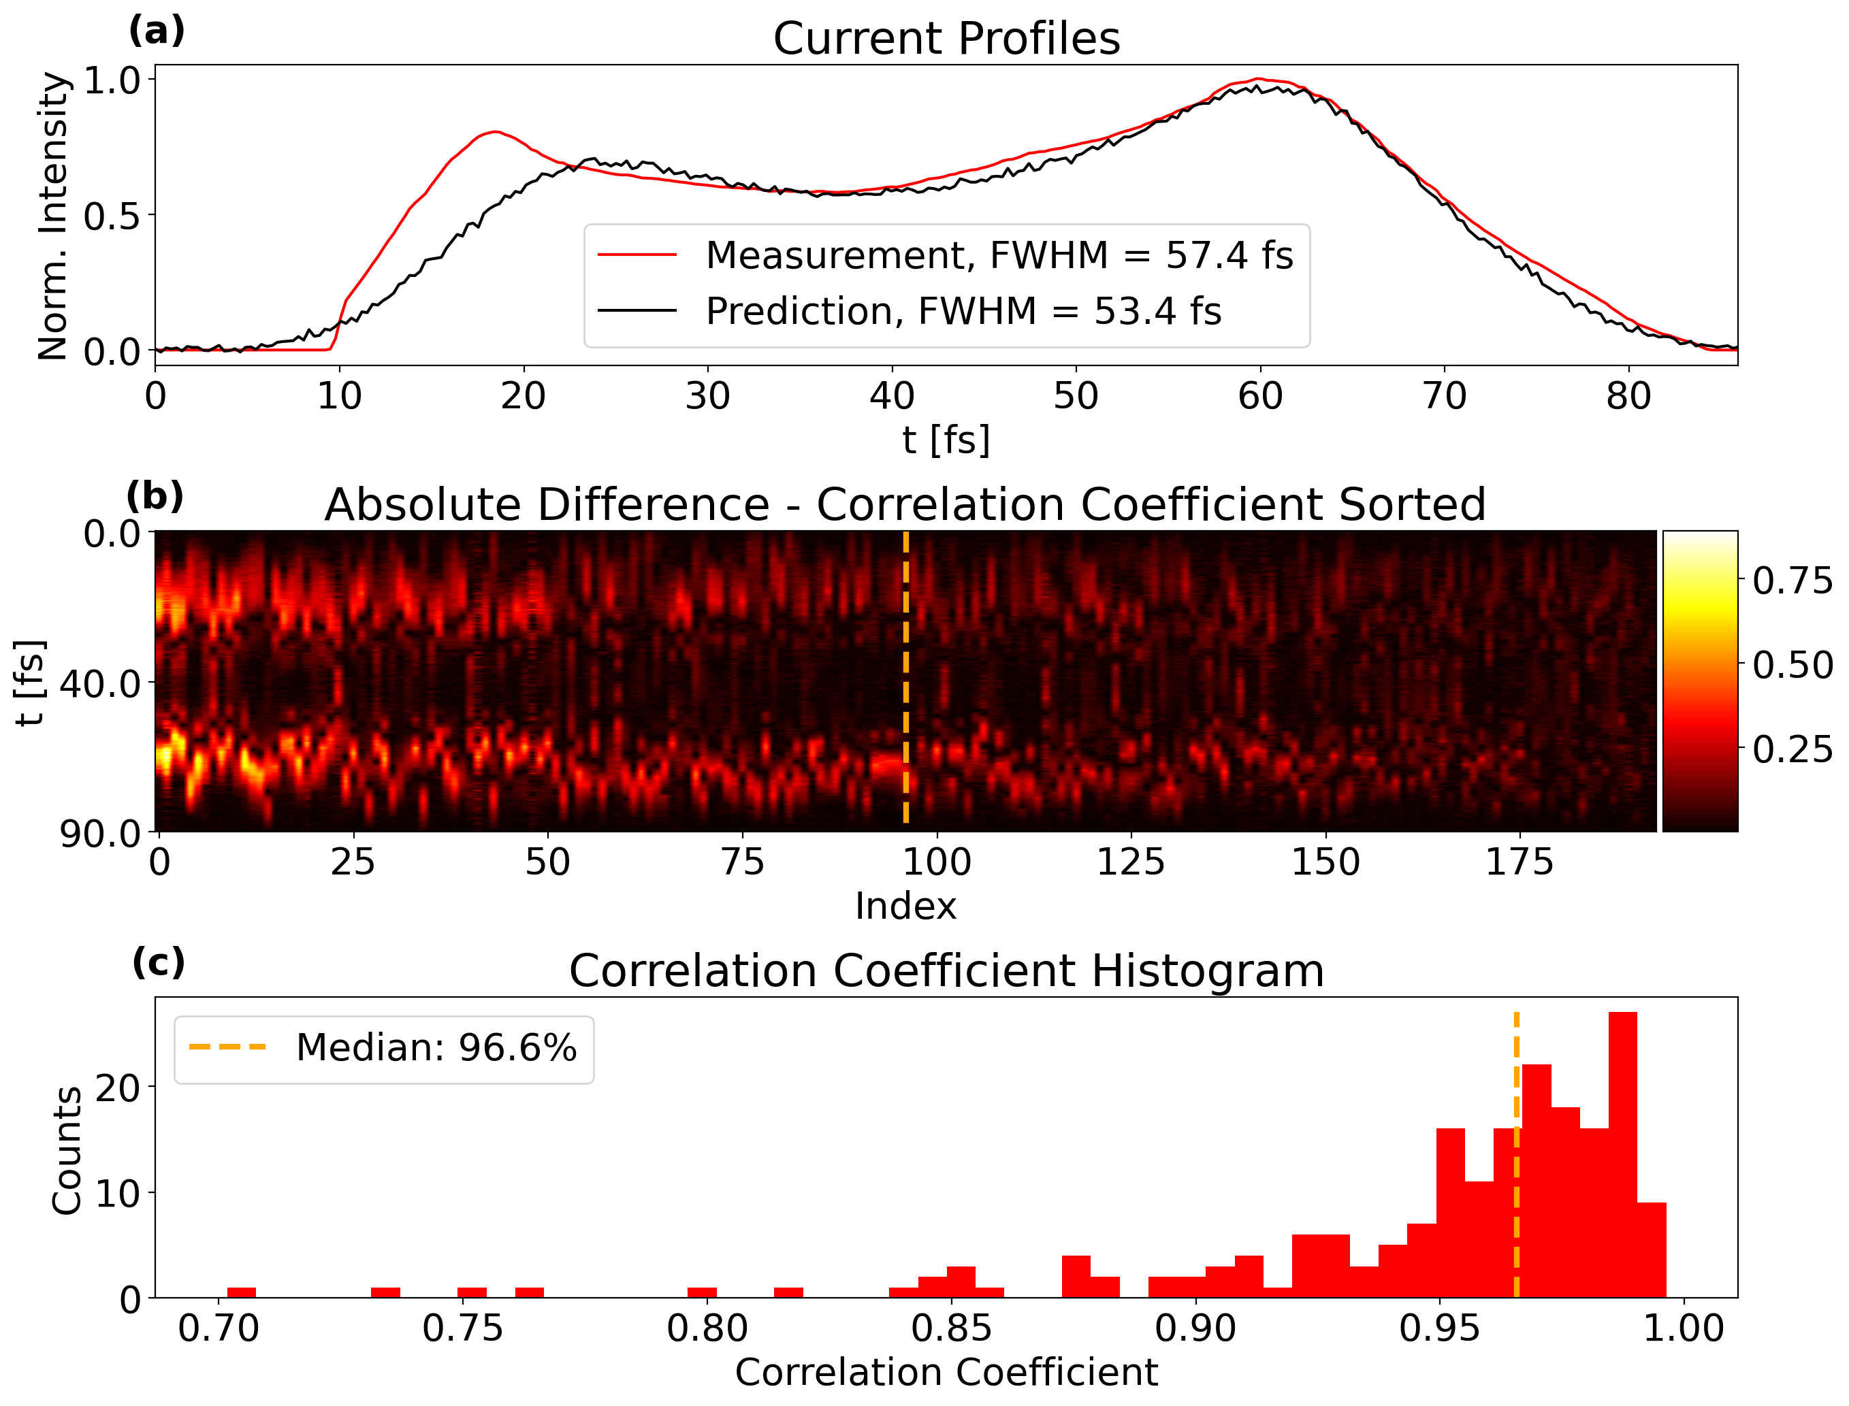
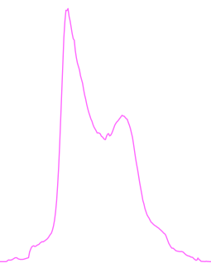
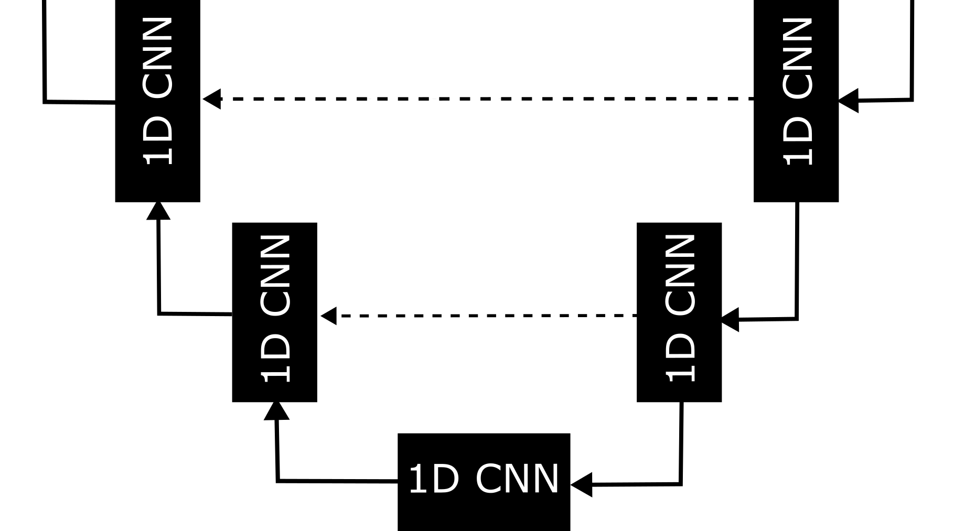
Passive Streaker Calibration using ML - Setup
Parameter Scans
2D Scan of phases before the two Bunch Compressors
DAQ first from C-Band TDS, then from PS
U-Net with Profiles in, Profiles out
1685 Profiles, 300 Length
1D CNN U-NET
250 000 Trainable param.
64
128
256
Notes:
Indicate that the waterfall is sorted by r2 somehow?

Slide 27
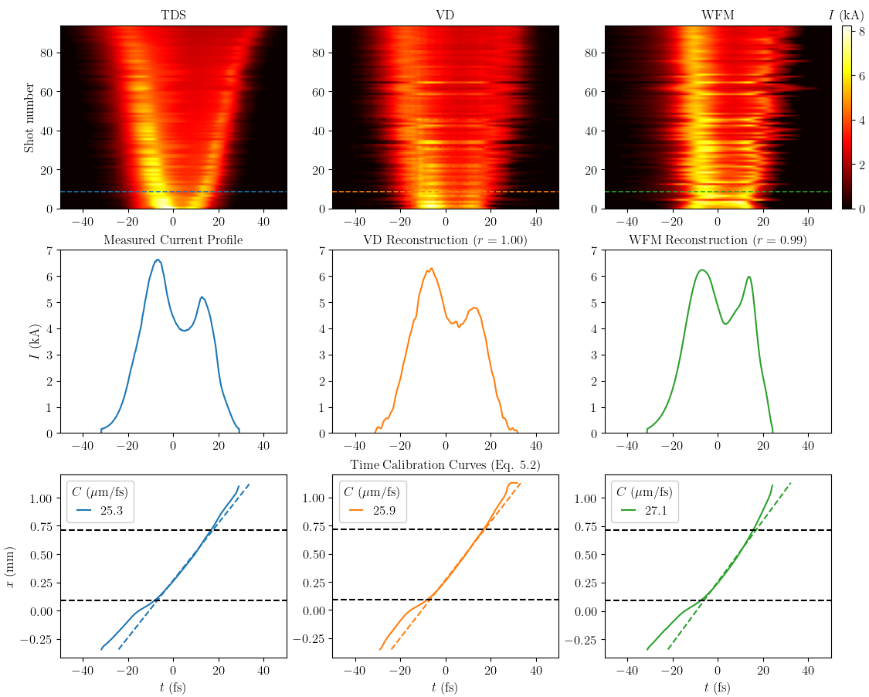
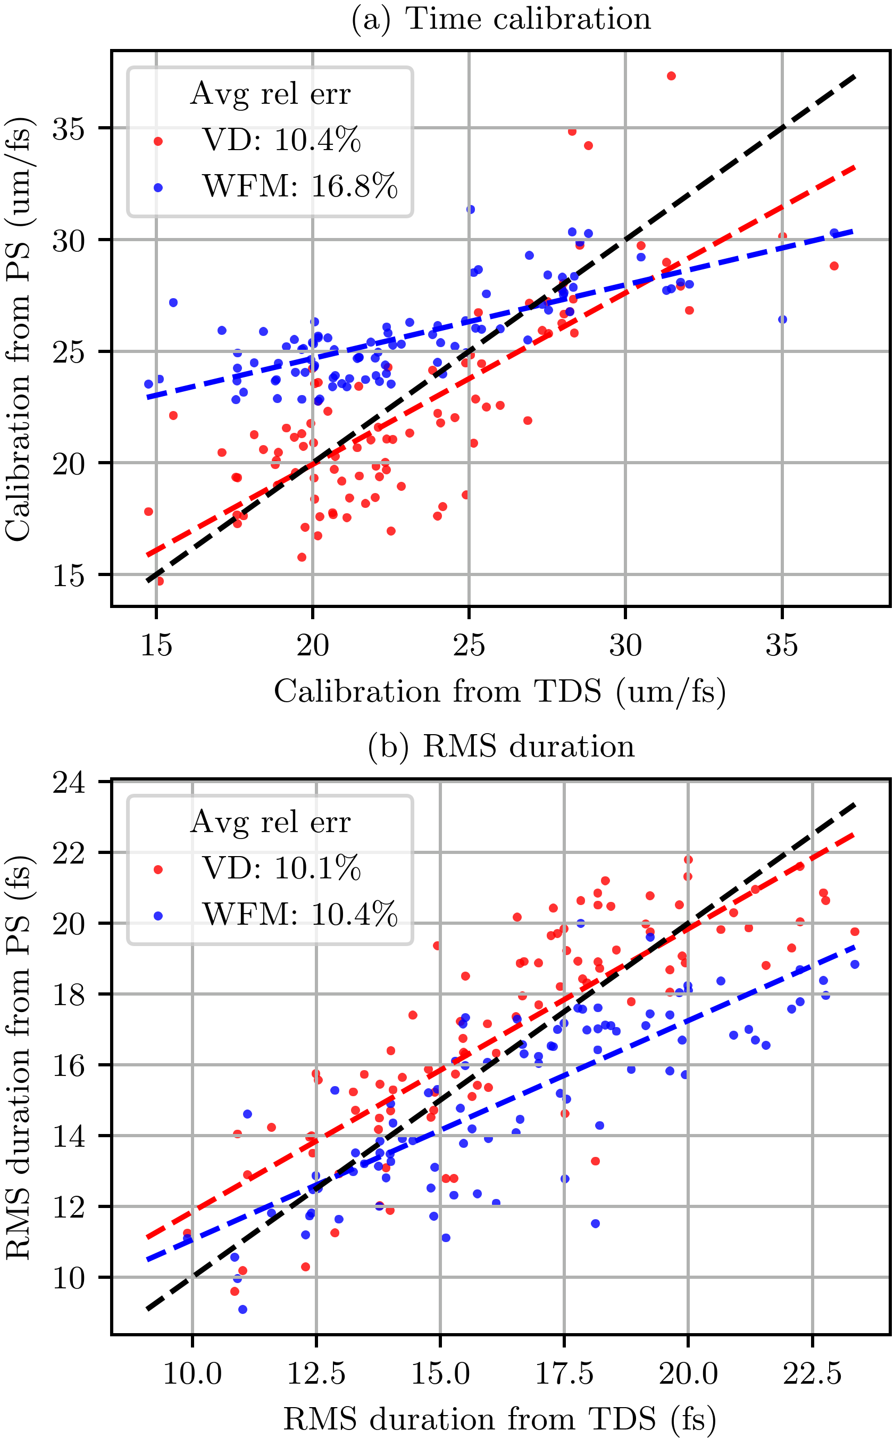
Results, RMS Bunch Lengths and Time calibration factors
U-Net VD could provide an improvement in repdoduced profiles.
Similar performance when comparing reconstructed bunch lengths and measured using TDS.
Clear improvement over non-ML technique when looking at generated time calibration curves
  Compared using the linear component of the calibration curve in the core of the beam (0.3<G<0.9)

Slide 28
FEL Power Profile Predictions with Image-Based Machine Learning at FLASH

Slide 29
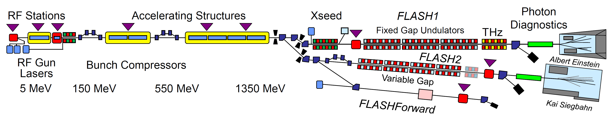
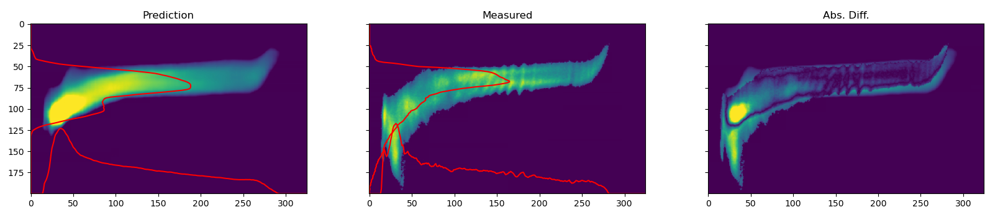
FLASH 2 Beamtime – 7/1-2026
Utilize VD to predict corresponding Non-lasing LPS, for use in reconstructing FEL Pulse Profile
Uses BCM, BAM and charge signals

Slide 30
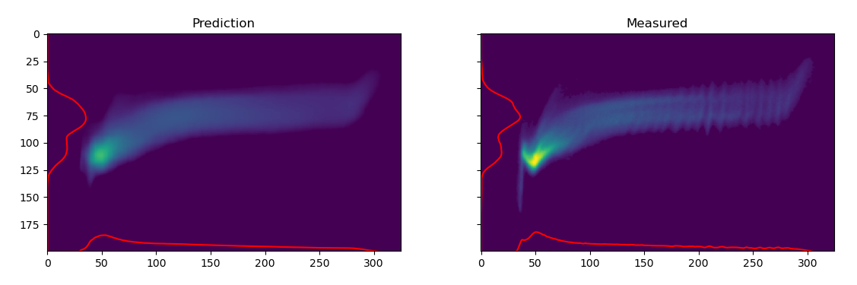
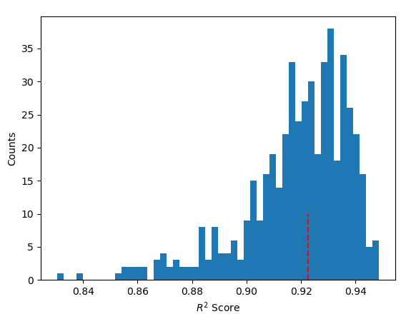
Data and VD Performance
Jitter Data, 6000 Non-lasing training shots
3150 test shots, Lasing
Non-Lasing
Lasing

Slide 31
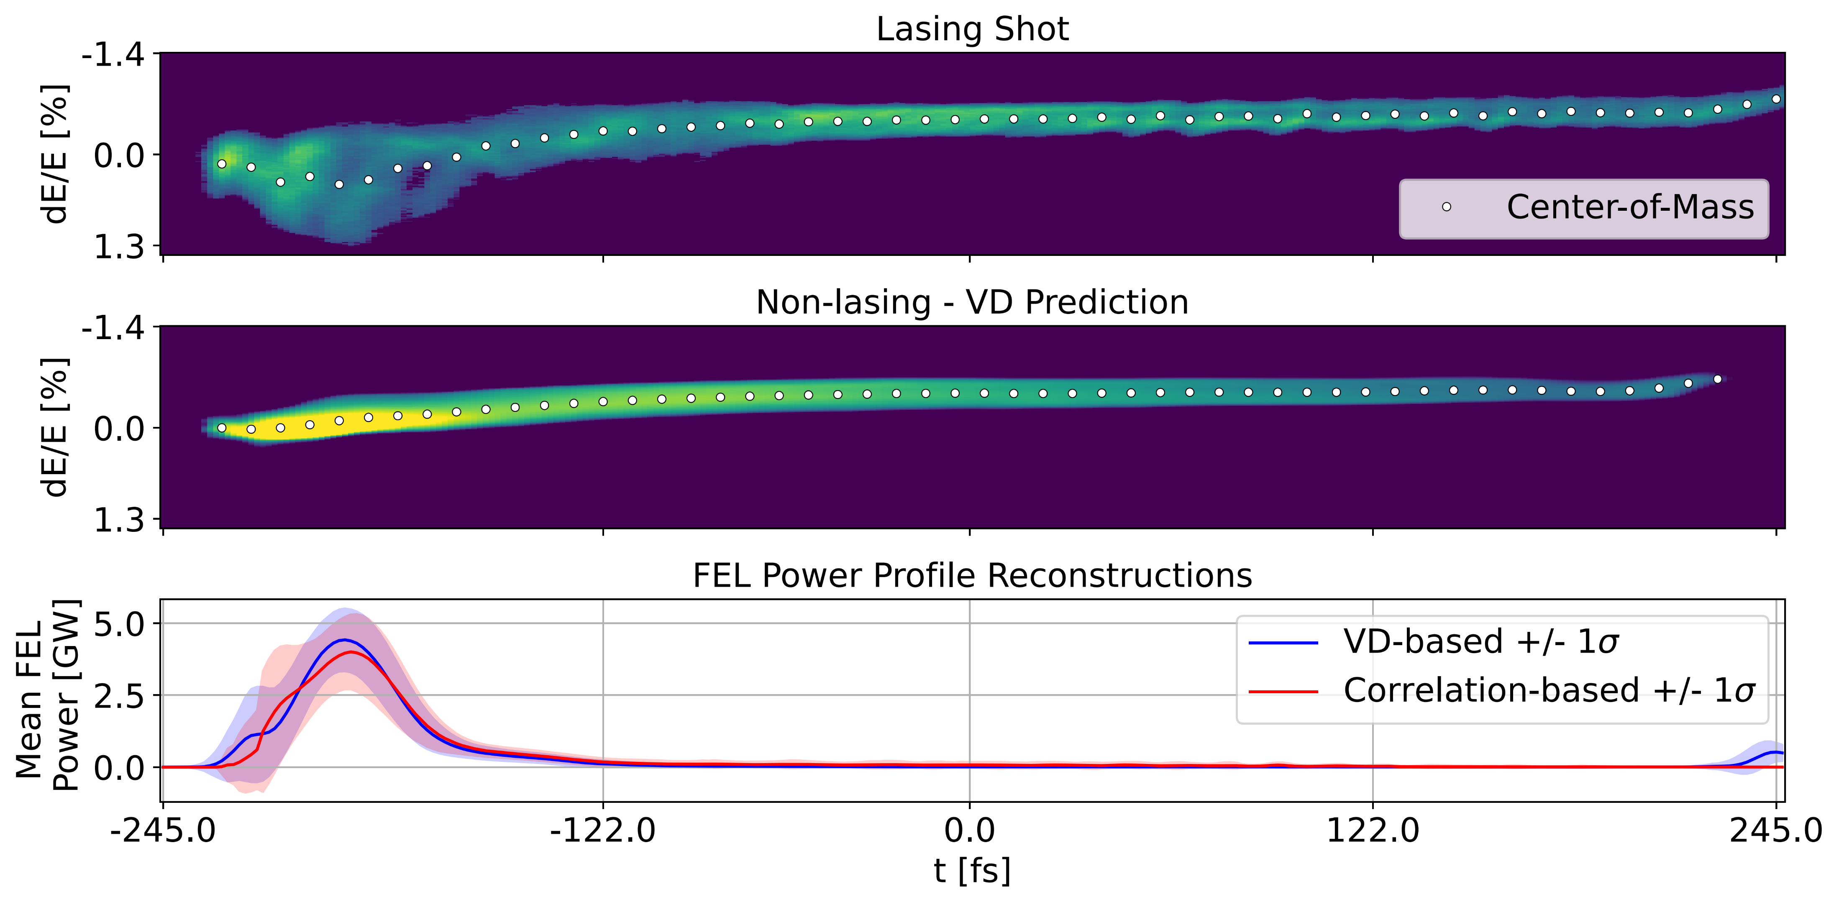
Final Performance and Comparison with Non-ML Technique
Power profile reconstructions using VD predictions and Non-VD choice of maximum similarity.
Taking the shift in COM, applying time calibration and charge normalization.
Techniques perform similarly well.

