Slide 1
Beam Intensity Considerations for NSLS-IIU
Aamna Khan
with V. Smaluk, T. Shaftan (BNL) and G. Stupakov (xLight)
NSLS-II / MAX IV Workshop
October 5, 2026

Slide 2
NSLS-IIU: From Design Parameters to Intensity Challenges
Parameter | NSLS-II (operation) | NSLS-IIU
Energy | 3 GeV | 4 GeV
Circumference | 792 m | 792 m
Lattice emittance, bare | 2086 pm | 41 pm
Emittance with IDs | 746 pm | 27 pm
Momentum compaction | 3.6 × 10⁻⁴ | 6.7 × 10⁻⁵
Beam current | 500 mA | 400 mA
RF voltage | 3.6 MV | 4.8 MV
Natural bunch length | 12.7 ps | 7.9 ps
Vacuum aperture | 76 × 25 mm | 18 mm, 11 mm CB dipoles
Intensity questions for NSLS-IIU
1
How much does intrabeam scattering blow up the emittance at operational current, and how well can we predict it?
2
How far can harmonic cavities stretch the bunch, and is it stable?
3
What does the smaller aperture cost in impedance and beam–induced heating?

Slide 3
Intrabeam Scattering

Slide 4
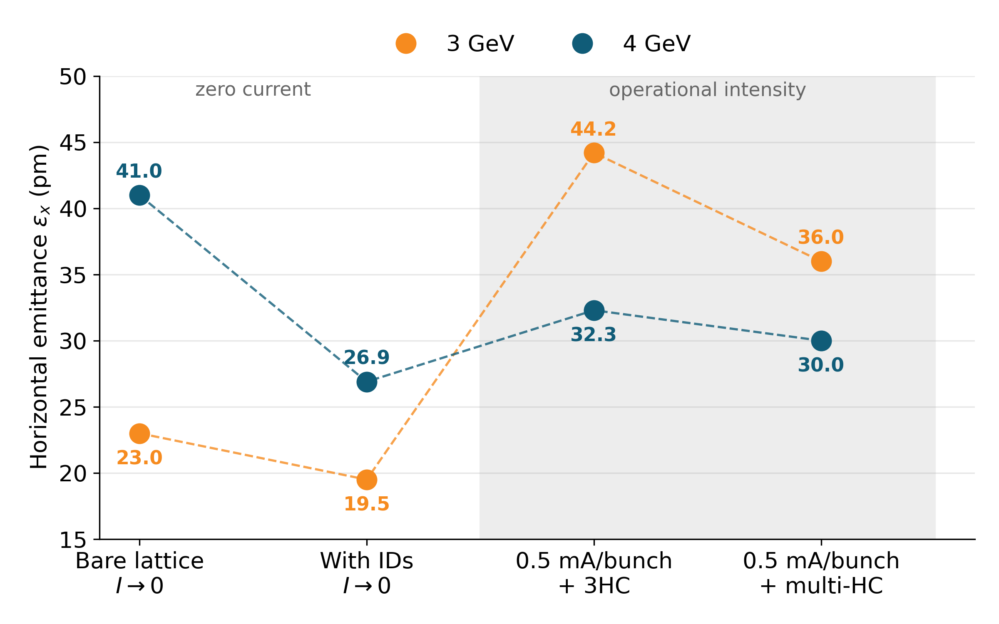
Low Emittance at High Beam Intensity
High brightness requires
  Low electron-beam emittance
  High beam intensity
  Optimized insertion-device performance
At operational intensity
  IBS increases emittance
  Bunch lengthening mitigates IBS
  Collective effects can limit achievable intensity
Minimum lattice emittance ≠ minimum emittance at operational intensity
NSLS-IIU complex-bend lattice: operational points include IBS, impedance-driven and harmonic-cavity bunch lengthening.
A. Khan, V. Smaluk, NSLS-II-U retreat (2023); V. Smaluk et al., J. Synchrotron Rad. 32 (2025).

Slide 5
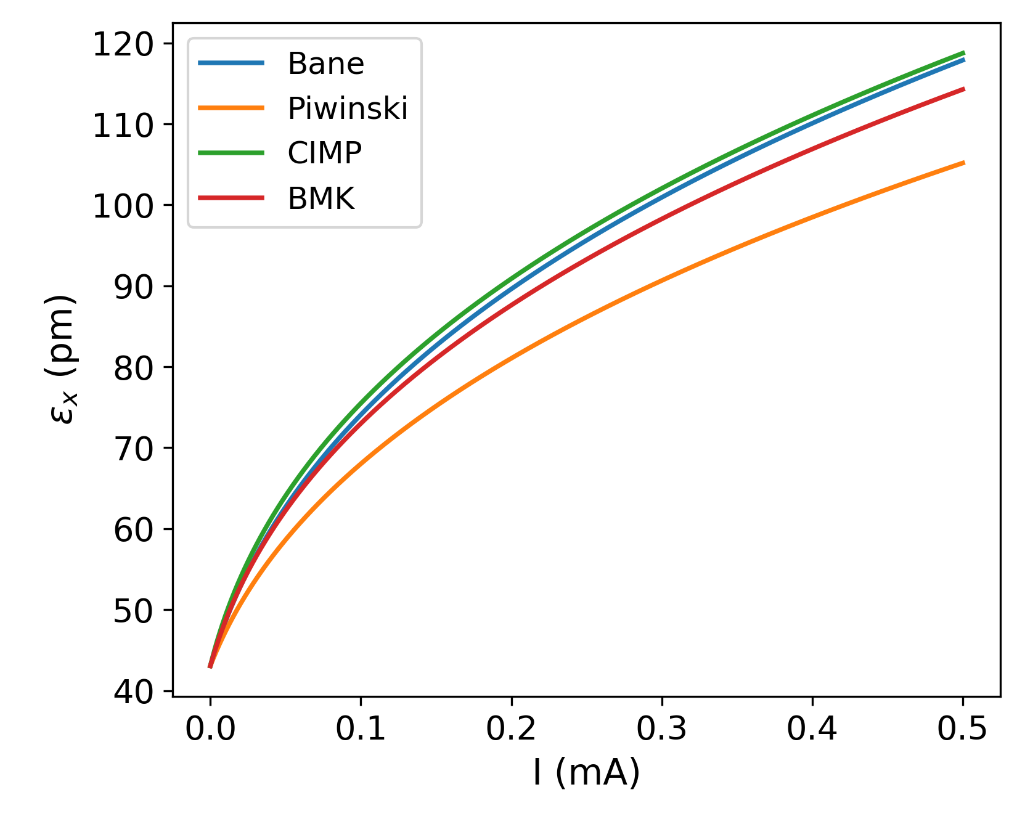
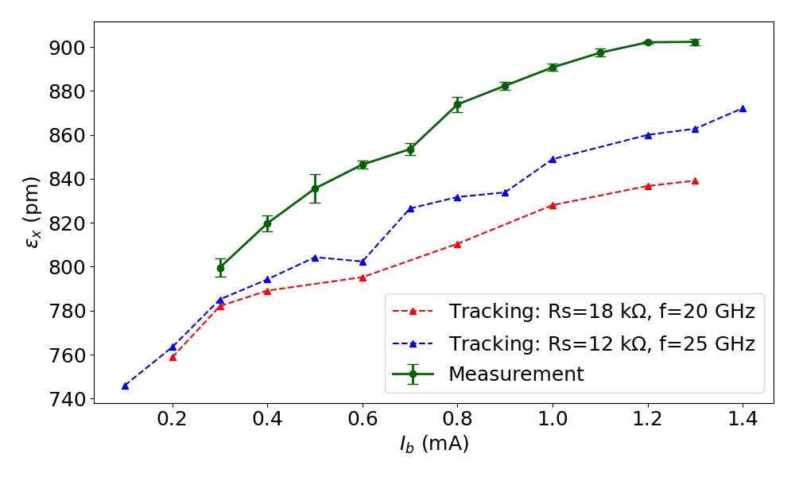
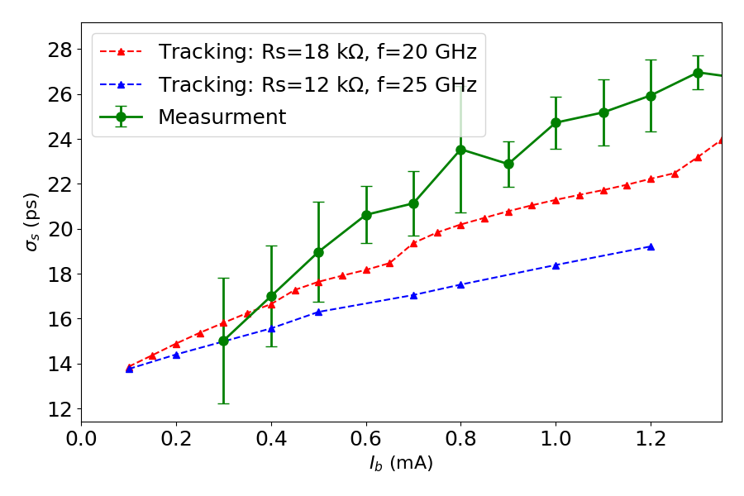
How Well Do We Know the IBS Growth?
IBS formulas compared
NSLS-IIU 4 GeV, bare lattice, no HHC
Model vs. measurement
NSLS-II operational lattice (all IDs, 746 pm)
IBS models agree within ~12%
IBS + impedance model reproduces measured hor. Emittance within ~5%
Conventional models share the same small-angle binary-collision framework.
NSLS-IIU: ~30× lower emittance → validation in the ultra-low-emittance regime is needed
A. Khan, G. Bassi, V. Smaluk, B. Bacha, “Measurements and simulations of intrabeam scattering effects at NSLS-II”, NAPAC’25 TUP063.

Slide 6
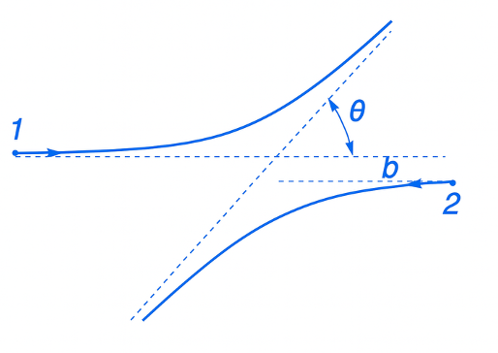
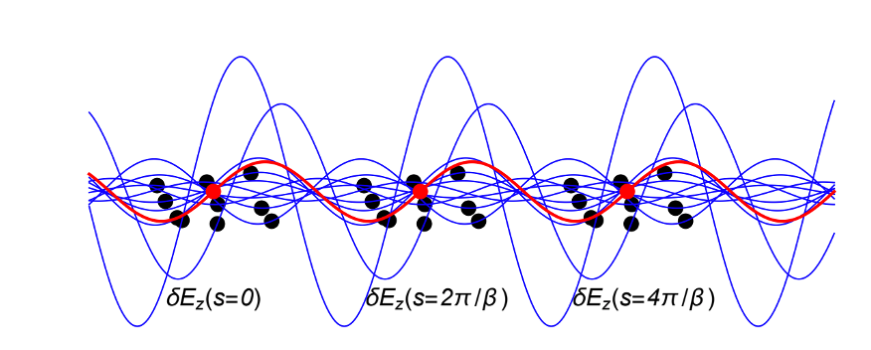
IBS: From Binary Collisions to Field Fluctuations
Conventional theories: binary collisions
Independent small-angle collisions of particle pairs
Successive collisions treated as uncorrelated
Local description of scattering
Coulomb logarithm requires \(b_{\min}\) and \(b_{\max}\)
Conventional theories: binary collisions
New approach: field fluctuations
New approach: field fluctuations
Particle samples the fluctuating field δE_{z} along its betatron trajectory
Kicks at separated locations can remain correlated
Nonlocal in s: correlation links s and s’
Finite transverse beam size regulates the long-range contribution
Conventional theories: binary collisions
Independent small-angle collisions of particle pairs
Successive collisions treated as uncorrelated
Local description of scattering
Coulomb logarithm requires b_{min} and b_{max}
DOE Early Career Research Program: “Maximizing Electron Beam Intensity for High-Brightness Synchrotron Light Sources”
G. Stupakov and A. Khan, “Intrabeam scattering and field fluctuations in relativistic beams”, submitted to PRAB (2026)
A. Khan, G. Stupakov, V. Smaluk, T. Shaftan, Proc. IPAC’26, TUP2302.

Slide 7
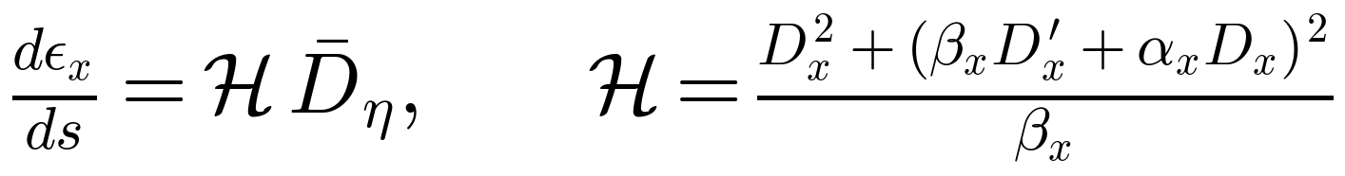
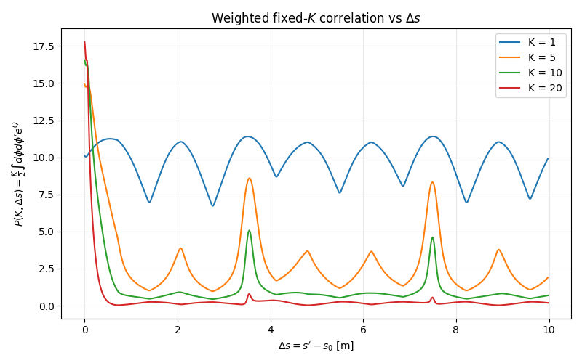
First Results: Long-Range Correlations in IBS
Status: lattice optics and dispersion included; longitudinal slippage in bending magnets neglected
Main result
Δs → 0: short-range / conventional IBS
Larger Δs: repeating peaks from betatron phase realignment
Low K: long-range correlations persist
✓ Checked
Small-scale limit → Lebedev–Nagaitsev IBS
Next →
Bending-induced slippage + realistic storage-ring evaluation
P(K, Δs) vs. distance Δs between source and observation point, fixed K (simple FODO lattice)
G. Stupakov and A. Khan, “Intrabeam scattering and field fluctuations in relativistic beams”, submitted to PRAB (2026)

Slide 8
Higher Harmonic Cavities

Slide 9
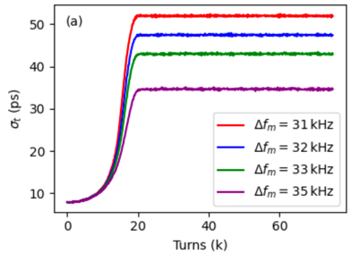
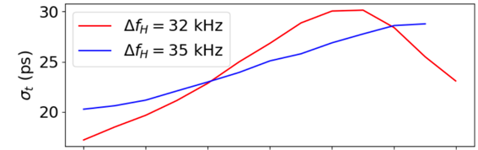
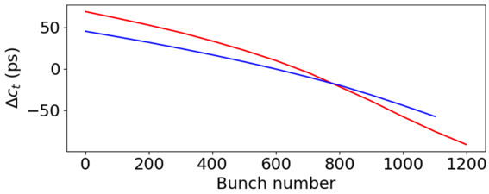
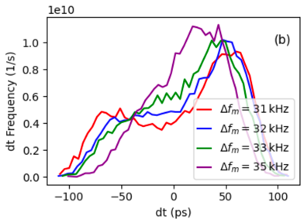
Single Passive HHC: 4 GeV Case Study
ELEGANT simulations
Uniform fill
Realistic fill with a gap
Setup: passive superconducting 3HC (R_{H} = 8.8 GΩ, Q_{H} = 10⁸), 4 GeV, 400 mA, detuning 31–35 kHz
Uniform fill: σ_{t} : 7.9 → 35–52 ps (×4.4–6.6)
Small detuning → double-peaked bunch
Fill with a gap: σ_{t} : 17–30 ps (×2–4) along the train
Transient beam loading → centroid shifts
→ Realistic fill reduces lengthening below the ~5–6× IBS-mitigation target
Bunch length along the train
(a) Bunch length vs. turn
Centroid shift along the train (transient beam loading)
35 kHz → more uniform bunch length along the train
(b) Profiles: single peak at 35 kHz, double at 31–32 kHz
A. Khan, G. Bassi, V. Smaluk, “Passive higher-harmonic RF cavity simulations for bunch lengthening in the NSLS-II-U”, Proc. NAPAC’25, TUP088, pp. 577–581.

Slide 10
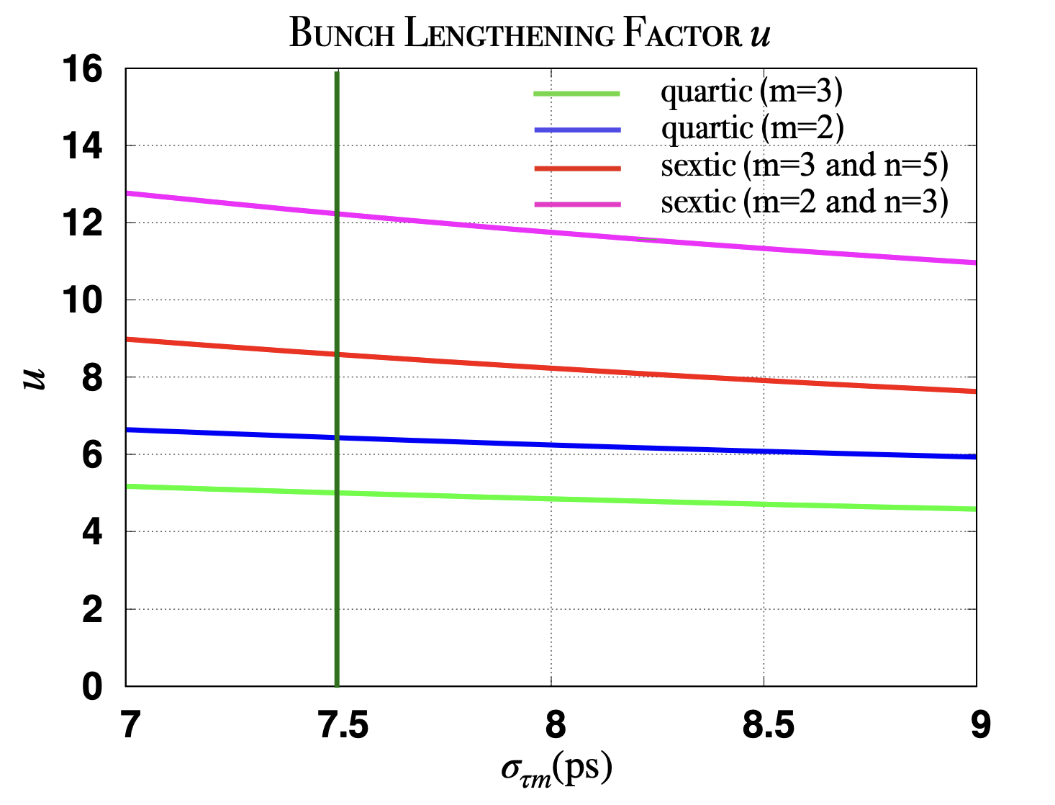
Multi-harmonic Bunch Lengthening
Equilibrium predictions for active RF systems
Target
Approximately 5-6× lengthening for IBS mitigation.
Prediction
Different harmonics increase the equilibrium bunch length.
Stability question
Can this lengthening remain stable with realistic filling patterns?
G. Bassi, A. Khan, V. Smaluk, IPAC’24, THBD2.

Slide 11
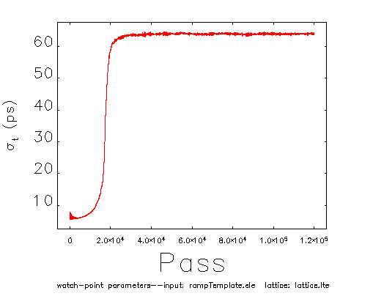
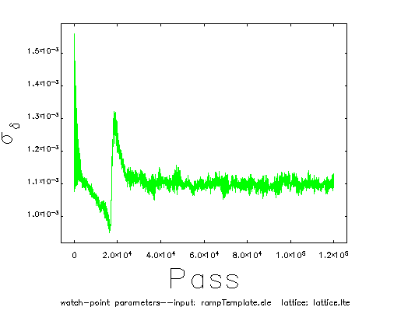
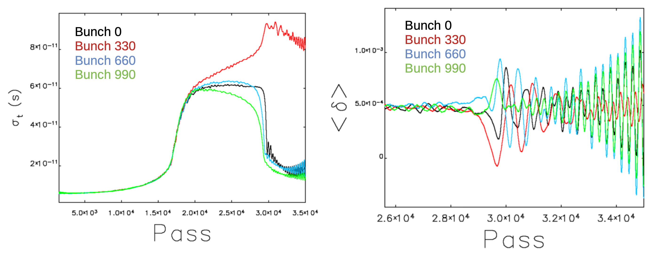
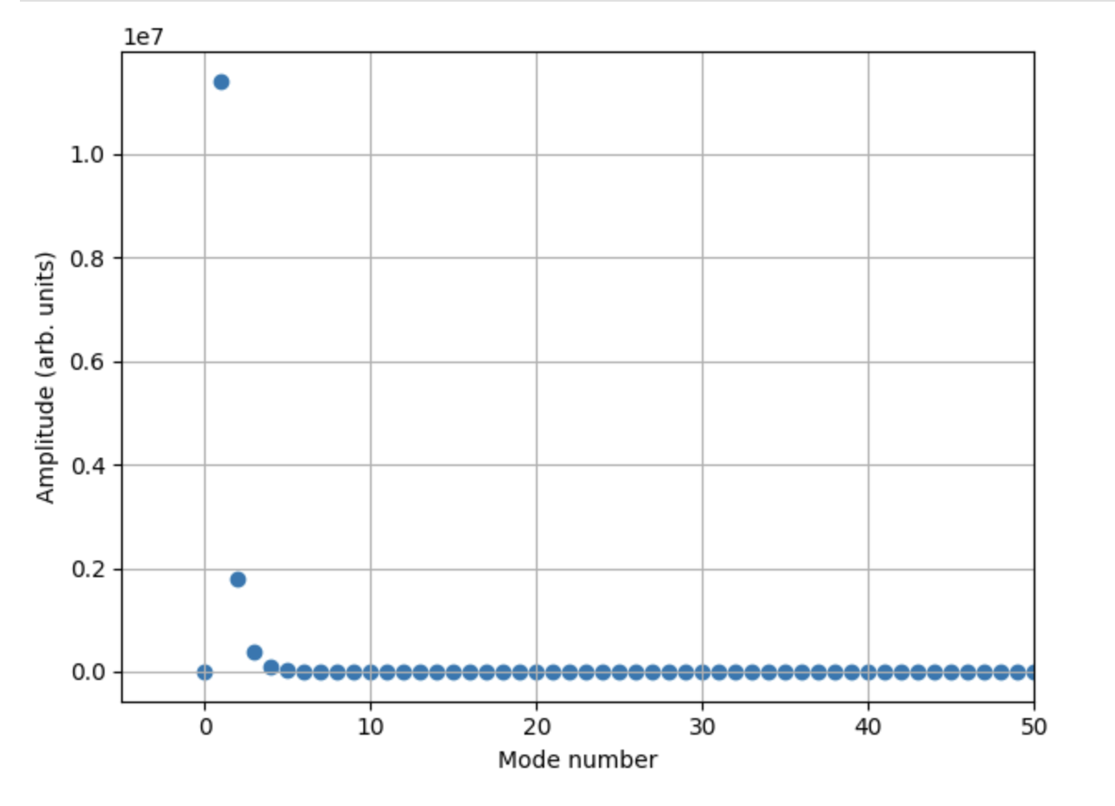
Passive 3HC + Active 5HC: Stability
Pseudo-bunch (mode 0) studies in ELEGANT
1320 bunches: unstable
All bunches identical, so only mode 0 can grow. σ_{t}: 7.9 → ≈ 63 ps (u ≈ 8), held for 1.2 × 10⁵ turns; σ_{δ} returns to 1.1 × 10⁻³
Bunches 0, 330, 660, 990: lengthening, then collapse and growing ⟨δ⟩ oscillation
Cavity (RF-group parameters) | R (MΩ) | Q | V | Detuning
Main (active) | 24 900 | 5.6 × 10⁸ | 4.8 MV | −1.64 kHz
3HC (SC, passive) | 8 900 | 1 × 10⁸ | beam-induced | +24 kHz
5HC (active) | 0.93 | 1.5 × 10⁴ | 0.24 MV | −141.5 kHz
(preliminary studies)
4 GeV, 400 mA, ELEGANT simulations with beam-loaded cavities
Further multibunch instability and mitigation studies are planned

Slide 12
Impedance

Slide 13
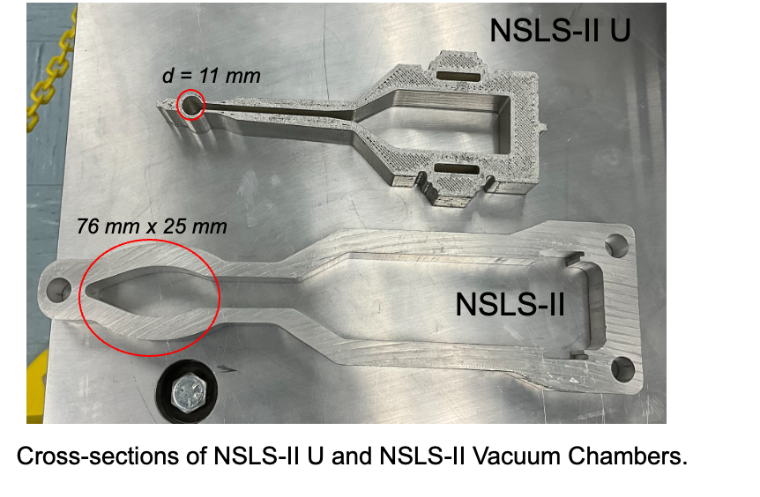
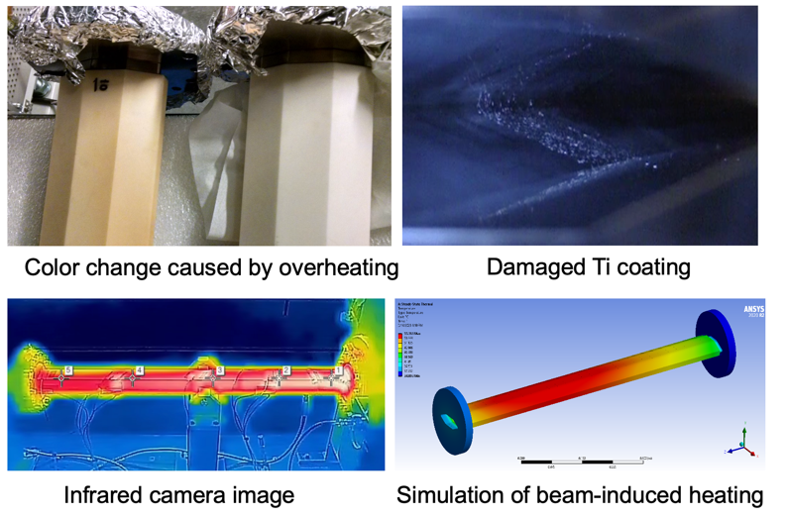
Small Apertures: Impedance and Beam-Induced Heating
NSLS-II → NSLS-IIU
12.5 mm → 5.5 mm vertical half-aperture
Resistive-wall scaling: Z∥ ∝ 1/b, Z⊥ ∝ 1/b³
→ Z∥ ×2.3, Z⊥ ×12
NSLS-II ceramic kicker chambers:
measured heating reproduced by impedance + thermal simulations
A. Khan et al., PRAB 27, 084501 (2024)
NSLS-IIU: small-aperture components require both impedance and thermal evaluation.

Slide 14
NSLS-II-U Vacuum Components
Cell layout with ID extraction (left) and BM extraction (right). Courtesy of R. Todd
Component (per ring) | NSLS-II | NSLS-II-U | NSLS-II Σk_{loss} (V/pC)*
RF-sealed flanges | 756 | 1260 | 449
Bellows | 218 | 360 | 109
BPMs | 250 | 510 | 47
Gate valves | 61 | 60 | 31
Vacuum chambers | 150 | 420 (120 CB) | 0.3
Tapered transitions | 1 | 240 | 30
NSLS-IIU vacuum system
18 mm nominal aperture; 11 mm in CB regions
Substantially more vacuum components
240 tapered transitions introduced by the new layout
* σ_{s} = 0.3 mm, NSLS-II impedance budget; NSLS-IIU counts exclude ID chambers and diagnostics. Cell layout: R. Todd (Sep. 2026).
A. Blednykh, et al., Nucl. Instrum. Methods Phys. Res. A, vol. 1005, p. 165349, 2021.

Slide 15
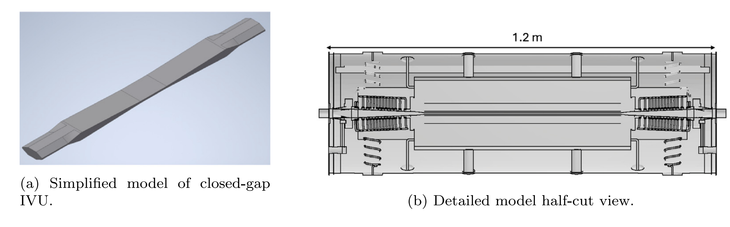
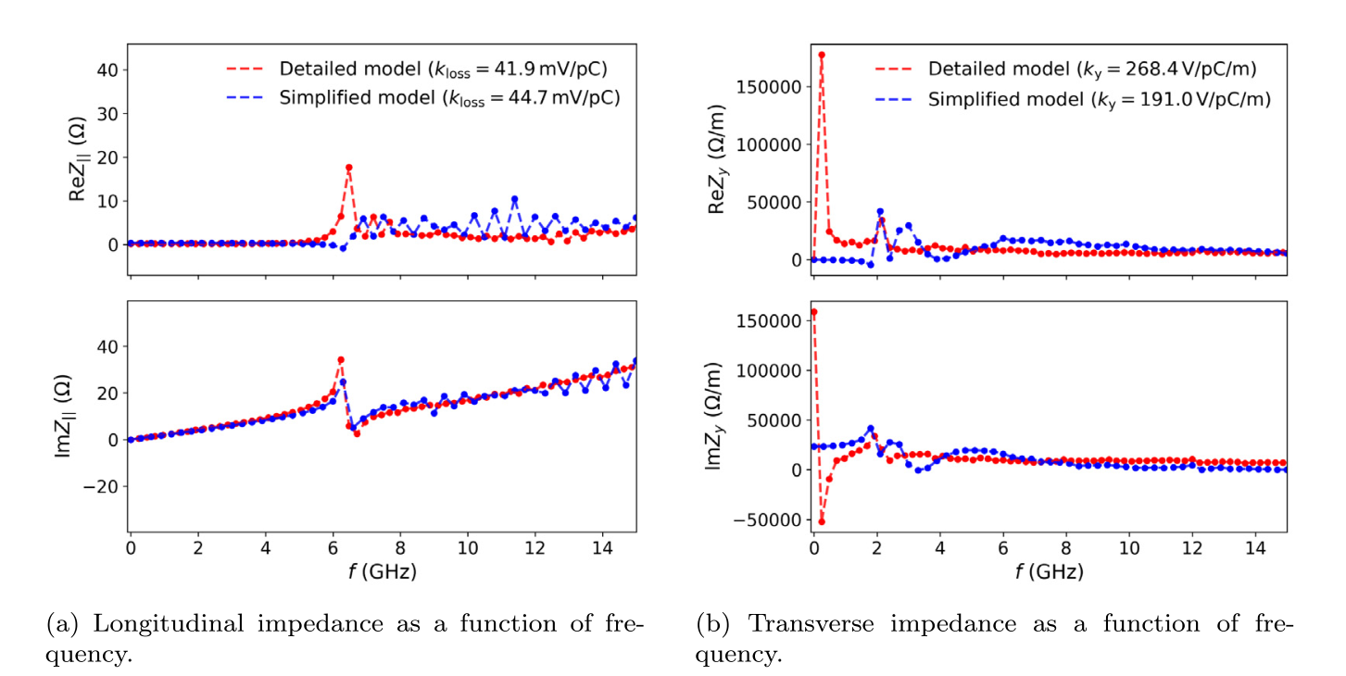
Impedance Tools and Model Validation
Converged codes agree within ~10% for the tested loss and kick factors.
 | GdfidL | ECHO3D
Method | Finite integration | Low-dispersion TE/TM
Mesh* | σₛ/15 | σₛ/5
Parallelization | MPI Multi-node | OpenMP Single node
IVU models: taper only (left) and detailed chamber (right)
*Approximate Δ limits in the tested cases.
ECHO3D permits coarser transverse meshing.
Geometric details for IVU
The detailed IVU model gives a higher transverse kick factor and better agreement with the measurements.
IVU impedance: detailed (red) vs. taper-only (blue) model, ECHO3D
A. Khan and V. Smaluk, NIM A 1082 (2025), 171073; A. Khan et al., IPAC’24, THPC46.
.

Slide 16
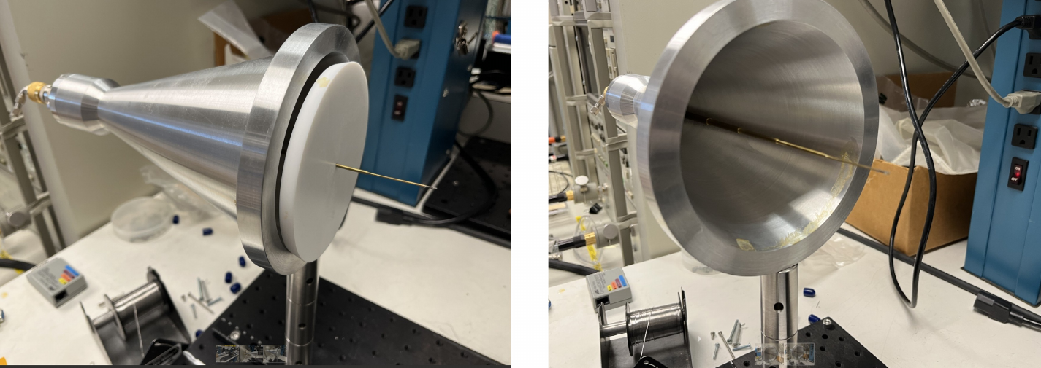
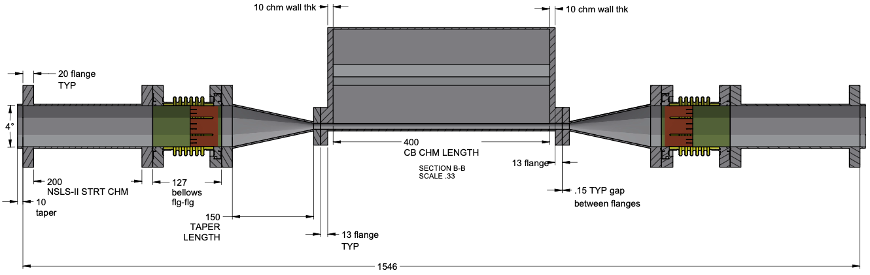
Impedance Validation: Simulation → Bench → Beam
Build the NSLS-IIU impedance budget and validate critical components before installation.
1 SIMULATION
2 BENCH TEST
3 BEAM TEST
Component models
CB chamber • tapers • bellows • RF flanges
Cell 1 / NSLS-II test straight
prototype
→
50 GHz VNA + Goubau line
→
Install selected upgrade hardware
• measure beam-induced heating
• monitor thermal + vacuum response
• compare with simulations
Measure prototype impedance
• calibration in progress
• compare directly with CST / wake simulations
Calculate wake / impedance / power deposition
→ build component budget
Hardware ↔ model validation
Validate models under
beam conditions
Validated codes agree ≈10%
LDRD 26-036 (V. Smaluk et al.)

Slide 17
Summary and Discussion
IBS prediction
NSLS-II: conventional IBS + impedance model agrees with measured emittance to ~5%
Ongoing: field-fluctuation theory for the ultra-low-emittance regime
How well do IBS models reproduce your measurements at high bunch intensity?
Harmonic-cavity stability
single 3HC: u ≈ 4 (3 with a gap); 3HC + 5HC: u ≈ 8 in mode 0, but mode 1 is unstable
What has MAX IV learned about optimizing multi-HHC operation with realistic filling patterns and mitigating coupled-bunch instabilities?
Impedance validation
Tools: simulations benchmarked and ongoing work on bench test measurements and beam tests
Which components have caused impedance/heating issues at MAX IV, and how were they identified?
17

Slide 18
Thank you

