Slide 1
5. Collective Effects
NSLS II-MAX IV workshop
5-6 Oct. 2026
Francis Cullinan, Murilo Barbosa Alves MAX IV

Slide 2
Outline
Single-bunch instabilities
Bunch lengthening and mode-1 instability
Predictions for MAX4^{U}, experiments on present R3 ring
  Reuse of majority of vacuum chambers (impedance budget)
  Components of RF system available (performance to be demonstrated)

Slide 3
R3 vs. TDR-1
 | R3 (as designed) | MAX 4^{U} (TDR-1) | Units
Natural emittance | 328 | 65 | pm rad
Natural energy spread | 7.7 | 8.5 | 10⁻⁴
RF voltage | 1.8 | 1.0 | MV
Momentum compaction factor | 3.06 | 0.53 | 10⁻⁴
Energy loss per turn (dipoles) | 360 | 474 | keV
Natural bunch length | 29 | 19 | ps
Synchrotron frequency | 1274 | 376 | Hz
Average | 3.73 / 6.85 | 3.18 / 6.13 | m
Damping times (H/ V/ L) | 15.73 / 29.05 /25.19 | 11.45 / 22.29 / 21.17 | ms
Fill pattern | 176/176 buckets filled
Factor of 6 reduction
->biggest challenge

Slide 4
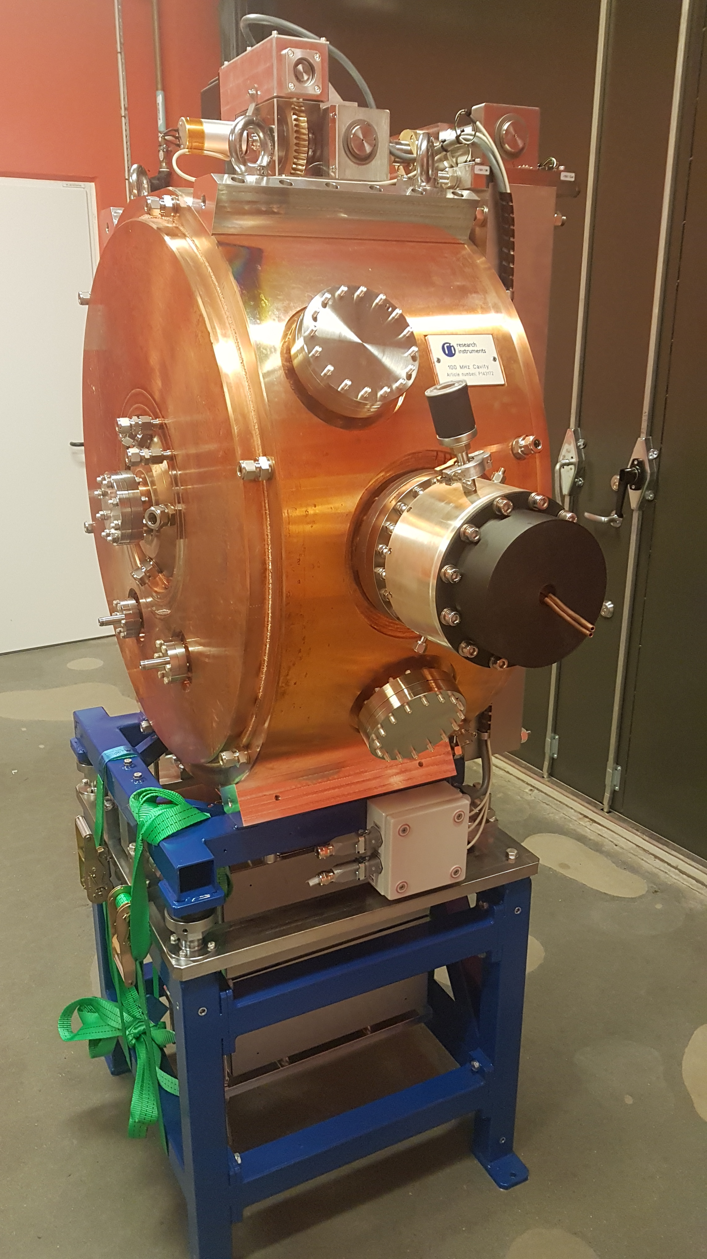
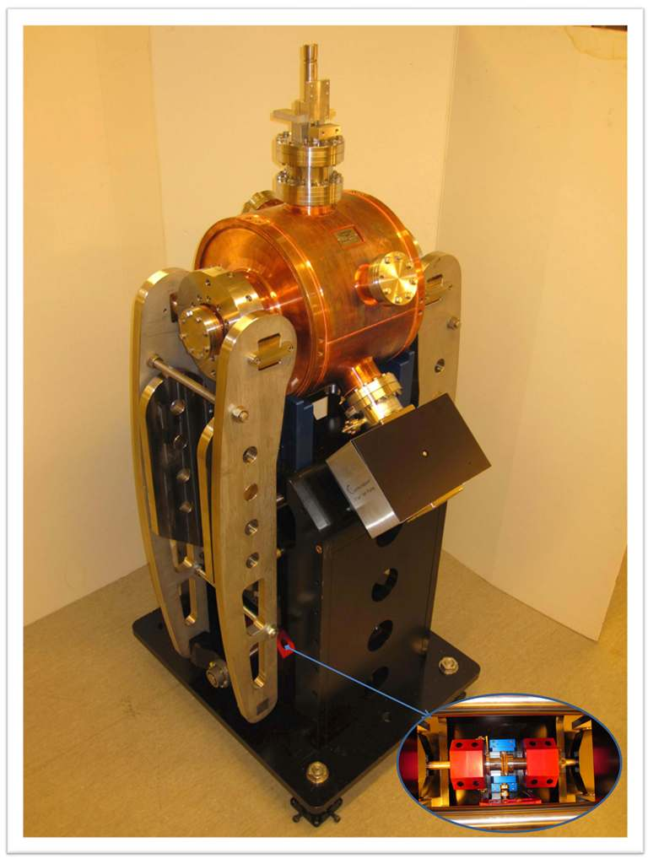
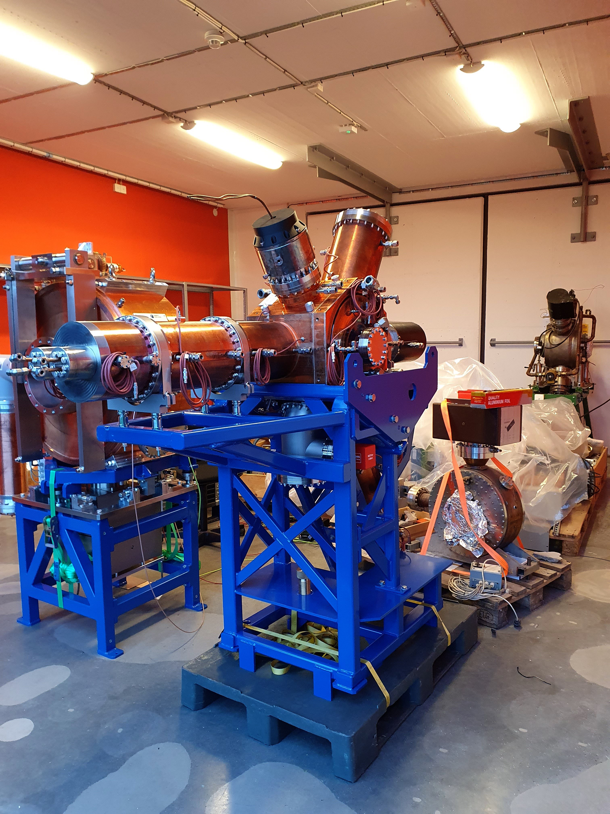
RF Cavities at MAX IV:
Slide by Åke Andersson
Main
HC3
HC5
300 MHz
Rs0=2.75 MΩ
Q0=20800
500 MHz
Rs0=4 MΩ
Q0=31000
100 MHz
Rs0=1.71 MΩ
Q0=20284

Slide 5
Single-Bunch Effects

Slide 6
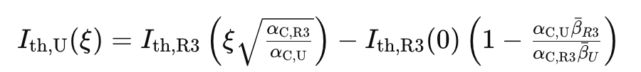
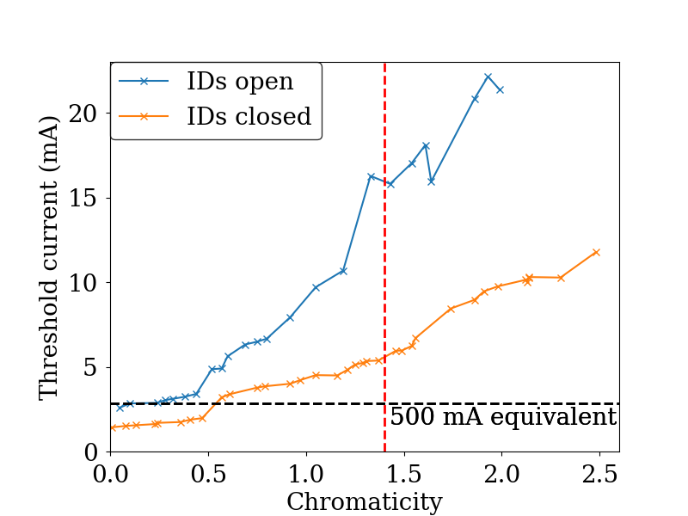
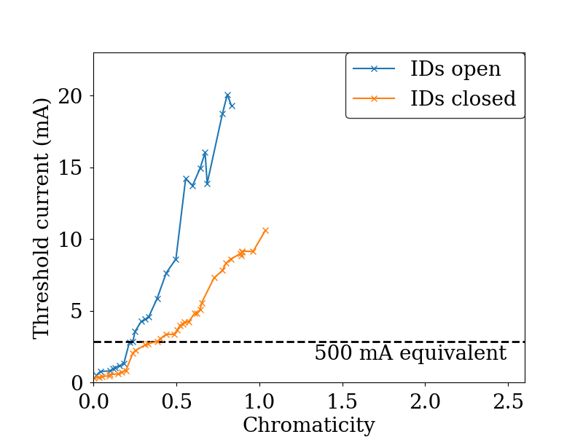
Transverse Mode-Coupling Instability
Vertical plane
Mode-coupling calculations based on the impedance model overestimate current thresholds in R3*
TDR1 estimates obtained from R3 measured data after offset + chromaticity scaling
2.4
0.8
TDR1
R3 measured
scaled
Delivery
value
*V. Smaluk, “Impedance computations and beam-based measurements: a problem of discrepancy”, NIMA 888 22-30, 2018.

Slide 7
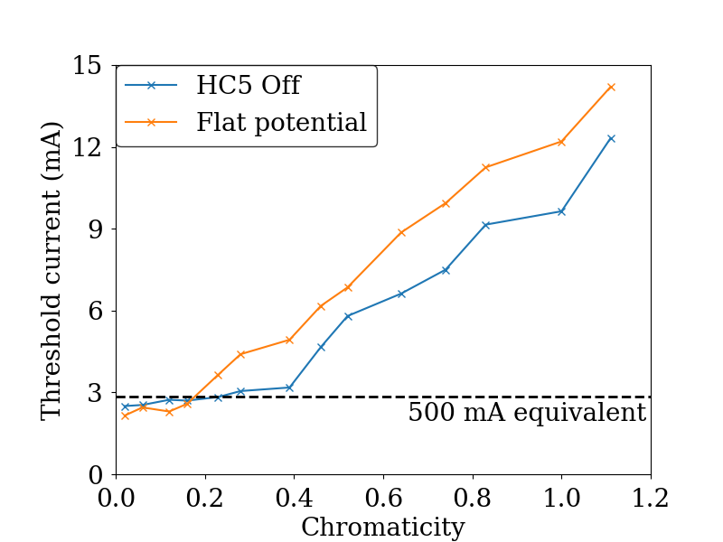
  Effect Of HC5 Lengthening on TMCI
Active HC5 enables single-bunch experiments with high bunch charge but low total current
R3 measurements show moderate increase from chromaticity>0.2
Thresholds repeatable to within 0.1 mA
R3

Slide 8
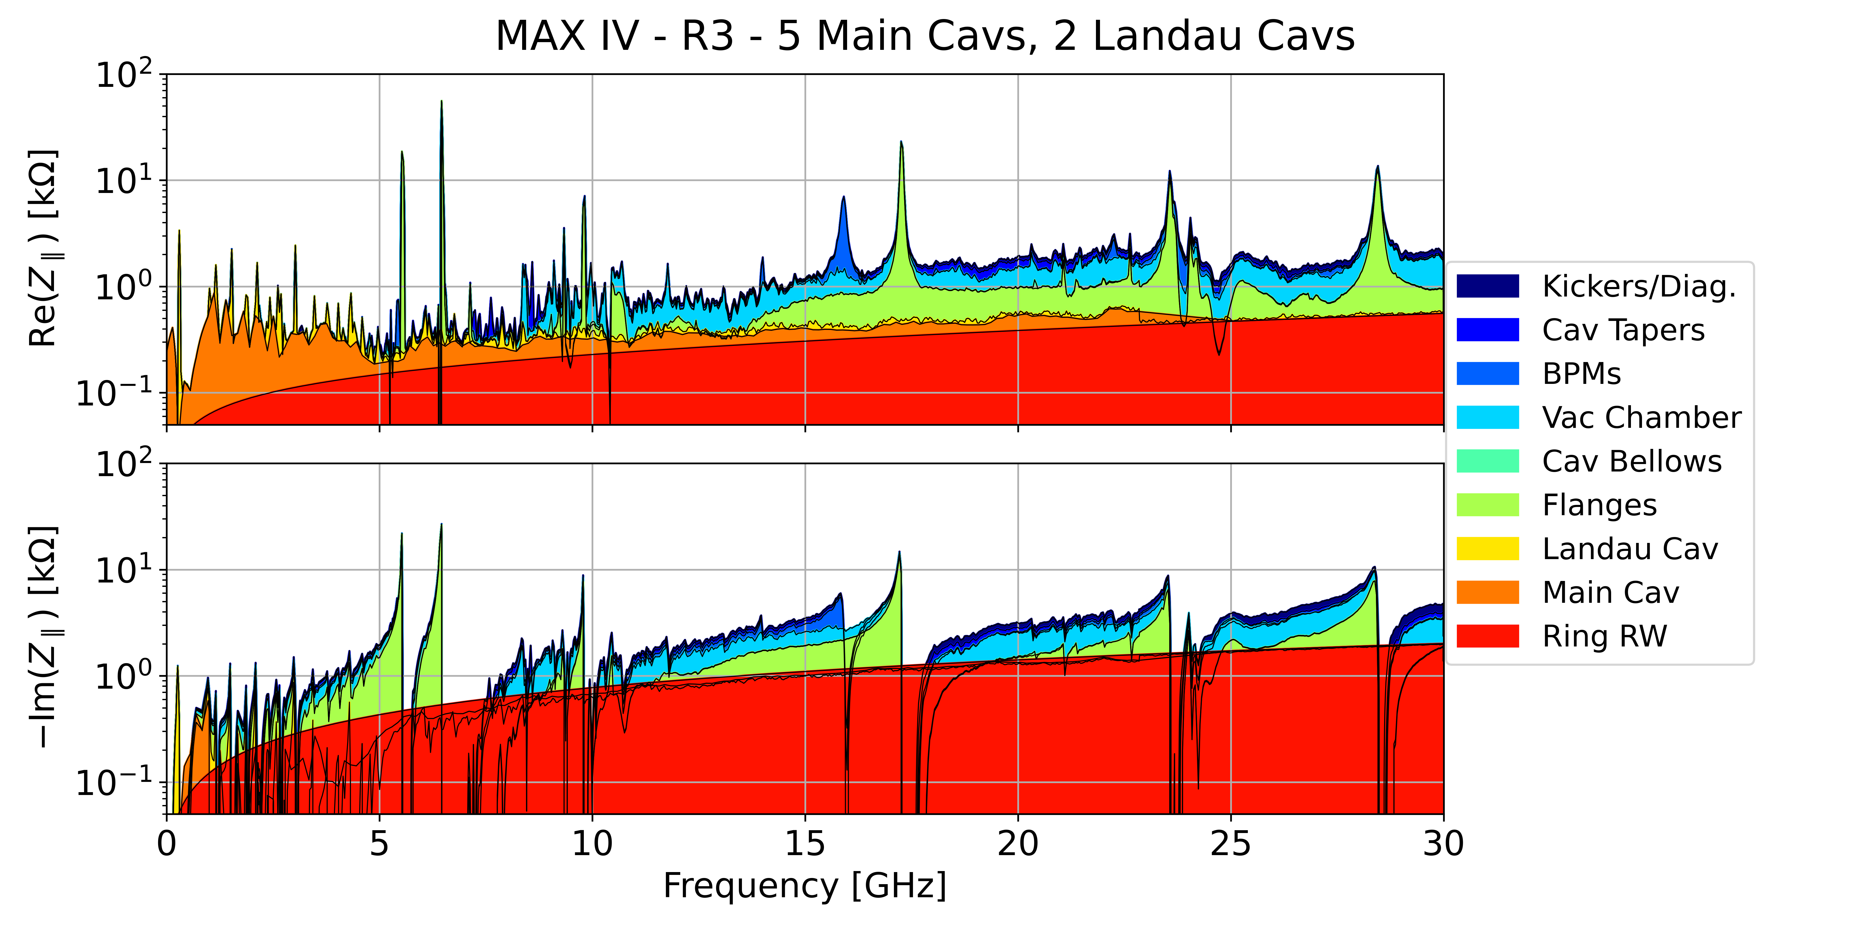
R3 impedance budget
R3 impedance model based on ImpedanceWake2D (resistive wall)+ GdfidL (geometric)
To add: 500 MHz cavity, injection striplines, CSR
MAX IV R3 longitudinal impedance - 5 Main Cavities 2*HC3

Slide 9
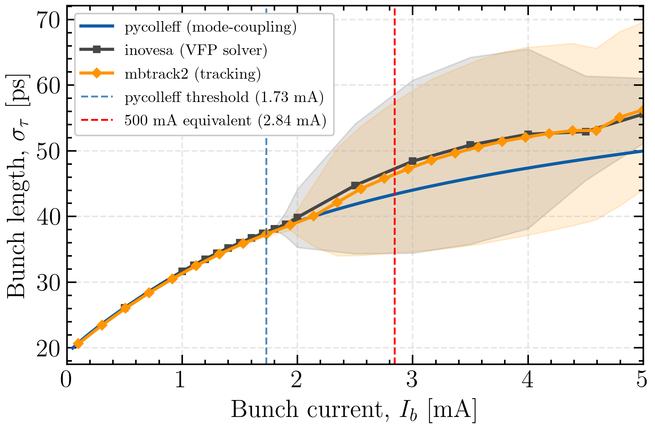
Microwave threshold, no IBS
Three methods predict the same microwave instability threshold for TDR1
Current threshold below value required for 500 mA
Method | MWI threshold [mA]
Pycolleff (mode-coupling) | 1.73
Inovesa (VFP solver) | 1.80
Mbtrack2 (tracking) | 1.90

Slide 10
Microwave Instability with IBS
IBS added to different methods
  Mbtrack2: self-consistent recalculation of IBS kicks using Completely Integrated Modified Piwinski Model (CIMP)
  Pycollef+Inovesa: current-dependent energy spread as input
Method | MWI without IBS | MWI with IBS | Increment
Pycollef (mode-coupling) | 1.73 | 2.77 | +60%
Inovesa (VFP solver) | 1.8 | 3.0 | +67%
Mbtrack2 (tracking) | 1.9 | 2.1 | +10%

Slide 11
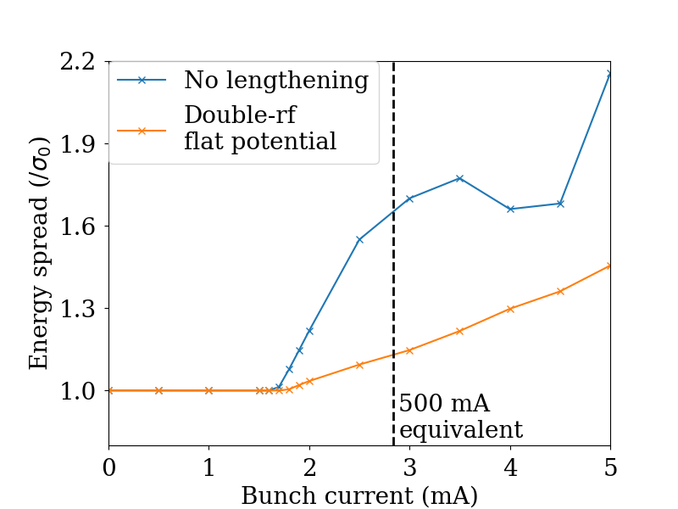
Effect of Harmonic-Cavity Lengthening
Inovesa predicted next to no effect of HC3 on microwave threshold
Strong influence of HC5 lengthening measured in R3*
  No lengthening: 6.4 mA
  At flat potential: 11.3 mA
Work in progress to understand discrepancies in calculations/simulation with HCs and IBS
Inovesa on CDR SG lattice
*Insertion devices closed (necessary to see instability with HC5 on)

Slide 12
Bunch Lengthening

Slide 13
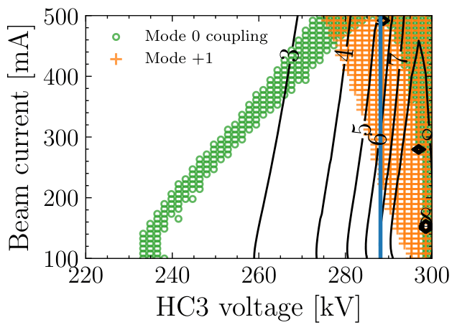
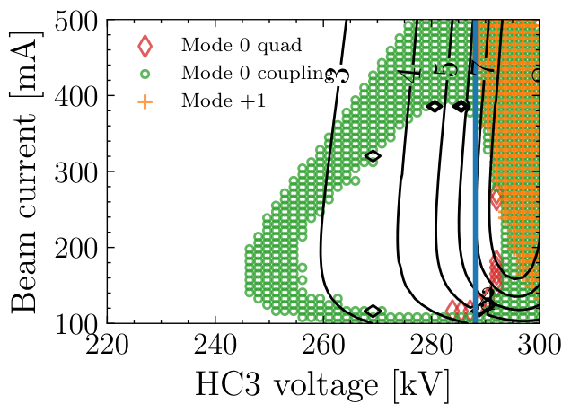
Double-RF: passive HC3
Semi-flat potential: correct amplitude but not phase
Predictions using Pycolleff
2 HC3s
1 HC3
Black contours:
Touschek lifetime improvement factor
Mode 0 should be controlled by Mode 0 Damper (as in R3)
Mode 1 unstable with 2 HC3s
Mode 1 stable with single passive HC3
Notes:
\begin{equation}
R = \frac{\int d\tau \lambda_0^2(\tau)}{\int d\tau \lambda^2(\tau)},
\end{equation}

Slide 14
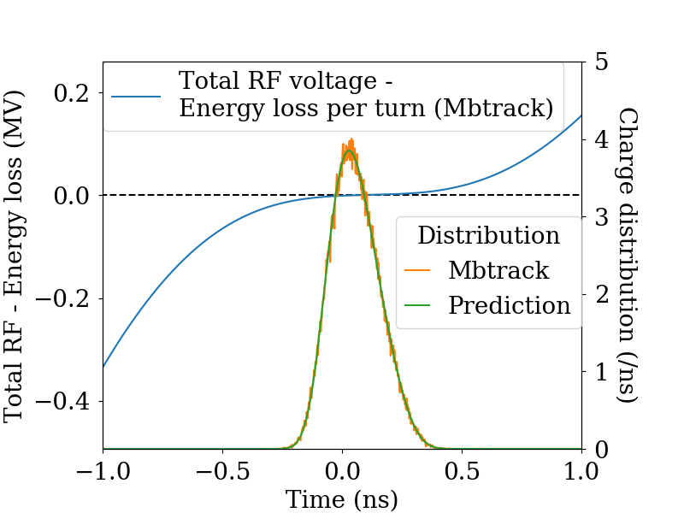
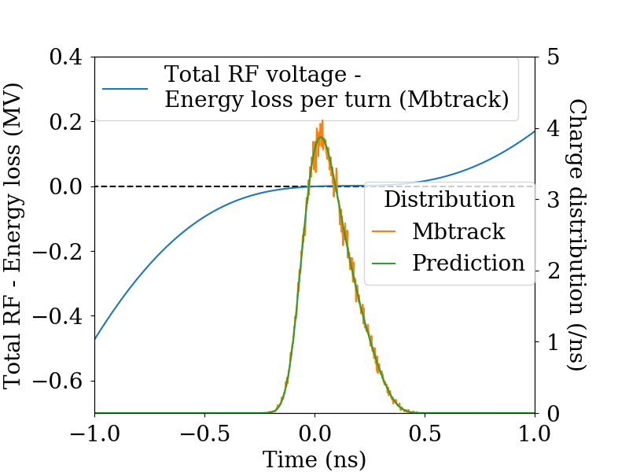
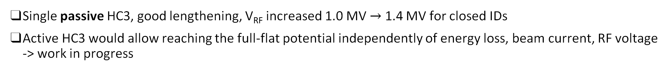
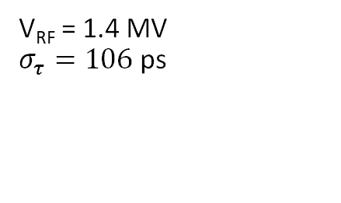
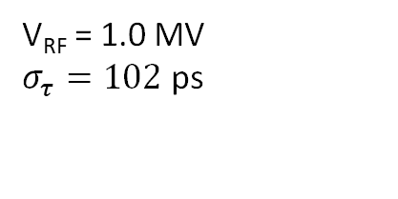
Double-RF and energy loss per turn
Single passive HC3, good lengthening, V_{RF} increased 1.0 MV $→$ 1.4 MV for closed IDs
Active HC3 would allow reaching the full-flat potential independently of energy loss, beam current, RF voltage -> work in progress
IDs open, 474 keV
IDs closed, 800 keV
V_{RF} = 1.0 MV
$σ_{τ}=102$ ps
V_{RF} = 1.4 MV
$σ_{τ}=106$ ps

Slide 15
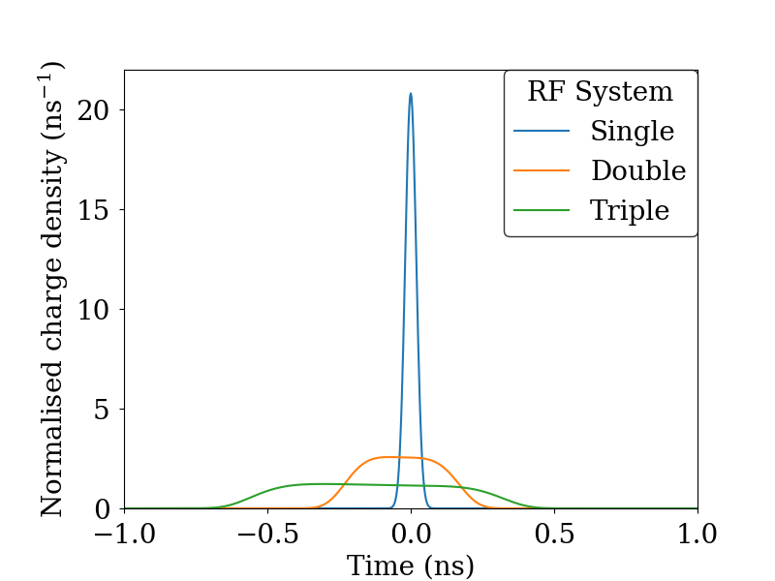
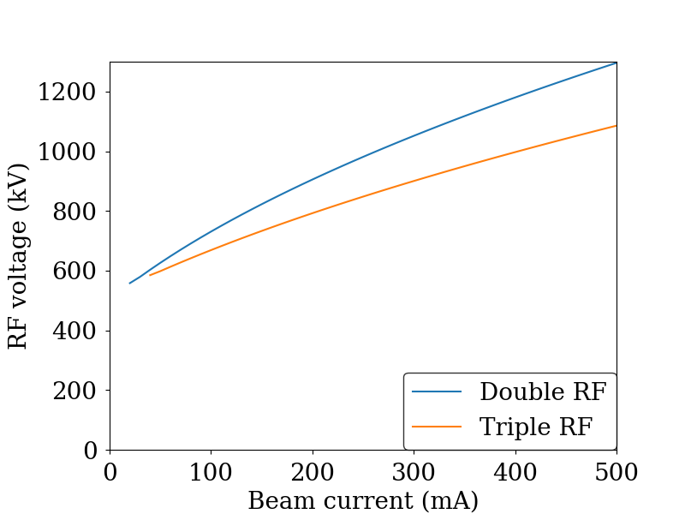
Triple-RF Lengthening
Factor of two additional lengthening can be achieved by adding active HC5 to HC3
RF voltage needs to be adjusted for HC3 passive
στ = 19.2 ps
στ = 125 ps
στ = 257 ps

Slide 16
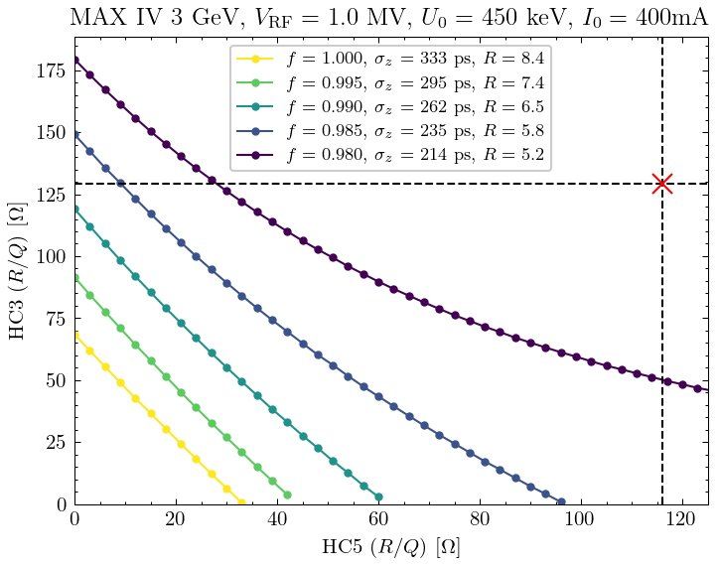
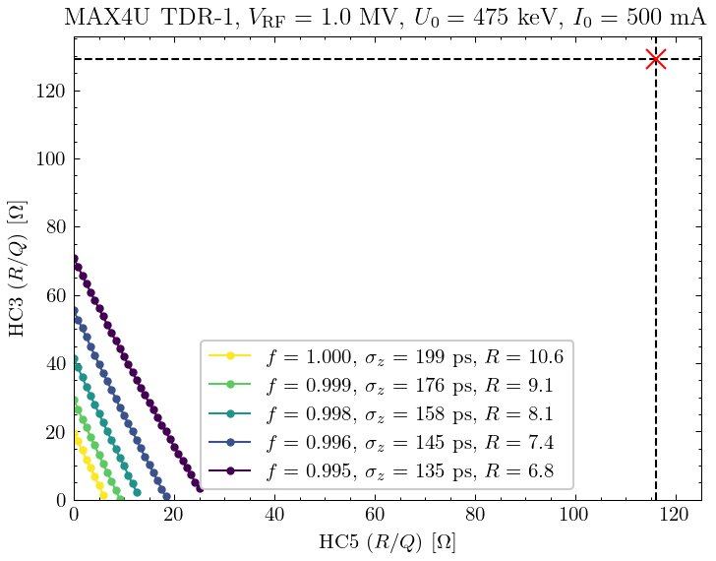
Triple-RF Mode 1 Limitations
Triple active system
Unreasonable constraints on R/Q to keep mode 1 stable
Mode-1 feedback necessary
Existing cavities (one of each)
existing HC3
TDR1
R3
existing HC5

Slide 17
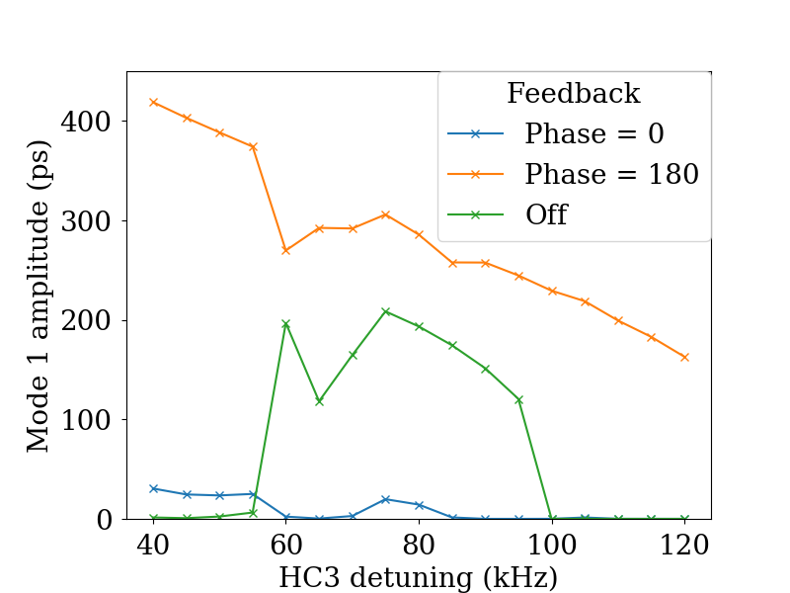
Mode-1 Reactive Feedback
Initial simulations show promise of reactive mode-1 feedback
Mbtrack, R3 double RF, 2*HC3, 400 mA
R3

Slide 18
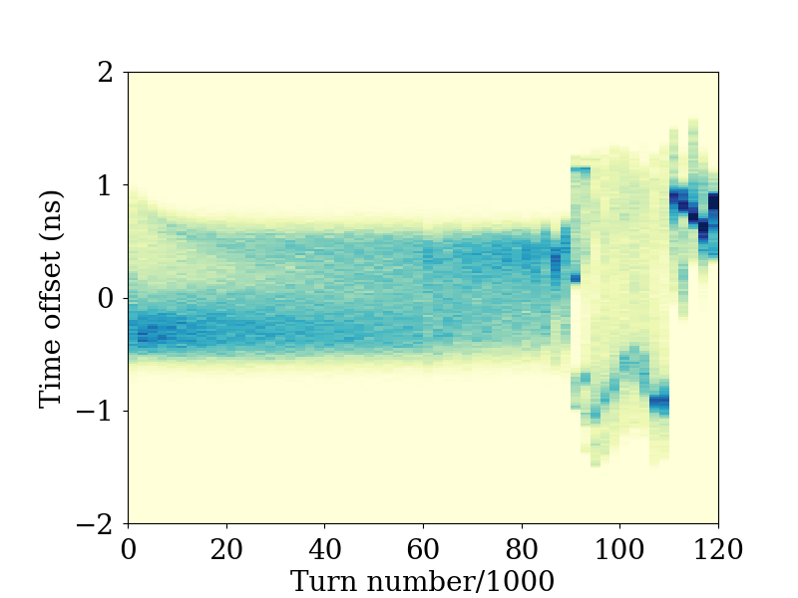
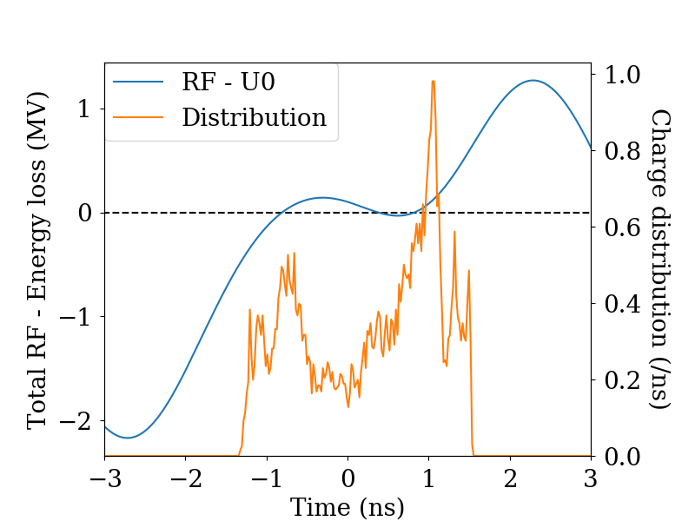
Triple-RF Macroparticle Simulation Attempts
Strange mode-0 instability observed when attempting to simulate all three cavities, even with reduced shunt impedances
Increased radiation damping impacts bunch lengths and profiles
RF Feedback on
Turn 94
R3, 400 mA triple-active system
10% Rs
Radiation
damping ✕ 1000

Slide 19
Conclusions
Low momentum compaction leads to many challenges regarding collective effects in MAX4^{U}
Active harmonic-cavity system in R3 is a useful test environment for single-bunch collective effects
TMCI can be controlled with chromaticity, bunch lengthening expected to be beneficial
Microwave instability happens below design current, effects of IBS and bunch lengthening under investigation
Components not included yet on the impedance budget: stripline kickers, 500 MHz cavity, CSR
MAX4^{U} bunch lengthening requires overcoming technical obstacles
  Double RF: power dissipation in single HC3
  Triple RF: need for mode-1 feedback, working macroparticle simulations

Slide 20
Complementary Material

Slide 21
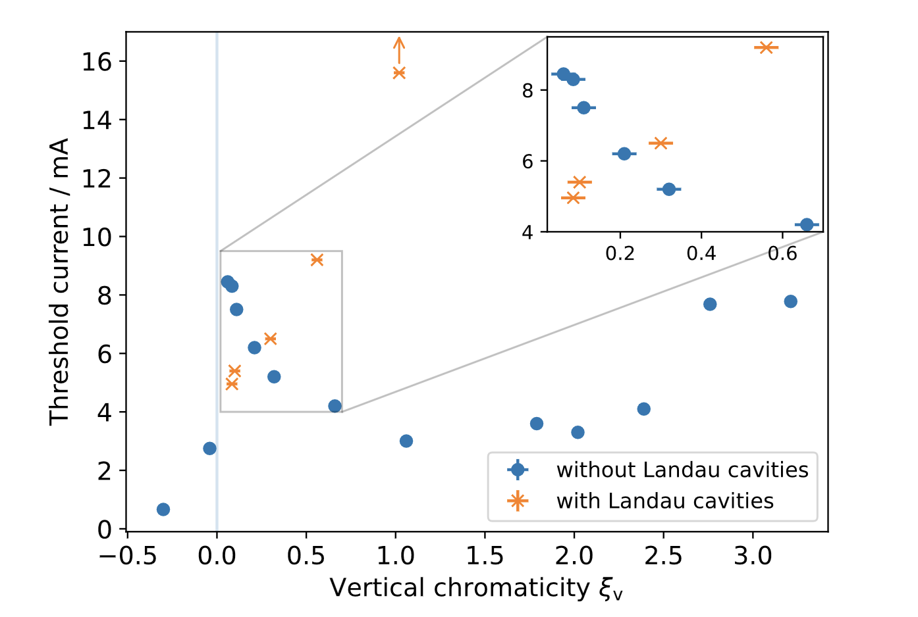
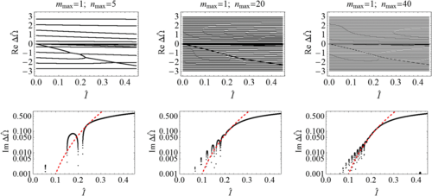
  Effect Of Harmonic-Cavity Lengthening
Venturini* predicts decreased TMCI threshold at zero chromaticity with HC lengthening
M. Brosi & F. Cullinan, WEPM098, IPAC 2025
measurements in R1
*M. Venturini, “Harmonic cavities and the transverse mode-coupling instability driven by a resistive wall”, PRAB 21 024402, 2018

Slide 22
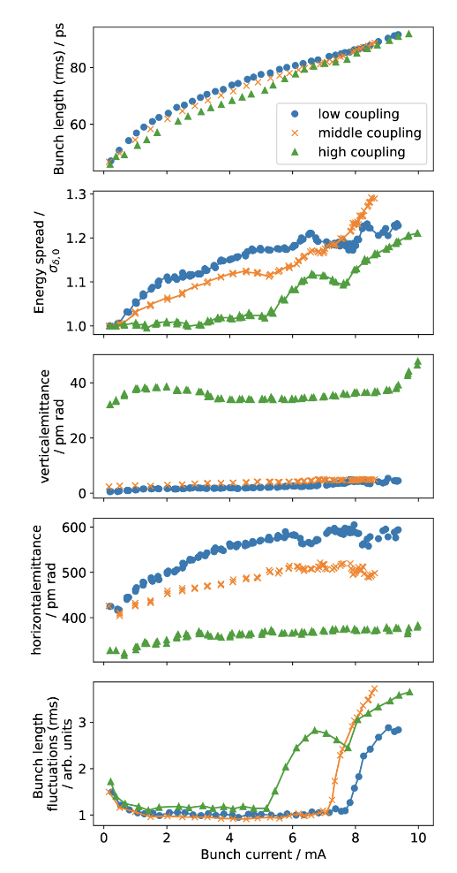
Microwave Instability in R3
M. Brosi et al., WEPM099, IPAC 2025
Impact of IBS measured in R3
Energy spread dependence on bunch current
Beam size in three dimensions
Good agreement with thresholds predicted by Inovesa
R3

Slide 23
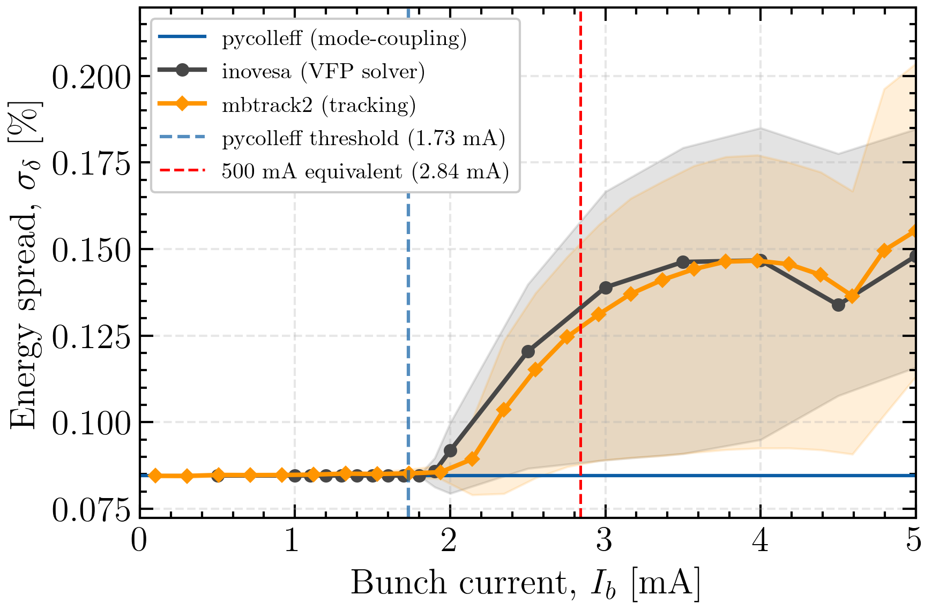
Microwave Instability
Energy spread

Slide 24
Tools
  pycolleff
    Longitudinal mode-coupling theory for Gaussian bunches, linear longitudinal dynamics (single-rf)
    Input: longitudinal impedance
    Instability criterium: growth rate > 0
  Inovesa
    Vlasov-Fokker-Planck numerical solver on frequency-domain
    Input: longitudinal impedance
    CSR models (free-space and shielded parallel plates)
    Ideal harmonic cavity
    Instability criterium: large energy spread variation
  mbtrack2
    Macroparticle tracking on time-domain (100k macroparticles, 50k turns)
    Input: wake function
    CSR models (free-space and shielded parallel plates)
    Intrabeam scattering (IBS)
    Instability criterium: large energy spread variation

