Slide 1
Complex Bend R&D for NSLS-IIU: from prototype beamline testing to NSLS-II SR Operation with CB
Guimei Wang
NSLS-II, Brookhaven National Laboratory
MAX IV – NSLS-IIU Joint Workshop, Oct. 5-6, 2026

Slide 2
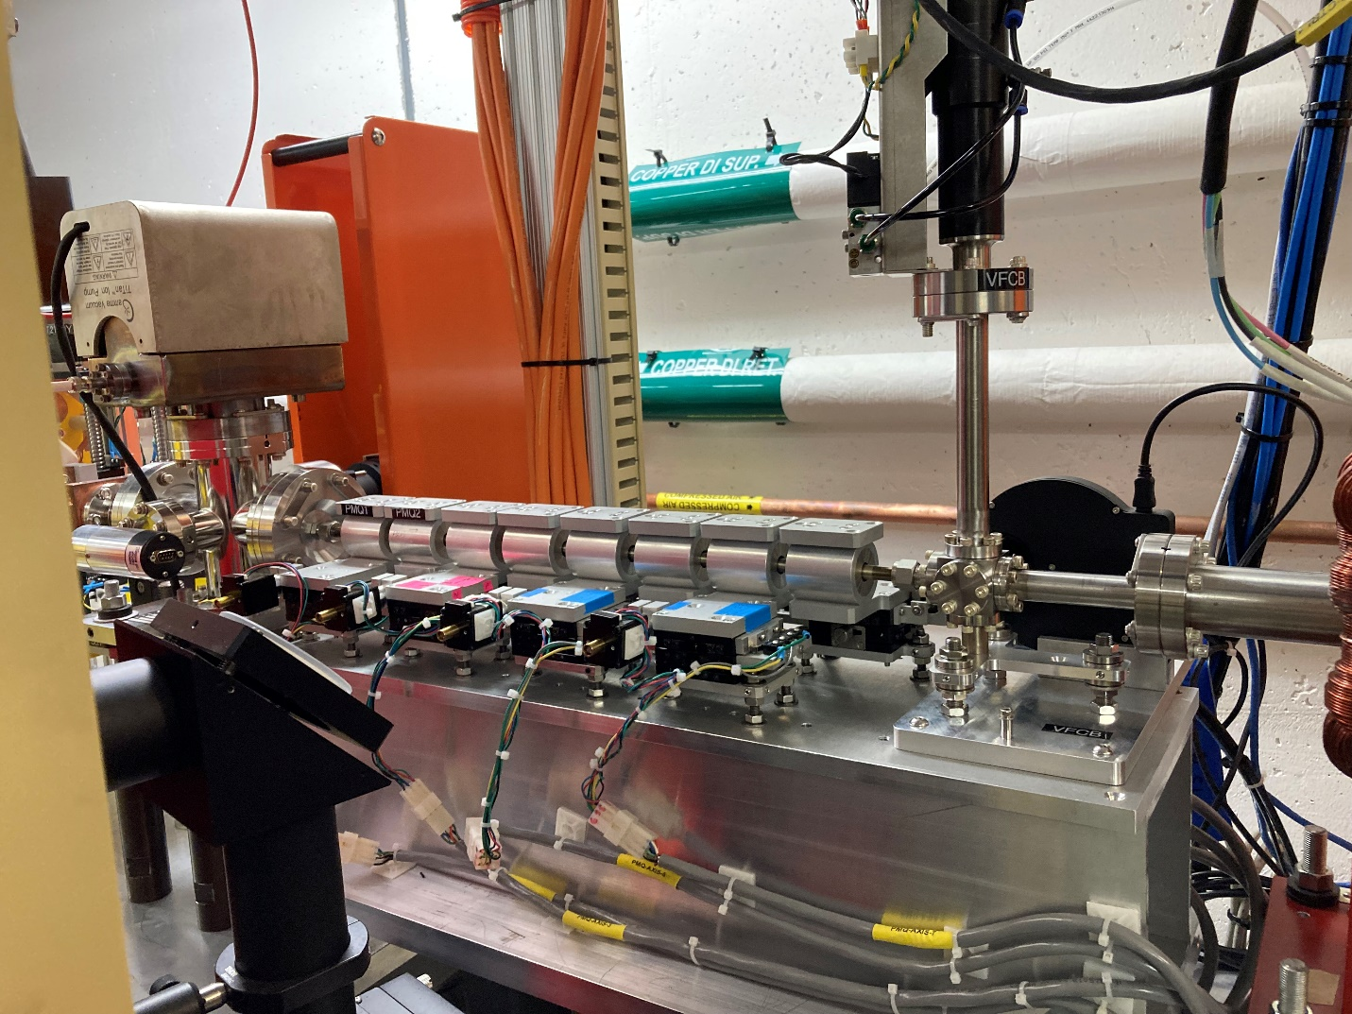
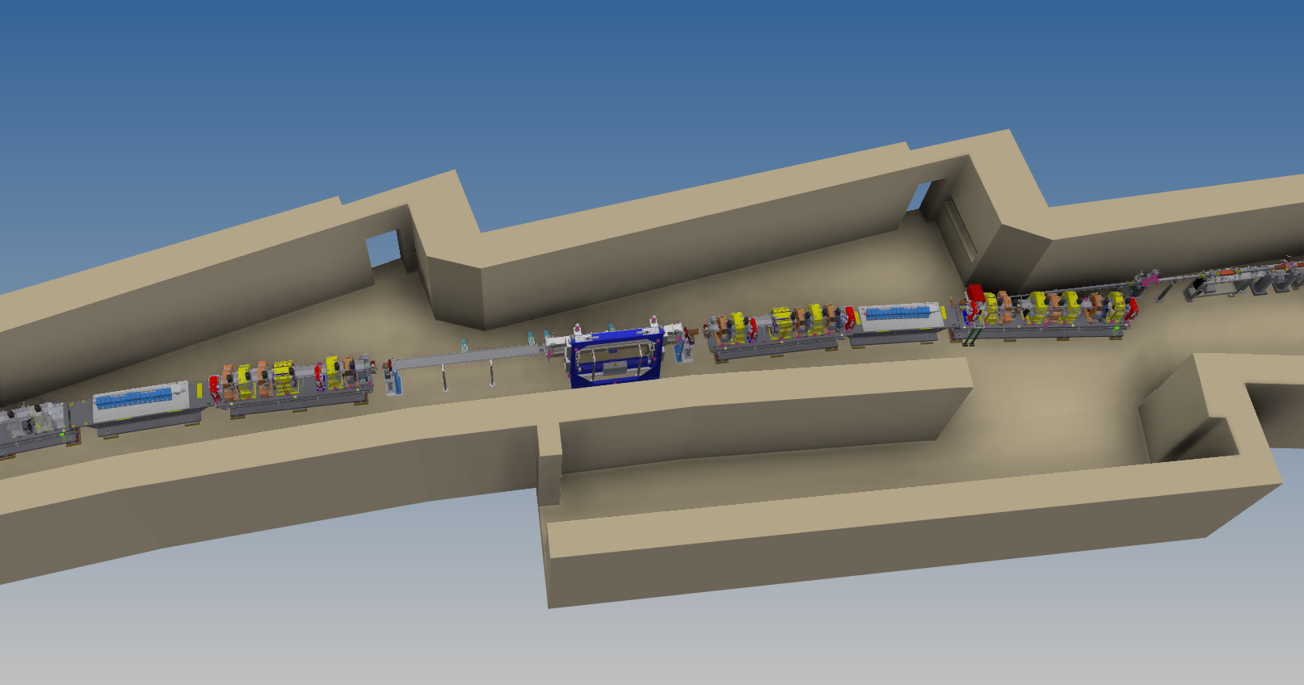
CB R&D path toward NSLS-IIU: experimental validation of CB technology
100-200 MeV Linac CB prototype beamline
Low energy, single pass
Scaled-down, compact CB enabled with lower beam rigidity
  Demonstrate high-gradient PMQ technology
  Demonstrate strong focusing + bending
3 GeV SR CB replacement
Full energy, SR normal operation
SR beam dynamics + operational feasibility proof
  Field quality, alignment accuracy and error correction
  DA/MA, injection, lifetime
  PMQ radiation resilience and long-term field stability

Slide 3
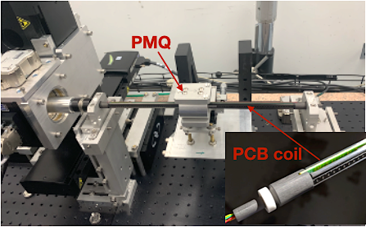
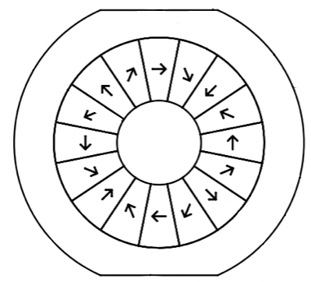
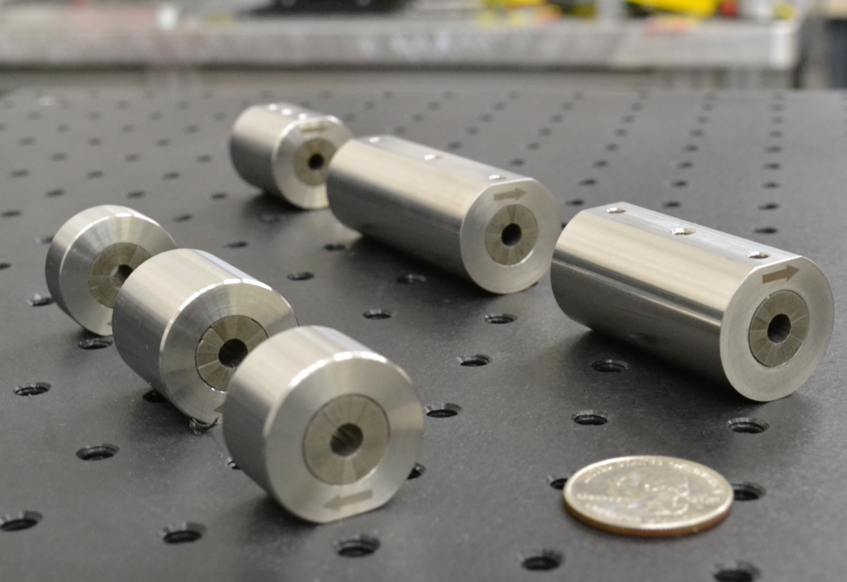
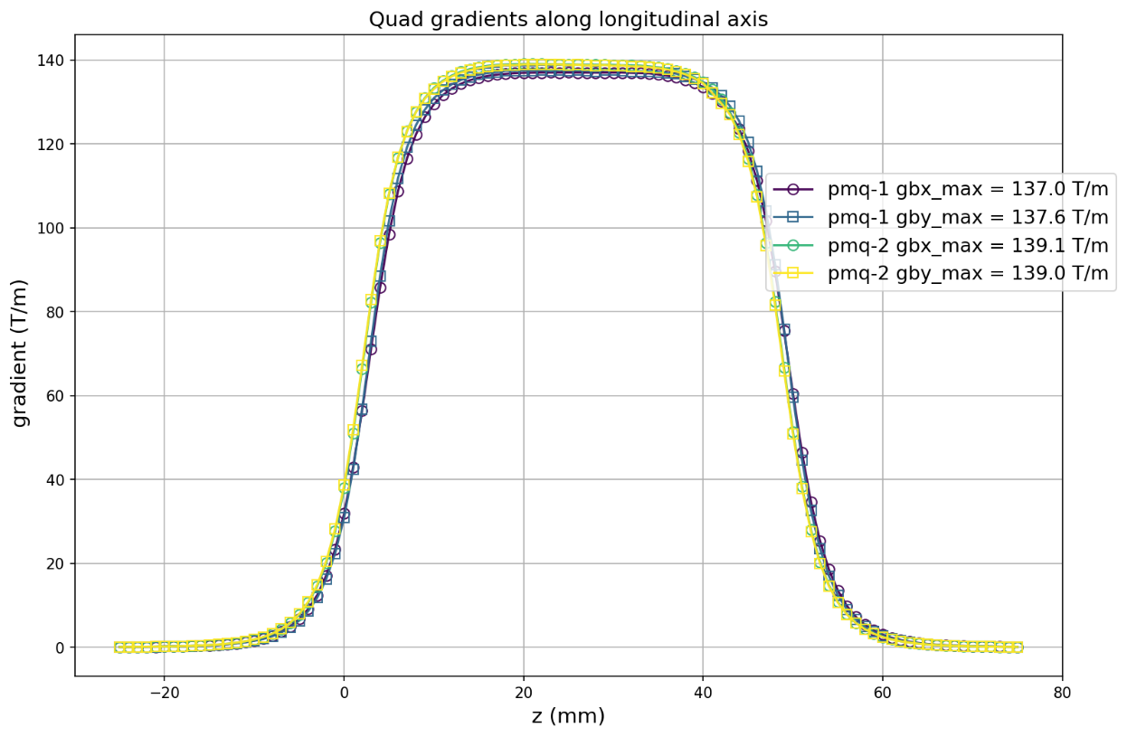
CB prototype: scale down energy, preserve strong focusing
PMQ on PCB rotating coil measurement bench
Scale Energy strategy: 3 GeV→100-200 MeV
Demonstrate high-gradient PMQ technology
Preserve high-gradient strong focusing while scaling down the CB dimensions: CB pole length from 30 cm to 4.7 cm
Prototype PMQ: 12.7 mm aperture, 4.7 cm length with design gradient ~150 T/m
Maintain stable optics by optimizing the drift between CB poles
16-wedge Halbach PMQ design; 9 prototype poles fabricated
Measured gradient: 137–139 T/m, with <1% pole-to-pole variation
Compact permanent magnets can achieve the high gradient required by the CB concept.
PMQ from RadiaBeam

Slide 4
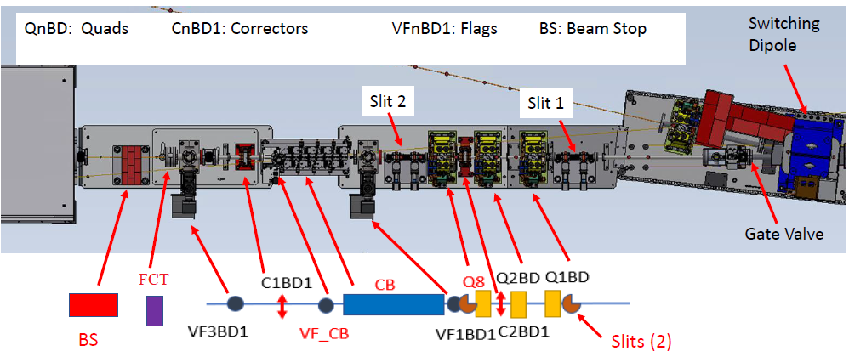


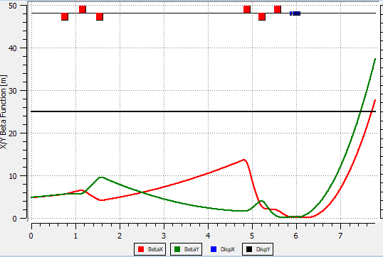
CB prototype test beamline
Quad:
Corrector:
Flag:
Aperture:
FCT3
ICT1
Installed at the end of the NSLS-II linac
Dedicated CB test beamline branched from the normal diagnostic beamline
6 quadrupoles for optics matching
4 correctors for trajectory control
Beam diagnostics: 3 flags, 2 slits, high-resolution profile monitor
Each CB pole mounted on a motorized translation stage for alignment and controlled offset studies
Commissioning performed with 1 → 2 → 4 CB periods
CB beamline optics

Slide 5
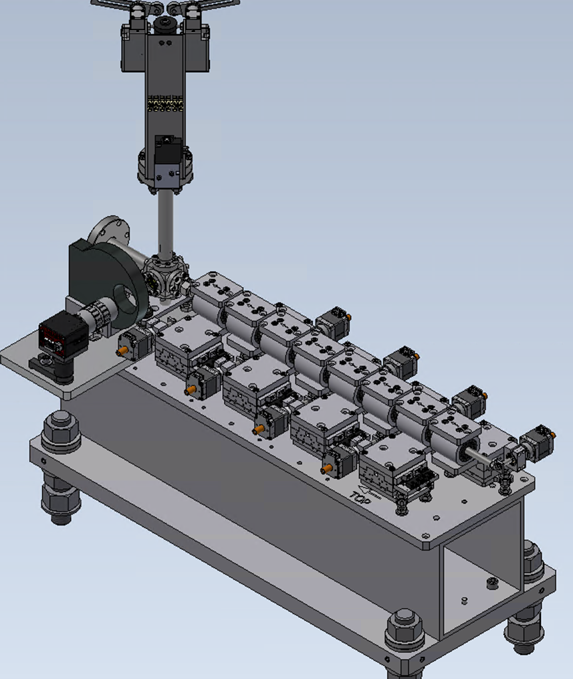
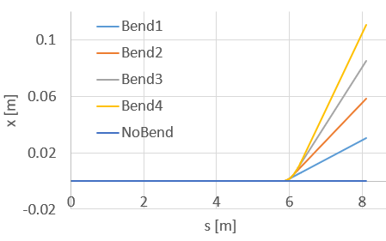
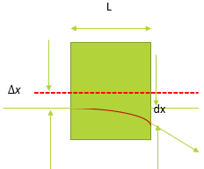
CB prototype commissioning: strong focusing → bending
Phase I: strong focusing
  Beam centered through each PMQ
  No intentional dipole component
  Commissioned with 1 → 2 → 4 CB periods
  Verify stable strong-focusing optics
  Compare measured beam size with model
Phase II — Bending + strong focusing
  Intentionally offset each PMQ from the beam trajectory
  Quadrupole offset generates dipole field
  PMQ offset ~1 mm
  Bending ~0.8° per CB period
  4 periods → ~3.2° total bend

Slide 6
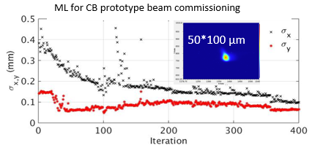
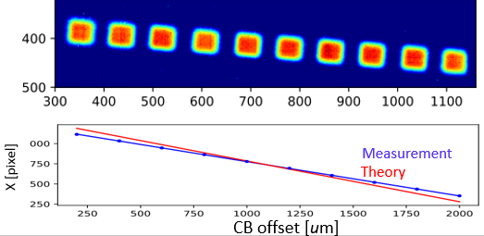
CB prototype commissioning results
Jan. 2023
Aug.-Dec. 2023
Jan. 2024
1 CB period
Strong focusing
2/4 CB periods
Strong focusing
4 CB periods
PMQ-offset bending + focusing
Phase I: strong focusing demonstrated
  Tested at 100 / 168 / 200 MeV
  ML optimization achieved beam size <100 μm
  Stable focusing maintained through multi-period CB
Phase II: bending demonstrated
  Bend angle changes linearly with PMQ offset
  1.3 mm offset→ 0.78° bend/period
  4 periods→ ~3.2° total bend; measurement agrees with theory within ~15%

Slide 7
From single-pass CB prototype to storage-ring demonstration
100-200 MeV single-pass prototype
Demonstrated the CB principle
High-gradient PMQ technology
Strong focusing through multiple CB periods
Controlled bending from PMQ offset
Beam response consistent with model
3 GeV storage-ring CB replacement
Validate CB under real beam operation
Replace two existing dipoles with CBs
Integrate into the existing NSLS-II SR lattice
Maintain injection, lifetime and beam performance for operation
Evaluate field/alignment errors and correction
Validate PM Radiation-Resistance and long-term stability
From magnet/beam proof-of-principle → to beam-dynamics and operational validation.

Slide 8
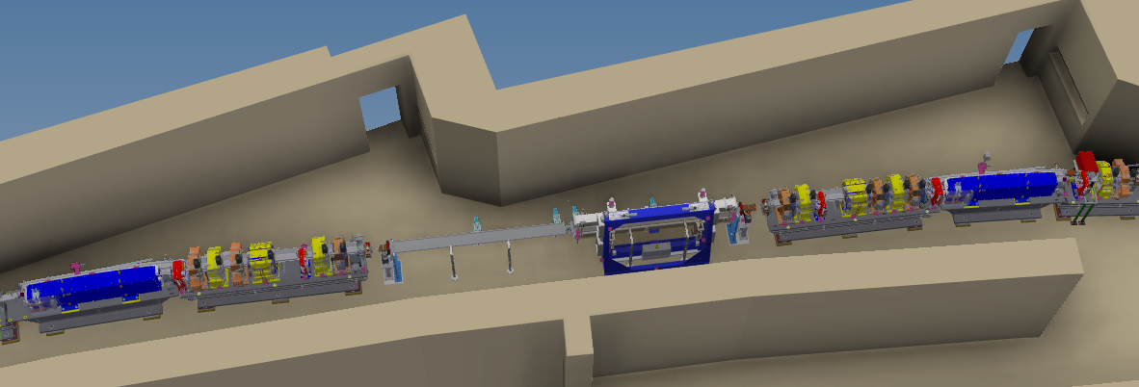
3 GeV CB replacement at NSLS-II: project goals
Develop and integrate the full-scale CB design into the existing NSLS-II 3 GeV storage-ring lattice
Use scraper and multipole correctors to evaluate impact of reduced aperture, field/alignment errors, and correction strategies before CB installation.
Build and characterize two CB assemblies and verify their magnetic and mechanical specifications using measurement benches
Replace two existing NSLS-II dipoles, install the CBs within a single shutdown, and commission the modified SR lattice to support normal user operation.
Characterize CB impact on optics, injection, and lifetime, and assess long-term PM field stability under radiation exposure.
C14-G3
Dipole
C13-G5
Dipole
C14 Straight
Complex
Bend B
Complex
Bend A
Funded R&D project: replace two 2.62 m NSLS-II dipoles with CBs (FY26-FY28)
8

Slide 9
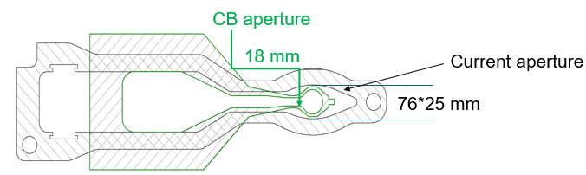
Key design constraints for CB integration into NSLS-II
Preserve beam entry and exit coordinates and minimize modifications to neighboring girders.
Use a symmetric two-dipole replacement to preserve lattice symmetry.
Match the local CB optics to the existing ring while keeping nearby quadrupole gradients within 22 T/m limits
Maintain sufficient DA and MA for 10 mm off-axis injection and adequate beam lifetime.
Accommodate the smaller CB physical aperture: ~18 mm vs. 76 × 25 mm dipole chamber.
Minimize sextupole power-supply changes and maintain tolerance to realistic field and alignment errors

Slide 10
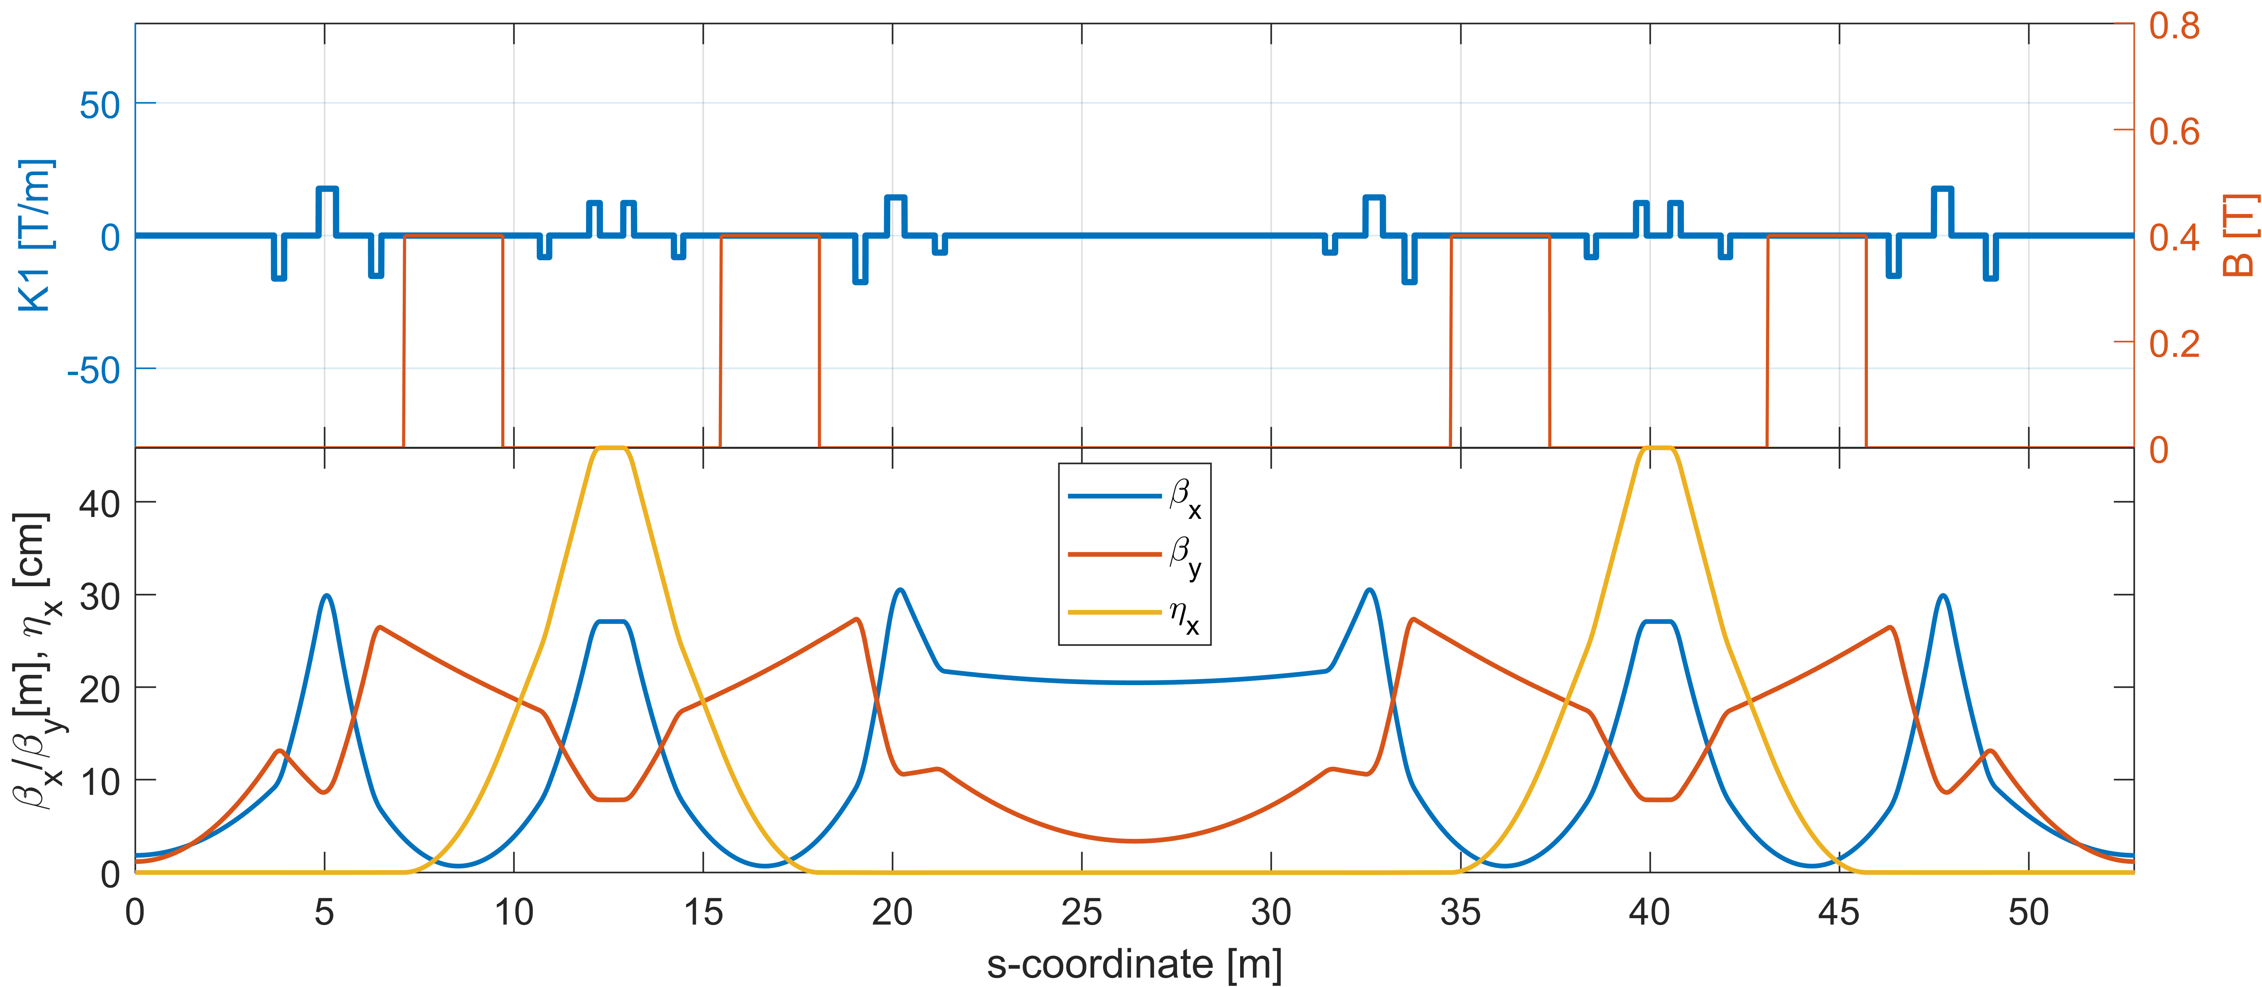
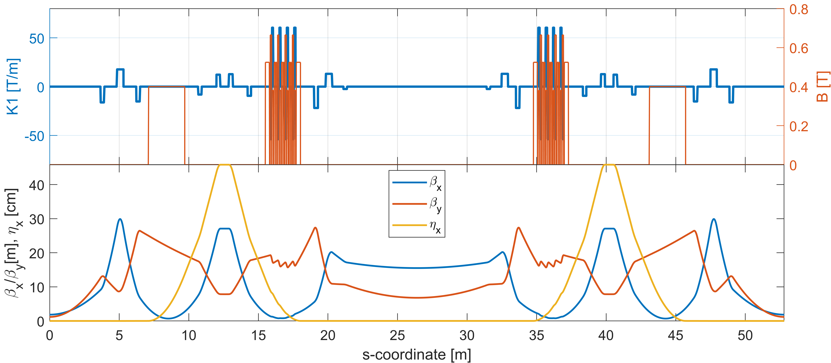
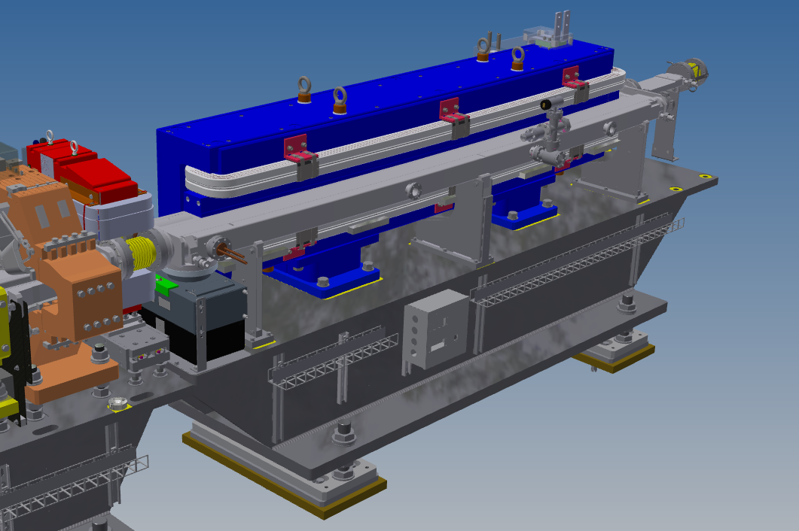
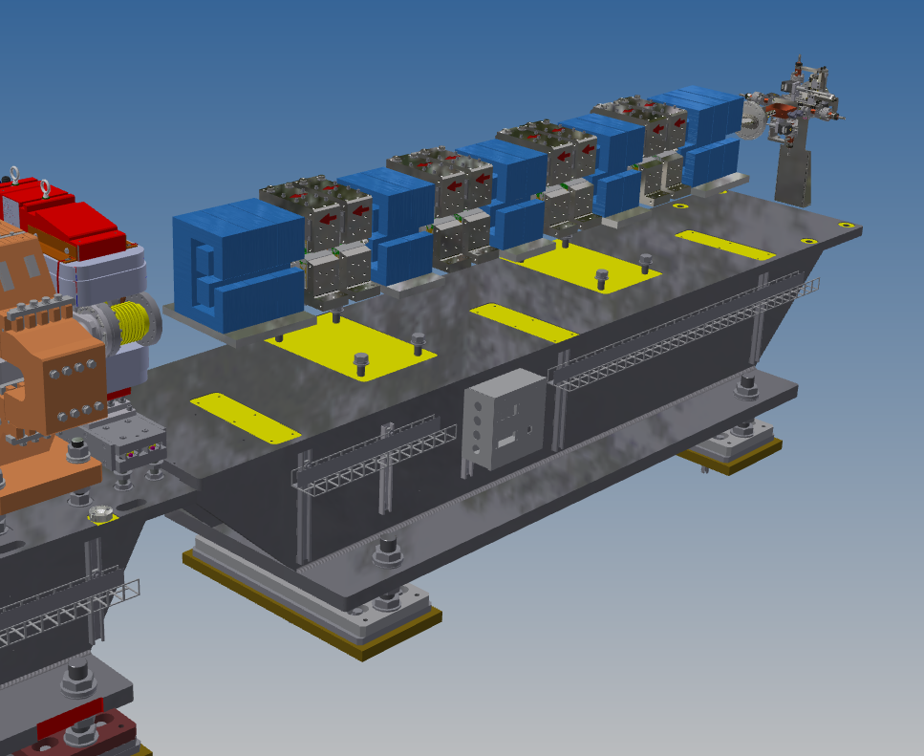
Complex bend lattice design
Lattice supercell with complex bends and Twiss function along the supercell
Original lattice supercell layout and Twiss function along the supercell
Beam entry/exit CB coordinate matched within 1.6 μm
Within limits
$$Bmax=B+G∗magnet bore radius \left(12mm\right)$$
Existing dipole
 | L [m] | B (T)
B | 2.62 | 0.4
Complex bend parameters
 | L [cm] | B (T) | G (T/m) | Bmax (T)
B | 20/30 | 0.52
BQD | 10 | 0.66 | -53.86 | 1.31
BQF | 10 | 0.38 | 60.41 | 1.11
Poles Gap | BQD to BQF 3 cm, BQD/BQF to B 5 cm
Existing quadrupole strength: ~20 T/m
Existing Dipole
Complex Bend
Local emittance contributions over 30 cells have a minor impact on the overall SR emittance!

Slide 11
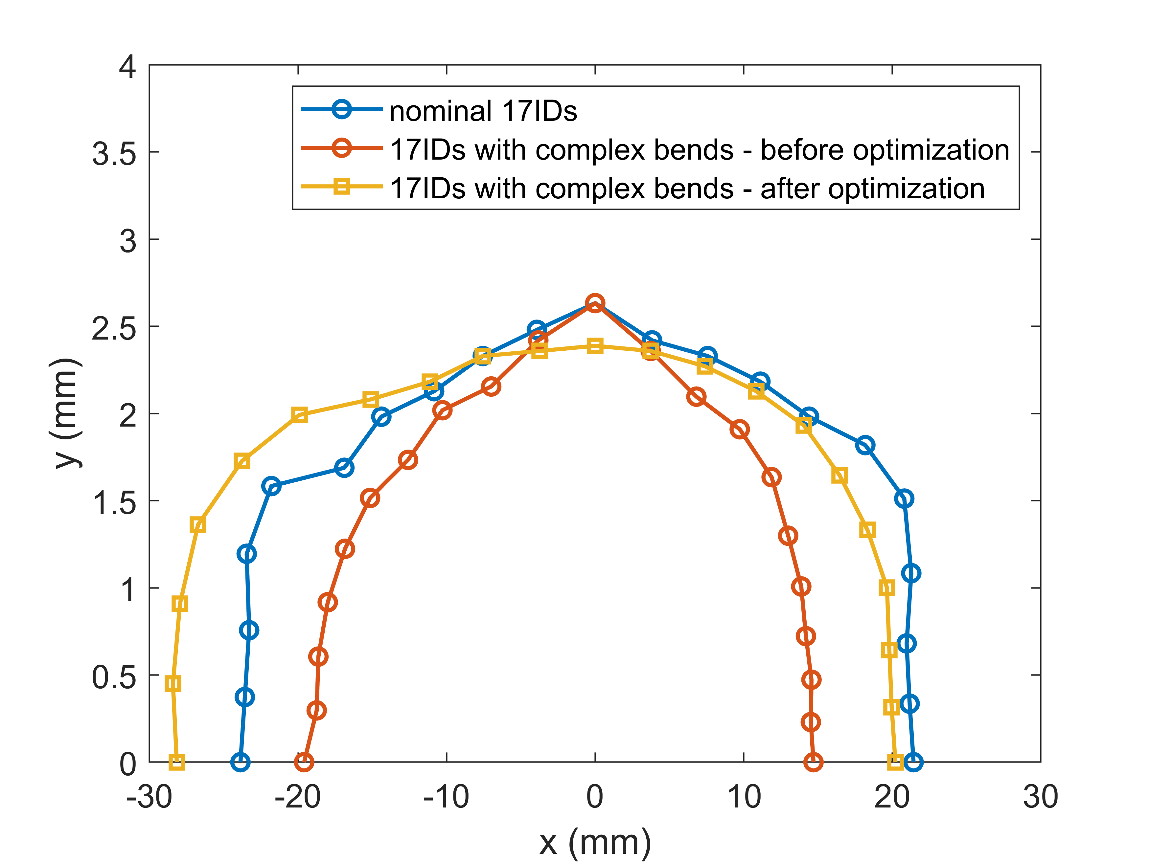
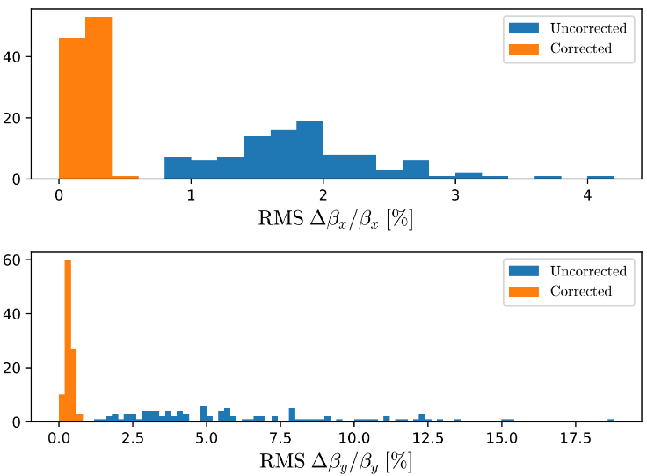
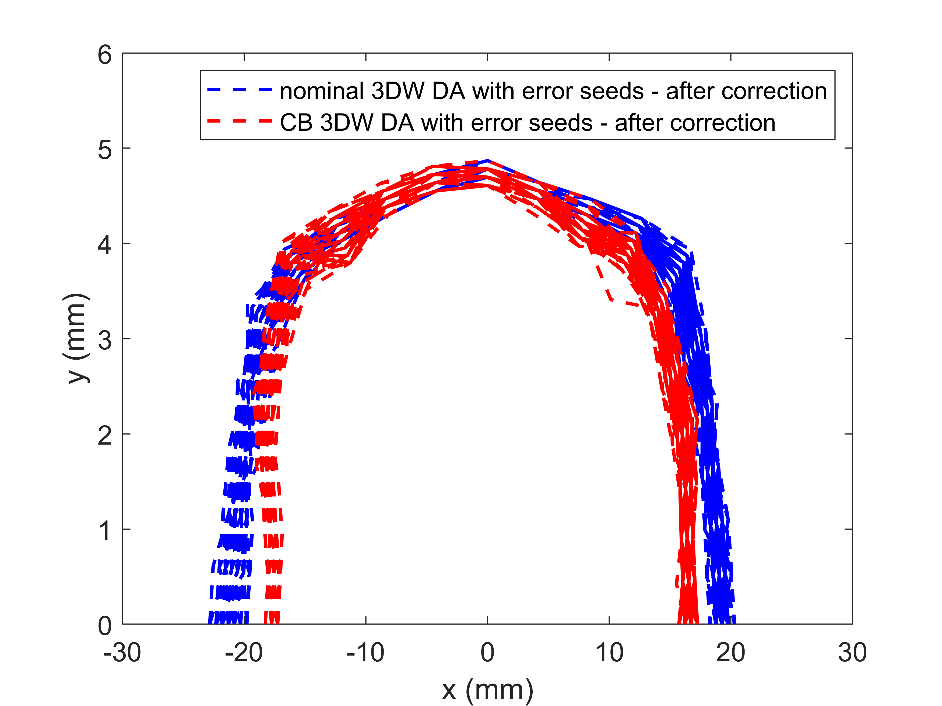
CB lattice: nonlinear performance & error robustness
Nonlinear optimization
CBs break lattice symmetry and initially degrade DA/MA
Optimize harmonic sextupoles with minimal power-supply changes
DA and MA restored to near-nominal levels
Realistic error analysis
Apply realistic magnet field, alignment, BPM, and girder errors to the optimized CB lattice.
Evaluate robustness with 100 random error seeds
Use existing correction system: 360 BPMs/correctors for orbit; 300 normal + 30 skew quads for optics correction.
After correction: orbit/optics close to nominal; DA nearly restored.
Dynamic aperture: nominal vs. CB lattice
Robustness to realistic errors
CB error | RMS
X/Y offset | 30 μm
Roll | 0.5 mrad
Dipole error | 0.1%
Quads error | 1%
Sextupole, K2 | 0.7 m⁻³
Octupole, K3 | 150 m⁻⁴

Slide 12
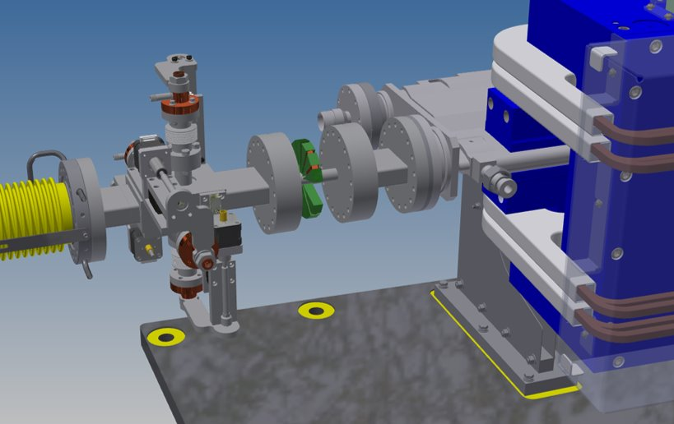
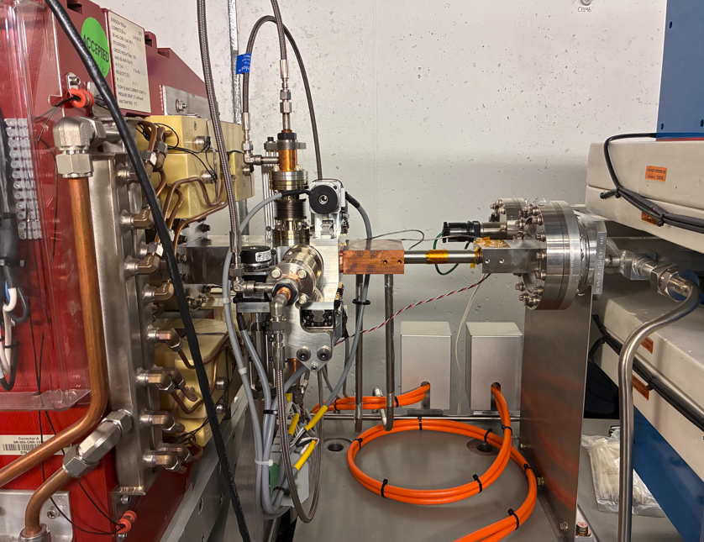
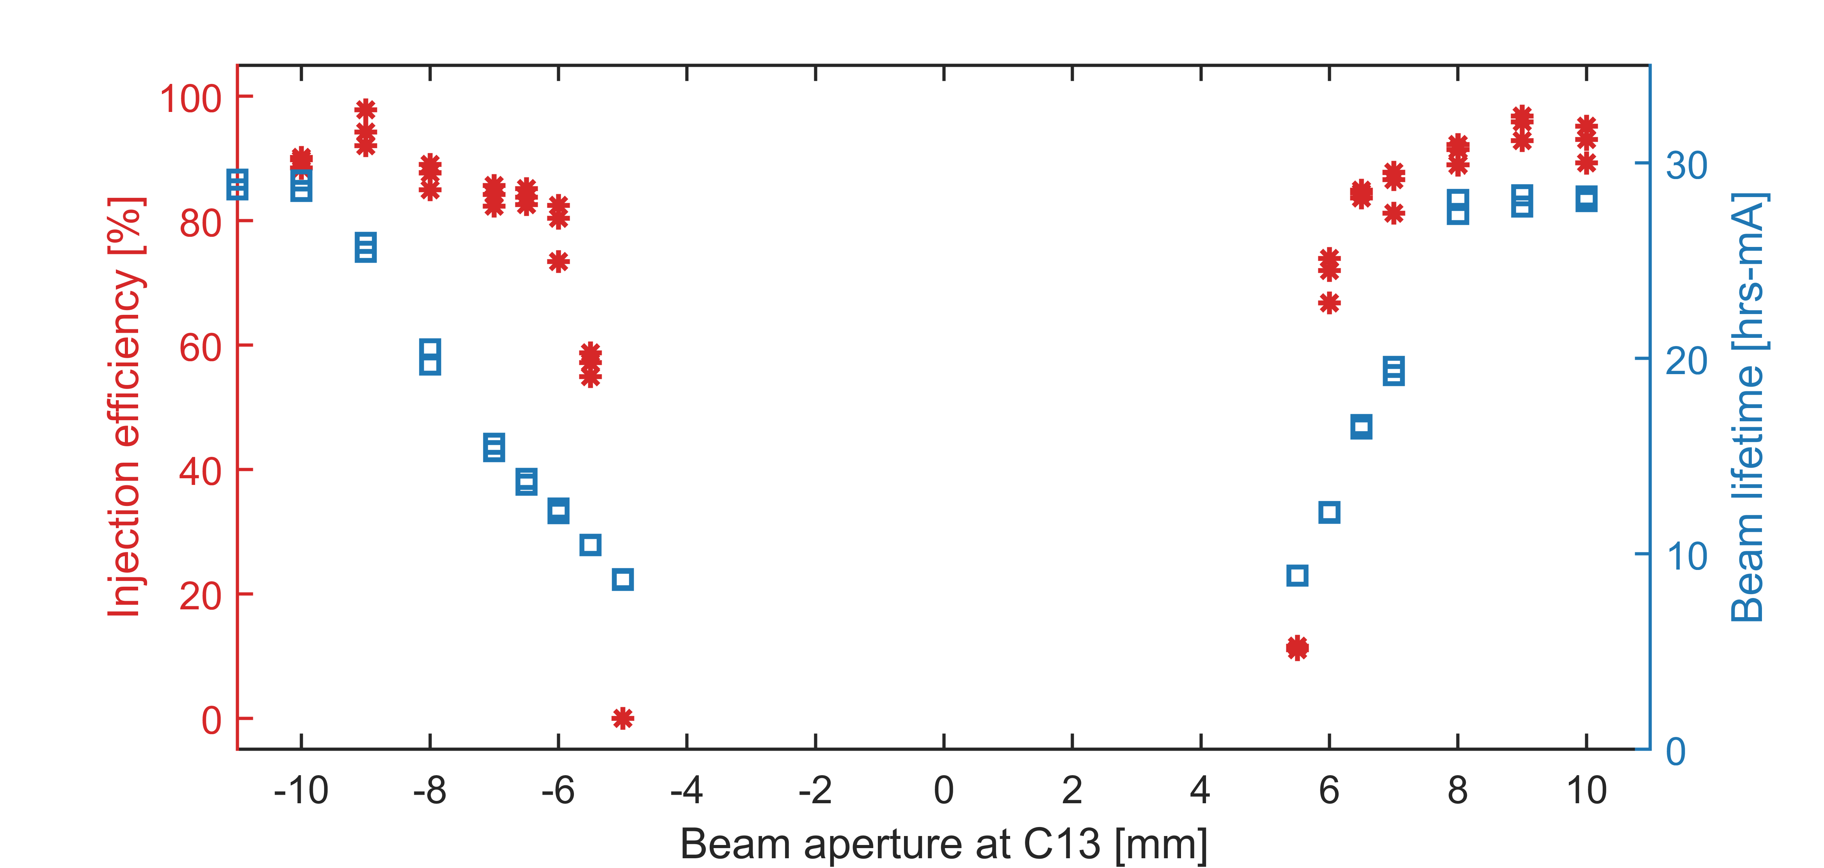
CB aperture verification: scraper design → installation → beam test
Dedicated scraper design
  H/V precision scraper reproduces the local CB aperture constraint to evaluate its impact on beam dynamics
  Enables controlled aperture scans before CB installation
  Target CB aperture: ~18 mm
Installed in NSLS-II
  Scraper fabricated and installed in Cell 13, near CB installation region
  Provides direct beam-based test of the proposed CB aperture
Beam-tested aperture requirement
  Scan aperture in both horizontal and vertical planes
  Measure aperture impact on injection efficiency and beam lifetime
  Injection remains robust down to ~14 mm
  ~18 mm aperture required to preserve beam lifetime
  Measurements agree well with simulation
H&V Scrapers
C13 local small physical aperture test
Horizontal aperture impact on efficiency & lifetime

Slide 13
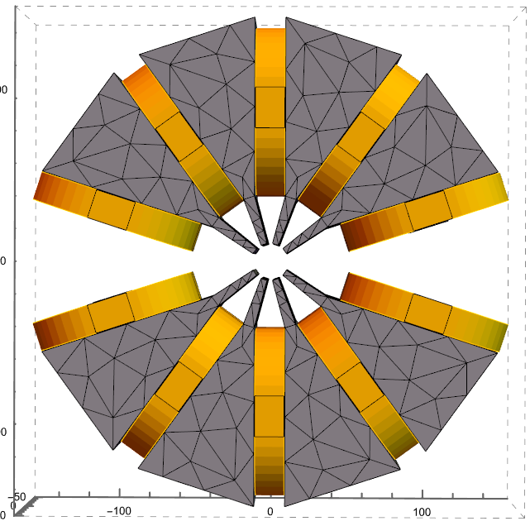
8-pole corrector: beam-based CB error studies
Dedicated 8-pole corrector under development will be installed near the CB location to reproduce expected CB field/alignment errors before installation
Designed to provide independent normal and skew multipoles, N = 1–4, to generate controlled CB-like perturbations to orbit and optics
Will enable beam studies of the CB’s error impact on orbit, optics, injection efficiency, and beam lifetime.
CB field and alignment errors are mapped to equivalent corrector strengths to cover the expected error range
After CB installation, the same corrector can provide local residual-error compensation
350 mm
350 mm
Bore diameter: 23 mm
Length: 100 mm
10 independent power-supply channels

Slide 14
Summary
Linac prototype demonstrated the core CB concept: high-gradient PMQ, strong focusing, and controlled bending.
3 GeV storage-ring replacement extends the R&D from proof-of-principle to operational validation
  Lattice studies show acceptable DA/MA and robustness to realistic errors; beam studies validate the aperture size requirement.
  The funded CB replacement will test full-scale magnet technology, beam dynamics, correction capability, radiation resilience, and long-term operation stability
  CB installation and beam commissioning are planned in 2028.
The CB replacement project provides the experimental and operational bridge to full NSLS-IIU implementation

Slide 15
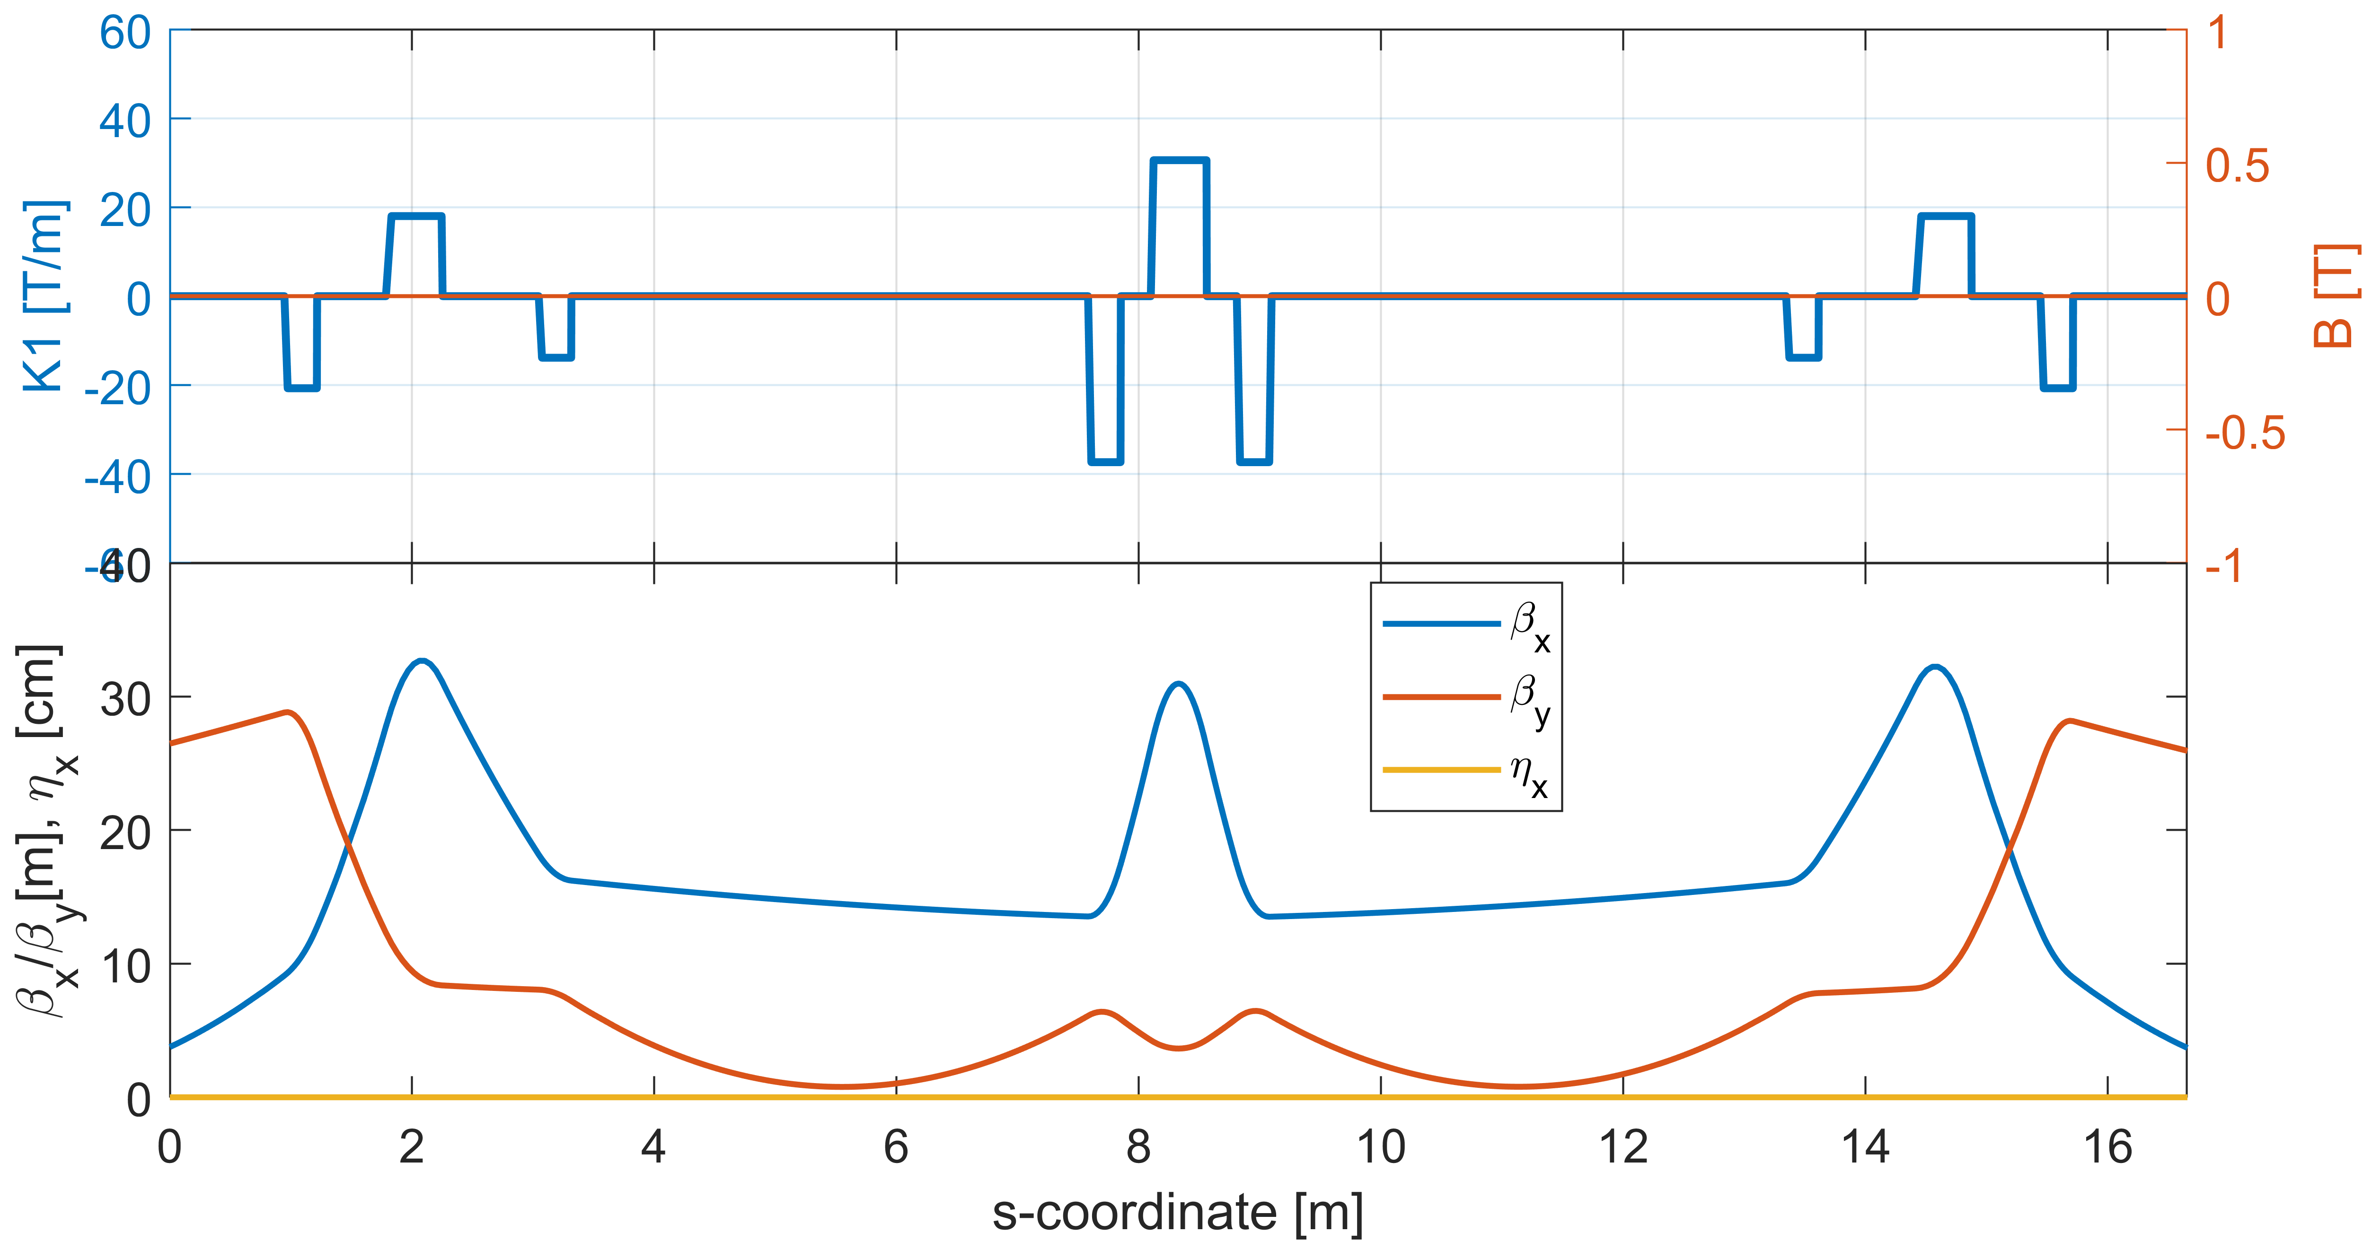
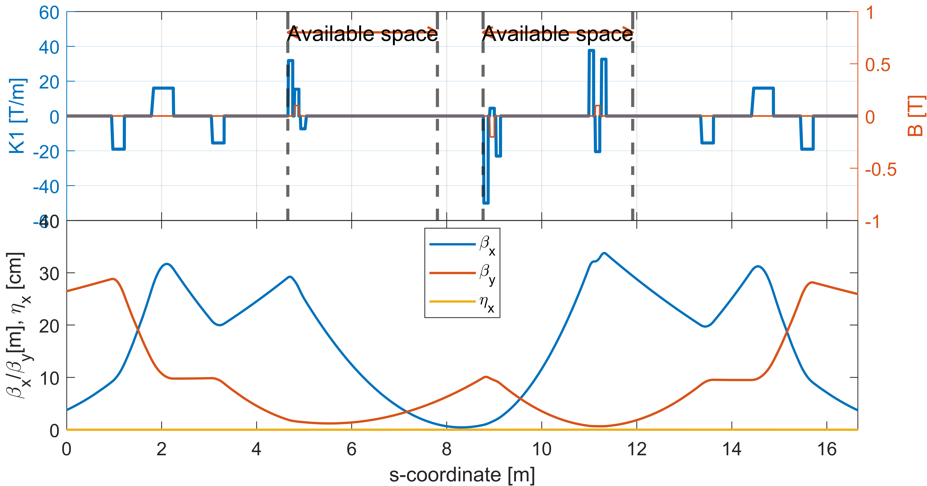
Mini CB project: Install 3 CB arrays in the ID section
QFC26
 | L (m) | K1 (T/m)
QDC26A | 0.268 | -37.29331
QFC26 | 0.46 | 30.5529
QDC26B | 0.268 | -37.29331
QDC26A
QDC26B
Start the optics matching from the downstream B1G5C25B and match the optics at the upstream B1G3C26A.
 | B(T) | K1(T/m)
CB1-1 |  | 31.8235
CB1-2 | 0.1 | 15.3594
CB1-3 |  | -7.3592
CB2-1 |  | -50.0152
CB2-2 | -0.2 | 4.4561
CB2-3 |  | -23.0097
CB3-1 |  | 37.6295
CB3-2 | 0.1 | -20.4543
CB3-3 |  | 32.6139
CB1-1
The middle PMQ of each triplet as a combined-function magnet. The two side PMQs are pure quadrupoles.
The three PM triplets with canted angles of (+1) mrad, (-2) mrad, and (+1) mrad.
Optics is matched.
Emittance contribution is only 4.5pm, negligible.
Each CB PMQ length = 10cm.
Adjacent CB PMQ distance = 3cm.
CB3-1
CB3-3
CB1-3
CB2-2
CB1-2
CB2-1
CB2-3
CB3-2

Slide 16
Discussion points / feedback requested
PM magnet field quality and error correction: Are the planned magnetic specification verification before installation sufficient to characterize the expected CB field and alignment errors? After installation, are the local 8-pole correctors together with the existing global orbit/optics correction system sufficient to compensate the remaining errors? What additional error scenarios or measurements should we prioritize?
Operational margins: with the local physical aperture reduced from the existing dipole aperture to ~18 mm, does the scraper beam study provide sufficient confidence in the operational margin for injection, lifetime, and beam-loss/radiation control? What additional machine-protection/beam study should we include?
Path to NSLS-IIU: What aspects of the two-CB 3 GeV demonstration would you consider most important to validate before scaling the technology to a future low-emittance upgrade?

Slide 17
Backup slides

Slide 18
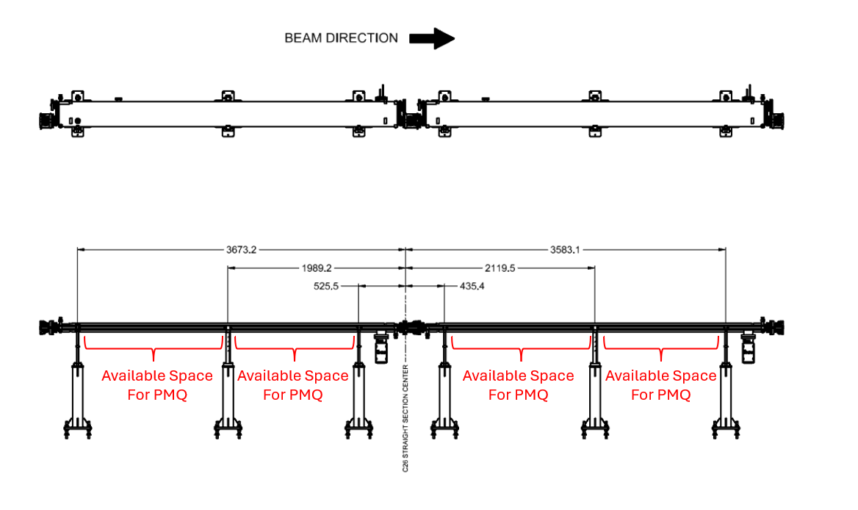
Mini-CB project
Constraints in geometry

Slide 19
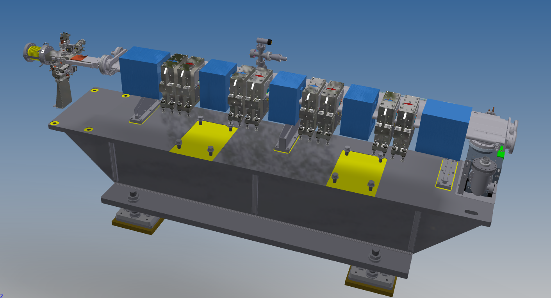
CB replacement magnet design
Full CB assembly: alternating dipole + focusing/defocusing hybrid PM elements provide the required bending and strong alternating-gradient focusing
Hybrid Sm₂Co₁₇ PMQs: achieve the required field/gradient with pole-tip fields up to ~1.3 T, comparable to the future NSLS-IIU design, with good radiation resistance.
Built-in tuning and alignment: PMQs are mounted on horizontal translation stages (±0.5 mm) for alignment adjustment; iron tuning plates provide ~ 5% gradient tuning with small harmonic impact
Field-quality control: ~10-unit field quality achieved after shimming; cross-talk corrected with shims and temperature compensation included.
B (0.52 T)
PM Dipole
BQD (0.66 T / -53.86 T/m)
De-focusing Hybrid PM
BQF (0.38 T / 60.4 T/m)
Focusing Hybrid PM
B
BQD
BQF

Slide 20
CB error specification
CB alignment and field errors were translated into an equivalent multipole-corrector specification
Target components include dipole, quadrupole, skew quad and sextupole terms
This provides the basis for both error-sensitivity studies and correction tests
CB error specifications
Component | Error Parameter | RMS | Unit | Cutoff (σ)
BPMs | Offset x/y | 100 | μm | 1.0
 | Roll | 0.2 | mrad | 1.0
Complex Bend: CB1 / CB2 | Offset x/y | 30 | μm | 1.0
 | Roll | 0.5 | mrad | 1.0
 | FSE_DIPOLE | 0.1% | — | 1.0
 | FSE_QUADRUPOLE | 1% | — | 1.0
 | K2 (sextupole) | 0.7 | m⁻³ | 1.0
 | K3 (octupole) | 150 | m⁻⁴ | 1.0
Complex Bend: B | Offset x/y | 30 | μm | 1.0
 | Roll | 0.5 | mrad | 1.0
 | FSE_DIPOLE | 1×10⁻³ | — | 1.0
 | K2 (sextupole) | 0.7 | m⁻³ | 1.0
 | K3 (octupole) | 150 | m⁻⁴ | 1.0
Equivalent integral multipole error
 | Integral multipole strength
Dipole X | By*L [T-m] | 1.0467E-03
Dipole Y | Bx*L [T-m] | 5.2333E-04
Normal Q | G*L [T] | 4.8000E-01
Skew Q | G*L [T] | 4.8000E-02
Sextupole | S*L [T/m] | 1.4000E+01

Slide 21
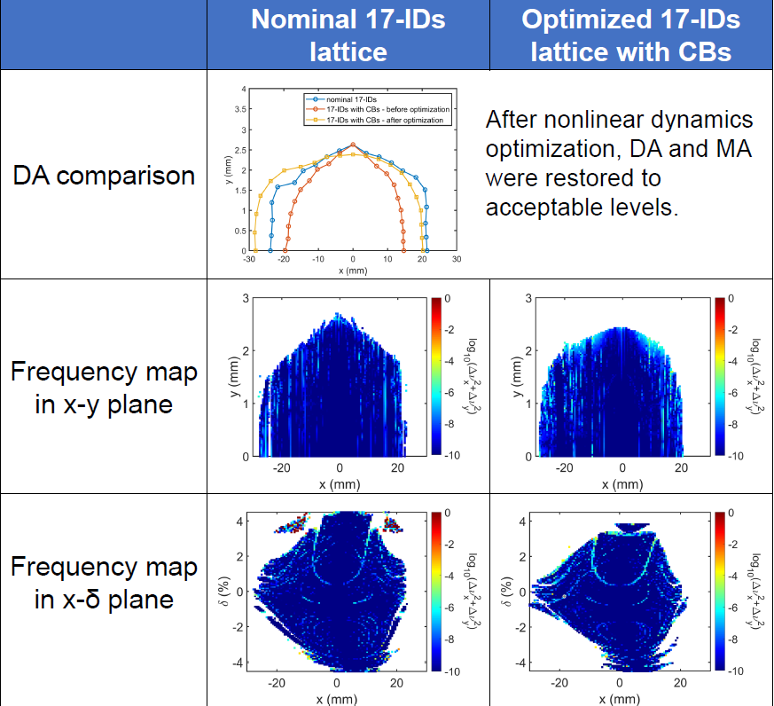
Nonlinear dynamics optimization

