Slide 1
NSLS-IIU Harmonic Cavity Options
Feng Gao, Carlos Marques and Yi Xie, NSLS-II RF Group
October 5-6th , 2026 for NSLS-IIU – MAX IV Workshop

Slide 2
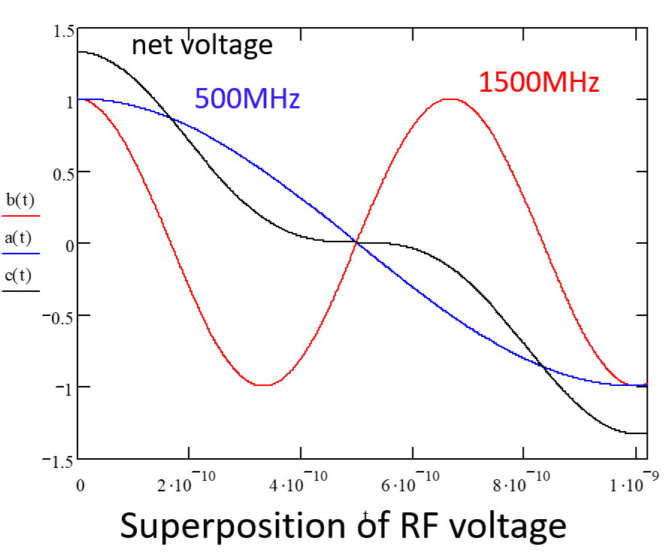
Outline
Current Status of the NSLS-II Storage Ring Cavities
NSLS-IIU Cavity Voltage Requirements
Past Work on the NSLS-II 3rd Harmonic Cavity
Options for 3rd Harmonic Cavities:
Normal conducting
4K superconducting 2-cell
Nb3Sn superconducting 1-cell
2K superconducting 1-cell
5th Harmonic Cavity
Summary

Slide 3
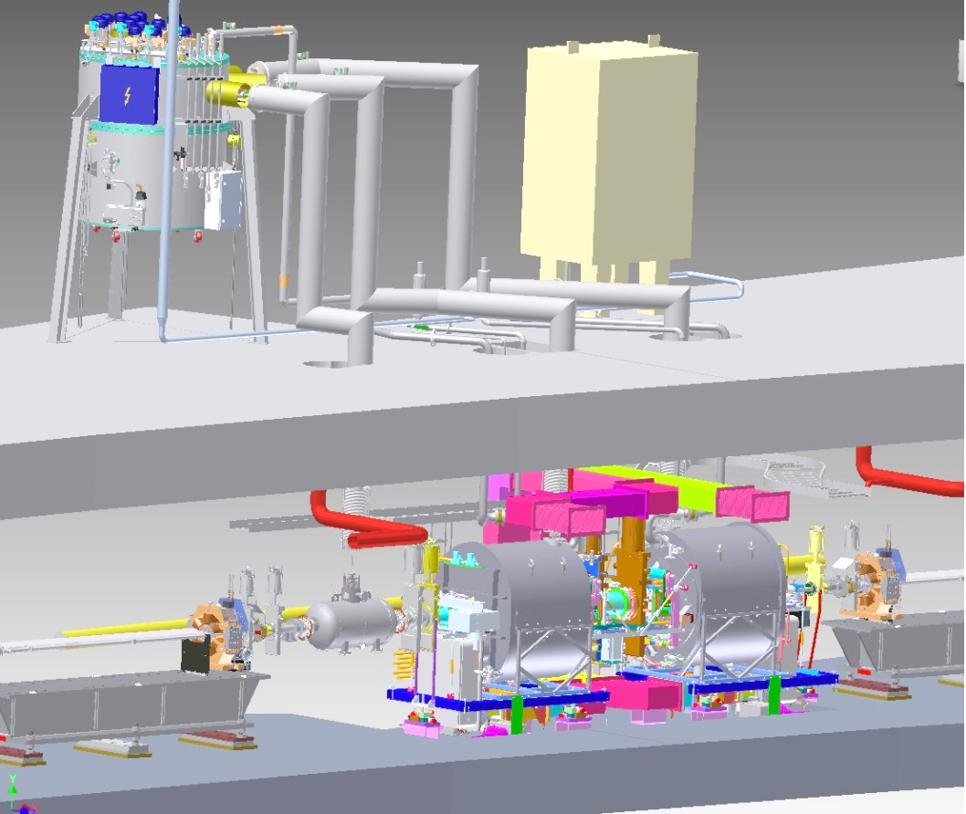
Current Status of the NSLS-II Storage Ring Cavities
NSLS-II has two 9.3-meter RF straights, and each is for two main 500MHz CESR-B type SC cavities and one harmonic cavity. At each RF straight there are three cryo lines for these three cavities.
Currently we have three main cavities installed and have a 4th cavity offline as a spare.
No harmonic cavity has been installed. Options for both the 3rd and higher harmonic cavities are being evaluated.
Now the harmonic cavity cryo lines are being used as bypasses during main cavity cooldown.

Slide 4
NSLS-IIU Cavity Voltage Requirements
We plan to install a 4th 500MHz system for NSLS-IIU to meet the beam power requirement. The total voltage at 500MHz will be 4.8MV. We need to add 3rd harmonic cavities and higher harmonic cavities to lengthen the beam.
For the 3rd harmonic cavity, the voltage requirement is thus ~4.8MV/3 = 1.6MV. Therefore, NSLS-IIU plan to add two 3rd harmonic cavities, with cavity voltage of 0.8MV each.
Thanks to existing cryo infrastructure, there won’t be significant additional cost if the 3rd harmonic cavities are superconducting, except for the 2k option.
Various options for reference: Normal conducting, Taiwan TPS/NSRRC SC 2-cell (similar to the NSLS-II design in 2011), Cornell research project Nb3Sn coated SC for 4K, and Argonne APS SC 1-cell at 2K.
Higher harmonic cavity options are also being investigated.
 | 500MHz | 1500MHz
# of Cav | 4 | 2
Total Vc (kV) | 4800 | 1600
Vc each (kV) | 1200 | 800
Total Pbeam (kW) | 850 (Ib=400mA)
Pbeam/cav (kW) | 213

Slide 5
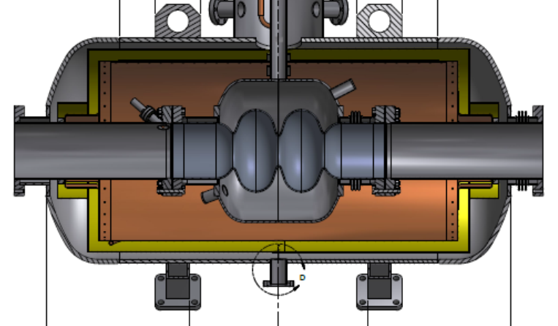
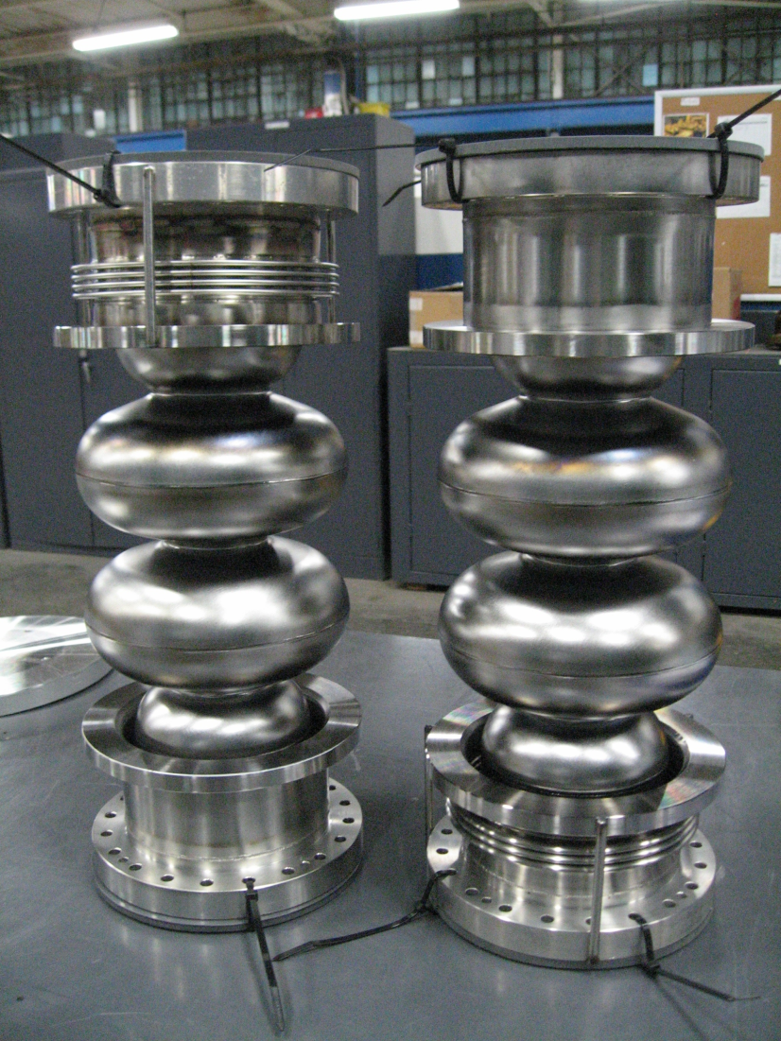
Past Work on the NSLS-II 3rd Harmonic Cavity
Back in 2011 a prototype 1500MHz cryomodule was built for NSLS-II under SBIR. It lacks a proper cryogenic interface, a tuner, critical instrumentations, etc.
The flange-to-flange length is 1.2 meter with thermal transition beam pipes, excluding HOM dampers and gate valves.
The budget for static + dynamic loads is 60 watts.
Led by James Rose

Slide 6
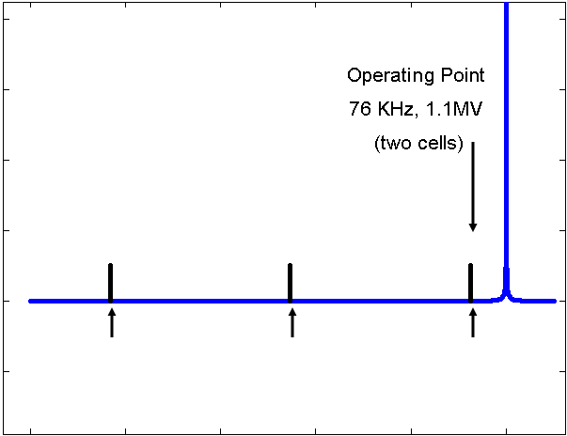

NSLS-II 1500MHz As-built Cavity Parameters
0-mode
π-mode
Freq(π-mode) | MHz | 1499.25
R/Q (Pi) | Ω | 88
Q₀ | @4.5K | 2.6*10⁸
Accelerating Voltage | MV | 1.0
Freq (0-mode) | MHz | 1478.03
R/Q (zero) | Ω | 0.15
Q₀ | @4.5K | 2.7*10⁸
ΔF=(nF_{rev} -55kHz)
~80 kHz for 1.1 MV excitation
~110kHz to “Park” mode between revolution lines
{
3F_{RF} +(1/2)F_{rev}
3F_{RF} –(n+1)F_{rev}
3F_{RF} –(n)F_{rev}
3F_{RF}
The design would work well in an ideal case. But for operation, due to the 2-cell design, It is easy for the 0-mode to run into beam revolution lines when the tuner position and other parameters change.
F_{rev} ~ 378kHz, n~56

Slide 7
Options for 3rd Harmonic Cavities
Normal conducting like MAX IV
Improve the NSLS-II 2-cell SC Nb cavity design
4K Nb3Sn design
2K SC design like Argonne APS-U
More details on next few slides

Slide 8
Normal Conducting 1500MHz: Pcav is high
For a hypothetical NC 1500MHz cavity:
# of cells per cavity | f0 (MHz) | Vc (kV) | r/Q (Ω) ≡ (VT)^2/(2ωU) | Q0 | Rsh (MΩ) unloaded | Pc (kW)
1 | 1500 | 800/1000 | 100 | 20000 | 2.0 | 161/251
2 | 1500 | 800/1000 | 200 | 20000 | 4.0 | 81/126
3 | 1500 | 800/1000 | 300 | 20000 | 6.0 | 53/84
Challenges:
High cavity power for the size, even with a relatively high r/Q (which is not good for minimizing HOMs).
If more than one cell, the 2nd and/or 3rd same-order-modes may complicate the spectrum.
HOM damper design.
Depending on the design, a transmitter may be needed.

Slide 9
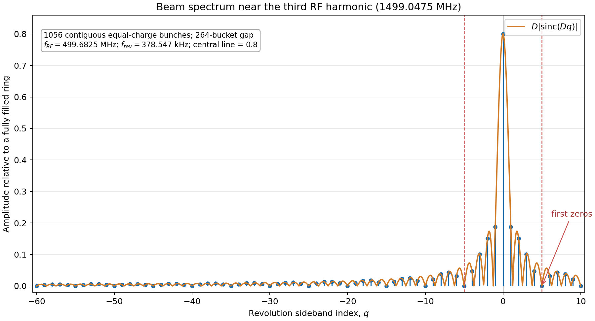
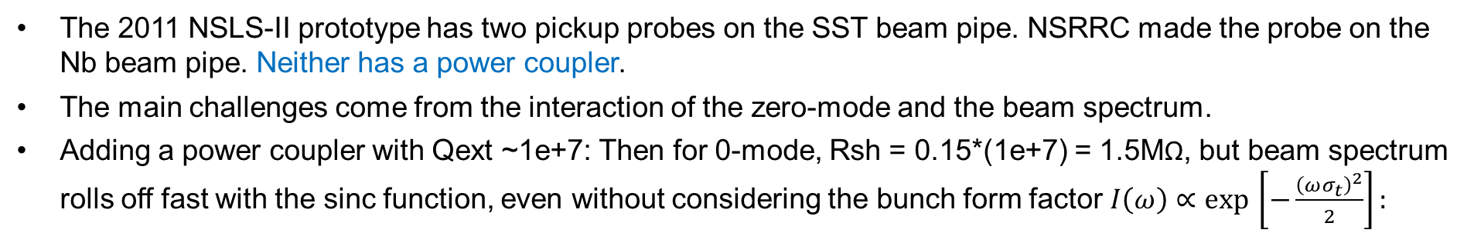
2011 NSLS-II 2-Cell Design (similar to NSRRC)
# of cells per cavity | f0 (MHz) | Vc (kV) | r/Q (Ω) ≡ (VT)^2/(2ωU) | Q0 | Rsh (MΩ) unloaded | Pc (kW)
2 | 1500 | 800/1000 | 88 | 1e+8 (derated) | 8800 | .036/.057
The 2011 NSLS-II prototype has two pickup probes on the SST beam pipe. NSRRC made the probe on the Nb beam pipe. Neither has a power coupler.
The main challenges come from the interaction of the zero-mode and the beam spectrum.
Adding a power coupler with Qext ~1e+7: Then for 0-mode, Rsh = 0.15*(1e+7) = 1.5MΩ, but beam spectrum rolls off fast with the sinc function, even without considering the bunch form factor $I\left(ω\right)∝\exp{​}\left[−\frac{{\left(ωσ_{t}\right)}^{2}}{2}\right]:$
frev~ 378kHz, n~56
0-mode (approximate)
pi-mode (approximate)

Slide 10
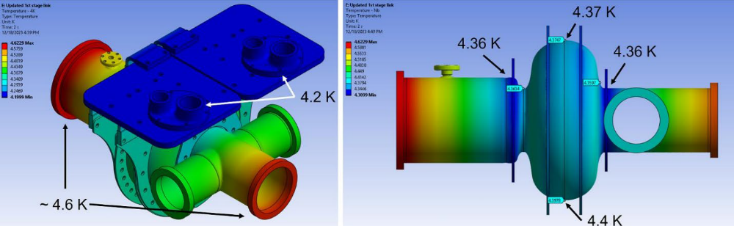
Nb3Sn Option: Cornell1.3 GHz Nb3Sn cavity
Jake Parsons, SRF 2025
The frequency is close to the 1500MHz that NSLS-II needs.
Cornell cavity is conduction-cooled and use cryocoolers. A helium bath shouldn’t be a problem as well.
If we can design the cavity with conduction cooling, we can continue to use that cryo line as bypass.
An FNAL Nb3Sn 9-cell cavity has demonstrated tuning range of 1.4MHz at f0=1.3GHz without trouble (Sam Posen, et al, SRF2019-THFUB1)
Cooldown needs to be slow around Tc=18K for the temperature profile to be uniform (dT<1K) to avoid magnetic flux trapping.
Harder to fabricate than normal Nb cavities.

Slide 11
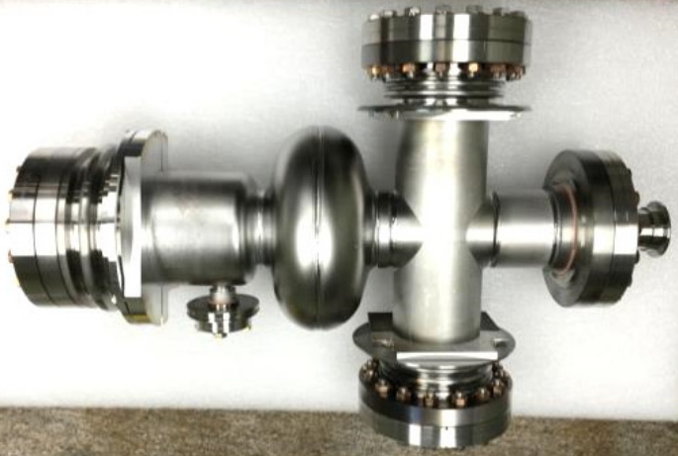
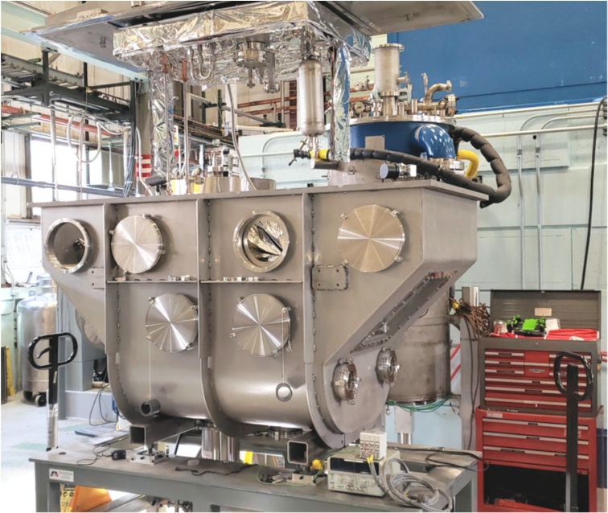
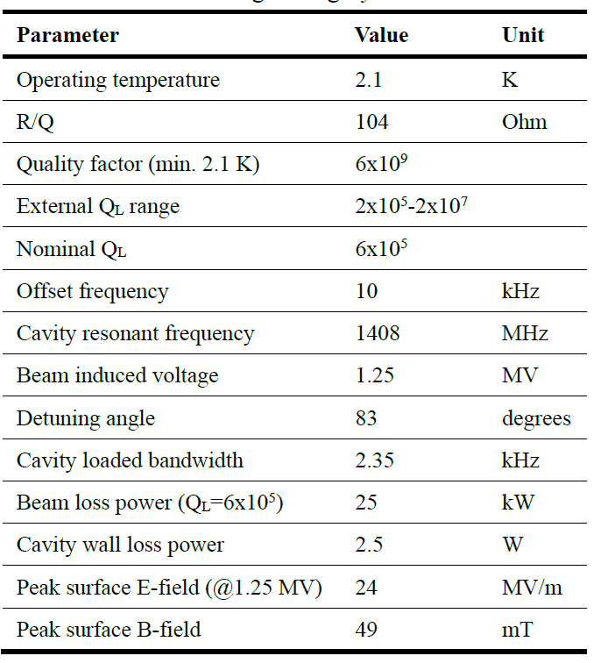
2k Option: Argonne APS-U 4th Harmonic Cavity
(VT)^2/(ωU)
M.P. Kelly, SRF 2019,
doi:10.18429/JACoW-SRF2019-TUP102
The frequency is close to the 1500MHz that NSLS-II needs.
APS-U 4th harmonic cavity has two power couplers and runs at 2K.
A 2K system needs to be developed.
Space limitations need to be investigated.
Occasionally has “quench” trips at lower cavity voltage (Vadim presentation at NSLS-II).
Recovery time to trip time ratio ~3:1. Partially warmed up a few times always below 120K. No full warmup yet. (Private conservation, Steve MacDonald).

Slide 12
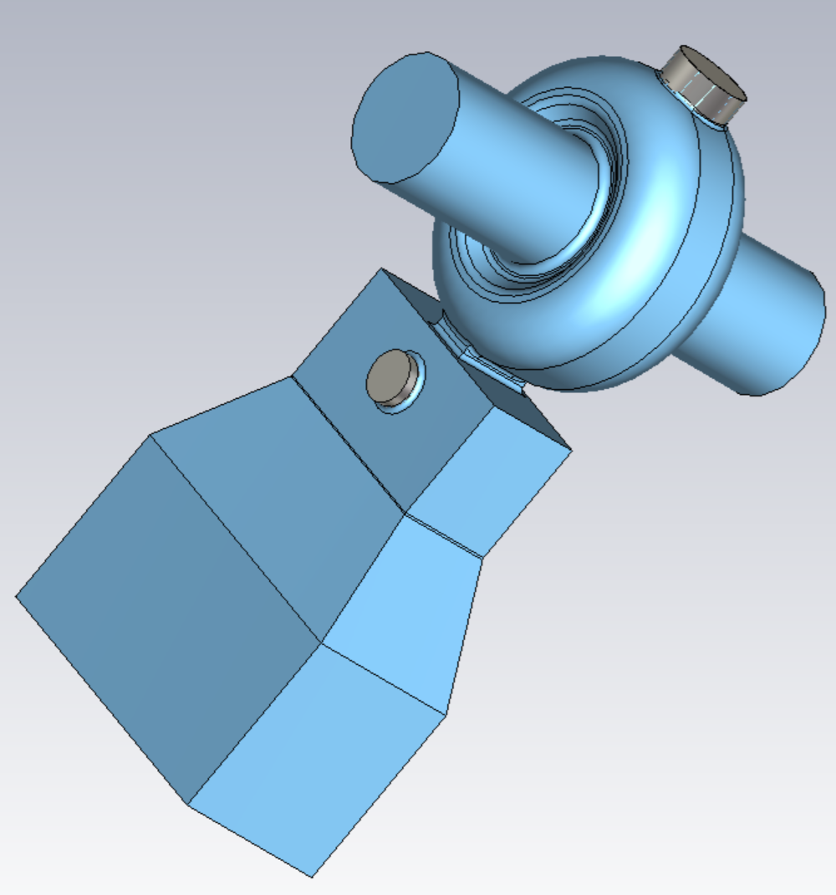
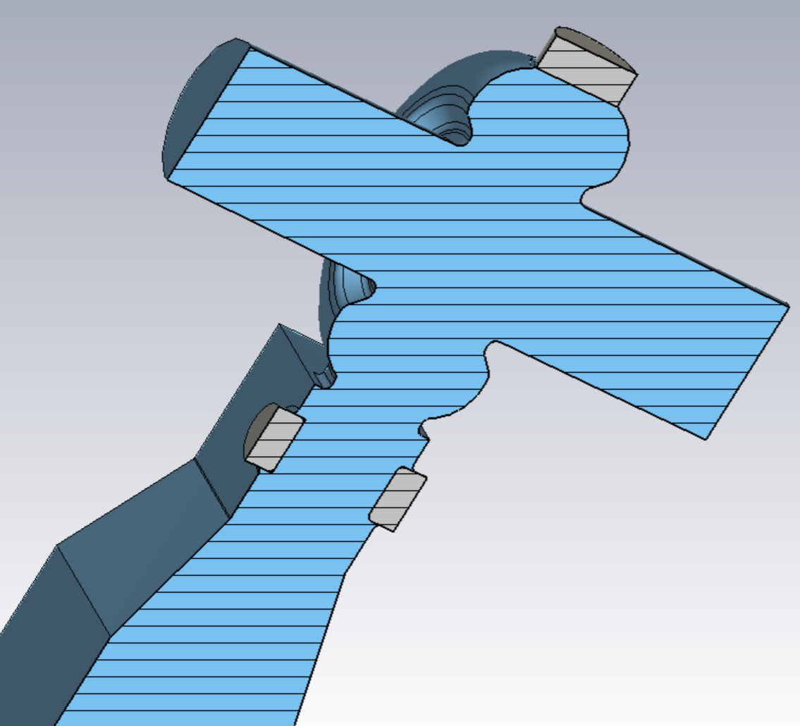
Higher Harmonic Cavity – 2500MHz Active
Four normal-conducting active 2500MHz 5th harmonic cavities, with Vc~125kV each and an adjustable power coupler for adjusting Qext.
Four 2500MHz 10kW solid-state transmitters
BNL Collider/Accelerator Department (RHIC) built a 3-cell cavity like this at 2.1GHz. Improvements of the tuner took some time. (Binpin Xiao, et al, PRSTAB 22, 030101 (2019))

Slide 13
Summary: Options for Harmonic Cavities
1500MHz 3rd Harmonic Cavity
Normal conducting like MAX IV: 800-1000kV per cavity would introduce cavity power in the ballpark of 100kW.
Continue with the 2-cell design like Taiwan Photo Source: The zero-mode is hard to control. The RF(dynamic) loss heavily depends on how well the cavity is processed. Adding a power coupler can lower QL thus RL of the 0-mode and improve instability.
Nb3Sn coating for 4K operation: Recently great progress has been made. It is still challenging to design, fabricate and operate. Nb3Sn is brittle but Fermi Lab results shows 1.4MHz tuning range at 1.3GHz. Cornell made a prototype for conduction cooling application.
2k design like Argonne APS-U: This would only require 1-cell per cavity, and the RF loss is on the order of 1 watt. But the 2k system design is challenging.
2500MHz 5th Harmonic Cavity
Conventional normal conducting design: Single cell, Vc~125kV each, Pfwd ~10kW.

Slide 14
Which one?
The 4K Nb 2-cell design needs more investigation: A power coupler can reduce the 0-mode impedance. This mode can be added to beam dynamics simulation to check the effects on beam stability.
Nb3Sn coated single cell is also an option. We may not be able to use the cavity as a bypass anymore due to how carefully the cavity needs be handled.
If the Nb3Sn option does not work well, we could remove the coating and go to 2K.
For the 5th harmonic cavities, the design is more mature and less risky.
We have already received partial fund for the 3rd harmonic cavity project. Your comments is highly appreciated. Please share with us your experience on cavity selection, construction and operation.

Slide 15
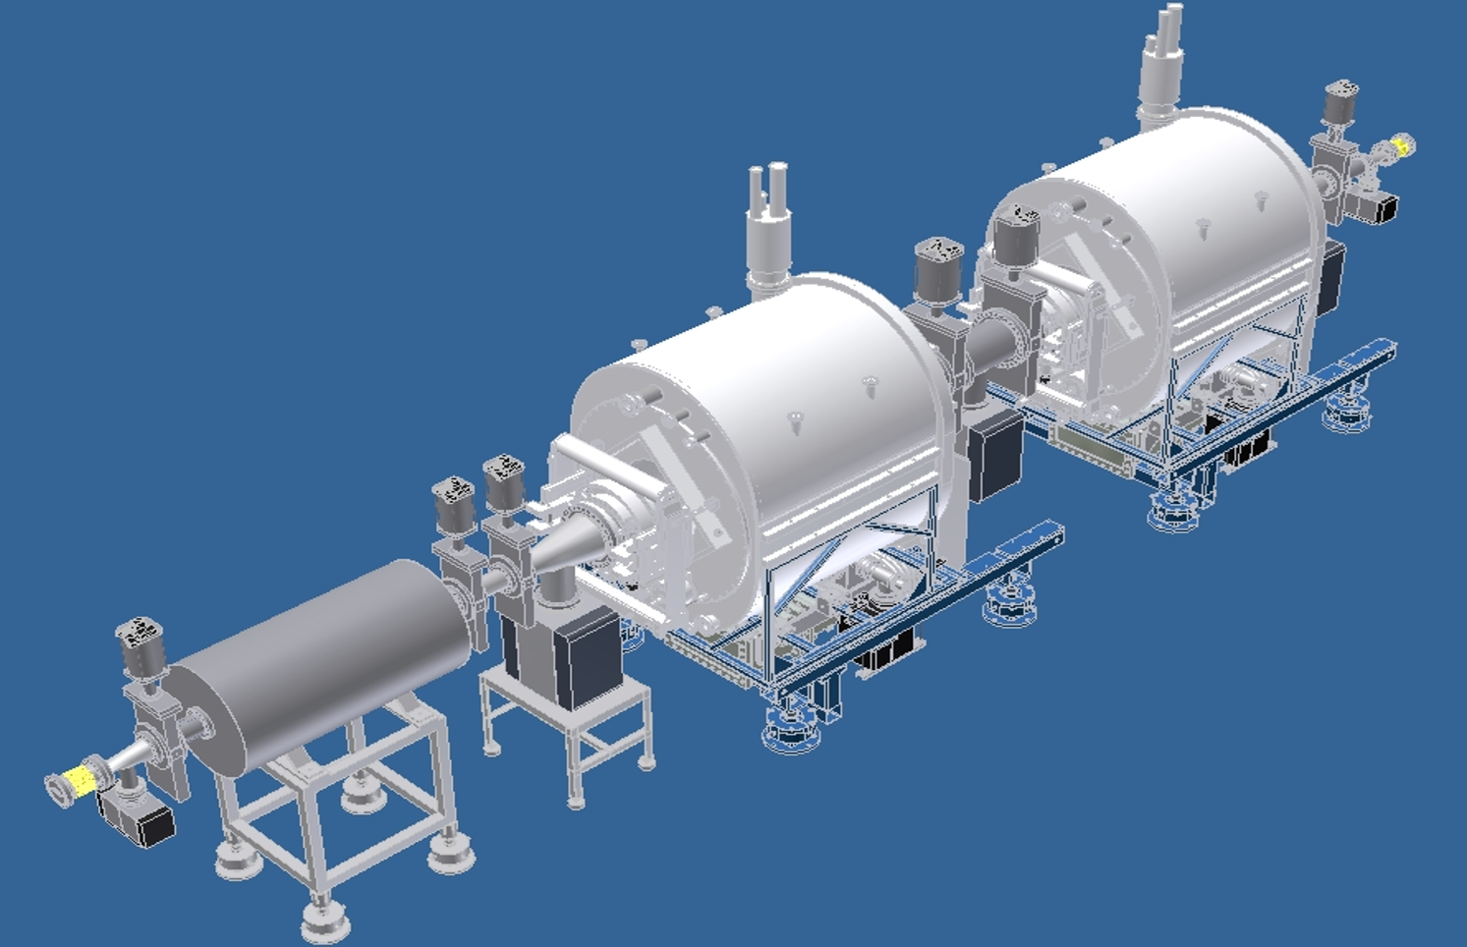
Thank you!
?
Notes:
*Max IV 3rd harmonic cavity total voltage 538kV @300MHz. Åke Andersson et al, iFAST Low Emittance Rings workshop, February 2024. MAX IV note, 2016-08-11. 3rd EuCARD2 Annual meeting, April 2016 at the University of Malta .

