Slide 1
Single and Multiple Harmonic Cavities
NSLS II-MAX IV workshop
5-6 Oct. 2026
Åke Andersson

Slide 2
Outline
MAX-Lab & MAX IV Harmonic Cavity (HC) saga
Bunch lengthening from theory, different HC combinations
Power consumption, different HC combinations
Higher Order Mode (HOM) damping
R/Q considerations
Active vs Passive operation
Conclusions
Questions and Discussions

Slide 3
Looking back
At the old MAX Laboratory we had HCs in all storage rings:
One 3rd HC (1.5 GHz) in MAX-I (1988-2015)
Four 3rd HCs (1.5 GHz) in MAX-II (1997-2005)
In 2005 we changed the main RF to a commercial 100 MHz:
One 5th HC (500 MHz) in MAX-II (2005-2015)
One 5th HC (500 MHz) in MAX-III, together with one 3rd HC (300 MHz), (2010-2015). This was the HC prototype for the MAX IV Laboratory rings

Slide 4
Looking back
At the present MAX IV Laboratory both rings (R1 & R3) were designed and commissioned with 3rd HCs from start:
2015-2016: Three 3rd HCs (300 MHz) in R3 (Were running up to 200 mA with HCs parked, using BbB longitudinal FB)
2016: Two 3rd HCs (300 MHz) in R1 (No FB needed, reached 500 mA stable operation after a couple of years)
2017-2022: 3rd HCs in lengthening mode in R3 (Mode-0 FB was needed, Mode-1 always present (to my knowledge))
January 2023: Two 3rd HCs (300 MHz) in R3 (Mode-0 FB still needed, but Mode-1 not anymore annoying even at 400 mA)

Slide 5
Looking back
2025 Summer: Installed one HOM-damped active 5th harmonic (500 MHz) in R3 (Difficult to park, but we survived delivery for ½ year)
Jan 2026: We decided to park the two 3rd HCs at symmetric positions around 3*rf, and did passive stretching with the 5th HC (Mode-0 FB needed; we allowed a strong Mode-1)
2026 Summer: Removed both 3rd HCs from R3 (Mode-0 FB needed, a weak Mode-1 & a weak Mode-167, originating from main cavities; both damped with our BbB system)

Slide 6
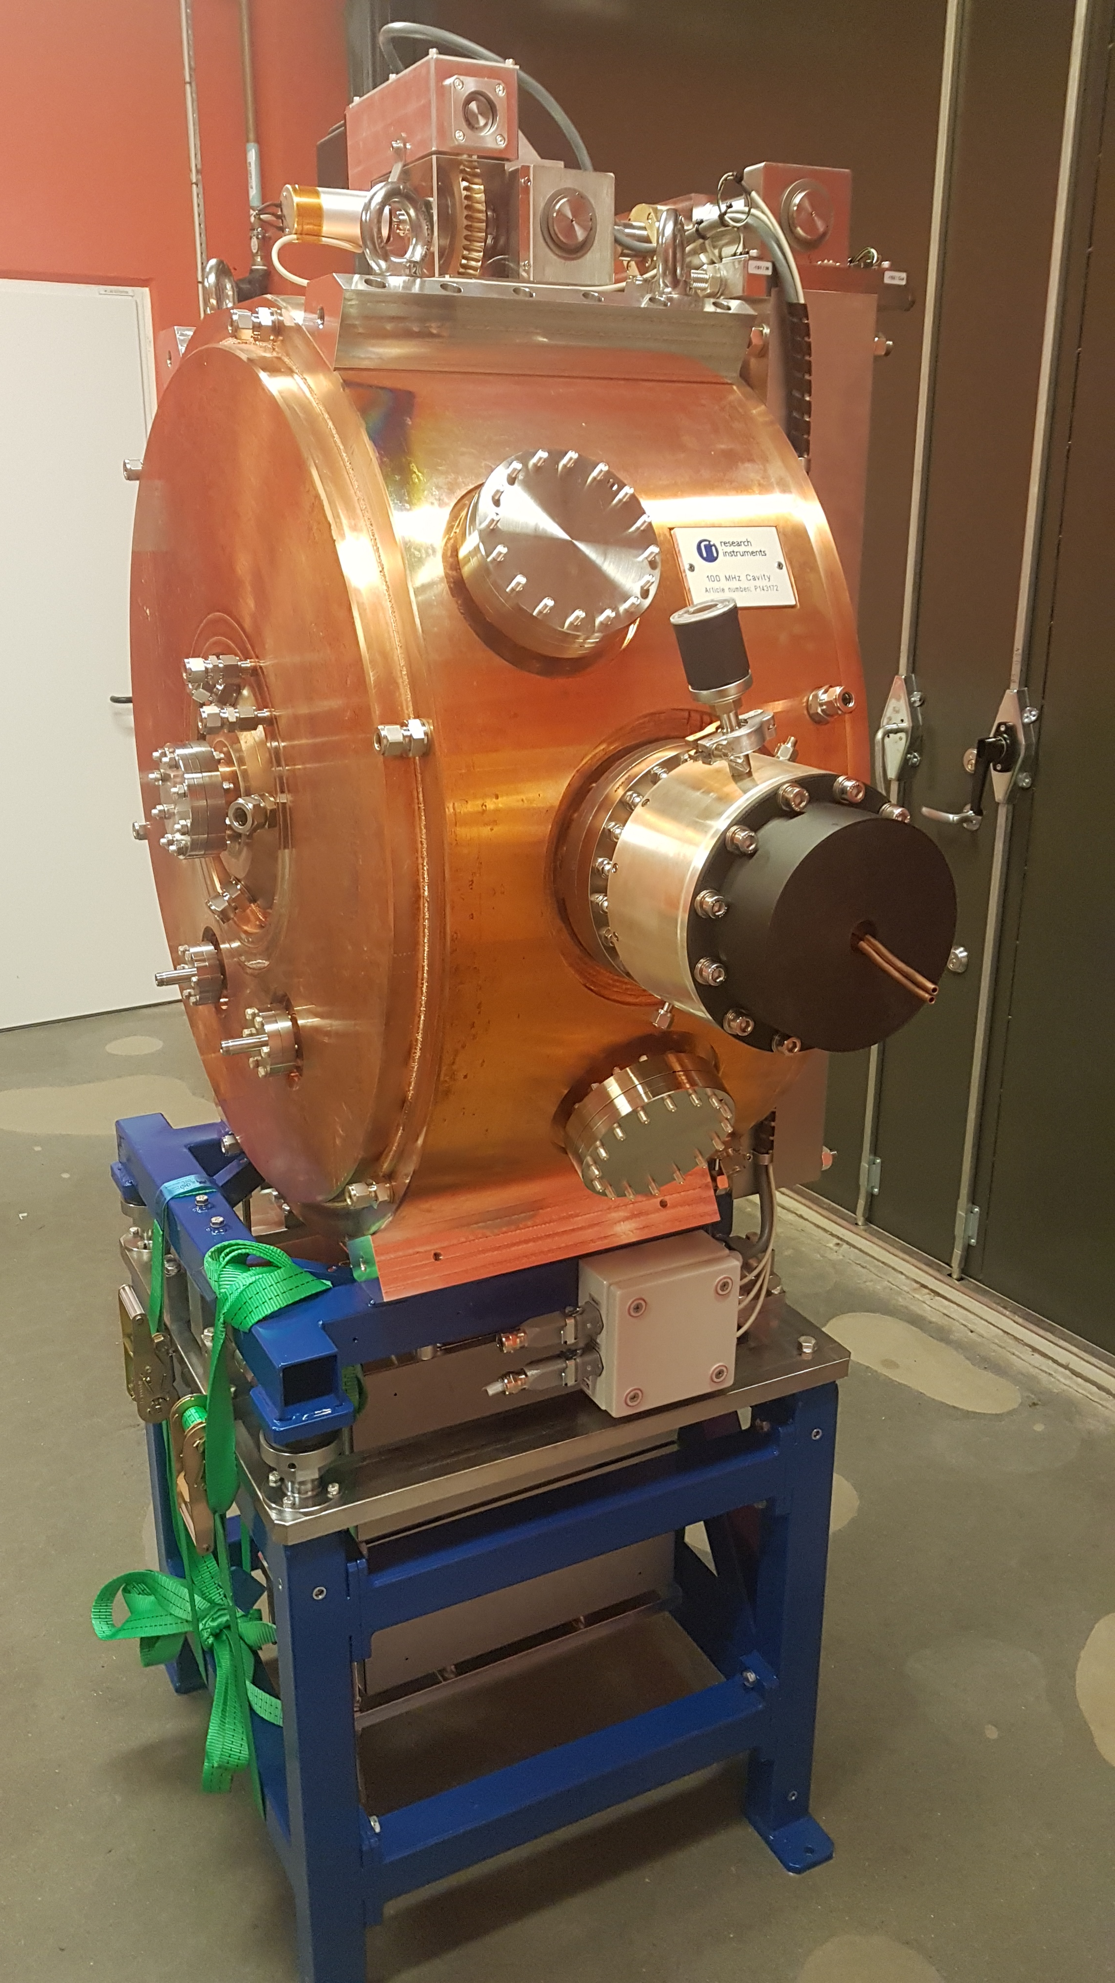
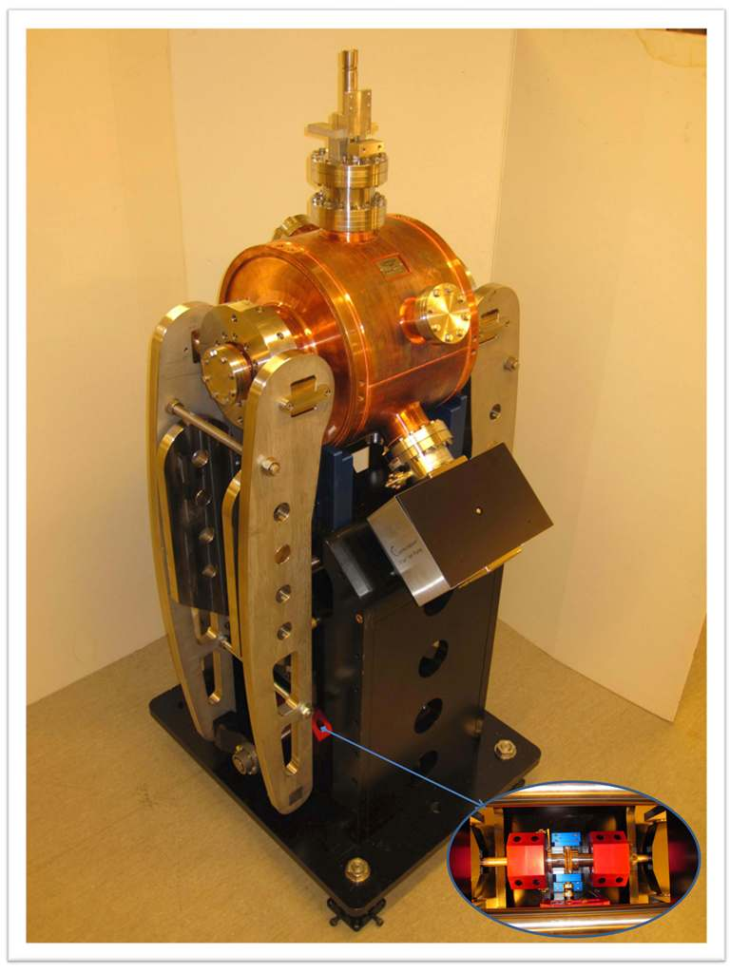
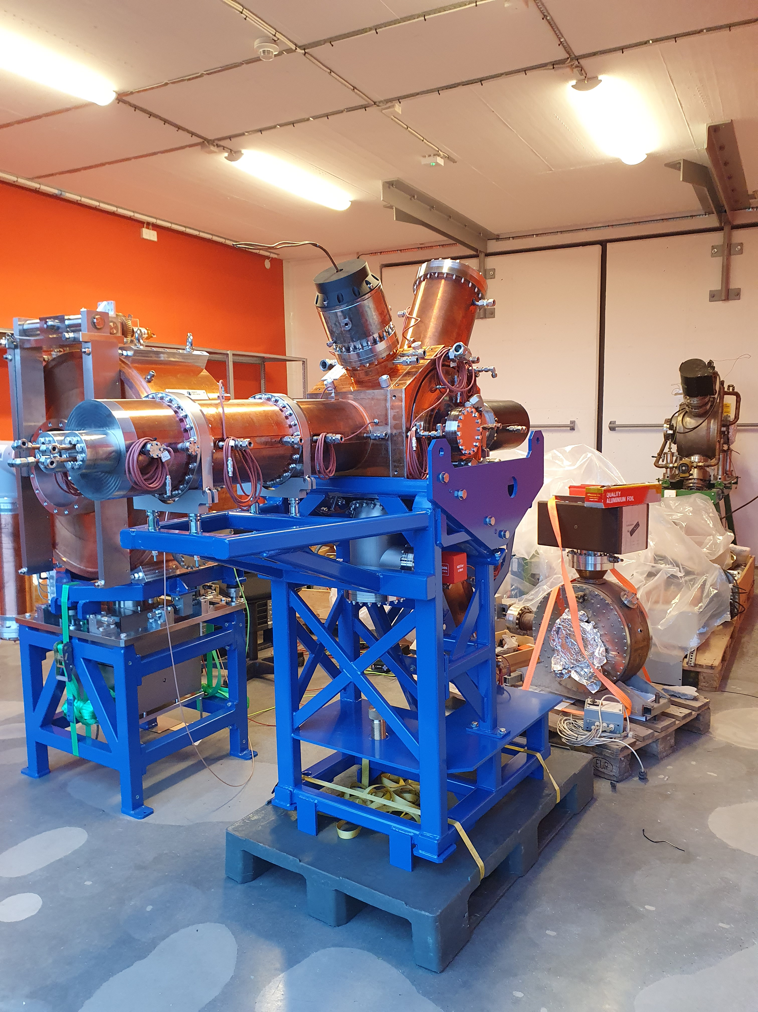
Our cavities in R3
Main Cavity
HC3 (Passive)
HC5 (Active)
HOM-damped
HOM-damped
2 installed (0 now)
300 MHz
Rs0=2.7 MΩ
Q0=20900
1 installed (Summer 2025)
500 MHz
Rs0=3.6 MΩ
Q0=31000
5 installed
100 MHz
Rs0=1.7 MΩ
Q0=20400

Slide 7
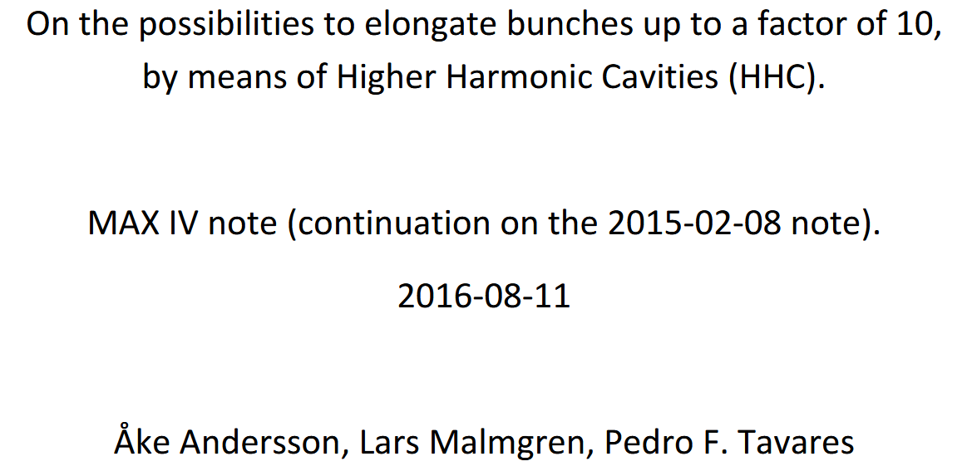
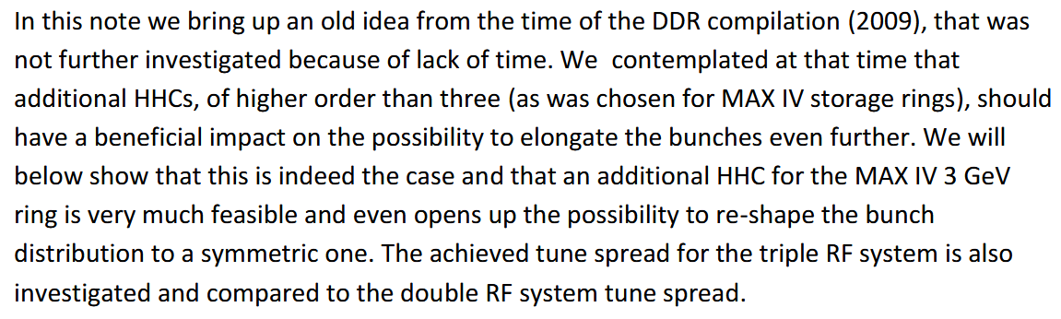
Multiple Harmonic Cavities

Slide 8
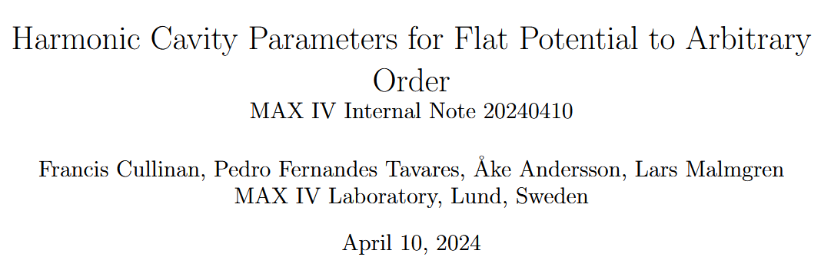
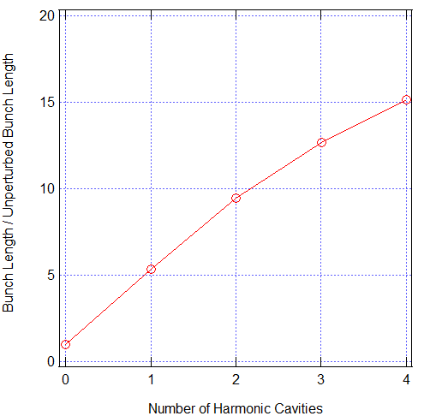
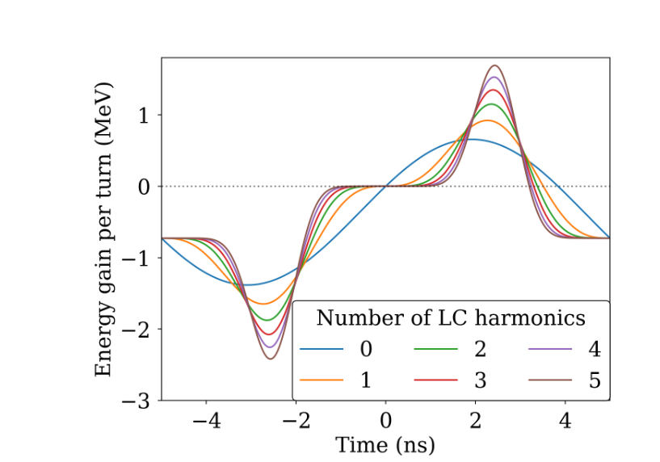
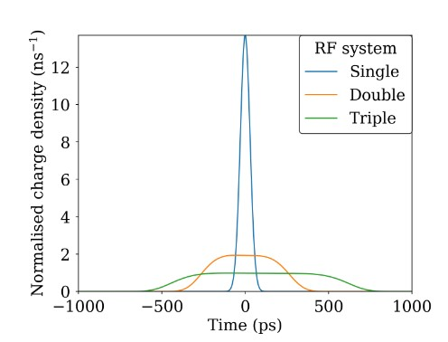
Illustrations for odd harmonics, but formulae valid for arbitrary harmonics.
Plots: Curtesy of F. Cullinan & P. F. Tavares

Slide 9
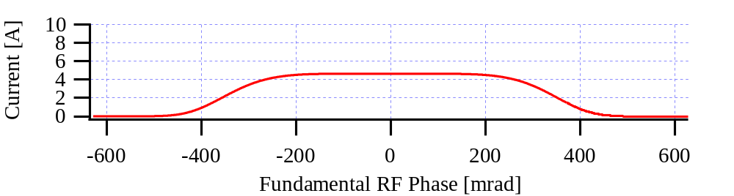
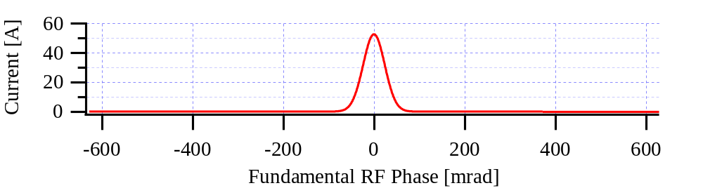
R3
480 keV/turn
Main V₁₀₀ =1200 kV
I_{av} = 400 mA
2 ns
FWHM = 1090 ps
Phasor diagram (in scale), for FP N=2.
As seen from V₅₀₀, that cavity needs to be active.
V₁₀₀ =1200 kV
Natural bunch length, single RF system
FWHM = 89 ps
V₅₀₀ =107 kV
-I_{av}
P_{cav500} =1.4 kW
P_{beam500} = I_{av}*U₅₀₀*F₅₀₀ =3.1 kW
P_{gen500} = 4.5 kW
Very moderate power requirement to 500 MHz cavity!
At FP | RMS-lengthening | FWHM-lengthening
1 HC frequency | 5.0 | 6.7
2 HC frequencies | 8.7 | 12.2
V₃₀₀ =538 kV

Slide 10
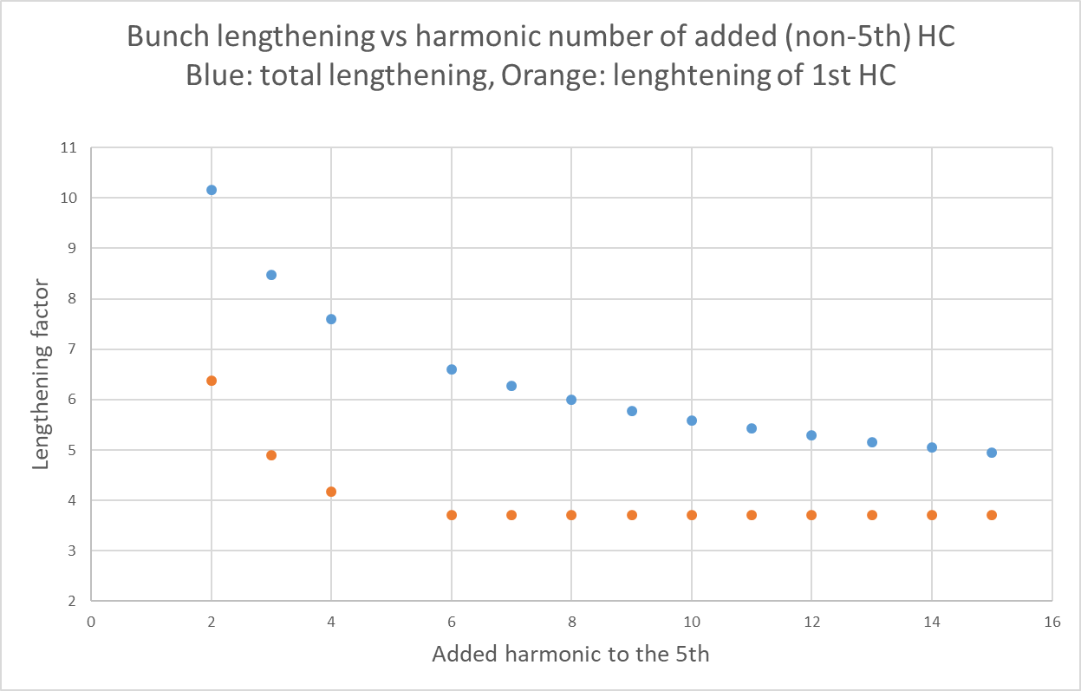
Quantitative lengthening for two harmonic frequencies in R3
Example, where we considered keeping the 5th HC, while varying the frequency of the other HC;
U₀ = 500 keV
V₁₀₀ = 1130 kV

Slide 11
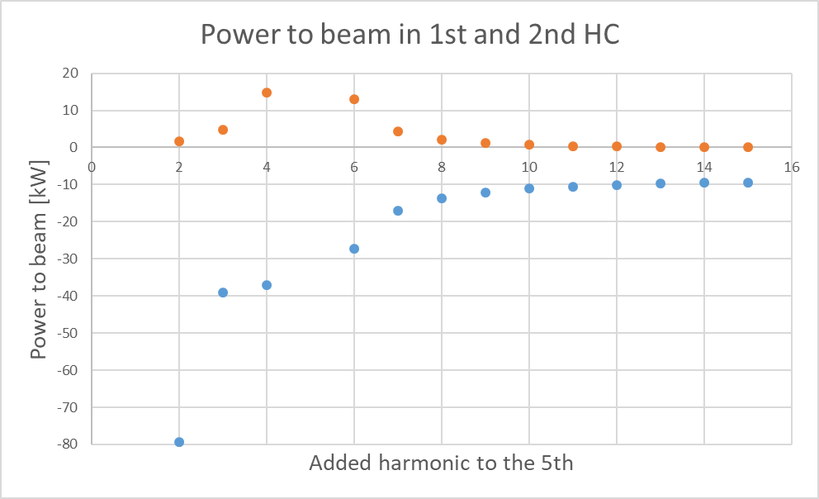
Power exchange with beam at SupFP, R3
Adding the powers from the two frequencies, scaled by the FF, the (-) sum needs always to be supplied by the main RF system.
Ohmic losses adds to this, but the beam power in 1st HC may be used.
The same example as above with 200 kW synchrotron radiation losses
2nd harmonic
1st harmonic
Our choice of a 3rd and a 5th harmonic frequency gives good lengthening (~ 9) and reasonable power consumption

Slide 12
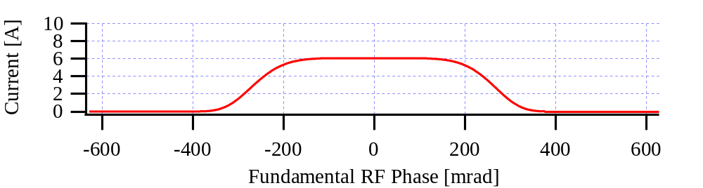
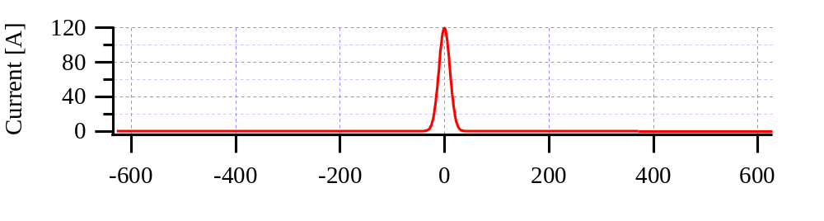
M4^{U}
800 keV/turn
Main V₁₀₀ =1400 kV
I_{av} = 500 mA
2 ns
FWHM = 838 ps
V₁₀₀ =1400 kV
Natural bunch length, single RF system
Phasor diagram (not fully in scale), SupFP
FWHM = 39 ps
V₅₀₀ =106 kV
-I_{av}
P_{cav500} = 1.4 kW
P_{beam500} = I_{av}*U₅₀₀*F₅₀₀ =6.7 kW
P_{gen500} = 8.1 kW
At FP | RMS-lengthening | FWHM-lengthening
1 HC frequency | 7.6 | 10
2 HC frequencies | 15 | 21
V₃₀₀ =543 kV
P_{cav300} = 55 kW

Slide 13
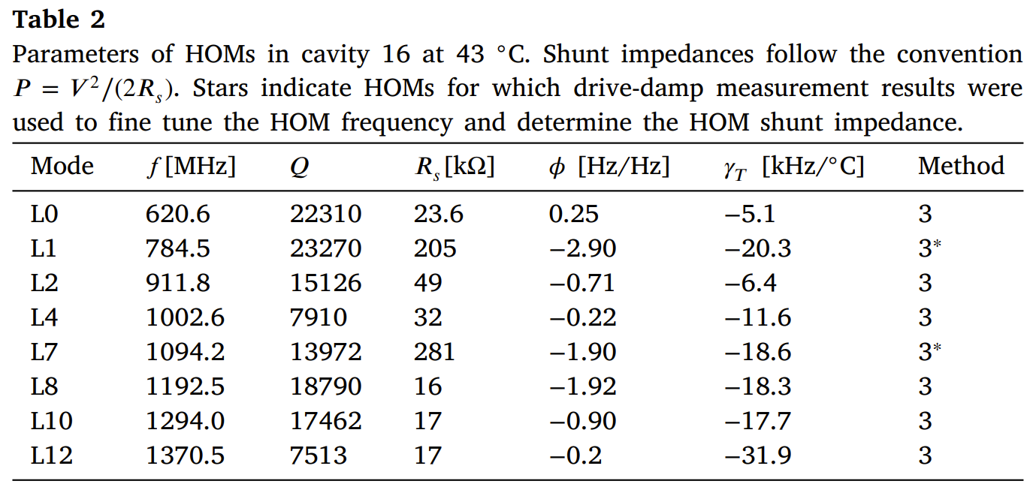
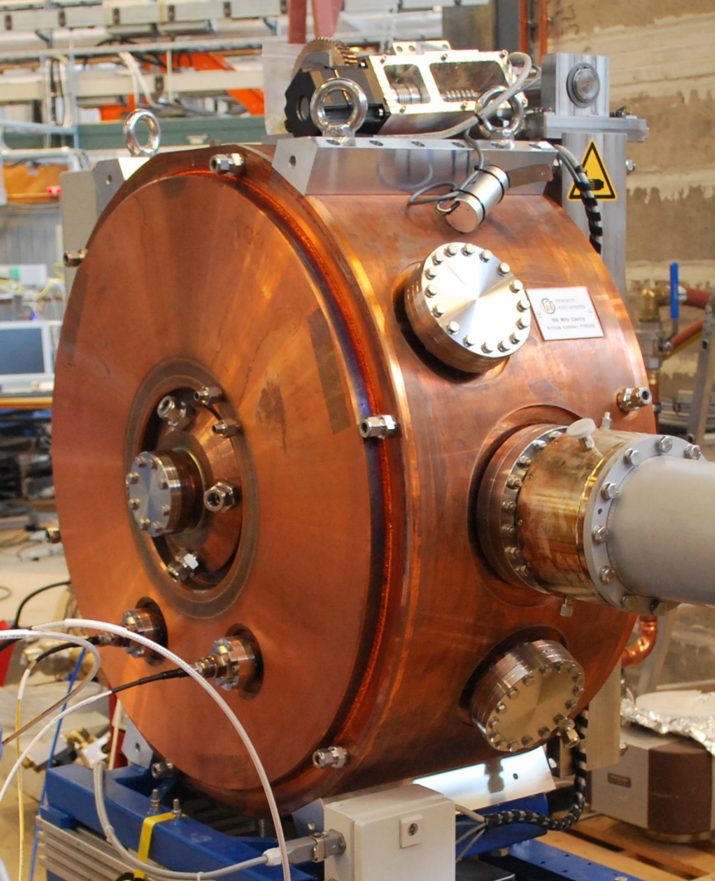
HOM-damping main cavities

Slide 14
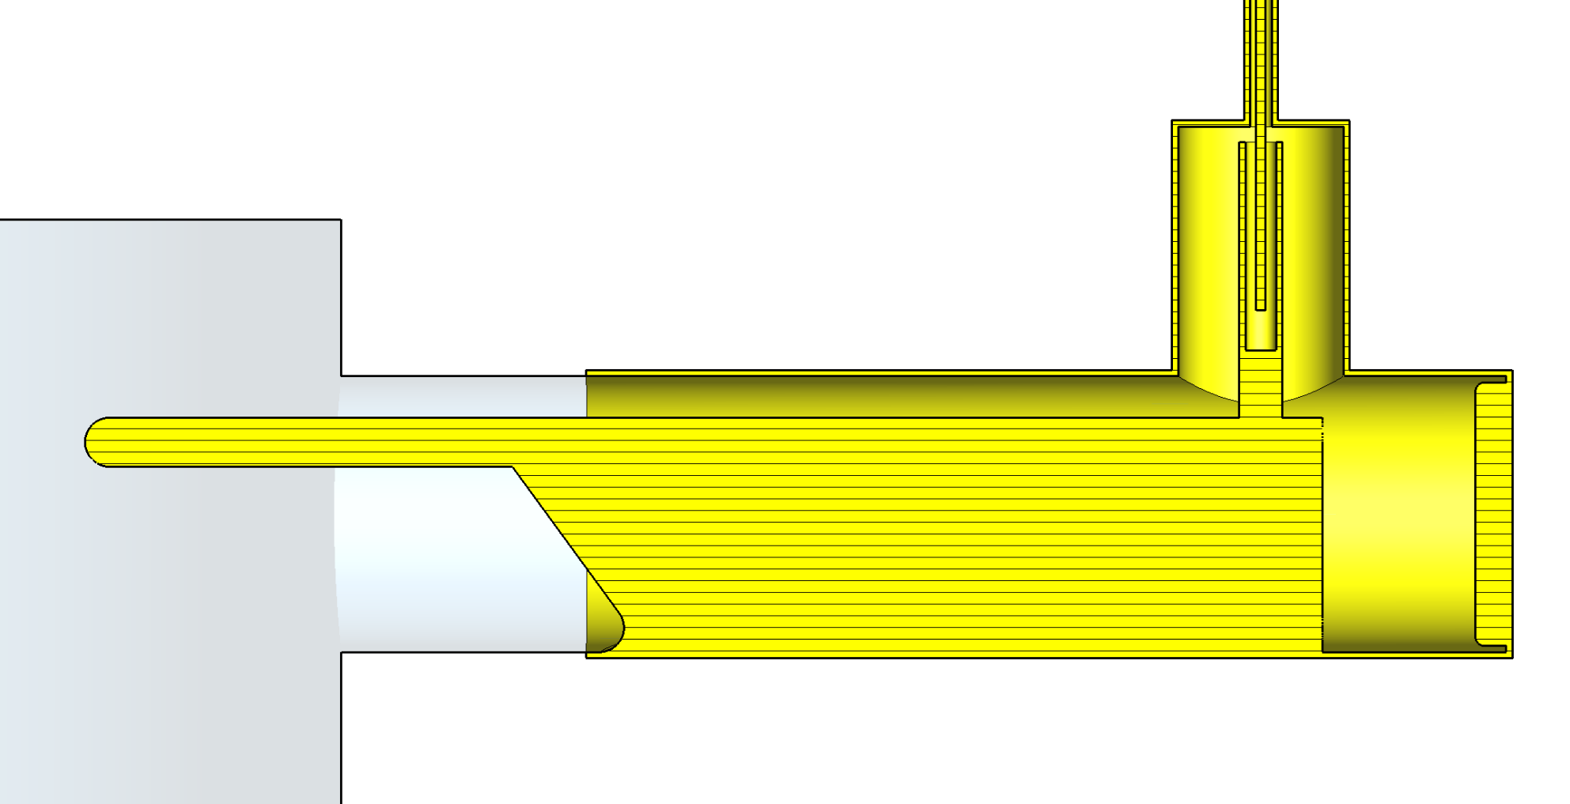
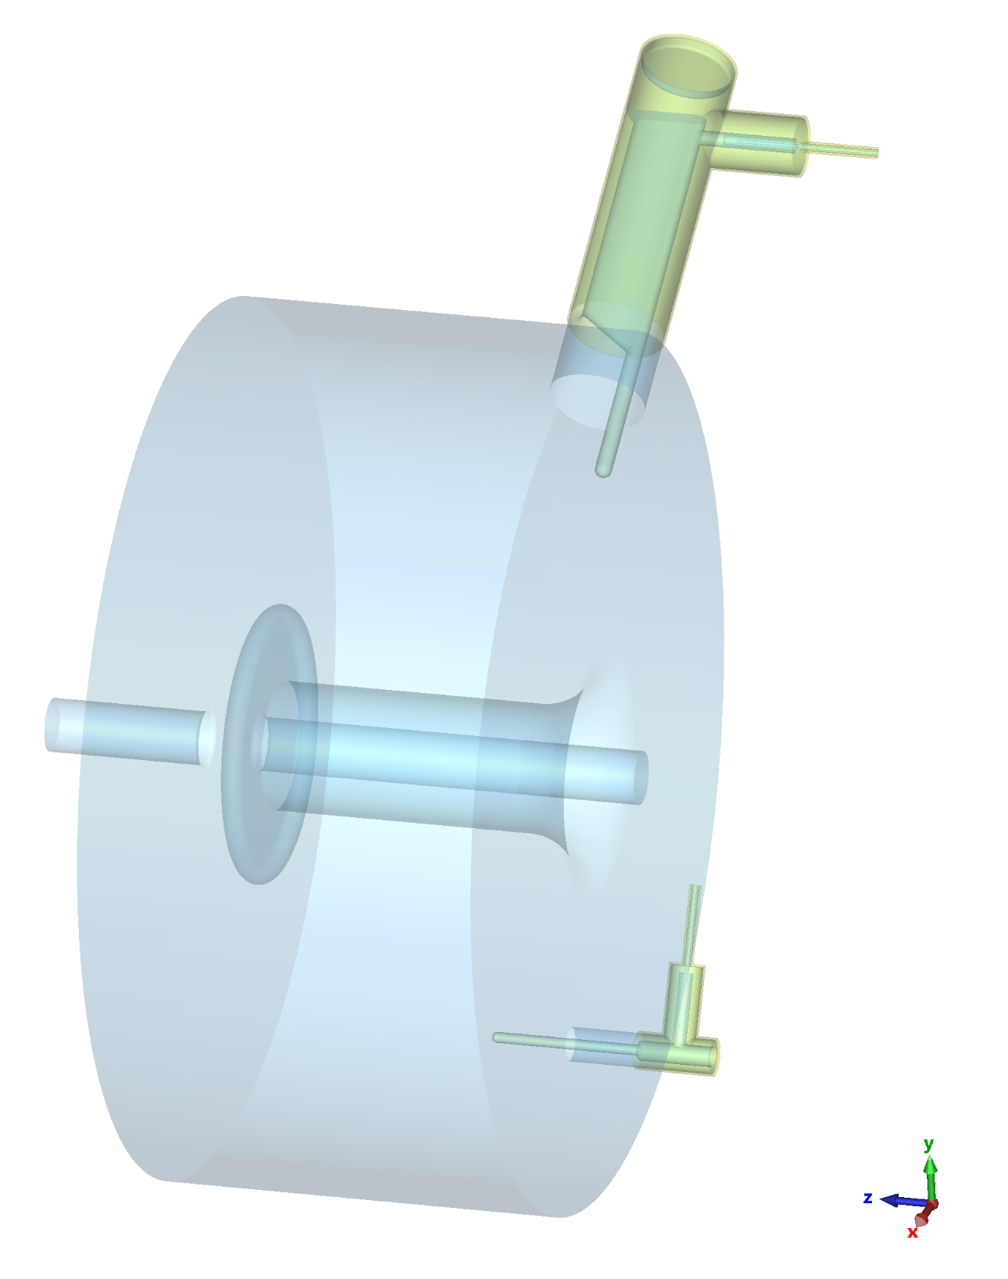
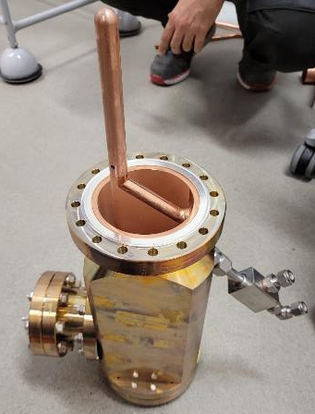
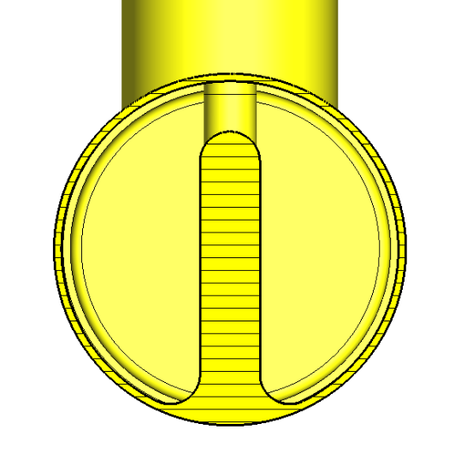
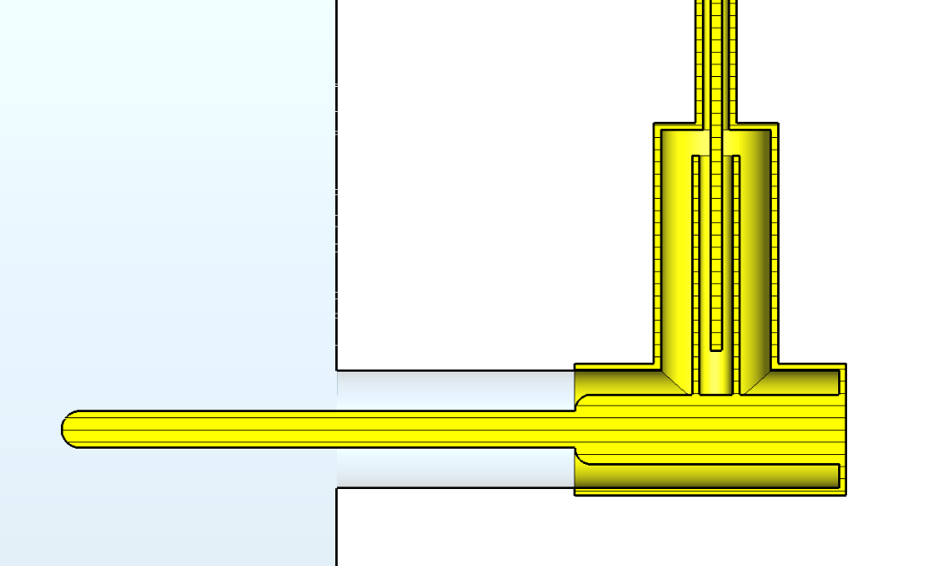
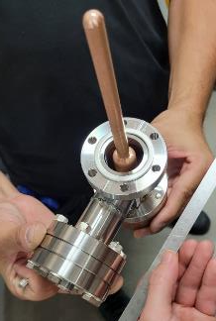
All-but-L7 HOM Dampers
75 dB fundamental power rejection
Slide: Curtesy of Henrique o. Caiafa Duarte

Slide 15
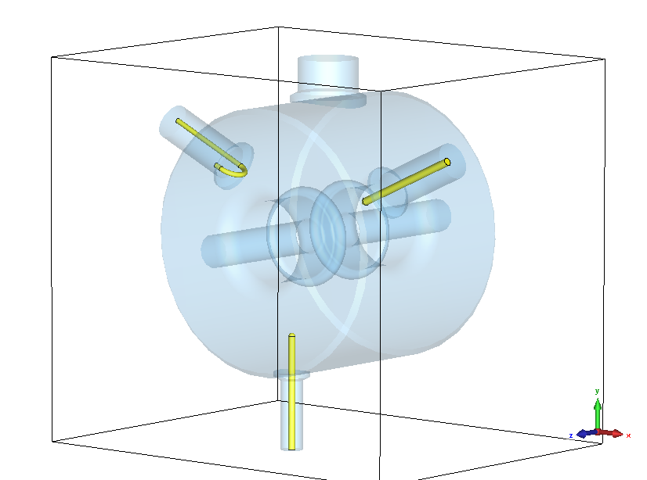
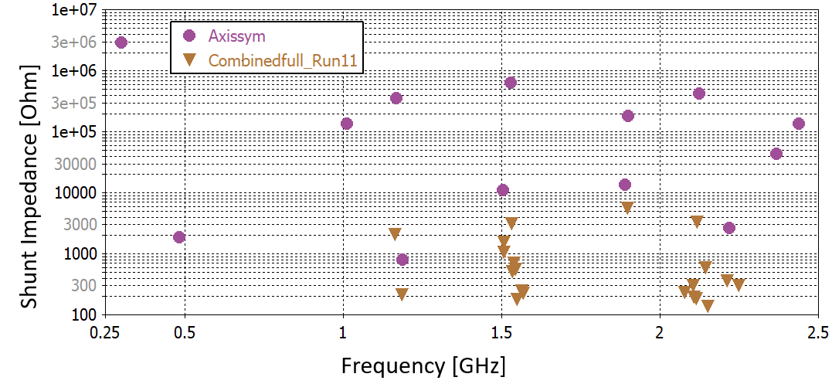
HOM-damping HC3 (preliminary)
Slide: Curtesy of Henrique o. C. Duarte

Slide 16
HOM-damping summary
After the installation of main cavity HOM-dampers the reproducibility of delivery conditions became much better
Before, we had to rely on very tight temperature regulation of each main cavity
We are now looking forward to Henrique O. Caiafa Duarte making the same magic installations in our 300 MHz cavities ☺
The 5th HC is the “EU-type” already HOM-damped with Wave-guides and in-vacuum ferrites

Slide 17
R/Q considerations
It was already shown by Dr. Cullinan and Dr. Alves, that two 300 MHz cavities will prevent us from reaching full stretching with a one-harmonic system for M4U (presentation by F. Cullinan)
Therefore, a project is launched for improving both cooling and tuning at our present 300 MHz cavities.
Kilpatrick limit is up at 700 kV in those cavities, and we would not need more than 550 kV
Goal is to handle the power and fields in a single cavity, i.e lowering the total R/Q by a factor 2

Slide 18
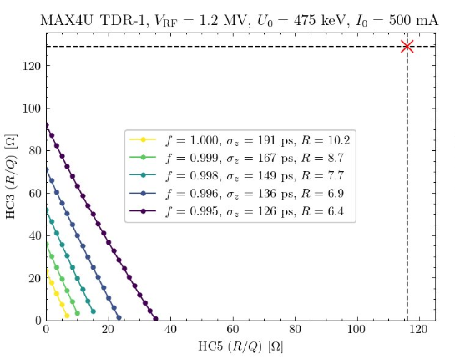
R/Q considerations
However…..
Recent calculations by Dr. Alves show that with two HC frequencies, the R/Q of both HCs need to be very low, ~10 Ω, in order to avoid the Mode-1 instability.
Similar simulation results reported from HALF (China)
Looks like we need a dedicated Mode-1 feedback !!
To be discussed …..

Slide 19
Active vs Passive Operation
Our present point of view is that the triple RF is more sensitive to phase and amplitude changes == > Speaks for active operation, both on 1st and 2nd harmonic system.
To be discussed …

Slide 20
Conclusions
While choosing HC frequencies, power considerations may be important
HOM-damped cavities preferable
R/Q for a double HC system tend to very low values
Also the power consuming HC frequency may need active input, for precise operation

Slide 21
Questions and Discussions
…..?
…..?
…..?

Slide 22
Complementary Material

