Slide 1
8. MAX 4^{U} Magnet system
NSLS II-MAX IV workshop
5-6 Oct. 2026
Aashoo Sharma, Henrique C. Duarte
(Contributions from Karl Åhnberg & Linus Roslund)

Slide 2
Outline
MAXIV Magnet system
Magnet system development plan
Prototyping activity planning, status
Magnetic measurements of reverse bend in Magnet block
Permanent Magnet Dipole project status
Magnet workshop set up

Slide 3
MAX4^{U} Magnet System development plan
Design and Validation
Conceptual Design - Completed
Manufacturing
Launch Procurement for Series production
Integration and commissioning
Handover for Installation
Technical Design - Ongoing (Henrique's presentation)
Prototype - Ongoing
Generate final technical specification for Procurement
Follow up series production
Factory acceptance test
Incoming inspection and storage
Magnet system installation and partial commissioning of installed achromats
Magnet system commissioning as per MAX4U Commissioning plan
Timeline
2026-28
2029- 31 Q2
2031 Q3 - 32

Slide 4
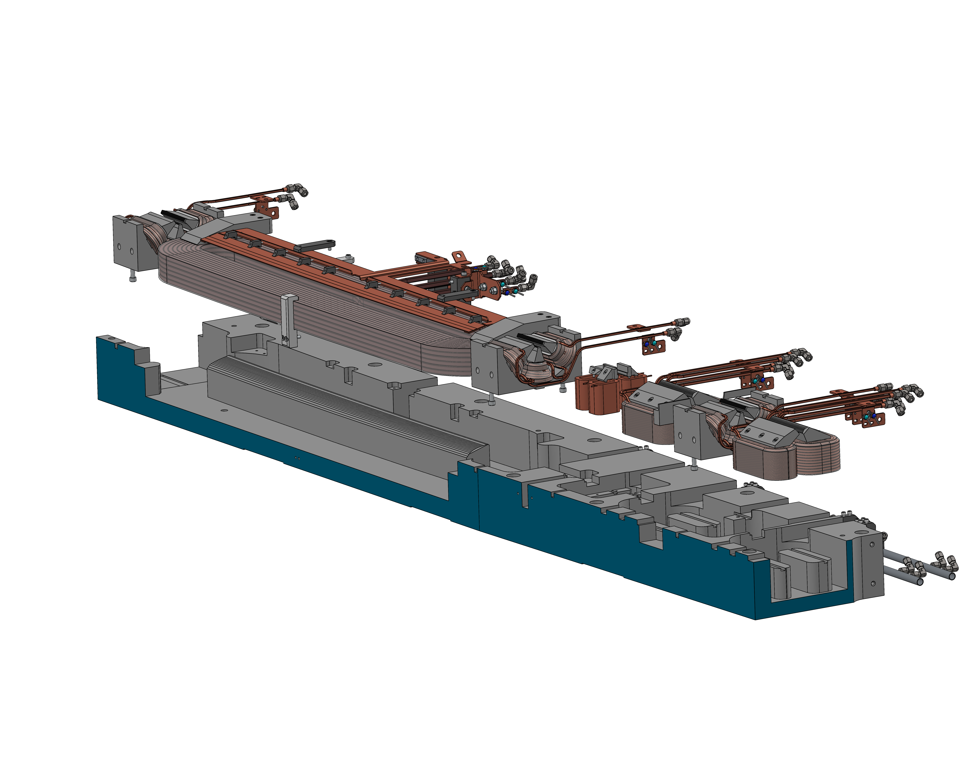
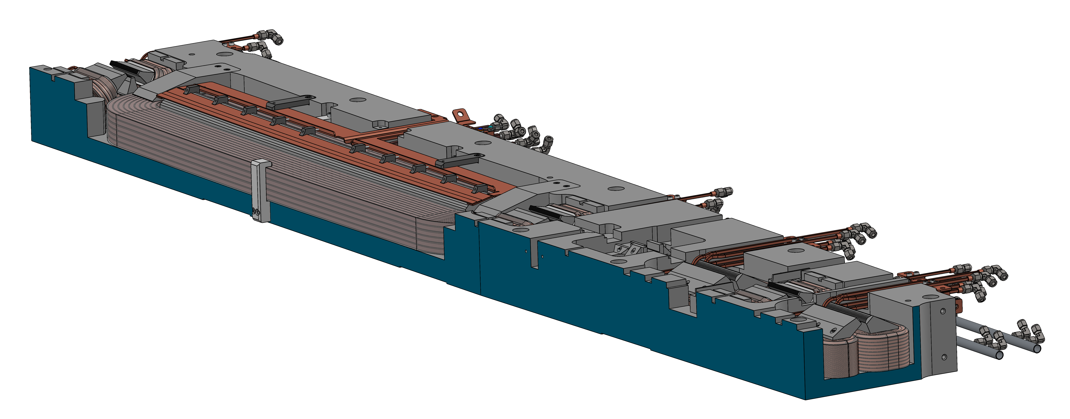
MAX4^{U} Magnet System – Design approach
MAX IV magnet system
MAX4^{U} magnet system
Maximise performance • Minimise modifications • Reuse existing components

Slide 5
Prototyping plan
Validate precision machining procedures
Validate coil fabrication, hydraulic and power supply interfaces
Finalise dimensional measurement procedures
Apply lessons learnt from R3 and finalise MAX4^{U} processes
Validation of manufacturing procedures
Validation of Magnet designs
Production readiness
Validate insulation integrity, cooling flow and pressure performance
Validate magnetic performance through excitation curves, field mapping, harmonics and cross-talk measurements
Verify magnetic axis alignment
Validate new designs: reverse bends, trim coils and pole-face strips
Finalize magnetic measurement methods and acceptance procedures
Use prototype results to finalise the technical specification for procurement of the MAX4^{U} magnet system
Notes:
Refer to error models etc??

Slide 6
Selection of Prototype Cell
Why UC2 was selected
Validates the most demanding magnet designs: D2 and R2
Allows validation of S1/S2 (only coils need to be replaced)
Lower cost than UC3
If budget and schedule allow, a second MC1/2 prototype will be built
R2
R2
R2
R2
D2
UC3
S4
S3
S3
S4
R2
R2
D2
UC2/4
S4
S3
S3
R1
R2
D2
UC1/5
UC2/4 provides the best balance of design coverage, validation capability and cost
S2
S3
S3
Note:
All sextupoles have identical yoke, pole root, pole tip designs, S3, S4 and S1, S2 use identical coils
Horizontal and Vertical corrector magnets, CH, CV are not represented in these schematics
Q1
Q2
S1
D1
MC1/2
O1
O2
O3
Notes:
This representation has been shown earlier, but here I have stacked the different cells to give you a visual context of why UC2 was selected for prototyping.

Slide 7
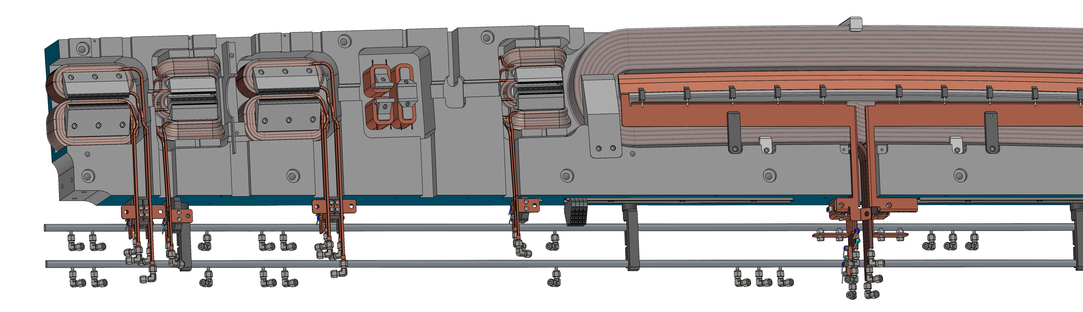
Status of UC2 Prototype
Contract awarded
Manufacturing and qualification expected during 2027

Slide 8
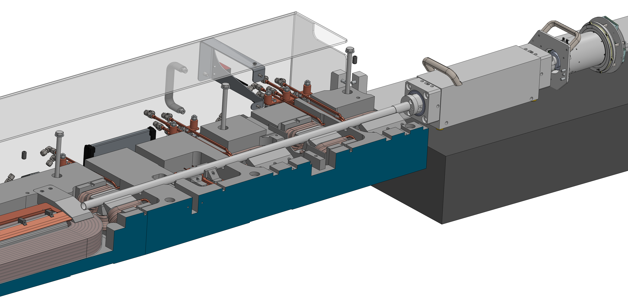
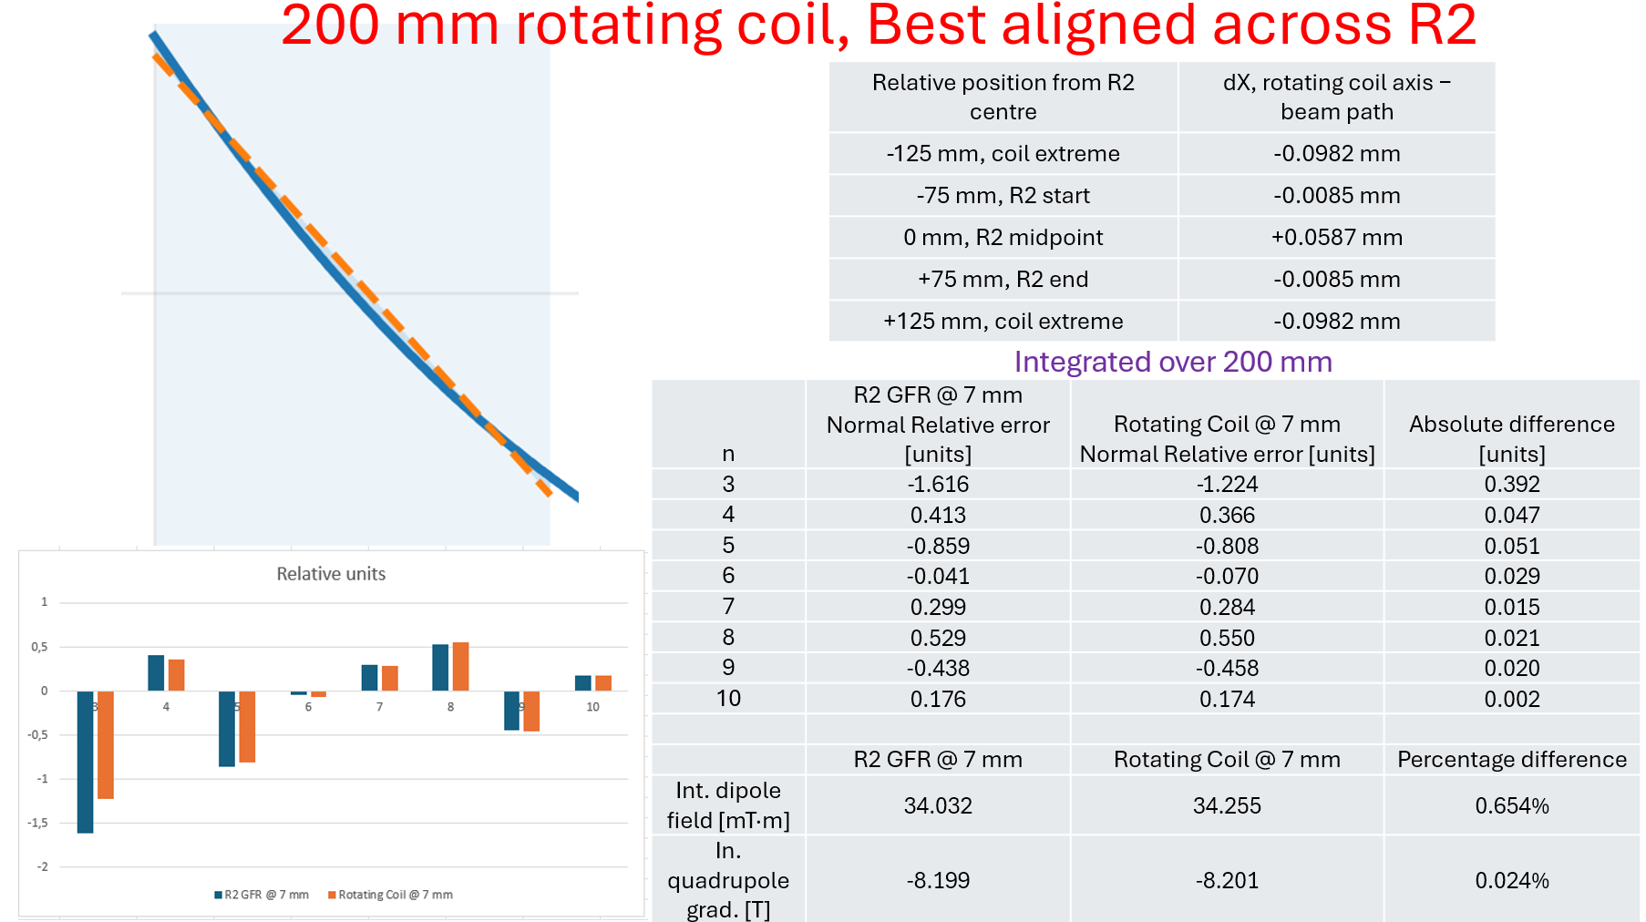
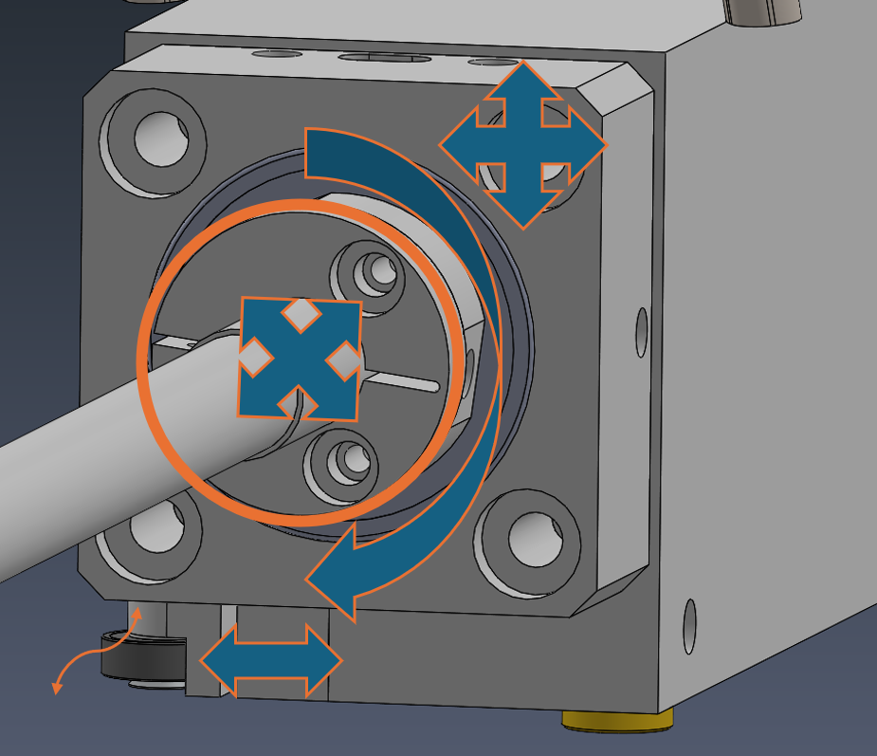
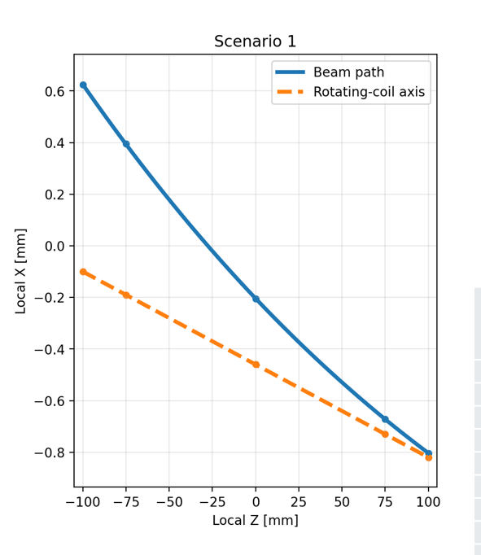
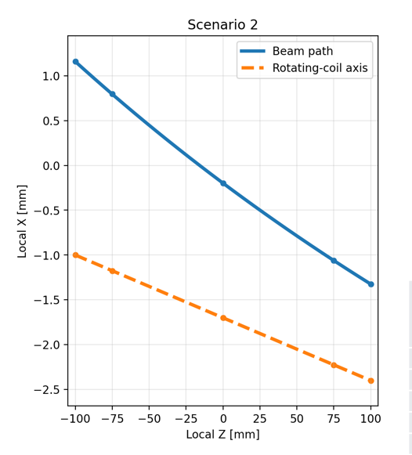
Rotating coil Measurement Plan for Reverse Bends
From Linus
Optimise rotating coil measurement position
Assess measurements against CST simulation results
Finalise measurement procedure and acceptance criteria

Slide 9
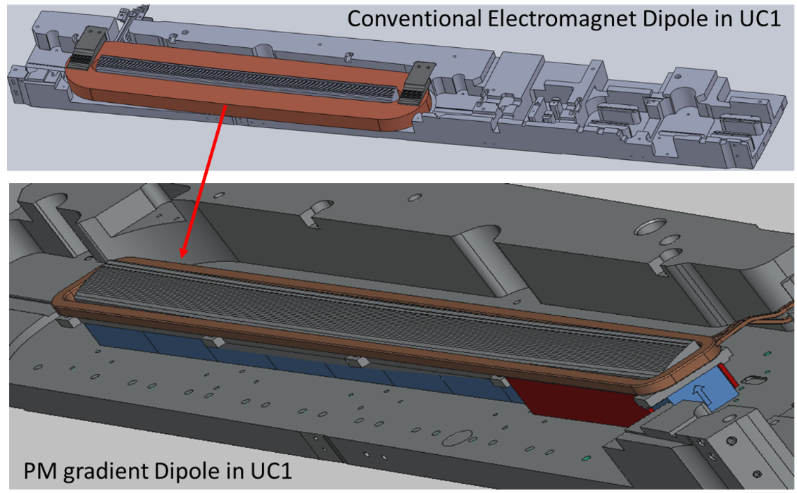
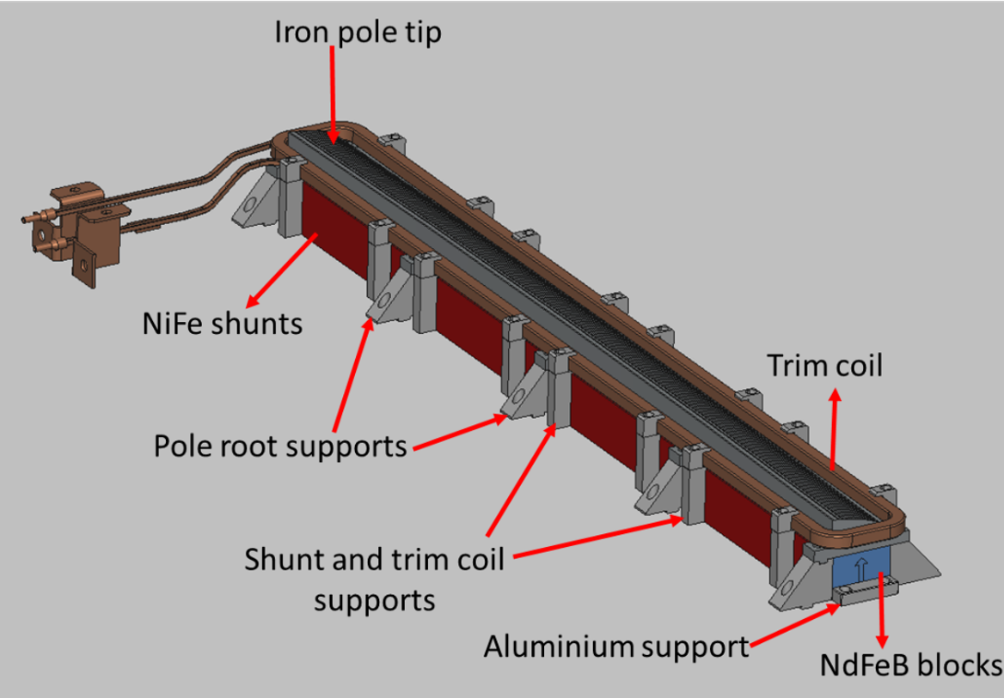
Permanent Magnet Dipole prototype
EU funded Project, RF 2.0, duration 2024-26
A resistive dipole magnet of UC1 of MAX IV R3, has been replicated with a Permanent Magnet based dipole
All procurement and manufacturing (Yoke, Poles, supports, Pole face trip, Trim coils and assembly tooling) completed. Assembly is ongoing at vendor site
MAX 4^{U} magnet system will likely be, mainly resistive electromagnets, but this may be adapted based on our overall experience with PM technology and its possible impact on other work packages
PM Material | NdFeB, Grade: N46 M
PM Br / HcB | 1.35 T / 1015 kA/m
Integrated Dipole Strength | 0.5 T.m, Tuning range ± 2.2 % with Trim Coils
Integrated Gradient | 8.6 T, Tuning range ± 5 % with Pole face trip
Pole Face Strip | Air cooled, ±150 A
Designed Temp stability | < 25 ppm/°C using NiFe shunts
Trim coil | Water cooled, Nominal current: ±300 A
PM Support structure | Aluminium

Slide 10
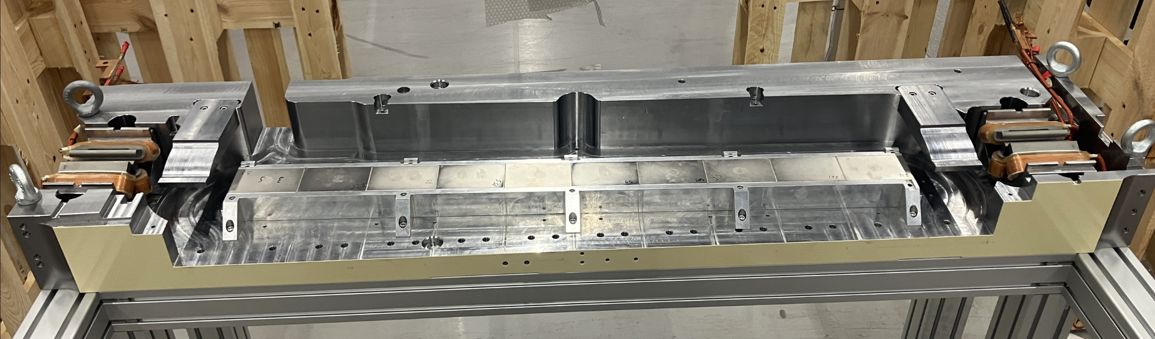
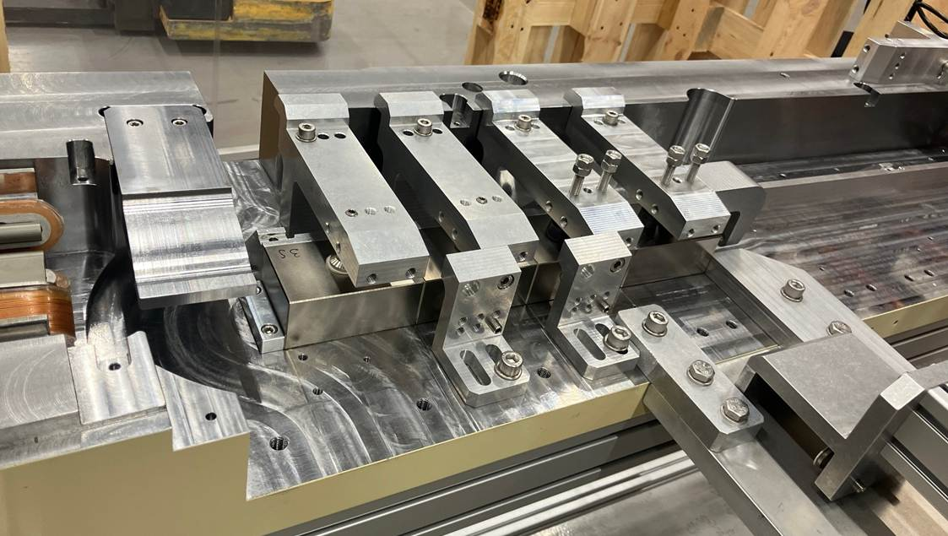
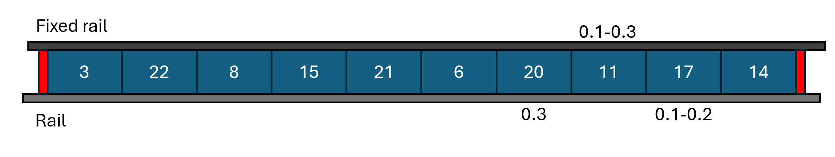
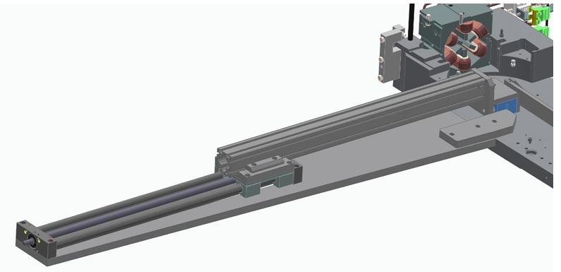
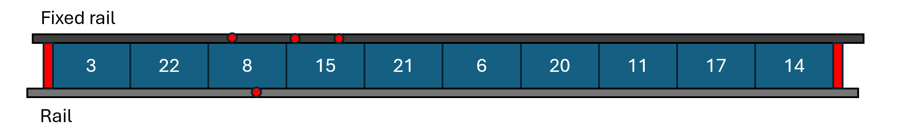
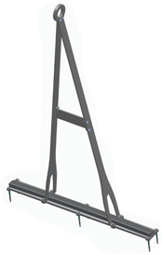
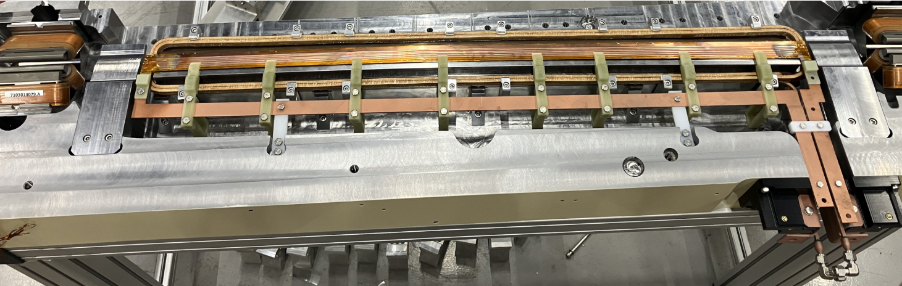
Assembly Progress
Gap between magnet and Alu. supports
Customized tooling
Elevation difference
Fully assembled Lower Yoke

Slide 11
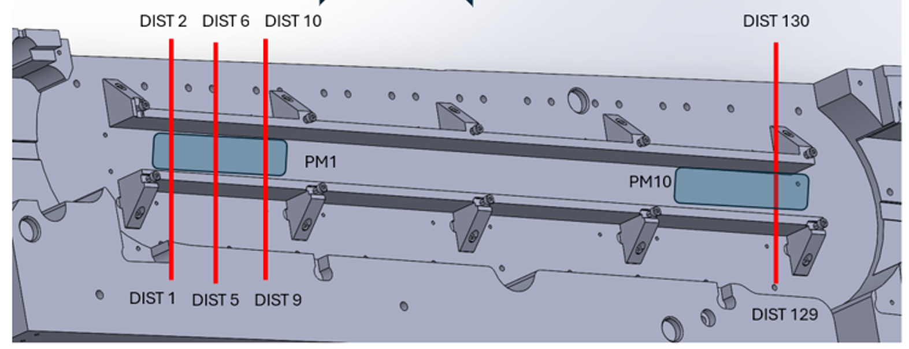
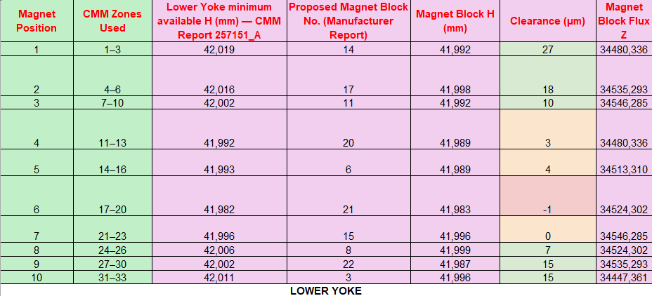
Sorting of PM blocks
Magnetic measurement plan
▦
1 Main mapping campaign
↯
2 Tuning & thermal stability
Complete 2D field map
Trim-coil effect on dipole field tuning
x = ±15 mm, Δx = 1 mm
s = 0–1223.78 mm, Δs = 5 mm
Pole-face-strip for gradient tuning
≈ 7,600 points
Temperature dependence to assess NiFe shunt thickness
Selected line scans
Reproducibility after dismantling/remounting top magnet half
12 transverse positions + longitudinal scan along x = 0
11

Slide 12
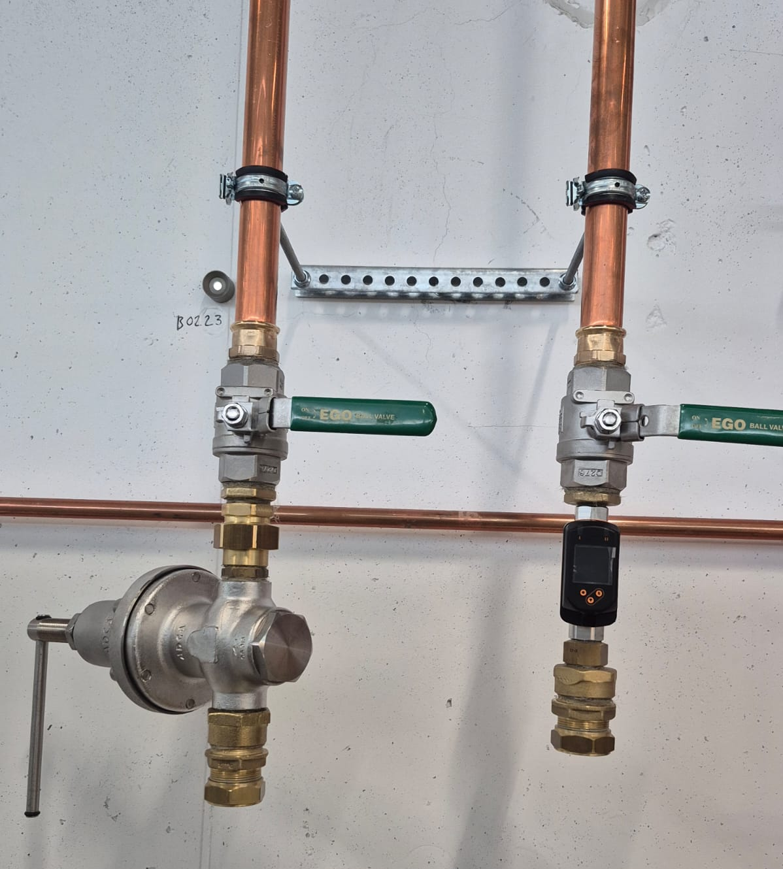
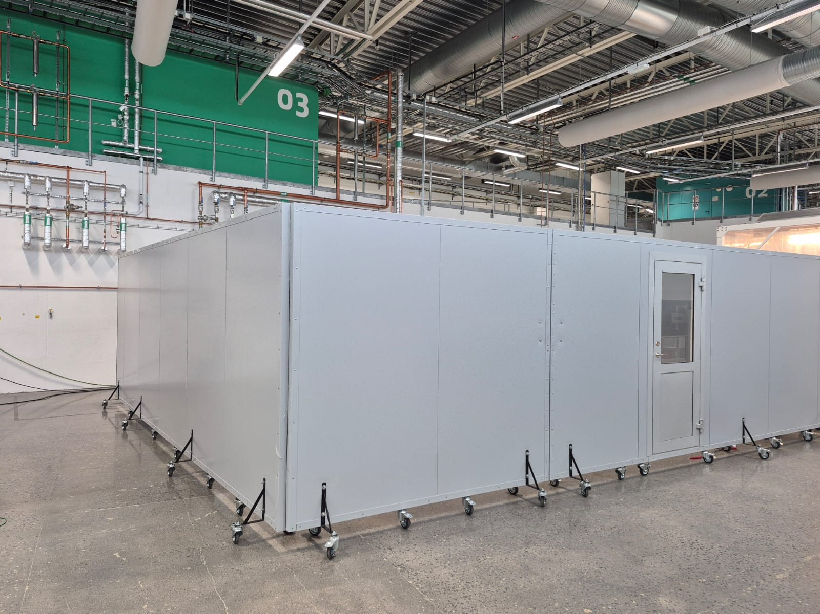
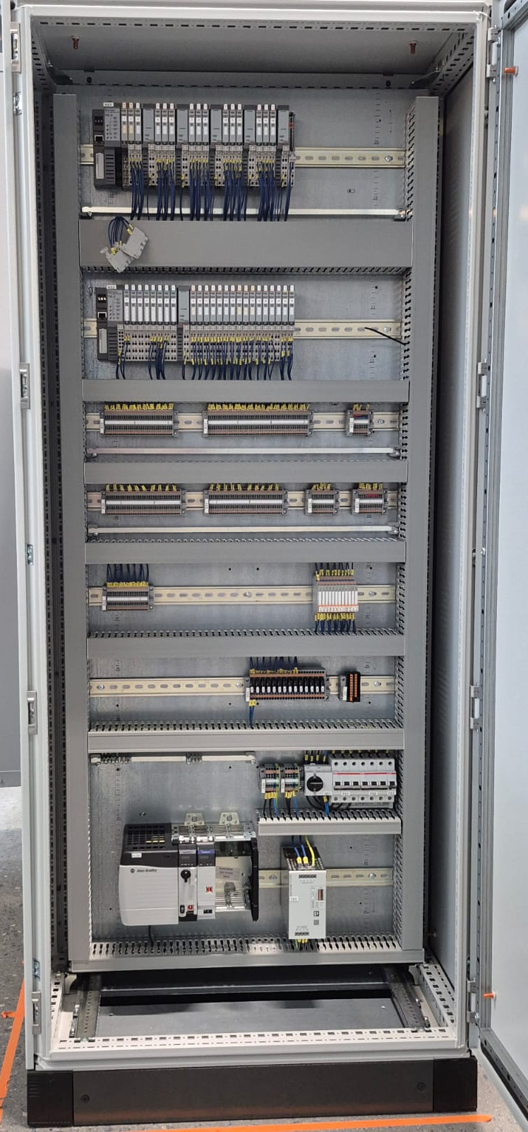
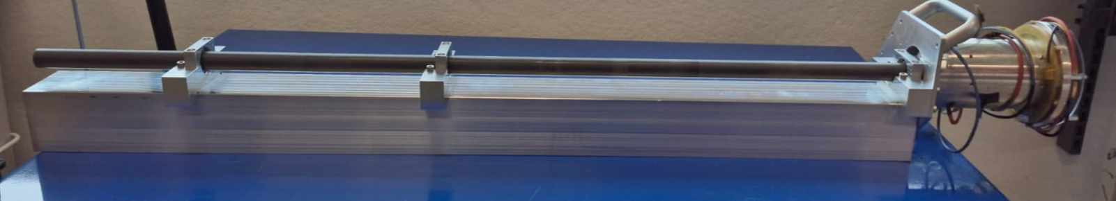
Development of Magnet Lab to Support Prototyping Activities
Building an in-house capability for:
  Installation trials and interface checks with subsystems, e.g. vacuum chamber
  Testing new magnets within the existing unit/matching-cell footprint, including new coils and additional cooling
  Incoming inspection and pre-assembly inspection
These tests are not intended to cover the full SAT scope, to avoid delaying the return of unit cells to the supplier for repair or corrective action
Lab Area
Cooling connections
Control Cabinet
Rotating coil set up

Slide 13
Conclusions and Next steps
Magnet design for TDR-01 lattice is ongoing
Prototyping activities for the MAX4^{U} Unit cell have been initiated
A permanent magnet based gradient dipole has been manufactured and assembled, characterisation is ongoing
Magnet lab is being built to support prototyping and selective acceptance testing of MAX4^{U} magnets
Lessons learnt from current prototyping activities will be used to finalise the magnet system design for the TDR-01 lattice

Slide 14
MAX 4^{U} Magnet design
NSLS II-MAX IV workshop
5-6 Oct. 2026
Henrique Caiafa Duarte

Slide 15
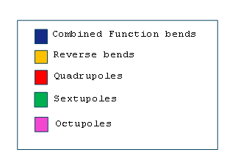

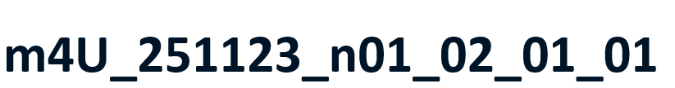
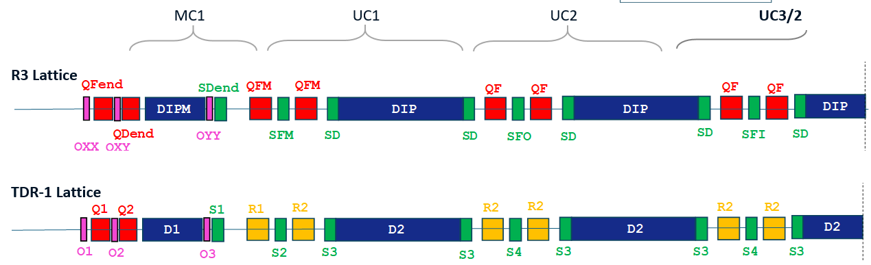
Outline
Introduction/recap
EM Designs
Crosstalk Studies
Next Steps
Conclusions

Slide 16
Introduction
Methodology
  CST Studio Suite (3D) and OPERA-2D for design, cross-checks with OPERA-3D
  3D multipole decomposition on polar basis
Good field region (GFR) radius reduced from 10 mm (R3 lattice) to 7 mm (TDR-1) allowed modifications keeping $±$1 Unit field quality.
.Design ’tricks’ we can play with
Narrowing the pole tip ( )
Widening the pole root ( )
Permendur for pole tip material instead of ARMCO
Q1,Q2

Slide 17
Outline
.Introduction/recap
EM Designs
Crosstalk Studies
Next Steps
Conclusions
+29%
-13%
-16%
+16%
+90%
Rel. mag. strength change
+36%
+71 %
-32%
+157%
+40%
*Octupoles do not need redesign

Slide 18
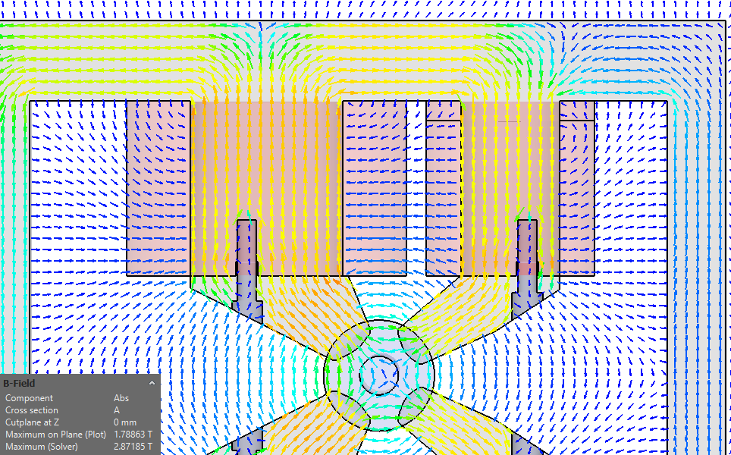
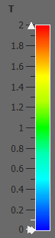
R2 Reverse Bend Design
R2 design consists of two hyperbolae tangent to the horizontally shifted aperture circle (thus having different bore radii). Coils are sized accordingly.
‘Single-sided’ trim coils combined with main coils allow variation of
  G within –18.9%/+8.1% for fixed B1
  B1 within –13.2%/+13.7% for fixed G
B[T]
2
1.8
1.6
1.4
1.2
1
0.8
0.6
0.4
0.2
0

Slide 19
R2 Reverse Bend Performance
Parameter | R2 (QF in R3)
Integrated Strength | 9.079 (6.654) T gradient
 | -39.46 (0) mT m dipole
Magnetic Length [mm] | 142.5 (143.2) gradient
 | 157.5 (NA) dipole
Inom [A] | 146.7 (74.4)
Bore radius [mm] | 14.84 inner, 9.60 outer (12.50)
# of Turns/coil | 43 inner, 18 outer (39), 450 trim
Efficiency [%] | 88.4 (79.6)
Temperature rise [degC] | 14.85 (8.91)
Power/magnet [W] | 1003.9 (514.6)
Trim B1
+14% -175 -24 -8
-13% 168 21 10

Slide 20
Outline
.Introduction/recap
EM Designs
Crosstalk Studies
Next Steps
Conclusions

Slide 21
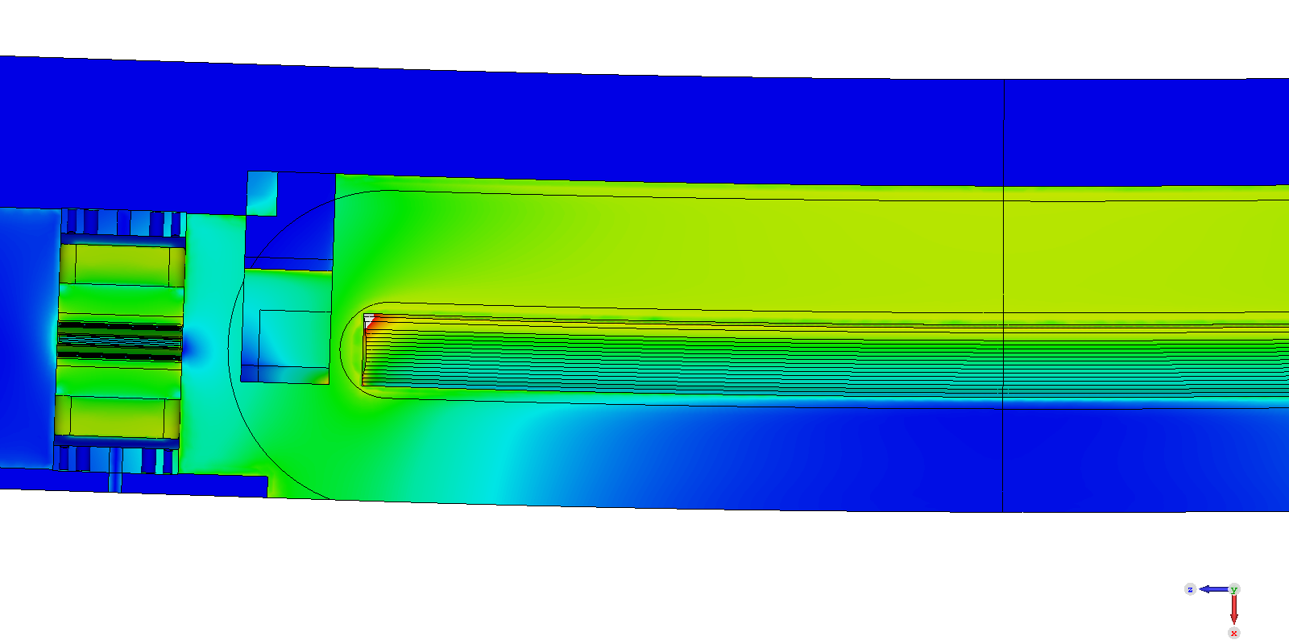
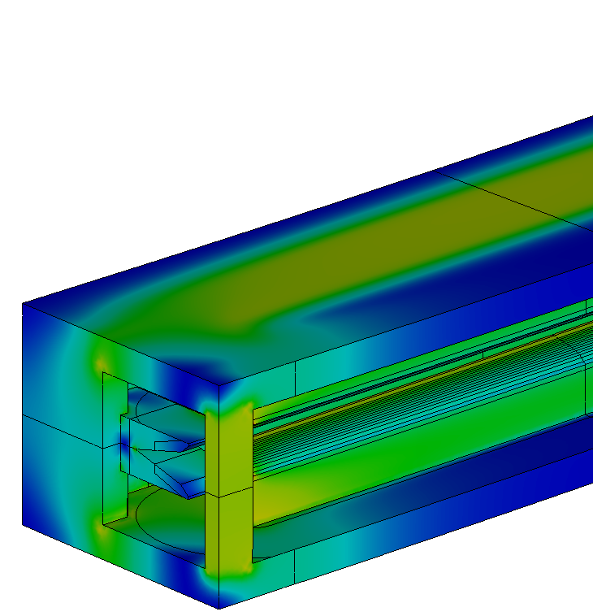
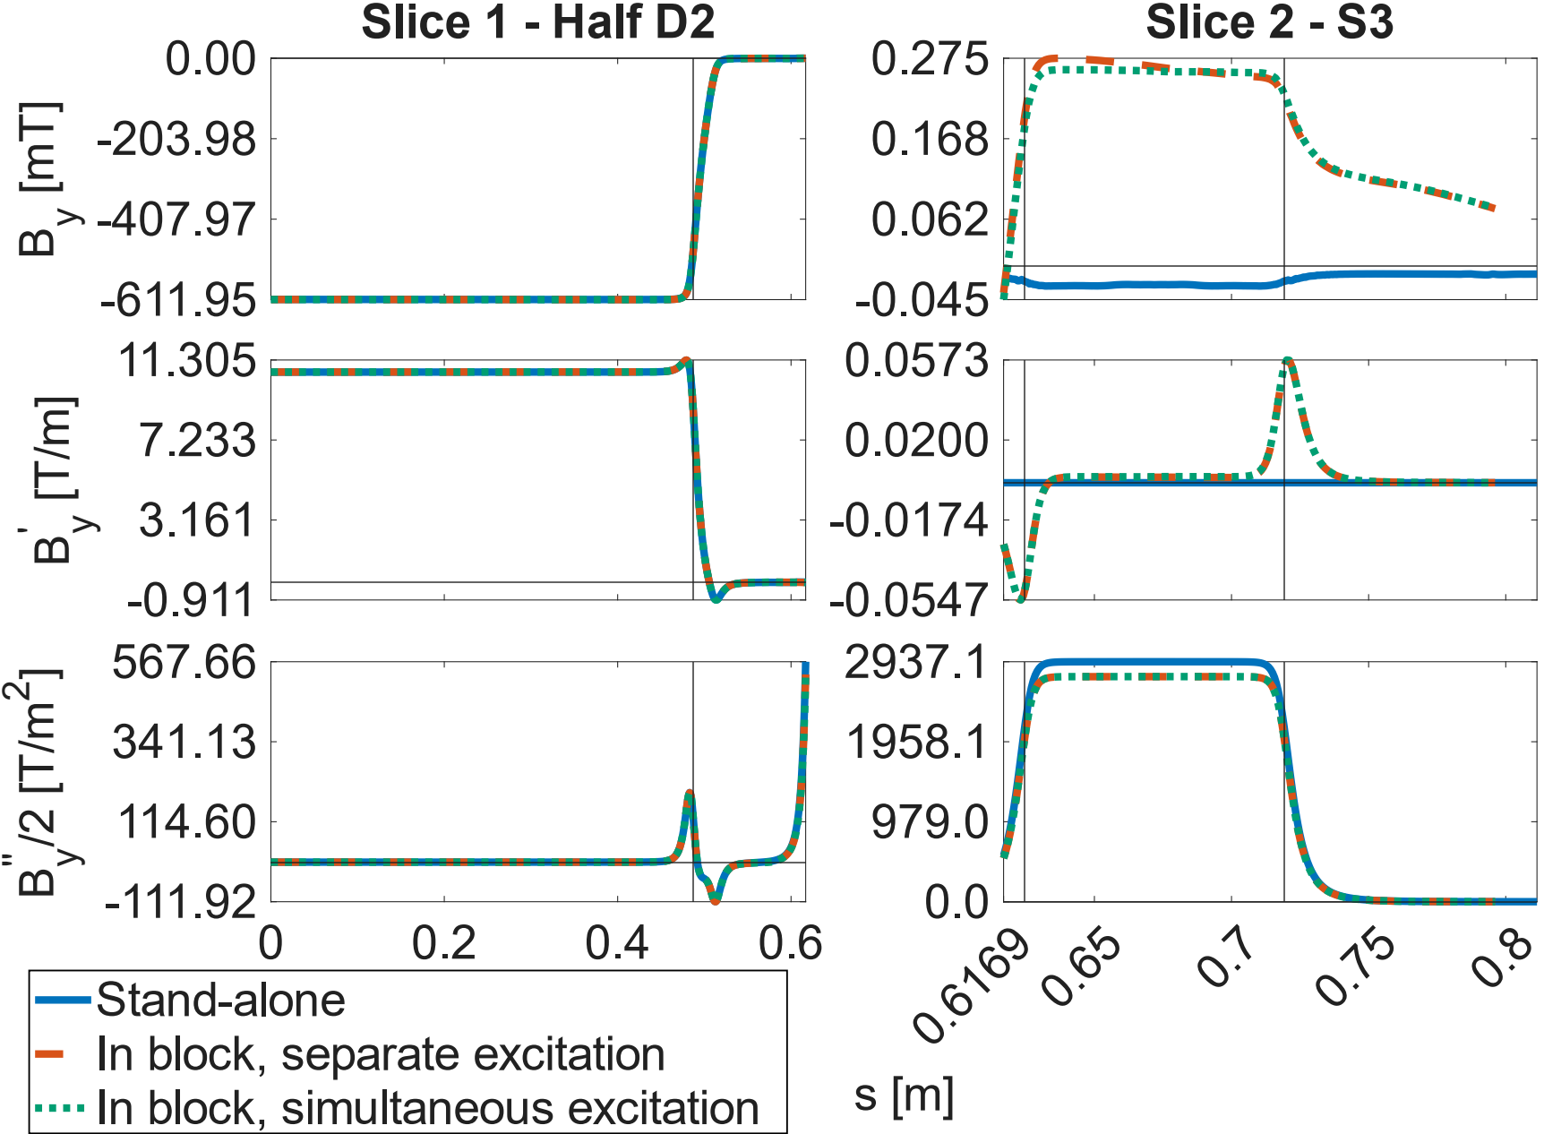
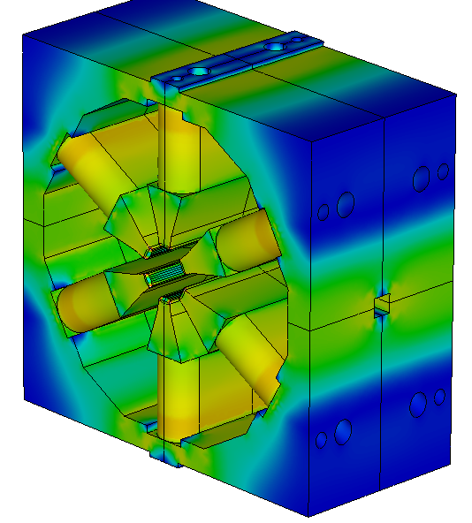
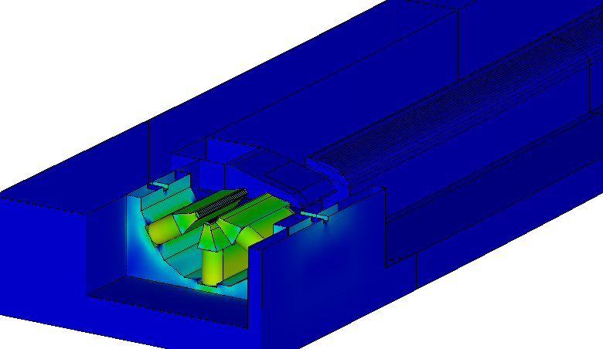
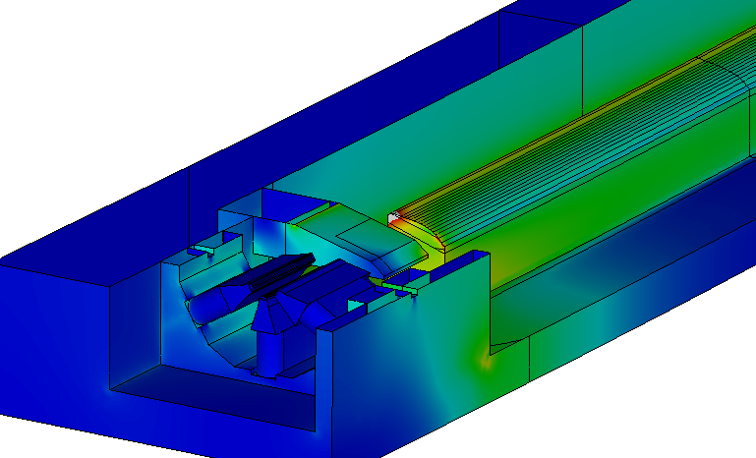
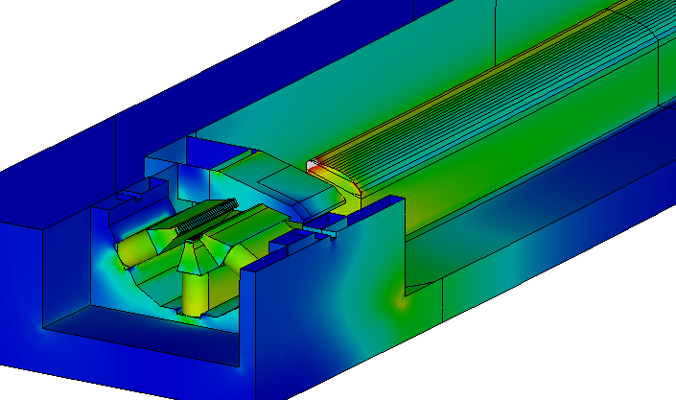
S3-D2-S3 Cross-Talk
x
y
z
integrated
33.74 μT m
b1=25 units
integrated 6.77 T/m
(2.3% of S3)
6.19%

Slide 22
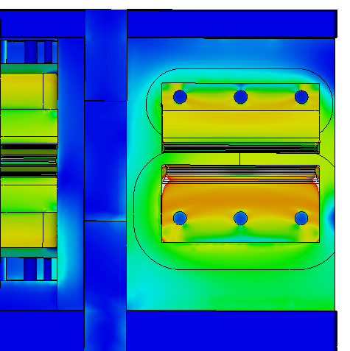
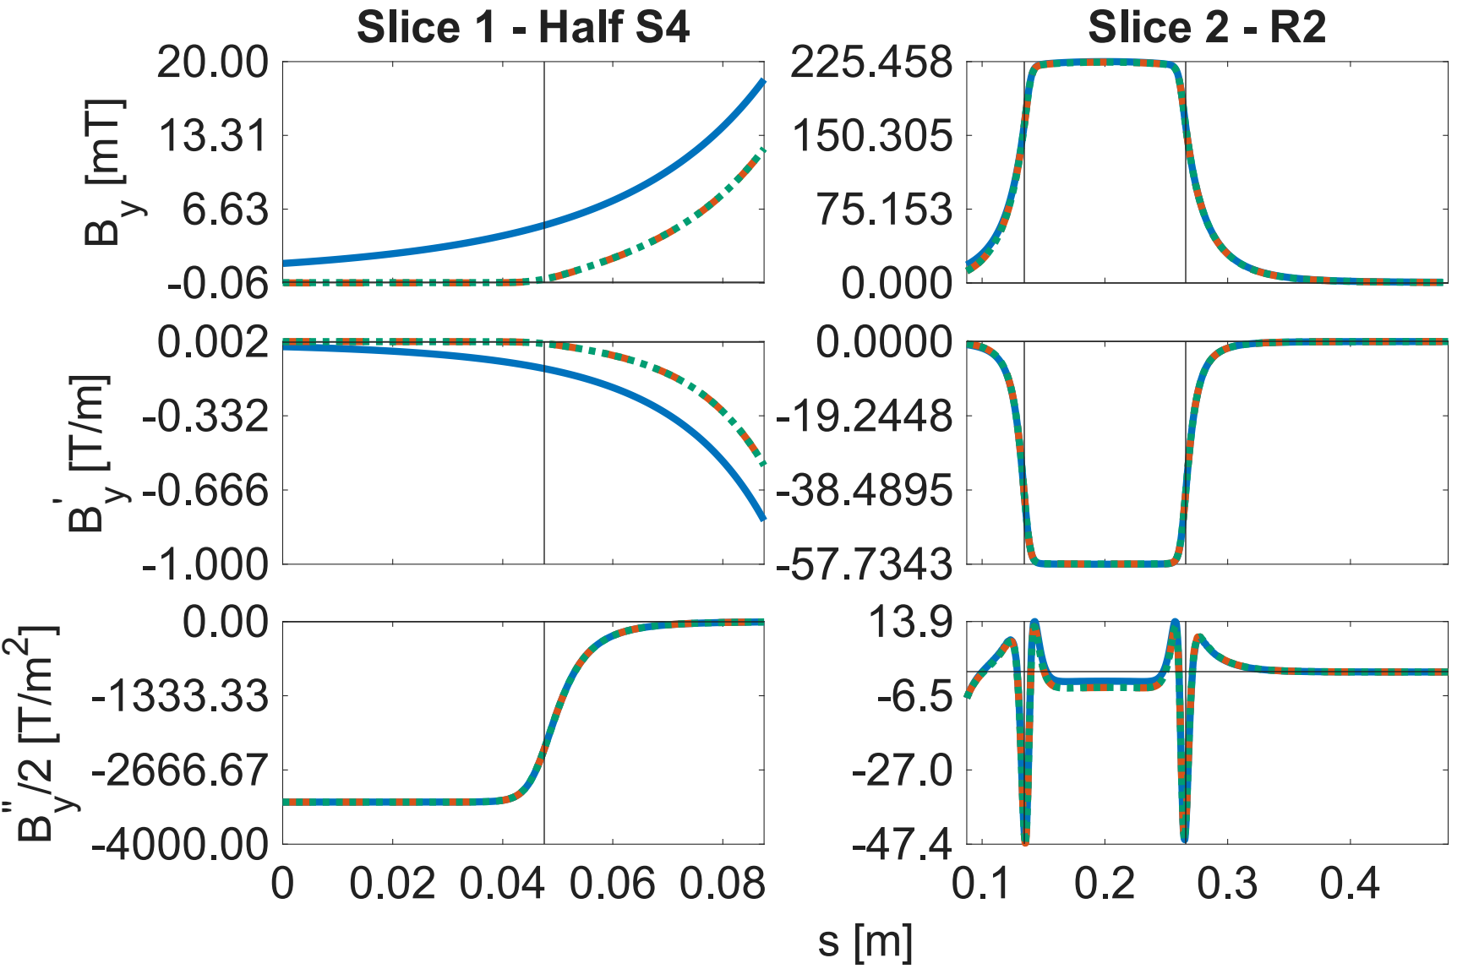
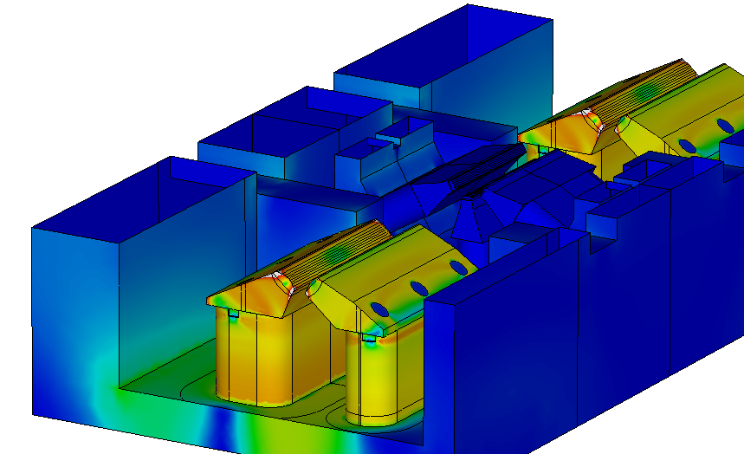
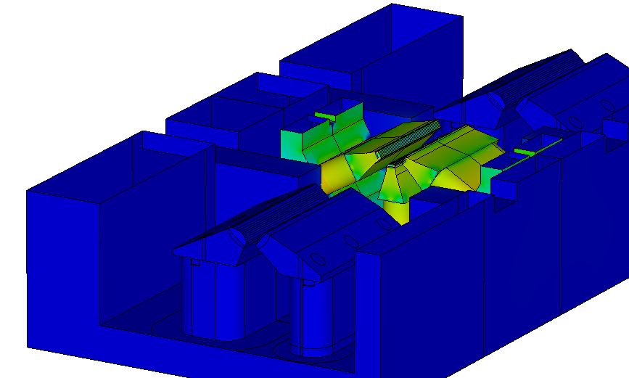
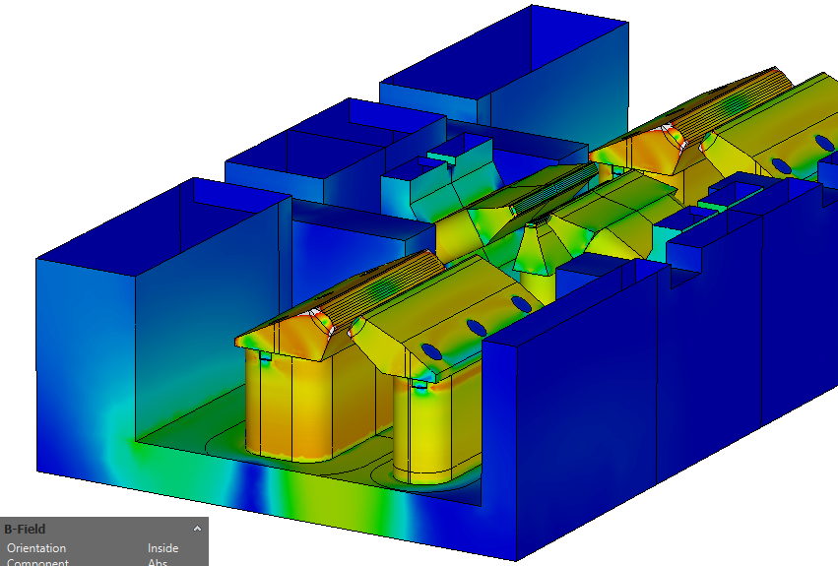
R2-S4-R2 Cross-Talk
x
y
z
1% R2 integr. B1
S4 b1=-216 units
0.16% R2 integr. G
S4 b2=55 units

Slide 23
Conclusions and Next Steps
Magnet designs for MAX 4^{U} have been presented that achieve the required strengths and satisfactory field quality.
Cross-talk effects have been identified as an important aspect of the design. The impact of the non-considered multipoles will be incorporated in the beam dynamics lattice model.
Next Steps
  Fine redesign of standalone models affected by the insertion in the block.
  Full block models (excitation level verification and crosstalk).

Slide 24
MAX 4^{U} Pulsed (Electro)Magnet
NSLS II-MAX IV workshop
5-6 Oct. 2026
Henrique Caiafa Duarte

Slide 25


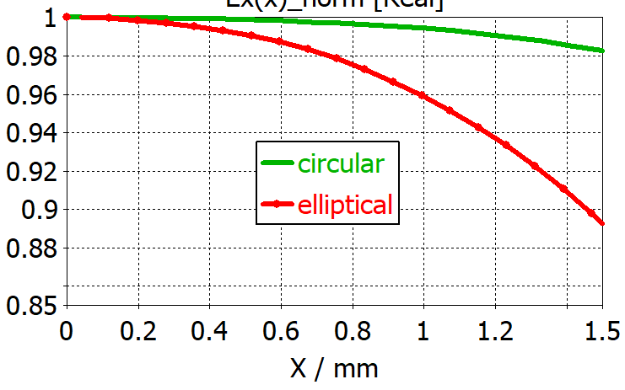
Fast Kicker Stripline
Analytical (parallel plates) stripline estimations for 8 modules: 15 cm length, 330 μrad kick / module, pulse flat-top duration > 1.2 ns.
Slotted circular and elliptical shape considered maximizes kick strength at the cost of transverse field flatness. Z_{odd}=50 Ω, Z_{even}=~57 Ω
Next steps: fine-tuning 2D cross section, 3D simulations (High frequency, Wakefield)
Parallel plates
Circular (φ9mm)
Elliptical
Field flatness @ horizontal plane
12x4
12x4
12x4
Ex(y=0) / normal. units
20 kV
14.0 kV
10.2 kV

Slide 26
Fast Kicker Pulser
Slide by Carl Järmyr Eriksson

Slide 27
Complementary Material

Slide 28
Magnet Parameters
With 10% safety margin for the most stringent MAX 4^{U} magnets, where T_{rise} is calculated for 2 bar water pressure drop and 2 cooling circuits per magnet (exception is 4 for Q1). In parenthesis is the corresponding R3 lattice magnet.
Parameter | D2 (DIP) | Q1 (QFend) | R2 (QF) | S4 (SFo)
Integrated Strength | 0.607 (0.524) T m | 13.02 (10.06) T | 9.079 (6.654) T | 364.4 (191.53) T/m
 | -10.511 (-8.537) T |  | -39.46 (0) mT m
Magnetic Length [mm] | 991.9 (998.1) | 243.3 (243.3) | 142.5 (143.2) | 102.1 (103.4)
 | 983.4 (987.3) |  | 157.5 (NA)
Inom [A] | 141.9 (121.6) | 118.7 (73.9) | 146.7 (74.4) | 100.3 (66.1)
Bore radius [mm] | 13.50 (14.00) | 12.50 (12.50) | 14.84 inner, 9.60 outer (12.50) | 12.50 (12.50)
# of Turns/coil | 54 (54) | 29 (39) | 43 inner, 18 outer (39) | 19 (15)
Efficiency [%] | 94.3 (98.0) | 96.7 (89.1) | 88.4 (79.6) | 97.0 (96.8)
Temperature rise [degC] | 8.15 (5.98) | 6.39 (11.34) | 14.85 (8.91) | 8.96 (2.98)
Power/magnet [W] | 1701.3 (1238.9) | 975.1 (511.8) | 1003.9 (514.6) | 468.7 (168.1)

Slide 29
D2 Dipole Design
D2 required modification only on the pole profile (new By/G ratio)
Pole-face strips are designed in 2D

Slide 30
D2 Dipole Performance
Parameter | D2 (DIP in R3)
Integrated Strength | 0.607 (0.524) T m
 | -10.511 (-8.537) T
Magnetic Length [mm] | 991.9 (998.1)
 | 983.4 (987.3)
Inom [A] | 141.9 (121.6)
Bore radius [mm] | 13.50 (14.00)
# of Turns/coil | 54 (54)
Efficiency [%] | 94.3 (98.0)
Temperature rise [degC] | 8.15 (5.98)
Power/magnet [W] | 1701.3 (1238.9)

Slide 31
S3, S4 Sextupoles (and S1, S2) Design
Design unification – Same core design for all families
  Same coil geometry for S4 and S3
  Same coil geometry for S1 and S2
Compared to R3 designs, pole tips were narrowed from 10 to 7 mm and roots widened from 10 or 20 to 24 mm.
Trim coils specs kept from R3 sextupoles (44 A.turns)
B[T]
2
1.8
1.6
1.4
1.2
1
0.8
0.6
0.4
0.2
0
S4

Slide 32
S3, S4 Sextupoles (and S1, S2) Performance
Parameter | S4 (Sfo in R3)
Integrated Strength | 364.4 (191.53) T/m
Magnetic Length [mm] | 102.1 (103.4)
Inom [A] | 100.3 (66.1)
Bore radius [mm] | 12.50 (12.50)
# of Turns/coil | 19 (15)
Efficiency [%] | 97.0 (96.8)
Temperature rise [degC] | 8.96 (2.98)
Power/magnet [W] | 468.7 (168.1)

Slide 34
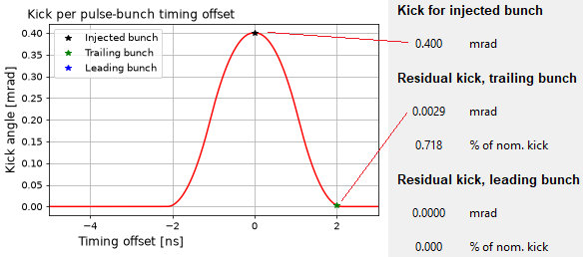
Program input:
Discrete voltage pulse waveform, along with stripline parameters.
(The values in this column are per module at the moment)
Program output:
Kick as function of pulse-to-bunch timing offset.

Slide 35
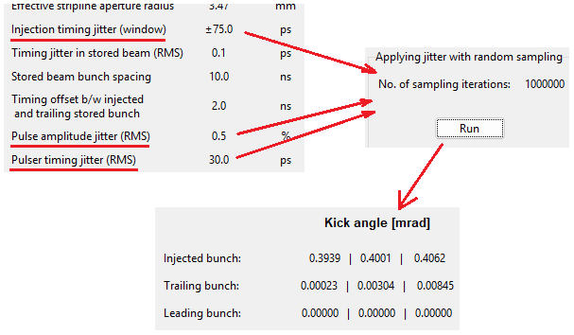
Implementation of jitter parameters:
Intervals for timing and amplitude jitter are given as input.
X no. of kicks are calculated with random samples of pulse timing and amplitude.
Output is 3-sigma interval and mean of the resulting kick distributions, per respective bunch.

