Slide 1
Complex Bend PMQs Magnets development for NSLSII-U
NSLS II- MAX IV Workshop: Fourth and Future Generation Light Source Design Challenges
P. N’Gotta
5-6 October 2026

Slide 2
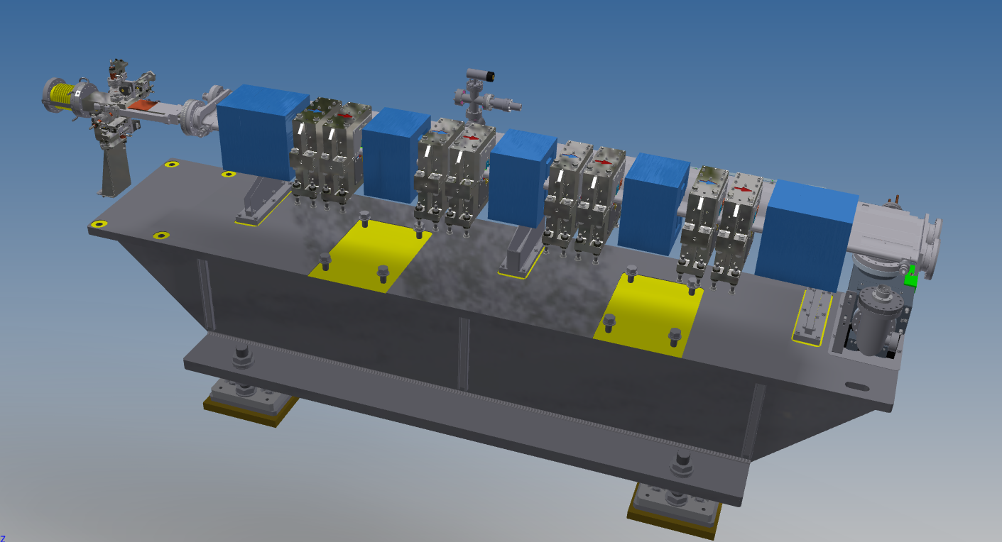
Outline
Trend in magnet for new accelerators
Historical and recent application of PM technology
NSLSII-U: Complex Bend lattice and Magnets
Development of Halbach PMQ
  Magnetic design
  Prototypes measurement
  Field harmonics correction
Development of hybrid PMQ
  Magnetic design
  Prototype measurement
  Cross-talk, tuning, alignment
8 Poles corrector, NLK designs
Conclusion

Slide 3
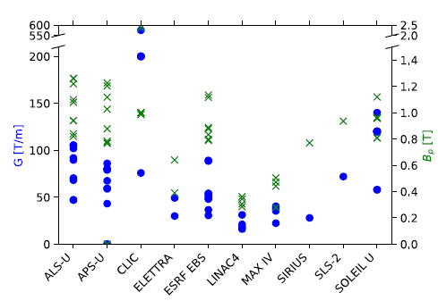
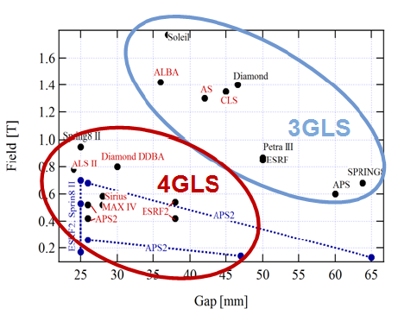
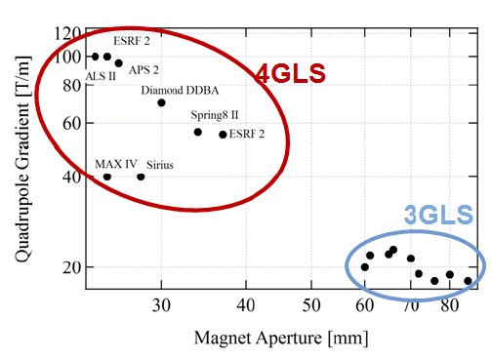
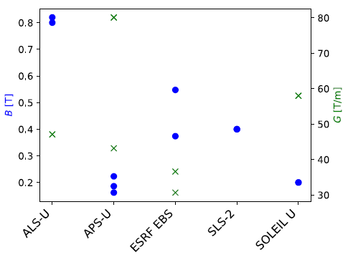
Trend in Magnets Field Requirements
Quadrupole Magnets
Dipole Magnets
Quadrupole Magnets
Dipole-Quadrupole
(courtesy J. Chavanne, DLSR 2013)
New generation accelerators requirements:
Low field dipoles
High gradient quadrupoles
Combined function field+ higher order
Small bore aperture
PM technology more suitable
(courtesy P. Schnizer)

Slide 4
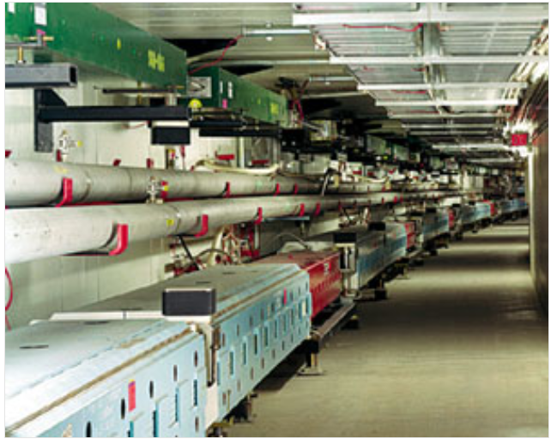
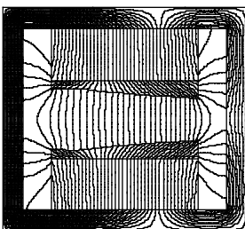
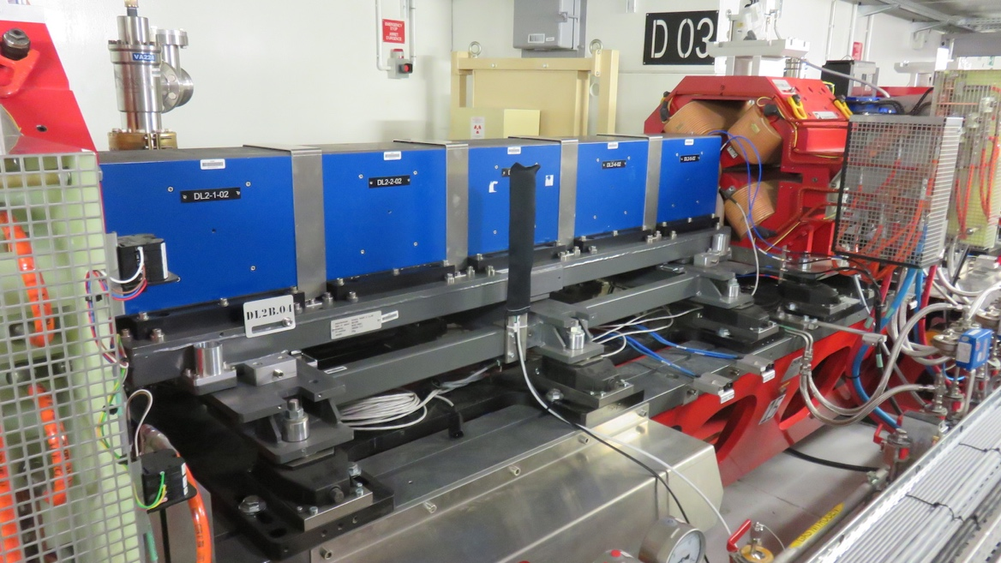
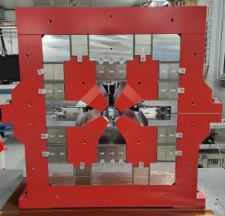
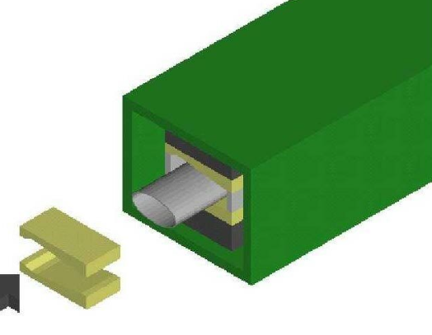
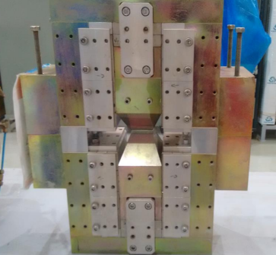
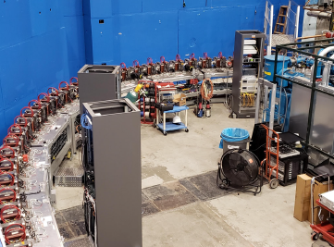
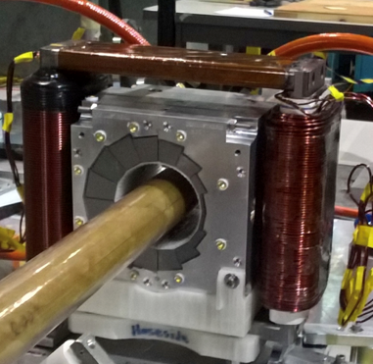
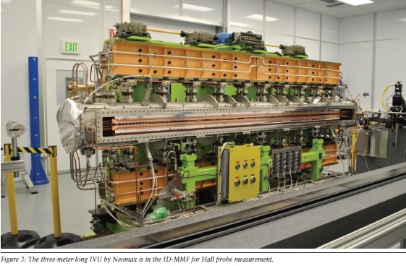
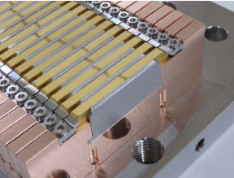
Historical and Recent use of PM in Accelerators
Fermilab Recycler ring
PM for recent accelerator upgrade
First accelerator with use of PM
Low field magnet
Strontium Ferrite PM (cheap)
Temperature compensation of PM
PM dipoles, ESRF-EBS
PM quadrupoles SLS-II
(G.W. Foster et al.)
Insertion Devices
Massive use of PM for ID
SmCo, NdFeB, PrFeB PM material
In-air, In-Vacuum, Cryogenic designs
Mature technology, >30 years experience
PM superbend, LNLS
CEBAF accelerator at Cornell
Halbach PMQ
Use of PM technology for different type accelerators (light source, SP accelerators, collider)
Hybrid and Halbach designs
Dipoles, quadrupoles, magnets

Slide 5
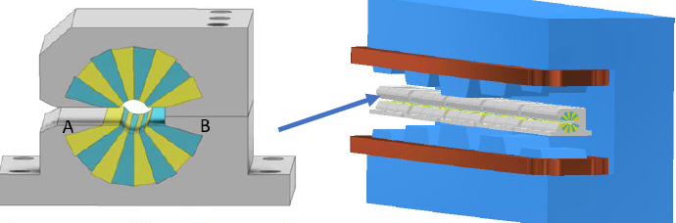
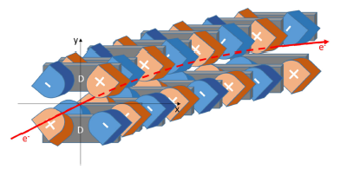
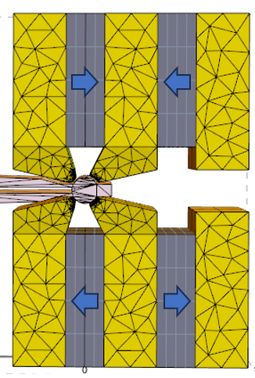
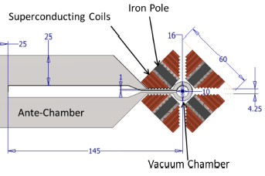
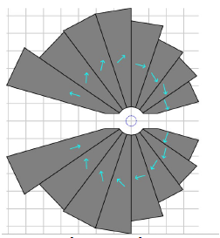
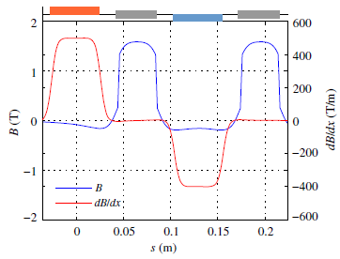
NSLSII-U Complex Bend Lattice Magnets
History of Complex Bend development
T. Shaftan et al., Complex Bend II, BNL-211223-2019-TECH, Oct 2018
T. Shaftan, Methodology for designing Complex Bend lattice, BNL-223858-2023-TECH, Jan 2022
Complex Bend concept
(Interleaved dipoles and quadrupoles)
Decoupled Dipole-Quadrupole magnets (B=0.25-0.5 T, G=±250T/m)
G. Wang et al., PRAB 22,(2019)
  A magnet consisting of many poles: bending and strong focusing
  Keeping the beta functions and dispersion oscillating at low values
  resulting in low emittance
  A compact design provides more space for insertion devices and other components
Combined Function Dipole-Quadrupole PMQs (B=0.25-0.5T, G=±130T/m)
Superconducting magnet design (B=1.05T, G=500T/m)
G. Wang et al., PRAB 21,(2018)
Halbach type
Hybrid type
S. Brooks et al., PRAB,(2020)
P. N’Gotta et al., PRAB,(2016)

Slide 6
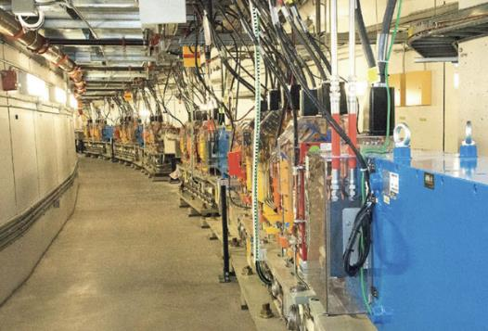
Bend Lattice Magnets Specifications and Projects
(1) NSLSII- accelerator Upgrade
(2) Complex Bend test in linac
Focusing: 0.25 T ; 130 T/m
Defocusing: 0.5 T ; -130 T/m
Bore diameter: 16 mm
GFR: ±3 mm
Field harmonics: ≤10 units
(3) Complex Bend test in cells 13 &14
Focusing: 0.38 T ; 60 T/m
Defocusing: 0.66 T ; -53.8 T/m
Bore diameter: 24 mm
GFR: ±9 mm
Field harmonics: ≤10 units
Install and test CB lattice with PMQS (FY28)
Characterize and validate CB lattice performances
Demonstrate PMQs magnetic performance (strength, field quality, alignment)
Demonstrate PMQs radiation resistance

Slide 7
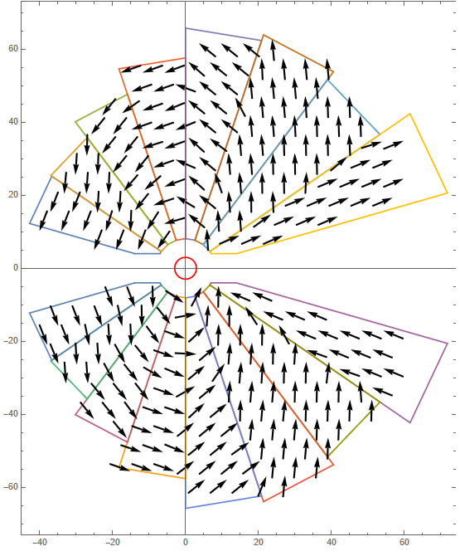
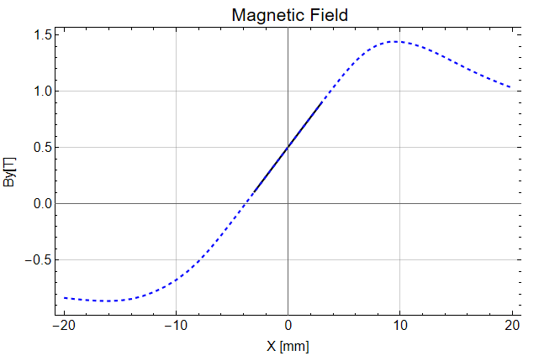
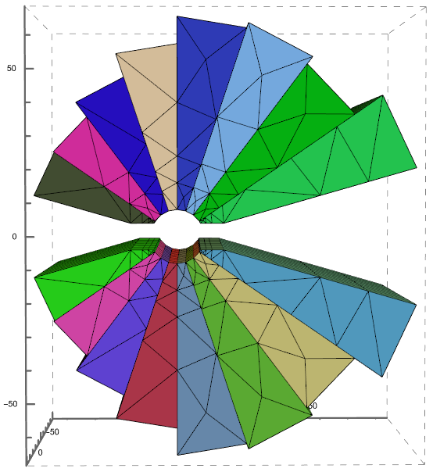
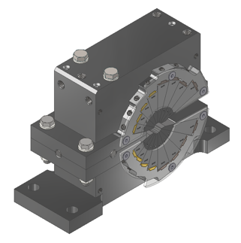
Halbach PMQ Development- Magnetic design
First magnetic design
PM wedges magnetization
132 mm
Bore diameter: 16 mm
G=130 T/m; B=0.5 T
Harmonics: ~10 units
185 mm
Compact Design
Good Field Quality
Similar to CBETA magnets
113 mm
(courtesy S. Brooks)
Large sensitivity to errors
Magnetic correction?
In-House prototype

Slide 8
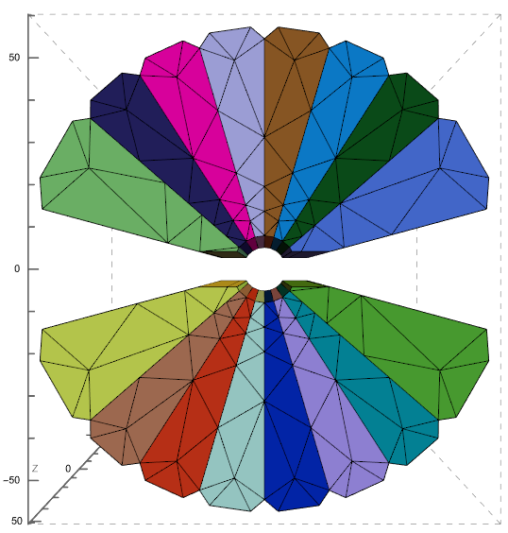
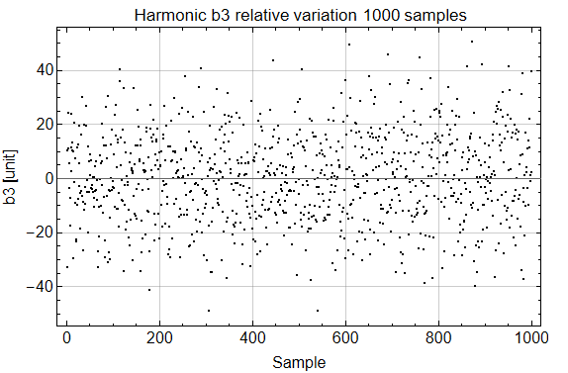
Halbach PMQ Development- Sensitivity to errors
New magnetic design
Sensitivity to PM errors
1000 Simulations
Random errors in model
Impact on harmonics
118 mm
Errors type and range
Br: ±1 %
Angle: ±1.5 degree
Geometry: 100 um
Errors impact on sextupole component
118 mm
Similar magnetic performance & PM volume
Regular wedges dimensions
Simpler mechanical design
Larger space for vacuum chamber
Expected field quality after assembly
Design: 10 units
Errors: 25 units
Total: 35 units (5 units specification)

Slide 9
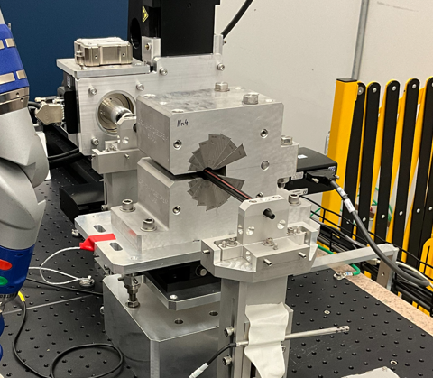
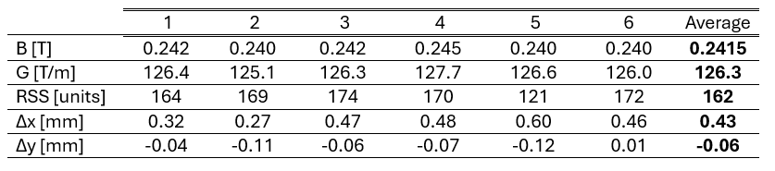
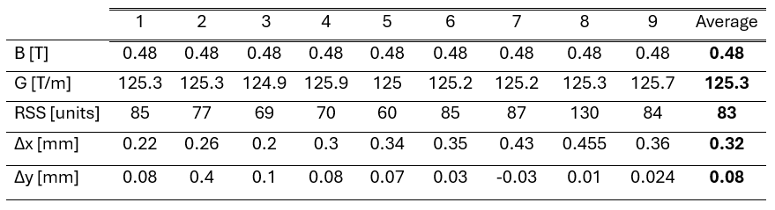
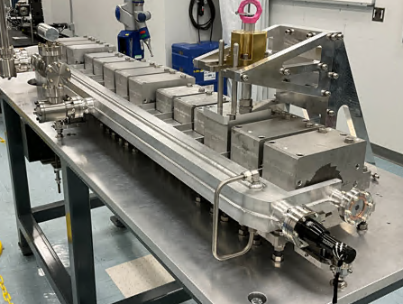
Halbach PMQ Development-Prototypes Measurement
Focusing PMQs measurement
Defocusing PMQs measurement
PMQ on rotating coil bench
1 PMQ assembled in-house
15 PMQs procured from Vac Magnetics company, 9 defocusing and 6 focusing.
Magnetic measurement with high precision rotating coil bench (0.1-unit precision)
Field and gradient close to specification
Harmonics RSS of 80 units in average (rebuilt PMQs)
Harmonics RSS of 50 units at best (rebuilt PMQs)
Wedges with brackets will improve field quality after assembly
Full scale CB PMQs assembly with vacuum chamber

Slide 10
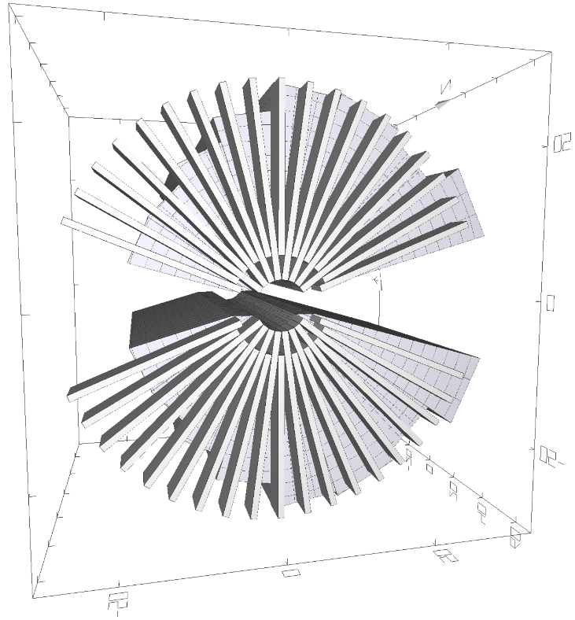
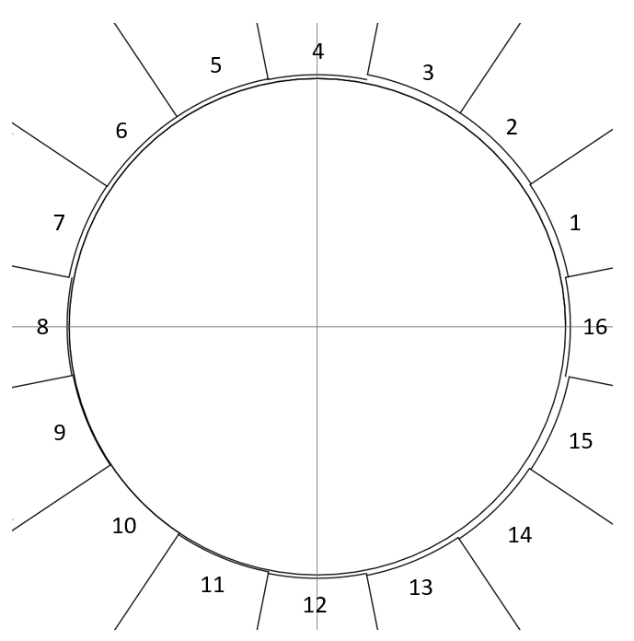
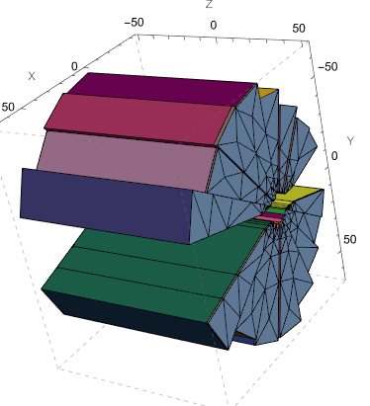
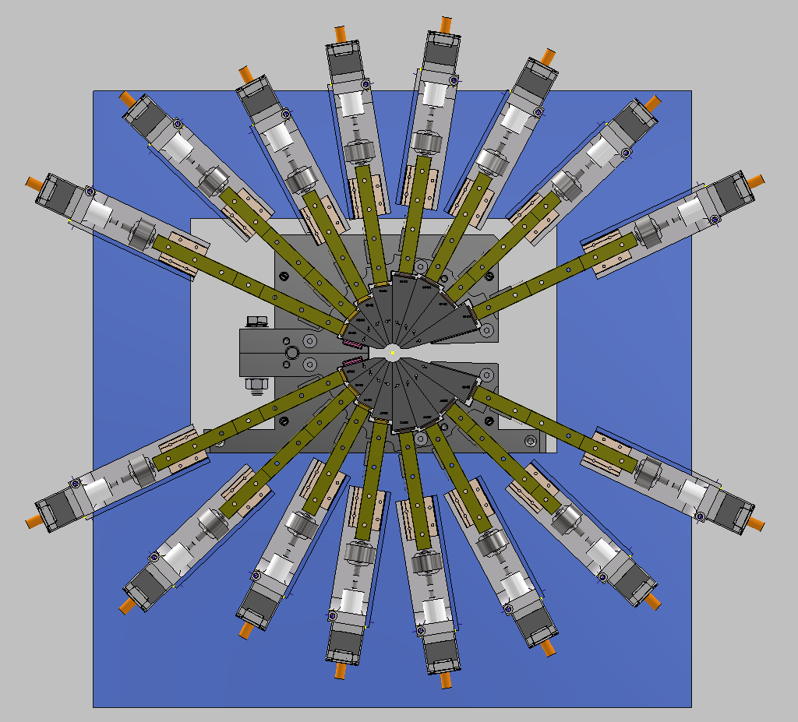
Halbach PMQ Development- Harmonics correction
“Magic” Fingers
Inner bore machining
Wedge radial adjustment
Iron Shim
Presented by S. Sharma
O.Chubar (PI)
Several field harmonics correction method for Halbach PMQ
Correction capability of 150 units (100 units requirement)
Radial adjustment method adapted for large scale correction

Slide 11

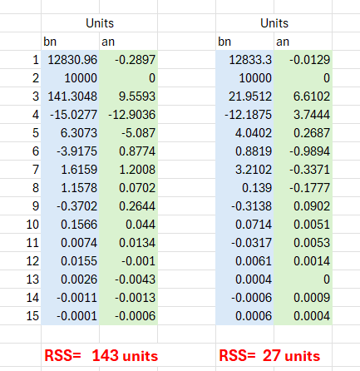
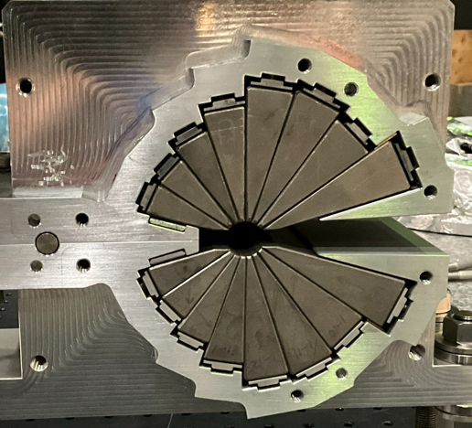
Halbach PMQ Development- Harmonics correction
Correction profile calculated with measurement and magnet model
~ 1 mm thickness machining
Wire EDM method with ~15 µm precision
Correction of >100 units harmonics
Method equivalent to wedge radial adjustment method
Inner bore profiling with wire EDM
Measurement results
Initial
Correction
Calculated bore profile correction
(~ 1 mm machining)

Slide 12
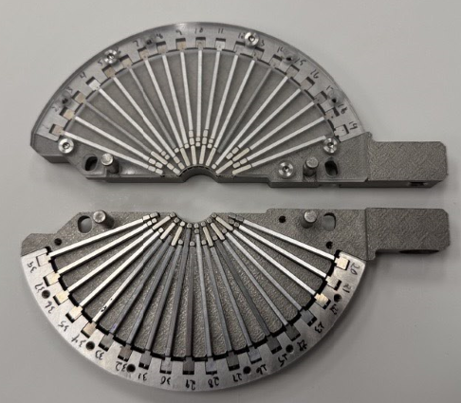
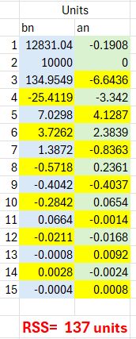
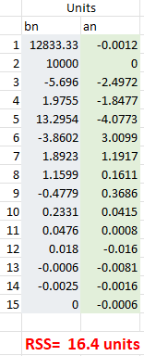
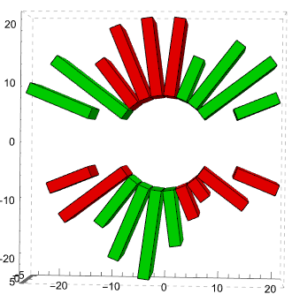
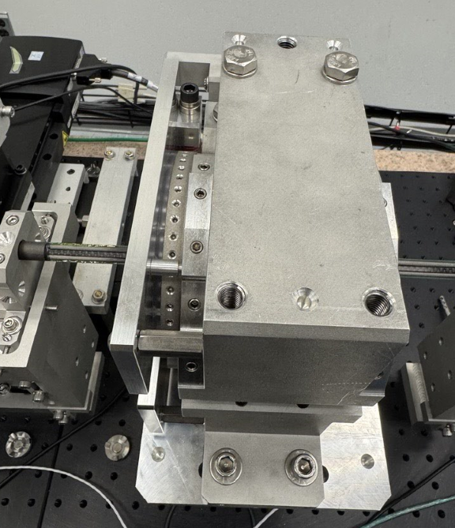
Halbach PMQ Development- Harmonics correction
“Magic Fingers”
Discrete stack of PM assembly (2 mm)
PM radial length and magnetization direction modulated
15 mm longitudinal length
Correction of >100 units harmonics
Measurement results
Initial
Correction
Magic finger assembly and installation on the PMQ

Slide 13
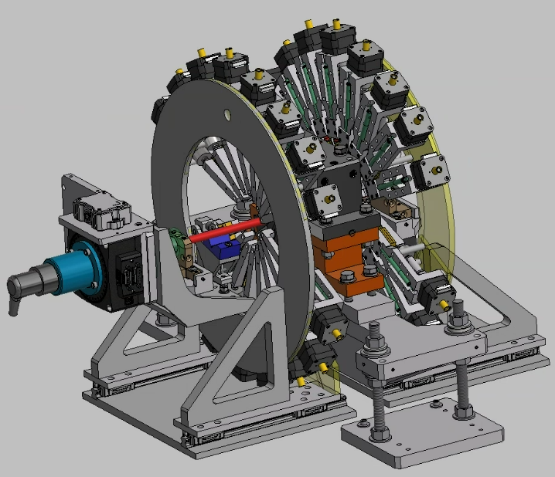
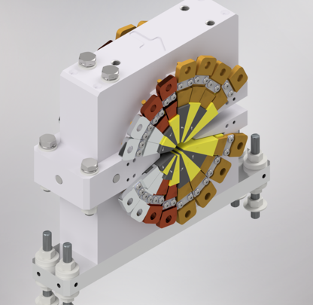
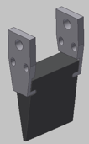
Halbach PMQ Development- Harmonics correction
PM wedges radial adjustment correction system
PM wedges radial adjustment
32 actuators
±500 µm PM wedge radial displacement
150 Units correction capability
Large scale PMQ correction (2700 PMQs)
Expected ~ 1 hour for PMQ tuning
Mechanical design (M. Breitfeller)
PM wedge with aluminum Brackets
PMQ Design

Slide 14
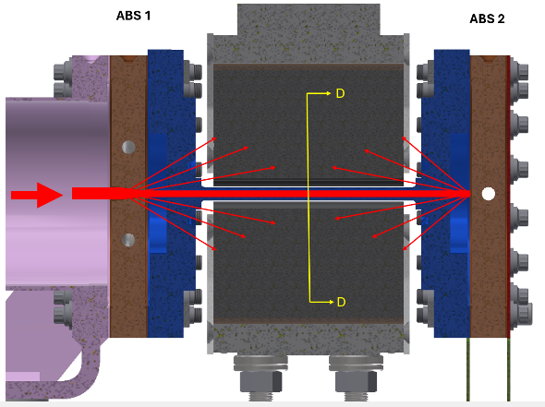
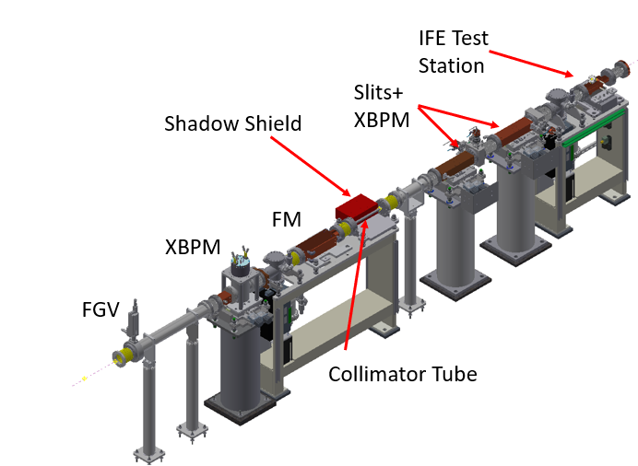
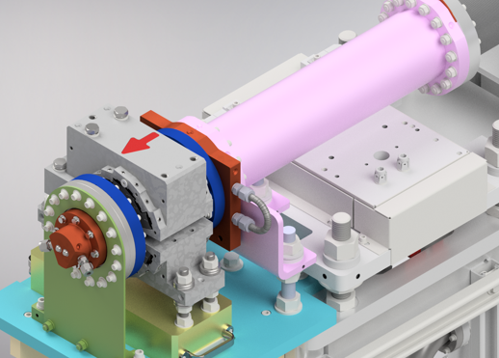
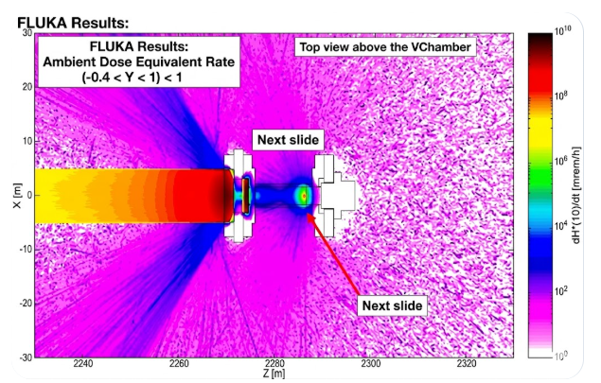
Halbach PMQ Development- PM Radiation Resistance
Sm2Co17 PM choice for radiation hardness
Magnet long term radiation exposure test
Magnetic field change will be measured
Radiochromic (FWT-60-20F) films for radiation dose measurement
X-ray and neutron radiation resistance test planned
US and DS Absorbers
X-ray scattering in the PMQ
(courtesy T. Roff, R. Todd)
Instrumentation Front End (IFE)
Test Setup in IFE
PMQ
Fluka simulation for radiation dose
(courtesy J. Saraiva)

Slide 15




Hybrid PMQ Development- Magnetic Design for NSLSII-U
Defocusing magnet
G=-130 T/m ; B= -0.5 T
Bore aperture: 16 mm
PM SmCo, Br=1.17 T
Material pole& yoke: Low carbon Iron
Material pole tip (right): Iron-Cobalt
Optimized poles profiles
B=-0.5 T @ X=0.7 mm
200 mm
134 mm

Slide 16
Hybrid PMQ Development- Design for Cell replacement project
Magnets Specifications
Focusing: 0.38 T ; 60 T/m
Defocusing: 0.66 T ; -53.8 T/m
Bore diameter: 24 mm
GFR: ±9 mm
Field harmonics: ≤10 units
202 mm
202 mm
267 mm
173 mm
144 mm
122 mm
Pure Dipole
Defocusing
Focusing
  Project: Install and test CB lattice with PMQS (FY28)
  Similar hybrid-based design
  Similar Bmax at pole tip (~1.3 T)
  Field strength and field quality achieved
  Mechanical design finalized
Cell CB assembly layout

Slide 17






Hybrid PMQ Development- Cross-talk
B
BQF
BQD
B
5 cm
3 cm
5 cm
Dipole and quadrupole components along the PMQ assembly
Cross-talk: magnetic interaction between the magnets
Create field and gradient deviation from initial setting
1
2
3
4
Cross-talk mitigation
Field-gradient adjustment
Increase space between the magnet (space constraint)
Chamfer on poles extremity (moderate effect, strength reduction)
Correct with field adjustment system (limited capacity)
Compensate cross-talk in the PMQs design
Up to 2.6 % field variation
Up to 2.8 % gradient variation
Dipole and quadrupole errors cause by cross-talk

Slide 18



Hybrid PMQ Development- Alignment
Cell CB PMQs alignment on the curved trajectory
Alignment strategy
  Match each PMQ integrated strength (field, gradient) with hard edge model integrated strength
  Each PMQ: zero output angle, residual output trajectory error (local field difference with ideal field)
  Align PMQs axis to ideal trajectory
  Simulation: trajectory, close orbit, tune, twiss function
  Adjust PMQs strength and alignment
  Trajectory error < +/- 100 µm
Ideal field and PMQs field along the trajectory
(See Minghao’s-Ihar’s presentation)

Slide 19





Hybrid PMQ Development- First Inhouse Prototype
Measurement results
Prototype results
Initial
Corrected
Field and gradient strength achieved
Field quality of 10 units achieved after correction with iron shim
PM remanence below 5% of specification
Poles material saturation below specification (ASI1006 and cobalt-iron)
Prototype improvement
Mechanical improvement
Use same material for the poles
Implement temperature compensation
Inhouse hybrid PMQ prototype on the measurement bench

Slide 20



Hybrid PMQ Development- Gradient Tuning
PM design: lack of tunability
Ideally: +/-5 % gradient tuning
Solution: tuning with moveable soft iron plate
Plate mounted on a translation stage
4% gradient tuning achieved (x2 possible)
Low harmonics variation (< 5 units)
Dipole variation (4%) compensated with horizontal stage
Simple and robust solution for remote tuning
Soft iron plate
Translation stage
Measurement
Gradient vs Plate position

Slide 21



8 Poles Multipoles corrector
Correct residual magnetic error (field strength, alignment)
Located upstream and downstream of CB element
Efficient design for short longitudinal space (no coil extremity)
Normal-skew multipoles from N=1 to N=4 (dipole-octupole)
Independent control of each multipoles
10 power supply (2 A)
Mechanical design finalized, Prototype in assembly
300 mm
Generated multipoles
300 mm
50 mm
Mechanical design
Test Coil

Slide 22






Prototype a Novel NLK Injection System for NSLSIIU: Enhance NSLS-II Performance
NLK installation Layout at ID2 upstream
Xi Yang et al.
  Beam-dynamics determine
  Optimal NLK location at the NSLSII and injected trajectory
  Feasible eight-wire NLK design
  Optimized wire geometry satisfies stored-beam transparency, aperture, pulsed-power, mechanical, and fabrication constraints
  Prototype engineering requirements include
  Pulsed-power stability, vacuum integration, mechanical tolerances,
  controls, diagnostics, and protection requirements established
Summary:
We have to overcome integration challenges
Perform beam validation at NSLS-II: Commission the prototype with beam, demonstrating pulsed-field performance, trajectory control, and injection performance
Pulsed power circuit
Injected beam oscillation reduction
22
22
0

Slide 23
Conclusion
Validated magnetic designs of Halbach and hybrid PMQs for the NSLS-IIU
15 Halbach PMQs procured from Vac Magnetics and 1 PMQ assembled in-house
Halbach PMQ updated design with harmonics correction
A hybrid PMQ prototype built and assembled in-house
Test of complex bend concept in NSLS-II ring with hybrid PMQs
Radiation resistance study of Sm2Co17 PM
Accurate magnets assembly alignment and measurement on curved trajectory
Production of 2700+ PMQs for NSLSII-U

Slide 24
Acknowledgements
Contributors:
BNL/NSLS-II:
S. Sharma, T. Brookbank , M. Breitfeller, S. Brooks, O. Chubar, F. DePaola, L. Doom, R. Faussete, R. Gambella, B. Holland, P. Joshi, A. Khan, B. Kosciuk, M. Musardo, D. Padrazo, B. Parker, M. Seegitz, T. Shaftan, V. Smalyuk, C. Spataro,, C. Stelmach, T. Tanabe, R. Todd, G. Wang, T. Yuke, T. Roff, A. Caruso
ANL/APSU: C. Doose, A. Jain, M. Jaski
FermiLab: J. DiMarco

