Slide 1
Emittance Diagnostics
NSLS II-MAX IV workshop
5-6 Oct. 2026
Jonas Breunlin on behalf of the MAX IV diagnostic beamlines team

Slide 2
Outline
Intro : the MAX IV bending magnet diagnostic beamlines
Transverse and longitudinal beam diagnostics today
Towards MAX4^{U}: resolving smaller horizontal beam sizes
Optics components degradation

Slide 3
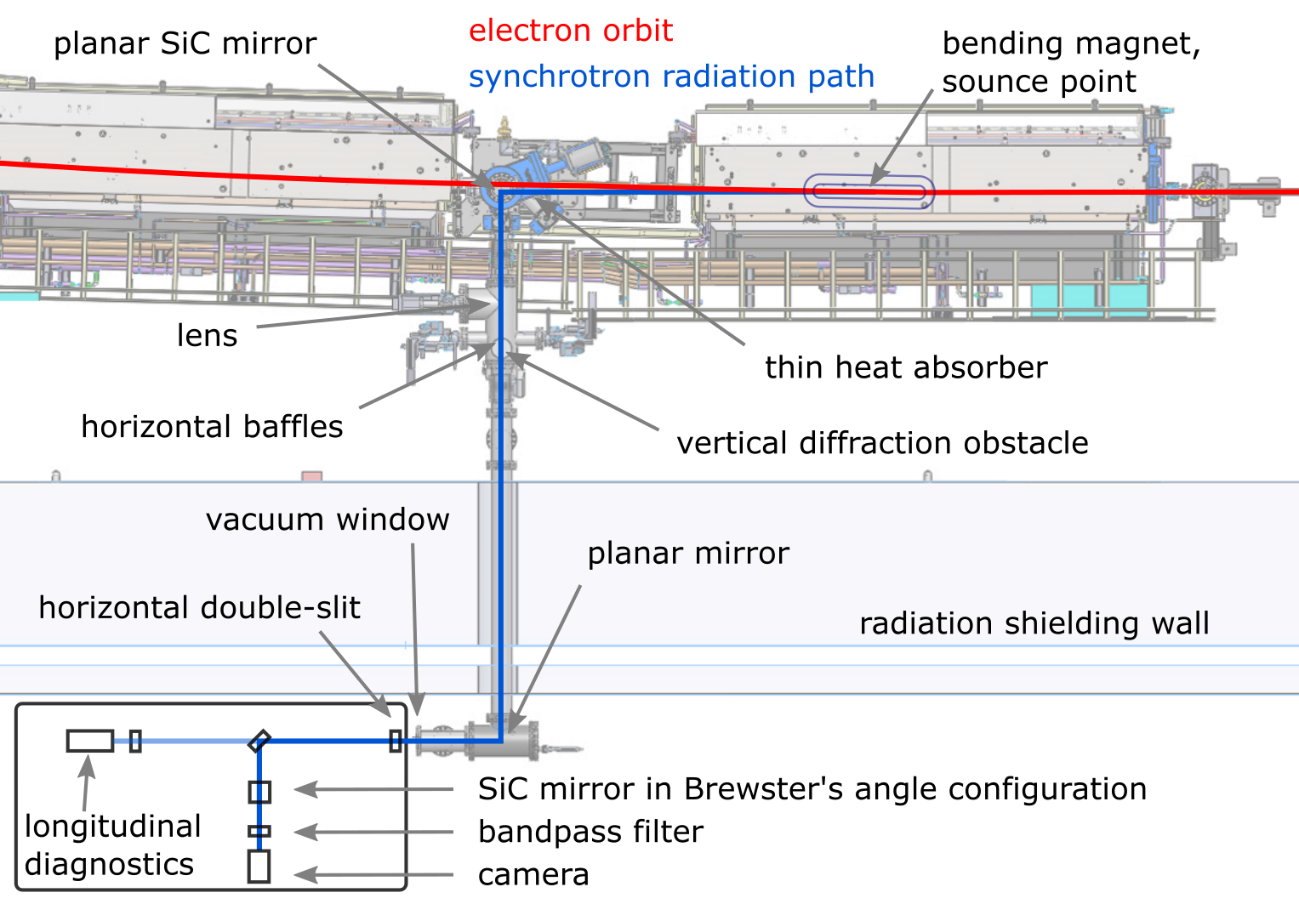
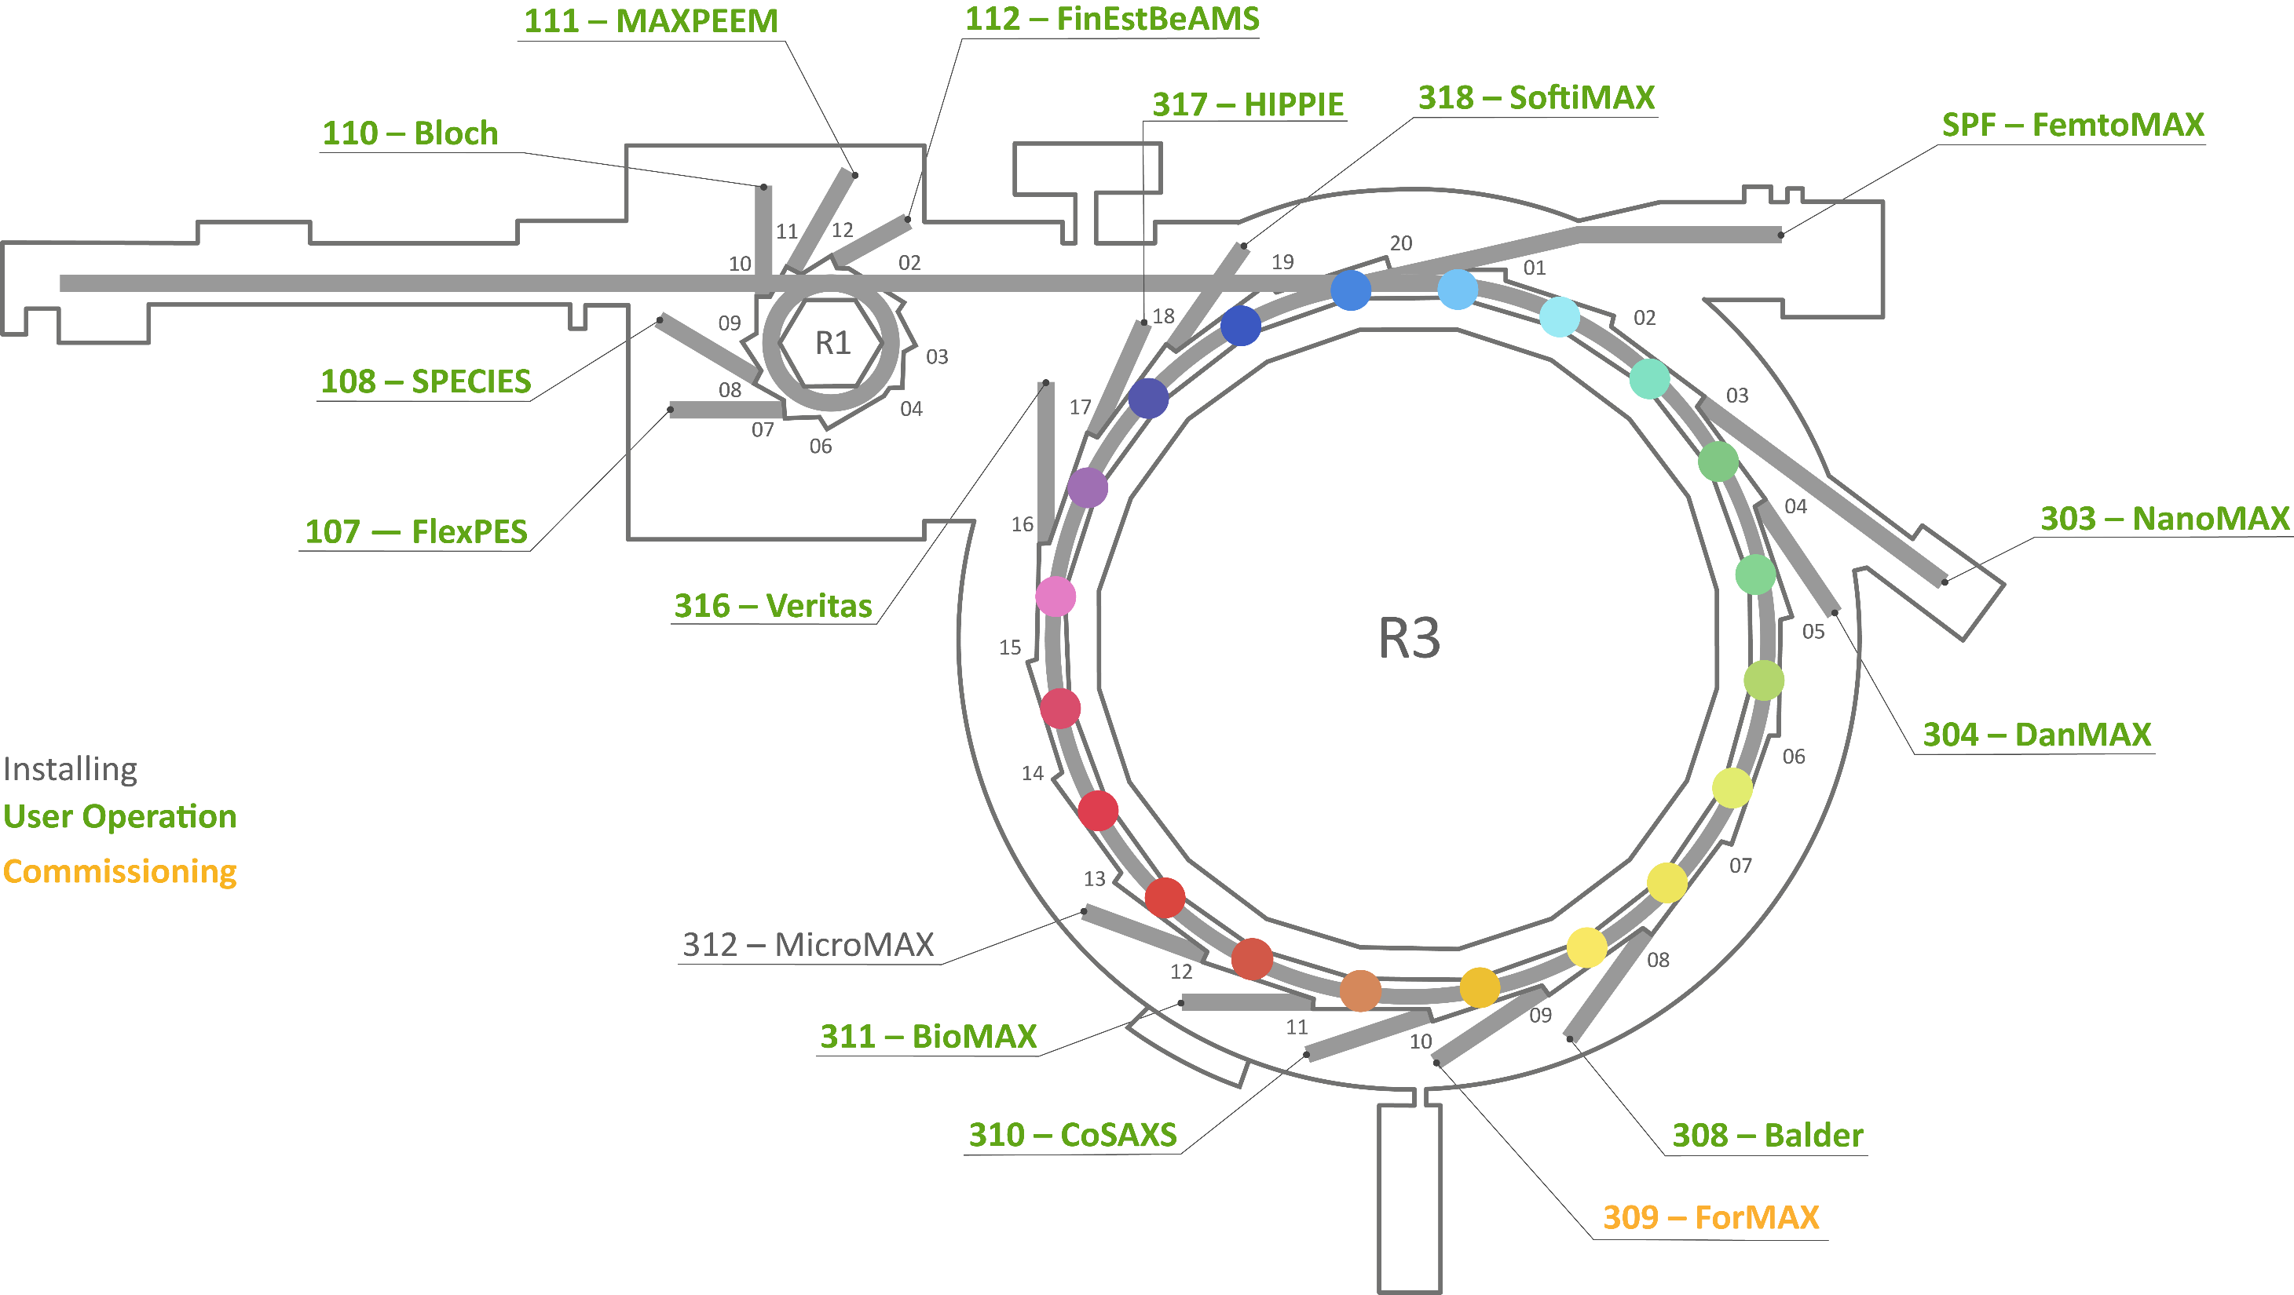
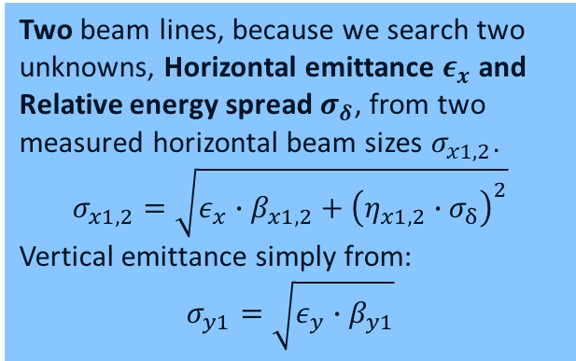
Overview: bending magnet diagnostic beamlines at MAX IV
Two beam lines, because we search two unknowns, Horizontal emittance $ε_{x}$ and Relative energy spread $σ_{δ}$, from two measured horizontal beam sizes $σ_{x1,2}$.
$$σ_{x1,2}=\sqrt{ε_{x}∙β_{x1,2}+{\left(η_{x1,2}∙σ_{δ}\right)}^{2}}$$
Vertical emittance simply from:
$$σ_{y1}=\sqrt{ε_{y}∙β_{y1}}$$
Bend magn diagBLs:
B320B & B302B

Slide 4
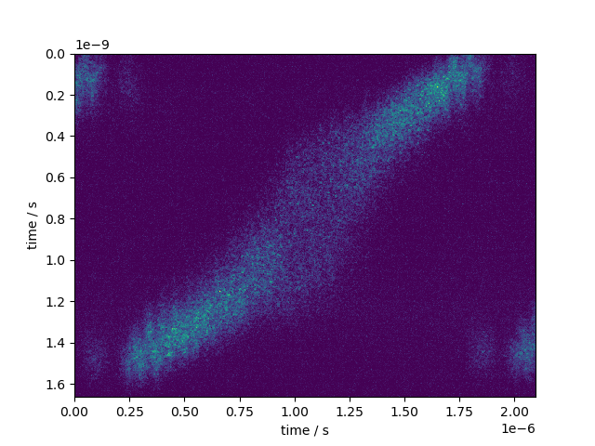
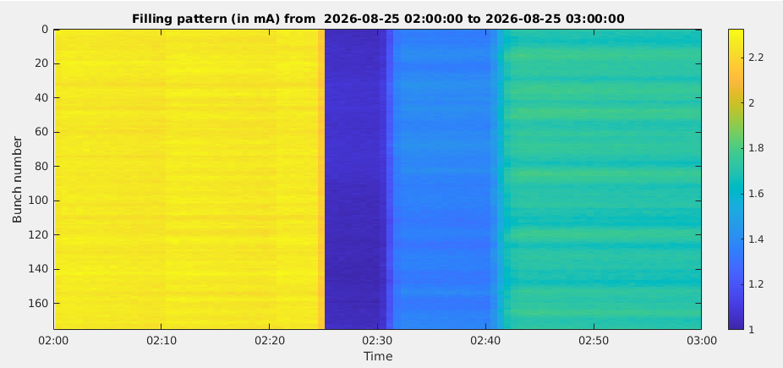
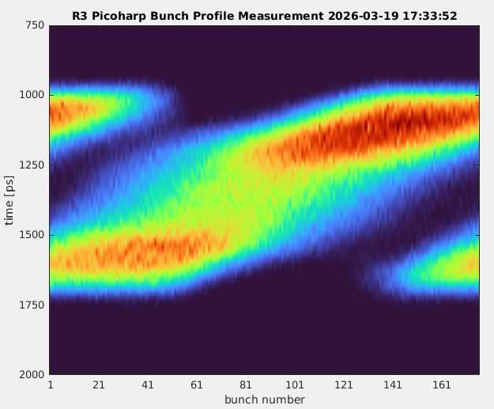
Longitudinal (time-resolved) beam diagnostics
Streak Camera
Time-Correlated Single Photon Counting
Importance of long. diagnostics bunch lengthening with multiple passive / active harmonic cavities, also for the upgrade!

Slide 5
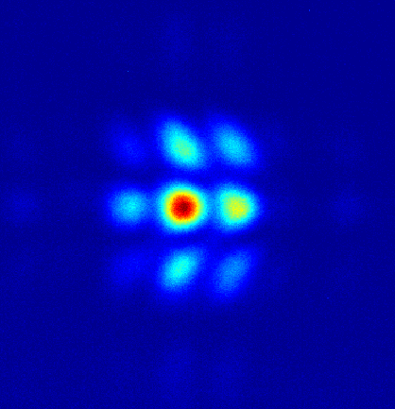
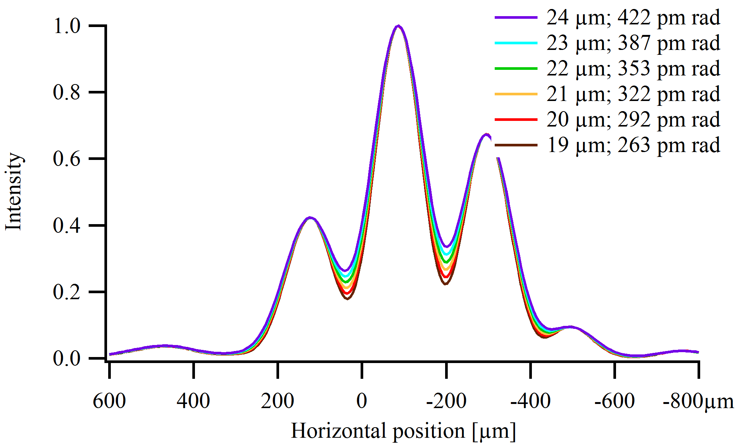
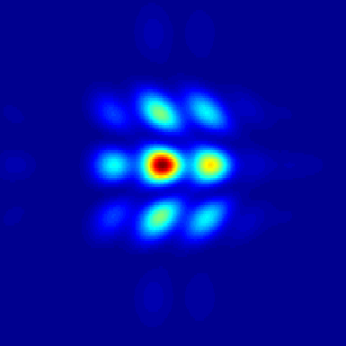
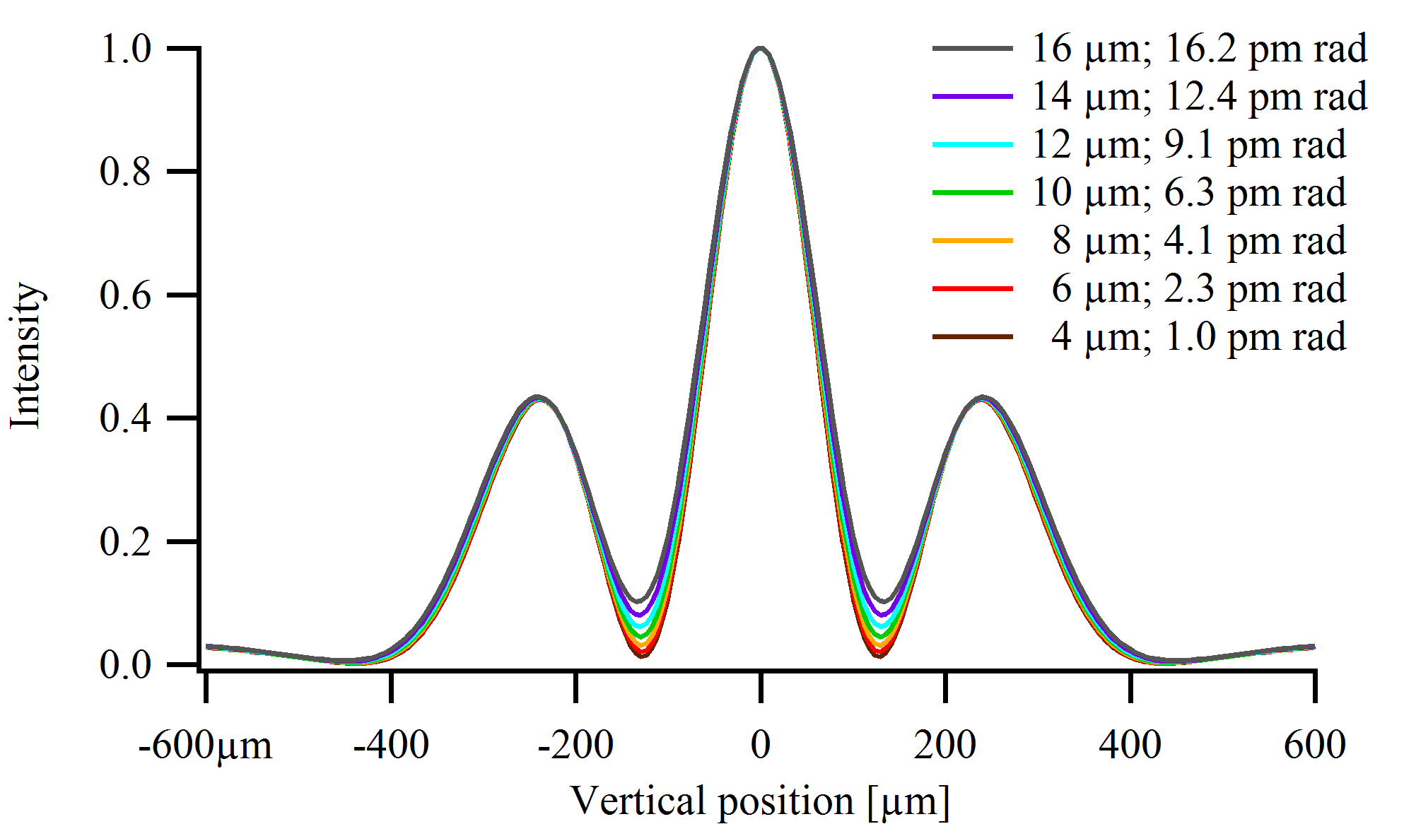
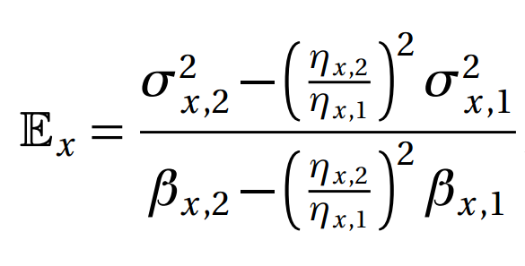
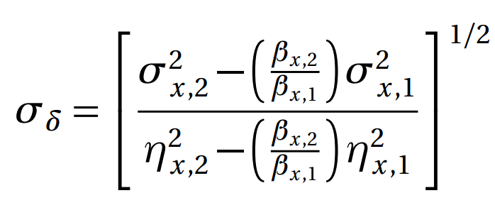


Transverse beam size diagnostics today
B320B measurement
Horizontal intensity profile, sensitive to $σ_{x}$
Imaging with synchrotron radiation from micrometer electron beams: Interference and SR inherent effects dominate!
Model-based calculations done in the Synchrotron Radiation Workshop (SRW)
Fringe visibility gives beam sizes
Online image evaluation for beam size measurements
Combination of beam size measurements to get emittances and energy spread:
SRW calculation for B320B
Vertical intensity profile, sensitive to $σ_{y}$

Slide 6
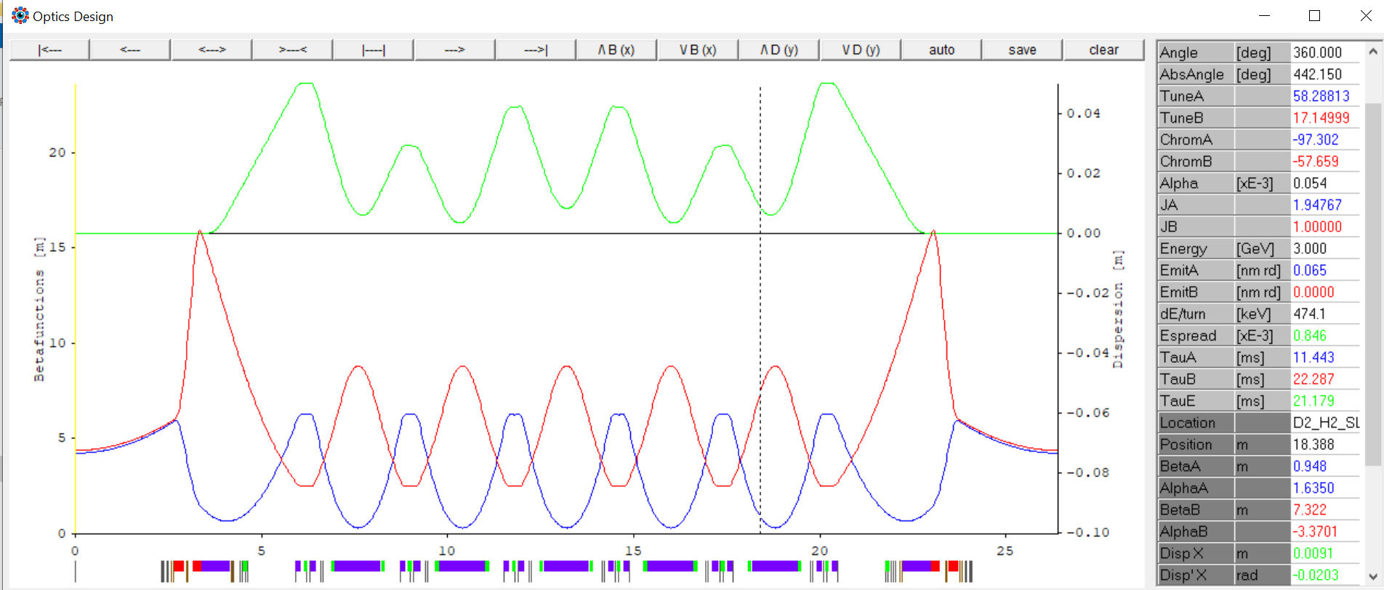
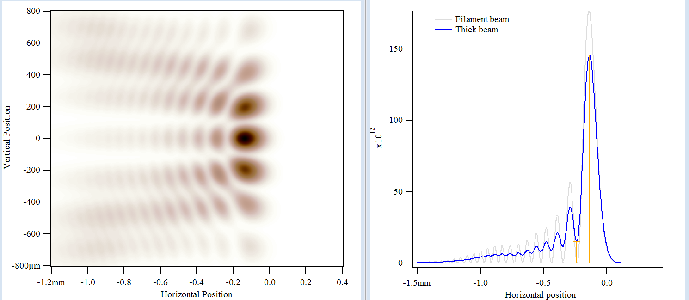
Preparing for the upgrade
Lattice functions at B302B source point for the 65 pm TDR-1 lattice. Åke Andersson
Source points of diagnostic beamlines are kept
Vacuum chambers will be designed if needed, such that vis-UV dipole radiation can be extracted.
Majority of the vacuum system etc. can be kept
Reduction in horizontal emittance, beta functions and dispersion.
  Resolve horizontal beam sizes > 10 micrometers
  Requires retuning of the horizontal beam size method
No significant changes to the vertical beam size and emittance expected.
Example shown to the right:
SRW calculation of a 10 micrometer horizontal beam, imaged at 365 nm with a horizontal acceptance angle of 16 mrad

Slide 7
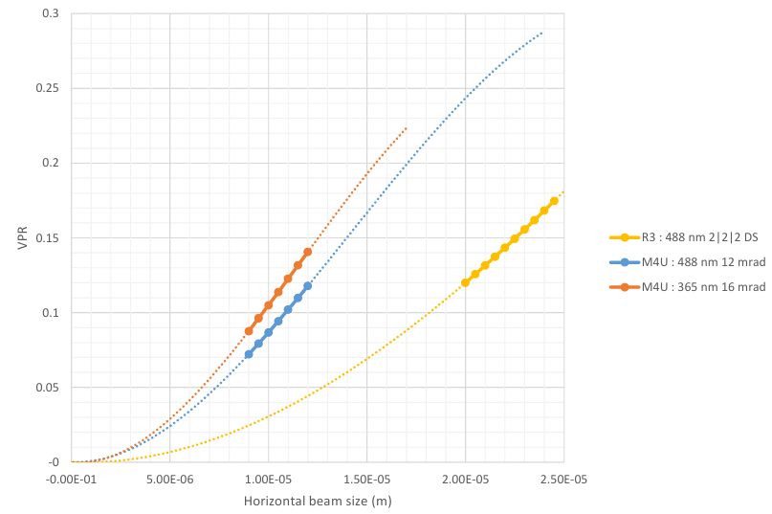
Horizontal beam size methods
Beam size resolution from the slope of the sensitivity curve:
  change of the observable VPR (valley-to-peak ratio) per change in beam size
A horizontal method combines multiple beamline parameters.
The goal is to maximize beam size sensitivity for a given (range of) beam size(s).
Many beamline parameters can be easily changed:
  Wavelength -> bandpass filter
  Acceptance angle -> movable apertures
  …etc.
There is a limit to the maximum accepance angles! -> engineering challenge!
B320B today, optimized for 22 micrometers
B320B @ MAX4U, optimized for 10 micrometers. Two method candidates.
Side note: even today‘s method has a non-zero slope at MAX4^{U} beam sizes!

Slide 8
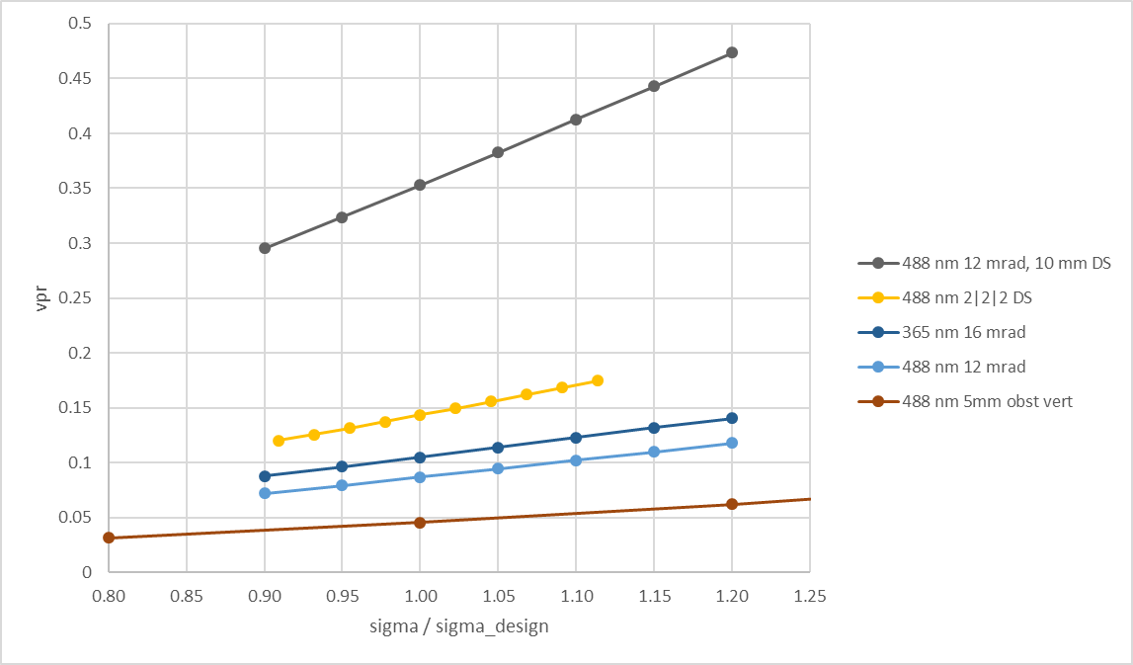
Horizontal beam size resolution estimates
Measured mean and standard deviation of B320B horizontal valley-to-peak ratio and σ_x at cold beam:
vpr = 0.1546 ± 0.0019 -> 1.3 %
σ_x = 22.934 ± 0.167 µm -> 0.7 %
Comparing methods by their horizontal beam size resolution
The slope:
Δ(vpr) / Δ(σ_x/σ_x,design) = 0.27
std(vpr) / 0.27 = std(σ_x/σ_x,design) = 0.007
The slope:
Δ(vpr) / Δ(σ_x/σ_x,design) = 0.175
std(vpr) / 0.175 = std(σ_x/σ_x,design) = 0.0108
The slope:
Δ(vpr) / Δ(σ_x/σ_x,design) = 0.151
std(vpr) / 0.175 = std(σ_x/σ_x,design) = 0.0126
-> The standard deviation of the measured horizontal beam size is expected to increase from 0.7% (B320B, R3) to 1.26% (B320B, MAX4^{U}) assuming a more conservative method.

Slide 9
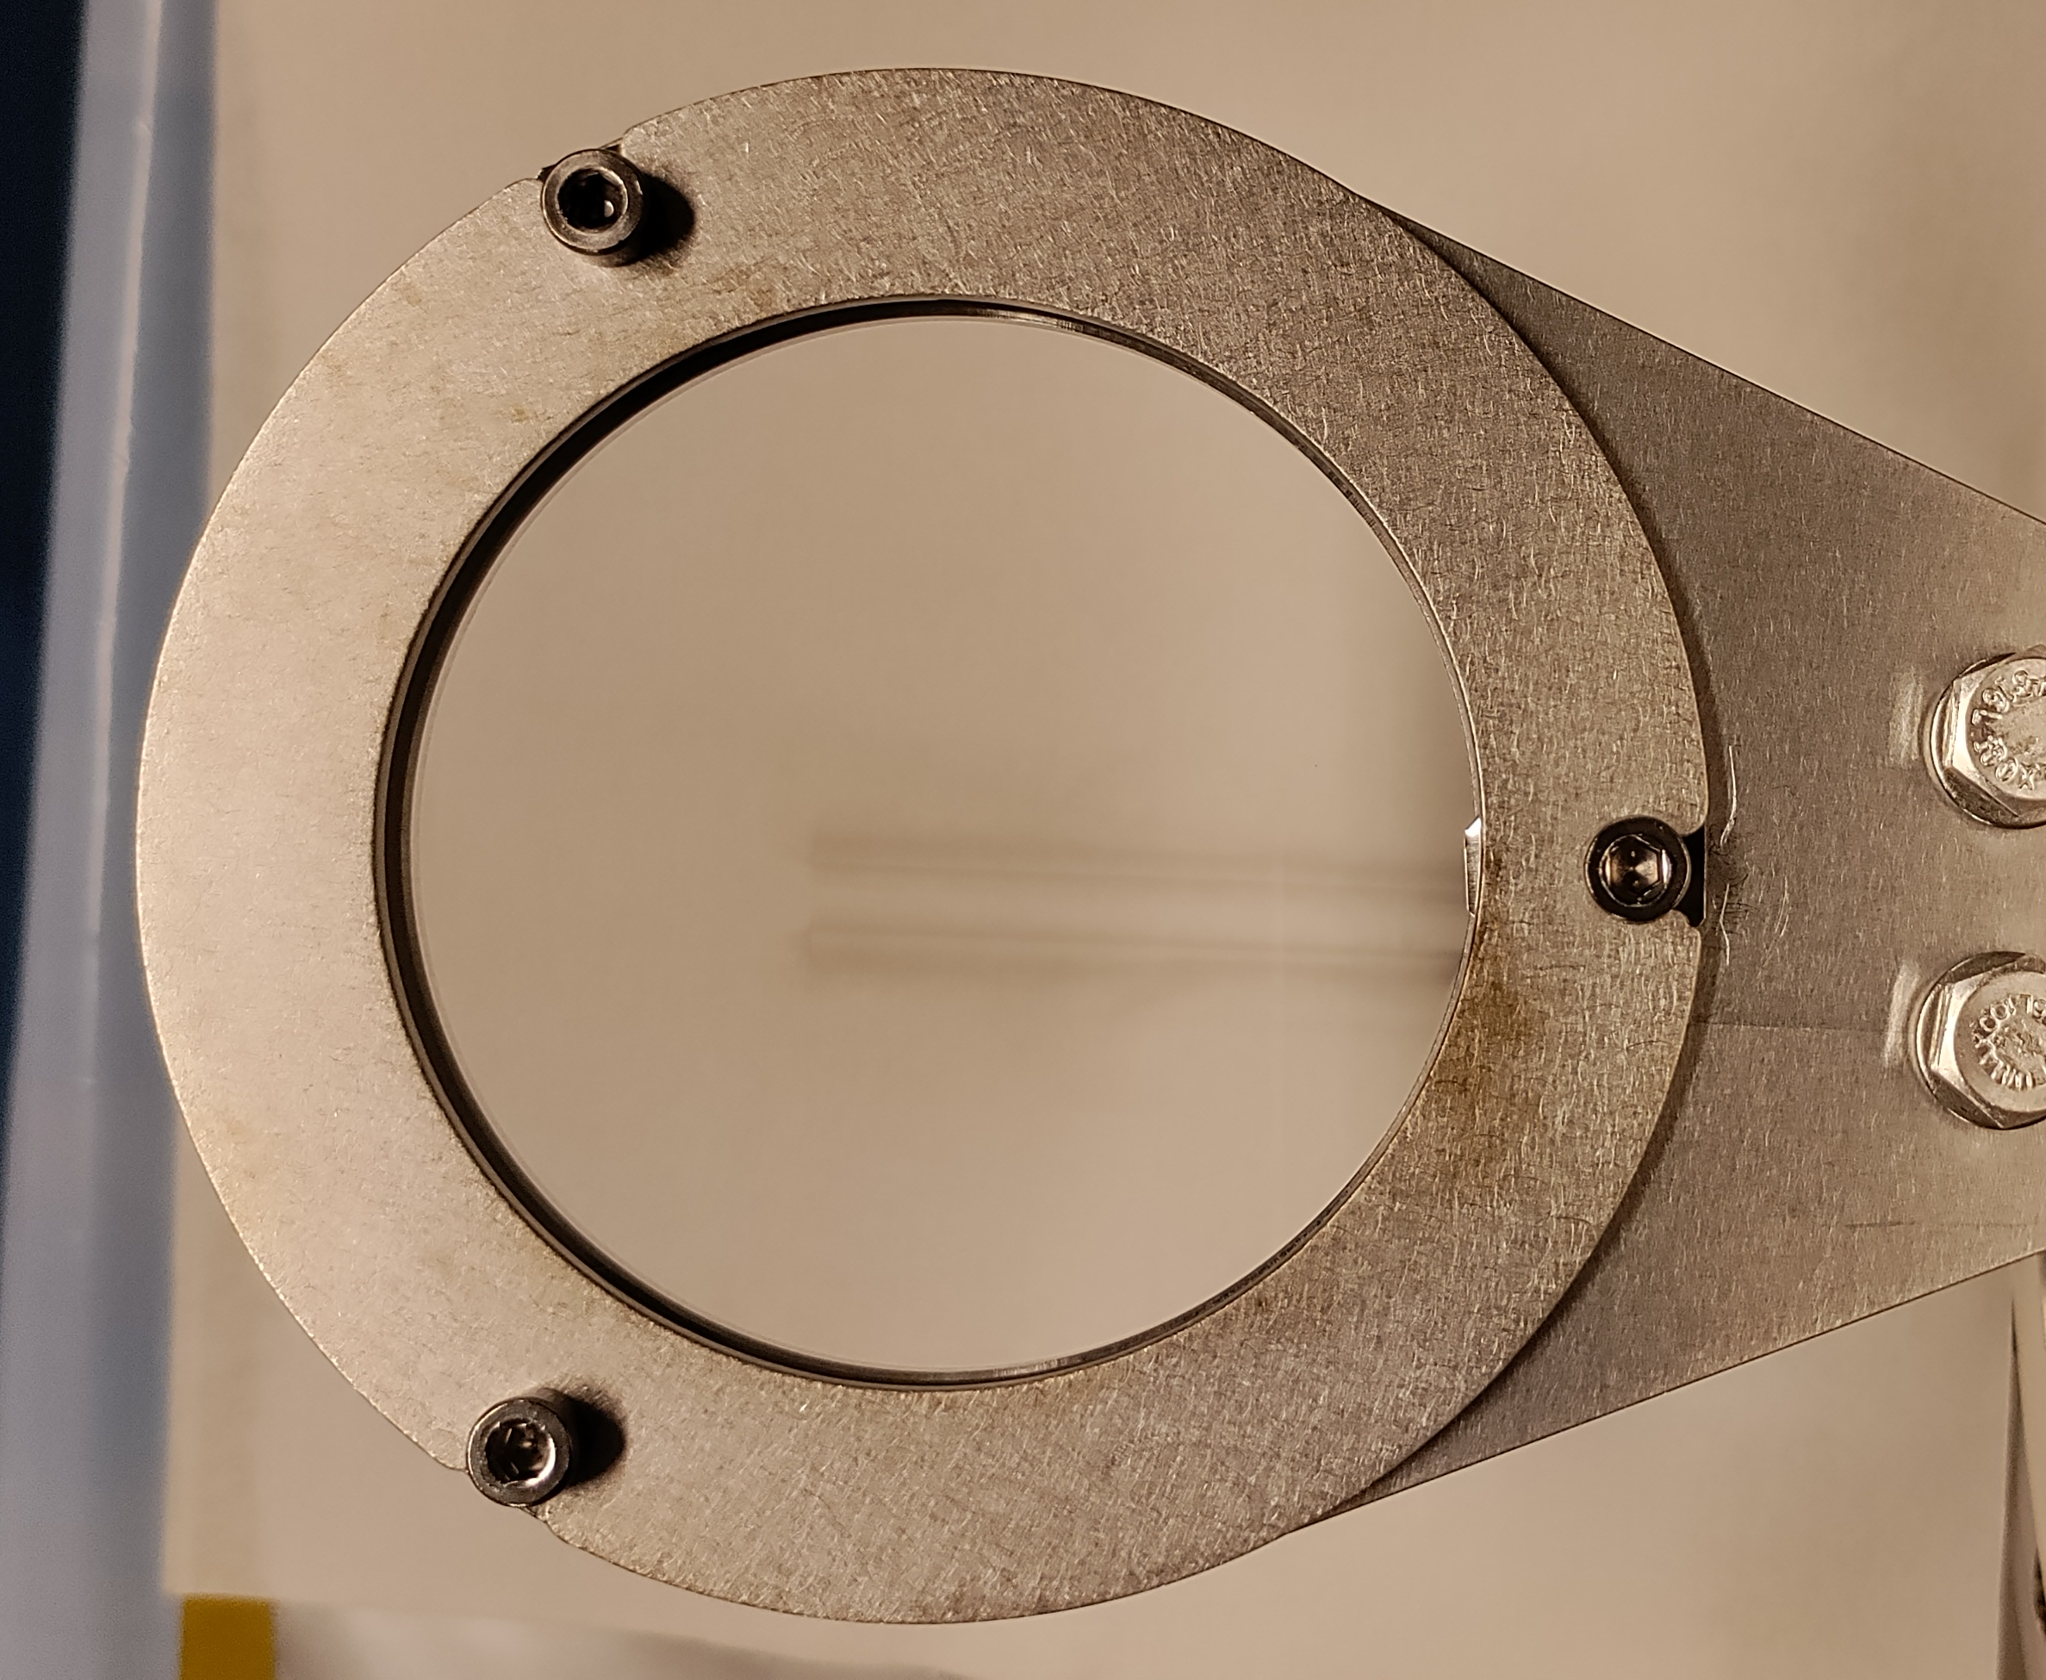
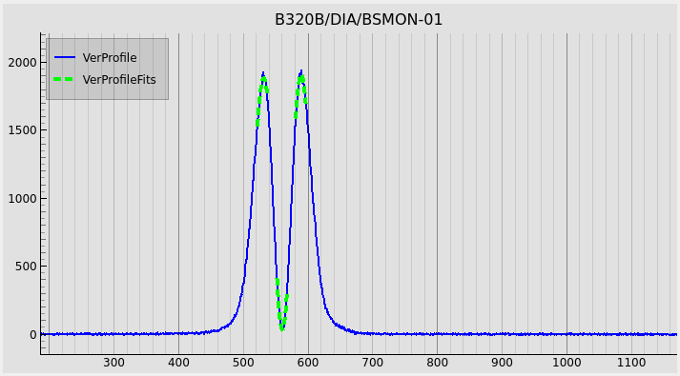
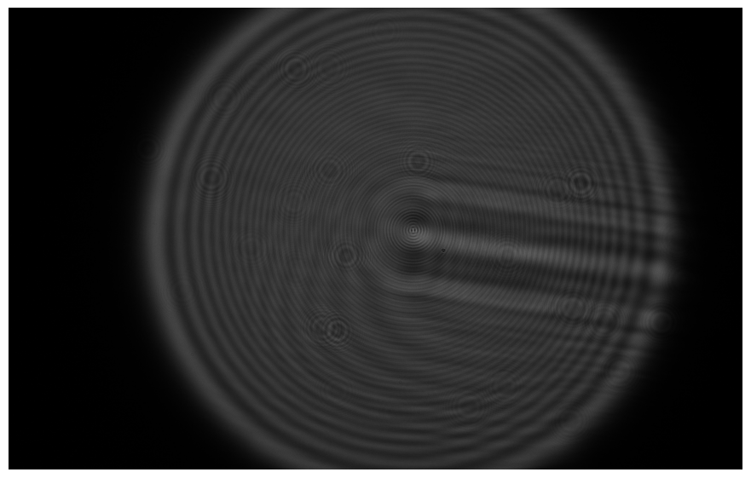
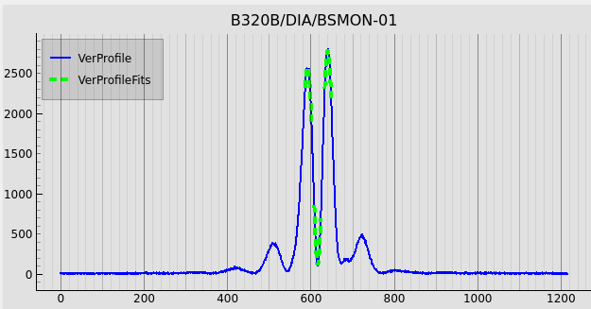
UV-induced optics degradation
The optics degradation affects beam size measurements already after a short while of exposure: 2 weeks of delivery beam (400 mA).
Fused Silica Lens (76 mm diameter)
After ca. 1 year of exposure. The visible contamination is Hydrocarbons
Apart from surface contamination there is a bulk effect as well. Image obtained via HeNe illumination on a test bed on an B320B-exposed lense, that does not show any degradation visible to the eye!
2 weeks of delivery beam (400 mA).
Image by Eleni Moschovaki
Approach currently under investigation: protecting the optics by introduction of an additional mirror (downstream the SiC, but upstream of any FS element) and thereby removing harmful spectral components in the UV.

Slide 10
Conclusions
vis-UV bending magnet diagnostic beamlines continue to be vital diagnostics…
worth taking them with us through the upgrade
there a challenges ahead:
  Engineering: preserve opening angles
  Opitimize the ‘methods’
  Understand and solve the optics degradation problem

Slide 11
Complementary Material

