Slide 1
MAX 4^{U} Vacuum system
NSLS II-MAX IV workshop
5-6 Oct. 2026
Marek Grabski on behalf of Vacuum team

Slide 2
Outline
MAX 4^{U} vacuum requirements
MAX IV 3 GeV storage ring performance and design
MAX 4^{U} lattice (TDR-1) vacuum system arc layout
MAX 4^{U} validation studies
In-situ vacuum Installation scenarios and concept
Next steps, Conclusions

Slide 3
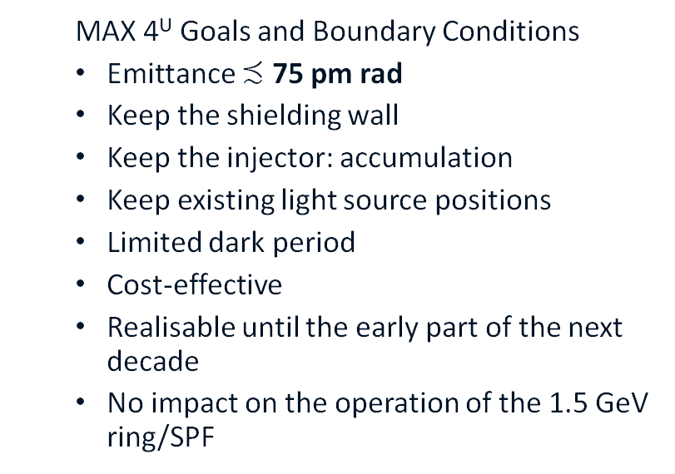
MAX 4^{U} vacuum requirements and design assumptions
Critical vacuum requirements are:
  500 mA design electron beam current,
  <1E-9 mbar N₂ equivalent, average dynamic pressure. Gas lifetime >40 hours.
  Fast vacuum conditioning (25-50 Ah),
  Reuse of existing vacuum chambers, pumps, instrumentation, and infrastructure
  MAX 4^{U} Goals and Boundary Conditions
  Emittance $≾$ 75 pm rad
  Keep the shielding wall
  Keep the injector: accumulation
  Keep existing light source positions
  Limited dark period
  Cost-effective
  Realisable until the early part of the next decade
  No impact on the operation of the 1.5 GeV ring/SPF

Slide 4
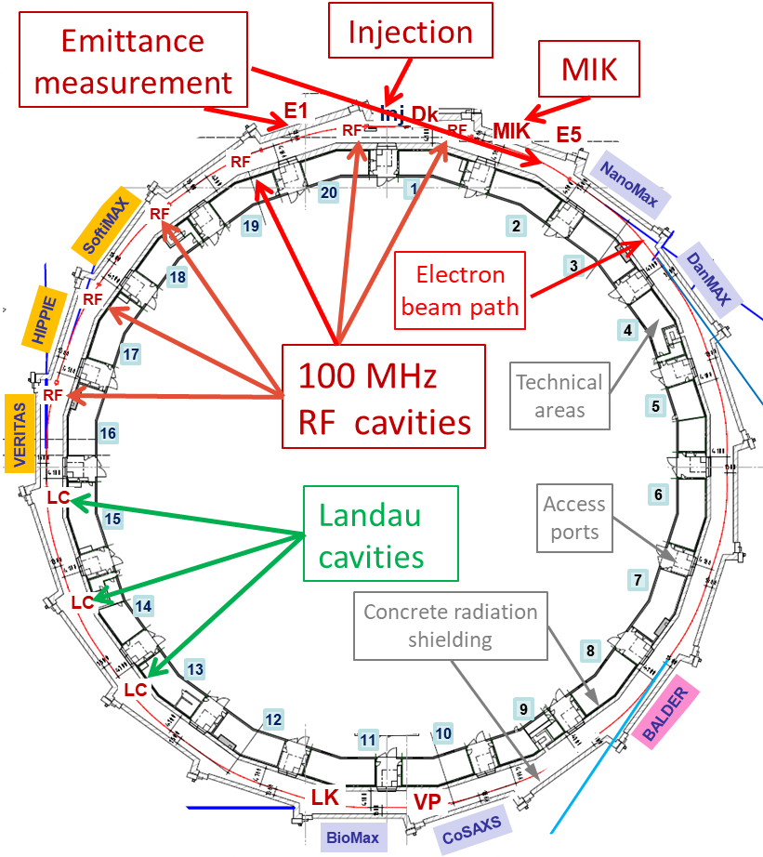
MAX IV (MAX 4^{U}) 3 GeV storage ring layout
Energy: 3 GeV
Design current: 500 mA
Horizontal Emittance: 0.2-0.33 nm rad
Circumference: 528 m
#of achromats: 20
#straight sections: 20 x 4.5 m
  Legend:
  Dk: Dipole kicker (S1)
  MIK: Multipole Injection Kicker (L)
  LK: Longitudinal kicker (S2)
  VP: Vertical pinger (S2)
  RS: 500 MHz RF cavity (S2)
      L=long straight, S=short straight,
Installed Insertion Devices:
6 In-vacuum undulators:
NanoMax, BioMax IVU18
Cosaxs IVU 19.3, DanMax IVU16
ForMax IVU17, MicroMax IVU18
3 EPUs (4 m long, min gap 11 mm)
VERITAS, SOFTIMAX - EPU48
HIPPIE - EPU53
RS
1 In vacuum Wiggler (2.4 m long)
BALDER IVW50
ForMAX
MicroMAX

Slide 5
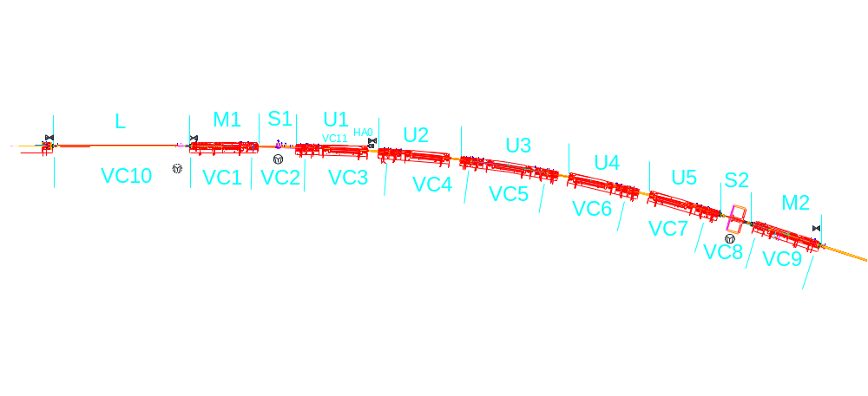
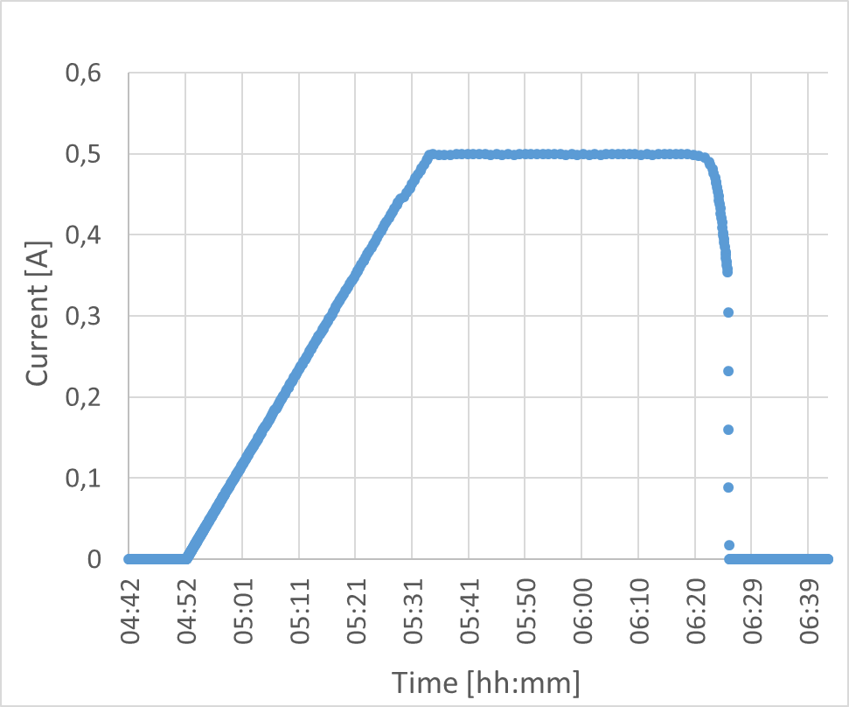
MAX IV 3 GeV vacuum performance
Beam direction
Extractor gauge
Average base pressure (April 2024):
  ~1.5e-10 mbar (extractor gauges)
Penning gauge
Accumulated beam dose:
20258 Ah (October 2026)
Max. stored current:
500 mA (November 2018)
total lifetime was 14 h,
Beam current for delivery to beamlines:
400 mA, (total beam lifetime ~15 h)

Slide 6
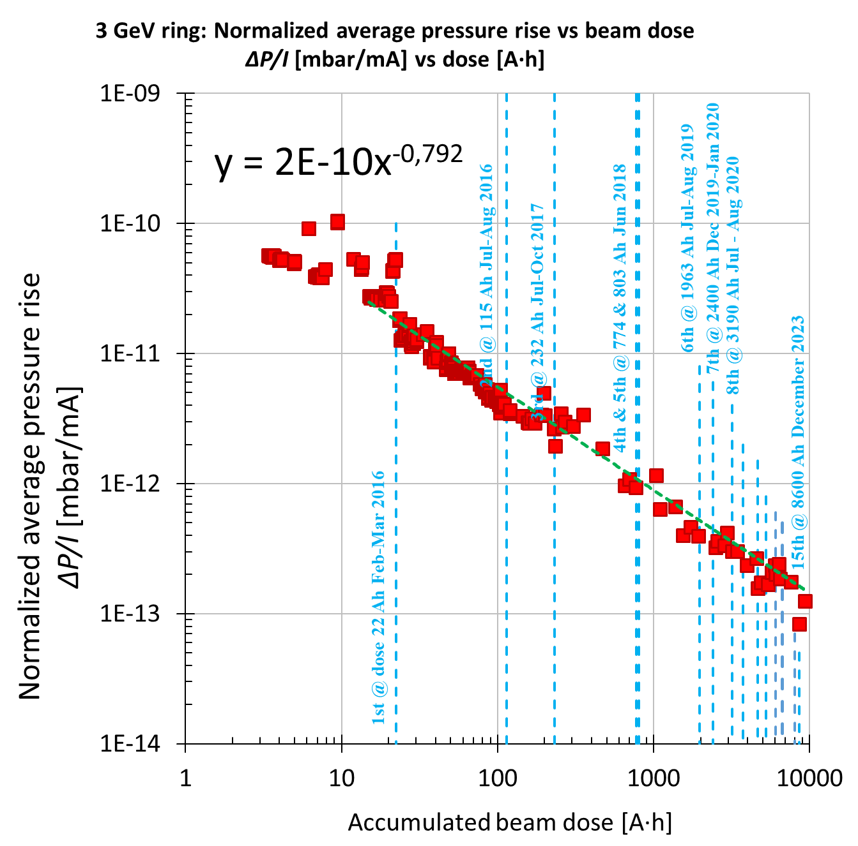
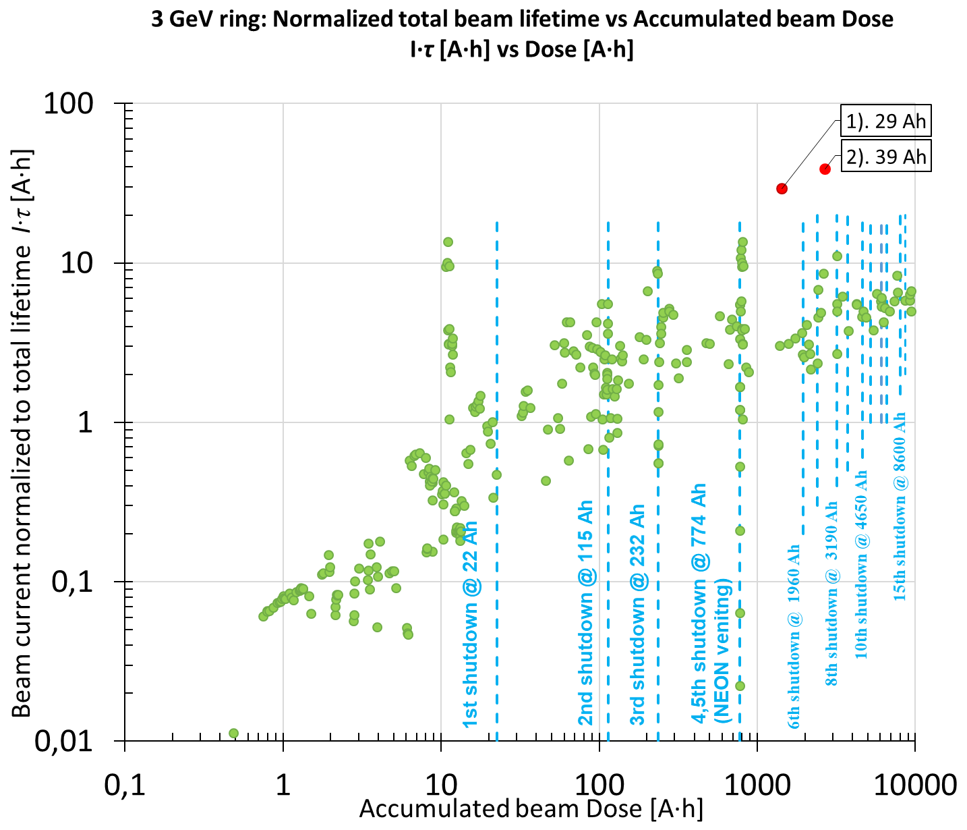
MAX IV 3 GeV vacuum performance
Vacuum performance of MAX IV 3 GeV ring is very good, thus the same concept will be used for MAX 4^{U}.
*3 GeV ring accumulated beam dose (October 2026):
~20258 Ah

Slide 7
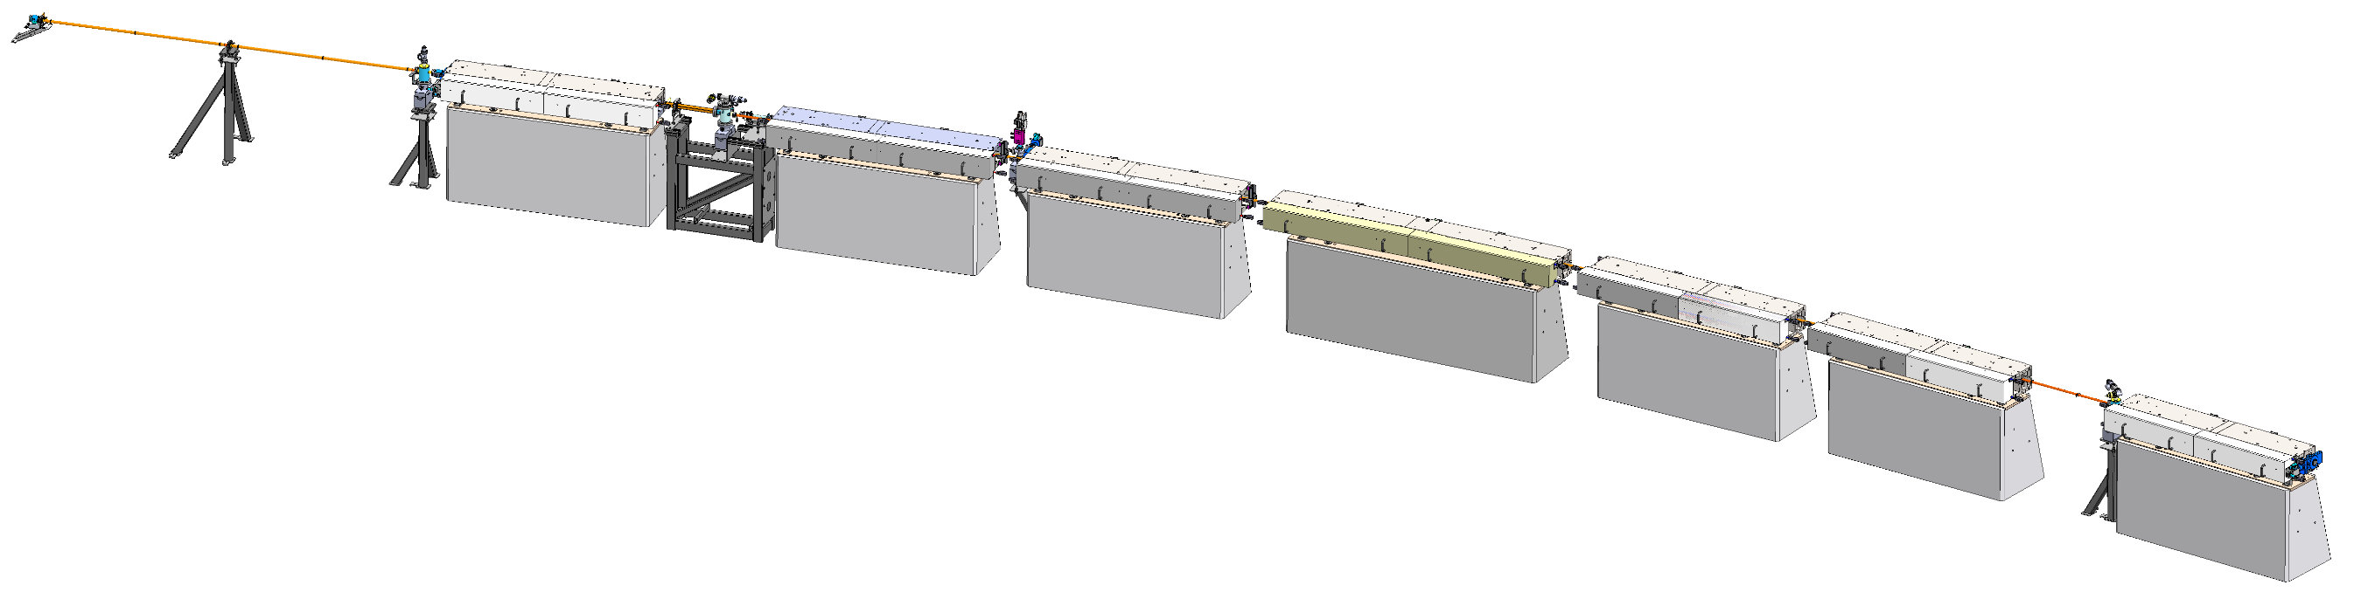
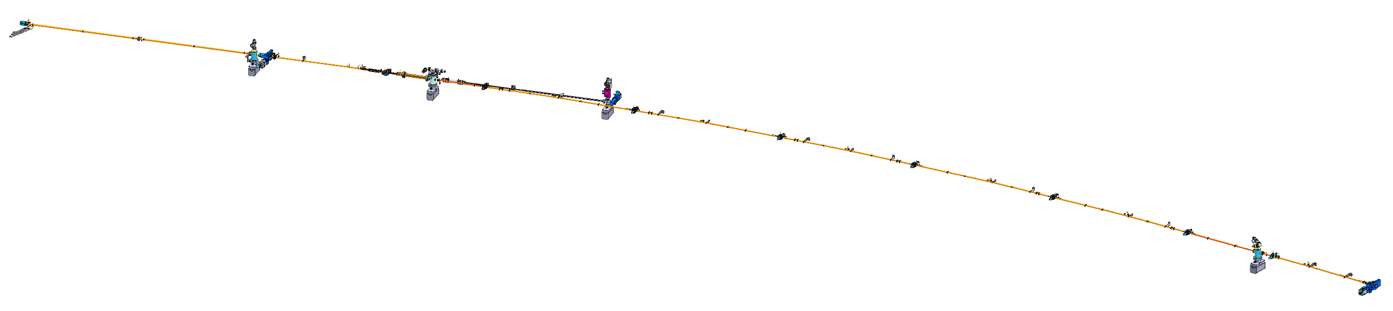
MAX IV (MAX 4^{U}) 3 GeV Vacuum achromat layout
1 achromat 26.4 m long (including straight section)
VC-10
VC-1
VC-2
Magnet blocks
VC-3
Beam direction
VC-4
L
VC-5
MAX 4^{U} will have the same layout (7BA).
For MAX 4^{U} the magnet aperture is unchanged (25 mm bore diameter).
For MAX 4^{U} Vacuum pumps and instrumentation to be reused.
M1
S1
VC-6
U1
VC-7
U2
VC-8
VC-9
U3
Concrete girders
U4
U5
S2
M2
Gate Valve
Extractor gauge,
crotch absorber
Beam Position Monitor (10 per achromat)
VC-10
Gate Valve
Gate Valve
(to front end)
VC-1
VC-2
VC-3
VC-4
Photon Beam
Cold cathode gauge
VC-5
VC-6
IP (L)
IP (S1)
VC-7
Gate Valve
IP (U1)
VC-8
VC-9
Legend: L: long straight section; S1, S2: short straight sections 1 and 2; M1, M2: matching cell magnet blocks 1 and 2; U1–U5: unit cell magnet blocks; IP: ion pumps; VC-n: vacuum chamber types.
Electron Beam
IP (S2)

Slide 8
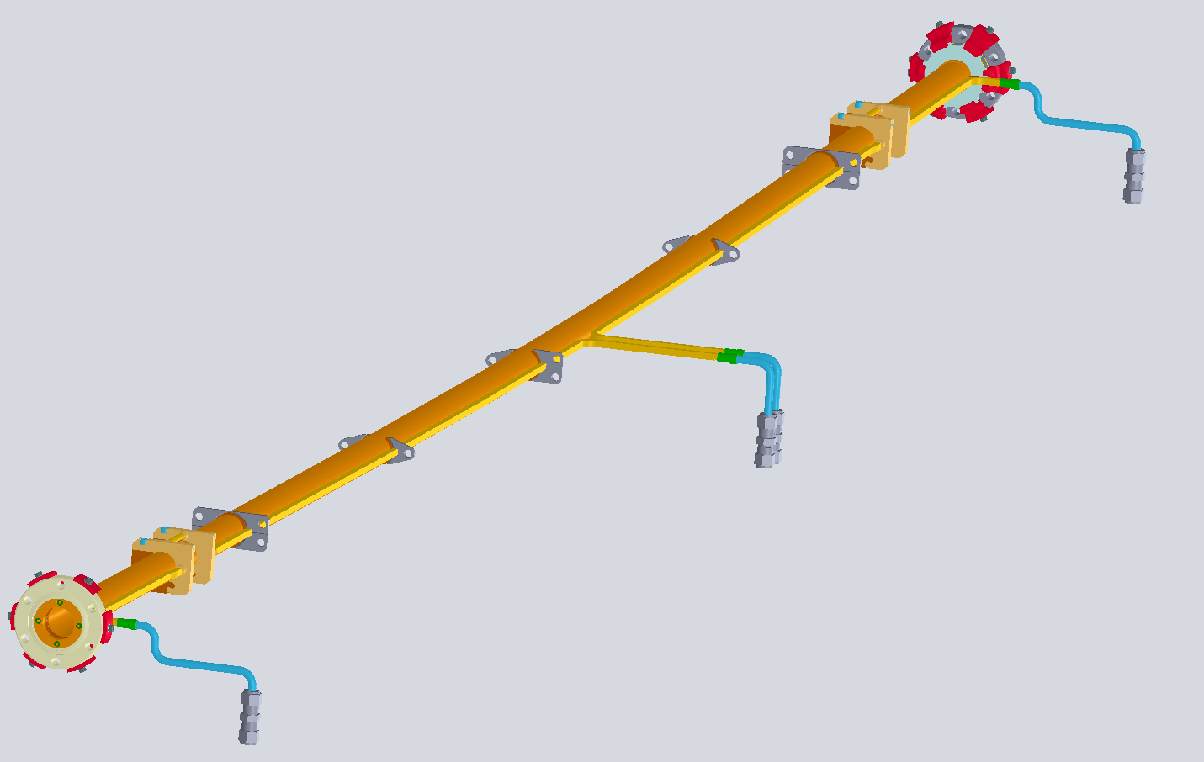
MAX IV 3 GeV Standard vacuum chamber geometry VC5 in U3
One achromat
VC5
Beam direction
Welded bellows
VC5 chamber
Material: OFS copper
Inside diameter: 22 mm,
Total length: 2.5 m,
Arc length: 1 m,
Bending angle: 3⁰,
Bending radius: 19 m.
NEG-coated inside.
Chamber body
U1-U5, M2 vacuum chambers are flexible and easy to bend thus they will be reused for MAX 4^{U},
Their geometry will be adapted to the new beam orbit by bending (elastically).
Beam direction
Cooling for corrector
Ribs
Welded bellows
Bent part
Distributed cooling
Cooling for corrector
Beam Position Monitors (BPMs) are mostly stand alone (10 per achromat) with 4 welded buttons and will be reused for MAX 4^{U} as they are.

Slide 9
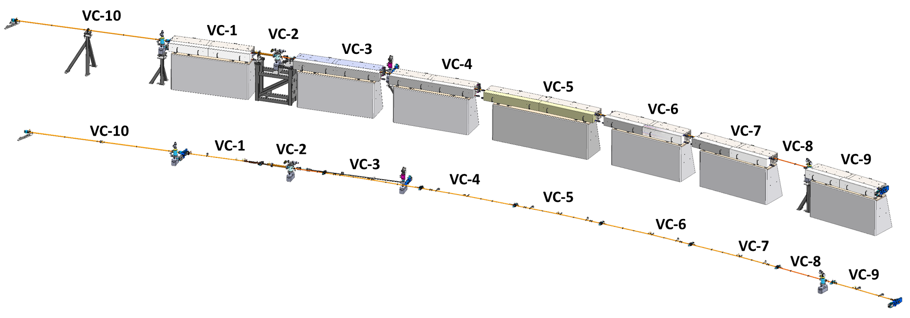
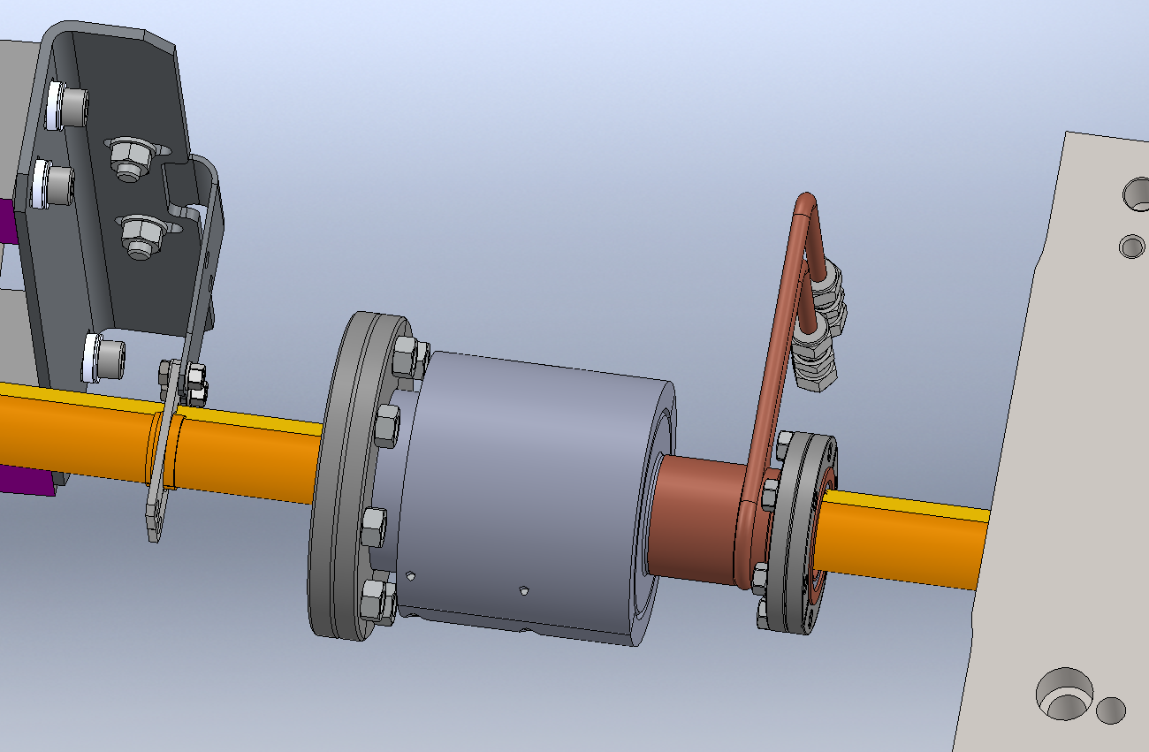
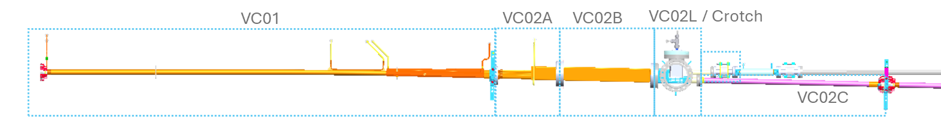
MAX 4^{U} (TDR-1 lattice) standard achromat layout (achromat without RF cavities)
New bellow VCU04B
Chamber | Length (m) | Status
VC01 | 2.1 | New
VC02A | 0.3 | New
VC02B | 0.4 | New
VC02L | 0.5 | New
Crotch absorber |  | New
VC02C | 0.85 | New
VC03 | 2.8 | Reuse and bend
VCU04A VCU04B VCU04C | 2.8 | New: bellow, upstream and downstream chambers
VC05 | 2.6 | Reuse and bend
VC06/07 | 2.8 | Reuse and bend
VC06/07 | 2.8 | Reuse and bend
VC08* | 1.7 | Reuse
VC09 | 2.1 | Reuse
* different chamber types (RF, diagnostics…etc)
30% new vacuum chambers needed (lengthwise), the rest will be reused and bent.
New bellow (and flanking chambers) added to allow insitu baking of the achromat arc section.
Remaining vacuum chambers to be reused after venting and bending.
Standard long straight (ID) sections are unchanged will not be vented.

Slide 10
Validation simulations, studies, and testing
MAX 4^{U} vacuum design principle is based on adapting majority of the standard vacuum chambers to the new lattice by deformation, possible issues were addressed:
Can the chambers operate for longer if we reused:
  NEG coating condition (saturation, pumping speed).
  Water Cooling channel corrosion.
Will the chambers withstand the deformation
when bent:
  NEG coating peel-off study.
  Bellows deformation.
  Mechanical simulations.
  Bending tests.
Will the chambers withstand the additional power:
  Raytracing.
  Thermal simulations.
Can we achieve this, in practice:
  Mock-up of the system manipulation, installation and integration.
Studies done – no issues observed, study to continue
Study done – no issues observed
Study done – no issues with NEG adhesion after bending cycling observed
Bellows have enough stroke
Done – no issues found for standard vacuum chambers
Done – no issues found for standard vacuum chambers*
Ongoing, installation tools under design, need to be tested in the mockup later
*FEA analyses ongoing for VC1, VC2, crotch absorber and VC11A (those are not bent chambers)

Slide 11
NEG coating peel off study
Is the NEG coating film adhesion good enough after the vacuum chambers are bent?

Slide 12
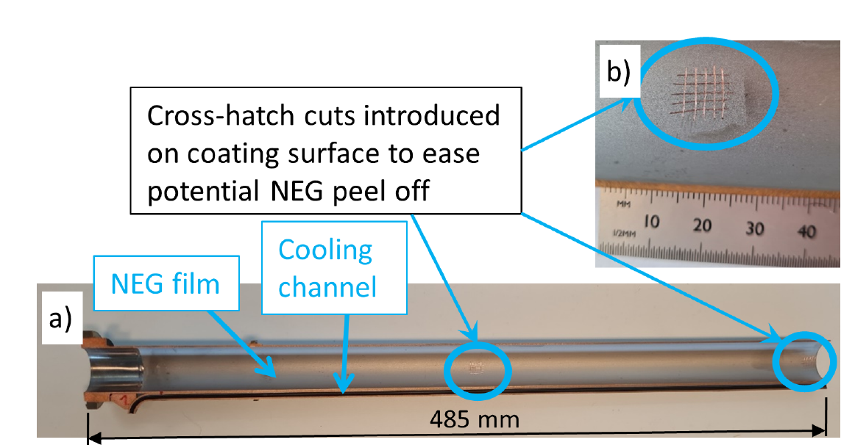
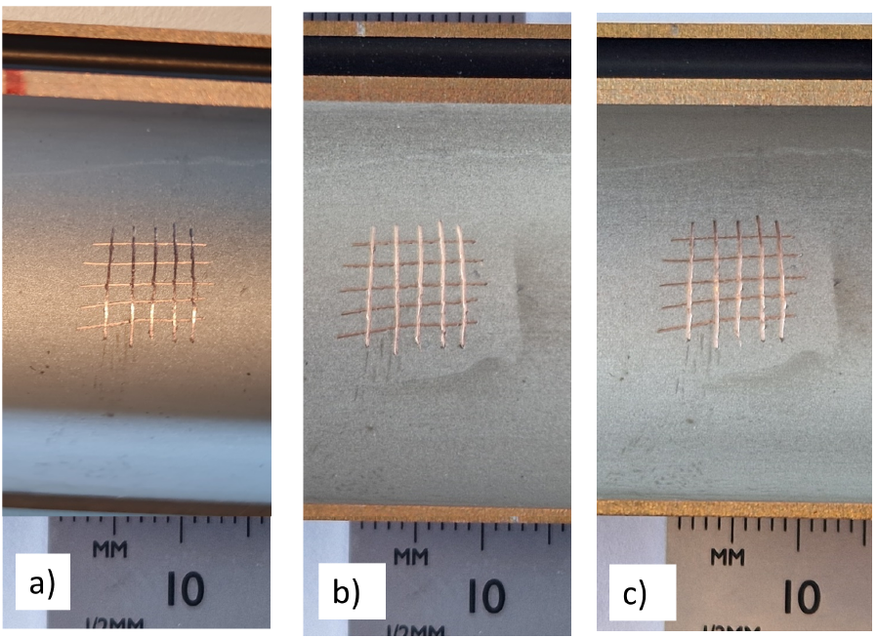
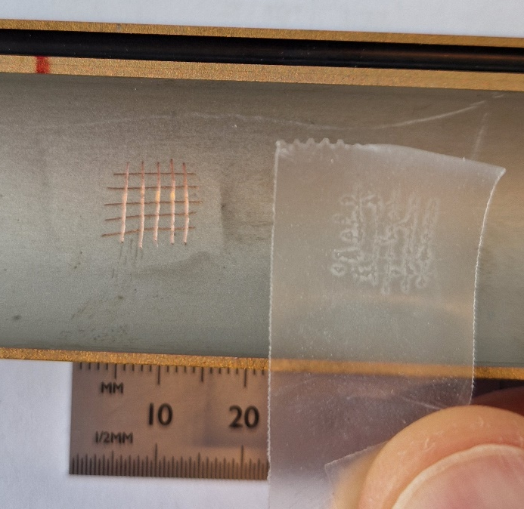
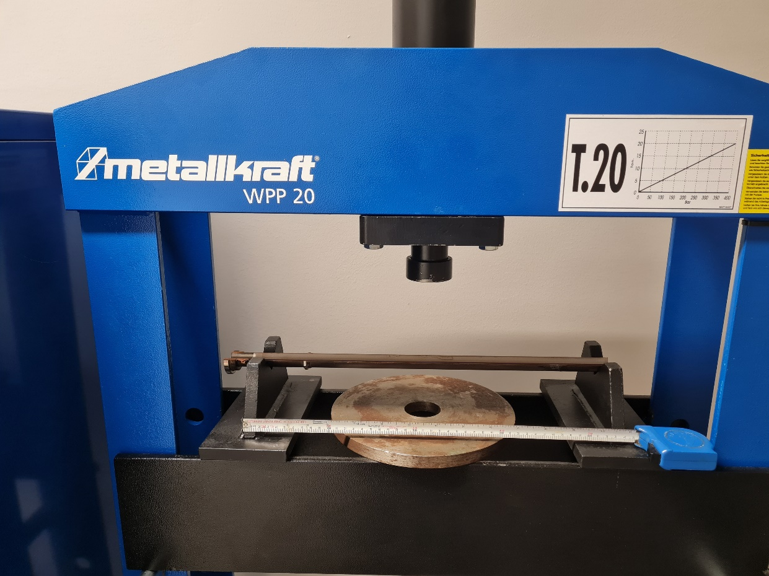
NEG coating adhesion tests* on 3 GeV vacuum chambers
Transversal shift of a chamber central point, keeping the ends fixed, was taken as 8 mm over a length of 1.6 m. Accordingly a NEG coated vacuum chamber sample was made and subjected to cycling.
Test results
Detail of NEG coated chamber sample:
a) before cycling tests, b) after 100 cycles, c) after 200 cycles
Cycling test setup – hydraulic press
c)
NEG coated sample
Hydraulic press
Conclusion: after 4 tests (200 bending cycles) there was no NEG coating peel-off observed – the NEG coating is stable with small vacuum chamber deformation and we can use the NEG coated chambers for MAX 4^{U}.
Sample supports
*similar to ASTM D3359 tape tests for coating adhesion.

Slide 13
NEG coating study
During the operation of the machine, desorbed gas was pumped by the the NEG-coated vacuum chambers reducing their pumping capacity.
What is the current condition of the NEG coating?
What is the pumping speed of the NEG coating?
Is the coating saturated?
Could the vacuum chambers be reused without venting and activating?

Slide 14
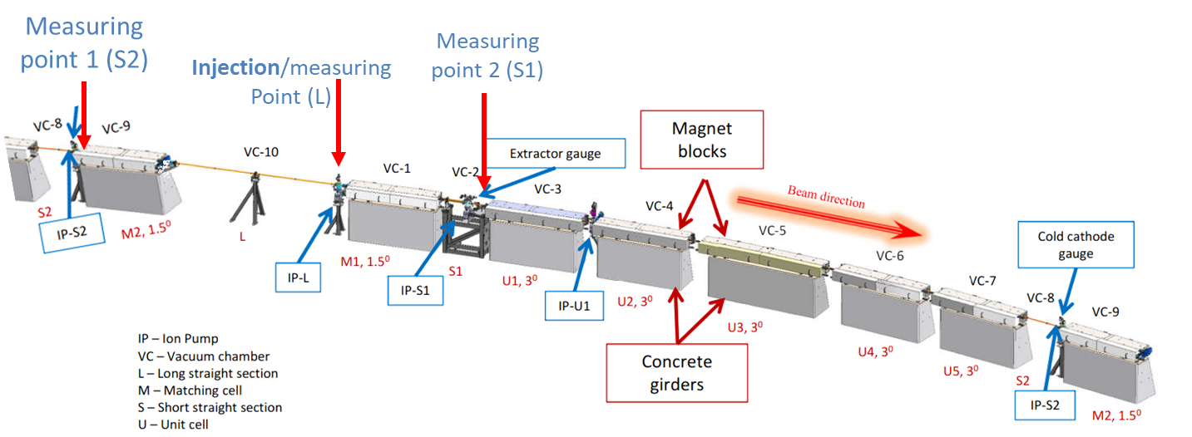
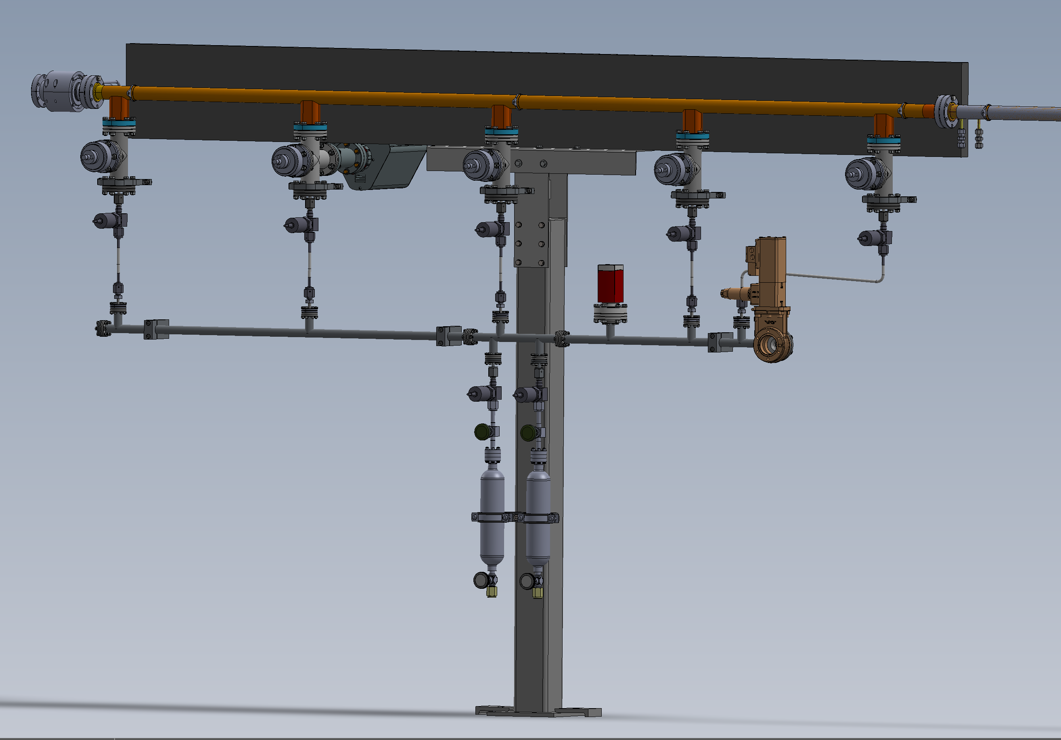
NEG coating study
The NEG coating study started in 2023 with the goal to measure, on an operating machine, how pumping speed and desorption yield changes with beam dose. It composes of two phases:
  Phase 1: Measurement on vacuum chambers already installed in the machine
    Local pumping speed at Injection point was measured for H2 and CO. Results showed a local saturation around the injection point.
    Distributed pumping speed was evaluated between Injection (L) and Measuring points (S1 and S2: 3,3 m and 6,9 m away from L respectively). Results showed high pressure ratios. This proves a good status of the NEG coating along the pipes.
  Phase 2: Measurement on a new vacuum chamber with 5 measurement ports
    On-hold due to issues with the new vacuum chamber
Notes:
Phase 1: Summary of results for local and distributed pumping speed measurements (2024),
Phase 2: Out of tunnel installation in 2025: the ports were NEG coated chamber was sent to remove the coating. Another chamber was tested but we struggled with activation temperature distribution. A dummy chamber (without ports) was tested - was OK chamber activated. The final after removing the coating did not activate at all.

Slide 15
Vacuum installation scenarios
  Possible vacuum scenarios (proposed in CDR):
  A: reuse all existing chambers and adapt them to the new orbit under vacuum (no venting).
  B: partial reuse of existing chambers. A few new chambers need to be introduced in the arcs, venting with noble gas.
  C: partial reuse of existing chambers, a larger number of new chambers need to be introduced in the arc, venting followed by reactivation of the NEG.
Valid for TDR-1 lattice
Reuse the existing vacuum chambers and adapt them to the new lattice, reuse all the ion pumps, gauges, controllers all to reduce:
  cost
  perhaps conditioning time

Slide 16
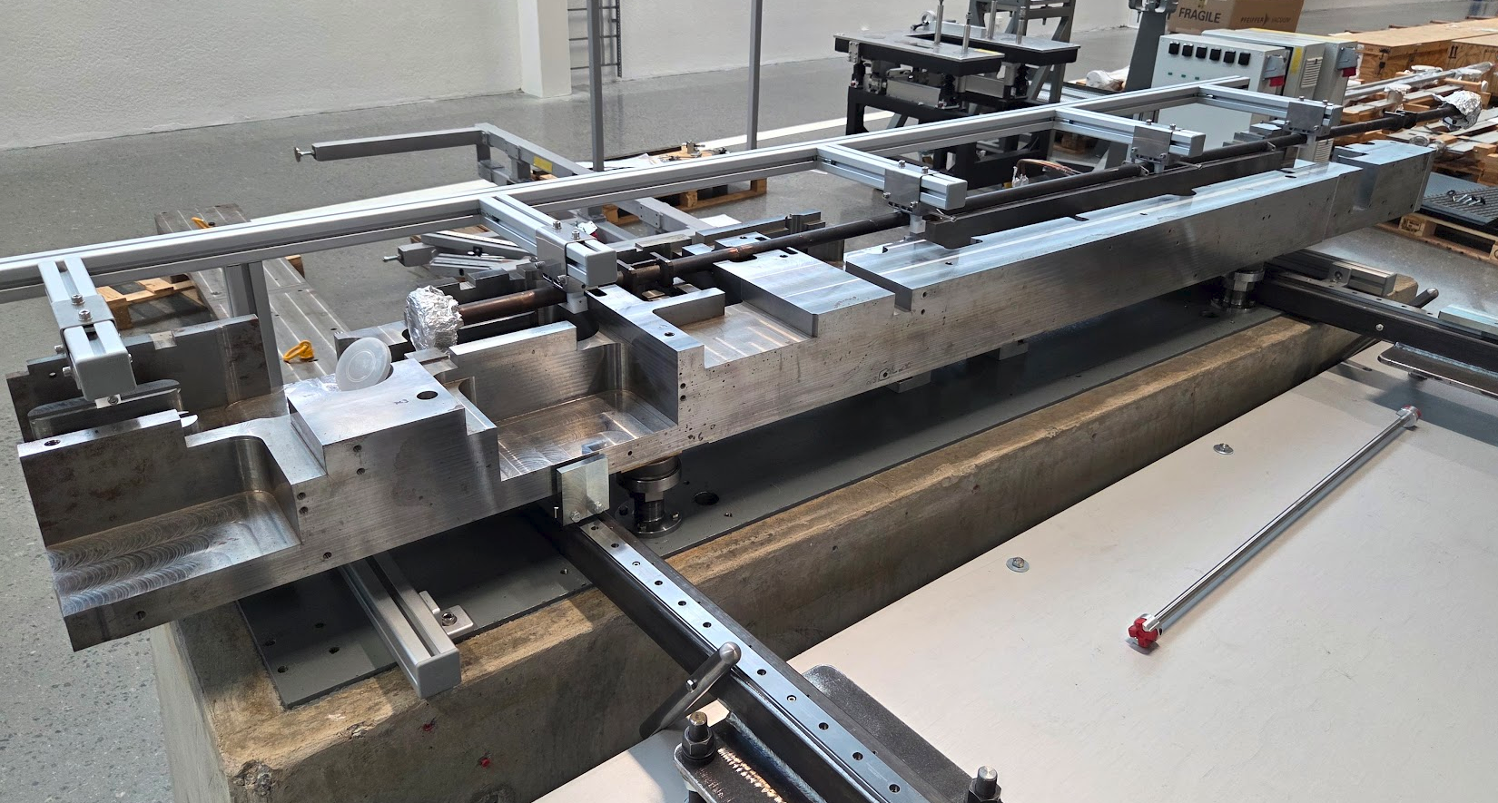
In-situ vacuum installation concept
MAX4^{U} vacuum installation will be more challenging comparing with MAX IV installation in 2015.
Installation and vacuum assembly will be done inside the tunnel during dark time, the tunnel has no removable roof.
The arc vacuum chambers will not be lifted, will stay at the nominal beam height during the installation (in-situ).
30% (lengthwise) of vacuum chambers will be new.
Reused unit cell chambers need to be bent to fit the new orbit.
The arc chambers need to be vented, then baked and NEG coating activated.
No venting of the ID Long straight sections is assumed (validation ongoing).
Vacuum chamber hanging and bending tool
e beam direction
Dummy chamber
Bottom magnet block removal tool

Slide 17
Next Steps
Calculate pressure profile of complete achromat for TDR-1 lattice
Continue designing installation tooling (supports, oven, hanging tools)
Validate and refine installation procedure in the mockup
Build mockup of the new vacuum system
Continue with NEG coating studies

Slide 18
Conclusions
The vacuum system design concept of the chosen TDR-1 lattice is identical to R3 (existing 3 GeV ring) at MAX IV
The vacuum performance is expected to be very similar to MAX IV 3 GeV ring
The installation process for one achromat is more challenging than that of MAX IV 3 GeV ring

Slide 19
Thank you

Slide 20
Complementary Material

Slide 21
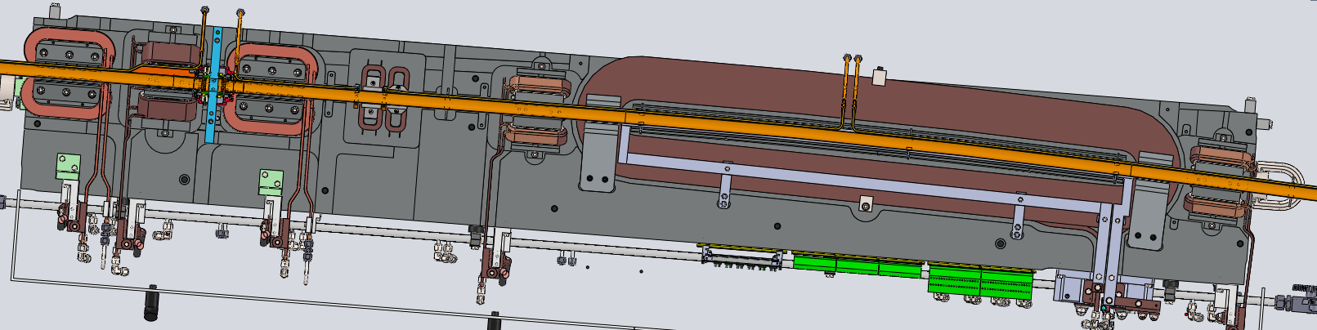
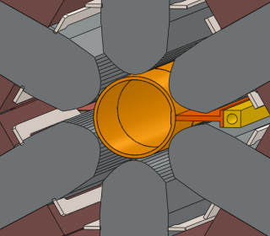
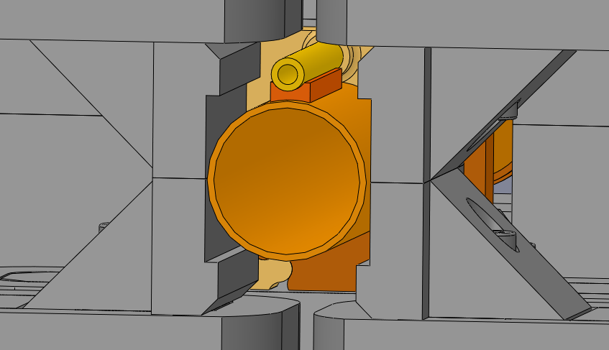
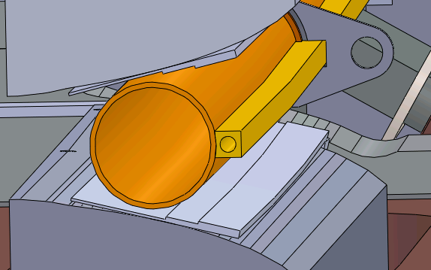

MAX IV (MAX 4^{U}) 3 GeV magnet and vacuum layout
One achromat
Photon beam
- Total length ~26 m,
- 4.5 m straight section (L)
Beam direction
U2, VC4
For MAX 4^{U} the magnet aperture is unchanged (25 mm bore diameter).
Sextupole
25mm
Corrector
Dipole
Ø22 (ID)
Ø25
Chamber ID 22mm
Magnet apertures Ø25mm
Min. clearance with the iron 0.5 mm, min. clearance with the coils 2 mm.

Slide 22
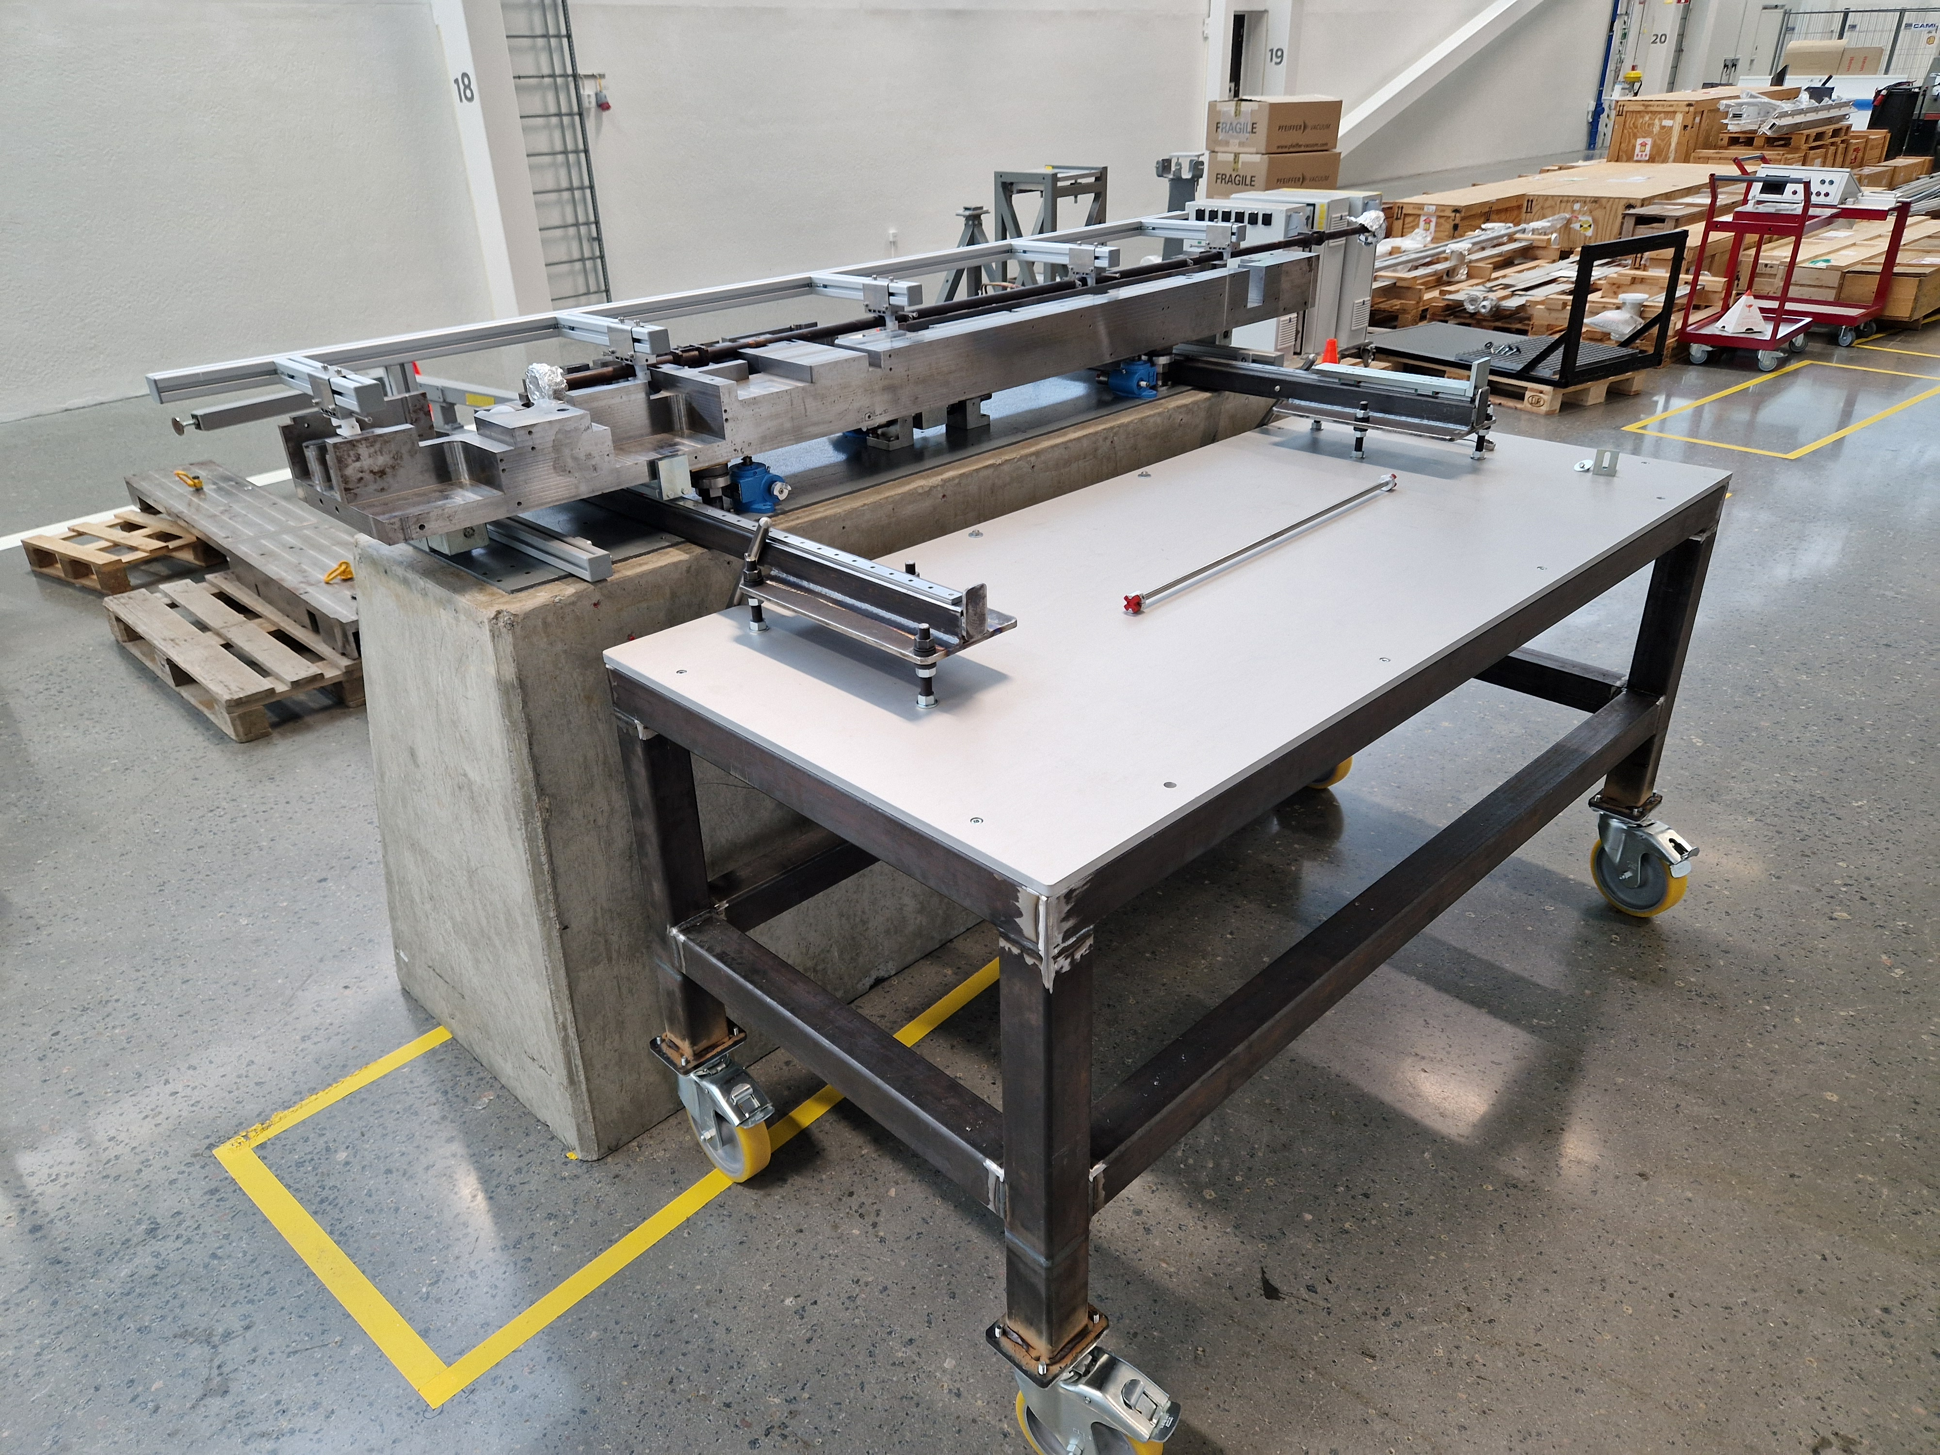
Mock up
First mock-up for development and practice
Concrete stand
Magnet dummy
  R3 UC1,2 iron yoke, top and bottom
Vacuum chambers
Local vacuum strongback
Magnet transportation table
Jacks for lowering bottom magnet cell
Testing procedures and tools

Slide 23
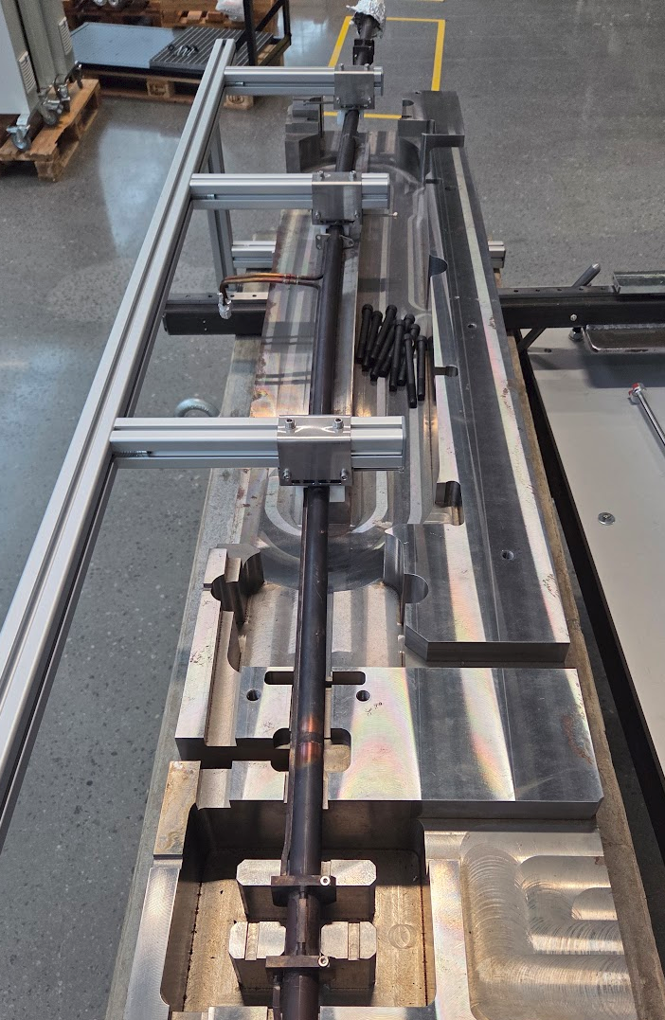
In-situ vacuum Installation concept
Simplified installation procedure for 1 standard achromat (excluding long straight section and RF cavities):
Remove top magnet halves
Install tooling to hang and bend the vacuum system. The tools allow longitudinal expansion of the chambers
Take reference from the old orbit (location of the vacuum chambers and BPMs)
Remove bottom magnet halves
Vent the achromat
Bend reused vacuum chambers to fit the new orbit, install new chambers, pump down, vacuum tests
Align vacuum components (mainly absorbers)
Release vacuum chambers (to allow longitudinal expansion)
Install baking oven, bake, activate NEG, remove oven, vacuum tests
Adjust the vacuum chambers’ shape to fit to the new orbit
Place new bottom magnet halves in nominal position, fit the chamber to the magnet (with pushers keeping the chambers in place)
Add side supports, remove tooling to hang chambers,
Align vacuum components (absorbers)
Place new top magnet halves
Tool to hang and bend vacuum chambers
Transversal adjustment points (bending)
e beam direction

Slide 24
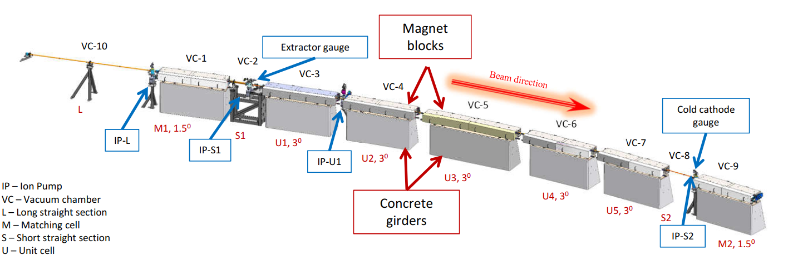
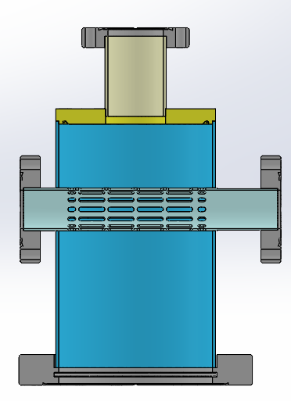
Vacuum Test set up in R3 achromat 6
Measuring point (S2)
Injection/measuring Point (L)
Measuring point (S1)
Conclusion:
The low conductance of the chamber provides a very differential pumping.
Saturation of NEG is only local.
Configuration at injection and measuring point

Slide 25
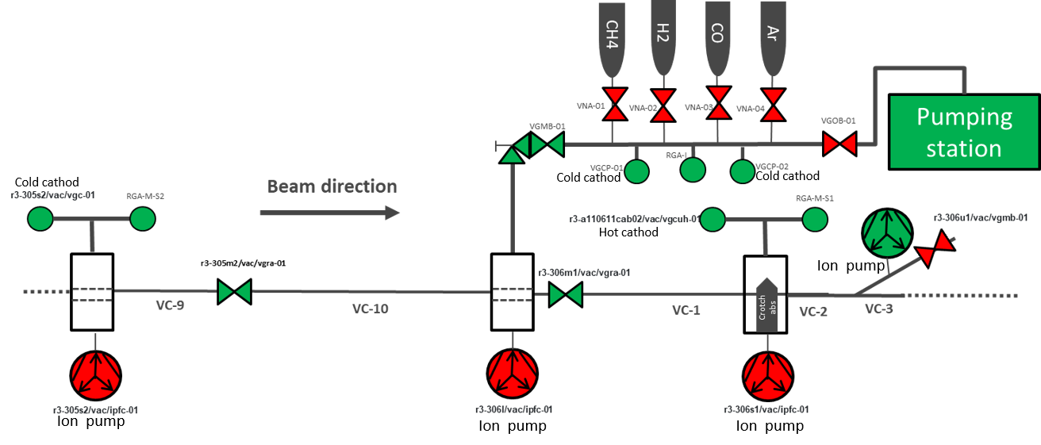
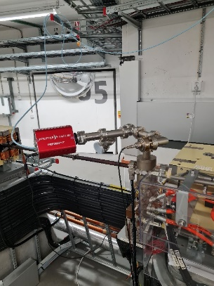
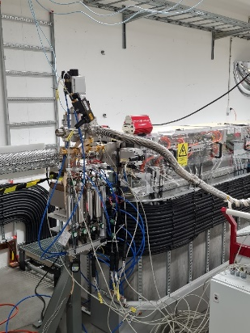
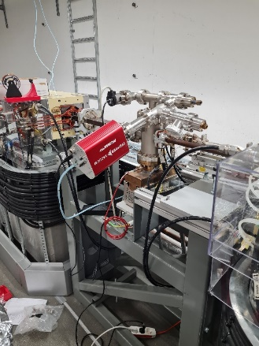
NEG coating study – phase 1
System configuration during measurements
Measuring point (S2)
Injection/measuring Point (L)
Measuring point (S1)
Local pumping speed at Injection point was measured for H₂ and CO. Results showed a local saturation around the injection point.
Distributed pumping speed was evaluated between Injection (L) and Measuring points (S1 and S2: 3,3 m and 6,9 m away from L respectively). Results showed high pressure ratios. This proves a good status of the NEG coating along the pipes.

Slide 26
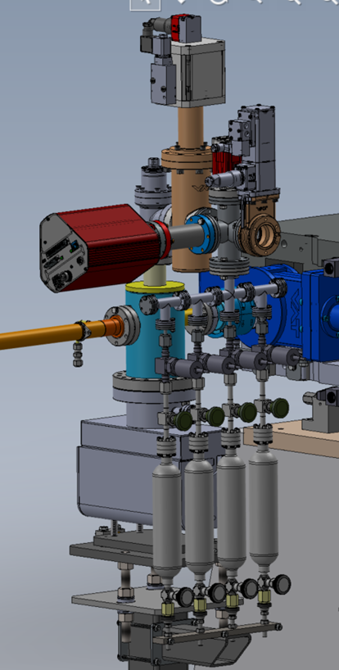
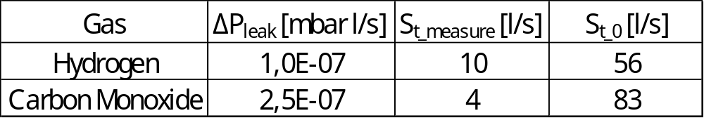

NEG coating study – phase 1
Pumping speed measurements, CO and H2
$$S_{NEG_local}=\frac{Q_{Calibrated leak}}{P_{Injection}−P_{No_Injection}}$$
$${∆P}_{Beam} ×S_{NEG_local}=Q_{Beam}$$

Slide 27
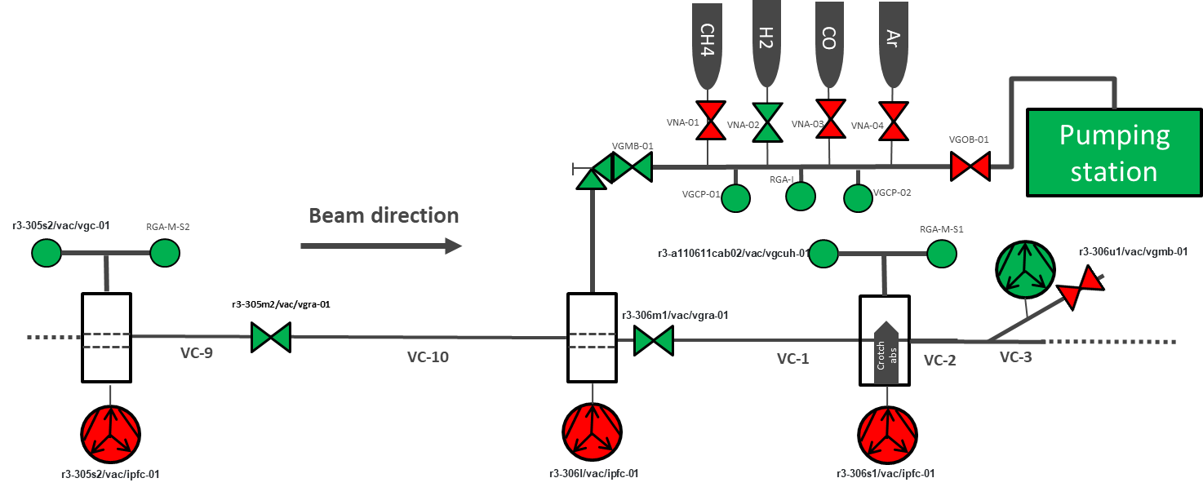





NEG coating study – phase 1
Pumping speed measurements, ratio method
P_{RGA-M-S2}
P_{RGA-M-S1}
<
5m
2m
$${Ratio}_{VC−9,VC−10}=\frac{P_{RGA−I}}{P_{RGA−M−S2}}$$
$${Ratio}_{VC−1}=\frac{P_{RGA−I}}{P_{RGA−M−S1}}$$
${Ratio}_{VC−1, CO}=$ 70000
${Ratio}_{VC−9,VC10}=$ N/A
${Ratio}_{VC−1, H2}=$ 1070
Confirmation of good state of the coating.

Slide 28

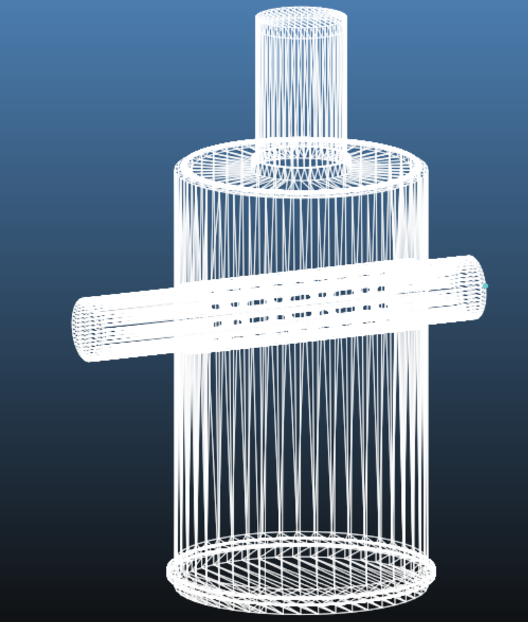
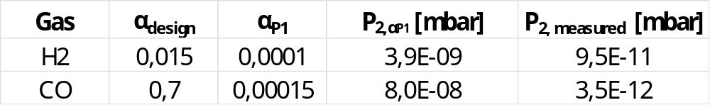
NEG coating study – phase 1
Pumping speed measurements, sticking factor
Q
P1
P2
α ?
2m
Saturation of NEG is local.
Pipe provides a very high differential pumping

Slide 29
NEG coating study – phase 1
Photon induced desorption (Q) measurement

Slide 30
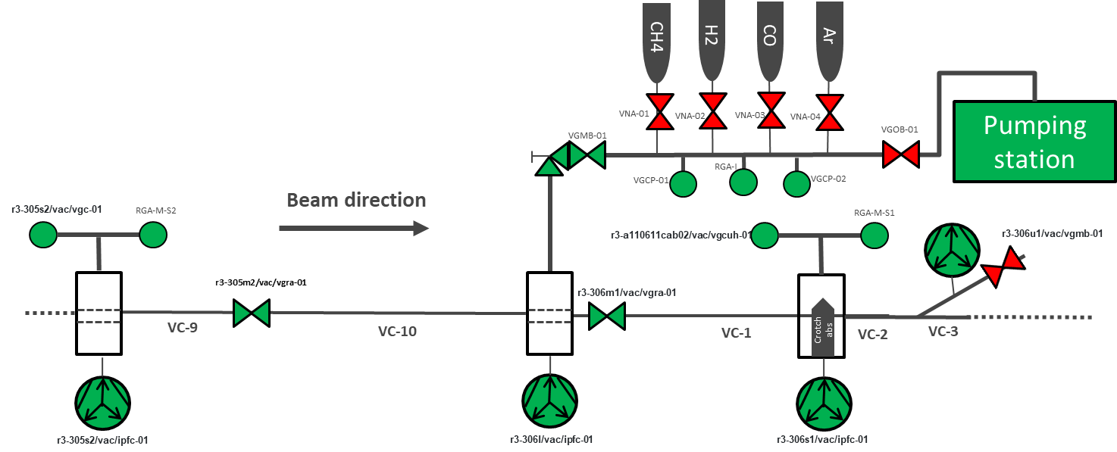
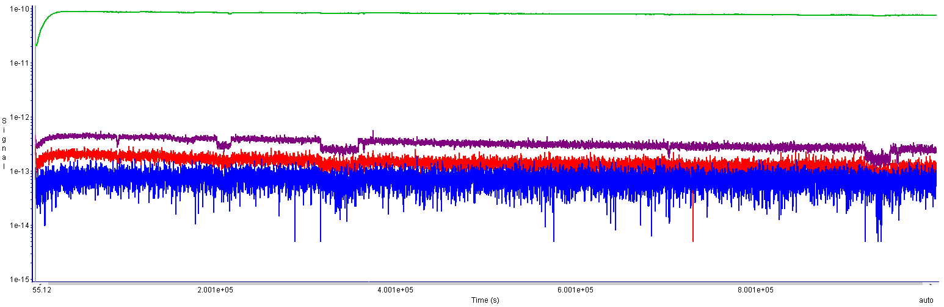
Beam Induced ΔP, IP ON
For operation reasons the IP were ON.
H2
NO BEAM
CO
Beam at 400 mAmp
CH4

Slide 31
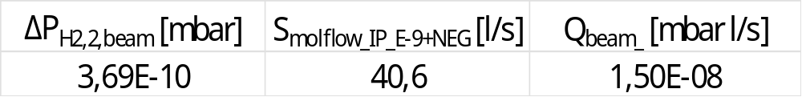
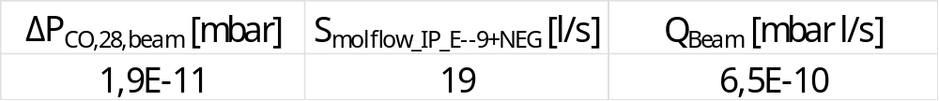
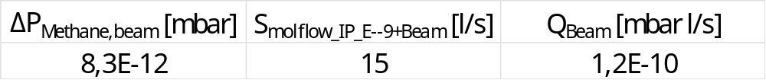
Beam induced desorption (400 mA)
$$Q_{Beam}=S_{NEG+IP_ON}×{∆P}_{Beam}$$

Slide 32
NEG coating study Phase 1 - results
Phase 1 measurements done in 2024 in the long straight section of achromat 6. Gas was injected in one location and pressure was measured with RGAs at the injection point (L) and at two measuring points: upstream (S2) and downstream (S1) injection.
Local pumping speed at injection point (L) of 4 l/s for CO and 10 l/s H₂ were measured. This results show a local saturation around the injection point.
Measured high pressure ratios between injection (L) and measuring points (S1 and S2: 3,3 m and 6,9 m away from L respectively) proves a good status of the NEG coating along the pipes.
CH4 beam pumping effect has been measured, with average specific pumping speed of 0,005 l/s/Amp.
Injection system schematics
Notes:
〖Ratio〗_(VC-1, CO)= 70,000
〖Ratio〗_(VC-1, H2)= 1,070
〖Ratio〗_(VC-9,VC10)= N/A

Slide 33
NEG coating study – phase 2
A new chamber with 5 lateral ports to be installed at the beginning of the achromat
Pumping speed measurements (local and integrals) to be taken after first activation
The same measurements to be taken with increasing level of synchrotron radiation dose

Slide 34
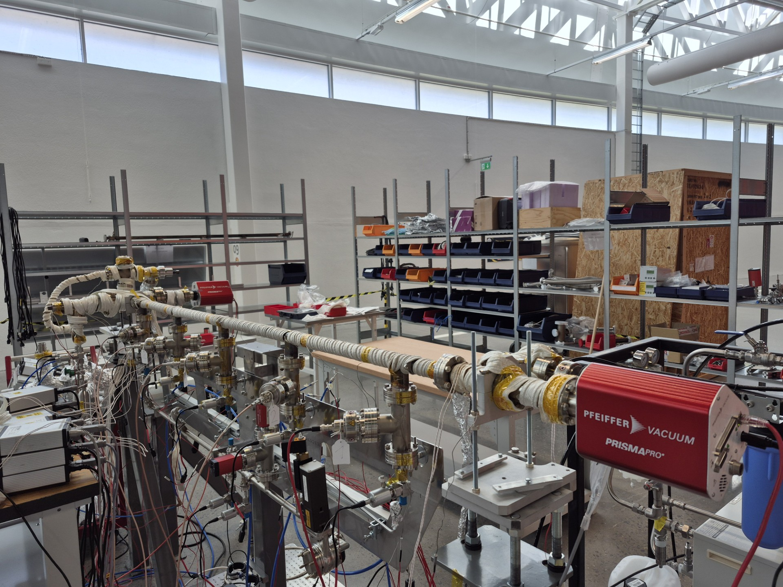
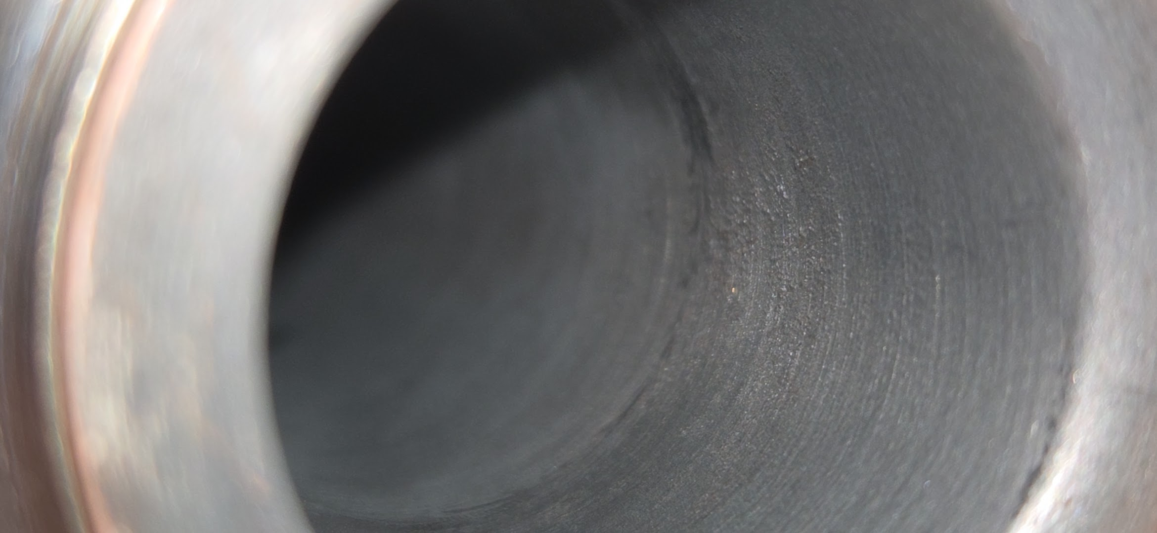
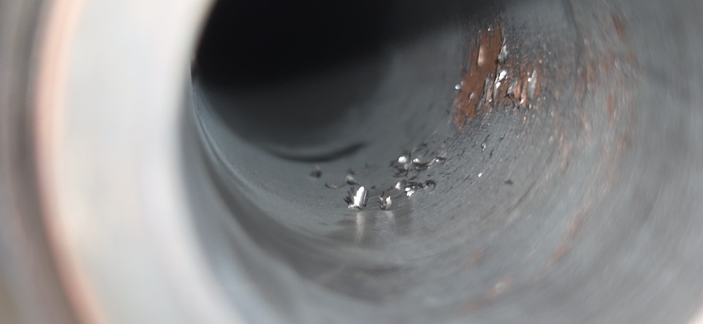
NEG coating study Phase 2 - Status
Gas injection
The chamber installation planned in 2025 was delayed because the lateral ports were NEG coated (which was not intended).
The chamber was shipped back to supplier where the coating was removed by mechanical abrasion. To remove eventual dust, the chamber was flushed with acetone.
No anomalies were observed at supplier during vacuum tests.
The chamber was installed outside the tunnel for testing. Uncoated parts were baked, then coated parts were activated.
After activation, the pressure was in 10E-7 range and no ratio was measurable (NEG coating did not activate).
The installation and measurements must be delayed again.
The NEG coating inside the chamber was peeling off on one side.
RGA 1
RGA 2
NEG coating before wiping with lint free wiper
NEG coating after wiping with lint free wiper

Slide 35
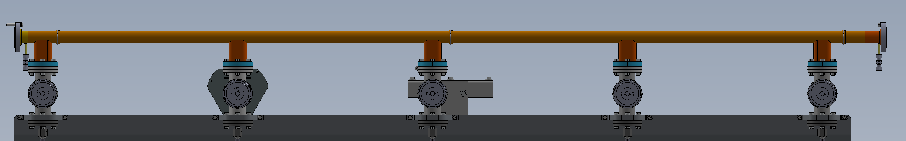
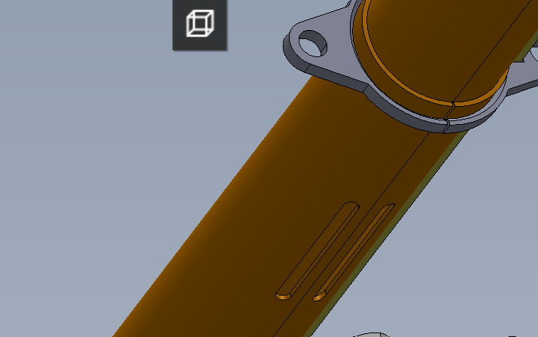
Phase 2 – Possible issues during activation
According to the nominal activation procedure the NEG coated parts shall be at 80 deg C while unbaked parts shall be at 300 deg C. This was not achievable because of the complexity of the chambers.
In the picture below the temperatures during bake-out are shown. Activation was at 180 degC for 24 hours.
Possible reasons
  We could not reach the bake-out correct temperatures. The bake-out run however for several days
  During the bake-out the gas could only “escape” through the small slits on the chamber. This could affect the efficacy of the process.
For validation test, a dummy chamber (without ports) was activated using the nominal (keeping uncoated parts at lower temperature) and simplified (keeping all parts at the same temperatures) activation procedures. The NEG film activated effectively only using the nominal procedure.
Gas injection assembly and RGA @ 300 degC
Coated pipe @ 50 deg C. We had to use water cooling to avoid heat transfer from the 5 appendixes and we could not find a better balance.
RGA @ 300 degC
Uncoated copper nipple @ 110 degC
Tee and gauge @ 250 degC
Notes:
Tests were done on a dummy chamber (without lateral ports) and we could measure high pressure ratio at the ends (chamber was activated). Chamber was activated using nominal activation procedure, if uniform baking/activation is used for the whole assembly the chamber was activating much less.

Slide 36
Phase 2 – possible solutions
A second attempt could be done to activate the chamber
If the problem is structural the following tasks can be implemented:
  Cut the chamber and analyse the coating to see if the type of contamination which saturated the coating
  Optimizing the size of the slits
  Move to a stainless-steel chamber. The lower thermal conductivity could allow to bake the uncoated nipple without increasing the pipe temperature too much
  Add pumping ports at the lateral nipples.

Slide 37
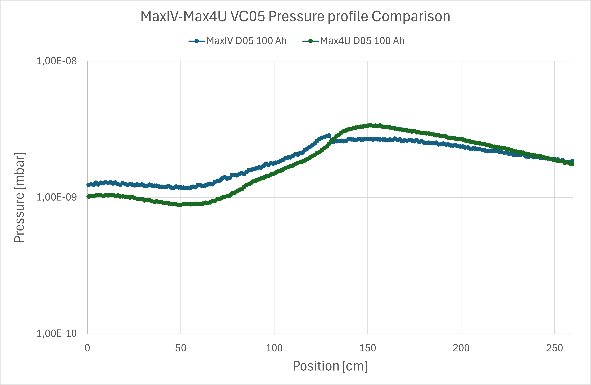
Pressure profile – preliminary along 2,5 m long chamber in the arc center
Pressure profile simulations done for previous lattice (8.08 mm max orbit deviation in the arc center). The pressure profile for TDR-1 lattice will be similar, thus similar to the existing storage ring. Work is ongoing.
Synrad+ used for photon flux from dipole and reverse bends.
Molflow+ was used for the pressure profile and compared to R3 at that section.
More detailed study is ongoing
Simulations by Simone Maria Scolari
Pressure profile for 8.08 mm orbit deviation, scenario C: All new vacuum chambers (activated), arc center (VC-5).

