Slide 1
Survey and Alignment Strategy for MAX 4^{U}
NSLS II-MAX IV workshop
5-6 Oct. 2026
Keyu Zhou

Slide 2
Outline
Survey and Alignment Work at MAX IV
What Does MAX 4^{U} Mean to Alignment?
Survey and Alignment Strategy for MAX 4^{U}
Conclusion

Slide 3
Outline
Survey and Alignment Work at MAX IV
Alignment needs at accelerators and beamlines
Survey and alignment networks at MAX IV
Alignment strategy at MAX IV
What Does MAX 4^{U} Mean to Alignment?
Survey and Alignment Strategy for MAX 4^{U}
Conclusion
Keyu Zhou
27 July 2023
OCT. 2026
Nsls ii-max iv wORKSHOP

Slide 4
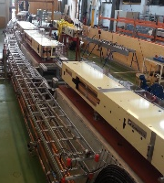
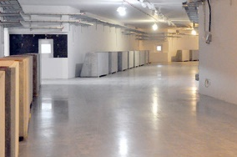
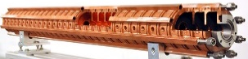
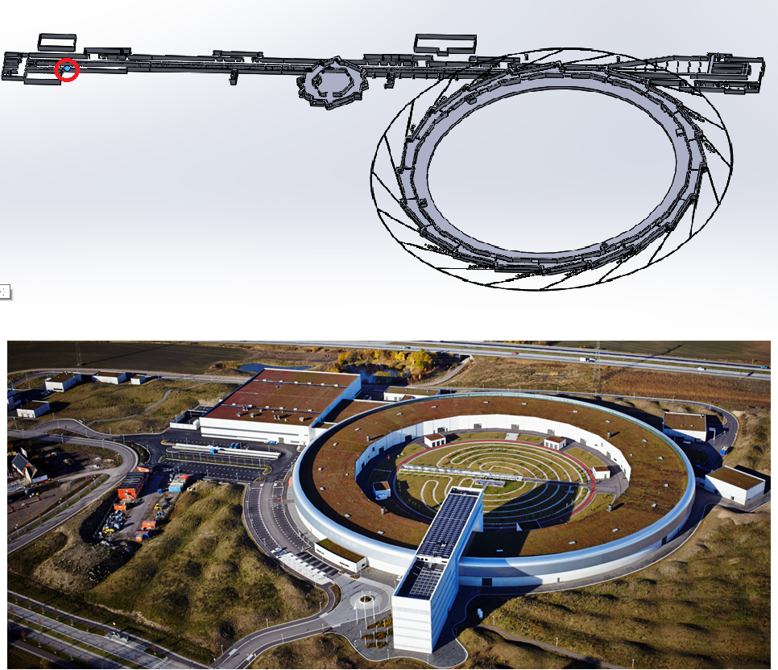
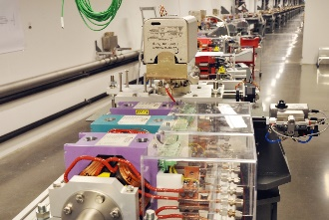
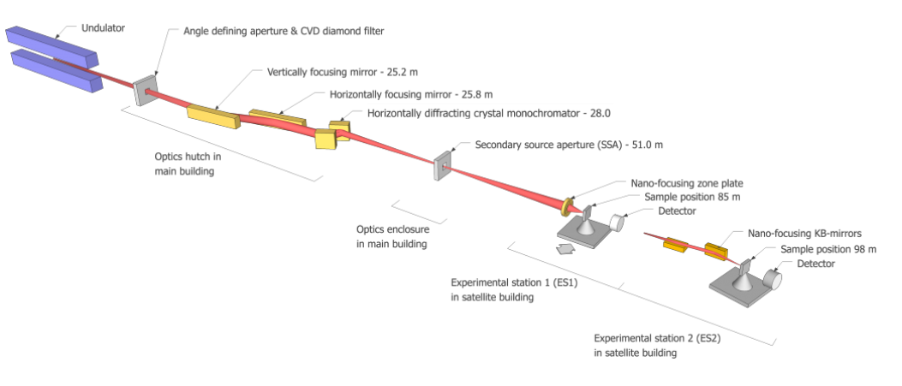
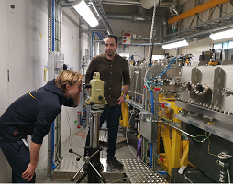
Alignment needs at MAX IV
Accelerators alignment:
Gun alignment
Linac element alignment
Transfer lines alignment
…
Linac element alignment
1.5 Gev Ring and 3 Gev Ring magnets alignment
Linac and SPF magnets alignment
Beamline alignment:
Insertion device alignment
Front End alignment
Optics alignment
End station alignment
…
CoSAXS optical hutch alignment
NanoMAX beamline

Slide 5
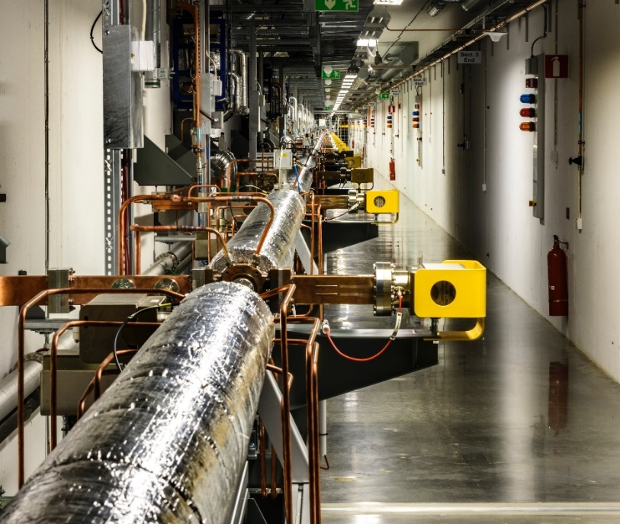
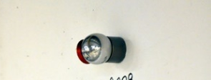
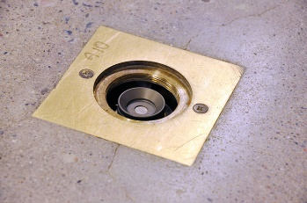
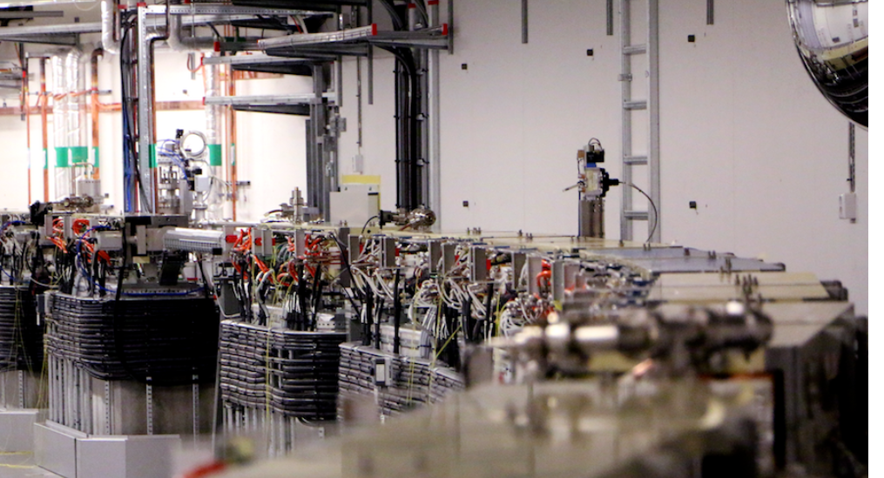
Alignment network at MAX IV
Local network, no connection to outside geodetic networks
Nests on both of sides of wall and floor
Two different height of wall nests to have better
differential distribution of vertical angle observations
Horizontal distance ~6 m
Floor nest:
Glued to the floor
Wall nest:
Mounted on the wall with
expansion bolts

Slide 6
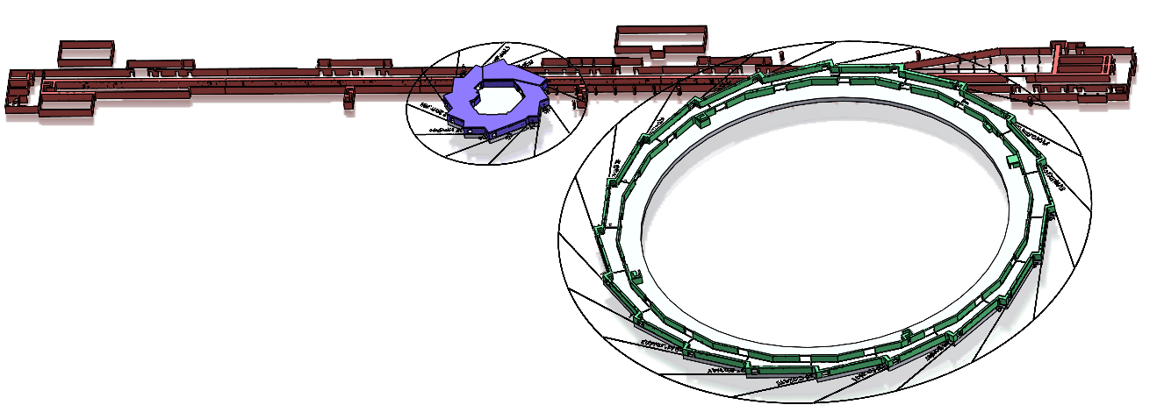
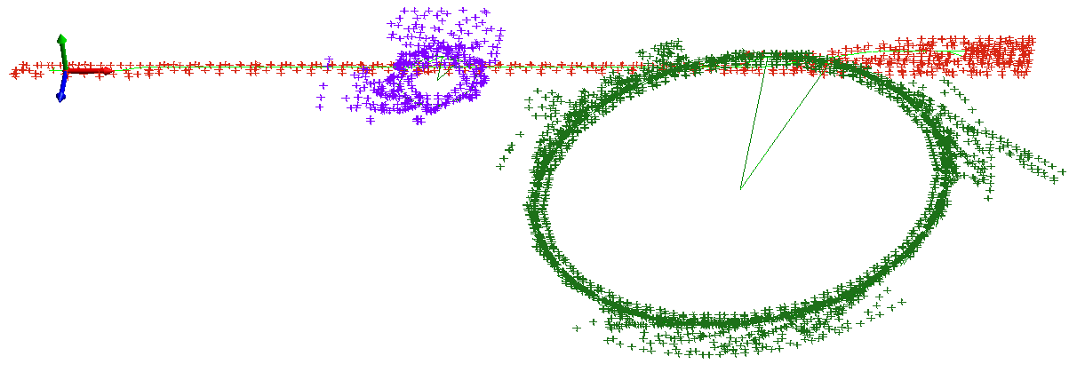
Alignment network at MAX IV
MAX IV Facility (CAD)
Three independent networks
Network 1: Linac tunnel +SPF area+TR1+TR3
Network 2: 3 GeV ring tunnel + 3 GeV ring beamline area
Network 3: 1.5 GeV ring + 1.5 GeV ring beamline area

Slide 7
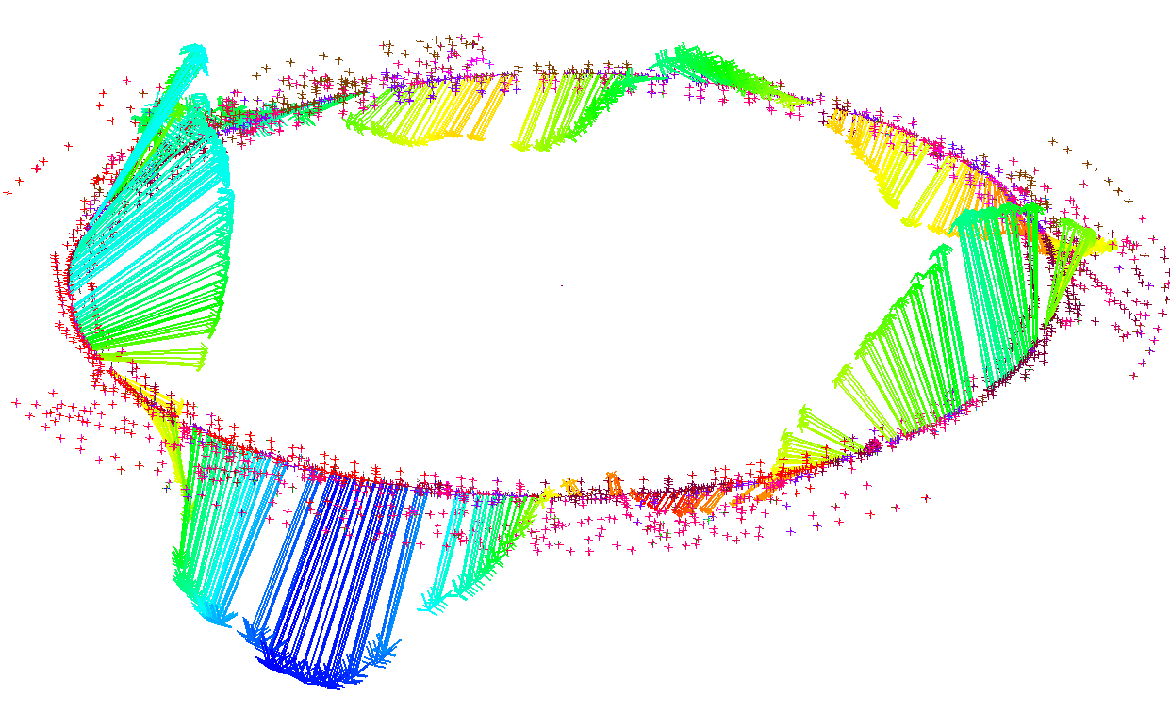
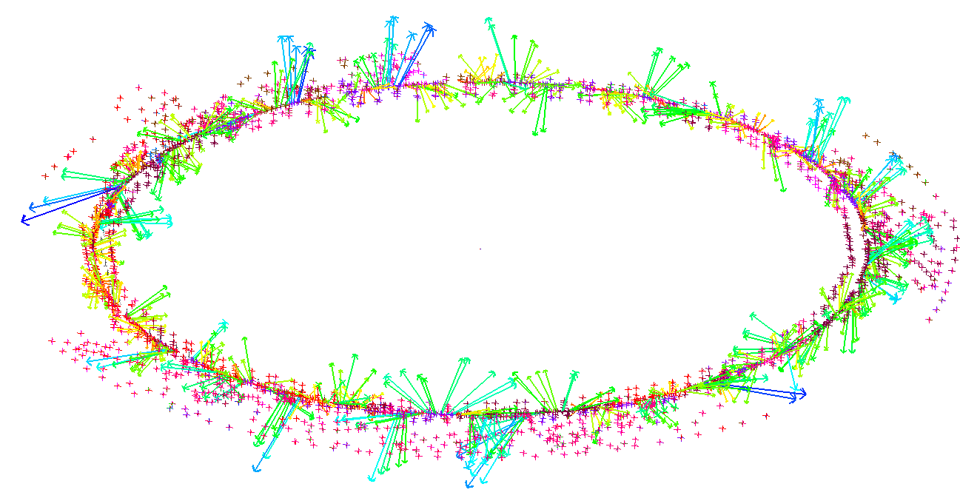
Alignment network at MAX IV
Limitation of free adjustment solution:
No Absolute external reference at MAX IV, the network remains floating in space
Blindness to gravity and earth’s curvature for large scale network
Stack-up error, especially with poor geometric diversity
Waviness:
Low spatial frequency error
Roughness:
High spatial frequency error
Errors=
+
We have a weak estimation of waviness
Corrector-magnets can handle the waviness
Boundary conditions introduced

Slide 8
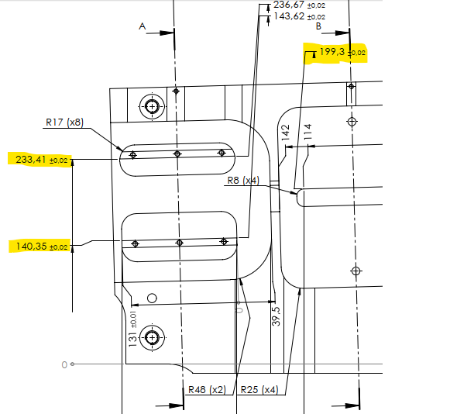
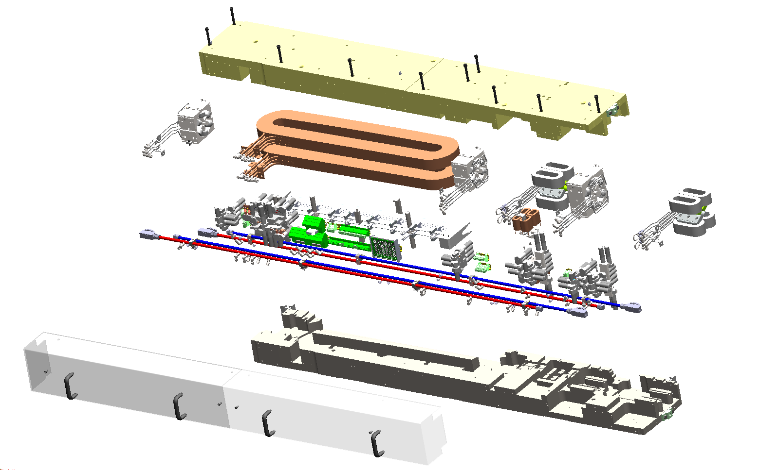
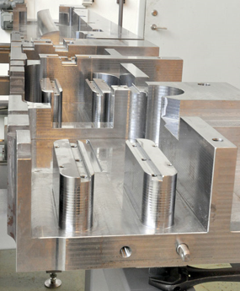
3 GeV ring magnets alignment
Magnet cell in 3 GeV ring: integrated unit containing consecutive magnet elements in a common solid iron block
Intra magnet cell alignment: Guaranteed by mechanical manufacturing tolerance
Upper yoke
Magnets
Lower yoke
UC4 magnet cell
Magnet half yoke with very tight manufacturing tolerance

Slide 9
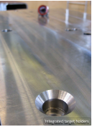
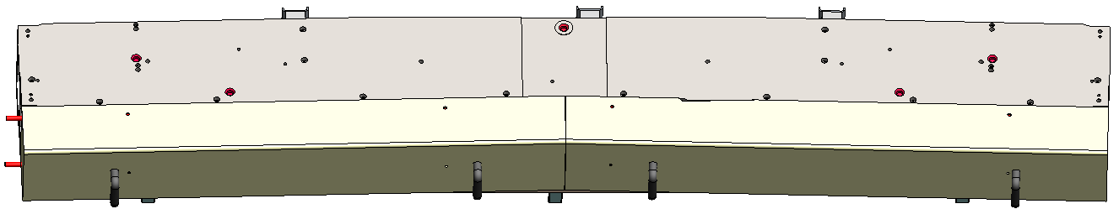
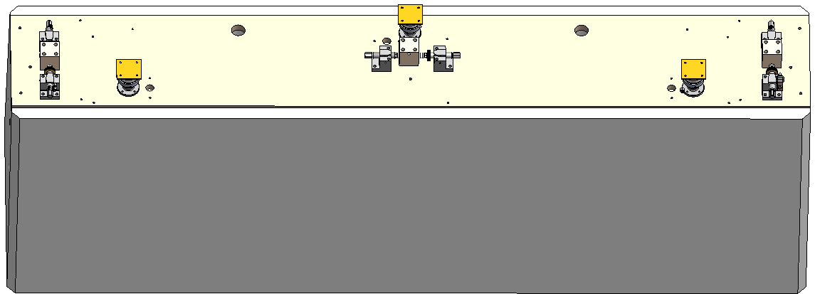
3 GeV ring magnets alignment
Inter magnet cell alignment:
Fiducialization is done by manufacturer
Cell to cell alignment is done with standard MAX IV alignment sets
5 Fiducial nests on each magnet cell
Standard MAX IV alignment sets

Slide 10
Outline
Survey and Alignment Work at MAX IV
What Does MAX 4^{U} Mean to Alignment?
Alignment requirements for 3 GeV ring
Error budget for MAX 4^{U}
Survey and Alignment Strategy for MAX 4^{U}
Conclusion
Keyu Zhou
27 July 2023
OCT. 2026
Nsls ii-max iv wORKSHOP

Slide 11
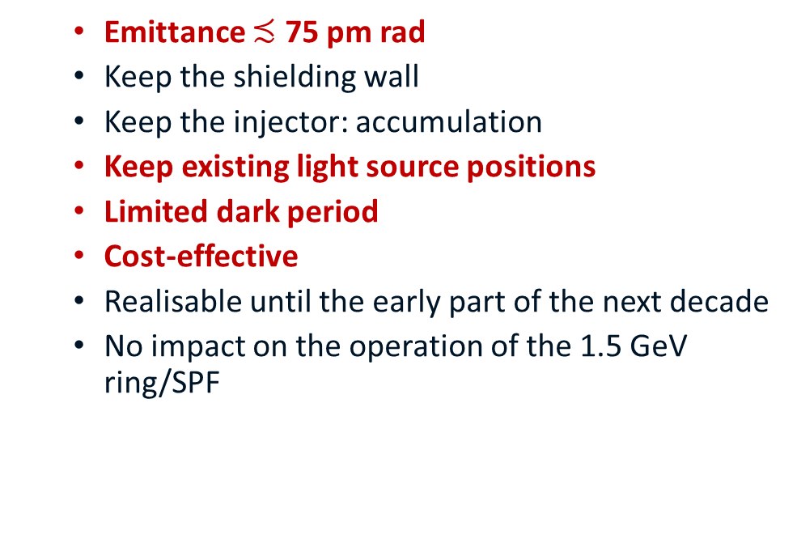
What does MAX 4^{U} mean to survey and alignment
MAX 4^{U} goals and boundary conditions
Survey and alignment assumptions based on MAX 4^{U} goals and boundary conditions:
  Emittance $≾$ 75 pm rad
  Keep the shielding wall
  Keep the injector: accumulation
  Keep existing light source positions
  Limited dark period
  Cost-effective
  Realisable until the early part of the next decade
  No impact on the operation of the 1.5 GeV ring/SPF
Tighter alignment requirements
Light sources/Insertion devices could be taken as boundary condition for the network solution, to keep the source positions of the beamlines.
The same fiducialization and alignment system as for 3 GeV ring will be adopted.

Slide 12
Alignment accuracy
1
Network Survey
Design review
Network/
Localization Accuracy
Proper alignment system
Alignment accuracy might achieve
Alignment accuracy achieved
Measurement accuracy
Fiducialization
Alignment
2

Slide 13
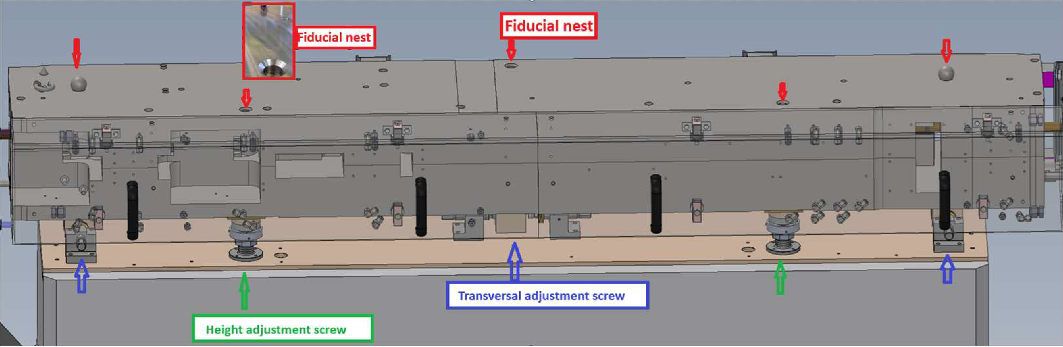
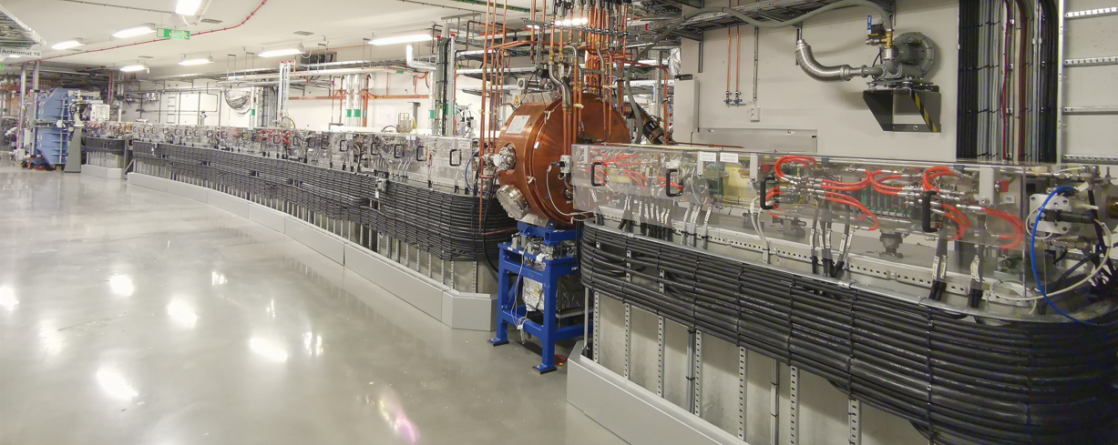

Alignment requirements in R3
UC 3 magnet in 3GeV-ring (CAD)
1 achromat in 3GeV-ring
3GeV-ring:
  140 integrated magnet blocks in 20 achromats.
  Block size: 256x350x2300-3350 mm.
  Block-to-block alignment requirements:
  100 (goal 50) μm, 1σ
  Roll: 0.2mrad, 1σ.
  Diameter size requirements: down to a few mm
We don’t have intra-girder alignment
Relative alignment requirement
Global alignment requirement
Accuracy of the magnets inside one block is guaranteed by machining tolerances.
Mechanical tolerances

Slide 14
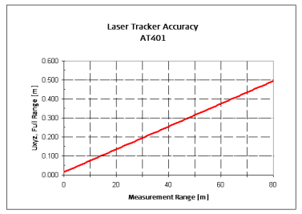
R3 magnet cell misalignment error
Measurement accuracy according to manufacturer
3D misalignment error analysis
3D Accuracy:
15 μm + 6 μm/m (MPE)
Laser tracker survey data from 3 independent surveys in Survey R3-2016, 2017 and 2021
For each survey, 100 stations inside R3 tunnel were used in simulation.
An average measurement distance of 6.1 m in radius in the three surveys.
Weight=1 on magnets nominals as boundary condition for local alignment uncertainty simulation.
Angular uncertainty: 1 arcsecond
Distance uncertainty: 0.00762 mm+0.0025 mm/m
Local alignment uncertainty does not include waviness of network

Slide 15
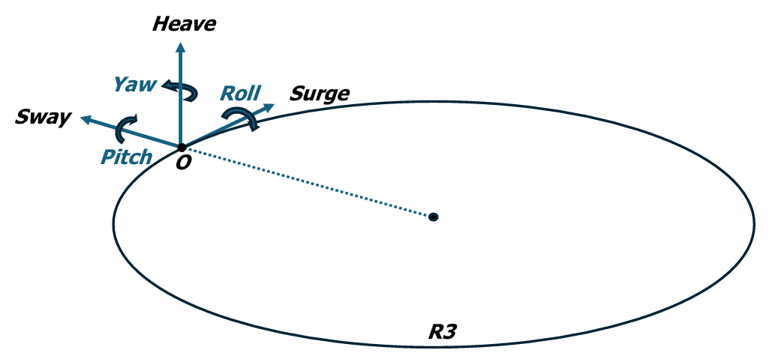
R3 magnet cell misalignment error
Simulation is based on:
6.6 m shot length assumed for laser tracker measurement in network survey.
3.5 m shot length assumed for laser tracker measurement in alignment.
New alignment network (no deformation) used for localization
Definition of frame with origin on the beam on the mid-point along a magnet-cell
Simulated 6-DOF error of A01M1 Cell
A 3D fiducial local absolute uncertainty of 63 µm (1σ) is used for simulation
This uncertainty simulation was presented in CDR phase.
It is now updated with new data after relative alignment study

Slide 16
Outline
Survey and Alignment Work at MAX IV
Alignment requirement for MAX 4^{U}
Survey and Alignment Strategy for MAX 4^{U}
Survey strategy for MAX 4^{U}
Alignment strategy for MAX 4^{U}
Conclusion
Keyu Zhou
27 July 2023
OCT. 2026
Nsls ii-max iv wORKSHOP

Slide 17
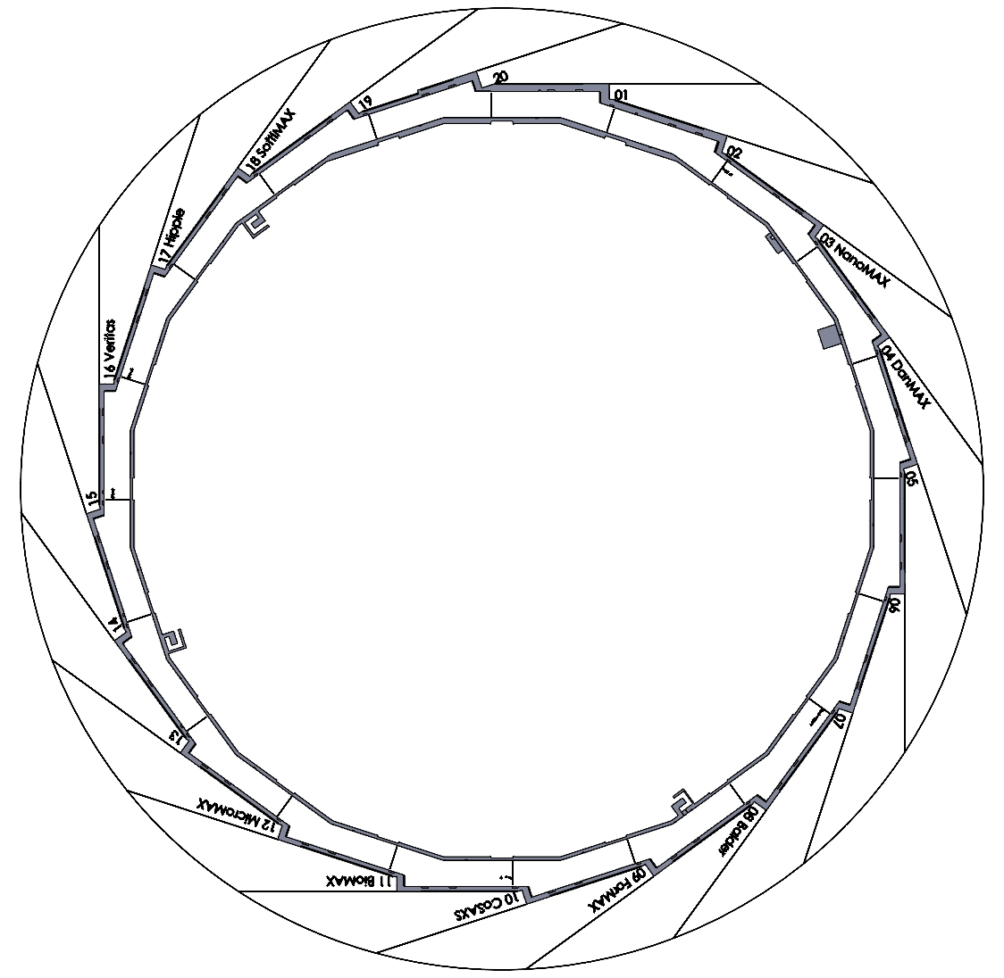
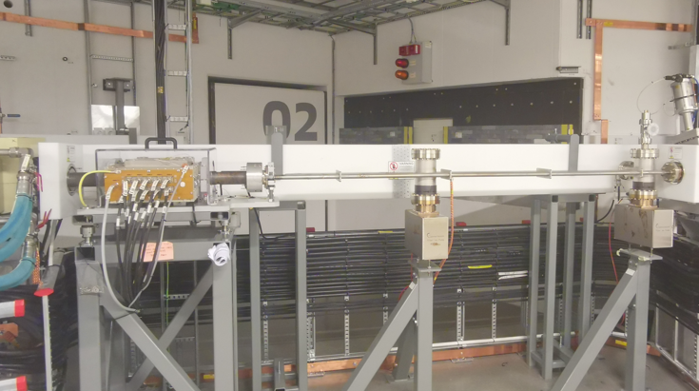
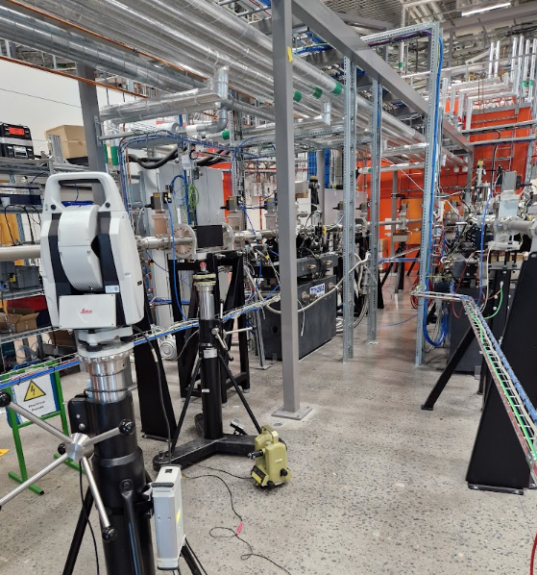
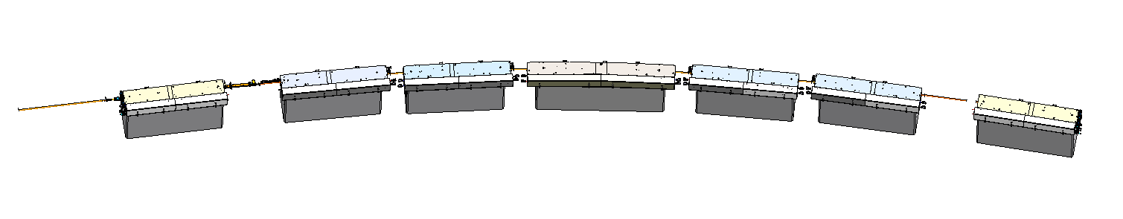
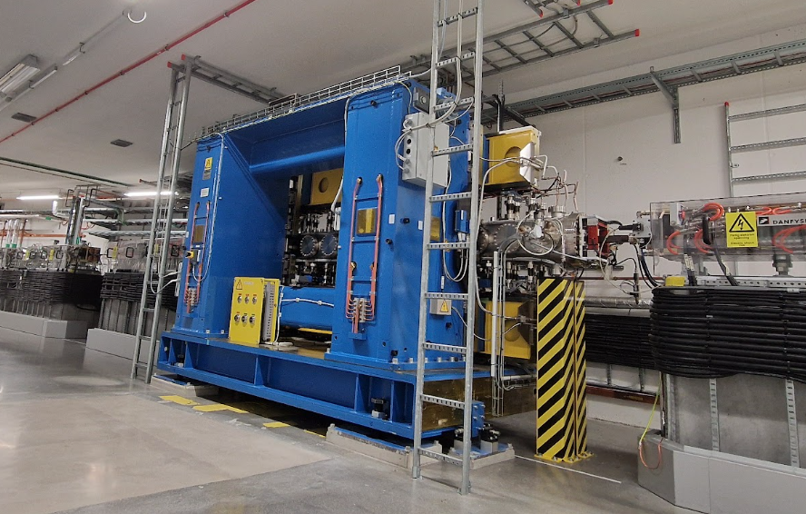
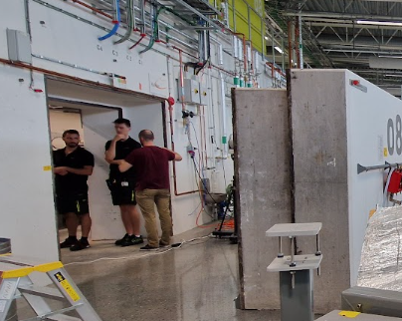
3 GeV ring network survey
Front end area in R3 tunnel
3 GeV ring boundary condition:
Hippie beamline area
Insertion device nominals
M1, U1, U2,U3,U4, U5, M2
magnets nominals
Network floor points inside tunnel
Network points at beamline area
NanoMAX undulator
Magnet cells in one achromat
Concrete gate connecting tunnel and beamline networks

Slide 18
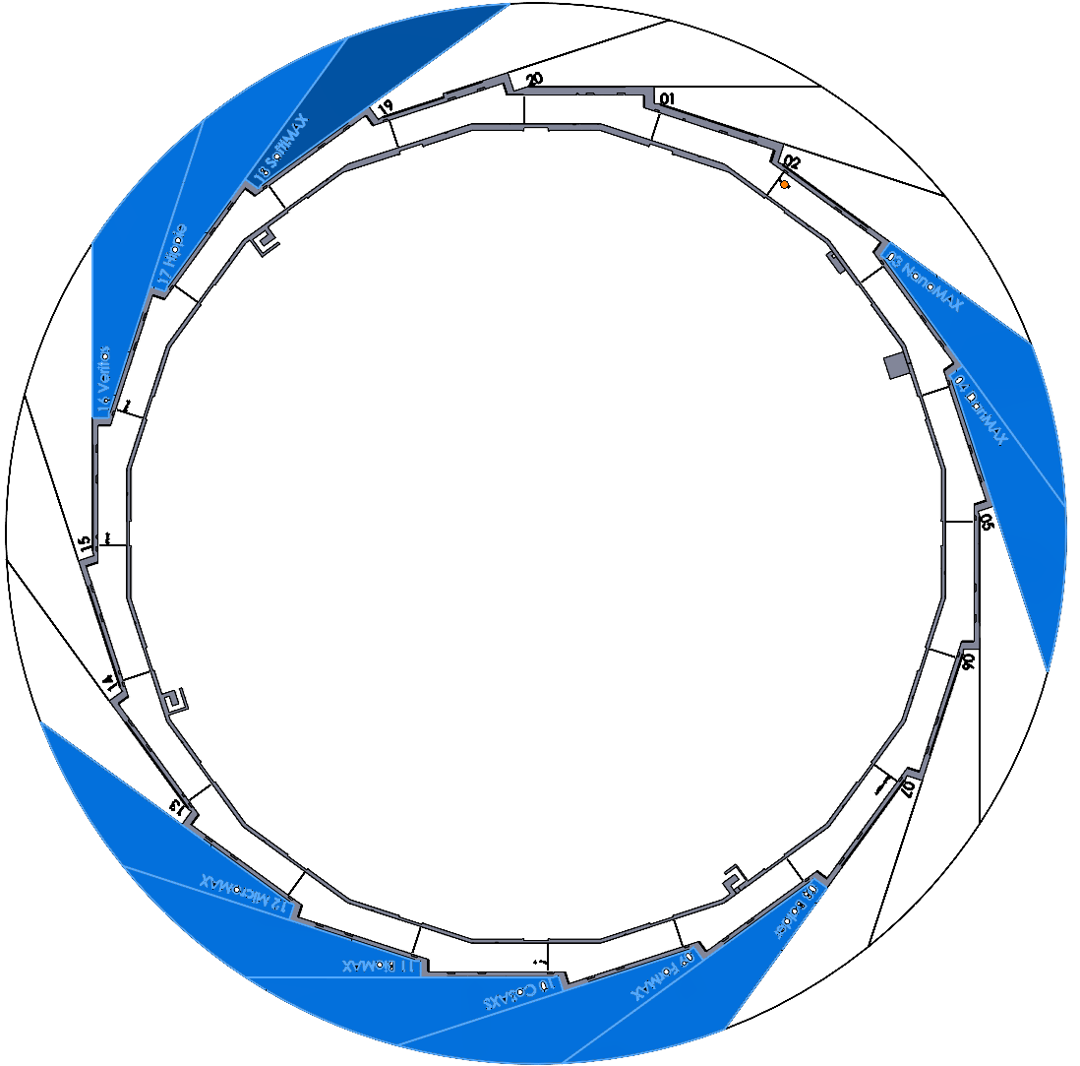
MAX 4^{U} network survey
TR3
MAX 4^{U} condition
MAX 4^{U} Survey Strategy
Magnet nominals will NOT be used as boundary conditions anymore.
A new alignment network should be used for the alignment of the magnet blocks.
A complete network survey needs to be done including beamline areas.
12 Insertion devices nominals will be used as network boundary condition
More floor points are added inside R3 tunnel. If floor points should be used as boundary conditions still under discussion
Magnet cells nominals will NOT be the same
10 Existing beamlines
1 New beamline under construction
Light sources/ Insertion devices nominals should NOT be changed or moved
TR3 might need realignment

Slide 19
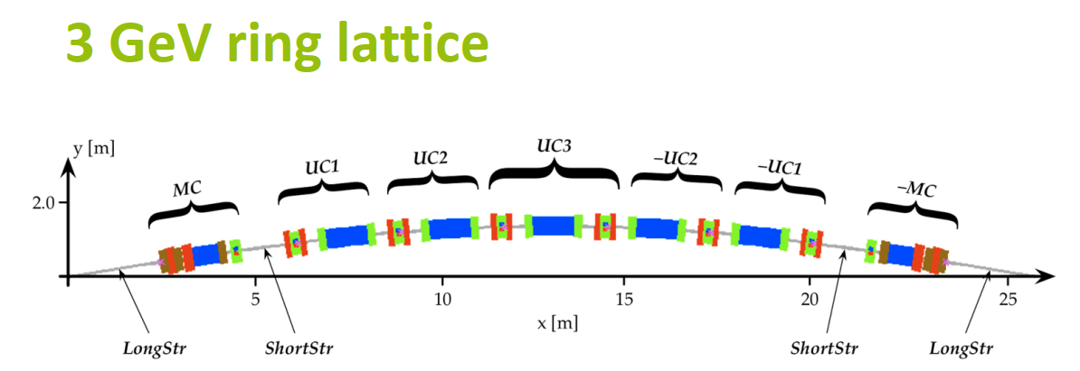
MAX 4^{U} alignment strategy
Assumptions:
Magnet cells will use Identical alignment systems and fiducialization strategies as it is in R3
Relative accuracy between the magnet cells are more important than global accuracy, the closer the magnet cells are, the tighter requirements are needed.
7 magnet cells in Achromat 3
Measurement project:
Relative-station
Absolute-station #2
(including network)
Absolute-station #1
(Including network)
Absolute station: Instrument localized with the network, using double face measurement.
Relative station: Instrument localized with neighboring magnet cells that are aligned (measured) in absolute stations, using single face measurement.

Slide 20
MAX 4^{U} alignment strategy
Strategy 1
6.5 m
10 m
Localization shots
Alignment shots
Absolute-station #1
Relative-station
13.2 m
Absolute-station #2
Strategy 2
6.5 m
Localization shots
7.4 m
Alignment shots
10 m
Absolute-station #1
Relative-station
Absolute-station #2
Strategy 3
Localization shots
Alignment shots
Absolute-station #1
Relative-station
Absolute-station #2
Project led by Behrouz Afzali Far

Slide 21
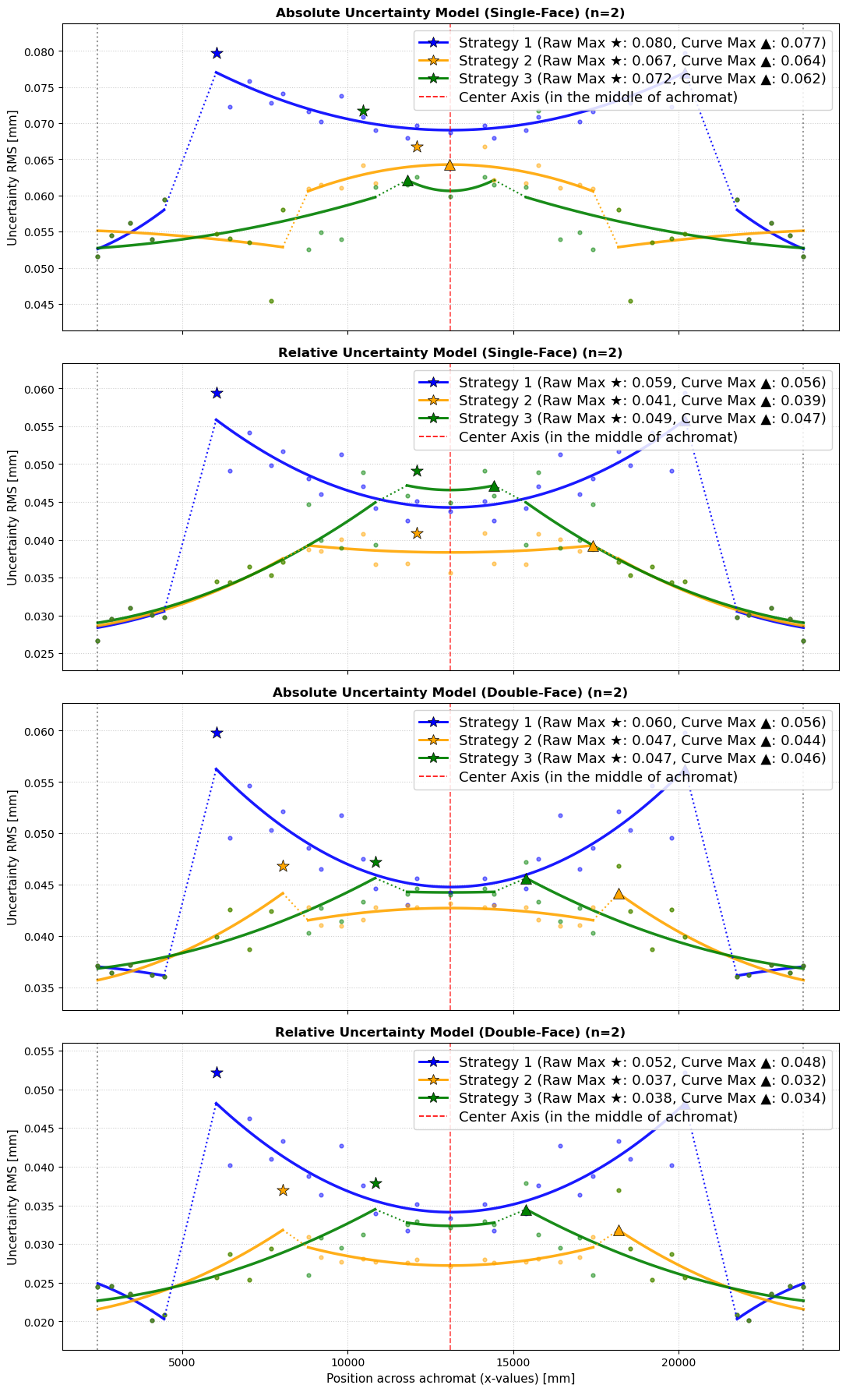
Preliminary Results (relative uncertainty)
Across one achromat
Strategy 2 yields the best results which according to the model, considering the manual uncertainty (16.7 µm), is roughly 40 µm.
If we consider the 120% factor of safety: 48 µm
Project led by Behrouz Afzali Far

Slide 22
Outline
Survey and Alignment Work at MAX IV
Alignment requirement for MAX 4U
Survey and Alignment Strategy for MAX 4U
Conclusion
Keyu Zhou
27 July 2023
OCT. 2026
Nsls ii-max iv wORKSHOP

Slide 23
Conclusion
Survey and alignment assumptions based on MAX 4^{U} goals and boundary conditions:
The same fiducialization and alignment system as on 3 GeV ring will be adopted.
A full network survey including beamline area needs to be taken before but close to the dark period, one option is in Summer shutdown 2030.
Light sources/Insertion devices should be taken as boundary conditions for the network solution, to keep the source positions of the beamlines.
Relative magnet-cell to magnet-cell alignment uncertainty needs to be considered with priority

Slide 24
Thank you

Slide 25
Complementary Material

Slide 26
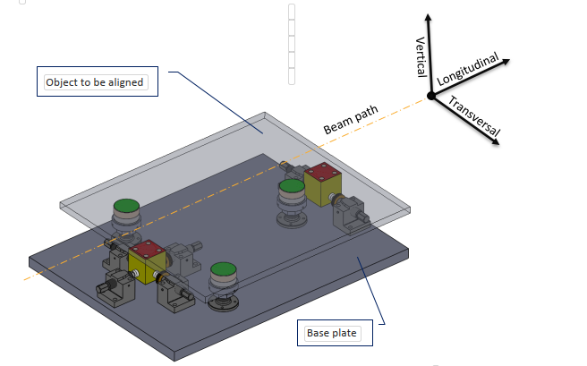
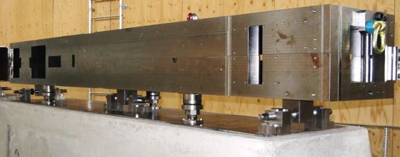
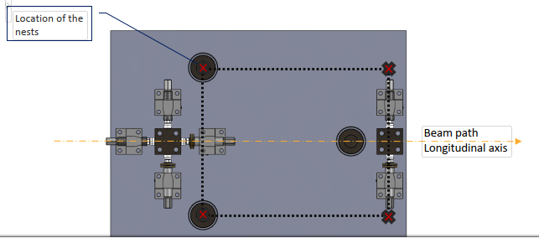
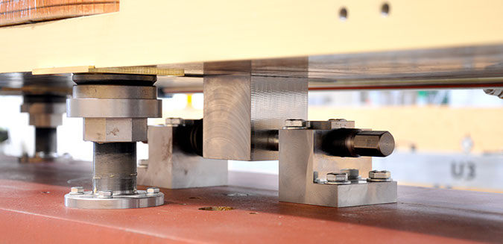
Alignment system
Minimal kinematic coupling
(one thing at a time)
Reflector nests close to feet to
minimize alignment iteration
MAX IV_Alignment _Standard-1.0

Slide 27
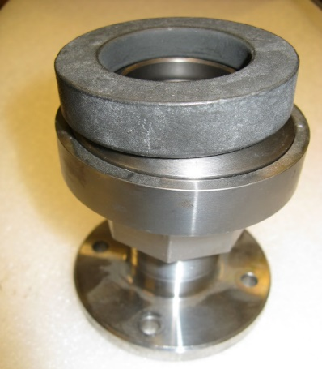
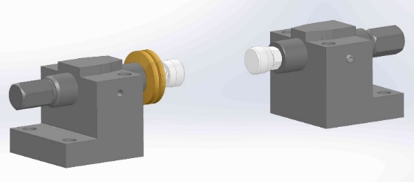
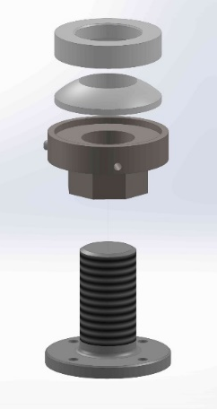
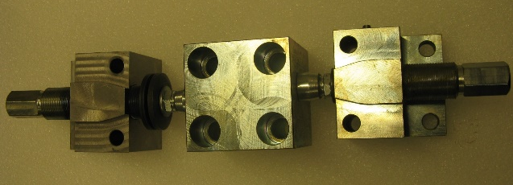
Alignment system
Vertical feet
Transversal feet
Structure
Pitch
Resolution
Full Range
Safe Range
Advantage
Threaded rod +spherical bearing
+sliding surfaces
Locking screws
1mm
5 μm
21 mm
±5 mm
index + Belleville washer (push-repush )
+spherical bearings + sliding surfaces
1mm
5 μm (one tenth of alignment tolerance)
36 mm
±12.5 mm
Minimal stick-and-slip, Easy and straightforward to use

Slide 28
Updated error model: magnitudes
No truly complete error model exists; reality is always more complex
 | Magnet misalignment (µm/µrad) [2,3] | Girder misalignment (µm/µrad) [1,4] | BPM "misalignment" (µm/µrad) [5]
Sway | 4 | 27 | 3
Heave | 9 | 21 | 3
Surge | (0) | 16 | (0)
Pitch | (0) | 21 | (0)
Yaw | (0) | 21 | (0)
Roll | 100 | 157 | 100
Sag | - | 20 | -
Bold – based on data (references below)
(parenthesis) – ignored as impact reasoned to be negligible
Red – proxy value used (measured BBA reproducibility, i.e. only includes random component)
Blue – unavailable, historical assumption used. NB! Magnet roll errors show up as skew components in evaluation of series production field measurement data.
Sources
Internal MAX IV report by SAM
M. Johansson et al., "Magnet design for a low-emittance storage ring", Journal of Synch. Rad., July 2014
M. Johansson et al., "MAX IV 3 GeV STORAGE RING MAGNET BLOCK PRODUCTION SERIES MEASUREMENT RESULTS", Proc. of IPAC 2015
Internal communication, Design Office
Experimental data
28

Slide 29
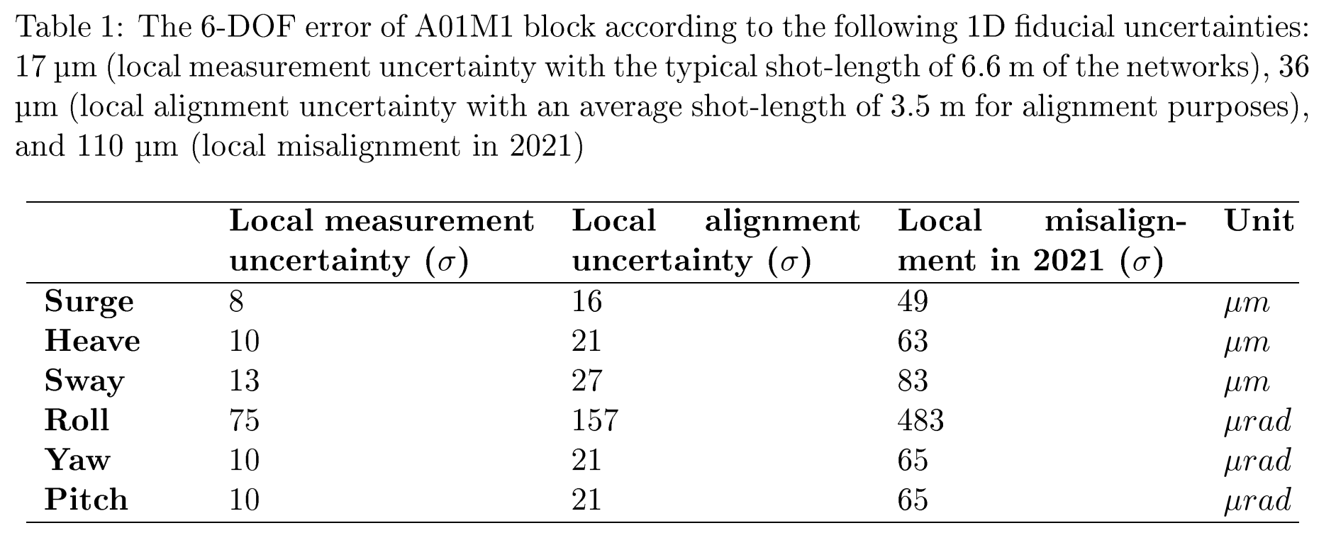
What is our error model?
Local error
Alignment uncertainty model:
Total (includes the waviness, this is not relevant for realignment)
Local (where nominal points are used to remove the stack-up error)
  Absolute (to the network)
  Relative (cell-to-cell)
alignment
measurement
Misalignment
Misalignment could be larger that alignment uncertainty because of additional errors related to building deformation over time, temperature, fiducialization, etc.
These values are given for 3.5m, and a fiducial absolute uncertainty of 63 µm

Slide 30
Preliminary Results (absolute uncertainty)
Across one achromat
At roughly 3.5 m, considering the network uncertainty (30 µm) and the manual uncertainty (16.7 µm), the absolute uncertainty is obtained as 53 µm.
$$factor of safety=\frac{conservative simulation }{measurement}=\frac{63}{53}≈120\%$$

