Slide 1
Alignment of Complex-Bend Magnets, Magnetic Measurement Lab and Temperature Stability
Sushil Sharma
NSLS-II/BNL
This information is controlled by the U.S. Department of Commerce Export Administration Regulations 15 CFR Parts 730-774 as EAR99 Technology.

Slide 2
Acknowledgment
NSLS-II:
  Alignment: Rodger Hubbard, Chenghao Yu
  Magnetic Measurements: Mark Breitfeller, Rich Fausette, Marco Musardo, Patrick N’gotta
  Temperature Stability: Lewis Doom, John Gosman
APS: C. Doose, A. Jain
FermiLab: J. DiMarco

Slide 3
Outline
Engineering specifications
Magnet alignment
  Fiducialization of magnetic axis
  Alignment of the fiducials
Magnetic measurement lab
  Printed circuit board (PCB) coil magnetic measurement bench and upgrade
  PCB coils
  Stretched wire bench
Temperature stability in the SR Tunnel
  Temporal (with respect to time)
  Spatial (with respect to location)
Conclusions

Slide 4
Engineering Specifications
2-Cell Complex Bend
Magnetic field measurement error
  < 1 unit of harmonics error
Alignment
  30 µm, rms, ±1σ cut-off
  Roll angle, < 0.2 mrad, rms
Vibration
  (25, 70) nm rms (X, Y) uncorrelated
SR temperature stability
  ±0.1 ºC (temporal, local cells 13 and 14)
NSLSII-U
Magnetic field measurements
  < 1 unit of harmonics error
Alignment:
  15 µm, rms, ±1σ cut-off (adjacent PMQs)
  Roll angle, < 0.2 mrad, rms
Vibration
  ~ 25 nm rms(X,Y) uncorrelated
SR temperature stability
  ±0.1 ºC (temporal and all 30 cells)

Slide 5
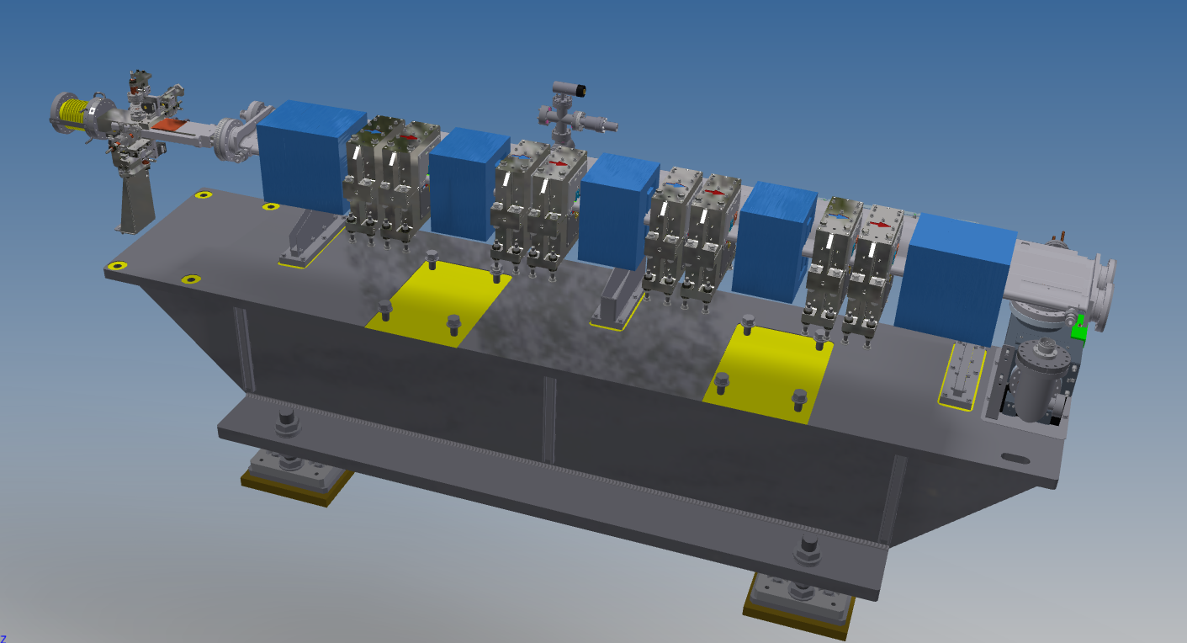
Magnet Alignment
Complex-Bend Assembly
Error budget for NSLSII-U
Fiducialization of magnetic axis, ( ~ 5 µm, with CMM), ~ 10 µm with Laser trackers
Alignment of the magnets on a common girder (~ 10 µm)
Total error < 15 µm (rms)

Slide 6
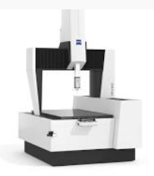
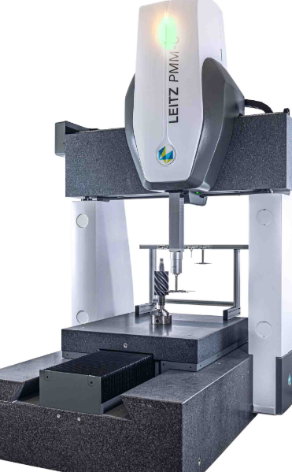
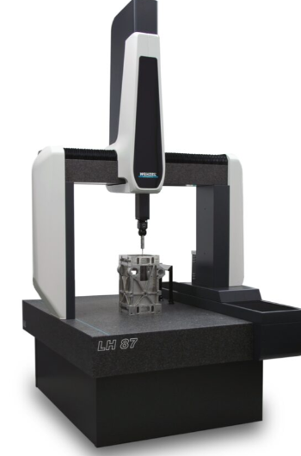
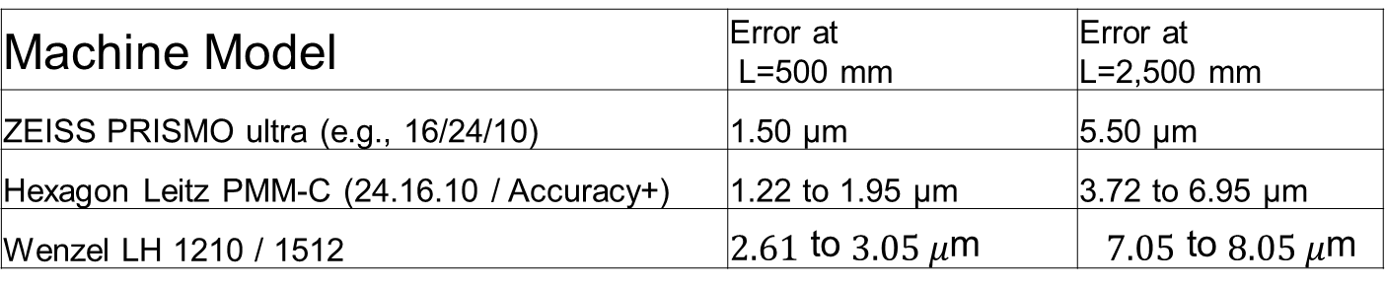
CMM for Magnet Alignment
ZEISS PRISMO ultra
Hexagon Leitz PMM-C
Wenzel LH 1210 / 1512
Fiducialization
Alignment
Machine Model | Error at L=500 mm | Error at L=2,500 mm
ZEISS PRISMO ultra (e.g., 16/24/10) | 1.50 μm | 5.50 μm
Hexagon Leitz PMM-C (24.16.10 / Accuracy+) | 1.22 to 1.95 μm | 3.72 to 6.95 μm
Wenzel LH 1210 / 1512 | $$2.61 \text{to} 3.05 μ\text{m}$$ | $$7.05 \text{to} 8.05 μ\text{m}$$

Slide 7
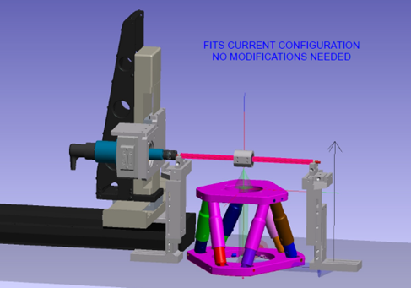
Fiducialization Steps
From internal magnetic axis to measurable fiducial points
Courtesy: Chenghao Yu
Fiducialize the rotating printed circuit board (PCB) coil and Hexapod and PMQs mechanically.
Adjust the location of PMQs relative to the PCB coil by use of Hexapod so that the magnetic axis of the PMQ and PCB coil is coaxial (micron level accuracy).
Measure the fiducials on rotating coil and magnets with a CMM or laser trackers.
Build a local frame of the PMQs so that magnetic center and fiducials can be related.

Slide 8
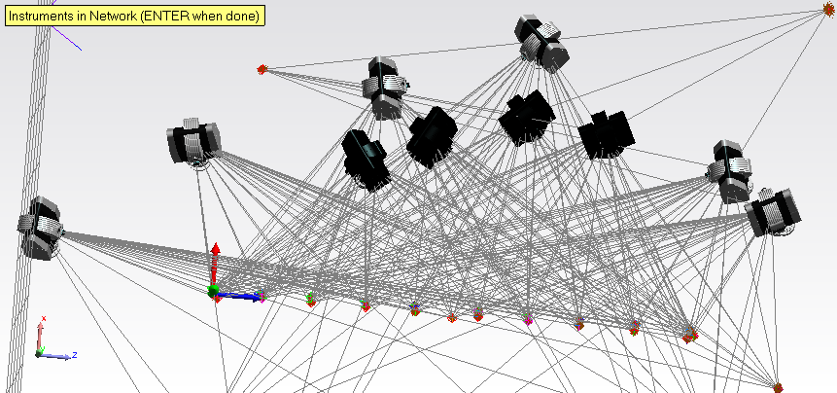
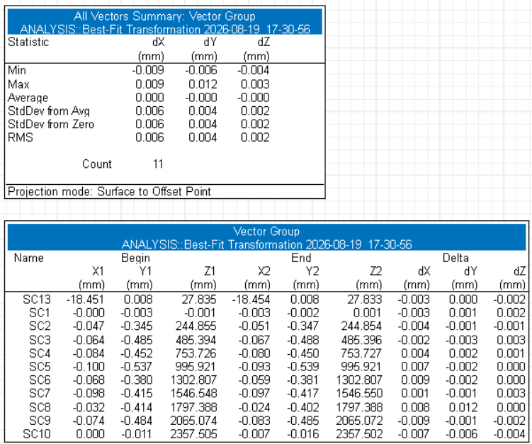
Alignment by Multiple Laser Trackers Setup
The difference between 4 and 10 laser trackers setup is ~ 5 µm. This is expected to be smaller in a temperature-controlled lab.

Slide 9
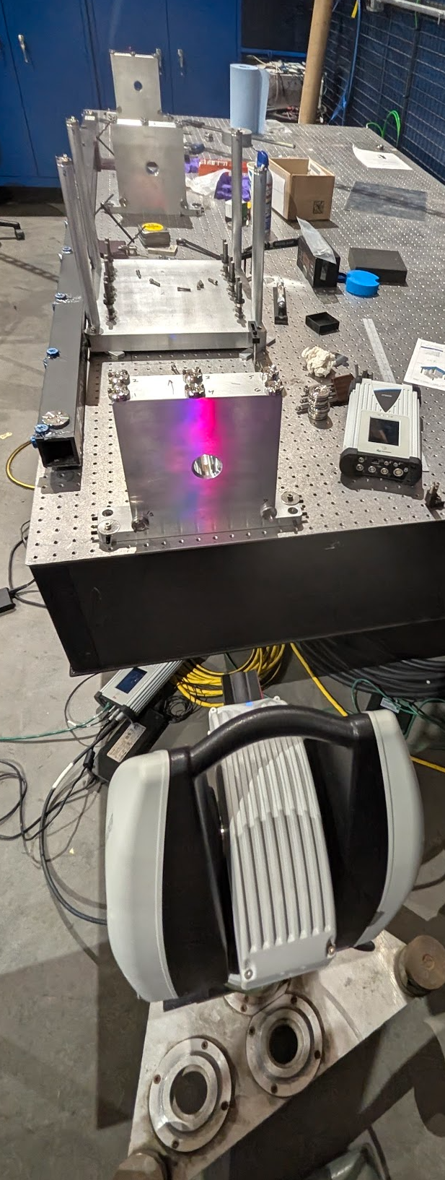
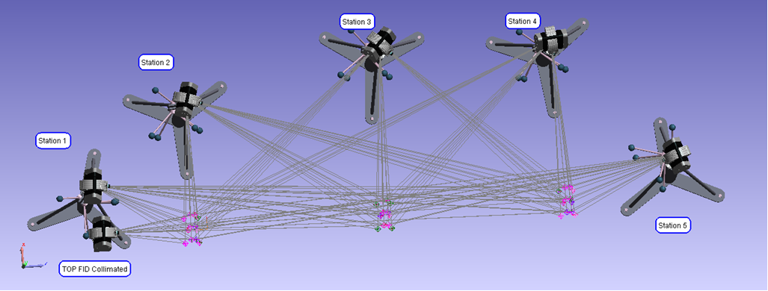

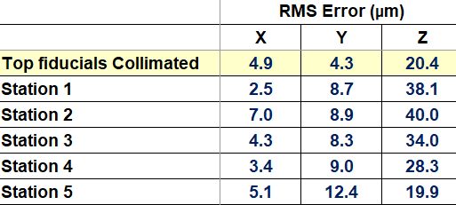
High-Precision Alignment with Collimated Magnet Fiducials
3
2
1
High precision is achieved by using top magnet fiducials collimated with the laser tracker.
Alignment of ~ 5 µm is achieved which compares favorably with multiple laser trackers technique.
C. Yu, et al.,” High Precision Alignment R&D Activities in NSLS-II”, IWAA2026, October 5-9, 2026, Tokyo, Japan

Slide 10
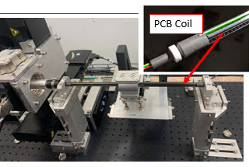
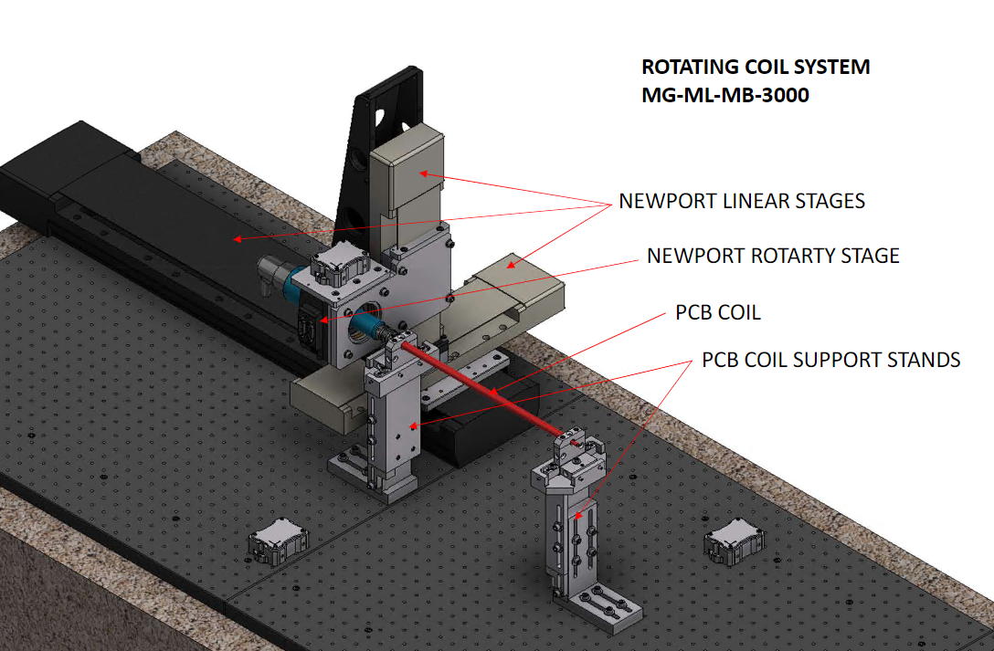
Magnetic Measurement Bench
PMQ
Fixed Support
A magnetic measurement bench was built in collaboration with APS
3 small diameter (12 mm Φ ) PCB coils were built by Fermilab.

Slide 11
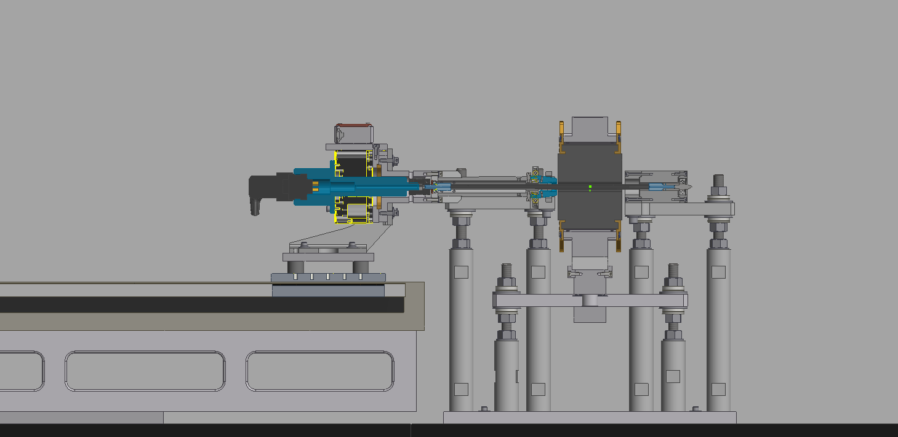


Rotating Coil Support Mechanism
With the Coil’s Bullet Pin fully inserted into Fixed Bearing, the Grip Jaws are released, and coil can rotate.
Bushing Disc
PMQ Magnet
Coil
Bullet Pin
Rotary Stage
Linear Stage

Slide 12
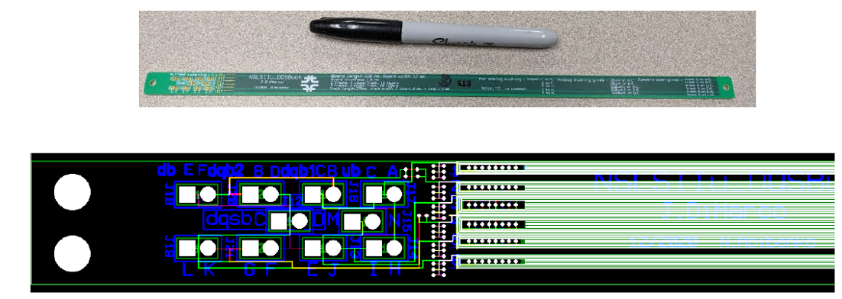
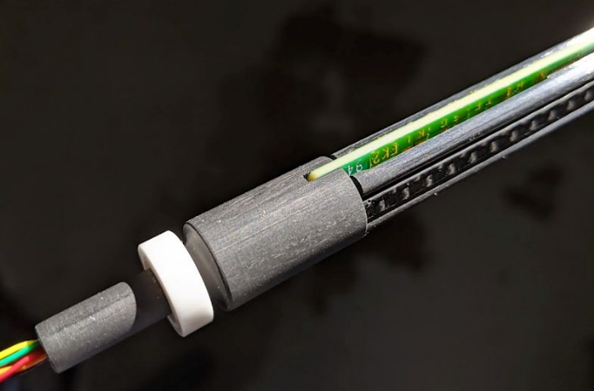
New PCB Coils for 2-Cell CB
Reference Radius = 9 mm
Parameter | Reproducibility | Absolute Accuracy | Conditions / Comments
Magnetic Center Position | ±1 µm | ±5 µm
Magnetic Roll Angle | ±0.05 mRad | ±0.1 mRad | With offset calibration applied
Magnetic Integral Strength | 0.01% | 0.05% | Circular measurement, field integral ≥ 0.01 Tm
Higher Harmonic Content | 0.05 unit | 0.1 unit | Per higher harmonic multipole term relative to main harmonic
Bucking (DB, DQB, DQSB) ratio | > 50 | > 500
16 layers with 75 µm wide trace

Slide 13
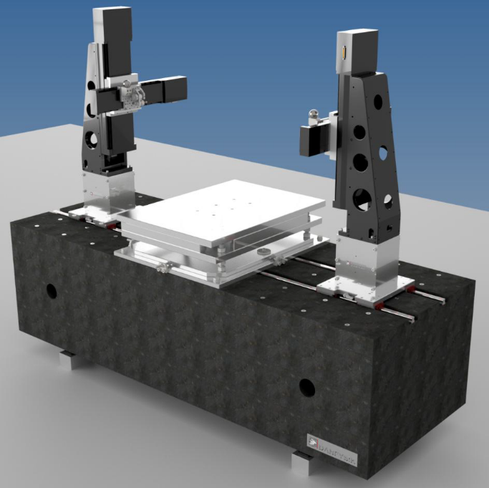
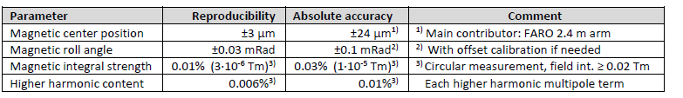
Stretched Wire Magnetic Measurement Bench
Danfysik
Model 694
Performance specifications for magnet with aperture larger than 30 mm

Slide 14
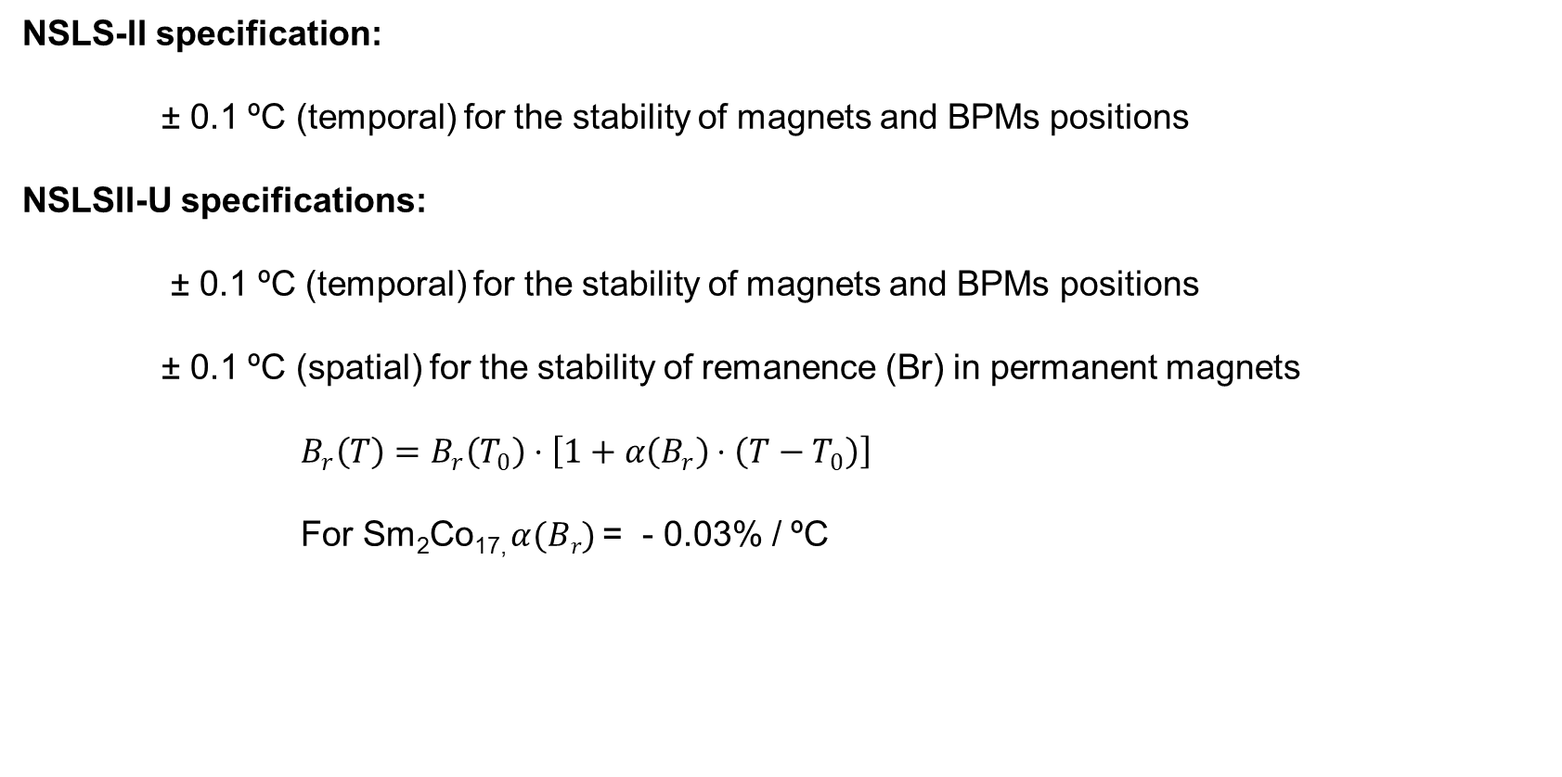
Temperature Stability in SR Tunnel
NSLS-II specification:
± 0.1 ºC (temporal) for the stability of magnets and BPMs positions
NSLSII-U specifications:
± 0.1 ºC (temporal) for the stability of magnets and BPMs positions
± 0.1 ºC (spatial) for the stability of remanence (Br) in permanent magnets
$B_{r}\left(T\right)=B_{r}\left(T_{0}\right)⋅\left[1+α\left(B_{r}\right)⋅\left(T−T_{0}\right)\right]$
For Sm₂Co_{17,} $α(Br)$ = - 0.03% / ºC

Slide 15
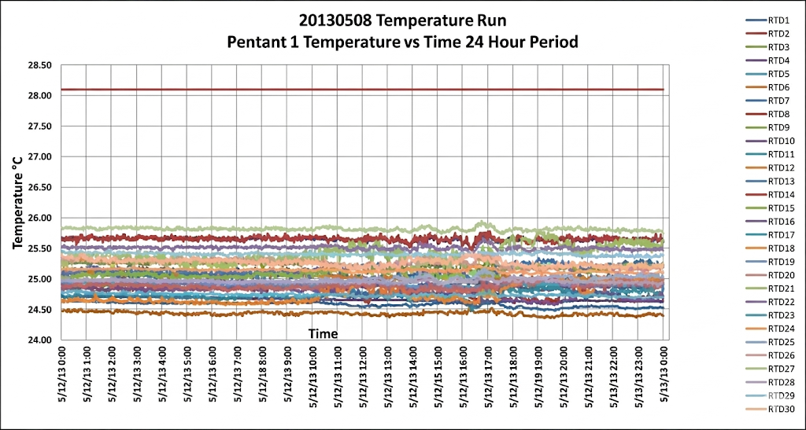
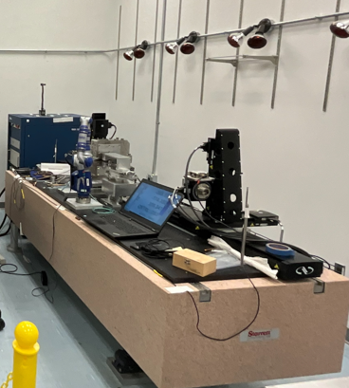
Temperature Stability in the SR Tunnel
Infrared Heater for Temperature Stability
The SR tunnel already has a temporal stability of ± 0.1 ºC. Local adjustment of the air-conditioning/heating system will be required to achieve spatial stability of ± 0.1 ºC.
With infrared heaters around the magnetic measurement bench, temperature stability < ± 0.05 ºC
As a backup, thermal shunts will be incorporated in the PMQ designs for NSLSII-U.

Slide 16
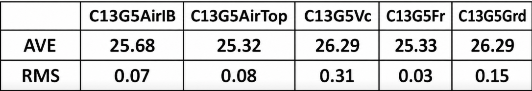
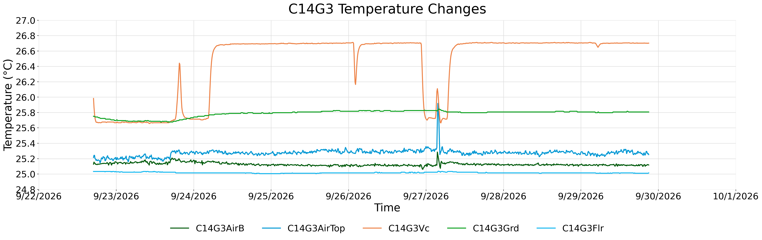
One-Week Temperature Profile in Cells 13, 14
Girder temperature rises by ~ 0.2 ºC when beam on.
Vacuum chamber temperature rises by ~ 1 ºC
In general, temperature stability in time (temporal) is within specifications

Slide 17
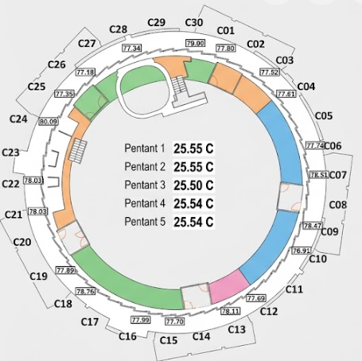
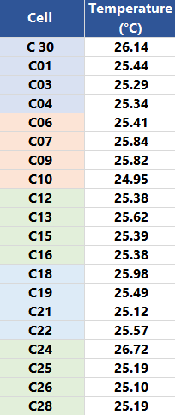
Spatial Temperature Stability

Slide 18
Conclusions
The alignment specifications for the 2-Cell CB match those for NSLS-II and can be met using existing equipment.
NSLS-II-U will require equipment upgrades (e.g., CMM, new laser trackers) and further R&D on the collimated fiducials technique.
The PCB-coil magnetic measurement bench will be retrofitted with new supports to improve fiducialization and magnetic field measurements.
NSLS-II-U will require additional benches; procurement for a stretched-wire bench is underway.
Temporal temperature stability in the SR tunnel meets specifications, while R&D is underway to improve spatial temperature stability.

